Slide 1
Marketing basics
A SMART Skills Manual

Slide 2
Skills for Marketing and Rural Transformation (SMART skills)
SMART Skills manuals:
Introduction to SMART skills for rural development
Organizing and managing farmer groups
Understanding natural resources
Managing natural resources
Marketing basics
Seven steps of marketing
Promoting innovation

Slide 3
Purpose of the SMART skills series
To introduce you to the following five skill areas:
Group organization
Natural resources management
Finance
Marketing
Innovation

Slide 4
Manual content
Ten lessons:
What is agricultural marketing?
Supply and demand
Costs, income, prices and profit
Types of markets
Adding value after harvest
Changes in markets
The value chain
Developing marketing strategies
The four Ps of marketing
Entrepreneurial spirit

Slide 5
Lesson 1: What is agricultural marketing?

Slide 6
Outcomes
After this lesson you will be able to:
List some of the activities that go into agricultural marketing.
Describe what marketing means.

Slide 7
Overview
Lesson 1 covers the following content:
Agricultural marketing
Marketing begins before planting
Marketing means planning

Slide 8
Agricultural marketing
Agricultural marketing:
Is about finding out what consumers need and then making a profit by satisfying those needs.
Includes all the activities and services involved in moving an agricultural product from the farm to where it is sold to a consumer. This is known as the value chain that links farmers with consumers.

Slide 9
The value chain: Linking farmers with consumers

Slide 10
Agricultural marketing: Activities
The activities commonly associated with marketing include:
Cleaning, drying, sorting, grading and storage
Transport, processing, packaging, advertising
Finding buyers
Selling the product
It is important to note that marketing does not begin after the harvest. – Farmers have to start thinking about markets well before planting.

Slide 11
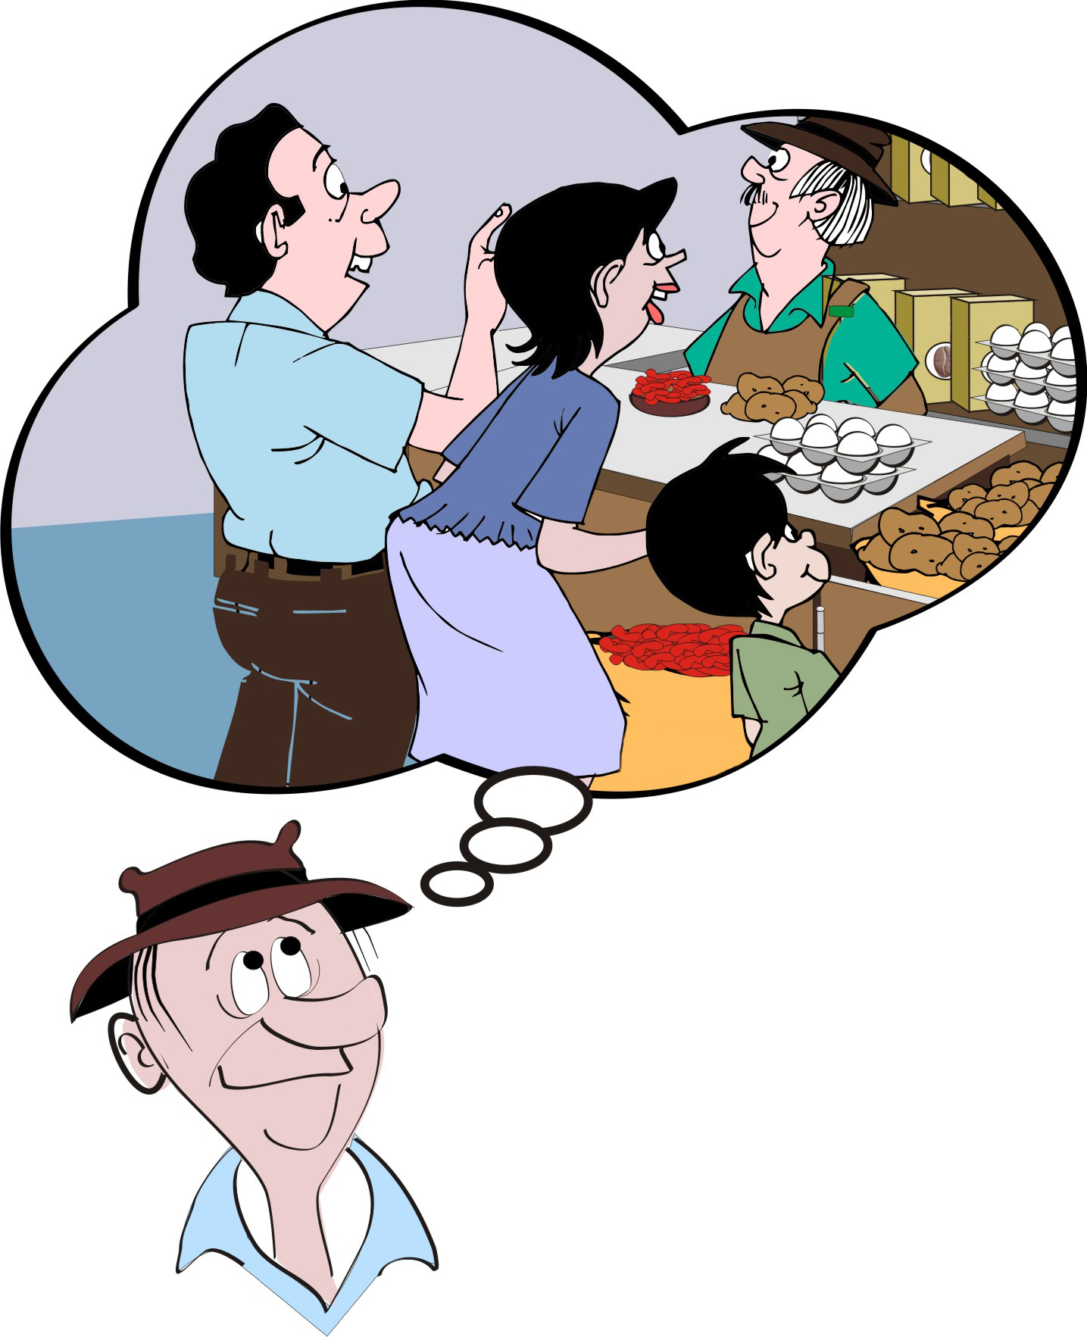
Marketing begins before planting
To sell at a profit, marketing needs to begin even before planting.
Farmers need to offer products that male and female customers want to buy.

Slide 12
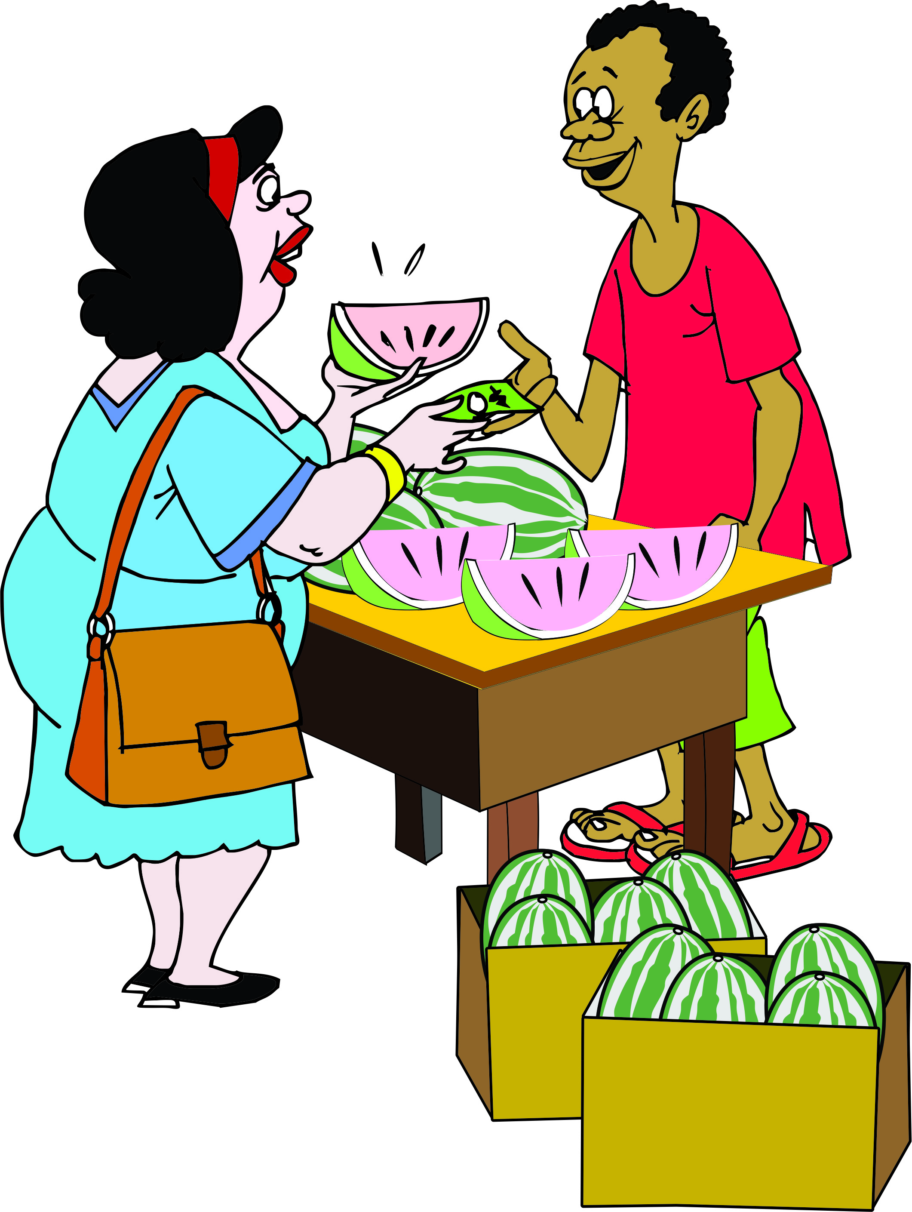
Marketing begins before planting (Continued)
Farmers should offer products:
At the right time of year
In the right quantities
In the right place
In the right form (fresh, dried, processed)
At the quality and packaging required
At a price that customers are willing to pay.

Slide 13
Marketing means planning
In industrial countries, many farmers plant a crop only after they have:
Found a buyer
Agreed on the terms of sale
Completed a business plan
Farmers in developing countries should do the same. A marketing plan helps them decide:
What to plant
When to plant
How to produce a crop
Who to sell to when the crop is harvested.

Slide 14
Smallholders approaching marketing as a group

Slide 15
Lesson 2: Supply and demand

Slide 16
Outcomes
After this lesson you will be able to:
Explain the meaning of supply and demand.
Give examples of why demand and supply might rise or fall.
Describe the effect of rising and falling supply on prices.
Describe the effect of rising and falling demand on prices.

Slide 17
Overview
Lesson 2 covers the following content:
Market supply and market demand
Importance of understanding supply and demand
Supply of a product going up or going down
High demand and low demand

Slide 18
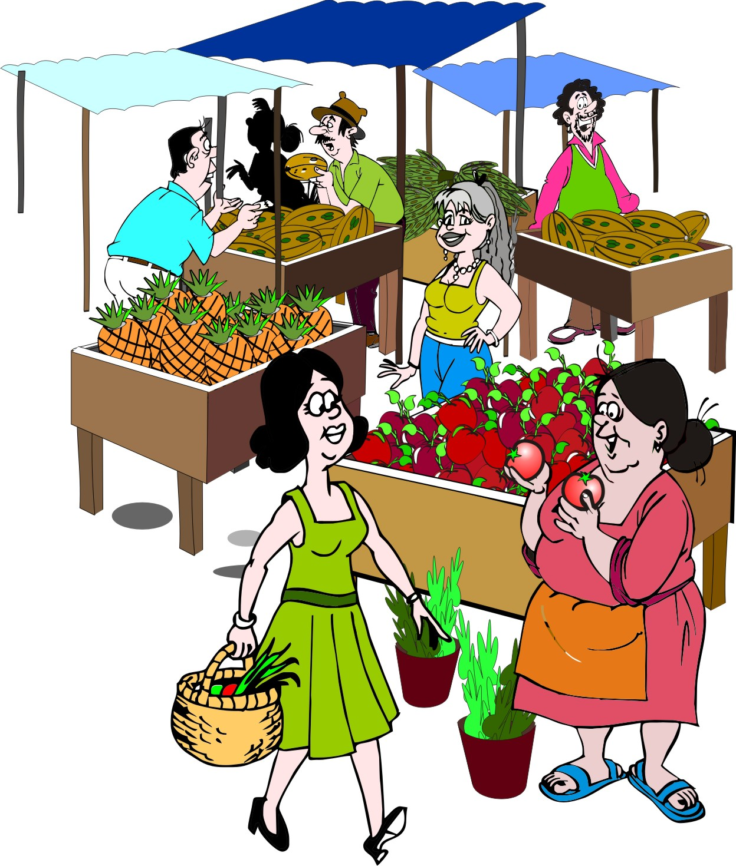
Market supply
Market supply is the amount of a product that producers are able to take to the market for sale.
The supply of a product depends on:
Price
Cost of production
Access to seeds, water, fertilizer
Local conditions (e.g. rainfall)
Roads and transport vehicles
Farmer health and nutrition

Slide 19
Market supply and price
Price is one of the most important determinants of market supply:
If farmers see that the price of a product is high, they will try to sell it immediately. They are also likely to grow more of the product next season.
If the farmers see that the price of a product falling, they may keep their products in storage until the price recovers.
Low prices will also discourage them from planting the same crop next season.

Slide 20
Market demand
Market demand is the amount of the product that customers are willing and able to buy.
Market demand partly depends on the price:
If the price is low, more people will want to buy, and each person may want to buy more of the product.
If the price goes up, fewer people want to buy, and each person will probably buy a smaller amount.

Slide 21
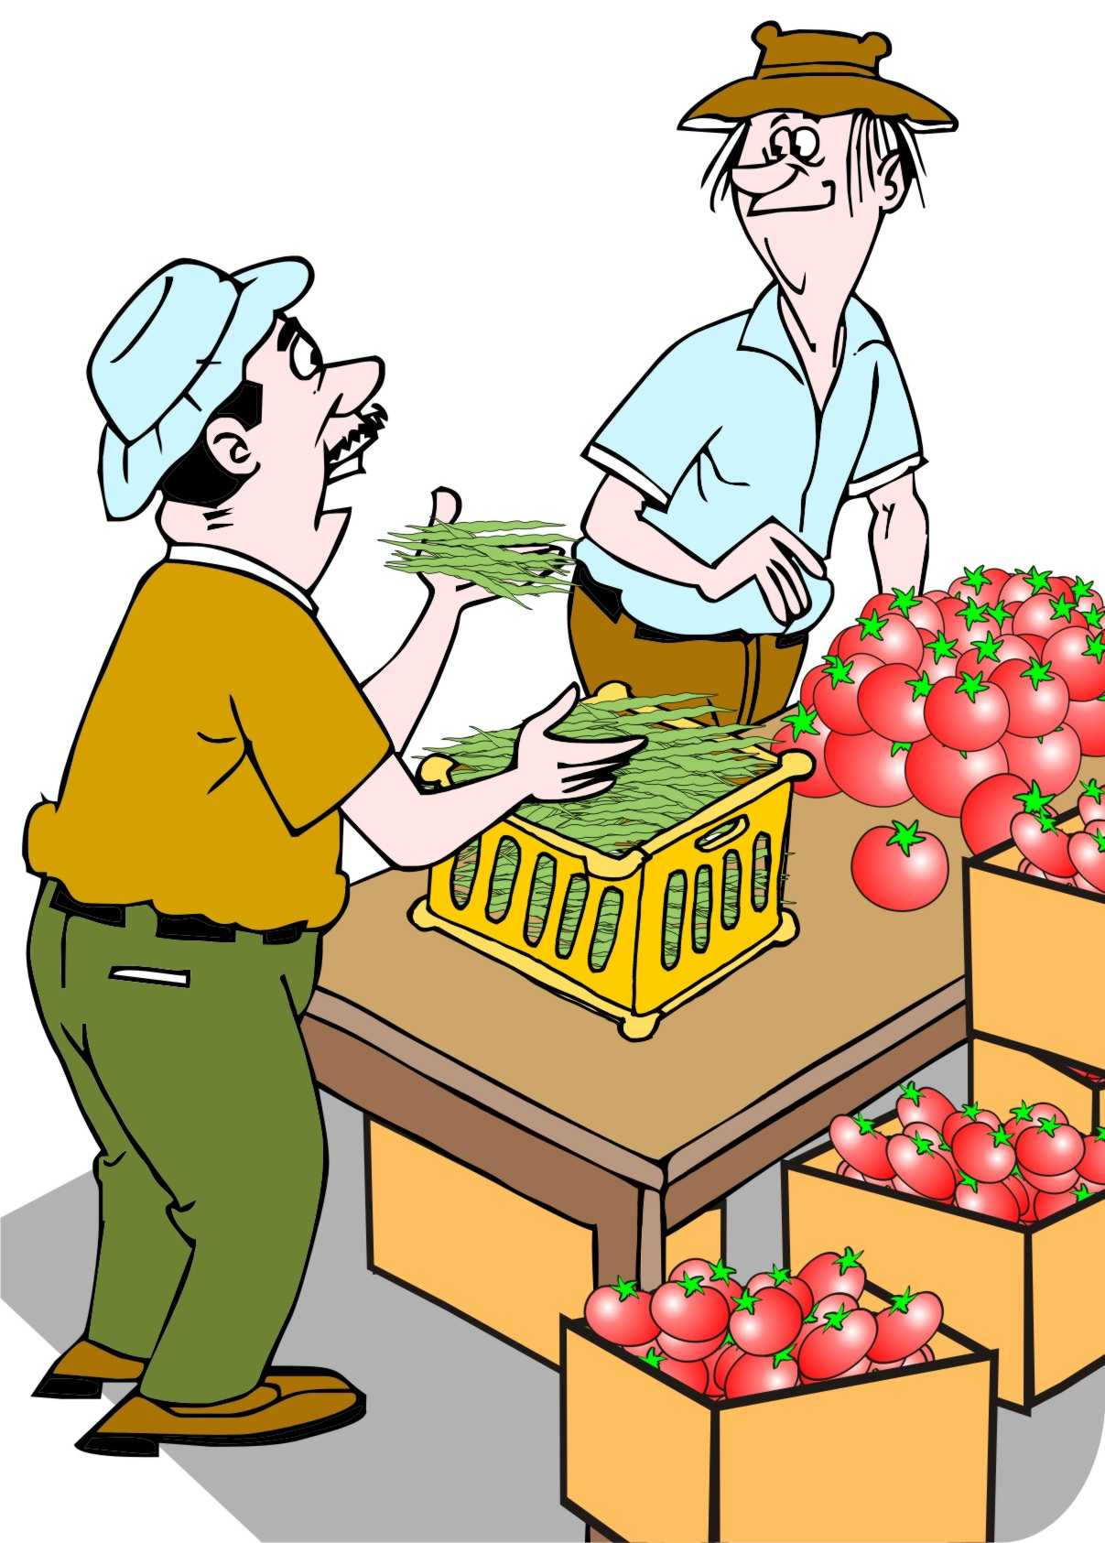
Factors determining market demand
Customers generally want to buy more:
Staple foods (e.g. maize or wheat) and major vegetables (such as onions and tomatoes) and less of unfamiliar types of food or items they use in small quantities only
High-quality products rather than items that are low-quality or damaged.

Slide 22
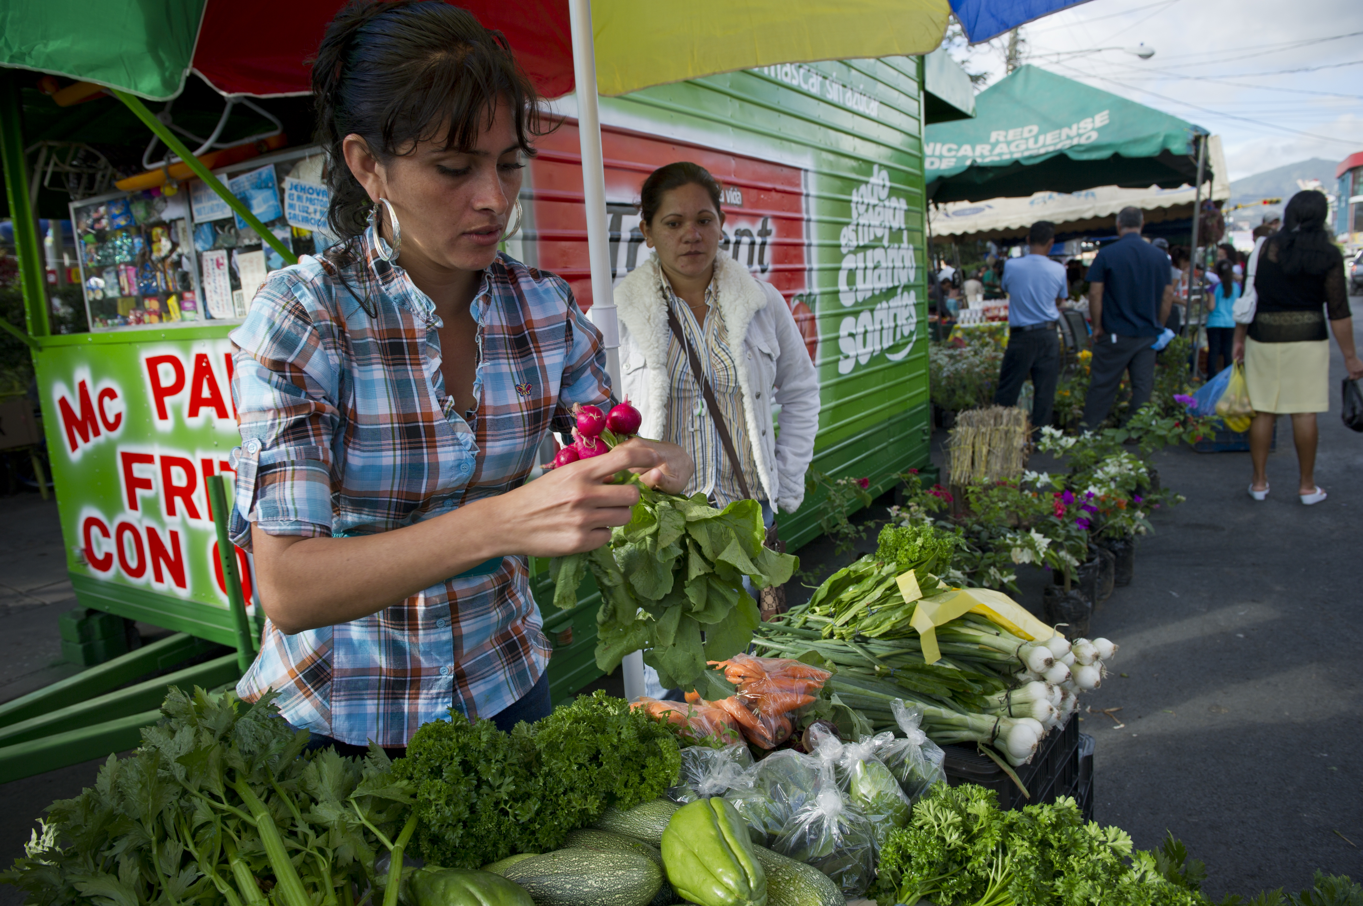
Factors determining market demand (Continued)
Customers generally want to buy more:
Tasty products rather than those with bland flavors.
Fresh products rather than produce what was harvested weeks ago.
Scarce items such as the first fruits in the season.

Slide 23
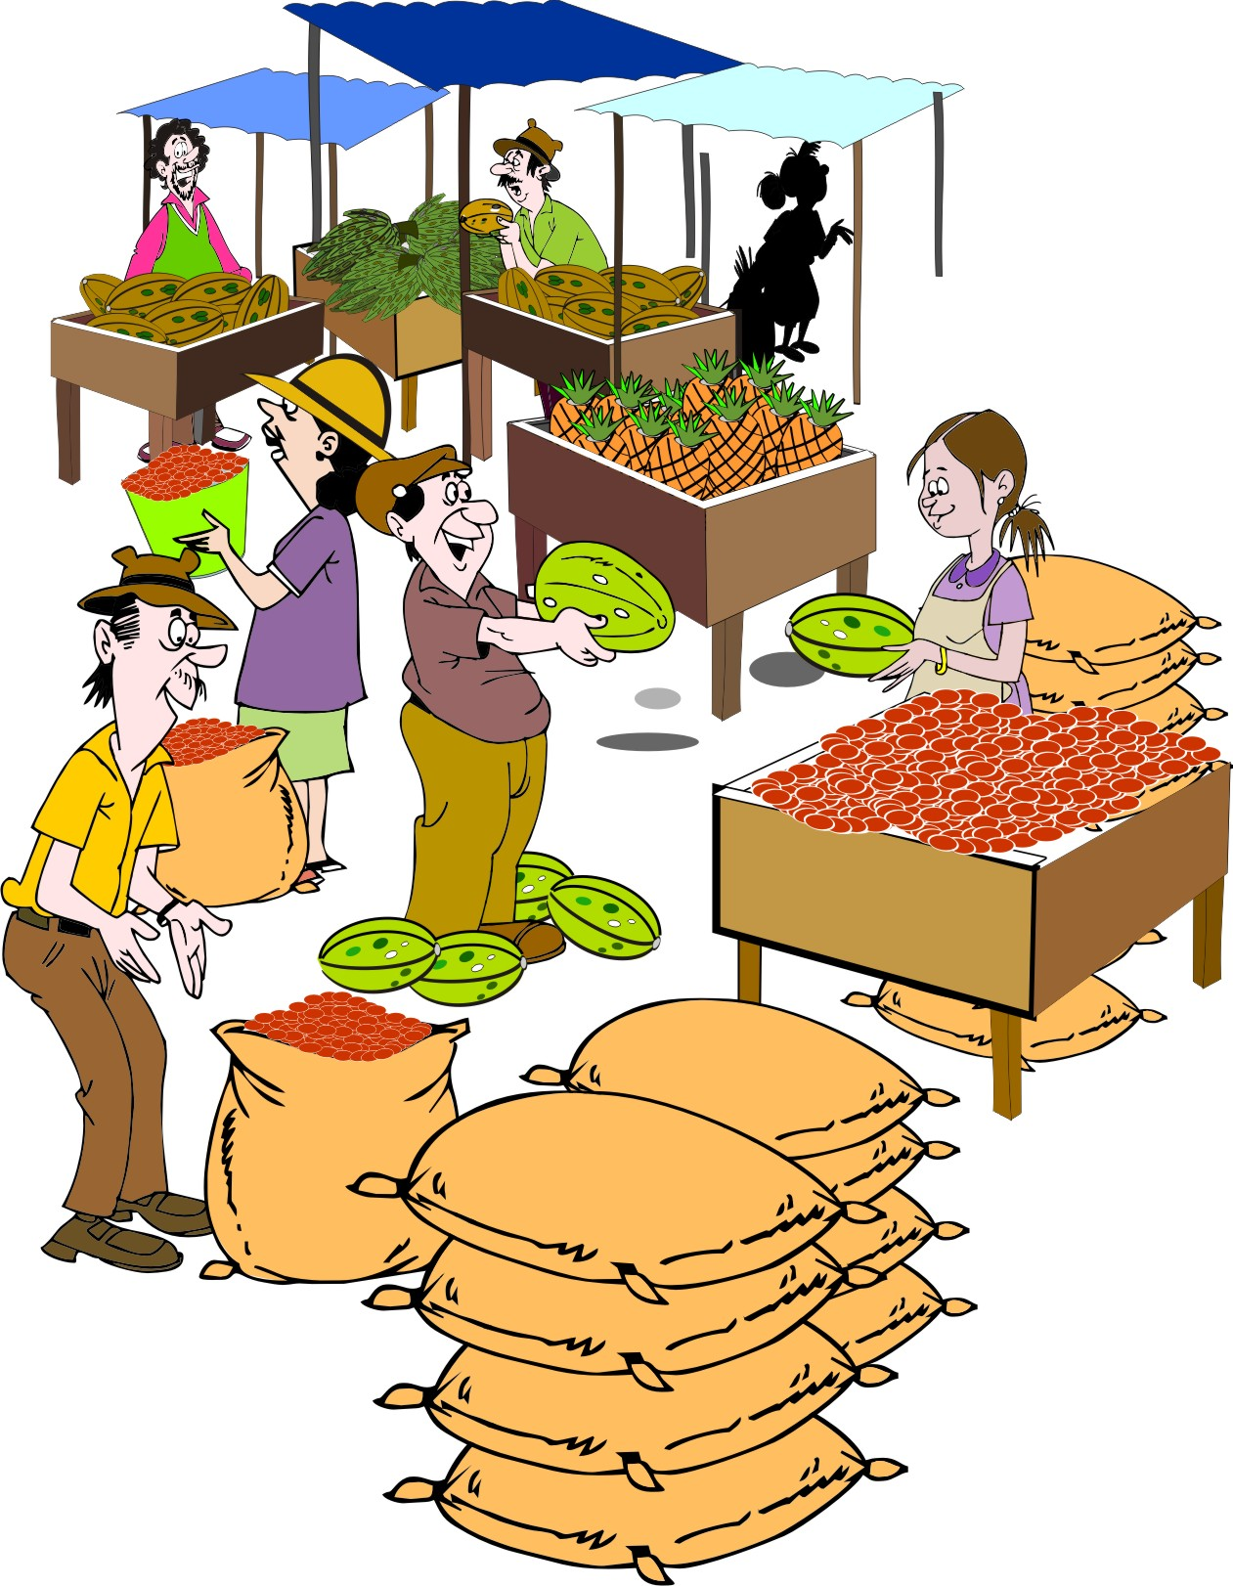
Supply of a product going up
If the supply of a product goes up – e.g. right after the grain harvest, when all farmers want to sell their grain at the same time and there are large numbers of suppliers – but there are only a few people who want to buy grain – the price of grain will fall.
This means that, if the supply of a product goes up, the price falls.

Slide 24
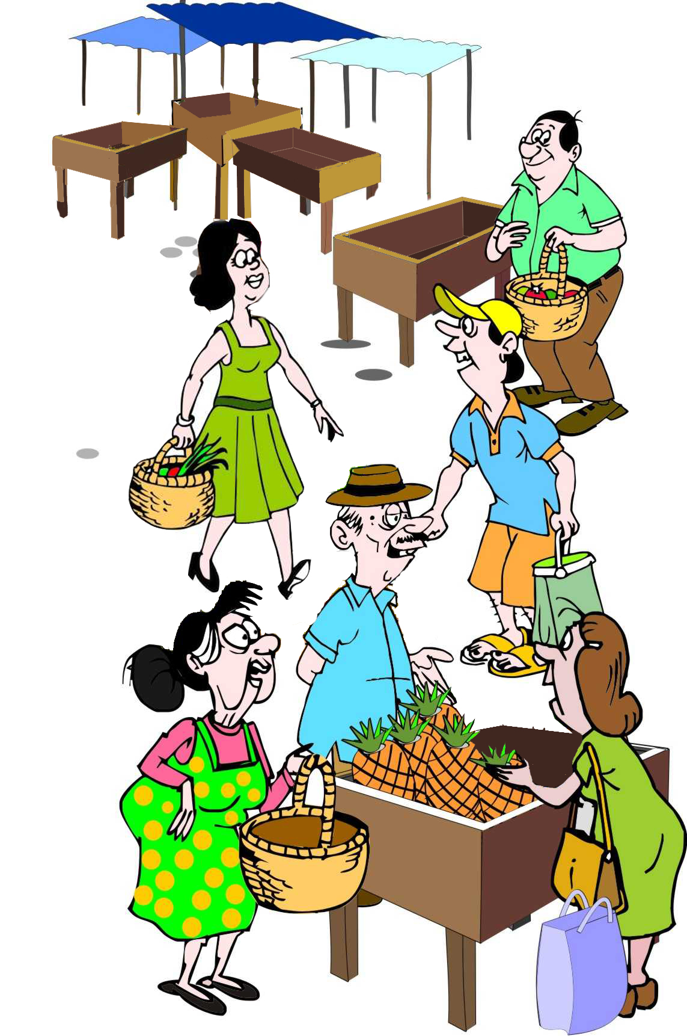
Supply of a product going down
If the grain harvest is bad and only a few farmers have any grain to sell, then customers are desperate to buy grain and they are willing to pay more and. Therefore, the price will rise.
This means that:
When the crop is in over-supply (e.g. after the harvest), the price is low.
When there are shortages, the price goes up.

Slide 25
Supply and prices
Prices
Supply
Early Harvest
Main Harvest

Slide 26
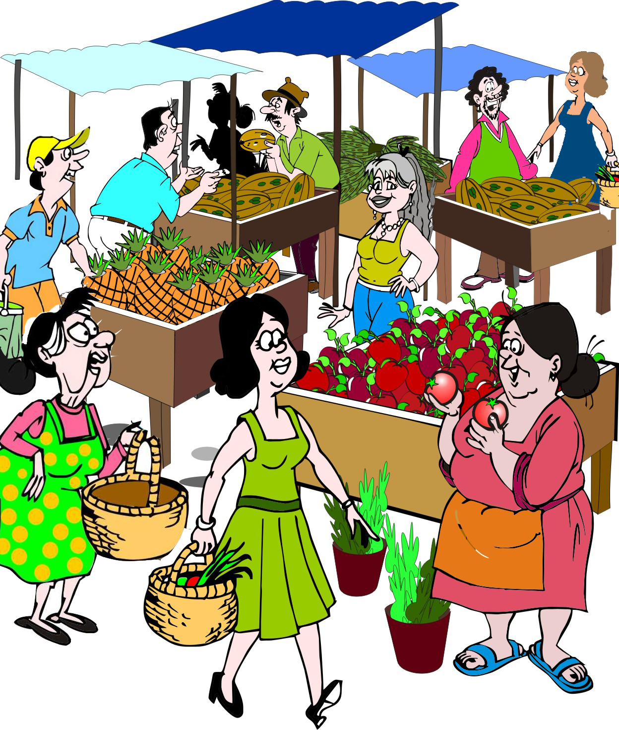
High demand: Example
A lot of people come into a particular area to work on a construction project. Suddenly, there are many more customers who want to buy food in the local market. Sellers find that they can ask a higher price for their produce.
This means that:
The price of a product tends to go up because of high demand.

Slide 27
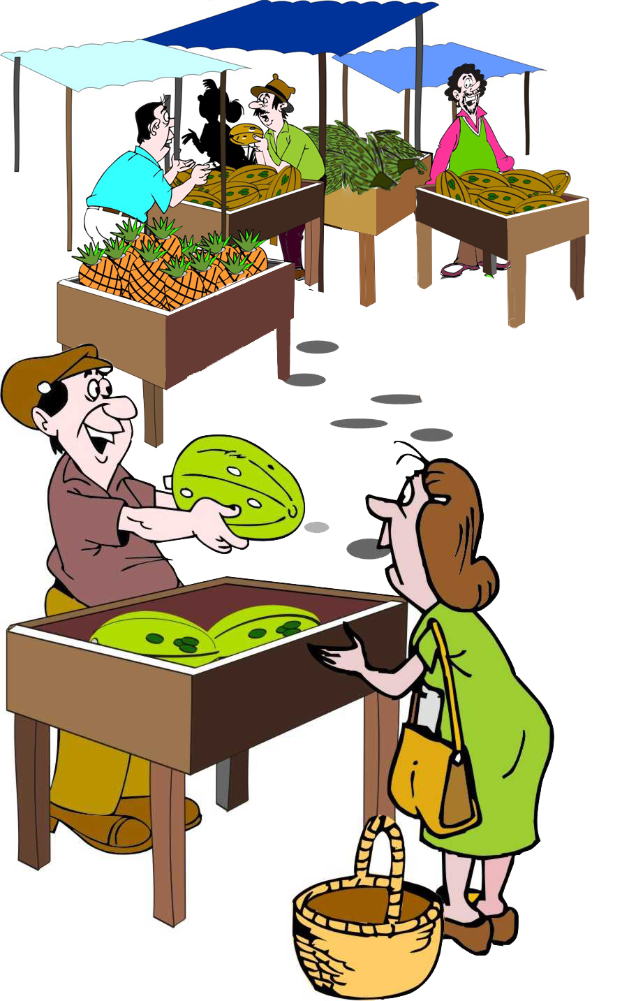
Low demand: Example
The construction project is finished and the workers move away. Food sellers find that fewer customers want to buy their produce. They have to lower their prices in order to sell it.
This means that:
The price of a product tends to fall because of low demand.

Slide 28
Demand and prices
Festival

Slide 29
The importance of understanding supply and demand
If farmers understand supply and demand, they can:
Plan what crops to grow, when to plant and harvest and where to sell their produce
Plan to harvest their crops at the beginning or the end of the season, when prices are higher
Grow a crop variety that fetches a higher price
Decide to grow a more nutritious crop (e.g. vegetables) in addition to their staple crops such as maize
Decide when best to sell their crop
Try to increase the quality of the crop so that it fetches a higher price

Slide 30
Lesson 3: Costs, income, prices and profit

Slide 31
Outcomes
After this lesson you will be able to:
Name the two major types of costs in agricultural production
Name some of the factors that affect a farmer’s income
Explain what profit is
Calculate the costs, income and profit for a single crop or livestock type
Name the two ways to increase profit.

Slide 32
Overview
Lesson 3 covers the following content:
Type of costs: material costs, labor costs and hidden costs
Income
Prices
Profit and increasing profits
Counting the cost of family labor

Slide 33
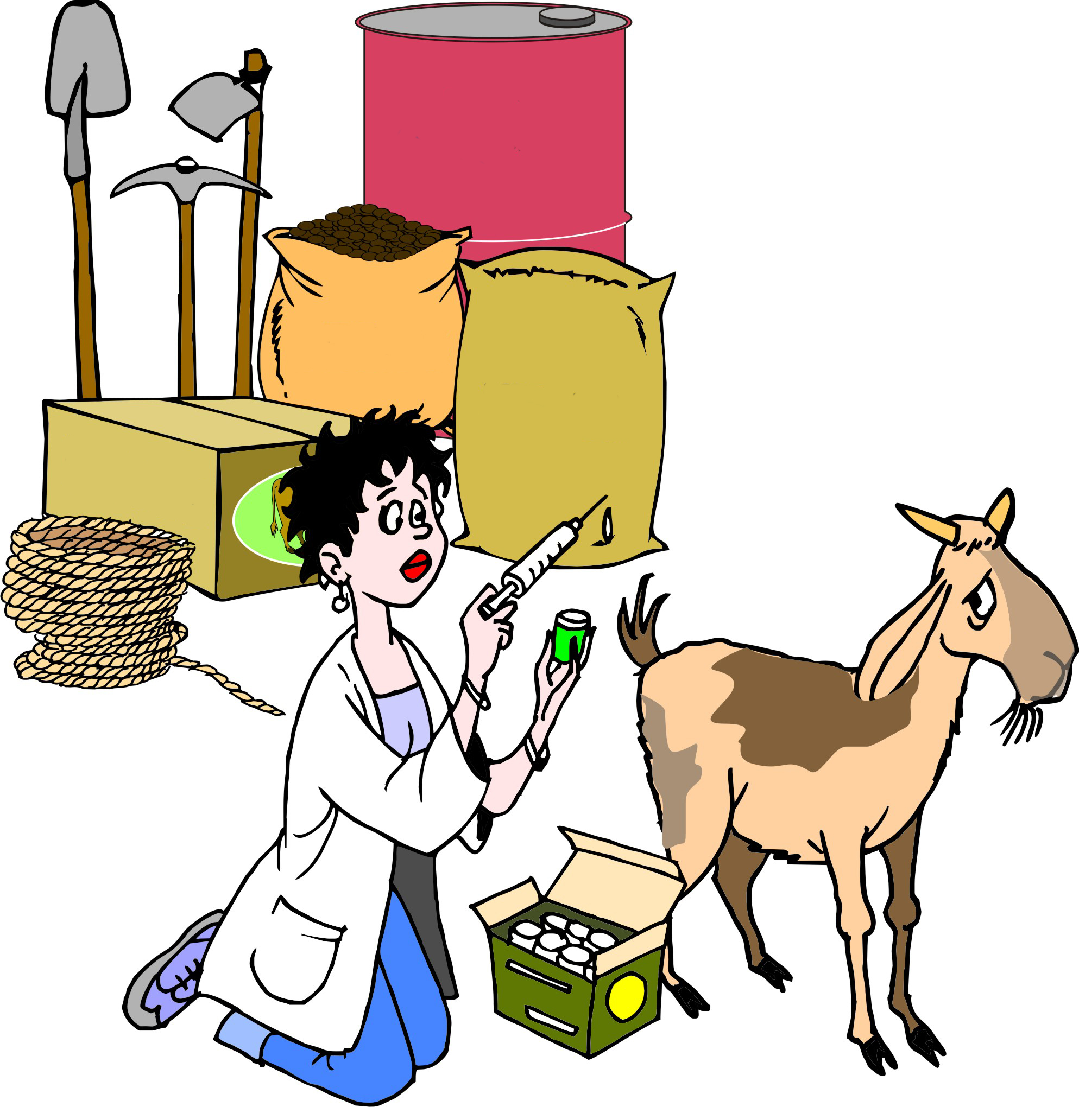
Costs: Material costs
Material costs refers to the costs of the materials, fees and service charges that are required to grow, harvest, process and market a crop – i.e. the cost of:

Slide 34
Costs: Material costs: Examples
Material costs may include:
Renting land
Hoes, machetes and other tools
Seed, fertilizer, chemical pesticides, herbicides and fuel
Animal feed and veterinary services
Storage bags, crates and labels
Marketing fees and transportation charges

Slide 35
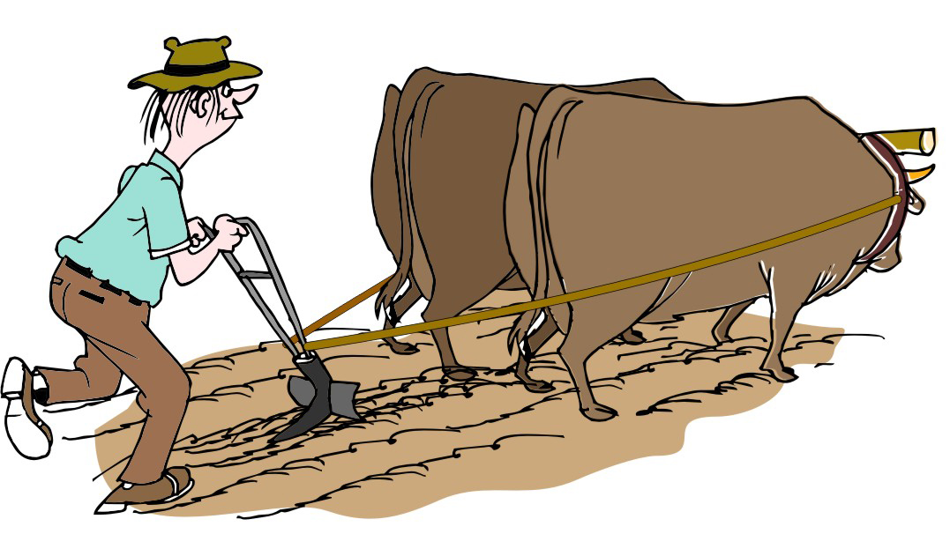
Costs: Labor costs
Labor costs include all the labor costs required to grow, harvest, process and market the crop.

Slide 36
Costs: Labor costs: Examples
Labor costs include:
The labor of workers contracted on an hourly or daily basis
Family labor for purchasing inputs
Post-harvest activities such as drying, cleaning, sorting, grading and storage
Time taken for marketing activities
Hiring market staff to carry produce from trucks to market stalls

Slide 37
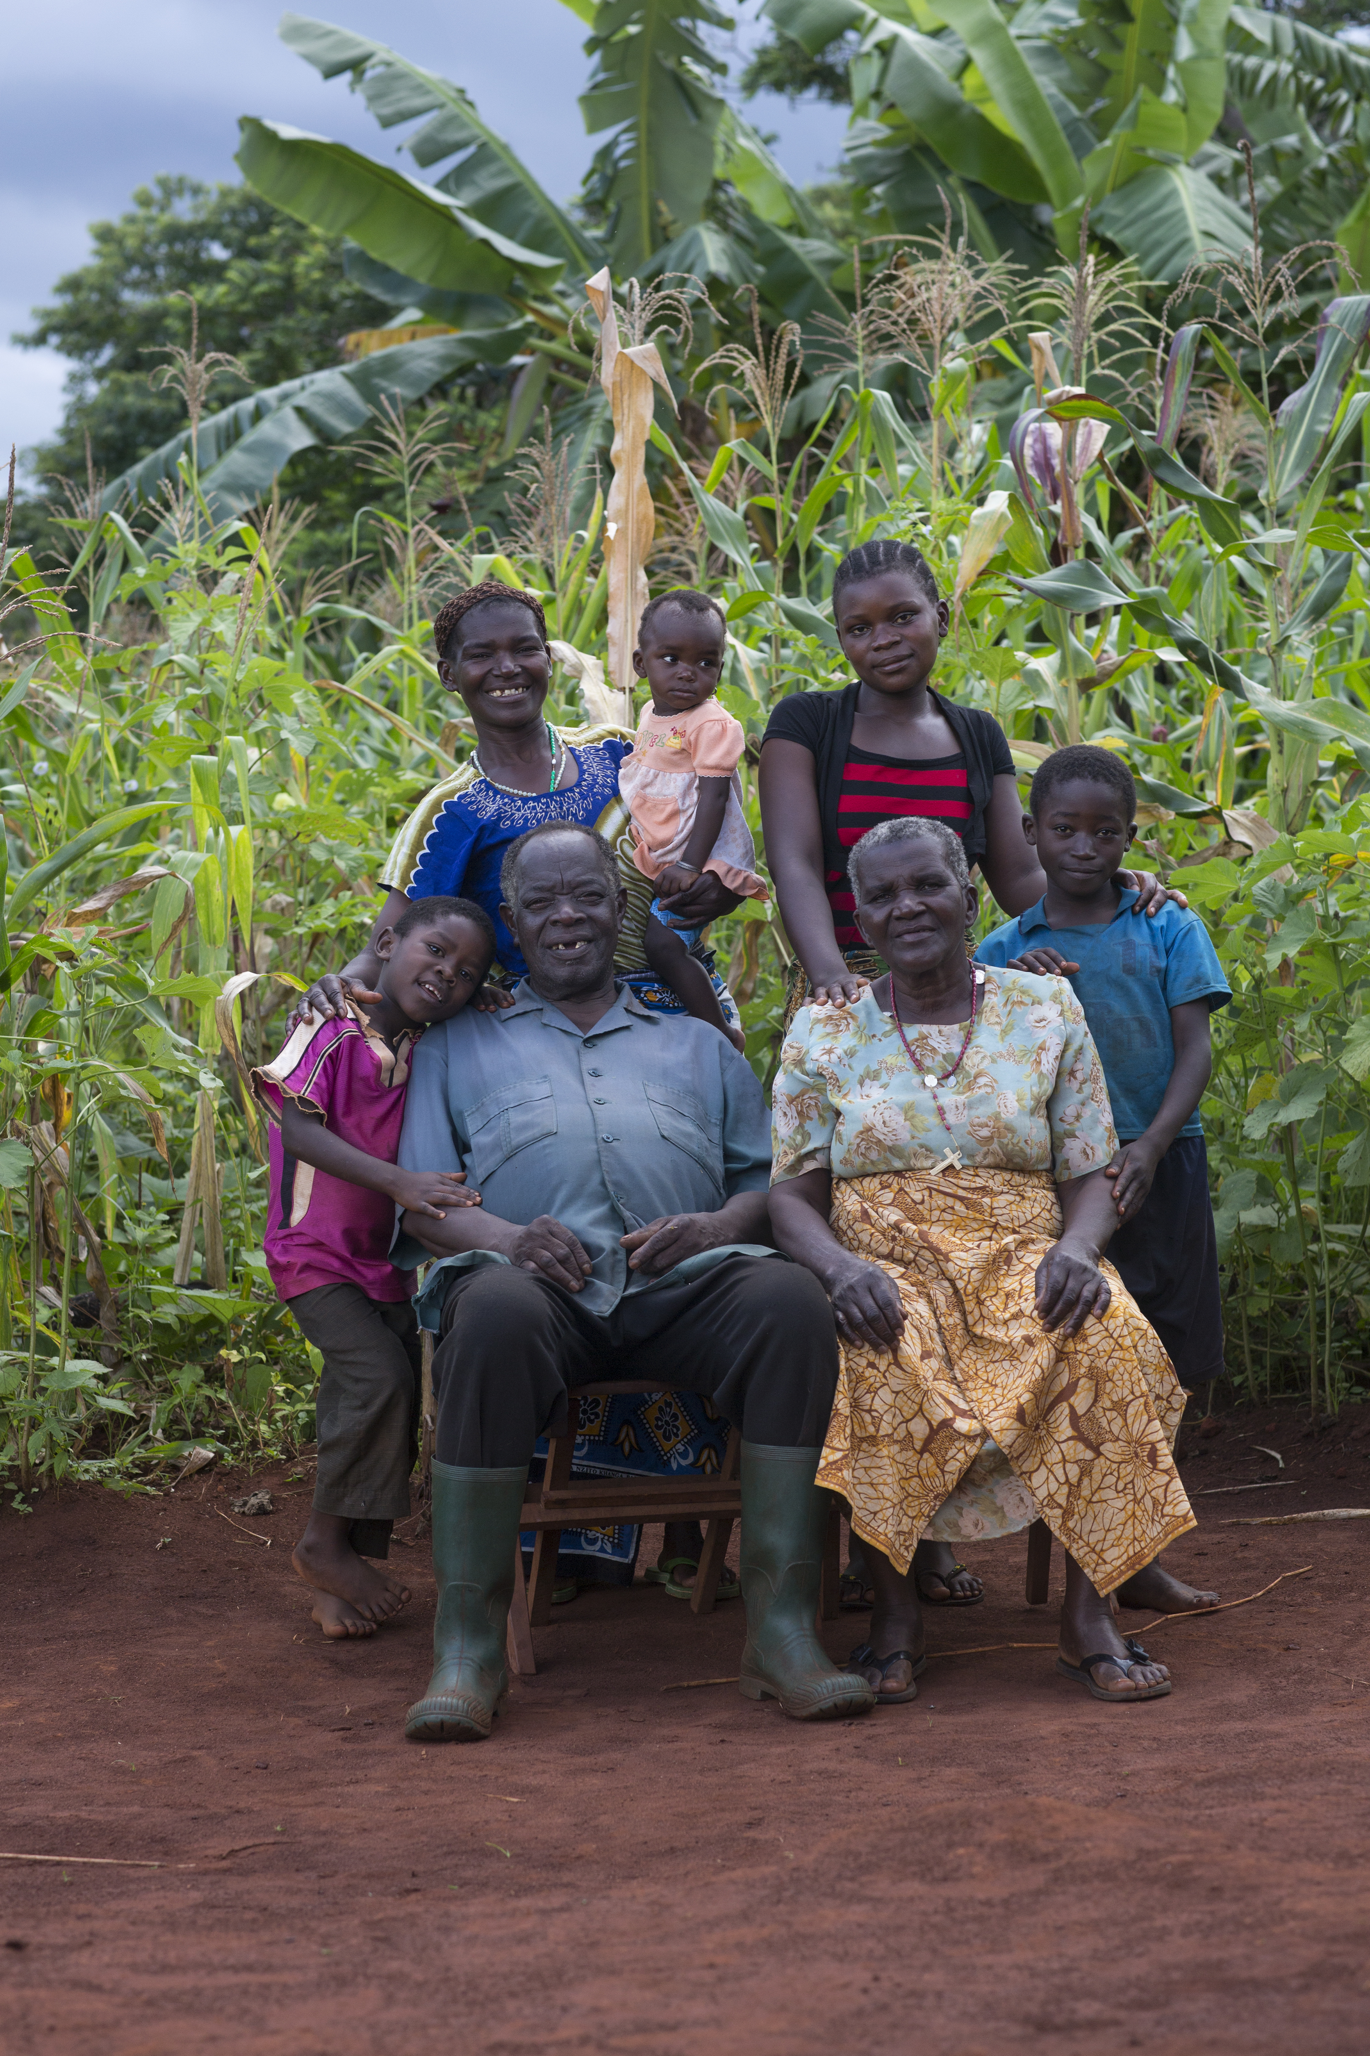
Counting the cost of family labor
Farmers often do not count the cost of their own labor or the work of their family members, because they do not think it is necessary to count it. You should take it into account that your family members could be doing something else that may be more profitable for them.
You can calculate two numbers:
The gross margin (which does not count family labor)
The overall profit (which does include it).

Slide 38
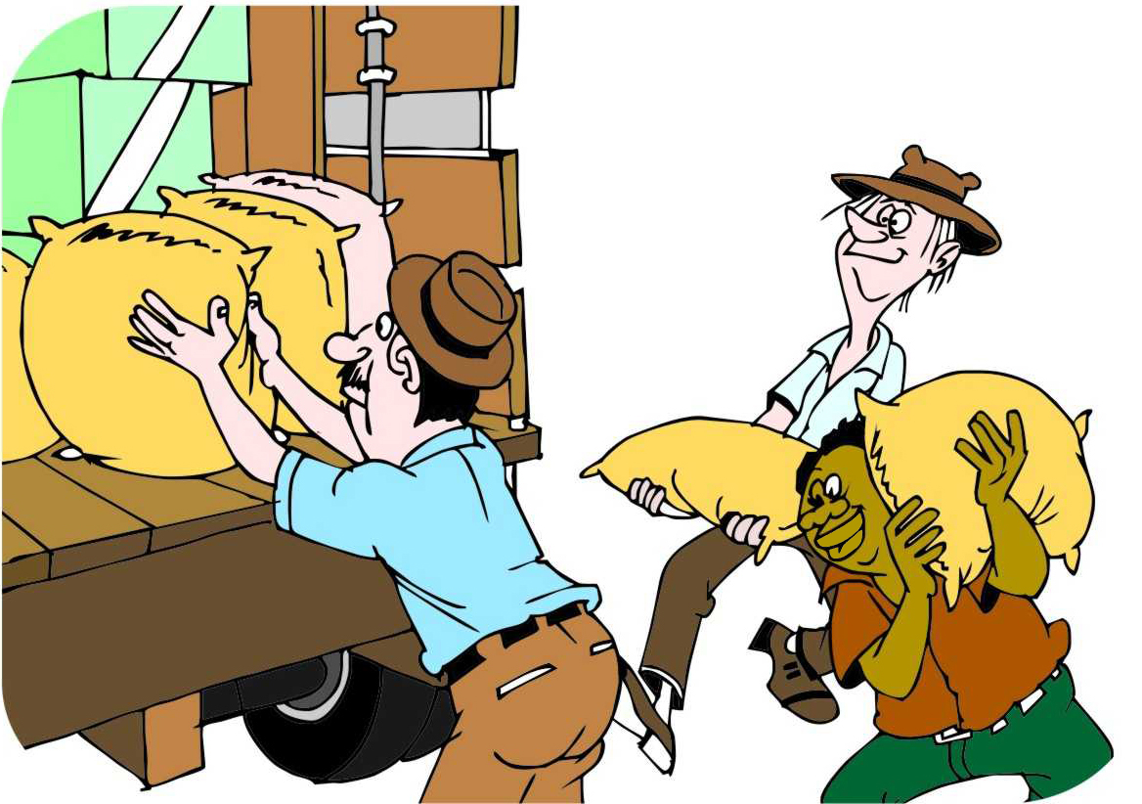
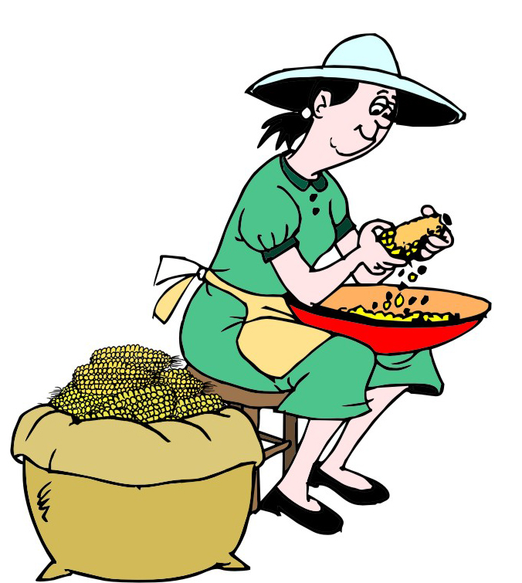
Costs: Hidden costs
Hidden costs are those costs that are not directly associated with a particular productive activity and can be difficult to quantify.
Hidden costs:
May or may not have a monetary value
Usually represent the loss of an opportunity to do something of benefit for the person or persons involved.

Slide 39
Hidden costs: Examples
Family labor: Using family labor prevents the family member from doing something else, e.g. children cannot go to school if they have to tend livestock or help harvest crops
If a farmer takes her produce to market, she may not have time to manage the household and she may have to get a family member or hired help to do these things
Environmental damage (e.g. soil erosion) resulting from producing the product.
If it is possible to put a value on a hidden cost, it should be included in the cost calculations.

Slide 40
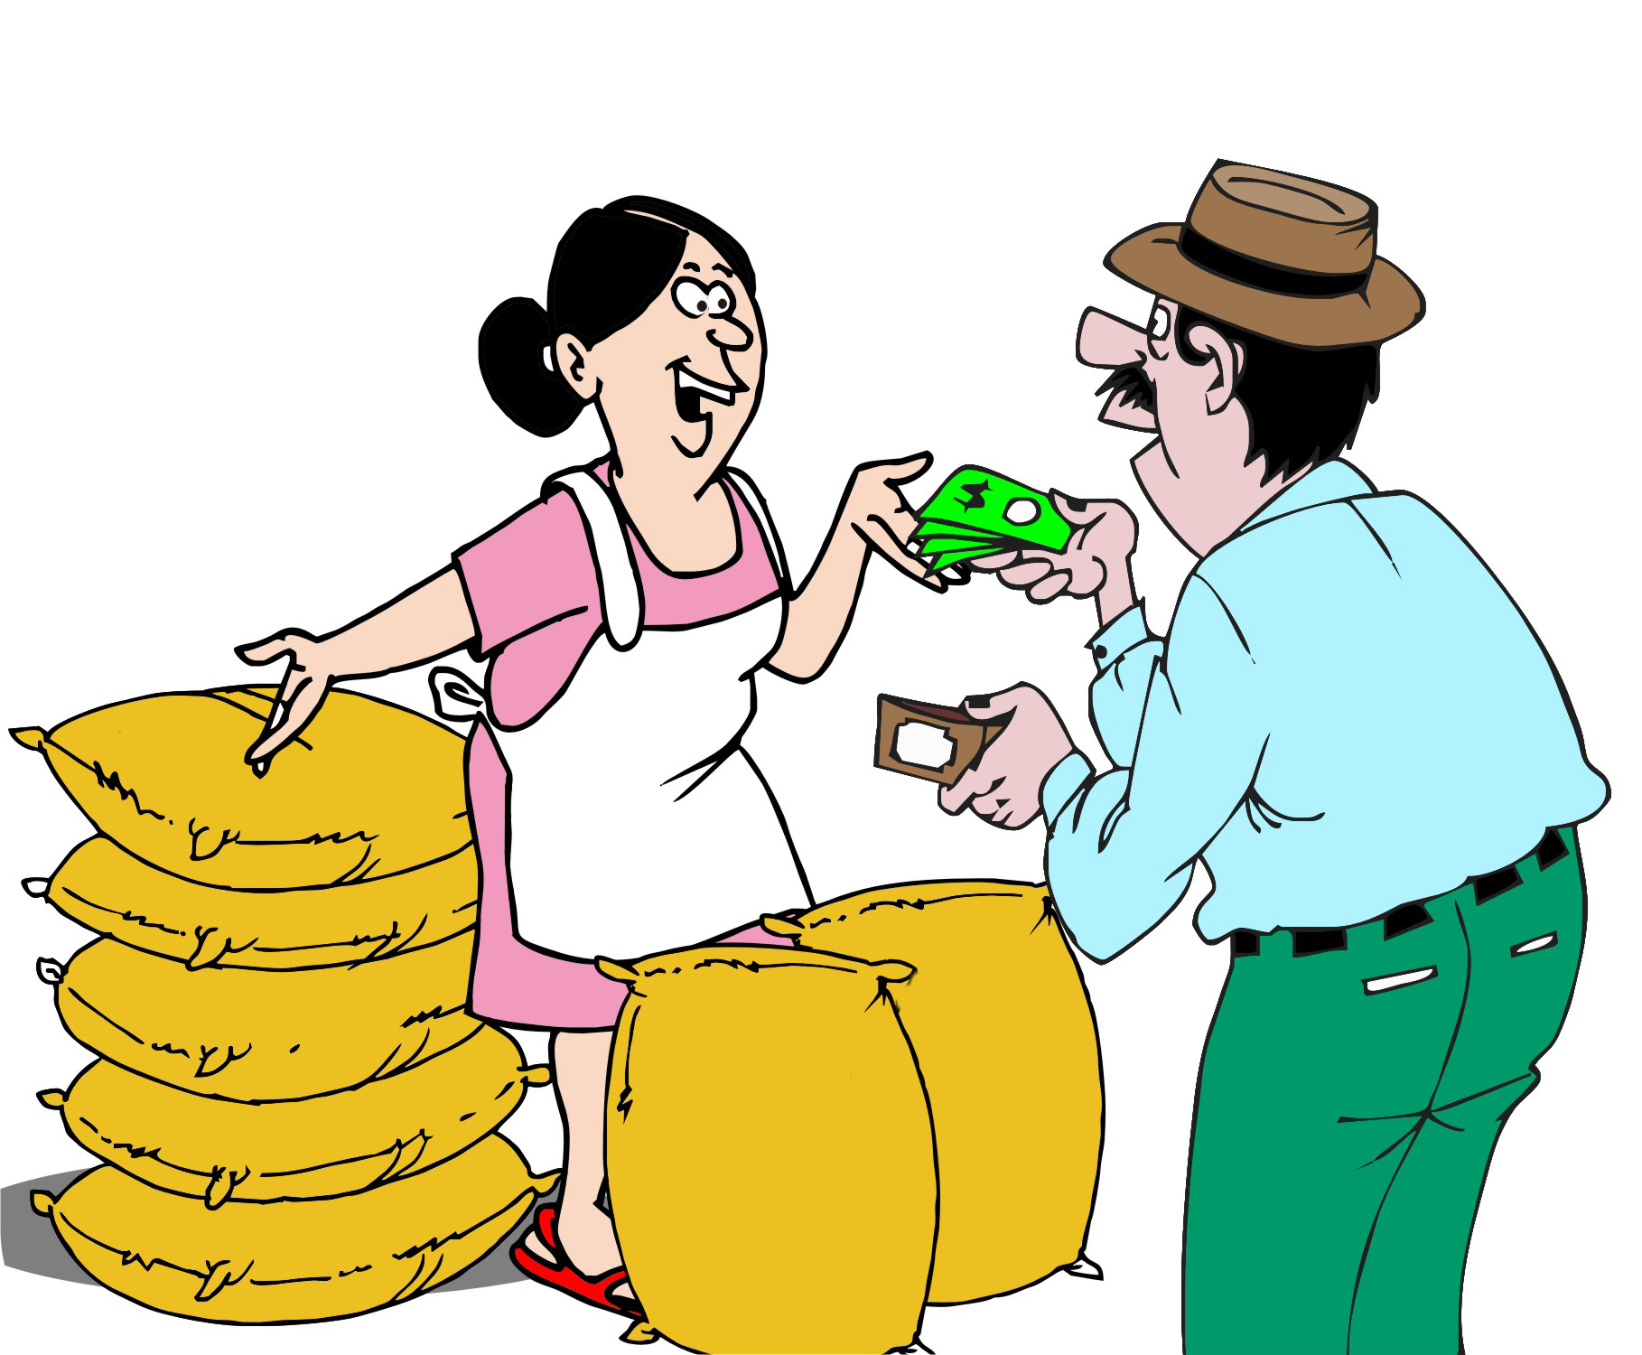
Income
The farmer’s income from a product depends on the following two things:
The price per kilogram (or sack or crate) of the produce
The number of kilograms (or sacks or crates) that the farmer can sell

Slide 41
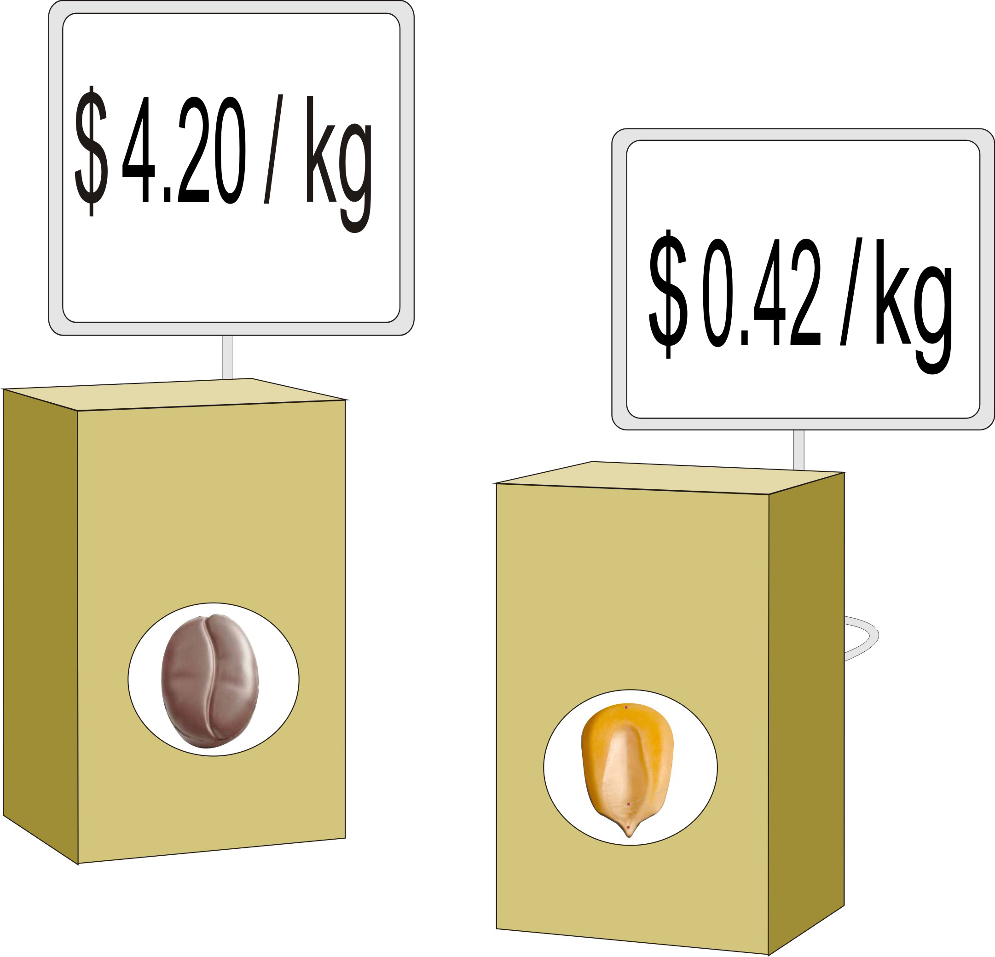
Prices: Factors that affect product prices
Type of product
Product quality
Amount of the product
Packaging
Time of sale
Place of sale
Processing
Marketing arrangements

Slide 42
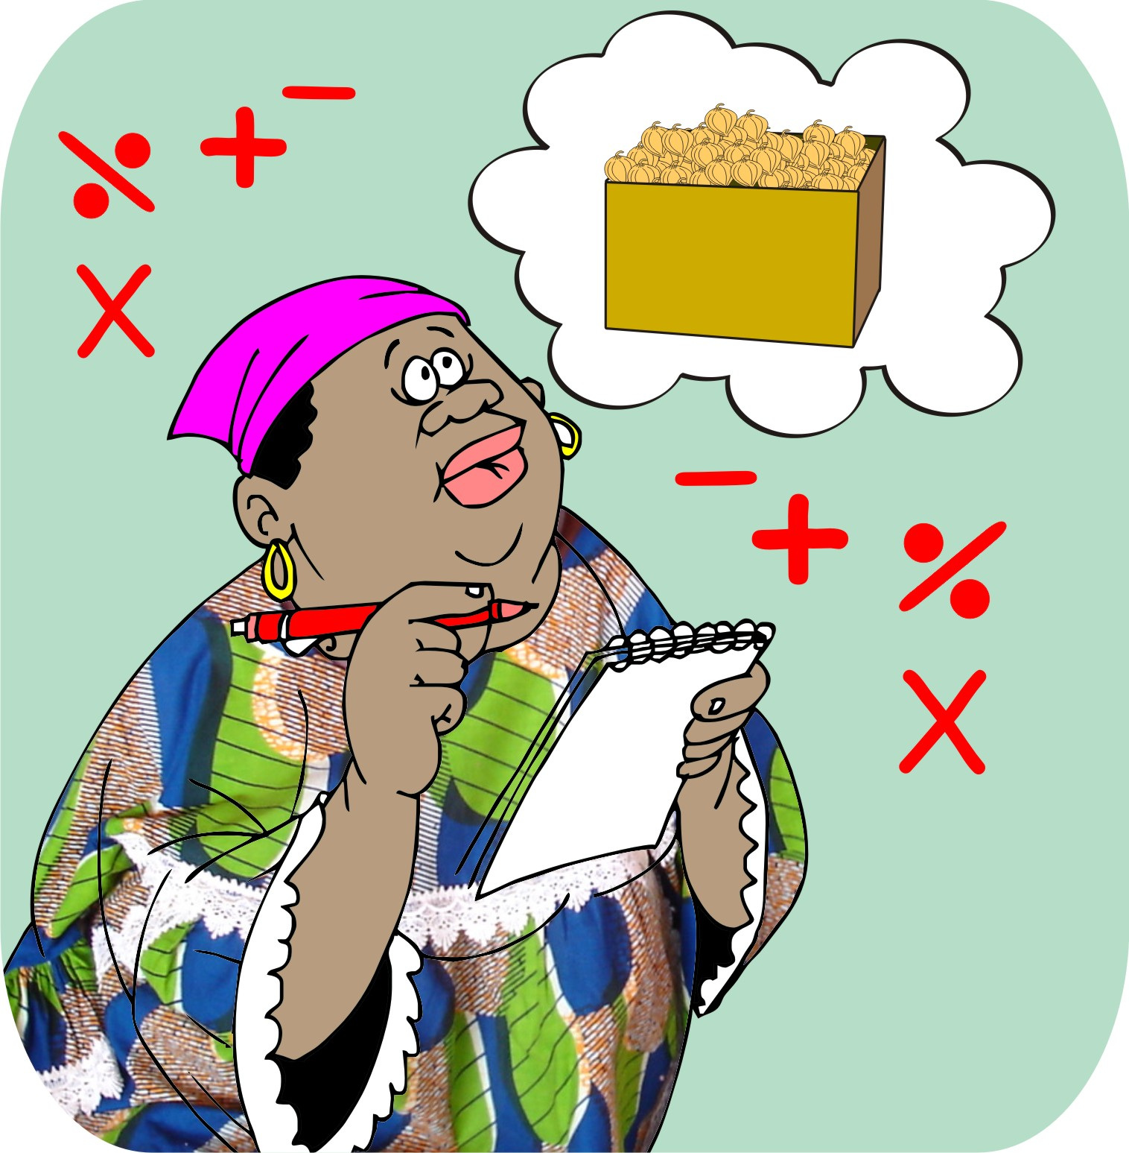
Profit:
Profit = Income – Costs
Profit = The amount of extra money that the farmer has left from a sale after paying for all the production, processing and marketing costs.

Slide 43
Profit and loss
If the income is higher than the costs, then the farmer makes a profit.
If the costs are higher than the income, the farmer makes a loss – i.e. there is less money to go round.

Slide 44
Increasing profit
Farmers can increase their profit (or avoid making a loss) by:
Increasing their income
Reducing their costs
Marketing can help farmers by:
Marketing can increase income by helping farmers plan what crops to grow and how much to grow
Marketing can help farmers to make decisions on how and where to sell their products at a higher price
Marketing can reduce costs by helping farmers plan their production and marketing efforts better.

Slide 45
Lesson 4: Types of markets

Slide 46
Outcomes
After this lesson you will be able to:
List different types of markets where farmers can sell their products.
Compare among the different types of markets.
Describe different market segments.
Select a market for a particular type of product.

Slide 47
Overview
Lesson 4 covers the following content:
On-farm sales
Barter markets
Assembly markets
Wholesale markets
Retail markets
Supermarkets
Comparing markets
Market segmentation

Slide 48
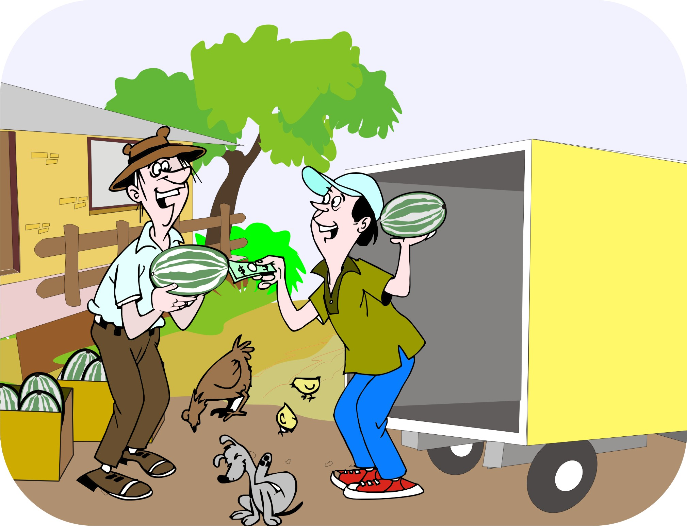
On-farm sales
On-farm sales are sales where the farmers sell their products directly to neighbors, traders or to local buying agents.

Slide 49
On-farm sales: Convenience and prices
Selling at the farm is convenient for the farmer, because there are no:
Additional marketing costs (e.g. loading or unloading)
Problems in reaching agreements with the other members of a marketing group
The disadvantage of on-farm sales is that prices of produce are usually lower than prices at markets.

Slide 50
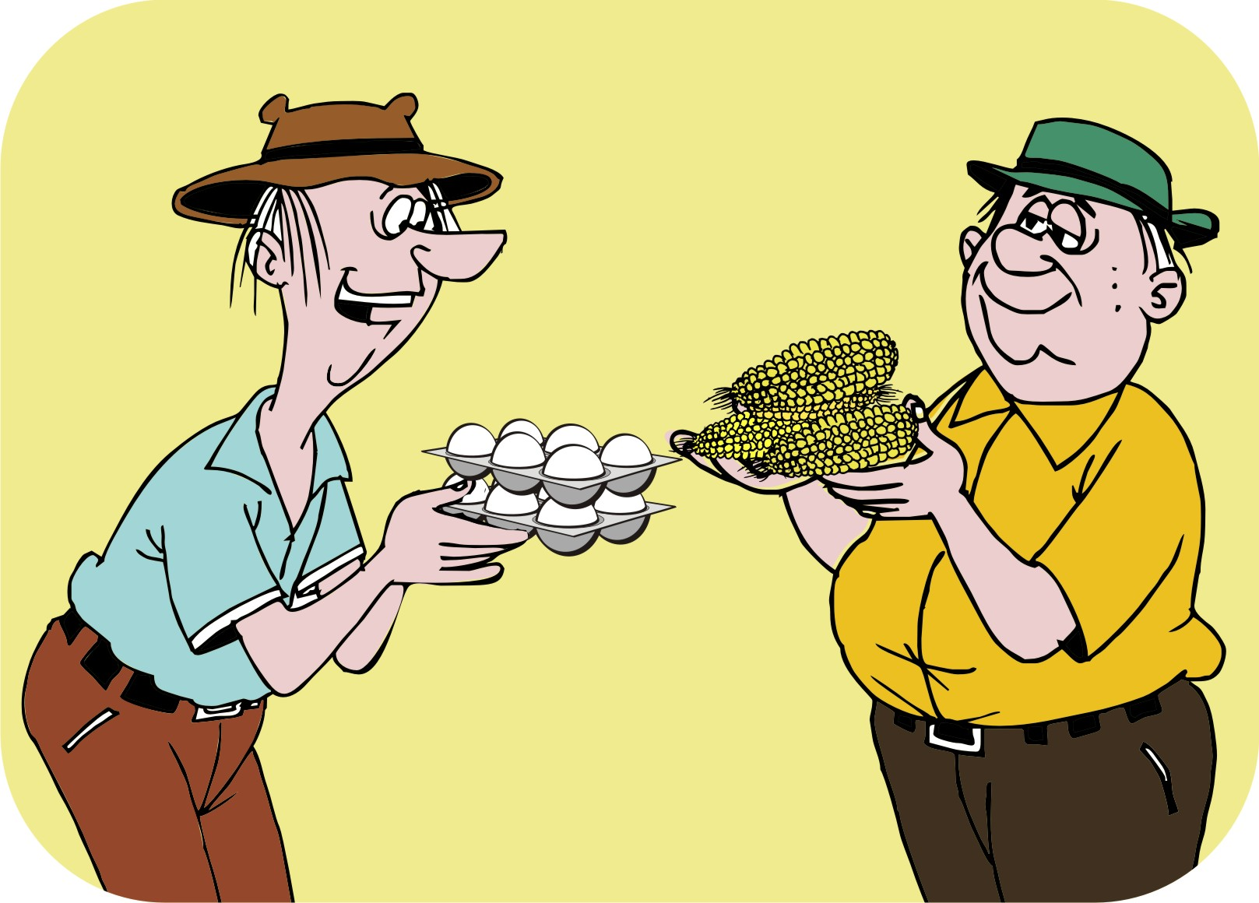
Barter markets
Barter markets are the simplest form of markets, where people come together to exchange goods without the use of money, e.g. one farmer swapping maize for another farmer’s eggs.
Bartering occurs in very remote places, or after a disaster, when there is no money to use as a means of exchange.

Slide 51
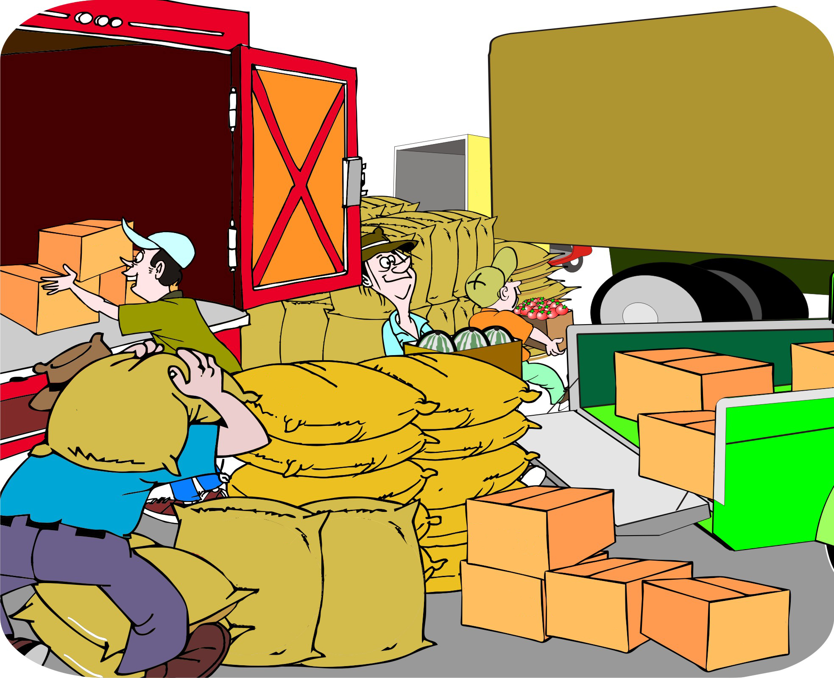
Assembly markets
Assembly markets are markets where farmers and small local traders come together regularly to sell their goods to larger traders.
Farmers can sell their product as individuals or collectively.
The buyers in assembly markets are traders – not consumers.
Assembly markets are normally found in rural areas or in small towns close to farming areas.

Slide 52
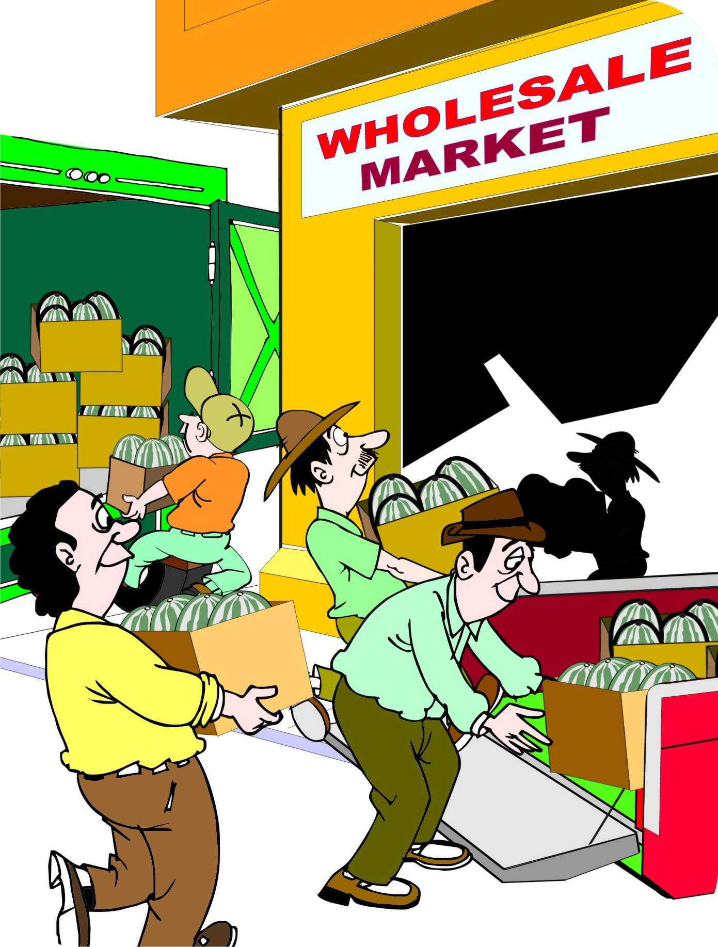
Wholesale markets
Wholesale markets are markets where traders deliver produce in bulk.
Wholesale markets are generally found in larger towns and cities.
Retailers (people who sell goods directly to consumers) come to these markets to buy large amounts of goods to sell in their stalls and shops.

Slide 53
Retail markets
Retail markets are markets where consumers and small businesses buy their daily or weekly supplies of food.
If farmers want to sell in bulk directly to retail markets, they must work out a system with the retailer.
Wholesalers may try to prevent farmers from selling directly to retailers.

Slide 54
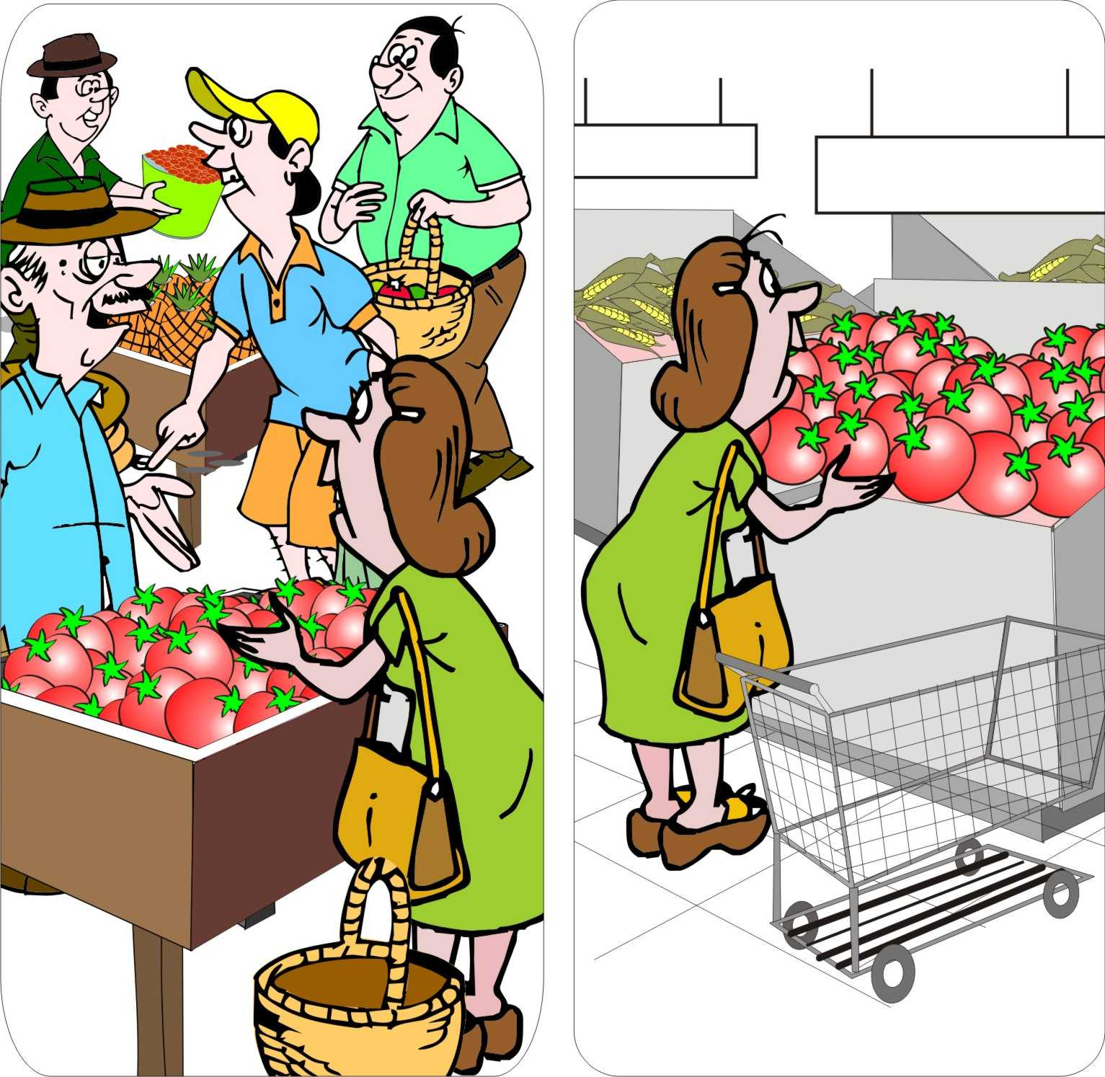
Supermarkets
Supermarkets are convenient, one-stop shops that enable consumers to buy many different types of goods at the same time.
The food is attractively packaged and good quality.
Farmers can sell directly to supermarkets, but they must meet strict volume and quality requirements.

Slide 55
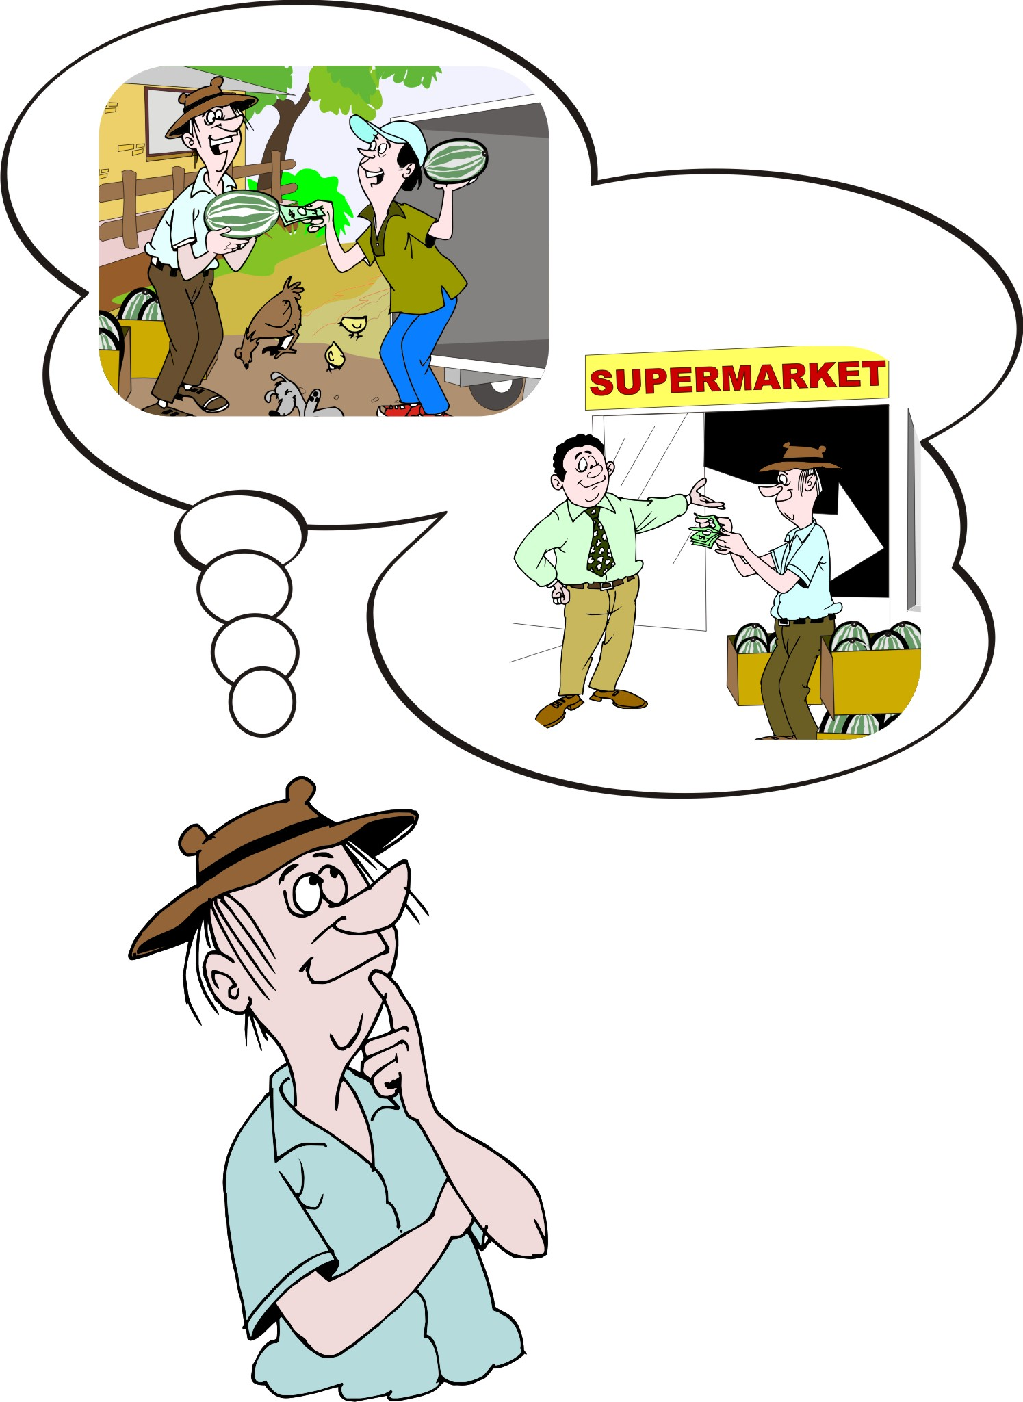
Comparing markets
Each type of market:
Serves a specific role
Offers a different combination of quality, quantity, prices and presentation of goods.

Slide 56
Market types and farmers’ profit
Generally, farmers receive the lowest price if they sell unsorted produce at the farm gate.
The more distant markets may offer higher prices, but marketing costs – especially – transport will also be higher.

Slide 57
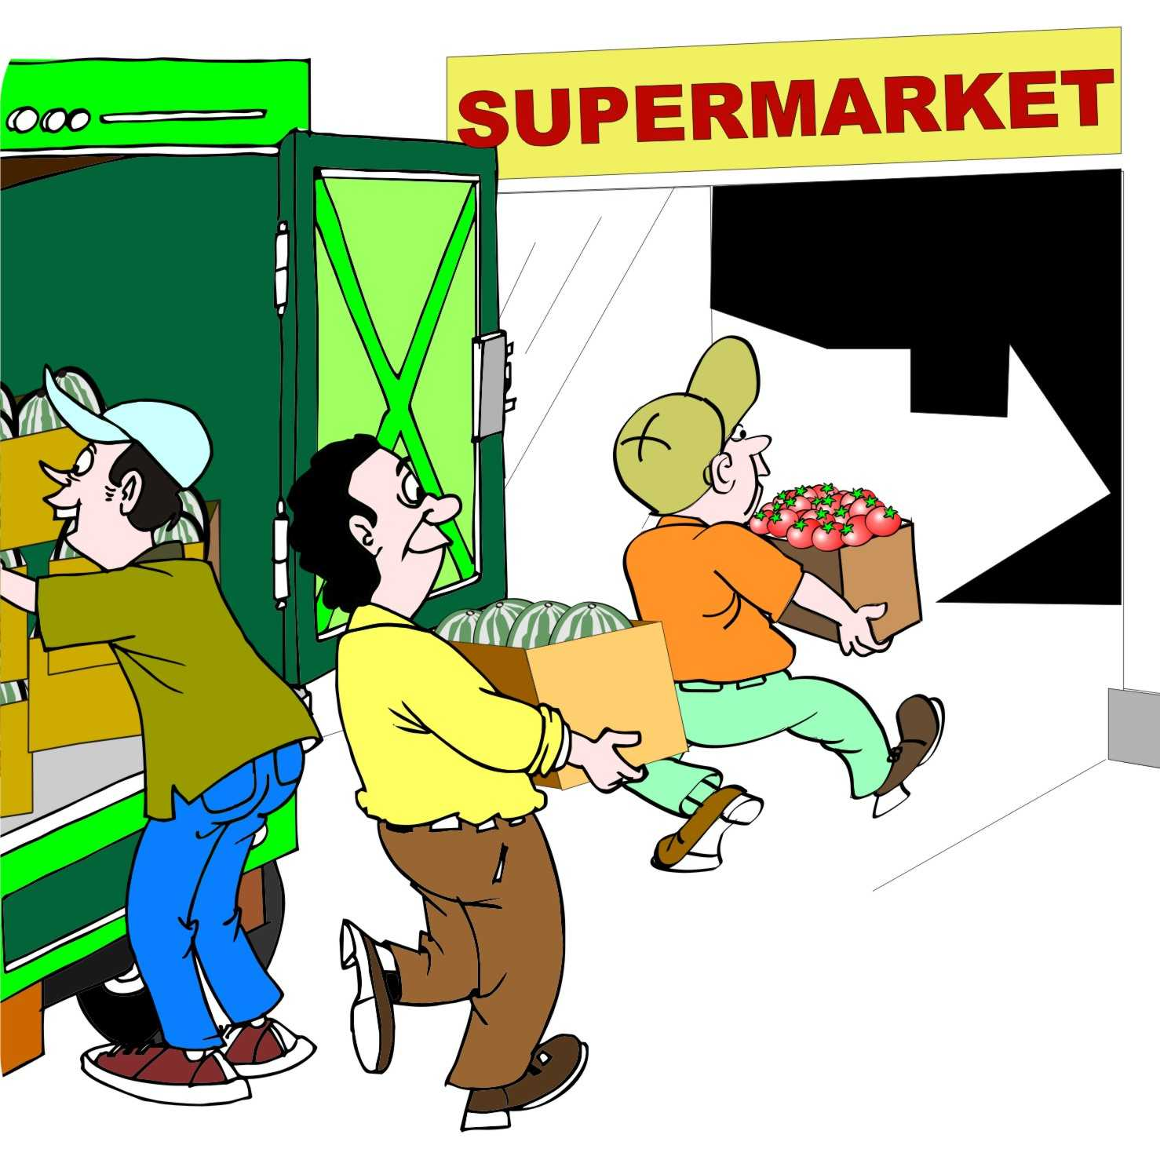
Market types and farmers’ profit: Supermarkets
Supermarkets may offer the highest price, but farmers need to meet many conditions and requirements in terms of:
Sorting
Grading
Packaging their output.

Slide 58
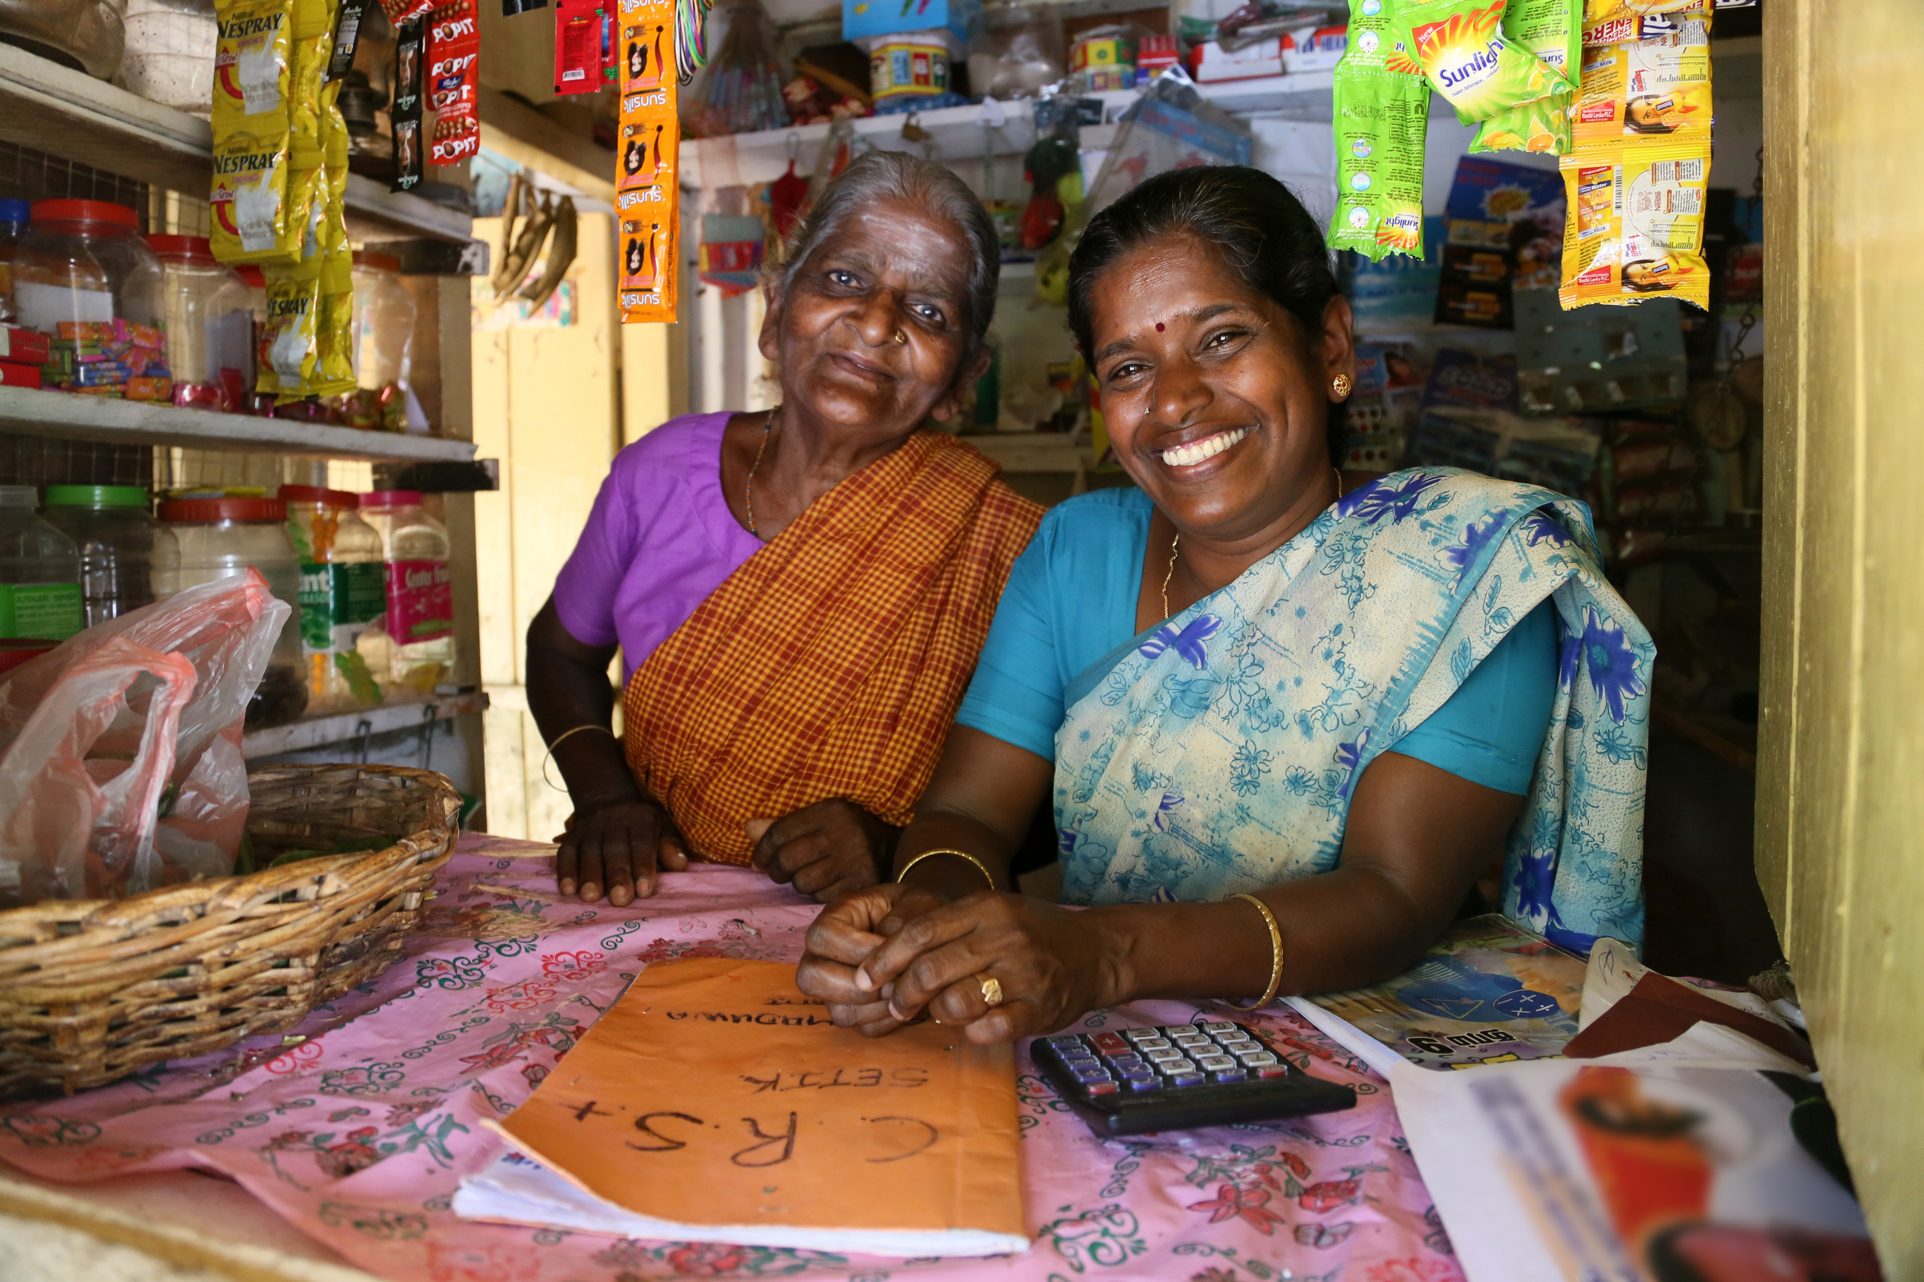
Market types and farmers’ profit: Costs and income
To identify the best venue to sell their produce, farmers need to make the following calculations in terms of selling in different markets:
Costs
Income
Profits

Slide 59
Market segmentation
We can divide consumers according to their age, sex, religion, personality, location or income.
Examples:
Young, well-off people in cities
Middle-aged, well-off people in cities
Young parents with families
Children

Slide 60
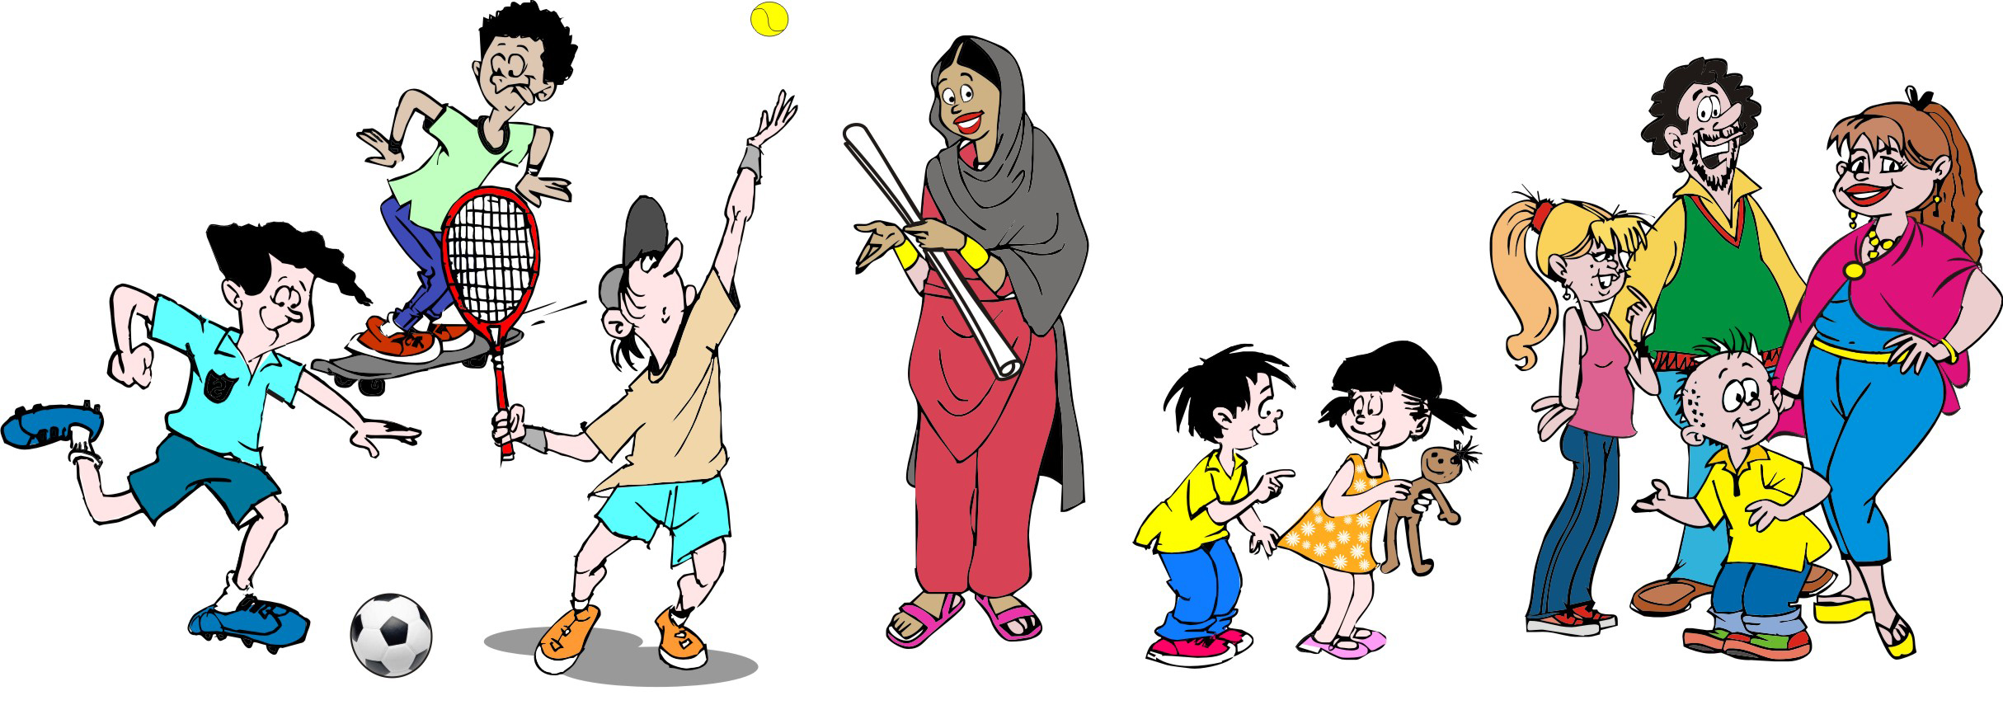
Needs and preferences of market segments
To sell products to a particular market segment, you need to target your marketing strategy to the needs and preferences to the consumers in that segment.
Example: Young, well-off people may like to go shopping in supermarkets, while older people may tend to buy their food in traditional markets.

Slide 61
Lesson 5: Adding value after harvest

Slide 62
Outcomes
After this lesson you will be able to:
Describe the different steps in processing a farm product after harvest and before sale.
Explain why these steps add value to the product.

Slide 63
Overview
Lesson 5 covers the following content:
Earning money from maize
Drying and shelling
Cleaning and sorting
Bulking
Packaging
Storage
Processing
Adding value

Slide 64
Earning money by adding value after the harvest
In the following sections, we will explore the activities that a farmer can perform after a crop is harvested to earn more money.
We will use maize as our example, but the same principles apply to any farm product.

Slide 65
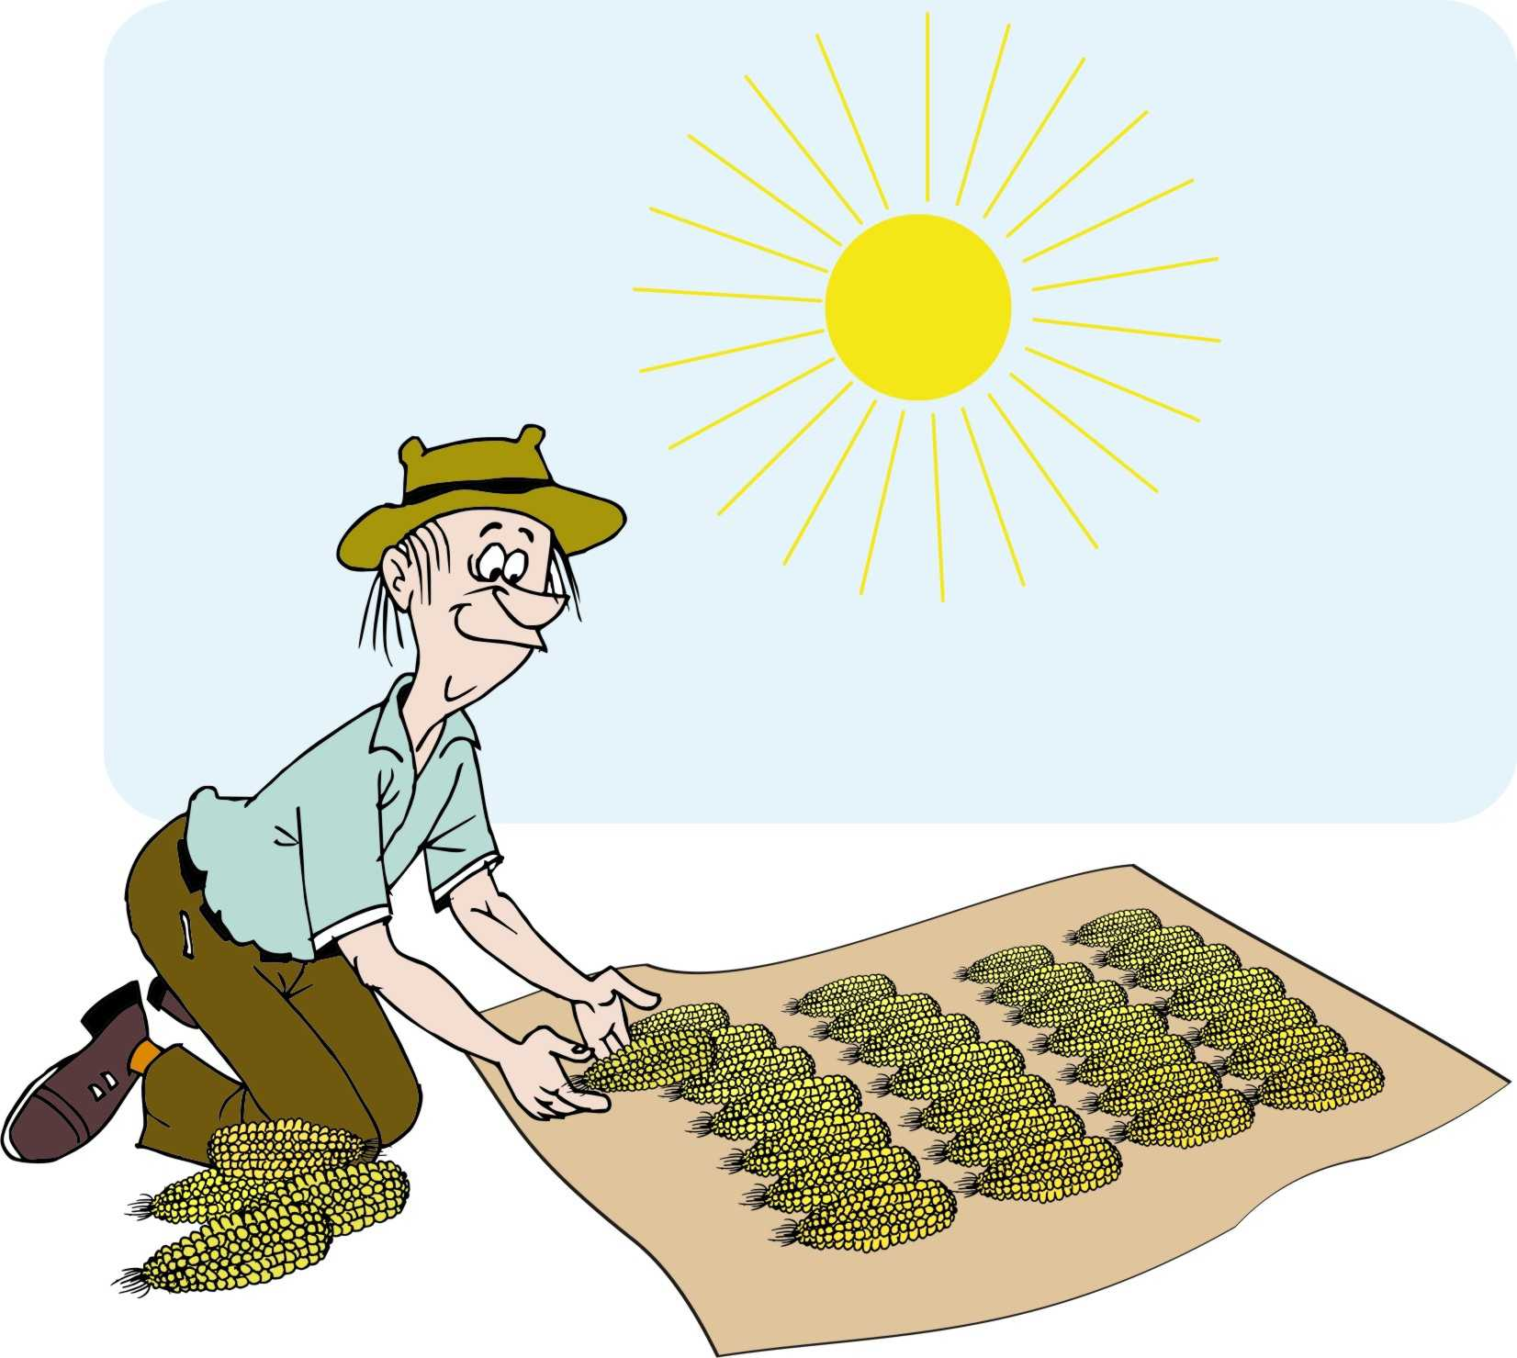
Drying and shelling
Maize has to be dry before it can be stored and milled properly.
The farmer:
Removes the husks from the harvested maize
Spreads the cobs out in the sun
Shells the maize when it is dry by removing the grain from the cobs.

Slide 66
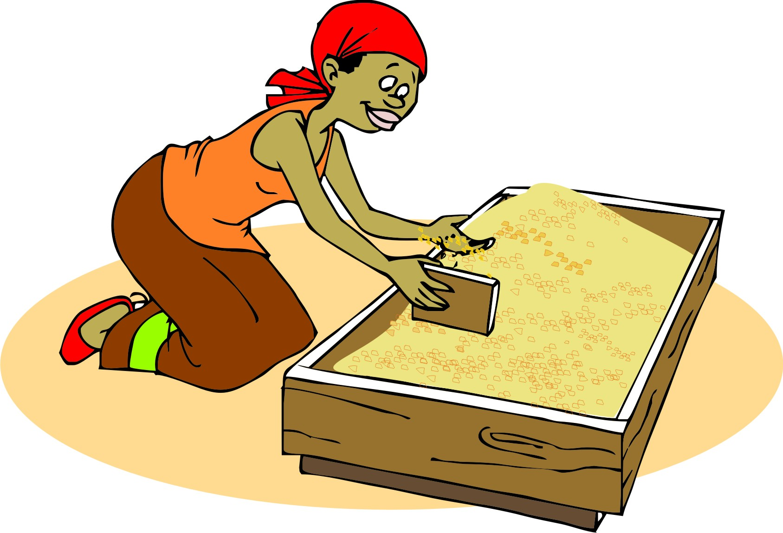
Cleaning and sorting
Traders often pay a higher price if the produce:
Is clean – it does not contain foreign matter such as sand, straw, stones or empty grains
Is sorted according to variety, size, color, shape, amount of impurity and ripeness.
The farmer:
Picks out the straw and stones
Sieve the grain to remove sand and empty grains

Slide 67
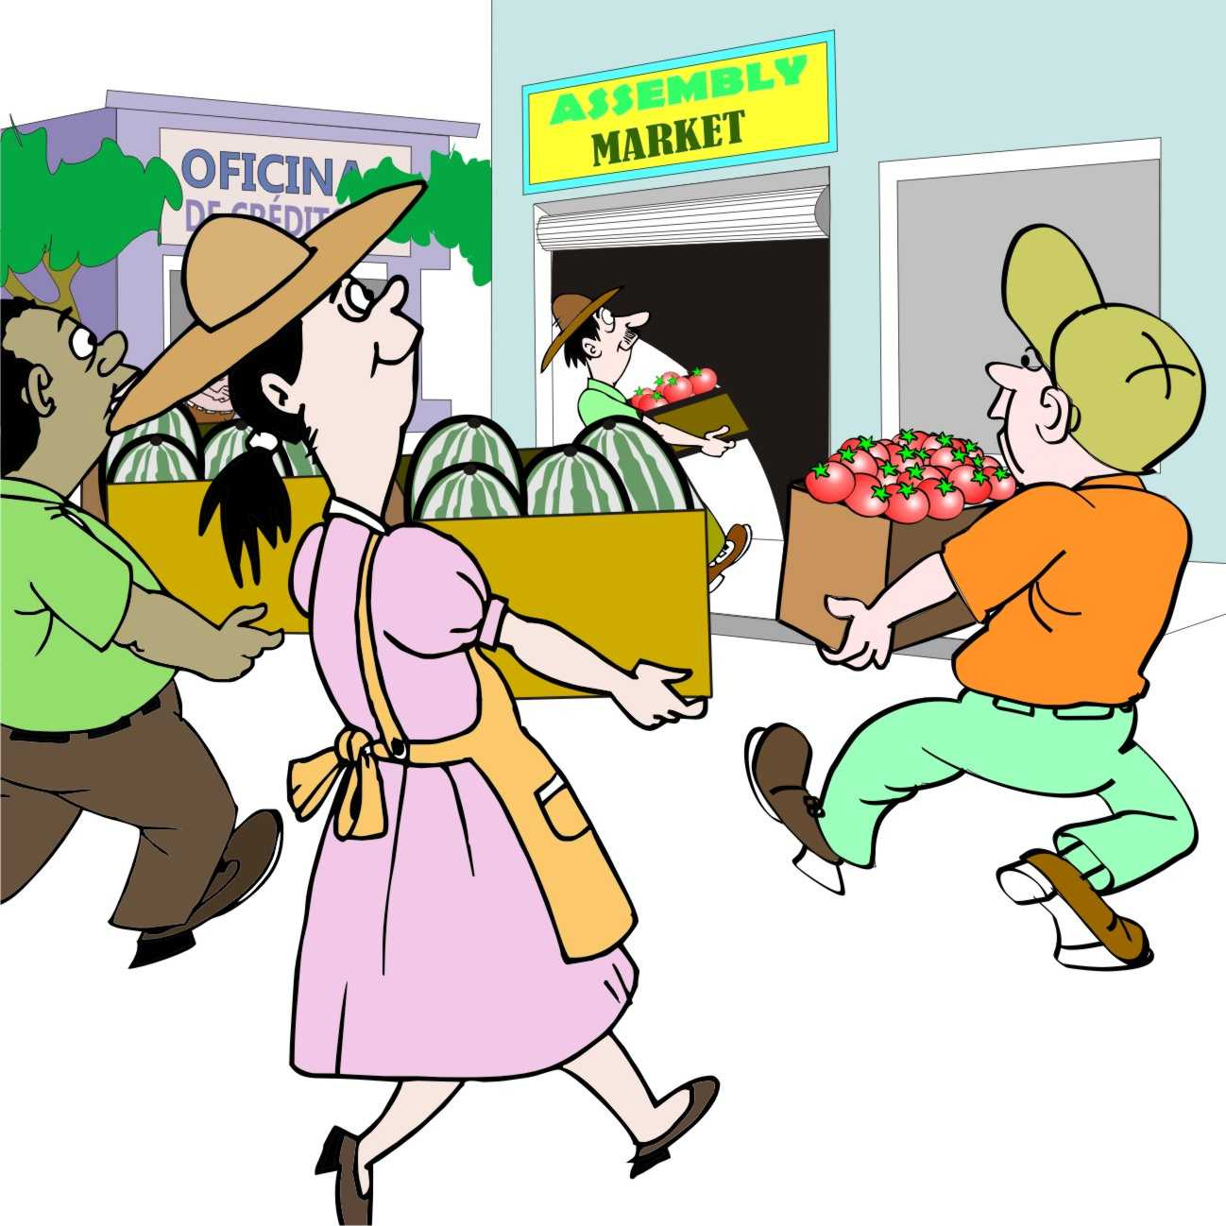
Bulking
Bulking involves a group of farmers:
Bringing their sacks of maize to a central point in the village, so they have enough to fill a pickup or truck
Negotiating with a bigger trader, who pays more per kilogram for the convenience of buying a single load

Slide 68
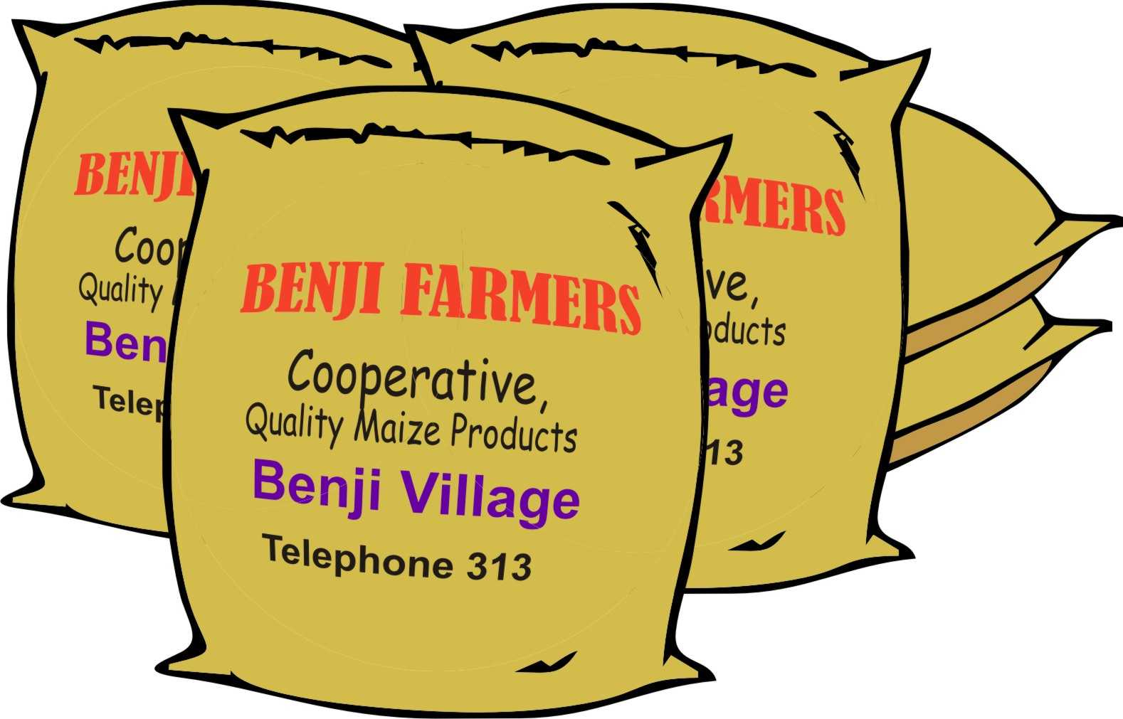
Packaging
Farmers put their maize into standard-sized sacks and stack them in a dry place.
Packaging protects the product from damage, contamination or theft.
Standard sized sacks or crates make it easy to keep track of how much produce there is.
The packaging can be labelled with the name of the farmer’s group.

Slide 69
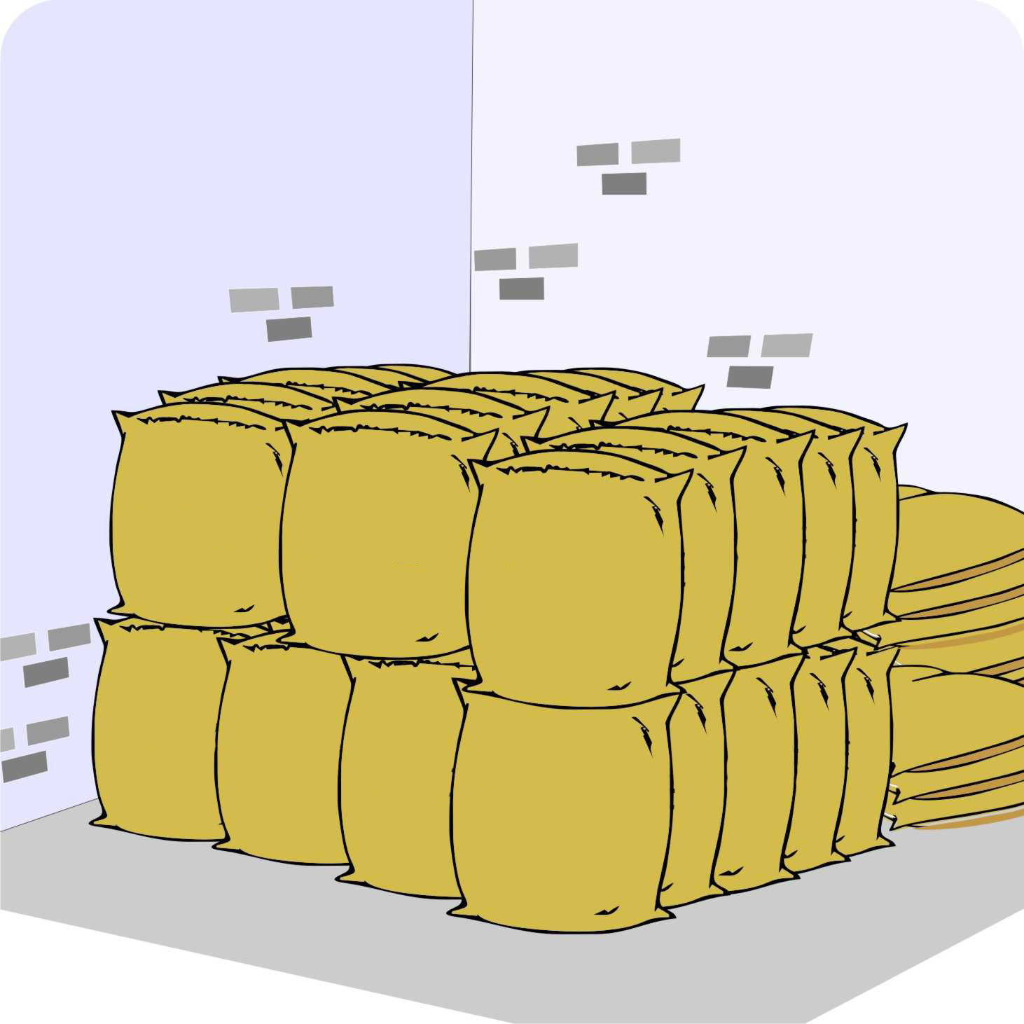
Storage
The farmers:
Put their sacks of maize in a secure, dry warehouse
They put the sacks on wooden pallets to keep them off the floor
Set traps for mice and rats
Cover the sacks with polythene and use a fumigant to prevent insect damage, if necessary

Slide 70
Keeping produce in storage
For most products, prices are often low immediately after harvest. Therefore, it is a good idea to store grain until the price has recovered and/or increased.
The farmers monitor market prices to decide when to sell the grain to get a good price.
For storage to be profitable, farmers must receive a price that is higher than the costs of storage, including any losses (e.g. moisture loss).

Slide 71
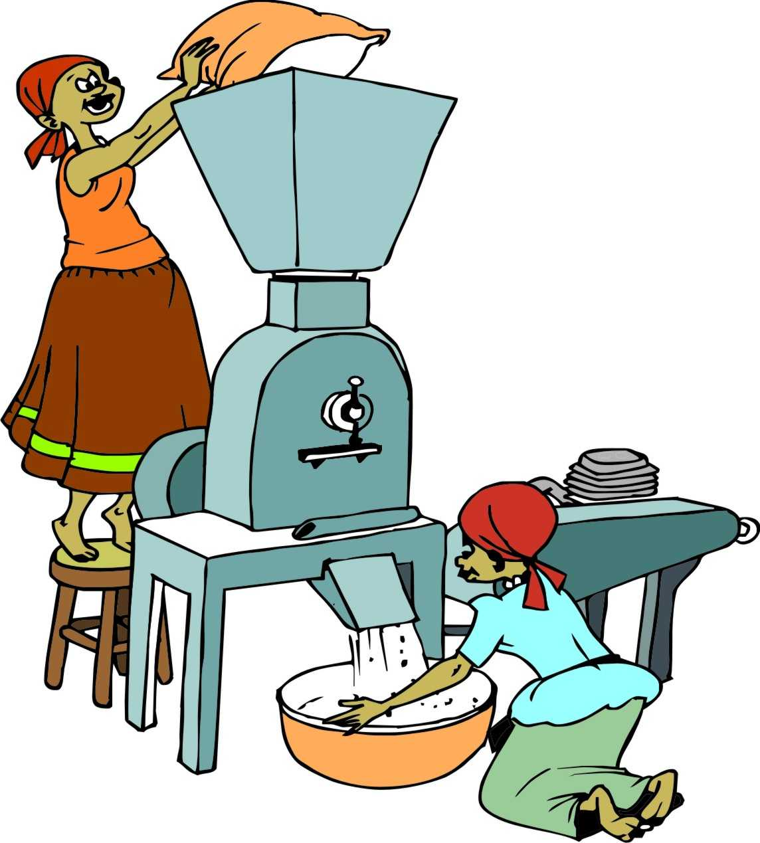
Processing
Farmers can add value to many crops by processing them into other products.
Examples:
Milled rice fetches a higher price than paddy
Cassava flour is worth more than roots
Meat is worth more than live animals

Slide 72
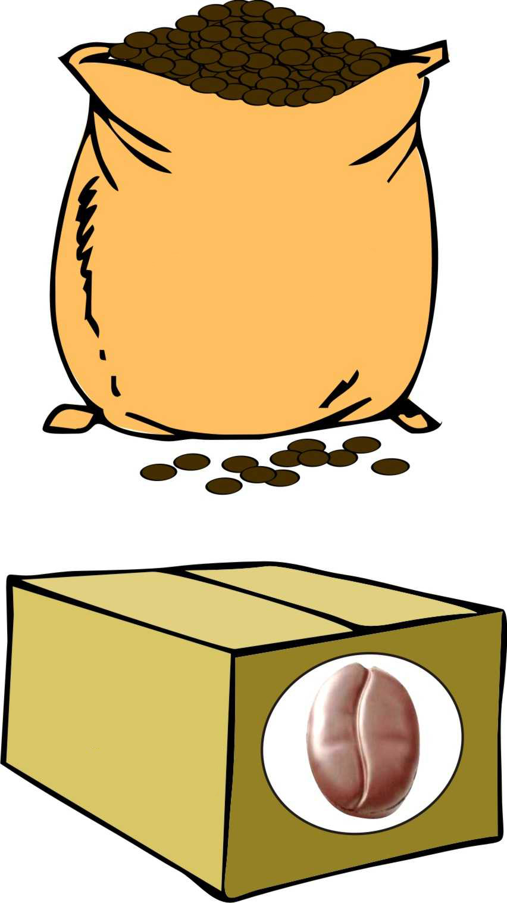
Adding value
All these value adding activities make a product more attractive and convenient for consumers to buy.
Someone in the value chain – a trader or a processor with the capital and skilled labor – has to do the tasks of de-husking, shelling, making packages of frozen food, etc. (at a cost).
By organizing themselves, smallholder farmers can do many of these value adding tasks themselves and can earn extra money by doing so.

Slide 73
Lesson 6: Changes in the markets

Slide 74
Outcomes
After this lesson you will be able to:
Describe how the markets of agricultural products are being changed by:
Population trends
Market trends
New technologies
Consumer concerns
New products and markets

Slide 75
Overview
Lesson 6 covers the following content:
Changes in markets
Population trends, rising incomes and urbanization
Market trends and globalization
Product price trends
Supermarkets and vertical integration
Pressure to reduce costs
New technologies
Consumer concerns
New products and markets

Slide 76
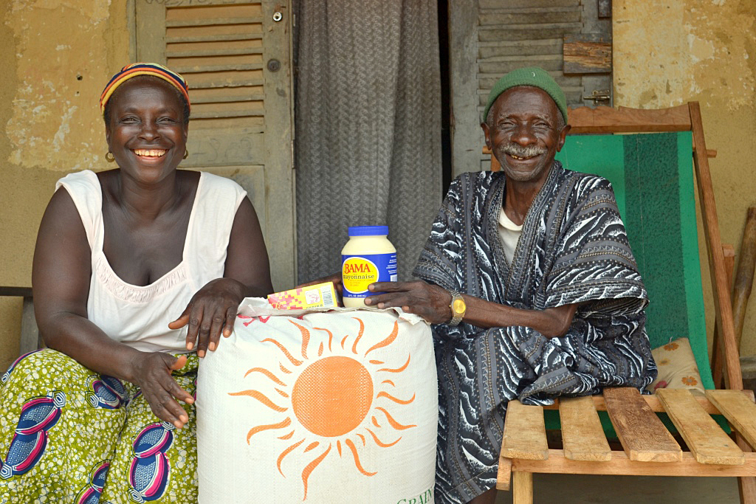
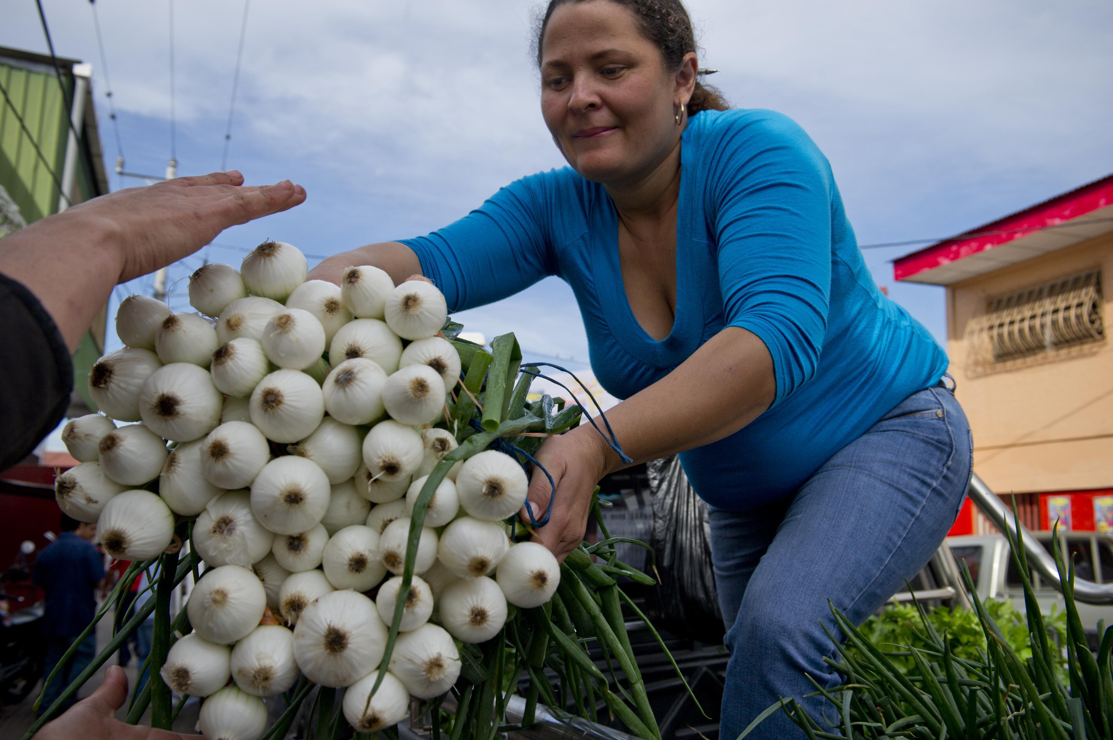
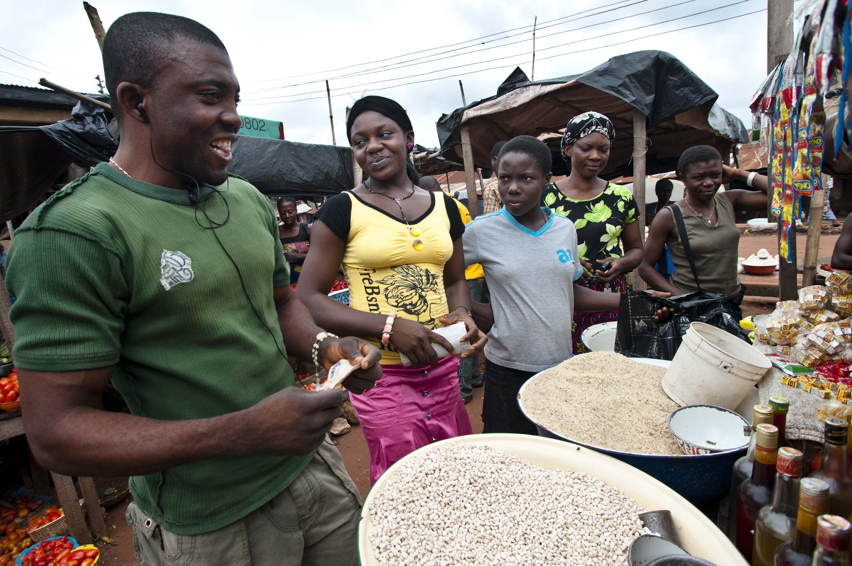
Changes in markets
Markets are in constant, rapid change and if farmers:
Understand some of these changes in their country and region, they will be better able to produce what consumers want
Know what consumers want, they will know what products they should produce.

Slide 77
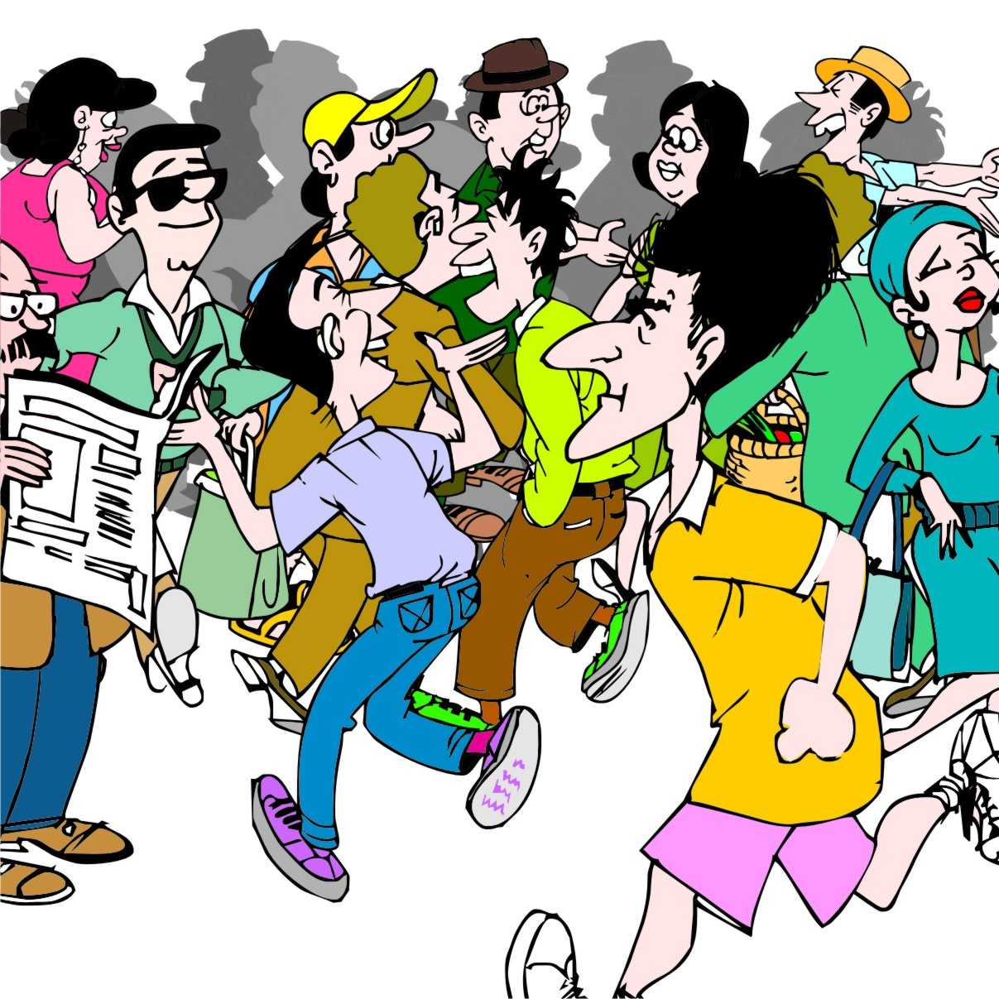
Population trends: Population growth
The number of people in developing countries is growing rapidly.
This means:
More mouths to feed and more bodies to clothe.
Higher demand for many types of agricultural products

Slide 78
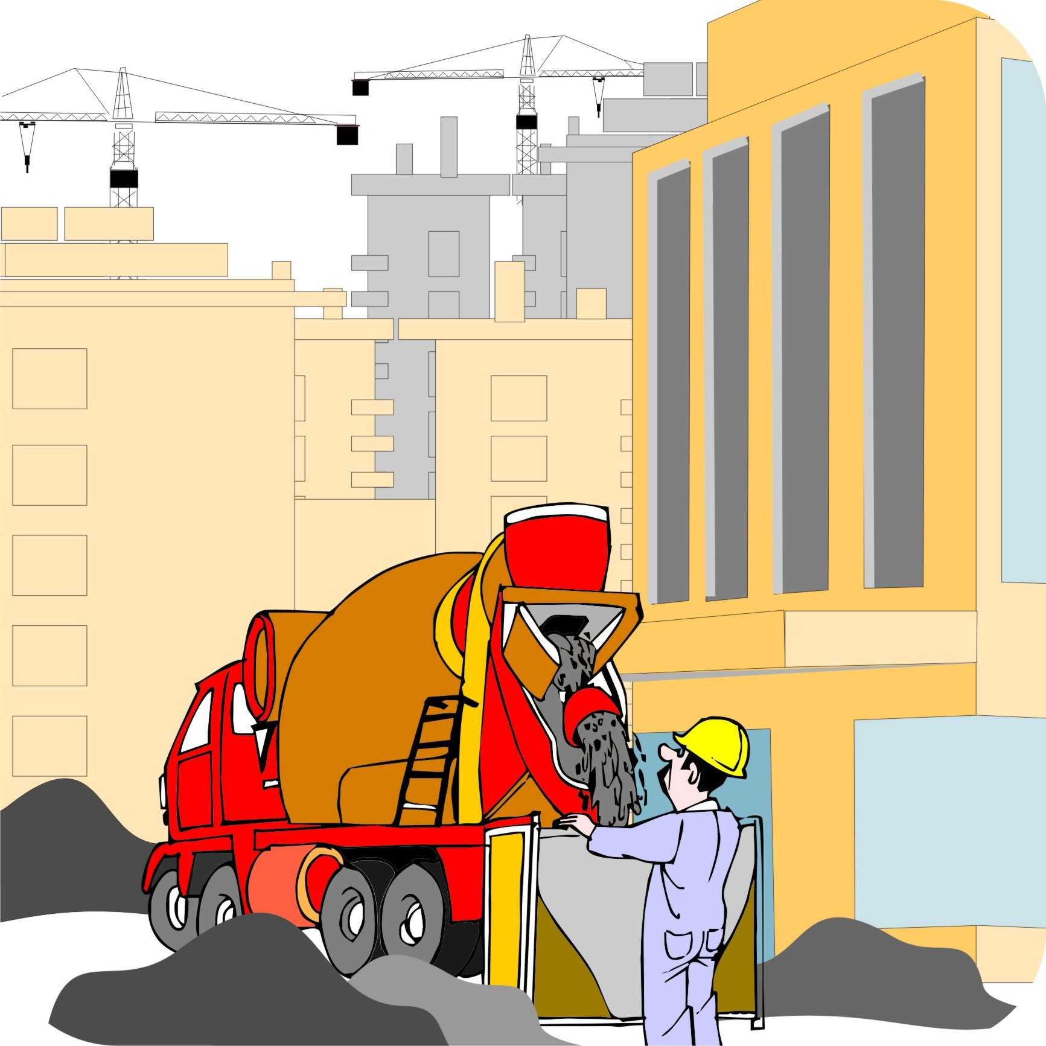
Population trends: Urbanization
Around half of the world’s population now lives in towns and cities and more people move to cities every year.
That means that people need to buy more food and other agricultural produce rather than growing it for themselves.

Slide 79
Population trends: Rising incomes
In most countries, incomes are rising, especially in the cities.
Richer people want higher quality or more processed foods and a wider range of products.
A growing middle class demands more sophisticated goods and prefers to shop in supermarkets rather than from traditional market stalls.

Slide 80
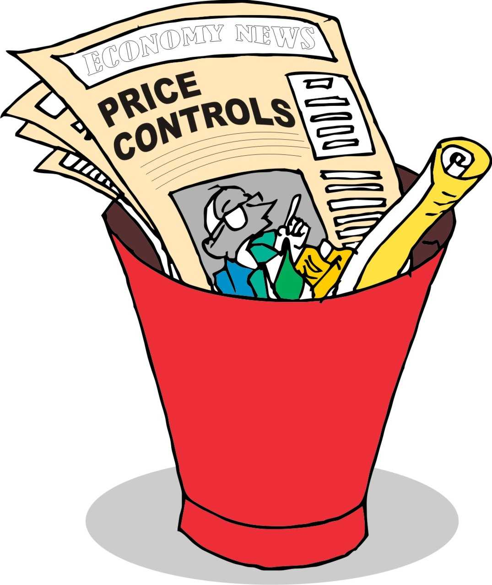
Market trends: Market openness or “liberalization”
Many governments have reduced their control over markets and opened them to foreign suppliers.
Governments still provide a regulatory framework, but the market is managed by a host of private sector actors.
In most cases this has led to more competition and can open up new market opportunities for farmers.

Slide 81
Market trends: Globalization
Changes in banking and improved transport and communications have boosted trade and made markets in different countries more dependent on one another.
Although that has led to growth, it has caused serious problems in many developing countries, e.g. the imports of cheap food can undermine local producers.

Slide 82
Market trends: Product price trends
Over the last 20 years, the prices of many agricultural commodities on the world market have fallen.
Prices have recently started to rise again, but have been very volatile because of factors such as bad weather and economic recession.

Slide 83
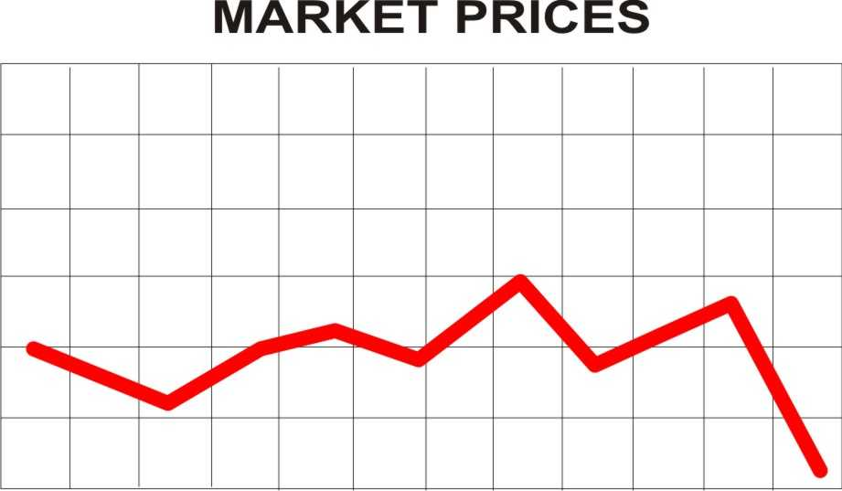
Market trends: Product price trends (Continued)
Volatile agricultural markets and prices make it difficult for farmers growing agricultural products to predict prices and to make a profit.

Slide 84
Market trends: Supermarkets and vertical integration
In industrial countries, supermarkets are the dominant buyers and farmers must meet their strict quality controls and price structures.
In many countries, the number of more formal markets is growing and are replacing smaller retail stores.
Some big companies now handle tasks all along the value chain: they may grow, transport, process, package and retail certain products.
This vertical integration can lock out smaller growers from the market.

Slide 85
Market trends: Pressure to reduce costs
In order to attract customers by offering low prices, supermarkets put pressure on traders and processors to reduce their costs.
These actors, in turn, try to cut the prices they pay to farmers, which forces farmers to find ways to reduce their own costs.
Large trading companies and supermarkets are now the dominant actors in many value chains and they have a big influence on prices. They may look for cheaper suppliers, or buy directly from large producers, cutting out small-scale farmers and traders.

Slide 86
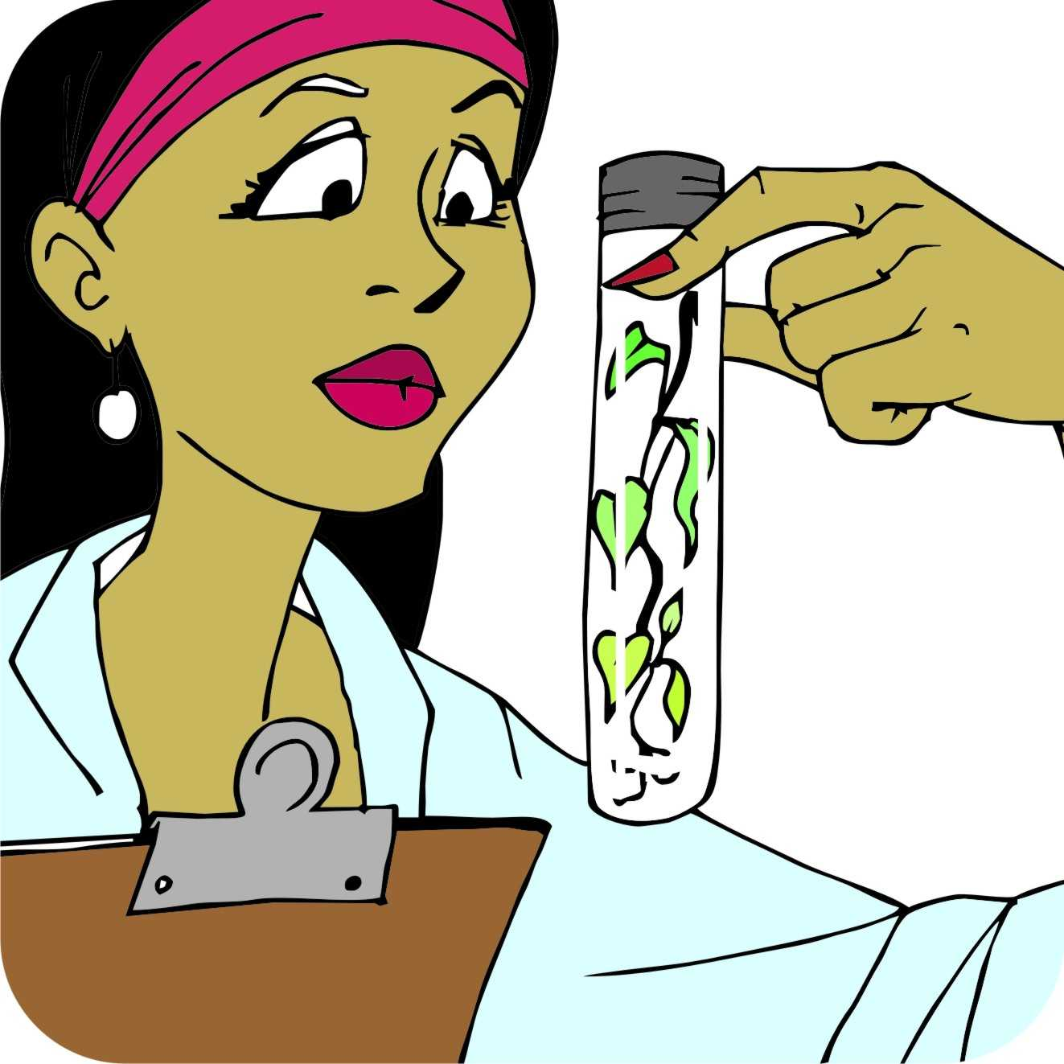
New technologies: Research and innovation
The research and innovation efforts in the agricultural sectors mean different challenges and opportunities for farmers.

Slide 87
Research and innovation challenges and opportunities
New technologies, research and innovations have resulted in the following challenges and opportunities for farmers, who produce agricultural products:
Agricultural research produces new crop varieties and new technologies.
Production methods are changing.
New ways of communicating are being developed.
New financial services are emerging.

Slide 88
New technologies: Information and communication
Computers and mobile phones are making it possible for rural people to communicate and get information.
Farmers and traders can use mobile phones as trading tools to:
Compare prices
Seek new customers
Negotiate deals

Slide 89
Consumer concerns: Food safety
Food scares have made consumers and governments concerned about food safety.
New rules and standards require companies to invest in new equipment and procedures to prevent problems such as diseases and pesticide contamination.
If companies fail to meet these standards, they must pay fines and the products are destroyed.
Companies insist that farmers comply with the new rules, e.g. food items must now be tagged to show where they were grown.

Slide 90
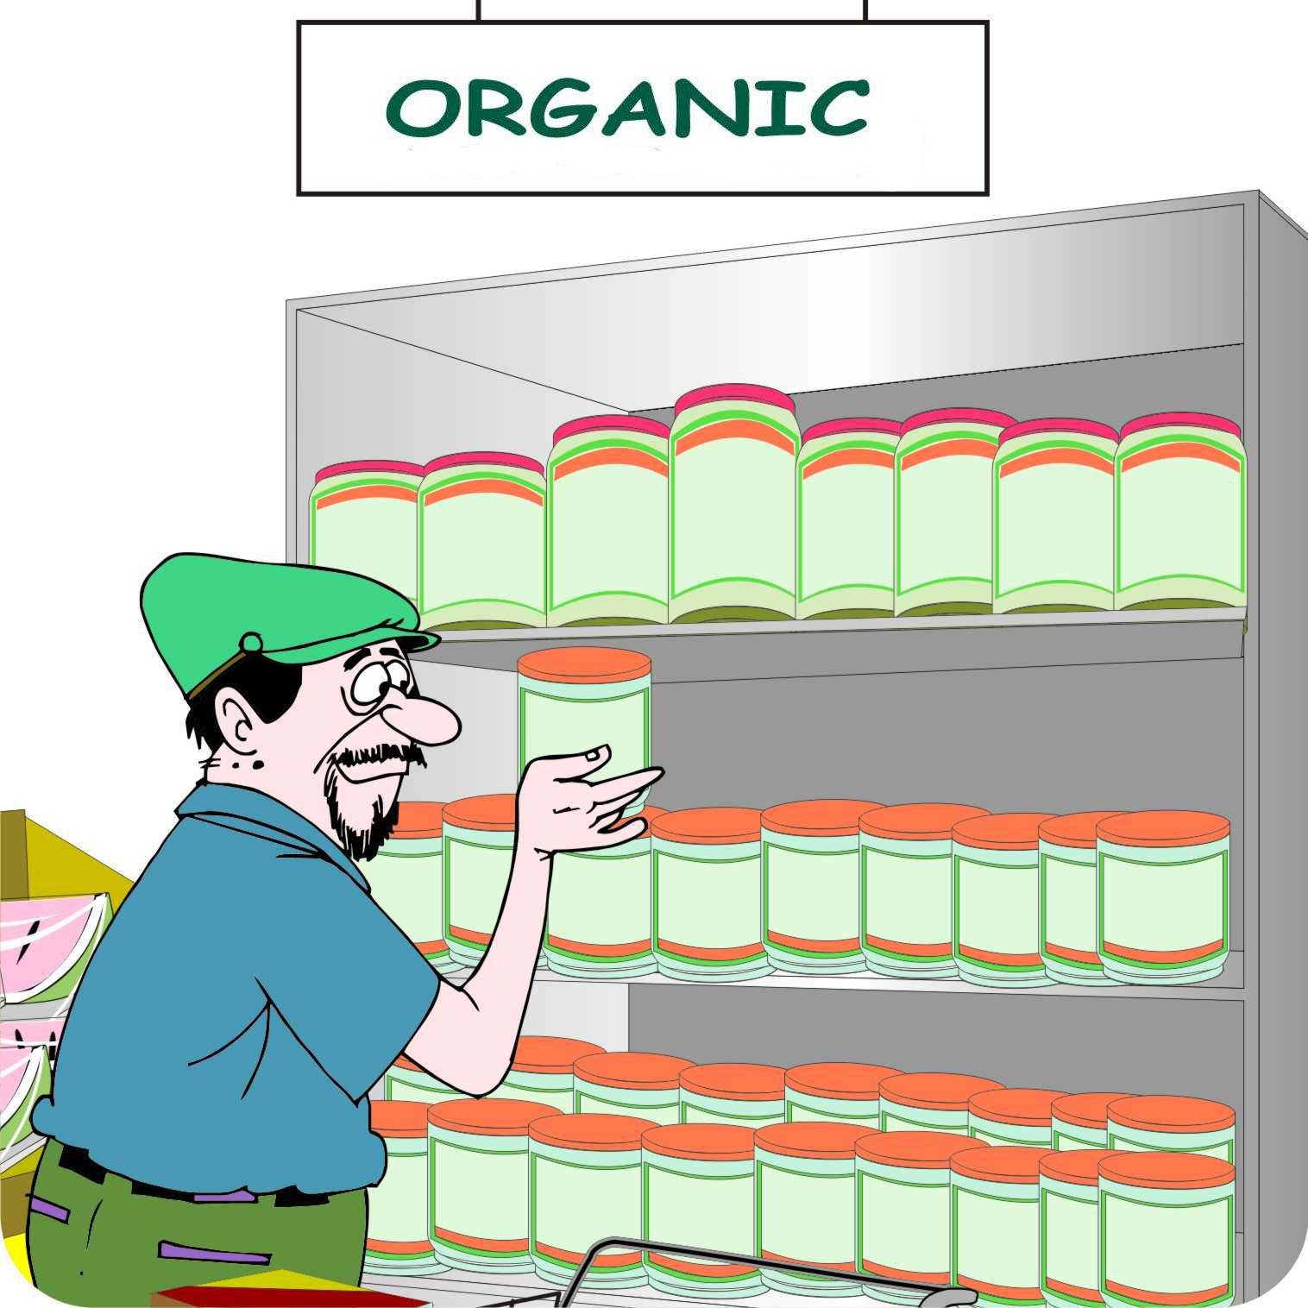
Consumer concerns: Organic products
The organic market is growing quickly and many supermarkets and specialist stores have large sections with organic products.
This is an opportunity for farmers who can produce without artificial chemicals.
Getting certified as “organic” is complex and expensive; so farmers have to get organized if they want to take advantage of this opportunity.

Slide 91
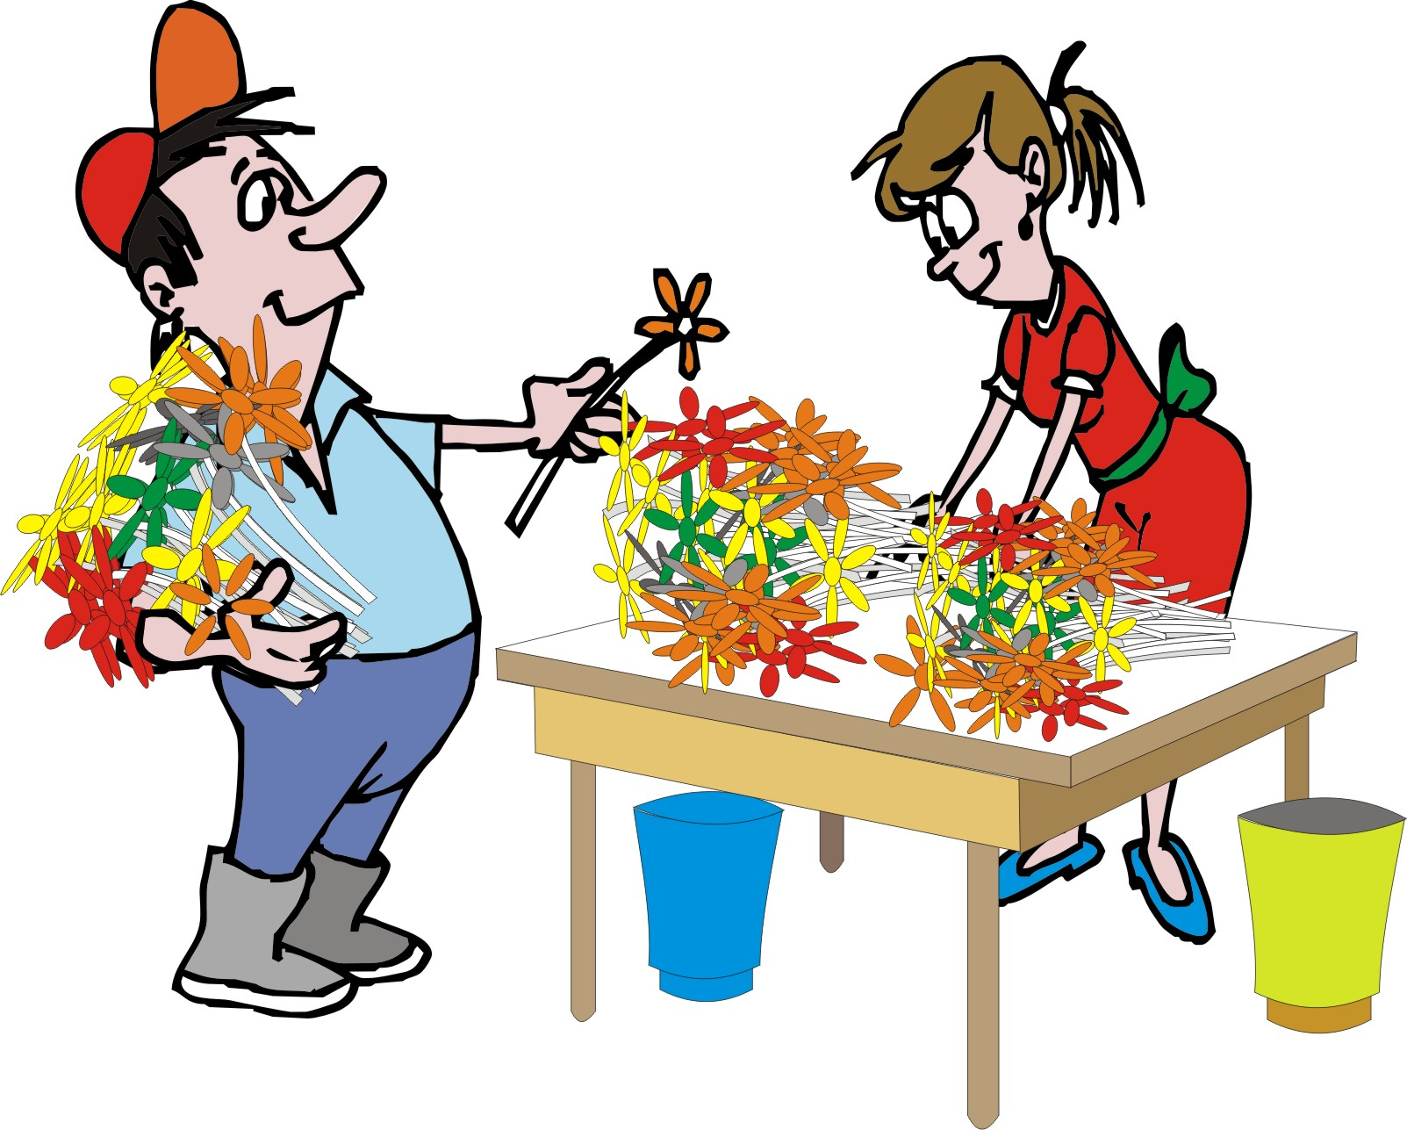
New products and markets: High-value products
As the prices of basic commodities – such as maize and wheat – fall, interest has risen in diversifying production into higher-value products, such as:
Fruit and vegetables
Cut flowers
Spices and herbs

Slide 92
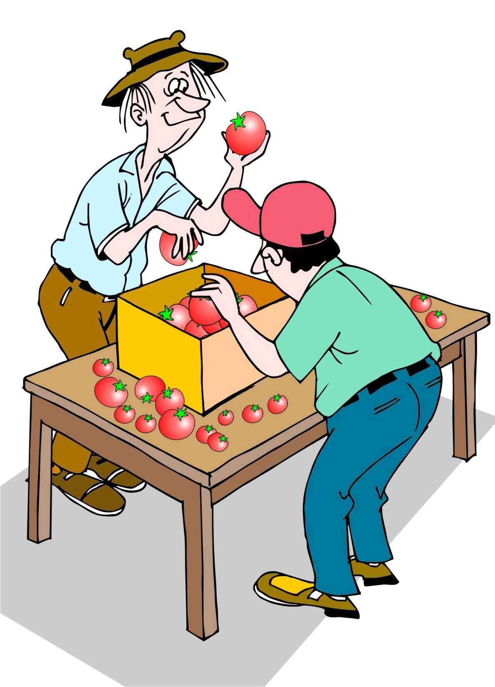
New products and markets: High-value products (Continued)
Diversifying production takes a lot of:
Investment
Information
Skills
Organization
Therefore, it is only possible only for the best-organized groups of smallholders.

Slide 93
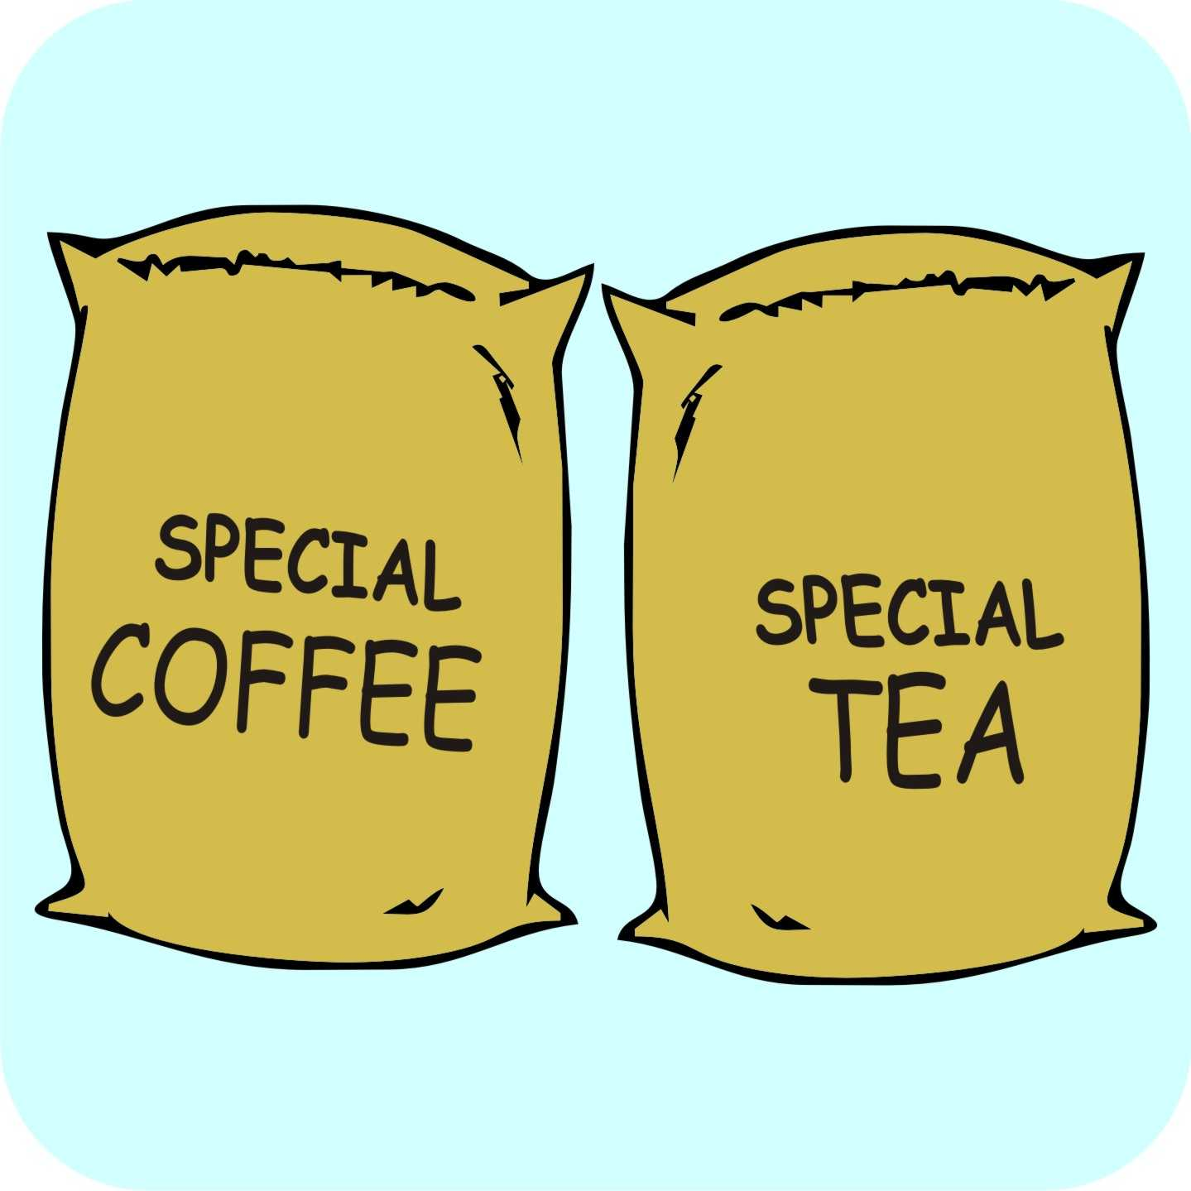
New products and markets: Niche markets
Richer consumers can afford to pay more for niche products, such as exotic or specialty products, e.g. specialty coffee.
These products can fetch a price many times higher than normal coffee.
Niche markets require strong linkages between the farmers and the traders and they demand high quality standards.

Slide 94
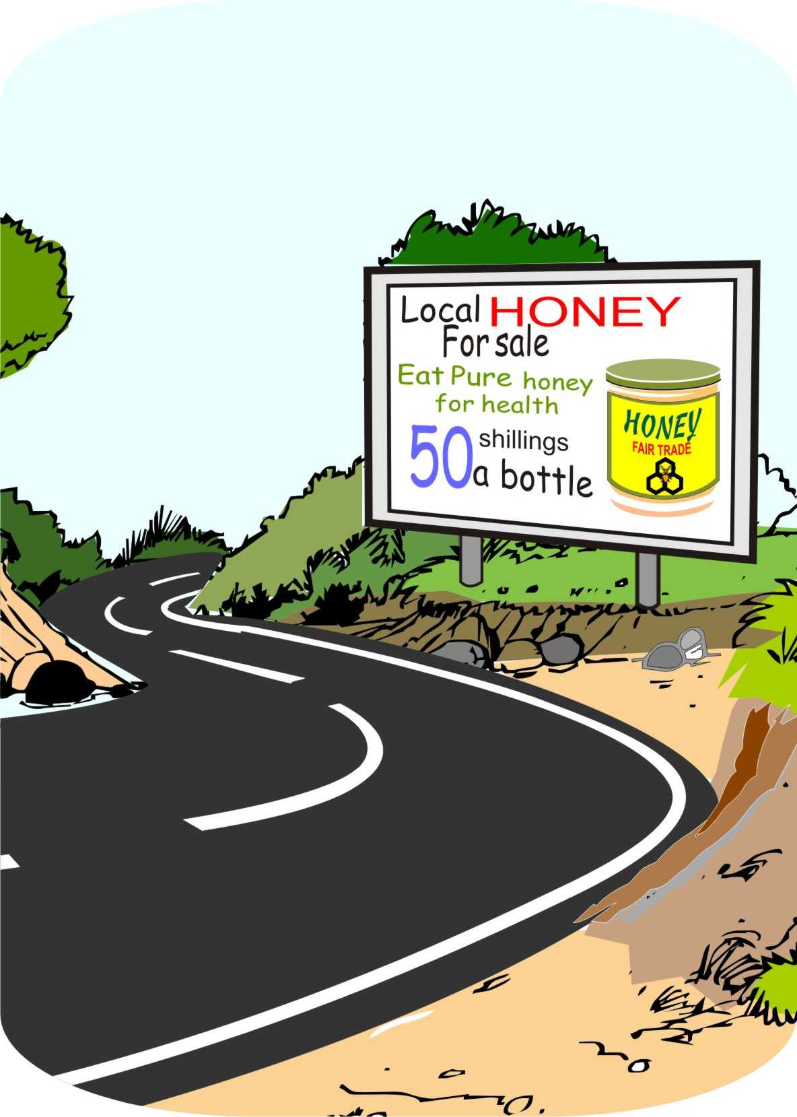
New products and markets: Fair trade
Some consumers look for goods that are sold with a guarantee that the farmers get a bigger share of the final price.
Such fair trade products include: cocoa, coffee, cotton, fruit, herbs and spices, honey, juice, nuts, rice, sugar and tea.

Slide 95
New products and markets: Fair trade (Continued)
As with organic products, fair trade labelling:
Is complex
Requires farmers to organize themselves well to take advantage of this opportunity.

Slide 96
Lesson 7: The value chain

Slide 97
Outcomes
After this lesson you will be able to:
Outline the value chain for a particular product.
List the major actors in the value chain.
List the main types of business services that serve the value chain.
List some of the institutions and rules that govern the value chain.

Slide 98
Overview
Lesson 7 covers the following content:
The value chain and value chain analysis
Core chain actors
Communications in the value chain
Training and advisory services
Financial services
Market information
Research
Business services and the value chain
Institutions and rules

Slide 99
The value chain
Many people are involved in getting agricultural products from the producer to the consumer, including:
The men and women farmers
Traders and processors
Various business services and institutions that support the process.
These are all part of what is called a value chain that links farmers to consumers.

Slide 100
The value chain analysis
A value chain analysis maps out and characterizes all the actors, services and institutions involved in the chain that links the farmers to the consumers.
The value chain analysis allows you to:
Identify the strengths and weaknesses of each of the actors in the chain
Decide on suitable actions that you can take to strengthen your participation in the market

Slide 101
Core value chain actors
Most farm products are bought and sold several times before they reach the final consumers. There are many different types of traders, each with a different function, e.g. collectors, wholesalers and retailers.
As towns and cities grow:
The distance between rural producers and urban consumers increases
Market chains get longer
More people are involved in the process of buying and selling goods before they reach the consumers

Slide 102
Core value chain actors

Slide 103
Short and long value chains
Short value chain:
The farmer sells to trader, who sells to consumer.
Long value chain:
There are several intermediaries between the farmer and the consumer, each with a particular function.

Slide 104
Short and long value chains

Slide 105
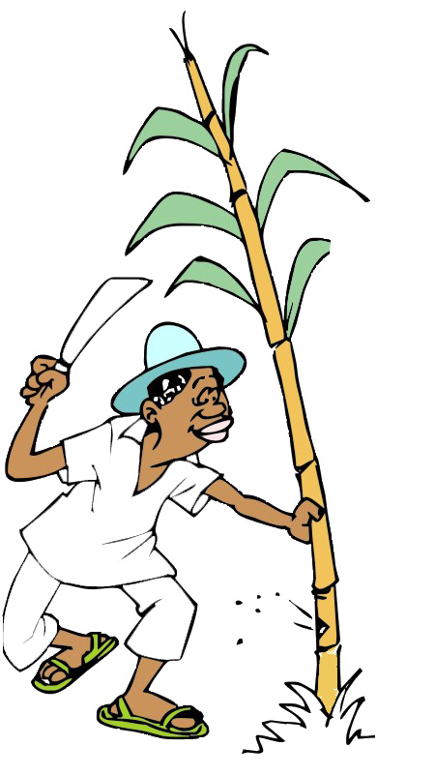
Farmers
Grow crops or raise livestock
Do the initial processing (harvesting, drying, sorting, etc.) with the help of their family members
Occasionally sell directly to consumers (other people in their village), although they mostly sell to traders.

Slide 106
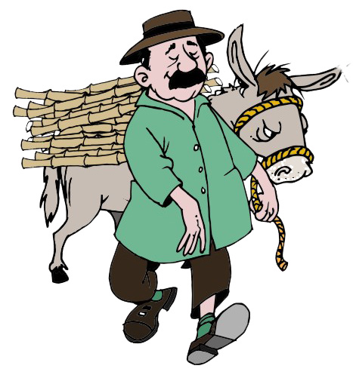
Collectors
Are small, local traders who buy directly from individual farmers
May buy a few bags of produce from many farmers
Store them until they have enough to sell to a larger trader or processor
Have limited capital and trade small volumes
May use motorbikes or may own or rent a small truck

Slide 107
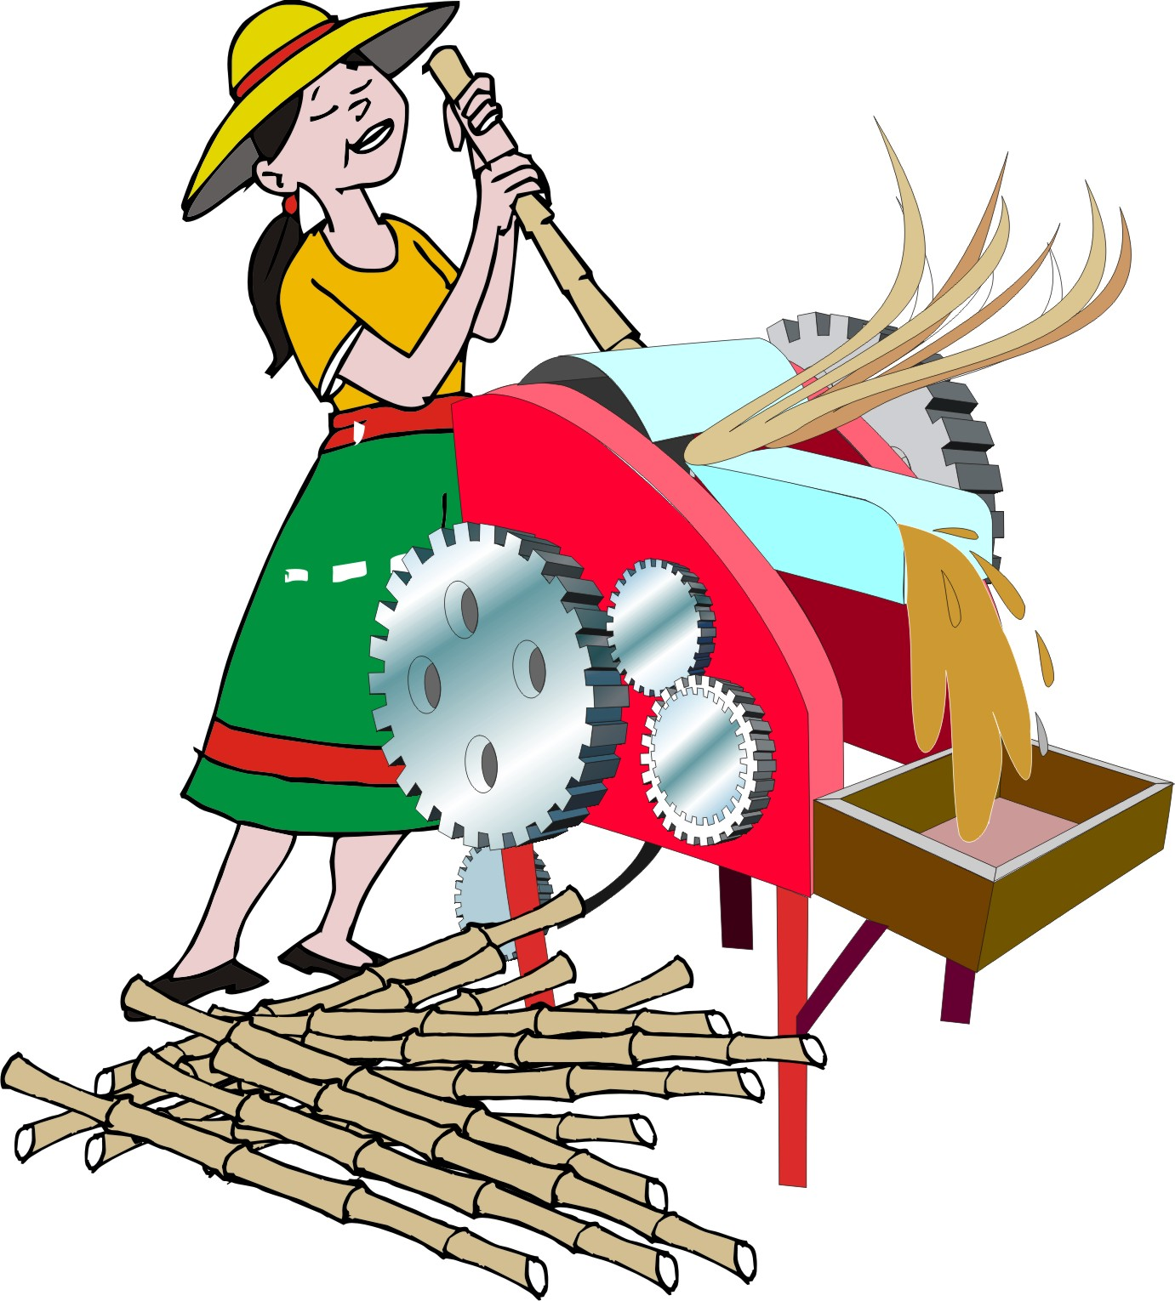
Processors
Transform the product in some way and include millers, feed manufacturers, butchers, leather workers and coffee roasters
Can be small household enterprises or big firms
May use traditional or modern technologies
Can be located in rural areas or in towns or cities

Slide 108
Wholesalers
Deal with much larger volumes than collectors
Own or rent a bigger vehicle
Have their own storage warehouses
Buy most of their supplies from smaller traders or processors, but some also buy directly from farmers
Supply retailers in towns and cities and, also, processors, exporters and other large traders

Slide 109
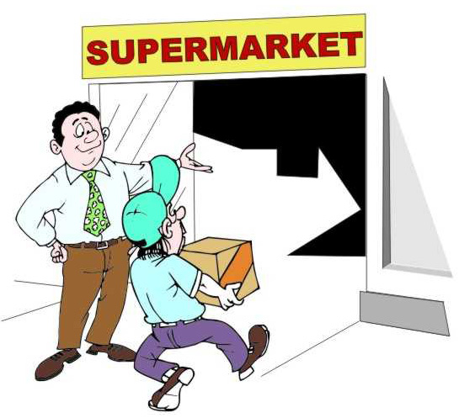
Retailers
Sell products to consumers
Are very diverse, e.g. supermarket chains are large companies that handle big volumes of many different products – unlike small shops and market vendors that sell much smaller volumes and fewer goods, and do not keep sizeable stocks

Slide 110
Consumers
Are the people who use the product
Are at the end of the value chain
Include the end-consumers who eat or drink the food or wear clothes made of wool or cotton
Also include companies that use the product to make something else , e.g. a restaurant that uses peanut oil to fry food

Slide 111
Business services
To work, a value chain needs many types of business services.
These are people and organizations that support the production and marketing of goods, but do not own the product.
Although these services are essential for a productive value chain, farmers often face multiple challenges that prevent them from accessing the services.

Slide 112
Input suppliers
Input suppliers provide the many things needed to grow crops and raise animals: seed, agro-chemicals, veterinary medicines, irrigation pumps and pipes, farm tools, equipment etc.
But: The inputs that farmers need are often unavailable, expensive, or arrive too late.

Slide 113
Infrastructure
Water supplies for irrigation and processing
Electricity
Fuel supplies
Roads and transport services.
But: Many villages are without electricity, roads are poor and transport is expensive.

Slide 114
Communications
Smooth information flows are vital for the functioning of a value chain.
Communication methods may include:
Word of mouth
Telephones and mobile phones
The Internet and e-mail
Postal service
But: Many places lack phone coverage, and the internet needs electricity and computer skills.

Slide 115
Training and advisory services
Farmers and other actors in the chain need specialized information and advice about:
Production
Post-harvest activities
Processing
Marketing
Management
Finance
Business strategy

Slide 116
Training and advisory service providers
The main sources of advisory services are:
Agricultural extension officers
NGO field agents
Consultancy firms
But: Declining government support means that many extension agents are unable to assist farmers in remote areas.

Slide 117
Market information: Price
Farmers need the following types of information on prices:
Spot price: A product price at a certain place at a specific time
Price trends: How the price varies from place-to-place and from season-to-season
Price premiums: The prices offered for specific grades or standards of produce or for larger or smaller amounts of the product

Slide 118
Market information: Other types of information
Farmers also need the following types of market information:
Links with potential buyers
Information on product quality and quantity required and frequency of delivery
Payment conditions:
How is the payment made: in cash, by check, or by bank transfer?
When is the payment made: on delivery, at the end of the month, after 30 days after 90 days?

Slide 119
Sources of market information
Farmers can get market information in the following ways:
Government market information services
Subscription to private information services on the Internet or via mobile phone
Market visits
Visits to potential buyers
Phone calls to traders in different markets
Attending agricultural fairs

Slide 120
Financial services
Financial services provide the capital that actors in the value chain need to keep their business viable.
Farmers need credit to:
Buy seeds and fertilizer
Pay laborers
Buy sacks and crates
Mill their grain
Take produce to market
Similarly, traders and processors also need credit to buy produce, pay for transport and storage, etc.

Slide 121
Financial services: Credit providers
Credit providers include:
Local moneylenders
Savings and loans clubs
Microfinance institutions
Banks.
Other types of financial services include:
Savings and insurance
Leasing
Warehouse receipts
Loan guarantees.

Slide 122
Farmers’ and trader’s seasonal financial needs
Beginning of the season: Farmers need loans for seed, fertilizer and labor, which are repaid only after the harvest.
Mid-season: Farmers need loans for weeding, which they will be able to repay after harvest
Harvest time: Farmers may need loans so they can hold onto their crops until the price has risen.
Traders need short-term loans, so that they can buy products to sell and, in some cases, buy produce to store and sell.

Slide 123
Research
Research provides farmers with:
New products and crop varieties that may be higher yielding, resist pests and diseases, have higher nutrient content, or tolerate drought
New/better production methods and farming methods that may enable farmers to increase their productivity or reduce their costs.
Helps farmers become more competitive, improve their quality, reduce their losses, or add value to their output.

Slide 124
Research problems
Research results often fail to reach farmers in a form they can use.
New technologies may also increase labor or other costs for other value chain players, e.g. a new high yielding seed may result in a tougher skin of a root crop. The farmer produces more of the crop, but the processor needs to use more labor to remove the peel.

Slide 125
Business services and the value chain
Business services provide various types of support at different stages in the value chain.
Some (such as seed suppliers and field agents) serve farmers, while others (such as transport companies) provide services to traders and processors.
Different financial services serve different parts of the chain.
Farmers can get loans from savings-and-credit groups and microfinance institutions, while banks and insurance companies provide financial services to large processors and retailers.

Slide 126
Costs of business services
Farmers and other users can get some business services for free, for example:
They can use a road or listen to the radio without paying)
Research, crop extension and market information services may also be free
Users have to pay for many other types of services, for example:
They have to hire a truck to carry their produce, buy
seed and fertilizer
Pay for vaccines and veterinary advice

Slide 127
Covering the costs of business services
Business services cover their costs by charging a fee:
Transport companies charge per sack or crate moved
Millers charge for milling grains such as maize
Graters charge for grating roots such as cassava

Slide 128
Covering the costs of business services
Government also has to pay for the business services it provides.
Government covers some of the costs through taxes or project grants, but may also charge fees.
Radio and television stations often pay for their broadcasts through advertising.
NGOs are increasingly also charging fees for certain services.

Slide 129
Development agencies and the private sector
If development agencies provide certain services for free, they will prevent private companies from charging for the same services. This will:
Stop private business services from growing
Make many projects unsustainable
Instead of competing with the private sector, development agencies should try to find ways to stimulate the private sector to develop such services.

Slide 130
Institutions and rules: Laws and policies
Governments:
Set laws and policies to regulate the flow of goods and services
May impose taxes, offer subsidies or control prices
May restrict or encourage the production of certain crops
Limit the movement of plants and animals to prevent diseases from spreading

Slide 131
Institutions and rules: Laws and policies (Continued)
Governments:
Promote land reform
Encourage soil and water conservation
Provide certain types of business services, such as extension and market information services

Slide 132
Standards
Identify the minimum requirements for the quality and safety of a product, e.g. tomato traders may insist on tomatoes being of a certain variety, size, not damaged and packed in crates
May be formal or informal
May be imposed by the government, individual traders or an industry association
Farmers need to know these standards, so that they can comply with them.

Slide 133
Food safety standards
Standards that ensure food safety address:
Type of pesticides that farmers may use
Level of toxins in stored grain
Moisture content of grain
Levels of broken grans, discolored grains and fungal infections

Slide 134
Certification
If they want to enter higher value markets, farmers often have to:
Meet environmental, social and financial standards set by certification organizations
Produce their products according to the rules of certification of organizations, such as fair trade
Use specific farming methods, e.g. organic farming
Become members of a fair trade approved cooperative
Agree to an annual audit to show their social accountability payments

Slide 135
Security
The police, lawyers and judges:
Maintain order
Ensure that people in the value chain comply with contracts and do not break the law

Slide 136
Lesson 8: Developing marketing strategies

Slide 137
Outcomes and overview
After this lesson you will be able to:
Describe four marketing strategies and give examples of each.
Lesson 8 covers the following content:
Marketing strategies:
Existing product, existing market
Existing product, new market
New product, existing market
New product, new market

Slide 138
Choosing a marketing strategy
Farmers and other actors in the value chain can consider:
Selling a existing product
Develop new products
Serving an existing market,
Trying to find new markets for their products

Slide 139
Marketing strategies: The product/market matrix
 | Existing product | New product
Existing market | Market penetration | Product development
New market | Market development | Diversification

Slide 140
Existing product, existing market: Market penetration
Farmers can try to increase the sales of their existing products, in markets they already serve.
This approach is called market penetration.
It is generally seen as the safest marketing strategy, as the sellers are already familiar with both the product and the market.

Slide 141
Existing product, existing market: Example
A group of tomato farmers uses new farming techniques that:
Increase yields
Save labor
Reduce the costs of materials.
That allows them to:
Offer their produce to their current buyers at a lower price
Maintain their profit
Increase demand for their product, because buyers want to buy more tomatoes.

Slide 142
Existing product, new market: Market development
Farmers can sell an existing product to a new market. This approach is called market development.
Example:
Instead of selling to the local trader, the farmers could sell their tomatoes for a higher price directly to a nearby tourist resort, where there are a lot of restaurants.

Slide 143
New product, existing market: Product development
Farmers can develop new products to serve an existing market. This approach is known as product development.
Example:
The tomato farmers can start growing beans to sell to the same buyers.

Slide 144
New product, new market: Diversification
Farmers can develop a new product for a new market. This approach is known as diversification.
Diversification is the riskiest and most expensive marketing strategy, as it requires developing both a new product and stepping into an unknown market.
Example:
The farmers could start producing and selling beans to the tourist resort.

Slide 145
Lesson 9: The four Ps of marketing

Slide 146
Outcomes
After this lesson you will be able to:
List the four Ps of marketing and describe each one
Describe how to use the four Ps in teaching marketing, planning a marketing strategy and monitoring the market.

Slide 147
Overview
Lesson 9 covers the following content:
Identifying the four Ps of marketing:
Product
Price
Place
Promotion
Using the four Ps of marketing

Slide 148
The four Ps of marketing
When developing a marketing plan, organize your ideas around the four Ps of marketing:
Product: What to produce
Price: At what price to sell the product
Place: Where to sell the product
Promotion: How to promote the product

Slide 149
Product
What product should you produce: what crop variety or breed of animal?
What characteristics should the product have to satisfy the buyer?
What quality and quantity do you need at what time of year?
How should you package the product: in sacks, bags, crates or boxes?
Are there ways you can make your product different than those of your competitors?
Do your production practices improve product quality?

Slide 150
Price
At what price should you sell the product?
Will the price allow you to cover labor costs and make a profit?
What prices does your competition charge?
Can you charge more or less than your competitors?
Should you negotiate a fixed price with the buyer?
What are the payment conditions?

Slide 151
Place
To whom should you sell the product: a small collector-trader, a wholesaler or a supermarket?
Where should you sell it: at the farm gate, at a village collection center, or in the local market or at a central market in the city?
How will you transport your products to where you will sell them?

Slide 152
Promotion
How should you promote the product?
Do you need to advertise or is it sufficient to maintain contact with the buyer by visiting or calling by phone?
How should you identify new customers and persuade them to buy your product?
Should you label the product, so that the buyer knows what they are buying?
What can you do to make your product more attractive to the buyer?

Slide 153
Using the four Ps of marketing
You can use the four Ps of marketing in various ways:
When teaching farmers about marketing, e.g. by studying the market of a product according to the four Ps
When planning a marketing strategy
In monitoring the market and changes in the market

Slide 154
Lesson 10: Entrepreneurial spirit

Slide 155
Outcomes and overview
After this lesson, you will able to:
Describe the characteristics of a successful entrepreneur
Lesson 10 covers the following content:
What does it take to be a successful entrepreneur:
Personality
Relationships
Skills and experience

Slide 156
What does it take to be an entrepreneur?
You need a lot of knowledge and skills to be successful in marketing agricultural products.
It is not easy to set up a new business venture and keep it competitive.
People with the needed characteristics might make good business managers of farmer groups that want to market their products together or they may make good marketing managers who are responsible for identifying where and to whom the group should sell their products.

Slide 157
Personality
Someone with entrepreneurial spirit:
Is confident and believes in what she is doing
Is optimistic, has a positive attitude and looks on the bright side of things
Is outward looking, can seek out new market opportunities and notices possibilities in situations
Is willing to take risks by trying out new products and markets
Shows discipline and determination

Slide 158
Relationships
Someone with entrepreneurial spirit:
Has strong leadership abilities and is good at working with other people and motivating them
Is good at communicating ideas
Can negotiate agreements
Is trustworthy
Takes responsibility for his/her decisions and actions
Is respected by others and has a good reputation

Slide 159
Skills and experience
Someone with entrepreneurial spirit has the following types of skills and experience:
Educational level: Can read, write and do arithmetic
Outside experience: has broad experiences and connections
Business ability: Can see where a profit can be made and can calculate costs, income and profits
Organization: Is organized and can bring together information and ideas systematically

Slide 160
Module summary
In this module, you have learned:
The principles of agricultural marketing
The concepts of supply and demand and costs, income, prices and profit
Different types of agricultural markets
The process of adding value to a product after harvest
The value chain
The development of marketing strategies
The four Ps of marketing
The characteristics of an individual with an entrepreneurial spirit

