Slide 1
Managing natural resources
A SMART Skills Manual

Slide 2
Skills for Marketing and Rural Transformation (SMART skills)
SMART Skills manuals:
Introduction to SMART skills for rural development
Organizing and managing farmer groups
Understanding natural resources
Managing natural resources
Marketing basics
Seven steps of marketing
Promoting innovation

Slide 3
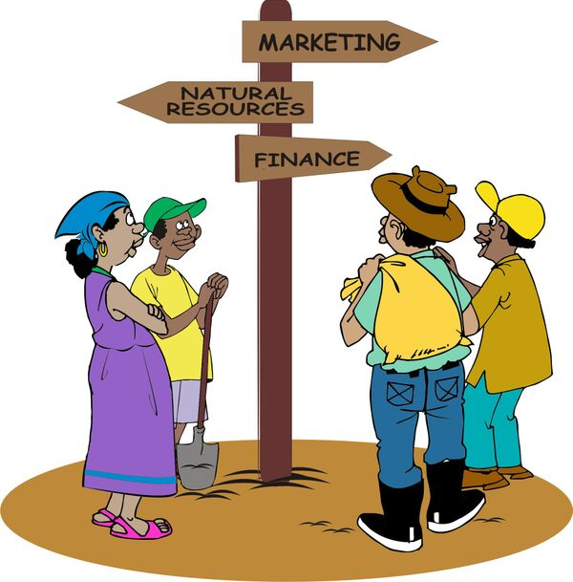
Purpose of the SMART skills series
To introduce you to the following five skill areas:
Group organization
Natural resources management
Finance
Marketing
Innovation

Slide 4
Manual content
Seven lessons:
Engaging the community
Understand the community context
Identifying and engaging stakeholders
Mapping problems and opportunities
Making a natural resources management plan
Managing natural resources projects
Monitoring progress

Slide 5
Lesson 1:
Engaging the community

Slide 6
Outcomes
After this lesson, you will be able to:
Determine the focus of a project: types of groups, level of groups (plot/farm, watershed or community).
Hold your first meeting to generate ownership about natural resource management.

Slide 7
Overview
Lesson 1 covers the following content:
Project focus: Groups or individuals
Types of groups
Geographic scope
Watershed and community approaches
Project level
First meetings
Farmers’ vision and goals
Sustainability and community ownership

Slide 8
Determining the project focus
The first step is to decide:
With whom will you be working: Individuals or groups?
If you are working with groups, what kinds of groups?
What is the geographic scope of your work: Plot/farm level, micro-watershed level or community level?
Will you be working within watershed boundaries or administrative boundaries?

Slide 9
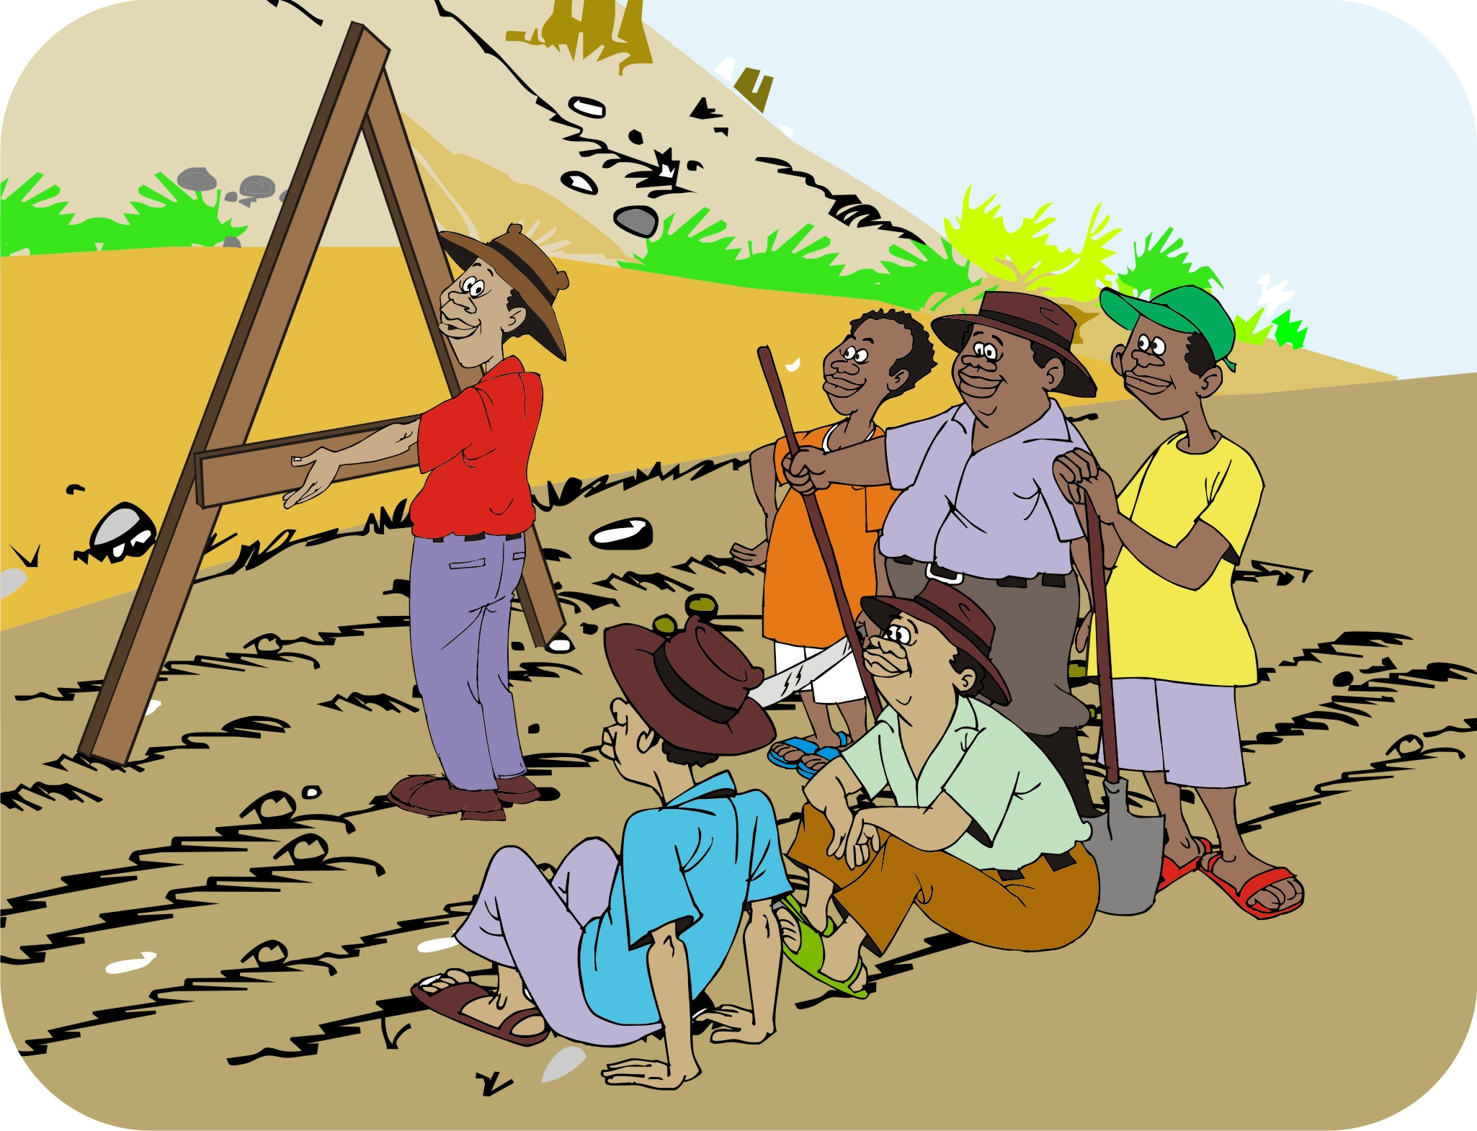
Reasons for choosing to work with organized groups
Many tasks can be tackled only by groups, farm families or by the community as a whole.
Working with groups lets you reach more people than if you were to visit individual farmers.
Organized groups are likely to be more effective than the same number of unorganized individuals working independently.

Slide 10
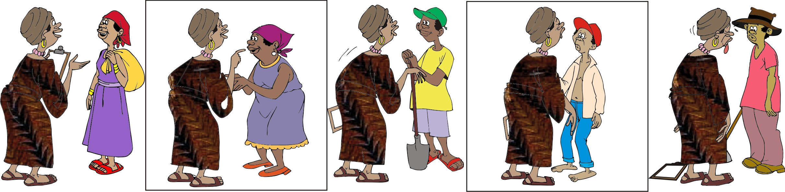
Working with individuals
Sometimes, it may be necessary to work with individuals, e.g. when the practices of landowners, who own land in critical areas of a watershed, affect farmers downstream.
Working with individuals is often time-consuming and requires a lot of effort and resources, but they may be critical to the resource management of the whole community.

Slide 11
Types of groups
The type of group you work with will depend on the kind of project:
If your project focuses on managing natural resources, you may work with groups already involved in some aspect of natural resources, e.g. producers’ associations, water committees, and innovation groups.
If the natural resources aspects are part of a marketing or production project, you may work with other groups, e.g. savings and lending committees or marketing and agro-enterprise groups.

Slide 12
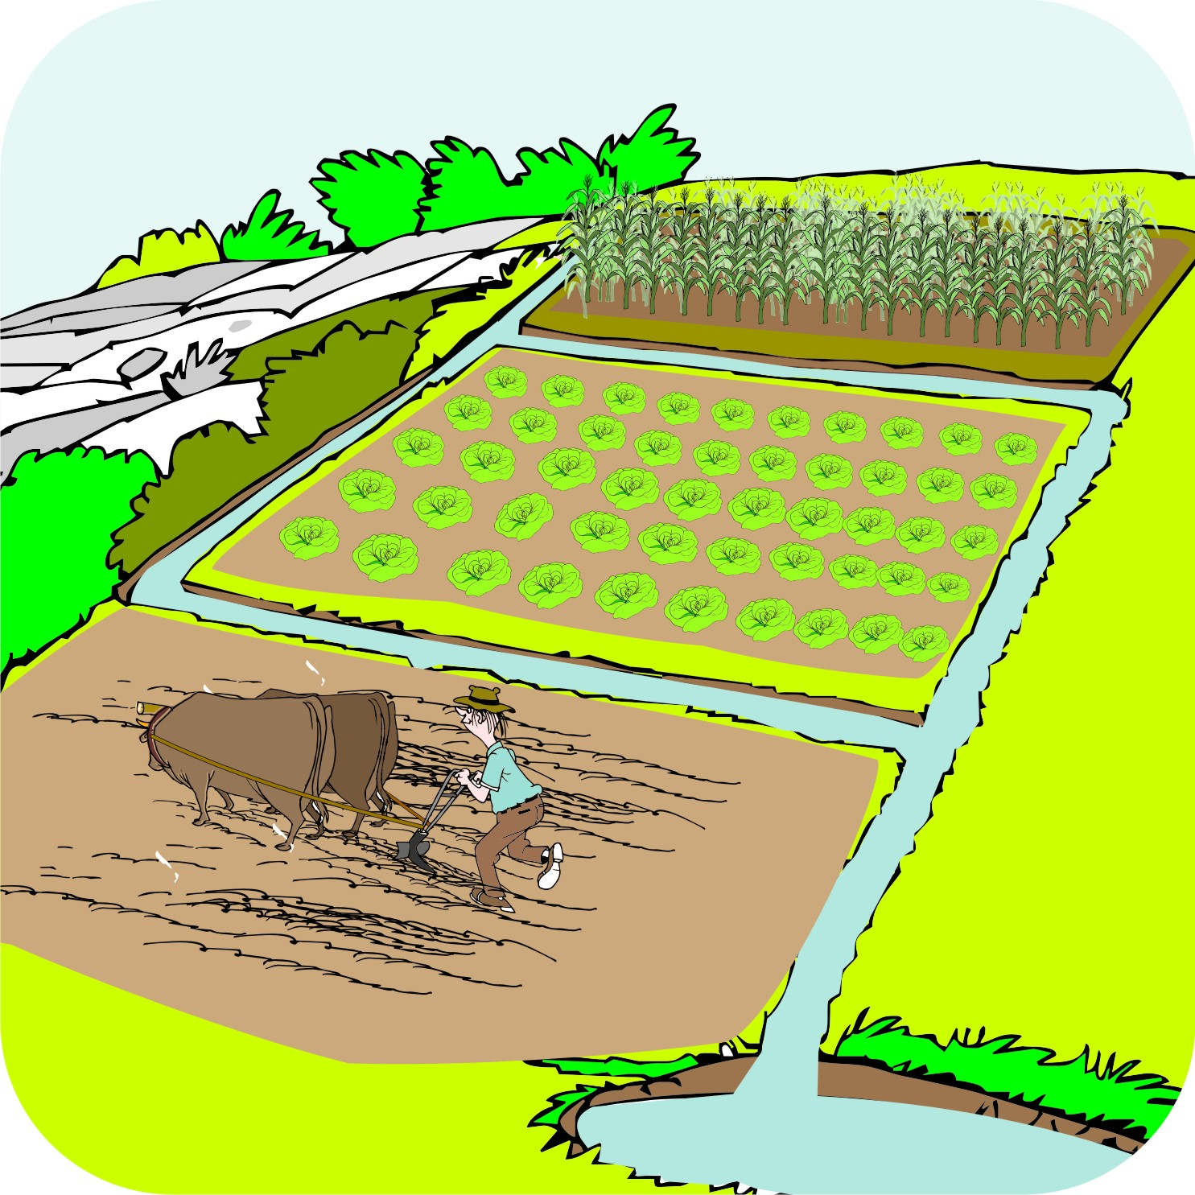
Geographical scope: Individual farms
The following types of work can be done by individual farmers on their own land:
Planting grass strips
Making compost
Improved cultivation practices
Planting forage on bunds
Reducing pesticide use
Recycling waste
Planting trees on field boundaries and at home

Slide 13
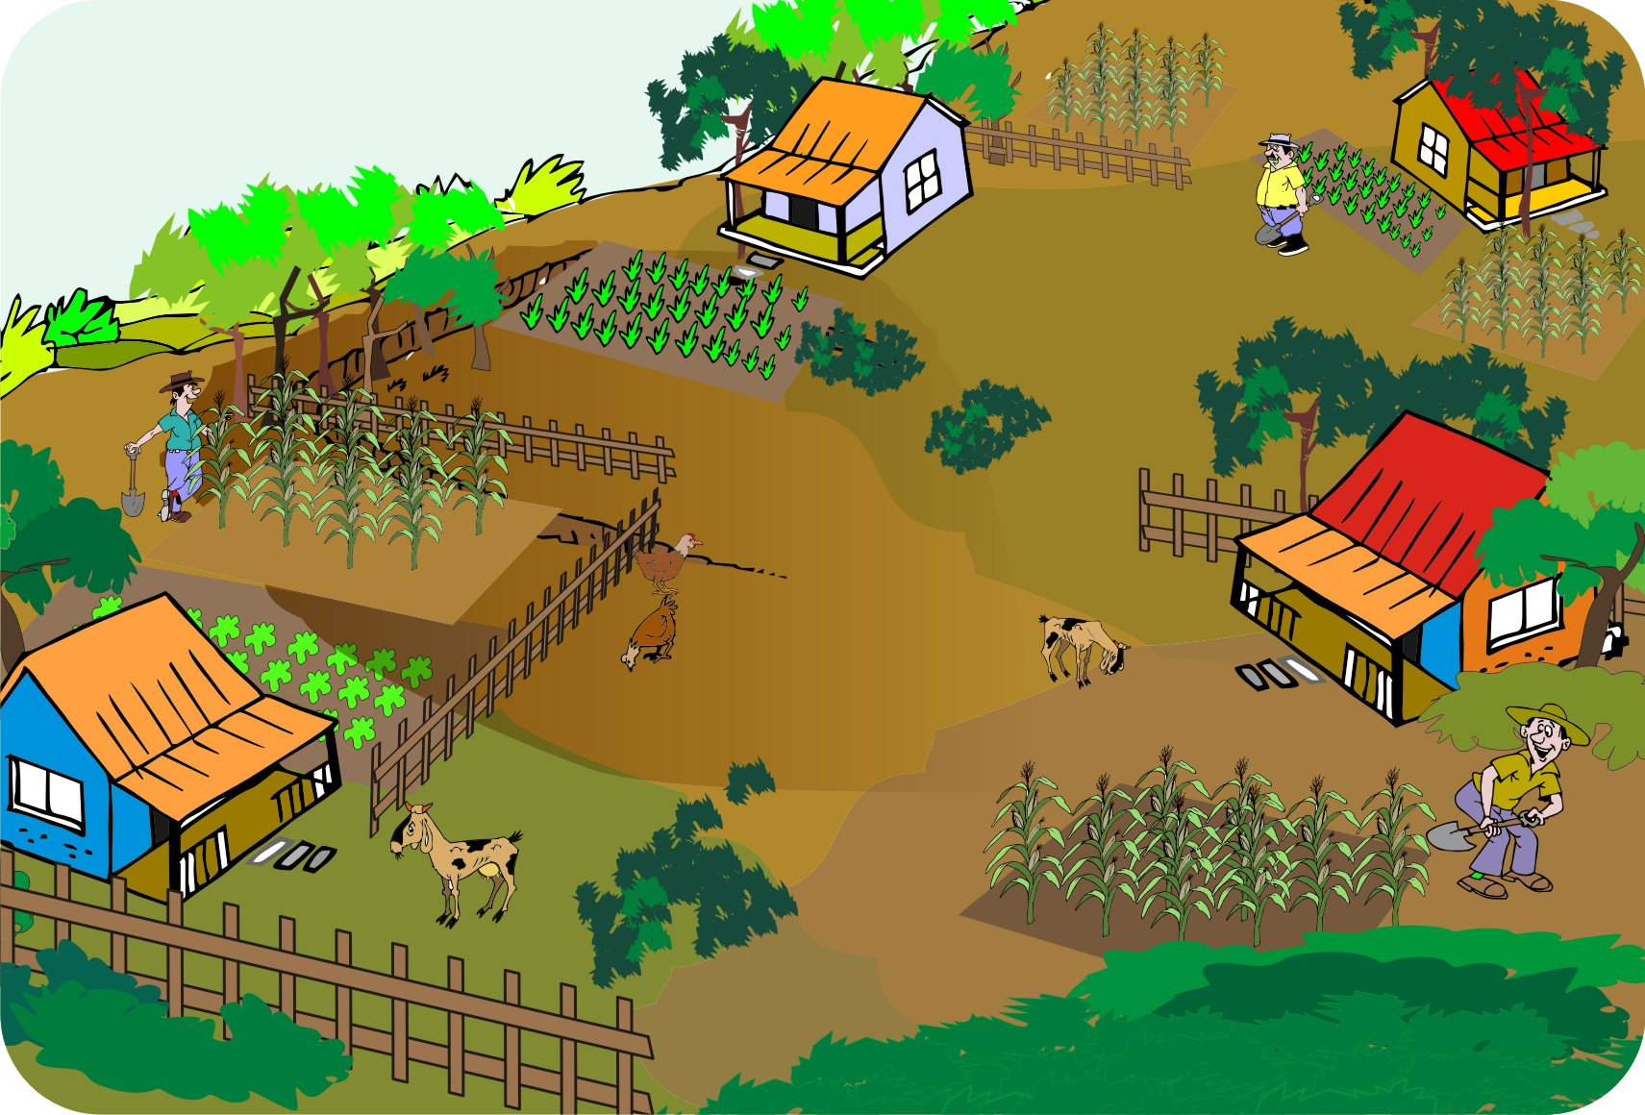
Geographical scope: Groups of farmers
Other types of work, e.g. work requiring a lot of labor, may be better handled by groups. These types of work require several neighboring farmers to cooperate.

Slide 14
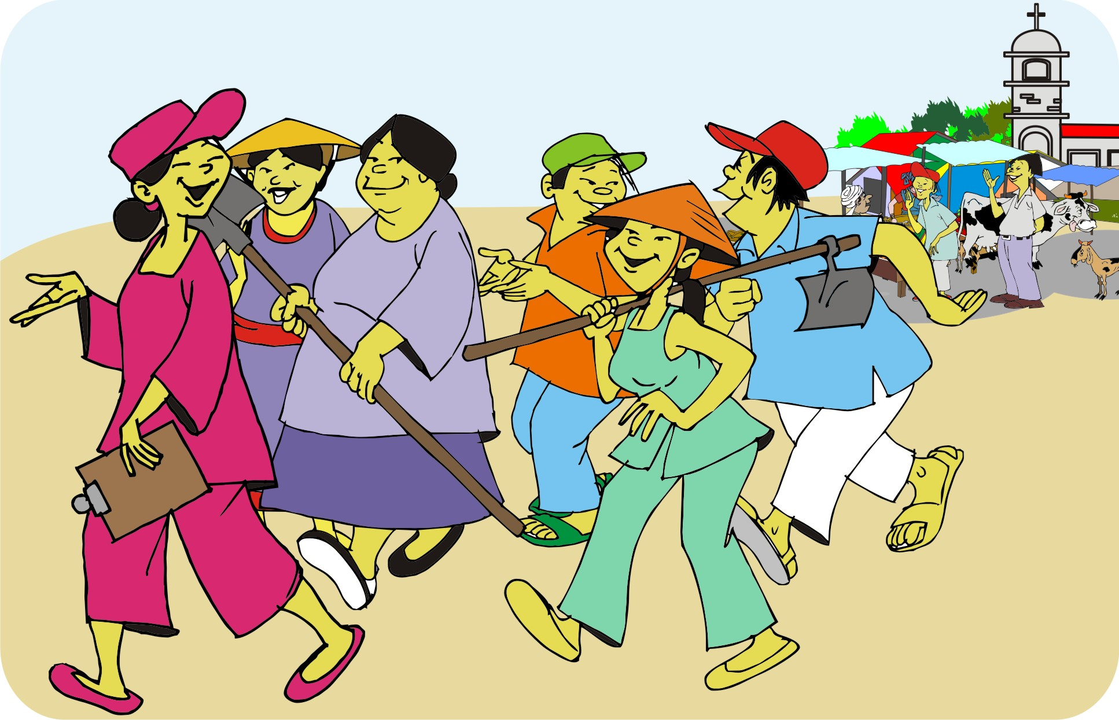
Geographical scope: Examples of group work
Examples of tasks that require group work:
Building terraces, contour bunds and channels to divert water
Maintaining tree nurseries
Planting woodlots and windbreaks

Slide 15
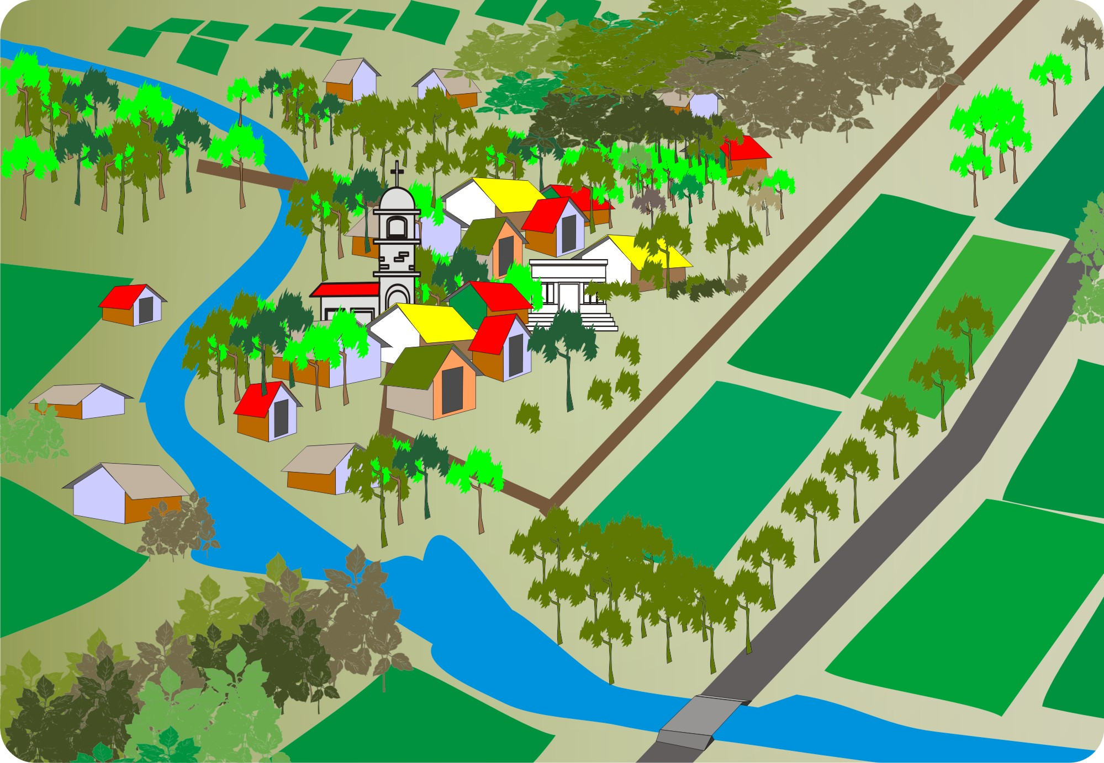
Geographical scope: Community or watershed
Some types of work need to be planned and carried out by the community as a whole or even over an entire watershed.
This type of work directly affects the entire community and requires the community’s participation.

Slide 16
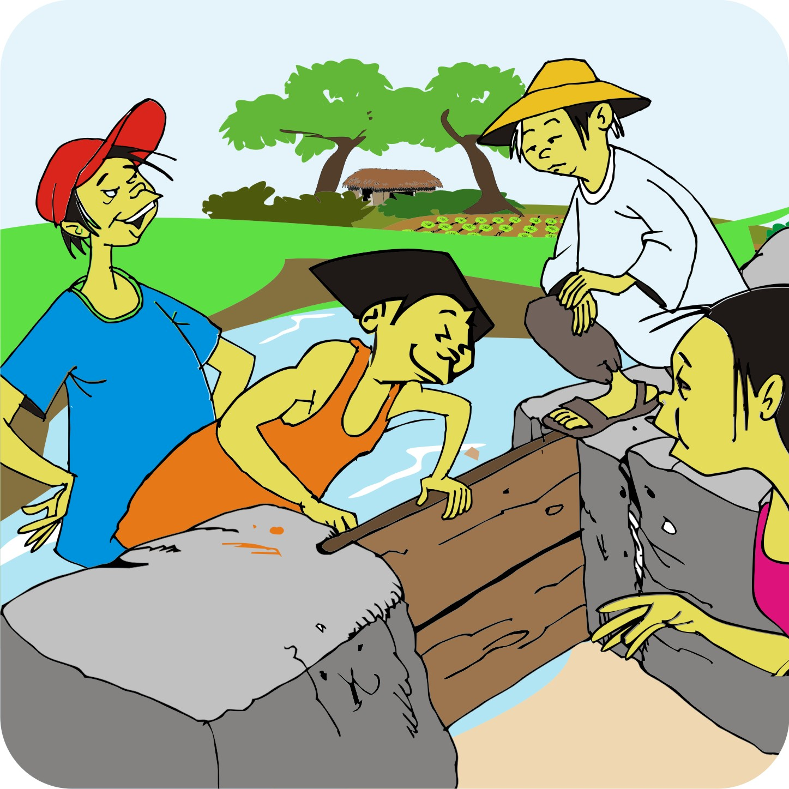
Geographical scope: Examples of community work
Examples of work that involves an entire community or watershed:
Filling in large gullies
Keeping livestock out of certain areas
Protecting springs and watercourses
Building small-scale irrigation schemes

Slide 17
Geographical scope: District or national
Certain activities need the involvement of the district authority or the national government, including:
Major earthworks that require heavy equipment and professional expertise
Policy changes
Works that require government approval

Slide 18
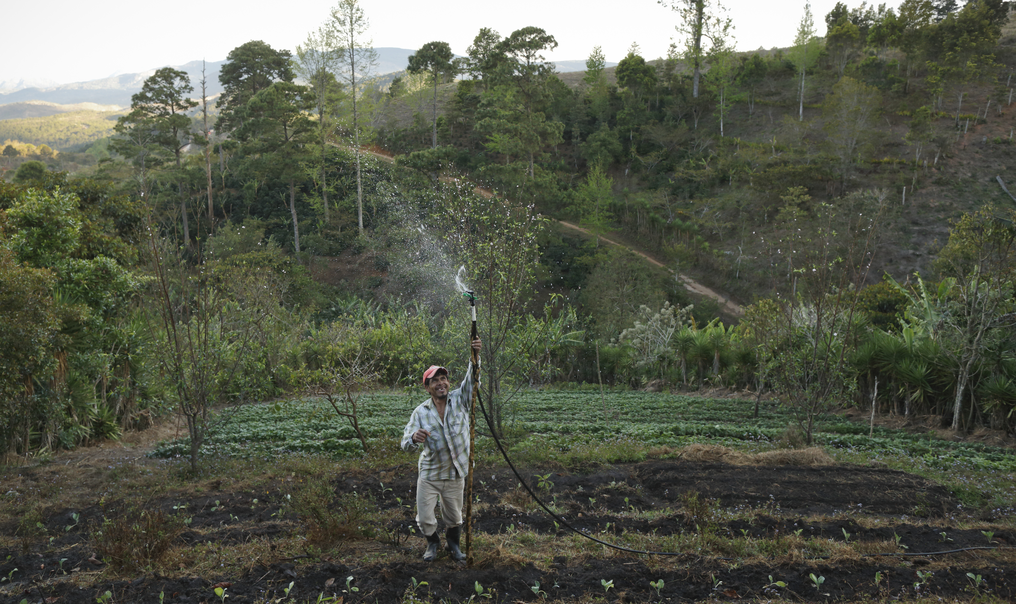
Geographical scope: Examples of district or national activities
Examples of activities on district or national scale:
Building large dams or big irrigation schemes
Transfer of responsibility for managing forests

Slide 19
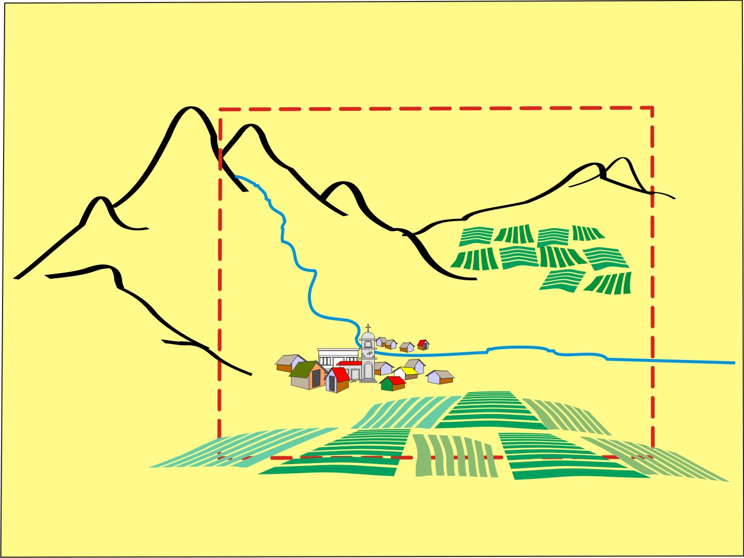
Watershed approach
People within watersheds share the same resources, which means that, what someone does upstream has an effect downstream.
Therefore, a watershed approach enables communities to:
Focus their efforts to plan and manage their shared resource activities.

Slide 20
Watershed approach: Advantages and disadvantages
May be a good approach when watershed areas are easily defined (e.g. hilly areas) and where erosion and water conservation are problems.
Where a watershed crosses administrative boundaries, coordination with different local authorities, private landowners and other community members will be required.
The approach also requires good communication between people living upstream and those living downstream.

Slide 21
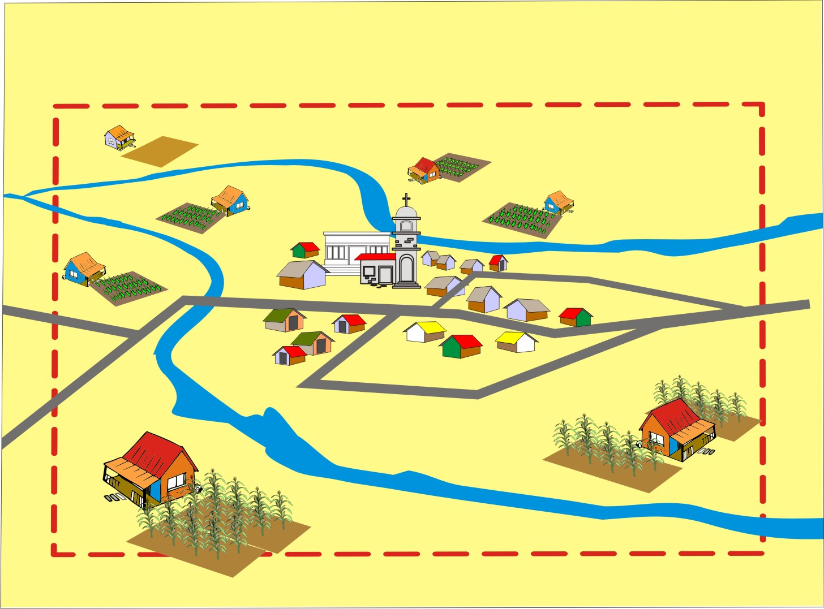
Community approach
A community approach refers to managing an area that is defined by the people living in it – even if it covers more than one watershed.

Slide 22
Community approach: Advantages and disadvantages
The community approach:
Is appropriate when watershed boundaries are difficult to mark or when watershed protection is not a priority.
Makes it easier to plan and manage activities with local authorities.
Conflict or management concerns may arise if communities span more than one watershed, or if parts of a watershed or community area are owned by landholders who do not wish to participate in your natural resource management efforts.

Slide 23
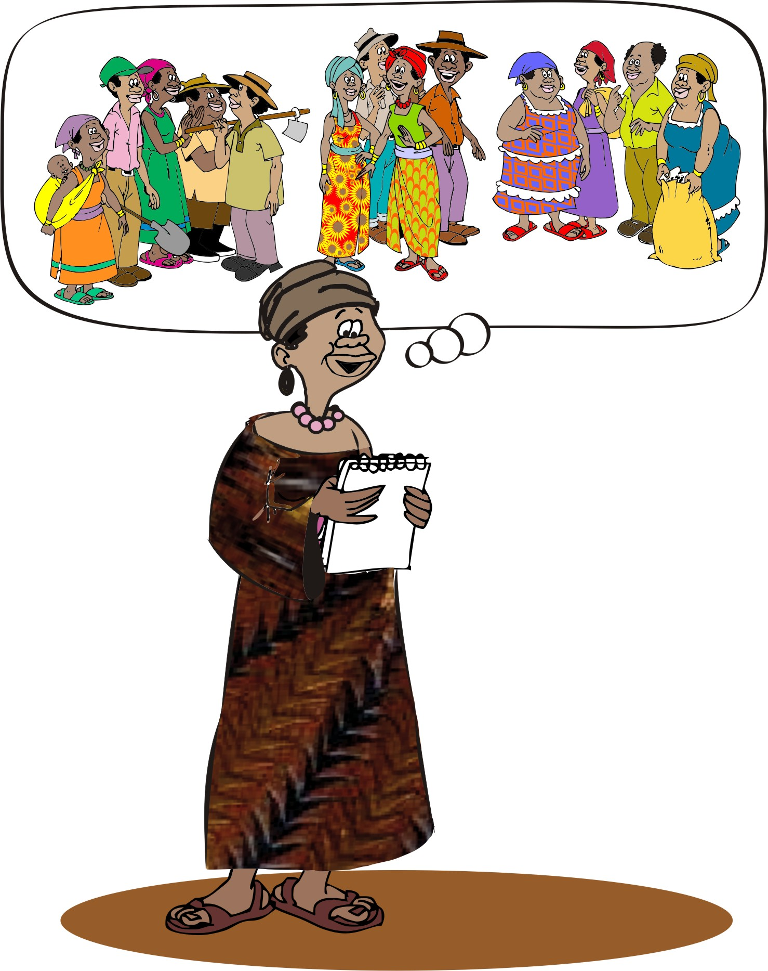
First meetings
You are ready for your first meetings if:
You have identified the groups to work with
Determined the scope of your project.

Slide 24
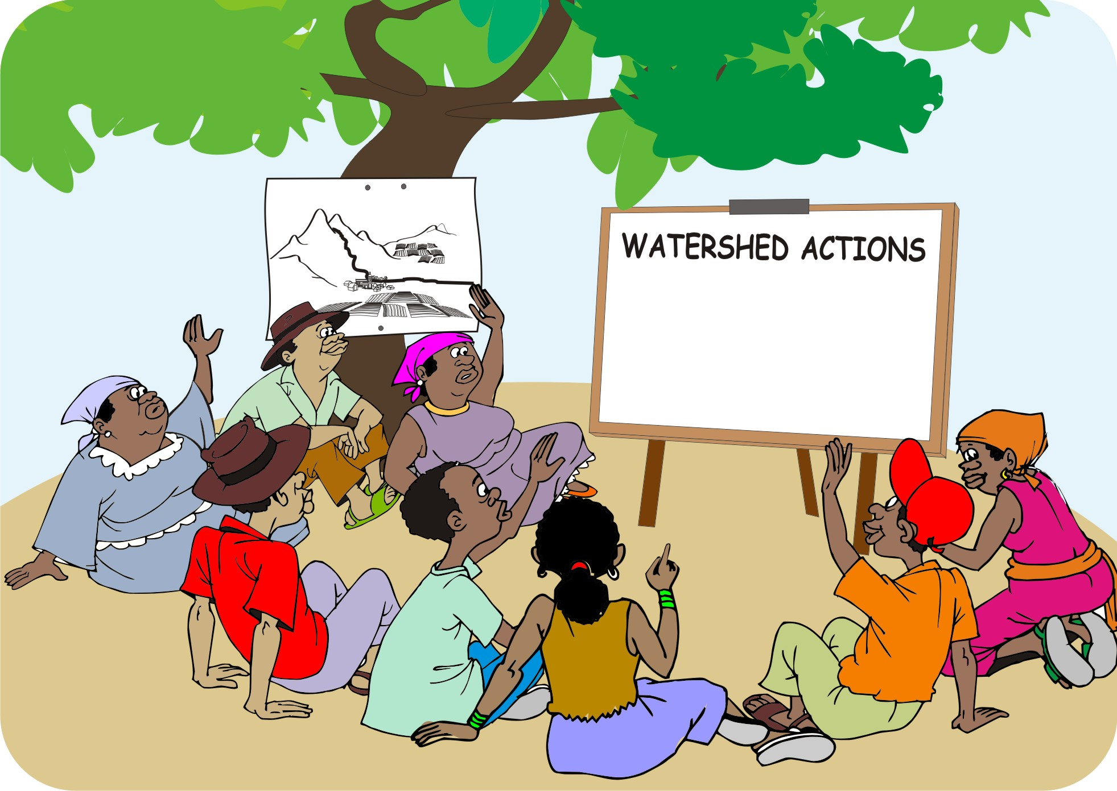
First meetings (Continued)
During these first meetings, you can:
Introduce the groups to the project
Begin discussing what goals in terms of natural resources to achieve

Slide 25
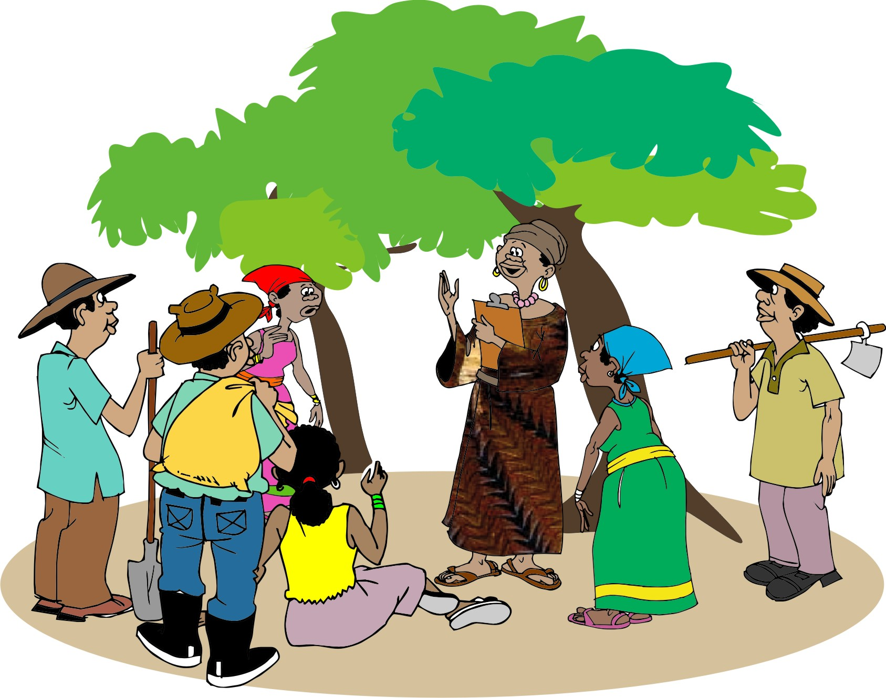
Farmer’s vision and goals
To work effectively together, farmers need to develop common goals regarding crop production and the sustainable management of natural resources.
These goals must reflect the different voices, needs and interests in the community, so that you can help them build links between these goals and livelihood needs.

Slide 26
Identifying farmers’ vision: Questions to ask
What would you like to improve regarding your land, water, vegetation and other resources?
What natural resources do you want to maintain?
How does natural resource management fit within the broader livelihood and community goals?
Five years from now, how would you like your community to look: What is the state of the forest, water and soil resources? What natural resource problems have been resolved?

Slide 27
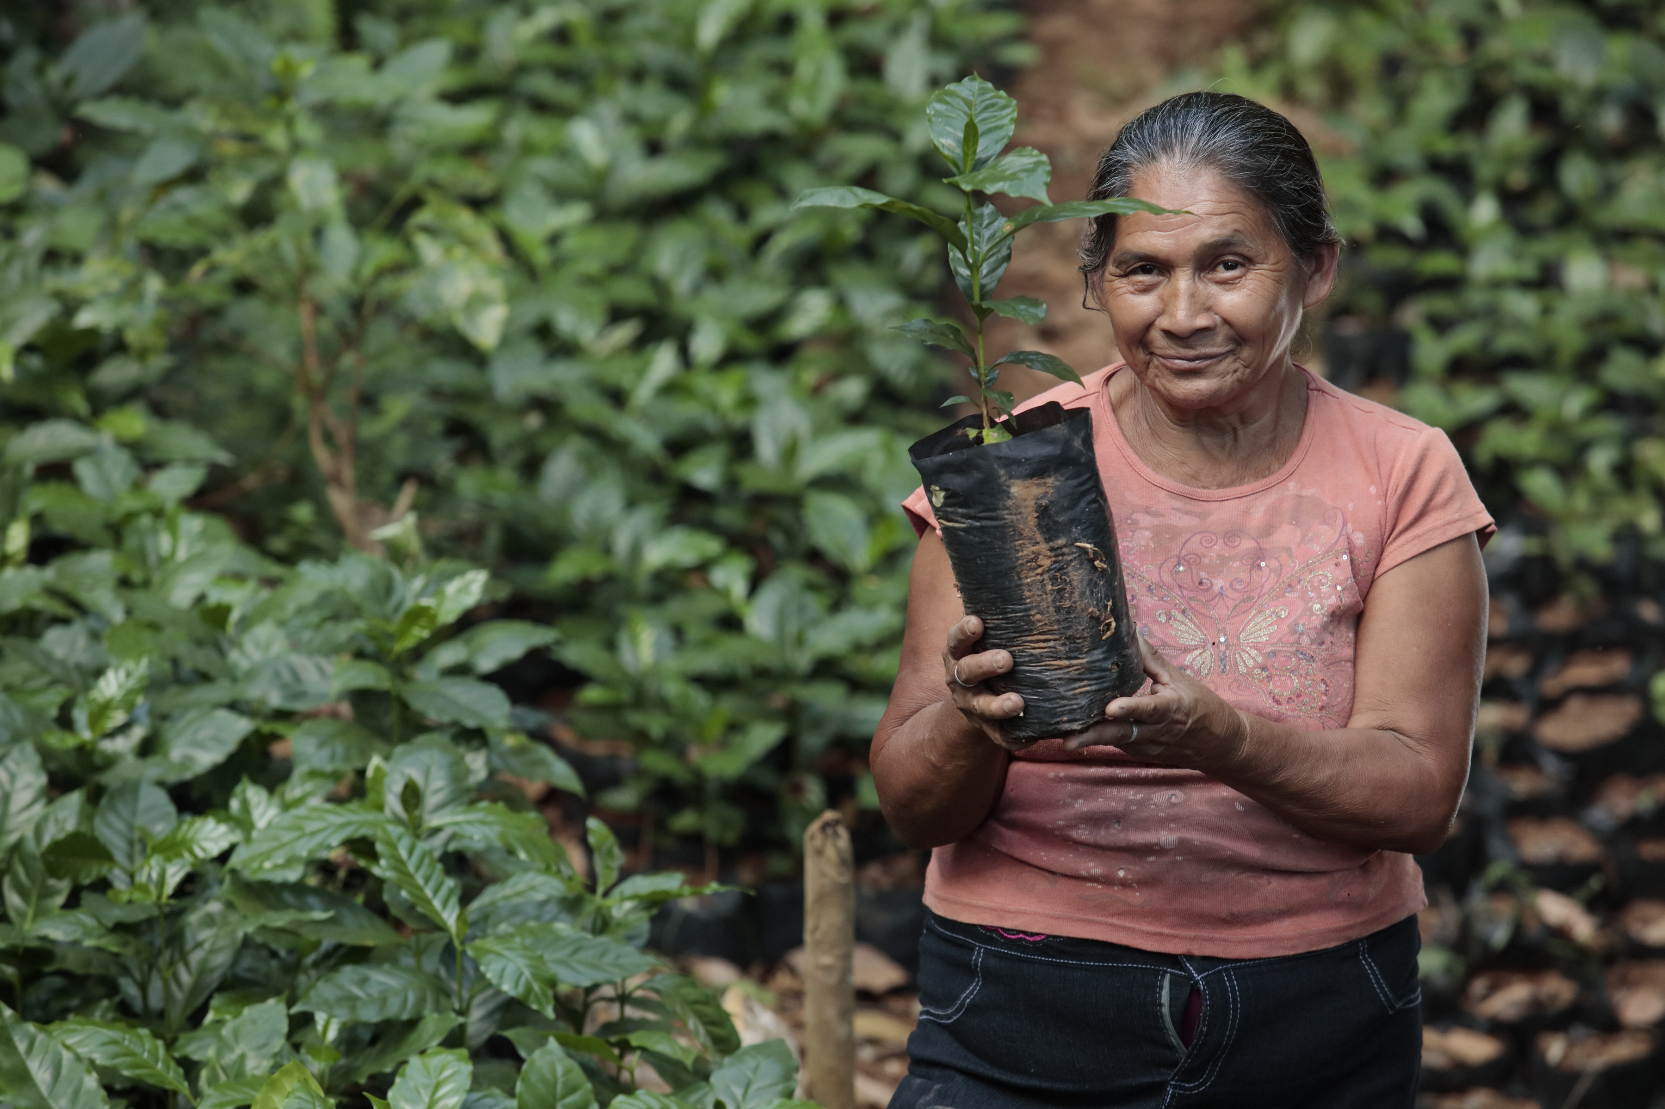
Identifying farmers’ goals: General goals
Examples of more general goals:
Reduce erosion in the community.
Improve overall production by managing soil fertility.
Stop the decline in firewood and timber.

Slide 28
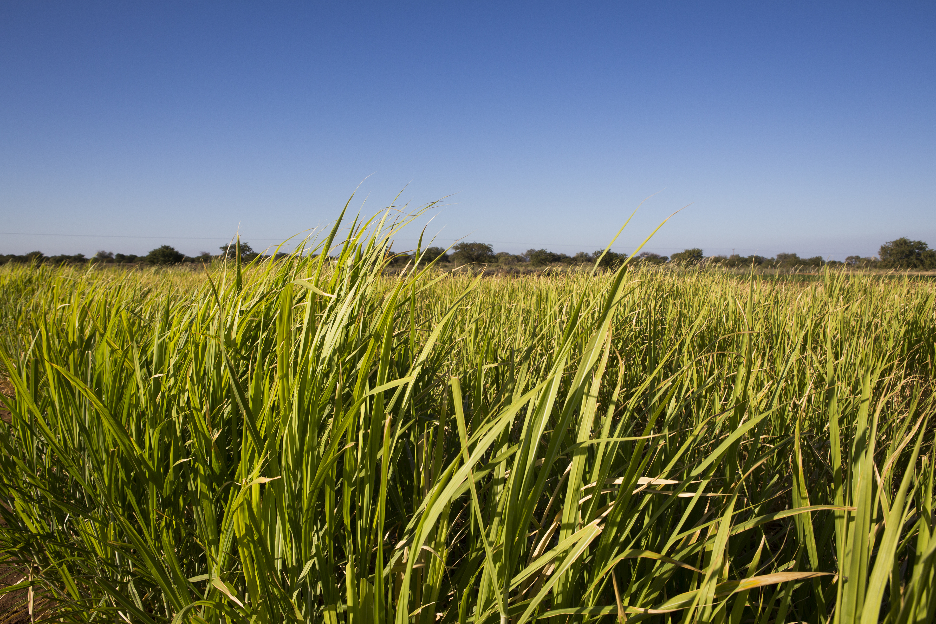
Identifying farmers’ goals: Specific goals
Examples of more specific goals:
Develop a woodlot to assure a ready supply of firewood and timber.
Maintain reed-beds to make mats and baskets.

Slide 29
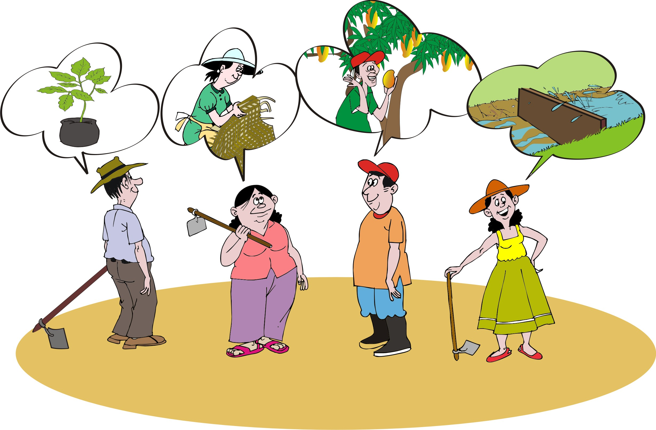
Sustainability and community ownership
Projects are more likely to be sustainable if:
The community group sees value in them.
Participants really own the process
Take leadership in decision-making about activities as early as possible

Slide 30
Lesson 2:
Understanding the community context

Slide 31
Outcomes
After this lesson, you will be able to:
Demonstrate an understanding of the biophysical and socioeconomic information in natural resources projects.
Assess some of the participatory rural appraisal tools that you can use to gather biophysical and socioeconomic information.

Slide 32
Overview
Lesson 2 covers the following content:
Learning about where you work
Trends in the physical environment
Agroecology
Soils, plants, water and livestock
Vulnerable or high risk areas
Social and economic issues in managing natural resources
The economy and markets

Slide 33
Understanding the community where you work
Try to learn about:
The main natural resources and biophysical characteristics of the area
How local people value and use their different natural resources
Men and women’s access to natural resources
The local social and economic conditions that affect natural resources and people’s livelihoods
Key stakeholders that you have to work with
Policies and governance structures that have authority on the use of water, land and forests

Slide 34
Trends in the physical environment
A good way to collect the most important information is to look at opportunities, challenges and trends.
Ask farmers:
How do you use these resources now?
What are the opportunities that these resources offer you in the future?
What challenges do these resources present?
What are trends over the past five years and ten years?

Slide 35
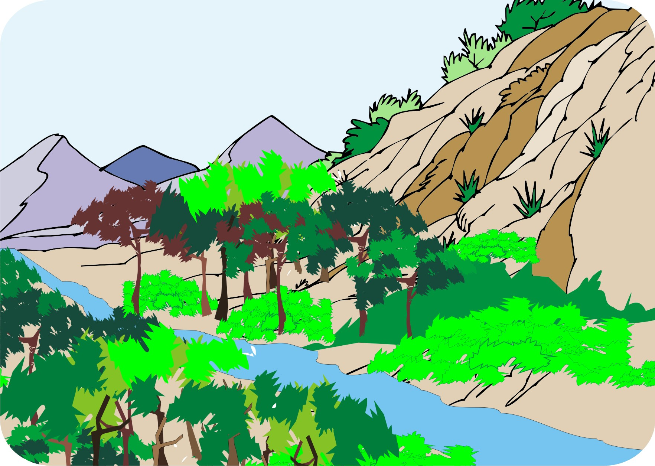
Agroecology
Establish the following:
Is the area arid, semi-arid, or humid?
Is the land flat, gently sloping, or hilly?
Are there any wild birds or animals?

Slide 36
Agroecology (Continued)
Establish the following:
Is the land irrigated or non-irrigated?
Have people noticed any changes in overall climate or in the patterns of rainy or dry seasons?

Slide 37
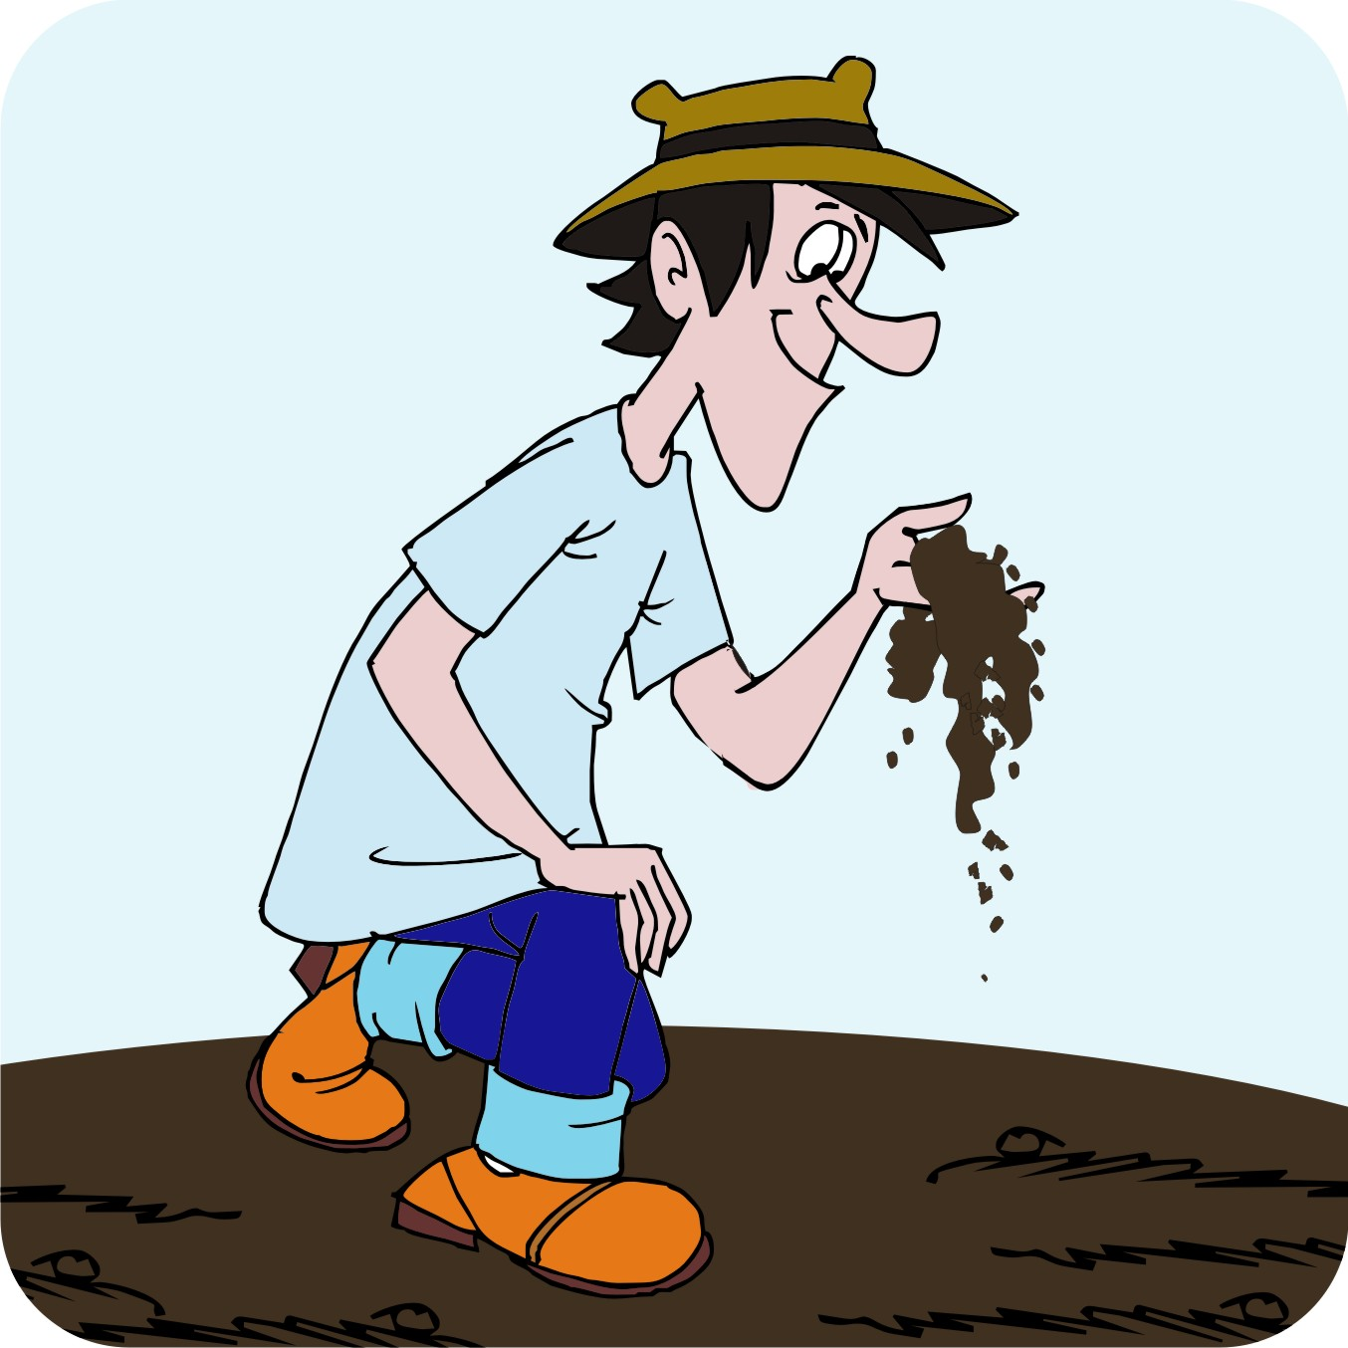
Soil characteristics
What types of soil are there?
What are the soil characteristics?
How deep is the topsoil?
How long will the soil hold water?
Is the soil easy to cultivate?

Slide 38
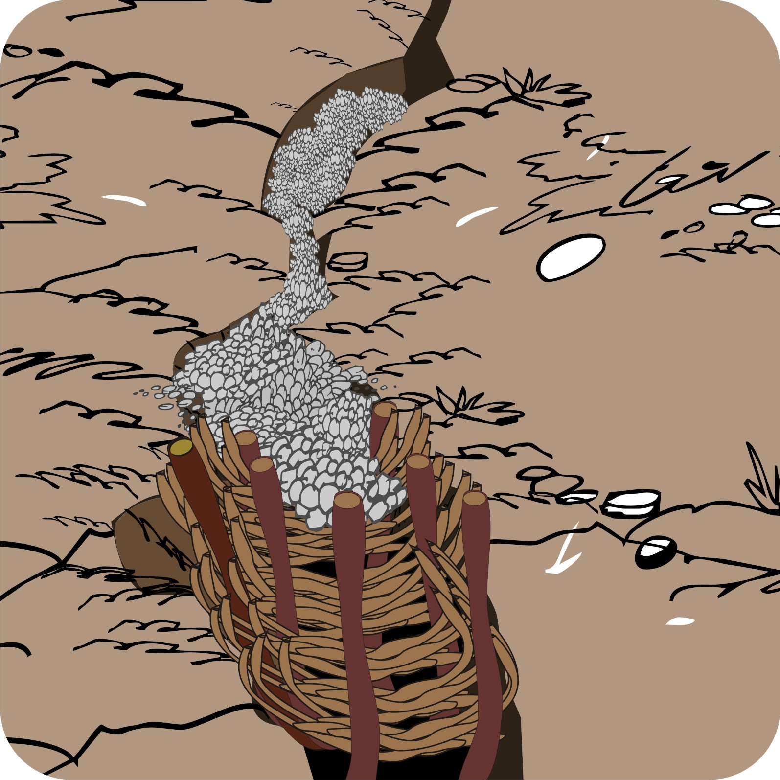
Soil characteristics (Continued)
Are the soils different in different parts of the area?
What do farmers do to maintain their soil fertility?
Are there any signs of soil erosion?
What do people do about the erosion?

Slide 39
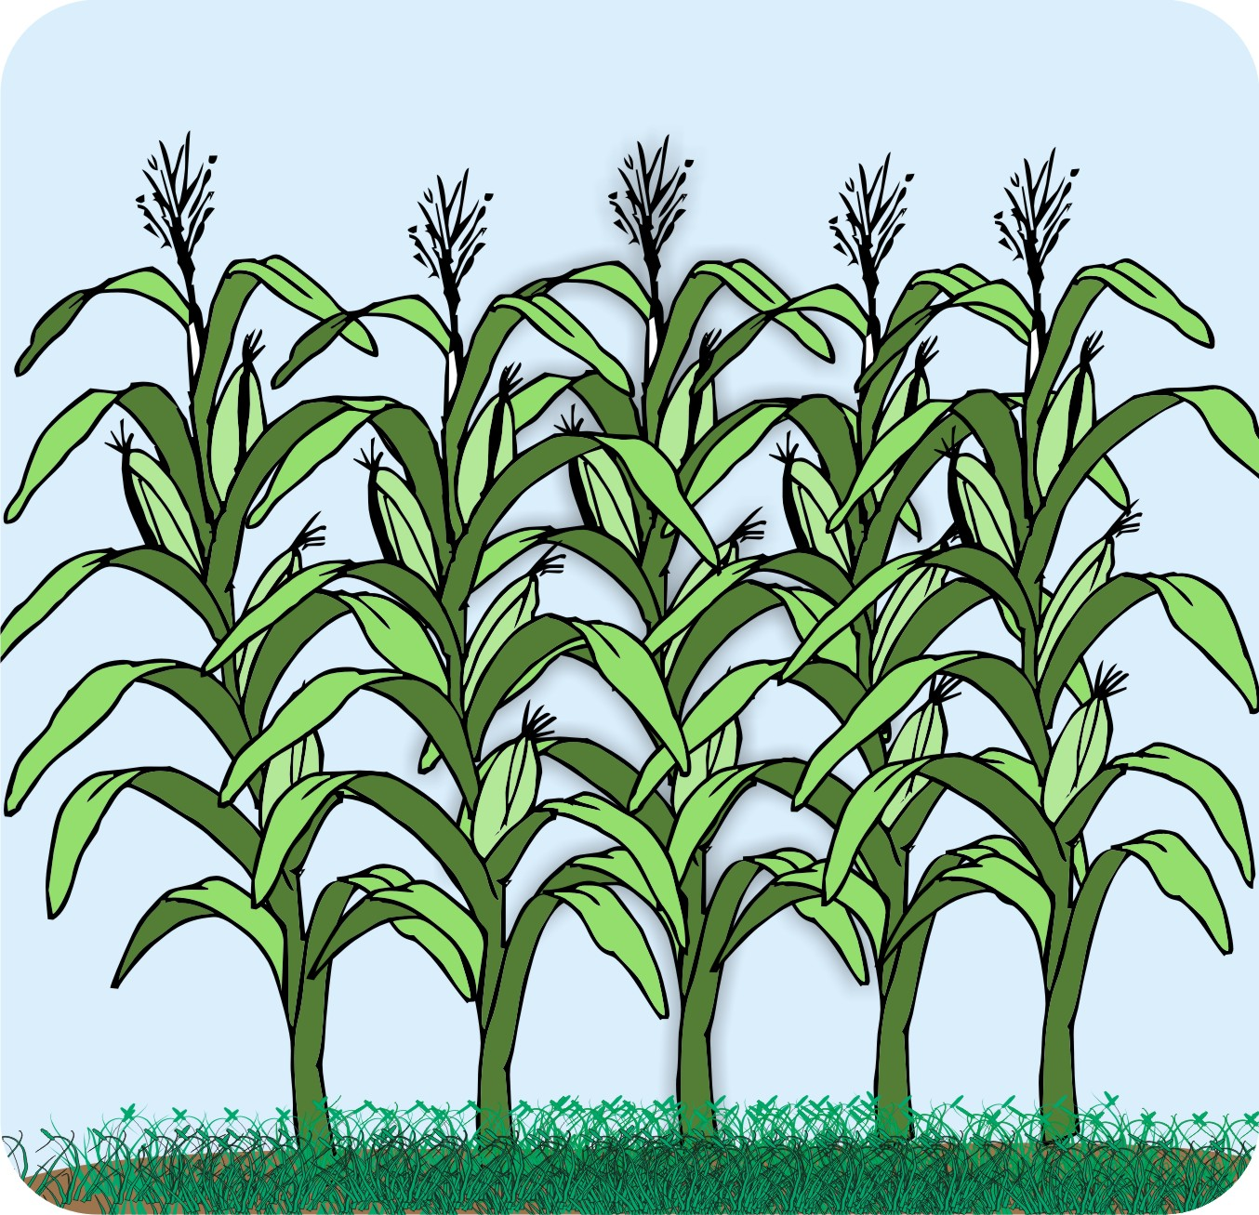
Plants: Crops and trees
Crops:
What crops are growing well on which soils?
Which crops are grown, using which practices?
Trees:
Which tree/plant species do people use and where are they found?
What types of trees do people plant and where?

Slide 40
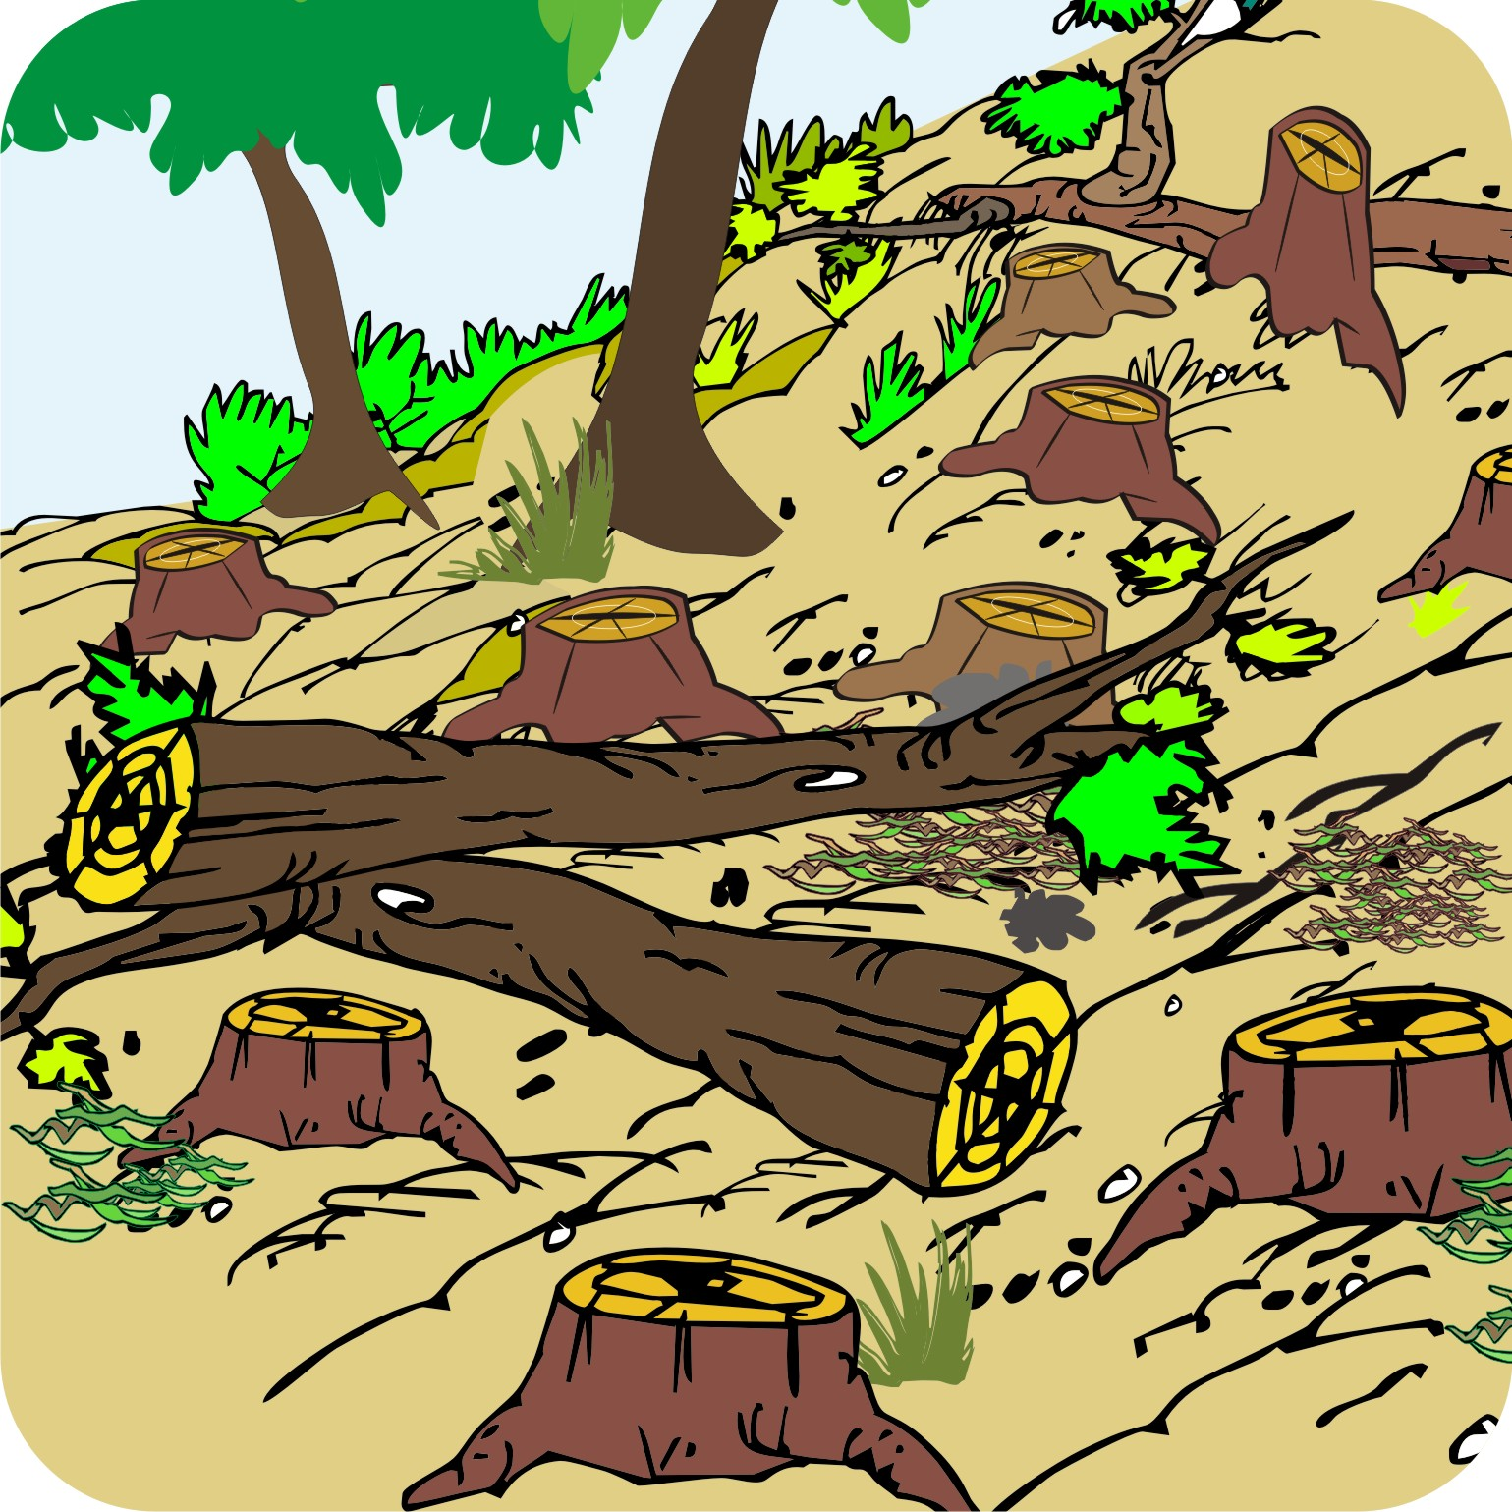
Plants: Trees
Is the cutting of trees in forests or communal lands controlled and, if so, how and by whom?
What has happened to the forests over the last ten years?

Slide 41
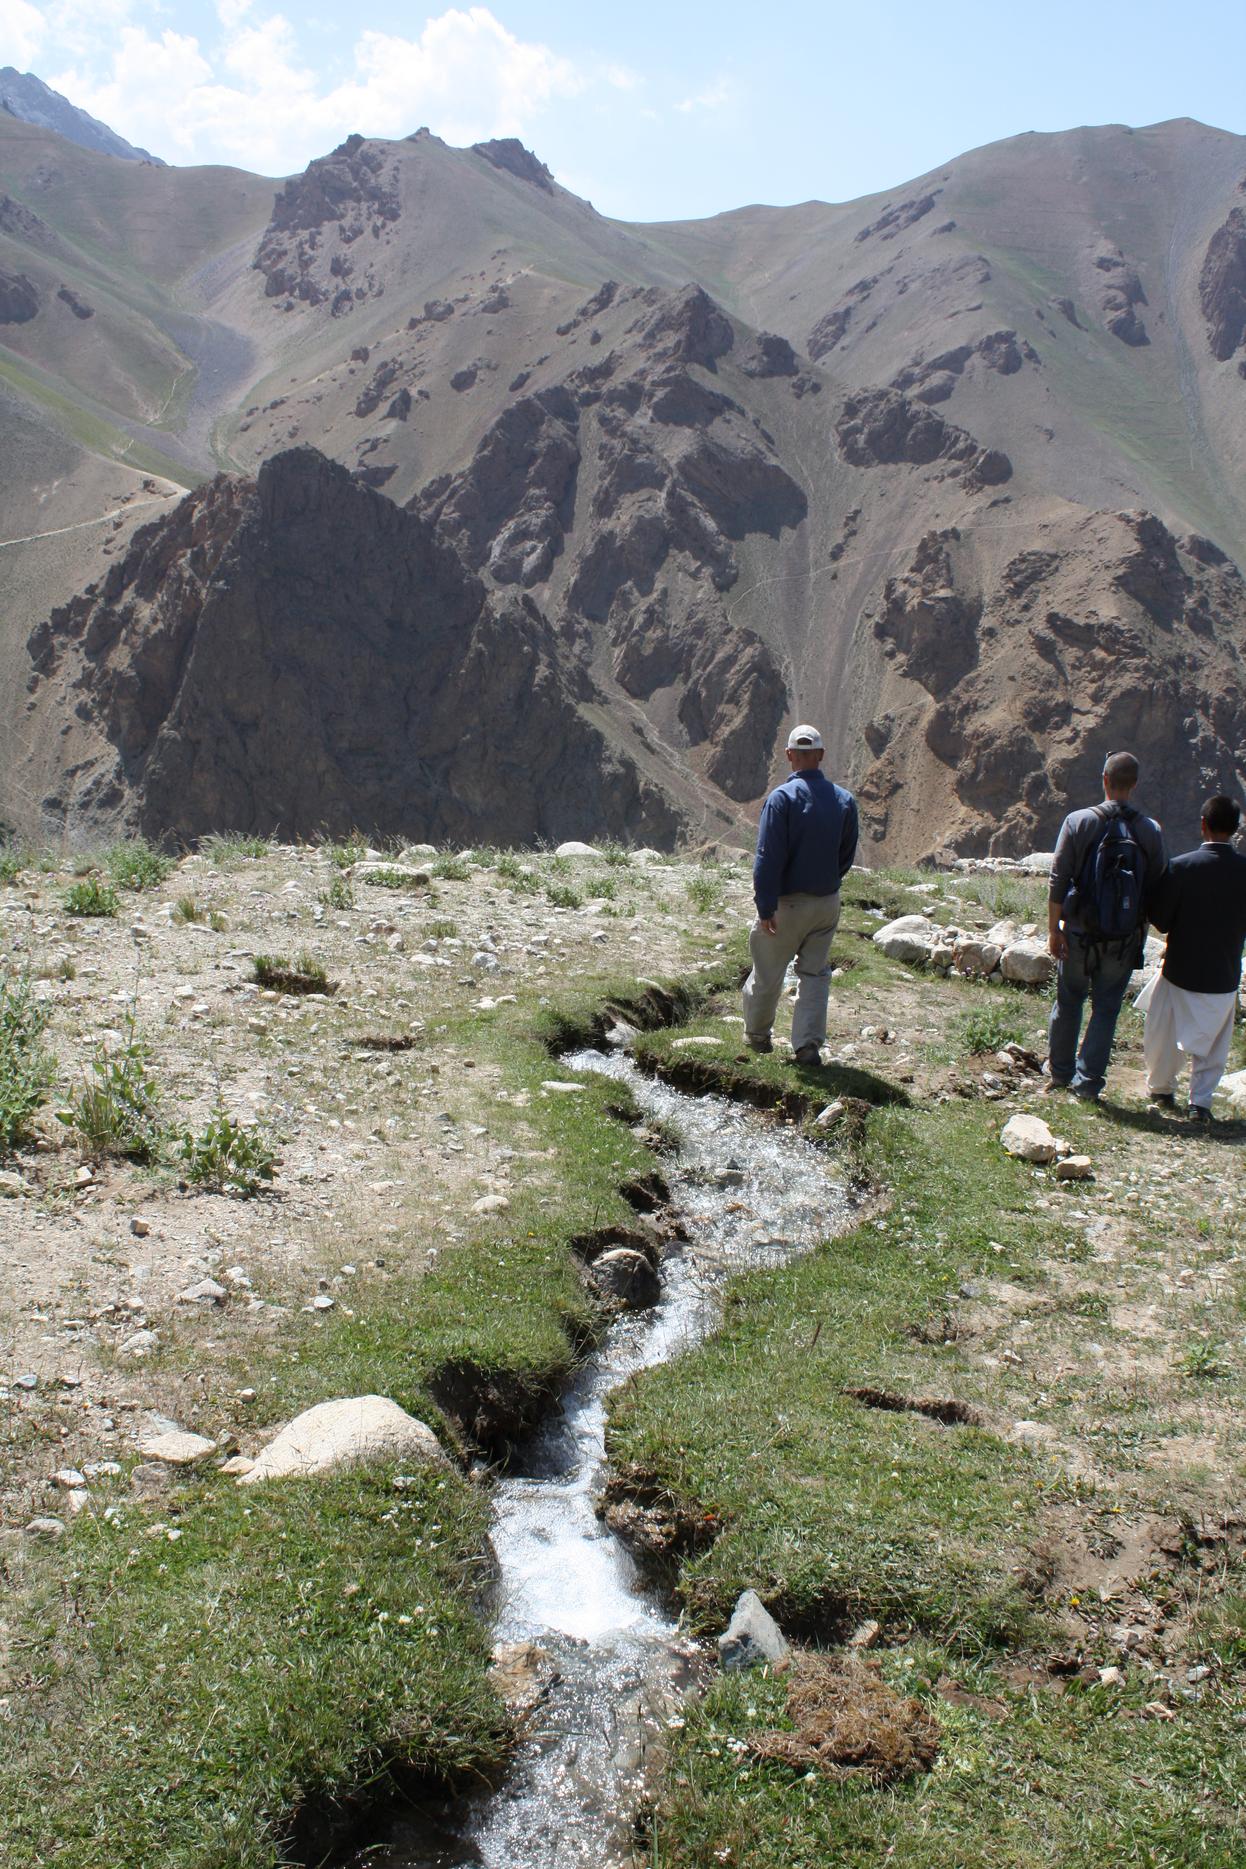
Water use and watershed management
Water use
What are the community’s main water sources?
How do they use water?
Are water resources increasing or decreasing and why?
Watershed management
Do people manage their watershed?
What is happening within local watersheds?
Is water lost through too much runoff?

Slide 42
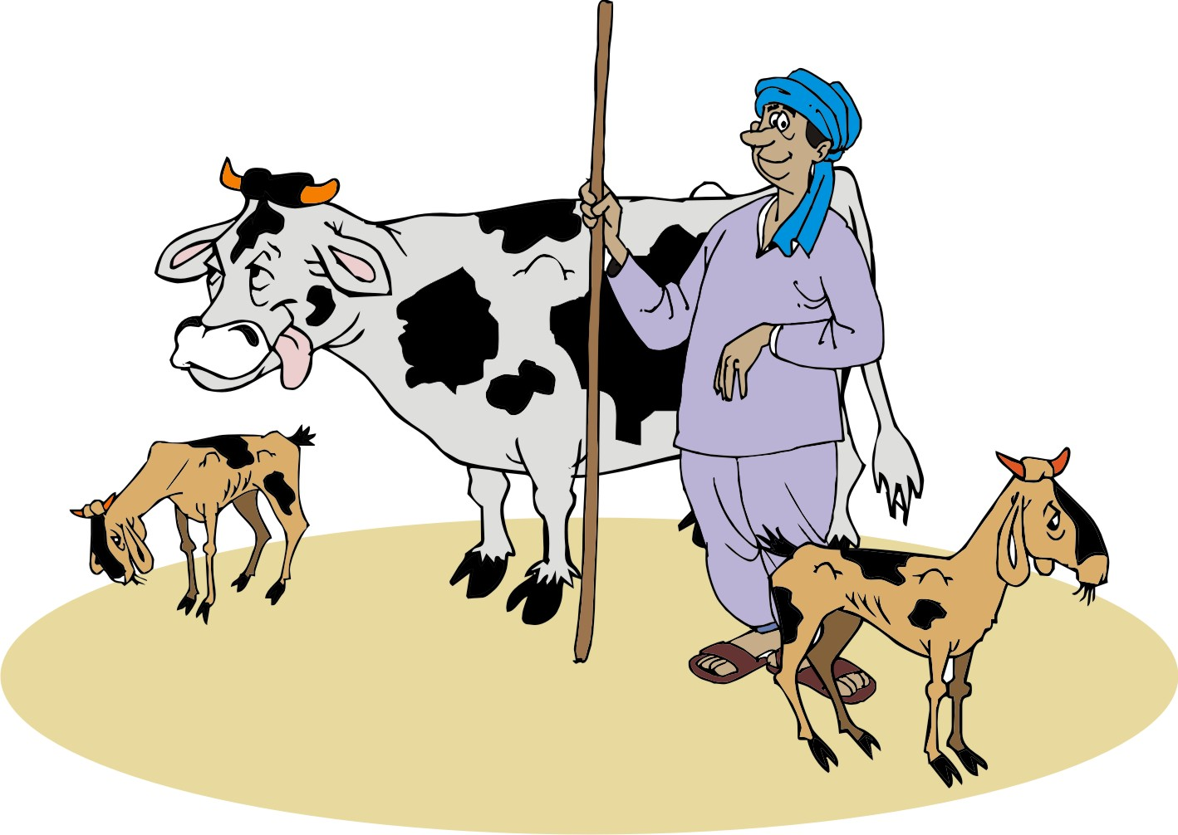
Livestock
What kind of livestock do people keep?
Are the numbers of livestock in the area increasing or decreasing?
Which types of animals are kept?
What is the impact on people and the environment?

Slide 43
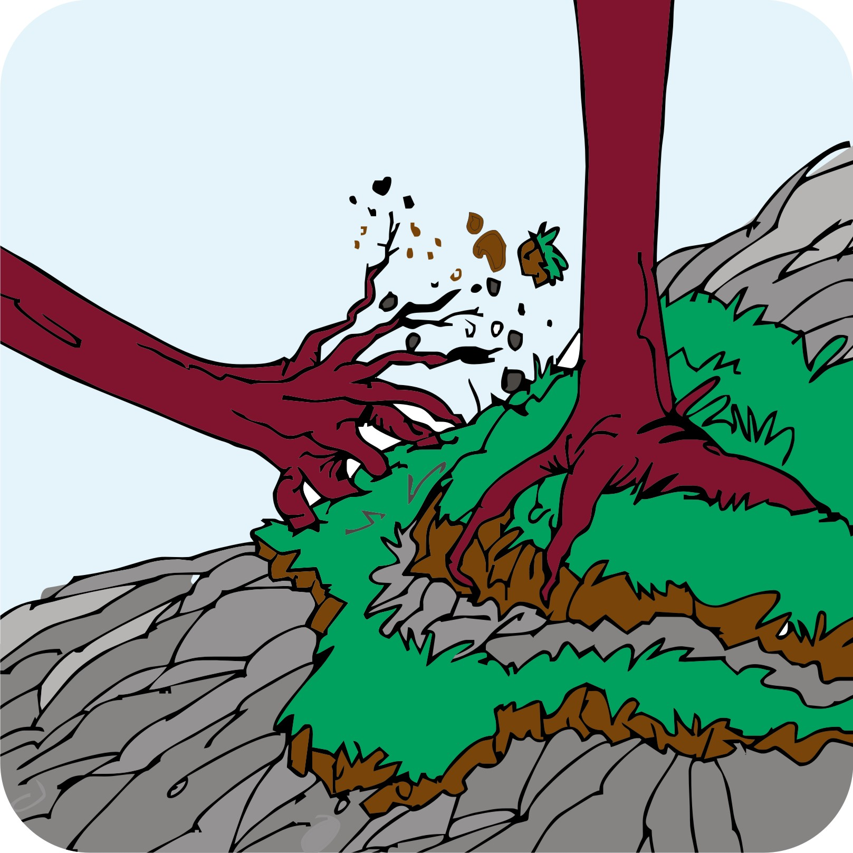
Vulnerable or high risk areas
In the past ten years, what natural events have threatened natural resources or livelihoods?
Are these at risk of happening again?
Is the frequency of natural disasters increasing or decreasing?
Which natural disasters are occurring?
What might be the cause(s)?

Slide 44
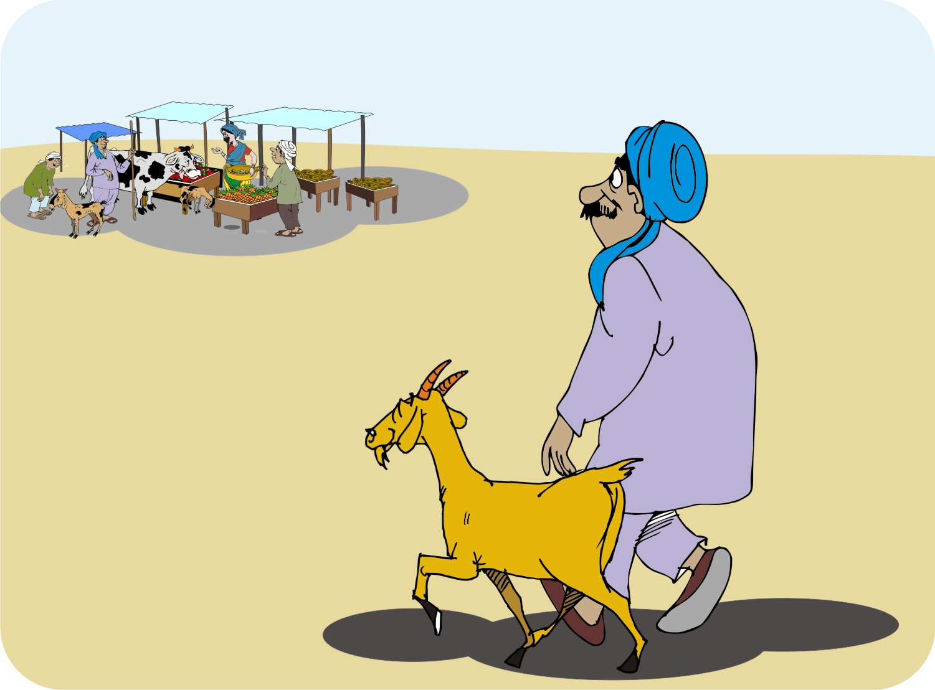
Social and economic issues in managing natural resources
Improving the management of natural resources requires an understanding of:
The physical environment:
  Soils, plants, water, etc.
Social and economic situation:
  Economy and markets, policies and governance

Slide 45
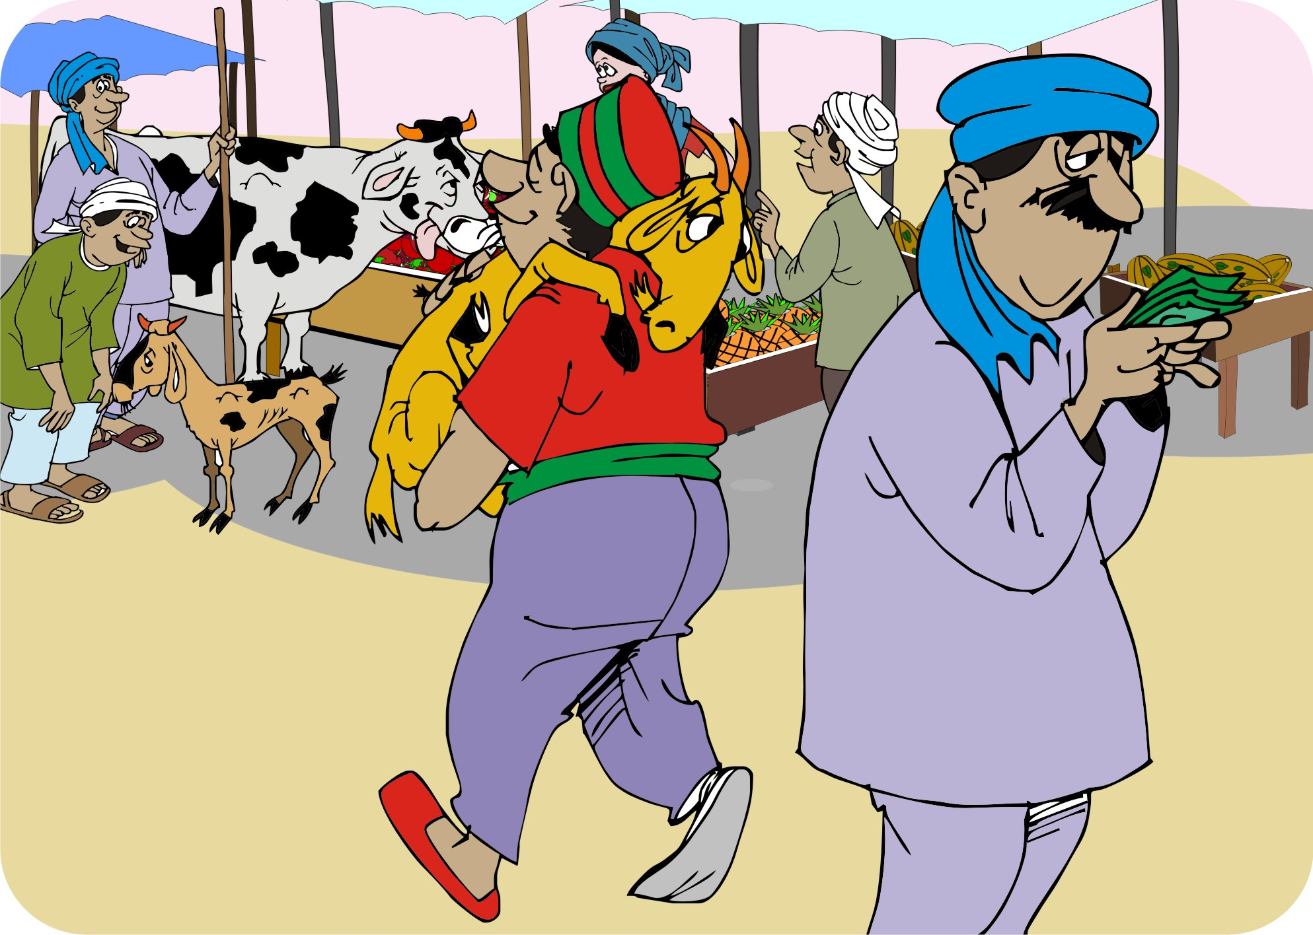
The economy and markets
People’s economic situation may be a driver of how they value natural resource management.
If agriculture is their main income, they can improve their livelihoods by managing natural resources well.
Farmer groups need to understand the local market potential of their product.

Slide 46
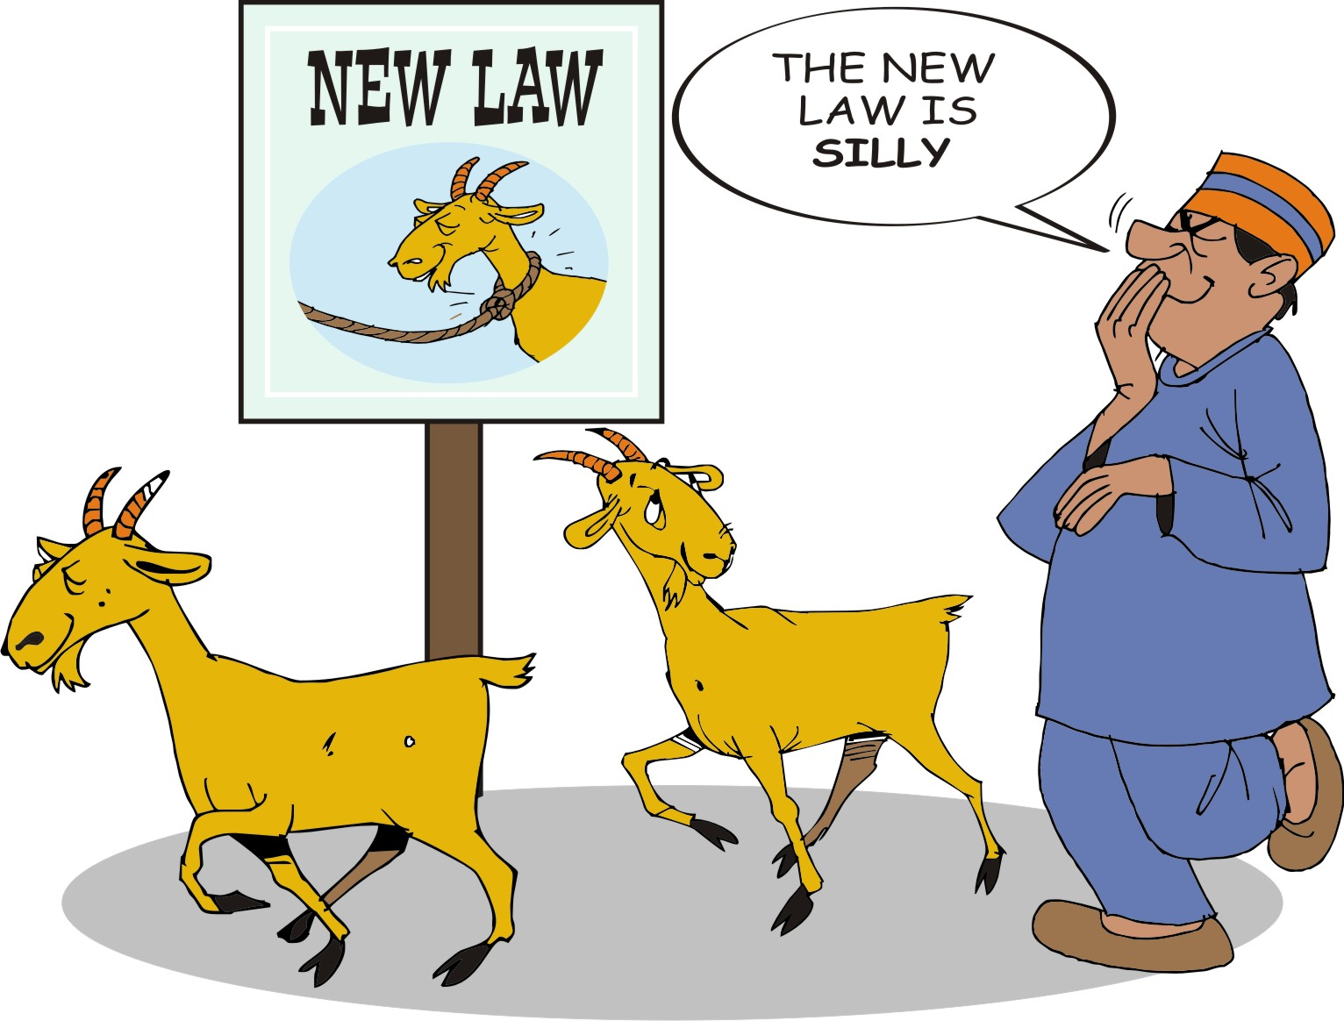
Policies, laws and institutions
Every country has different policies on managing resources and policies can differ quite widely from one resource to the next.
Some governments are quite strict in enforcing policies, while others countries may not apply their laws very strictly or sometimes not at all.

Slide 47
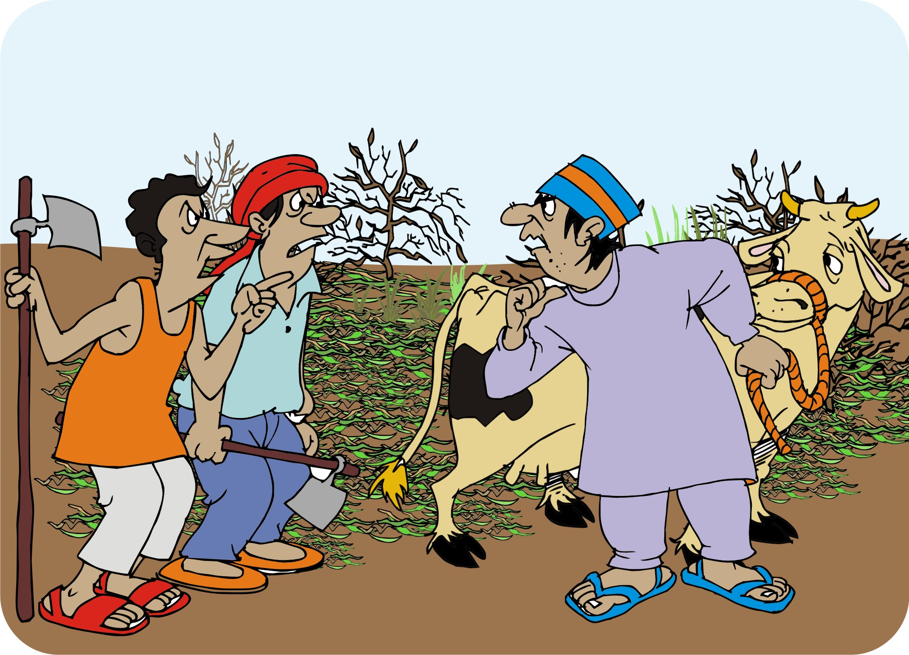
Ownership and control of natural resources: Land tenure
Some people own their own land, while others have to use other people’s land to farm.
Land tenure and how land is passed from one person to another also vary from place to place.

Slide 48
Ownership and control of natural resources: Fishing and hunting rights
Some local communities have exclusive fishing, hunting or gathering rights.
In other communities, they have to share their resources with nearby communities.

Slide 49
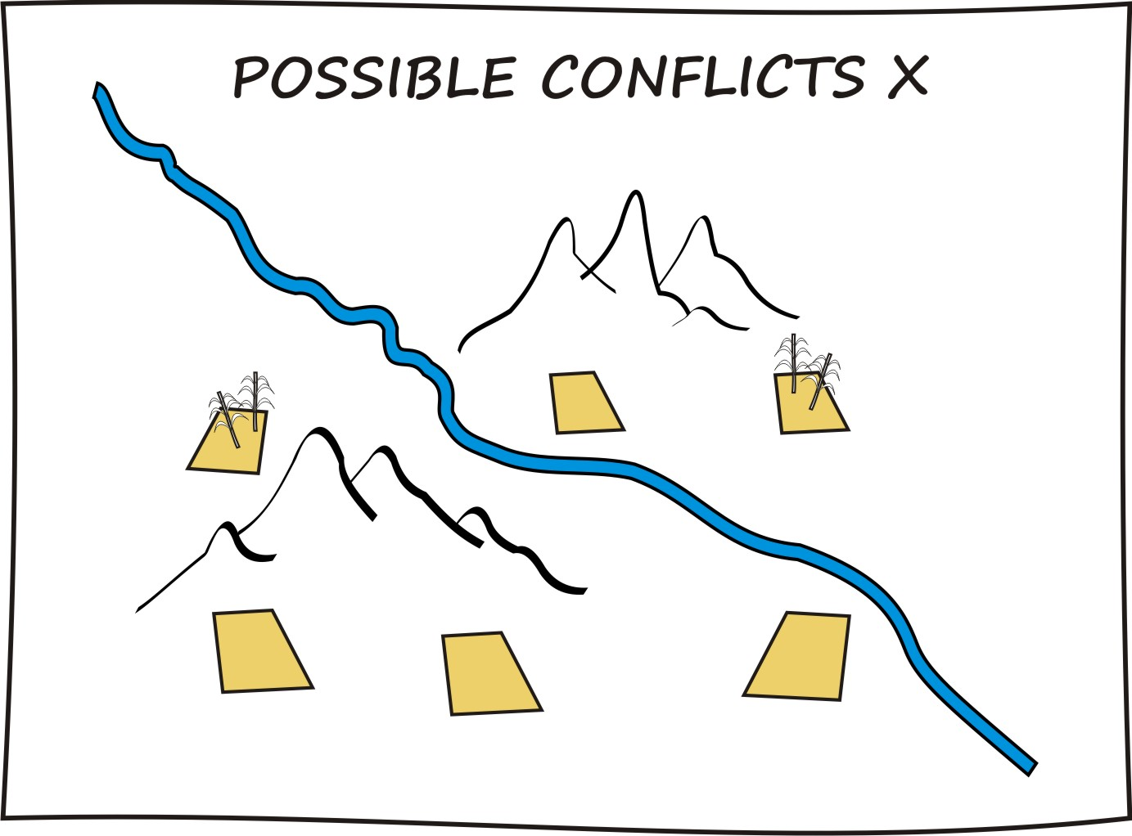
Ownership and control of natural resources: Conflict
Scarce resources may be a great source of conflict.
If different groups of people use resources in different ways, it may also cause conflict.

Slide 50
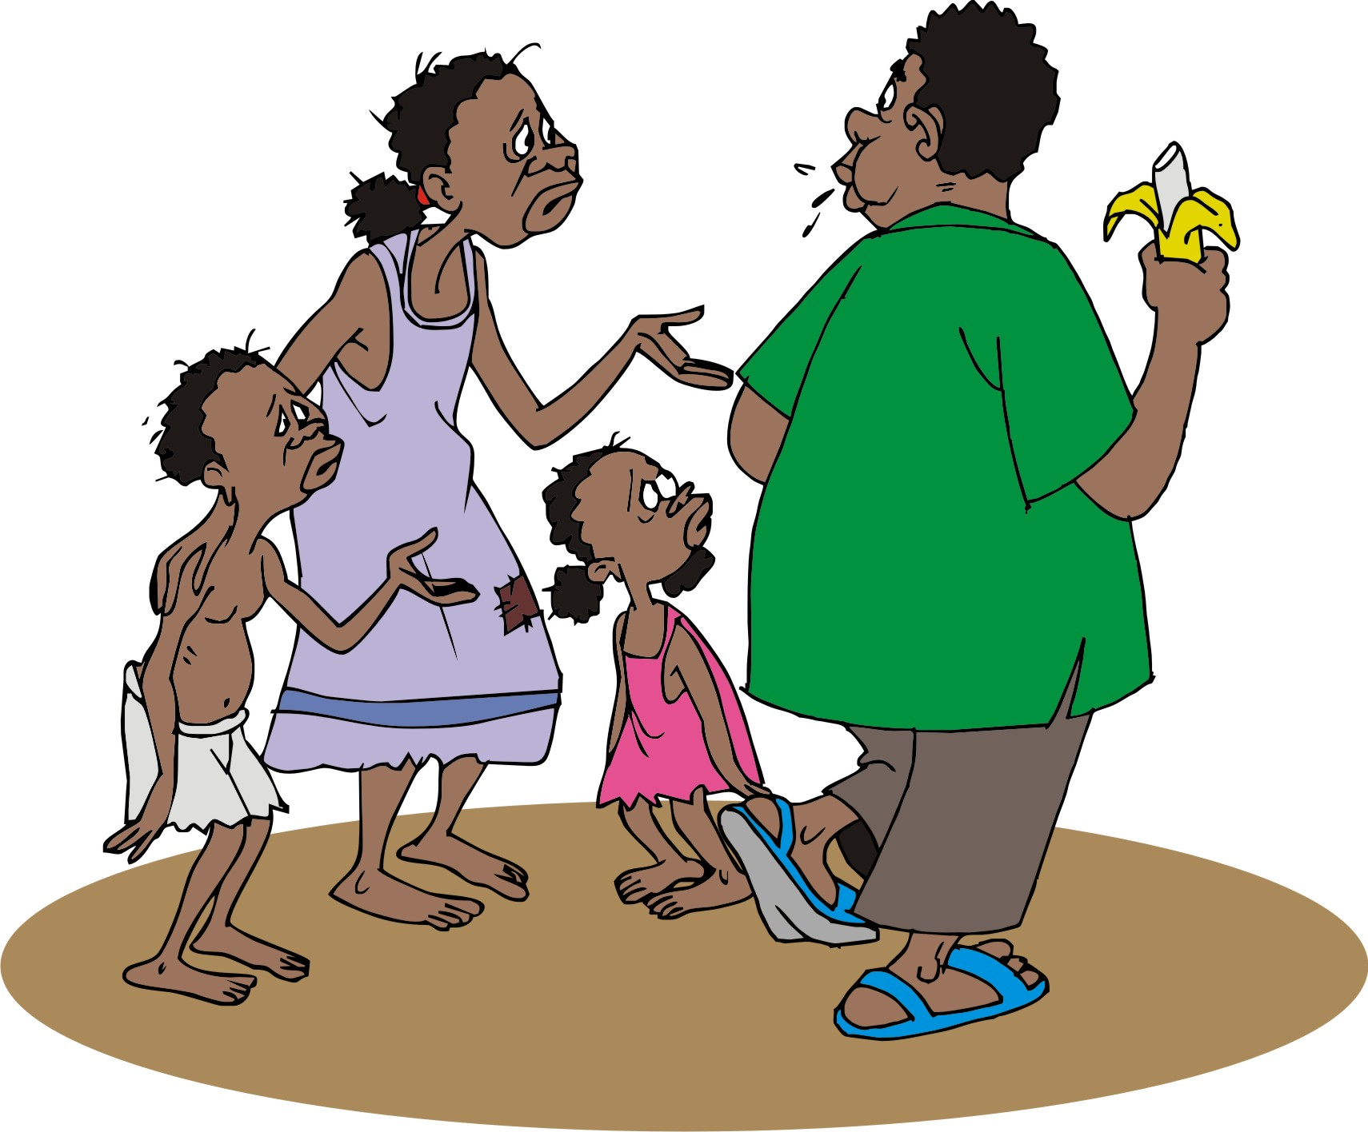
Vulnerable people: Characteristics
Vulnerable people usually:
Are the poorest farmers in a community
Have little or no education
Live with disabilities
Are faced with other challenges, e.g. HIV/AIDS
May belong to minority ethnic groups or lower socio-economic classes

Slide 51
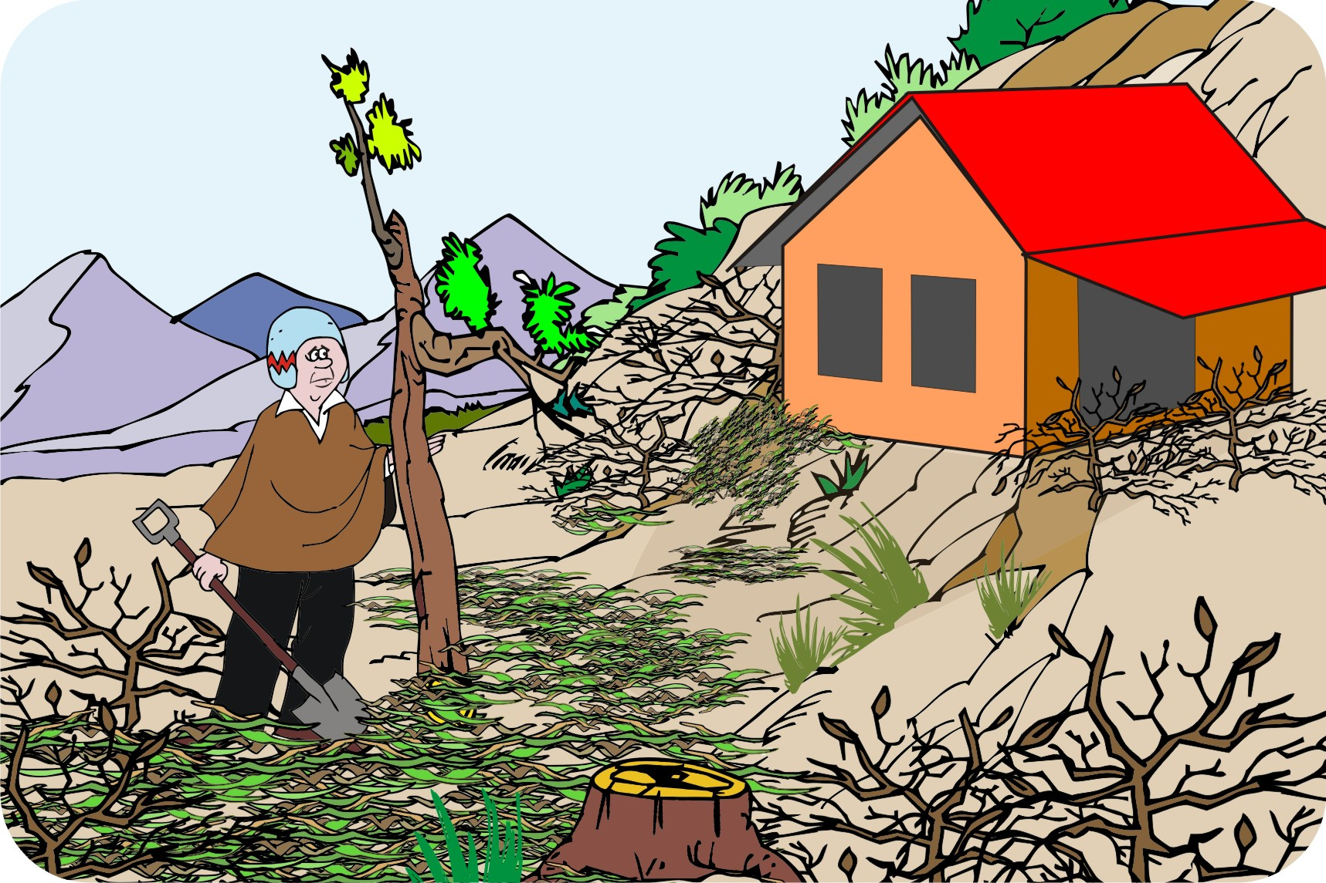
Involved vulnerable people in projects
Vulnerable people may:
Not have any land, or their land may be in the most remote places or have the worst soils on the steepest slopes
May not be able to spare time to attend discussions
May be stigmatized from participating in events
May need extra help in trying out new technologies

Slide 52
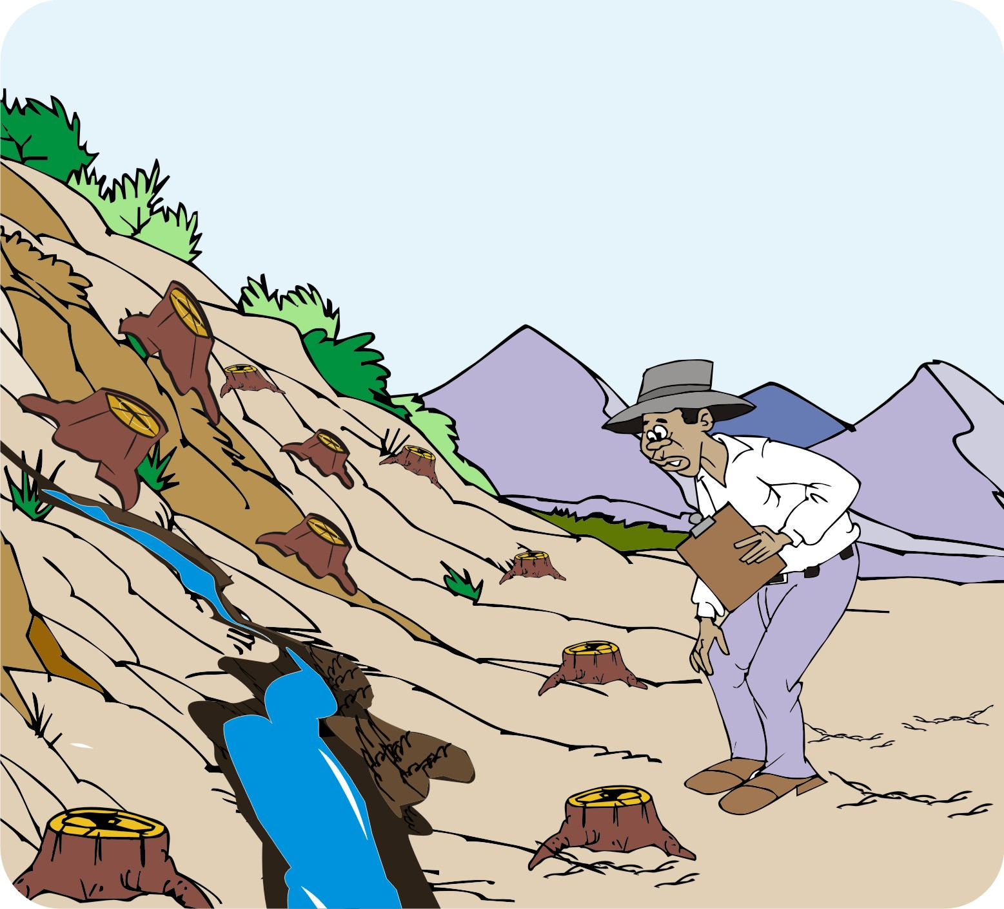
Collecting initial information: Direct observation
Use your own experience and training to identify problems and possible solutions in the area.
Walk around to become familiar with the area and its problems.
If you visit in the rainy season, remember that things may look very different in the dry season.
Examine the soil attentively: it can tell you a lot about the area and its potential.

Slide 53
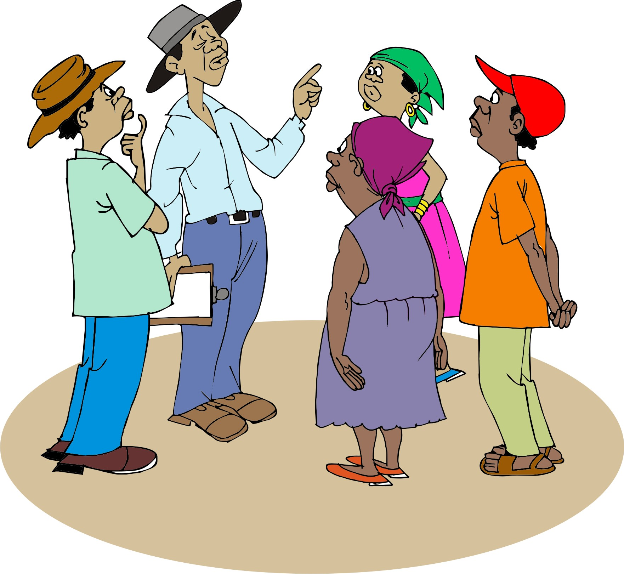
Collecting initial information: Talking to local people
Talk to a wide range of people to find out their problems and the solutions they hope for.
Interview people individually, in small groups, or conduct focus-group discussions.
Make sure you talk to a cross-section of people.
Make sure you meet with local leaders before you plan any community meetings.

Slide 54
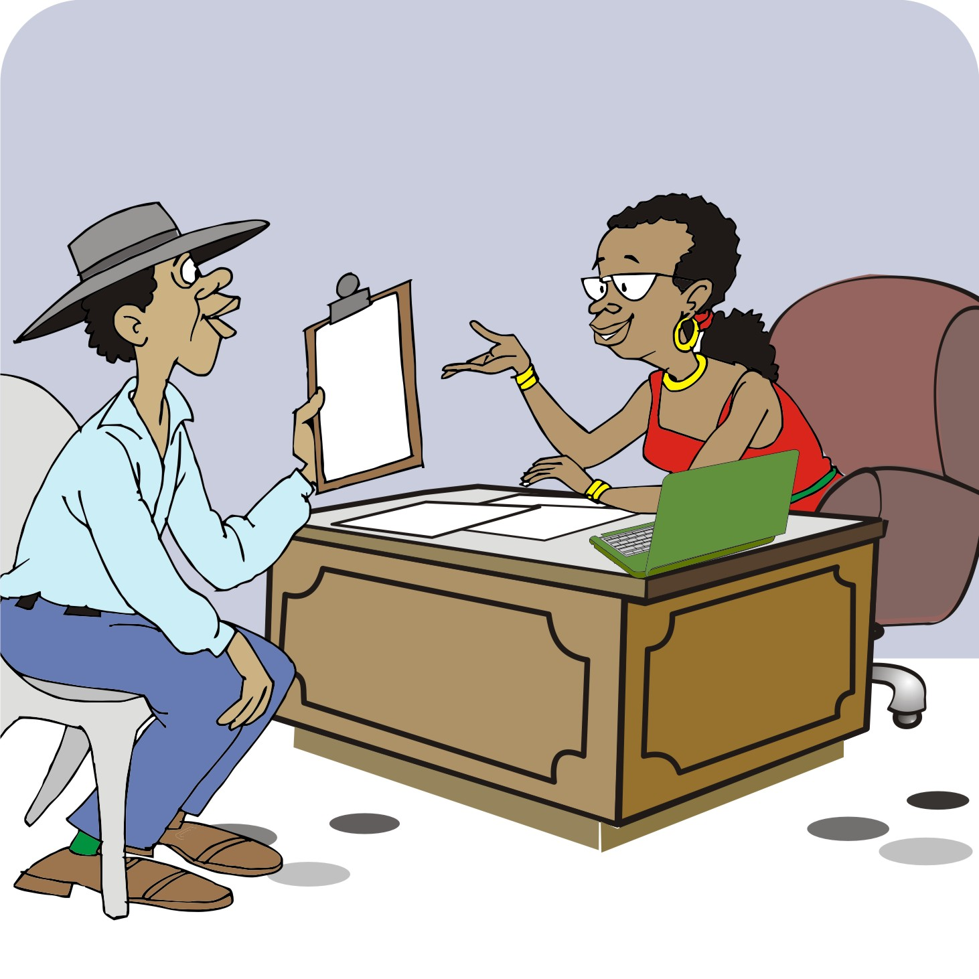
Collecting initial information: Key informant interviews
Find out who are the key individuals and leaders in the community:
Heads of producer or marketing groups
Heads of women’s groups
Heads of watershed or water-user committees
Officials from the relevant ministries or local government units
Staff of development organizations
Stakeholders in the private sector

Slide 55
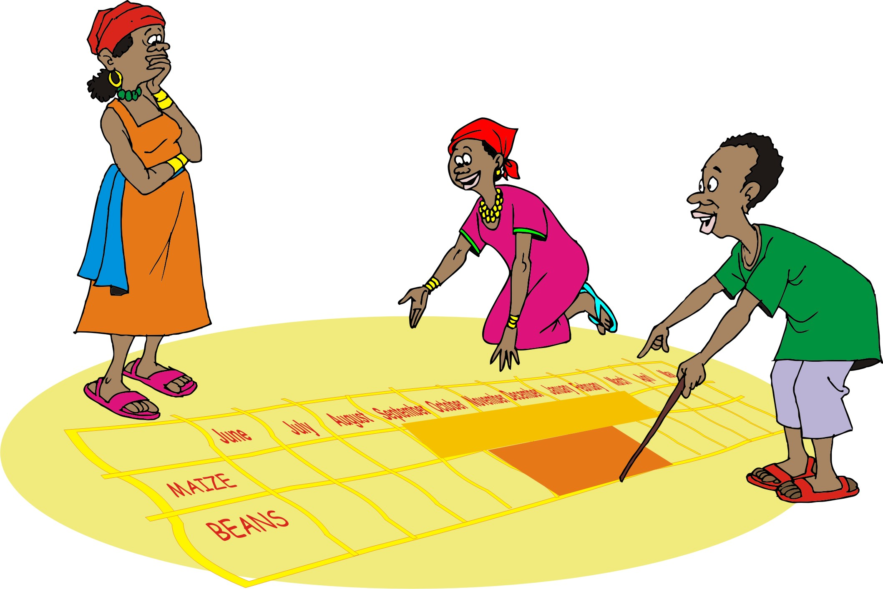
Collecting initial information: Participatory appraisal
The following techniques are helpful:
Transect walks
Seasonal calendars are
Some techniques, such as socio-economic analyses, may require more time with the communities

Slide 56

Collecting initial information: Secondary information
Collect information from:
Reports and documents
Maps, satellite and aerial photographs
Official statistics
Other development agencies and projects

Slide 57

Collecting initial information: Secondary information (Continued)
You may be able to find the following information:
In the community and local government offices
Through national government ministries
From development organizations

Slide 58
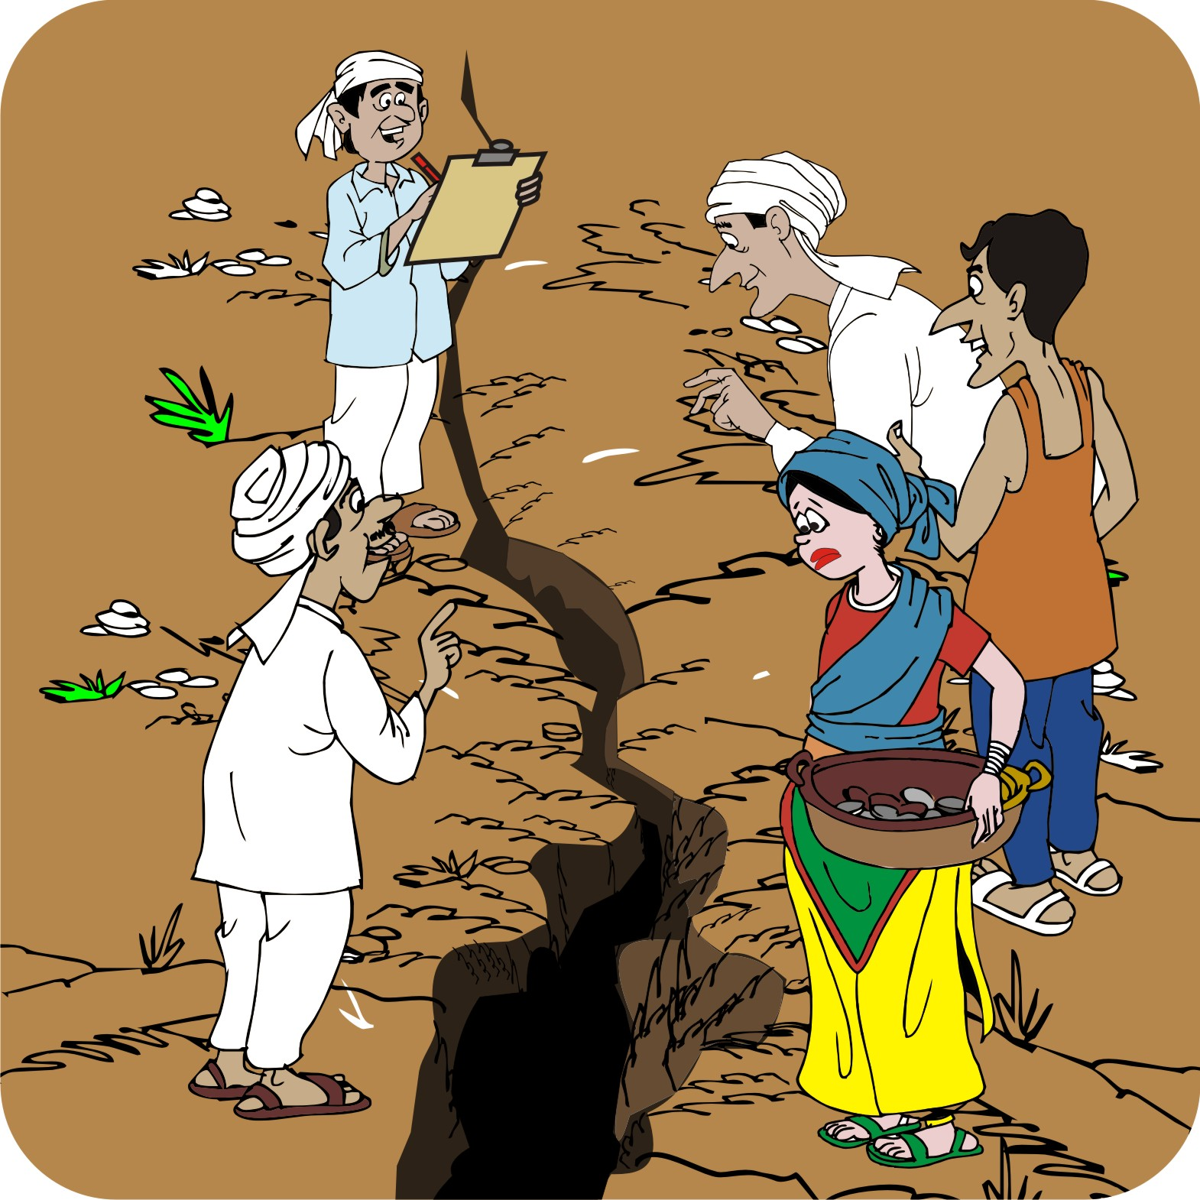
Collecting initial information: Transect walks
A transect walk is an organized walk across an area during which the participants examine and record the challenges and areas of high potential.
The route for the walk is selected from a natural resource map of the area.

Slide 59
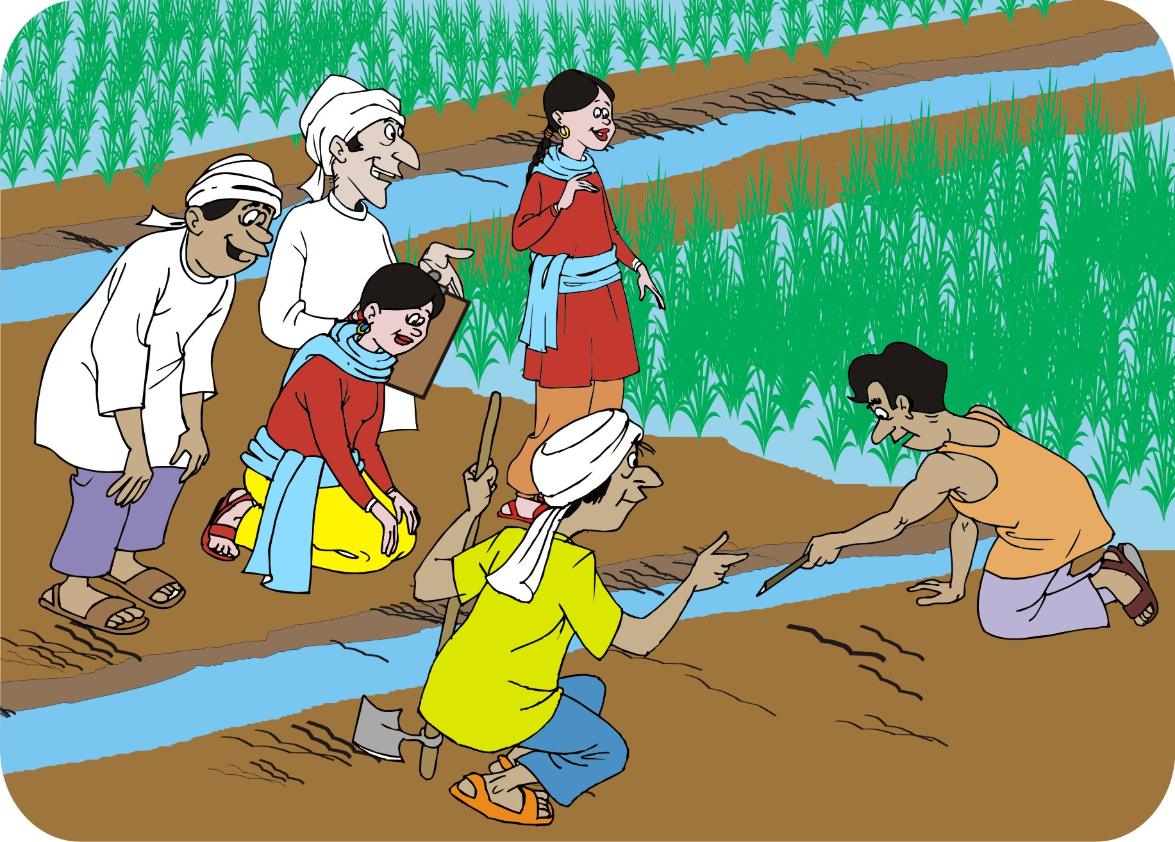
Collecting initial information: Transect diagram
Use the information collected on the transect walk to create a transect diagram that shows:
Water sources
Crops, tree types and other vegetation
Soil types
Infrastructure: dams, erosion and waterlogging

Slide 60
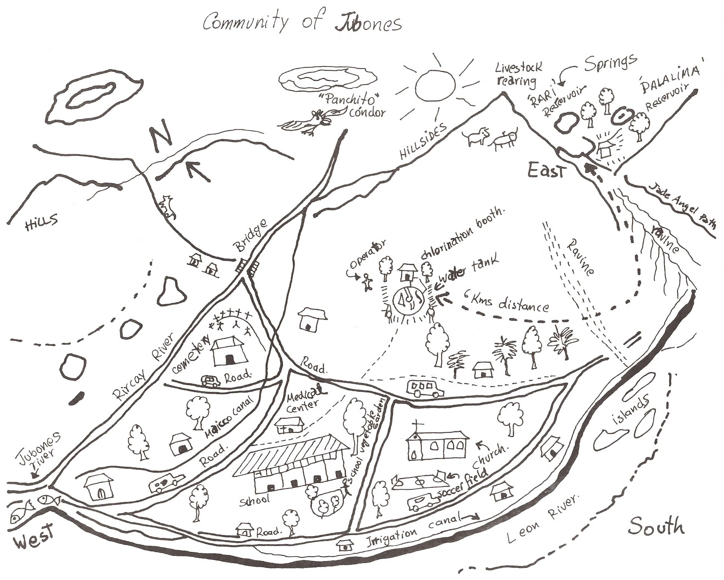
Example of a resource map of an area

Slide 61
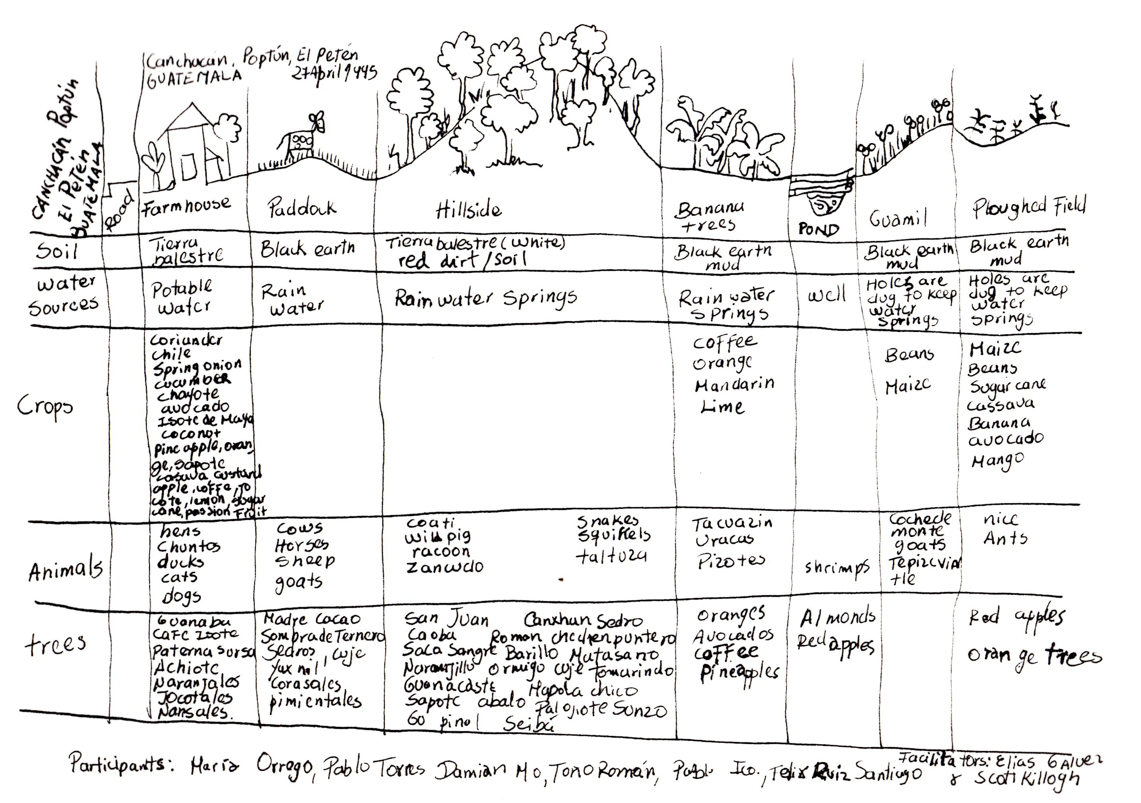
Example of a transect diagram

Slide 62
Collecting initial information: Using maps
There are different types of maps, e.g. maps on crop production, land use, soils and erosion and roads and other infrastructure.
A topographical map is a critical resource for soil and water management, because it shows:
Elevations, slopes, hills and valleys
Rivers, roads and settlements
Satellite and aerial images or maps can also help you study the topography and identify physical features, including forest or vegetative cover, or other land use in the community.

Slide 63
Lesson 3:
Identifying and engaging stakeholders

Slide 64
Outcomes
After this lesson, you will be able to:
Identify and engage stakeholders: Community leaders, governments, NGOs, or other actors.
Recognize the importance of partnerships.

Slide 65
Overview
Lesson 3 covers the following content:
The importance of stakeholders
State and local governments
Local people
Learning from stakeholders’ activities

Slide 66
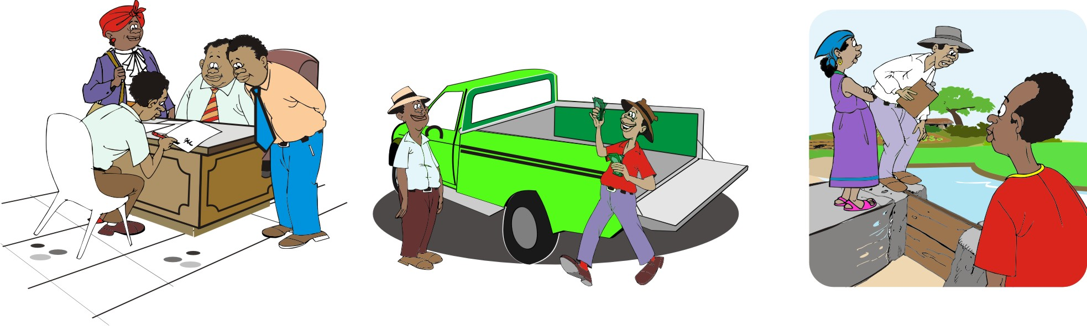
The importance of stakeholders
Stakeholders are those individuals, groups or organizations that have an interest or relation to a project or, in this case, a natural resource.
Various people and organizations outside the community may also have an interest in the resource, or they may influence it. They are also stakeholders.

Slide 67
The stakeholder analysis
A stakeholder analysis helps:
You to identify stakeholders and to decide how and when they should be involved in your project.
Farmers to note individual landowners who could be helpful but, alternatively, could pose a challenge to working in a given community
Farmers to assess how groups and organizations may support or hinder the implementation of the resource management strategy you develop together
To explore connecting with other organizations to scale up your work across a wider area

Slide 68
Purpose of the stakeholder analysis
The purpose of the stakeholder analysis is to determine:
Who has interest in or influence over the resources in the watershed or community area
Who is affected by changes in these different resources
Where are the stakeholders located: inside or outside the watershed or community area
How do they currently use the resources in question
What are their needs or interests for future use of these resources
How do the different stakeholders need to be involved in the resource planning and implementation process

Slide 69
Stakeholders: State and local governments
State, local governments and non-governmental organizations are key stakeholders that may play the following roles:
Funding resource management projects or proving access to funding
Providing consultations and approvals
Planning, implementation and monitoring projects
Enforcing policies that restrict pollution or improve infrastructure (e.g. drainage)
Providing regulation and political leverage

Slide 70
Stakeholders: Local people
As the most important stakeholders in resource management projects, members of the local communities should:
Recognize the problems and opportunities in their area and agree what to do about them
Work together on long-term projects (particularly communities in large areas)
Engage with government or development organizations

Slide 71
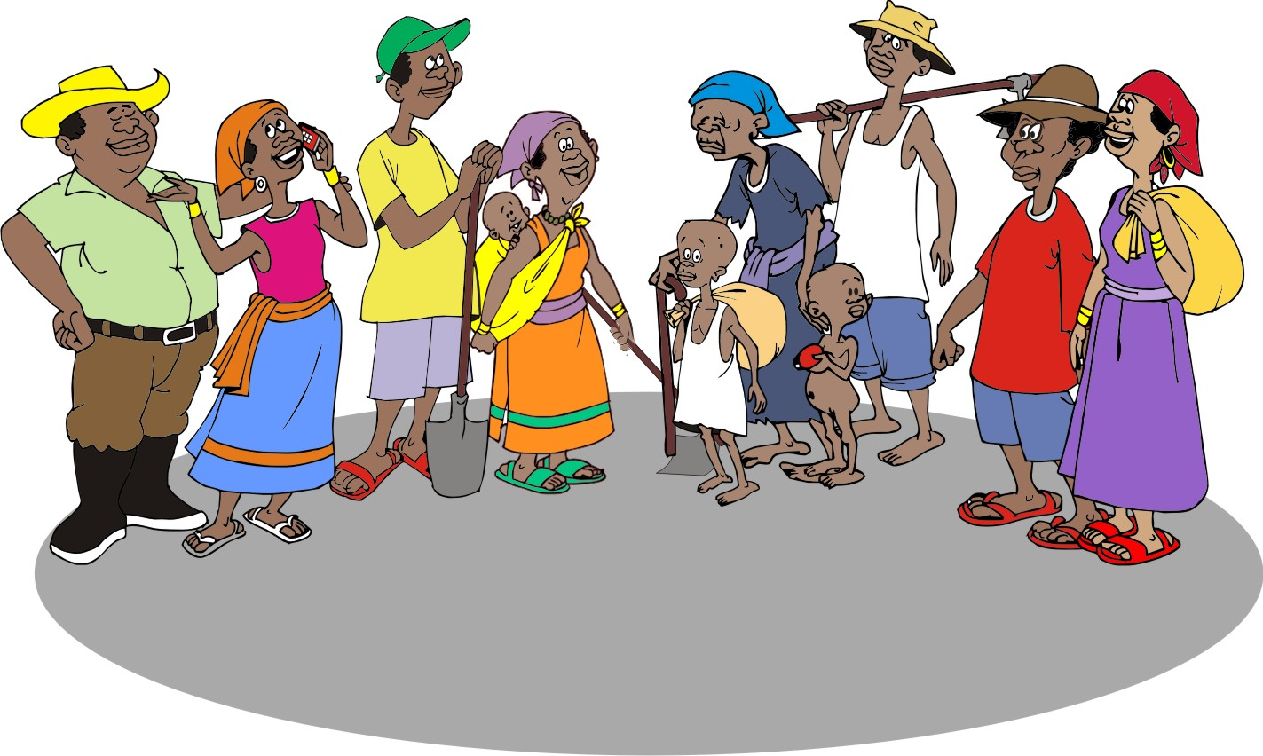
Local people: Building awareness
The most challenging aspect of working with local communities is:
Building awareness about the critical importance of managing natural resources sustainably
Motivating groups of farmers to come together and take action

Slide 72
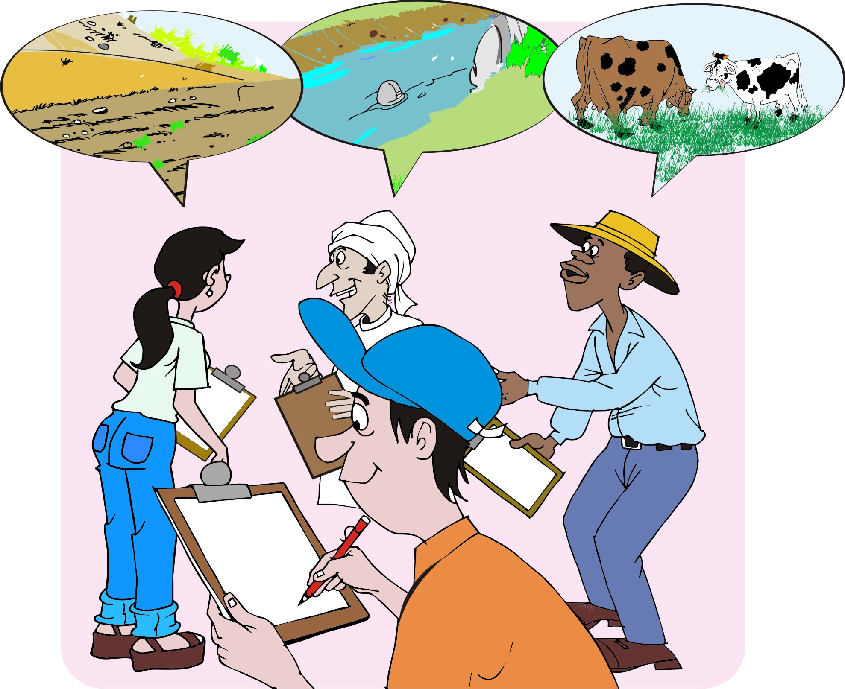
Learning from other stakeholders’ activities
Find out about other resource management initiatives and interventions in your area – e.g. inventions of government, NGOs and local groups – and learn from their successes and mistakes.

Slide 73
Lesson 4: Mapping problems and opportunties

Slide 74
Outcomes
After this lesson, you will be able to:
Conduct participatory mapping of the resources in an area, taking into account the social factors that influence the way people use and benefit from their resources.
Analyze men’s and women’s roles, responsibilities and preferences about natural resources and their management.
Help communities identify hotspots or problems in natural resource management, as well as areas of high potential.

Slide 75
Overview
Lesson 4 covers the following content:
Mapping resources in a community or watershed
Mapping social data
Gendered resource mapping
Identifying and prioritizing problems and opportunities in natural resource management
Identifying natural resource problems or hotspots on watershed and farm level
Identifying causes of hotspots an problems on farm level
Identifying areas of high potential

Slide 76
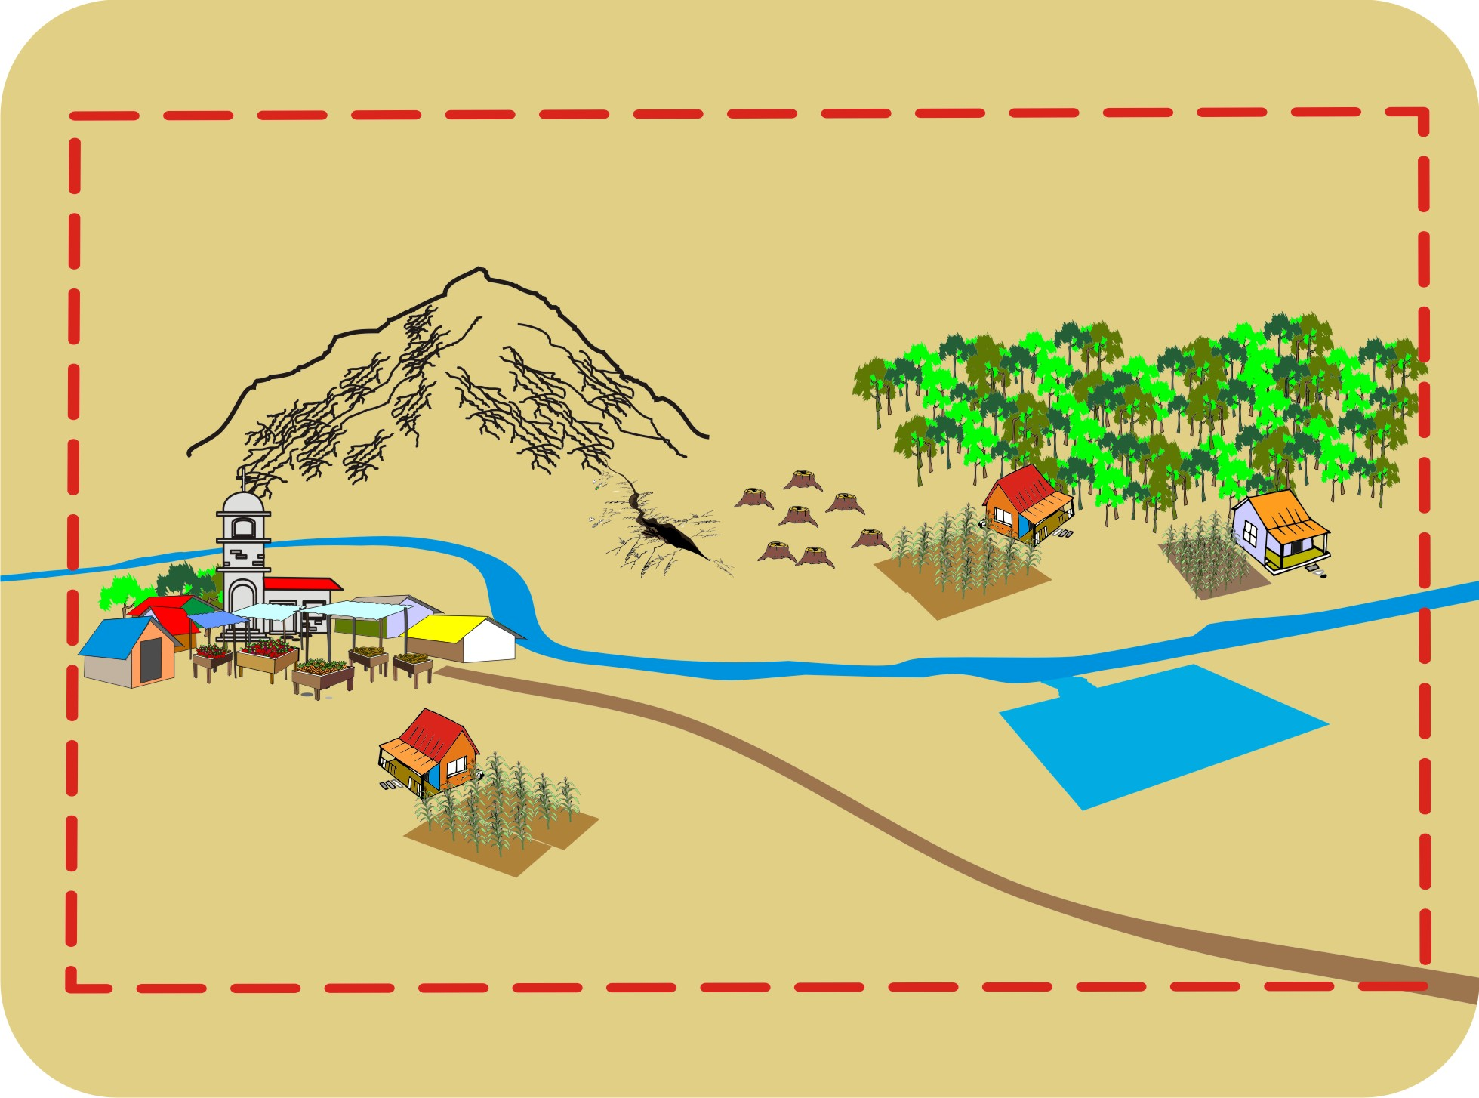
Mapping resources in a community or watershed
For field agents and local people, maps are a useful way of visualizing problems and opportunities related to natural resources and planning interventions.

Slide 77
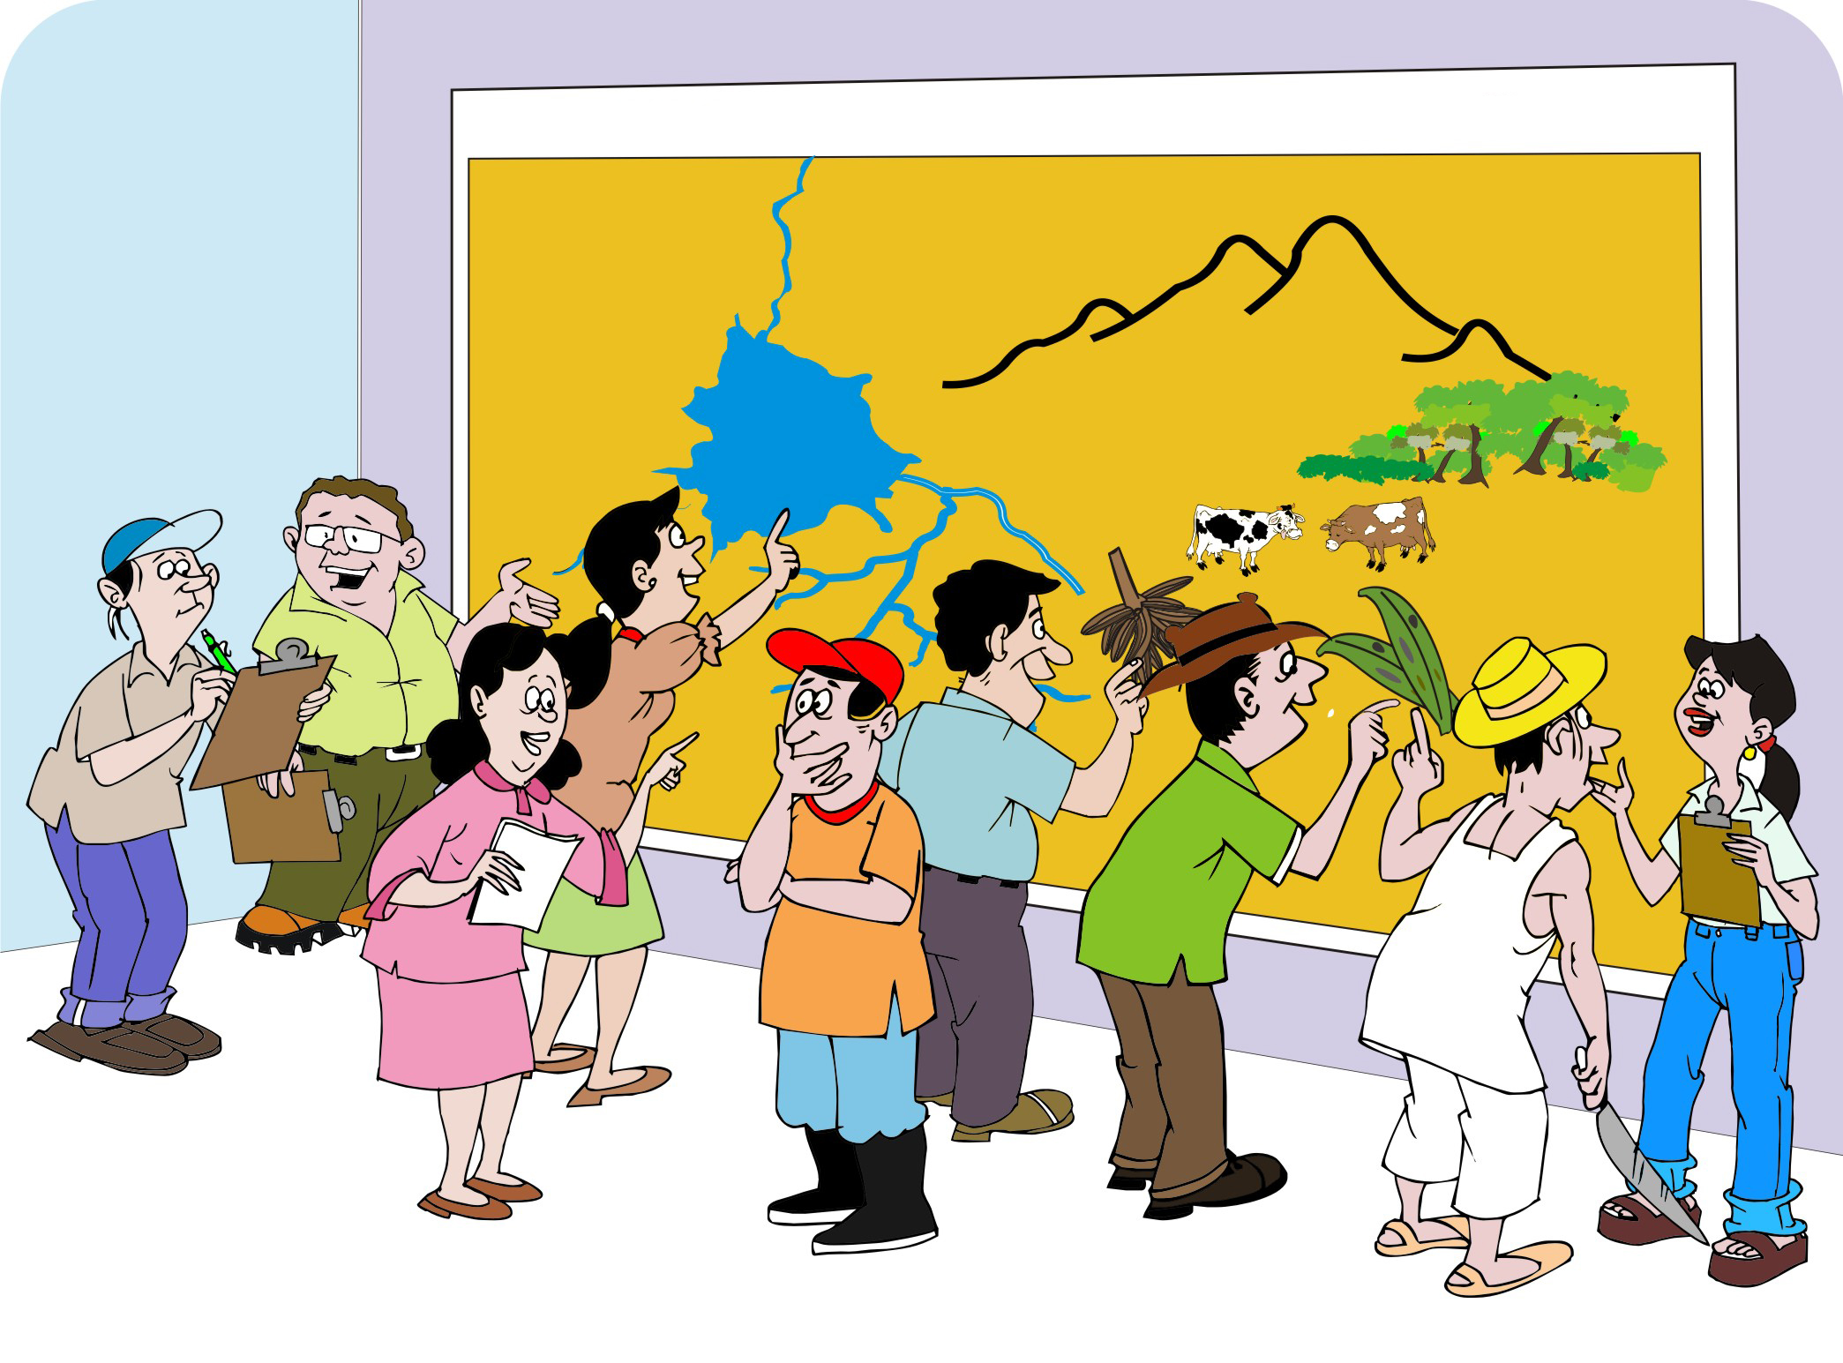
Mapping resources in a community or watershed (Continued)
The local people should be able to identify and map:
Their fields and houses
Key landmarks such as rivers, ponds, hills and valleys.

Slide 78
Mapping resources: Method
When drawing a map, collecting information on the way in which people perceive their resources is more important than accuracy.
Depending on what is available, participants can use:
Markers to draw a map on a large piece of paper
Sticks to draw a map on the ground
Leaves and stones to mark key landmarks (rivers, fields, forests, houses etc.)

Slide 79
Mapping resources: Scope of the map
Maps may cover:
The entire community or
Watershed
Part of the village, e.g. a hillside where people wish to control erosion
Individual farms (for planning windbreaks, crop rotations and finding sites for animal housing and compost piles)

Slide 80
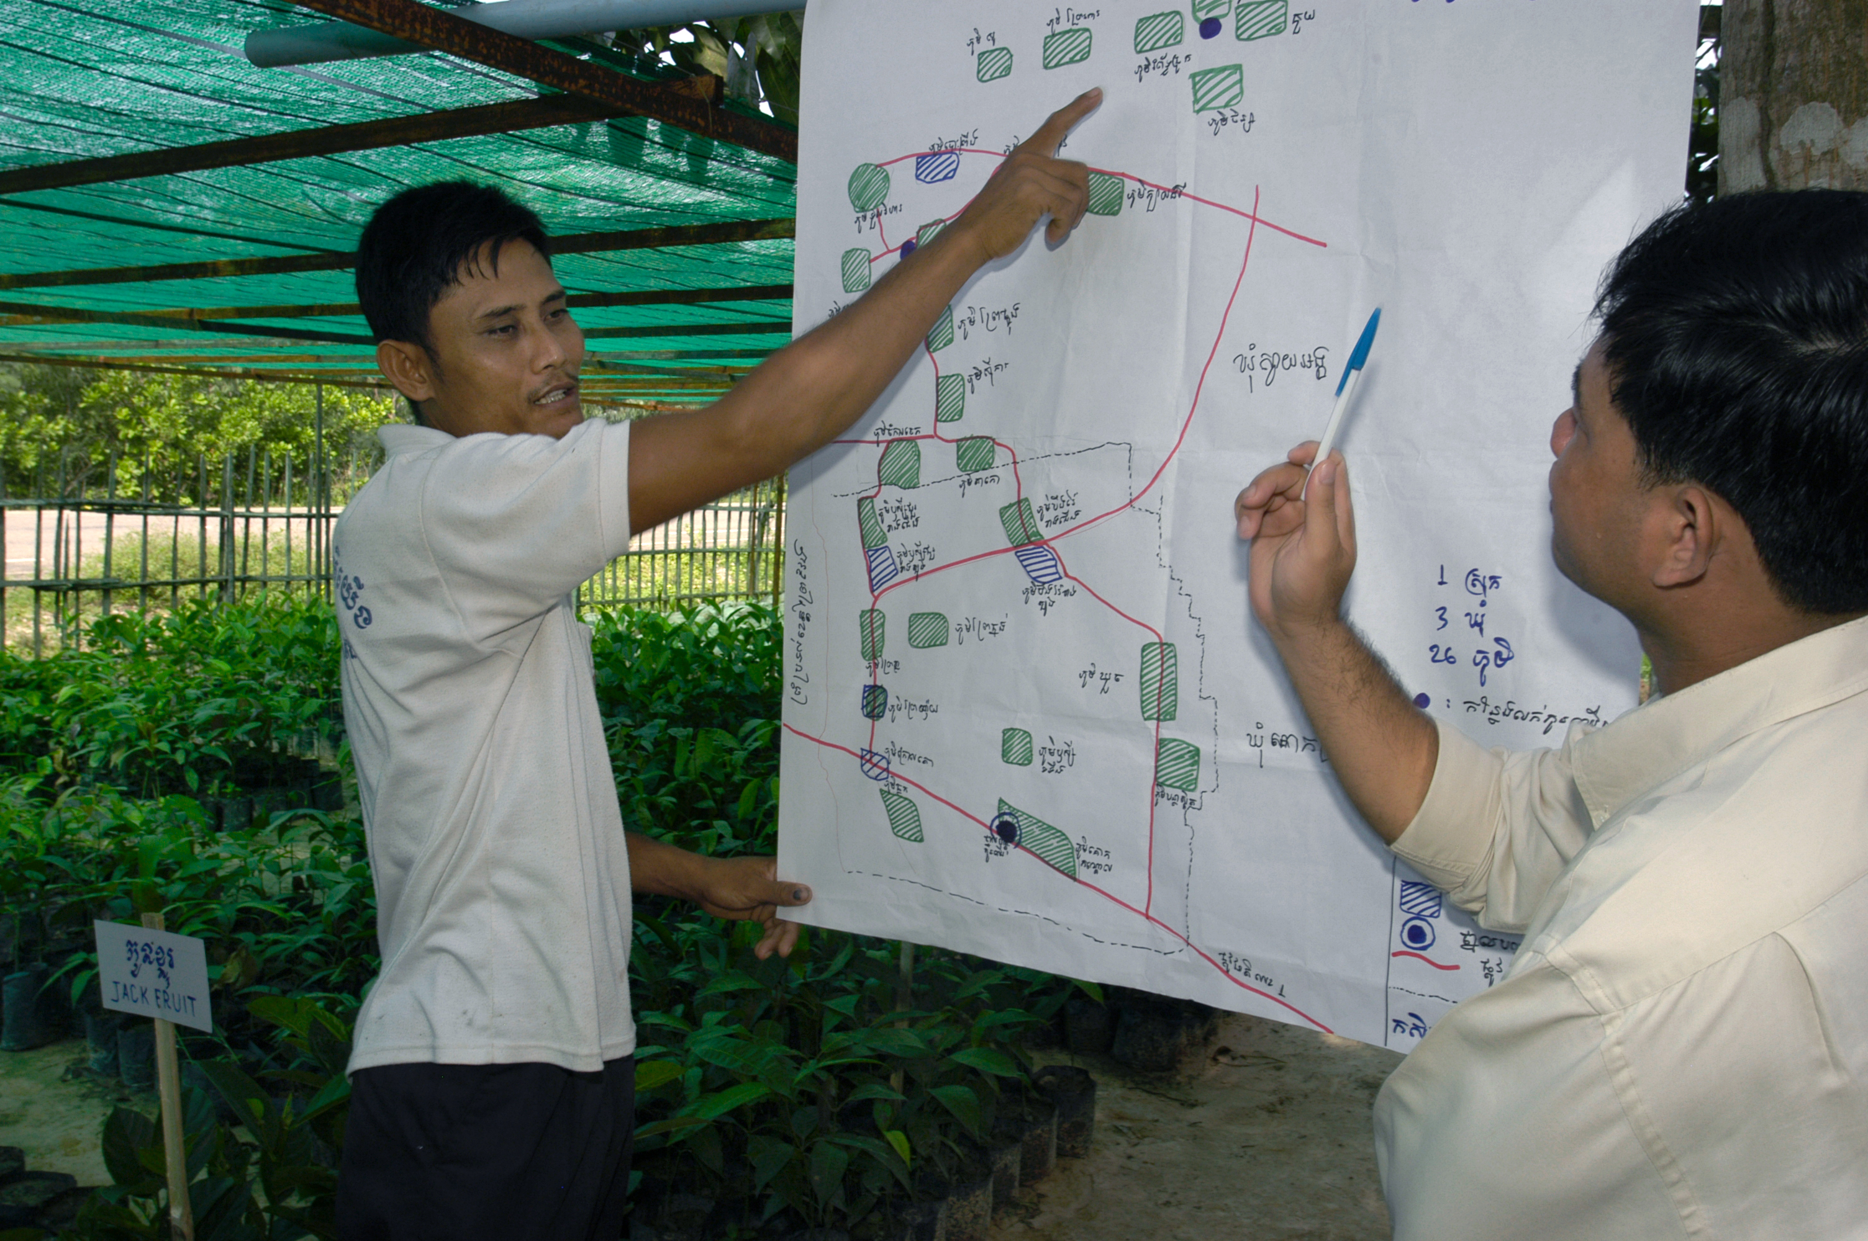
Mapping resources: Scope of the map: Example

Slide 81
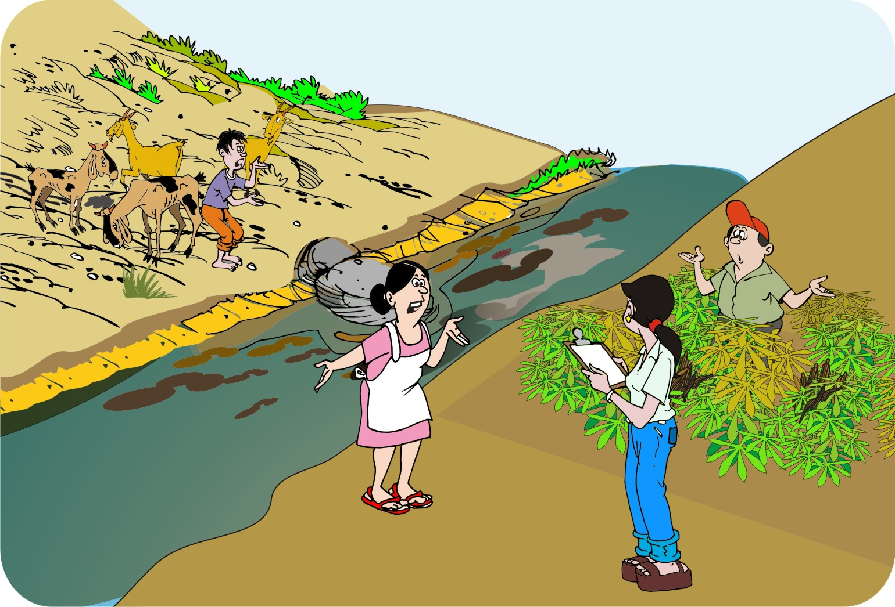
Mapping social data
In addition to the biophysical characteristics of an area, you also need to understand how people use the resources.
You can find out:
What resources people value
How they interact with these resources
What policies guide them
Who has influence over them

Slide 82
Steps in drawing a social resource map
Determine the limits and boundaries of the mapping area—i.e. the area that the map should cover.
Choose a starting point, e.g. a river for a watershed or sub-watershed area.
Ask the participants to mark other important resources on the map: villages, settlements, landscapes and soils, water resources, problem areas, etc.
Ask the participants a series of questions on the way in which they interact with their resources.
Ask the participants to discuss and describe what the map shows.

Slide 83
Drawing a social resource map
When drawing a social resource map may, ask questions on:
Demographics and vulnerability: How many families live in the area, etc.
Important resources: How many people use the resources? Which are the hotspots?
Areas of under-utilized potential: Which areas have the most potential?
Areas of social concern or potential conflict: Which areas are the riskiest?
Leadership: Who has access or control over the resources?

Slide 84
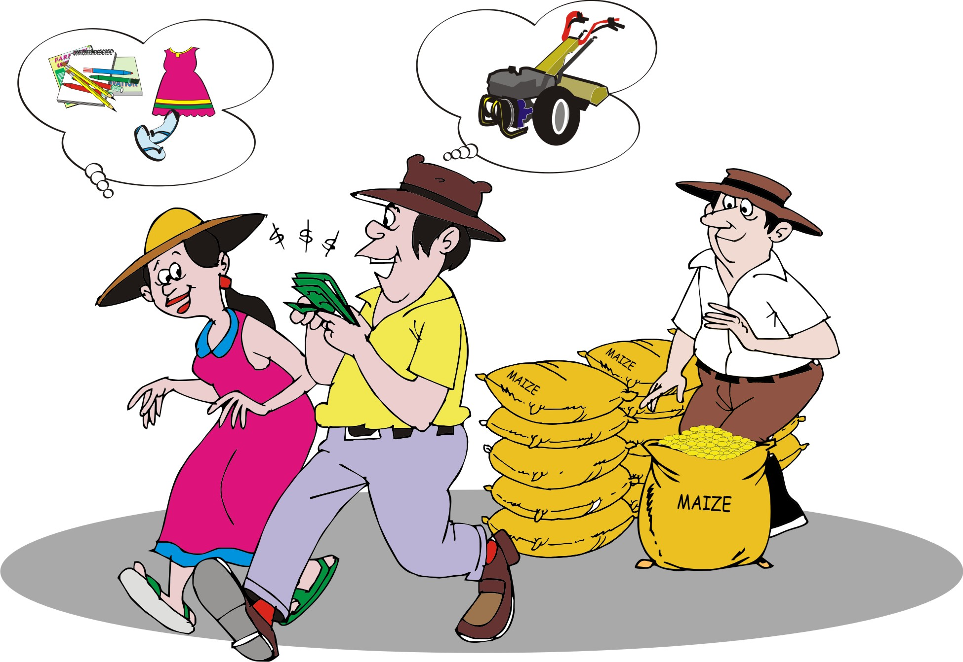
Gendered resource mapping
It is important to consider the different roles and responsibilities of men and women on the farm and in the community and in managing natural resources.
Men and women have different skills and opinions as to what is important and they have different roles in decision-making.

Slide 85
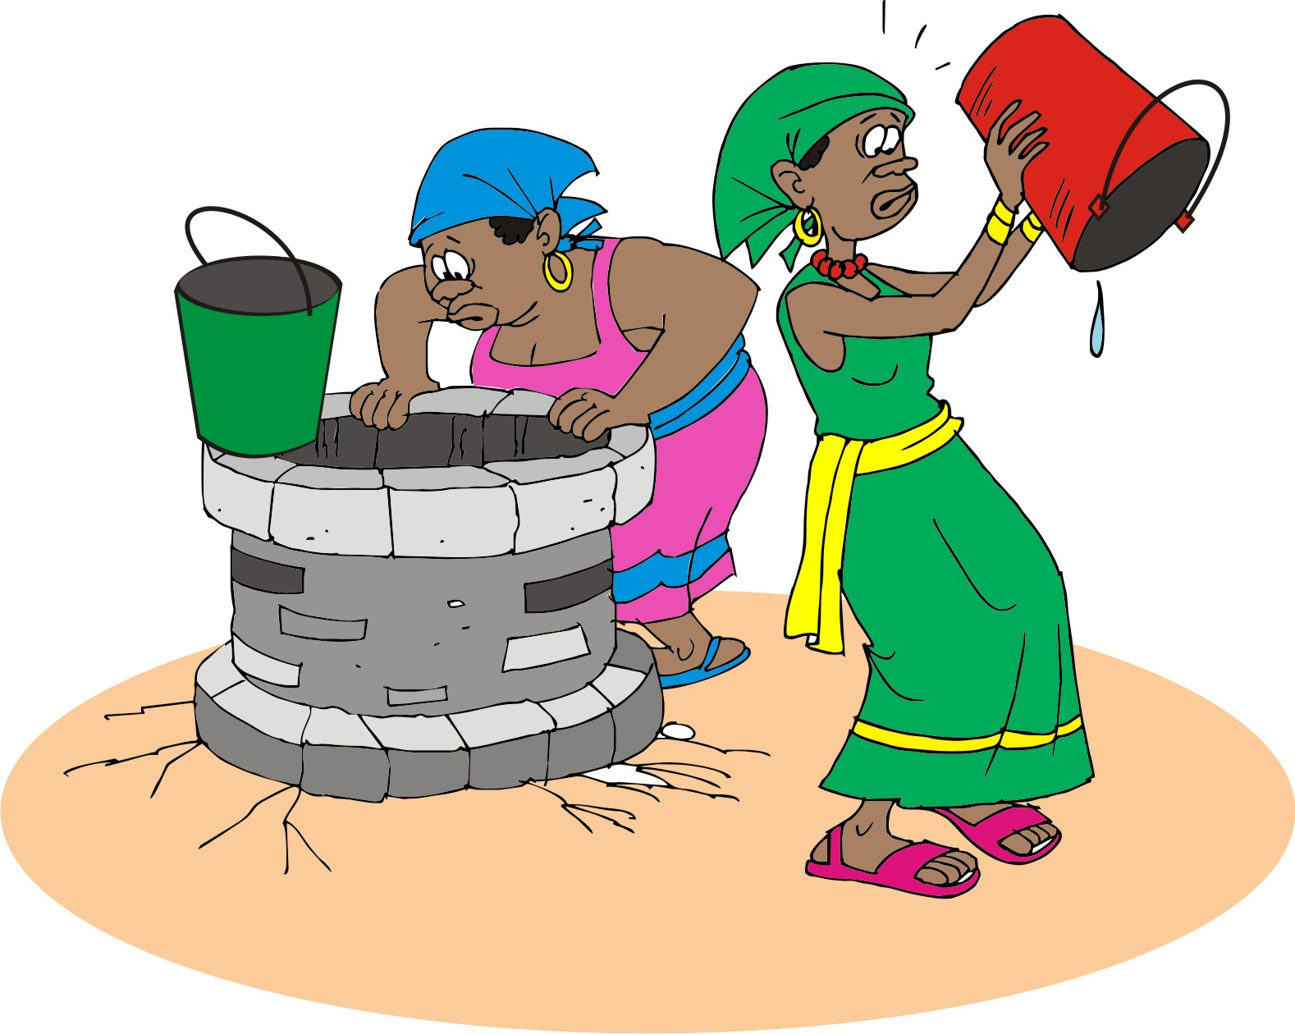
Identifying and prioritizing problems and opportunities
It is you job to help local people:
Recognize their natural resource problems
Understand the cause of the problems
Realize that they can solve the problems
Identify possible solutions
Get organized to put the identified solutions into effect

Slide 86
Watershed level: Hotspots to identify
Biodiversity hotspot is an area with many different species of endangered plants, animals, or insects.
An agro-environmental hotspot is an area where human agricultural activities have a detrimental impact on the environment and, thereby, reducing agricultural productivity.
An environmental hotspot is an area where any natural resource is at risk, e.g. areas at risk of disasters due to floods, landslides, droughts, or other natural hazards.

Slide 87
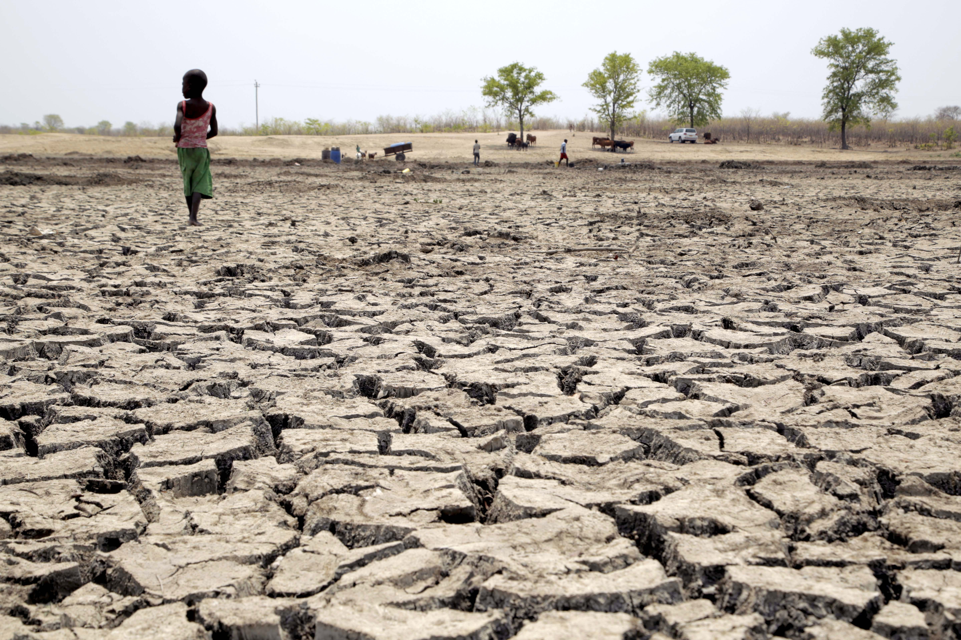
Common signs of hotspots: Erosion
Rills or gullies
Patches of bare, stony soil where the topsoil has been removed
Exposed tree roots
Muddy water in streams
Accumulations of silt in flat areas

Slide 88

Common signs of hotspots: Other water problems
Signs of other water problems:
Yellow or stunted crops
Damaged canals and bunds
Dry wells and springs
Areas at risk of landslides

Slide 89

Common signs of hotspots: Soil fertility problems
Signs of soil fertility problems:
Bare, stony soil
Poor crop growth
Abandoned fields
Certain types of weeds
Evidence of burning fields to clear brush

Slide 90
Common signs of hotspots: Deforestation
Signs of deforestation:
Tree stumps and trees with branches hacked off
Land covered with bushes or coarse grasses that cannot be used for grazing
Hills with trees only in small areas
Evidence of charcoal making

Slide 91

Common signs of hotspots: Loss of native habitat and declining biodiversity
Signs of loss of native habitat and declining biodiversity:
Trends in land cover of native habitats
Changes in the number of different plant or animal species
Loss of forests or bush, replaced by houses or fields

Slide 92
Farm level: Identifying natural resource problems
If you are working on farm level—rather than income watershed level—you will look more closely at some natural resource problems, in order to help the farmers/farmer groups to:
Identify and address natural resource problems
Increase production
Increase organic matter production

Slide 93

Causes of low crop productivity: Insufficient water
Signs of insufficient water:
Wilting plants
Soil is not moist below the surface
Presence of certain pests such as spider mites that feed on
drought-stressed plants
Plants may die, starting from the tops of the plants, or the outsides

Slide 94

Causes of low crop productivity: Soil fertility problems
Signs of soil fertility problems:
Bare, stony soil
Thin topsoil and/or few soil animals in topsoil
On slopes, a higher level of soil on one side of tree trunks or fence posts than the downslope side, which may indicate loss of topsoil

Slide 95
Causes of low crop productivity: Soil fertility problems (Continued)
Signs of soil fertility problems:
Discolored leaves that show nutrient deficiencies, such as not having enough nitrogen, phosphorous or potassium
Dried or burned leaves, which may indicate improper fertilizer application

Slide 96

Causes of low crop productivity: Signs of soil fertility problems
 | Healthy leaf
 | Nitrogen deficiency
 | Phosphorous deficiency
 | Potassium deficiency

Slide 97

Causes of low crop productivity: Plant pests and diseases
Signs of plant pests and diseases:
Low yields
Discolored or shrivelled leaves or roots
Visible pests s of plant pests and diseases
You may need to consult a local agronomist help you identify and identify these issues.

Slide 98

Identifying causes of hotspots and problems
During your first meetings, you identify:
The natural resource management goals of the farmer groups
The potential of these resources
Causes and contributing factors that hinder productivity

Slide 99
Identifying causes of hotspots and problems: The problem tree analysis
The next step is to determine the cause of the problems resulting from poor natural resource management, for which the problem tree analysis is an excellent tool.
Problem trees are diagrams that show:
The anatomy of a particular issue, e.g. river pollution
A distinction between the causes and effects of the problem or issue
Such a diagram helps you to identify the key areas on which to devote time and resources.

Slide 100

Example of a problem tree

Slide 101
A cause or a contributing factors?
The cause of a resource problem is the immediate underlying factor creating the problem.
However, it is important to look at and address the contributing factors adding to the source of the problem—before addressing the problem itself.
The actions adding to the problem may hide the driver—i.e. the underlying need of the community driving this harmful behavior.

Slide 102
Areas of high potential
Questions to assess natural resource potential:
What natural resources seem to be in abundance (e.g. clean rivers, fertile soils, ample forest cover)?
Are these resources being used currently and, if so, by whom and how intensively?
Are they reaching their potential?
If they are not reaching their potential, what are the existing livelihood practices that could benefit from better use of this resource?
What new activities can harness the potential of this resource?

Slide 103
Lesson 5:
Making a natural resources management plan

Slide 104
Outcomes
After this lesson, you will be able to:
Use collected information to help farmer groups to decide what goals they want to achieve and what techniques and technologies are most appropriate in achieving those objectives.
Help farmer groups to make a natural resource plan that includes timing, people responsible and estimated costs of activities.

Slide 105
Overview
Lesson 5 covers the following content:
Selecting the right techniques
Finding and choosing solutions
Types of solutions
Building on local knowledge
Choosing solutions that you can support
Issues that farmer groups cannot address on their own
The stakeholder check
Making an action plan
Budgeting for activities

Slide 106
Selecting the right techniques
Techniques to manage natural resources are location-specific, which means that you have to work with farmers to adapt them to their needs.
The package of technologies you choose with the farmer groups must directly address the causes of the problem, as well as any contributing factors that may exacerbate or sustain the problem.
Alternatively, instead of responding to a problem by developing new interventions, you could scale up existing practices that work well.

Slide 107

Finding and choosing solutions
A problem may have several possible solutions that will vary in their effectiveness, costs and adaptability to local circumstances.
Look around for existing solutions (e.g. traditional practices) that work.
Encourage farmers to be creative in thinking about solutions.
Bear in mind that the solution may not be obvious.

Slide 108
Types of solutions: Vegetation or biological solutions
Biological solutions involve:
Planting live contour barriers
Ensuring yearlong ground cover
Agronomic fixes for farm-level issues such as soil fertility amendments

Slide 109
Types of solutions: Infrastructure or physical solutions
Physical solutions involve:
Moving earth or rocks
Making terraces
Creating or constructing gully plugs.
Constructing dams
Physical and infrastructure solutions require more work than vegetative solutions.

Slide 110

Types of solutions: Social solutions
A social solution is a social or legal policy or management decision that tries to change people’s behavior.
The behavior changes of social solutions can occur through:
Community-led behavior change education
Social pressure
Official legal policies

Slide 111
The solution to “Not do”
In some cases, the best solution for soil, water, or vegetation management is to not do anything. “Not do” solutions include the use of exclusion and natural succession.
It is important to note that natural succession will not restore land when:
There are no sources of seeds or native plants nearby
Rapidly spreading foreign plants take over and crowd out desirable plants
The land is so degraded or contaminated that nothing will grow

Slide 112

Building on local knowledge
Projects will be more sustainable if they build on local practices and knowledge. Farmers have an intimate knowledge of the natural resources on their farms and in their communities. Therefore, you should:
Encourage farmers to build on successful local practices
Look for and encourage promising initiatives, e.g. farms that are productive despite a drought

Slide 113
Choosing solutions that you can support
Before investing time and money on a solution, you should be confident that it will work:
Consider seeking technical advice from your colleagues or from external experts.
Try out potential solutions on a small scale before scaling them up.
Select strategies and approaches that are feasible for the group.
Consider the budget and types of support that you have available to the group, as well as the group’s capabilities and degree or organization.

Slide 114
Issues that farmer groups cannot address on their own
To address issues that involve external stakeholders, it will be necessary to find the right social channels through which to engage these stakeholders.
These could be either formal channels – such as village or community-level committees – or informal channels, such friends or relatives who live in upstream communities.

Slide 115
Watershed-level interventions
Watershed-level interventions can be complicated because there are so many stakeholders involved.
Apart from organizing meetings of relevant stakeholders in the community, you along with the community, may choose to organize a watershed steering committee to lead the decision-making about the watershed.
The committee prioritizes concerns and form a micro-watershed management plan.
If your group is interested in whole watershed planning, additional steps may be necessary.

Slide 116
Stakeholder check
Are there any priority areas selected that require participation of people outside the group in order to find and implement effective solutions?
If yes, who are the other stakeholders that need to be involved?
What are the appropriate channels through which they can be successfully engaged?
Are the proposed solutions reasonable and beneficial to all stakeholders?

Slide 117
Making a natural resources management action plan
A natural resource management action plan should include:
Goals and objectives
Problems and solutions
Activities and inputs
Location
Person’s responsible
Timing and budget
Monitoring

Slide 118
Budgeting for activities
A budget is a key component to any plan and it has to include:
A list of each activity
The number of units needed
The cost of each unit needed
The total cost for the number of units needed
The source of the funding for each activity
The duration of the planned action

Slide 119
Lesson 6:
Managing natural resources projects

Slide 120
Outcomes
After this lesson, you will be able to:
Identify the roles that you have as a field agent.
Hone some of the key skills of a good manager of natural resources.
Demonstrate an understanding of adaptive management
Modify activities by examining results.

Slide 121
Overview
Lesson 6 covers the following content:
The roles of natural resources managers, including:
  Training farmers in new technologies
  Creating demonstration plots
  Testing new ideas
The skills of natural resources managers, including:
  Keeping people enthusiastic and getting incentives right
  Maintaining work quality
  Helping people change behaviors that damage natural resources
  Adjusting your project based on results through adaptive management
Good leadership

Slide 122
Roles of natural resources managers
As a field agent, you are also the manager of the natural resources component of your project.
You may have multiple roles, including:
Training farmers in new technologies, such as using an A-frame to lay out contour trenches
Creating demonstration plots to showcase technologies and monitor progress
Testing new ideas in selected
Providing materials, including inputs, equipment, refreshments, or payment for specialist services

Slide 123
Training farmers in new technologies
If you need more information on a particular technology, you should seek advice and support, for example:
Experienced farmers in the community
Expertise in your organization
Expertise in other organizations
Active government projects
Specialized libraries
The Internet

Slide 124

Example of a new technology: Using an A-frame level
SALT: Sloping agriculture land technology

Slide 125
Creating demonstration plots: Purpose
The purpose of demonstration plots is to:
Establish demonstration parcels, where farmers can observe resource improvement first-hand
Encourage farmers to apply new technologies
Demonstrate to farmers what does not work and what needs to be changed

Slide 126

Creating demonstration plots: Approach
Field agents can take different approaches to demonstration plots.
Experiment with different extension models and determine which works best for your groups.
Example: The lead farmer approach

Slide 127
Creating demonstration plots: Monitoring
A critical component of farmer training in demonstration plots is to monitor understanding and adoption of the techniques.
This monitoring process requires you to:
Register all your farmer groups
Note the skills or techniques you are promoting
Create a monitoring plan where you visit the fields of other group members other than the lead farmer or demonstration plot

Slide 128
Testing new ideas: On-farm trials
If you and your groups have decided to test or implement some technologies for the first time, on-farm trials or pilot projects may be a good activity.
On-farm trials:
Enable farmers to identify hypotheses
Decide on possible solutions
Establish trials
Measure the impact of the technology
Ideally, you should also be monitoring farmer group adoption of these technologies through your visit log, making mid-course adjustments as you go.

Slide 129

Skills of natural resources managers
Keeping people enthusiastic and getting incentives right
Making sure people take full ownership by promoting good leadership
Maintaining work quality
Helping people change behaviors that damage natural resources
Adjusting your project based on results through adaptive management

Slide 130
Keeping people enthusiastic and getting incentives right
Ideas to increase motivation and encourage people to adopt new techniques:
Identify some “quick wins,” or activities that will show immediate or dramatic results.
Make sure all members of your farmer groups are involved in designing the project.
Take farmers to see other farmer groups that have successfully implemented the practices you are promoting.
Celebrate a finished job with a launching ceremony or give out certificates to people who are good adopters.

Slide 131
Giving away inputs
Groups should take on activities because they see the short and long-term benefits.
As a facilitator, you should be supporting the process of natural resources management – not subsidizing all activities through cash or in-kind payments.
Where interventions need to be subsidized, the benefiting communities should be required to contribute to the process, e.g. contributing materials, labor and other inputs.

Slide 132
Good leadership
A good leader is:
Enthusiastic and inspiring
Confident
Purposeful in situations of uncertainty
Calm and composed
Steadfast during emergencies

Slide 133
Good leadership (Continued)
A good leader:
Has an exemplary character
Can be trusted
Is focused and analytical
Is knowledgeable
Is committed to excellence

Slide 134

Maintaining work quality
Different people may be responsible for monitoring the technical quality of the demonstration plots.
Example: In a lead farmer approach, the farmers with advanced knowledge or agronomy ensures high technical standards, while others are responsible for monitoring quality.

Slide 135
Helping people to change behavior
Changing behaviour that damages natural resources is a long process.
Consider the following ways to promote it:
Find people who have successfully changed a behavior and ask them to share their experiences.
Create demonstration plots that highlight the behavior you want to promote and invite farmers to watch the progress.
Discuss the importance of the behavior at different forums and meetings.

Slide 136

Adaptive resource management
Because some activities may not work right the first time, you may need to adjust your strategy.
Adjusting your project based on ongoing or preliminary results is called adaptive management and it is a central part in natural resources management programs.

Slide 137
Lesson 7:
Monitoring progress

Slide 138
Outcomes
After this lesson, you will be able to:
Create a realistic monitoring plan and develop indicators with farmer groups.
Use a Google Earth maps to monitor key data over time.
Integrate a gender-responsive approach to monitoring impact.

Slide 139
Overview
Lesson 7 covers the following content:
Monitoring is a natural process
SMART indicators
Participatory monitoring and evaluation
Monitoring progress by using maps
Ensuring gender equity in your natural resource work
Measuring the value of natural resources management

Slide 140
Monitoring is a natural process
Every time a farmer checks how her crop is growing, she is monitoring it.
If she compares how it was doing for several consecutive months and then considers the reasons why she obtains the results, she is evaluating her farming.
Monitoring is an excellent tool to check up on the results of your activities and adjusting future actions.
This is an essential step after you have developed and implemented your natural resources management strategy.

Slide 141

Indicators
Monitoring the implementation of your natural resources management plan involves:
Output indicator: Has the technology been built or the practice adopted?
Impact indicator: Is there measurable improvement in natural resources management towards meeting the group’s objectives and goals?

Slide 142
Output and impact indicators
The output indicator only measures if some activity has been done – not the impact of the activity.
  Example: The number of farmers trained in building rock barriers
The impact indicator measures the result of the activity or the change that is occurring – whether positive or negative.
  Example: The percentage change in erosion rate thanks to the rock barriers

Slide 143
Quantitative indicators
A quantitative indicator measures change, based on percentages or absolute numbers.
Quantitative indicators are often based on statistical surveys.
Quantitative data is often collected through:
Measurement (directly measuring and calculating crop yield, level of soil moisture, rainfall)
Written questions in questionnaires or tests

Slide 144
Qualitative indictors
A qualitative indicator focuses on socio-economic and political factors.
Qualitative data can be collected through:
Oral questions (interviews or group discussions)
Pictures (photographs and drawings)
Observations
The data collection you choose will depend on:
The type of data required
The time available
Skills of the staff
Funds available for data collection

Slide 145

SMART Indicators
Specific
Measurable
Achievable
Relevant
Time-bound

Slide 146

SMART indicators: Specific
Indicators should be clear and specific in what they are measuring.
If you want to promote a specific technique, state it clearly, e.g. the number of women farmers practicing water harvesting.

Slide 147
SMART indicators: Measurable
You should be able to measure or count data and it should not be difficult to collect, for example: Do not ask people to count the number of earthworms per hectare. Try instead to count the number in a small, easily measurable area of 1 meter by 1 meter.
Information should not be sensitive or confidential, such as money or number of cattle.

Slide 148

SMART indicators: Achievable
The groups need to be able to reach the targets set.
Therefore, the indicators need to be realistic, based on the time and resources available for the project.
Choose goals together with the groups to make sure that they indicators are achievable.

Slide 149

SMART indicators: Relevant
Indicators should be linked to:
Farmer groups’ goals and objectives
Expected results
Activities
Example: You do not need to measure water supply for a project if the groups have not identified water as a problem they are addressing.

Slide 150

SMART indicators: Time-bound
Indicators should relate to the correct period.
Choose a period and measure data during that period only.
Example: Changes in yield from July to October

Slide 151
Participatory monitoring and evaluation
Farmer groups should be involved in decisions about:
Indicators that will be used for each intervention
How each of intervention will be measured
Farmers should also help to:
Collect and record this information
Analyze the results
Such a participatory approach:
Helps reduce your workload
Gives more project ownership to the farmers
Allows group to continue with the monitoring even after the project has closed

Slide 152
Monitoring progress using maps
Maps are very helpful for tracking your progress as well as for advocacy. For example, you can map the areas where you are doing community-based soil and water conservation work, or the particular locations where you have established demonstration plots.
There are various computer based tools – like Google Earth – that you can use to monitor the progress of your natural resources management project(s).

Slide 153

Monitoring progress using maps: Google Earth
Google Earth image showing control and treatment of watersheds

Slide 154
Ensuring gender equity in natural resources work
You can use the following output and impact indictors help you track the benefits of your resources management project to both men and women.
Output indicators: Measure participation in or contribution to a certain activity, such as the number of men or women who are trained in a specific technique.
Impact indicators: Measure some change related to the roles of men and women, or the relations between them.

Slide 155

Ensuring gender equity in natural resources work: Quantitative indicators
Quantitative indicators
Amount of time women and men take daily to implement natural resources activities
Number of women and men using a specific improved technique or a new crop
Amount of land accessed by or owned by women and men.

Slide 156

Ensuring gender equity in natural resources work: Qualitative indicators
Qualitative indicators
Benefits women and men derived from their participation in a natural resources project, e.g. prestige, respect, time off, acquired knowledge, etc.
Characteristics that women and men prefer in tree or crop varieties.

Slide 157

Measuring the value of natural resources management: Profitability analysis
A basic profitability analysis is one way of recording and demonstrating the economic value of natural resources activities.
Bear in mind that benefits and costs are not only about profit. They can be cultural, social or political as well.

Slide 158

Measuring the value of natural resources management: Cost-benefits analysis
Another way to measure the value of natural resources management is through a simple cost-benefit analysis of impacts.
If people understand the quantified costs and benefits from their actions, they can be motivated more easily to continue natural resources work on their own.

Slide 159
Module summary
In this module, you have learned:
The community context and how to engage a local community
Identifying and engaging stakeholders
Mapping problems and opportunities
Make a natural resources management plan
Managing human resources projects
Monitoring the progress of human resources projects

