Slide 1
Conflict Sensitivity in Emergency Programming
ONE-DAY WORKSHOP FOR PRACTITIONERS
© 2017 Catholic Relief Services. All rights reserved.
Any “fair use” under US copyright law should contain appropriate citation and attribution to Catholic Relief Services.

Slide 2
Welcome and Overview
Session One:

Slide 3
Workshop Objectives
Participants understand the ways in which humanitarian programming interacts with conflict dynamics.
Participants recognize the importance of conflict sensitivity in humanitarian programming.
Participants become familiar with key analysis tools and planning considerations to integrate conflict sensitivity into programming.

Slide 4
Role Play
Session Two:

Slide 5
Shorkha & Lamdang
Shorkha District | Lamdang District
Most people live in remote rural villages | Most people live in remote rural villages
Larger population | Smaller population
Capital is Shorkha City | Capital is Lamdang Town
Located on a river; connected national industry and commerce | High agricultural productivity; hub of regional commerce, but poor transportation system
Has a university | No university; students go to Shorkha
Residents are considered better-educated, have better job prospects | Residents are considered less educated and less sophisticated
Shorkha City is under government control | Lamdang Town under government control; rural areas have Maoist rebel presence
Notes:
Shorkha and Lamdang are neighboring districts. They are very similar in size and geography, with most of the population living in rural villages, most of which are only accessed via very rugged unpaved roads; however, Shorkha has a larger population due to the city at its center (Shorkha City), while the district capitol of Lamdang is simply a large town (Lamdang Town).
Shorkha City is on a river that connects it to industrial and commercial hubs in the country. It also holds a university that attracts students from both Shorkha and Lamdang districts. Because of this, Shorkha residents are considered to be better educated and have better job prospects than Lamdang residents. Lamdang has more productive agricultural fields than Shorkha District, making Lamdang Town a hub of regional commerce, but it lacks good transportation systems. Lamdang residents are considered to be less educated and more backwards.
Both districts have experienced intense fighting over the past two decades in the ongoing conflict between rebels and the central government. Both Shorkha City and Lamdang Town are under government control, although there has been a very strong rebel presence in rural areas of Lamdang. The rebels are Maoist in their philosophy, and are actively opposed to institutions they consider elitist, such as religious organizations, universities, and so forth.

Slide 6
Overview of Conflict Sensitivity
Session Three:

Slide 7
Conflict, Peace, Violence
CONFLICT:
“Any situation in which two or more individuals or groups perceive their interests as mutually incompatible, and act on the basis of this perception.”
—Matt Levinger, Conflict Analysis (USIP 2013)

Slide 8
Conflict, Peace, Violence (cont.)
VIOLENCE:
Direct violence: The use or threat of physical force or verbal attacks by a perpetrator that can be clearly identified.
Structural violence: How certain groups are discriminated against through social, political, and economic systems.
Cultural violence: Deeply ingrained attitudes and beliefs that justify the necessity of violence.
PEACE:
Negative peace: The absence of the direct violence only.
Positive peace: The absence of direct and structural violence with mechanisms to promote inclusive social and structural relationships.
—Concept by J. Galtung

Slide 9
Humanitarian Principles and Conflict Sensitivity
Humanity
Impartiality
Independence
Neutrality
Notes:
Any project set in a conflict-prone region will inevitably have an impact on the peace and conflict environment—positive or negative, direct or indirect, intentional or unintentional. (Bush, K. 1998)

Slide 10
Conflict Sensitivity
The ability of an organization to:
1. Understand the context it operates in.
2. Understand the interaction between its intervention and that context.
3. Act upon this understanding in order to minimize negative impacts and maximize positive impacts on conflict.
—Definition from the Conflict Sensitivity Consortium

Slide 11
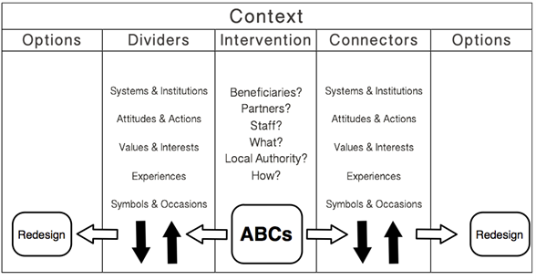
Do No Harm and the Relationship Framework
Source: CDA

Slide 12
Conflict Analysis Tools
Session Four:

Slide 13
Conflict Analysis
Why?
What?
When?
Who?
How?
Where?

Slide 14
3 Ps: Problem, People, Process
PROFILE
From Peacebuilding: A Caritas Training Manual (2002)

Slide 15
Problem Tool: Conflict Tree
EFFECTS
CONFLICT TRIGGERS
CONFLICT DRIVERS
ROOT CAUSES

Slide 16
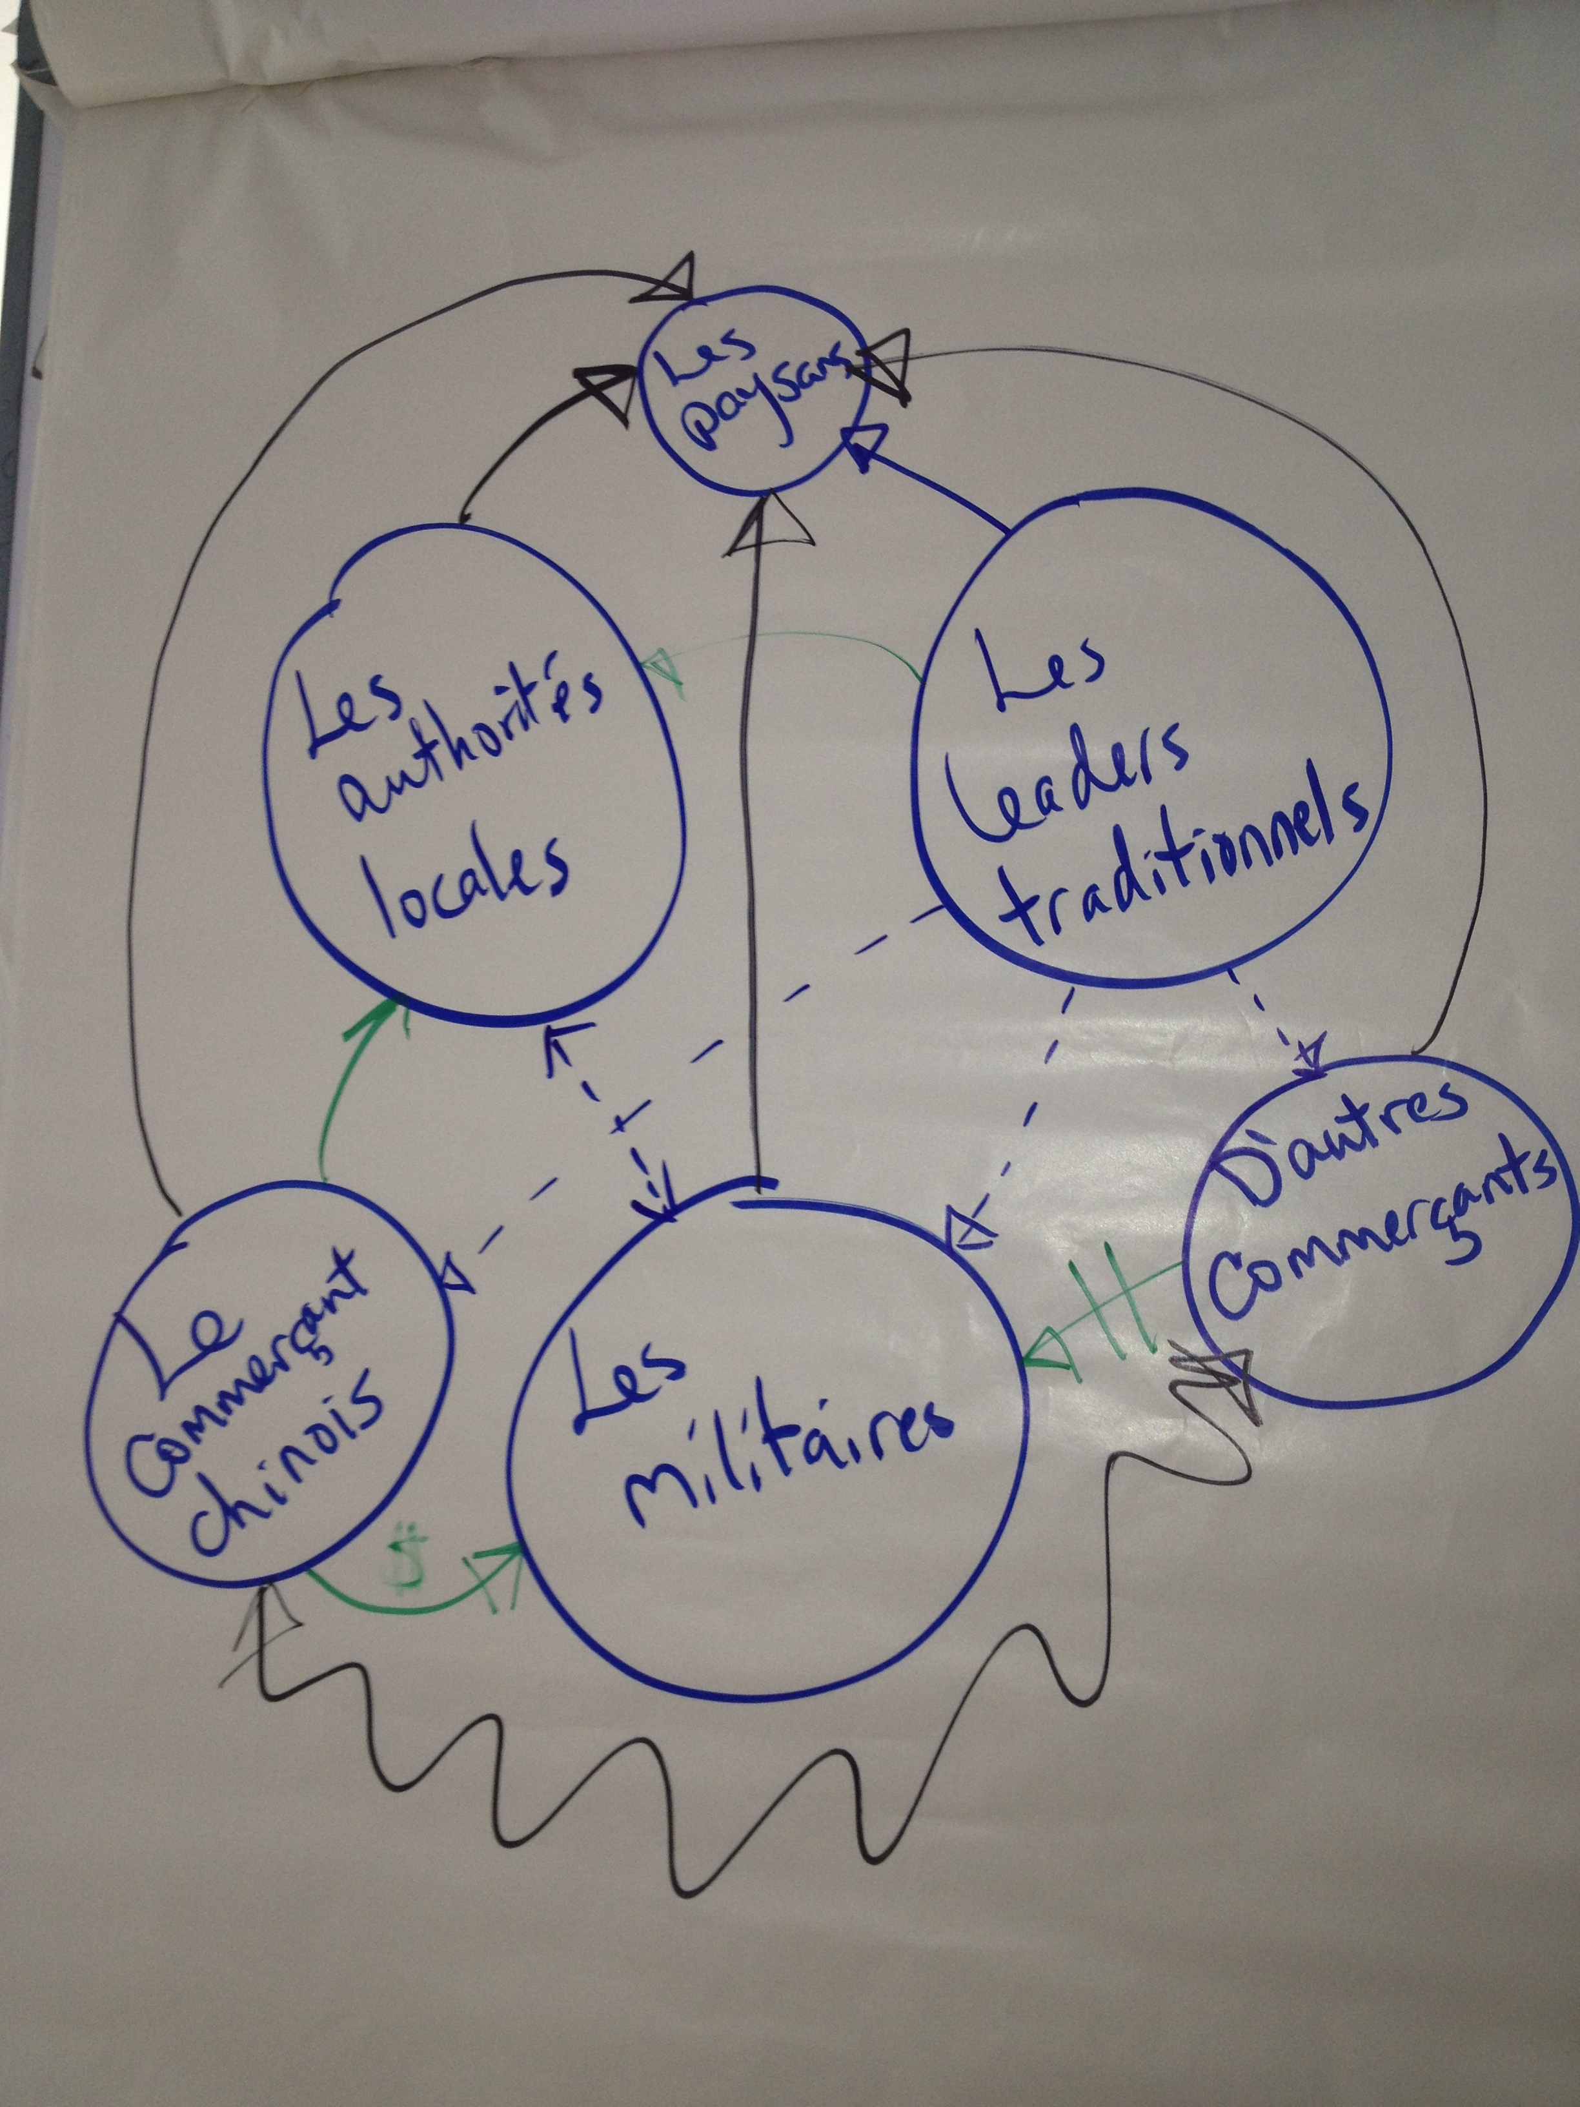
People Tool: Bubble Diagram
Notes:
Brainstorm list of relevant stakeholders
Rank them by level of influence
Draw circles on the map: bigger circle = more influence
Discuss relationships among stakeholders: Who influences whom? How? Who is in conflict with whom? Who is in alliance with whom?
Draw lines & arrows representing these relationships.
Or, to keep things simple, draw a Venn diagram, with collaborative relationships shown by overlapping circles

Slide 17
Process Tool: Dividers & Connectors
Category | Dividers | Connectors
Systems & Institutions
Attitudes & Actions
Values & Interests
Experiences
Symbols & Occasions
Adapted from CDA’s Do No Harm materials
Notes:
*Connector: A potential source of cohesion within or between groups. When leaders mobilize their constituents around a given connector, it may be transformed into a driver of peace.
*Divider: A potential source of polarization within or between groups. When leaders mobilize their constituents around a given divider, it may be transformed into a driver of conflict.

Slide 18
Applying Conflict Sensitivity
Session Five:

Slide 19
Conflict Sensitivity in Our Work
Planning & Design
Assessments
Startup & Implementation
Staffing/Hiring
Stakeholder Relationships
MEAL & Exit
Monitoring
Targeting
Design
Partnership
Implementation Modalities
Accountability
Evaluation & Learning
Exit Strategy

