Slide 1
FEED THE FUTURE
S34D & NML WEBINAR

Slide 2
FEED THE FUTURE GLOBAL SUPPORTING SEED SYSTEMS FOR DEVELOPMENT – S34D

Slide 3
S34D Consortium Partners

Slide 4
Implementing partners of this study

Slide 5
Acknowledgement
The authors wish to thank Amy Azania, Ian Barker, Colin Christensen, Bram de Jonge, Bert Visser, Geoffrey Otim, Dieudonne Baributsa, Duncan Onduru, Melinda Smale, Neils Louwaars, Shawn McGuire, and Robert Tripp for their insights and contributions provided in the development of this study. Expert comments provided in the development of this study are not attributed, unless approved and noted. The authors also wish to thank Folashade Oladipo, who was a Legal Fellow with the New Markets Lab, for her research support.

Slide 6
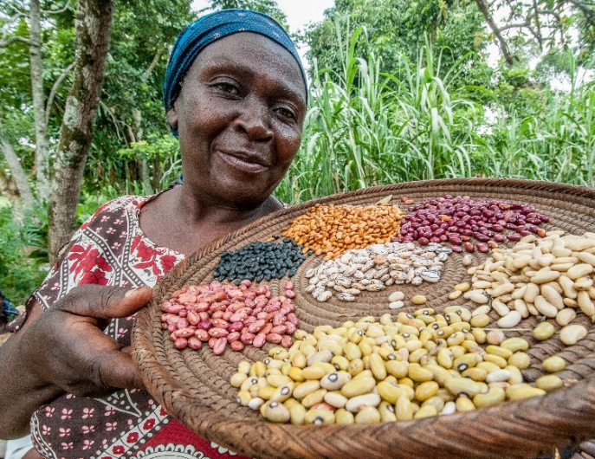
S34D Quick Facts
Life of Activity: 2018 – 2023
Sponsors: Feed the Future through RFS / USAID through OFDA
Consortium: Catholic Relief Services, CIAT/PABRA, IFDC, Opportunity International, Purdue University, Agri-Experience
Key Partners: PIATA; AVISA; ISSD Africa; TASAI; Seeds2B, IITA
Service Providers: Kuza, New Markets Lab
Geography: Global—responding to any USAID Mission’s request

Slide 7
Activity Goal & Vision
S34D’s global experts in formal and informal seed systems, and humanitarian and emergency aid programming provide technical assistance that complement ongoing host government and USAID investments.
S34D is unique in that we operate on the interface between the different systems.
The Technical Assistance will address identified needs and gaps in the seed system and will strengthen the seed system to meet the agriculture-led inclusive economic growth objectives from the host government and USAID.
S34D’s vision is improved choices for farmers to access quality seeds for resilient livelihoods.
S34D’s goal is to improve the functioning of seed system through customized services to upgrade seed systems.

Slide 8
Objective of the present study
Seed laws and regulations define the institutional framework of seed sector and enforcement of the rules – thus impacting who produces, markets, and sells seeds, of what varieties, and under what conditions.
Using expert consultations and desk review, we have tried to learn from examples of case studies where, within existing legal and regulatory frameworks, national governments and partners have been able to navigate practical space for both formal and informal seed systems.
The result is expanded choice of crops and varieties for smallholder farmers in last-mile markets.

Slide 9
what are our goals for this webinar?
Generate discussions on creating space for increasing choices for farmers.
Identify gaps in literature and case studies, particularly with respect to implementation and impact.
Learn about ongoing projects that could contribute to or benefit from this approach.
Create (or strengthen existing) platform/community of practice to foster south-to-south learning.

Slide 10
Study areas
Study Area #1: Extending Market Frontiers
Directly impacts whether farmers can access seed of the right quality and variety at the right price in order to increase on-farm productivity
Flexible approaches can connect the informal seed sector with broader seed system
Study Area #2: Liberalizing Seed Quality Control Mechanisms
Focuses on assuring the quality of seeds in the market
Flexible approaches can guarantee quality of seed in the market while encouraging market entry for high quality traditional varieties
Study Area #3: Improving Seed Counterfeiting Approaches
Focuses on preventing counterfeit seeds in the market
Good regulatory practices, use of technology, and consumer protection can increase the effectiveness of these measures

Slide 11
Study design methodology
Evaluated study areas based on (1) literature and legal review of relevant elements of the legal and regulatory framework in key countries; (2) evaluation of how these elements correspond to farmers’ abilities and needs (Visser, 2016); and (3) qualitative assessment of regulatory design and implementation (NML, 2019).
Validated approach to study areas and findings through semi-structured interviews with key industry experts (Amy Azania, Ian Barker, Colin Christensen, Bram de Jonge, Bert Visser, Geoffrey Otim, Dieudonne Baributsa, Duncan Onduru, Melinda Smale, Neils Louwaars, Shawn McGuire, Robert Tripp)
Country examples and case studies chosen based on flexibility in regulatory systems corresponding to farmers’ needs and unique regulatory design elements.

Slide 12
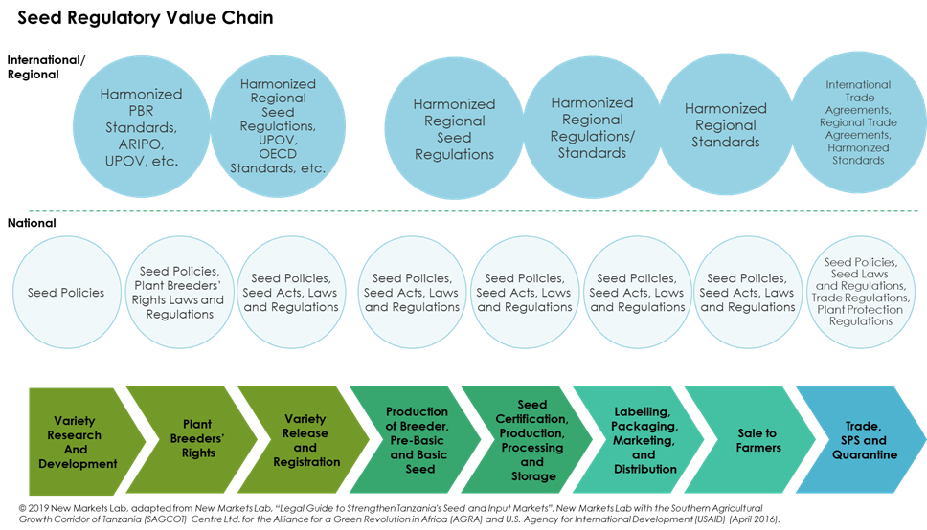
Seed Regulatory Value Chain

Slide 13
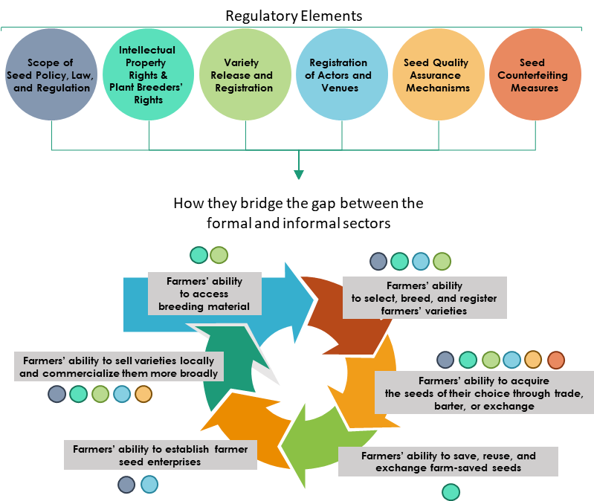
Relationship Between Regulatory Elements & seed systems
Source: © 2020 Kuhlmann, Dey, Garces Escobar, and Abregu, “regulatory elements”
Adapted from New Markets Lab, “Legal Guide to Strengthen Tanzania's Seed and Input Markets” (April 2016); and “Farmers’ Abilities” adapted from Visser, Bert, A Summary of the Impact of National Seed Legislation on the Functioning of Small-Scale Farmers’ Seed Systems in Peru, Vietnam and Zimbabwe, December 2015 and A Study Into Seeds Laws in Selected Developing Countries, Oxfam, March 16, 2016.

Slide 14
Methodology for Assessing Legal and Regulatory Design
Regulatory Design Dimensions
System Design (Comprehensive, Differentiated, or Market-Led)
Regulatory Philosophy (Ex Ante or Ex Post)
Degree of Regulatory Flexibility (adaptability to diverse stakeholders and needs in the market)
Regulatory Implementation Dimensions
Efficiency (time, cost, and number of steps)
Regulatory Preconditions (”gateways” to move from one regulatory process to another; common in ex ante systems)
Engagement of private sector and civil society
Effectiveness (alignment with policy goals)
Source: New Markets Lab, Approach to Legal and Regulatory Reform, 2019, available at https://www.newmarketslab.org/about

Slide 15
Study area #1: Extending Market Frontiers

Slide 16
Study area # 1: Extending Market Frontiers
Regulatory Elements
Scope of
Seed Policy, Law,
and Regulation
Intellectual
Property
Rights &
Plant Breeders’
Rights
Variety
Release and
Registration
Registration
of Actors and
Venues
Seed Quality
Assurance
Mechanisms
Seed
Counterfeiting
Measures
How they bridge the gap between the formal and informal sectors
Source: © 2020 Kuhlmann, Dey, Garces Escobar, and Abregu, “regulatory elements”
Adapted from New Markets Lab, “Legal Guide to Strengthen Tanzania's Seed and Input Markets” (April 2016); and “Farmers’ Abilities” adapted from Visser, Bert, A Summary of the Impact of National Seed Legislation on the Functioning of Small-Scale Farmers’ Seed Systems in Peru, Vietnam and Zimbabwe, December 2015 and A Study Into Seeds Laws in Selected Developing Countries, Oxfam, March 16, 2016.
Farmers’ ability
to access
breeding material
Farmers’ ability
to select, breed, and register
farmers’ varieties
Farmers’ ability to sell varieties locally and commercialize them more broadly
Farmers’ ability to acquire
the seeds of their choice through trade, barter, or exchange
Farmers’ ability to establish farmer seed enterprises
Farmers’ ability to save, reuse, and exchange farm-saved seeds

Slide 17
Study area #1: Extending Market Frontiers
1.1 Registration of Seed Actors and Venues (impacts farmers’ ability to select, acquire, and sell seeds of their choice and ability to establish farmers’ enterprises)
1.1.1 Comprehensive Registration
1.1.2 Differentiated Registration
1.1.3 Flexible Registration with Exemptions
1.2 Flexible Approaches to Seed Variety Registration (impacts farmers’ ability to select, acquire, and sell seeds of their choice)
1.3 Flexible Approaches to Plant Variety Protection (impacts farmers’ ability to select, acquire, sell, and save seeds, as well as ability to access breeding material)

Slide 18
1.1 Registration of Seed Actors & Venues
1.1.1 Comprehensive Registration
Strict regulatory approaches that require registration of all actors; small-scale farmers cannot store, share, or commercialize other farmers’ seeds if not registered
Colombia: Registration required for all actors in the seed system
1.1.2 Differentiated Registration
Differentiated regulatory approaches, which establish different requirements for formal and informal actors, can result in extended access to seed systems, while maintaining quality standards and registration
Still may impose restrictions on registration of actors, which may include limitations on venues or crop varieties that can be traded by informal actors
India: Case Study
1.1.3 Flexible Registration
Registration required for all stakeholders, but exemptions exist
Peru: Exception from registration for actors involved in the production, exchange, and storage of traditional varieties
Tanzania: Farmers selling QDS seed exempted

Slide 19
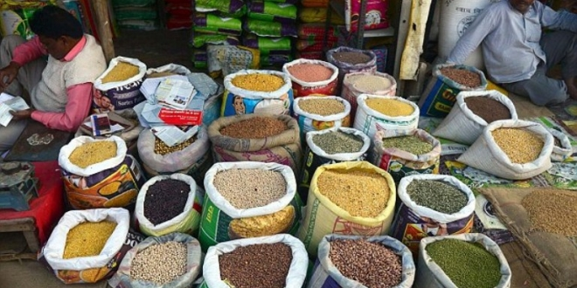
Case Study: India’s Differentiated Approach
India has adopted a regulatory approach for registration of actors that differentiates between formal and informal actors. The Indian Ministry of Agriculture and Farmers' Welfare regulates the production, distribution, and sale of varieties in the formal seed sector, while the informal sector is regulated under the National Seeds Policy, 2002.
Seed dealers (sellers, importers, exporters) are required to register under the Seeds Control Order (1983) and are also required to comply with the Seeds Act (1966), and the New Policy on Seeds Development (1988).
India’s National Seed Policy exempts farmers from compulsory registration and allows them to produce and sell seed varieties freely, with the limitation that they cannot sell any seed under a brand name.
New Seeds Bill (not yet enacted) includes provisions allowing farmers to sell their seed on their own premises or in the local market, provided that the seed is not branded
This regulatory framework adapts to the reality of actors in the seed system
India – Farmers selling their varieties in the market
Source: https://www.ippmedia.com/en/business/local-pigeon-pea-pulses-farmers-secure-market-indian-b2b-road

Slide 20
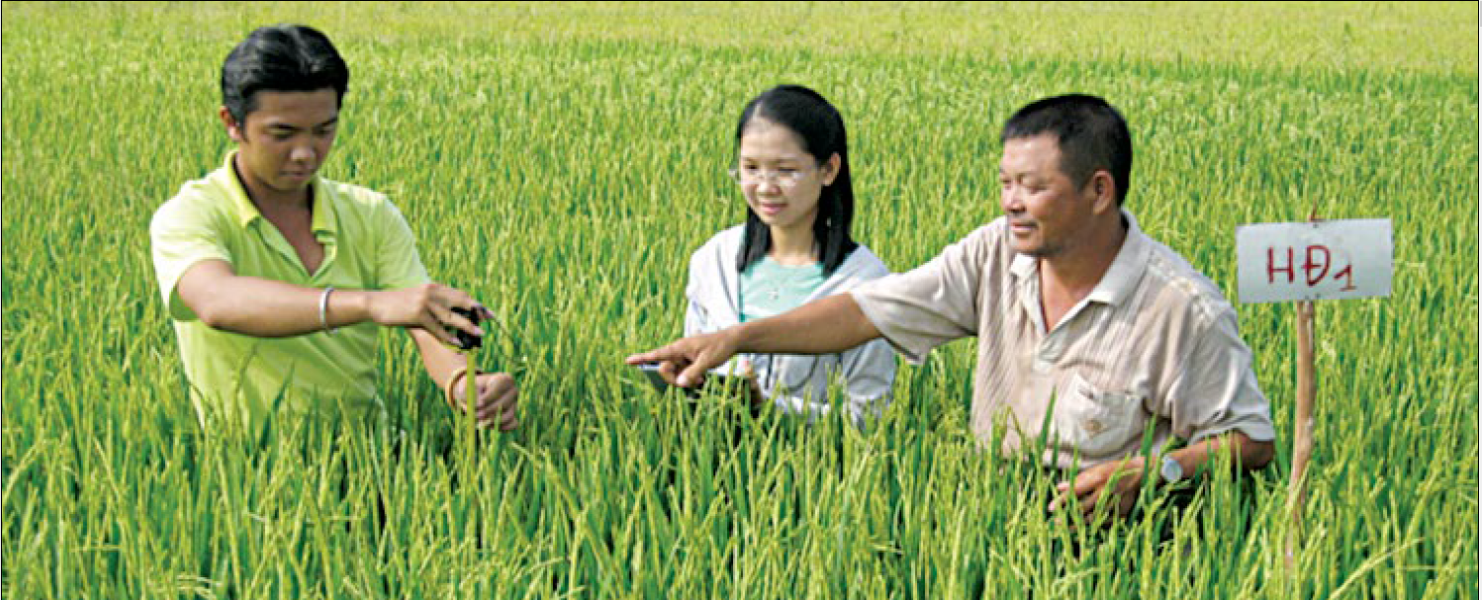
Case Study: organized seed groups
Organized seed groups can be one way to offset the costs of individual dealer registration and build trust surrounding seed sales in rural areas. These may include seed villages, seed clubs, or production centers that are trusted sellers of quality seed.
Vietnam’s Seed Club in the Mekong Delta: Seed clubs are common in Vietnam and have helped smaller farmers secure market presence. Vietnam’s seed clubs are typically supported by local government agriculture extension officers, seed centers, and research institutes.
Myanmar’s Seed Village Scheme (Myanmar National Seeds Policy, 2016) is another example of the role that organized seed groups can play in a formally regulated system.
Source: SEARICE. 2019. Securing the Local Seed Systems: The Journey of Farmers’ Seed Clubs in Vietnam. Southeast Asia Regional Initiatives for Community Empowerment.

Slide 21
1.2 Flexible Approaches to Seed Variety Registration
Flexibility exists for registering farmers’ and landrace varieties (Laos, Nepal, Peru, Malaysia, and India)(See Recha et al., 2018; Visser, 2015; FAO, 2018; NML and SFSA, 2018)
Differentiated seed registries (Peru, Brazil, Benin, France, Italy), with different testing requirements (NML and SFSA, 2018); in Benin, landraces are only subject to VCU testing (de Jonge et al., 2019).
Variety registration and release can be formally regulated at the national level, but more flexible approaches may be applicable at the subnational level (Laos’ national regulations are rigorous for the release of new varieties, excluding traditional crops, but procedures at the provincial level are more flexible and allow for the provincial release of traditional varieties and their commercialization in provinces.)
Regional Harmonization and recognition of informal seed systems. (e.g. SADC provides for registration of landraces)

Slide 22
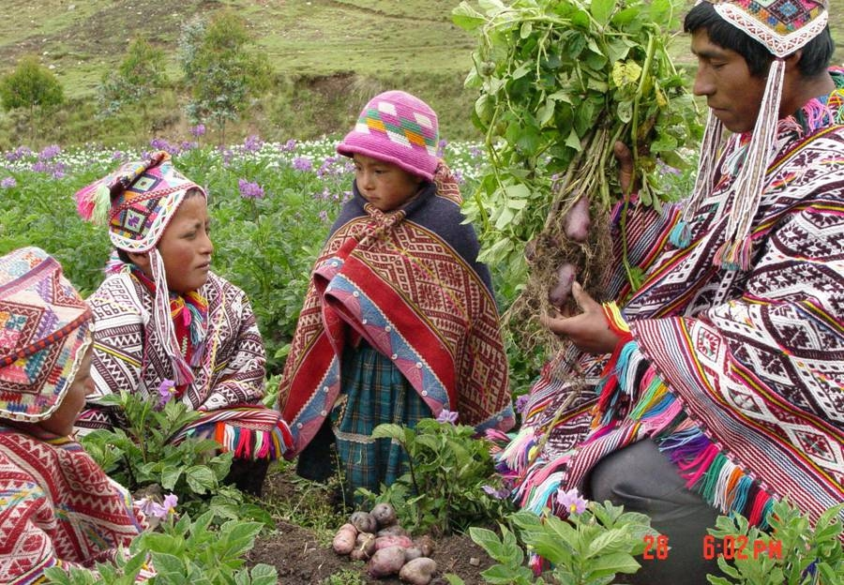
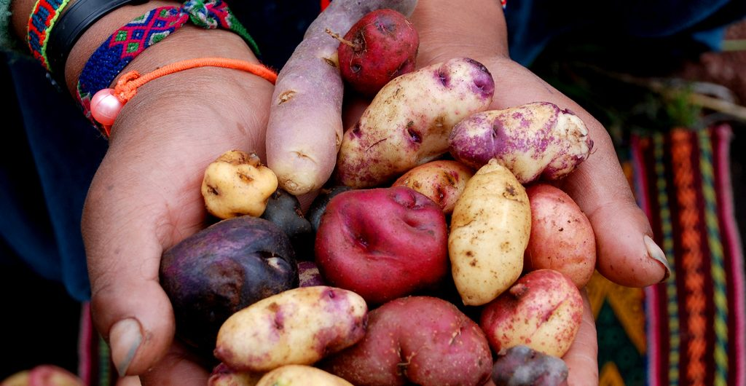
1.3 Flexible Approaches to plant variety protection
Protection and recognition of existing varieties, farmers’ communities' varieties, landraces, local varieties, and traditional varieties (e.g. India, Peru, Thailand, Ethiopia, and Vietnam) (See Oxfam, 2018; NML and SFSA, 2019; Visser et al., 2019).
Case Study: Peru’s Protection of Traditional Knowledge
Protection for traditional knowledge is incorporated into Peru’s IP system and Peru’s anticorruption system
Farmers’ organizations can apply for PVP, but varieties must still meet the novelty and DUS requirements
Farmers collecting traditional crops in Peru
Source: https://www.panoramas.pitt.edu/health-and-society/meet-%E2%80%98potato-guardians%E2%80%99-working-peru%E2%80%99s-highlands-promote-crop-diversity-face; https://www.aracari.com/blog/stories/a-guide-to-peruvian-potatoes/.

Slide 23
Study Area #1: Extending Market Frontiers
Lessons Learned
Examples illustrate that flexibility can be built into a legal and regulatory system to expand crop and variety choices and opportunities for farmers
These exist to varying degrees across registration of actors (India, Peru, Kenya), registration of varieties (Laos, Brazil, Benin), and plant variety protection (India, Peru)
Legal recognition of community and farmers’ associations can integrate informal actors into the system
More flexible regulatory approaches can be adopted at the sub-national level, particularly when there is some autonomy from the national government
Good evidence exists on flexible design approaches, but little exists with respect to implementation

Slide 24
Study Area # 2: Liberalizing Seed Quality Control Mechanisms

Slide 25
Study Area #2: Liberalizing Seed Quality Control Mechanisms
Regulatory Elements
Scope of
Seed Policy, Law,
and Regulation
Intellectual
Property
Rights &
Plant Breeders’
Rights
Variety
Release and
Registration
Registration
of Actors and
Venues
Seed Quality
Assurance
Mechanisms
Seed
Counterfeiting
Measures
How they bridge the gap between the formal and informal sectors
Farmers’ ability
to access
breeding material
Farmers’ ability
to select, breed, and register
farmers’ varieties
Source: © 2020 Kuhlmann, Dey, Garces Escobar, and Abregu, “regulatory elements”
Adapted from New Markets Lab, “Legal Guide to Strengthen Tanzania's Seed and Input Markets” (April 2016); and “Farmers’ Abilities” adapted from Visser, Bert, A Summary of the Impact of National Seed Legislation on the Functioning of Small-Scale Farmers’ Seed Systems in Peru, Vietnam and Zimbabwe, December 2015 and A Study Into Seeds Laws in Selected Developing Countries, Oxfam, March 16, 2016.
Farmers’ ability to sell varieties locally and commercialize them more broadly
Farmers’ ability to acquire
the seeds of their choice through trade, barter, or exchange
Farmers’ ability to establish farmer seed enterprises
Farmers’ ability to save, reuse, and exchange farm-saved seeds

Slide 26
Regulatory Approaches to Quality Control
Impacts farmers’ ability to acquire and sell seeds of their choice
Mandatory Certification
Contingent on variety and actors’ registration (regulatory preconditions)
Relies upon advanced regulatory environment and appropriate infrastructure
Examples: Uganda, Rwanda, etc.
Mandatory Certification with Flexibility
Can include third-party seed certification (e.g., Peru); private seed inspectors and labs (e.g., Zambia, Zimbabwe, and Kenya for inspectors; Afghanistan for labs)
Seed clubs and associations have been formally recognized and can sell seeds at the local level under certain conditions (e.g. Vietnam and Zimbabwe, where Zaka Association registered as a certifying authority)

Slide 27
Regulatory Approaches to Quality Control
Quality Declared Seed (QDS)
Can be used as a more flexible alternative for quality assurance, especially for local and farmers’ varieties
Often limited to specific regions or crops
Examples: Tanzania, Uganda, Madagascar, Peru, and Guatemala (e.g. MASFRIJOL)
Truth-in-Labeling and Self-Certification
Relies on seed producer self-regulation and adherence to minimum quality standards
Examples: South Africa, India (mixed system), and Nepal (mixed system)

Slide 28
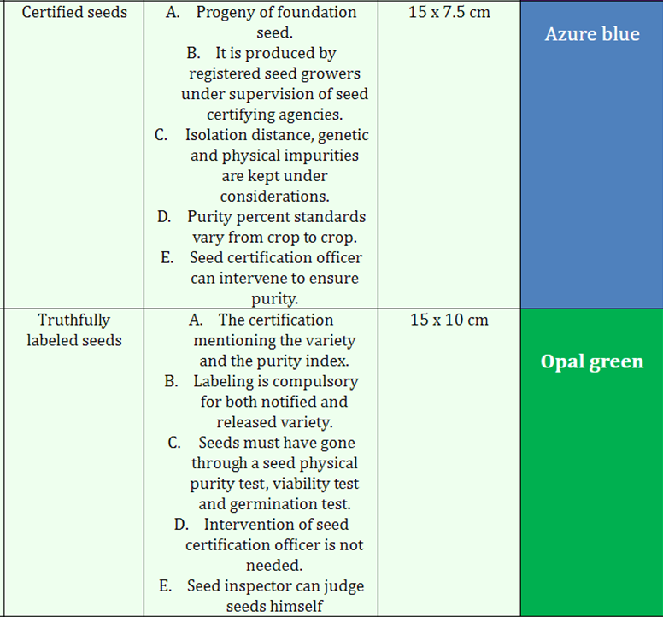
Case Study: India Mixed System
Several approaches to quality control can co-exist within a national system, as India’s system illustrates
India does maintain formal certification, and certified seeds must meet ISTA and OECD quality assurance requirements
Certified seed must be labeled, but all labeled seed need not be certified
Truthfully-labeled seed can be produced and sold within India by private entities with recognized laboratory facilities; priced lower than certified seed
Self-regulation based on minimum standards is also part of India’s system
Small producers use certification system on a voluntary basis, reducing costs related to formal seed certification
Labels in India
Source: Hortipedia India, 2018, https://www.hortipediaindia.co.in/2018/07/seed-tag-colour.html

Slide 29
Case Study: Nepal Seed Certification & Truthful Labelling
Nepal’s Seed Rules admit a blend of seed quality control mechanisms, including both seed certification and truthful labelling for all seed classes (breeder seed, foundation seed, certified seed, and improved seed)
Seed certification is voluntary and is carried out by authorized agencies
For seed that has not been certified, truthful labelling becomes a compulsory requirement and is carried out by seed producers
While quality assurance under seed certification is the responsibility of Nepal’s certification agency, for truthful labeling this responsibility lies with the producer
Element | Seed Certification | Truthful Labelling
Type of seed | Breeder seed, foundation seed, certified seed, improved seed | Breeder seed, source seed, label seed, improved seed
Mandatory | Voluntary | Compulsory if certification is not done
Who does the certification? | Authorized agencies (Seed Quality Control Centre (SQCC) and Regional Seed Testing Laboratory) | Seed producers
Procedure to follow | Procedure set through regulations; inflexible | Flexible procedure; producers can allocate available time to monitor quality
Who is responsible? | Certification agency is responsible. | Producers are responsible

Slide 30
Study Area #2: Liberalizing Seed Quality Control Mechanisms - Lessons Learned
Flexible quality assurance systems exist in some legal and regulatory systems to enable smallholders to purchase and sell farmers’, landrace, and traditional varieties, even if within a more limited market
Vietnam’s system is particularly interesting, because the seed clubs (and guarantee system by local government authorities) have enabled small farmers to sell small volumes of non-certified seed within local boundaries; some seed club varieties have also been formally certified (e.g. HD1)
Because some of these systems are still new in many cases (e.g. QDS in Tanzania and Uganda), their full impact cannot yet be assessed

Slide 31
Study Area # 3: Addressing Seed Counterfeiting

Slide 32
Study Area #3: Addressing Seed Counterfeiting
Regulatory Elements
Scope of
Seed Policy, Law,
and Regulation
Intellectual
Property
Rights &
Plant Breeders’
Rights
Variety
Release and
Registration
Registration
of Actors and
Venues
Seed Quality
Assurance
Mechanisms
Seed
Counterfeiting
Measures
How they bridge the gap between the formal and informal sectors
Farmers’ ability
to access
breeding material
Farmers’ ability
to select, breed, and register
farmers’ varieties
Source: © 2020 Kuhlmann, Dey, Garces Escobar, and Abregu, “regulatory elements”
Adapted from New Markets Lab, “Legal Guide to Strengthen Tanzania's Seed and Input Markets” (April 2016); and “Farmers’ Abilities” adapted from Visser, Bert, A Summary of the Impact of National Seed Legislation on the Functioning of Small-Scale Farmers’ Seed Systems in Peru, Vietnam and Zimbabwe, December 2015 and A Study Into Seeds Laws in Selected Developing Countries, Oxfam, March 16, 2016.
Farmers’ ability to sell varieties locally and commercialize them more broadly
Farmers’ ability to acquire
the seeds of their choice through trade, barter, or exchange
Farmers’ ability to establish farmer seed enterprises
Farmers’ ability to save, reuse, and exchange farm-saved seeds

Slide 33
Anti-Counterfeiting Regulatory Approaches
Impacts farmers ability to acquire seeds of their choice
Regulatory Approaches
Market based practices
End-user authentication (scratch-off label, holograms, pin codes)
E-tag system (with GPS traceability)
Companies’ practices
Building local import facilities and distribution centers to have direct access to seed marketing channels
Packaging and labeling innovation
Enforcement measures
Penalties and punitive measures
Awareness campaigns
Consumer protection rules

Slide 34
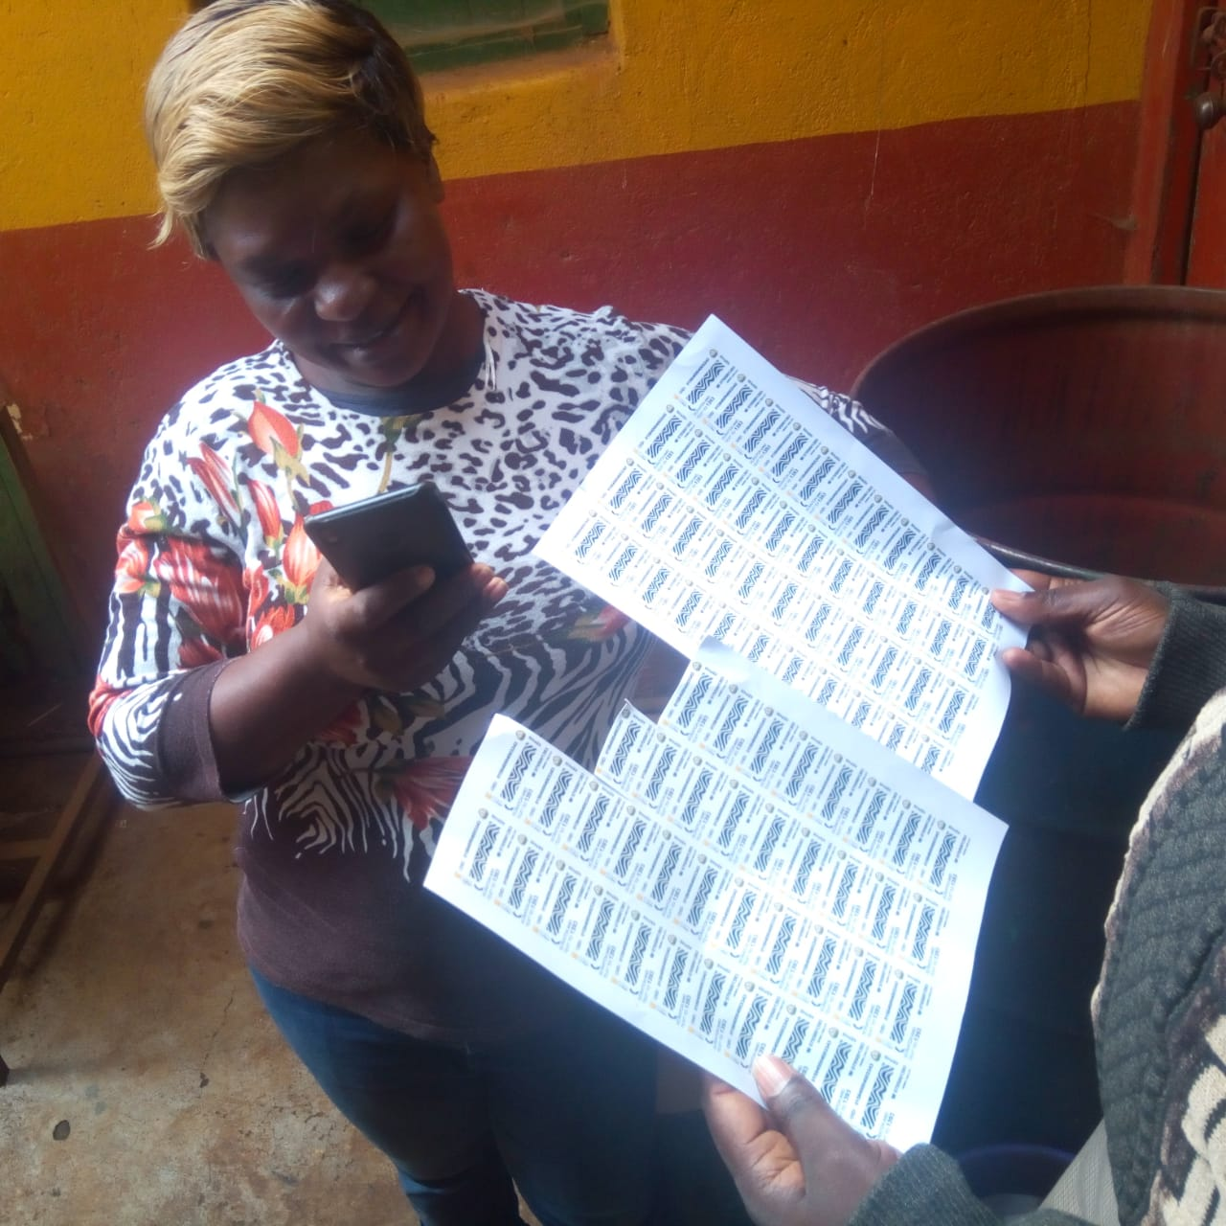
Case Study: Kenya Scratch-Off Label System
E-tag system through a scratch-off label that allows farmers to verify each batch through mobile phone
Farmers receive verification code issued by public authorities
Aspects of Kenya’s system that make possible:
Clear standards for packaging and labeling
IT infrastructure
Wide use of mobile phones
Challenges
Tailored to certain crops (e.g. maize)
Source: Pictures provided by Duncan Onduru during expert consultations

Slide 35
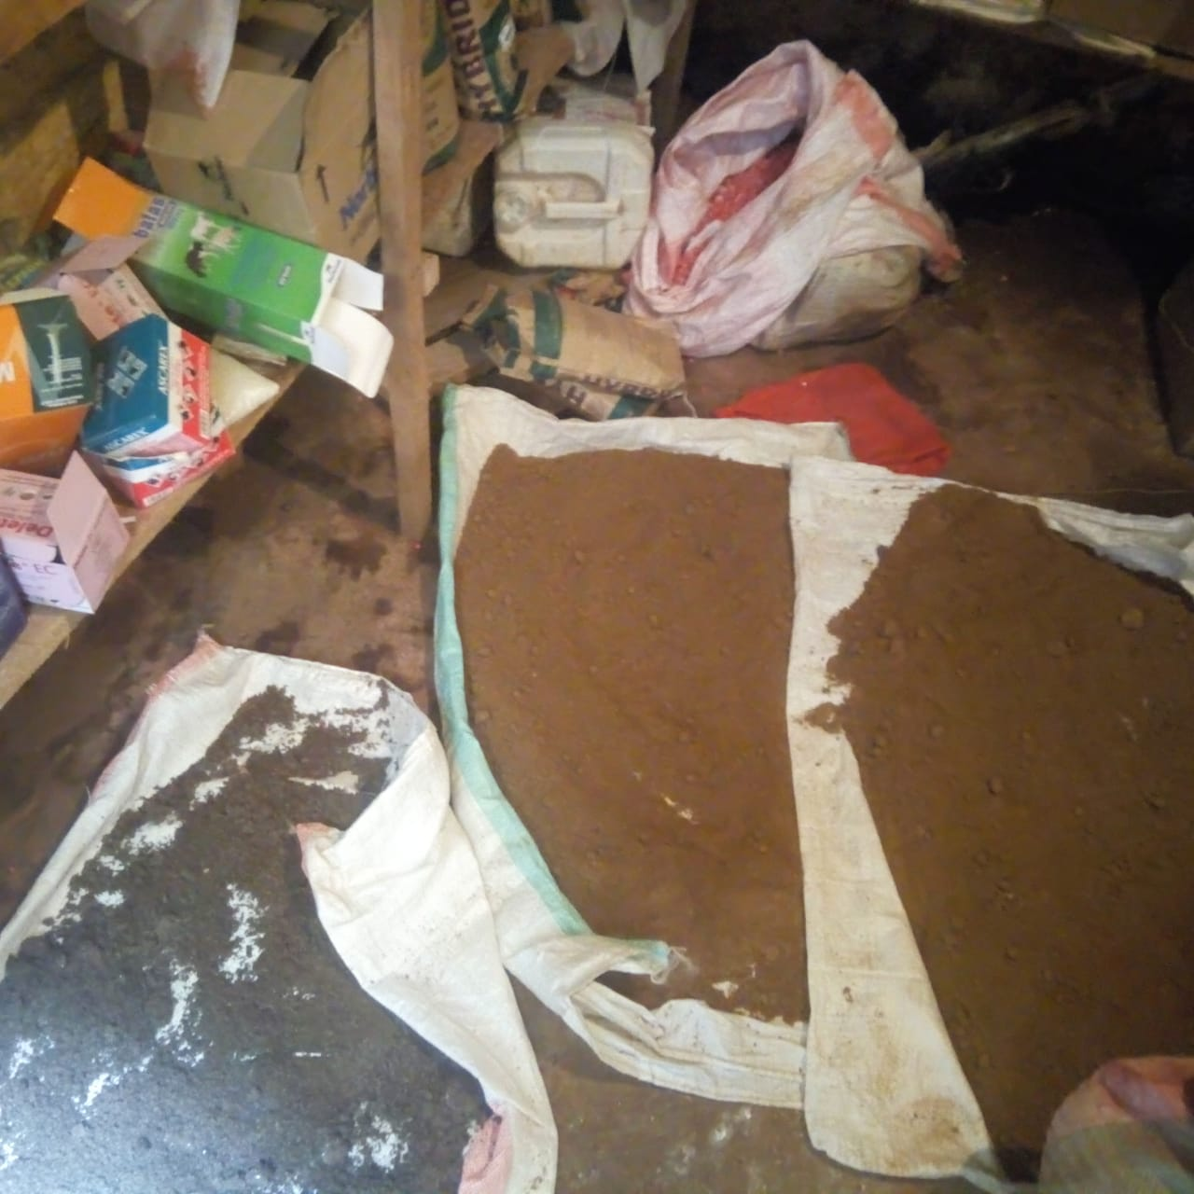
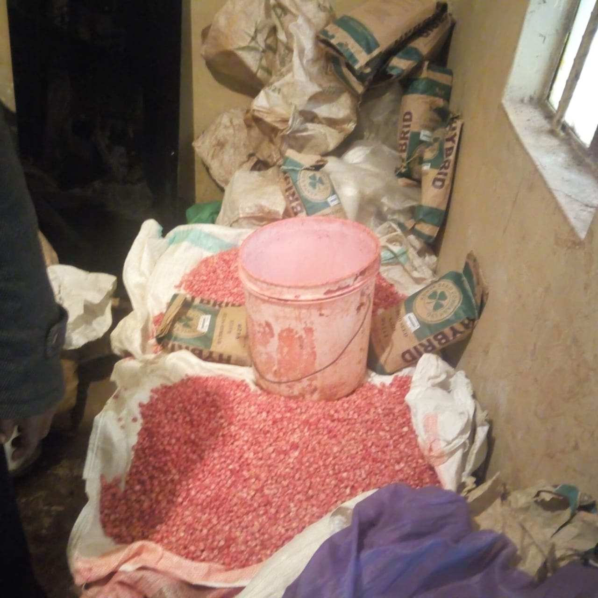
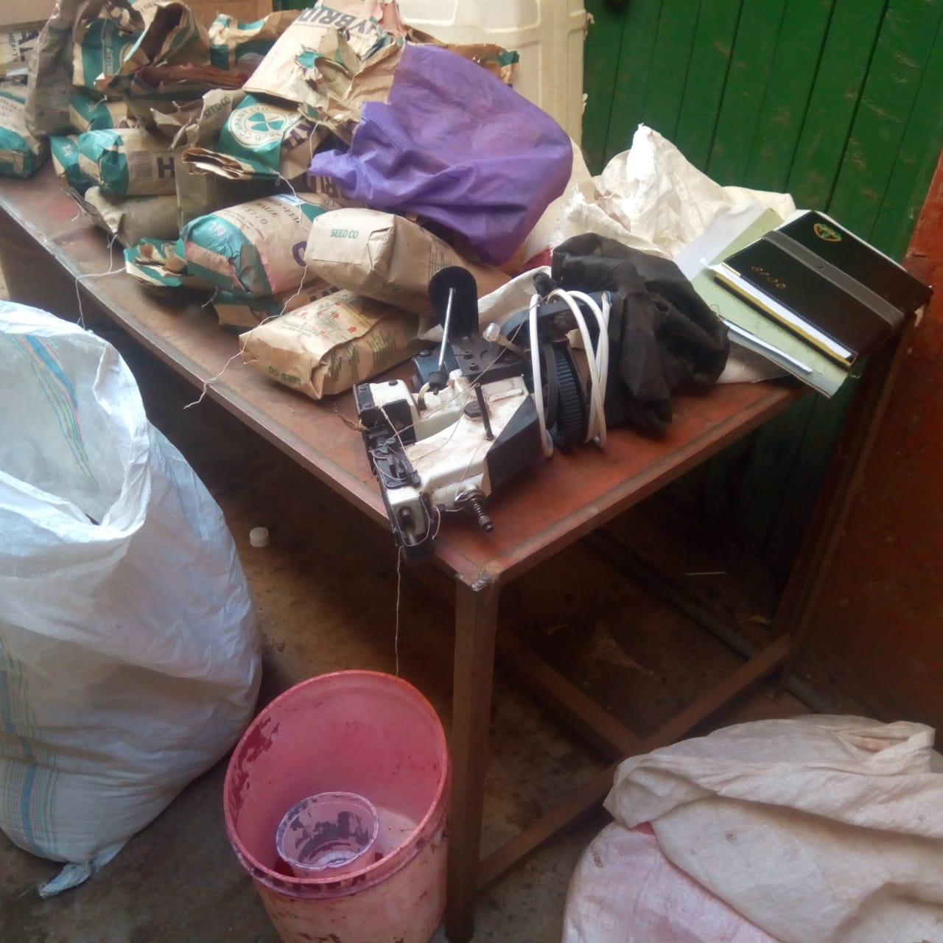
Case Study: dyed seeds
Source: Pictures provided by Duncan Onduru during expert consultations

Slide 36
Study Area # 3: Addressing Seed Counterfeiting
Lessons Learned
Innovative anti-counterfeiting measures exist and are still being rolled out
Measures that integrate multiple aspects of the supply chain seem to more effective (packaging, repackaging, storage, and labeling)
A robust consumer protection system that is accessible (realistic costs) and available, with appropriate resources and legal processes, can be an important anti-counterfeiting tool for farmers and consumers

Slide 37
guiding questions FOR OPEN DISCUSSION
As a community, how can we help shape flexible regulatory design, open up practical space within existing systems to increase farmers’ choices and preserve biodiversity?
Could separate regulatory approaches be established for registering farmers’ varieties, including separate testing, fee structures, timing?
How could quality assurance systems be brought closer to farmers?
Do you know of any examples of use of consumer protection rules to protect farmers from counterfeit seed?
How do national, sub-national, and local governments play a role?
How can more flexible approaches be best adapted to local needs?
How should we disseminate the findings from this study?
How can we create effective tools and platforms to foster south-south learning?

Slide 38
Thank you!

Slide 39
Katrin Kuhlmann is President and Founder of the New Markets Lab and a Visiting Professor at Georgetown University Law Center. Her areas of expertise include law and development, comparative economic law, agricultural regulation and trade corridors, regional trade harmonization, and international trade and development. Professor Kuhlmann is also a Senior Associate with the Global Food Security Project of the Center for Strategic and International Studies (CSIS) and a member of the Trade Advisory Committee on Africa at the Office of the U.S. Trade Representative (USTR). Previously, she was a Lecturer on Law at Harvard Law School; Senior Fellow and Director at the Aspen Institute; Director at USTR; and international lawyer in private practice. J.D. Harvard Law School; BA Creighton University; Fulbright Scholar 1992.
Dr. Bhramar Dey (Senior Technical Advisor, S34D CRS)brings a unique blend of project design, management, and analytical skills focusing on country-led interventions (often through negotiations with governments) in data, policy, monitoring and evaluation, and agricultural input systems. She has over 15 years of experience in data and regulatory reform analyses, and designing, managing large client and stakeholder-oriented projects. Prior to joining CRS, Dr. Dey worked at the Bill and Melinda Gates Foundation (BMGF) - Agriculture initiative. Passionate about turning data into information, Dr. Dey focuses on institution strengthening, and bridging gaps between evidence and impact. Bhramar holds a Ph.D. in Applied Economics from Clark University.

Slide 40
www.feedthefuture.gov

