Slide 1
General Overview of S34D
May 25, 2021

Slide 2
FEED THE FUTURE GLOBAL SUPPORTING SEED SYSTEMS FOR DEVELOPMENT – S34D

Slide 3
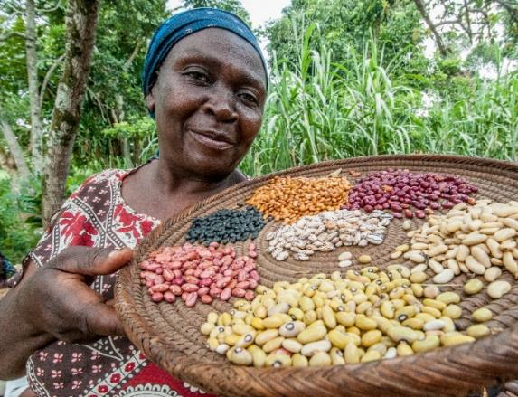
Overview S34D
Life of Activity: 2018 – 2023
Mechanism: Leader With Associate
Sponsors: Feed the Future through RFS / USAID through BHA (OFDA)
Consortium: CRS, the Alliance, PABRA, Opportunity International and Agri Experience
Service Providers: Dimagi, Kuza, New Markets Lab, WCDI-ISSD, Purdue University, IFDC
Geography: Global—responding to USAID Mission’s request

Slide 4
Seed Systems Interface, Goal and Vision
S34D operates on the interface between formal and informal seed systems, and humanitarian and emergency aid programming and provides technical assistance that complements ongoing host government and USAID investments.
S34D’s goal is to improve the functioning of seed systems to meet the agriculture-led inclusive economic growth objectives.
S34D’s vision is improving choices for farmers to access quality seeds for resilient livelihoods.

Slide 5
S34D Interventions areas
Interface of different seed systems.
Translating research onto farmers’ fields through sustainable and economically viable business models.
Extending market frontiers at the last mile segments.
Financial services.
Developing training materials that build capacity and knowledge.
Analytics that foster real-time market information; generate/scale-up feed-forward and feedback mechanisms on varietal adoption and varietal preferences.
Implementation and facilitation of seed regulations and policies.
Notes:
Forage seed in Ethiopia
Yellow Bean study incl. DNA fingerprinting in Tanzania and forage feed pellets business model in Ethiopia
Market-led approach for Seed Vouchers and Fairs, global reviews
Financial service providers seed sector financing potential in East Africa and Niger
Uganda Seed Trade Association training to seed companies and Zambia Seed Control and Certification Institute partnership on seed inspectors’ training
Point of sale in Kenya, and forage metrics dashboard and seed demand forecasting in Ethiopia
New seed classification in Kenya (Standards seed) and Stop Bad Seed campaign in Tanzania.
These are all examples of pilot, testing (with core funds), and for scaling S34D will need buyin or AA. We can implement these examples in many different countries.

Slide 6
S34D example interventions
Forage seed and feed reserves in Ethiopia
Yellow Bean study incl. DNA fingerprinting in Tanzania and forage feed pellets business model in Ethiopia
Market-led approach for Seed Vouchers and Fairs, global reviews
Financial service providers seed sector financing potential in East Africa and Niger
Uganda Seed Trade Association training to seed companies and Zambia Seed Control and Certification Institute partnership on seed inspectors’ training
Point of Sale in Kenya, and forage metrics dashboard and seed demand forecasting in Ethiopia
New seed classification in Kenya (Standards seed) and Stop Bad Seed campaign in Tanzania.
Notes:
These are all examples of pilot, testing (with core funds), and for scaling S34D will need buyin or AA. We can implement these examples in many different countries.

Slide 7
Contact Information
Activity Email: S34D@crs.org
Chief of Party: Nikaj.vanWees@crs.org

Slide 8
www.feedthefuture.gov

Slide 9
Overview S34D
Life of Activity: 2018 – 2023
Sponsors: Feed the Future through RFS / USAID through BHA (OFDA)
Consortium: CRS, ABC-PABRA, Opportunity International and Agri Experience
TA, Goal and Vision:
Service Providers: Dimagi, Kuza, New Markets Lab, WCDI-ISSD, Purdue University, IFDC
Geography: Global—responding to USAID Mission’s request
Notes:
S34D operates on the interface between formal and informal seed systems, and humanitarian and emergency aid programming and provides technical assistance that complements ongoing host government and USAID investments.
S34D’s goal is to improve the functioning of seed systems to meet the agriculture-led inclusive economic growth objectives.
S34D’s vision is improving choices for farmers to access quality seeds for resilient livelihoods.
Seed profile work was a collaboration of Agri Experience, CIAT/PABRA, CRS to collect and analyze data, draft report and present.

Slide 10
INTRODUCTION
This profile focuses on four aspects of the seed sector in Uganda and the interactions between
(i) formal seed system,
(ii) semi-formal or Quality Declared Seed system,
(iii) informal seed system, and
(iv) emergency seed provisioning.
The report examines current strategies for seed sector development and makes recommendations for ways in which a more integrated, mutually supportive seed systems can be promoted at the broad, sectoral level, to increase smallholder farmers’ access to quality seed of improved varieties.
Notes:
What quantities of seed are moving through the formal, informal and emergency seed systems?
What is the demand for maize and beans in the formal and informal systems?
Are seed strategies from government, private sector, and/or NGOs working across the different seed systems?
What are the interactions between the formal, informal and emergency seed systems, both positive and negative?

Slide 11
Areas to consider
Addressing issues of weak and missing data
Modernizing Early Generation Seed (EGS) production
Quality control and quality assurance
Market volatility in seed production
Semi-formal Quality Declared Seed (QDS) next steps
Informal seed systems and innovation to broaden access
Emergency seed procurement and distribution
Addressing counterfeit - fake – low quality seed

Slide 12
1. Challenges of weak and missing data
The lack of reliable and accessing seed data is a considerable barrier for management and investment by the private and public sector.
The Ministry would benefit from establishing a modern information and management system to restore confidence in the seed system and support a central data point with data on;
early generation seed (EGS),
formal certified,
semi-formal QDS,
innovative but informal seed systems, and
emergency and or Government subsidized interventions.
The lack of data combined with the absence of a quality seed verification system, has led to a systemic prevalence of fake seed and use of expired seed.
Notes:
At present the data is held in many different places. Would be helpful to have a centralized data point (seed coordination unit)
Add a point on why there is missing data?
Politics has not been kind to the seed systems.. Recent AGRA grant failure…
As Uganda rebuilds its seed system, the Ministry needs to establish a modern information and management system that can restore confidence in the system and verify amounts of different types of seed moving through the system, including early generation seed, (EGS), formal certified, semi-formal QDS, and seed used for emergency and or Government subsidized interventions.
The lack of data combined with the absence of a quality seed verification system has led to a systemic prevalence of fake seed and use of expired seed. These negative practices are undermining the credibility of the commercial seed sector. This issue is unlikely to be resolved without better quality assurance and information management systems that are supported by the seed systems stakeholders, including the government

Slide 13
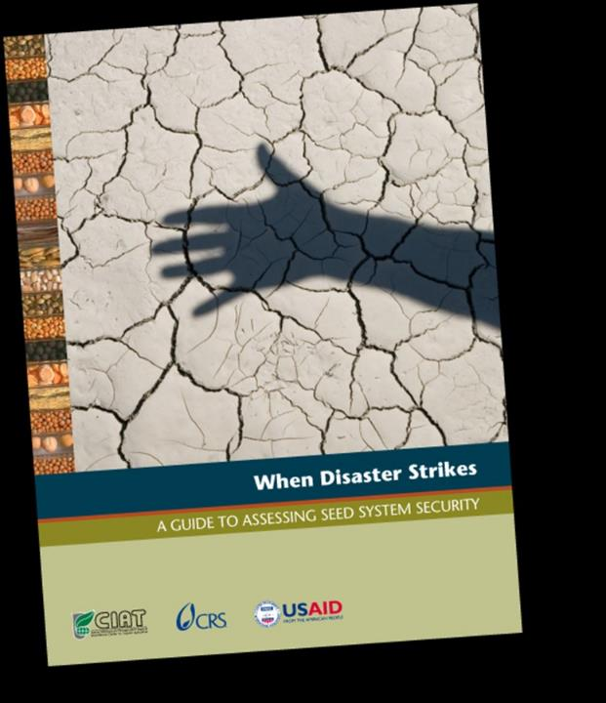
1. Recommendations to address weak and missing data
Strengthen or develop a more robust seed data and monitoring system.
Undertake assessments to identify options for better information management.
Address the Emergency agencies’ unwillingness to share data.
Notes:
Strengthen or develop a seed data and monitoring system: Uganda needs a modern seed management and monitoring system to collect and compile systematic, centralized data, including accurate records of quantities of certified seed, QDS and emergency seed.
Studies / assessments are needed to understand the seed system:
Role of QDS in project-based seed supply, volumes, costs and the sustainability of QDS with Local Seed Businesses in post-project situations,
Should emergency seed systems distribute certified seed?
Which types of emergency or free seed distribution modalities are most effective.
Given that emergency agencies were reluctant to share their data on seed distribution, how can data on the levels of emergency seed being procured and distribution be made available to Government, international agencies, non-governmental organizations and research actors.

Slide 14
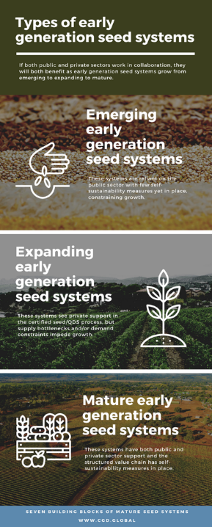
2. Modernizing EGS production
All seed sectors depend on a functional EGS system with high-quality parental lines and access to foundation seed.
EGS system lacks a centralized and commercially based process for ordering and receiving known quantities of breeder and foundation seed.
NARO has established a new enterprise unit, NARO Holdings, to formalize the EGS process and provide an auditable commercial transaction for EGS.
NARO and CGIAR should explore non-exclusive licenses to private companies – This will be help to diversify the source of Early Generation Seed and strengthen the private sector development
Notes:
The management of the EGS production and certification process should ideally consolidate seed orders across the industry, through an open, online system and this process should include both commercial and public procurement.
The system should have routine audits to test the quality and purity of parental lines used to produce early generation seed, using internationally recognized best practices.
The EGS system should be able to provide foundation seed, or parental lines, for at least two years in advance of supply, to synchronize parental lines and foundation seed with the production of certified seed by the seed companies and QDS by local seed businesses (LSBs).
There are concerns about the funding levels being invested into this service and whether they have the resources in staff, equipment and management processes to make this venture a success.
There are also questions about whether the Government should undertake both quality control (QC) of its EGS seed systems and also be the auditor providing quality assurance of the seed system (QA). Despite these questions, the increased investment in quality control is a positive endeavor to address a clear need.

Slide 15
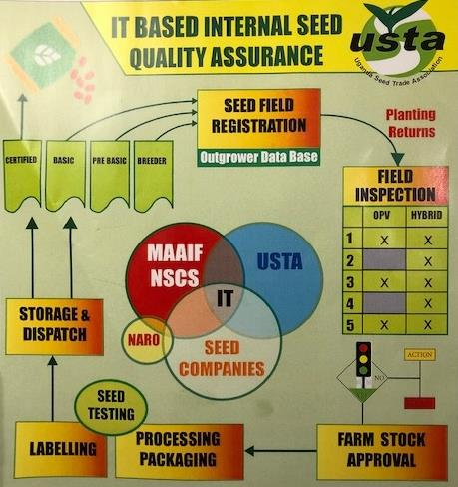
2. Recommendations: for strengthening the national Early Generation Seed system
Identify critical challenges within the EGS system and provide viable process upgrading solutions.
Develop more robust mechanisms, processes for pre-booking foundation seed.
USTA explores prospects for deploying a digital platform to improve coordination of production of EGS and ability to plan within the seed sector.
Notes:
Identify an upgrading team to work with NARO and the Seed unit to map current EGS and certification processes in a HACCP type analysis to identify hazard points within the system and provide viable process upgrading solutions.
Develop more robust mechanisms, processes for pre-booking foundation seed with NARO and link EGS sales to NARO Holdings, avoid direct contracting of research staff to produce special EGS seed lots.
Examine prospects for deploying a digital platform to improve coordination of production of EGS seed and ability to plan within the seed sector

Slide 16
3. Recommendations for Quality Assurance strengthening
Build reference seed laboratory facilities and the staff capacity
Support national inspection and regional seed testing facilities
Integrate the private sector into the QA systems
Revisit seed labelling system, get ownership from Government stakeholders
Strengthen seed procurement processes and policies
Raise customer awareness among agro-dealers and farmers about seed quality
Develop and implement a quality assurance program to validate and improve the quality of seed sold by agrodealers
Notes:
National regulatory ability to carry out certification must be brought in line with international best practices. Areas to be strengthened include:
Building laboratory facilities and capacity; Rebuild field inspection capacity and logistics; IT support; ISTA-accreditation for a national government laboratory to serve as a reference laboratory and audit regional and potentially outsourced certification results.
Integrate the private sector into the seed inspection and certification process, to reduce costs for Government and enable scaling of certification.
Seed labelling system: Revisit prospects for introducing an enhanced seed labelling system conforming to best practices and anti-counterfeiting measures, that meets the needs of Government, private sector and farming community.
Support national inspection and testing facilities to encourage more efficient and cost-effective seed certification processes between countries.
Procurement policies: Work with emergency seed distribution agencies to assess their procurement policies and evaluate the effectiveness of using scarce, certified seed in their seed interventions.

Slide 17
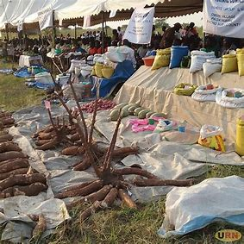
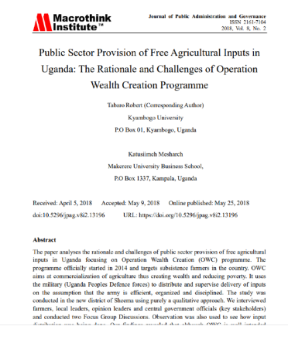
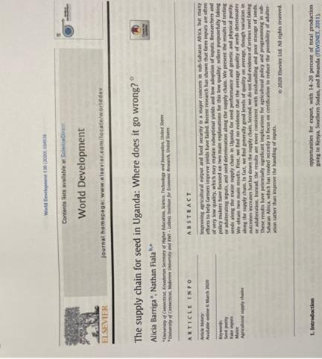
4. Market volatility in seed production rates
Seed supplies remain highly volatile, due to market, weather and institutional buying variability.
Example, - Formal sector maize seed production reached almost 22,000 MT in 2017 but dropped to 6,000 MT in 2018.
Key factors: a sudden reduction in seed purchased by Operation Wealth Creation, a Government subsidy program that provided free seed to farmers, and,
There was a bumper harvest, which caused prices to fall, and farmers were less interested in buying quality seed.
Institutional buying is high and is not based on market forces or quality.

Slide 18
4. Recommendations for understanding and then reducing market volatility in seed production rates
Volatility: Volatility affects both formal and informal seed sector, but there are also data challenges in both areas that creates difficulties in terms of understanding status and trends.
Learning about demand: better data management for specific crops, only needs to be 4-5 crops, could start with maize and beans.
Setting targets: working with Government, private sector and CGIAR / NGOs to support improved coordination of seed production for target crops.
Better coordination: Provide forums and opportunities for data collection points, sharing to get a better understanding of trends, key players, roles and interactions.
Note that this dataset is not comprehensive, this was the information discovered and
compiled by the review team, there is no central data point for certified seed volumes, USTA
Notes:
Learning about demand: Despite difficulties in providing accurate market forecasts for seed, uncertainty in the markets could be reduced by sharing more information about seed production and seed distributions between major agencies. If data was collected annually, from private sector and public procurement teams (Government and NGO), then anonymized and shared at the national level, this could provide trends in market demand for various seed types and provide information on geographic demand and demand profiles for different crops.
Setting targets: Improved seed information by the stakeholders could help in setting national and regional targets for key commercial / food security crops, starting with maize and bean seed, which comprise the two largest seed markets by volume. Targets could then be used to help plan EGS destined for the commercial certified seed sector and the informal seed sector.
Better coordination: Government, donors and other stakeholders should develop a clearer, agreed understanding of the roles and interactions of the seed sub-sectors (formal, QDS, informal, emergency, etc.) as this could help in building a clearer understanding about trends in seed demand across the different crops and geographies and matching different client needs with seed companies, seed producer groups, Local Seed Businesses (LSB), NGO projects, and local government demands for the EGS supply.

Slide 19
5. Quality Declared Seed (QDS)
QDS aims to open new market channels that integrate formal, semi-formal and informal seed systems.
QDS is lower cost than certified seed.
Seed companies are not allowed to produce QDS.
Despite the promise there is little documentation about the volumes sold and sustainability of QDS seed businesses.
QDS producer groups are mainly supported through donor projects and these ventures tend to fail when funding ceases.
Notes:
Seed companies are not allowed to produce QDS.
This less stringent seed class is particularly suited to true breeding crops such as beans, rice and groundnuts, where the private sector struggles to make profit.

Slide 20
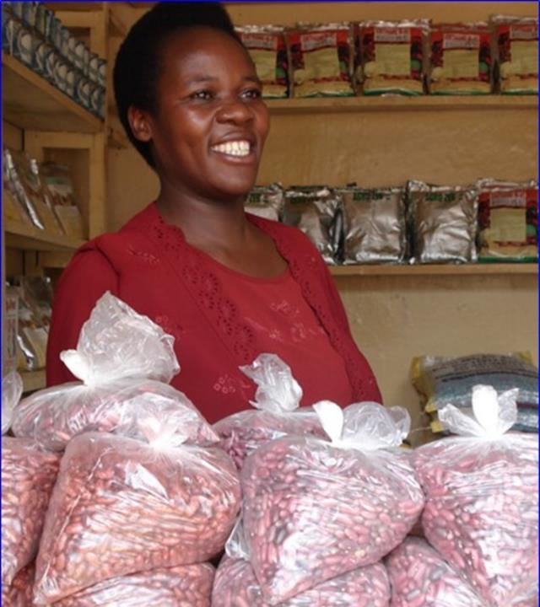
5. Recommendations for Quality declared seed (QDS)
Conduct a cost benefit assessment of QDS and Local Seed Businesses to determine whether current models being used by projects can launch sustainable seed enterprises
Question: Can QDS transition from donor-supported production into commercial ventures,
or;
Whether new business models and alternative seed classes such as standard seed may be a more sustainable way of extending the market frontier for quality seed by seed companies.
Notes:
Experiences from different projects and approaches should be shared to learn more about the volumes of seed being produced and sold, and the types of business relationships that were developed with smallholder farmer seed producers versus large farm seed production.
More information is also required about the ability of QDS to compete with free seed distributions and local markets selling high quality grain as seed.
Cost benefit and sustainability analysis – explore how can it be linking to breeding program and informal seed systems – using the market preferred varieties

Slide 21
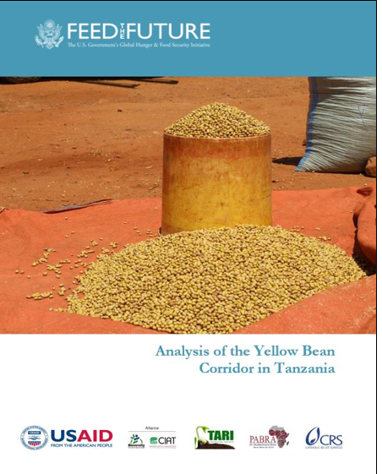
6. Recommendations for informal seed systems
The informal market options remain the least invested in approach, despite being the way that most farmers receive non-hybrid seed.
Informal seed system distribution: Test trader to farmer, and farmer to farmer dissemination of improved varieties which is an effective means for disseminating varieties especially when improved varieties are incorporated into local grain / food markets.
Finding new policy options / ways to enable trained traders to separate seed from grain and sell at a premium.
Exposing new varieties to QDS farmers as a means of testing and disseminating quality seed of improved varieties, is well illustrated in the recent yellow bean corridor analysis, developed by CIAT.
Find new ways to introduce critical quantities of seed of Farmer Preferred / Market Driven Varieties by seed companies or emergency seed operations then support informal production through farmer – traders – farmers.
Notes:
Especially establishing linkages between traders, seed producers and NARO breeding program
Exposing new varieties to QDS farmers
Identification of farmer preferred and market demand varieties (FPMDV)
Increase locally the seed of these FPMDV through QDS producers
once the variety becomes popular
inject critical quantity of seed of the FPMDV by seed companies or emergency seed operations
informal takes over the supply through farmer – traders – farmers

Slide 22
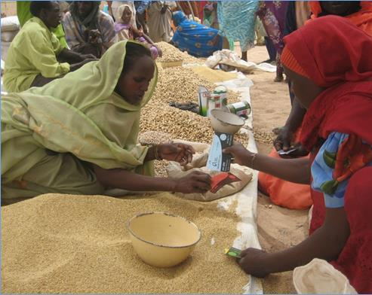
7. Emergency seed distribution:
A significant proportion of certified seed is distributed in Uganda through emergency programs and free hand-outs (e.g., Operation Wealth Creation, and through international aid agencies such as FAO, NGOs, churches and politicians).
Formal sector seed production appears to be heavily dependent on institutional purchases for emergency seed provisioning. Many of these distributions are based on an assumed rather than an actual need for seed, and the impacts of recurrent free seed delivery have not been documented.
The 2018 National Seed Strategy fails to recognize the negative effects of free and emergency seed distribution on the overall seed system.
Notes:
Emergency seed provisioning should be programmed according to estimated volumes required for upcoming production seasons.
Emergency seed provisioning should be designed in ways that support, not undermine, commercial seed sector development in the longer term.
New thinking is required to avoid the disruption to formal commercial certified seed markets by emergency aid.
More attention is required to explore the link between procurement policies and compliance used by international aid agencies such as the FAO, versus the actual needs of their target farmers. Compliance systems should not be disruptive to the broader seed system.
Organizations involved in emergency response should also be more willing to share their data on volumes of seed procured and distributed; some were unwilling to share this data for this report despite being major actors in the seed emergency system.
As with QDS, more information is required about whether seed distribution methods such as seed fairs and vouchers actually lead to long term seed business opportunities for the private sector, or not, and whether cash systems can provide the same outcome more efficiently.

Slide 23
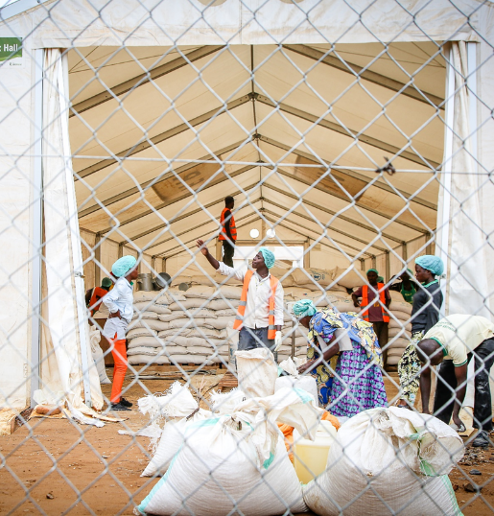
7. Recommendations in Emergency seed distribution:
Agencies who provide subsidized or free seed to farmers and refugees should declare their levels and sources of procurement; This data should be held with MAAIF.
All free distribution of seed, should follow a seed systems security assessment.
Humanitarian agencies should review their procurement policies in the light of the Uganda case, and adapt the methods to avoid market distortion in the formal seed sector
Ongoing e-voucher pilot is encouraging, and this is one approach to encouraging more farmers to test then buy into commercial certified seed.
Where farmers need access to seed, test use of cash transfers so that farmers can buy seed locally available.
Notes:
Emergency seed provisioning should be programmed according to estimated volumes required for upcoming production seasons.
Emergency seed provisioning should be designed in ways that support, not undermine, commercial seed sector development in the longer term.
New thinking is required to avoid the disruption to formal commercial certified seed markets by emergency aid.
More attention is required to explore the link between procurement policies and compliance used by international aid agencies such as the FAO, versus the actual needs of their target farmers. Compliance systems should not be disruptive to the broader seed system.
Organizations involved in emergency response should also be more willing to share their data on volumes of seed procured and distributed; some were unwilling to share this data for this report despite being major actors in the seed emergency system.
As with QDS, more information is required about whether seed distribution methods such as seed fairs and vouchers actually lead to long term seed business opportunities for the private sector, or not, and whether cash systems can provide the same outcome more efficiently.

Slide 24
8. Recommendations for counterfeit / low quality seed
Counterfeit - fake seed: The problem of fake or low-quality seed is partly driven by demand for emergency seed.
Procurement of seed from the aid system is based on an assumed need for seed and not farmer demand.
Seed companies also encourage seed aid as there are few quality controls and high prices.
Addressing fake seed requires:
more effective seed inspection and
Better quality control / assurance and labelling
Understanding why seed aid gives certified seeds rather than cash
Enabling Farmers with feedback / complaint channels if they receive low quality seed to pinpoint poor seed.
Regulators should act quickly to crack down on fake seeds.
Counterfeiting gangs have learned to dye regular maize with the characteristic pinkish orange color of industrially processed maize seed Photograph: Scott Barbour/Getty Images
Notes:
Procurement systems: Many large aid agencies have become bound to buying certified seed by their procurement systems, i.e., they have internal quality criteria, which requires them to buy the highest quality seed that is available on the market, so that they can provide a product of known quality to their beneficiaries. These are often highly vulnerable farmers, working in marginal land, that receive seed aid on a short-term basis.
This unpredictable and short-term procurement system drives the market for counterfeit seed in two ways: (i) buying large amounts of certified seed, in an unplanned manner, means that seed destined for the more commercial farmers or agrodealer channels suddenly becomes unavailable and this vacuum in the market drives counterfeit supply; and (ii) seed suppliers and other intermediaries also provide fake seed or for example expired “certified” seed to aid agencies who then distribute for emergencies.
Empowering Ugandan farmers: new ways are required that enable farmers to speak up and be heard when they have purchased or received low quality seed. The ability of farmers to recognize and have effective labels that prevents the spread of fake seed, will all help to drive higher levels of quality seed in the market and deter those who are producing and/or selling sub-standard seed.
Regulation by the seed certifiers. When fake seed is recognized in the system, the seed regulators need to act and enforce standards. Holding counterfeiters, or suppliers of low-quality seed, accountable by removing licenses and declaring fines will deter would-be counterfeiters from selling low quality goods into the commercial markets.

Slide 25
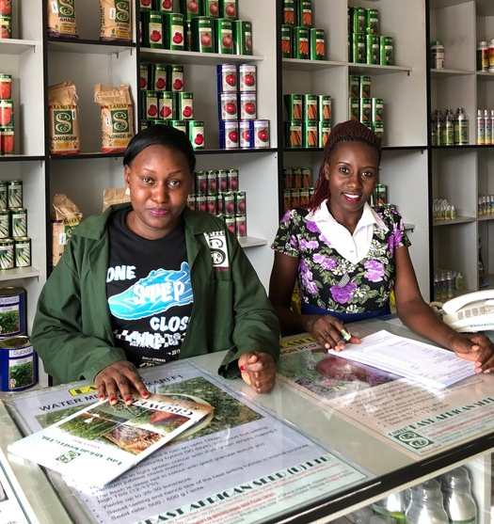
Conclusions
Uganda has real challenges in the formal seed system:
Quality Control and Quality Assurance are weak – low quality seed,
Government regulatory agency is not functioning
Government is ambivalent to commercial seed markets
Semi-formal system interventions support QDS:
Not clear if QDS approach has commercial prospects.
Informal system is under invested:
Greater investment in informal strategies could provide better access to quality seed
Innovation in policy and EGS strategies would open new market channels that leverage the informal private sector
Emergency seed system is large and distorting markets:
This may be driving fake seed
Humanitarian agencies need to share data
Innovation and shift from seed to cash transfers
Notes:
Not clear if the Government of Uganda, supports a strong policy framework for seeds, or feels that is an area that offer better opportunities when opaque and not well coordinated

Slide 26
TA to integrate seed systems:
Better coordination across sectors and data sharing
Strengthen seed monitoring systems across the seed sectors
Strengthen the national EGS system (NARO-holdings)
Strengthen formal system and linkages to informal sector delivery
Seed quality assurance
Strengthen regulation by the seed certification agency
Evaluating QDS performance to bolster formal seed sector
Work with seed stakeholders to control quality through better labelling
Strengthening informal seed system
Link formal to informal for effective dissemination of quality seed of improved varieties
Multi level approach to reducing fake seed
Evaluate the need and role of free emergency seed i.r.t. volatile seed markets
Empowering Ugandan farmers with feedback loops

Slide 27
Questions or Feedback?
What do you see as a priority for an activity like S34D to focus on?

Slide 28
Contact Information
Activity Email: S34D@crs.org
Chief of Party: Nikaj.vanWees@crs.org

Slide 29
www.feedthefuture.gov

