Slide 2
Notes:
Perhaps add your own slide before this one, including pictures and brief biographies of the facilitator(s)

Slide 5
Notes:
Examples of “shared norms” are things like: turn mobile phones to silent, don’t talk when someone else is talking, etc.

Slide 25
Notes:
This diagram illustrates how Proframe and the ToC Pathway Model are the same (the area in the middle) and how they are different (the areas on each side).

Slide 29
Notes:
You do not need to do the bottle race energizer. You could choose to play any game that would be fun for your participants.
The bottle race is a game where participants split into two teams and form two lines. The team members at the front of each line hold a water bottle. When the facilitator says “go,” the person at the front of the line hands the water bottle, over his or her head, to the person behind them and then runs to the back of the line. That person hands it, over his or her head, to the person behind them, and so on until the team leader returns to their place at the front of the line. The first team to bring their team leader back to the front of the line wins.

Slide 34
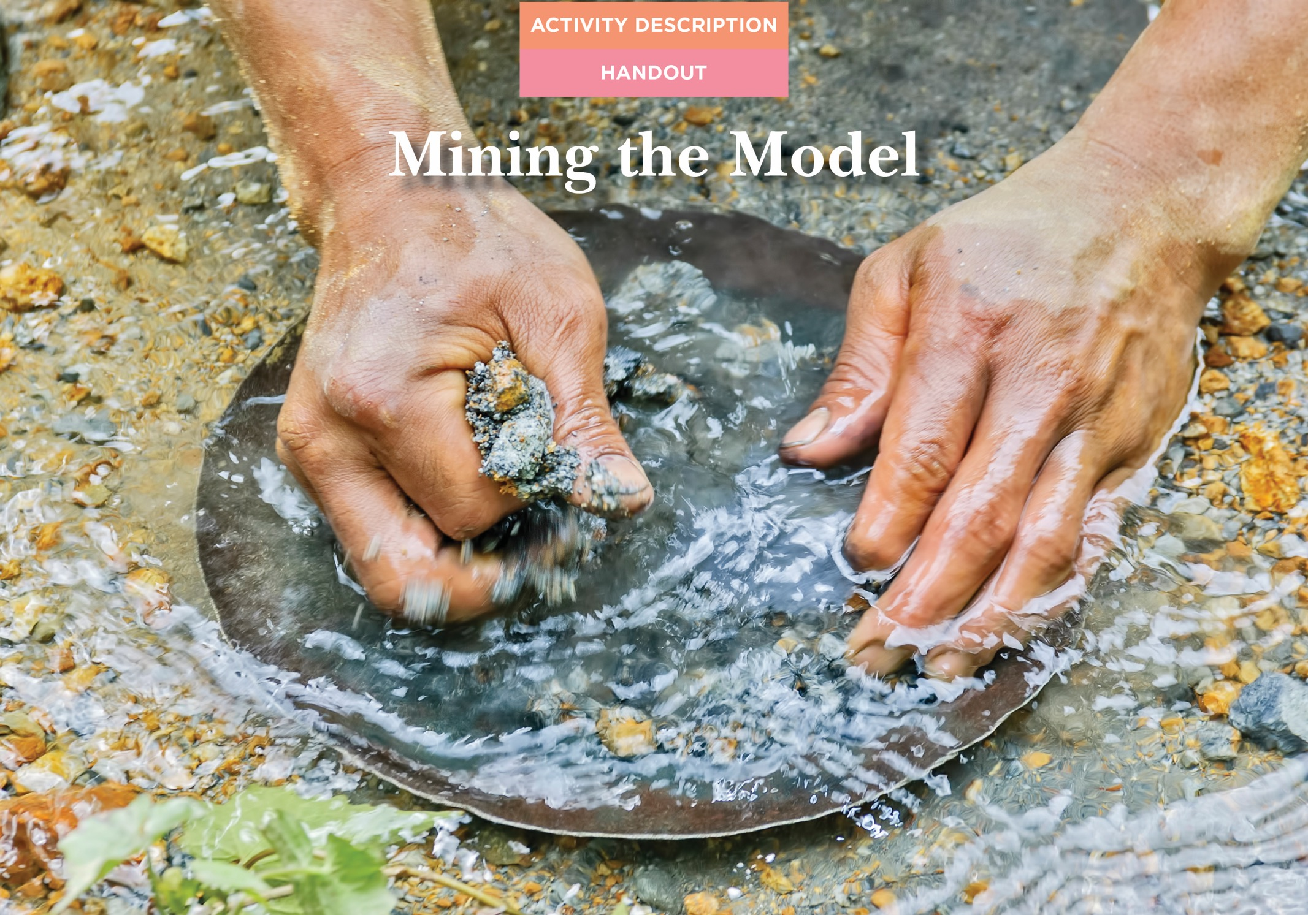

Slide 47
Notes:
Evaluative thinking should not only be used for formal evaluation. ET will allow for good decision making around immediate adaptations to your program, planning for local, less formal evaluation AND for planning the most formal evaluations. When we talk about developing learning plans, we are talking about written plans (which may have more or less detail depending on the situation) for EITHER/BOTH formal and local, less formal evaluations.

Slide 72
Notes:
Using a less formal, simpler method when trying to make a big, complex claim is like trying to catch a whale with a goldfish net. At the same time, using a complex, more formal method to make a smaller, more localized claim is like hitting a fly with a hammer – overkill.

Slide 82
Notes:
The words on this slide are examples of the types of constructs we are often interested in measuring as part of community-based programs. The image of the tape measure is there to emphasize that unlike a construct like length, there are no standard measurement tools that will work in all contexts and situations for the constructs listed on this slide.

Slide 83
Notes:
Indicators are ways to know if an outcome (construct) is taking place. In this example, the construct is knowledge. In the six circles around the word knowledge we have listed possible sources of evidence (indicators) of knowledge.

Slide 84
Notes:
This image shows that for each indicator (as listed on the previous slide), there may be many different evidence gathering tools that would be appropriate. Each will have its own strengths and weaknesses so the team developing the evaluation must use ET to carefully decide which method(s) are best in their context.

Slide 85
Notes:
In the diagram on the left, the population is represented by the large, white circle. The sample (the cream colored circle on the left) is the 10 individuals selected from the larger population. In the example on the right, the sample is the entire population. In other words, no individuals were selected from the group to represent the entire population. Instead, in this example, information was collected from every individual in the population.

