Slide 1
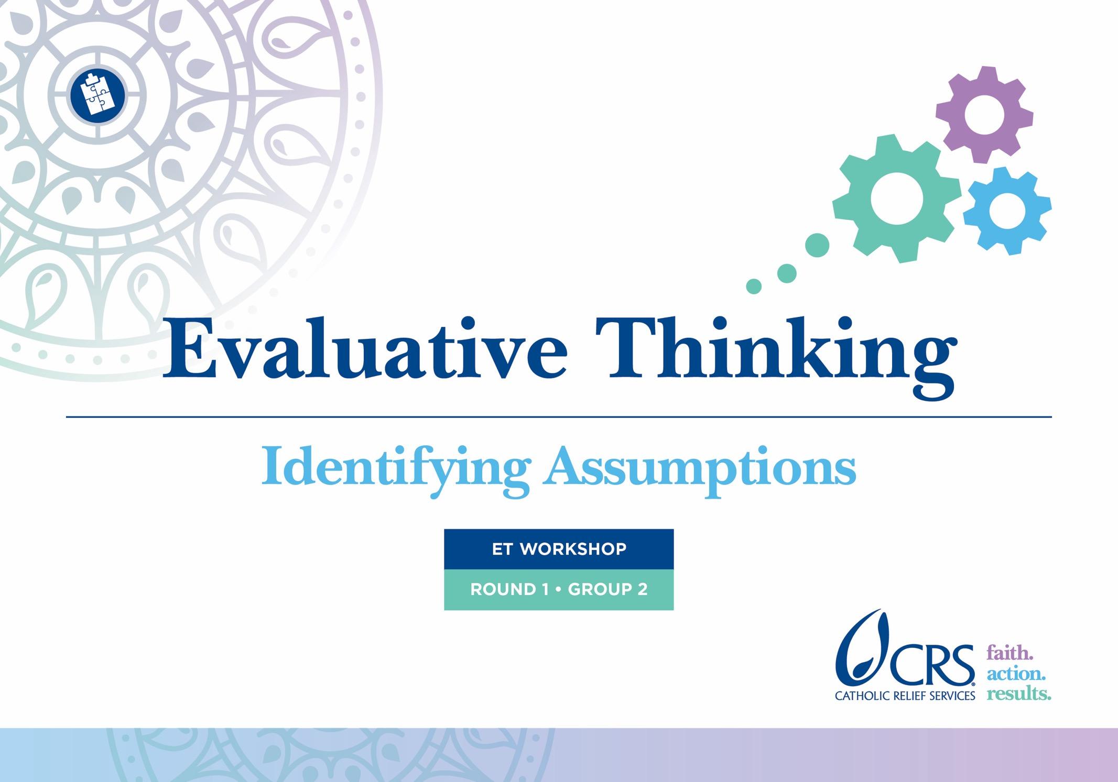

Slide 2
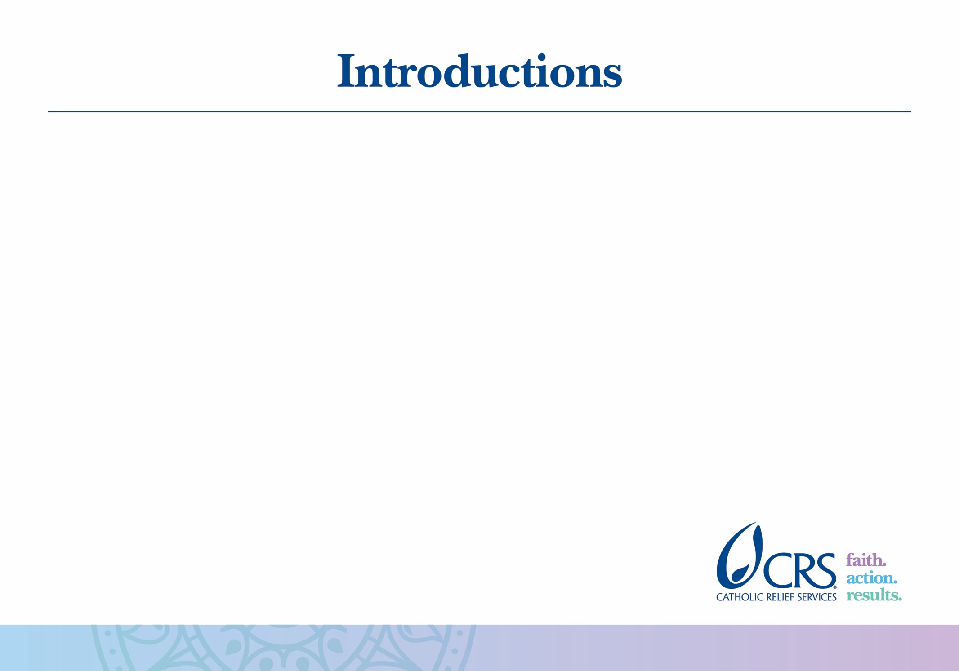
Notes:
Add your own slide here with pictures and brief biographies of the facilitator(s)

Slide 3


Slide 4
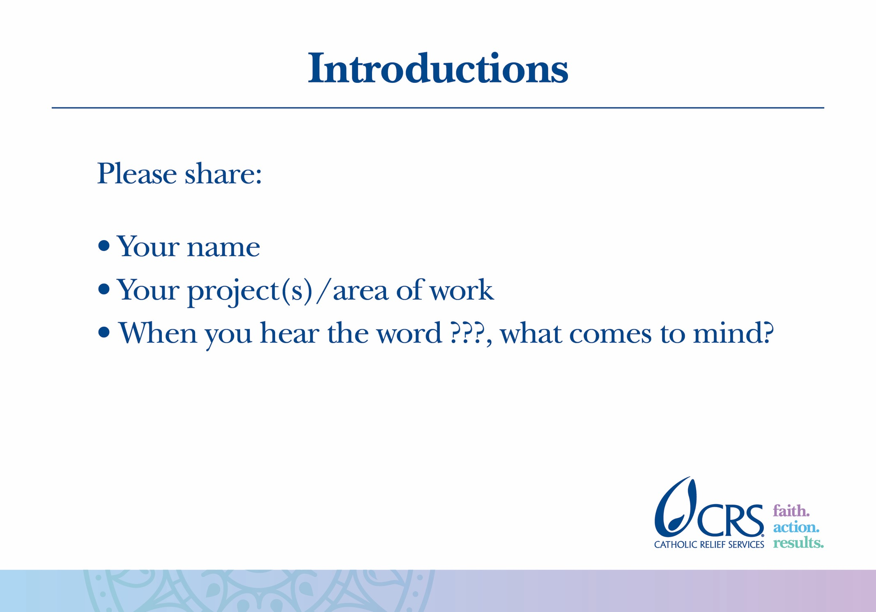
Notes:
The purpose of asking each participant to describe what they think of when they hear a word (for example, “river”) is to demonstrate the great variety of perspectives and prior experiences that the participants bring to this workshop. This relates to subsequent activities in this workshop regarding stakeholder perspectives and program context.

Slide 5
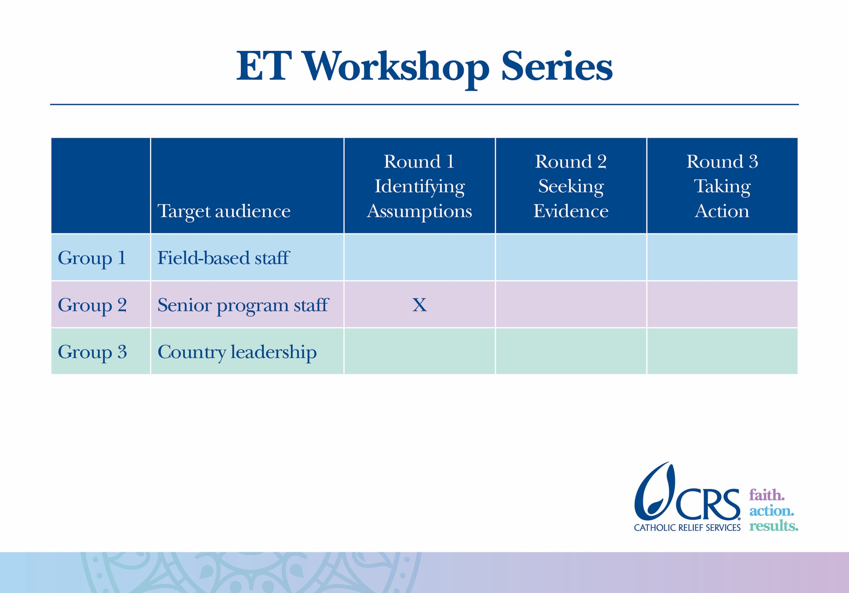

Slide 6
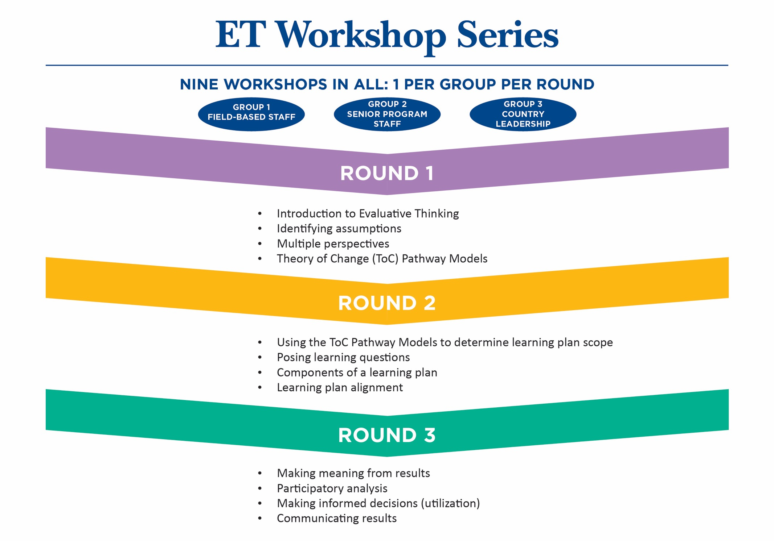

Slide 7
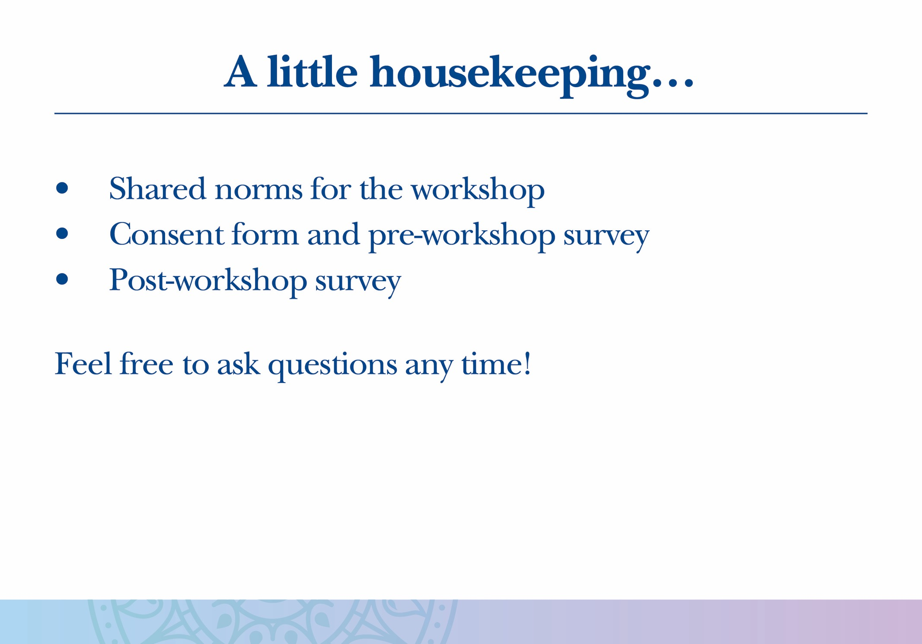
Notes:
Examples of “shared norms” are things like: turn mobile phones to silent, don’t talk when someone else is talking, etc.

Slide 8
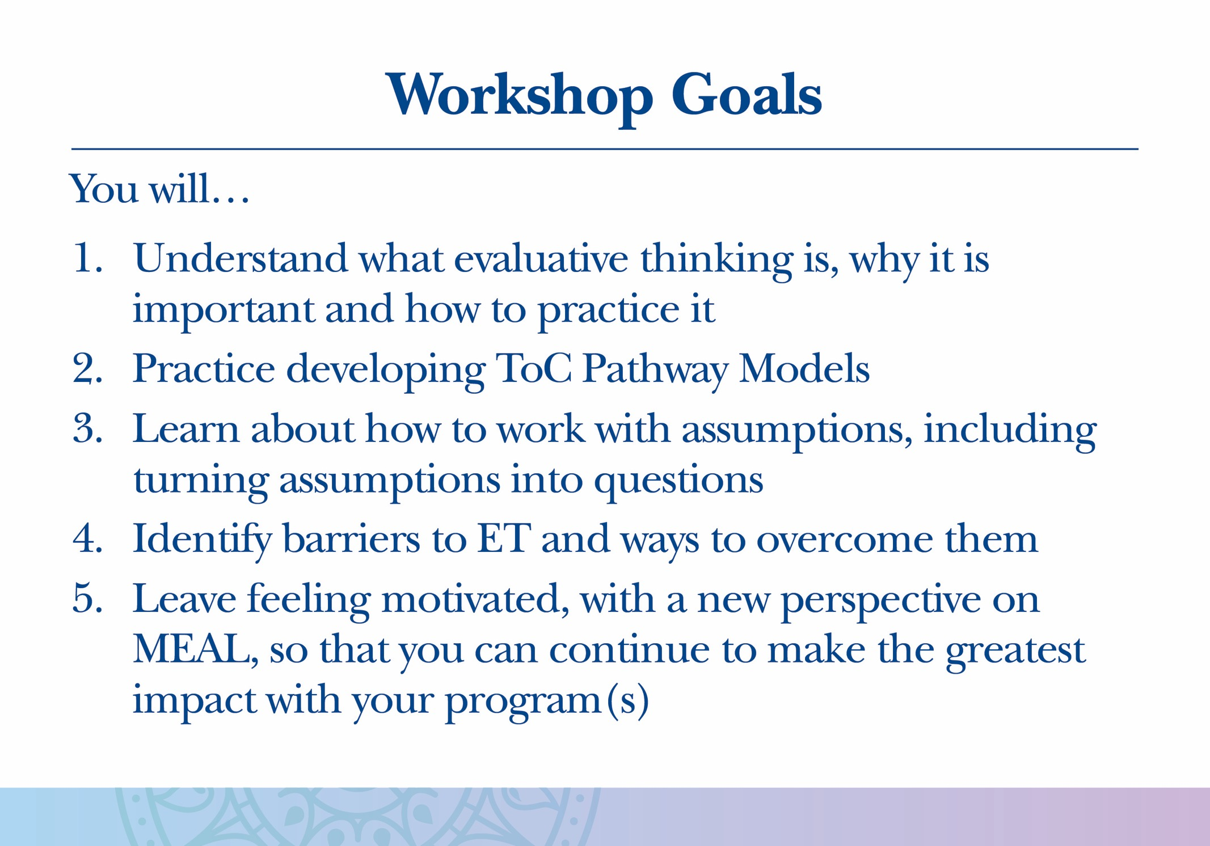

Slide 9
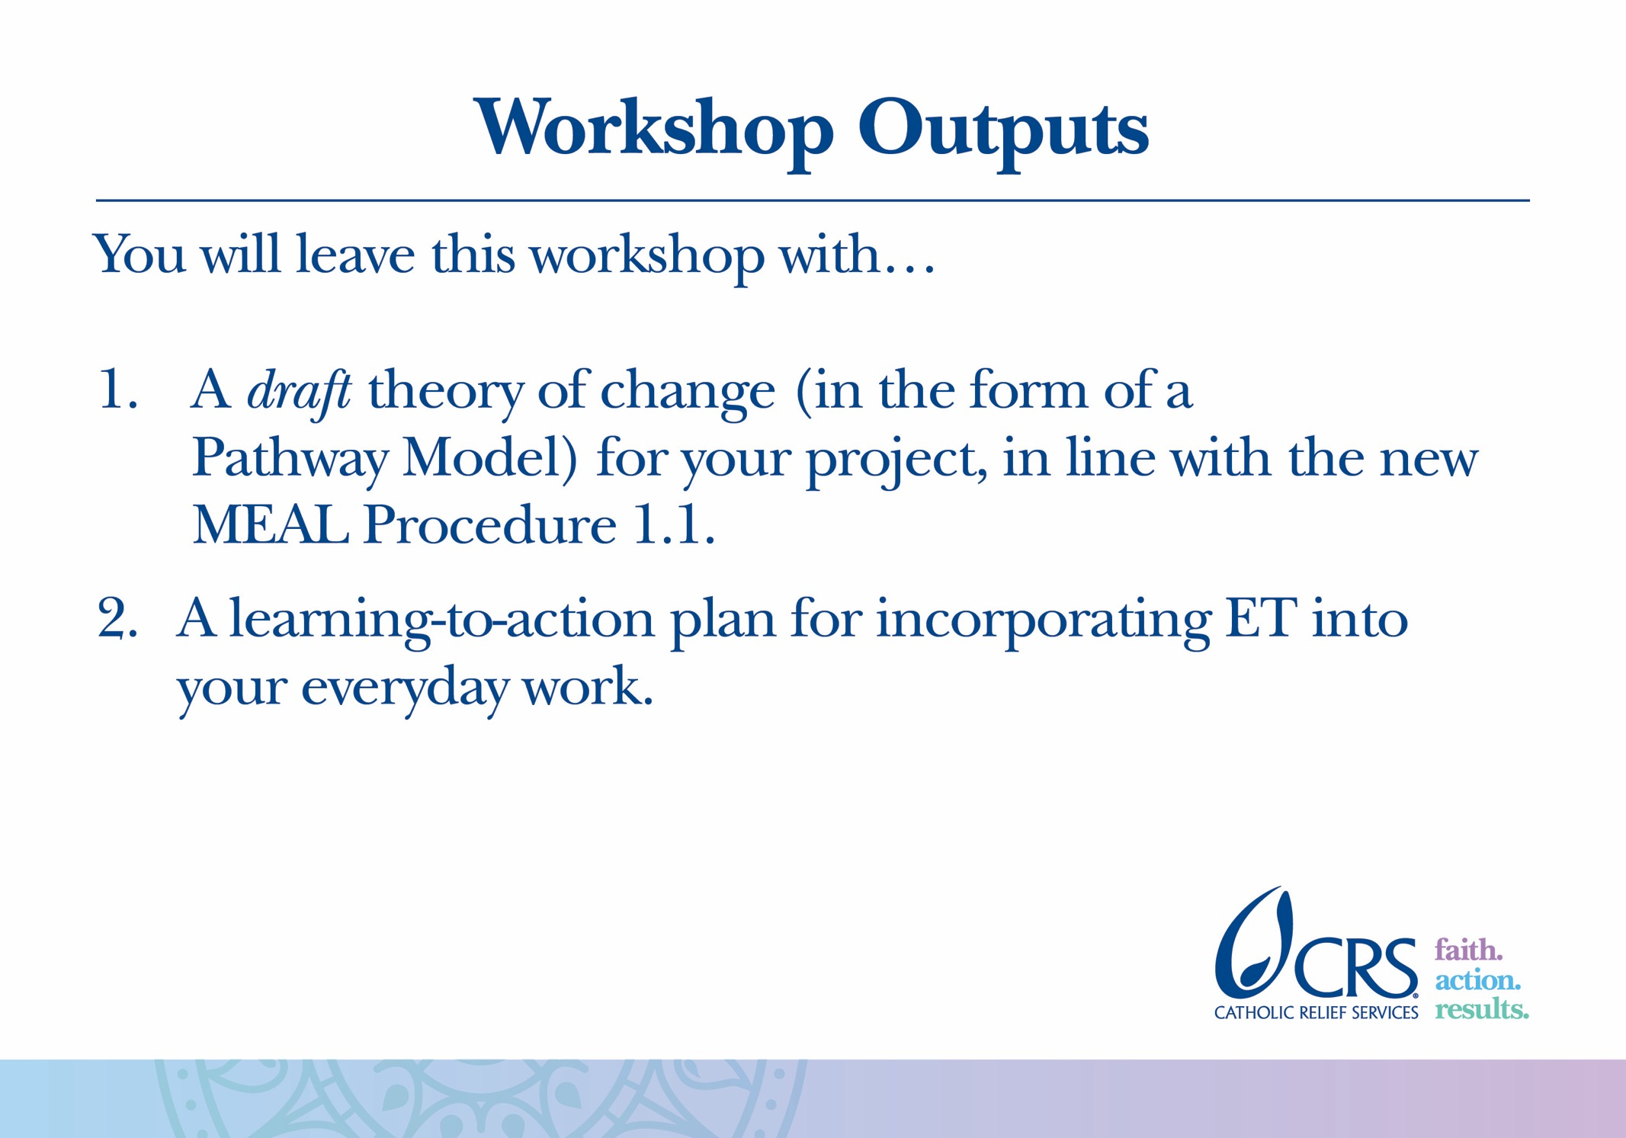

Slide 10
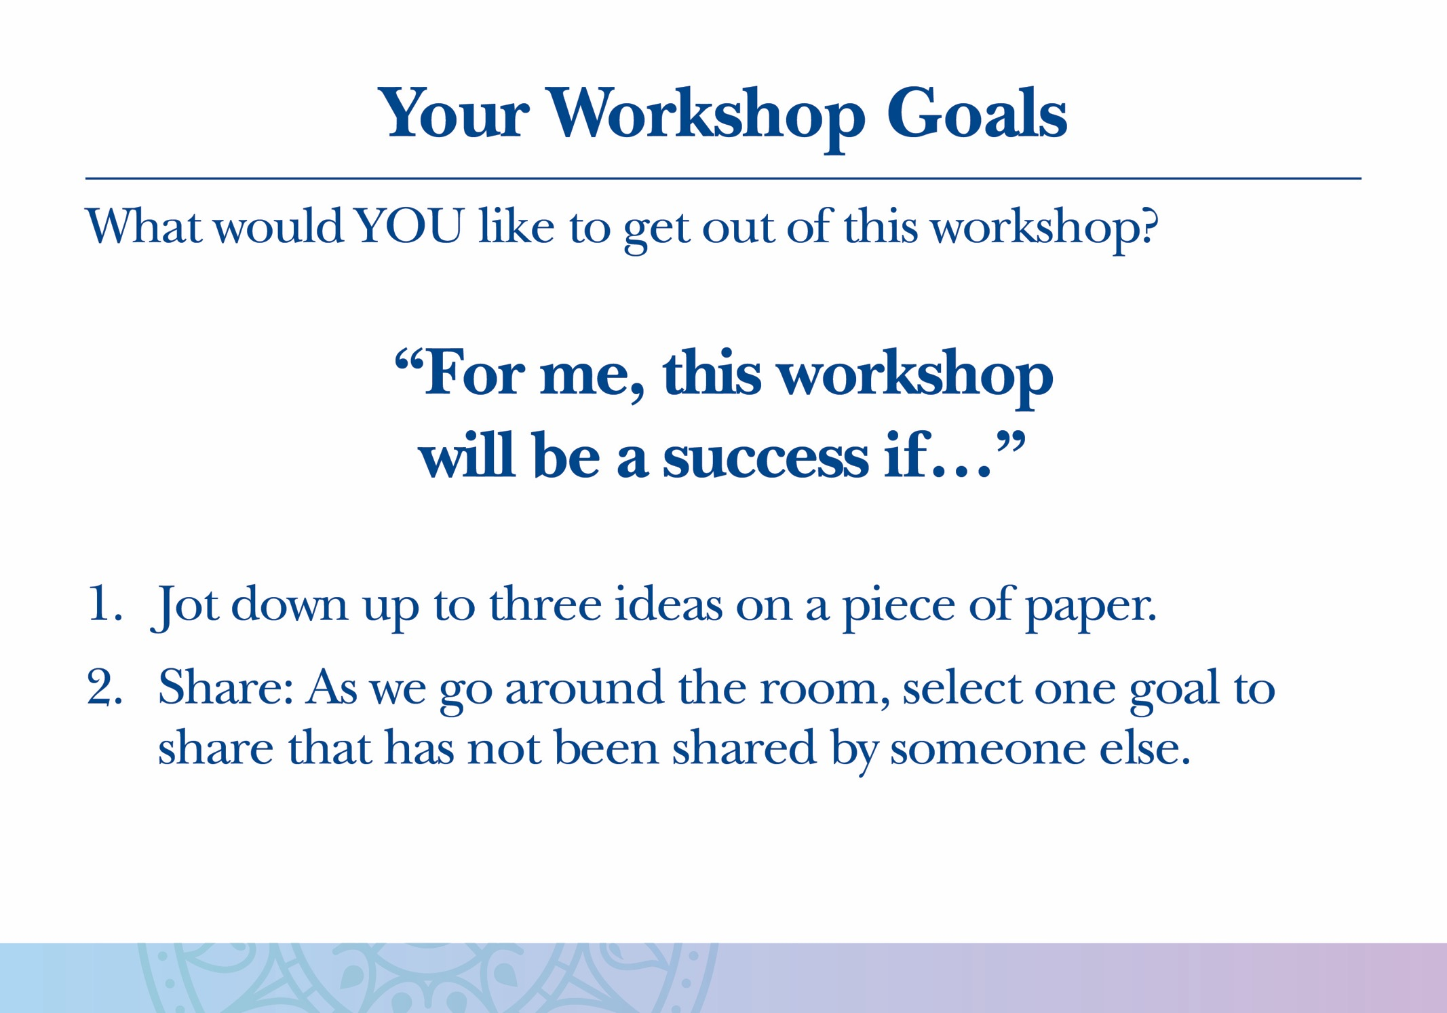

Slide 11
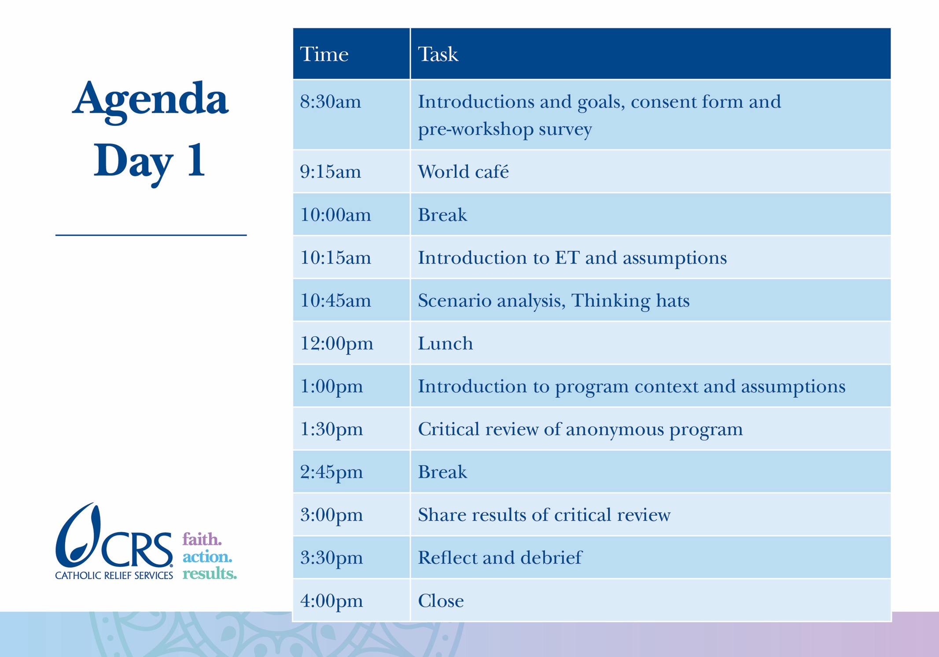

Slide 12
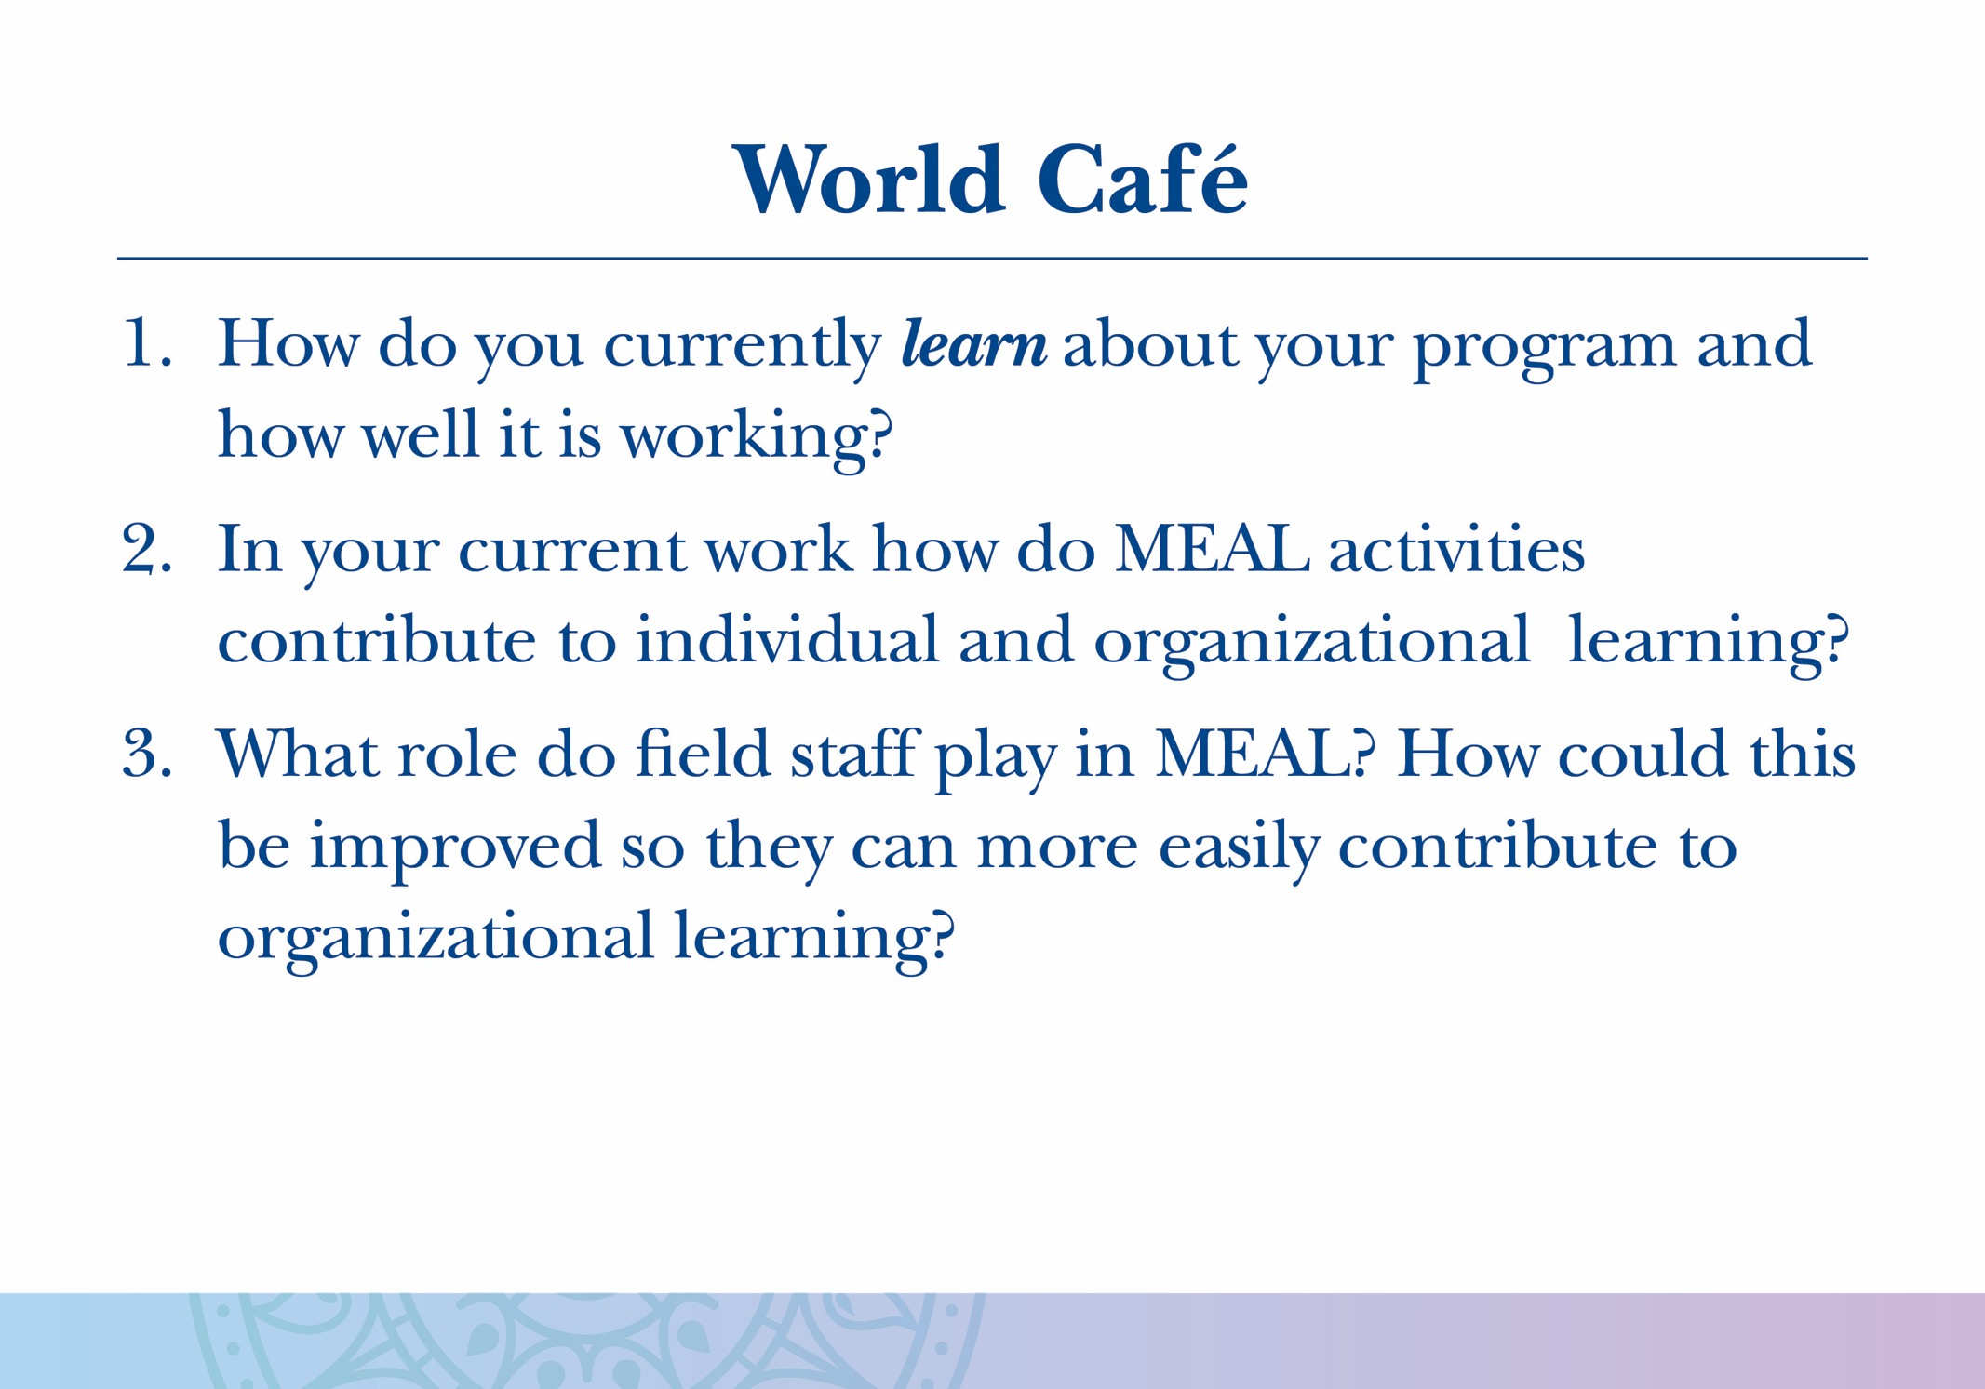

Slide 13
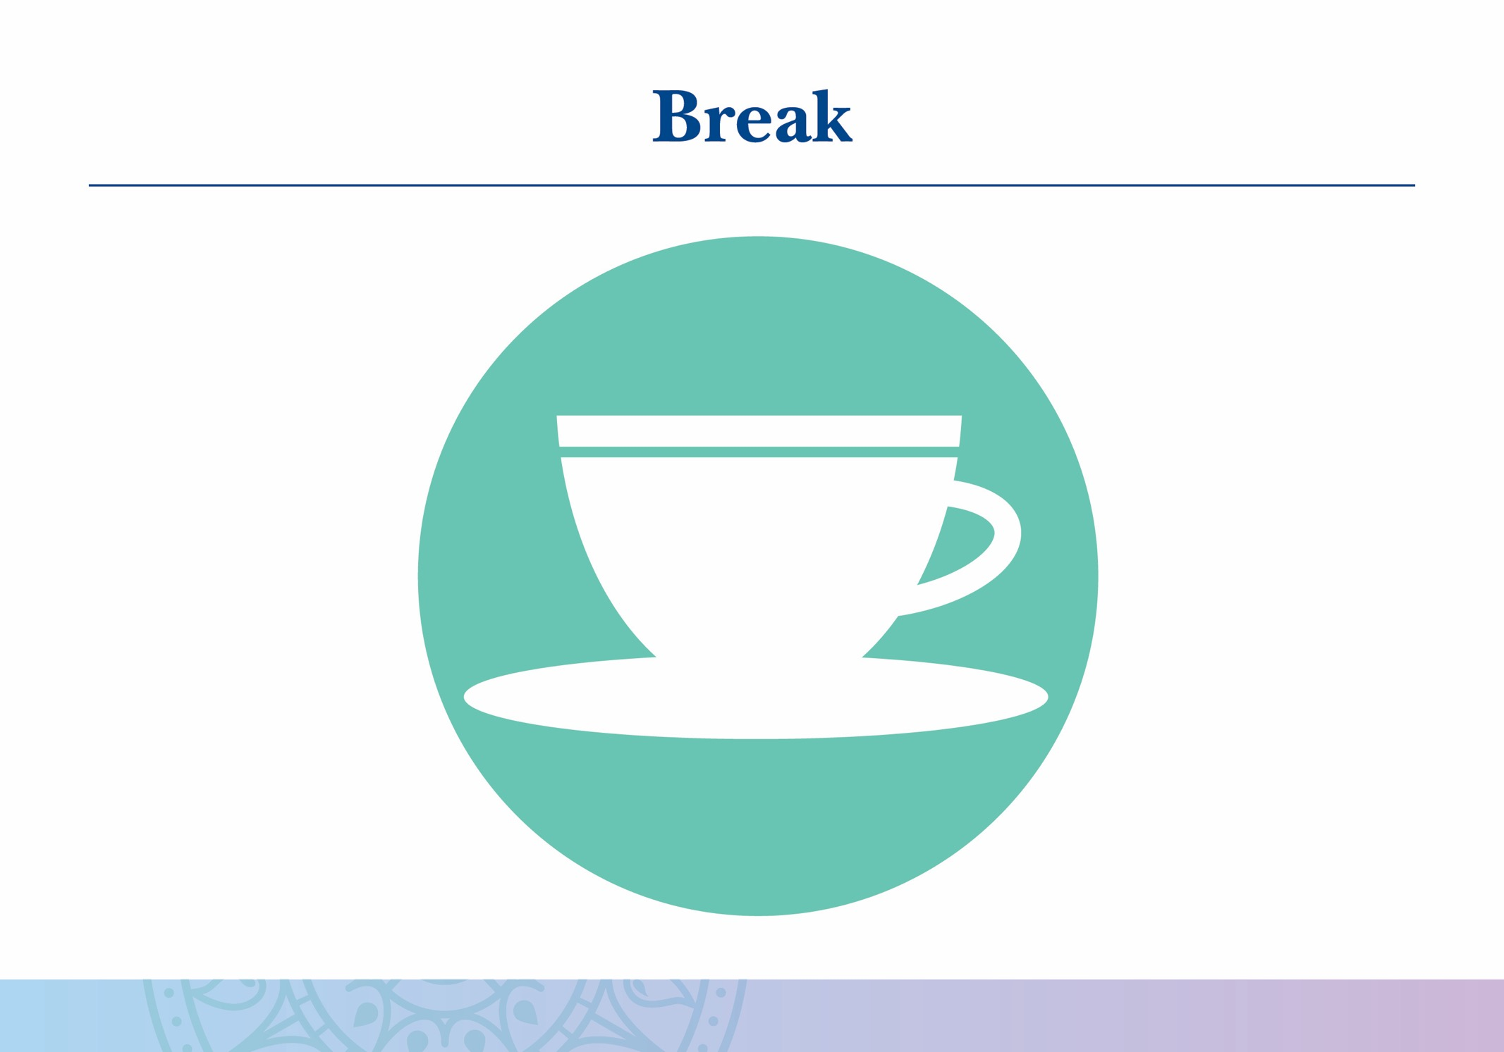

Slide 14


Slide 15
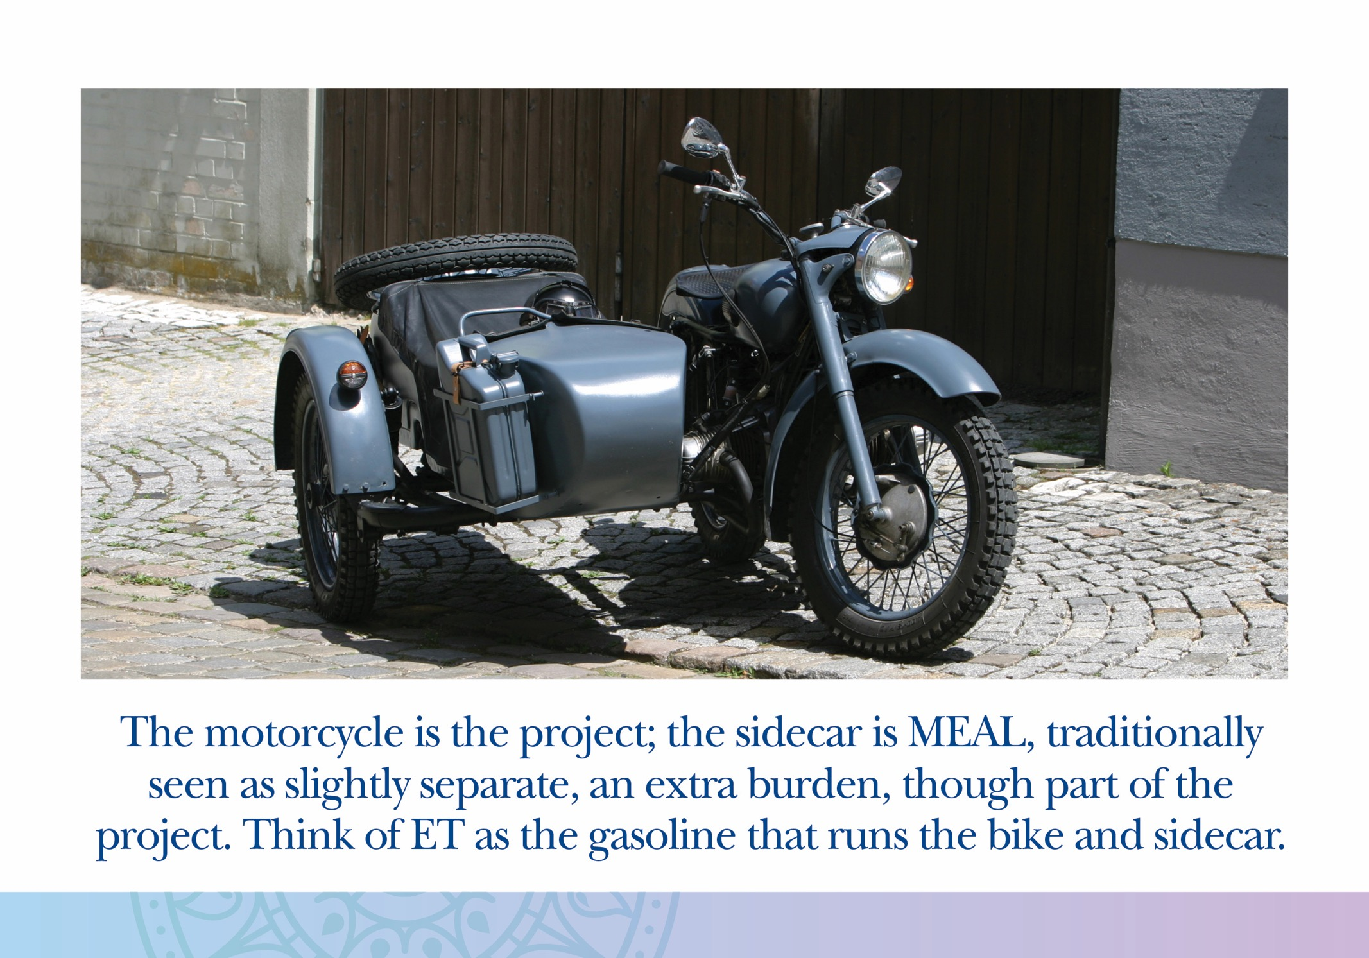

Slide 16
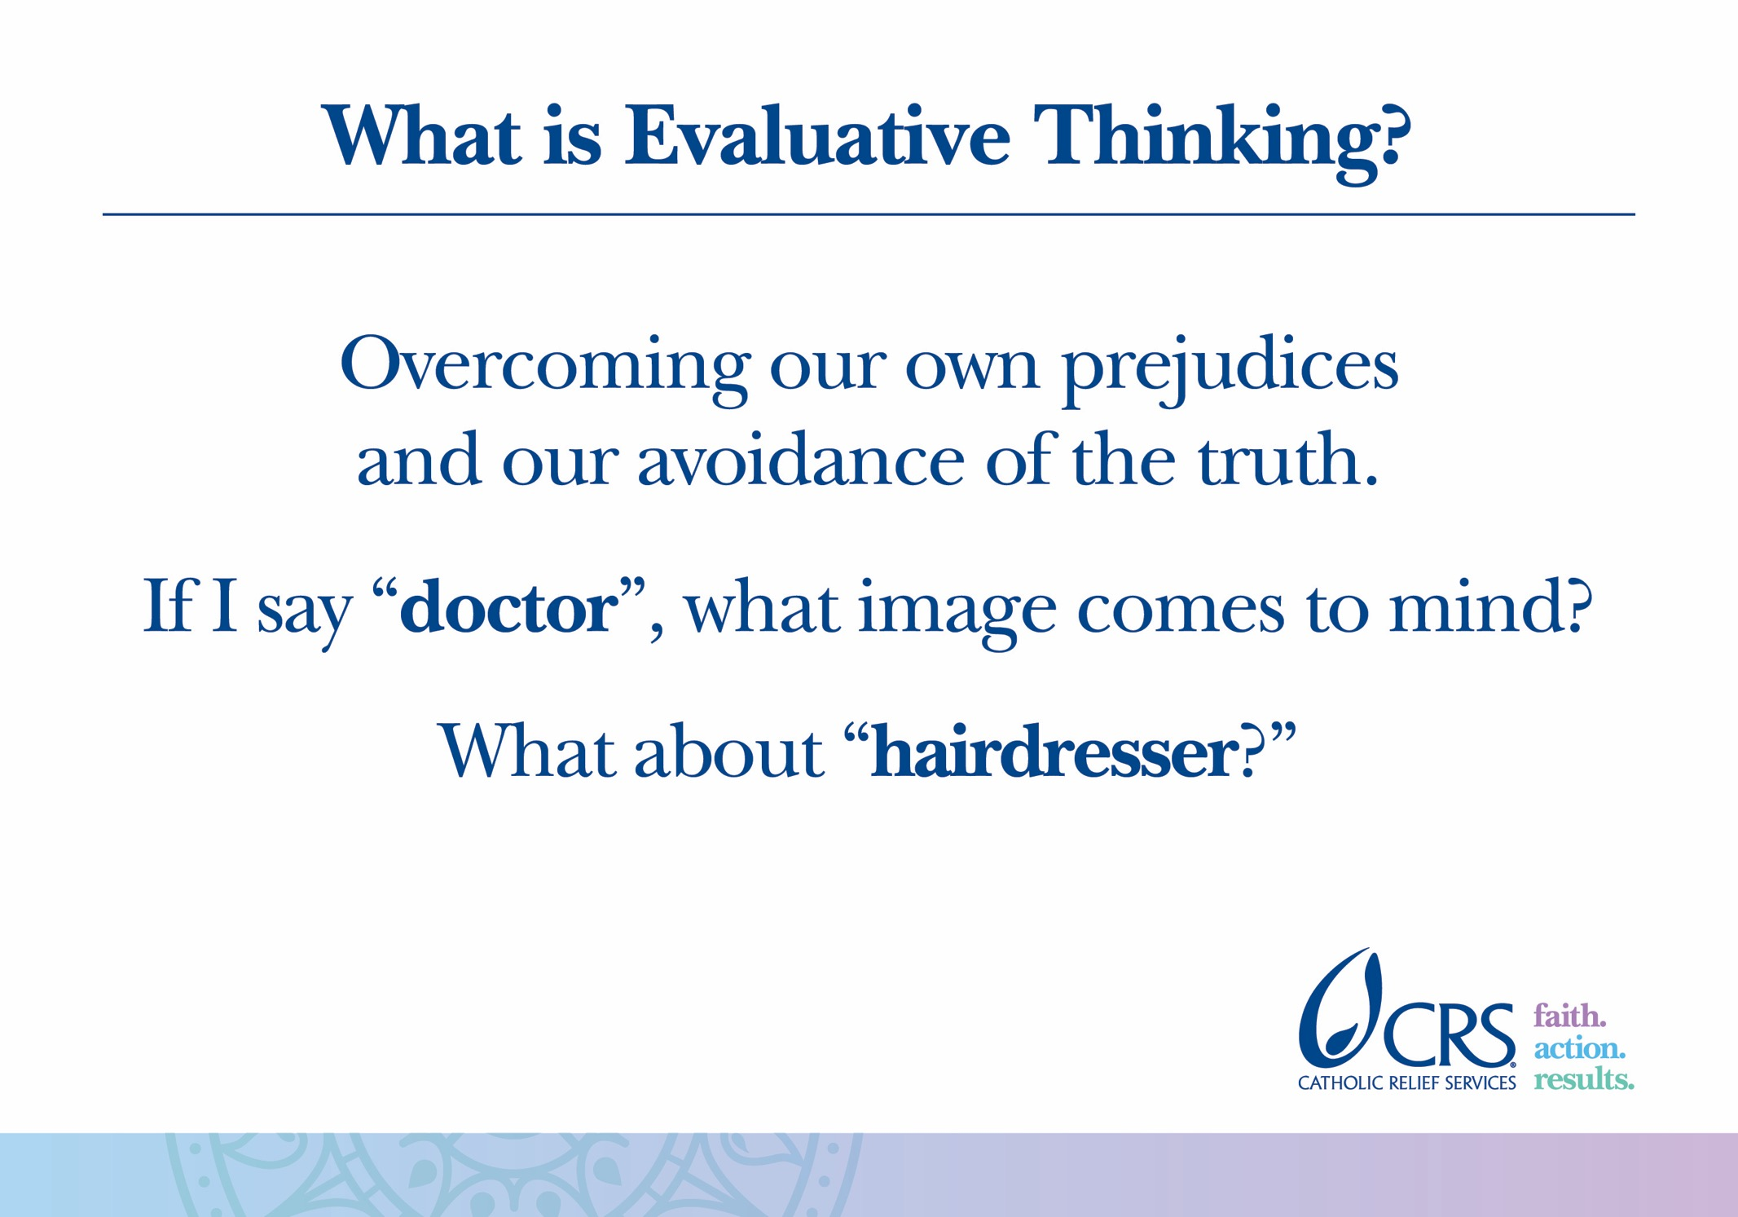
Notes:
The words “doctor” and “hairdresser” may conjure stereotypes about gender, race, age or other. These types of prejudices are normal and human. Evaluative thinking is all about stopping yourself when you inevitably use these stereotypes, and instead consider the likely alternatives.

Slide 17
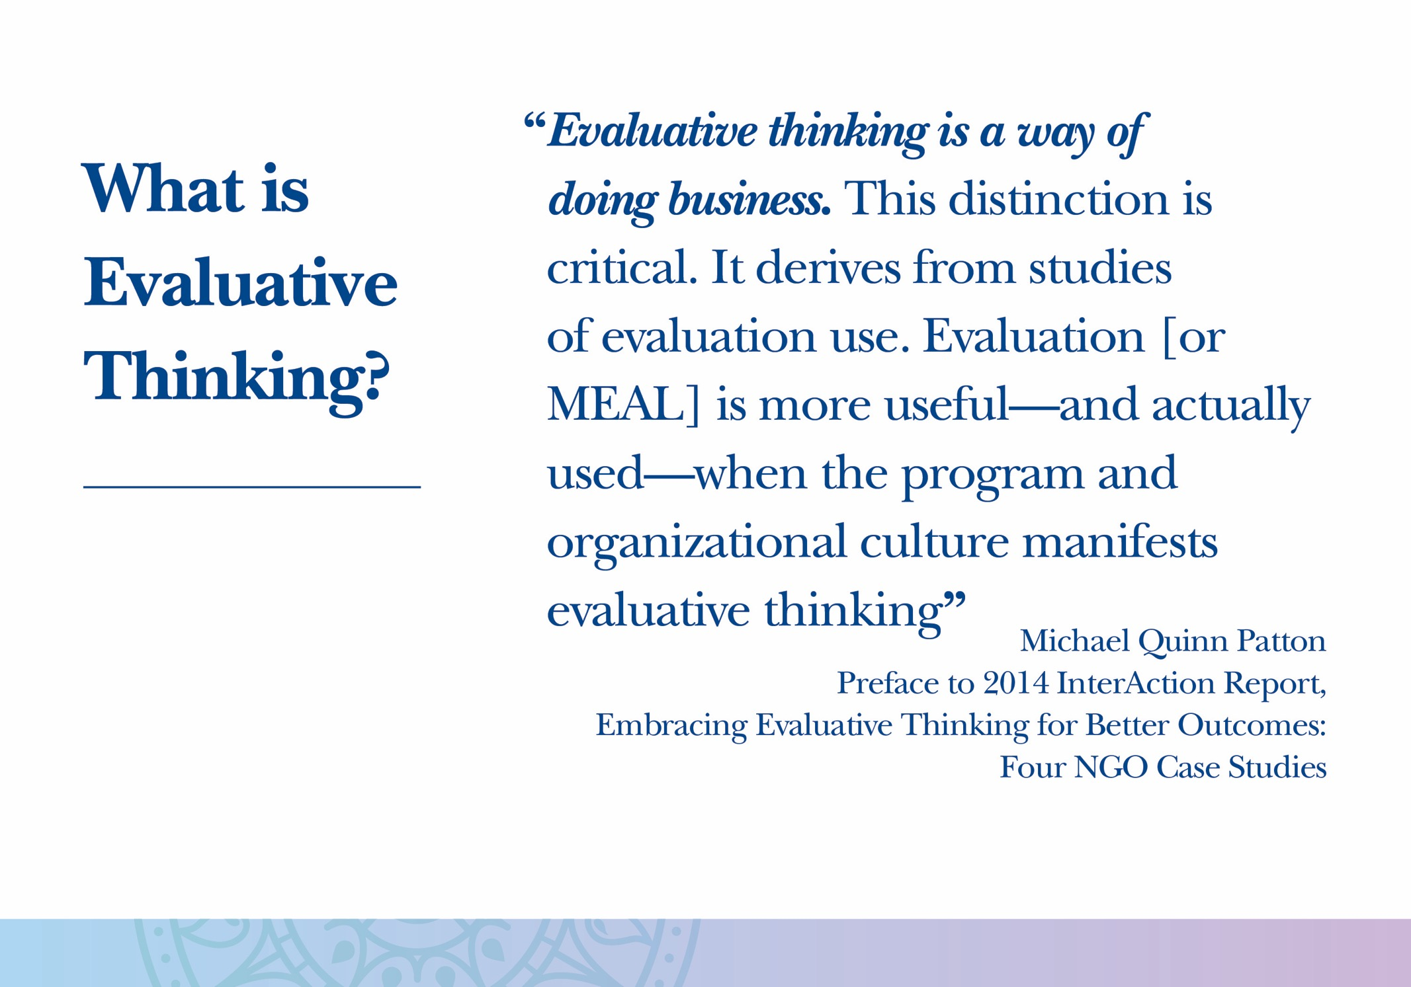

Slide 18
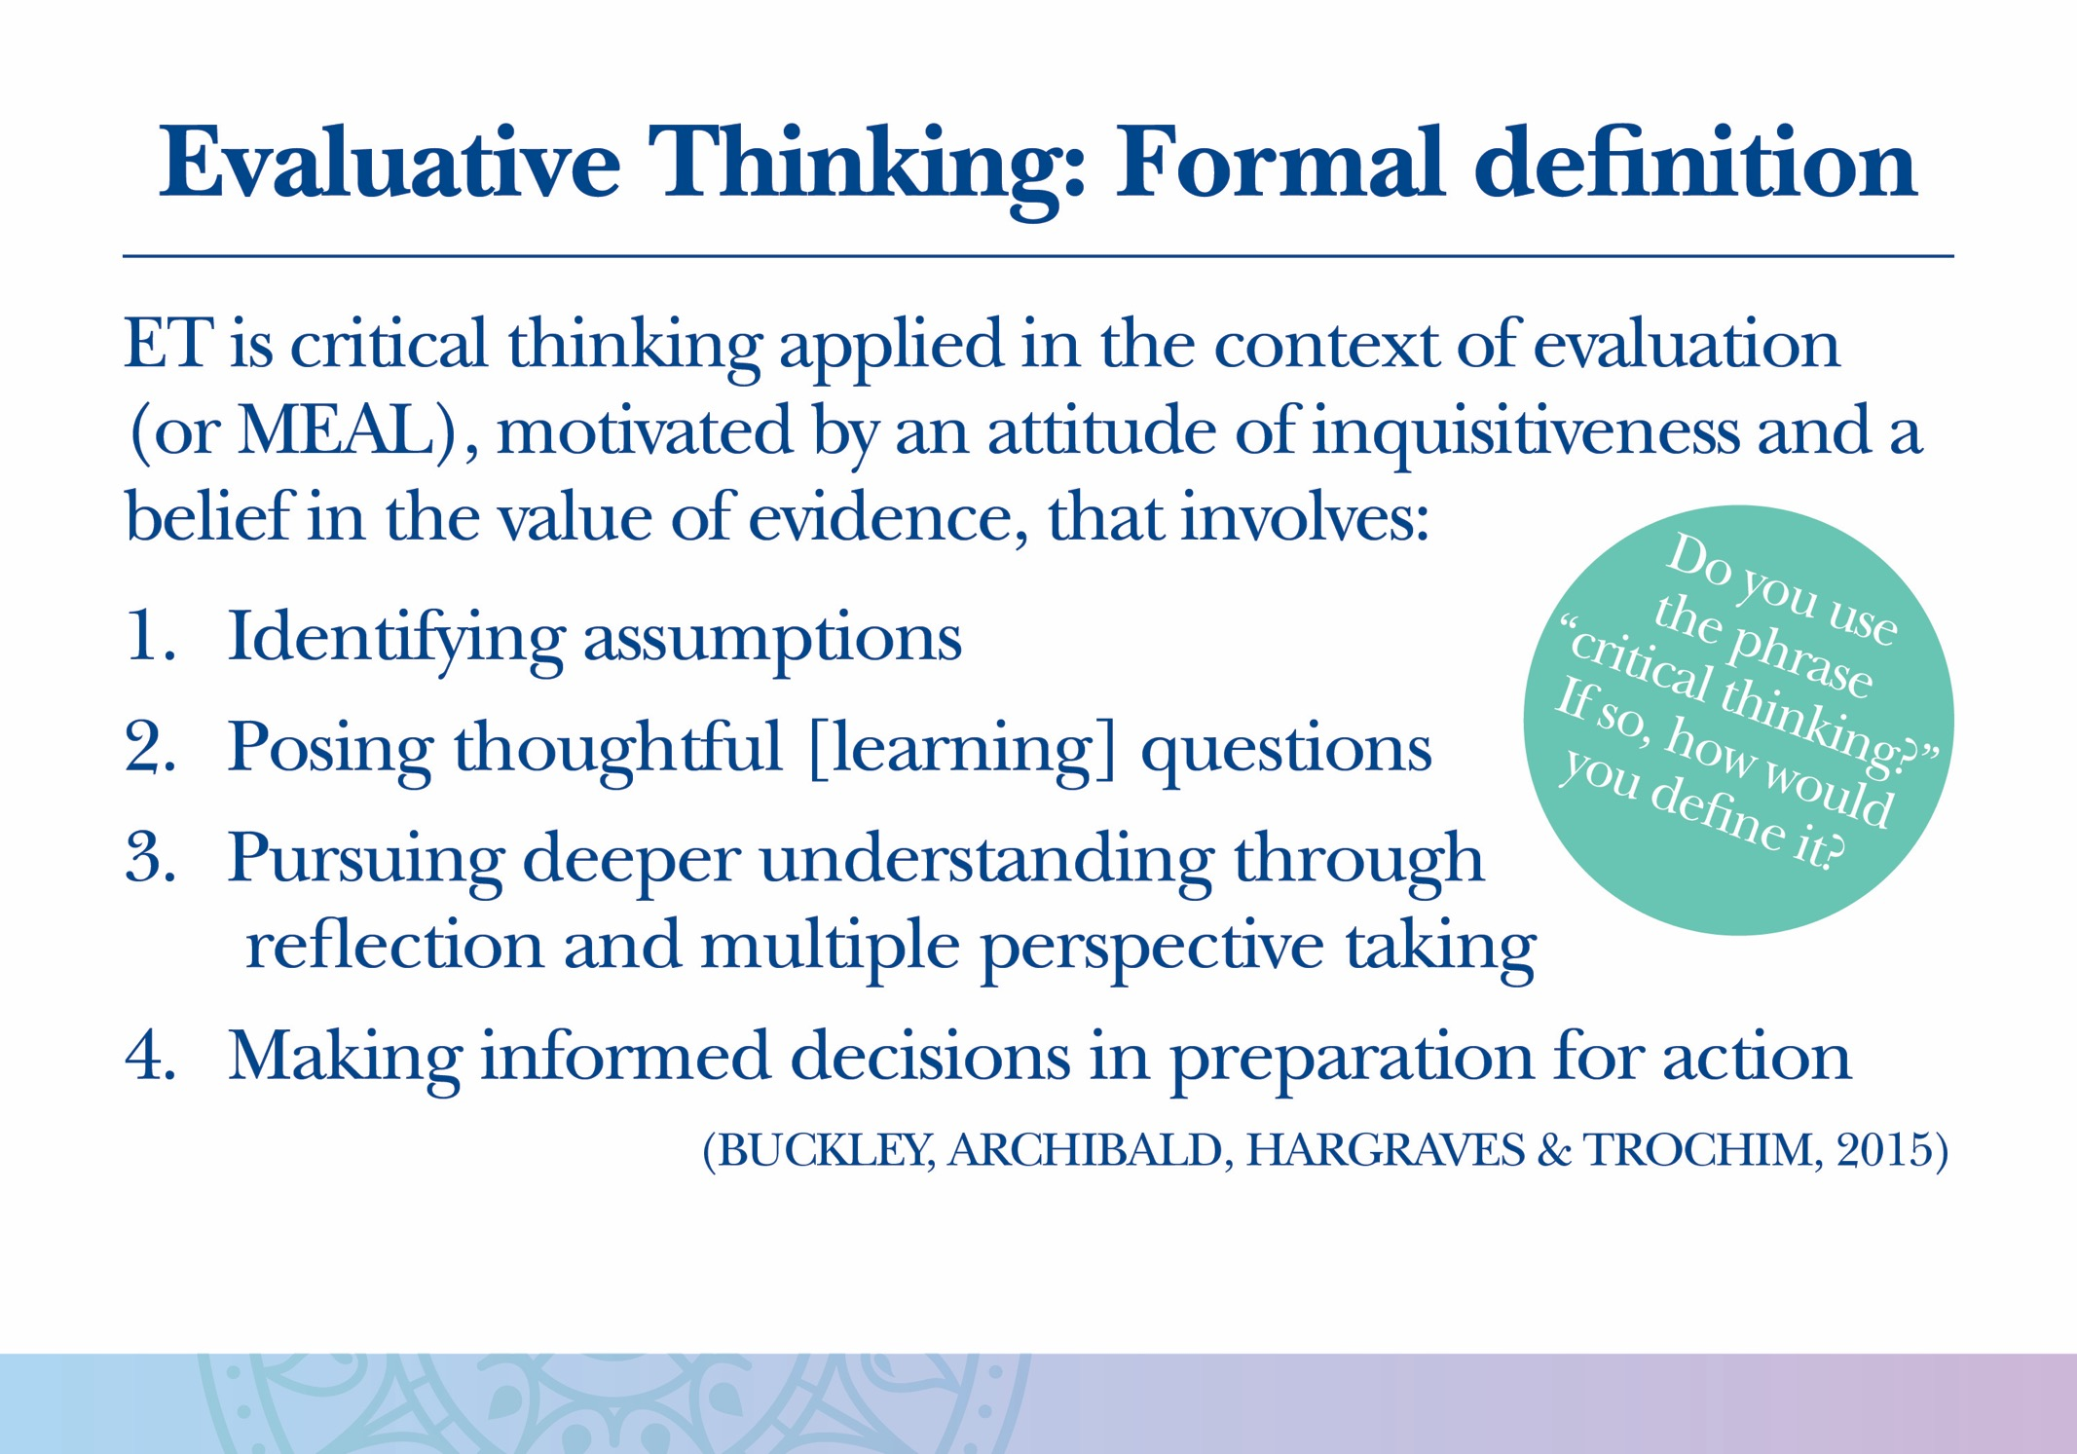

Slide 19


Slide 20
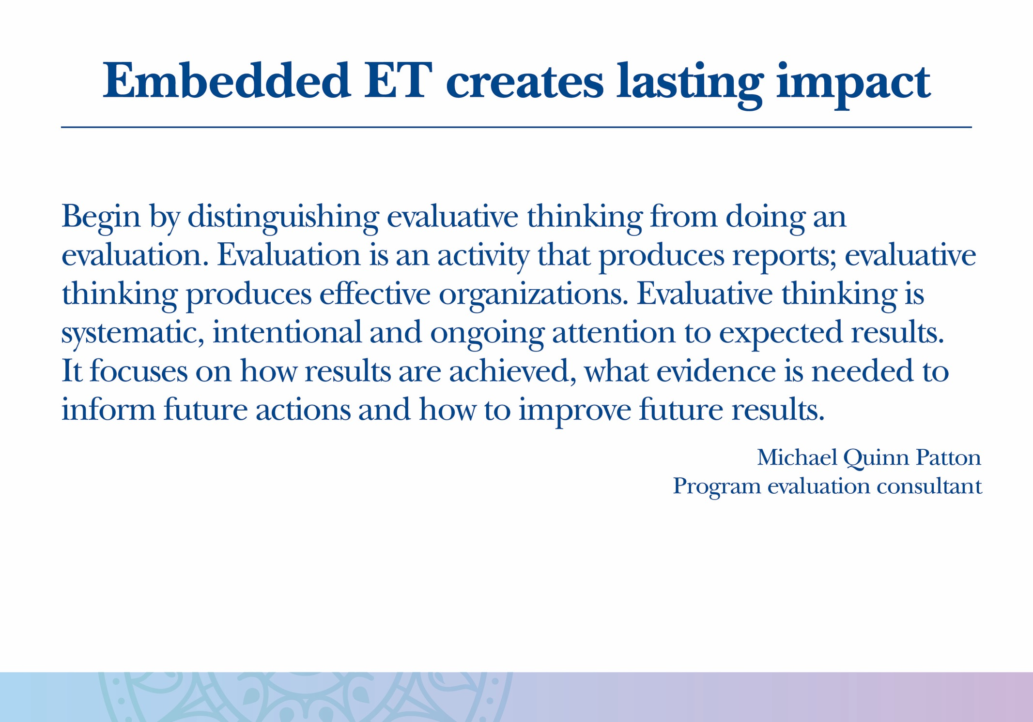

Slide 21
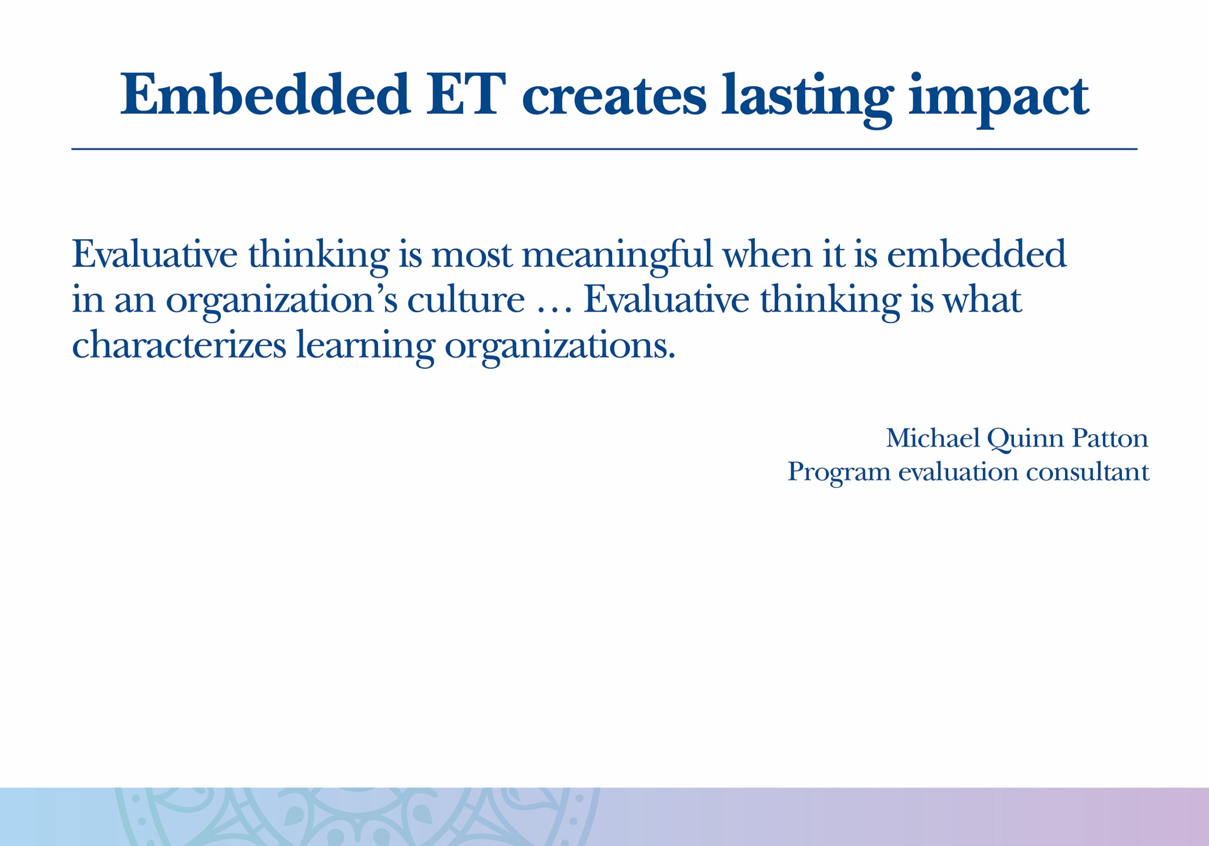

Slide 22
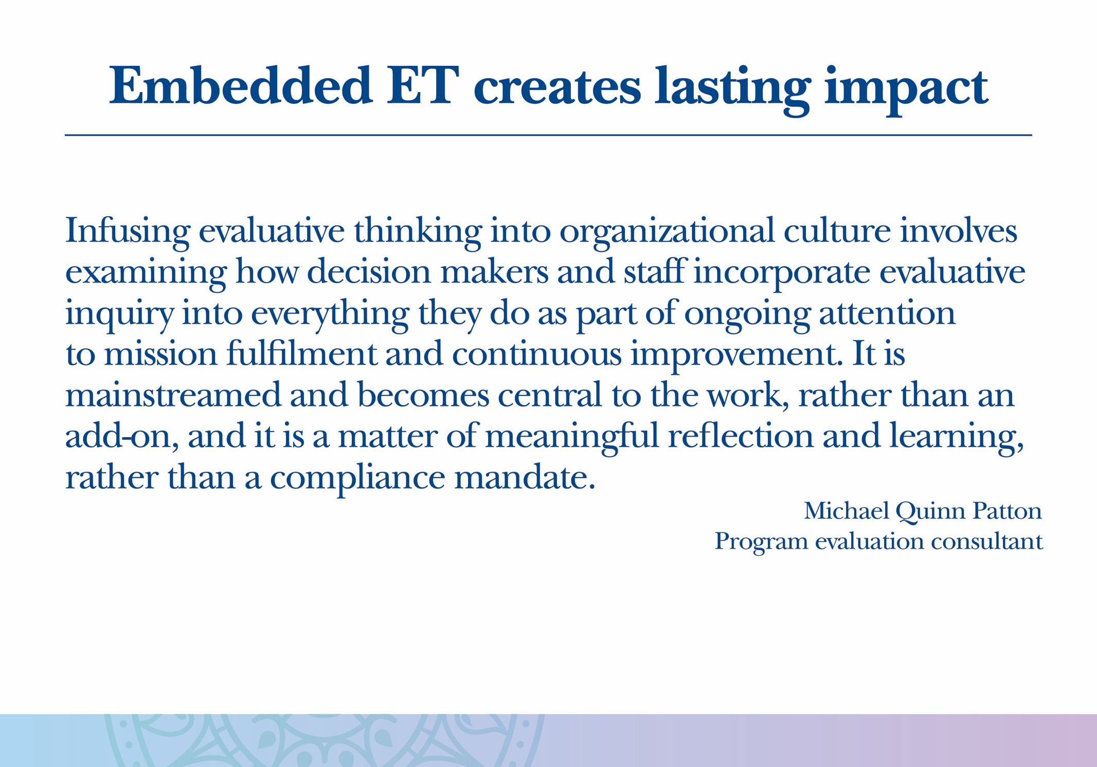

Slide 23
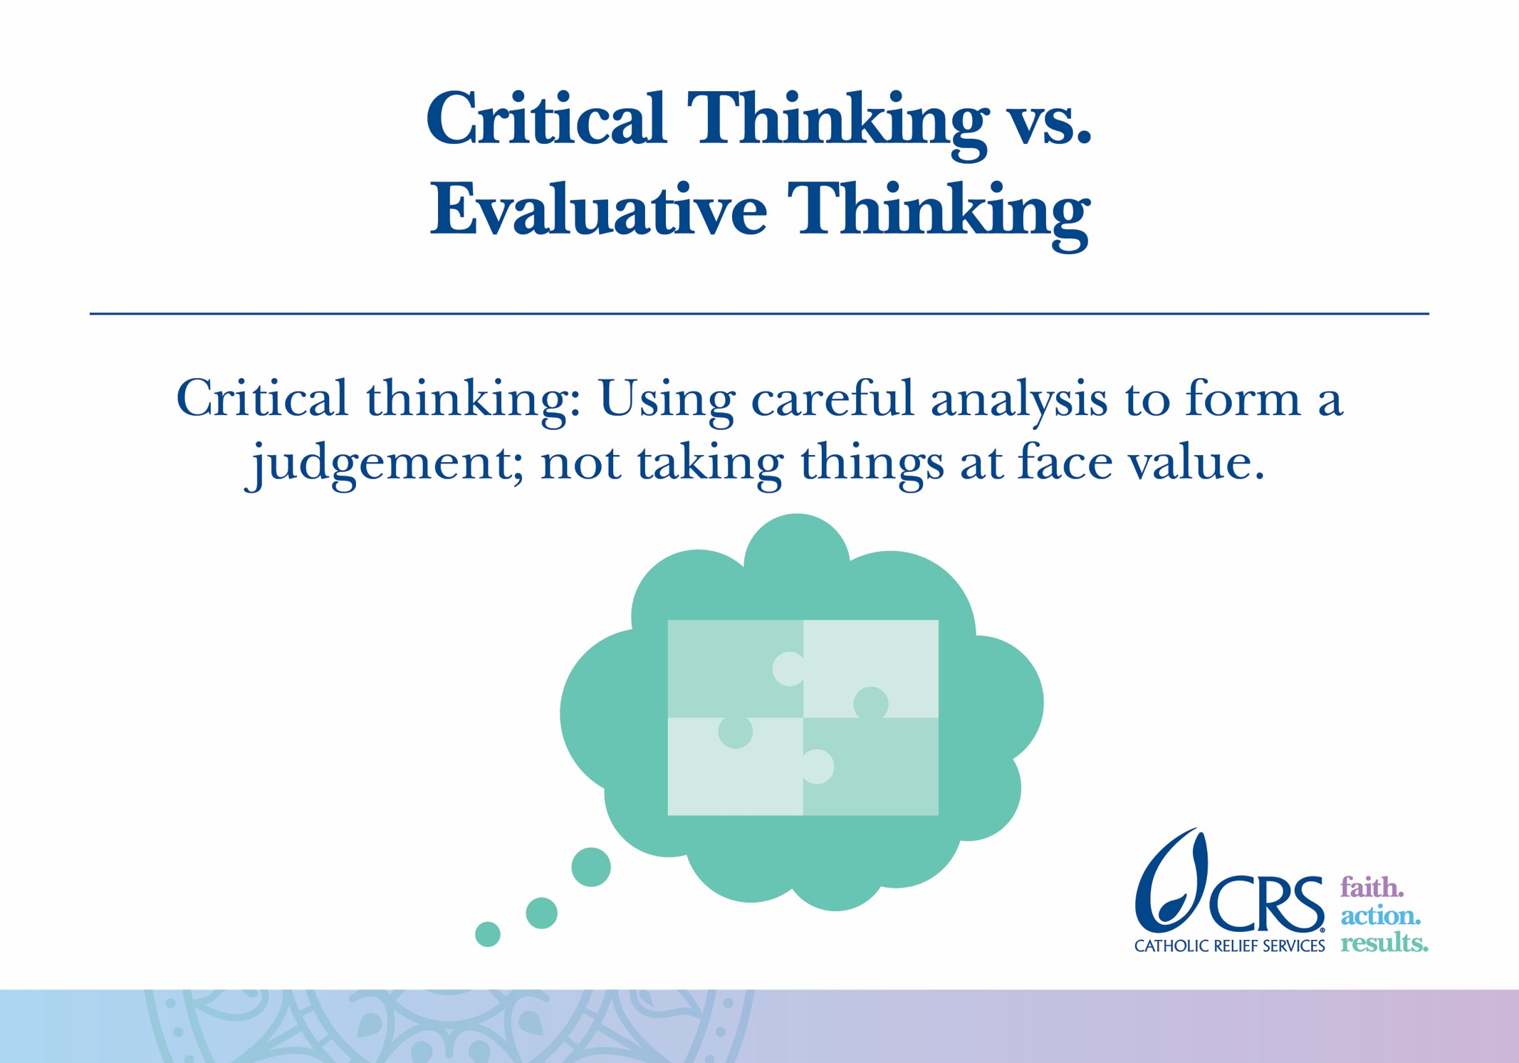

Slide 24
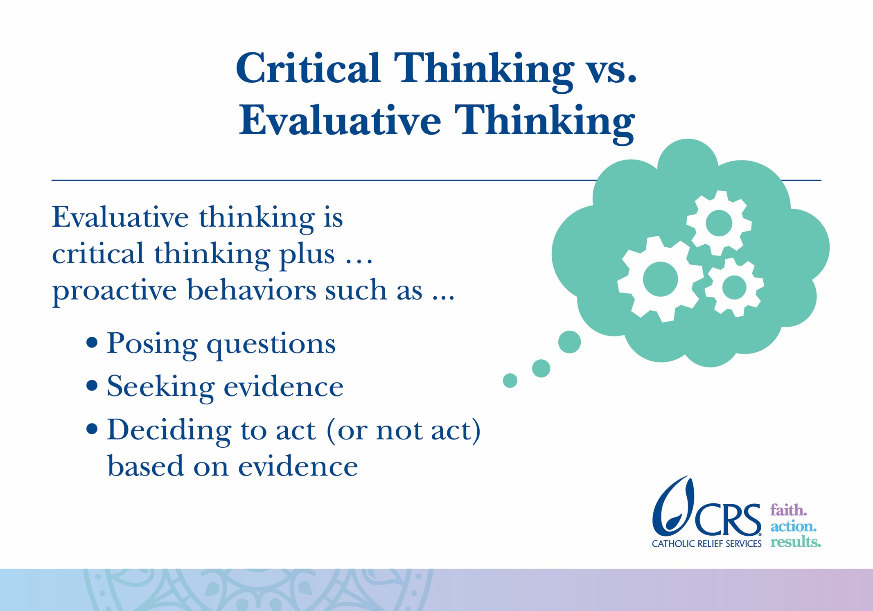

Slide 25
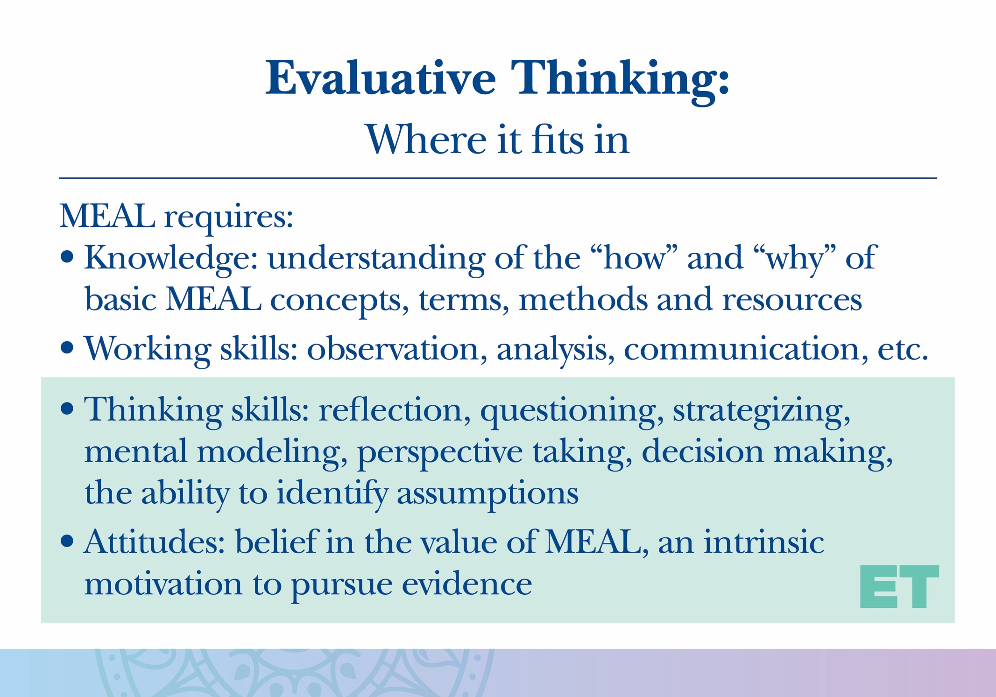

Slide 26
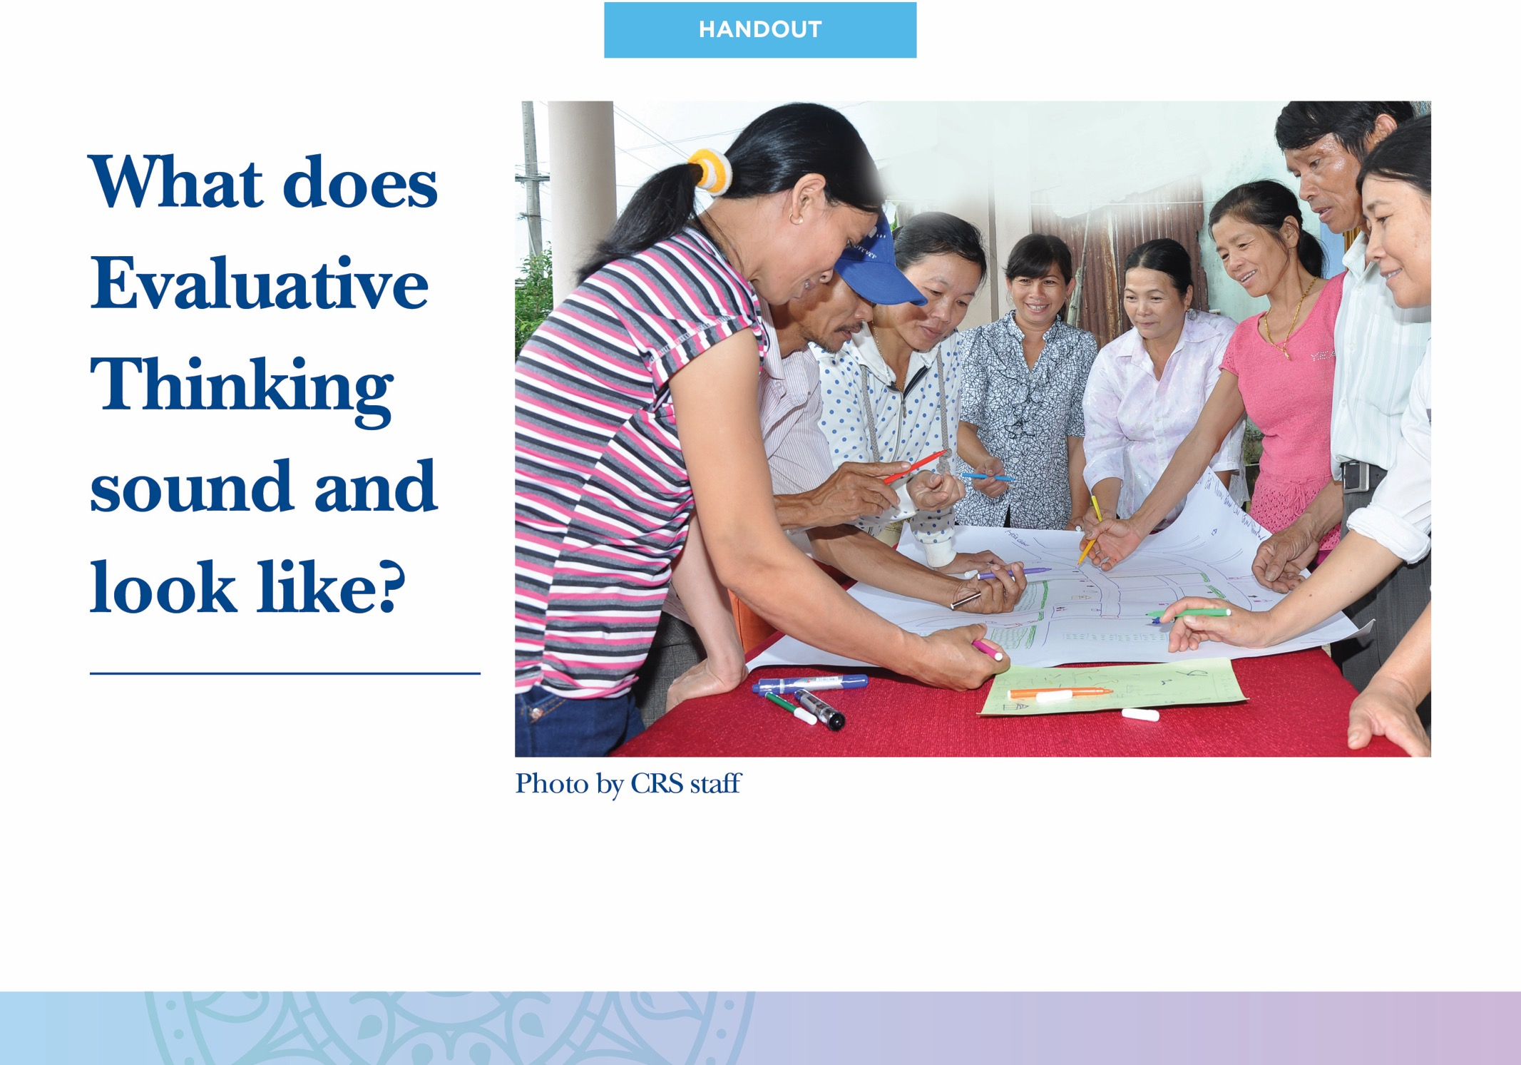

Slide 27
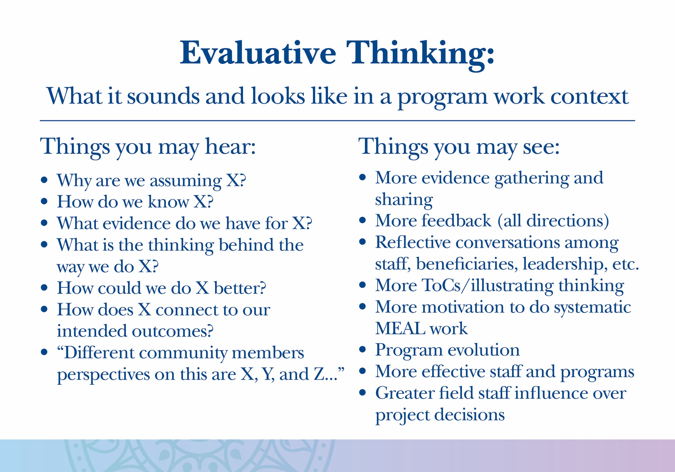

Slide 28
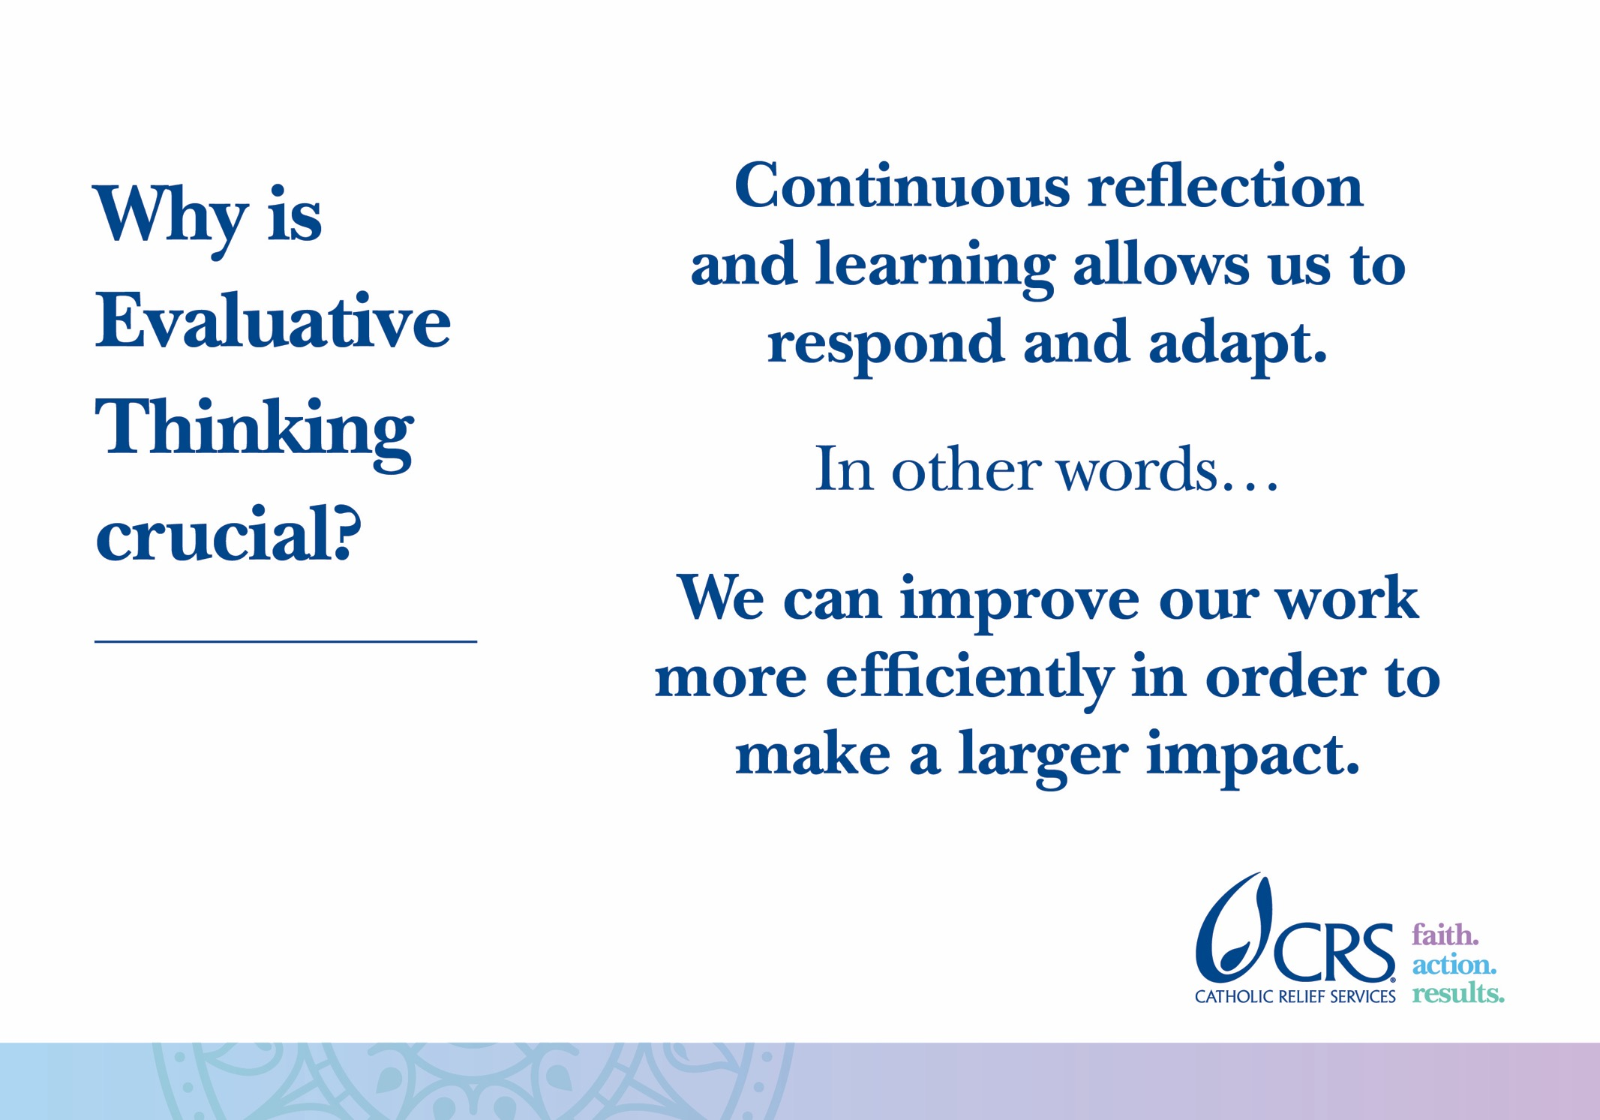

Slide 29
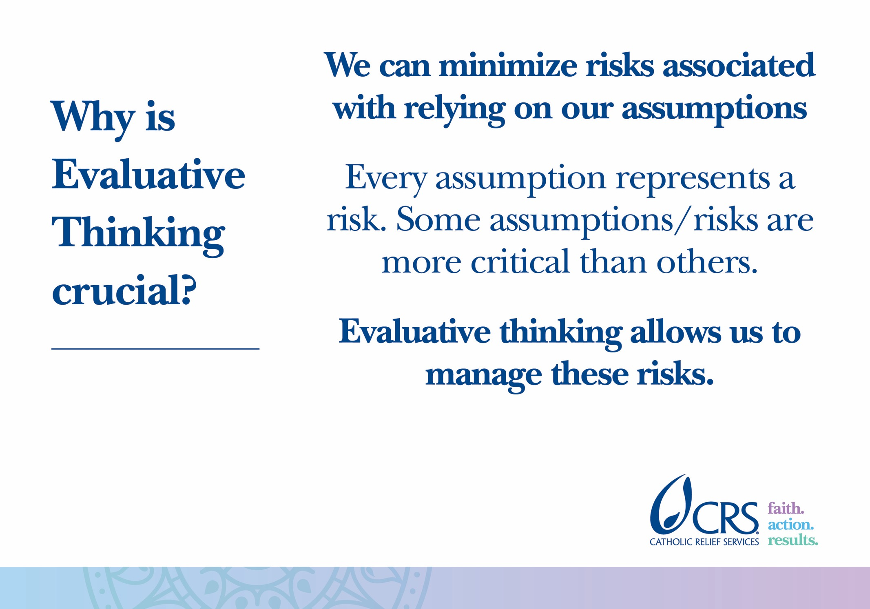

Slide 30


Slide 31
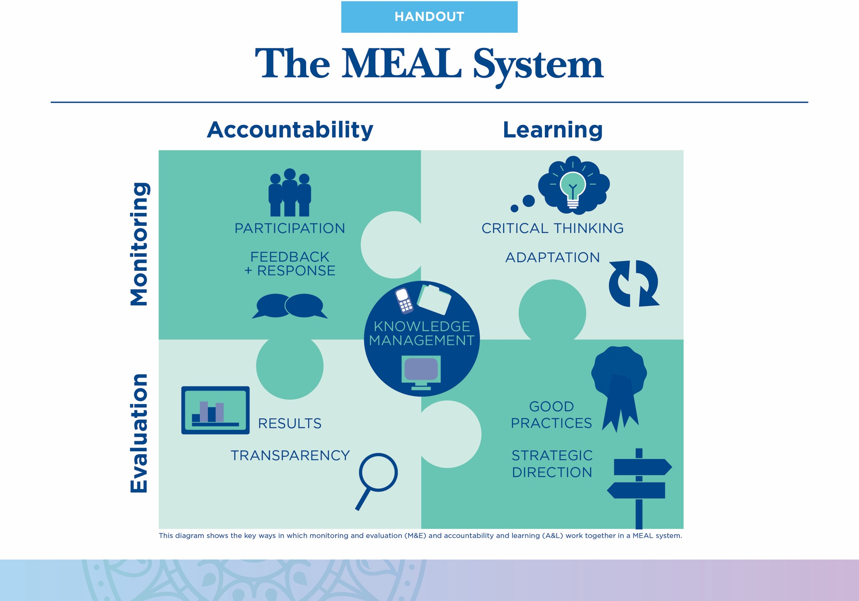

Slide 32
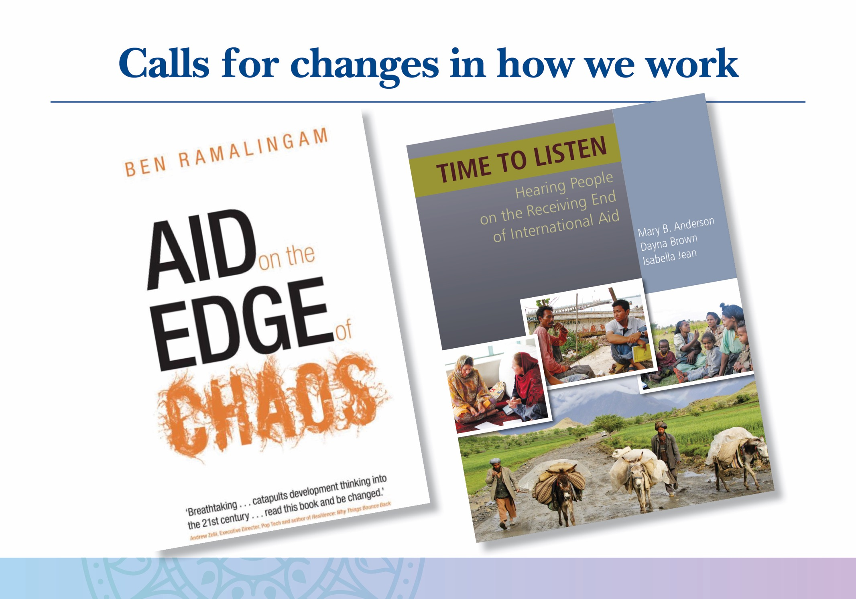

Slide 33
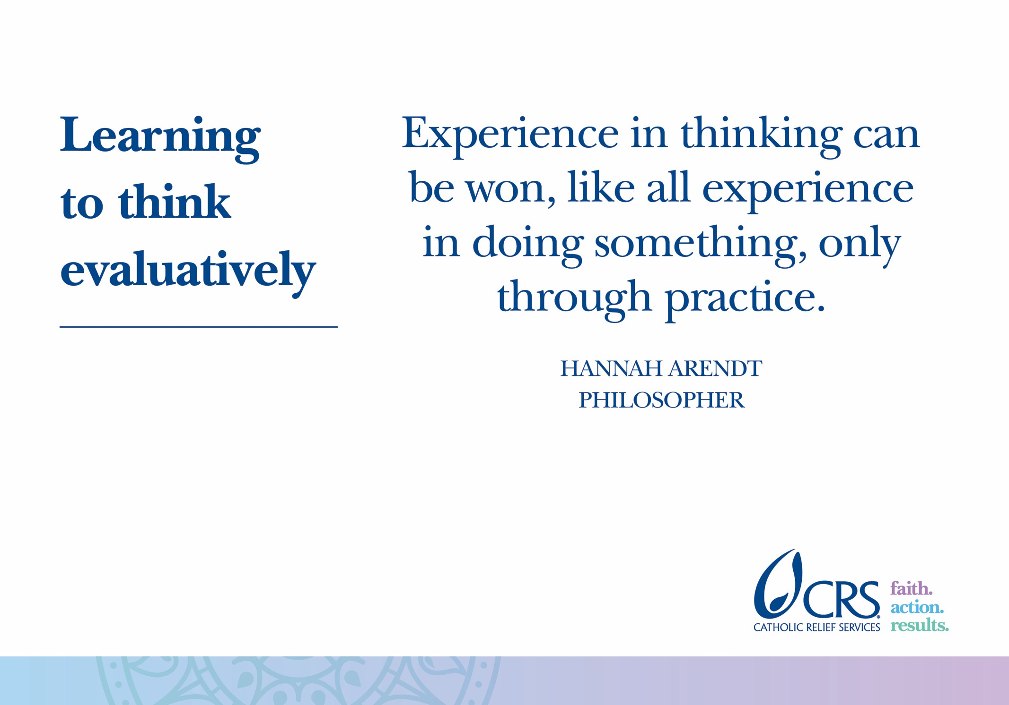

Slide 34
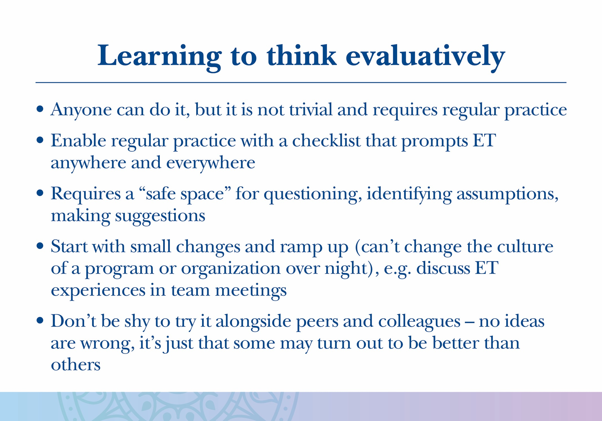

Slide 35
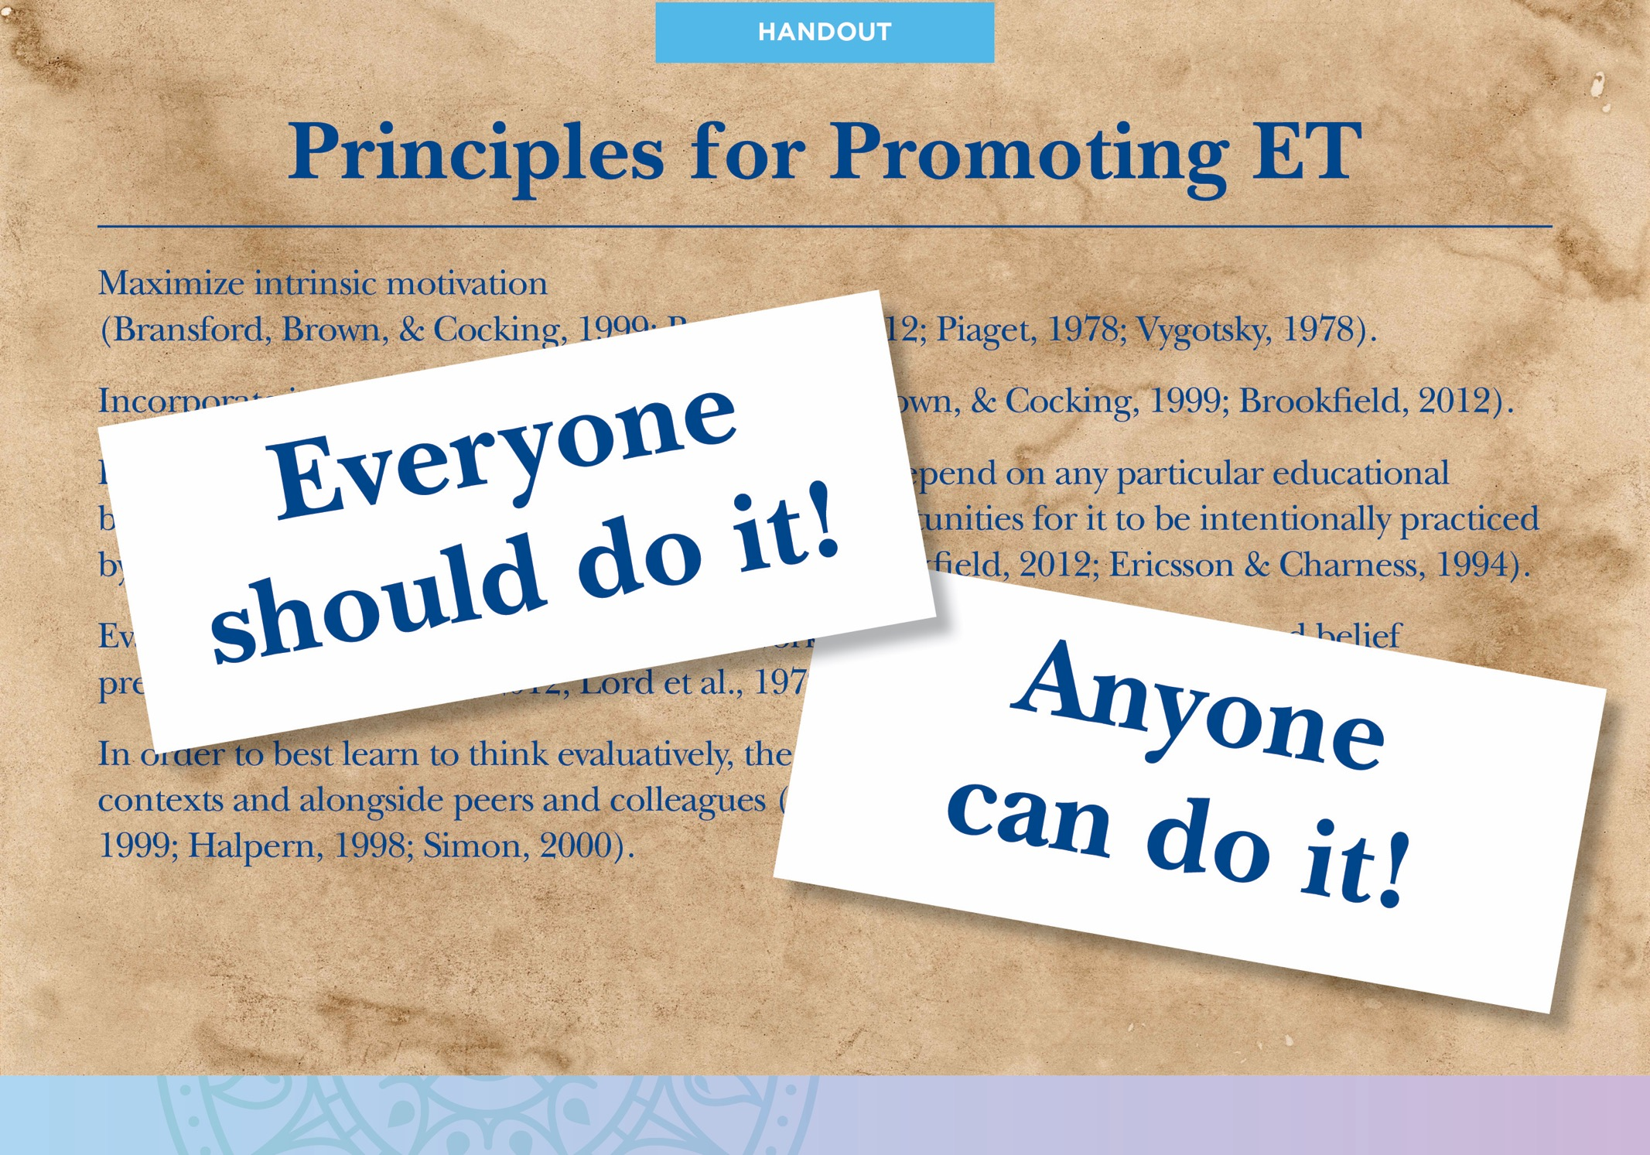

Slide 36
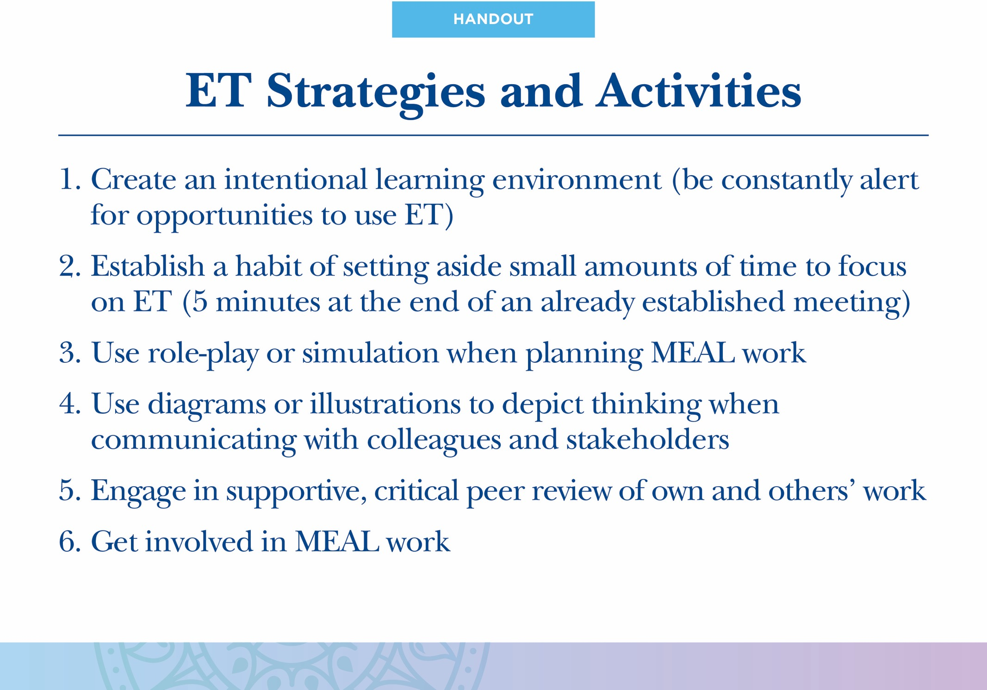

Slide 37
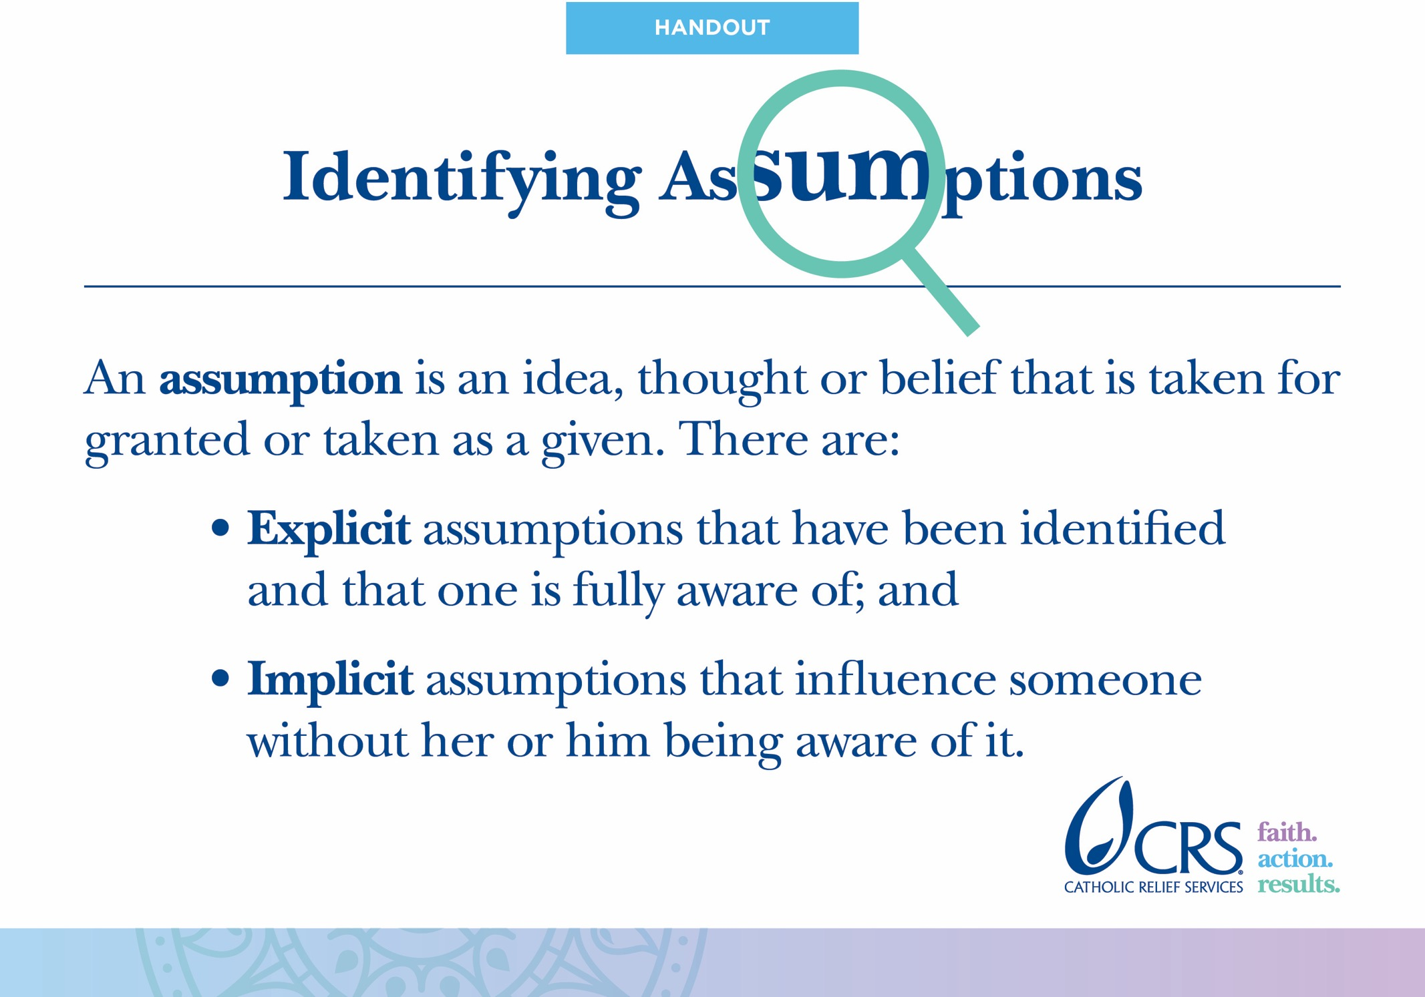

Slide 38
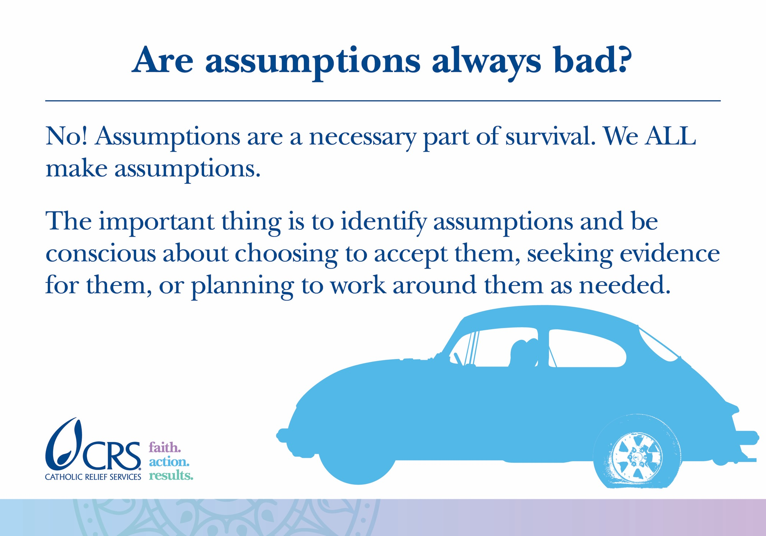
Notes:
For example, when we get in a car to go somewhere, we assume that the car’s tires have air in them. We don’t check the air pressure every time we get in; we don’t even think about the tires at all. That’s ok! It would be a waste of time, considered crazy even, to check the tires every time we got into a car. The assumption in this case is adaptive. It helps us move through life more efficiently.

Slide 39
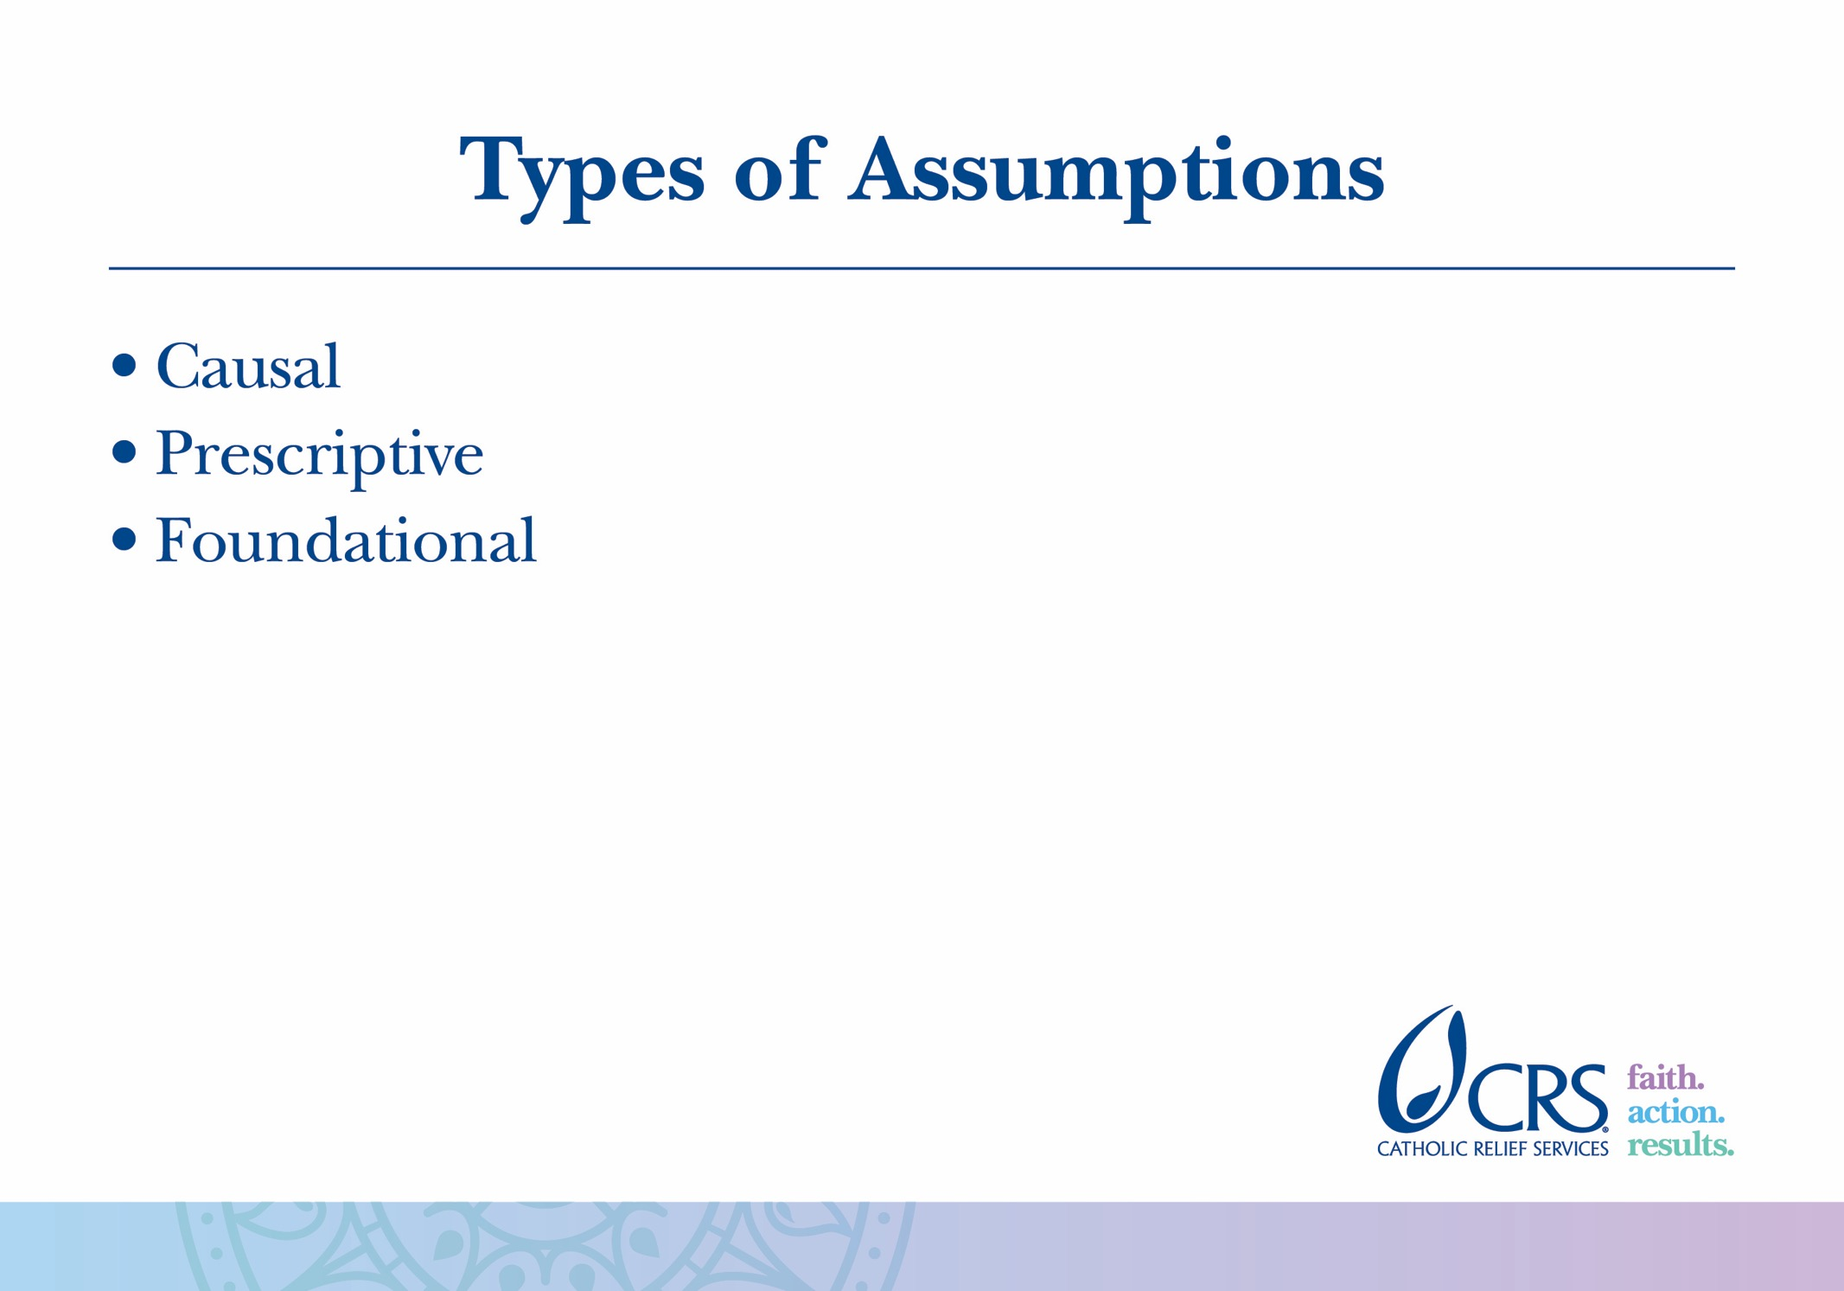

Slide 40
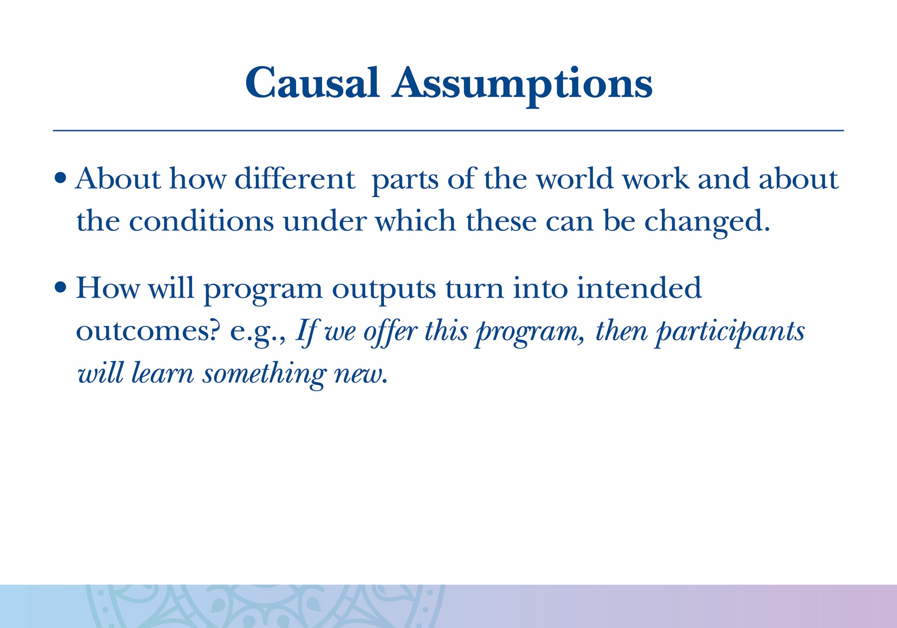

Slide 41
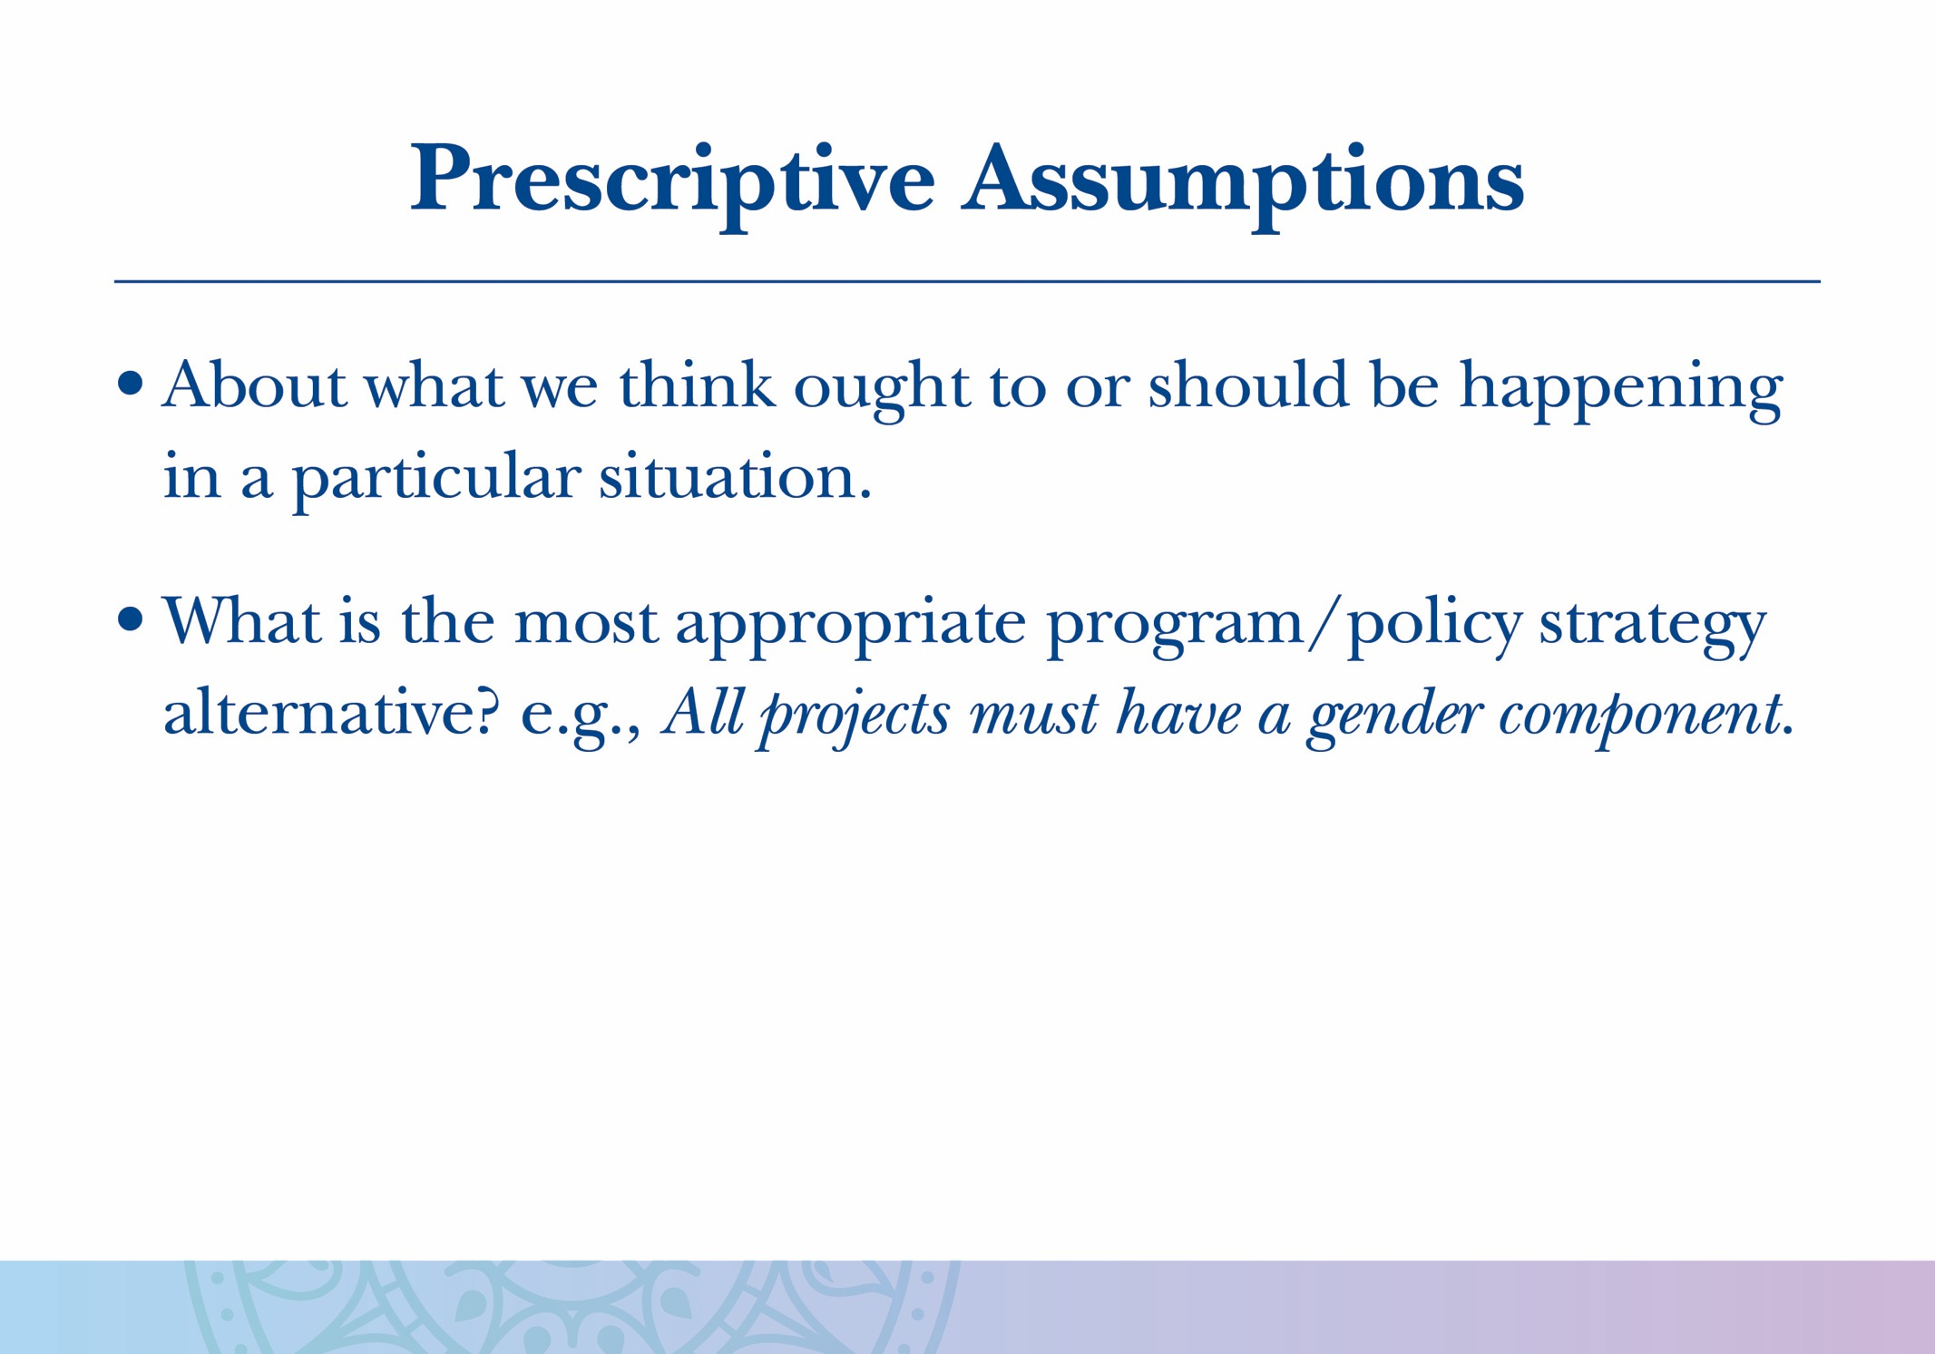

Slide 42
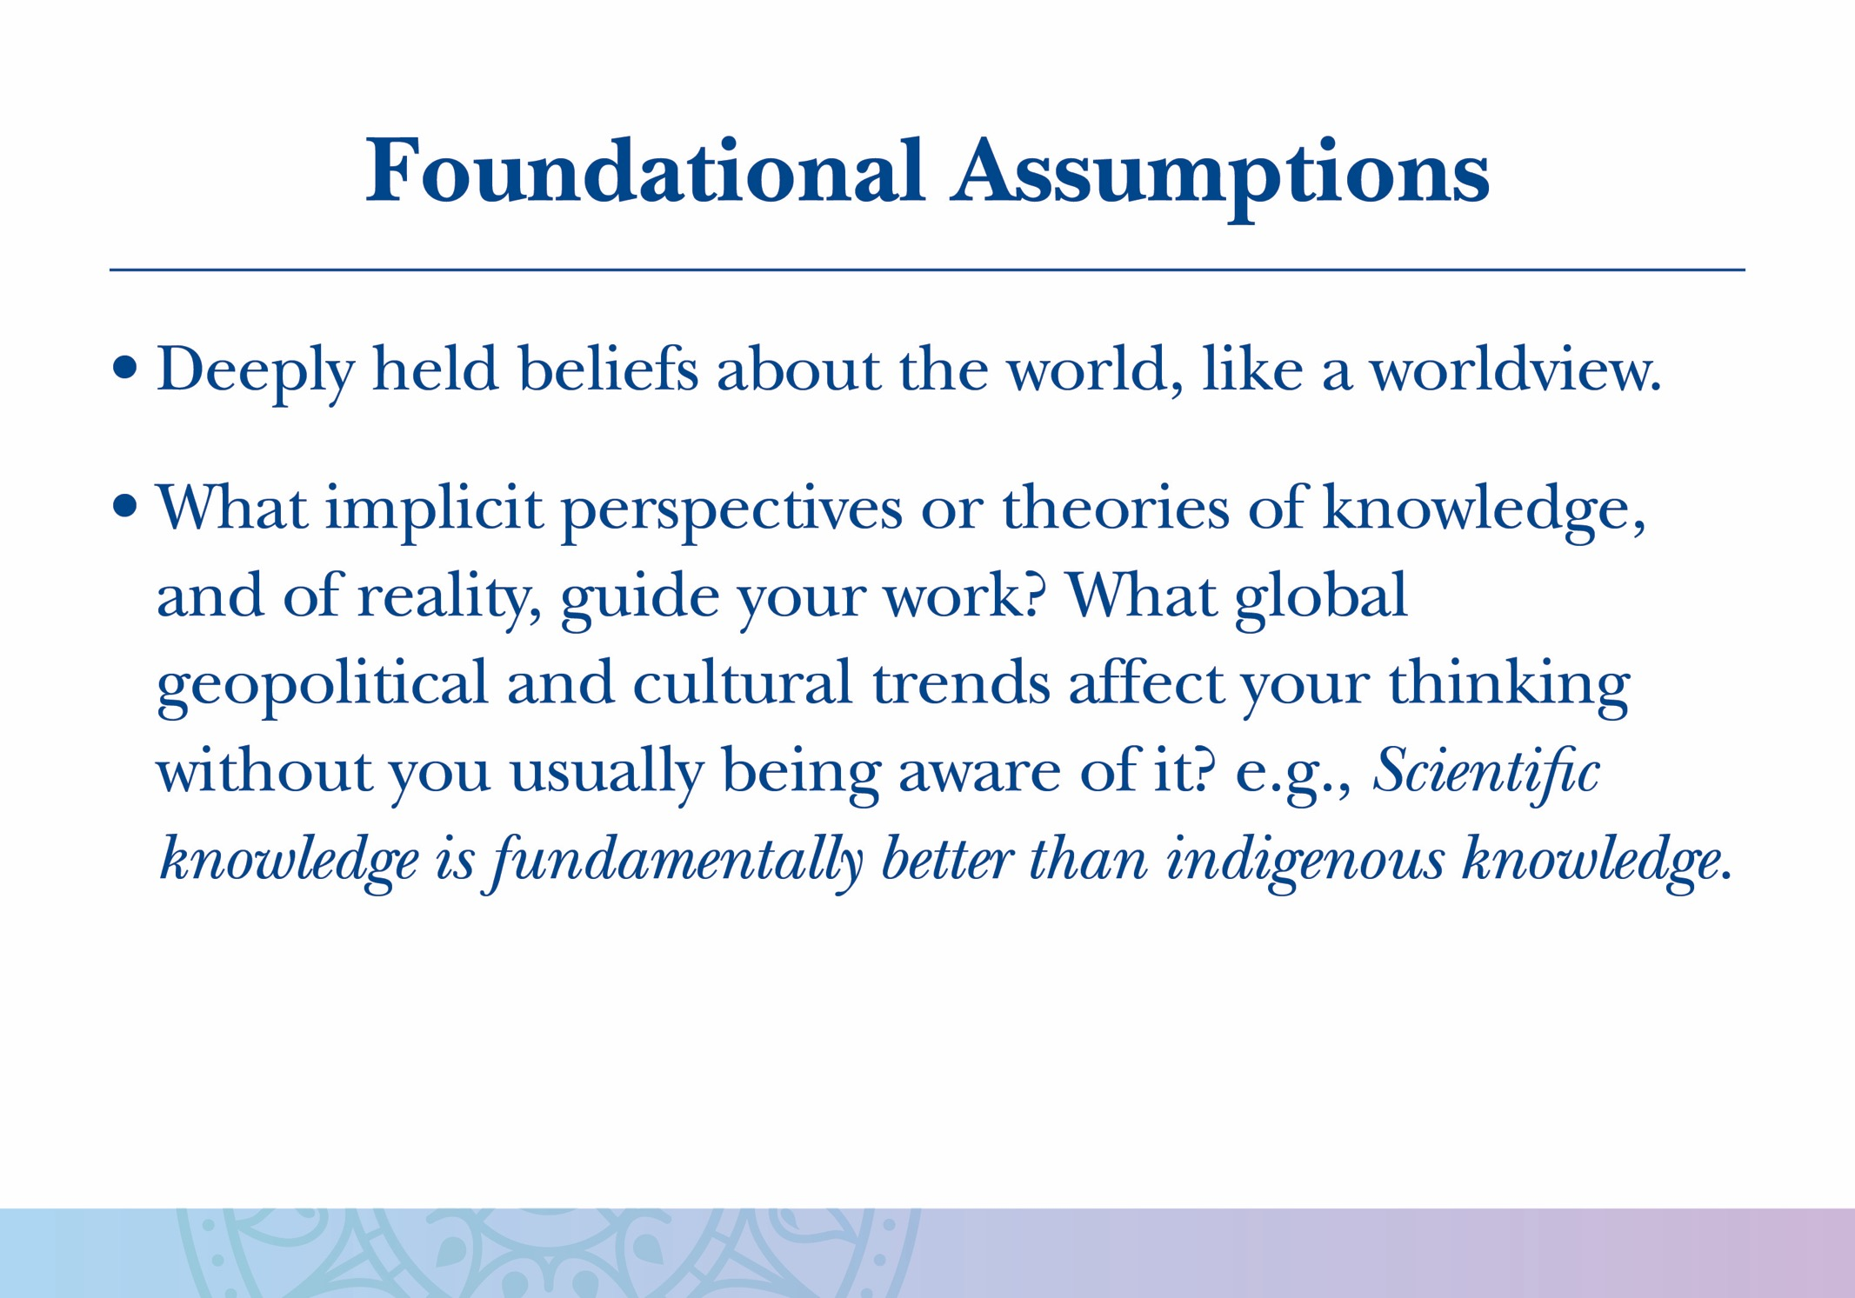

Slide 43
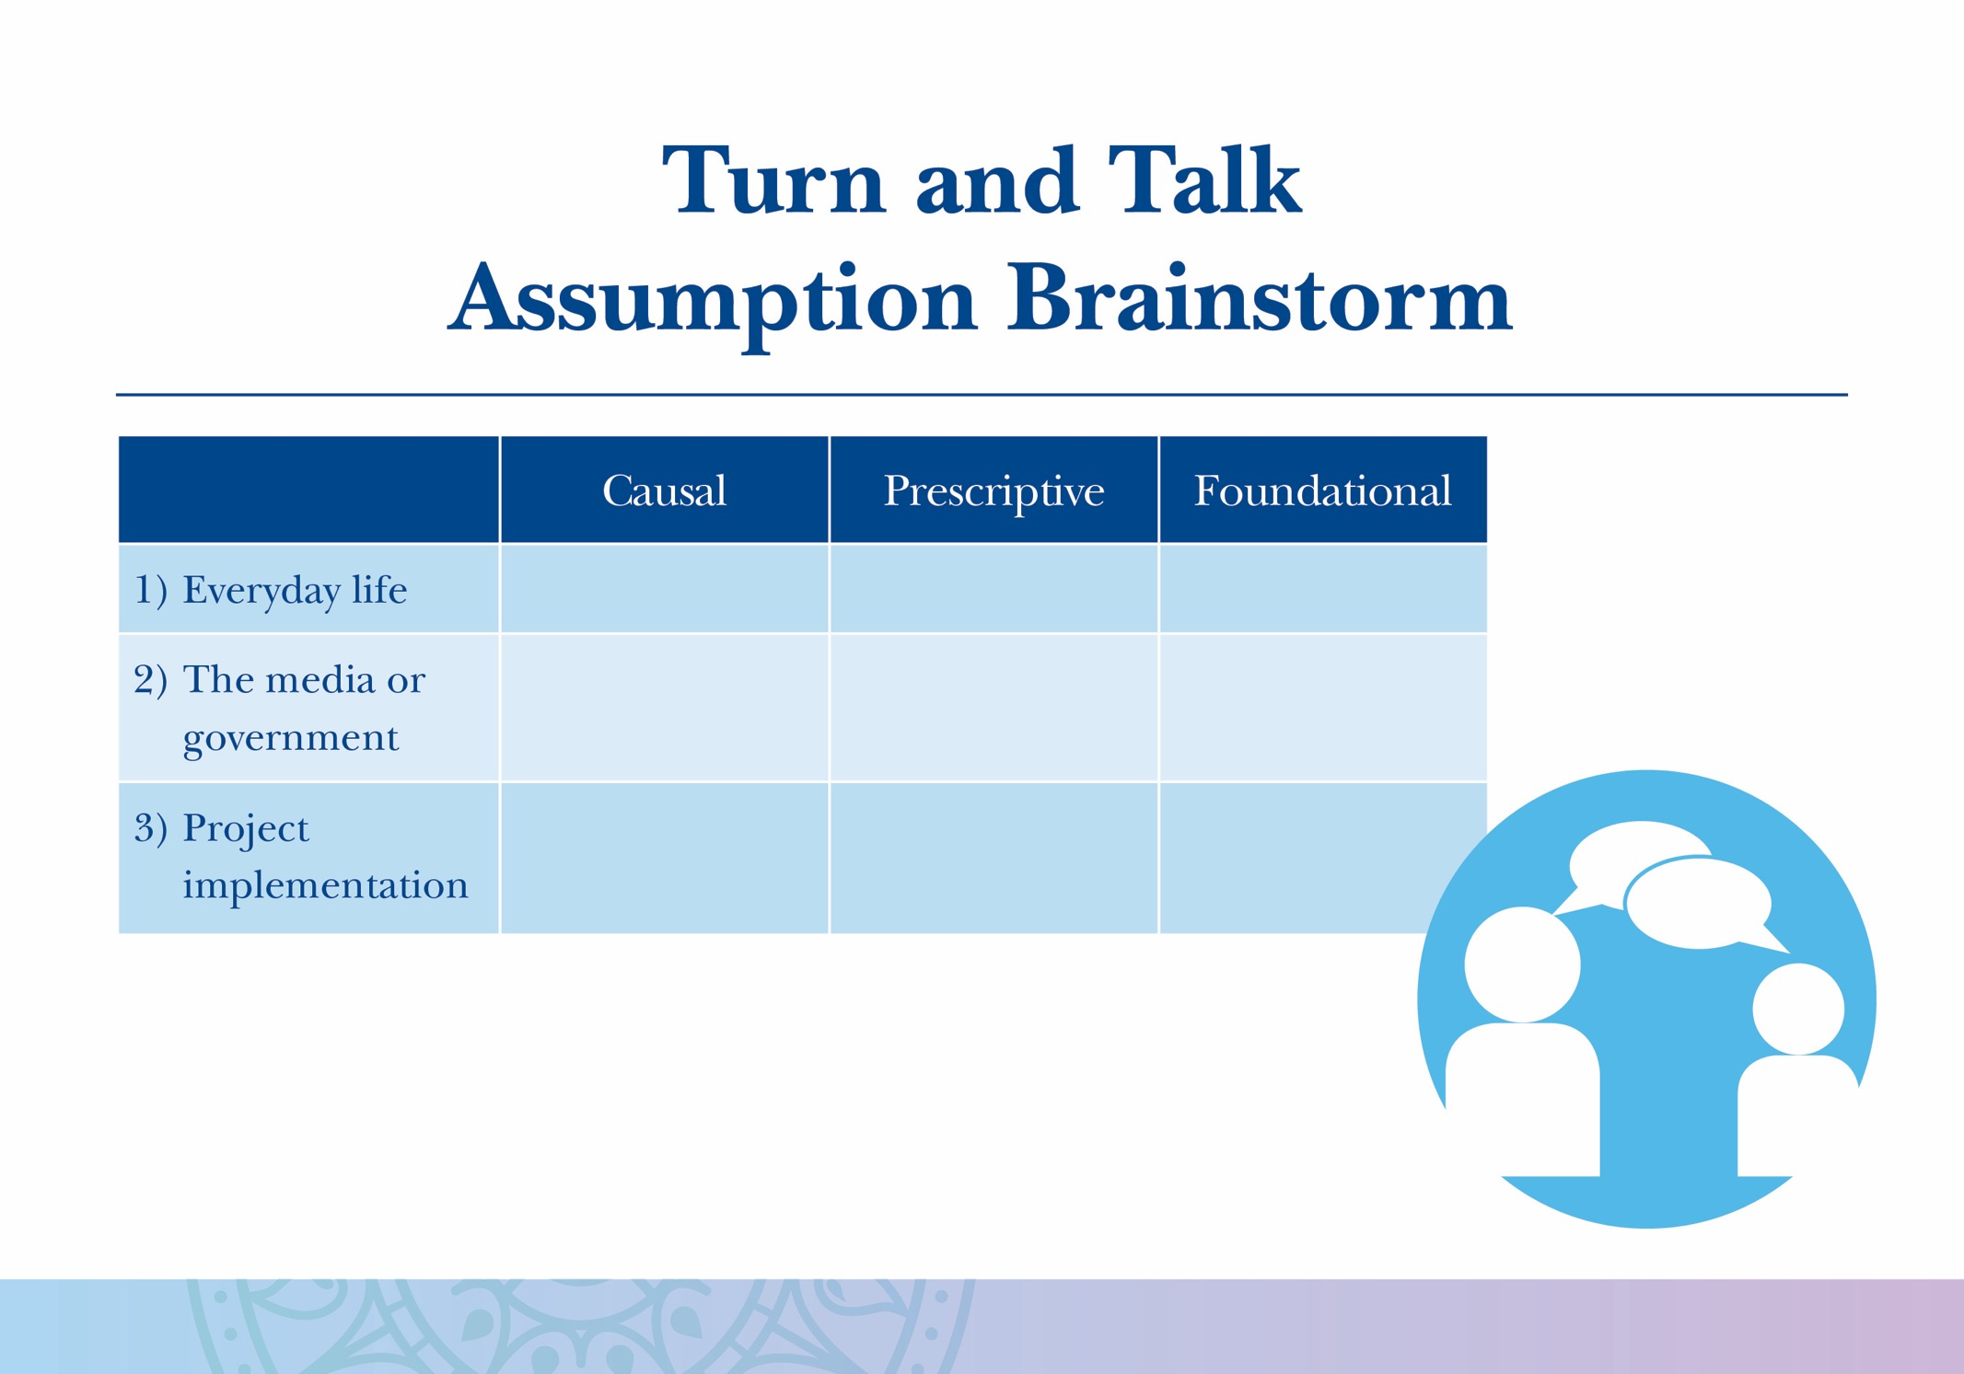

Slide 44
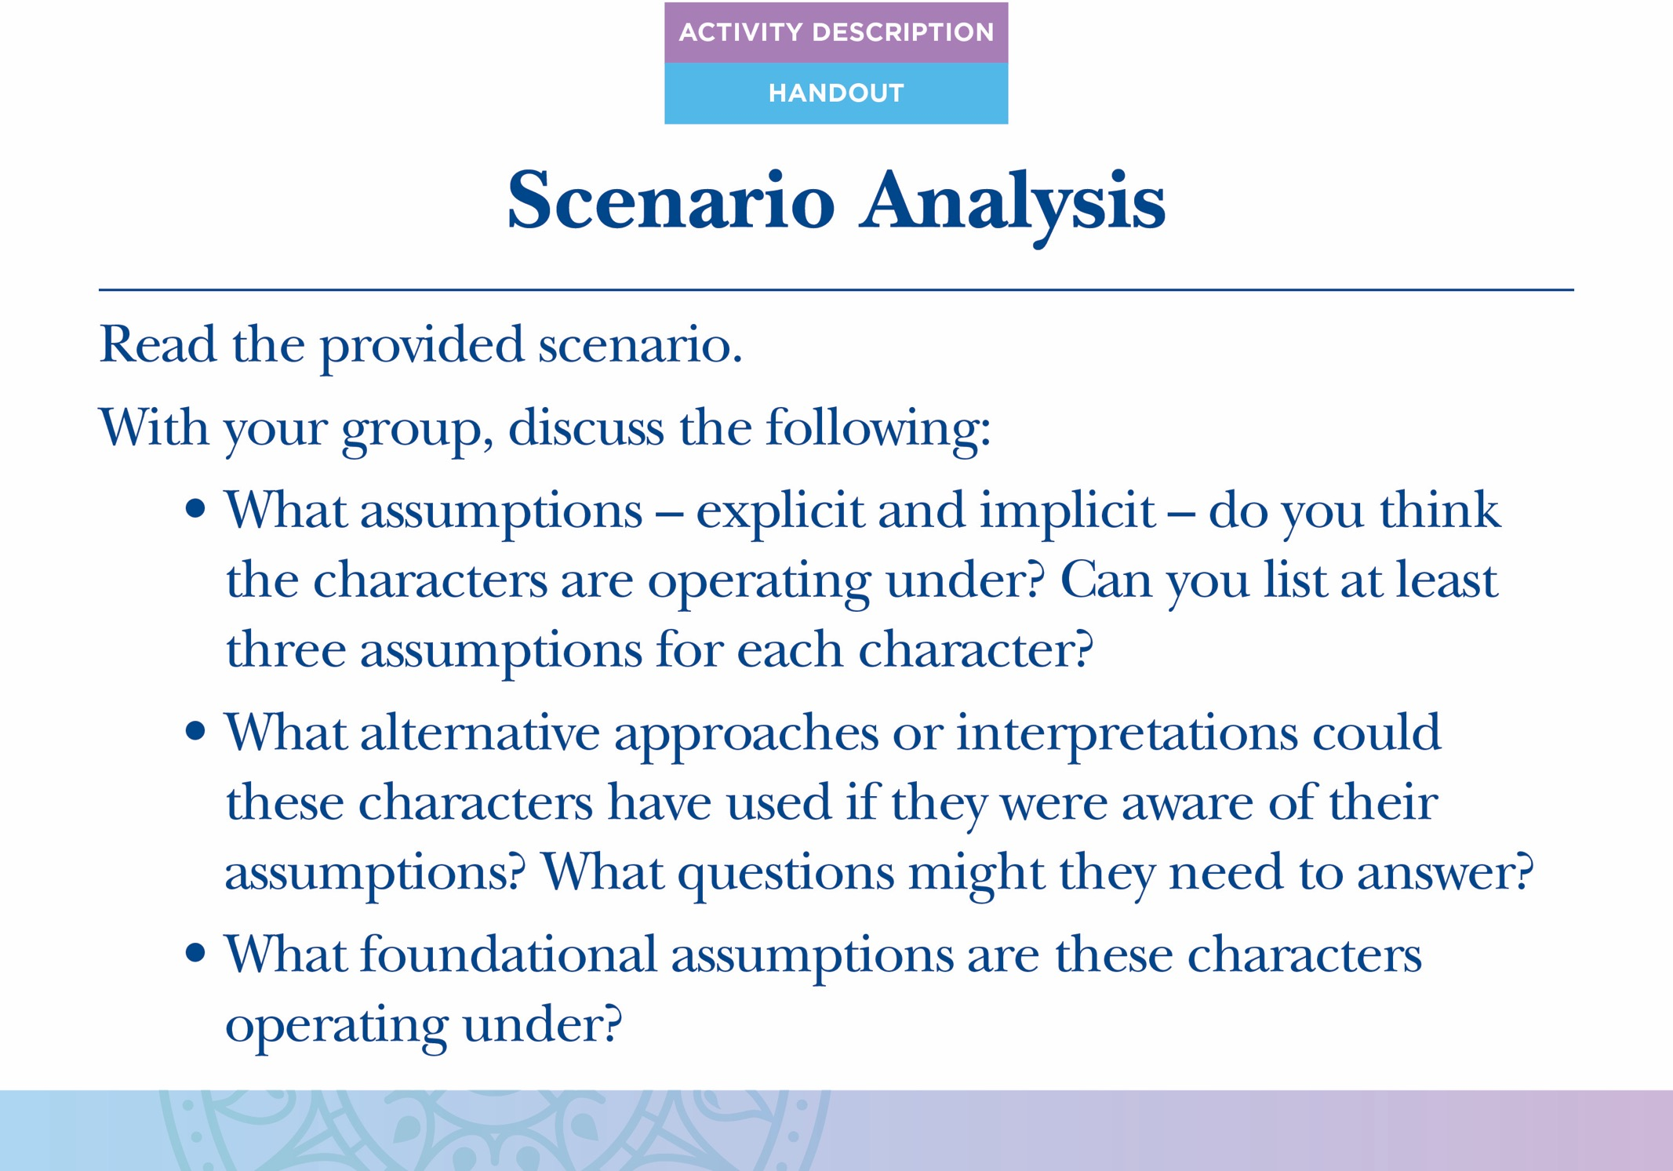

Slide 45
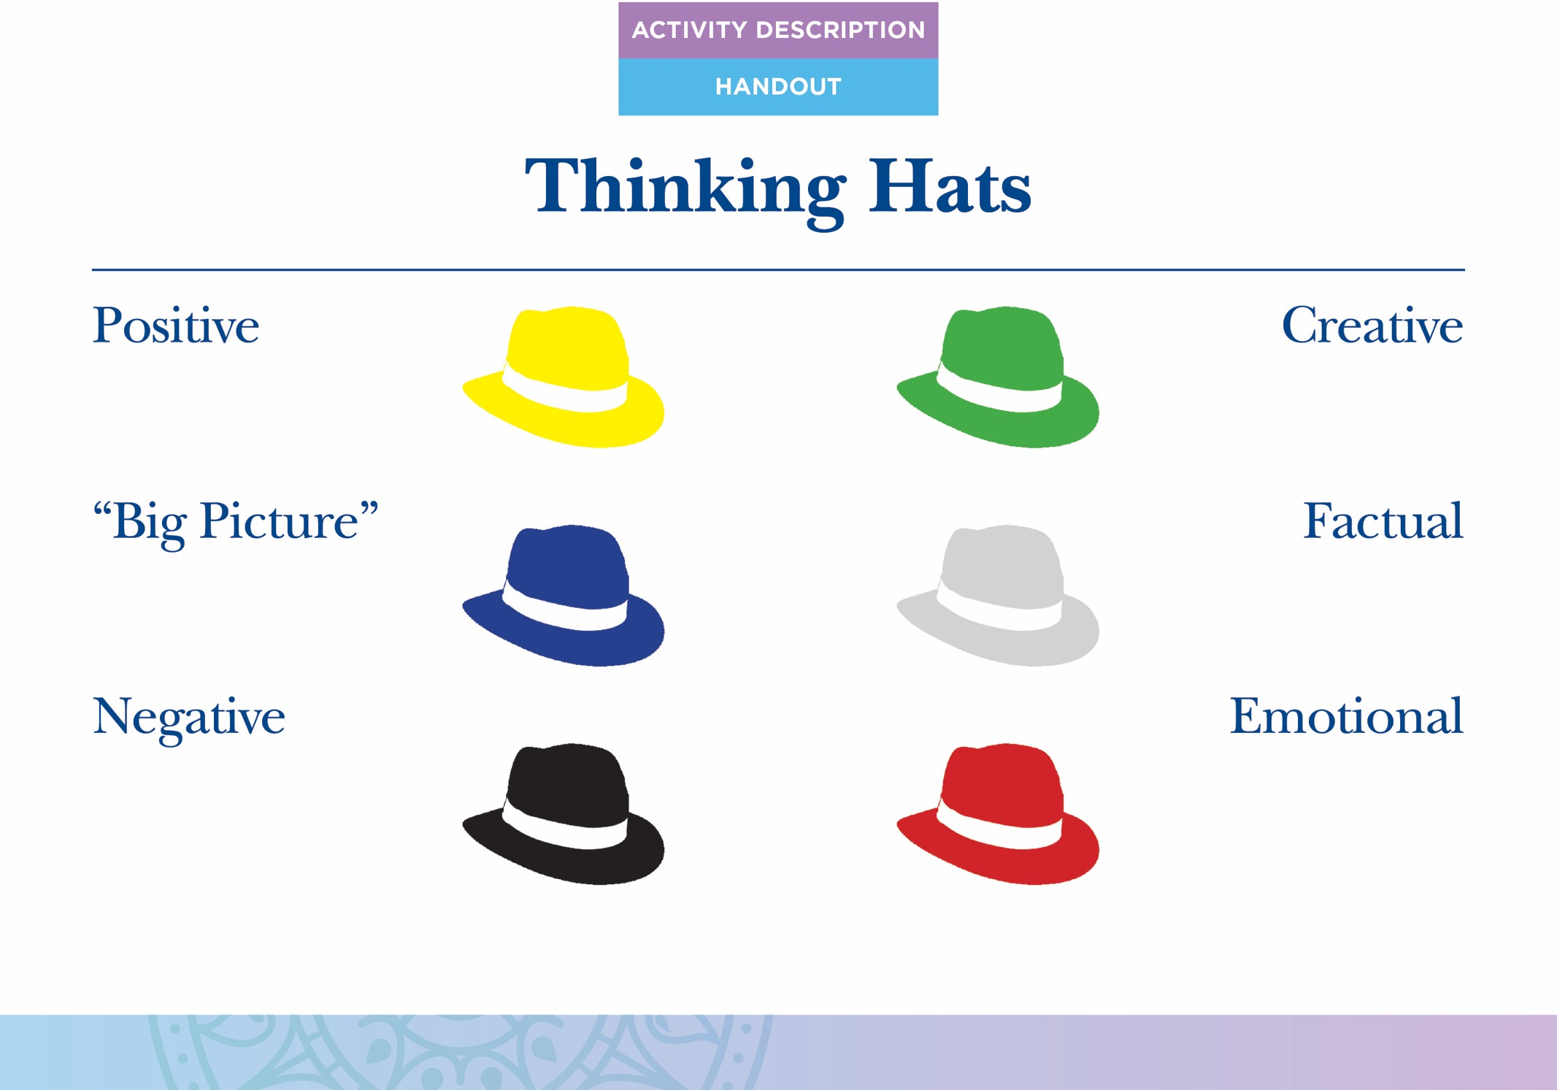

Slide 46
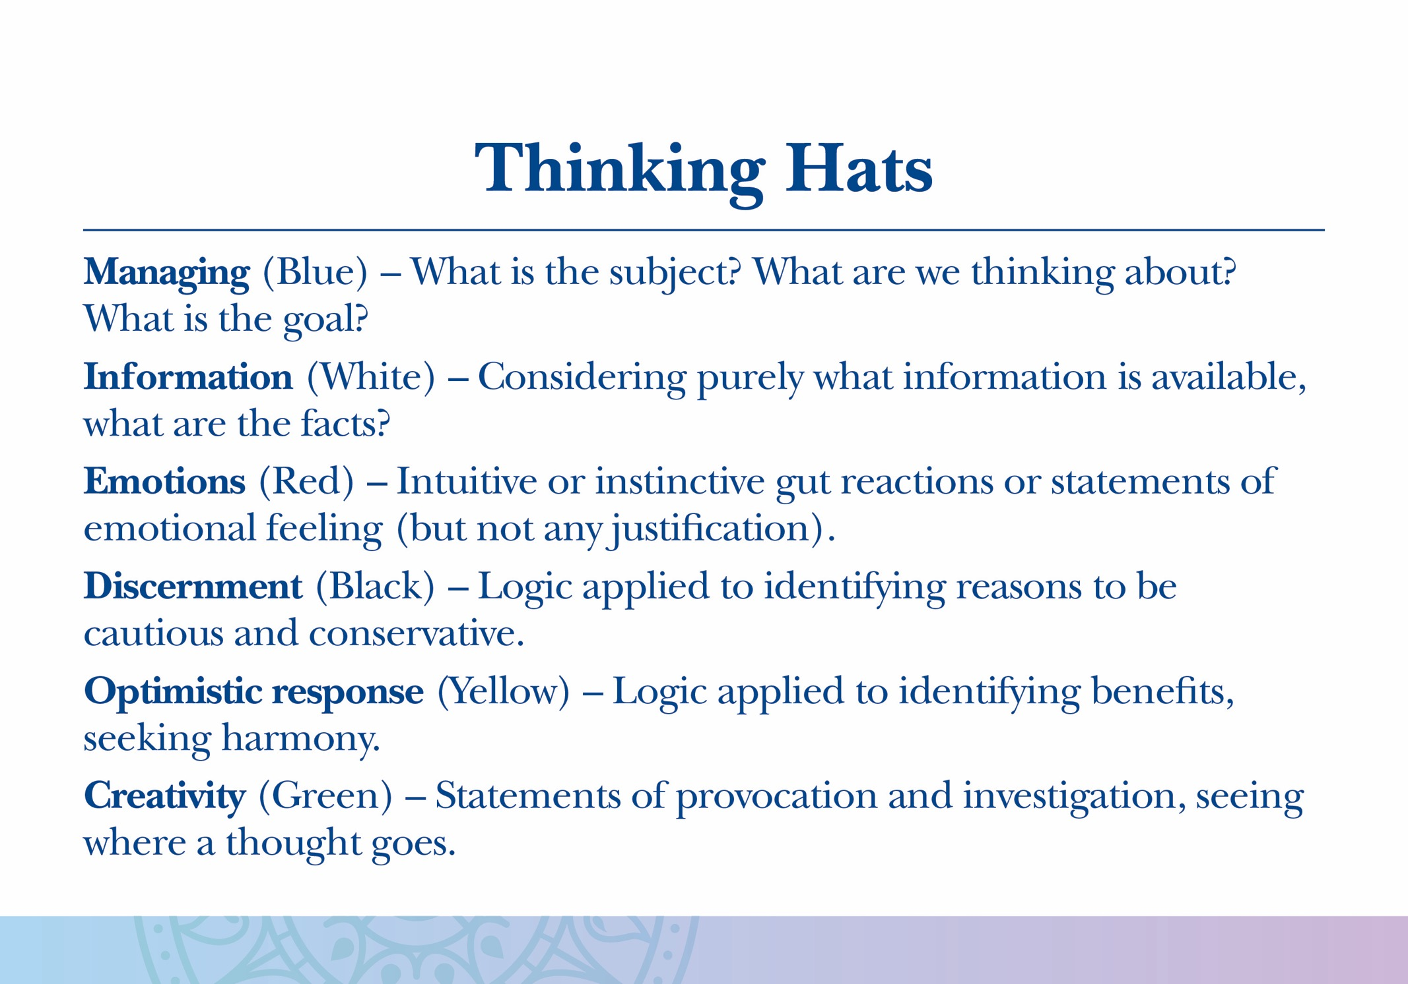

Slide 47
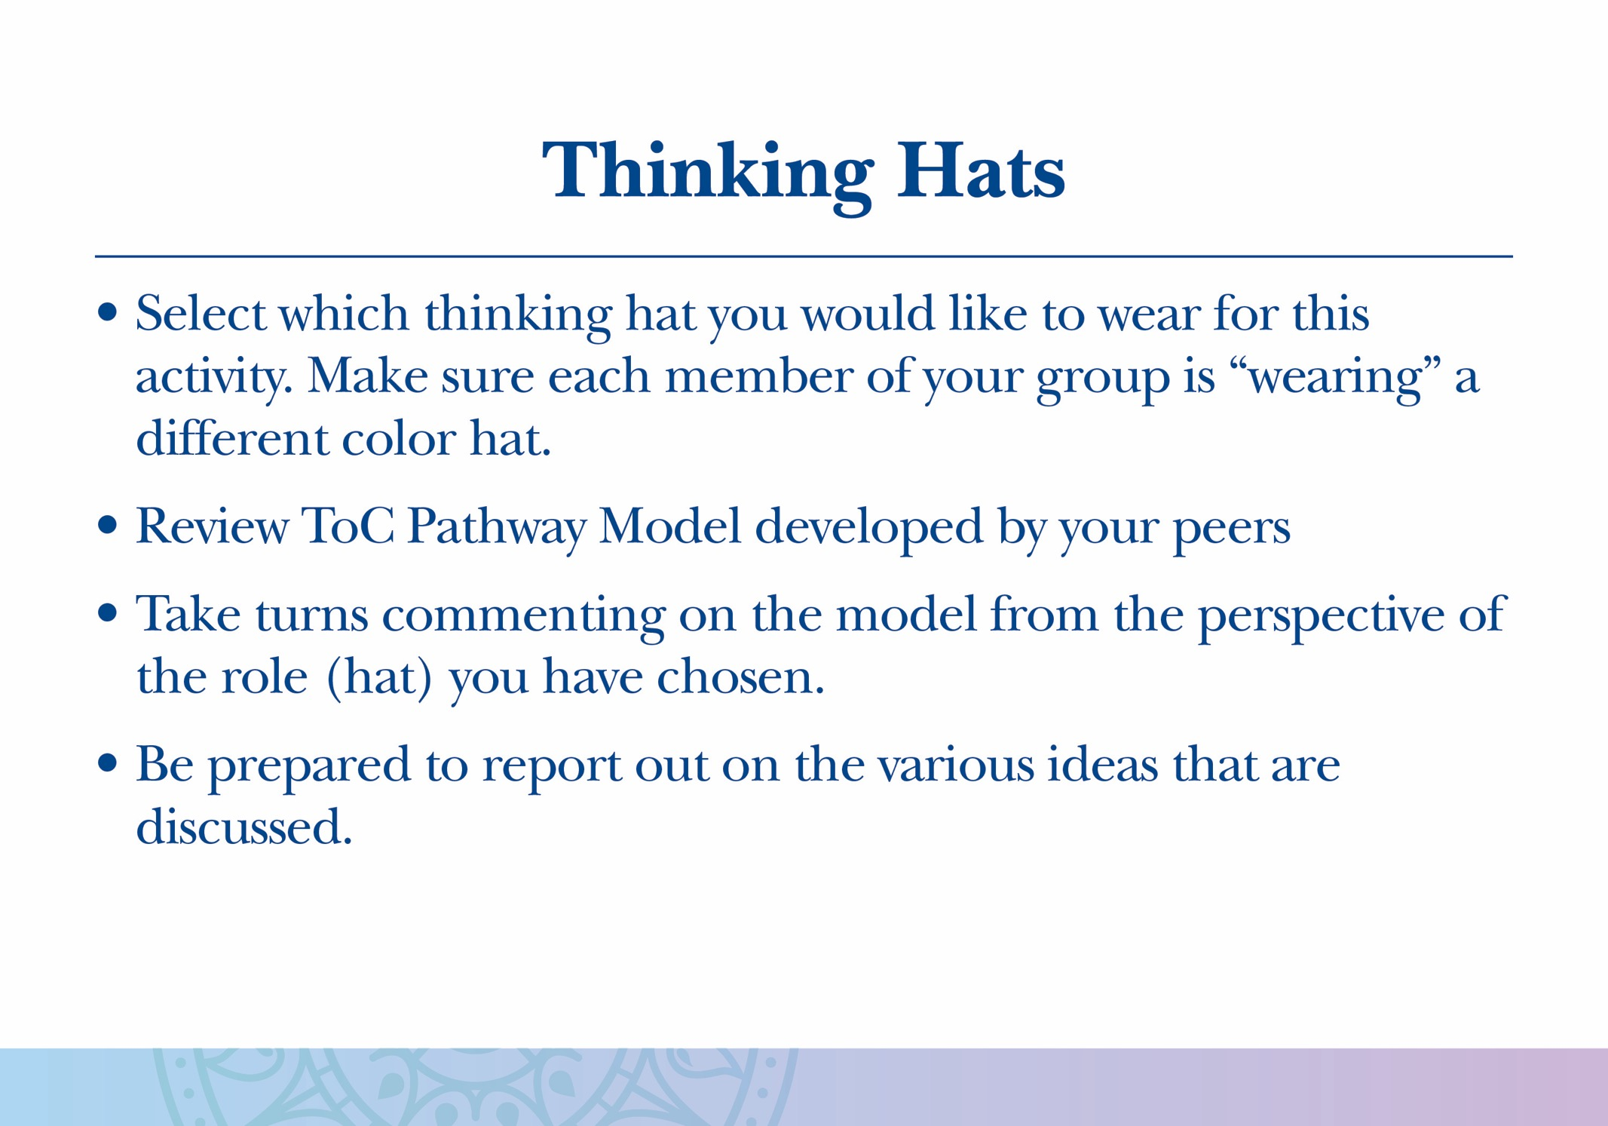

Slide 48
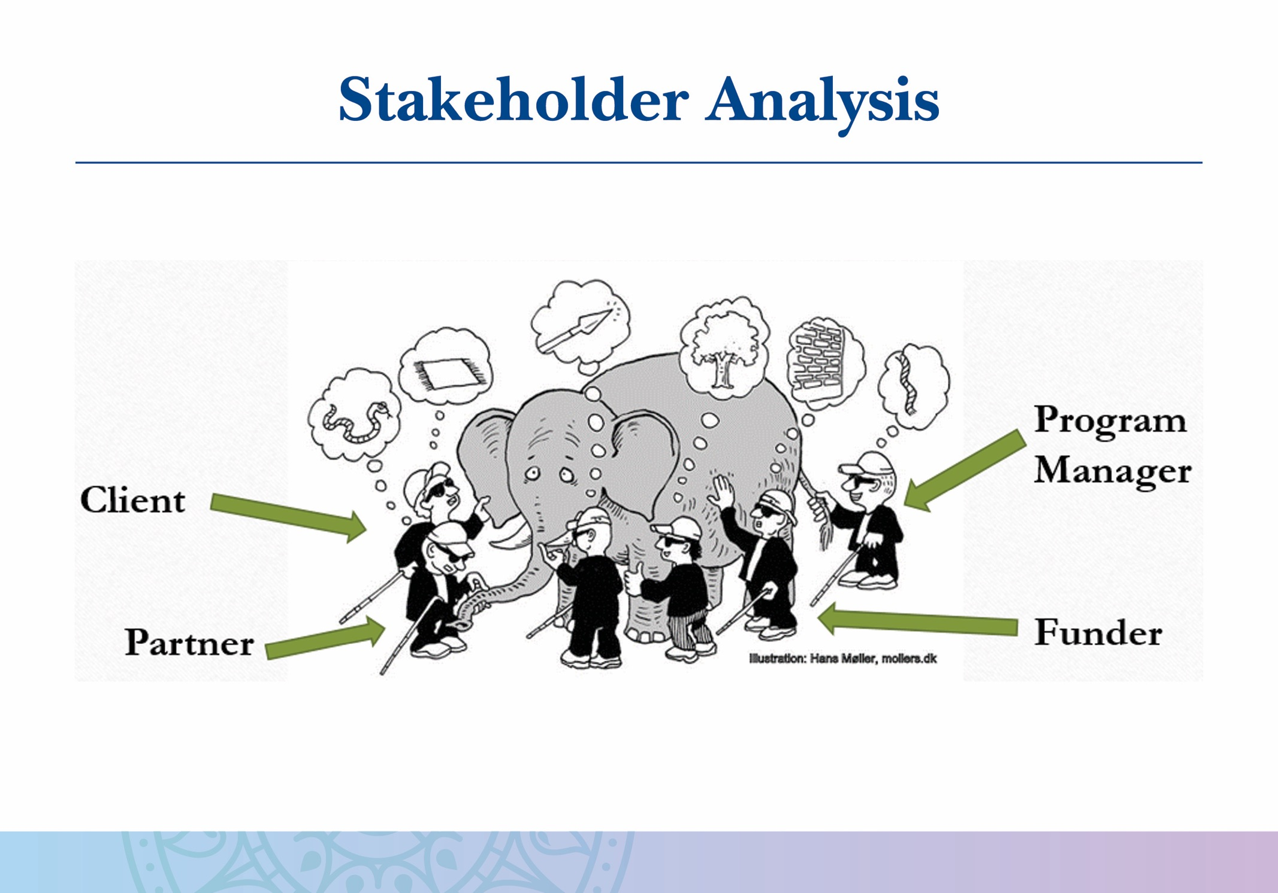
Notes:
These are all blind men who are feeling different parts of the elephant. Based on what they feel (rather than what they see), each describes something different. This is analogous to various stakeholders’ perspectives on a program.

Slide 49
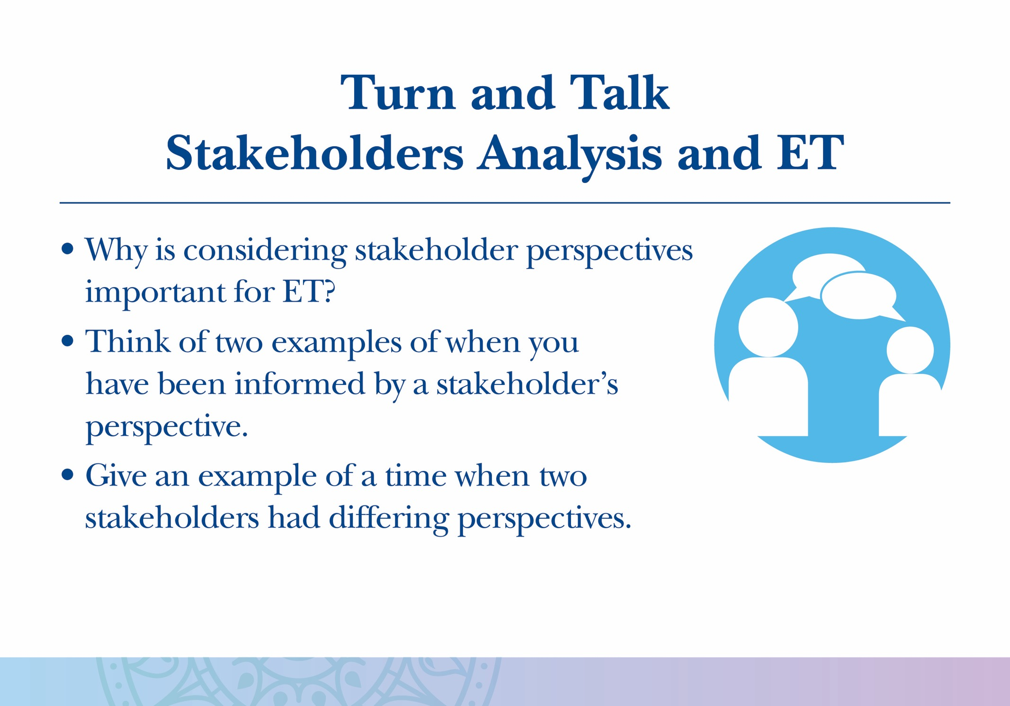

Slide 50
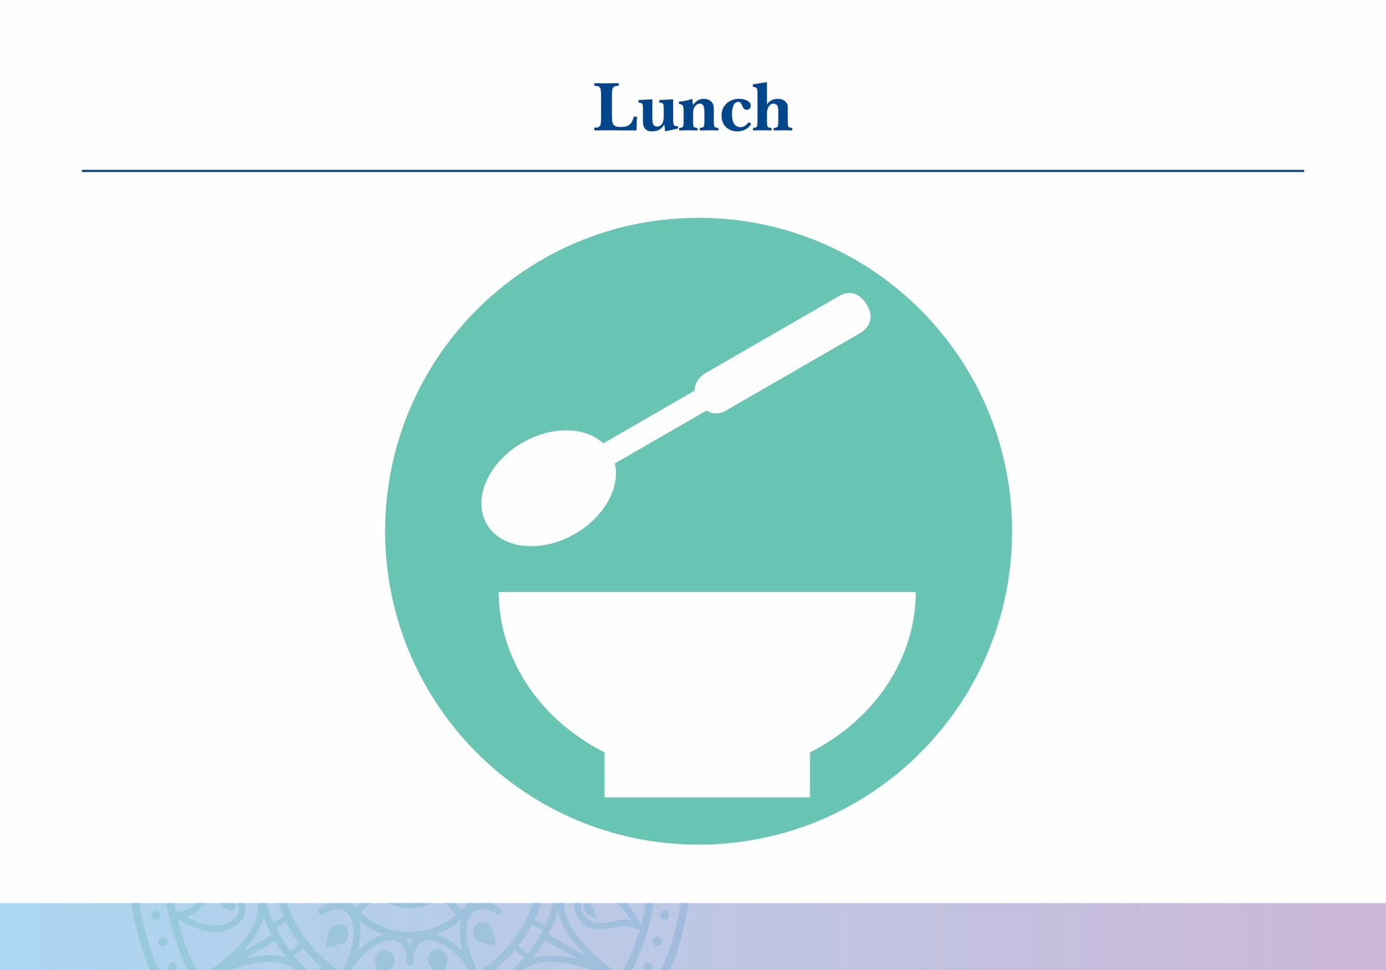

Slide 51
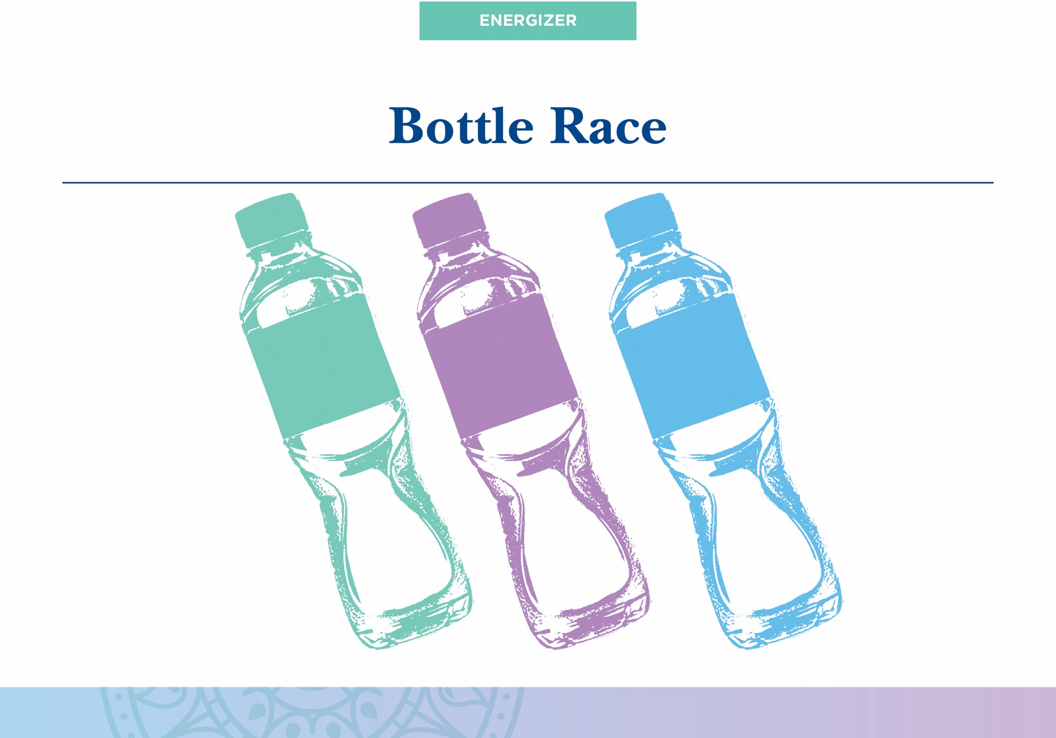
Notes:
You do not need to do the bottle race energizer. You could choose to play any game that would be fun for your participants.
The bottle race is a game where participants split into two teams and form two lines. The team members at the front of each line hold a water bottle. When the facilitator says “go,” the person at the front of the line hands the water bottle, over his or her head, to the person behind them and then runs to the back of the line. That person hands it, over his or her head, to the person behind them, and so on until the team leader returns to their place at the front of the line. The first team to bring their team leader back to the front of the line wins.

Slide 52
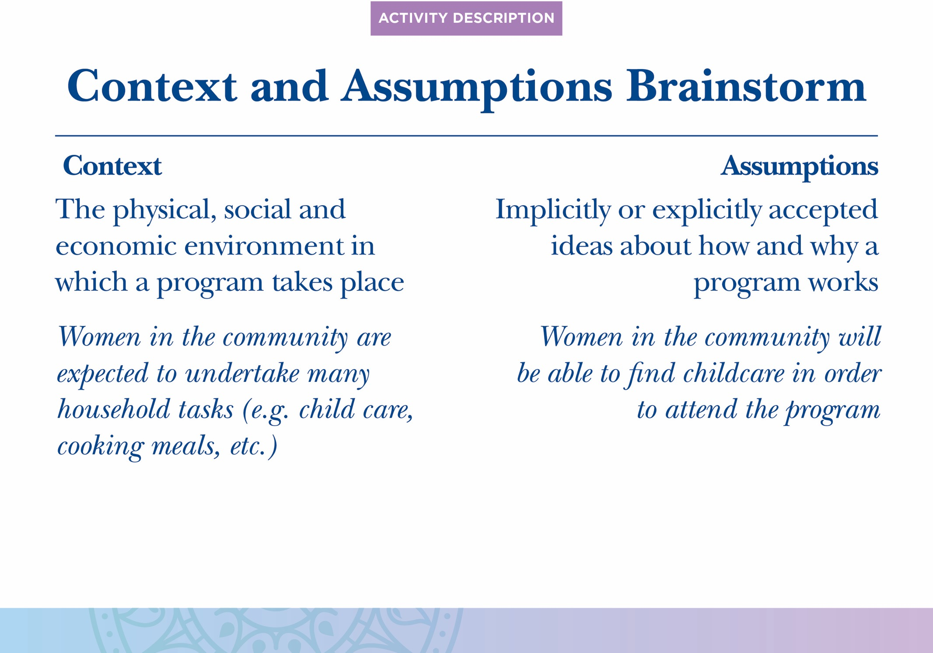

Slide 53
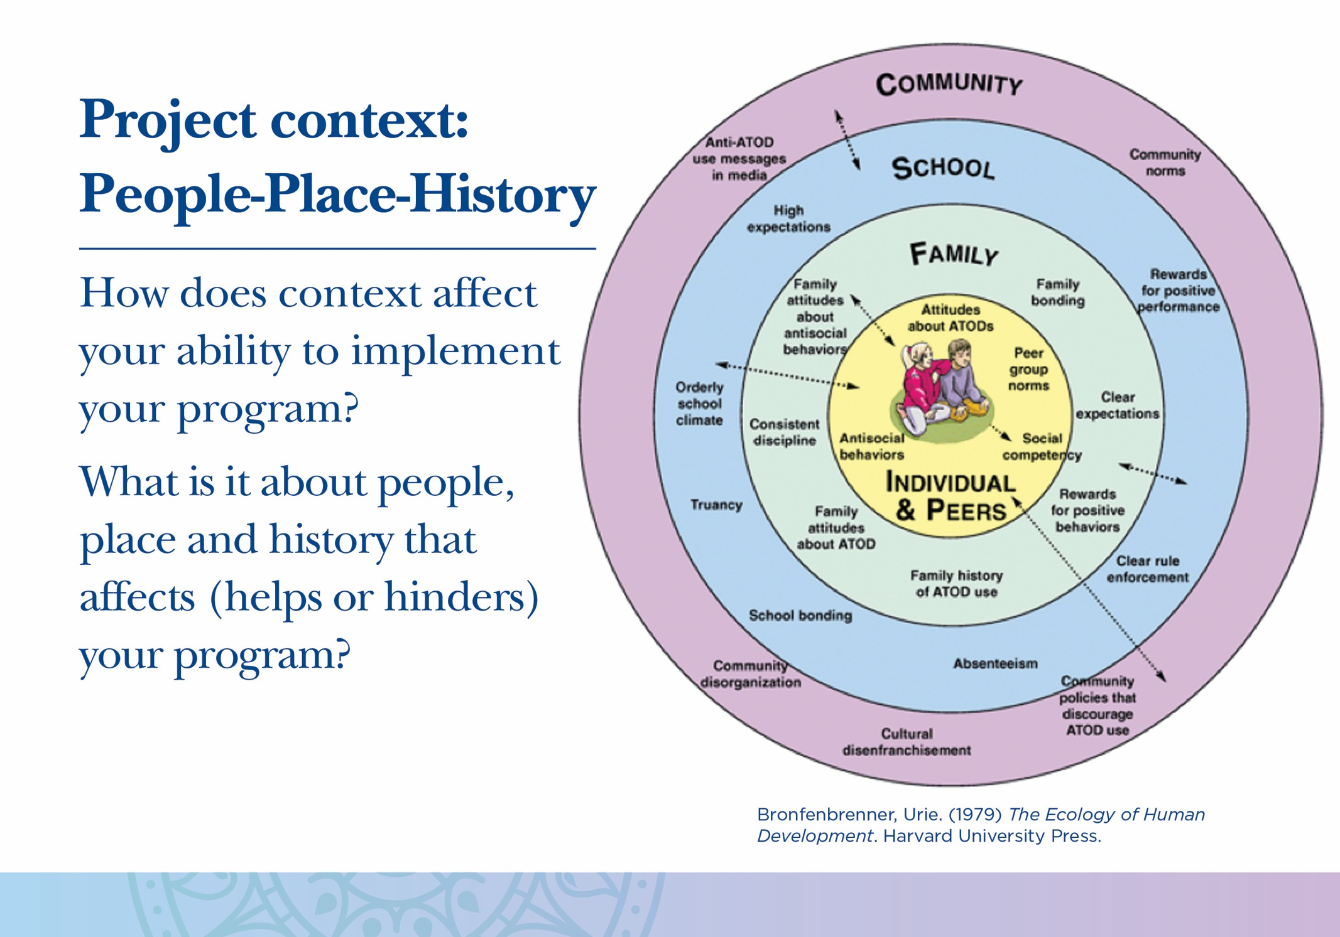

Slide 54
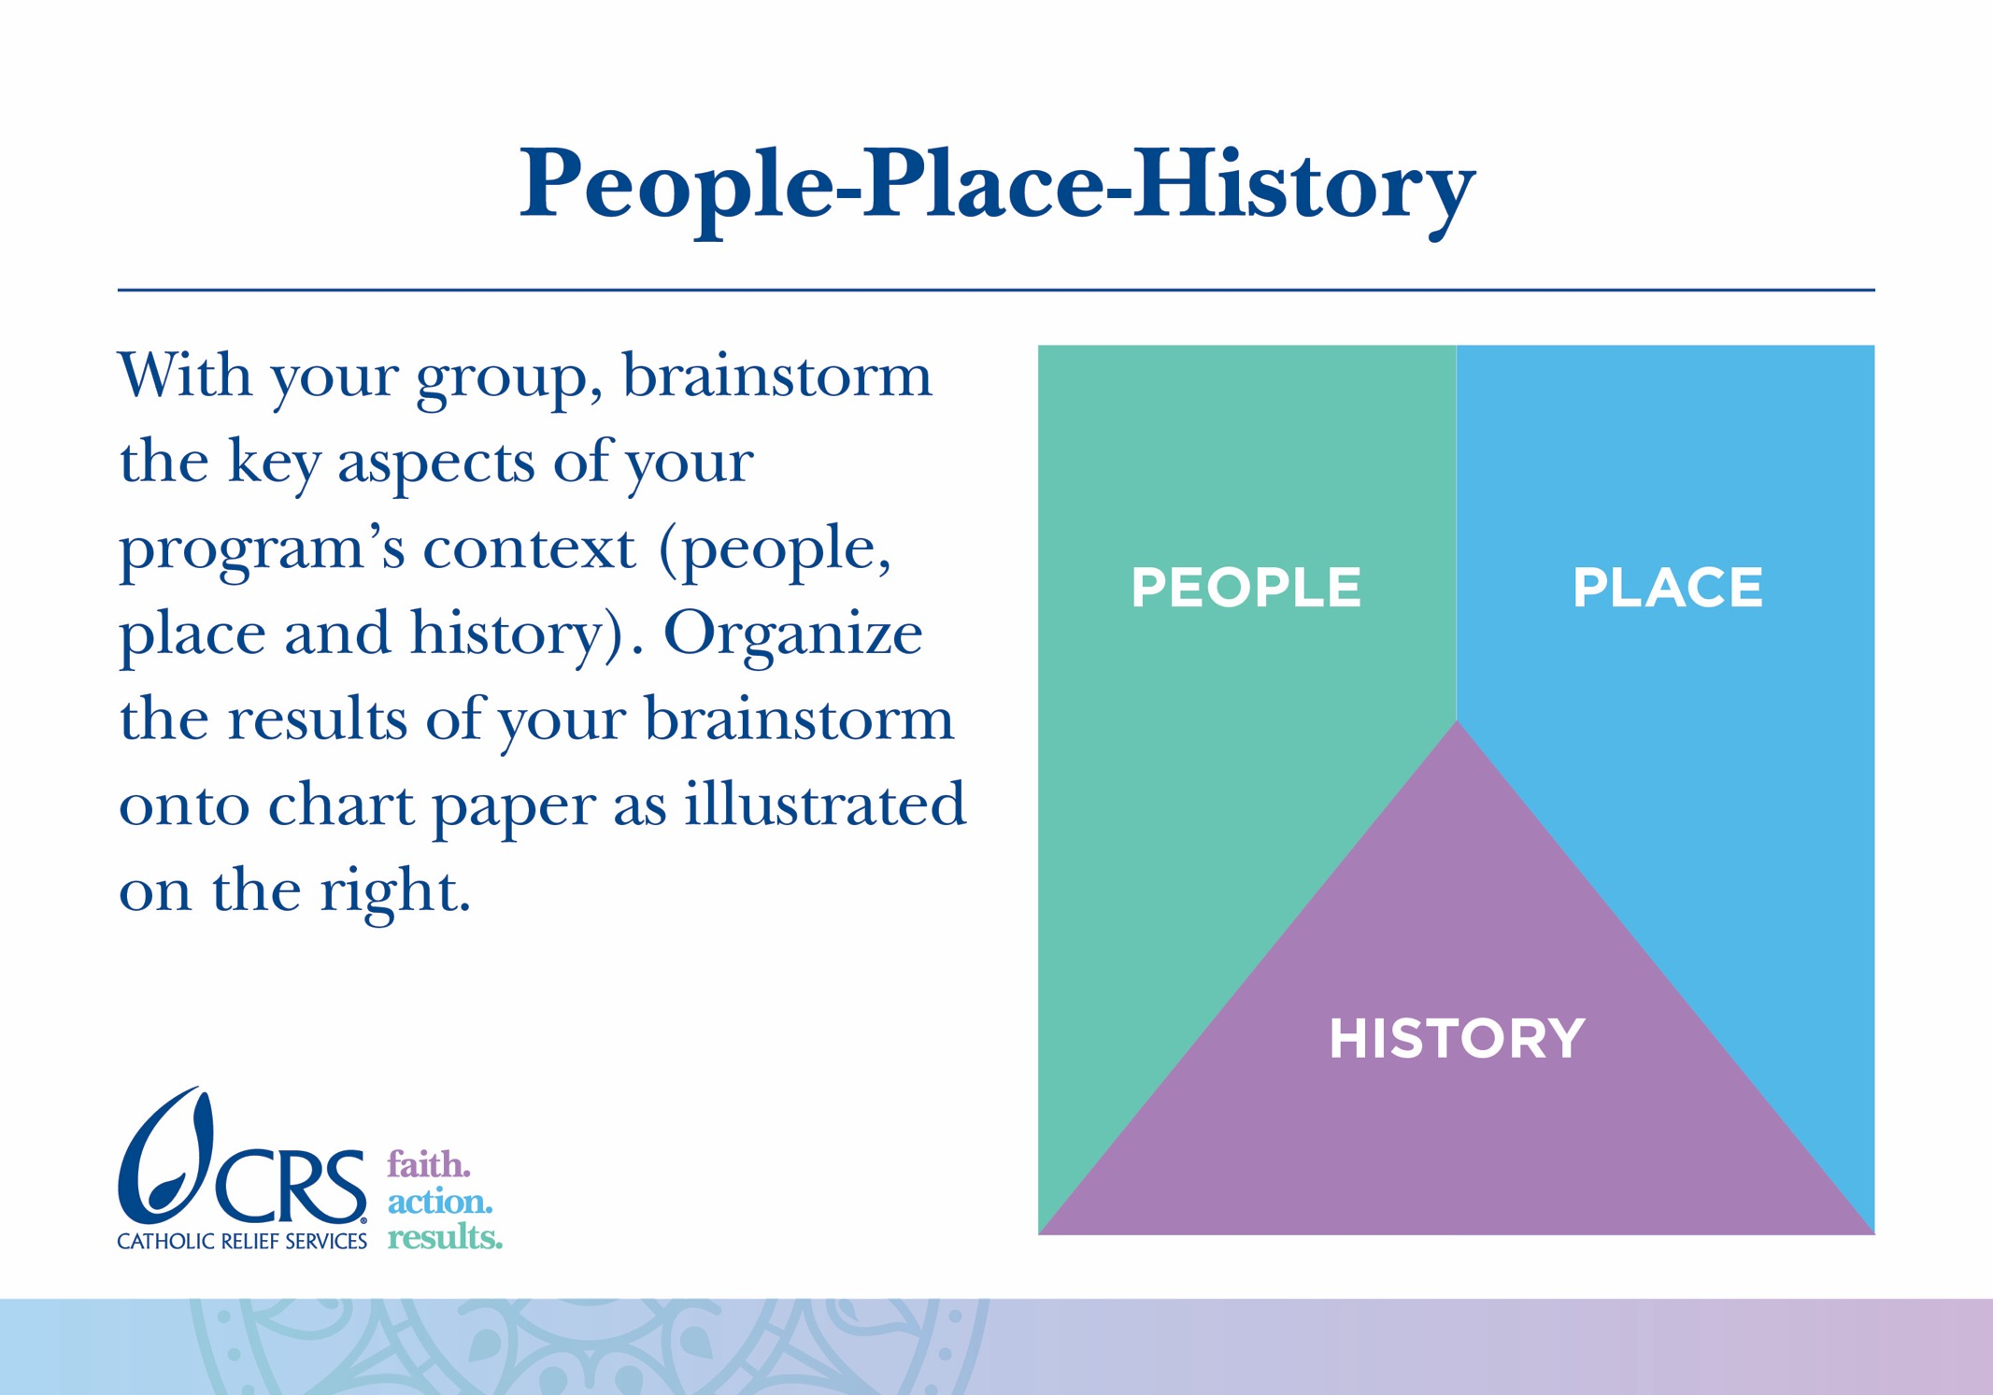

Slide 55


Slide 57


Slide 58


Slide 59


Slide 60


Slide 61


Slide 62


Slide 63


Slide 64


Slide 65


Slide 66


Slide 67


Slide 68


Slide 69


Slide 70


Slide 71


Slide 72

Notes:
This diagram illustrates how Proframe and the ToC Pathway Model are the same (the area in the middle) and how they are different (the pink and blue areas on the sides).

Slide 73


Slide 74


Slide 75


Slide 76


Slide 77


Slide 78


Slide 79


Slide 80


Slide 81


Slide 82

Notes:
You do not need to do the portrait race energizer. You could choose to play any game that would be fun for your participants.
To do the portrait race, you will need two places to draw (two easels with large pieces of paper, a chalkboard, etc) and something to draw with.
Split the participants into two teams and have each team line up in front of the easels. Each team should select one person to be the subject. That person should stand next to the easel. Then, when the facilitator says “go,” the first person in line should begin to draw a portrait of the subject for their team. After about 10 seconds, the facilitator calls “switch!” Then, the person who is drawing hands the marker to the next person in line and goes to the back of the line. The next person in line draws for 10 seconds, and so on until everyone has had a turn. At the end of the game the portraits are revealed to the subjects.

Slide 83


Slide 84


Slide 86


Slide 87


Slide 88


Slide 92


Slide 93


Slide 94


Slide 95


Slide 97


Slide 98


Slide 99


Slide 100


Slide 102


Slide 103


Slide 104


Slide 105


Slide 106


Slide 107


Slide 109


Slide 110


Slide 111


Slide 112


Slide 113


Slide 114


Slide 115


Slide 117

Notes:
You do not need to do the “Follow the Leader” energizer. You could choose to play any game that would be fun for your participants.
To play follow the leader, have all participants stand in a circle. One at a time, participants should take turns demonstrating a motion (or dance move) that the rest of the participants then have to copy.

Slide 118


Slide 119


Slide 120


Slide 121


Slide 122


Slide 124


Slide 125


Slide 126


Slide 127


Slide 128


Slide 129


Slide 130


Slide 131


