Slide 2
Notes:
Add your own slide here with pictures and brief biographies of the facilitator(s)

Slide 9
Notes:
Examples of “shared norms” are things like: turn mobile phones to silent, don’t talk when someone else is talking, etc.

Slide 27
Notes:
You do not need to do the bottle race energizer. You could choose to play any game that would be fun for your participants.
The bottle race is a game where participants split into two teams and form two lines. The team members at the front of each line hold a water bottle. When the facilitator says “go,” the person at the front of the line hands the water bottle, over his or her head, to the person behind them and then runs to the back of the line. That person hands it, over his or her head, to the person behind them, and so on until the team leader returns to their place at the front of the line. The first team to bring their team leader back to the front of the line wins.

Slide 29
Notes:
This slide shows how the different types of assumptions map onto a theory of change. Prescriptive assumptions come “before” the activities, or as part of the program planning process. Causal assumptions come between activities and outcomes (or between two outcomes), where we theorize that one causes or contributes to the next. Foundational assumptions are all around the theory of change. They can be thought of as part of the environment in which the program exists.

Slide 34
Notes:
For example, when we get in a car to go somewhere, we assume that the car’s tires have air in them. We don’t check the air pressure every time we get in; we don’t even think about the tires at all. That’s ok! It would be a waste of time, considered crazy even, to check the tires every time we got into a car. The assumption in this case is adaptive. It helps us move through life more efficiently.

Slide 37
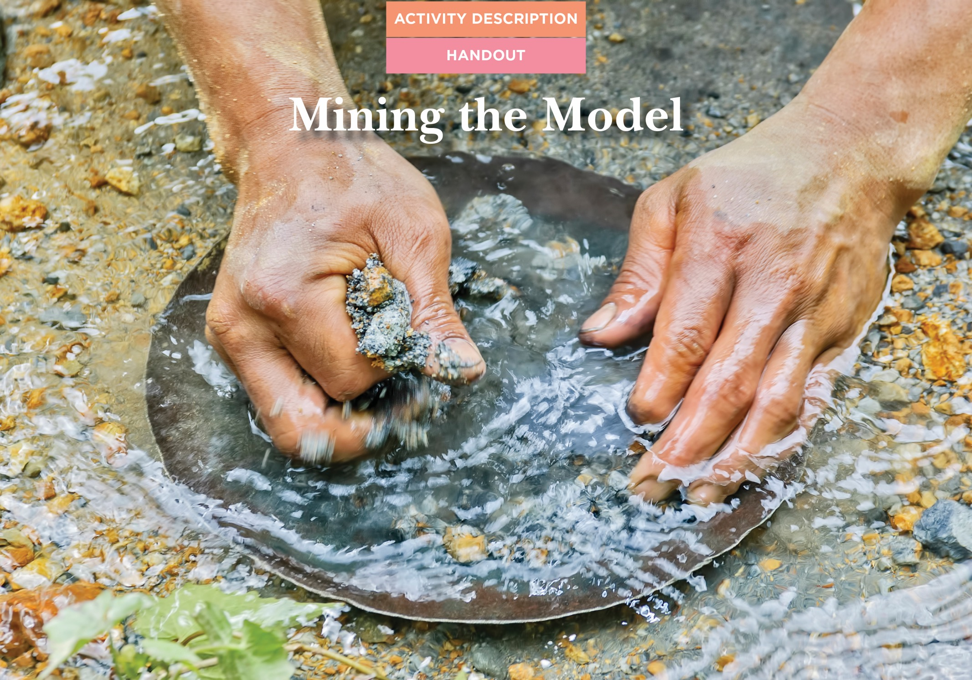

Slide 50
Notes:
Evaluative thinking should not only be used for formal evaluation. ET will allow for good decision making around immediate adaptations to your program, planning for local, less formal evaluation AND for planning the most formal evaluations. When we talk about developing learning plans, we are talking about written plans (which may have more or less detail depending on the situation) for EITHER/BOTH formal and local, less formal evaluations.

Slide 74
Notes:
Using a less formal, simpler method when trying to make a big, complex claim is like trying to catch a whale with a goldfish net. At the same time, using a complex, more formal method to make a smaller, more localized claim is like hitting a fly with a hammer – overkill.

Slide 83
Notes:
The words on this slide are examples of the types of constructs we are often interested in measuring as part of community-based programs. The image of the tape measure is there to emphasize that unlike a construct like length, there are no standard measurement tools that will work in all contexts and situations for the constructs listed on this slide.

Slide 84
Notes:
Indicators are ways to know if an outcome (construct) is taking place. In this example, the construct is knowledge. In the six circles around the word knowledge we have listed possible sources of evidence (indicators) of knowledge.

Slide 85
Notes:
This image shows that for each indicator (as listed on the previous slide), there may be many different evidence gathering tools that would be appropriate. Each will have its own strengths and weaknesses so the team developing the evaluation must use ET to carefully decide which method(s) are best in their context.

