Slide 1
The Importance of Play for Children
Session Three

Slide 2
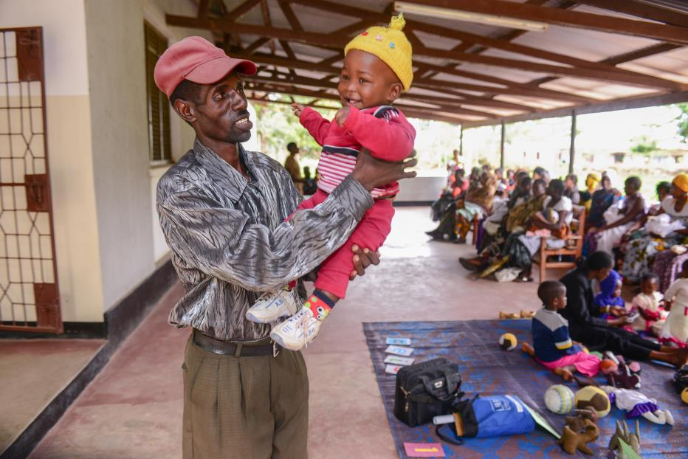
Baby Games
Playing with baby helps her to feel safe and loved and develop feelings of trust.
Tummy tickles
Silly songs
Blowing bubbles
Peek a boo
Lifting high in the sky
Other?

Slide 3
Play in the Early Years
The early years, especially birth through three years of age, are extremely significant in shaping the brain since "hands on" experiences cause the child to develop increasing numbers of brain synapses, or connections that shape and pattern the growing brain.
Play, in the context of secure attachments to adults, gives children the enrichment, stimulation, and physical activity they need to develop their brains for future learning. (Shore, l997)

Slide 4
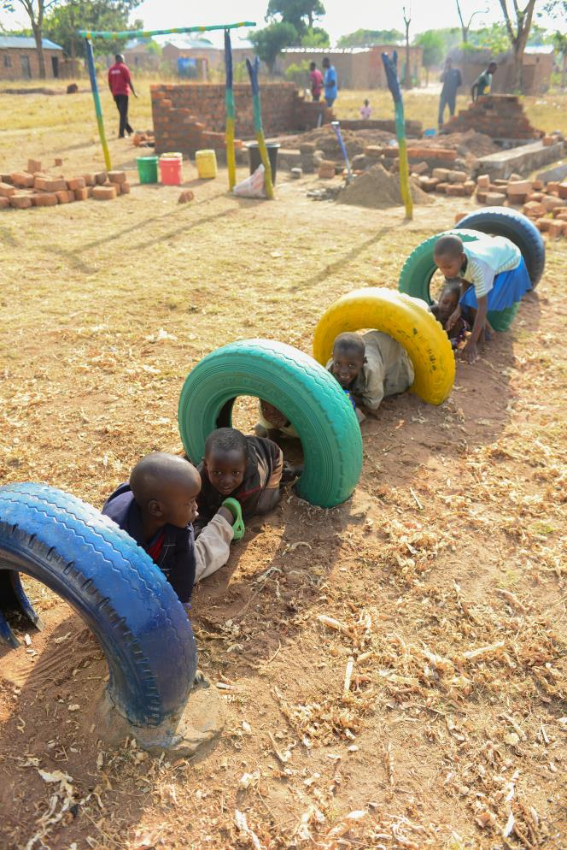
Play is:
A universal interdisciplinary process
A self-expressive activity based on imagination.
An expression of cross-cultural themes - nurturing, family relationships, roles
A fundamental right of the child
Notes:
Play is innately a self-expressive activity based on the child's powers of imagination.
Across cultures, children's play involves the same themes--nurturing, family relationships, and roles of people.
Play, alongside health, nutrition, water and sanitation, adequate standard of living, education, leisure, cultural activities etc., is one of the relevant elements to ensure the maximum development of the child.
While play is an unstructured activity, assuming many different forms, the CRC Committee has often expressed concern for the lack of child-friendly structures and venues for children’s play. The Committee has thus encouraged government initiatives to promote and facilitate children’s play through provision of parks and more appropriate play grounds.

Slide 5
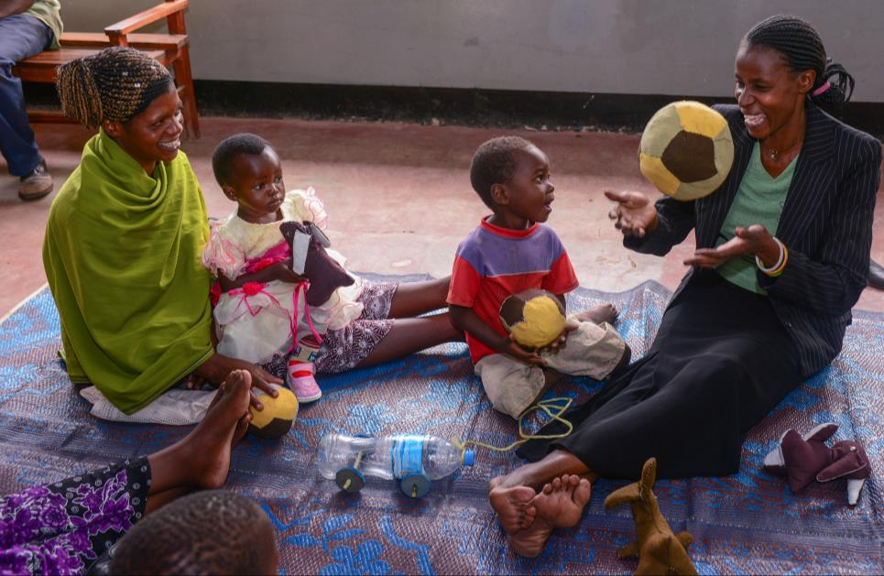
Remember…
Play promotes development, learning, and future success
Play activities can be created from local resources
Interaction with adults is an important part of play
Notes:
By providing play opportunities for young children, we are promoting development, learning, and future success. Play activities often do not require extensive funding, but rather require the wise use of local resources in the context of caring relationships.

Slide 6
Children from birth to
3 years of age

Slide 7
Language and Literacy
Play involves:
Simple words, sounds and naming
Words become sentences
Interactions lead to conversational skills
Expressing needs, negotiating and sharing ideas
Responding to the language models of adults and other children
Notes:
Simple words and sounds, in the context of play, become the building blocks of sentences and grammatical structures.
Children learn vocabulary by naming things as they play. Increasingly, words become complex sentences and interactions lead to conversational skills.
Expressing needs, negotiating, and sharing ideas are all communicated through play activities.
Additionally, adults and other children serve as language models for young children who frequently learn through imitation.

Slide 8
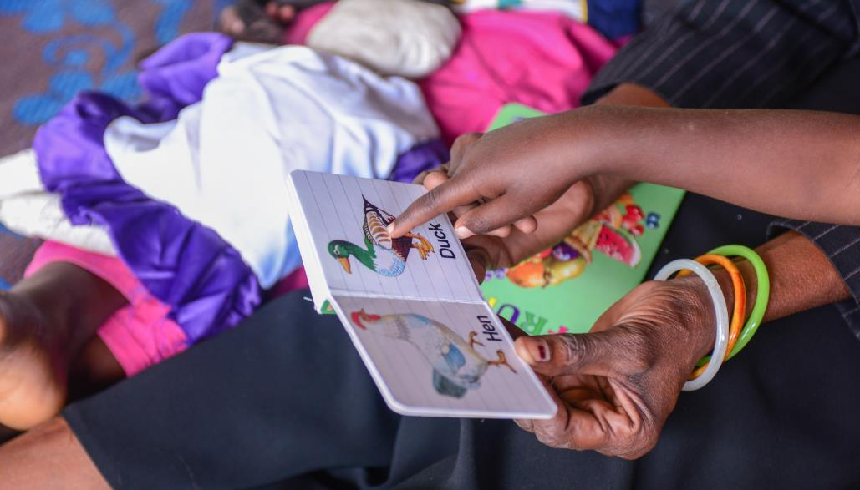
Toys that Support Language and Literacy
Picture/photos—familiar people, family, pets, animals
Cloth books –sew together pieces of fabric and use non-toxic markers to make simple pictures
Puppets—make sock puppets and sew on button eyes

Slide 9
Social and Emotional Development
Feelings of trust and acceptance allow the child to express emotions, take risks, accept disappointments, and experiment.
Non-verbal cues are as important as verbal
Children become aware of the posture, facial expression, feeling tone, and energy level of adults as they engage in play.

Slide 10
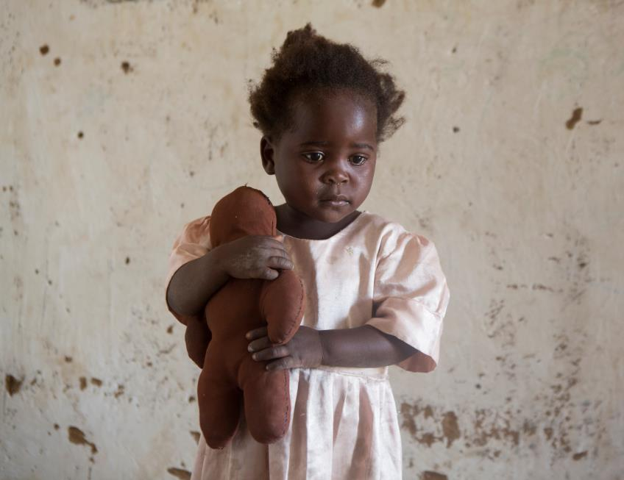
Play that Supports Social & Emotional Development
Soft, fabric toys
A 6-7 page picture book
A set of medium size, colored light wood or plastic blocks (15-30 pieces)
Games with adults
Notes:
Soft, fabric toys provide sensory stimulation
A picture book made out of cloth or plastic in colour (6-7 pages) Picture books provide visual stimulation, promote imagination and increase adult/child interaction and allow for expression of feelings and thoughts
A set of medium size, coloured light wood or plastic blocks (15-30 pieces)-This toy fosters creativity and imagination, develops thinking, creativity and fine motor skills, and promotes social interaction.
Games with adults such as peek-a-boo -- hiding faces, objects

Slide 11
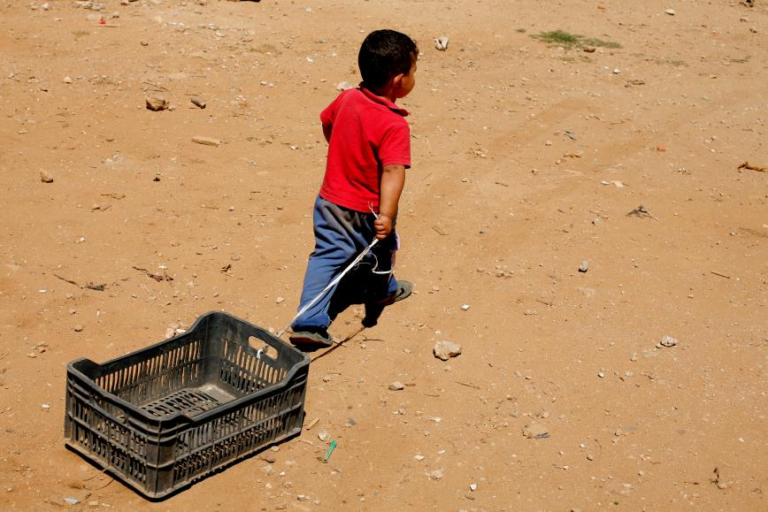
Physical Health and Motor Development
Activities/things to support motor development include
Space to crawl
Pull toys
Balls, or stuffed old stockings
Riding toys
Small slides
Notes:
Space to crawl--clean, safe, comfortable
Pull toys
Balls, or stuffed old stockings--to practice throwing and catching, and possibly large baskets to throw them in
Riding toys--tricycles, or take a square board and attach wheels to it so children can move it with their feet.
Small slides

Slide 12
Logic and Reasoning
Thinking skills are supported by:
Plastic objects
Shakers with different sounds
Stacking toys
Matching games
Sorting games
Puzzles with large pieces
Sand and water play
Notes:
Plastic objects--bowls, spoons, lids to sort and fit together
Shakers with different sounds--put different quantities of shells or pebbles in cans with the plastic tops glued on for safety
Spools (old and empty)--sand them to make stacking toys
Matching games--matching sets of pieces of coloured paper, fabric, old wallpaper
Sorting games--collections of large items (that cannot be swallowed) like seashells, big pieces of coloured cardboard for playing "put together what goes together“
Puzzles with large pieces. Jigsaw puzzles--take a simple magazine picture and glue it to a piece of cardboard. Cut the image into 3 or 4 pieces and let the child reconstruct it.
Sand and water play--sand can be dry or mixed with water. Provide: spoons, shovels, pails, plastic containers, funnels, and strainers, if available

Slide 13
Play Related to a Child’s Approach to Learning
Opening up possibilities, creativity, divergent thinking and resilience are supported by:
Pretend and fantasy play
Things that make noise – create ‘music’
Painting, coloring
Use of clay and play dough
Notes:
Pretend and fantasy play, opens up new possibilities, novel combinations and syntheses of ideas, divergent thinking, and the creation of meaning.
Play builds mental health and resilience, strengthening the self and the capacity for creative problem solving.
Initiative, task persistence, and attentiveness, all of which takes place within play, enables children to develop and follow through on plans and tasks;
Imagination and Invention are a part of play and are associated with the ability to form images of what is not actually present and to extend conventional thinking.
Things that make noise/musical instruments--banging on pots, drums
Props for pretend play--old clothes for dress-up, hats, fabric, old kitchen items (bowl, spoon, pot), toy telephone, doll babies

Slide 14
Assessment
At this age level areas of focus are:
motor activity (fine and gross motor)
oral language and communication
social behavior
activities chosen and attention span
willingness to try new tasks, explore, and discover
Notes:
At this age level, particular areas of focus are:
- motor activity (fine and gross motor)
- oral language and communication
- social behaviour
- activities chosen and attention span
- willingness to try new tasks, explore,
and discover

Slide 15
Children from Three to
Five years of age

Slide 16
Children from Three to Five
Children are
Ready to engage in pretend, imaginative play
Able to initiate play
Parents and other caregivers should
Provide space and toys
Encourage and appreciate child’s play
Notes:
Children are developmentally ready to engage in pretend, imaginative play, and they need play materials to play with and play spaces at home and in childcare centres.
Parents and other caregivers should encourage and appreciate their children's play, sometimes joining in and guiding the play, but the majority of play should be child initiated. In this way, children learn to further develop their own ideas, solve problems, and use corresponding and appropriate language.

Slide 17
Language and Literacy
Memory games
Lotto games
Sequence games
Storytelling
Conversation
Notes:
Lotto games--made like bingo games with pictures of familiar objects, shapes, letters, numbers, children's names
Storytelling--reading books of family stories written down, photo albums, joke books, children's dictated stories about the neighbourhood; have children enact stories from the books; create a library play area; purchase books, if possible

Slide 18
Social and Emotional Development
In support of self-expression use:
Puppets
Dolls
Pretend play costumes and props
Singing, action games, movement play
Notes:
Puppets--a variety; paper bag puppets, sock puppets, stick puppets, mitten puppets and puppet theatre--made from a big cardboard box
Dolls--made by parents and children, or purchased
Pretend play costumes and props--old dress up clothes and/or uniforms, shoes, hats, kitchen equipment, dolls and doll bed empty food boxes, fabric, masks, play telephone (or a sanded and painted piece of wood)
Singing, action games, movement play

Slide 19
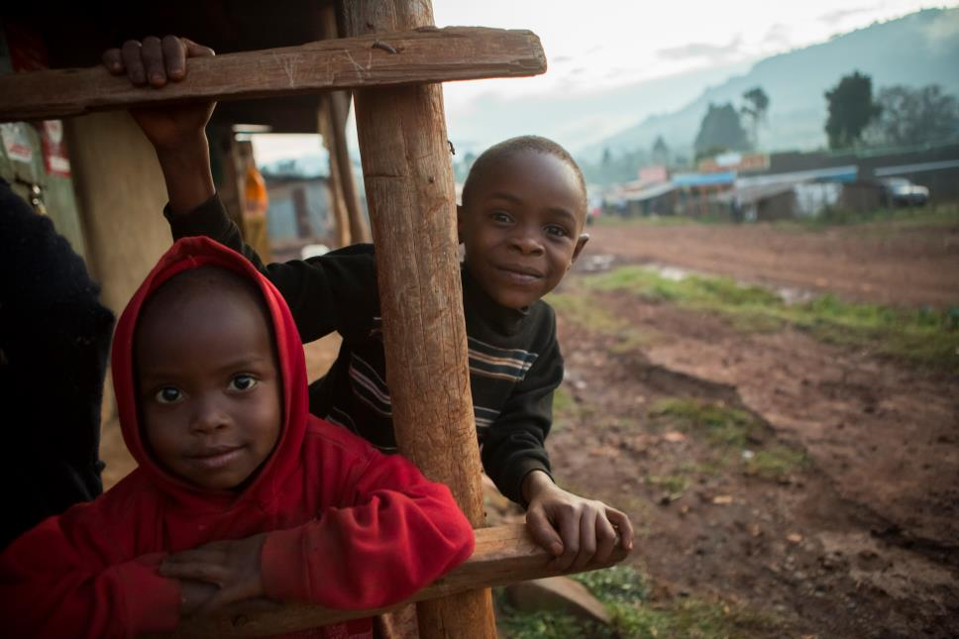
Physical Health and Motor Development
In support of large and small motor development use:
Objects for stringing
Active play outdoors
Notes:
Beads for stringing--spools, old hair curlers, cut up towel rolls, cut up plastic straws
Active play outdoors--climbing equipment, slides, swings, jump ropes, balls, obstacle courses, wheeled vehicles (wagons, trucks, tricycles) made or bought, balance beam (wood), balls, a target for throwing (hoop, basket, box)

Slide 20
Logic and Reasoning
In support of problem-solving use:
Sorting
Puzzles
Wooden or cardboard blocks
Notes:
Sorting--use an old egg carton for compartments; buttons, sticks, shells, stones, cork, pieces of wood, bark, bottle caps, feathers
Puzzles--create jigsaw puzzles
Blocks--wooden blocks (sanded pieces of wood), or a variety of cardboard boxes (taped closed)

Slide 21
Approaches Toward Learning
In support of exploration use:
Art materials
Collage materials
Things to build constructions
Musical instruments
Notes:
Art materials--paint, clay, drawing materials (crayons, pencils), paper, crafts (macramé, origami, basket and tile making), wet sand, collage, sewing equipment, scissors
Collage--paper, or newspaper; glue, or a mixture of flour and water; nature items (acorns, shells, sticks, leaves), cut up old magazines, pieces of material, old wrappers
Constructions--discarded pieces of wood (sanded for safety) that children can glue or hammer together, if hammer and nails are available and if adults supervise
Musical instruments--make them from daily items

Slide 22
Assessment Through Observation
how play is initiated
predominant themes of imaginative play
amount of time spent engaged in play activities
evidence of creativity and the imagination
use of language
physical abilities
social skills
attitude toward play
Notes:
Through observation, adults can monitor and record
- children's organisation of play (to see if it has a beginning, middle, and end);
- how play is initiated;
- predominant themes of imaginative play;
- amount of time spent engaged in play activities;
- evidence of creativity and the imagination;
- use of language (vocabulary, grammar, conversation and negotiation skills);
- physical abilities;
- social skills (sharing, turn taking, compromise, experiencing pleasure);
- attitude toward play;

Slide 23
Children from
Six to Eight Years of Age

Slide 24
Children from Six to Eight
In formal school setting there are explicit expectations
Able to attend to tasks for longer periods of time
Dependence on adults has decreased
Role of the peer group increased in regulating social behavior.
Notes:
When children reach this age, they have usually entered a formal school setting, with explicit expectations for learning and academic performance.
They have passed through the highly energetic pre-school years and now are able to attend to academic tasks for longer periods of time.
Their dependence on adults has decreased, and the role of the peer group has dramatically increased.
Children spend more time with the peer group and to a great extent the group tends to regulate social behaviour.

Slide 25
Language and Literacy
To develop language use:
Books to look through and for adults to read
Puppetry
Drama and acting out stories
Opportunities to read simple words and phrases
Opportunities to express themselves through storytelling and writing
Notes:
Books to look through and for adults to read to the child: folktales, stories dictated by children and parents, storybooks, comic books, newspapers, magazines, joke books, photo albums, books of children's collections (i.e., leaves, stamps)
Puppetry
Drama and acting out stories
Opportunities to read simply words and phrases
Opportunities to express themselves through storytelling and writing

Slide 26
Social and Emotional Development
Children in this age group:
Are interested in real-life tasks
Become competitive
Learn complex social rules
Notes:
Children are interested in real-life tasks (i.e., cooking, building things) as well as fantasy play. Through these activities, they build a sense of teamwork and learn the importance of following rules.
Children become competitive, yet at the same time, they are learning complex social rules and so a sense of morality develops. Their experience of play reflects these developmental changes

Slide 27
Physical Health and Motor Development
Physically children are more mature:
Outdoor play space is important
Equipment should challenge motor skills and encourage interactive play.
Boys and girls should be given equal opportunities with all play equipment.
Outdoor playgrounds should be clean, safe, and well supervised
Notes:
Community playgrounds are optimal for children from six to eight years of age. Equipment should be chosen that challenges children's growing motor skills and encourages interactive social play. Sensitive to gender segregation that may occur at this age, both boys and girls should be given equal opportunities with all play equipment. Outdoor playgrounds should be clean, safe, and well supervised

Slide 28
Physical Health and Motor Development: Outdoor Options
Stationary and movable equipment
Permanent equipment includes swings, climbers
Movable equipment includes:
old tires, open wooden boxes, plastic crates, bicycles, tricycles, wagons
Provision for sports (i.e., soccer, baseball, basketball) and the necessary equipment.
Notes:
There should be stationary equipment, as well as movable equipment, so children feel empowered to change and recreate the play space according to their interests and needs.
movable equipment might be
old, carefully selected tires,
open wooden boxes, plastic crates, etc.
bicycles, tricycles, wagons
Permanent climbing equipment that is sturdy and firmly anchored into the ground (swings, climbers
Provision for sports (i.e., soccer, baseball, basketball) and the necessary equipment.

Slide 29
Indoor Play Spaces
Community centers and play libraries, to include:
Board games
Art and crafts materials
Pretend play costumes
Books
Clean, safe and supervised space
Notes:
The sense of community should be enriched through the provision of indoor play spaces, preferably in community centres and play libraries.
board games,
art and crafts materials,
pretend play costumes,
books,
Community members should contribute culturally specific and relevant stories and games, and should be involved in staffing of community centre play spaces.
Play libraries allow games and other play materials to be borrowed and taken home.

Slide 30
Logic and Reasoning
Children
Are capable of taking multiple perspectives
Have developed extensive memory for people and events,
Are learning about their culture and nationality as part of identity and group awareness.
Toys include:
Table games
Manipulative materials
Notes:
Cognitively, children’s minds are capable of taking multiple perspectives, they've developed extensive memory for people and events, and they possess a growing amount of content knowledge. They are learning about their culture and nationality as part of identity and group awareness.
Table Games--playing cards, dominoes, checkers, puzzles, lotto, board games (a variety) floor games--jacks (or use little stones), marbles, hopscotch
Manipulative: Puzzles (100+ pieces), blocks, construction toys such as interlocking shapes (legos), treading

Slide 31
Approaches Toward Learning
To extend exploration and problem solving include:
Items for pretend play
Musical Instruments
Construction Materials
Notes:
Pretend Play: old dress up clothes, props, fabric, hats, real-world items (i.e., typewriters, cash registers that are no longer useful), dolls, pretend play phones, kitchen items, some office items (i.e., old briefcase that's of no use), some medical items (i.e., old stethoscope) if available, empty food boxes, containers for children's collections--old boxes, plastic containers, egg cartons
Musical Instruments: can be made with the children, or purchased, if possible
Construction Materials: pieces of wood, wire, string, buttons, old fabric, woodworking--hammers, nails, glue, pieces of discarded wood, sandpaper

Slide 32
Assessment
At home and in group settings
use checklists, anecdotal records, and a weekly play journal.
Children
Can reflect on their own play
Are able to keep a play portfolio- through writing and drawing
Notes:
Assessment helps adults to see individual and group patterns of play development which provides the data necessary to plan new activities and support individual children's growth.
Assessment of children's play can be done at home and in group settings, by keeping checklists, anecdotal records, and a weekly play journal.

