Slide 1
What is Early Childhood Development and Why is it Important?
Session One

Slide 2
What is Early Childhood Development (ECD)?
ECD focuses on supporting young children’s development.
ECD links the young child’s cognitive, social, emotional, and physical processes with the care (by families, communities, and the nation) required for supporting their development.
ECD is interdisciplinary. It includes health, nutrition, education, social science, economics, child protection, and social welfare and social protection.
The ECD field strives to ensure young children’s overall wellbeing during the early years, thereby providing the foundation for the development of adults who are healthy, socially and environmentally responsible, intellectually competent, and economically productive.
Consultative Group on Early Childhood Care and Development. (2010)

Slide 3

Early Childhood
Conception to age eight
This timeframe is consistent with the understanding within developmental psychology of the ways in which children learn.
Including the ages of 6-8 allows educators and planners to address children’s needs for an adequate transition from early care and education settings to primary school.

Slide 4
Development
The process of change in which the child comes to master more and more complex levels of moving, thinking, feeling, and interacting with people and objects in the environment. Physical growth, mental, social, emotional and spiritual growth are crucial in a child’s overall development.
*Note that different governments and organizations may define different areas of development.

Slide 5
Developmental Milestones
Where we want babies and children to be by certain ages
Vary only slightly across cultures
Screening for any delays early on allows for early intervention, which increases the chances for recuperation of skills
These will be covered more in the following days by age group.

Slide 6
Key ECD messages
Exposure to biological and psychosocial risks affects the developing brain and compromises the development of children.
Inequalities in child development begin prenatally and in the first years of life.
With cumulative exposure to developmental risks, disparities widen and trajectories become more firmly established.
Notes:
Taken from two Lancet papers from the 2011 series on “Child Development 1: Inequality in early childhood: risk and protective factors for ECD” and “Child Development 2: Strategies for reducing inequalities and improving developmental outcomes for young children in low-income and middle-income countries.”

Slide 7
Key ECD Messages (continued)
Reducing inequalities requires early integrated interventions that target the many risks to which children in a particular setting are exposed.
The most effective and cost efficient time to prevent inequalities is early in life before trajectories have been firmly established.
Action or lack of action will have lifetime consequences for adult functioning, for the care of the next generation and for the wellbeing of societies.

Slide 8
Most Quoted ECD Fact
“More than 200 million children younger than 5 years from low-income and middle-income countries are not attaining their developmental potential…”
2007 Series on ECD in The Lancet
Notes:
The rest of this sentence deals with the risks to ECD which is what we’re going to talk about next…

Slide 9

Risks to Reaching Developmental Potential
Poverty
Nutritional deficiencies
    Stunting, iodine deficiency, and iron-deficiency anemia
Inadequate learning opportunities
    Lack of cognitive stimulation
Notes:
Biological and psychosocial risk factors associated with poverty lead to inequalities in ECD which undermine educational attainment and adult productivity, thereby perpetuating the poverty cycle. Need to focus on the modifiable risks that affect large numbers of children younger than 5 years in LMIC.
Consider:
Type of risk—long list that we talked about
Timing: Specific ages are sensitive periods to certain types of risks—lots of research ongoing about this
Dose: co-occurring or cumulative risks and protective factors
Differential reactivity: (child’s temperment) child and contextual factors that mediate the effect of risk and protective factors

Slide 10
Additional Risk Factors
Maternal malnutrition
Malaria
Lead exposure
HIV infection
Maternal depression
Institutionalization
Exposure to violence
Notes:
Maternal nutrition: Under nutrition in 10-19% of mothers in LMIC. Maternal undernutrition does translate to low birth weights, but there is little information on association between maternal nutritional status and child development. Likewise little data on association between perinatal iron deficiency and child development. While more research is needed on the effects of maternal nutrition and micronutrients on child development, we do know that low birth weight is between 16-27% and that LBW is a risk to early development.
Malaria: Cerebral or severe malaria can have serious neuological sequelae including seizures and language and cognitive deficits. In Uganda, ECD interventions in cognitive training did improve function of malaria-affected children.
Lead exposure and other environmental toxins—Environmental toxins definitely impact on ECD, but variables include types of toxins, age of exposure, timing, and duration, so more evidence is needed on the effects of toxins on ECD.
HIV infection: So many variables or HIV-exposed children that it’s hard to make conclusive statements about all of the effects it has on them, but cognitive and motor defecits have been reported in HIV-exposed, uninfected children. Uninfected children are affected by parental HIV by potentially increasing their exposure to poverty, disrupted caregiving, and abandonment.
Maternal depression: Risk factors for maternal depression include poverty, low education, high stress, lack of empowerment and poor social support. Maternal depression increases risk of low birth weight—which effects development; maternal depression is negatively associated with child development and quality of parenting.
Institutionalization: Children’s response to institutionalization varies, mut many show long-term developmental deficits including poor growth, ill health, attachment disorders, attention disorders, poor cognitive function, anxiety and autistic-like behavior.
Exposure to societal violence: Domestic violence and child abuse are also common, but societal violence is the focus here because it mostly affects those in LMIC. Exposure to societal violence is related to insecure attachments, increased risk of behavior problems, reduced levels of pro-social behavior and increased aggressive behavior.

Slide 11
Risks and Resiliency
Children who don’t receive the proper nutrition, stimulation, education, environment, etc., have greater risks for long-term development
BUT….
  Children are resilient and many overcome odds to become thriving and productive adults.

Slide 12
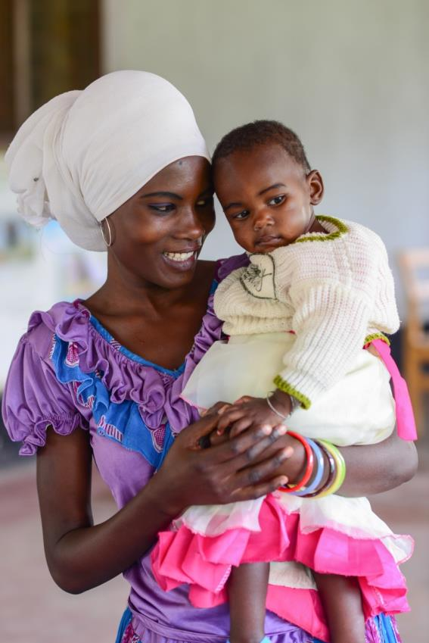
Protective Factors
Many protective factors are the inverse of risk factors
Many more studies in high income countries identifying protective factors
LMIC protective factors include:
  Breastfeeding
  Maternal education
  Early cognitive and social-emotional stimulation
Notes:
Risk factor = insecure attachment; protective factor = secure attachment
Maternal education: linked to reduced child mortality, higher levels of cognitive development—while ECD interventions do not do much to change mother’s education level, this should remain an important point for advocacy and policy change for ECD.

Slide 13
Conclusion About Risks and Protective Factors
“The greater the exposure to cumulative risks the greater the inequality, suggesting that early interventions that prevent inequality are more effective than later intervention which attempt to remedy cumulative deficits.”
“Risk factors are likely to co-occur, emphasizing the importance of integrated interventions involving the simultaneous reduction of multiple risks.”
Inequality in early childhood: risk and protective factors for early child development. Lancet 2011 series, September 23, 2011
Notes:
From “Inequality in early childhood: risk and protective factors for early child development” Lancet 2011 series, September 23, 2011

Slide 14

Quick Partner Work
Notes:
Partners are given a name for the baby: either David or Jessica.
Ask them to imagine what the baby is feeling.
What do they think is happening around the baby?

Slide 15
Gender Differences in Development?
Overall there are only small differences between boys’ and girls’ processes of development.
For example, girls are more verbally-oriented than boys throughout life. They are talking 1 to 2 months earlier than boys, but boys have as much language by age 4 to 5 years.
Notes:
Sex differences in the brain are reflected in the somewhat different developmental timetables of girls and boys. By most measures of sensory and cognitive development, girls are slightly more advanced: vision, hearing, memory, smell and touch are all more acute in female than male infants. Girl babies also tend to be somewhat more socially attuned, responding more readily to human voices or faces, or crying more vigorously in response to another infant’s cry. Girls generally lead boys in the emergence of fine motor and language skills.

Slide 16
Variability and Overlap
While there are differences overall on some skills between boys and girls, there is also a great deal of overlap.
For example, many boys are better than many girls at language and many girls are better than many boys at visual-spatial abilities.
There is larger variation in the ability of boys overall than in girls overall.
For example, boys are more likely to be found at the top AND the bottom of the distribution of abilities.

Slide 17
Riddle
A son and his father are in a car accident. Two ambulances arrive and take them to two separate hospitals. When the son arrives at the hospital, he is taken into surgery. The surgeon says, “Wait! I can’t operate on him! He’s my son!”
How is that possible?

Slide 18
Role of Culture
Culture has a strong influence on the development of abilities.
For example, parents in all societies begin to treat boys and girls differently at birth. They have different expectations for boys and girls.
In many cultures, girls are at the same level as boys through the first grade of school, but a proportion of girls fall behind after puberty.

Slide 19
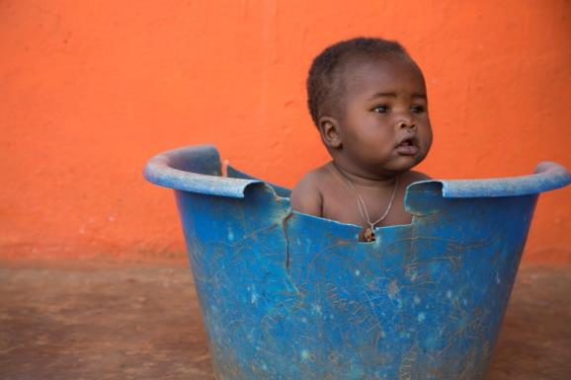
Perceptions Matter
This is David /Jessica.
Parents’ perceptions of children’s behavior and emotions will influence their actions towards those children.
This influence will occur even if parents are determined to treat their sons and daughters alike.
Notes:
Some studies have interviewed parents just after the birth of their child, at the point where the first question that 80% of parents ask — is it a boy or a girl? — has been answered. Parents of boys describe their babies as stronger, heartier, and bigger than parents of girls. The investigators also looked at the babies' medical records and asked whether there really were differences between the boys and girls in weight, strength, or coordination. The boys and girls were indistinguishable in these respects, but the parents' descriptions were different.
At 12 months of age, girls and boys show equal abilities to walk, crawl, or clamber. But before one study, Karen Adolph, an investigator of infants' locomotor development, asked parents to predict how well their child would do on a set of crawling tasks: Would the child be able to crawl down a sloping ramp? Parents of sons were more confident that their child would make it down the ramp than parents of daughters. When Adolph tested the infants on the ramp, there was no difference whatever between the sons and daughters, but there was a difference in the parents' predictions.
My third example, moving up in age, comes from the studies of Jackie Eccles. She asked parents of boys and girls in sixth grade, how talented do you think your child is in mathematics? Parents of sons were more likely to judge that their sons had talent than parents of daughters. A panoply of objective measures, including math grades in school, performance on standardized tests, teachers' evaluations, and children's expressed interest in math, revealed no differences between the girls and boys. Still, there was a difference in parents' perception of their child's intangible talent. Other studies have shown a similar effect for science.
There's clearly a mismatch between what parents perceive in their kids and what objective measures reveal. But is it possible that the parents are seeing something that the objective measures are missing? Maybe the boy getting B's in his math class really is a mathematical genius, and his mom or dad has sensed that. To eliminate that possibility, we need to present observers with the very same baby, or child, or Ph.D. candidate, and manipulate their belief about the person's gender. Then we can ask whether their belief influences their perception.

Slide 20

Lessons from Gender Labeling Studies
From the moment of birth, males and females are perceived differently, in ways that work to the disadvantage of females.
Perceptions aren’t everything
Boys and girls learn the same things and develop into men and women with equal aptitude in math and science. Strong evidence that mathematical and scientific reasoning have a biological basis, shared by males and females.
Perceptions don’t create a sense of maleness or femaleness in children. Biological sex differences are real.
Notes:
From the moment of birth to the moment of tenure, throughout this great developmental progression, there are unintentional but pervasive and important differences in the ways that males and females are perceived and evaluated.
Emphasize that perceptions are not everything. When cases are unambiguous, you don't see these effects. What's more, cognitive development is robust: boys and girls show equal capacities and achievements in educational settings, including in science and mathematics, despite the very different ways in which boys and girls are perceived and evaluated. I think it's really great news that males and females develop along common paths and gain common sets of abilities. The equal performance of males and females, despite their unequal treatment, strongly suggests that mathematical and scientific reasoning has a biological foundation, and this foundation is shared by males and females.
Finally, you do not create someone who feels like a girl or boy simply by perceiving them as male or female. That's the lesson that comes from the studies of people of one sex who are raised as the opposite sex. Biological sex differences are real and important. Sex is not a cultural construction that's imposed on people.

Slide 21
Discussion
In small groups, discuss the following:
  What are the common adjectives or descriptive words used to describe young boys in your culture? Young girls?
  What are girls believed to do well in your culture? Boys?
  How do you see your culture treating young girls and boys (ages 5 and under) differently?

Slide 22
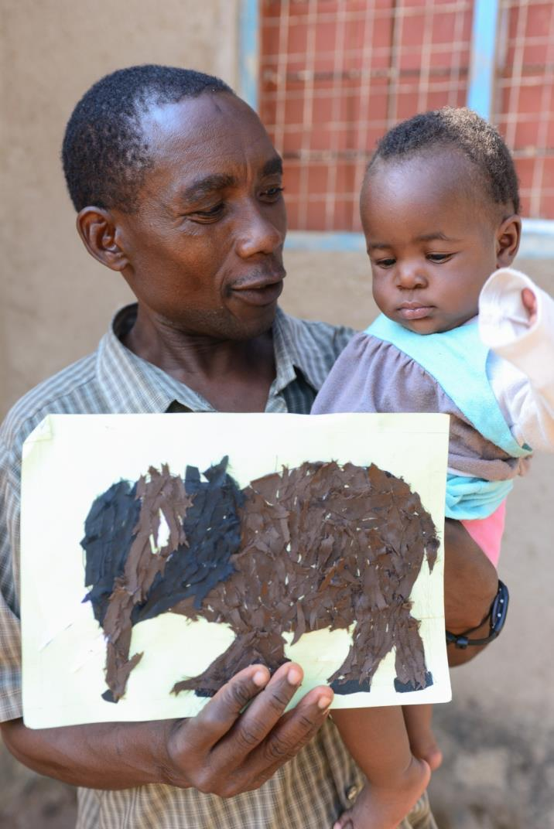
Discussion
What is a father?
What role does he play in a child’s life?

Slide 23
“Fathers may very well be the greatest untapped resources in the lives of Indigenous children. If we could support them to get involved and stay connected with their children, that would be a big protective factor for these youngsters as they grow up.”
Ed John, The Grand Chief of the First Nations Summit
in British Columbia, 2004

Slide 24

Nature Versus Nurture
Fathers have the capacity to provide care early on in a child's life.
There is nothing inherently or biologically different between men and women in terms of their ability to be responsive to children's needs, to nurture and be affectionate.
Notes:
Fathers have the capacity to provide care early on in a child's life. There is nothing inherently different between men and women in terms of their ability to be responsive to children's needs, to nurture and be affectionate. Fathers can be as nurturing and affectionate as mothers; they are as capable as mothers of providing infant care as well as older-child care.

Slide 25
Interactions Tend to be Different
Fathers tend to engage in more physically active, rough and tumble play, especially with their boys. They may use more direct communication, such as commanding, telling, disciplining, and instructing.
Mothers try to involve their child in more conversation, asking questions, exclaiming, and reinforcing the child’s talking or performance.
When mothers are engaged with their children, they tend to assume the role of ‘teacher, whereas when men are engaged with their children, they tend to assume the role of friend, playmate, and sometimes ‘coach.’
Both parents have an important contribution to make.
Notes:
How are mother-child and father-child interactions different?
Research shows some major differences in the ways that fathers interact with their children compared to the ways that mothers interact with their children. In general, fathers tend to engage in more physically active, rough and tumble play, especially with their boys. They may use more direct communication, such as commanding, telling, disciplining, and instructing.
Mothers typically try to involve their child in more conversation, asking questions, exclaiming, and reinforcing the child’s talking or performance. Mothers do more of the day to day care giving tasks of soothing, feeding, clothing, as well as taking care of a child’s health and illnesses. Some studies show that in general, when mothers are engaged with their children, they tend to assume the role of ‘teacher, whereas when men are engaged with their children, they tend to assume the role of friend, playmate, and sometimes ‘coach.’
Ball,in press

Slide 26
Direct Contribution
Men in many cultures contribute to the wellbeing of their children through the provision of income to support the activities of the family.
However, men are not the only ones who contribute financially to the family. Increasingly women are making substantial and sometimes even majority contributions to the family income.
  In Madras, India, women contribute 46% to the family income while men contribute 42%, with 12% coming from joint income.
  In Nepal women contribute 50% of the family income; in the Philippines women's income exceeds men's by 10% when home production is taken into account; and in Ghana women maintain 33% of the households. (Bruce 1994)
Notes:
Contributions to the Family
One way that men in many cultures contribute to the wellbeing of their children is through the
provision of income to support the activities of the family. However, men are not the only ones
who contribute financially to the family. Increasingly women are making substantial and
sometimes even majority contributions to the family income. For example, in Madras, India,
women contribute 46% to the family income while men contribute 42%, with 12% coming from
joint income. In Nepal women contribute 50% of the family income; in the Philippines women's
income exceeds men's by 10% when home production is taken into account; and in Ghana
women maintain 33% of the households. (Bruce 1994)

Slide 27
Indirect Contribution
Men help avert harm to children.
  Children in households in which men are present are much less likely to be abused or exploited by other men in the community than children living only with women.
Provide social value.
  The mere fact of having a father who acknowledges and lives with them may confer social value on children, especially in societies with very high father absence.
Alleviate women’s stress.
  Women who live with partners tend to report that they are less stressed about child care issues. The benefits of fathers in children’s lives, particularly in their early years, might accrue particularly through the supportive influence of a partner on maternal behavior.
Guma and Henda, 2004; Clarke-Stewart, 1978; Richter, 2006.
Notes:
Men may also be able to avert harm to children. Guma and Henda (2004) suggest that children in households in which men are present are much less likely to be abused or exploited by other men in the community than children living only with women. The mere fact of having a father who acknowledges and lives with them may confer social value on children, especially in societies with very high father absence. Fathers also have indirect effects on children through their support for mothers. For example, women who live with partners tend to report that they are less stressed about child care issues. The benefits of fathers in children’s lives, particularly in their early years, might accrue particularly through the supportive influence of a partner on maternal behaviour (Clarke-Stewart, 1978; Richter, 2006).

Slide 28
Impact of Fathers on Children
Father presence contributes to cognitive development, intellectual functioning and school achievement (Amato, 1998).
  In South Africa, Mboya & Nesengani (1999) found that boys who lived in father-present households had higher academic achievement than boys who lived in father-absent households.
Father presence also contributes to emotional well-being/ Children are less likely to manifest emotional and behavioral problems if their father is available to them, and father presence shows a strong relationship with higher self-esteem amongst girls (Hunt & Hunt, 1977).
Notes:
Father presence contributes to cognitive development, intellectual functioning and school achievement (Amato, 1998). For example, in South Africa, Mboya & Nesengani (1999) found that boys who lived in father-present households had higher academic achievement than boys who lived in father-absent households.
Father presence also contributes to emotional well-being (Johnson, 1997). Children are less likely to manifest emotional and behavioural problems if their father is available to them, and father presence shows a strong relationship with higher self-esteem amongst girls (Hunt & Hunt, 1977).

Slide 29
Impact (continued)
Father availability tends to have a modulating effect on boys’ aggressive tendencies, so that boys who grow up with a father tend to be less aggressive than boys without this male guidance (Seltzer & Bianchi, 1988).
Father involvement has also been shown to have positive effects on fathers’ mental health (Milkie, Bianchi, Mattingly & Robinson, 2002).
It’s also been associated with fewer accidental and premature deaths, fewer criminal convictions, fewer hospital admissions, less substance abuse, and greater sense of well-being (Pleck & Masciadrelli, 2004).
Girls without present fathers have also been shown to engage in more high risk behavior in general (e.g. sexual activity, alcohol use, drug use).
Notes:
- Father absence or lack of contact with fathers appears to have its most dramatic effects on male children. Father availability tends to have a modulating effect on boys’ aggressive tendencies, so that boys who grow up with a father tend to be less aggressive than boys without this male guidance (Seltzer & Bianchi, 1988).

Slide 30
Impact (continued)
Some studies suggest that it is fathers’ psychological care and “emotional generosity” (expressiveness and intimacy) that has the greatest long-term implications for children’s development (Grossman, Pollack & Golding, 1988).
The factors that emerge as significant are the level of involvement and the type of involvement the father has with his child, rather than the amount of time that the father spends interacting with the child.
Nonetheless…
Notes:
The literature, on availability and involvement of fathers, is highly consistent with respect to showing benefits for children in school performance, reduced aggressive behaviours in boys and increased self-esteem in girls (Palkowitz, 2002). Some studies suggest that it is fathers’ psychological care and “emotional generosity” (expressiveness and intimacy) that has the greatest long-term implications for children’s development (Grossman, Pollack & Golding, 1988).

Slide 31

Influences on Father’s Role
Migration
Culture & Role Prescription
Household Structures
Changing Situations

Slide 32
Culture & Role Prescription
Authority and Power. The ascription of power and authority is important in terms of a father's relationship with his family. In many cases this authority has been given to them as a result of the dominant religious beliefs.
Decision making. In many cultures men are the decision-makers in terms of what happens both within the family and as the family interacts with the world.
Economic role Historically men have been the major providers for the family.
  If men have difficulties fulfilling the bread-winning role and women increase their capacity to support the family financially, men's authority role is undermined. This sometimes leaves them at a loss in terms of how they should now relate to family members.
Women’s status. For many women, their status within the community is defined by their parenting role. The woman is respected and given identity based on her ability to care for and nurture her children.
Notes:
In looking at cross-cultural studies in terms of the father's role in the lives of young children, it
can be concluded that the more cooperation and communication required of men and women in
their daily activities (i.e., if they are both involved in securing food for the family or both
undertake similar tasks on behalf of the family) the more they are likely to be jointly involved in
childcare. The more separate men's and women's roles and tasks, the more prescribed men's roles
are in relation to children, and generally the more limited men's roles are in terms of caregiving.
There are many variables that determine the kind of roles that fathers have in relation to their
children.
Authority and Power. The ascription of power and authority is important in terms of a father's
relationship with his family. In many cultures men are the decision-makers in terms of what
happens both within the family and as the family interacts with the world. Historically this power
comes from the fact that men have been the major providers for the family. In many cases this
authority has been given to them as a result of the dominant religious beliefs. If men have
difficulties fulfilling the bread-winning role and women increase their capacity to support the
family financially, men's authority role is undermined. This sometimes leaves them at a loss in
terms of how they should now relate to family members.
In Brown's work in Jamaica she noted that men's "role as economic providers was clear, but if
they were not able to fulfill this role, they could find no other place in the family for themselves."
(as summarized by Engle 1994, 22)
. The way in which roles for men and
women have been prescribed culturally and over time affects what both men and women see as
their responsibilities in terms of caregiving. In many cultures women are seen as the exclusive
caregivers in the early months of a child's life. The extent and the timing of the involvement of
others (the father, extended family members, community) in the child's life differs across cultures.
In seeking to define an expanded or different role for fathers it is necessary to evaluate what that
would mean for mothers and others already involved in caring for the child.
For many women, their status within the community is defined by their parenting role. The
woman is respected and given identity based on her ability to care for and nurture her children. If
program developers seek to relieve women of that responsibility by an expansion of men's roles in
the lives of children or through the provision of alternative childcare, it may be quite reasonably
blocked by women. An example of this phenomenon occurred in Pakistan. In Chitral those
involved in the Women in Development program were working with local women to develop an
informal cooperative village-based childcare system that would make it possible for mothers to
leave their young children with one of the village women whenever they went to work in the
fields. This was seen as very positive by the women, as they would find it easier to walk the long
distances back and forth from the fields without having to carry children, and they would not have to constantly monitor what their child was doing while they were working

Slide 33
Culture & Role Prescription (continued)
Men’s involvement in the early care of his children, and his continued close engagement with them during childhood, is largely determined by women.
Wives, mothers and other women in the community, function as gatekeepers who either invite men in and encourage them to take responsibility for children’s care, or close them out, making them feel incompetent in matters of children, and less of a man for getting involved (Tom Beardshaw, from Father’s Direct www.fathersdirect.com).
Notes:
. The way in which roles for men and
women have been prescribed culturally and over time affects what both men and women see as
their responsibilities in terms of caregiving. In many cultures women are seen as the exclusive
caregivers in the early months of a child's life. The extent and the timing of the involvement of
others (the father, extended family members, community) in the child's life differs across cultures.
In seeking to define an expanded or different role for fathers it is necessary to evaluate what that
would mean for mothers and others already involved in caring for the child.
For many women, their status within the community is defined by their parenting role. The
woman is respected and given identity based on her ability to care for and nurture her children. If
program developers seek to relieve women of that responsibility by an expansion of men's roles in
the lives of children or through the provision of alternative childcare, it may be quite reasonably
blocked by women. An example of this phenomenon occurred in Pakistan. In Chitral those
involved in the Women in Development program were working with local women to develop an
informal cooperative village-based childcare system that would make it possible for mothers to
leave their young children with one of the village women whenever they went to work in the
fields. This was seen as very positive by the women, as they would find it easier to walk the long
distances back and forth from the fields without having to carry children, and they would not have to constantly monitor what their child was doing while they were working
Men’s involvement in the early care of his children, and his continued close engagement with them during childhood, is largely determined by women. Wives, mothers and other women in the community, function as gatekeepers who either invite men in and encourage them to take responsibility for children’s care, or close them out, making them feel incompetent in matters of children, and less of a man for getting involved (Tom Beardshaw, from Father’s Direct www.fathersdirect.com)

Slide 34
Culture & Role Prescription (continued)
Religion interacts with other variables in a given culture to have an impact on the relationship that fathers are likely to have with their children.
  For example, in Northern Pakistan there is strict adherence to differentiation of roles. In fact, for the most part, women are sequestered in the home and are not seen on the streets. Women are not allowed to interact with males outside of their family. The father is the interface for the child between the home and world. To play this role the father needs to have an understanding of the child's needs and take appropriate actions to support the child's development. A parent education program in this part of the world would certainly need to focus on providing the father with appropriate child development information and support him in his role as caregiver.
Notes:
All the major religions of the world define the roles for men and women
clearly and separately. Yet within each of these religions there are significant differences in
interpretation, presenting us with a continuum in terms of how strictly these definitions are
adhered to in modern times. Thus it is not possible to say that "in all Muslim countries the belief
is that...", or "in all Catholic countries men are expected to...." Rather it is important to
understand how religion interacts with other variables in a given culture to have an impact on
the relationship that fathers are likely to have with their children.
For example, Pakistan is a predominantly Muslim country, and in Northern Pakistan there is
strict adherence to differentiation of sex roles. In fact, for the most part, women are sequestered
in the home and are not seen on the streets. Women are not allowed to interact with males
outside of their family. While many would view this as negative in terms of women's rights, it has
one potentially very positive outcome: Men have to be involved in their children's lives. Women
cannot take the child to visit the doctor. They cannot take the child to school. The father is the
interface for the child between the home and world. To play this role the father needs to have an
understanding of the child's needs and take appropriate actions to support the child's
development. A parent education program in this part of the world would certainly need to focus
on providing the father with appropriate child development information and support him in his
role as caregiver.

Slide 35
Culture & Role Prescription (continued)
In much of Africa, fatherhood is a social role. A father is a man who enacts the responsibility of caring for and protecting a child.
Child-rearing is the shared responsibility of the extended family. A man is a father because he has responsibility for a child
Through collective parenting, a father’s brother is also a child’s father. These other men are addressed as father and are expected to behave in a manner deserving of being called father
A man may father a child but never live in the same home with them; or he may live with a woman and care for her children from another man and, at the same time, support the children of his brother in a different household.
Notes:
Fatherhood is a social role – especially in Africa. In the western world it is generally accepted that a man becomes a father when he impregnates a women. This biological criterion of fatherhood, though, is under increasing stress. Some biological fathers don’t act like fathers and don’t support their children. In contrast, the isiZulu word, Baba, used also in some other languages, denotes both a social definition of fatherhood and connects us to a deeper, more archetypal view of what, in many cultures, is expected of a man called ‘father’ (Richter & Morrell, 2006).
In much of Africa, child-rearing is the shared responsibility of the extended family. A man is a father because he has responsibility for a child (Nsamenang, 1987). Through collective parenting, a father’s brother is also a child’s father, as is a mother’s sister, who is also a child’s mother. These other men are addressed as father and are expected to behave in a manner deserving of being called father (Mkhize, 2006)
Collective fatherhood is characteristic of traditional African society, but social fatherhood has become characteristic of life in cities and towns, as well. A man may father a child but never live in the same home with them; or he may live with a woman and care for her children from another man and, at the same time, support the children of his brother in a different household. In varying circumstances, many men provide father care and support for children who may not be their biological offspring (Mkhize, 2004). This is the African notion of father - a man who enacts the responsibility of caring for and protecting a child.

Slide 36
Culture & Role Prescription (continued)
The age of the child matters.
The father generally has a more limited role in infant and young child care than the mother.
The younger the child, the less the father is involved in the child's care.
As children get older, the father's role increases, particularly when the child is being socialized.
Fathers often play a key role in disciplining the child.
Notes:
The father has a more limited role in infant and young child care than the mother. The
younger the child, the less the father is involved in the child's care. As children get older the
father's role increases, particularly when the child is being socialized. Fathers often play a key role
in disciplining the child. In reviewing the literature on fathers' role in caregiving during the early
years, Engle and Breaux(1994) conclude, "Fathers are consistently reported to spend
approximately one third the amount of time in providing childcare that mothers do (slightly
lower if the mothers make the time estimates)." (15)
A fairly typical scenario of the limited roles men play in infant and young child care comes from a
study of childrearing practices in Lao. The study revealed that fathers do not get involved in any
childcare until the child is three to four years of age. The father's task is to provide food, clothes
and general support during this time. At times the father will carry the child, but he is not
involved in feeding, bathing or 'watching' the child. As the child grows older the father takes a
dominant role in teaching and disciplining the child. The father makes decisions related to
illness, attendance at school, division of work within the household. Fathers are also involved in
making toys for the children. (Phanjaruniti 1994, 12 )

Slide 37
Household Structure
Who is present, how the household is organized, and expectations of males and females in that setting—all contribute to a definition of how men relate to young children.
Types of households:
From extended to nuclear families
The mother-in-law dominated household
Female-headed households
Notes:
Family Structure. The structure of a family—who is present, how the household is organized,
and expectations of males and females in that setting—all contribute to a definition of how men
relate to young children.
In traditional families with an extended family system, in which there are grandmothers, aunts
and/or other wives available to help care for young children, the father's role is limited and
prescribed. However, as families become more nuclear in composition, caregiving roles
traditionally taken on by others may fall on the father. Zeitlin (1993) reported on what happened
to some families in Nigeria as they moved from the traditional extended family culture to the
modern nuclear family configuration. In essence, the move to urban living and the nuclear family
meant that fathers had to change their roles. Some became more involved in the lives of their
children; others withdrew. If there had been more support for fathers in the transition, perhaps
more of them would have been comfortable in increasing their involvement with their children.
Another family structure that is found in various parts of the world is the incorporation of the
young family within the husband's household of origin where the mother-in-law plays a dominant
role in determining how the household is run and how children are cared for. In many instances
fathers are systematically excluded from providing care for their children, although they may play
with children and be a part of the socialization process as the child grows older.
In Botswana there is yet another family structure in place. Anthropologists, Townsend and
Garey, studied the fathering patterns in rural Botswana. In one rural setting the person who took
on the father role was not always the biological father. The mother's father and/or brother were
expected to be the father during the child's early years. They became the 'social fathers' for the
child. One explanation for this may be related to the pattern of men's employment. In the area
being studied the men migrated to other countries for as long as 10 months a year. Thus they
were unlikely to be present during the child's formative years. Another explanation has to do
with the marriage process itself. Many children were born before the couple actually married as
the marriage negotiations could take as many as ten years, even though the couple was
committed to the marriage. Before the marriage the woman lived with her own mother. Thus
when a couple married they could have adolescent children. Again, this did not place the
biological father in the position of 'fathering' the child. The mother's father or brother, who were
present in the household, served as fathers. Before marriage the man's loyalty was to his family of
origin. Thus he sent money to support them rather than his wife (to be) and children, who lived
in a different household. (as reported on in Engle 1994a, 18)
There are other instances when a man's first loyalty is to his family of origin rather than to the
mother of his children. In Nicaragua and parts of the Caribbean the father's loyalty is to his own
mother first and then to his wife and family. (Engle 1994a, 23) As Brown notes in her work with
Jamaican men, "the man's links and obligations to his mother and sisters were very strong, and
perhaps stronger than linkage to his children. Men felt that they could not satisfy anyone because
of these multiple demands." (from Engle 1994a, 22). Thus it is important to understand where a
man's loyalty lies in evaluating his contribution to the family.

Slide 38
From Extended to Nuclear Families
In traditional families with an extended family system, in which there are grandmothers, aunts and/or other wives available to help care for young children, the father's role is limited and prescribed. However, as families become more nuclear in composition, caregiving roles traditionally taken on by others may fall on the father.
  In Nigeria the move to urban living and the nuclear family meant that fathers had to change their roles. Some became more involved in the lives of their children; others withdrew. If there had been more support for fathers in the transition, perhaps more of them would have been comfortable in increasing their involvement with their children. (Zeitlin, 1993)
Notes:
In traditional families with an extended family system, in which there are grandmothers, aunts and/or other wives available to help care for young children, the father's role is limited and prescribed. However, as families become more nuclear in composition, caregiving roles traditionally taken on by others may fall on the father.
In Nigeria the move to urban living and the nuclear family meant that fathers had to change their roles. Some became more involved in the lives of their children; others withdrew. If there had been more support for fathers in the transition, perhaps more of them would have been comfortable in increasing their involvement with their children. Zeitlin (1993)
the incorporation of the young family within the husband's household of origin. Here the mother-in-law plays a dominant role in determining how the household is run and how children are cared for. In many instances fathers are systematically excluded from providing care for their children, although they may play with children and be a part of the socialization process as the child grows older.

Slide 39
The Mother-in-Law Dominated Household
The incorporation of the young family within the husband's household of origin. Here the mother-in-law plays a dominant role in determining how the household is run and how children are cared for.
In many instances fathers are systematically excluded from providing care for their children, although they may play with children and be a part of the socialization process as the child grows older.
Notes:
The incorporation of the young family within the husband's household of origin. Here the mother-in-law plays a dominant role in determining how the household is run and how children are cared for. In many instances fathers are systematically excluded from providing care for their children, although they may play with children and be a part of the socialization process as the child grows older.

Slide 40
Migration
Patterns of migrant labor in the colonial period and the disruptions and displacements caused by war and famine, have made it difficult for many men to meet the societal expectation of a father as an economic provider.
For men working far from home their conceptions of a father are of a man who cares for and gives financial support to his family, refrains from unacceptable behavior such as beating children, and who guides his children and sets a good example for them
  In southern Africa, where migrant labor systems have been in place for many generations, a large proportion of men are absent from the households in which their children live. Fathers are absent from nearly a third of households in several southern African countries, and from more than half of all households in Namibia and South Africa. (Posel & Devey, 2006).
Notes:
Patterns of migrant labour in the colonial period and the disruptions and displacements caused by war and famine, have made it difficult for many men in Africa and in other developing areas of the world to meet the societal expectation of a father as an economic provider. In some cases the shame of being unable to provide for families has driven men away from their children, seeking solace in drink and other women (Ramphele, 2002). Another development is that amongst some younger men, respect for fathers and their own sense of responsibility for their own children has diminished, and it is now tragically common for young men to turn their backs on pregnant girlfriends and the children that they share.
In southern Africa, where migrant labour systems have been in place for many generations, a large proportion of men are absent from the households in which their children live. In addition, because of injury and violence, men have higher death rates than same-aged women. Fathers are absent from nearly a third of households in several southern African countries, and from more than half of all households in Namibia and South Africa. (Posel & Devey, 2006).

Slide 41
Children Without Present Fathers
Children are not invariably better off in male-headed households, because men’s decisions about how resources are allocated in a household, and between members of the household, do not always benefit children. Men tend to allocate less money to food, school fees and clothes than do women who have charge of money (Kennedy & Peters, 1992).
“Children are not necessarily disadvantaged by the absence of their father, but they are disadvantaged when they belong to a household without access to the social position, labor and financial support that is provided by men” (Townsend 2002, p. 270).
Notes:
Children are not invariably better off in male-headed households, because men’s decisions about how resources are allocated in a household, and between members of the household, do not always benefit children. Men tend to allocate less money to food, school fees and clothes than do women who have charge of money (Kennedy & Peters, 1992). Townsend contends that “Children are not necessarily disadvantaged by the absence of their father, but they are disadvantaged when they belong to a household without access to the social position, labour and financial support that is provided by men” (2002, p. 270).

Slide 42
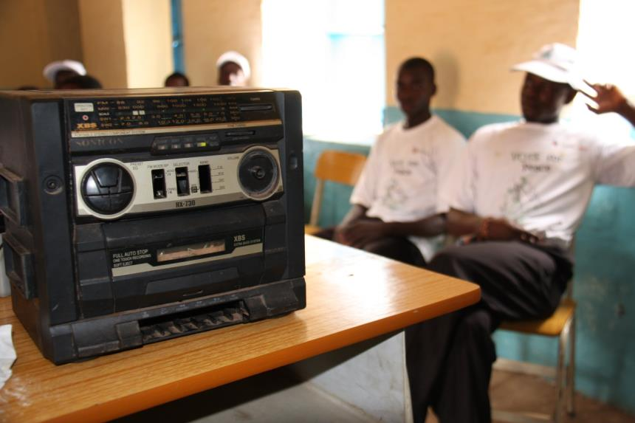
Society's Changing Expectations
Expectations of men are influenced by the images of fathering perpetuated by television, radio, and movies.
Some family intervention programs have successfully taken advantage of this trend.
Notes:
Society's changing expectations. Another dimension of the focus on men in the lives of
children is the fact that there are changing societal expectations in terms of the ways and extent
to which men should be involved in the lives of their children. There are several factors shifting
expectations of men. As mentioned above, the changing economic circumstances and moves to
more urban settings have changed family structures, putting pressure on parents to rethink their
roles and leaving men and women searching for models of how to behave in relation to children.
As the South (the Majority World) has increased contact with the North, particularly through
the mass media, expectations of men are often influenced by the images of fathering perpetuated
by television, radio, and movies. Even in remote corners of the world, television and radio
programs are providing models of men who are involved in their children's lives and upbringing.
Some family intervention programs have successfully taken advantage of this trend. For example,
in a breastfeeding project in Jordan, fathers, sons and mothers-in-law were chosen as messengers.
Because breastfeeding is sometimes regarded as an "unusual" practice in Jordan, one
breastfeeding intervention used a series of television spots which focused on the family and
the cultural legitimacy of breastfeeding. Messages to "eat better" emphasized the role played
by fathers and elder sons in encouraging the mother to take care of herself. The mother-in-law
was seen advising the young mother how to increase her breast milk and reminding her to
feed the baby on demand. Finally, quotes from the Koran recommending breastfeeding were
used to lend religious legitimacy. (USAID 1993)

Slide 43
Men's Desire to Change Their Role
Over the past 20 years or so, there has been a shift on the part of men in North countries toward greater recognition of their influence on the development of their children.
Many men have realized that they are missing out on an important experience by not being involved in the day-to-day lives of their children.
They are beginning to redefine fathering and look for social support in taking fathering more seriously.
Is this a trend that is also happening in your country?
Notes:
Men's desire to change their role. Over the past 20 years or so, there has been a shift on the
part of men in North countries toward greater recognition of their influence on the development
of their children. While the women's movement has certainly given an impetus to this, an added
piece is that many men have realized that they are missing out on an important experience by not
being involved in the day-to-day lives of their children. They are seeking ways to balance family
and work. They are also beginning to redefine fathering and look for social support in taking
fathering more seriously. Fledgling support groups have sprung up, numerous T.V. shows have
portrayed men who find themselves in the role of single parents or as active parents within
nontraditional households, and the topic has made the rounds of talk shows, magazine articles,
and nonfiction bestsellers.

Slide 44
“The mother's attitude toward the father's role in childcare can play a major role in his interactions with his children. Women who accept, encourage, and even model behaviors with children may have more involved spouses.... Mothers (are) more influential than fathers in deciding that the husband should take on a nontraditional primary caregiving role.”
(Engle and Breaux,1994, 33)
Notes:
With changing gender roles, and men’s increasing involvement in home and child care, men are beginning to grumble that the reason for their absence is that they are not made welcome in services for children.
Health providers, programme facilitators and teachers speak to women, report feeling uncomfortable with men and have, up to now, failed to adapt their approach and materials for male as well as female caregivers (Engle, Beardshaw & Loftin, 2006). The neglect and exclusion of men from programmes and services for young children, and the urgent need to include them, has been made very evident in the aftermath of AIDS-related deaths and the crisis of care for children associated with high adult mortality (Chirwa, 2002; Desmond & Desmond, 2006).

Slide 45
Summary
A positive connection between fathers and their children contributes to the overall well-being of the family, even when all family members may not be living under one roof.
Getting fathers positively involved in the lives of their children will be rewarding for the father and child, but it takes time
Involving fathers does not come easily and programs should start with small steps.
Parenting programs should ensure that they are actively seeking parent involvement and including fathers whenever possible.

Slide 46
Thank You!

