Slide 1
Child-Directed Interaction
Session Four

Slide 2
Eight Guiding Principles for Good Interaction
Show love
Talk to your child
Follow your child’s lead
Praise and appreciate
Help the child focus
Help the child to make sense of his/her world
Widen the child’s experience
Help your child to learn rules, limits and values
Notes:
Show your child you love him/her
Talk to your child. Get a conversation going by means of emotional expressions, gestures and sounds
Follow your child’s lead
Praise and appreciate what your child manages to do
Help your child focus his/her attention and share his experiences
Help your child to make sense of his/her world
Help your child to widen his/her experience
Help your child to learn rules, limits and values

Slide 3
Parent-Child Interaction
Child-Directed Interaction
Parent-Directed Interaction
Develops a strong parent-child relationship
Improves caregiver skills
Develops adaptive child social skills
Increases child self-esteem
Parents provide effective commands
Parents have age appropriate expectations
Parents practice non-violent discipline techniques

Slide 4
Child-Directed Interaction
PRIDE
Praise
Reflect
Imitate
Describe
Enthusiasm
The “Do” Skills
  P = Praise (Labeled and Unlabeled)
  R = Reflections
  I = Imitation
  D = Description (Behavioral and Information)
  E = Enthusiasm
The “Don’t” Skills
  Q = Questions
  C = Commands
  C = Criticisms
The “BIG IGNORE”
  Parents are taught to ignore their child’s
  inappropriate behaviors
  Attention seeking = Annoying or obnoxious
?

Slide 5
PRIDE
P Praise
R Reflection
I Imitation
D Description
E Enthusiasm

Slide 6
Praise
Child Directed Interaction
The Do Rules
Unlabeled praise is nonspecific
    Good!
    That's great!
Labeled praise tells child specifically what is good (handout)
    Thank you for using your indoor voice.
Increases the behavior it follows
Increases child's self-esteem
Increases positive feeling between parent and child

Slide 7
Praise & Encouragement
Praise positive social interactions and label them
(e.g. “Nice job sharing the crayons.”)
Model self-praise
Promote positive self-talk
Use specific encouraging statements
Avoid praising only perfection
Recognize social and academic behaviors that need praise
Build a child’s self-esteem through praise and encouragement

Slide 8
PRIDE
P Praise
R Reflection
I Imitation
D Description
E Enthusiasm

Slide 9
Reflection
Reflections are an important part of parent-child communication. When you reflect what a child says, you are telling your child:
  that you are listening to your child
  that you understand what your child is saying
  that what your child says to you is important
  that you approve of what your child is saying
However, just because reflections are important doesn’t mean that they are always easy!
  Sometimes it is hard to know what your child is saying and tough to figure out how to reflect the statement back to him/her.
  The easiest way to reflect what your child is saying to you is to act like a parrot!
  The trick? Say the same thing your child said, but use “you” instead of “I”.

Slide 10
Reflection
    “Mom, this is a funny thing on top of his head!”
    “Yes, his hat is very silly!”
Allows child to lead the conversation
Shows that parent is listening
Shows that parent understands
Improves and increases child’s speech

Slide 11
Reflection
Example 1:
  Child: I didn’t like going to school today, I had a math test.
  Dad: You didn’t like school today because you had a math test.
Example 2:
  Child: Dolls are for babies. I want to play with the blocks!
  Mom: You want to play with the blocks. (Don’t reflect the inappropriate part!)
Example 3:
  Child: (playing with cars on the ground) Vvrrooommmm! Vvvrrooommmm!
  Dad: Vvvrrooommmm! Vvvrrooommmm! (It’s OK to reflect sounds too!)

Slide 12
Reflection
Example 4:
  Child: I’m going to draw the biggest sun ever on this paper.
  Mom: What would you say?
Example 5:
  Child: This play-dough is really sticky; it’s all over my hands.
  Dad: What would you say?
Example 6:
  Child: I’m going to build a big castle for my stuffed doggie.
  Mom: What would you say?
Example 7:
  Child: I’m playing with a red bicycle.
  Mom: What would you say?

Slide 13
PRIDE
P Praise
R Reflection
I Imitation
D Description
E Enthusiasm

Slide 14
Imitation
Child Directed Interaction
The Do Rules
Doing the same thing as the child
    Parallel play
    Cooperative play
  Lets the child lead
  Teaches parent how to “play”
  Shows approval of child’s activity
  Teaches child how to play with others
      Sharing
      Taking turns

Slide 15
PRIDE
P Praise
R Reflection
I Imitation
D Description
E Enthusiasm

Slide 16
Description
Telling the child exactly what he or she is doing
  “You’re drawing a sun.”
Lets the child lead
Shows you are interested and paying attention
Shows approval of child’s activity
Models speech
Teaches vocabulary and concepts
Holds child’s attention to the task

Slide 17
Descriptions
Behavioral descriptions are also nice because they allow you to expand your child’s vocabulary (you are teaching them lots of words) and interact with your child even he/she is not talking to you (or can’t talk yet because he/she is too little).
Behavioral descriptions are a little different from informational descriptions. Behavioral descriptions describe what your child is doing with his/her hands or body; informational descriptions tell your child something or provide him/her with education.

Slide 18
Practicing Descriptions
Child: (drawing a huge sun with a yellow crayon)
Behavioral: You are drawing a picture of the sun with a yellow crayon.
Informational: The sun is very big and very hot and far away from the earth.
Example 1:
Child: (building a tower with blocks)
Mom: You are building a tall tower with colorful blocks.
Notes:
EXAMPLE:
Child: (drawing a huge sun with a yellow crayon)
Behavioral: You are drawing a picture of the sun with a yellow crayon.
Informational: The sun is very big and very hot and far away from the earth.
Example 1:
Child: (building a tower with blocks)
Mom: You are building a tall tower with colorful blocks.
Example 2:
Child: (getting out play-dough from the container)
Dad: You are getting out the red, blue, and green play-dough.
Example 3:
Child: (stacking blocks on top of each other)
Mom: What would you say?
Example 4:
Child: (running toy cars along the ground)
Dad: What would you say?
Example 5:
Child: (putting clothes on their baby-doll)
Mom: What would you say?

Slide 19
Practicing Descriptions
Example 2:
  Child: (getting out play-dough from the container)
  Dad: You are getting out the red, blue, and green play-dough
Example 3:
  Child: (stacking blocks on top of each other)
  Mom: What would you say?
Example 4:
  Child: (running toy cars along the ground)
  Dad: What would you say?
Example 5:
  Child: (putting clothes on a baby-doll)
  Mom: What would you say?
Notes:
EXAMPLE:
Child: (drawing a huge sun with a yellow crayon)
Behavioral: You are drawing a picture of the sun with a yellow crayon.
Informational: The sun is very big and very hot and far away from the earth.
Example 1:
Child: (building a tower with blocks)
Mom: You are building a tall tower with colorful blocks.
Example 2:
Child: (getting out play-dough from the container)
Dad: You are getting out the red, blue, and green play-dough.
Example 3:
Child: (stacking blocks on top of each other)
Mom: What would you say?
Example 4:
Child: (running toy cars along the ground)
Dad: What would you say?
Example 5:
Child: (putting clothes on their baby-doll)
Mom: What would you say?

Slide 20
PRIDE
P Praise
R Reflection
I Imitation
D Description
E Enthusiasm

Slide 21
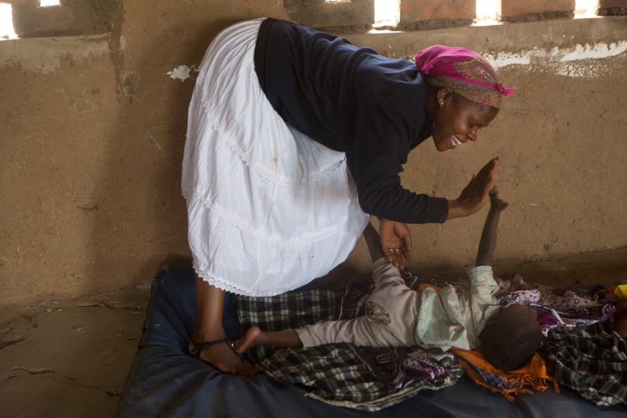
Enthusiasm
Lets child know the parent enjoys being with the child
Makes the play more fun for both parent and child
Adds a quality of warmth to the interaction

Slide 22
Practice
That’s a big tower that you’re building.
Your picture is beautiful.
You’re drawing a picture of a flower.
Thank you for putting away your toys.
You have been listening to Mommy so well!
Good job following Daddy’s directions.

Slide 23
Child-Directed Interaction
DO
  Praise
  Reflect
  Imitate
  Describe
DON’T
Give Commands
Ask Questions
Criticize
USE enthusiasm
IGNORE annoying behavior
STOP THE PLAY for dangerous or destructive behavior
Notes:
3
Discuss the E

Slide 24
PRIDE RULES | REASON | EXAMPLES
PRAISE appropriate behavior | Causes your child’s good behavior to increase. Lets your child know what you like. Increases your child’s self-esteem. Makes you and your child feel good. | Good job of putting the toys away! I like the way you’re playing so gently with the toys. Great idea to make a fence for the horses. Thank you for sharing with me.
REFLECT appropriate talk. | Lets your child lead the conversation. Shows your child that you are listening. Shows that you accept and understand your child. Improves your child’s speech. Increases the amount of talking you do with your child. | Child: I drew a tree. Parent: Yes, you made a tree. Child: The doggy has a black nose. Parent: The dog’s nose is black. Child: I like to play with the blocks. Parent: These blocks are fun.
IMITATE appropriate play. | Lets your child lead. Shows your child that you approve of the activity. Shows that you’re involved. Teaches your child how to play with others and take turns. Increases the child’s mirroring of the things that you do. | Child: I put a nose on the potato head. Parent: I’m putting a nose on Mr. Potato Head too. Child: (drawing circles on a piece of paper). Parent: I’m going to draw circles on my paper just like you.
DESCRIBE appropriate behavior. | Lets your child lead. Shows your child that you are interested. Teaches your child concepts or ideas. Models speech for your child. Holds your child’s attention on the task. Organizes your child’s thoughts about the activity. | You’re making a tower. You drew a square. You are putting together Mr. Potato Head. You put the girl inside the fire truck.
Be ENTHUSIATIC! | Lets you child know that you are enjoying the time you are spending together. Increases the warmth of the play. | Child: (carefully places the blue Lego on a tower). Parent: (gently touches the child’s back) You are REALLY being gentle with the toys.

Slide 25
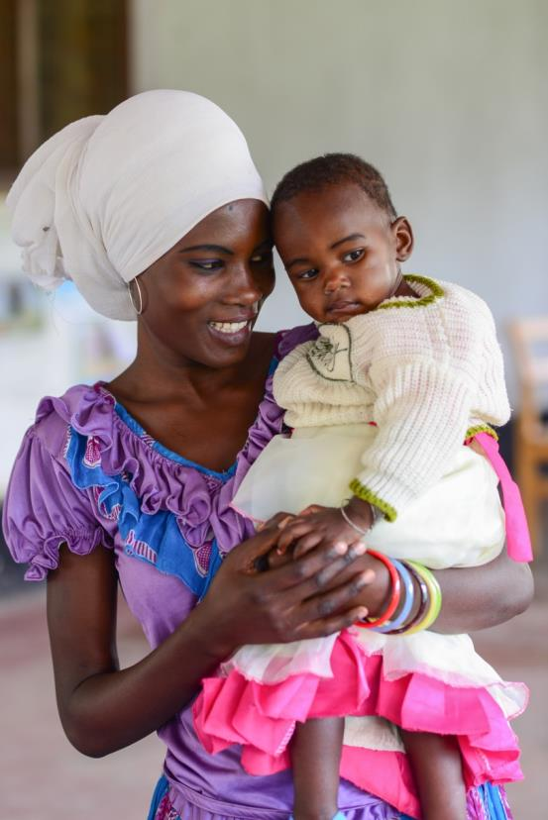
Child-Directed Interaction: The Don’t Rules
No commands
No questions
No criticism

Slide 26
The Don’t Rules
No Commands
  Direct:
  Sit here
  Indirect:
    Could you sit here?
  Why no commands?
    Attempt to lead
    Risk negative interaction

Slide 27
No Questions
Child Directed Interaction
The Don’t Rules
Questions ask for an answer
  Open
  Closed
Often hidden commands
Take lead from the child
Can suggest disapproval
Can suggest not listening

Slide 28
No Criticism
Examples
    “You’re a bad girl.”
    “That doesn’t go that way.”
    No, stop, quit, don’t
Points out mistakes rather than correcting them
  “That’s wrong” is a criticism
  “It goes like this” allows correction without criticism
Lowers self-esteem
Creates unpleasant interaction

Slide 29
Thank you!

