Slide 1
Positive Parenting
Optional Session

Slide 2
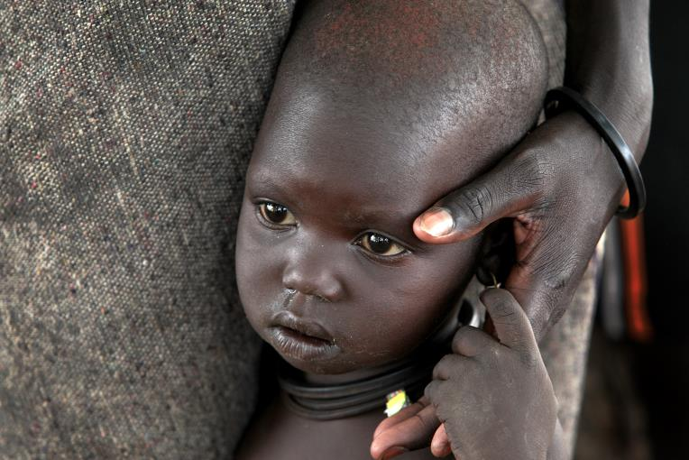
Who is considered a parent or caregiver?
Any person – biological, not related, legally or non-legally in the role of caring for and raising a child
Notes:
Parents and caregivers are any person that is in the role of caring for and raising a child. This includes a person who is biologically related, not related, has legal custody or is not legally bound, but is caring for a child. Caregiving is used interchangeably with parenting, although parenting is the preferred term when describing the long-term care of a child (Richter & Naicker, 2013).
There may be a certain image that we have in our mind when we picture a family, parents/caregivers- but these images differ with every individual. It is important to understand that anyone can become a parent/caregiver, but it is vital to understand what children need in order to develop and grow into healthy adults.

Slide 3
Brief Reflection
Reflect for a few minutes on ways that you think people become good parents:
    Do they read a book?
    Is it offered as a course in school?
    Do parents/caregivers teach their children to be good parents?
Notes:
Reflect for five minutes on ways that you think people become good parents:
Do they read a book?
Is it offered as course in school?
Do parents/caregivers teach their children?
Discussion: Have the group discuss the ways that they came up with for parents/caregivers to learn how to be good parents. Everyone grows up in different home environments and cultures. How well does the society that you have grown up in teach or support a parent/caregiver to properly raise a child?

Slide 4
What is the role of a parent or caregiver?
Providing a positive environment that allows for a child to develop and grow.
This includes:
  Physical Support
  Emotional Support
  Psychological Support
  Protection
Eshel, N., Daelmans, B., Cabral de Mello, M., & Martines, J. (2006, December). Responsive parenting: Interventions and outcomes. Bulletin of the World Health Organization, 84(12), pp. 991-998.
Notes:
What is the role of a parent or caregiver?
Providing a positive environment that allows for a child to develop and grow. This includes: physical support, emotional support, psychological support, and protection.

Slide 5
Parenting Around The World
Parenting practices vary among societies, governments and cultures.
These practices have three major goals:
    To ensure the health and safety of the child
    To prepare the child for a life that is productive when they reach adulthood
    To encourage the transmission of cultural values and practices
A healthy parent-child relationship is critical for encouraging healthy development.
Notes:
Parenting practices vary between societies, governments and cultures.
These practices have three major goals:
To ensure the health and safety of the child
To prepare the child for a life that is productive when they reach adulthood
To encourage the transmission of cultural values
Discussion around healthy parent and child relationships is so important for encouraging a child’s healthy development.
Kazdin, A. (ed.). (2000, March). Encyclopedia of psychology. American Psychological Association and Oxford University Press.

Slide 6
Requirements
Parents and caregivers need clear information, experience, support, education and guidance in order to provide a safe, nurturing and positive learning environment for their child to develop and grow.
Zepeda M, Varela F, Morales A. Promoting Positive Parenting Practices Through Parenting Education. In: Halfon N, Rice T, and Inkelas M, eds. Building State Early Childhood Comprehensive Systems Series, No. 13. National Center for Infant and Early Childhood Health Policy; 2004.
Notes:
Because there are so many variations and types of parents and caregivers, there is a definite need for clear information, experience, support, education and guidance in order to provide a safe, nurturing and positive learning environment for their child to develop and grow.

Slide 7

What do children need?
Of course, children require food and water, sanitation, and access to health services to survive.
BUT THEY ALSO NEED…
Affection, loving attention, mental stimulation, guidance and support in order to develop and grow in a secure and positive environment.
Notes:
What do children need? Of course, children require food and water, sanitation, and access to health services to survive.
BUT THEY ALSO NEED…
Affection, loving attention, mental stimulation, guidance and support in order to develop and grow in a secure and positive environment.

Slide 8
Parenting Education
Parenting Education includes the knowledge and skills that parents/caregivers need for child-rearing with the objective of improving a child’s health and development.
Strengthen the knowledge and skills of parents and caregivers in order to enhance positive parenting practices.
Zepeda M, Varela F, Morales A. Promoting Positive Parenting Practices Through Parenting Education. In: Halfon N, Rice T, and Inkelas M, eds. Building State Early Childhood Comprehensive Systems Series, No. 13. National Center for Infant and Early Childhood Health Policy; 2004.
Notes:
Parenting Education includes the knowledge and skills that parents/caregivers need for child-rearing with the objective of improving a child’s health and development. Not a universally accepted term (e.g. it is sometimes called ‘parent training’ or ‘parent education’ (can be considered inclusive of those individuals who are not biological or legal parent but who nonetheless carry the primary responsibility of raising a child.) For the purpose of this presentation, when discussing and using the term ‘parent’, it will include all caregivers, legal and non-legal that are raising/rearing children.
Parent Education is defined as information and education about children, child development, or other aspects of parenting. (Richter & Naicker, 2013)

Slide 9
Parenting/Caregiver Programs
“Parenting support programs aim to change parental beliefs and actions with the goal of changing child behavior which, in turn, is likely to lead to changes in parental well-being including the couple and family relationships”
  (Richter & Naicker, 2013)
Notes:
“Parenting support programs aim to change parental beliefs and actions with the goal of changing child behavior which, in turn, is likely to lead to changes in parental well-being including the couple and family relationships”
- “Most parenting support programs operate within a transactional model of parent-child relations (Sameroff, 2009). They assume that parental beliefs and actions affect children and that children’s beliefs and actions will affect parents. These transactional processes are therefor capable of producing virtuous and vicious cycles of interaction that become embedded with short- and long-term positive or negative outcomes for children, parents and their families.” (Richter & Naicker, 2013).

Slide 10
Brief Reflection Exercise
Reflect on how you were raised?
    Was it a healthy and stable environment?
    Did you get what you needed?
    Can you think of culturally specific practices that affected your development?
    What (if any) parenting education or support do you think your parents needed?
Notes:
Reflect on how you were raised?
Was it a healthy environment?
Did you have everything you needed?
Was it a stable environment?
Can you think of culturally specific practices that affected your growth?
Encourage people to write down some answers to the above questions. They can reflect on their answers as they learn more about positive parenting education programs.

Slide 11
Parenting Styles
There are two recognized major variables when considering parenting styles and child outcomes.
These variables help us to better understand differing parenting styles.
Baumrind, D. The development of instrumental competence through socialization. Minnesota Symp Child Psych. 1973;7:3-46.
Maccoby, E. E., & Martin, J. A. (1983). Socialization in the context of the family: Parent–child interaction. In P. H. Mussen & E. M.
Notes:
There are two recognized major variables when considering parenting styles and child outcomes. These variables help us to better understand differing parenting styles.

Slide 12
Variable 1
Responsiveness of the parent/caregiver to the child
  This type of parent/caregiver usually behaves
    Reasonably
    Is nurturing
    Provides encouraging or supportive feedback to the child
Photo: parent appears responsive to child
Baumrind, D. The development of instrumental competence through socialization. Minnesota Symp Child Psych. 1973;7:3-46.
Notes:
Variable 1:
Responsiveness of the parent/caregiver to the child
This type of parent/caregiver usually behaves
Reasonably
Is nurturing
Provides encouraging or supportive feedback to the child

Slide 13
Variable 2
Demandedness of the parent/caregiver seeks for the child to comply with established rules and expectations.
  This type of parent/caregiver usually
  Has expectations or demands of the child
  Wants behavior to be in control
  Monitors the child closely for adherence to these expectations.
Baumrind, D. The development of instrumental competence through socialization. Minnesota Symp Child Psych. 1973;7:3-46.
Notes:
Demandedness of the parent/caregiver seeks for the child to comply with established rules and expectations.
This type of parent/caregiver usually
Has expectations or demands of the child
Wants behavior to be in control
Monitors the child closely for adherence to these expectations.

Slide 14
Parenting Styles
The two major characteristics or variables, Responsiveness and Demandedness, contribute to the main PARENTING STYLES:
  AUTHORITARIAN
  PERMISSIVE
  AUTHORITATIVE
Notes:
The two major characteristics or variables discussed; Responsiveness and Demandedness, contribute to the main PARENTING STYLES by the degree of variables practices.
AUTHORITATIVE OR INDUCTIVE
AUTHORITARIAN OR COERCIVE
PERMISSIVE

Slide 15
Authoritarian Style
“You don’t need to understand, you only need to comply” – A motto of a strict authoritarian parent.
High on demandedness and low on responsiveness.
Rely heavy on “coercion” to force the child to comply.
Coercion includes using threats, intimidation, physical punishment, fear, and love withdrawal.
Children from these parents/caregivers are usually more anxious, withdrawn, and unhappy. They also can have more difficulty with peer relationships.
With the lack of parental support and responsive interaction, children tend to perform lower academically.
Notes:
Authoritarian Style
“You don’t need to understand, you only need to comply” – A motto of a strict authoritarian parent.
Rely heavy on “coercion” to force the child to comply.
High on demandedness and low on responsiveness.
Authoritarian Style
Rely heavy on “coercion” to force the child to comply.
Coercion includes using threats, intimidation, physical punishment, fear, and love withdrawal.
Children from these parents/caregivers are usually more anxious, withdrawn, and unhappy. They also can have more difficulty with peer relationships.
With the lack of parental support and responsive interaction, children tend to be lower academically.

Slide 16
Permissive Style
Permissive parents and caregivers are usually not specific in expectations and direction. There is miscommunication with rules for compliance.
Usually warm and nurturing and reasonably responsive to the physical and emotional needs of the child, they tend not to provide sufficient support or guidance that the child needs.
Low on demandedness and range low to high on responsiveness.
Often children from this type of parenting style are less mature when compared to other children from other parenting styles.
Children can be disobedient, rebellious, more self-centered and impulsive.
Notes:
Permissive parents and caregivers are usually not specific in expectations and direction. There is miscommunication with rules for compliance.
Usually warm and nurturing and reasonably responsive to the physical and emotional needs of the child, they tend not to provide sufficient support or guidance that the child needs.
Low on demandedness and range low to high on responsiveness.
Permissive Style
Often children from this type of parenting style are less mature when compared to other children from other parenting styles.
Children can be disobedient, rebellious, more self-centered and impulsive.

Slide 17
Authoritative Style
High in demandedness and high in responsiveness.
Reasonable with their expectations.
Provide warmth and nurturance in their response to their child.
Encourage the child to understand expectations of the parent.
Open discussion/dialogue that allows for feedback and collaboration on what the parent would like from the child.
Children of these parents/caregivers tend to be more well adjusted in life and more successful in school.
Notes:
Authoritative Style
High in demandedness and high in responsiveness.
These parents/caregivers tend to be reasonable with their expectations.
Provide warmth and nurturance in their response to their child.
Encourage the child to understand expectations of the parent (the issues and values of what is being asked for).
There is open discussion/dialogue that allows for feedback and collaboration on what the parent would like from the child.
Also referred to as “inductive” parenting.
Children of these parents/caregivers tend to be more well adjusted in life and more successful in school.

Slide 18
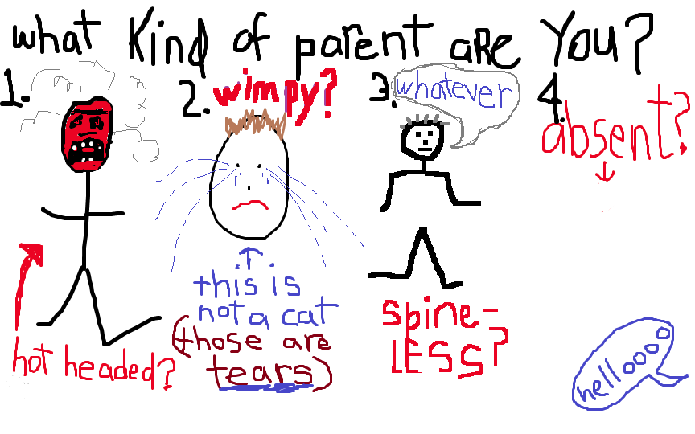

Slide 19
Positive Parenting
Parenting that supports a healthy parent-child relationship
Sometimes called positive discipline, gentle guidance, or loving guidance
Guidance that keeps children on the right path, offered in a positive way that resists any temptation to be punitive.

Slide 20
Why is it important?
Physical discipline is not only less effective than other non-coercive methods, it is more harmful than has often been understood.
Corporal punishment is associated with antisocial behavior and aggression in children, and later in life is linked to depression, unhappiness, anxiety, drug and alcohol use and psychological maladjustment.
Beyond beating, parents can also hurt children by humiliating them, labeling them in harmful ways (“Why are you so stupid?”), or continually criticizing their behavior.
Joan Durrant and Ron Ensom. Physical punishment of children: lessons from 20 years of research. CMAJ, 2012 DOI: 10.1503/cmaj.101314
Notes:
It is now well accepted that physical discipline is not only less effective than other non-coercive methods, it is more harmful than has often been understood — and not just to children.
A review of two decades worth of studies has shown that corporal punishment is associated with antisocial behavior and aggression in children, and later in life is linked to depression, unhappiness, anxiety, drug and alcohol use and psychological maladjustment. Beyond beating, parents can also hurt children by humiliating them, labeling them in harmful ways (“Why are you so stupid?”), or continually criticizing their behavior.
Results consistently suggest that physical punishment has a direct causal effect on externalizing behaviour, whether through a reflexive response to pain, modeling or coercive family processes," write the authors.
Physical punishment is also associated with a variety of mental health problems, such as depression, anxiety and use of drugs and alcohol. Physical punishment may change areas in the brain linked to performance on IQ tests and increase vulnerability to drug or alcohol dependence, as recent neuroimaging studies suggest. Attitudes toward the use of physical punishment have changed, and many countries have shifted focus to positive discipline of children and have legally abolished physical punishment.

Slide 21
Why physical punishment isn’t good
Results consistently suggest that physical punishment cause increased externalizing behaviors.
Physical punishment is associated with a variety of mental health problems, such as depression, anxiety and use of drugs and alcohol.
Physical punishment may change areas in the brain linked to performance on IQ tests and increase vulnerability to drug or alcohol dependence.
Attitudes toward the use of physical punishment have changed, and many countries have shifted focus to positive discipline of children and have legally abolished physical punishment.
What are the laws on physical punishment where you live?
Joan Durrant and Ron Ensom. Physical punishment of children: lessons from 20 years of research. CMAJ, 2012 DOI: 10.1503/cmaj.101314
Notes:
It is now well accepted that physical discipline is not only less effective than other non-coercive methods, it is more harmful than has often been understood — and not just to children.
A review of two decades worth of studies has shown that corporal punishment is associated with antisocial behavior and aggression in children, and later in life is linked to depression, unhappiness, anxiety, drug and alcohol use and psychological maladjustment. Beyond beating, parents can also hurt children by humiliating them, labeling them in harmful ways (“Why are you so stupid?”), or continually criticizing their behavior.
Results consistently suggest that physical punishment has a direct causal effect on externalizing behaviour, whether through a reflexive response to pain, modeling or coercive family processes," write the authors.
Physical punishment is also associated with a variety of mental health problems, such as depression, anxiety and use of drugs and alcohol. Physical punishment may change areas in the brain linked to performance on IQ tests and increase vulnerability to drug or alcohol dependence, as recent neuroimaging studies suggest. Attitudes toward the use of physical punishment have changed, and many countries have shifted focus to positive discipline of children and have legally abolished physical punishment.

Slide 22
Results of Positive Parenting Interventions
Child-Parent Centers provided comprehensive educational and family support to economically disadvantaged children and their parents. In a matched control trial, children participating in these centers had a 52 percent reduction in child maltreatment (Reynolds & Robertson, 2003).
Nurse-Family Partnership is a nurse home visitation program for low-income, first-time parents and their children beginning prenatally and continuing up to the child’s second birthday.
  The program encourages healthy behaviors during and after pregnancy, teaches appropriate parenting skills, and links parents to community services.
  A randomized controlled trial documented a 48 percent reduction in child maltreatment at the 15-year follow-up (Olds et al., 1997).

Slide 23
Results of Positive Parenting Interventions
Triple P is a multi-level system of parenting interventions based on need usually delivered through health care.
  In the U.S. Triple P System Trial, researchers found a 28% reduction in substantiated abuse cases, an 44% reduction in child out-of-home placements, and an 35% reduction in hospitalizations and emergency room visits for child injuries in nine study counties in South Carolina where parenting interventions were implemented (Prinz et al., 2009).
Incredible Years parenting program has shown marked results:
  Increases in parent positive affect such as praise and reduced use of criticism and negative commands
  Increases in parent use of effective limit-setting by replacing spanking and harsh discipline with non-violent discipline techniques and increased monitoring of children.
  Reductions in parental depression and increases in parental self-confidence.
  Increases in positive family communication and problem-solving.
  Reduced conduct problems in children’s interactions with parents and increases in their positive affect and compliance to parental commands.

Slide 24
Key Components of Positive Parenting
Positive Parenting education and support generally cover components of the following:
Developmental norms and milestones
A safe, interesting environment
A positive learning environment
Behavior management & assertive discipline
Realistic expectations
Self care for parents

Slide 25
Developmental Norms and Milestones
Children are not “little adults”
Parents require knowledge of developmental norms and milestones of their children, so they can understand how to interact appropriately with their children throughout their development
Parents should understand the key developmental norms associated with different age groups and the various domains of child development

Slide 26
Create a safe, interesting environment
When children play and explore it helps them develop skills.
A home that is safe is essential. Parents should be supported to create such a safe environment.
  Parenting education discusses possible safety hazards and how these can be mitigated.
Children also need interesting things to do. Parents require the education, skills, and support to create such interesting environments.
  No need for expensive toys. There are lots of low/no cost options. Parents should be supported to identify these options.

Slide 27
Positive Learning Environment
Children need their parents' attention. But that doesn't mean parents have to play with them every minute of the day.
Quality is more important than quantity.
Parents need to be positive about things their children are doing.
  Skills building on how to pay attention to children’s positive behaviors including praise. When children are rewarded for good behavior by their parents with just a bit of attention or recognition, they become more likely to engage in the good behavior again.
Additional parenting education and tips on positive learning environments:
  Speak nicely.
  Use "Incidental Teaching.”
  Share experiences. Children need practice at listening too.
  Be affectionate. Show children they are loved.
Notes:
Children need their parents' attention. But that doesn't mean parents have to play with them every minute of the day.
Quality is more important than quantity.
Parents need to be positive about things their children are doing.
Skills building on how to pay attention to children’s positive behaviors including praise. When children are rewarded for good behavior by their parents with just a bit of attention or recognition, they become more likely to engage in the good behavior again.
Additional parenting education and tips on positive learning environments:
Speak nicely.
Use "Incidental Teaching." This means teach them when you can. For example, don't just give your child an answer to a question. Prompt your child to talk about it or give them a clue to find the answer themselves. They'll learn more that way.
Share your own experiences. Children need practice at listening too. Tell them something about your day or something they may be interested in.
Be affectionate. Show your child you love them. Kisses, cuddles and hugs will make your child feel wanted and secure.

Slide 28
Behavior Management & Assertive Discipline
Children need boundaries and consistency, which helps them feel safe and secure and know what to expect.
Parents should have the skills to manage behavior and respond accordingly, including when to ignore and when to discipline.
Assertive discipline helps children understand that their behavior always has consequences and that those consequences are carried out in a predictable, loving environment.
Assertive discipline means parents are prepared. They set clear ground rules and tell their child what to do rather than what not to do. They give clear, calm instructions and are consistent from one day to the next.
If set rules are broken, parents act quickly, stay calm and follow up with fair, age-appropriate consequences, such as taking away a play thing for a short period.
Parents should remember to praise behavior they like.
  Catch them doing something good!

Slide 29
Realistic Expectations
Children aren't all the same. They're individuals with their own personalities. Even kids of the same age develop at different rates.
It's important that parents don't expect more - or less - of their child than he or she is capable of providing.
Nobody's perfect.
If parents expect their child will always be polite, happy or cooperative, they will be disappointed.
Children make mistakes, but most mistakes aren't intentional. It's okay to let children try and fail.

Slide 30
Self Care for Parents
Parenting is much easier when parents also take care of themselves!
Of course, raising children is a time-consuming job. When parents also have other jobs, multiple children, and many other demands, they tend to decrease their own self-care.
Parents need support from friends or family.
Parents should take time to things they enjoy.
When parents look after themselves, they feel more patient and calm when their child needs them.
They also feel more confident in their own parenting abilities.

