Slide 1
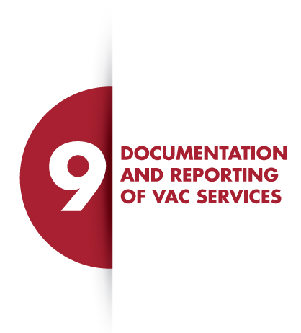
SLIDE 1

Slide 2
SLIDE 2
LEARNING OUTCOMES
At the end of this module, you should understand the following:
The importance of documenting VAC services that have been provided;
Types of tools used at health facilities to collect data from children who are at risk of or have experienced violence;
Data quality assurance methods

Slide 3
SLIDE 3
DOCUMENTATION FOR VAC SERVICES
Importance of Documentation
Provides estimate trends of the incidence and prevalence of VAC
Guides provision of appropriate follow-up care.
Aids the court in decision making.
NB: Information collected from the child at every service delivery point must be treated with uttermost confidentiality and privacy.

Slide 4
SLIDE 4
DATA COLLECTION TOOLS FOR VAC SERVICES
Referral documents, e.g. client-held records, can be given to an older child or a trusted caregiver.
Referral documents provide information to the service providers, e.g. social workers, regarding survivor follow-up and care.
Any referral made should be followed up and referrals coordinated with other service providers to ensure that the child receives essential services beyond the health facility.

Slide 5
SLIDE 5
DATA QUALITY ASSURANCE – DQA (1)
Information collected from the child during the consultation process should be accurate and complete in order for it to be useful for decision making.
The processes is undertaken routinely by assigned personnel to ensure that the data is regularly audited and cleaned

Slide 6
SLIDE 6
DATA QUALITY ASSURANCE
– DQA (2)
Monthly data reviews of client documentation forms and the VAC register to ensure completeness and accuracy.
The corrective measures include data verification from source documents and data reconstruction where possible.
Continuous training of health care providers on importance of collecting quality data, maintaining confidentiality of data and protecting private and personal information.
Quality considerations in data management include completeness, correctness, timeliness, security and typing error.

Slide 7
SLIDE 7
STORAGE OF DATA
Treat information collected with uttermost confidentiality and privacy.
Reassure the child and/or caregiver that the information will be kept safely
Ensure the child’s confidential and legal information is securely stored.
Store files in a dry and safe place under lock and key.

Slide 8
SLIDE 8

Slide 9
SLIDE 15
SUMMARY
Proper documentation is important for decision making.
Treat all VAC documents with outmost Privacy and confidentiality.

