Slide 1
SLIDE 1

Slide 2
SLIDE 2
LEARNING OUTCOMES
At the end of this module, you should gain or improve:
Knowledge and skills to provide immediate, first-line support to children who are at risk of or have undergone violence.

Slide 3
SLIDE 3
LIVES
Listen to the child closely, with empathy and without Judging
Inquire - Assess and respond to the child’s needs and concerns
Validate - Show the child that you understand & believe them – don’t blame them
Enhance Safety - Discuss a plan to protect the child from further harm
Support - helping connect the child & the caregiver to information, services & social support

Slide 4
SLIDE 4
E = ENHANCE SAFETY
The most important thing is to make sure that the child is not placed in further danger immediately.
The health worker should know when to provide immediate safety support and ensure safety

Slide 5
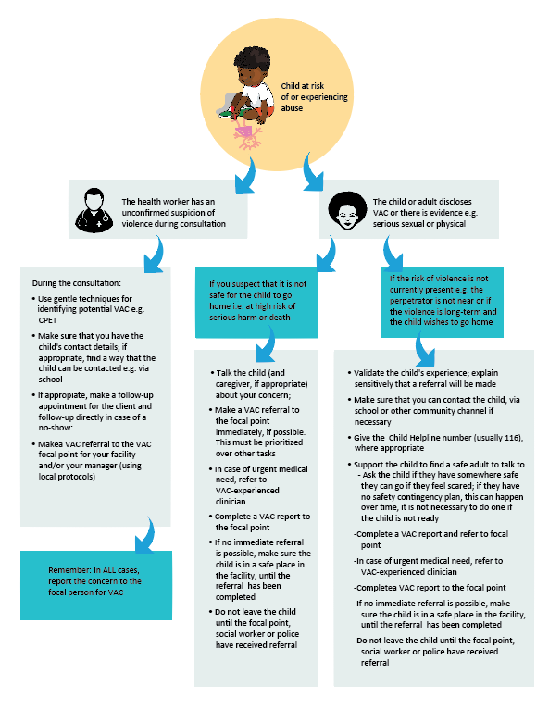
SLIDE 5
FLOWCHART TO ENHANCE SAFETY OF A CHILD AT
RISK OF VAC
When there is any doubt or suspicion, refer!
Always have a referral focal point who can be contacted, with a support plan.
Prioritize the child’s safety.
The flowchart helps to be clear what should be done in all cases and what must be done when a person suspects that a child is at risk of severe harm or death.
Must be locally adapted.

Slide 6
SLIDE 6
ENHANCE SAFETY - SUMMARY
The flowchart:
is not a screening tool
assists health worker to decide when to make an immediate referral to a VAC focal point or, if that focal point is not available, to a social worker.
Whenever there is suspicion, report to the child protection focal point.
Make sure that there are no negative consequences for child or family. Confidentiality is essential.
The most important thing to help a child to be safe is to listen to the child, validate the child’s experiences and ensure that the child has had the chance to say what she or he is comfortable saying. It is not necessary to encourage a child to disclose.
Always have easy-to-access information for sharing with children, e.g. Child Helpline (116) if available and other sources of local support.

Slide 7
SLIDE 7
S = SUPPORT
It is critical to connect a child who is at risk or is experiencing violence with other resources for her/his health, safety, and social support.
Violence prevention and response requires a multidisciplinary response.
These multidisciplinary services may be within the health facility and will always include some referrals to external service providers.
Health care providers can help by discussing the child’s needs with them and or their non-offending care giver telling them about other sources of help, and assisting them to get help if the child wants it.

Slide 8
SLIDE 8
ACTIVITY 2 ROLE PLAY
After you have acted out the role play, discuss:
What concerns do you have with how Fatima was attended to at the health facility?
What steps could be taken to ensure Fatima’s safety?
What steps could be taken to provide the appropriate social support to Fatima?
Have you ever experienced a situation where a child’s safety and support were not fully addressed? How could this situation be improved if it happened again?

Slide 9
SLIDE 9

Slide 10
SLIDE 10
SUMMARY
Whenever you have a concern about a child’s safety, remember LIVES.
Have a focal person for contacting in case of any concern.
If you have a concern that a child is facing risk to life or serious harm, keep the child safe and bring in support immediately.
If in doubt, assume that a child is at serious risk and contact the focal point.
Have a set of simple ‘keeping safe’ instructions for a child who may be at risk but does not appear to be in immediate harm.
Ongoing referrals and support are essential. These will be looked at in the next session.

