Slide 1
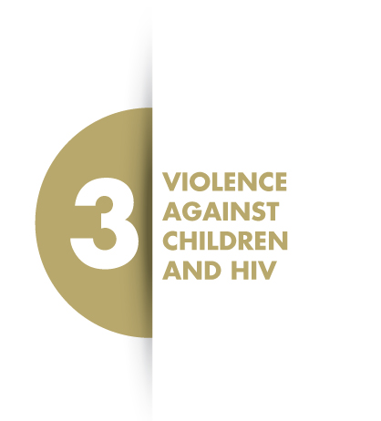
SLIDE 1

Slide 2
SLIDE 2
LEARNING OUTCOMES
At the end of this module, you should understand the following:
Interlinkages between VAC and HIV
The importance of integrating VAC into HIV services.

Slide 3
SLIDE 3
GROUP DISCUSSION (15 MINUTES)
How might HIV lead to VAC?
How might VAC lead to HIV?

Slide 4
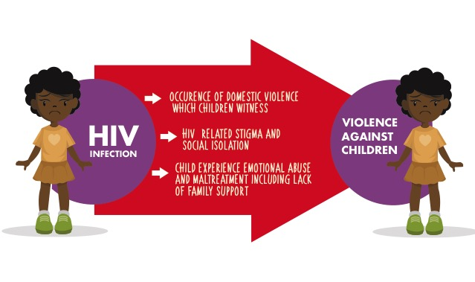
SLIDE 4
HOW HIV LEADS TO VAC
[SEE NOTE ABOUT CHANGING

Slide 5
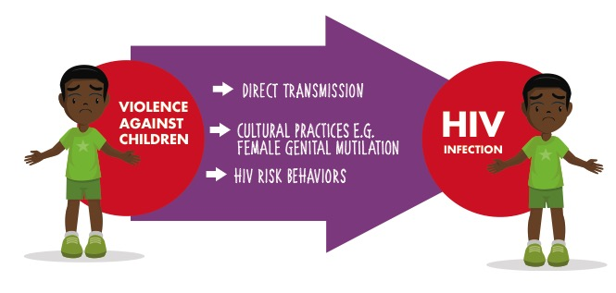
SLIDE 5
HOW VAC LEADS TO HIV [SEE NOTE ABOUT CHANGING COLOURS IN SLIDE]

Slide 6
SLIDE 6
RATIONALE FOR INTEGRATION OF VAC AND HIV
Global HIV policies and standards recognize that VAC is linked to HIV and the need to integrate VAC prevention and response into HIV services
Children who are at risk of or have experienced violence rarely disclose VAC, so it is important that health workers have the confidence to suspect and identify these children.
Healthcare providers regularly encounter child survivors of violence, in their routine practice but do not have the knowledge and skill on how to appropriately respond.
Available evidence shows that integrating VAC prevention and response into HIV services can improve HIV and other health related outcomes, health seeking behavior and partner communication (for adolescents).

Slide 7
SLIDE 7
“Inequality, a lack of empowerment and violence against women are human rights violations and are continuing to fuel new HIV infections. We must not let up in our efforts to address and root out harassment, abuse and violence, whether at home, in the community or in the workplace.”
Michel Sidibé, UNAIDS Director, July 2018

Slide 8
SLIDE 8

Slide 9
SLIDE 19
SUMMARY
VAC is a known risk factor for HIV infection or worsened HIV outcomes.
Similarly, HIV is a known risk factor for increased risk of violence amongst children
Integrating VAC prevention and response into HIV services can improve HIV and other health related outcomes, health seeking behavior and partner communication (for adolescents).

