Slide 1

SLIDE 1

Slide 2
SLIDE 2
LEARNING OUTCOMES
  By the end of this session, we will be able to:
  Apply guiding principles in providing care to children who are at risk of or have experienced violence.

Slide 3
SLIDE 3
GUIDING PRINCIPLES FOR RESPONDING TO VAC
Principle of best interest of the child
Principle of evolving capacities
Principle of non-discrimination
Principle of participation
Adapted from United Nations Convention on the Rights of Children (CRC) and African Charter on the Rights and Welfare of the Child (ACRWC)

Slide 4
SLIDE 4
PRINCIPLE 1: BEST INTERESTS
Health workers should:
Protect and promote safety
Provide sensitive, caring and non-judgmental services
Protect and promote privacy and confidentiality

Slide 5

SLIDE 5
PRINCIPLE 1: BEST INTERESTS - PROTECT AND PROMOTE SAFETY
Example: If a child told you that he or she is scared that a person who is harming the child could come to the health facility to further harm him or her, the child’s best interest principle necessitates that you assist the child to move to a safe, private place within the facility and seek immediate support.
Do you have other examples to share?

Slide 6
SLIDE 6
PRINCIPLE 1: BEST INTERESTS – PROVIDE SENSITIVE CARING AND NON-JUDGMENTAL SERVICES
Example: If a child discloses experience of violence, reassure him or her that you believe their story and remind the child that it was not their fault. Let the child know that she or he is safe and you are here to support him or her.
For younger children, use child-friendly tools, like pictures, toys or drawing, to motivate and stimulate a conversation in a gentle manner.
Do you have other examples to share?

Slide 7
SLIDE 7
PRINCIPLE 1: BEST INTERESTS - PROTECT AND PROMOTE PRIVACY AND CONFIDENTIALITY
Example: Most people think that children don’t need to be interviewed on their own. But sometimes you need to find a space where children are happy to talk to you without someone else is there.
You may sometimes need to tell someone else. In this case, you should make it clear to the child that you may need to tell someone else.
Do you have other examples to share

Slide 8
SLIDE 8
LIMITS TO CONFIDENTIALITY
(Where mandatory reporting is in the law) Ensure that the child or caregiver understands what may need to be reported before they disclose
Always ensure the child’s safety first – if he or she is afraid of consequences to reporting, address the fear fist
Where it is in the best interests of the child that a case of violence is reported, explain simply and clearly to the child what must be done
Best interests and limits of confidentiality: When keeping silent would have a negative impact on the child, cause the child greater harm or have an impact on the future prospects of the child

Slide 9
SLIDE 9
PRINCIPLE 2: EVOLVING CAPACITIES OF A CHILD
Applying these principles will differ according to the age of the child
Health workers should:
Provide age-appropriate information according to the child’s age and developmental stage.
  NB: Module 4: Communication will practice working with children of different ages.
Seek informed consent / assent as appropriate to the child’s age and the legal age of consent for obtaining clinical care for all decisions. (See Job aid on informed consent and assent)

Slide 10
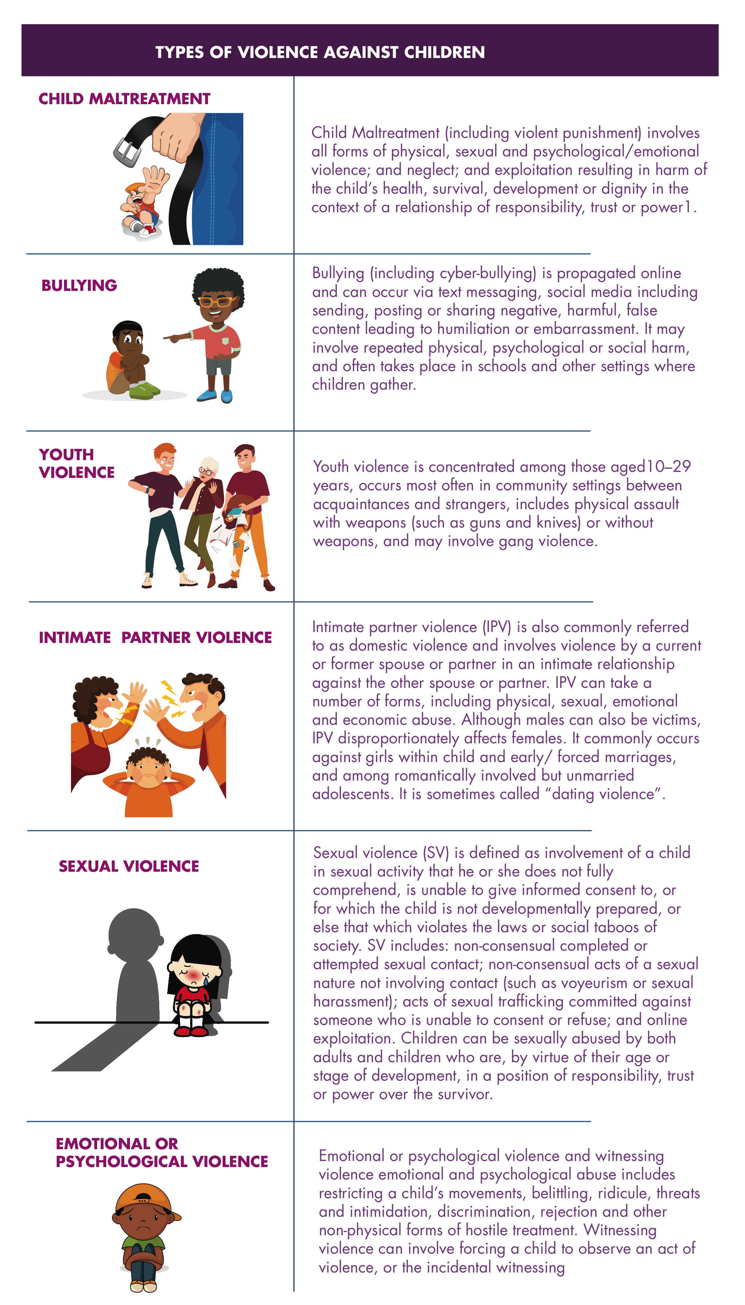
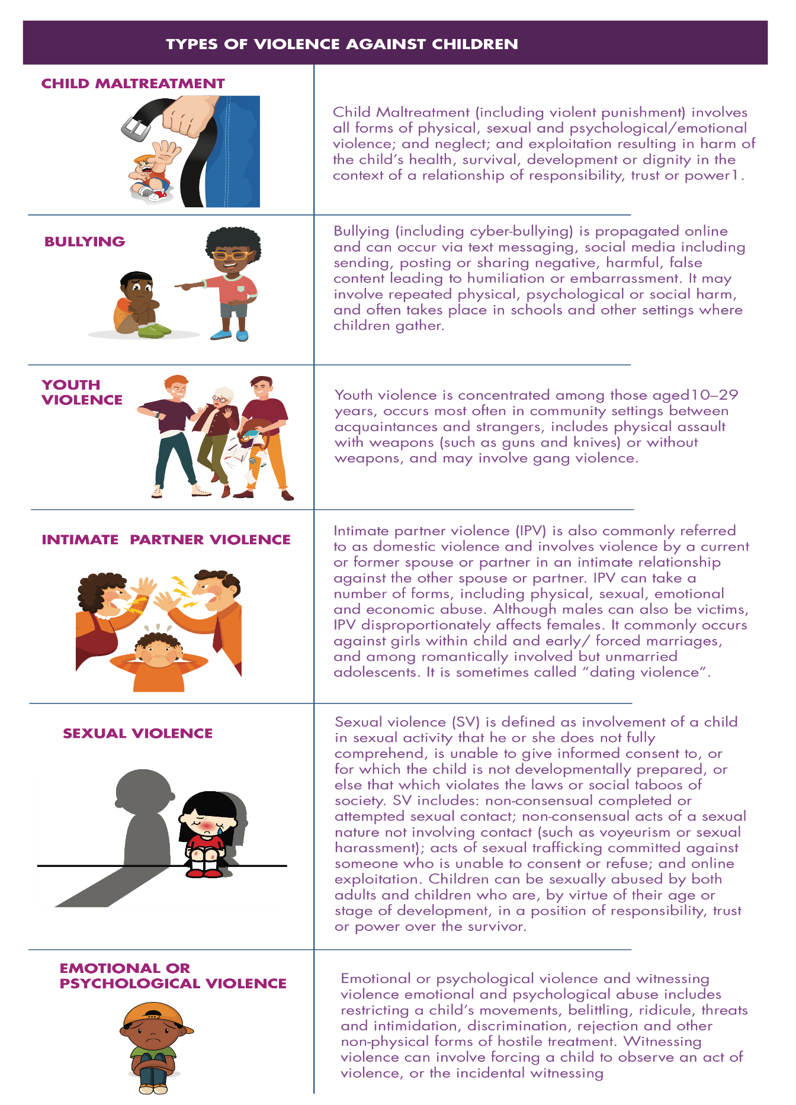
SLIDE 10
TYPES OF VIOLENCE AGAINST CHILDREN

Slide 11
SLIDE 11
PRINCIPLE 2: EVOLVING CAPACITIES
Example: Health workers should ask the child what they think about the options of services that are available to support them and their opinions should be respected and taken into account when decisions are being made in relation to clinical care being offered to them.
else.
Do you have other examples to share?

Slide 12
SLIDE 12
  PRINCIPLE 3: NON-DISCRIMINATION
Health workers should:
Ensure fairness in all interactions with the child
Recognize and take into account gender, disability and other social inequalities that can increase vulnerabilities to violence and pose barriers in access to services.
Pay special attention to the specific needs of vulnerable groups e.g. adolescent girls from poor communities

Slide 13
SLIDE 13
  PRINCIPLE 3: NON-DISCRIMINATION
Example: A child has not been receiving treatment at the health facility because she is often seen in the bars at night with older men and is known to sell sex occasionally. The nurse has often told her that she is a disgrace to her family and should go back to church.
Do you have other examples to share?

Slide 14
SLIDE 14
  PRINCIPLE 4: PARTICIPATION
Children have a right to participate in decisions that have implications for their lives, in accordance with their evolving capacities.

Slide 15
SLIDE 15
  PRINCIPLE 4: PARTICIPATION
Example: Before giving a caregiver a child’s treatment plan for HIV, talk with the child about what might help him take his drugs regularly and if he has other concerns about his HIV status. Provide regular opportunities for him to ask questions about his illness and treatment.
Help him to draw up his own treatment plan using a simple calendar that he has illustrated himself.
se.
Do you have other examples to share?

Slide 16

SLIDE 16

Slide 17
SLIDE 19
  SUMMARY
There are four core child rights principles:
Best interests – safety, services, confidentiality
Evolving capacities – age-appropriate, consent, child’s wishes
Non-discrimination – fairness, equality, inclusion
Participation - children have a right to participate in decisions that have implications for their lives
All health workers to apply these principles when working with all children.
Children at risk of or experiencing VAC will have particular need of these principles.

