Slide 1
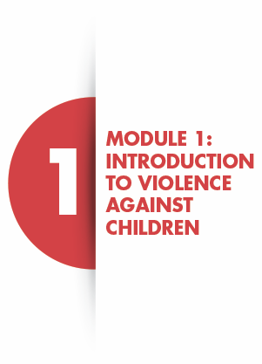
SLIDE 1

Slide 2
SLIDE 2
LEARNING OUTCOMES
At the end of this module, you should understand the following:
• The definition of violence against children;
•The different types of violence against children;
•The main causes of violence against children;
•The magnitude of violence against children;
•The main consequences of violence against children;
•The minimum package of a multisectoral response to children and adolescents at risk of or who have experienced violence
•International legal frameworks and guidelines that regulate the violence against children response.

Slide 3
SLIDE 3
VIOLENCE
An intentional use of force or power, threatened or actual, against one self, another person, or against a group or community that either results in or has a high likelihood of resulting in injury, death, psychological harm, mal-development, or deprivation.
World Health Organization, 2002

Slide 4
SLIDE 4
CHILD
“All human beings below the age of 18 years unless under the law applicable to the child, majority is attained earlier”
United Nations Convention on the Rights of the Child, 1989).

Slide 5
SLIDE 5
VIOLENCE AGAINST CHILDREN
All forms of physical or mental violence, injury and abuse, neglect or children negligent treatment, maltreatment or exploitation, including sexual abuse.
United Nations Convention on the Rights of the Child, 1989

Slide 6
SLIDE 6
PERPETRATOR
A person who directly inflicts or supports violence or other abuse inflicted on another against his/her will.
International Rescue Committee, 2012

Slide 7
SLIDE 7
RISK OF VIOLENCE
Factors that make one more vulnerable to or increases likelihood of experiencing abuse and/or perpetration.

Slide 8
SLIDE 8
SURVIVOR
Any adult or child who has experienced violence.

Slide 9
SLIDE 9
GROUP DISCUSSION
(15 minutes)
• What are the common types of VAC in your community?
• Who are the common perpetrator(s) of these types of VAC?

Slide 10
SLIDE 10
TYPES OF VIOLENCE AGAINST CHILDREN

Slide 11
SLIDE 11
MAGNITUDE OF VIOLENCE AGAINST CHILDREN
Close to 1.6 billion children globally experience any type of VAC annually
The WHO has estimated that 150 million girls and 73 million boys under the age of 18 have experienced sexual violence involving physical contact (WHO, 2006).
According to the VACS, only 10% of children who had experienced violence received services (UNICEF, 2014).
ADD ANY NATIONAL OR LOCAL DATA AVAILABLE ON VAC

Slide 12
SLIDE 12
WHAT DO YOU THINK ARE THE MAIN CAUSES OF VIOLENCE AGAINST CHILDREN?

Slide 13
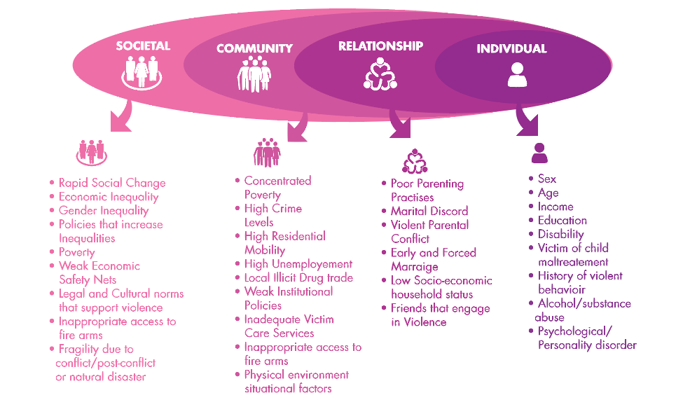
SLIDE 13
CAUSES OF VAC

Slide 14
SLIDE 14
WHAT DO YOU THINK ARE THE MAIN CAUSES OF VIOLENCE AGAINST CHILDREN?

Slide 15
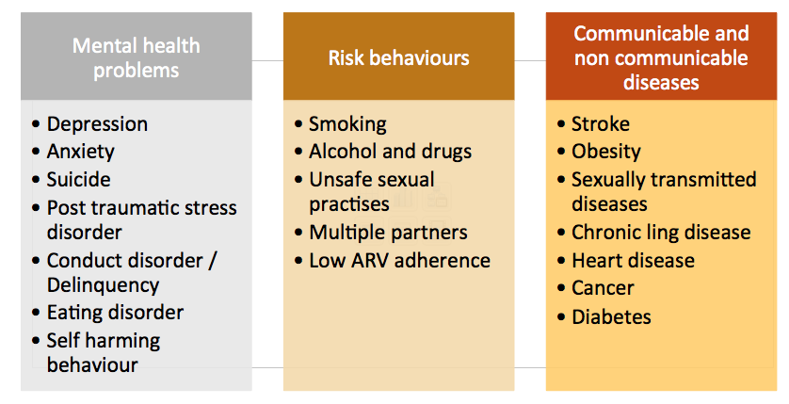
SLIDE 15
CONSEQUENCES OF VAC

Slide 16
SLIDE 16
HUMAN RIGHTS INSTRUMENTS FOR CHILDREN
The main human rights instrument is the Convention on the Rights of the Child (CRC). Human rights instruments focus on:
Protection from violence and abuse
Privacy
Participation
Health including access to care

Slide 17
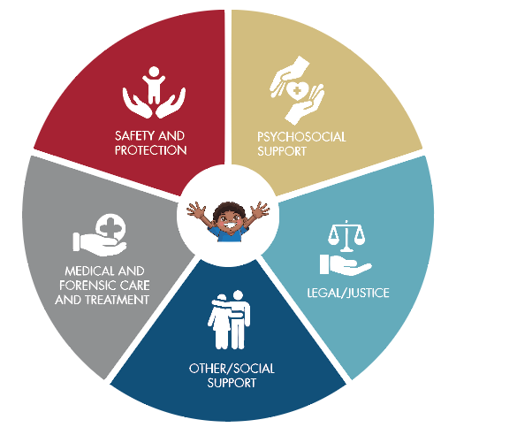
SLIDE 17
MINIMUM FRAMEWORK FOR COMPREHENSIVE RESPONSE

Slide 18
SLIDE 18

Slide 19
SLIDE 19
SUMMARY OF MODULE 1
The rate of violence against children is extremely high
VAC in all its forms is caused by a range of factors from individual up to society factors
All forms of VAC have adverse consequences on children and their lifetime development
There are international legal frameworks, and national specific laws that confer protection and safeguarding of children

