Slide 1
Promoting Innovation
A SMART Skills Manual

Slide 2
Skills for Marketing and Rural Transformation (SMART skills)
SMART Skills manuals:
Introduction to SMART skills for rural development
Organizing and managing farmer groups
Understanding natural resources
Managing natural resources
Marketing basics
Seven steps of marketing
Promoting innovation

Slide 3
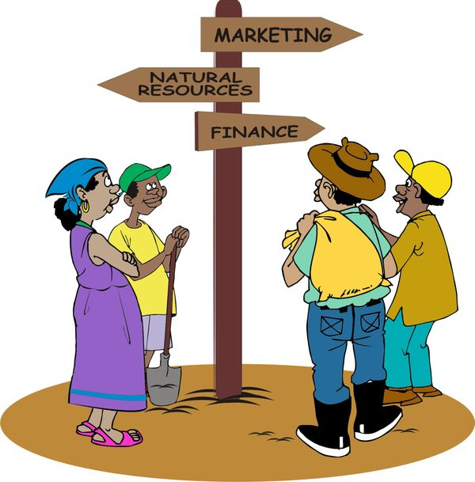
Purpose of the SMART skills series
To introduce you to the following five skill areas:
Group organization
Natural resources management
Finance
Marketing
Innovation

Slide 4
Manual content
Eight lessons:
Introduction to innovations
Identifying and understanding problems
Finding more information
Exploring possible solutions
Designing research
Collecting and recording observations
Analyzing and evaluating the results
Applying findings and sharing knowledge

Slide 5
Lesson 1:
Introduction to innovation

Slide 6
Outcomes
After this lesson, you will be able to:
Describe what an innovation is and why it important for rural people.
List different types of innovations.
Describe the role of field agents in helping farmers innovate.
List the key characteristics of members of an innovation group.

Slide 7
Overview
Lesson 1 covers the following content:
The importance of innovations
How innovations occur
Types of innovations
The role of research, extension and farmers
The systematic approach
The role of field agents
Organizing innovation groups
Basic principles of a participatory process

Slide 8
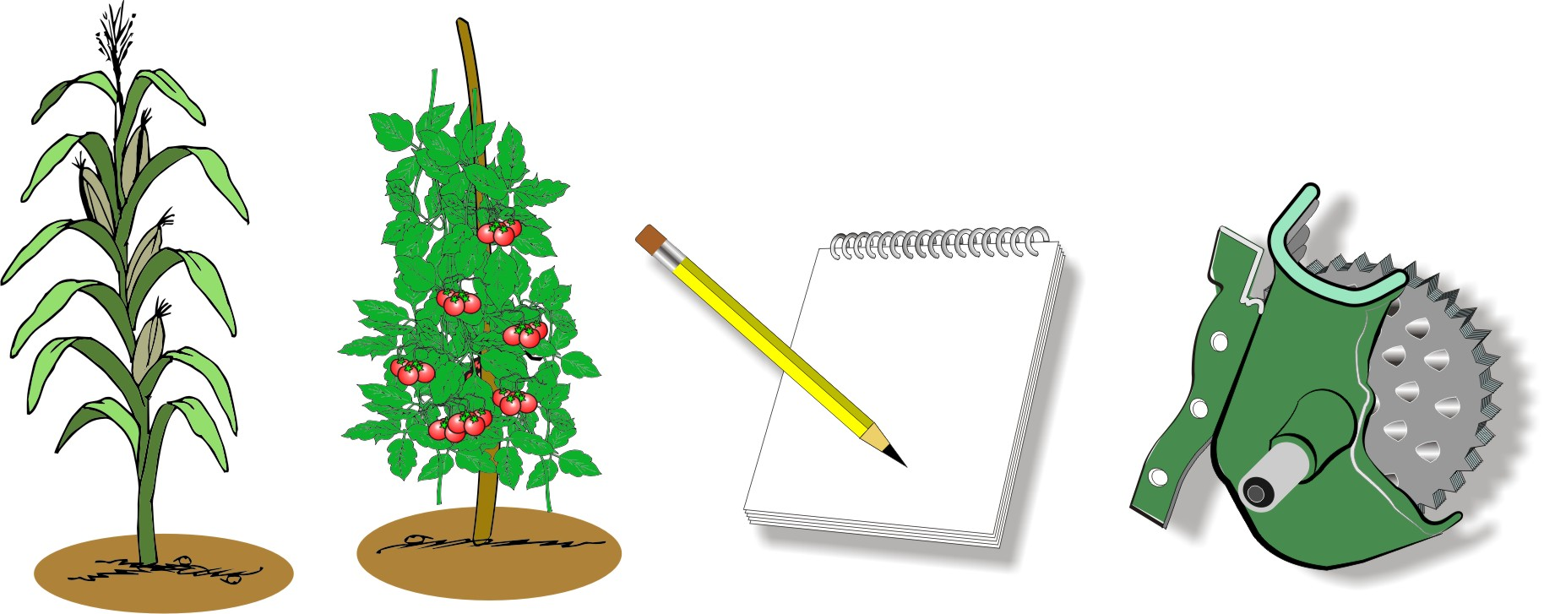
What is an innovation?
An innovation is an improvement or a change in knowledge or technology that results in an increase of productivity or competitiveness of a particular product.

Slide 9
The importance of innovations for rural communities
If rural communities want to improve their livelihoods, they have to:
Change the way they do things
Grow more and better-quality produce
Reduce their costs
Improve how they process and market their harvest
All these changes are innovations and they all help to improve people’s lives and increase their incomes in some way.

Slide 10
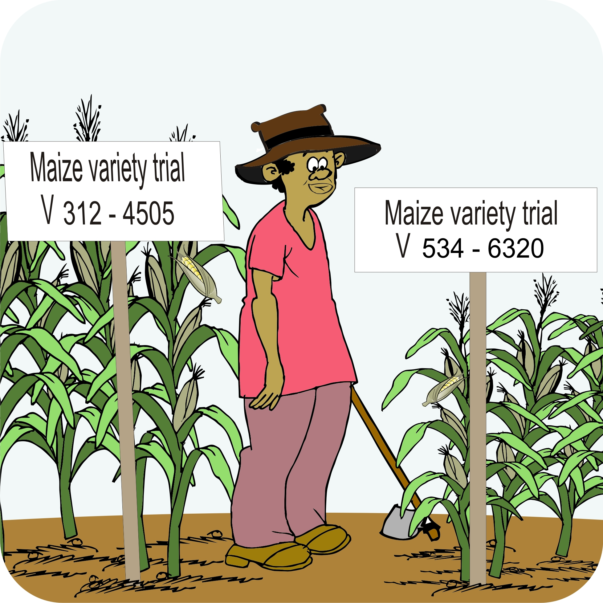
The world is changing
People feel it is necessary to grow more on the same amount of land, but the soil is degrading and water is becoming scarce.
A changing climate means farmers have to plant new types of crops and change the way they produce food.

Slide 11
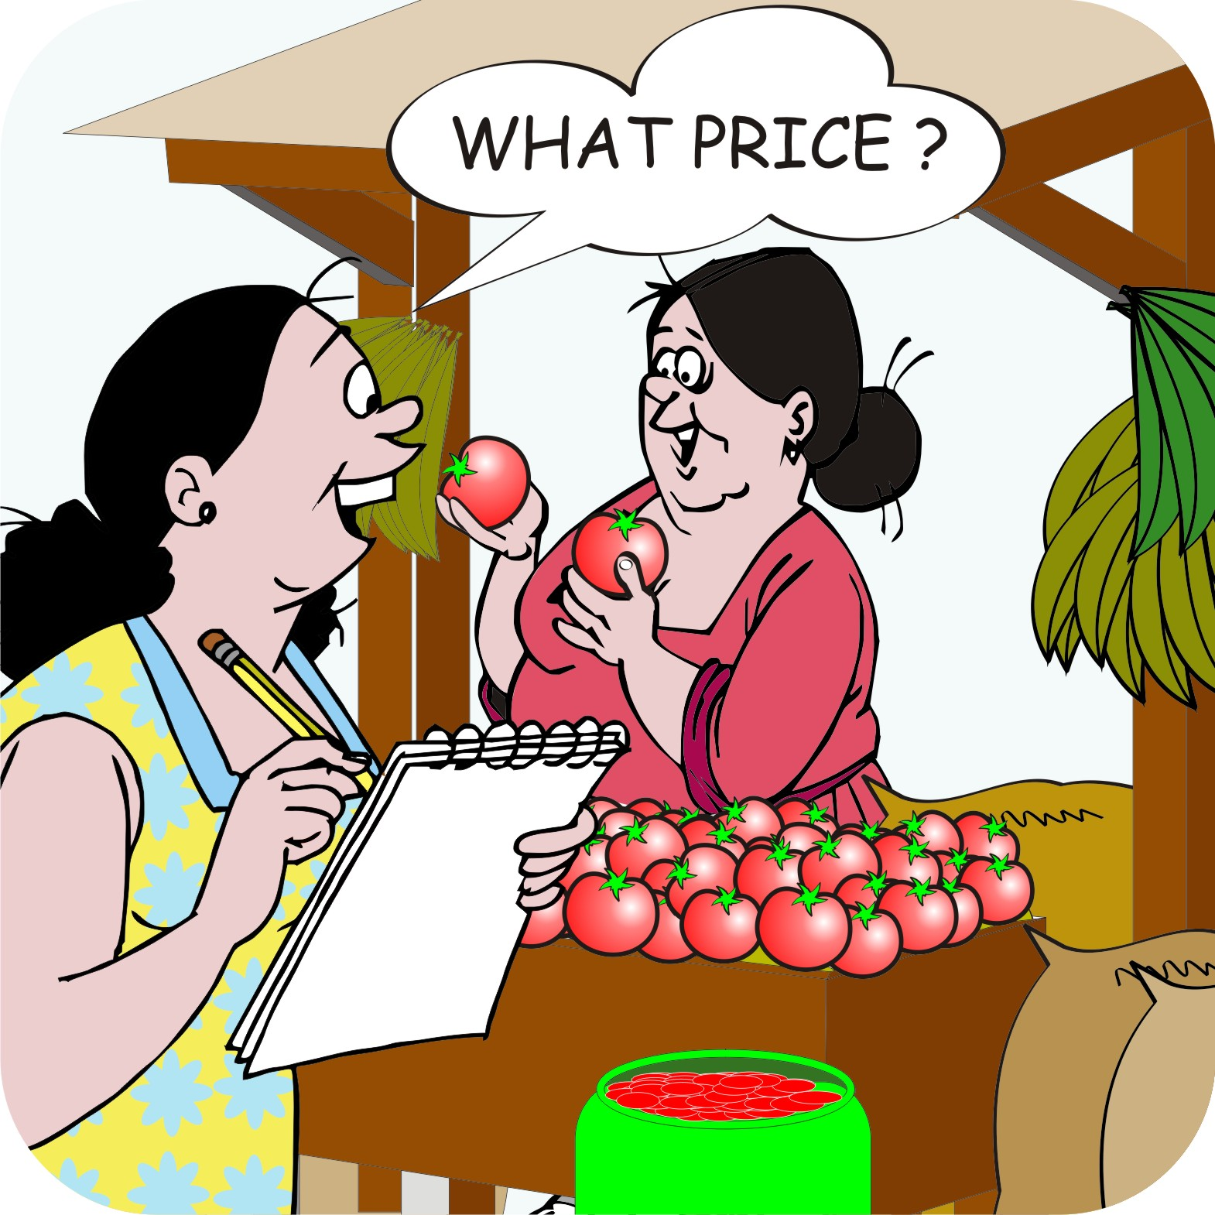
The world is changing: New market opportunities
New marketing opportunities are arising, but markets are becoming more competitive and demand better quality.

Slide 12
How do innovations occur
Innovations may occur as the result of:
A chance observation
A deliberate experiment
A survey
An invention
Inventions may also be introduced from elsewhere.

Slide 13
Types of innovations
Innovations may occur in all stages in the production and marketing of farm products:
Agricultural technology: Increasing productivity or introducing a new product
Management of the ecosystem and of the natural resources used in the production process.
Post-harvest technology related to conservation and storage, packaging and transport
Marketing and the presentation of the product in the market.

Slide 14
Role of research, extension and farmers
Scientists at research institutions:
Study problems
Come up with ideas for solving them
Develop new technologies
Conduct experiments to test their ideas and evaluate their results
They then pass on their findings to extension workers and field agents, who, in turn, introduce them to farmers.

Slide 15
Rural farmers and research
Rural farmers should not leave research to researchers because:
There are only a few researchers and they cannot solve all farmers’ problems
Solutions to problems may already exist without rural people knowing about them
Rural farmers are constantly making observations and developing new ideas
Conditions vary from place-to-place and farmers should adapt the solutions to suit their situation
People are likely to adopt ideas that they have tested

Slide 16
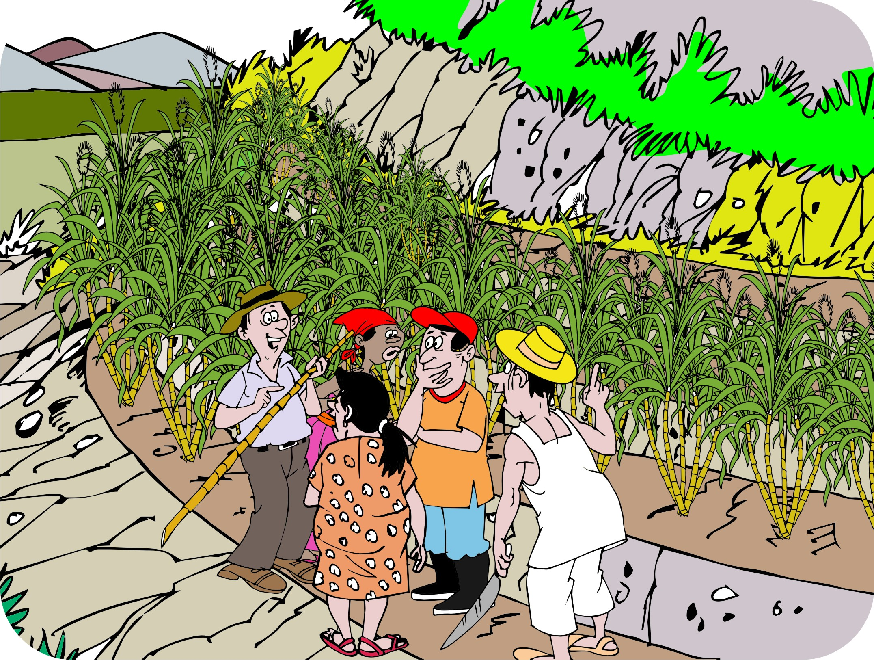
Systematic approach to innovation
Individual farmers can develop, test and implement innovations on their own.
However, innovations are more effective and spread faster if rural people are organized to solve problems they face.

Slide 17
The role of the field agent in innovation
As the field agent, it is your role to support rural people with innovation by helping them to:
Analyze their problems and seek solutions
Get organized to obtain information, conduct research
Evaluate and spread the research results
Monitor their activities
Develop links with other groups and organizations (e.g. research institutions) that can support them.

Slide 18
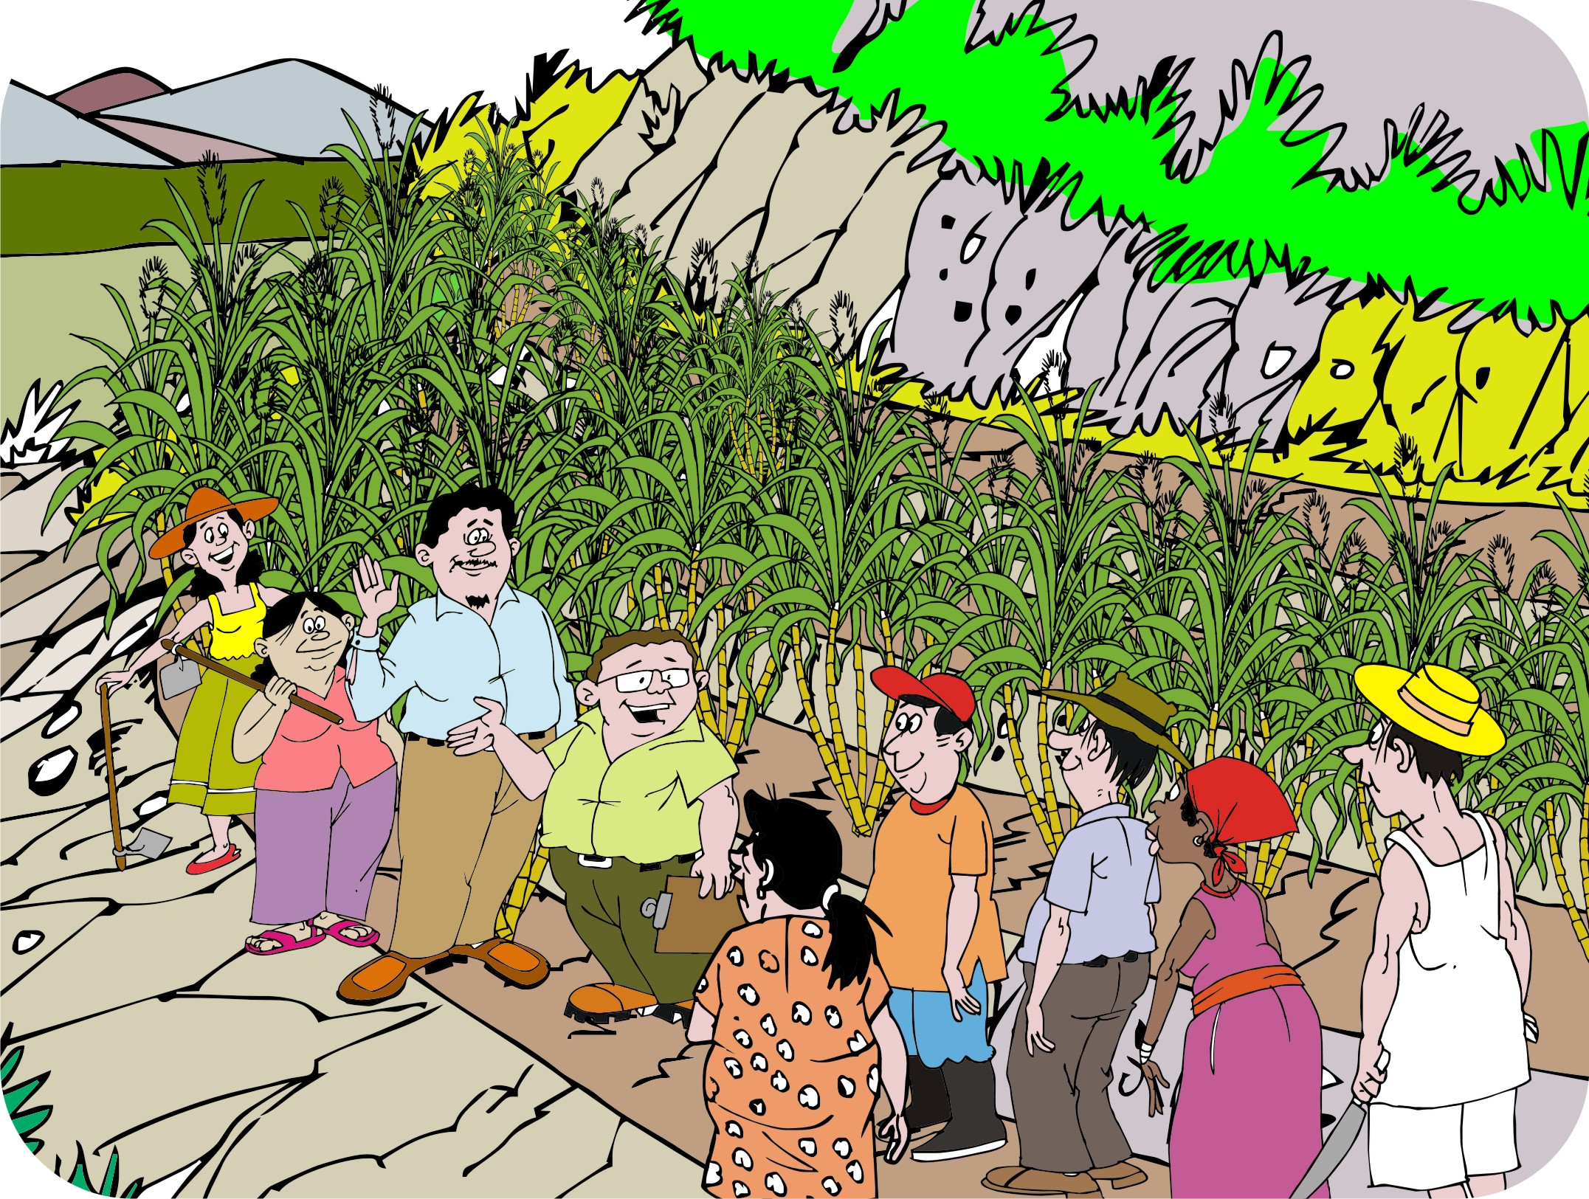
Organizing innovation groups
Innovation groups can be organized in the following two ways:
Innovation groups:
  Help interested members of the community to organize as separate innovation groups that can conduct experiments and spread them in the community.
Innovation subcommittees:
  Help each farmers’ group form subcommittees that focus on innovation.

Slide 19
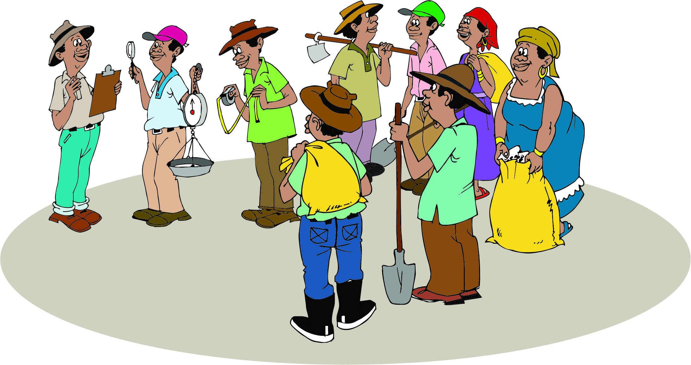
Forming Innovation Groups: What to keep in mind
Ensure representation of women and poorer people in the community
Start small and focus on a small number of manageable subjects
Aim for success
Make sure that ideas and findings are shared and spread, e.g. by encouraging regular and open discussions

Slide 20
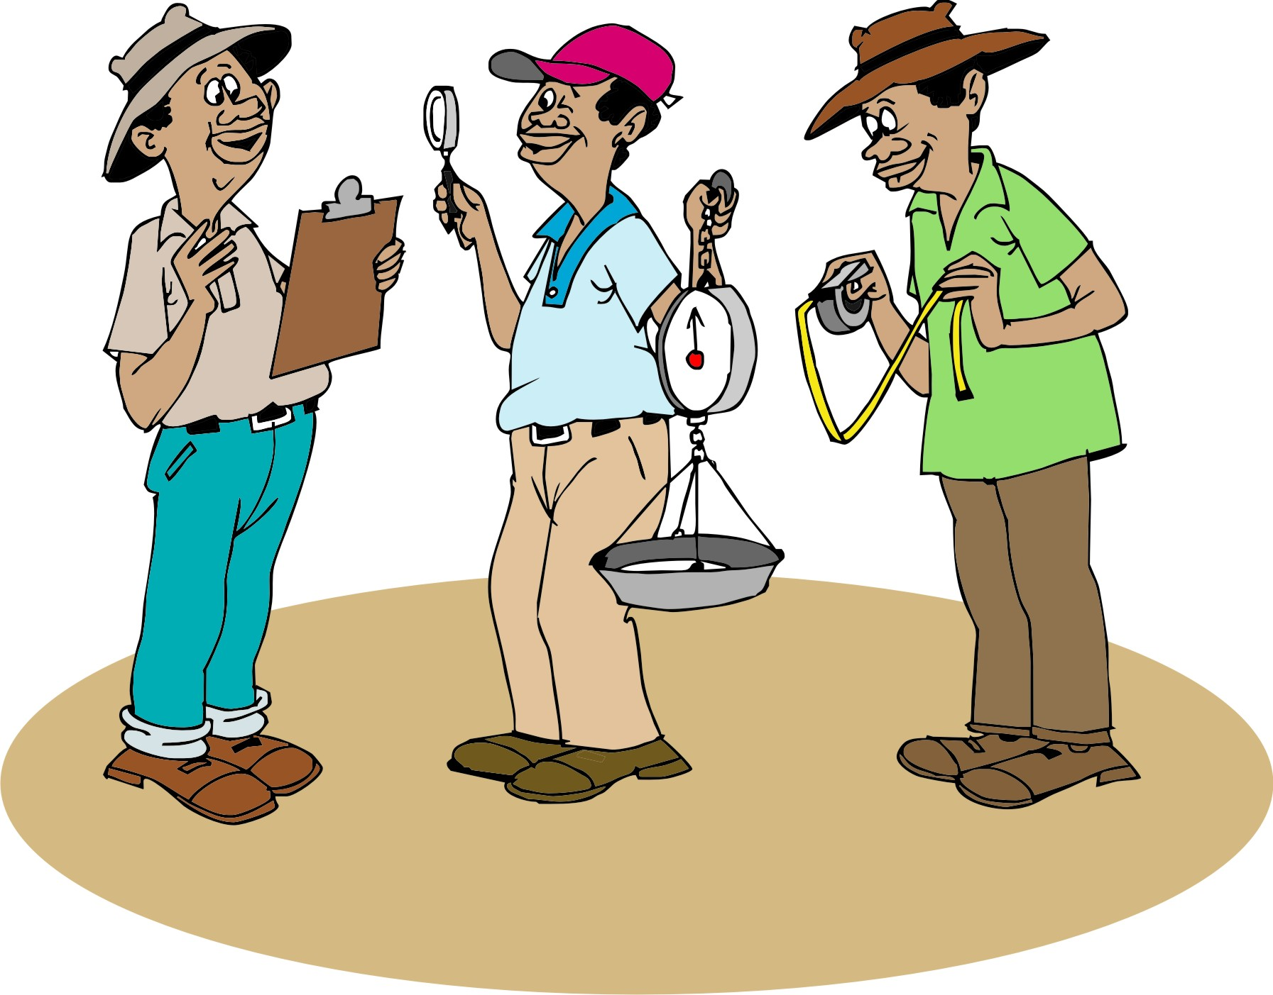
Members of the innovation group
Look for the following in innovation group members:
Time and resources to participate
Representativeness: Balance in terms of age, gender and wealth
Experience and expertise
Interest in experimentation
Communication skills

Slide 21
Principles of a participatory approach
Play a neutral role. Do not dominate meetings.
Encourage everyone to express their opinions freely.
Cross-check information by asking different people.
Learn from different stakeholders and involve them in all stages of the process
Link with research institutions and other sources of information.
Ensure that local communities make as many as possible of the decisions.
Make sure that the activities are sustainable and will continue after outside support has ceased.

Slide 22
Lesson 2:
Identifying and understanding problems

Slide 23
Outcomes
After this lesson you will be able to:
Describe how farmers can prioritize their problems.
Guide farmers in constructing a problem tree.
Help farmers choose among ways to solve their top problem.

Slide 24
Overview
Lesson 2 covers the following content:
Prioritizing problems
Understanding problems
Problem trees
Choosing potential solutions

Slide 25
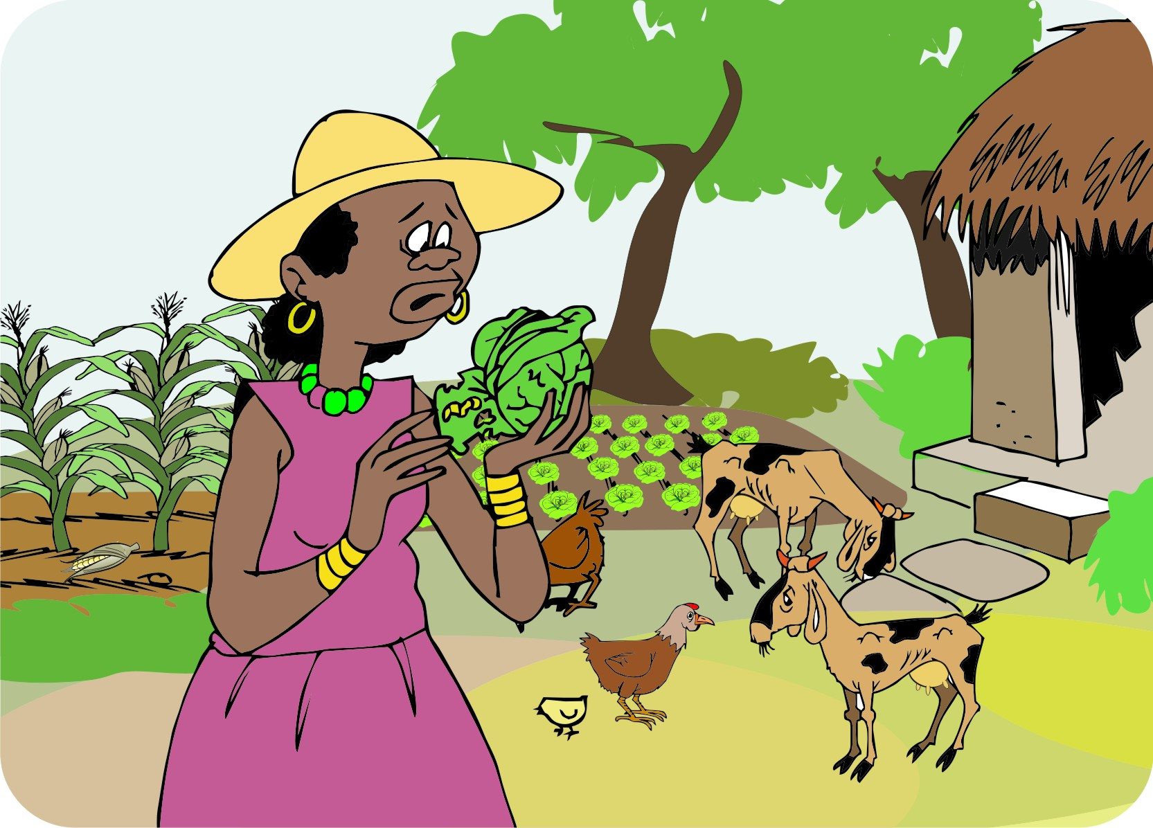
Prioritizing problems
Farmers cannot tackle all their problems at the same time; they have to solve them one at a time.
Therefore, they should:
List the problems
Decide on the problem with the highest priority

Slide 26
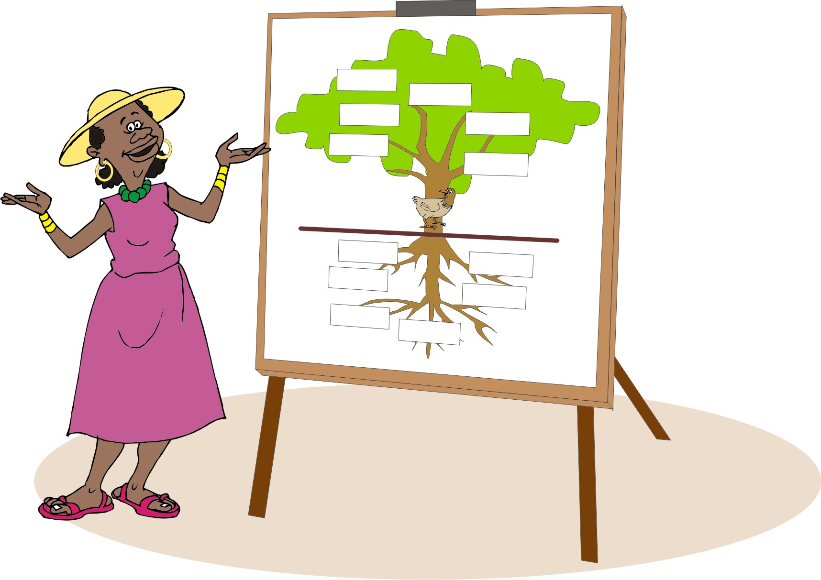
Understanding problems: Using problem trees
Understanding the root causes of a problem is important to find the most effective solution.
One way to do this is to build a problem tree that shows the causes and effects of the problem.

Slide 27
Steps in creating a problem tree
Step 1: List the root causes of the number.
Step 2: Identify current practices.
Step 3: Identify potential solutions.
Step 4: List the constraints for every potential solution – i.e. the difficulties in putting the solution into practice.
Step 5: Suggest concrete ways to overcome the identified constraints.

Slide 28
Lesson 3:
Finding more information

Slide 29
Outcomes and overview
After this lesson you will be able to:
List several possible sources of solutions to a problem.
Lesson 3 covers the following content:
Where to find solutions to problems:
Other farmers
Input dealers, innovators, traders and business service providers
Researchers and extension workers
The Internet

Slide 30
Finding solutions to problems: Sources of information
Other farmers: Neighbouring farms and villages
Input dealers: Suppliers of seeds and agrochemicals
Innovators: People trying new ideas
Traders: Knowledgeable about markets and prices
Researchers
Business service providers: Advice on technical and financial issues
Extension workers
Books, farming magazines and training materials
Radio, television and the Internet
Experiments

Slide 31
Lesson 4:
Exploring possible solutions

Slide 32
Outcomes
After this lesson you will be able to:
Give examples of an all-or-nothing technology and one that can be tried out on a small scale.
Describe how to help farmers find out about all-or-nothing technologies
List the likely benefits and disadvantages of an innovation.

Slide 33
Overview
Lesson 4 covers the following content:
Putting ideas into practice
All-or-nothing technologies
Trying things out on a small scale
Ideas to test
Thinking of implications
Positive and negative consequences

Slide 34
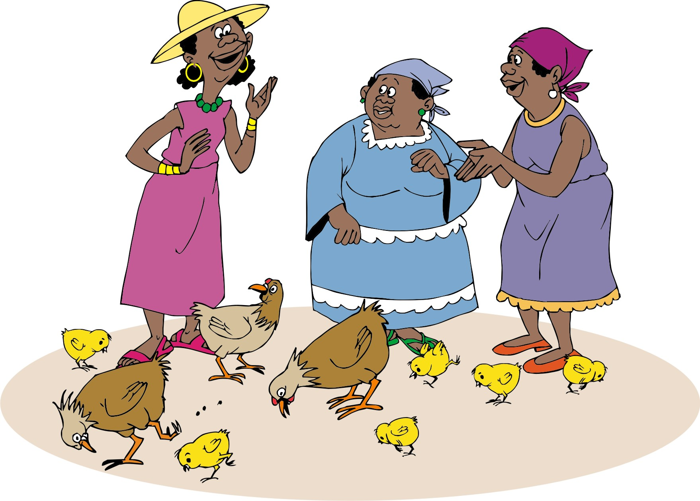
Putting ideas into practice
If the farmers are confident that the solution will work, they may decide to put it into practice straight away.
You may need to help them to:
Get organized to pay for inputs
Coordinate activities
Contribute labor
Pool their produce for marketing

Slide 35
All-or-nothing technologies
To help farmers to adopt all-or-nothing technologies – i.e. technologies that cannot be tried out on small scale, e.g. irrigation schemes and erosion control – you have to:
Organize visits to other villages already using these technologies.
Arrange for specialists to talk to the farmers.
Arrange training to make sure that they understand how to use the technology.
Discuss the implications of the technology: costs, benefits, advantages and disadvantages.

Slide 36
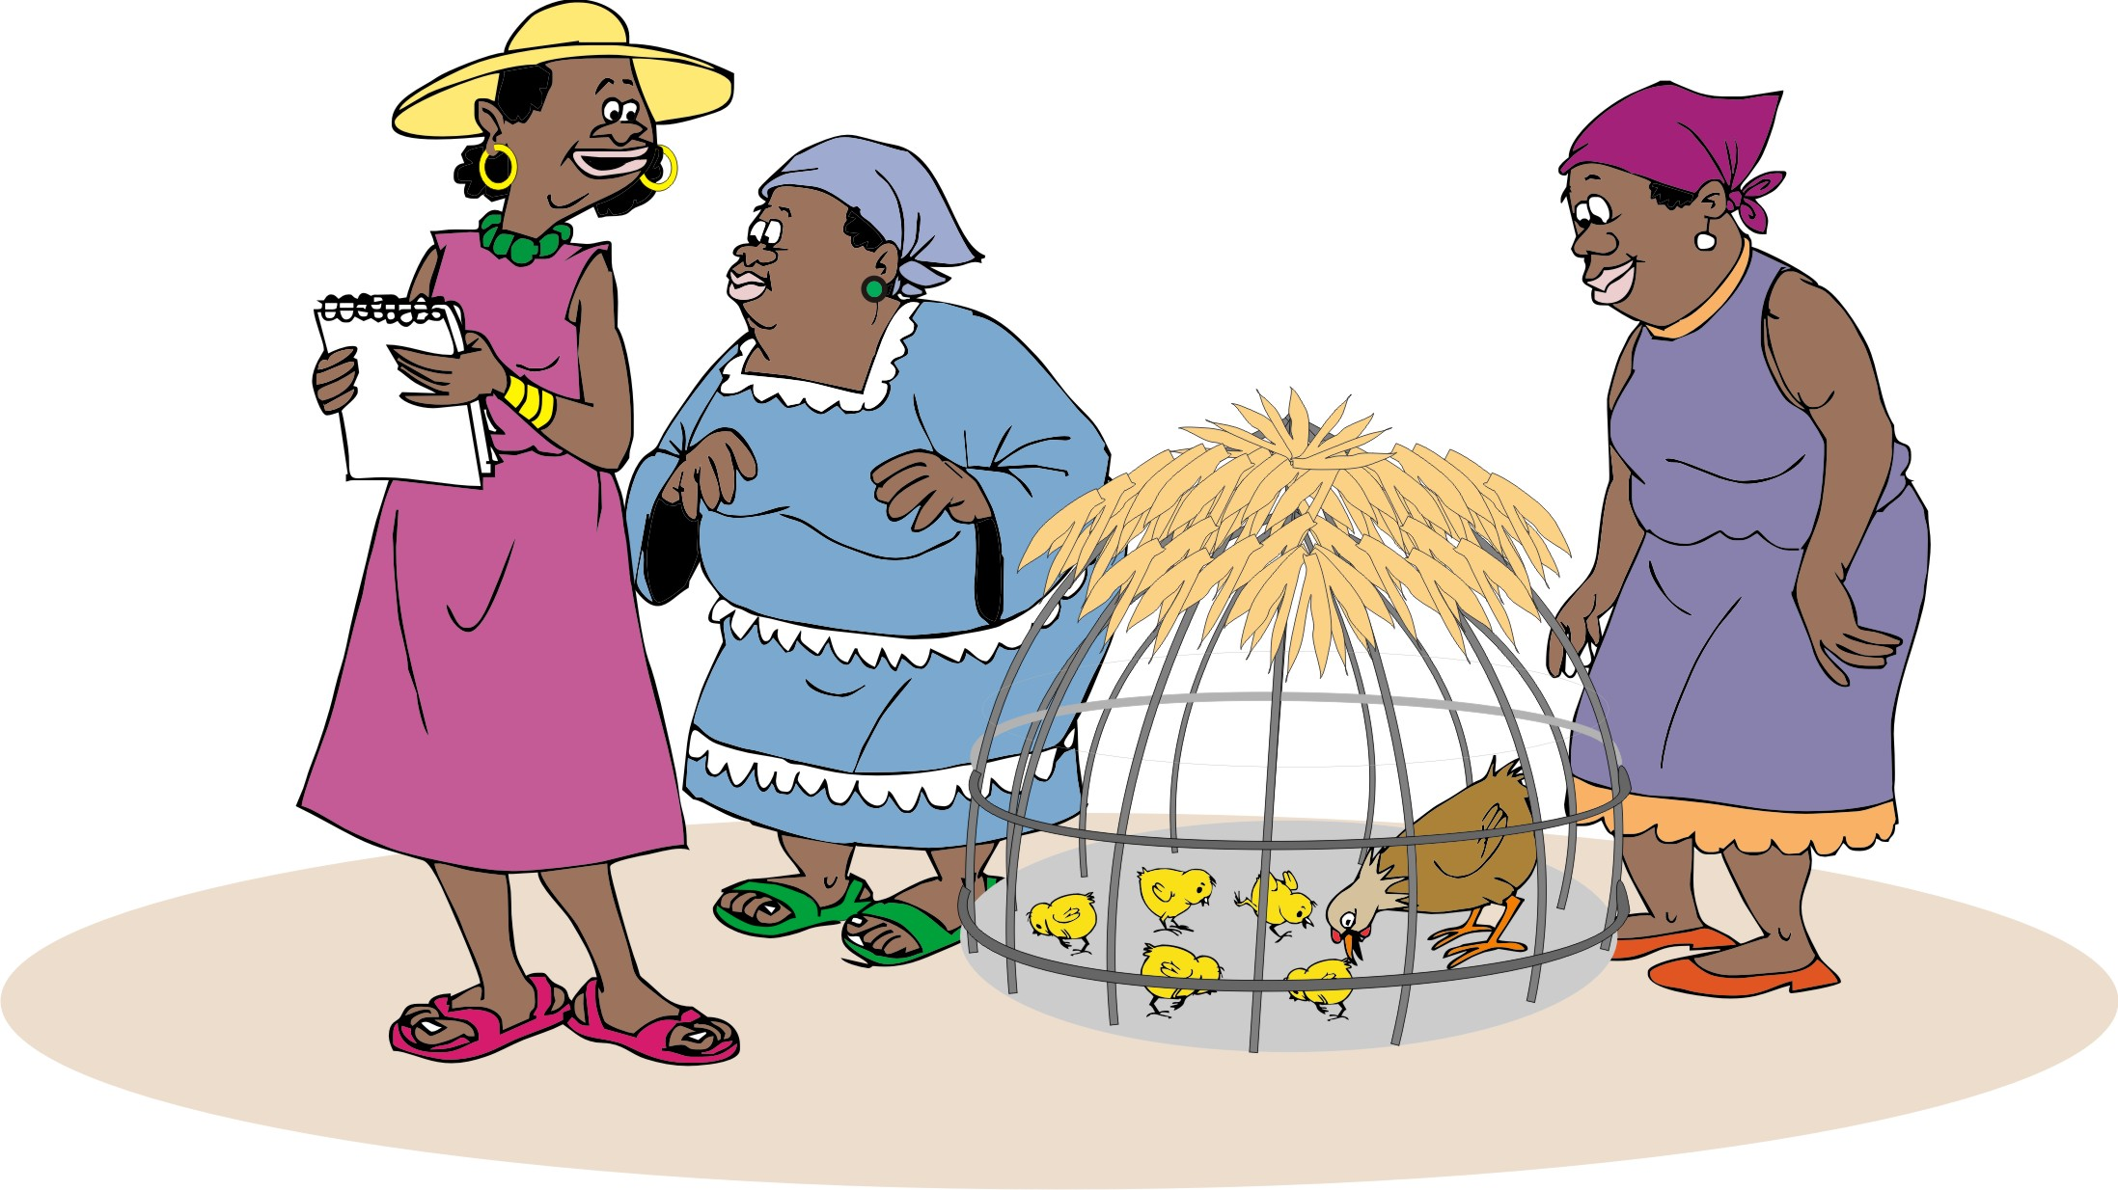
Trying things on a small scale
Some technologies can be tried out on a small scale, which helps farmers to decided whether to use them and to adapt the technique that suits their needs, for example:
New crop varieties
Plant spacing
Timing of planting
Pest control methods
Treatment of diseases
Feeding animals

Slide 37
Testing ideas and thinking of implications
Help the farmers think about the implications of the ideas that they want to test:
What are advantages and disadvantages?
Does the solution fix their problem?
Does the solution require something they do not have?
Has anyone in the neighbourhood tried it and, if so, has it worked for them?
How much time and money will this solution save (or cost)?
Can they change it to suit their needs?
Are they willing to experiment with the idea?

Slide 38
Problems, solutions and considerations
When identifying potential solutions for a problem, farmers should consider:
What are the costs involved in the solution?
Labor: Is the solution labor-intensive?
Does the solution required new knowledge or skills?
Effectiveness: How effective will it be?
Simplicity
Possible benefits
Possible negative impacts

Slide 39
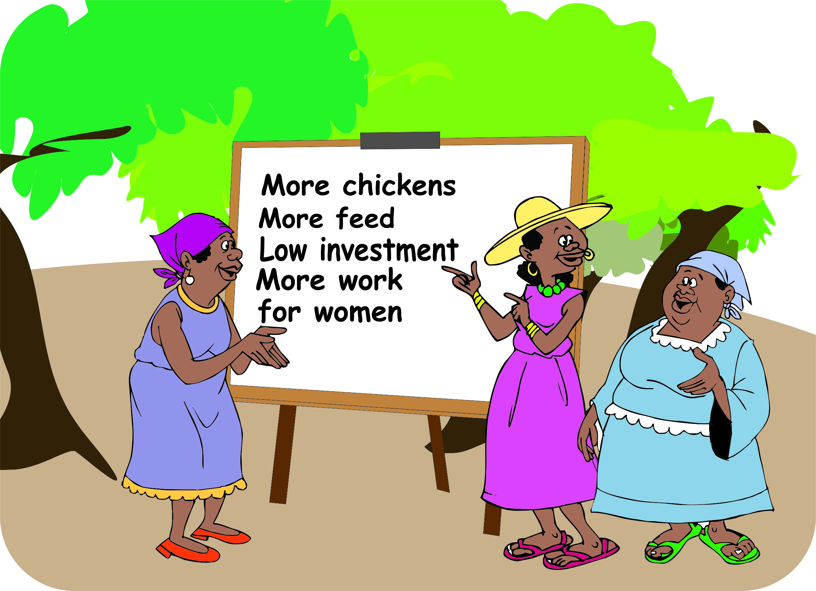
Positive and negative consequences
How will it affect the farm?
How will it affect the ecosystem?
How will it affect the household’s finances: Can they afford to take the risk?
How will lit affect men, women and children?

Slide 40
Lesson 5:
Designing research

Slide 41
Outcomes
After this lesson you will be able to:
List different types of research.
Explain what is meant by “treatment” and “control”, and explain why a control is necessary.
List six principles to remember when designing research.
Describe some research subjects in crop growing, livestock raising, post-harvest processing, and marketing.
Design an experiment to test a simple technology.

Slide 42
Overview
Lesson 5 covers the following content:
What is research and types of research
Choosing an appropriate comparison
Treatments and control
Repeating experiments
Keeping records
Livestock trials and experiments with larger animals
Post-harvest processing
Market research

Slide 43
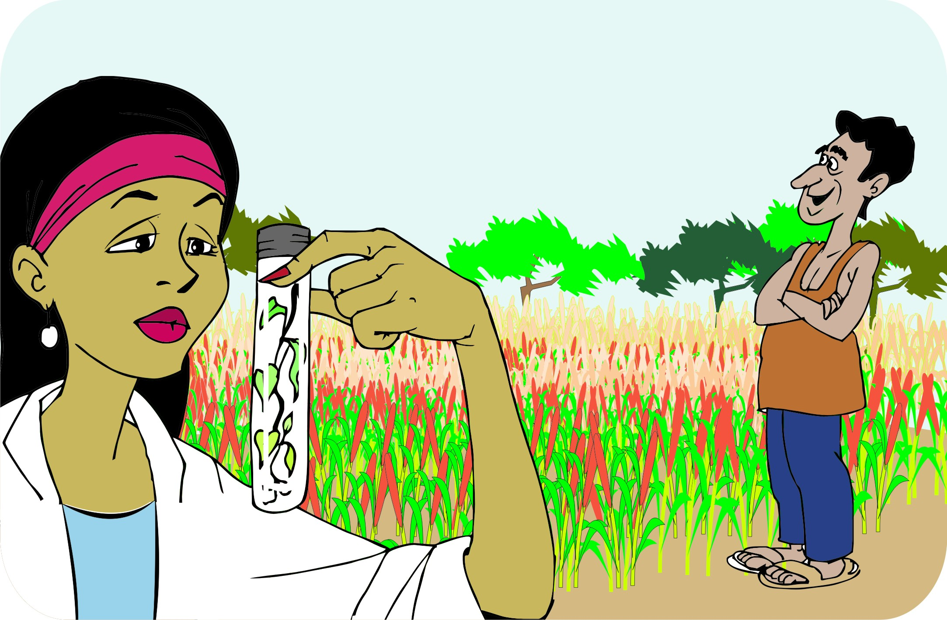
What is research?
Research does not have to be complicated and expensive. Many farmers do research every season when they:
Try out new crops
Look for ways to increase their yields
Seek out information on the best prices
All these things are research!

Slide 44
Types of research
Crop experiments: Testing crop varieties, planting dates and/or harvesting dates, pest and disease management
Livestock trials: Testing new breeds of animals, types of animal feed and housing
Post-harvesting processing trials: Testing ways to harvest and to dry and store crops
Market research: Collecting information on value chains, potential markets, prices, standards

Slide 45
Choosing an appropriate comparison
Comparing one year with another is not a good idea, because there are too many variables to consider.
Example
When testing a new maize variety, there are the following variables between the two years/seasons:
Weather
The amount of fertilizer used on the new crop
Cattle breaking into the crop field of the new variety just before harvest

Slide 46
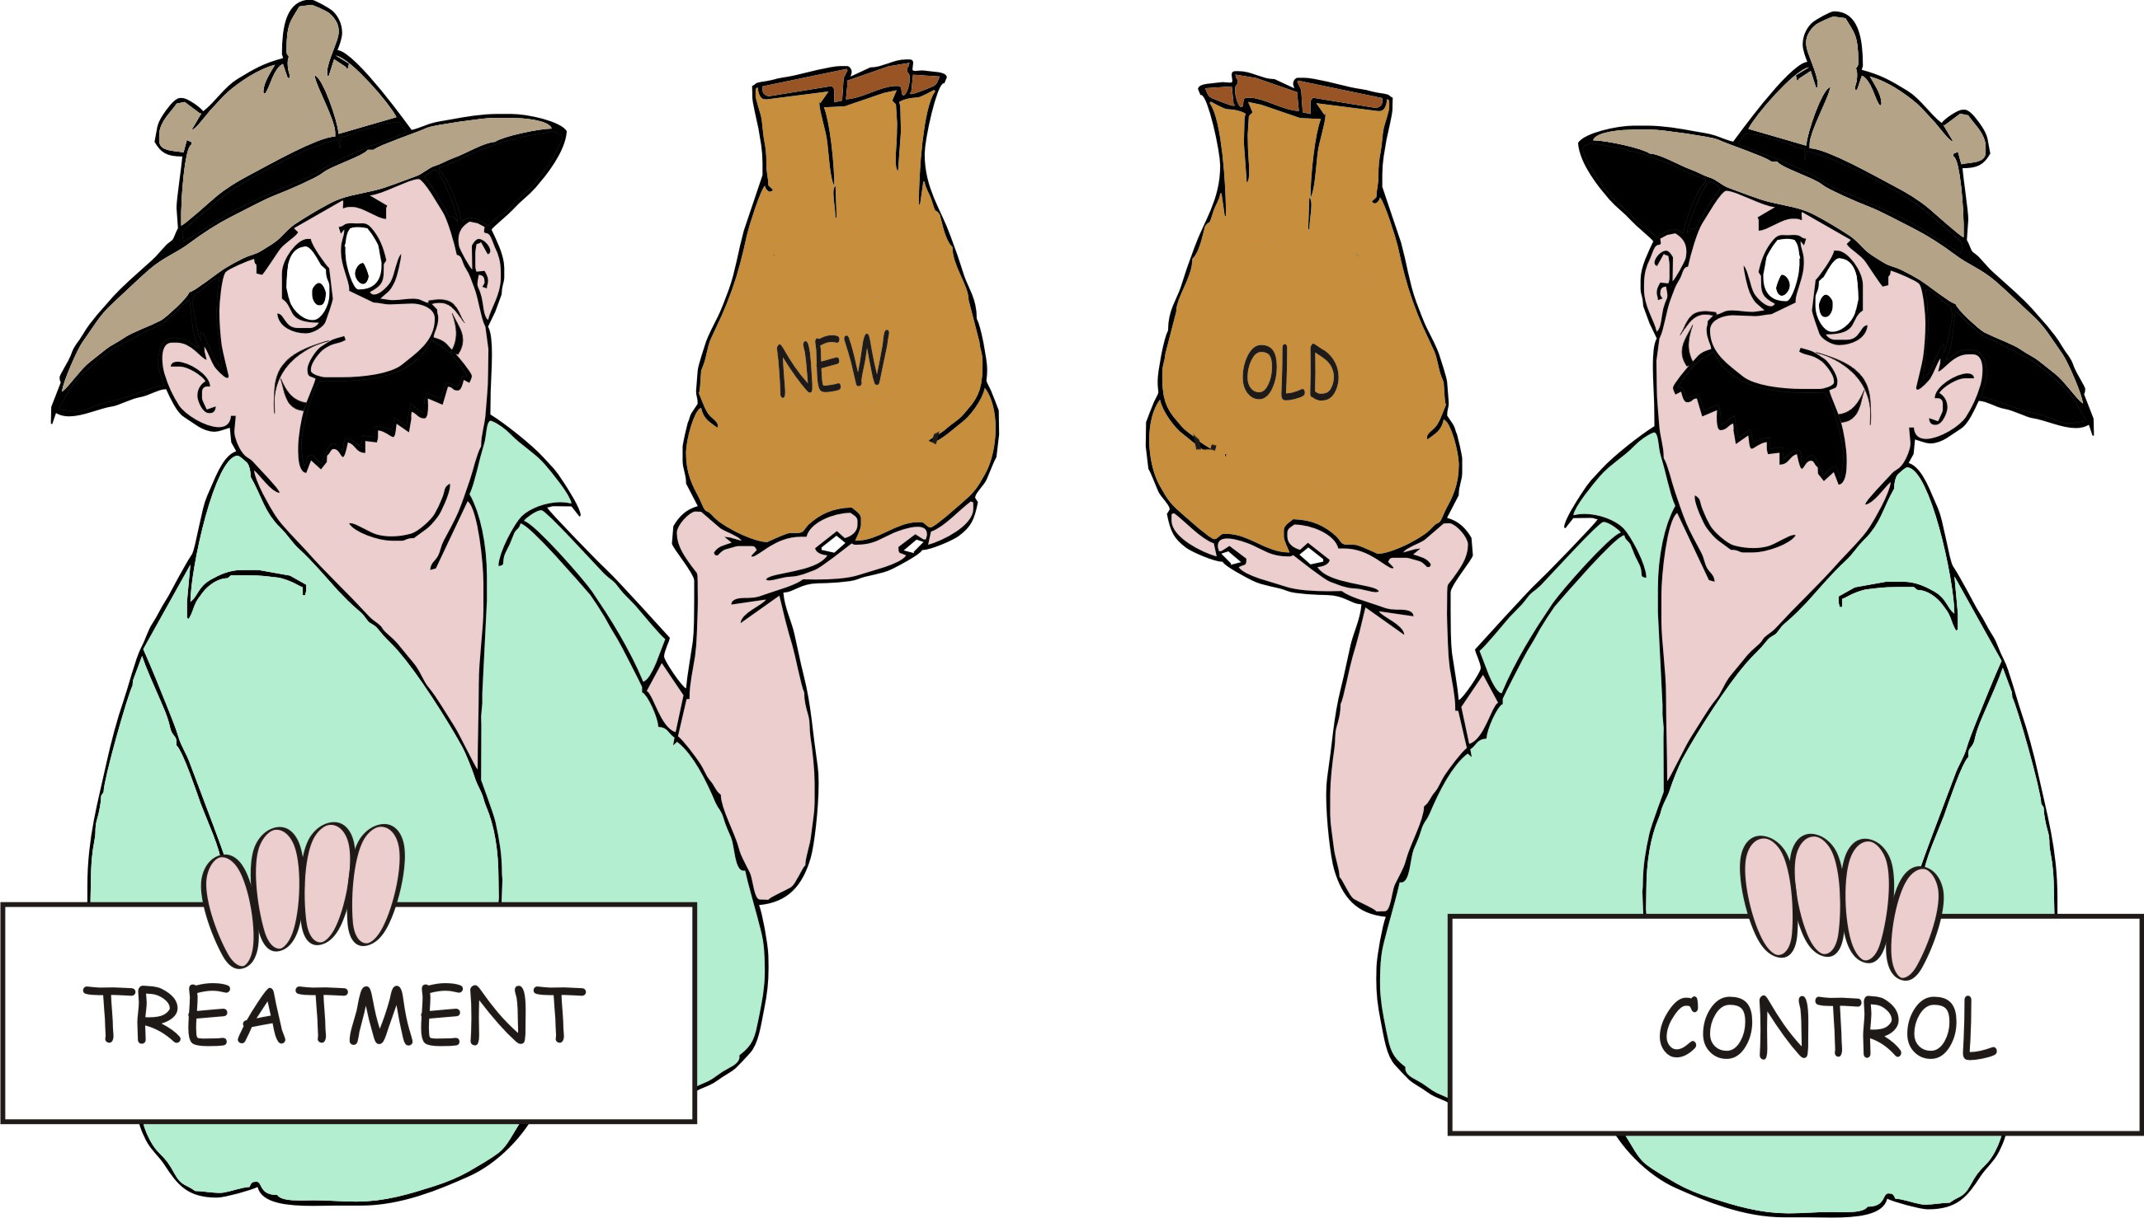
Treatments and control
Treatment = New technique to be tested
Control = What farmers already do

Slide 47
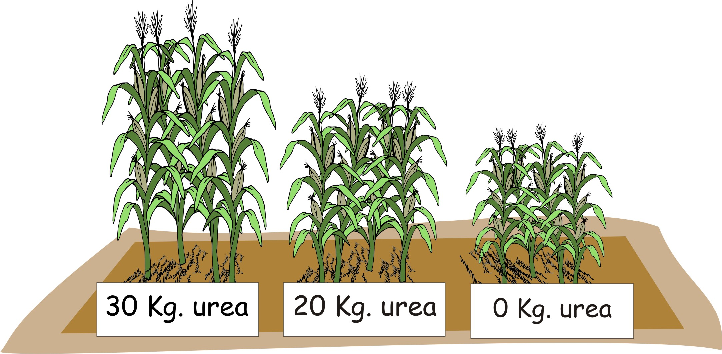
Applying more than one treatment
If a farmer wants to test two new varieties at the same time, he would:
Have two treatments (the new varieties)
Have One control (the old variety)
Slit the field into thirds, and plant one-third with each type of seed.

Slide 48
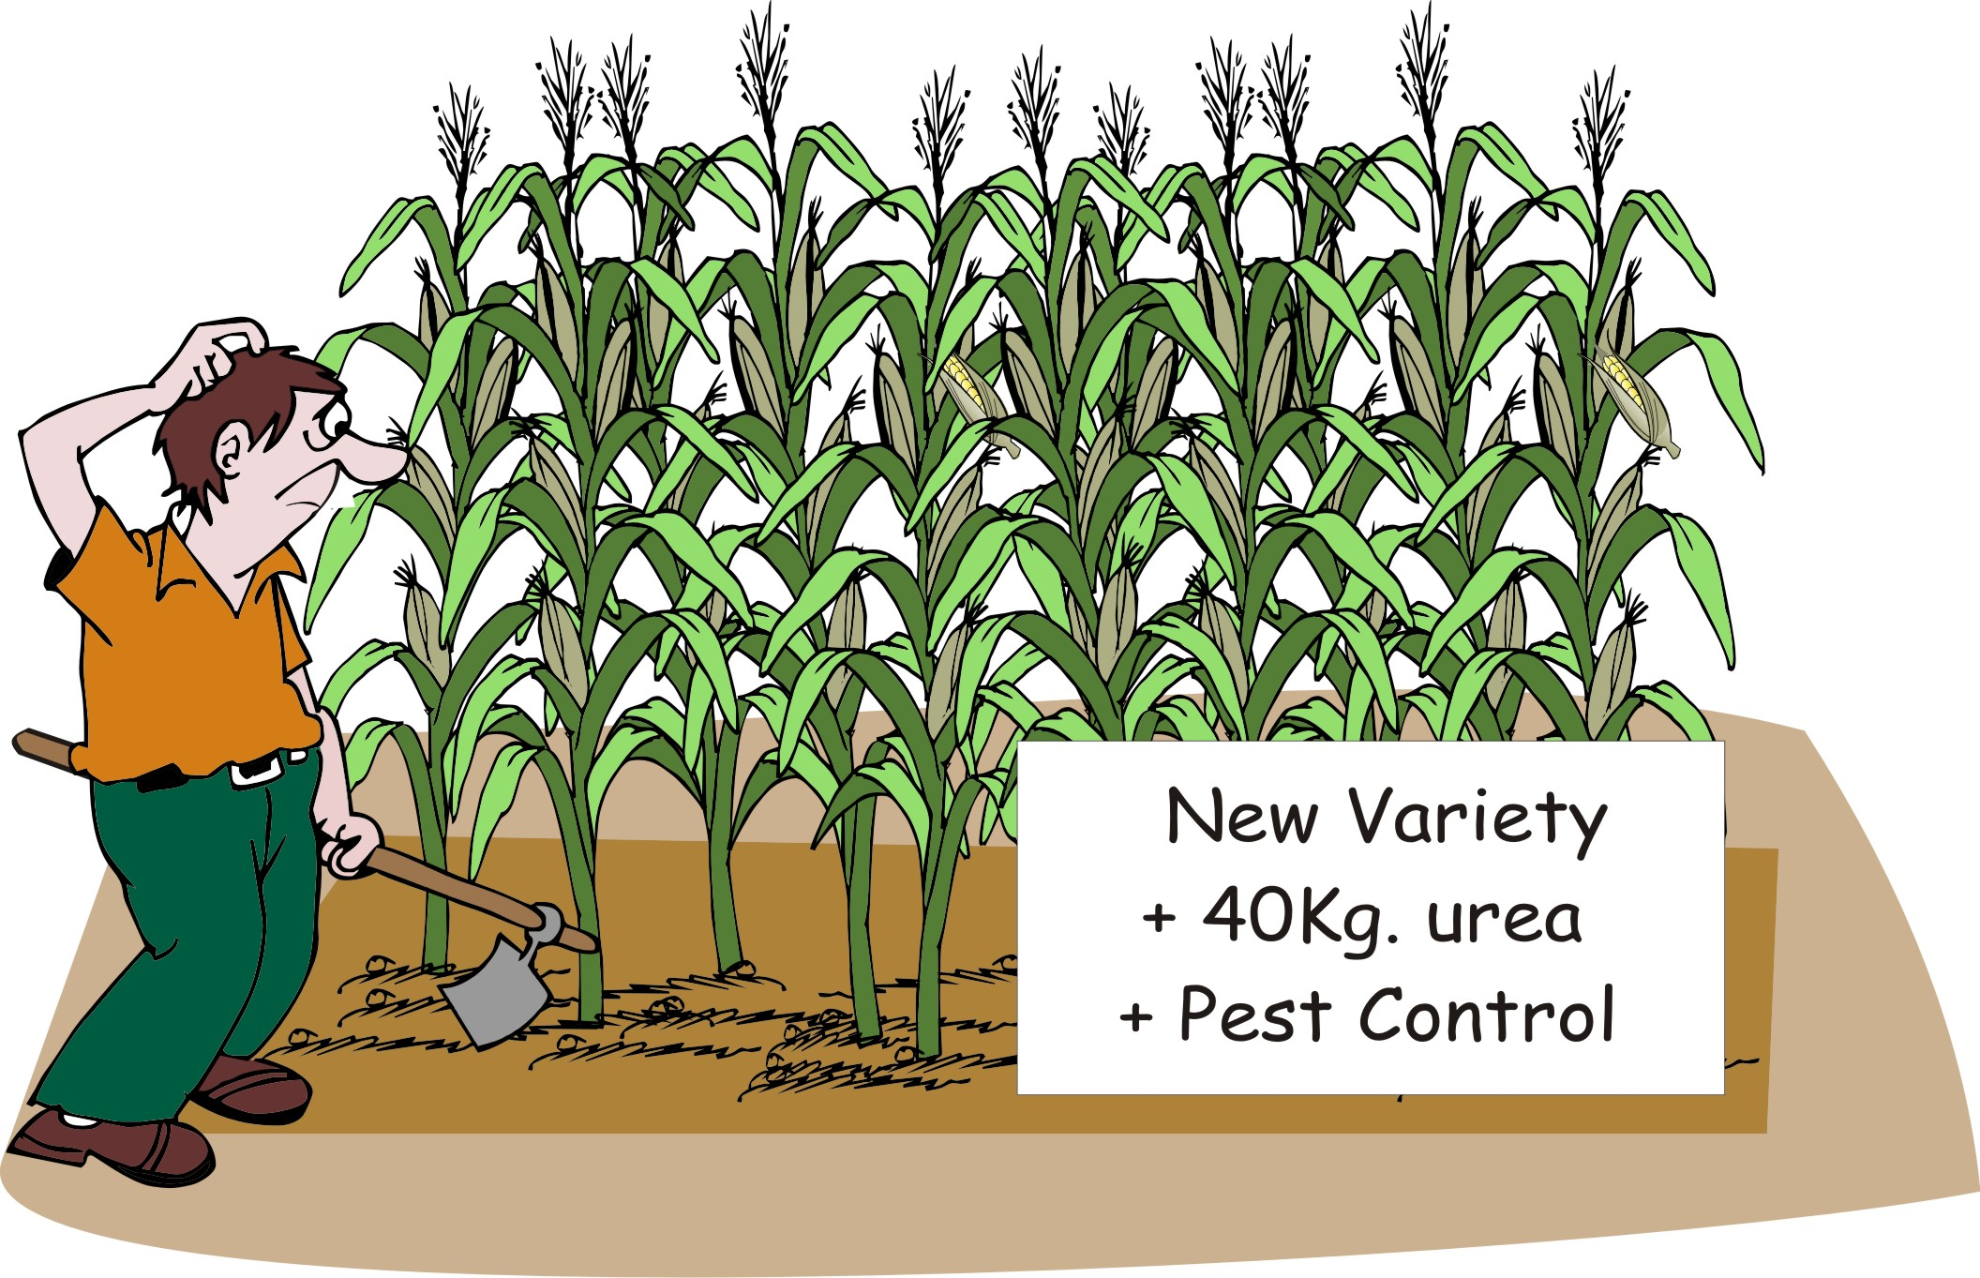
Keeping it simple: Testing one thing at a time
Encourage farmers to test one thing at a time: either varieties, or fertilizer rates or pest control methods – not all together.
They choose what they want to test first (e.g. varieties) and wait for the next season to test fertilizer rates of pest control methods.

Slide 49
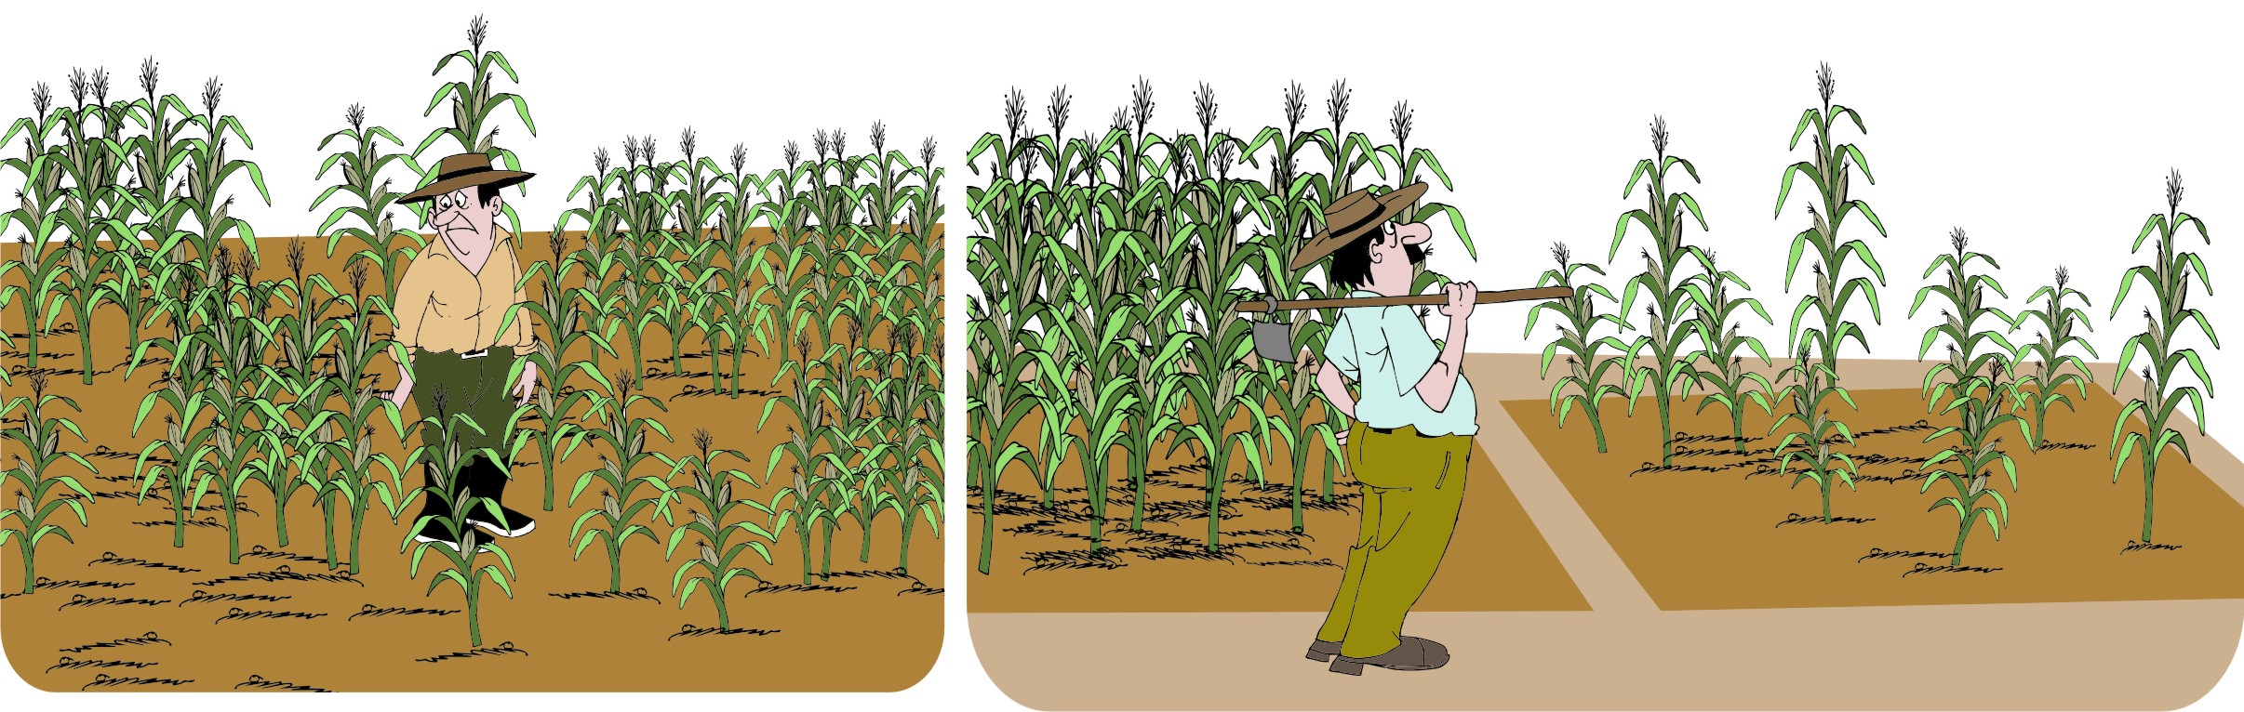
Starting small
Starting small:
Reduces the risk if something goes wrong
Can save money

Slide 50
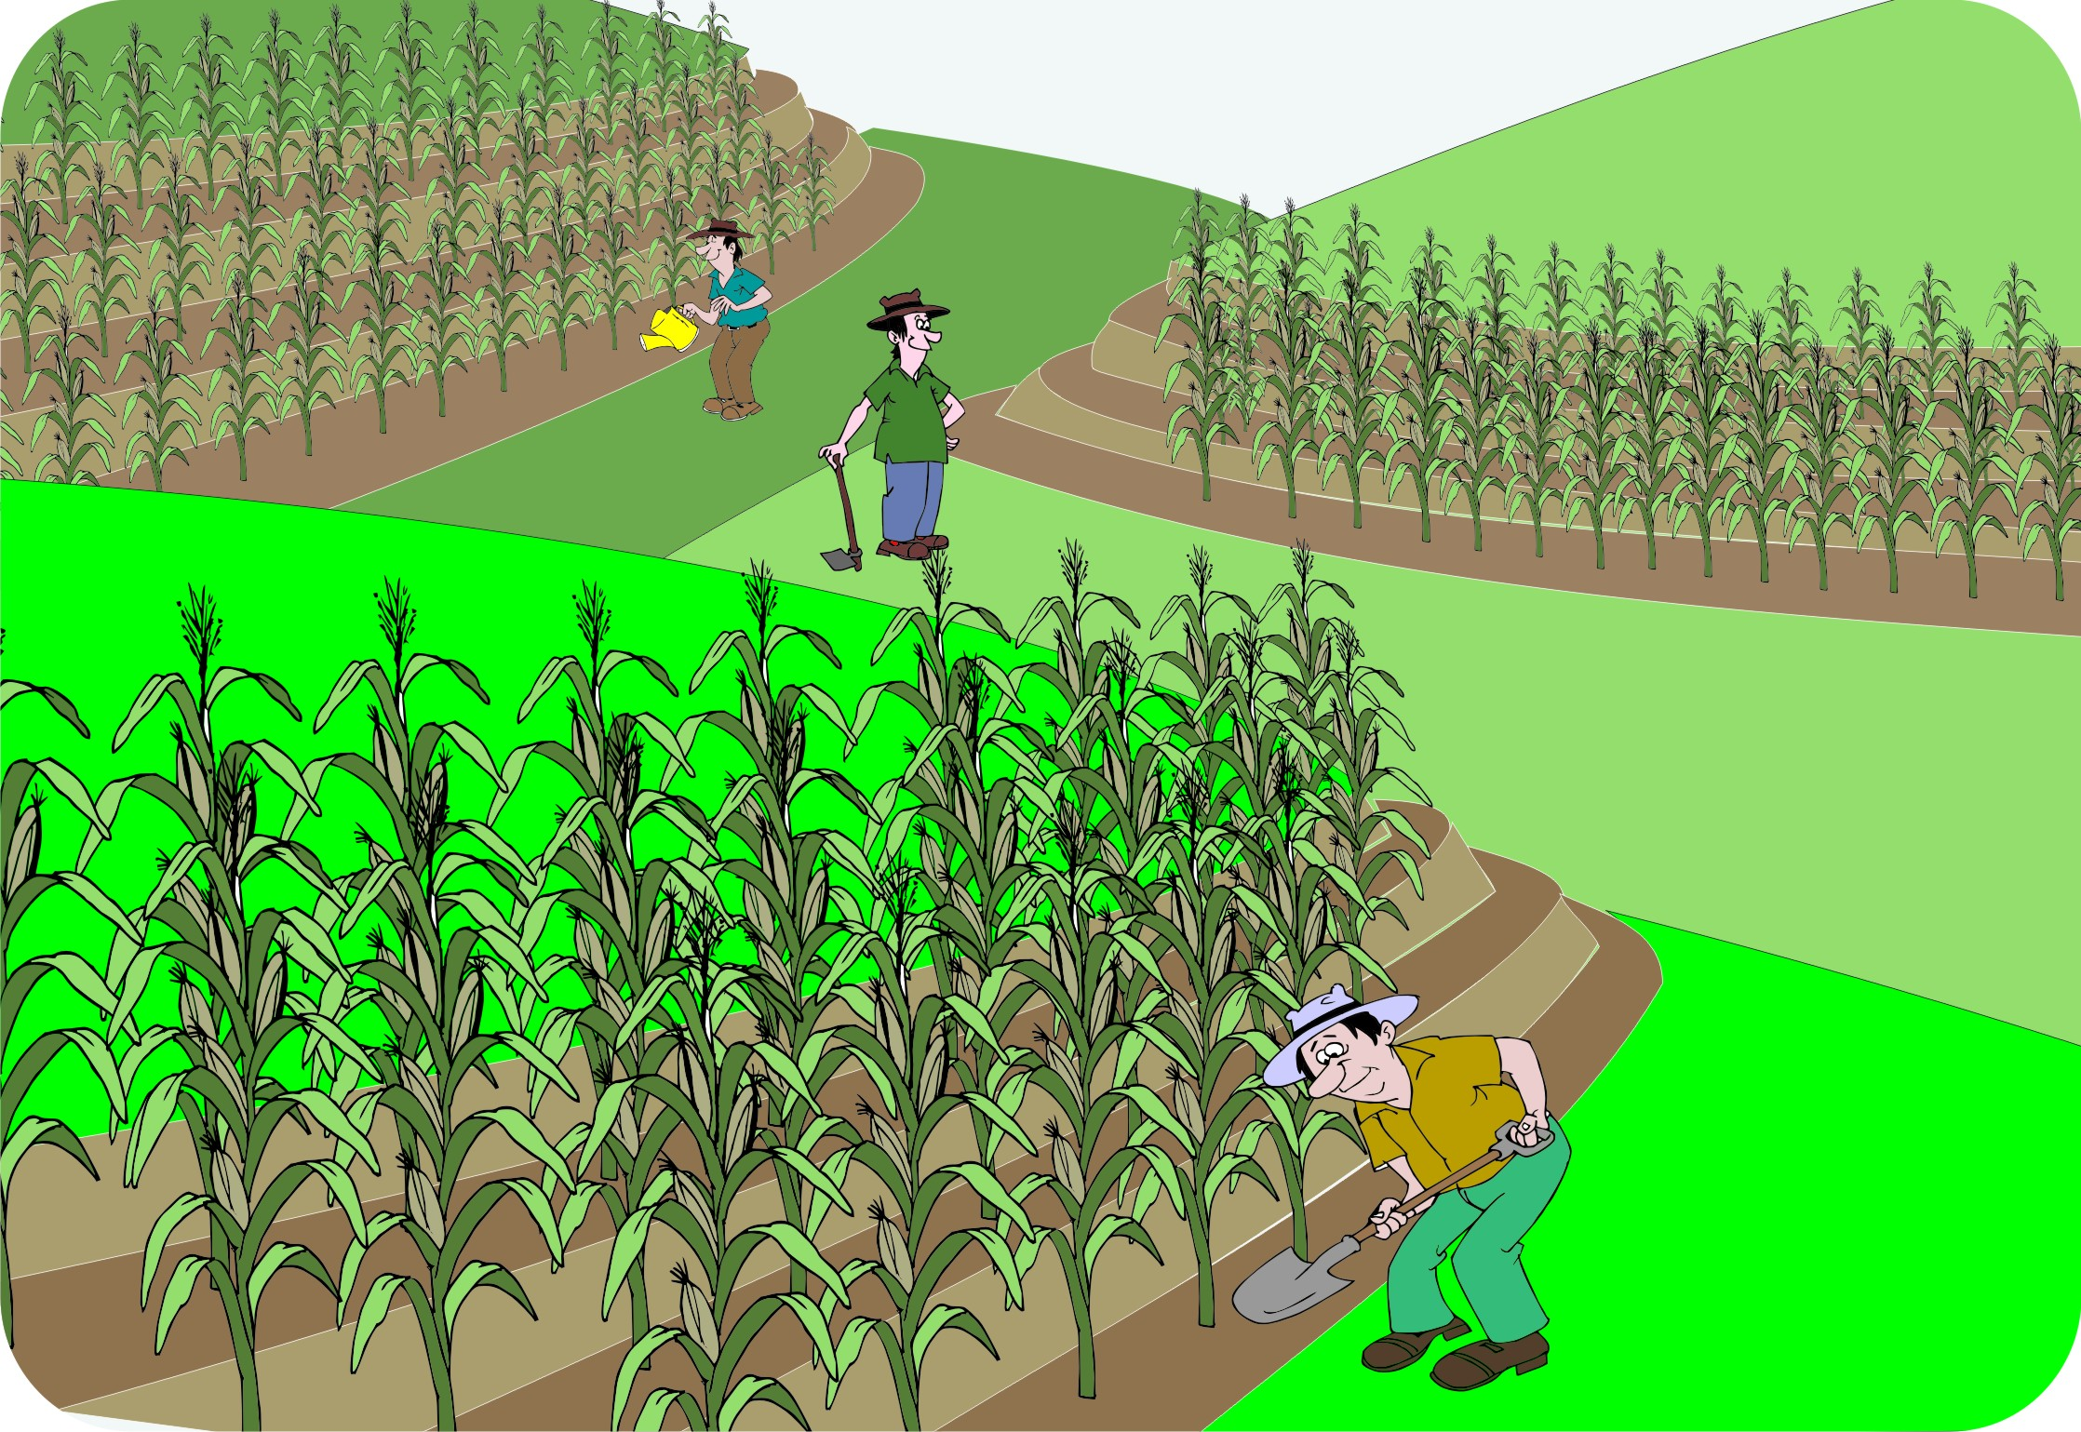
Repeating the experiment
If possible, repeat the experiment in different places:
Get three farmers to plant the test plots on their land.
Try to make the plots as similar as possible: similar soils, slopes and cropping history.
Replicating experiments gives you confidence in the data.

Slide 51
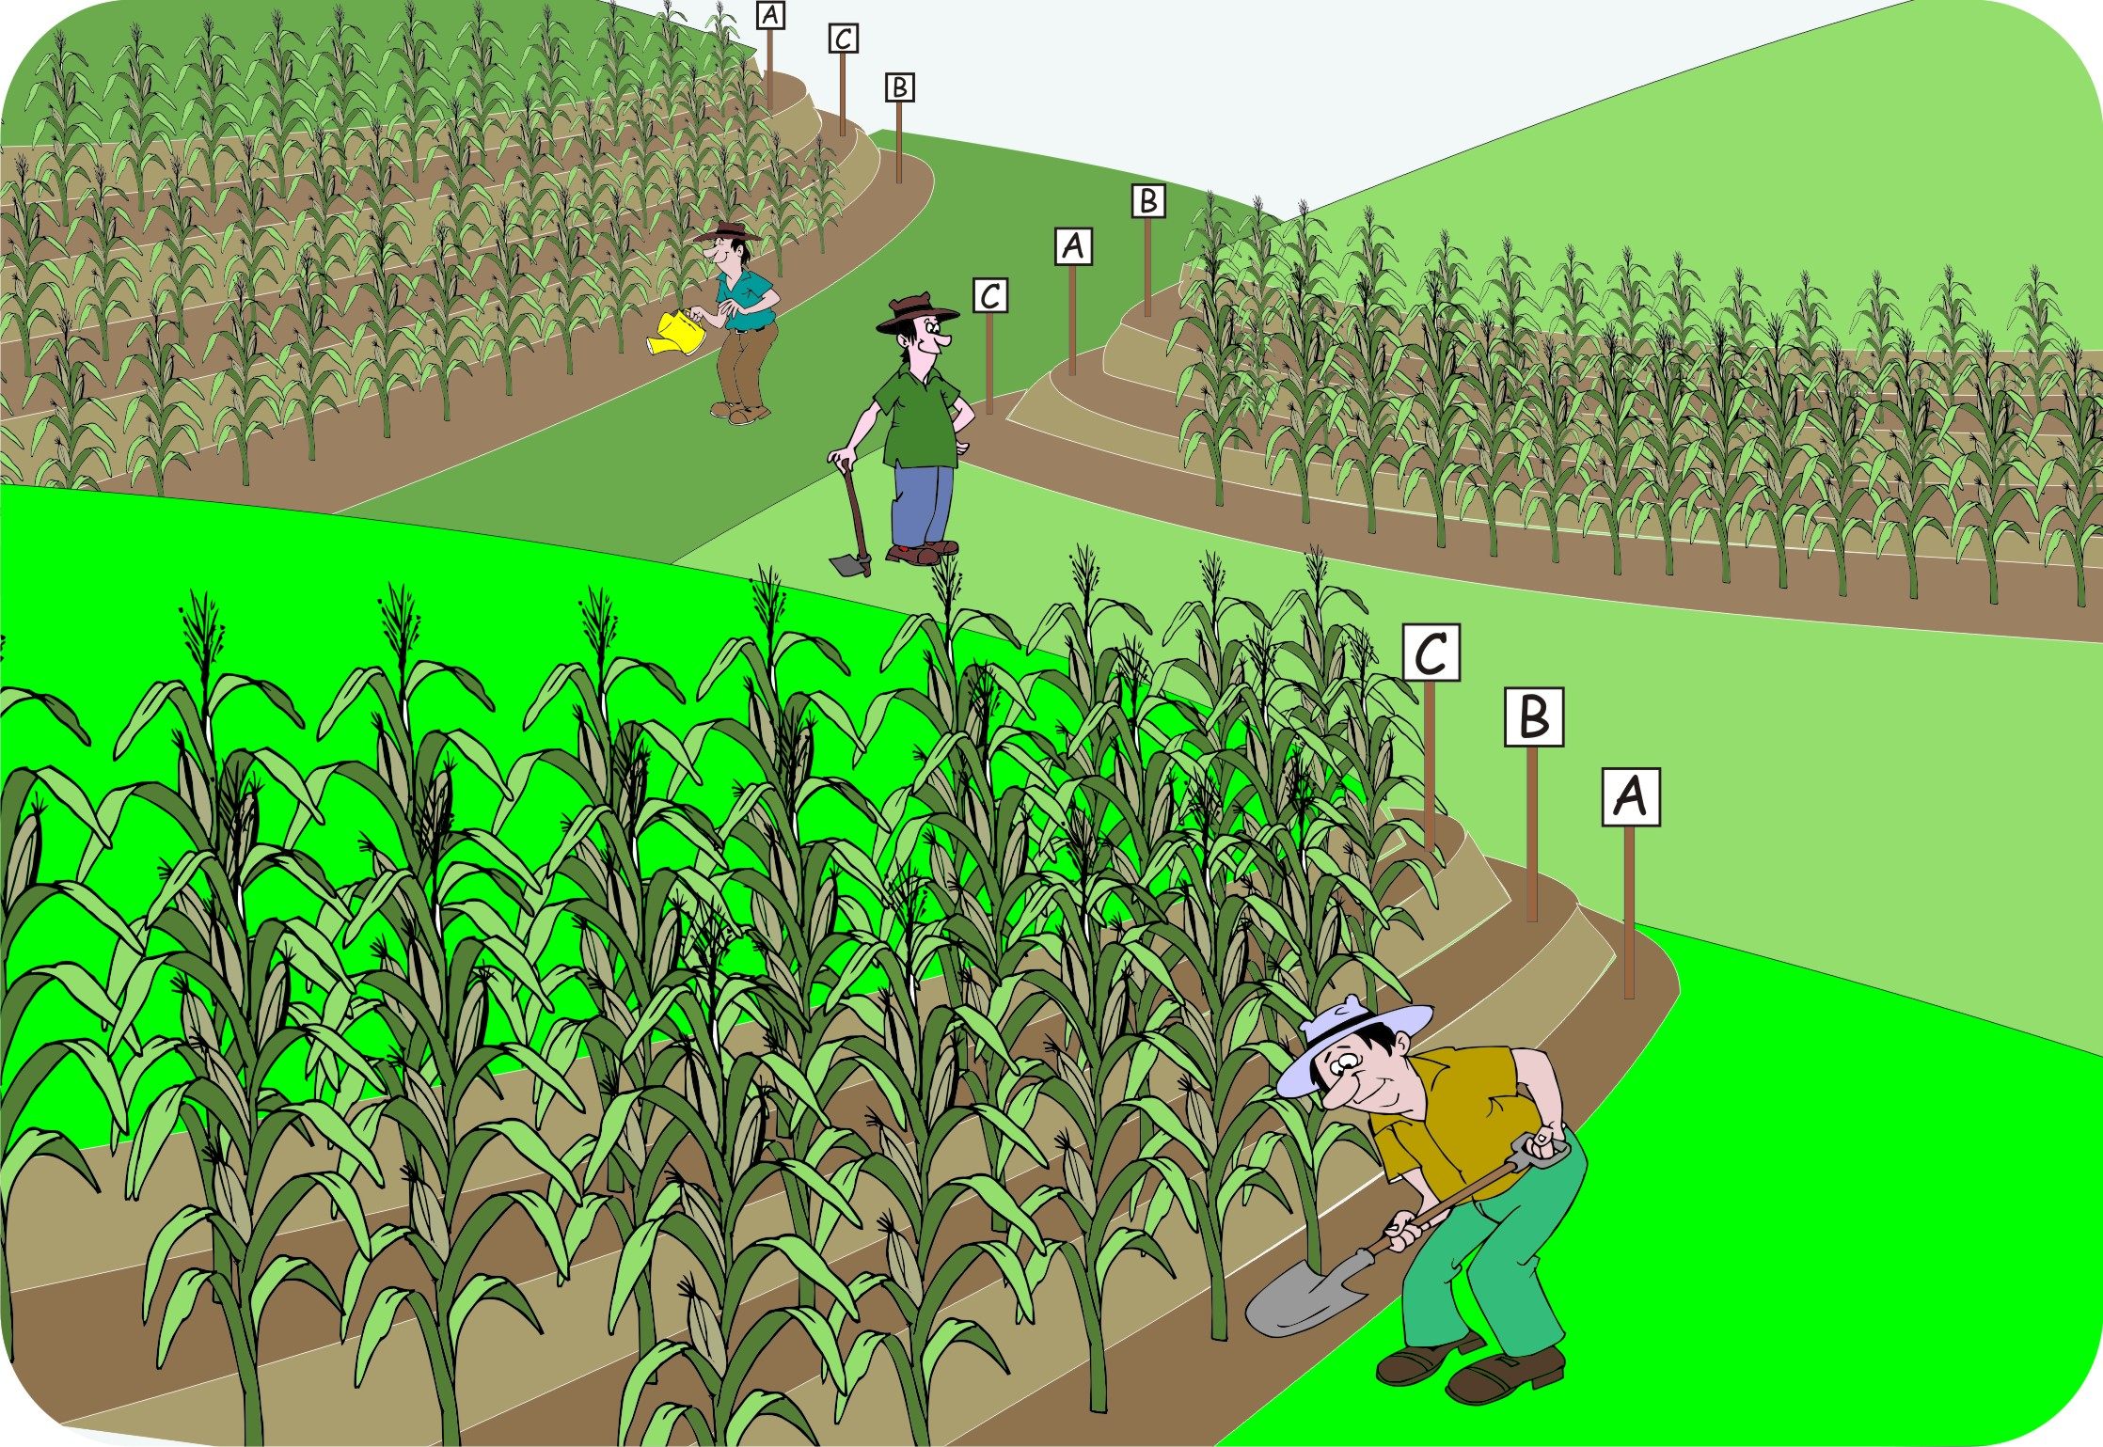
Making the pattern random
If you repeat the experiment, make sure that the treatments are in a different order in each of the plots.
Decide which variety goes in which plot at random.
This way, you avoid factors like slope or soil fertility from affecting the results of the experiment.

Slide 52
Making the pattern random: An example
Three farmers plant test plots with three different varieties: A, B and C.
Their farms are all on a slope.
They lay out their plots as shown in the figure.

Slide 53

Keeping records
Keep careful records of:
What you have sown
Dates of sowing, weeding and harvesting, etc.
Make a sketch of the plots, so that you know what treatment is in what plot – in case the signs get lost or mixed up.

Slide 54
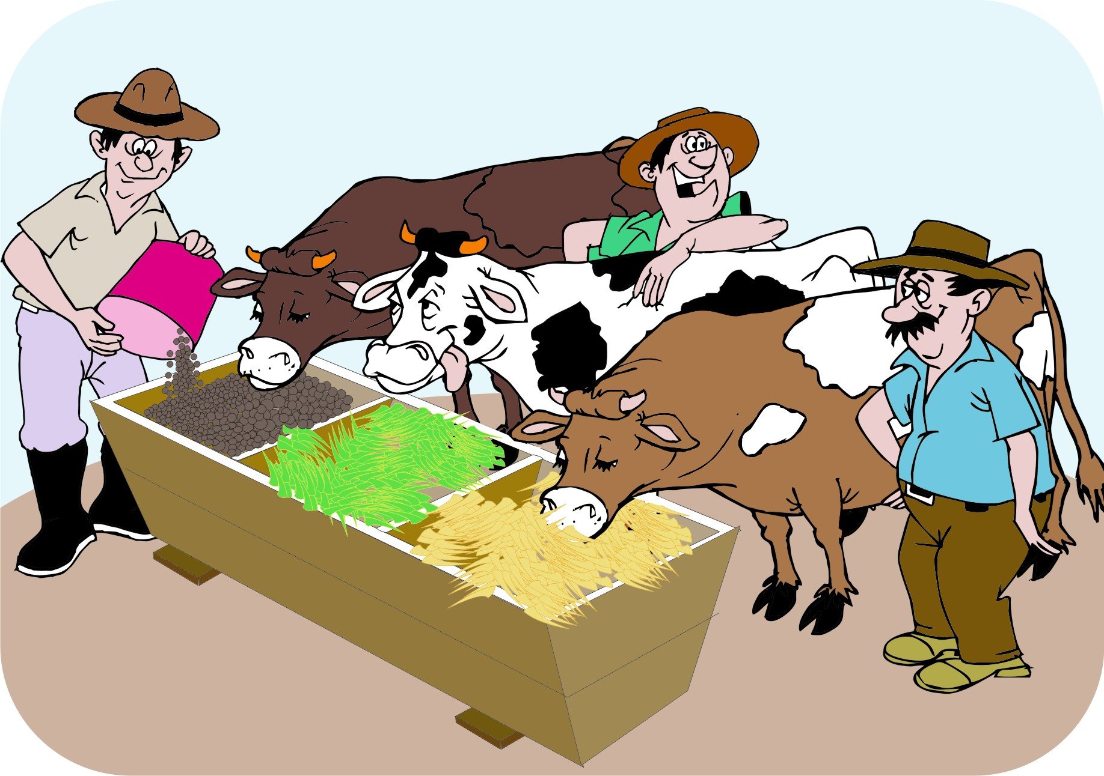
Experiments with larger animals
Experiments with larger animals can be risky. Some ways to mitigate risk:
Test fodder and feeding
Compare existing practices
Compensate for losses

Slide 55
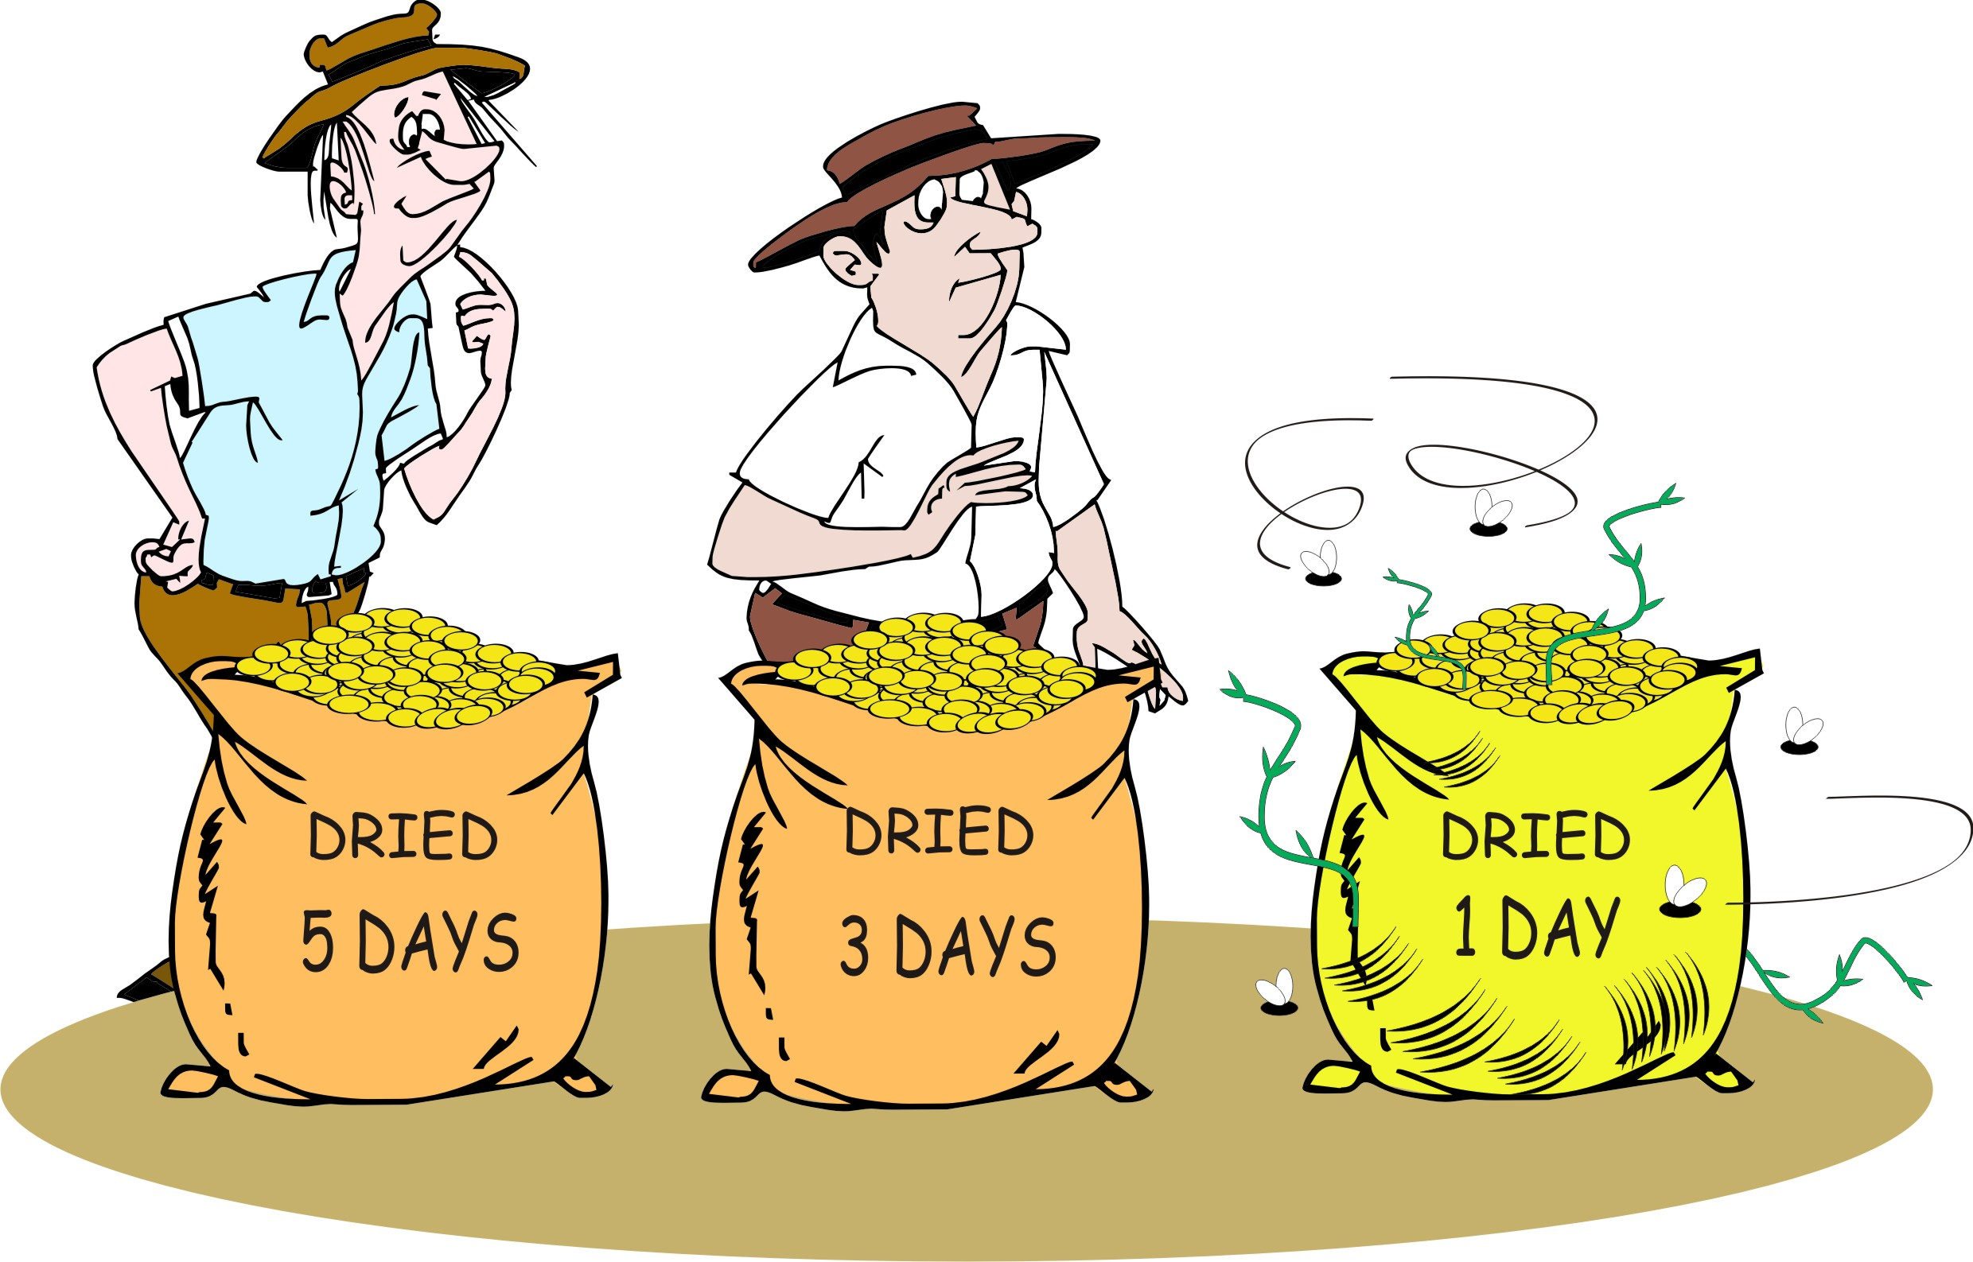
Post-harvest processing
Design experiments to test different handling methods after harvest:
Drying and preservation
Storage
Processing methods
Quality tests

Slide 56
Market research: Things to study
Research is a vital part of marketing. Farmers should study the following facets of the market for the products they want to produce:
Different products: Prices, quality requirements, standards, packaging, terms of delivery and payment
The value chain: People and organizations who buy, process and sell the product
Service providers: People and organizations who provide service to the value chain, e.g. inputs, financing, transport, processing and information

Slide 57
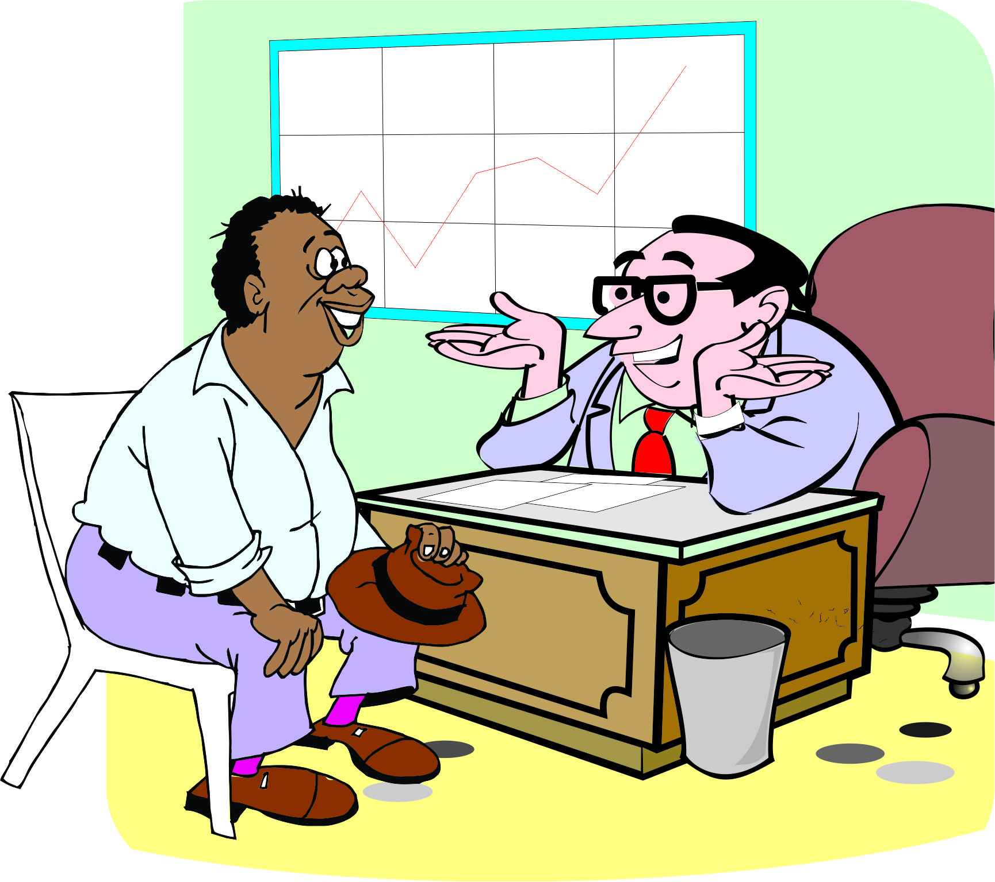
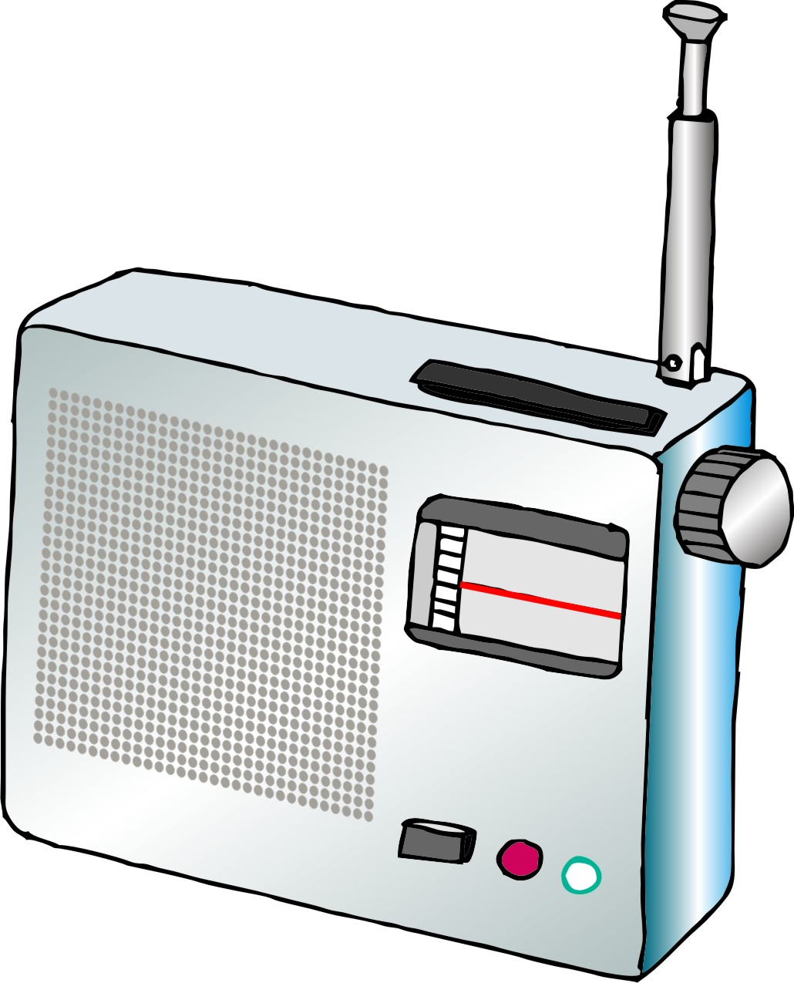
Market research: Sources of information
Buyers, traders, wholesalers, processors, retailers, consumers
Research and extension organizations
Banks and microfinance institutions
Input suppliers
Business service providers
Mobile phones, market information services and radio
The Internet

Slide 58
Ideas for market research
Conduct a simple survey of sample of people who may purchase the product.
Use mobile phones to get information on prices from urban markets to inform negotiation of farm-gate prices.
Learn from others who specialize in the product or have started a similar enterprise.
Talk to extension and local NGO staff who have experience in marketing.
Form a marketing research team to gather information to share with the wider community.

Slide 59
Lesson 6:
Collecting and recording observations

Slide 60
Outcomes
After this lesson you will be able to:
Describe some things to measure in an experiment to test crop yields.
Explain how to measure each thing.
Design a form to record data from an experiment.

Slide 61
Overview
Lesson 6 covers the following content:
Deciding what information to collect
Deciding what to count or measure and how to measure
Deciding when and how often to make observations
Tips for data collection and observation
Recording information
Designing forms for records
Simple ways to record data

Slide 62
Deciding what information to collect
It is important to keep good records of an experiment.
Therefore, you have to decide:
What do you want to count or measure?
How will you measure it?
When (and how often) should you measure it?
How will you keep records?

Slide 63
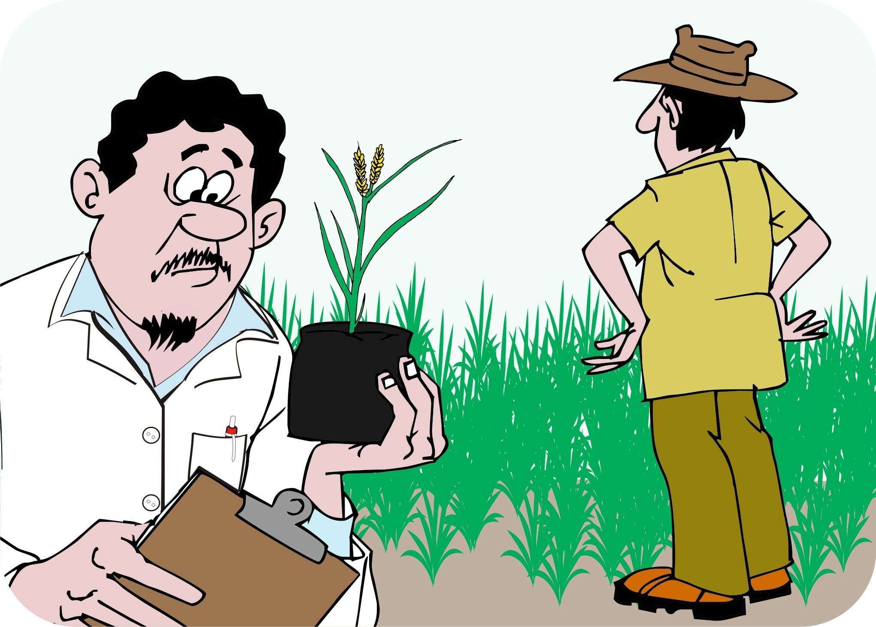
Deciding what to count or measure: A crop experiment
For a crop experiment, you would count/measure:
Dates of planting, weeding and harvest
Amount, type and dates of fertilizer application
Number of plants showing pest or disease symptoms
Plant height (every week)
Number of plants harvested

Slide 64
Deciding how to measure: Crop experiment
Example:
How will you measure plant height?
How do you measure maize yield: Do you count the number of cobs or do you weigh the grain?
Do you count or weigh before or after husking or shelling
Are you scales accurate
Are your bags a standard size?

Slide 65
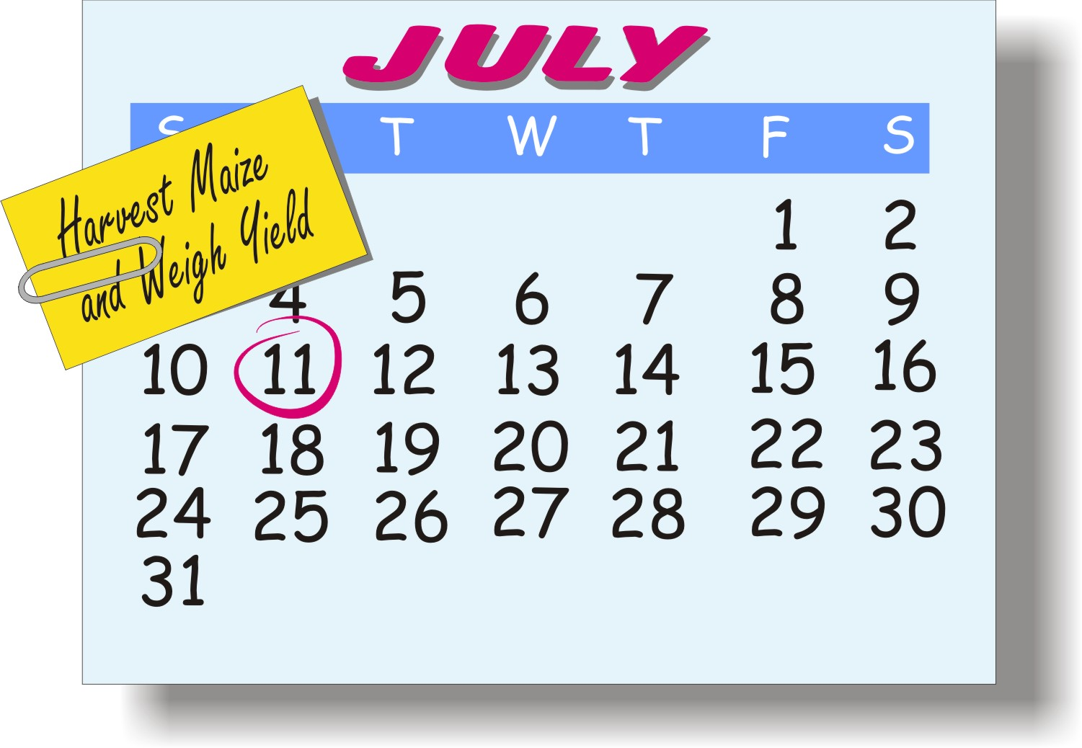
Deciding when and how often to make observations
Visit experiment plots regularly to observe what is happening to the crop (or the animals)
Information that should be collected regularly: Plant height, pests and diseases, weed problems and animal health
Information that is collected once: Planting and harvesting dates, amounts of fertilizer used and yield

Slide 66

Tips for data collection and observation
Take all measurements in the same conditions, using the same methods.
Apply treatments as uniformly as possible.
Collect data from each plot separately.
Take note of useful observations, e.g. weather, soil conditions, weed types, pest damage, chemicals applied

Slide 67
Tips for recording information
Use a sturdy exercise book that is big enough to record all your observations for your experiment.
Use separate pages for different record sheets.
Always include the date that observations are made.
Use a space on the sheet for different persons’ names.
Record observations immediately when you make them and write them directly in the book.
Record observations neatly and clearly.
Do not change or erase an observation that you made earlier. Instead, write a note or clarification with the correction.

Slide 68
Designing forms for records
Design forms with different columns for control and treatment.
Include one row for each week.
Add an extra row to calculate percentages.
When recording labor:
  Record each task and the time it takes to do it.
  Update the records every day.
  Keep a note of long each person takes to complete a task if several people work on an experiment.

Slide 69



Simple ways to record data
Rural people may not be used to writing things down.
Find simpler ways of letting them record observations:
Considering using simple line drawings instead of words.
Use strokes instead of numbers.
Consider using sticks, stones or large seeds as counters.

Slide 70

Avoid collecting too much data
Do not collect data that may be interesting or come in useful.
Decide on a few things to observe and keep careful records of them.
Choose carefully and involve different people in discussions to get different points of view.

Slide 71
Lesson 7:
Analyzing and evaluating the results

Slide 72
Outcomes
After this lesson you will be able to:
Analyze numerical data from an experiment.
Describe how to check people’s opinions about an experiment using focus groups, descriptive evaluation, and subjective scoring.
Compare the costs and benefits of two technologies in terms of money.

Slide 73
Overview
Lesson 7 covers the following content:
Tools for analyzing data:
Numerical evaluation
Focus groups
Descriptive evaluation
Subjective scoring
Cost-benefit analysis

Slide 74
Numerical evaluation
Numerical evaluation:
Compares the results of the current practice (the control) to those of the alternatives (the treatments).
Makes it possible for you to draw conclusions.

Slide 75
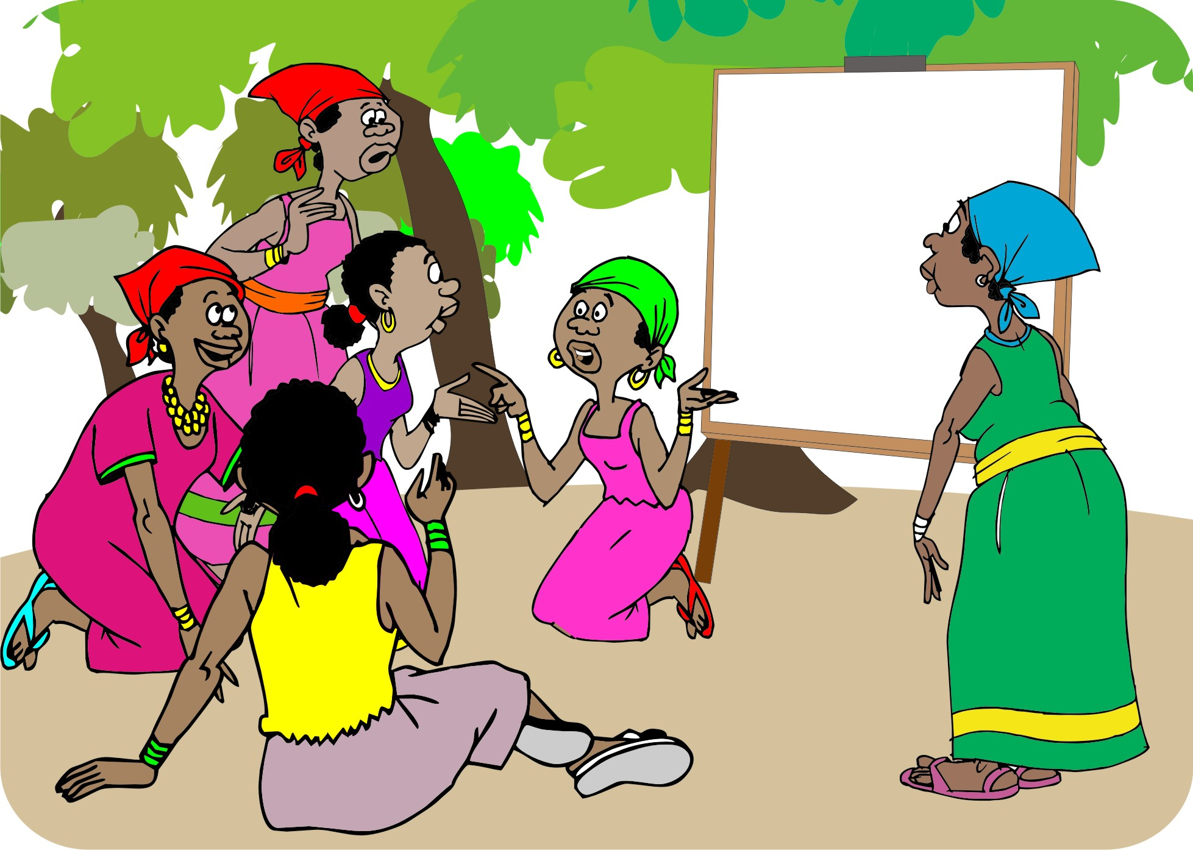
Focus groups
Facilitate one or more focus groups to discuss the ideas, issues, experiences, results and problems of the experiment.
Focus groups are a good way to:
Discuss the results of the experiments
Decide whether to implement the conclusions
Plan future research

Slide 76
Descriptive evaluation
Descriptive evaluation:
Is a simple description of what you liked or did not like about the treatments you chose for the experiment
Is a way to get a focus group discussion started about the experiment and the results you have obtained.
Gives the group the chance to express their perceptions of each of the treatments they have tested.

Slide 77
Subjective scoring
Subjective scoring is another way to collect people’s opinions about the results of an experiment.
Ask people to give a score to each of the treatments for the characteristics they are interested in.
Summarise the scores to give you a general idea of what people think overall.

Slide 78
Cost-benefit analysis
The cost-benefit analysis makes it possible to answer questions such as:
  How much does the new treatment cost?
  Does it give more profit?
You need good records to analyze the costs of:
  Inputs
  Labor
  Selling price
  Yield

Slide 79
Lesson 8:
Applying findings and sharing knowledge

Slide 80
Outcomes and overview
After this lesson, you will be able to:
Describe how to share results from research.
Lesson 8 covers the following content:
Deciding on follow-up
How to share information about innovations
The need to keep innovating

Slide 81
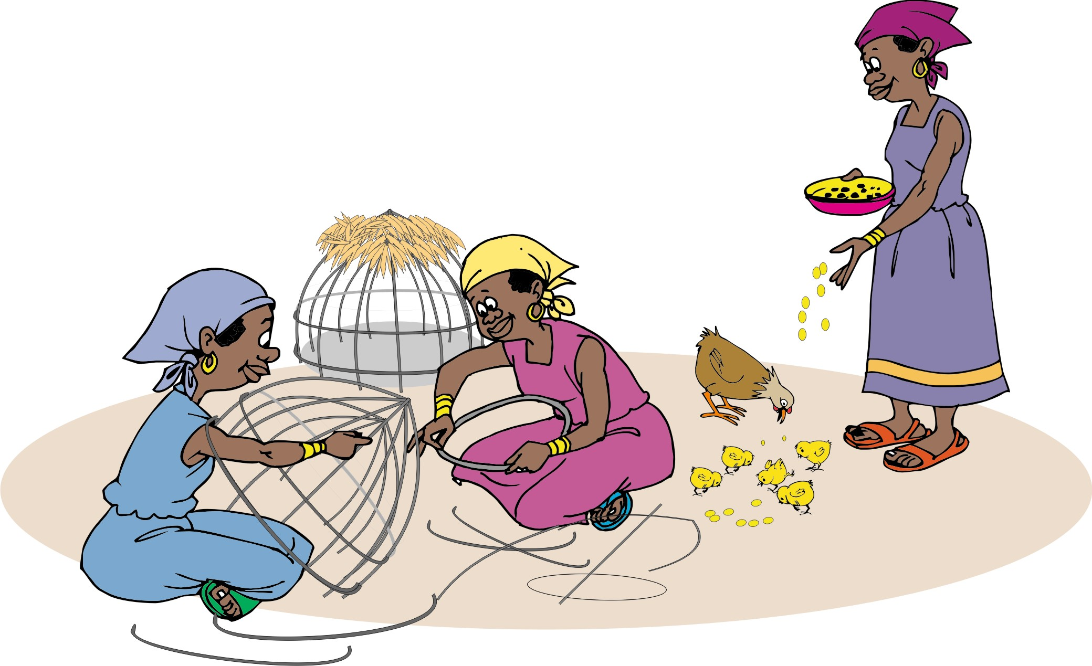
Sharing information about innovations
Hold meetings to discuss the results of experiments.
Invite people to visit the experiment site while it is running.
Run a demonstration of the innovation, e.g. show people how to do a particular task.

Slide 82
Additional ways of sharing information
Arranging cross-visits, field days or training for people from other villages.
Produce posters, brochures or information sheets about the innovation.
Organize groups in other villages to test and adopt the innovation.

Slide 83
Additional ways of sharing information (Continued)
Invite the local community radio station to cover the innovation.
Invite extension workers, government officials and researchers to see the innovation.
Arrange training for extension workers and villagers.

Slide 84
The need to keep innovating
Those who live off the land constantly need to look for new and better ways of producing more and better quality food, fodder and other materials. This means that the innovation process does not stop once one experiment has been completed.
Help farmers see the value of accessing knowledge and information from a wide range of sources and using it to solve problems on their own.
Once one problem has been resolved, there will no doubt be others that need to be tackled.

Slide 85
Module summary
In this module, you have learned about ways to promote innovation among rural farmers by:
Identifying and understanding problems
Finding more information
Exploring possible solutions
Designing research
Collecting and recording observations
Analysing and evaluating results
Applying findings and sharing knowledge

