Slide 1
The seven steps of marketing Booklet 4: Reviewing performance
A SMART Skills Manual

Slide 2
Skills for Marketing and Rural Transformation (SMART skills)
SMART Skills manuals:
Introduction to SMART skills for rural development
Organizing and managing farmer groups
Understanding natural resources
Managing natural resources
Marketing basics
Seven steps of marketing
Promoting innovation

Slide 3
Purpose of the SMART skills series
To introduce you to the following five skill areas:
Group organization
Natural resources management
Finance
Marketing
Innovation

Slide 4
The seven steps of marketing: Content
Step 1: Getting organized
Step 2: Identifying products and organizing groups
Step 3: Collecting information for the business plan
Step 4: Building a business plan
Step 5: Marketing as a group
Step 6: Reviewing agroenterprise performance
Step 7: Scaling up

Slide 5
Booklet 4: Reviewing performance
Step 6: Reviewing agroenterprise performance
Lesson 19: Calculating costs, income and profits
Lesson 20: Review, documentation and planning the next season
Step 7: Scaling up
Lesson 21: Scaling up

Slide 6
Step 6: Reviewing agroenterprise performance

Slide 7
Lesson 19: Reviewing agroenterprise performance

Slide 8
Outcomes
After this lesson you will be able to:
Calculate the actual costs of materials, labor and services, and loans incurred by an individual farmer to produce a particular product.
Calculate the farmer’s income and profit from that product.
Calculate the costs, income and profit for a farmers’ group.
Advise farmers what to do in case of a loss or a profit.
Suggest ways farmers can cut their losses or increase their profits.

Slide 9
Overview
Lesson 19 covers the following content:
Using standard measures
Area calculations
Consumable materials costs
Cost of durable material items
Total material costs, labor costs, the cost of loans and total costs
Calculating costs, income and profit for the farmers’ group
Comparing targets and actual costs, income and profit
Reasons for a loss

Slide 10
Calculations at the end of the season
At the end of the season, after the produce has been sold, you repeat the profitability calculations with actual numbers rather than the estimates and expected costs that you had to use at the beginning of the season.
The actual numbers come from the following two sources:
Costs: Information recorded by the farmers in their notebooks and records throughout the season
Income: Information on sales, recorded by the group secretary

Slide 11
Using standard measures
It is essential that you use standard measures (like kilograms and hectares) in your calculations, so that the numbers can be compared across farmers, districts and across countries.
If you do use local units (such as tins, basins or local units of land area), make sure to give the conversion factors to standard units.
The CRS Farmbook software does the conversion automatically for you.

Slide 12
Area calculations
When making production cost and profitability calculations with farmers, use the full area of production that they planted, e.g. if the farmer planted 0.5 acres or 2.5 acres, be sure to ask for all the costs related to that area.
At the end of calculation, you can then calculate unit area costs, such as costs per acre.
Always check the area that the farmer claims he has planted and make sure that did not overestimate the area that he planted.

Slide 13
Consumable material costs
Consumable material costs include:
Pre-production: Costs of seeds
Production: Cost of fertilizer
Postharvest: Cost of storage bags
Marketing costs: Expenses for transport to sales point and communication (mobile phone)
The field agent calculates the farmer’s consumable material costs for the area plant and then calculates the unit area costs, so that they can be compared to those of other farmers.

Slide 14
Costs of durable material items
Cost of durable material items may include:
Pre-production: A new plow
Production: Hoes and machetes
Postharvest: Baskets
Marketing: Drying sheet, cost of store and communication costs (mobile phone)

Slide 15
Total material costs
To calculate the total material costs, you add the:
Total consumable material costs per area planted; and
Total durable material costs per year for the area planted

Slide 16
Labor costs
In order to calculate labor costs, the farmer has to record the following information for pre-production, production, postharvest and marketing activities:
The number of person-days for hired workers and family labor
The wages for hired workers and family labor.

Slide 17
Cost of loans
If the farmers took out a loan, they have to pay interest on it. This is a cost and it has to be included in the calculation of the total costs.
The total cost of the loan is calculated as follows:
A: Amount of the loan
B: Interest rate per month
C: Number of months
D: Cost of loan B x C
Amount to be repaid = A + D

Slide 18
Income
Income is calculated as follows:
A: Number of bags of maize for sale
B: Price per bag
C: Total income = A x B

Slide 19
Cash profit (Gross margin)
Cash profit is calculated as follows:
A: Total income
B: Total costs (including loan costs)
C: Profit (gross margin) = A – B

Slide 20
Comparing costs
The field agent has to help farmers to compare what they had planned and what they actually sold, which means that they have to compare the pre-season estimate to the post-season actual figures.
Comparing the estimated and actual figures is a good way to help farmers to:
Forecast their costs and revenues
Correct any mistakes in the calculations
In this way, reliable farm records enables farmers to fine-tune their estimates.

Slide 21
Calculating costs, income and profit for the farmers’ group
Costs, income and profit can be calculated in the following ways:
Using the information in farm records of costs and income
Estimating from the farmers who do keep records
Using the information in records kept by the farmers’ group: figures of the amount of product that each farmer delivered and the amounts sold

Slide 22
Costs, income and profit: Calculation
Costs
A: Consumable materials
B: Durable items per year
C: Total material costs = A + B D: Hired labor costs
E: Family labor costs
Total labor costs = D + E
F: Loan costs
Total costs = C + D + E + F
Total profit = Total income - Total costs

Slide 23
Comparing targets and actual costs, income and profit
It is important to compare the actual figures of the end of the season with the estimates that the farmers made at the start of the season. Actual figures and estimates should be compared in terms of:
Volume (Number of bags)
Costs
Sales price
Income
Profit
This comparison enables farmers to check how well they have actually done and to plan better for the next season.

Slide 24
Reasons for a loss
Incorrect calculations: Farmers overestimated the costs or made a mistake in the calculations.
An obvious cause that cut product, e.g. a drought
A loss after ignoring family labor: The calculation may show a loss if family labor is included, but a small profit if it is ignored.
Cause the loss:
Why do the farmers think they lost money?
Were costs too high or was the income lower than expected, e g. if yields or prices were lower than hoped?

Slide 25
Celebrating a profit
Before celebrating a profit, check the following:
Are the calculations correct? Check the figures and calculations carefully.
Was there an obvious cause, such as a particularly good yield because or unusually good rains?
How can the farmers best invest the profit?
Determine what is the best way to spend the money.
Consider the investment needs for the enterprise and the costs of living until the next harvest, then see how much money is left over to spend.

Slide 26
Cutting losses and increasing profits
There are two ways to reduce losses or increase profits:
Cutting costs
Consider investing in equipment that will cut the amount of work required.
Use a different technique that allows them to avoid spending money (e.g. integrated pest management).
Increasing income
Harvesting earlier, thereby benefiting from higher prices
Increasing the area planted or switching to a higher-yielding variety
Selecting a different target market that pays more for the product.

Slide 27
Lesson 20: Review, documentation and planning the next season

Slide 28
Outcomes
After this lesson you will be able to:
Describe how to help farmers analyze the previous season’s results.
Compare the performance of several farmers’ groups.
Plan your guidance for the farmers for the next season.

Slide 29
Overview
Lesson 20 covers the following content:
Farmers’ records
Learning from the first season
Reviewing performance
Discussing results with your team
Documenting and reporting
Planning the next season
Taking a backseat

Slide 30
Farmers’ records: Individual farmers
As far as possible, individual farmers should be responsible for keeping their own records.
Keeping their own records will help farmers gain the skills they need to manage their businesses in a professional manner.
Encourage them to keep records and, where necessary, guide them how to do so.
Help them analyze the information they have gathered, so they can make decisions based on it.

Slide 31
Farmers’ records: Group records
It is vital that the elected agents of the farmers’ group keep records of:
Targets and actual production and sales
Details of financial transactions
The extension agent helps them to:
Collect the data
Maintain the records
Analyze the group’s performance
Report the result to group members
Use the information to make decisions.

Slide 32
Learning from the first season: Review quantitative aspects
Did the group meet the targets in terms of production?
Did the group meet their price targets?
Did the group manage to meet their cost targets?
Did they make the income and profits they had expected?
Did they repay their loans?
Was it profitable to take a loan?

Slide 33
Learning from the first season: Review qualitative aspects
Was the approach a success?
What went right?
What do they want to do again next season?
What went wrong?
What would they do differently next season?
What did we learn from the first season?
Are the farmers doing better in groups?

Slide 34
Reviewing performance
Farmers should also review the performance of their group members, particularly the marketing team, lead farmers and or committee members.
Performance monitoring should be discussed constructively.
You should be sensitive to problems in group dynamics and find ways to suggest where changes may help.
Elections are one (non-confrontational) way to ease changes in positions and enable other members of the group to take on new responsibilities.

Slide 35
Discussing results with your team
Comparing groups
Are some groups doing better than others and, if so, why? What can you share from your own experiences? What difficulties have you encountered and how can you overcome these?
Reviewing the agroenterprise approach
How successful was the agroenterprise approach? Did it help farmers to produce and sell for a profit? Did they learn new skills? Did the information gathering and processing help you to assist farmers? Does the approach reduce the time and costs of serving farmers?

Slide 36
Documenting and reporting
Government, donors, NGOs, financial institutions and private-sector investors need formal reports filled with data about the season’s activities and results.
Anecdotes: These are an effective way of on the work you have been doing with farmers. For example, you can describe how a particular family has succeeded by joining a farmer group.
Failures: Do not be afraid to report on failures. They are inevitable in any business venture – particularly when you are testing new ideas. Documenting and analyzing failures makes it possible to avoid them in future.

Slide 37
Planning the next season: Same product market
If they plan to target the same product and market, the farmers probably will not need to gather a lot of new information. They can use the information and contacts they already have.
Farmers should still check whether any major changes have taken place, e.g. changes in prices or market demand.
The can consider renewing agreements or contracts with suppliers and buyers and negotiate loan arrangements with financial institutions on similar terms than the previous season.

Slide 38
Planning the next season: Different product or market
them do this. Farmers may decide to:
Switch to other products
Add new products to their existing products
Target a different market
In these cases, they will probably need to do more work to gather and analyze information. You may need to help

Slide 39
Planning the next season: Seeking improvement
It is always possible to make improvements, even in the most successful business.
Encourage the farmers to look for ways to:
Cut costs
Increase their output
Obtain better prices
Invest money in a more effective way
Help the farmers repeat the profitability analysis to estimate their costs, income and profit from the next season’s enterprise.

Slide 40
Planning the next season: Business plan
The group should revise its business plan if necessary.
If they are sticking to the same product and market, few changes may be needed.
If they are changing products or markets, they will need to make more substantial revisions.

Slide 41
Planning the next season: Investing in the enterprise
Encourage the farmers to re-invest part of their profits in profitable ventures.
They may invest as individuals (e.g. by buying seed, fertilizer or equipment for their farms) or as a group (e.g. building a warehouse to store grain).
The higher the farmer savings to cover the costs of materials and labor, the more the farmer will keep in profit at the end of the year.

Slide 42
Taking a back seat
The farmers have had a season’s experience and they will start off with a much higher level of knowledge and understanding. Therefore, they should need less direct training and guidance from you and you can take a back seat.
Try to make sure they do as much of the planning, record keeping and analysis as possible.
Be clear that you have many other farmers to serve and that, although you will be pleased to provide support and advice, they have to run the agroenterprise themselves next season.

Slide 43
Step 7: Scaling up

Slide 44
Lesson 21: Scaling up

Slide 45
Outcomes
After this lesson you will be able to:
Work out how many farmers’ groups a field agent can manage.
Describe options for further training field agents.
Describe second-order farmers’ associations and farmer cooperatives.
Help farmers prepare a plan for scaling up their enterprise.
Describe other ways of helping develop and spread new ideas about production and marketing.

Slide 46
Overview
Lesson 21 covers the following content:
How many groups can a field agent manage?
Training other facilitators
Second-order associations
Farmer cooperatives
Cooperative management
Working with formal buyers
Promoting innovation
Comparing costs between crops
Communication and the media

Slide 47
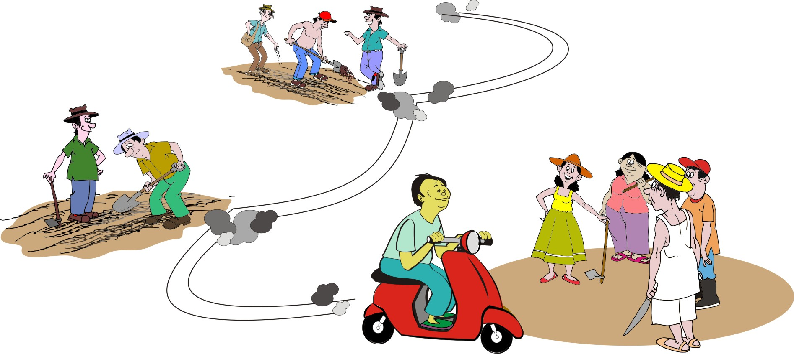
How many groups can a field agent manage?
There is no fixed number of farmers’ groups that a field agent can support. It depends on:
Type and detail of training provided
Location and the situation of the groups
Market options and capacity of the field agent.

Slide 48
Managing groups in production cycles
First production cycle: In an area where the farmers are poor but markets are functioning reasonably well, a well-trained field agent can start working with 5–10 farmer groups of 20–30 farmers each, in the first production cycle.
If the process is successful and there is demand from other farmer groups, the field agent can add five to ten or more groups each production cycle.
The timeframe for the production cycle may be a season, a year, or several years, depending on the product.

Slide 49
Outline for rolling training plan: Diagram

Slide 50
Outline for rolling training plan: Analysis
The diagram shows how a training can be organized:
Year 1: The field agent provides 10 farmers’ groups with intensive training.
Year 2: The field agent coaches these same groups, visiting them every month and at marketing time. This allows the field agent time to start new groups.
Year 3: The field agent comes to the first year group only when requested, coaches the groups who started in Year 2 and begins to work with a new set of farmer groups.

Slide 51
Training other facilitators: Staff or partner organization
Various NGOs, community organizations and extension agencies, which promote agricultural development, focus on increasing production or community organizing.
Training them in agroenterprise skills would enable their staff to expand their services and increase their impact.

Slide 52
Training other facilitators: Community field agents
Entrepreneurial farmers, especially young people, may be interested in taking on the role of being a private-sector field agent.
They may be able to work part-time or full-time to help groups improve their marketing.

Slide 53
Second-order associations
Collaboration among farmers’ groups:
Can help scale up the collective marketing of farm products
May take the form of a second-order marketing association
The association enables the farmers to buy from and sell to larger traders, and to get better prices.

Slide 54
Farmer cooperatives: Services to members
Cooperatives are more formal organizations with full-time staff that offer the following services:
Access to new technologies and veterinary services
Access to basic inputs at lower market costs
Extension service support for production
Financial support for loans and profitability analysis
Storage and crop conditioning facilities
Market information and support
Access to loans, insurance and warehouse receipt options
Support for certification

Slide 55
Farmer cooperatives: Social services
Social services, which may also be open to non-members (with members getting preferential rates) may include:
Access to medical clinics
Adult education
Basic infrastructural projects (water, sanitation, market access roads and transport)
To join a cooperative, a farmer usually pays a one-time or annual membership fee and is also asked to buy shares.

Slide 56
Cooperative management
Several cooperatives may be organized into unions:
Farmers’ groups (20–30 members)
Cooperatives (10–30 farmer groups)
Cooperative unions (4–5 cooperatives)
Because they serve so many farmers and are a place where farmers can learn and get information, cooperatives can be a very useful way to scale up the agroenterprise approach.

Slide 57
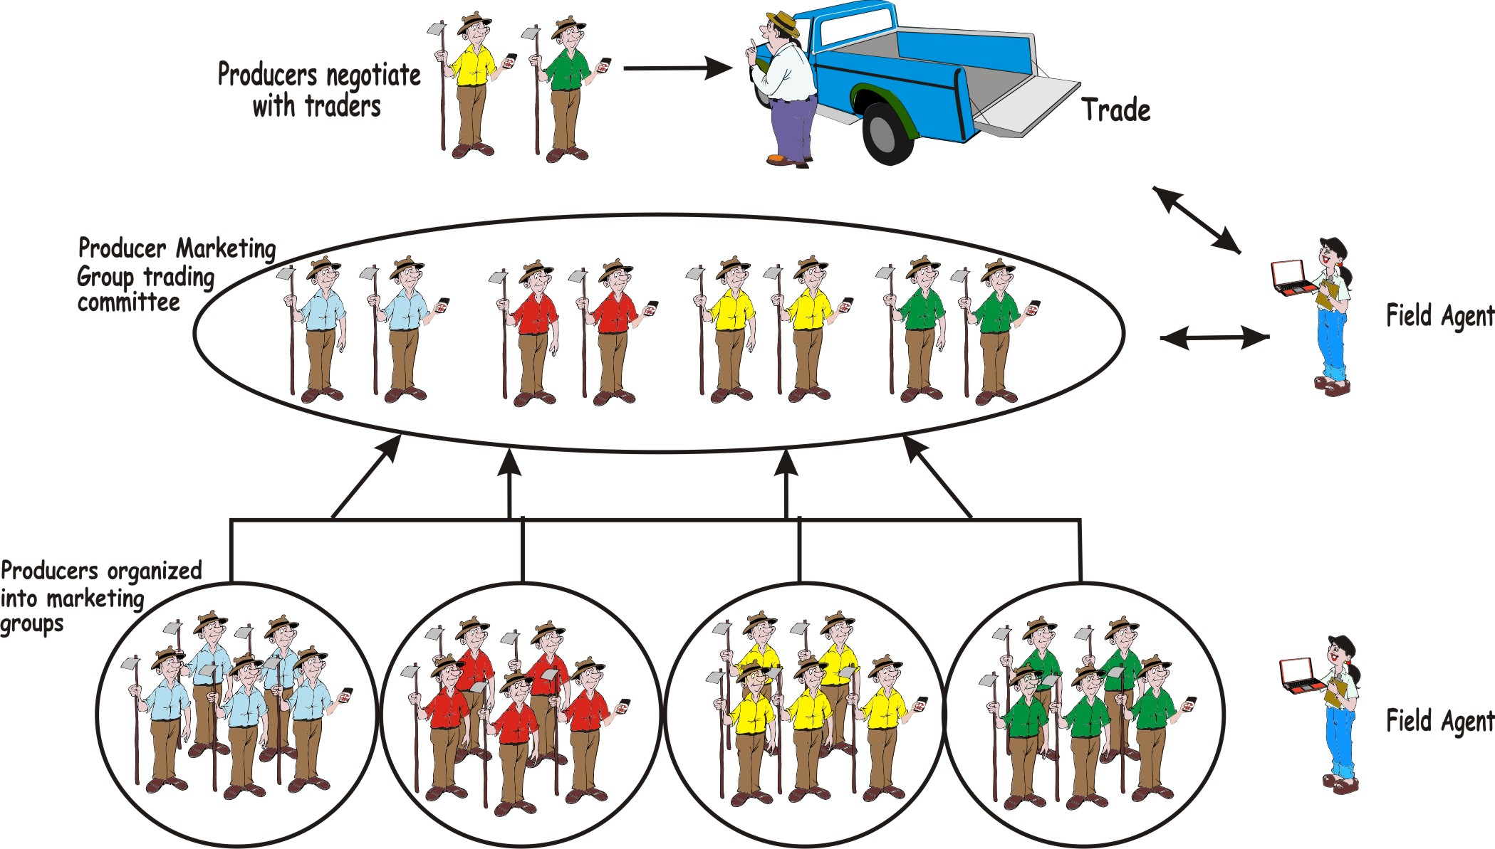
Cooperative management illustrated
If they are well managed, cooperatives improve the lot of their members. Millions of farmers support and are empowered by the cooperative movement.

Slide 58
Cooperatives: Mismanagement
In some countries, mismanagement of cooperatives has left many with a bad reputation, e.g. cooperatives may be:
Imposed by the government
Controlled by elites or politicians
Corrupt or inefficient because farmer’s groups have been manipulated for political purposes
Farmers may be suspicious of cooperatives and it may be challenging to work with them. Make sure that any organization that claims to support farmers is honest and provides services in the farmers’ interest and wellbeing.

Slide 59
Working with formal buyers
Local traders and other more formal buyers welcome the opportunity to negotiate to buy larger amounts from groups of farmers. They are often prepared to pay a higher price for the convenience of buying in bulk.
As a field agent, facilitate agreements between farmers and buyers to build trading relationships. Encourage farmers’ groups to monitor buyer trends, consumer demands and preferences, so they can work better with formal buyers.

Slide 60
Working with formal buyers
It is helpful to work with the buyers and to determine if:
They interested in buying more
They would like to buy other products as well
They would pay a better price for better quality
They can pay more quickly for reliable supplies

Slide 61
Promoting innovation
Farmers can often improve their incomes by:
Identifying new market trends and opportunities
Finding ways of supplying these new demands
Becoming more competitive by reducing their production costs or boosting their productivity

Slide 62
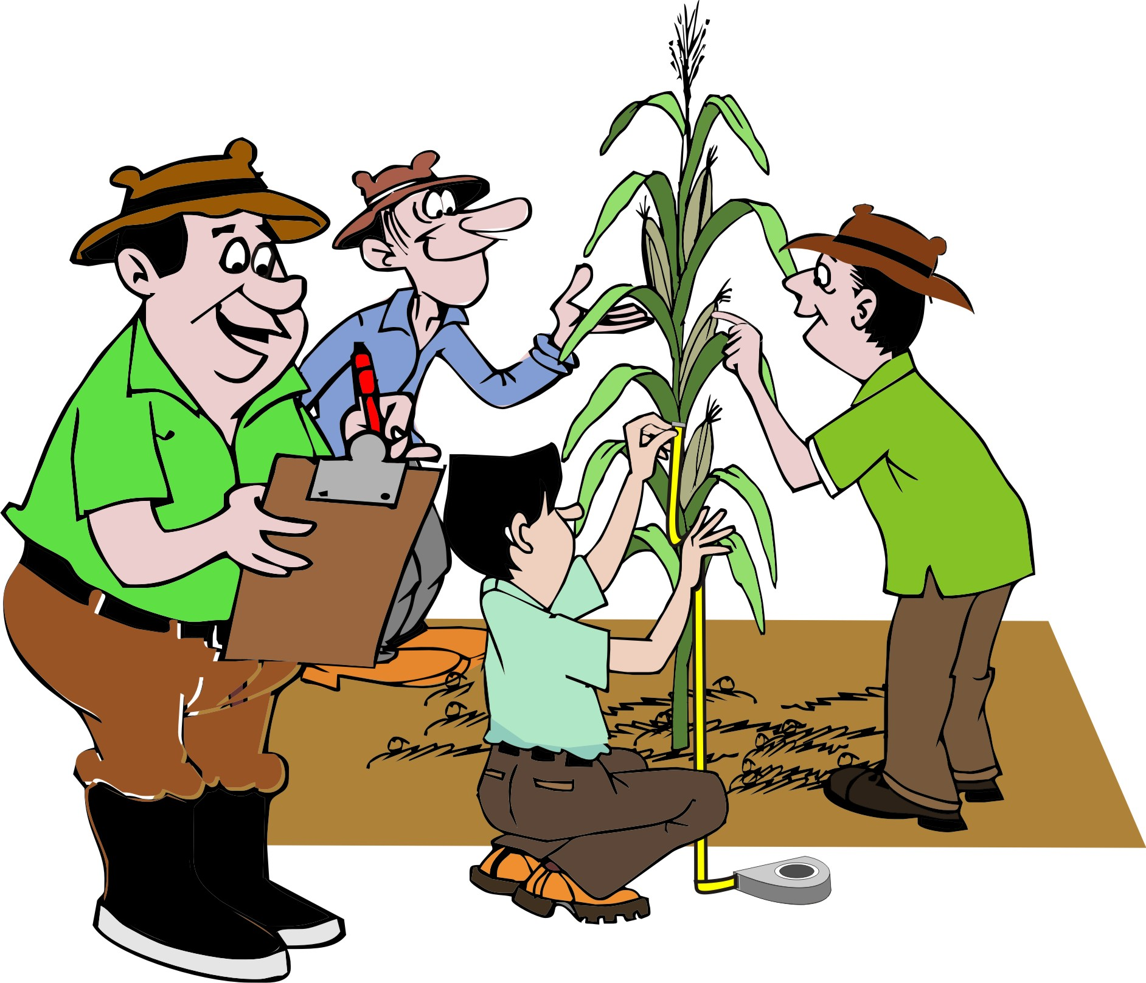
Sources of innovation
Innovation usually requires new production techniques.
Innovation typically starts with one person seeing a new way of doing things.
The idea is tested on a small scale – with a small group of farmers – before the whole group can adopt the technique and integrate it into their next business plan.

Slide 63
Comparing costs between crops
A field agent can help farmers to compare the profit or returns to land and labor from different types of crops.

Slide 64
Comparing costs between crops: Example
Example
Take the costs of production, (materials, labor and loans) and the income based on sales for maize and compare that on the same unit area for another crop such as cassava, rice or coffee.

Slide 65
Example of a cost comparison form
Costs | Crop A | Crop B | Differences
Based on the same unit area | Maize | Beans
Consumables
Durables
Hired labor
Family labor
Loan costs
Income
Profit

Slide 66
Communication and the media
Farmers listen to the radio and may be able to watch television.
Increasing numbers of farmers have mobile phones and may have access Internet cafés nearby.
If these information services are available, use them to promote agroenterprise development.

Slide 67
Using the media: Suggestions
Contribute to a radio drama about marketing
Be interviewed on a talk show, or become a regular guest talking about agriculture and prices in the market
Prepare and distribute printed production and marketing guides.
Contribute to information materials produced by the government or NGOs.
Explore ways to get information, such as prices, to farmers via their mobile phones.

Slide 68
Module summary
This was the fourth and final booklet in the Seven steps of marketing series.
In this booklet (module), you have learned the last two steps involved in linking farmers to markets and helping them develop their agroenterprises:
Step 6: Reviewing performance
Step 7: Scaling up

