Slide 1
The seven steps of marketing
Booklet 3: Marketing as a group
A SMART Skills Manual

Slide 2
Skills for Marketing and Rural Transformation (SMART skills)
SMART Skills manuals:
Introduction to SMART skills for rural development
Organizing and managing farmer groups
Understanding natural resources
Managing natural resources
Marketing basics
Seven steps of marketing
Promoting innovation

Slide 3
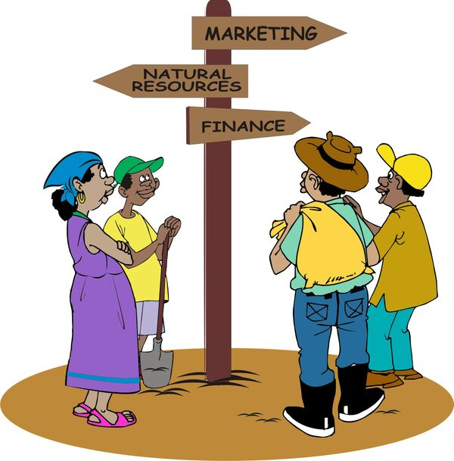
Purpose of the SMART skills series
To introduce you to the following five skill areas:
Group organization
Natural resources management
Finance
Marketing
Innovation

Slide 4
The seven steps of marketing: Content
Step 1: Getting organized
Step 2: Identifying products and organizing groups
Step 3: Collecting information for the business plan
Step 4: Building a business plan
Step 5: Marketing as a group
Step 6: Reviewing agroenterprise performance
Step 7: Scaling up

Slide 5
Booklet 3: Marketing as a group
Step 5: Marketing as a group
Lesson 17: Why market as a group?
Lesson 18: How do traders decide on price?

Slide 6
Step 5:
Marketing as a group

Slide 7
Lesson 17:
Why market as a group?

Slide 8
Outcomes
After this lesson you will be able to:
Describe why both traders and farmers can benefit if farmers market as a group.
Describe how a typical sale by a farmers’ group works.
List the costs incurred by the group’s marketing committee.
Explain some considerations when negotiating with a buyer.
Describe the agreements that the group members may have to make among themselves.
Explain the advantages of cooperatives and second-order marketing associations.
Describe some of the problems that may occur with collective marketing.

Slide 9
Overview
Lesson 17 covers the following content:
Advantages of collective marketing
A typical sale and variations
Costs of marketing
Finding a buyer
Negotiating with buyers
Agreements within the farmers’ group
Maintaining a continuous supply, quality and discipline
Keeping buyers informed
Developing a market strategy around quality options
Second-order marketing associations and cooperatives
Problems with collective marketing

Slide 10
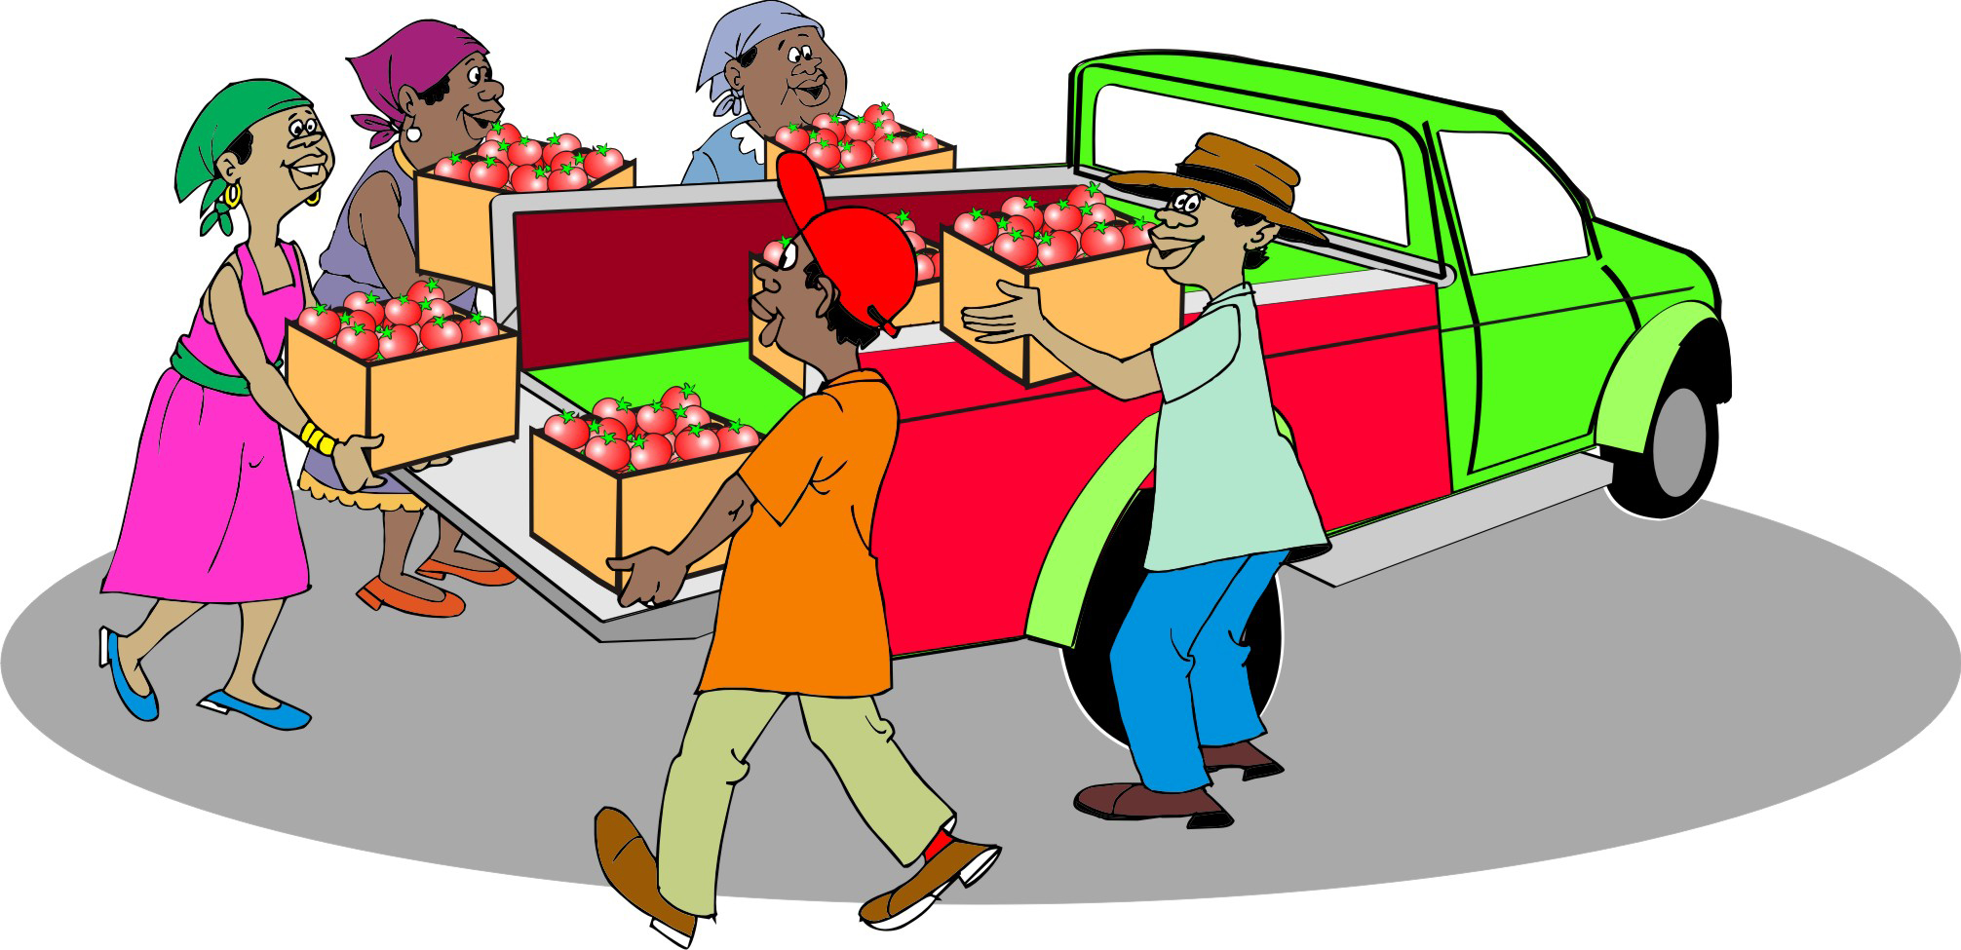
Collective marketing
Collective marketing is the marketing effort in which several farmers bring small amounts of their output (product) together at harvest time, market their product as a group and sell it in bulk.

Slide 11
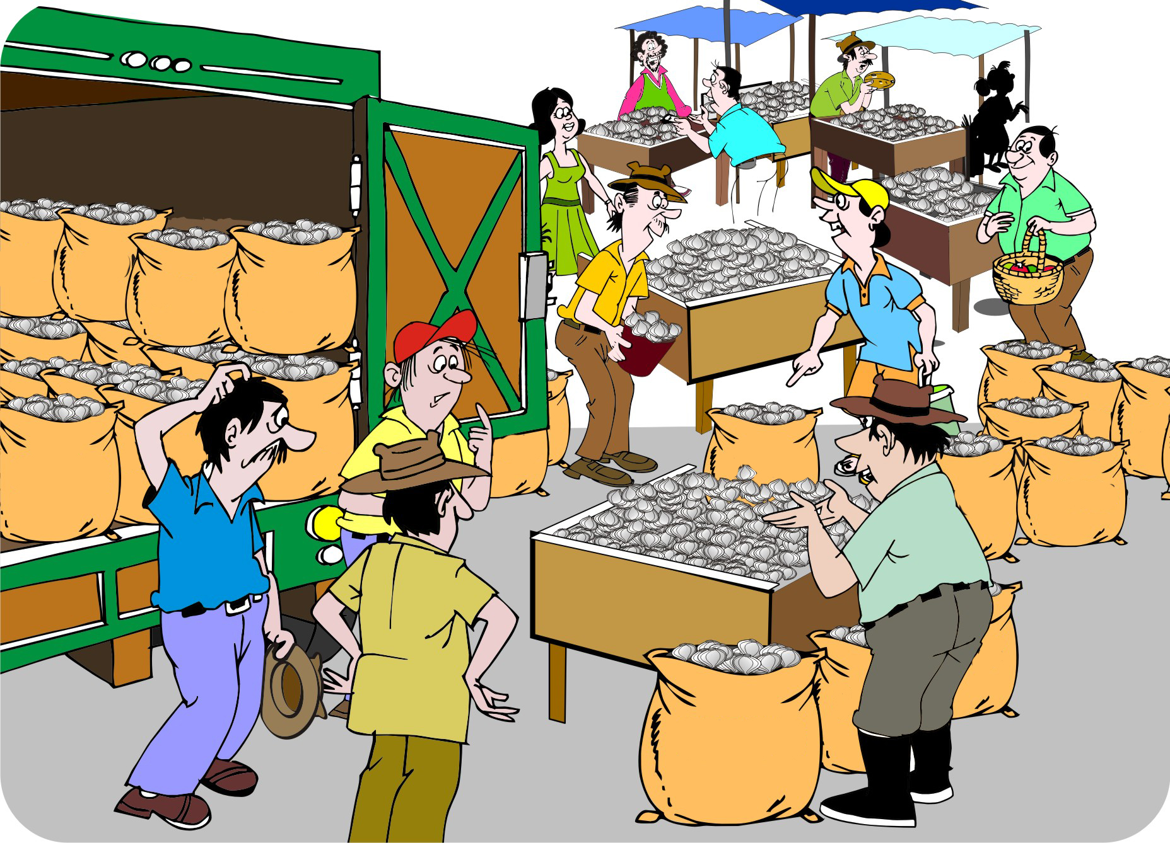
Advantages of collective marketing
Collective marketing and bulk selling have the following advantages for farmers and traders:
Bigger volumes
Bigger trades
Uniform quality
Reliable sellers
Reliable buyers
Continuous supply
Higher price
Better organization

Slide 12
Advantages of collective marketing: Bigger volumes
Farmers can pool their output (which is called bulking), so that traders can buy more at the same time and can fill up their vehicles or stores more easily.
Traders can:
Negotiate with one seller – a representative of the farmers’ group – rather than with lots of individual farmers.
Make one payment – often via a bank – rather than lots of small cash transactions. That is more convenient and saves having to carry lots of cash around.

Slide 13
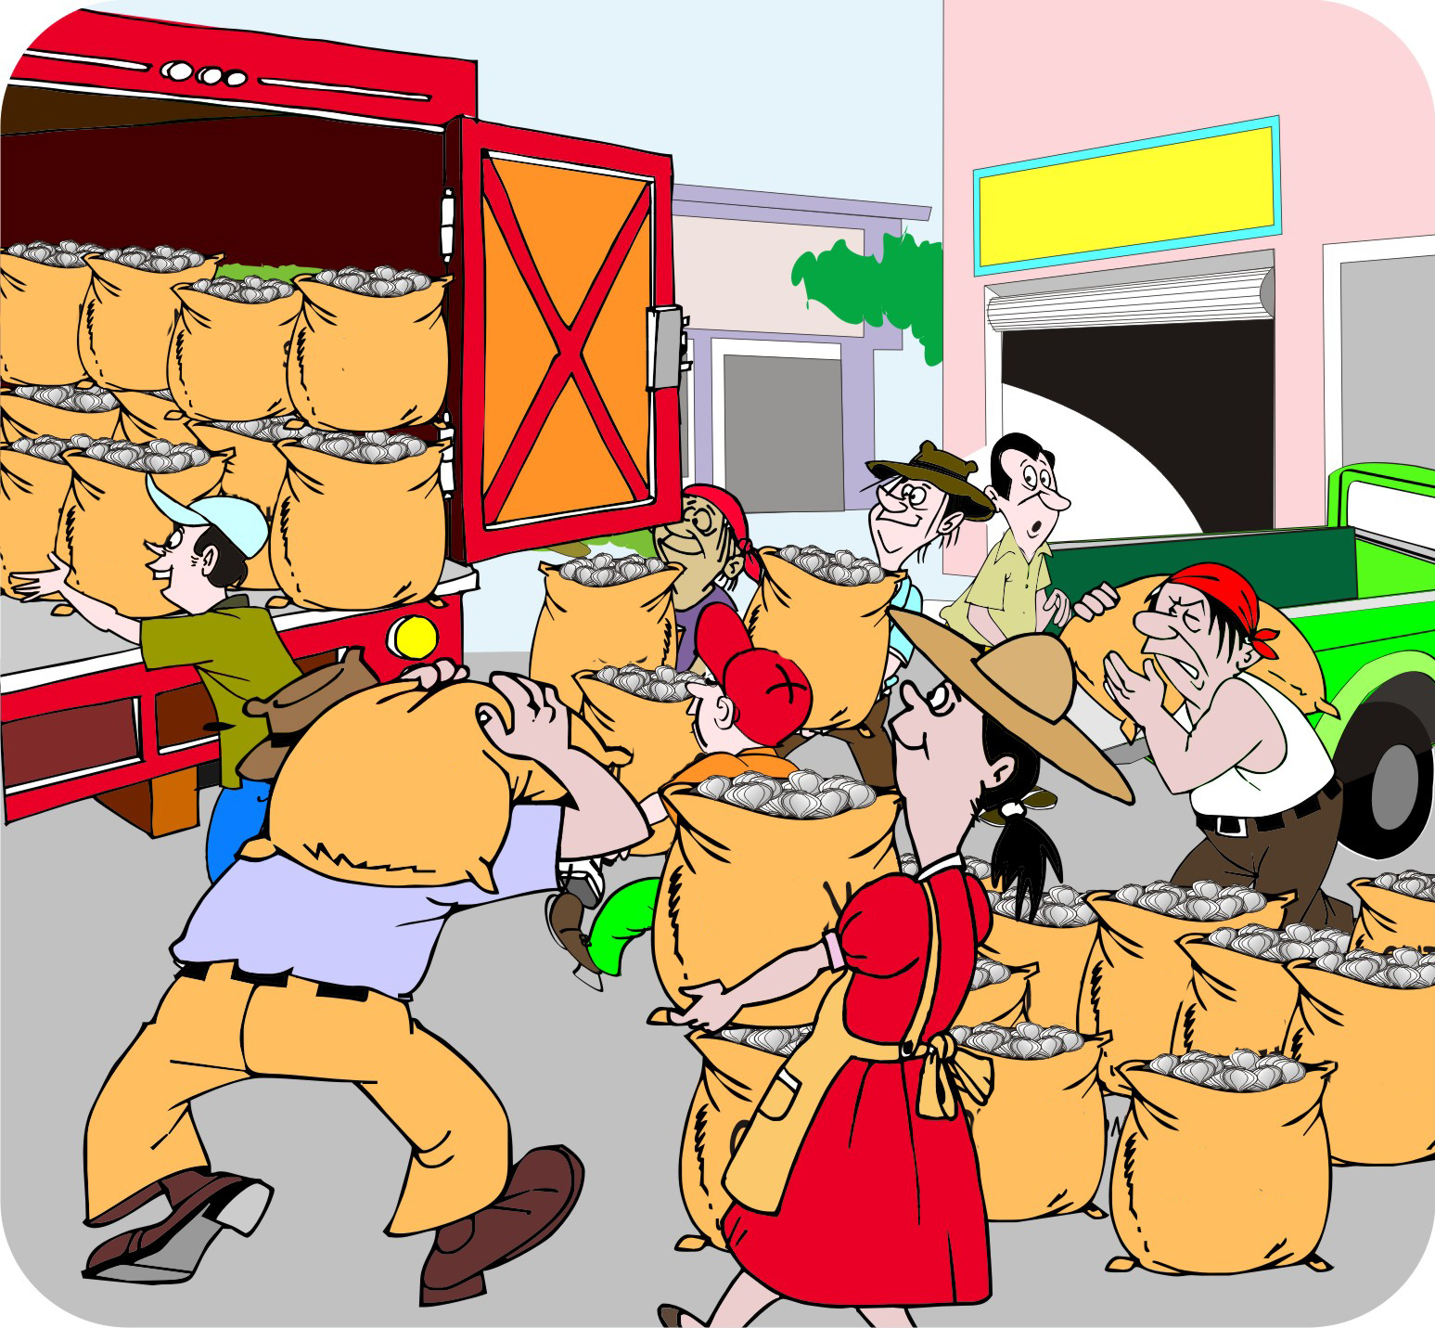
Advantages of collective marketing: Bigger trades
Collective marketing makes it possible to sell to bigger traders, who:
Offer better prices and conditions
Serve more distant markets
In this way, farmers can cut out local traders.

Slide 14
Advantages of collective marketing: Bigger trades (Continued)
The farmers’ group takes on some of the functions of smaller traders:
Transport to a central point
Bulking the produce into larger lots
Storage
Provision of loans to farmers

Slide 15
Advantages of collective marketing: Uniform quality
Traders:
Do not want big and small, ripe and unripe produce all mixed together
Want the produce they buy to be the same size and quality and free of dirt, sticks and other impurities.
With a larger volume, it is worthwhile for farmers to clean, sort and grade their product.

Slide 16
Advantages of collective marketing: Reliable sellers
Many things can come in the way of the successful trade of an individual farmer, such as:
Pest attacking a crop
The weather spoiling the harvest
The farmer falling ill.
Collective marketing reduces these risks:
If one farmer experiences a production problem, chances are that the other members of the group will be able to make up the shortfall.

Slide 17
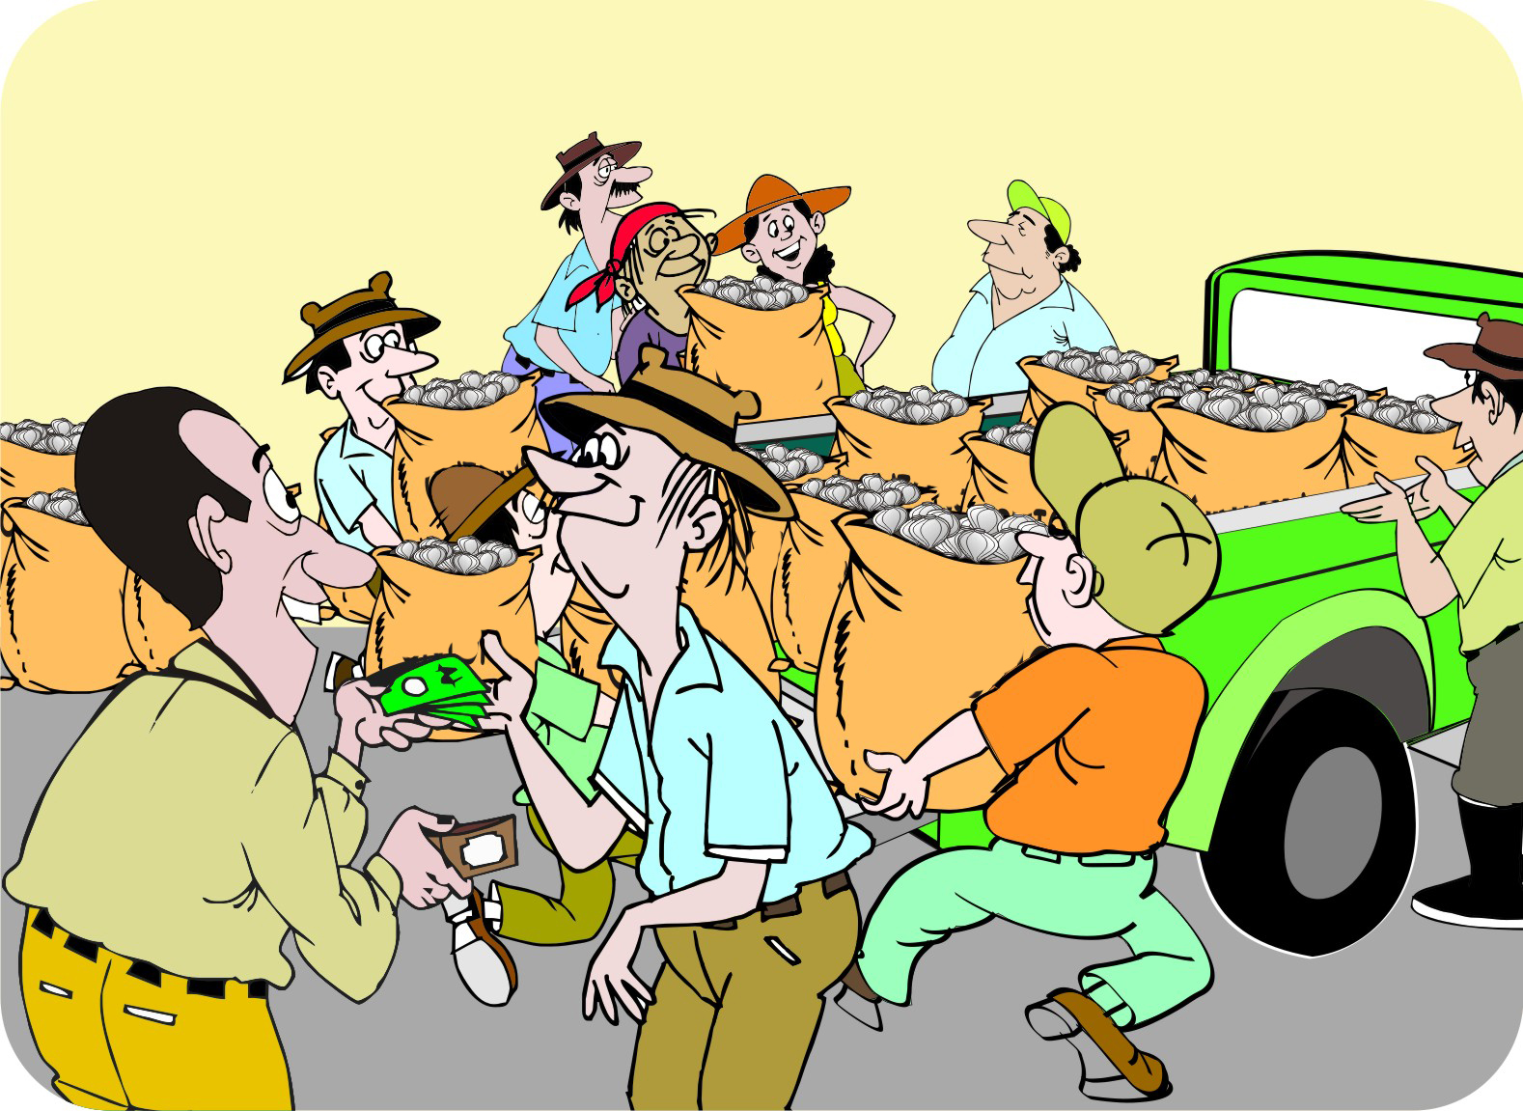
Advantages of collective marketing: Reliable buyers
If a trader knows there is a big consignment waiting, he/she will make sure to pick it up as promised and will pay the agreed price.
By selling collectively, the farmers can be more confident that the buyer will be reliable.

Slide 18
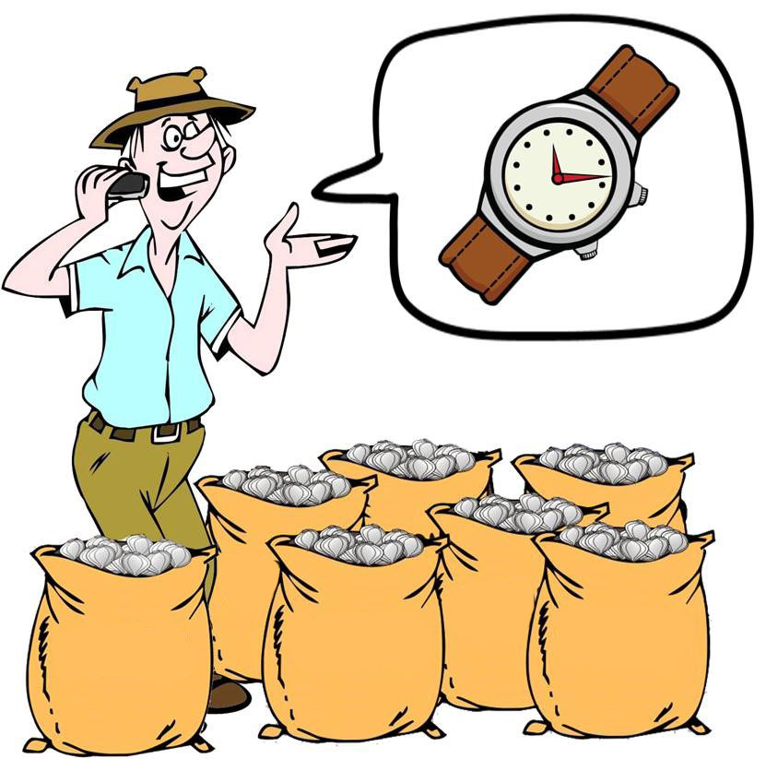
Advantages of collective marketing: Continuous supply
Many traders want a continuous supply of a product throughout the season.
Groups of farmers can:
Organize staggered plantings and harvests
Store produce, so they can deliver several truckloads of the product over an extended marketing period

Slide 19

Advantages of collective marketing: Higher price
Bulked, cleaned and graded produce is more valuable and traders are usually more willing to pay a better price for it.
By organizing as a group, the farmers improve their bargaining position, e.g. by negotiating with several potential buyers for the best terms, conditions and prices.

Slide 20
Advantages of collective marketing: Organization
Marketing collectively means that farmers have to get organized, which has the following benefits:
Farmers can learn from one another
Improve the quality of their produce
Set up savings-and-credit arrangements
Buy bulk inputs
Marketing collectively can be a good way to start a farmers’ group or strengthen an existing group.

Slide 21
Organizing collective marketing
It is not practical for 10–30 farmers to negotiate with buyers. Advise the group to nominate a team of two or three members to negotiate with traders on behalf of the group.
This marketing team should include:
The group’s marketing coordinator
Group chairperson
Team members who did the marketing survey
Having two or three people on the team is a good idea to ensure transparency and trust and to reduce the risk of the representative cheating the other members.

Slide 22
A typical sale: Step 1–5
Buyers show interest during the group’s market survey.
The group discusses buyers’ options and sets a target.
At harvest, the group advises the marketing team about the amounts they can sell for the planned sale(s).
The marketing team negotiates with the buyer and confirms the deal.
The group’s production coordinator arranges for the delivery of the product at the right time and place.

Slide 23
A typical sale: Step 6–11
The marketing coordinator weighs each farmers’ product and checks the quality.
The group secretary keeps record of each farmer’s supply.
The buyer comes to pick up the product.
The marketing coordinator arranges for the group members to load it onto the truck(s).
The group treasurer receives the payment from the buyer.
The treasurer pays the individual group members according to the amount each has supplied, after deducting all outstanding fees and costs.

Slide 24
Variations to the typical sale
The group may undertake additional tasks, such as storage, cleaning, drying, sorting, grading and packaging.
If the group has capital, it may pay the farmers in part or in full immediately when they deliver the product.
If the deal is made before the season begins, the production manager can coordinate how much each farmer plants and the timing of planting and harvesting.
The group may accept deliveries from non-members in order to increase the amount.

Slide 25
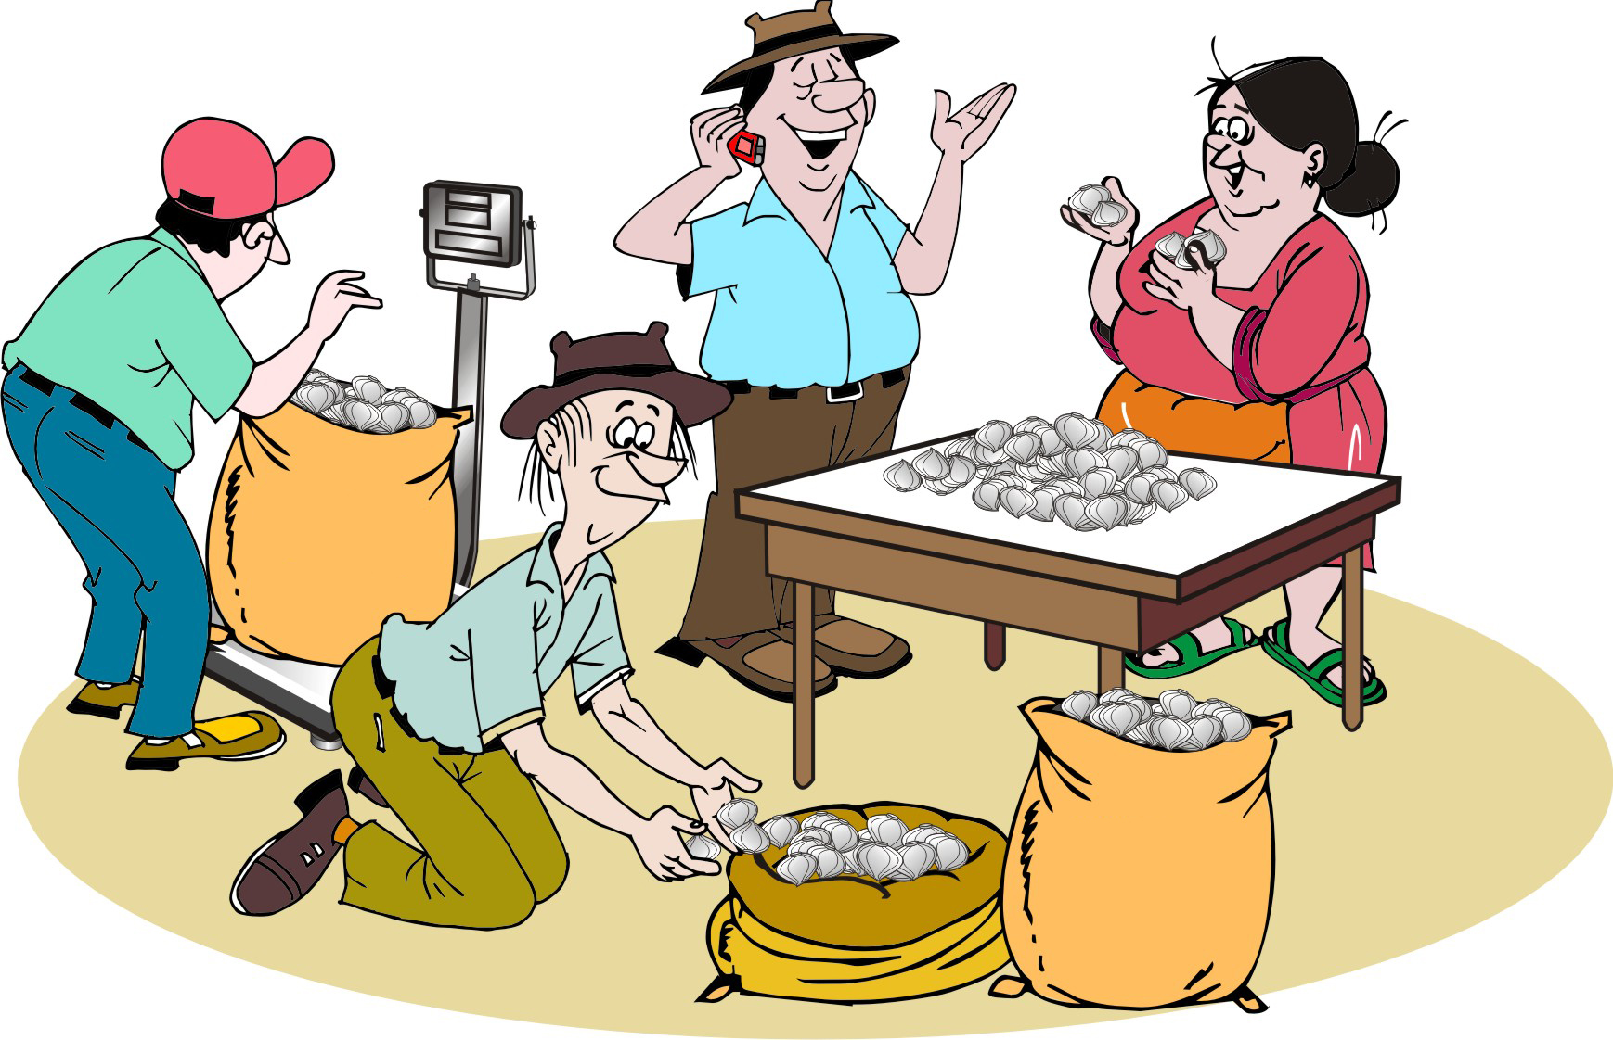
Costs of marketing
The marketing team will incur costs, such as:
The marketing team’s time
Cleaning, grading and sorting
Packaging and labelling
Storage, loading, and transport
Communications and travel
Mobile phone costs

Slide 26
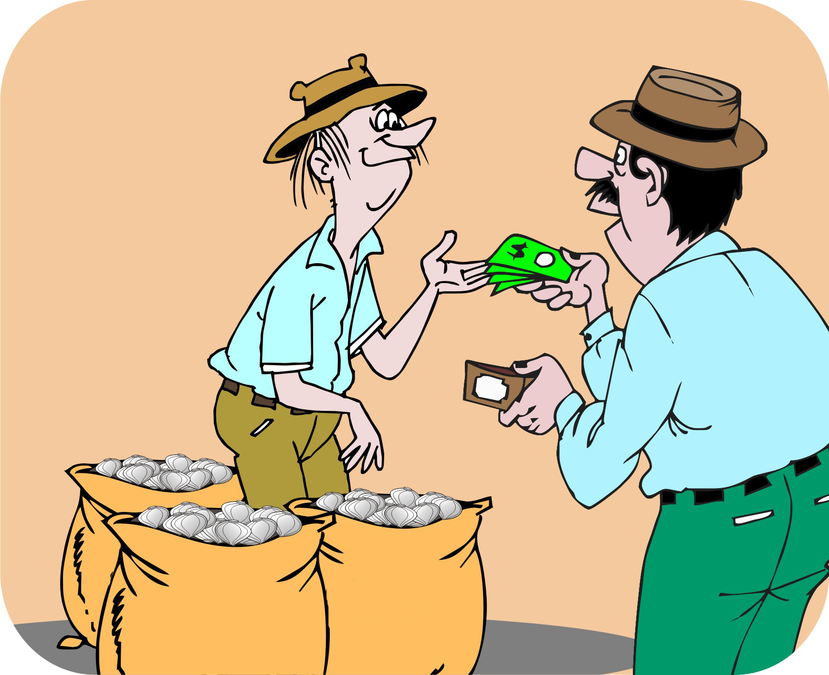
Finding a buyer
Try to identify and reach an agreement with a specific buyer for the product before the farmers have planted the crop.
This gives the farmers a degree of certainty and a willingness to invest in growing the crop.

Slide 27
Finding a buyer (Continued)
Make sure the buyer is reliable and trustworthy, which means:
The buyer can handle the amount of product the farmers plan to produce
Has a reputation for paying on time.
Farmers may need to identify more than one buyer, because the buyer offering the best price may have specific buying conditions, in terms of size, quality, timing and packaging.

Slide 28
Fill a truck and take it to the market
The farmers should negotiate with buyers about the timing of their sales delivery, price and payment method. Do not just load a truck and take it to the market.

Slide 29
Fill a truck and take it to the market (Continued)
Keep in mind that traders:
Do not like unexpected competition
Do not like being forced into trades
Work together to regulate the amount of produce: if too much produce arrives at the market, prices will fall.

Slide 30
Negotiating with buyers: Approaches
Wait for the buyer and negotiate for a better price
Sell to reliable buyers whom you know and trust
Agree on pre-arranged sales before the harvest at the market price at harvest time
Agree on a fixed price beforehand, which reduces the risks for the farmer and the buyer
Agree on a minimum price with the buyer

Slide 31
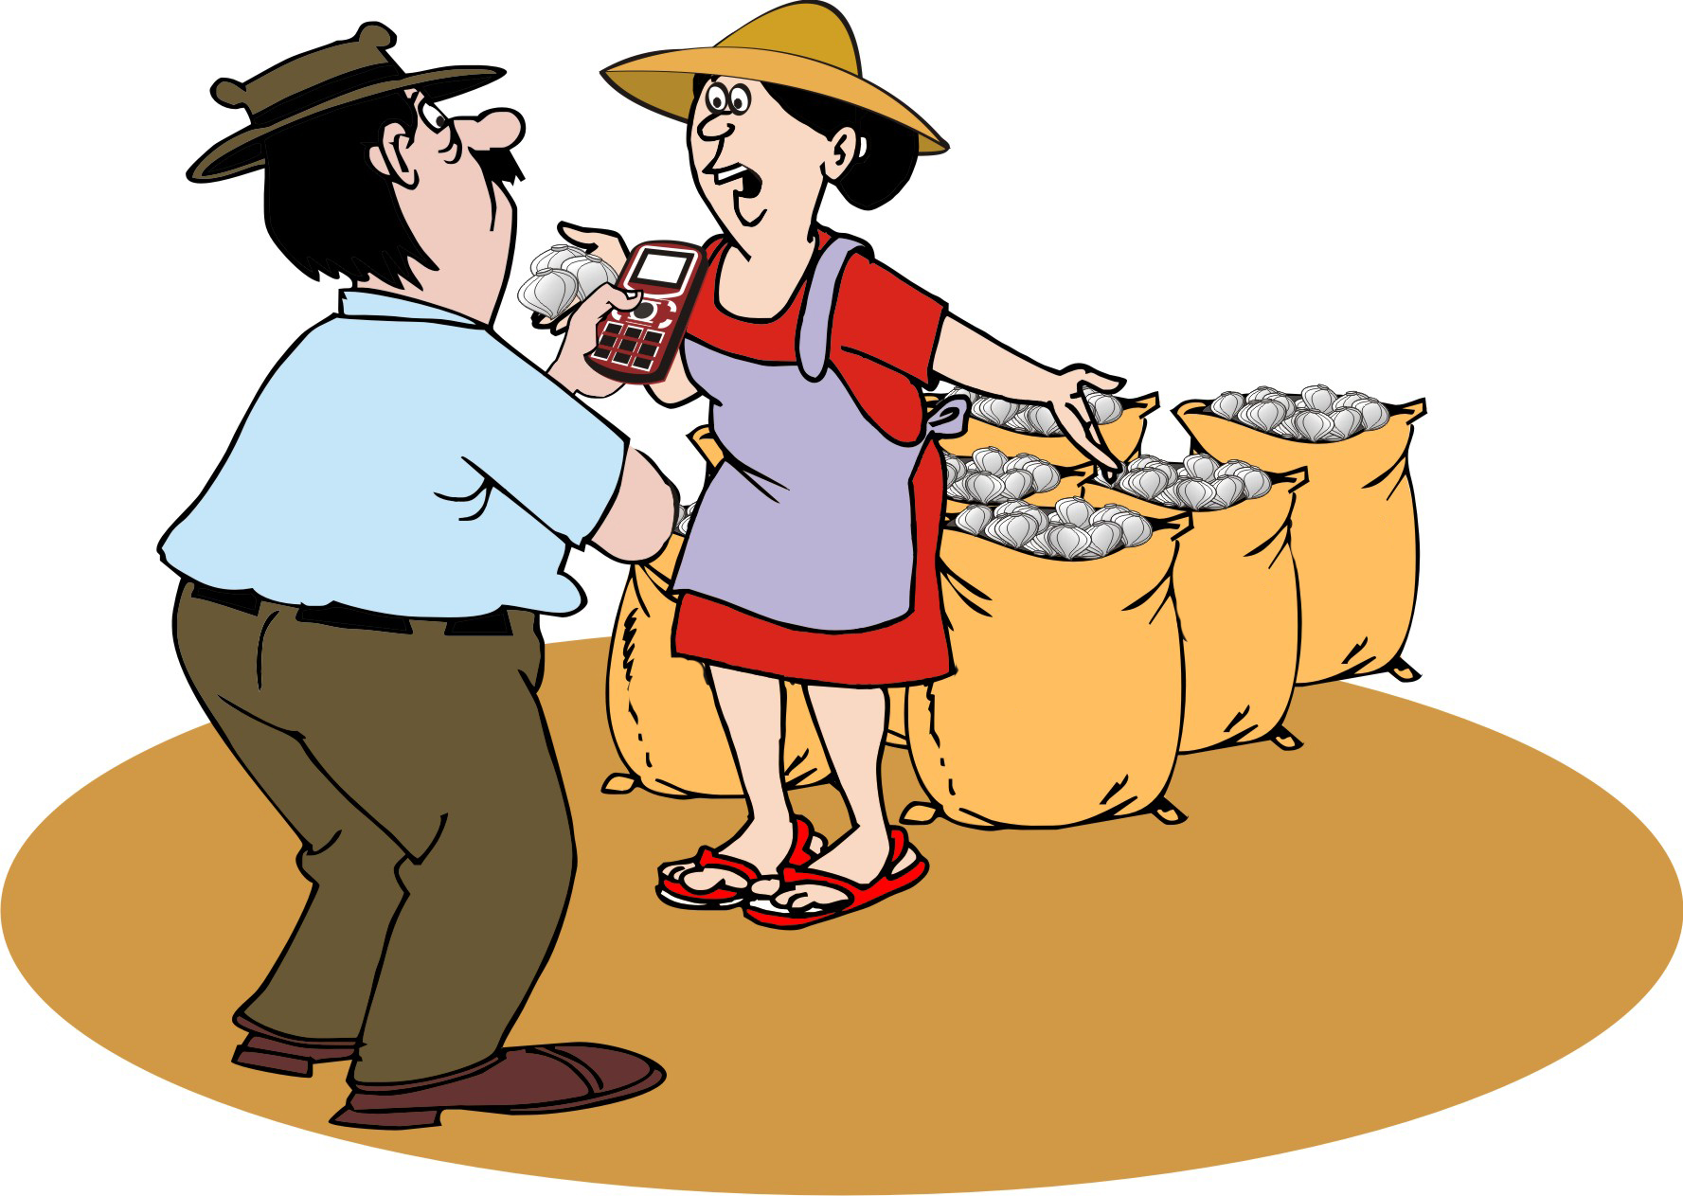
Negotiating with buyers: Approaches (Continued)
Deliver produce to an auction, where potential buyers compete to buy it
Contract farming: The buyers signs a contract with a farmers’ group to produce a product on a strict schedule.
Fair trade: Buyers agreeing on standards set by certifying organizations

Slide 32
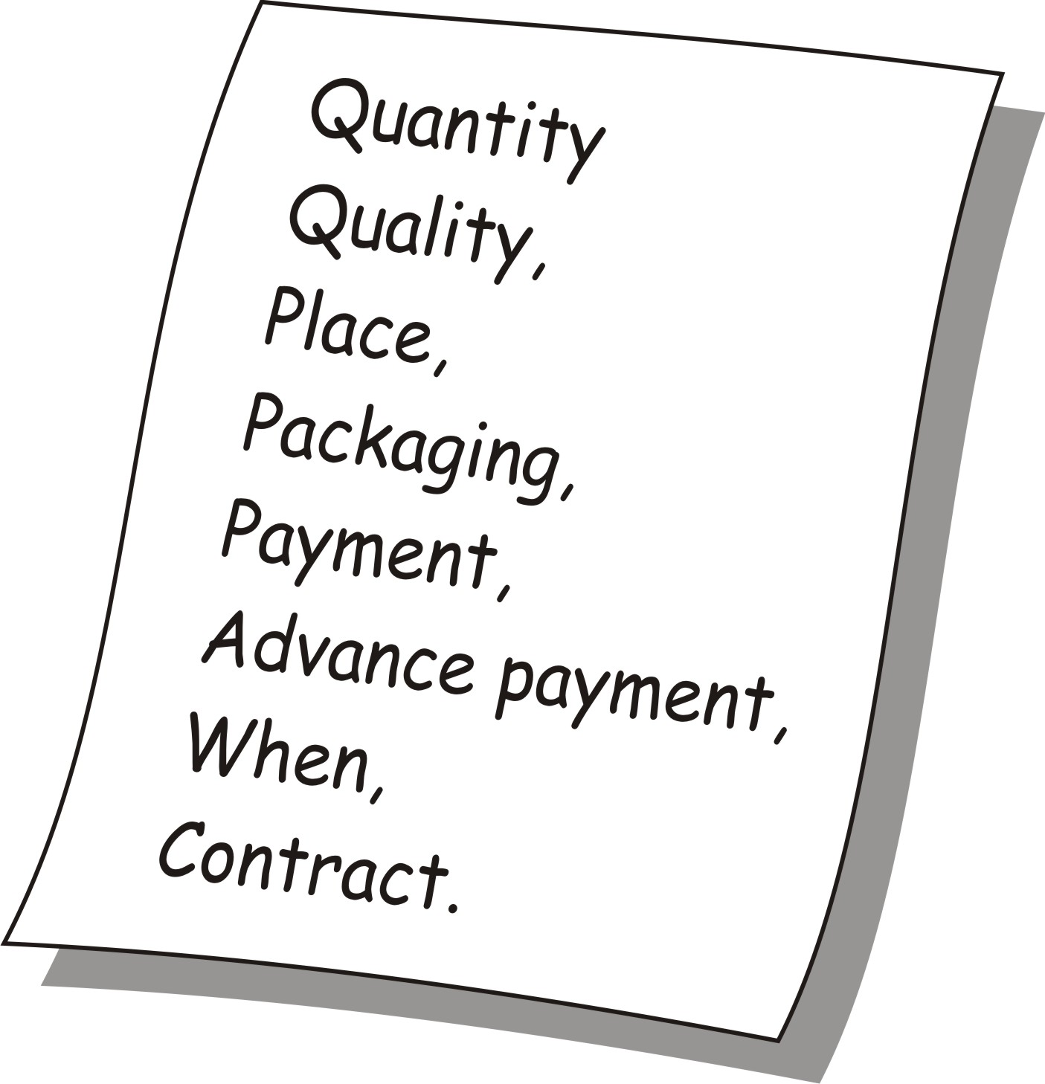
Negotiating with buyers: Points to negotiate
Buyer’s price
Quantity: How much will the buyer take and how is it measured?
Quality requirements specified by the buyer, e.g. drying for a certain period
Place of delivery, transport and loading
Packaging: Sacks, boxes, bags, etc.
Payment conditions
Timing: When will the sale take place?
Formality: Written or verbal contract, mutual trust or a handshake

Slide 33
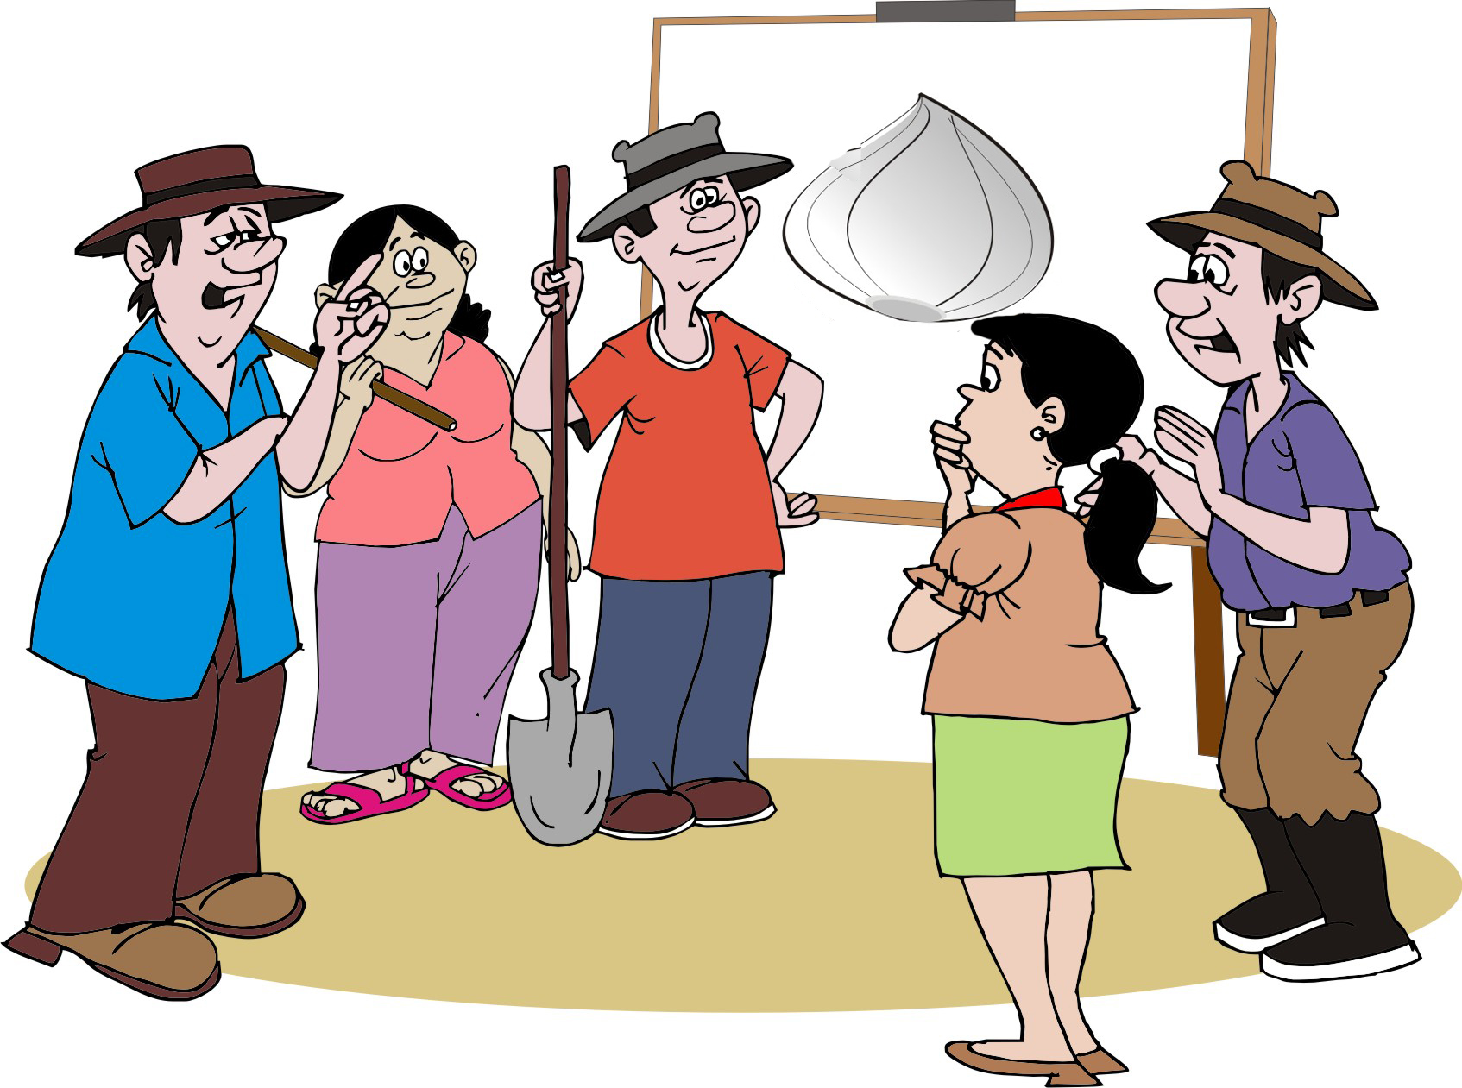
Agreements within the farmers’ group: Crops
Type of crop and variety to plant
How large an area will each farmer plant
When will each farmer plant their crop
Management techniques to produce the right amounts and quality, e.g. irrigation, fertilizer, pest and disease control

Slide 34
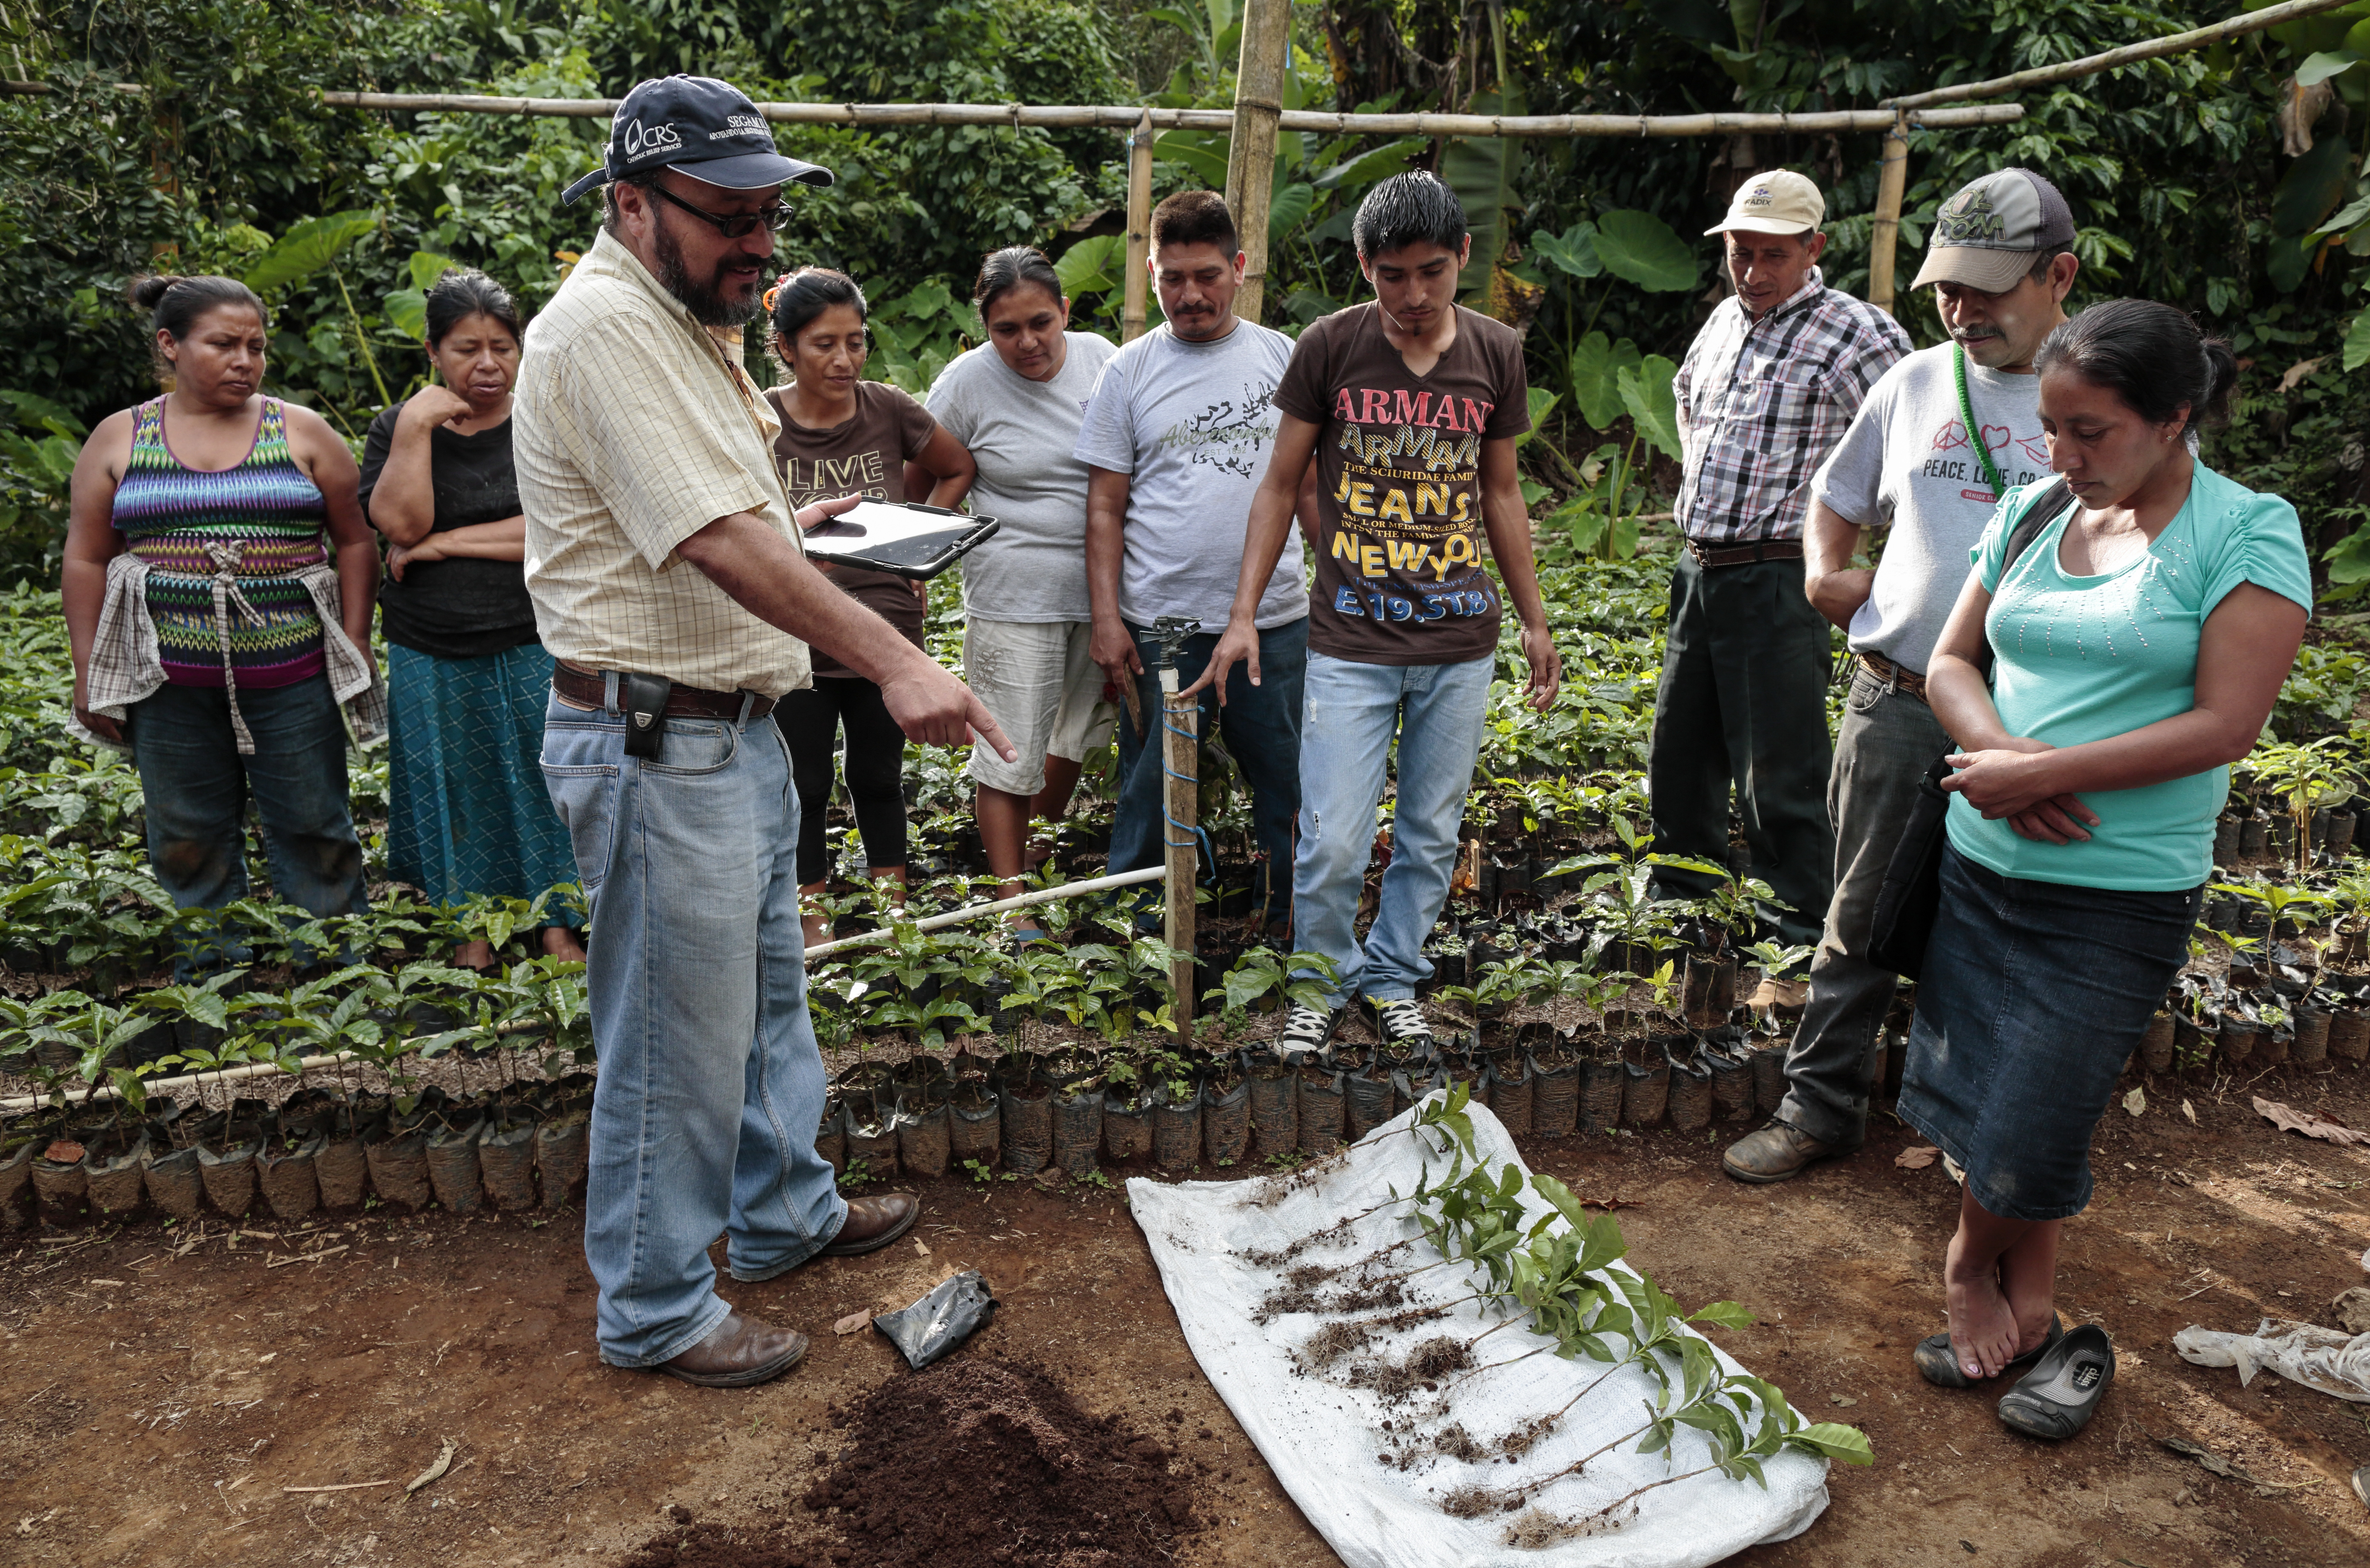
Agreements within the farmers’ group: Crops (Continued)
When will each farmer harvest the crop
What post-harvest processing to do: drying, washing, sorting and grading
How to package the crop: types of bags or crates, labels, etc.
Where to store the crop

Slide 35
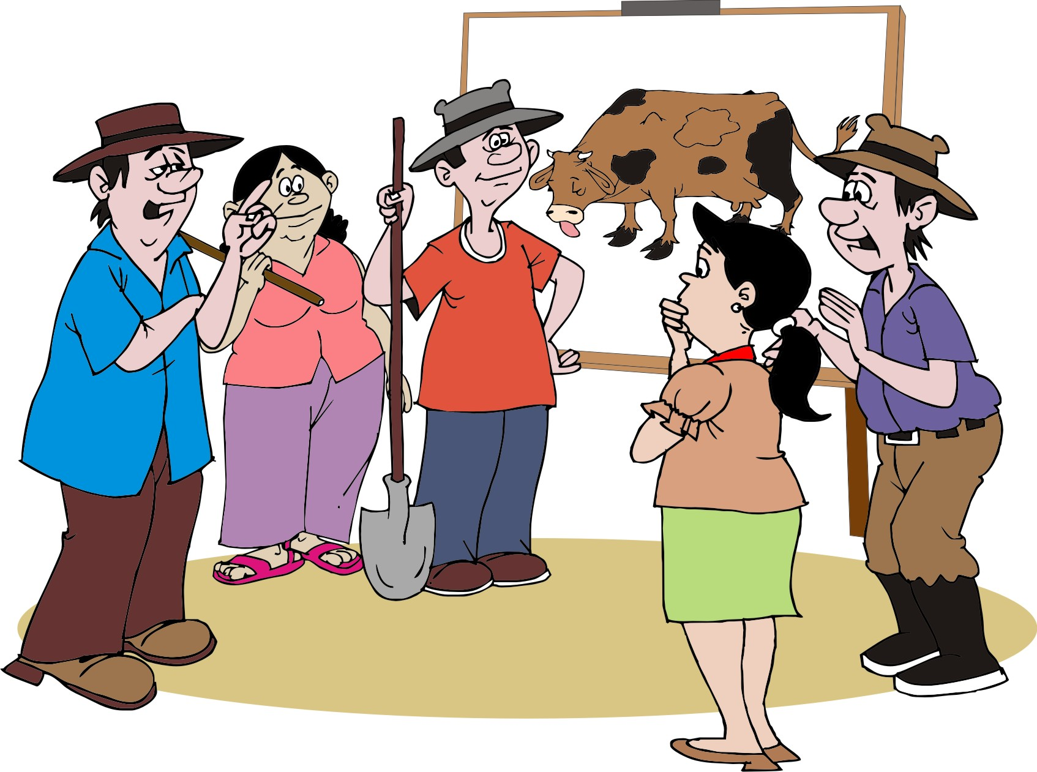
Agreements within the farmers’ group: Livestock
What type and breed of animal to produce
How many animals to raise
How to manage the animals: feeding, breeding, etc.
When should each farmer sell the animals

Slide 36
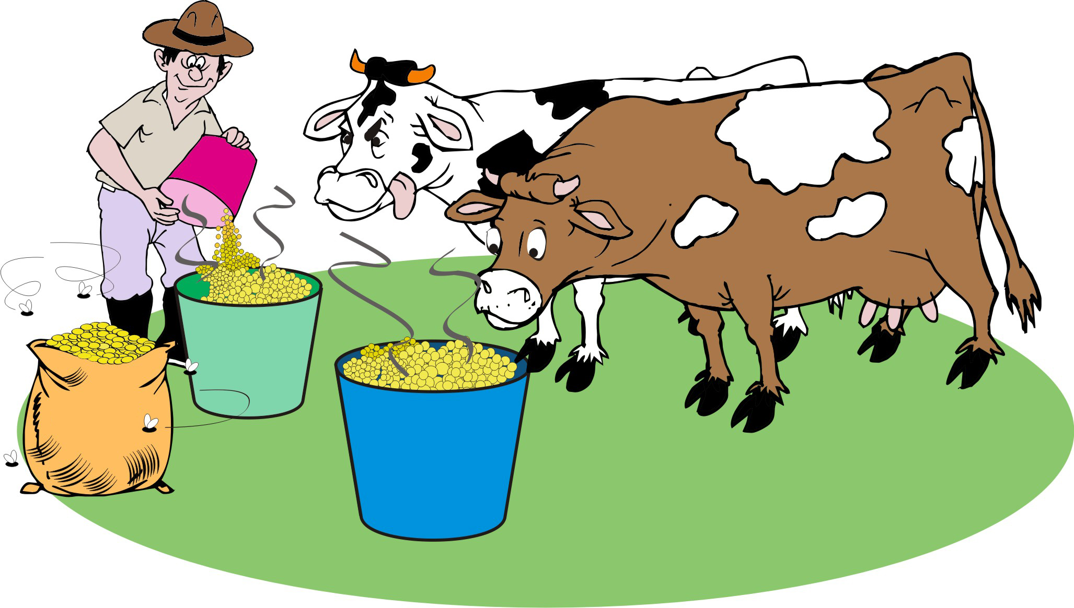
Agreements within the farmers’ group: Livestock (Continued)
How to maintain hygiene for products such as milk
How to prepare the product for transport
What market preparation is required, e.g. weighing, sorting and grading
Where to keep the animals or the products so the buyer can pick them up

Slide 37
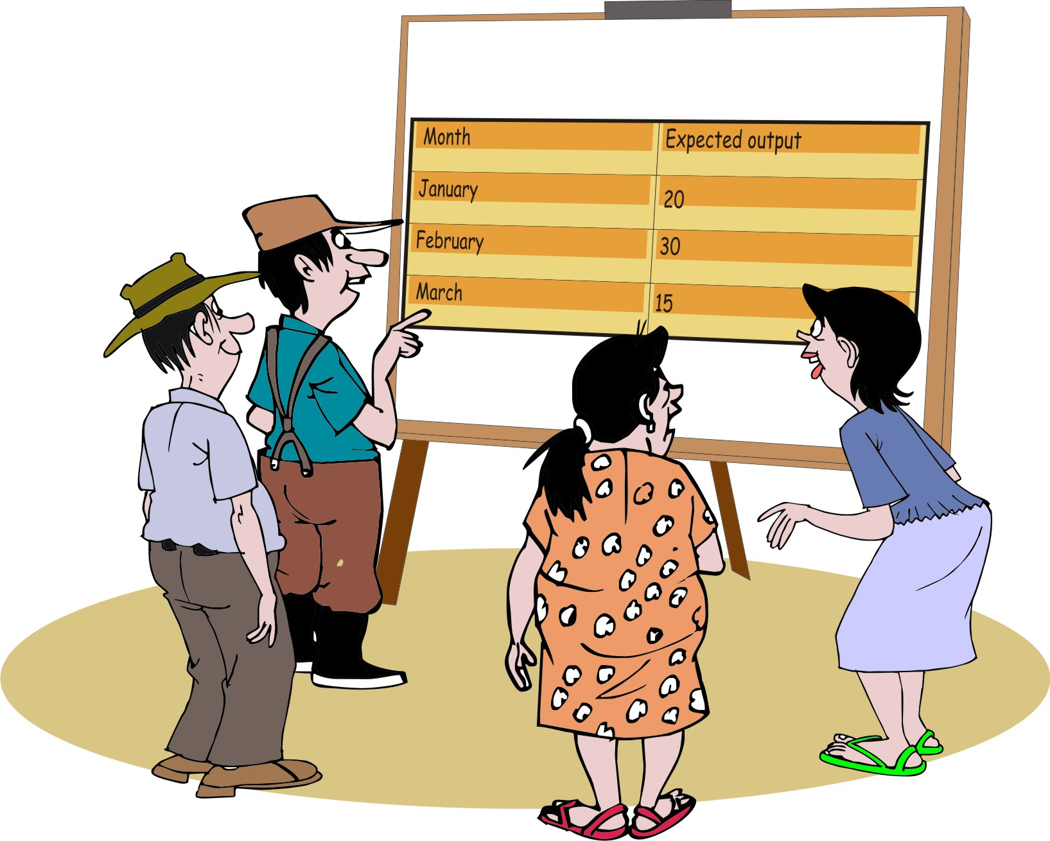
Maintaining a continuous supply
To serve the demand for a regular supply of a product, the farmers will have to think about a number of options:
How much they can deliver
When they can deliver the amount of vegetables needed
Who plants and harvests how much of the crop on what dates.

Slide 38
Maintaining a continuous supply: Methods
Farmers may consider the following methods to maintain a continuous supply:
Develop a production schedule
Stagger planting and harvesting dates
Plant in different areas, e.g. highland, lowland and wetland areas
Use different varieties (short and long duration)

Slide 39
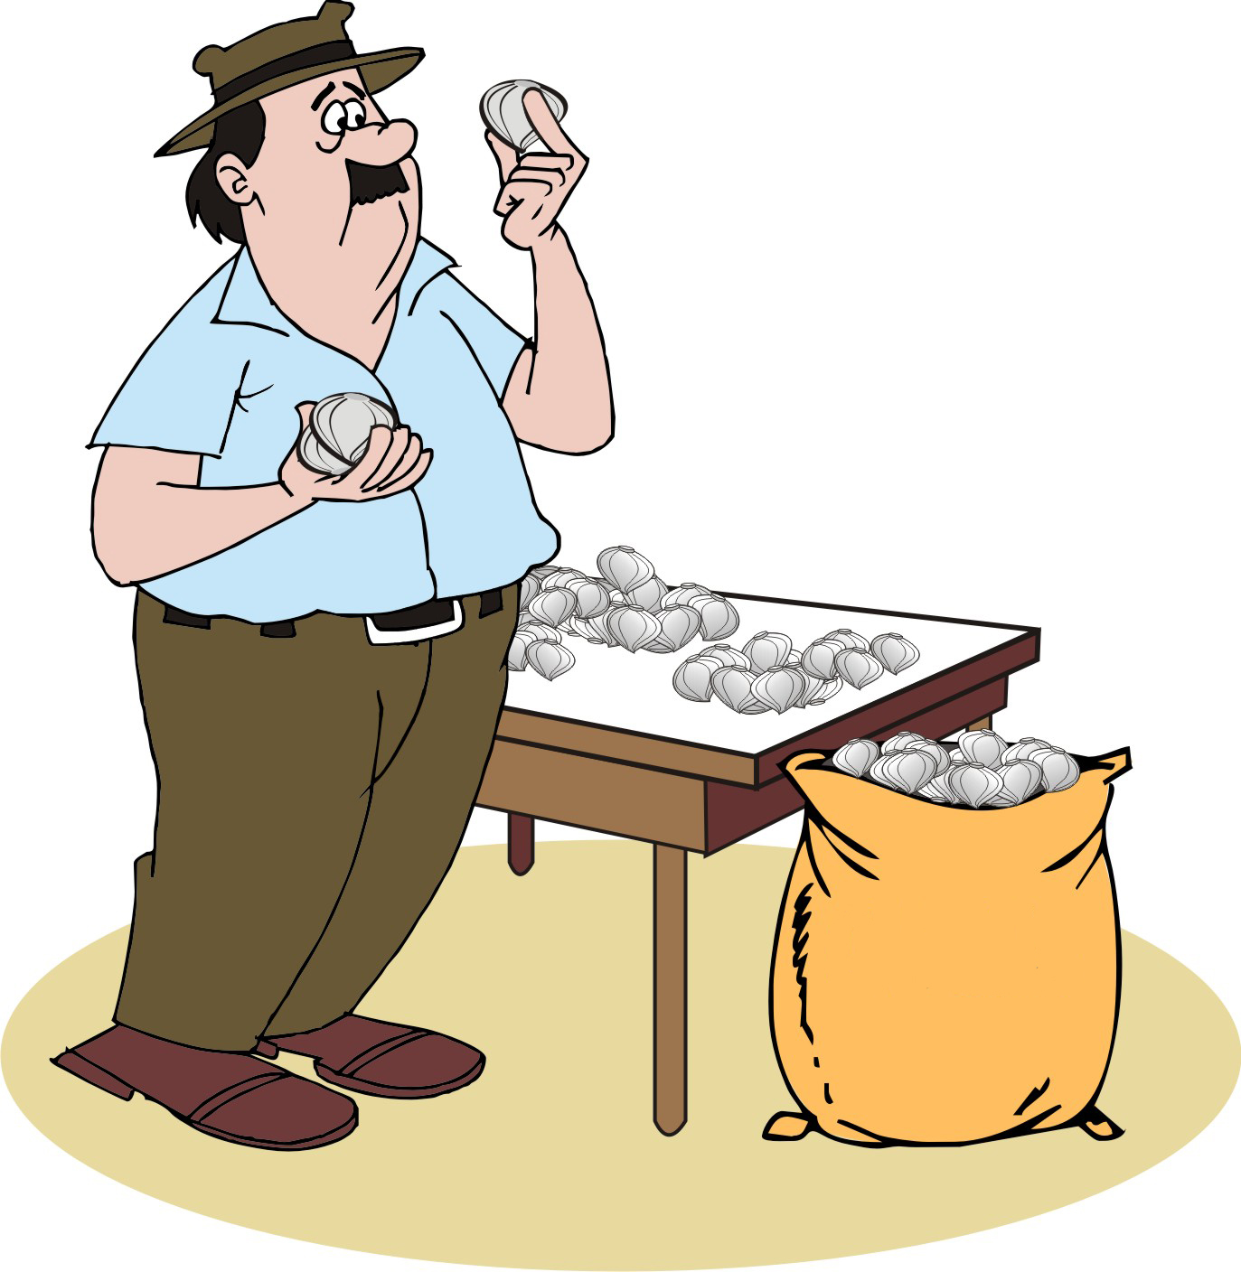
Maintaining quality
Buyers will only pay premium price if the produce meets agreed quality specifications.
It is important that all the farmers produce the right quality.
If even one farm does not, then everyone else suffers.

Slide 40
Maintaining quality: Methods
Find out what the buyers’ requirements or produce specifications are.
Negotiate a price premium if the farmers consistently comply with the requirements and specifications.
Ensure that all the members understand the quality requirements and know how to achieve them.
Monitor the quality of the product in the field and after harvest, e.g. by checking for pests and diseases and making sure that no one supplies a sub-standard product.

Slide 41
Maintaining discipline: Carrots and sticks
Carrots: Reward farmers who:
Attend all the meetings
Comply with all the agreements
Deliver the right amounts and quality at the right time
Sticks: Punish members who
Do not attend meetings
Fail to deliver the promised amounts
Deliver products of sub-standard quality
Punishments may include:
Fines
Exclusion from a credit arrangement
Expulsion from the group.

Slide 42
Keeping buyers informed
Many things can affect a crop or livestock product:
Too little or too much rain
Attacks by pests and diseases
Livestock trampling a field
Animals having more or fewer offspring than expected

Slide 43

Keeping buyers informed (Continued)
It is important for farmers’ groups to:
Monitor the crop in the field and try to forecast how much will be produced
Keep the prospective buyer informed about any changes in the anticipated production and production costs

Slide 44
Developing a market strategy around quality options
Marketing can be divided into the following three categories or segments:
Primary market: Supermarkets, restaurants, export market
Secondary market: Urban wholesalers, retail markets, assembly markets, road side stalls, farm gate
Tertiary markets: Local village market, livestock feed

Slide 45
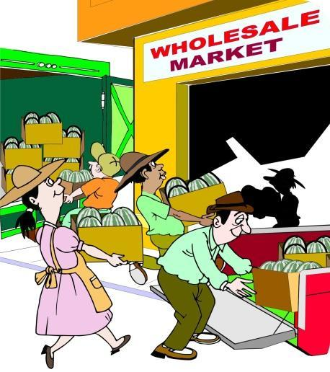
Primary markets
These are often formal markets where an enterprise sells the highest quality produce for the highest prices.
Formal or modern markets have strict quality standards.
Farmers must fully understand the buyer requirements/specifications of these markets to reduce the risk of rejects and to maintain their reputation as reliable suppliers.

Slide 46
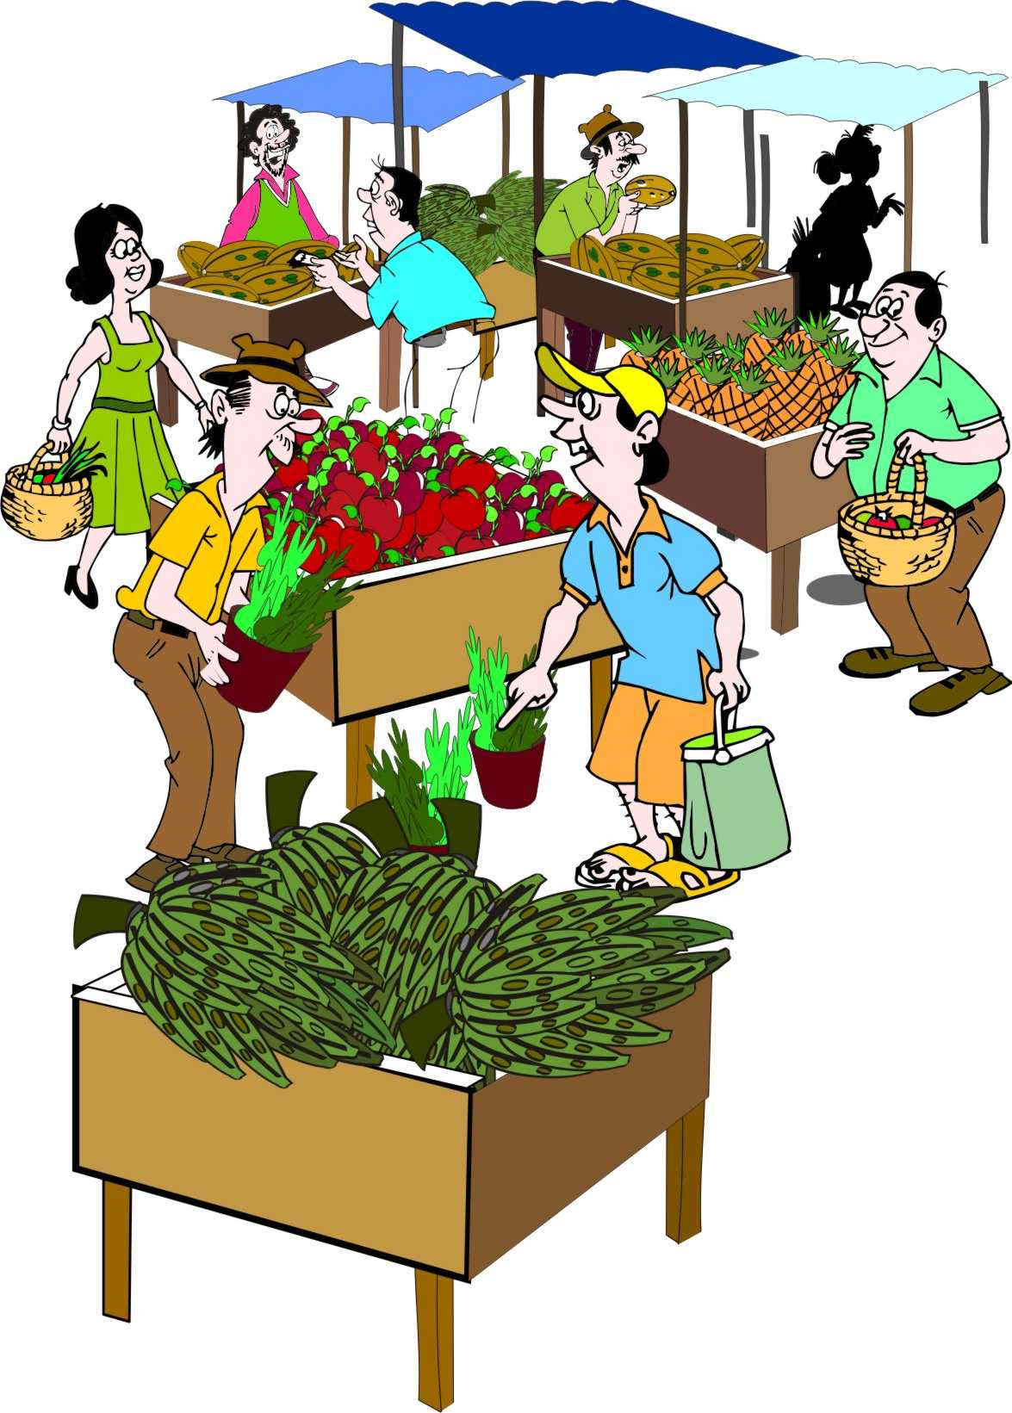
Secondary markets
These are informal markets where farmers currently sell most of their produce.
Secondary markets have few or no quality standards, but the produce sold here will fetch a lower price.
For most smallholder farmers, this market is the most important point of sales.

Slide 47
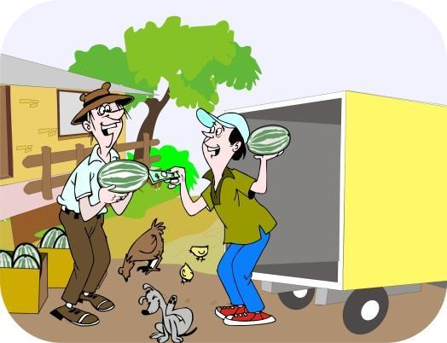
Tertiary markets
These are low value markets small, over-ripe, shrivelled or diseased produce.
The buyers at tertiary markets are not interested in quality and do not mind off-type produce.
Farmers may also be able to process edible but unsellable produce into longer shelf life products.

Slide 48
Mobiles for marketing
Farmers can use their mobile phones for marketing in the following ways:
Monitoring market prices
Communicating with the group
Arranging transport
Arranging sales
Maintaining business relationships
Accessing input credits
Making payments and/or transferring cash

Slide 49
Second-order marketing associations
Second-order marketing association refers to several farmers’ groups coming together and marketing their produce collectively.
In large projects with many farmer groups, the different groups can be organized into a second-order marketing association.
Each group should appoint two members (e.g. the marketing coordinator and the group chairperson) to an association trading committee.

Slide 50
Association trading committee
The trading committee:
Discusses the marketing strategy of the association
Agrees on the amounts of produce that each of the groups should supply and the price range it would like to achieve
Make recommendations about who to sell to, or which of the potential markets offer good prices
Assign two of its most experienced members to negotiate the sale with identified buyer(s) and arrange the time and location of the sale

Slide 51
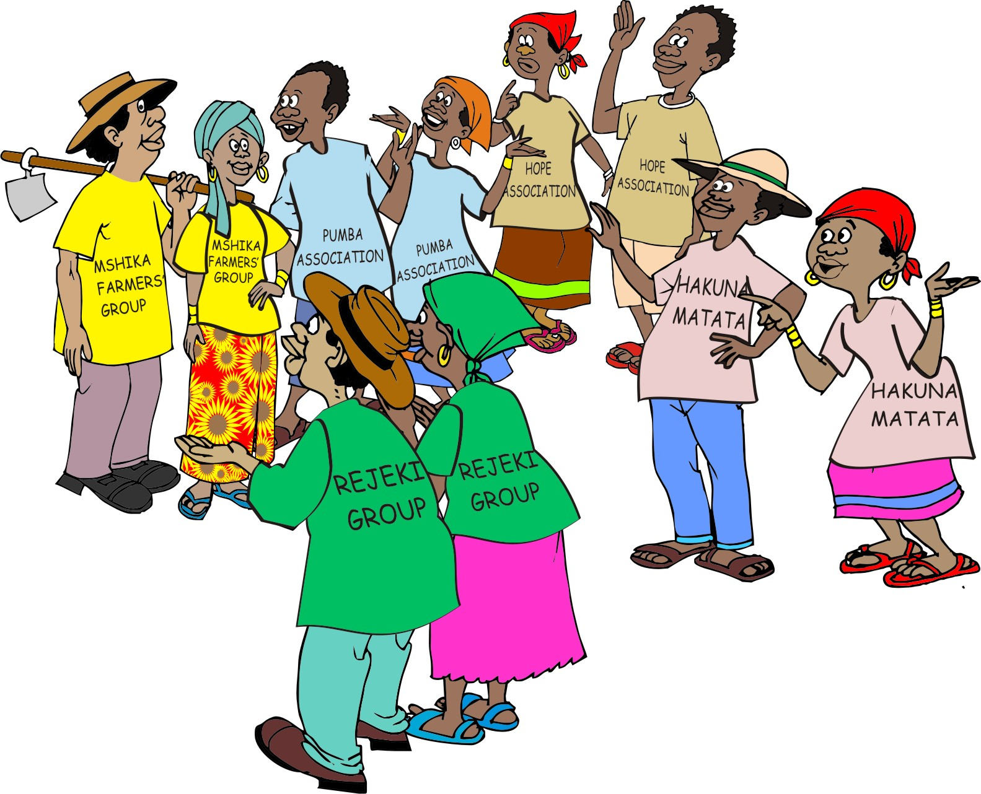
Cooperatives
A cooperative is an organisation that is owned and run jointly by its members (e.g. farmers’ groups), who share in the profits.
Formal farmers’ cooperatives can offer their members more services than informal arrangements like trading committees.

Slide 52
Cooperatives: Functioning
Cooperatives:
Usually have a range of services to group members, e.g. advice on production, finance, new technologies and access to marketing support at subsidized prices
Charge it members membership fees, in order to pay for their services
Are strong organizations in some countries, with excellent services
Suffer from political manipulation and financial mismanagement in other countries

Slide 53
Common problems with collective marketing problems
Social problems and emergencies
Repaying money lenders
Group members spending too much, pushing themselves into debt
Side-selling
Bad weather and disasters
Group members delivering variable quality
Costs of collective marketing

Slide 54
Social problems and emergencies
Examples
Weddings
Hospital costs
Medical bills
Funerals

Slide 55
Social problems and emergencies: Suggested solutions
Try to make sure that the farmers have another source of money.
Encourage them to form a savings and internal loans group.
Find a microfinance institution that can offer emergency loans.

Slide 56
Repaying moneylenders
The farmer has borrowed from the local moneylender.
The moneylender takes the farmer’s harvest (at a very low price) as repayment.
The farmer cannot deliver the agreed amount to the group.

Slide 57
Repaying moneylenders: Suggested solutions
When setting up the collective marketing process, make sure that farmers can really sell with the group.
Discuss the question of product ability to support the group at meetings.
Make sure that everyone in the group support the group.
Encourage the group to form a savings and internal loans group.
Find a microfinance institution for alternative source of loans.

Slide 58
Group members spending irresponsibly
After a successful year, group members want to celebrate.
Other villagers expect successful group members to pay for lavish weddings and other celebrations.
These celebrations can cost more than the year’s profit and they push people into debt.

Slide 59
Group members spending irresponsibly: Suggested solutions
Be aware of these situations and try not to “spoil the party”.
Encourage the group to think of their farm as a business.
Make sure that they plan their expenditures and that they have money invest in the next season.
Have a quiet conversation with group members about the danger of lavish spending and future debt.

Slide 60
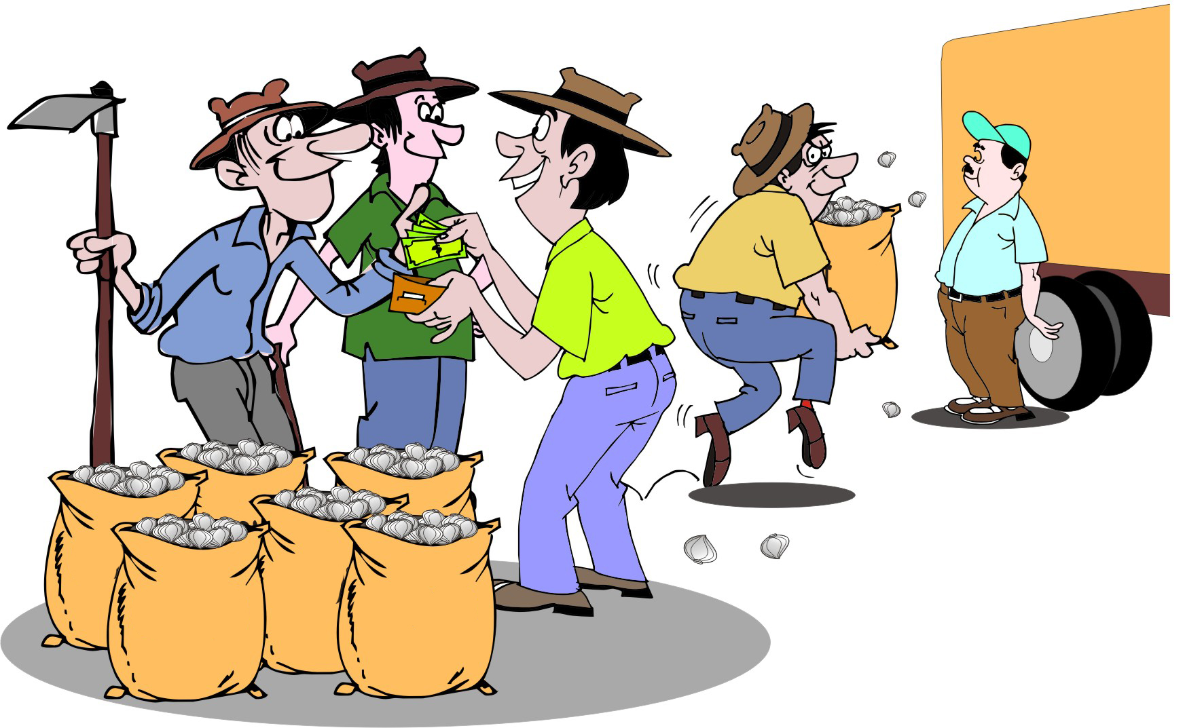
Side-selling
Group members sell their product on the side to a trader offering a better deal (a higher price or immediate cash), instead of to the group’s identified buyer, leaving the group without enough to sell to the original buyer.

Slide 61
Side-selling: Suggested solutions
Strong leadership is essential.
Implement severe penalties for side-selling, e.g. expelling members, who are guilty of side-selling from the group.
Discuss side-selling with the group at harvest time and make sure they understand the bad effect that it has on the group.
Persuade the group that it is in their interests to stay with the original plan.

Slide 62

Bad weather
Bad weather – e.g. drought and heavy rain – impact negatively on the crop and the yield and the group cannot produce the amounts they have agreed to sell to the buyer(s).

Slide 63
Bad weather: Suggested solutions
Encourage the group to plan, based on a conservative or an average yield – not on an outstanding year.
The production coordinator has to monitor conditions in the field and inform the marketing team in time about problems with the yield, so that the buyers can be informed.
The team must discuss crop performance at meetings.

Slide 64
Disasters
The buyer gave the group a loan to pay for inputs at the beginning of the season, repayable at harvest time.
However, the rains failed completely and the farmers have harvested almost nothing.
They will go hungry and they still have the loan to repay.

Slide 65
Disasters: Suggested solutions
Ask the loan agency that loan agreements and contracts have a disaster clause.
The agreement should specify a neutral party (e.g. an extension agent) who decides if the farmers have been unduly affected by a natural disaster.
If it does, the agreement should allow for reduced repayments or supplies, or for the agreement to be cancelled.
Consider an insurance product aimed at helping smallholder farmers against loss of inputs and crop value.

Slide 66
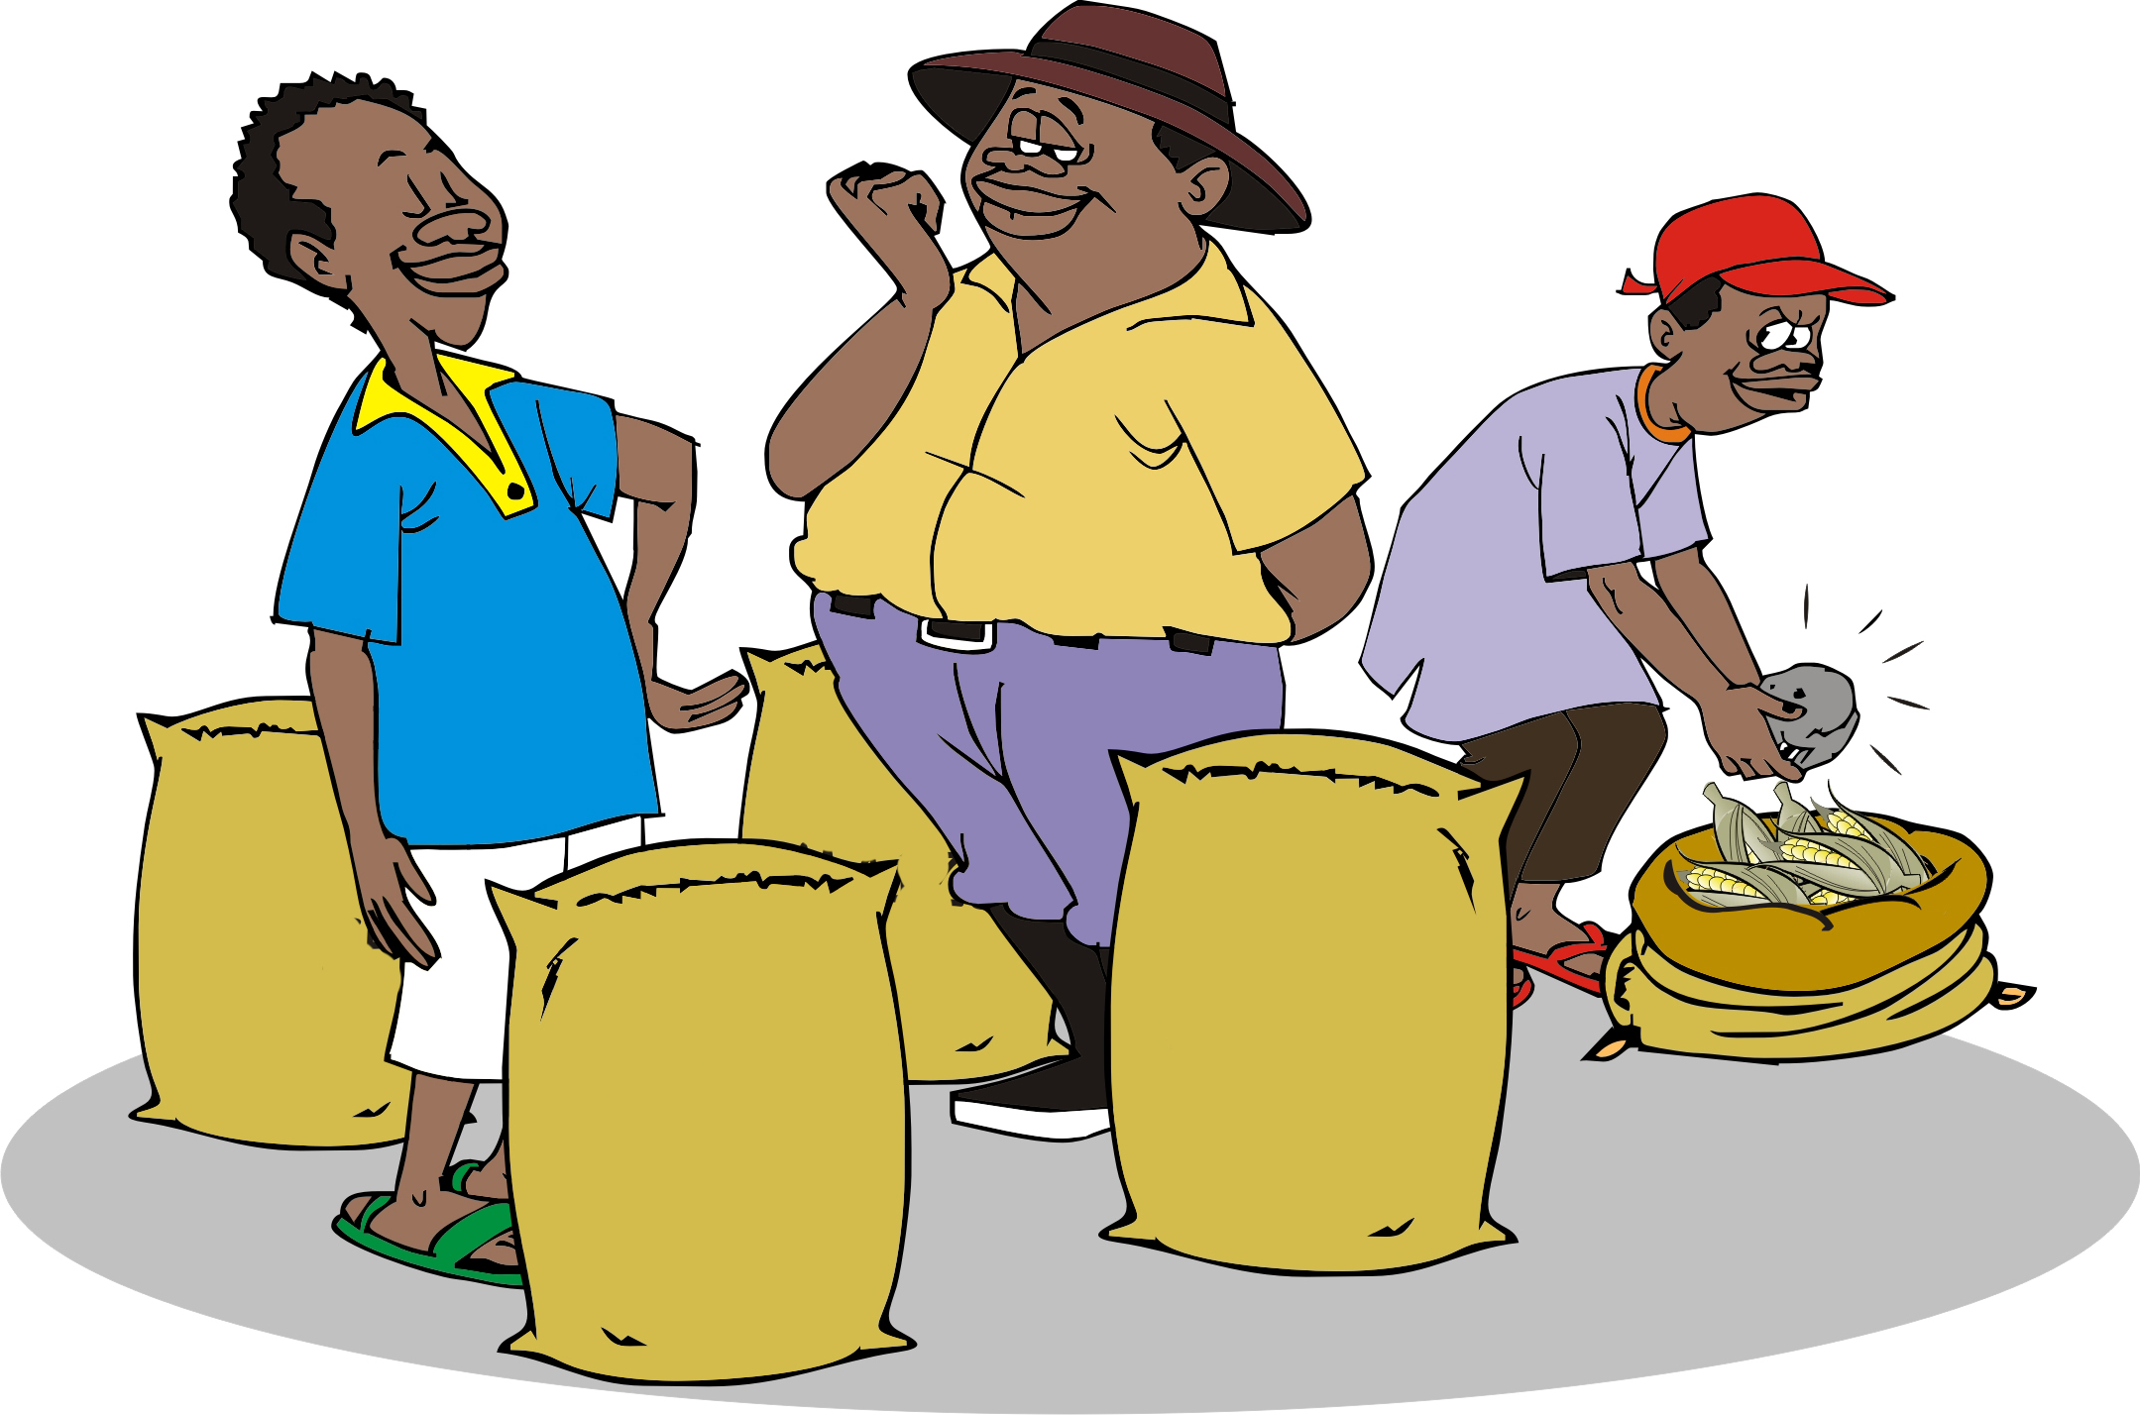
Variable quality
Some group members have delivered high-quality produce, while others have offered poor-quality, unsorted produce that reduces the value of the consignment.
The first farmers are frustrated, because they would have got a better price if they had sold individually.

Slide 67
Variable quality: Suggested solutions
Make sure that all the group members understand the requirements.
Illiterate farmers may need extra help to understand exactly that they have to do.
Show the farmers a bag of expected quality produce to explain the concept of quality and the relation between quality and price.

Slide 68
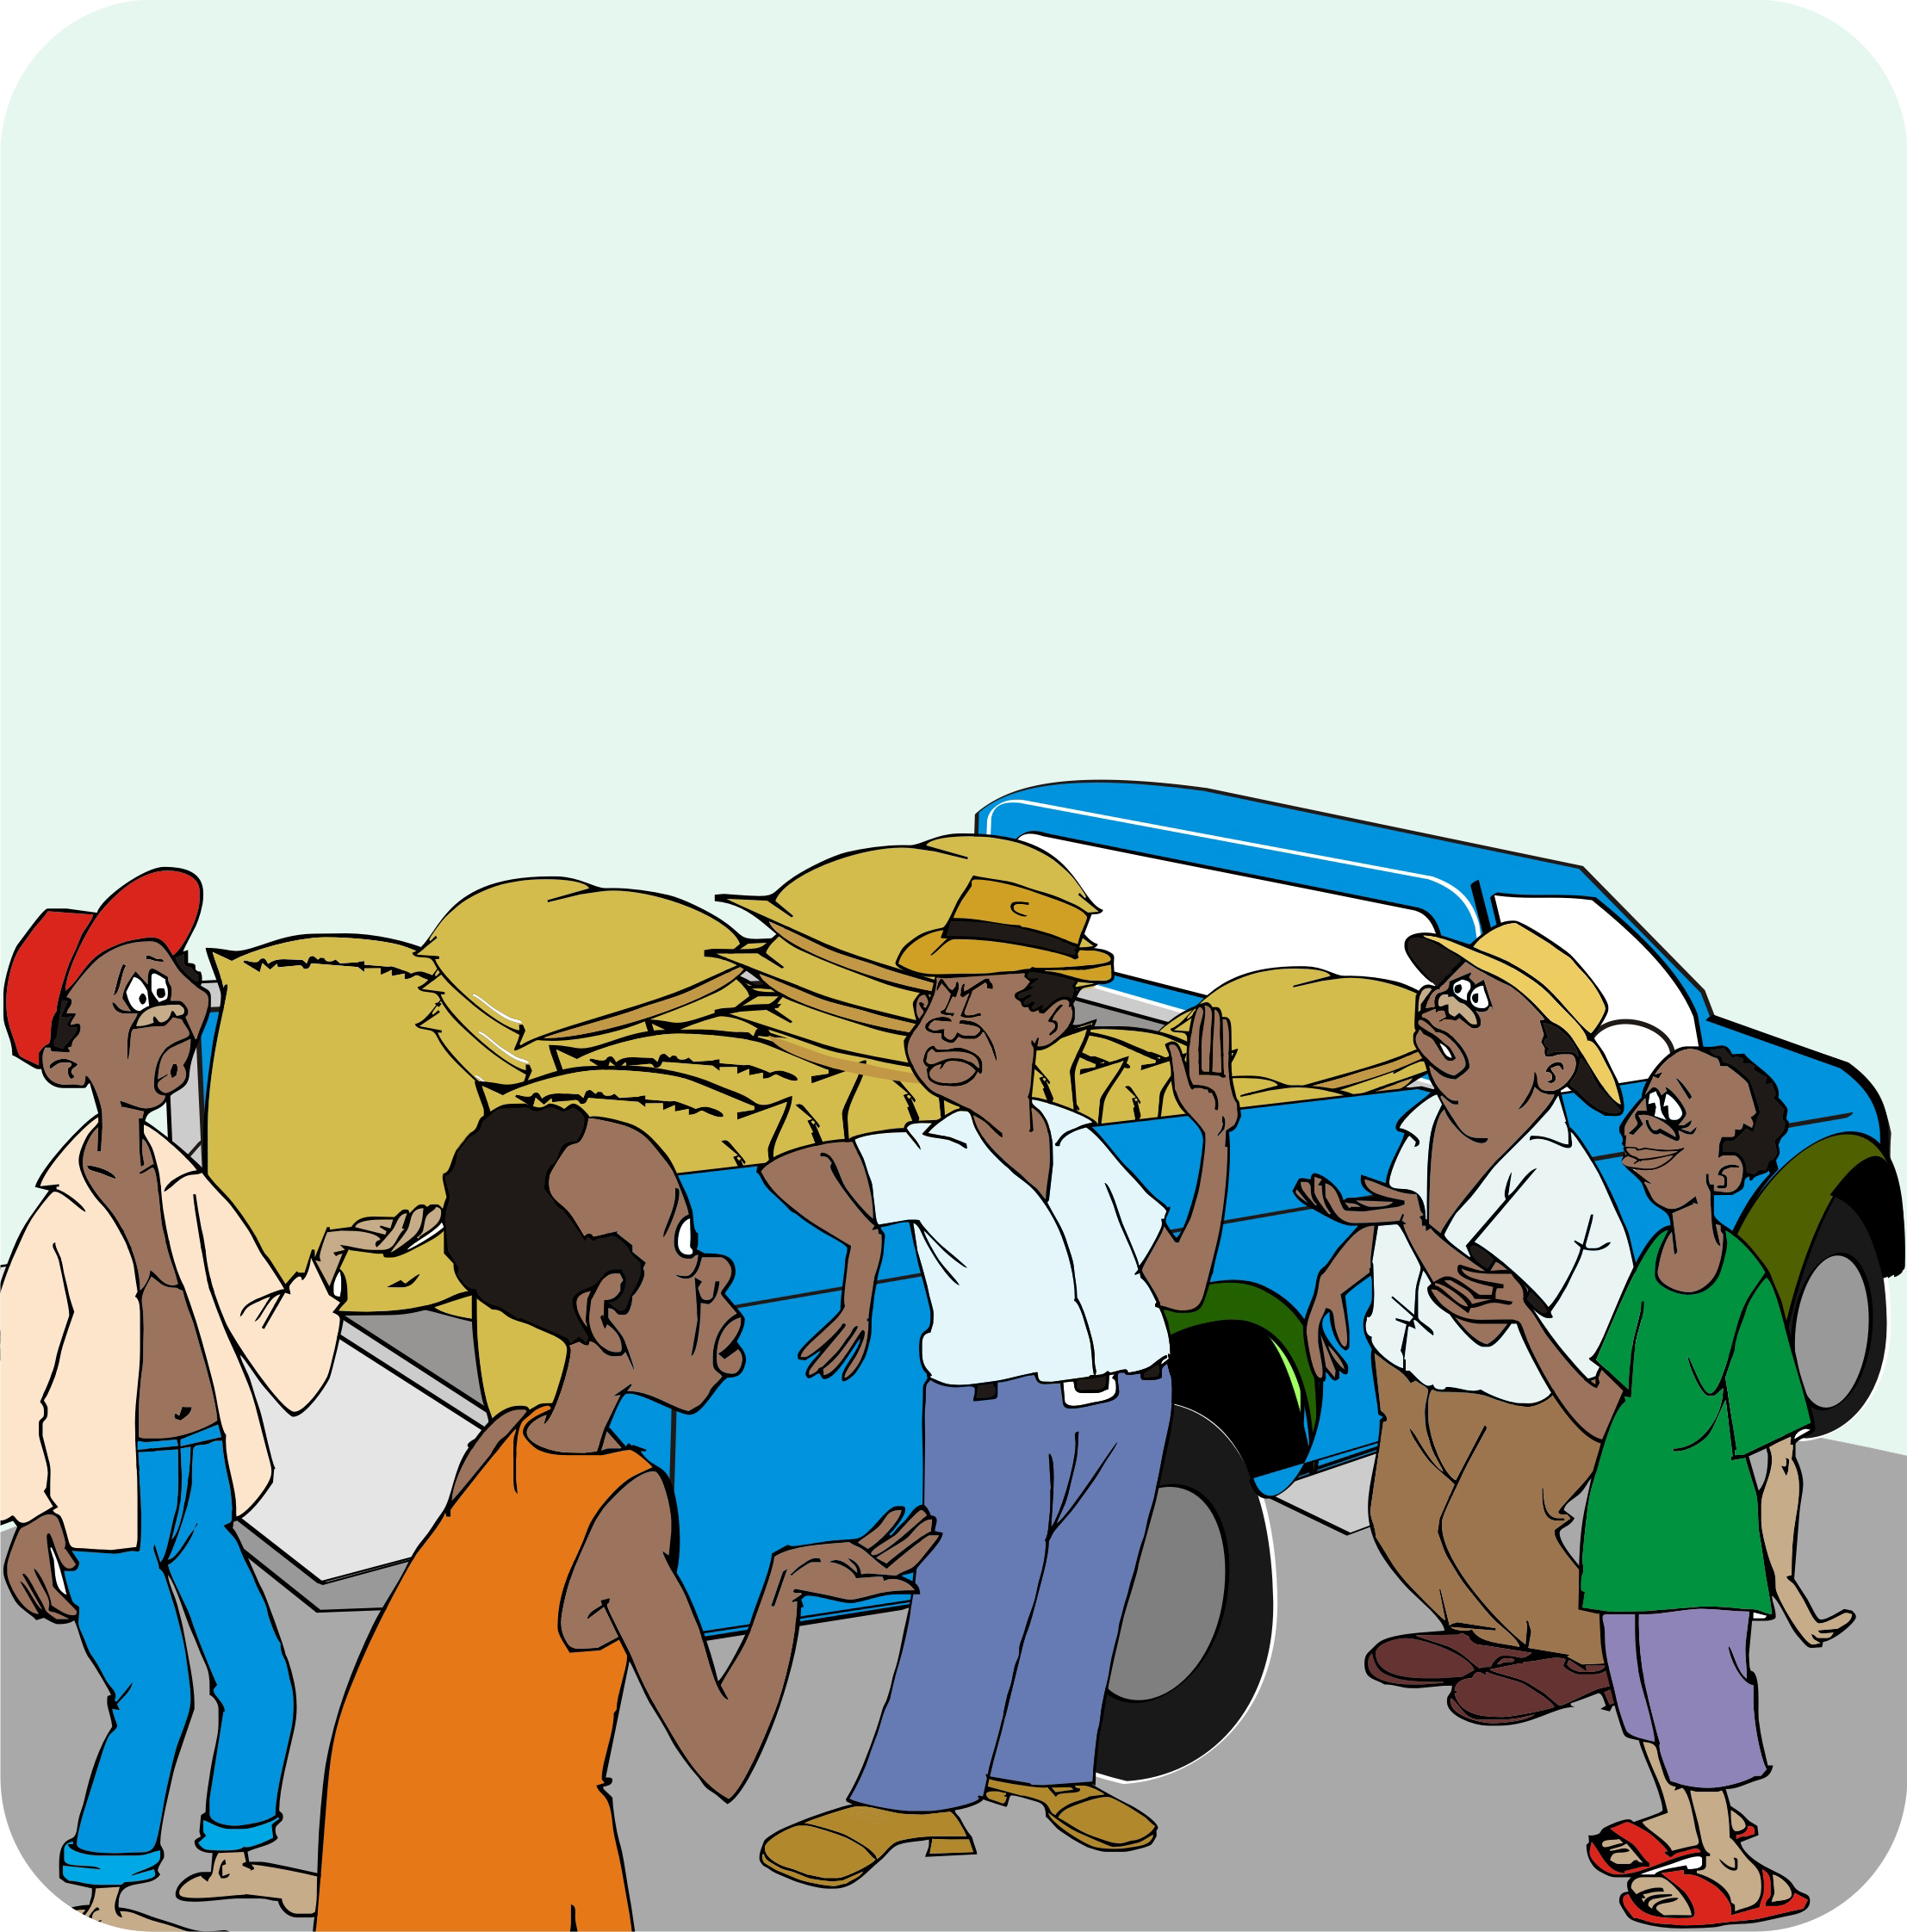
Cost of collective marketing
The farmers have delivered the produce, and the buyer has picked it up.
The farmers thought they would get their money straight away, but payment will take a couple of weeks.
Also, the members suspect that the marketing team is overpaying itself.

Slide 69
Cost of collective marketing: Suggested solutions
Make sure that:
Farmers in the group understand the sales process and realize that collective marketing is not free
Farmers agree with the terms
Payments to the marketing team and other group officials are transparent
Farmers know that being a member of a group is likely to involve costs.

Slide 70
Lesson 18:
How do traders decide on prices?

Slide 71
Outcomes
After this lesson you will be able to:
Describe how a trader calculates the price he/she offers to farmers
Explain the circumstances when a trader is likely to offer lower prices
Analyze price trends over several seasons and years.

Slide 72
Overview
Lesson 18 covers the following content:
How does a trader calculate prices?
Higher costs
Smaller purchase volumes
Buyer’s markets and seller’s markets
Helping farmers understand prices
Comparing traders’ prices with production and marketing costs

Slide 73
How does a trader calculate prices?
Usually, a trader offers farmers a price based on the current price in the market, minus the trader’s costs and profit margin.
The trader’s costs usually include wages for the truck driver and his helper, checkpoint and market fees, fuel cost, wages for the workers who unload the truck.

Slide 74
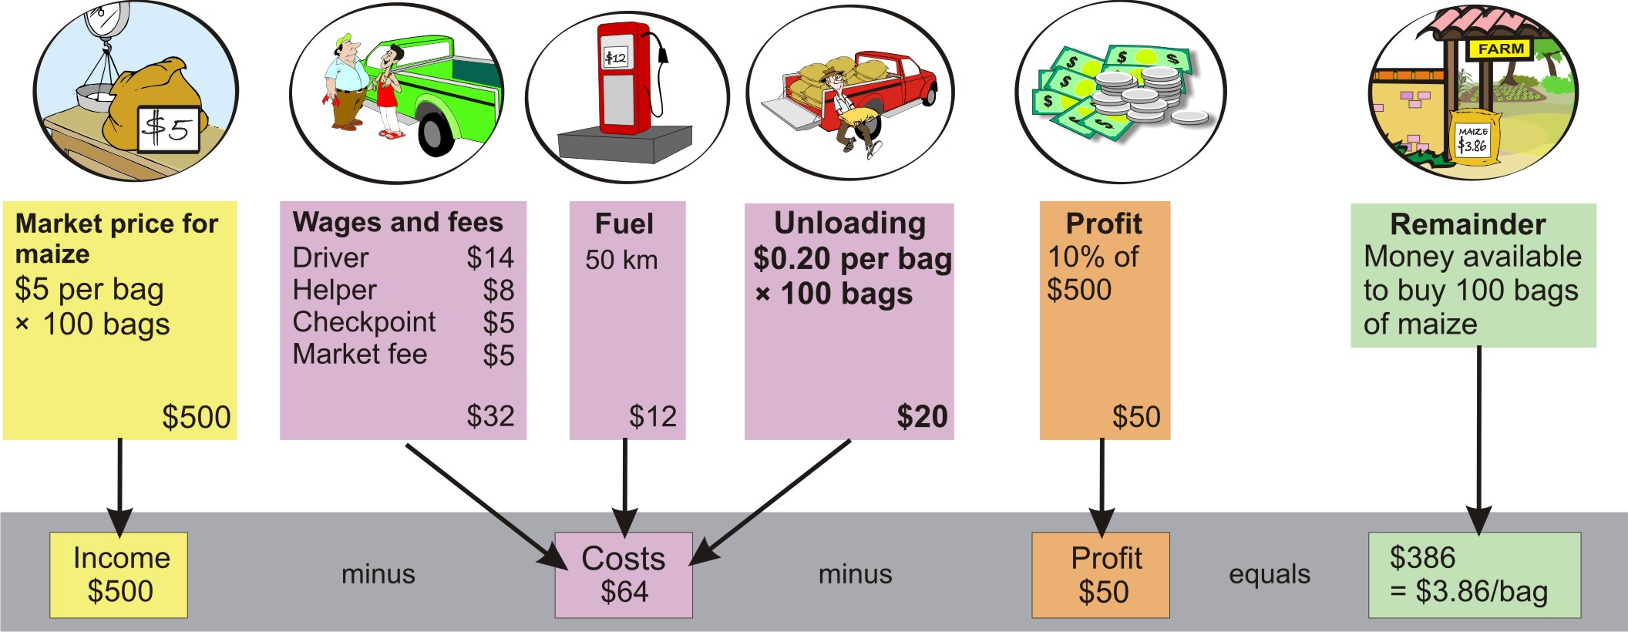
A trader’s price calculation

Slide 75
Higher cost
A trader’s cost would go up, if he has to collect a crop far away, e.g. 100 km away, instead of 50 km.
The distance will double the fuel costs, but all other costs will stay the same.
The increases in the distance may be so significant that the trader may even have to pay for additional checkpoints and higher wages for the truck driver and the helper.

Slide 76
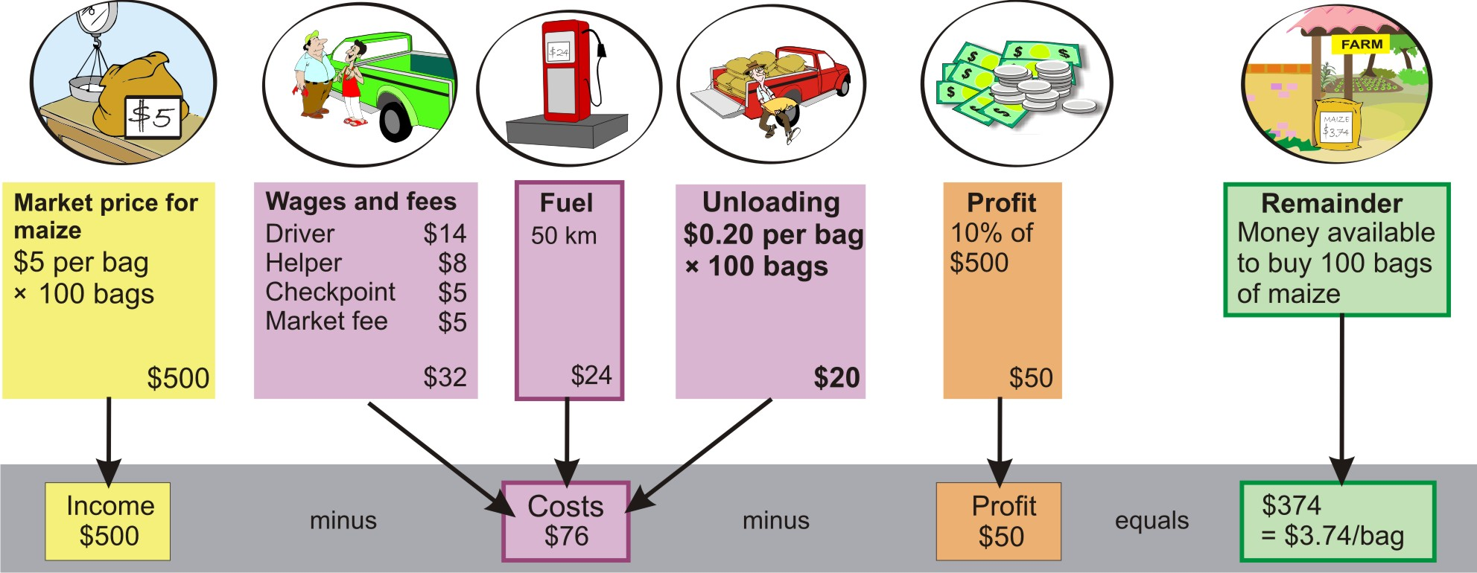
Calculating higher costs: Longer distance

Slide 77
Smaller purchase volumes
If a trader can buy only half a truckload, e.g. 50 bags of a product, instead or 100 bags:
The unloading costs go down, but the other costs stay the same.
The trader can sell only half the amount or produce, which means that his profit goes down to 10% of the total sale.
In this case, everyone gets a bad deal: the farmers, the trader (whose profit is halved) and the customers (who can buy only half the amount of produce).

Slide 78
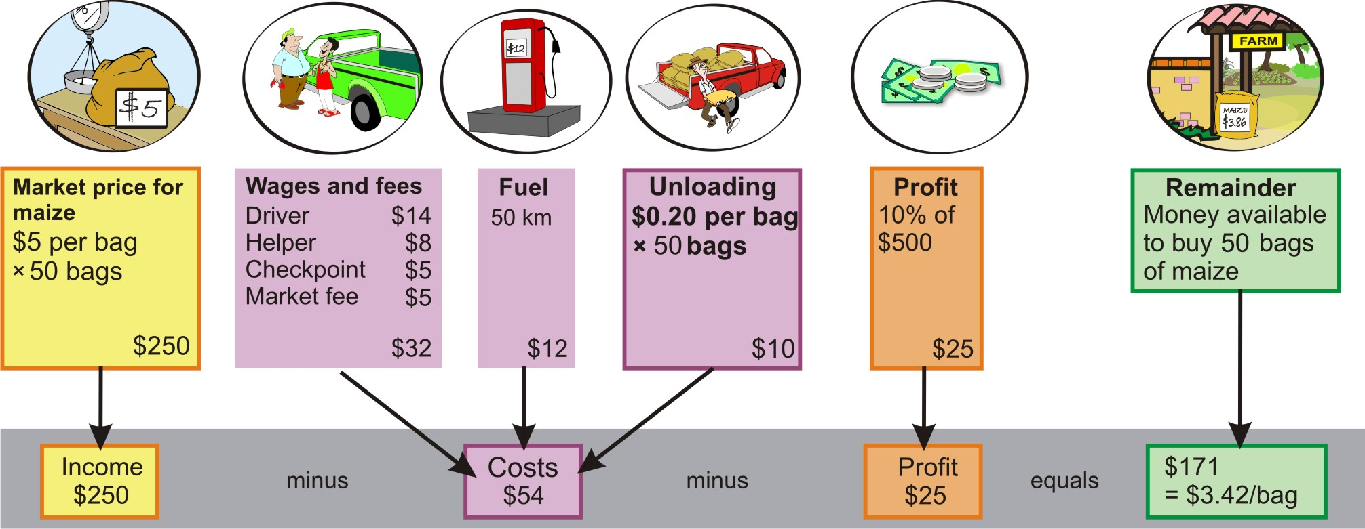
Calculating smaller purchase volumes

Slide 79
Buyer’s market and seller’s market
Buyer’s market
  If the buyers set the price in the market where the trader sells the product, it is known as a buyer’s market.
Seller’s market
  When there is a high demand for a product and the supply is scarce, it means that the seller has more influence over the price. This is know as a seller’s market. In the seller’s market, the trader has to accept the price at which the farmers will sell. Based on this costs and profit margin, the trader calculates a price at which he will sell in the market.

Slide 80
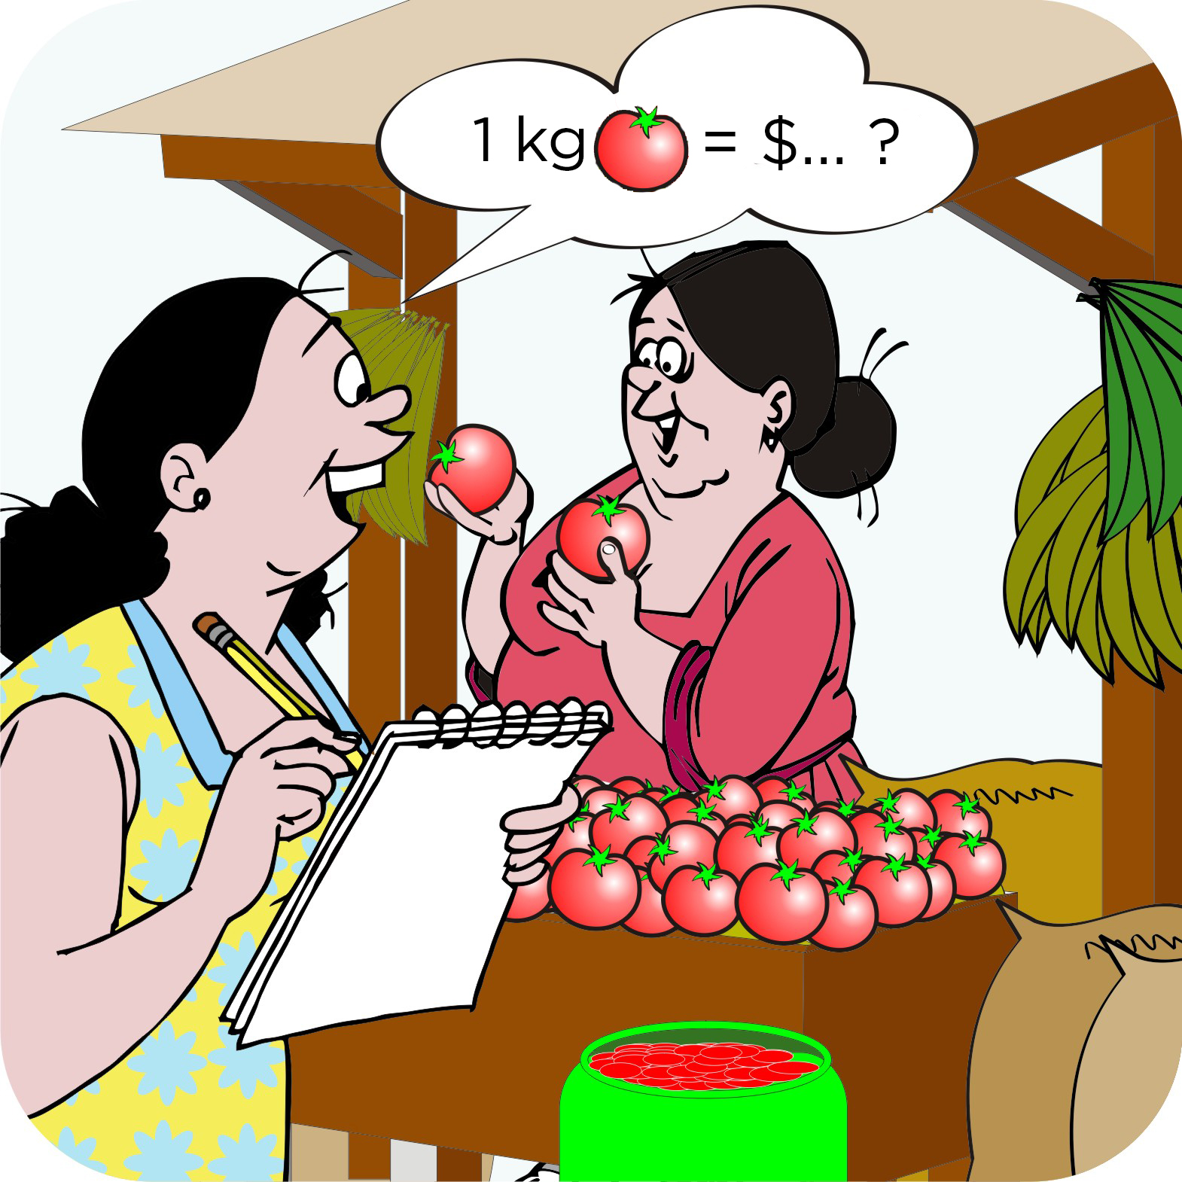
Helping farmers understand prices
You can help farmers understand prices so they can decide:
When to sell
Where to sell
What to sell
How much to sell at what price
You can help them get the following types of information:
Historical price data
Traders’ costs

Slide 81
Historical price data
Some agencies collect regular price data for a product at specific markets.
These data sets show how the price for a product has risen and fallen over the last few years.
This is helpful information for:
Farmers who are thinking about storing produce or planting early to take advantage of the high prices early in the year
Microfinance institutions interested in making loans to farmers who want to store their produce

Slide 82
Historical price data: Graph

Slide 83
Historical price data: Graph interpretation
The graph shows an example of historical price data for maize in the market of Masala, Ethiopia over five years.
The graph shows that the prices for maize:
Start falling in April, when the harvest starts
Are lowest in July
Rise to a peak in January–March
Rose from 2006 to 2009; so farmers were getting more money per kilogram of maize
Fell slightly in 2010

Slide 84
Traders’ costs
By working with some traders, you can:
Learn how they set up their prices
Explain the methods they use to the farmers
The strategies that traders use will change over time, with changes in market demand and supply. Therefore, you have to keep any information you have about prices current.

Slide 85
Comparing traders’ prices with production and marketing costs
The expected trader’s prices is lower than the farmers’ costs:
  The farmers can expect to make a loss. They should check if their cost calculations are correct, if they can reduce their costs further and if they can persuade traders to pay more for the product.
The expected trader’s price is higher than the farmers’ costs:
    The farmers can expect to make a profit. They should still work out how to reduce their costs and how to increase the price.

Slide 86
Module summary
This was the third booklet in the Seven steps of marketing series.
In this booklet (module), we have focused on Step 5 (Marketing as a group) in the process of linking farmers to markets and helping them to develop their agroenterprises.
You have learned:
The reasons for marketing as a group (collective marketing)
The way in which traders decide on their prices.

