Slide 1
The seven steps of marketing
Booklet 2: Business planning
A SMART Skills Manual

Slide 2
Skills for Marketing and Rural Transformation (SMART skills)
SMART Skills manuals:
Introduction to SMART skills for rural development
Organizing and managing farmer groups
Understanding natural resources
Managing natural resources
Marketing basics
Seven steps of marketing
Promoting innovation

Slide 3
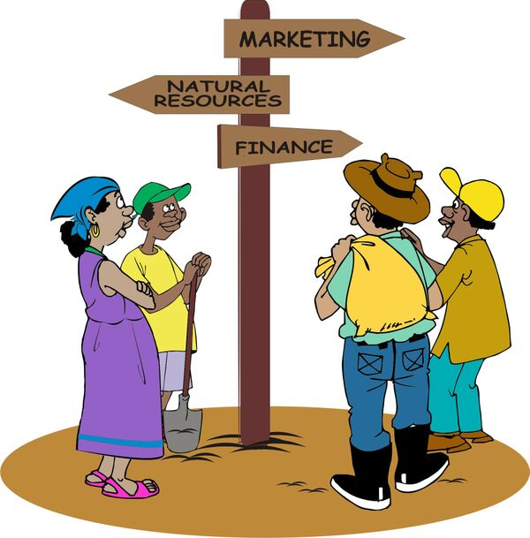
Purpose of the SMART skills series
To introduce you to the following five skill areas:
Group organization
Natural resources management
Finance
Marketing
Innovation

Slide 4
The seven steps of marketing : Content
Step 1: Getting organized
Step 2: Identifying products and organizing groups
Step 3: Collecting information for the business plan
Step 4: Building a business plan
Step 5: Marketing as a group
Step 6: Reviewing agroenterprise performance
Step 7: Scaling up

Slide 5
Booklet 2: Business planning
Step 3: Collecting information for the business plan
Lesson 7: market analysis
Lesson 8: Analyzing production
Lesson 9: Surveying and fostering business services
Lesson 10: Tools for financial analysis
Lesson 11: Deciding on credit
Lesson 12: Choosing an agroenterprise
Step 4: Building a business plan
Lesson 13: Tools for business planning
Lesson 14: The business model canvas
Lesson 15: Filling in the business plan
Lesson 16: Putting the business plan into effect

Slide 6
Step 3:
Collecting information for the business plan

Slide 7
Lesson 7: Market analysis

Slide 8
Outcomes
After this lesson you will be able to:
Decide which units and measures to use.
Guide farmers to prepare a market map for their products.
Guide farmers to conduct a market survey.
Help farmers analyze the information from a market survey.

Slide 9
Overview
Lesson 7 covers the following content:
Units, measures and conversion factors
Market mapping
Market survey
Analyzing and presenting market information

Slide 10
Using standard weights and measures
Before you can start to analyze markets and collect information about the demand for a product, you need to be sure that all the field agents use standard weights and measures.

Slide 11
Listing products and measuring units
At the beginning of the project, make a list of the products and units used in the local area:
Products, grades, and standards (e.g. quality grades and moisture content)
Production areas, local weights and volume measures
Prices, costs and currencies
Labor costs
Dates using international calendar

Slide 12
Listing products and measuring units: Rules
Clearly define any local measures and note the conversion factors into metric values.
Make a check list of commonly used costs for products, e.g. costs of fertilizers.
Note the prices in the local currency and record the conversion value into US dollars at the current exchange rate.
Note the grades and standards used locally.
Use the Western calendar to record dates.

Slide 13
Market mapping
A market map is a diagram of the market for a particular product that shows the:
Product and where it is produced
Prices where it is sold
Who buys it and how it is used
Drying, processing, storage and transport
The diagram may be a sketch map showing where these activities take place or it can be a flow diagram showing the individuals and organizations involved.

Slide 14
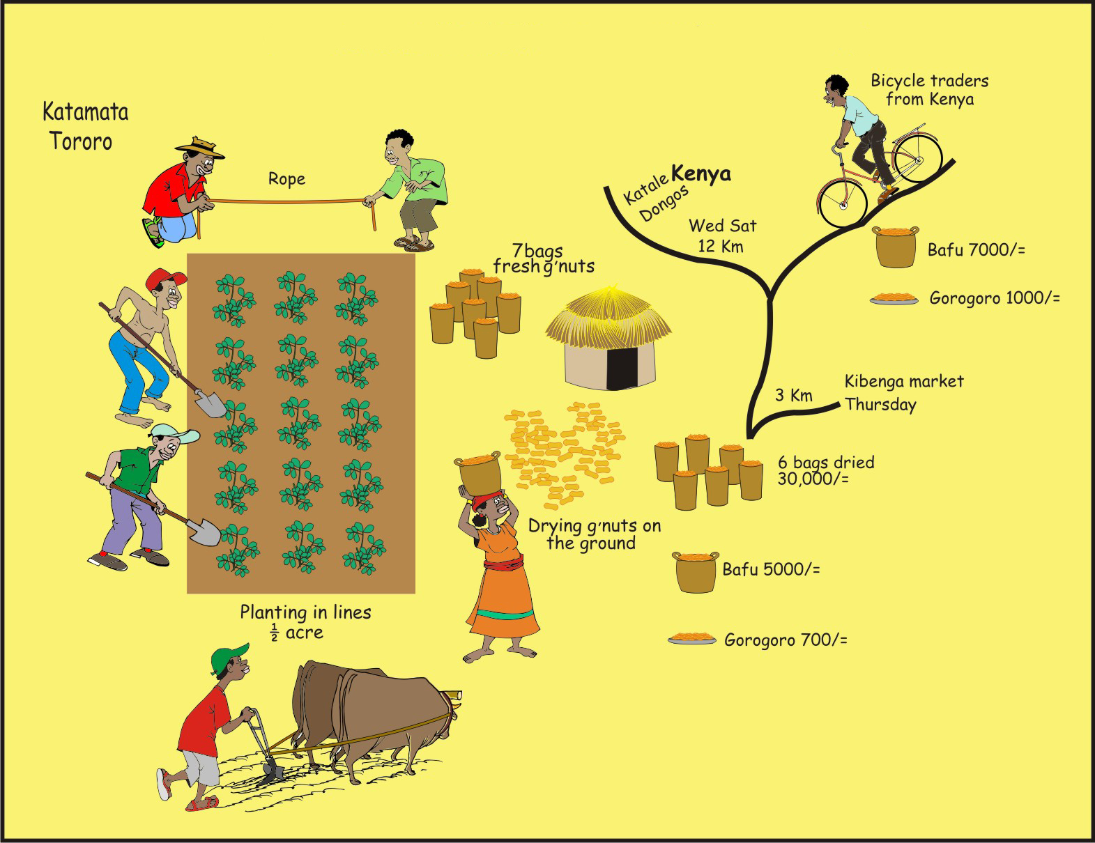
Importance of the market map
By drawing a market map, the farmers can better understand the market for their priority product(s).

Slide 15
Using the market map
You can use the market map in the following ways:
Find out what the farmers already know about their market and what they do not know
Determine what you need to find out from a market survey
Help the farmers understand how the value chain works
Help them plan their market survey
Use the market plan when creating the business plan

Slide 16
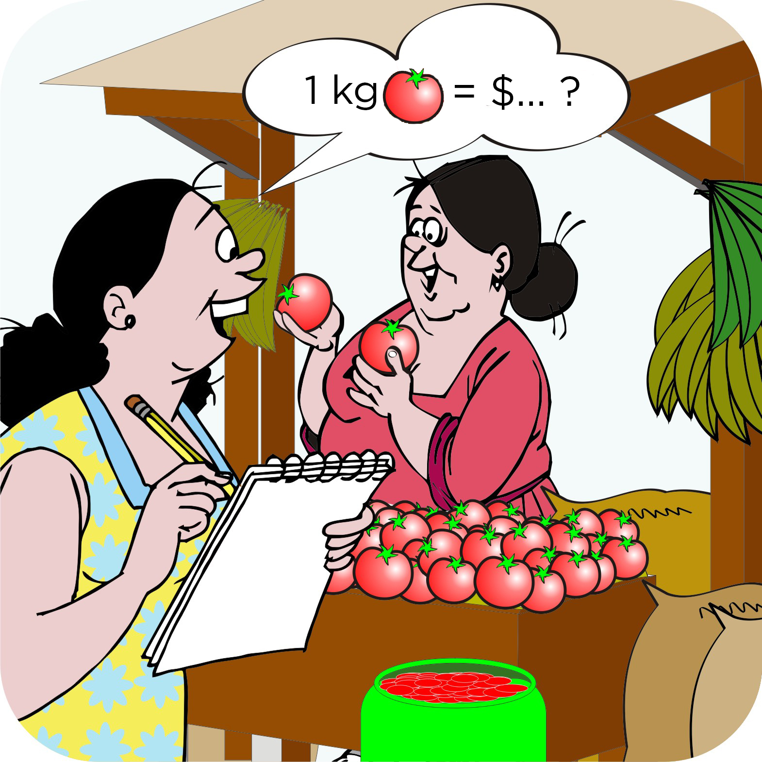
Market survey
The market survey aims to answer three main questions:
What is the demand for the products that the farmers are interested in?
What are the buying conditions for these products?
What other products are in high demand or scarce supply?

Slide 17
Market survey: Decisions
Which markets to visit: Depends on the priority products the farmers have chosen
Who should take part in the survey: It is not realistic for all farmers in a group to visit a market
How many traders should be interviewed: Ask two or three traders the same questions
How long does the survey take: Depends on the number of products, the number of markets and the distance between them

Slide 18
Market survey: Preparation
Organize a team.
Decide on the types of information to collect.
Decide where and when to visit: List the market sites to visit.
Plan the number of interviews in each market.
Prepare a questionnaire or a checklist, based on the type of information to be collected.
Prepare an introduction.
Rehearse the interview procedure with the team.
Arrange the interviews and arrange transport.

Slide 19
Market survey: Suggested procedure
Visit the market with the team of farmers.
Make contact with the market officials and tell them what you are planning to do in the market.
Conduct the interviews by following the interview plan you have worked out.
Make sure that you collect all the information you need.
Conclude the interview by thanking the interviewee for their time and information.
Collate the collected information , so that you can analyze and present it.

Slide 20
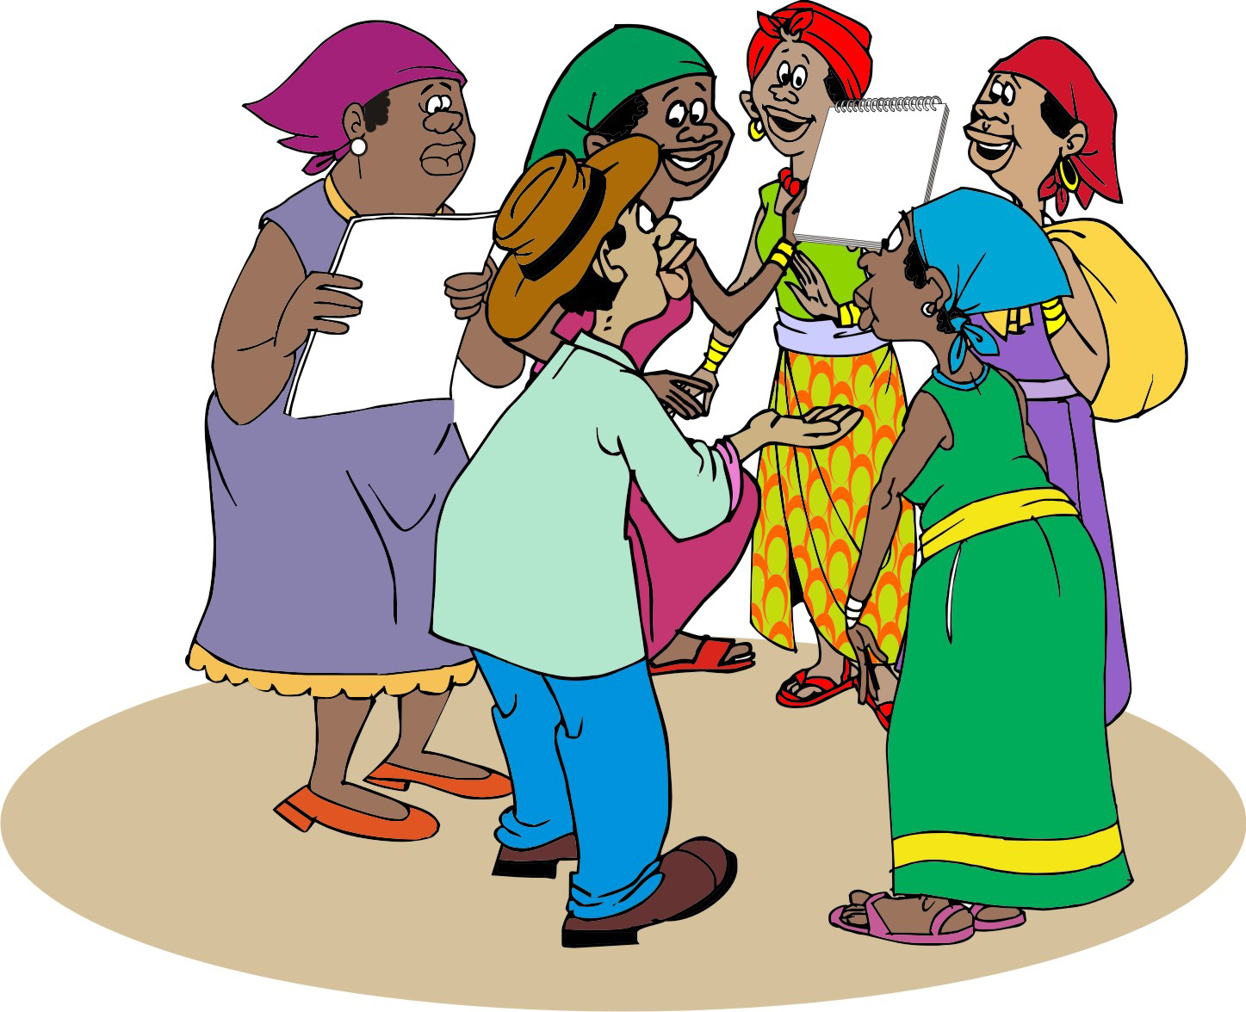
Analyzing and presenting marketing information
After the market survey, the survey team should write up and analyze the information it has collected and report it to the whole group.

Slide 21
Analyzing and presenting marketing information: Price data
Be particularly careful when reporting prices.
Things to note:
What was the product?
What was the quality or grade of the product and for what volume or weight?
Where (in which market) and when (i.e. when in the season)?

Slide 22
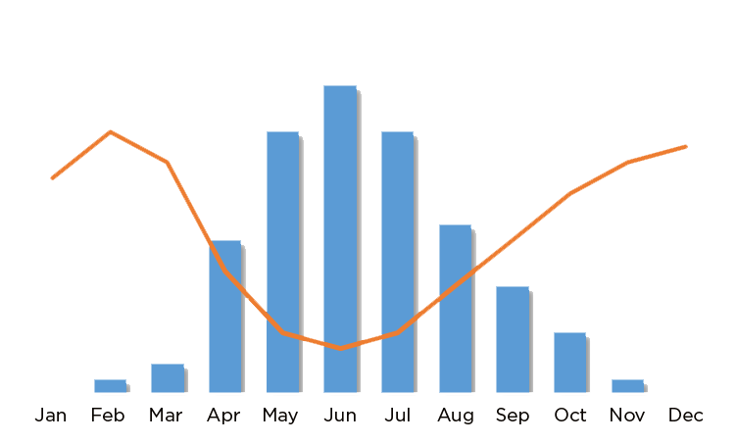
Prices at different seasons
Most products can be grown only at certain times of the year, so prices often go down at the main harvest time. Farmers can often get a better price by avoiding selling at this time.
Notes:
Here, the Blue Bars indicate supply, and the orange line indicates price.

Slide 23
Selling at the right time: Supply and pricing
Because prices go down when supply goes up (e.g. during the main harvest time), farmers should avoid selling at this time.
Some ways to do this are to:
Grow early maturing varieties.
Grow a product off-season (e.g. by using irrigation).
Stagger planting and harvesting dates.
Store the produce until the price goes up.

Slide 24
General financial considerations
Apart from the effect of demand and supply on pricing, the survey team should also answer more general questions, such as:
Where do we get the varieties that the buyers want?
When should I expect my first payment?
Is selling the product to one of the traders more profitable that what I am already doing?

Slide 25
Lesson 8:
Analyzing production

Slide 26
Outcomes and overview
After this lesson you will be able to:
Describe possible ways to improve production of a crop or livestock product.
Help farmers to choose a set of production technologies.
Lesson 8 covers on the following content:
Analyzing production
Ways of improving production and value

Slide 27
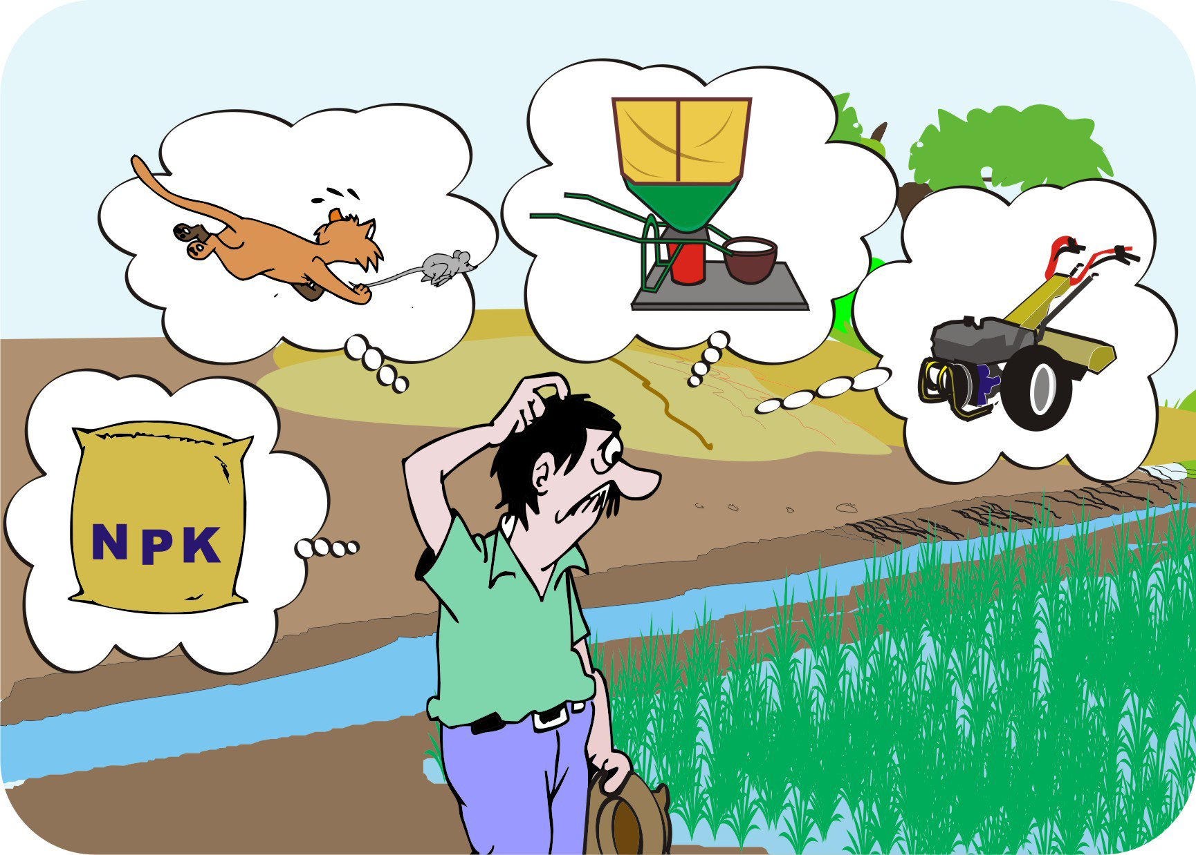
Improving production and value
Once farmers understand the market demand for one or more products, it is time for them to look at how they can produce these products and sell them at a competitive price.

Slide 28
Production and value: Considerations of the field agent
Find out about new varieties of a product that traders or processors want to buy.
Ask farmers for information on their current production methods and yields per unit area.
Find out if more commercial farmers are using any new production methods to increase their yields.
Talk to local agriculture or livestock experts to get tips on how to increase the levels of production and competitiveness of the product.
Organize visits to other farmers who are already using improved technologies to produce more.

Slide 29
Improving production and value: Approach
Use a similar approach that you used in the market analysis.
Help the farmers organize a small team to collect information on production and present it to the whole group.
Help the team think of ways they may improve their productivity and the price of their products

Slide 30
Strategies for increasing productivity and sales prices: Before planting
Increase land area: The most common way to raise production
Improve crop variety : The new variety may yield more, grow quickly and mature early
Stagger planting dates: Avoid harvest at peak periods
Planting in rows: Increases crop density and makes weeding easier
Seed preparation: Consider a having a nursery for seedlings before planting in the field
Seed dressing: Chemical treatment of seed avoids losses through pests and diseases

Slide 31
Strategies for increasing productivity and sales prices: After planting
Organic or inorganic fertilizer: Can boos yields
Irrigation: Increases soil production and extends production season
Mulch or plastic covers: Accelerates early growth and suppresses weeds
Regular weeding: Reduces yield losses due to weeds
Chemical herbicides: Reduce weeds or allow zero tillage, thereby cutting soil erosion and costs of land preparation

Slide 32
Strategies for increasing productivity and sales prices: After harvest
Drying floors: Reduces time for drying, as well as trash in final product
Sorting areas: Allow for cleaning and sorting before sale
Grading: Makes it possible to sell high quality grades at higher prices
Bulking produce: Attracts premium prices from traders
Processing: Increases product value
Storing: Avoids peak sales times

Slide 33
Lesson 9:
Surveying and fostering business services

Slide 34
Outcomes
After this lesson you will be able to:
Describe how business services support value chains.
Describe how to foster business services.
List ways to help farmers get financial services so they can invest in their enterprises.

Slide 35
Overview
Lesson 9 covers the following content:
Surveying business services
What happens when farmers cannot access essential services?
Fostering business services
Examples of fostering business support services
Financing

Slide 36
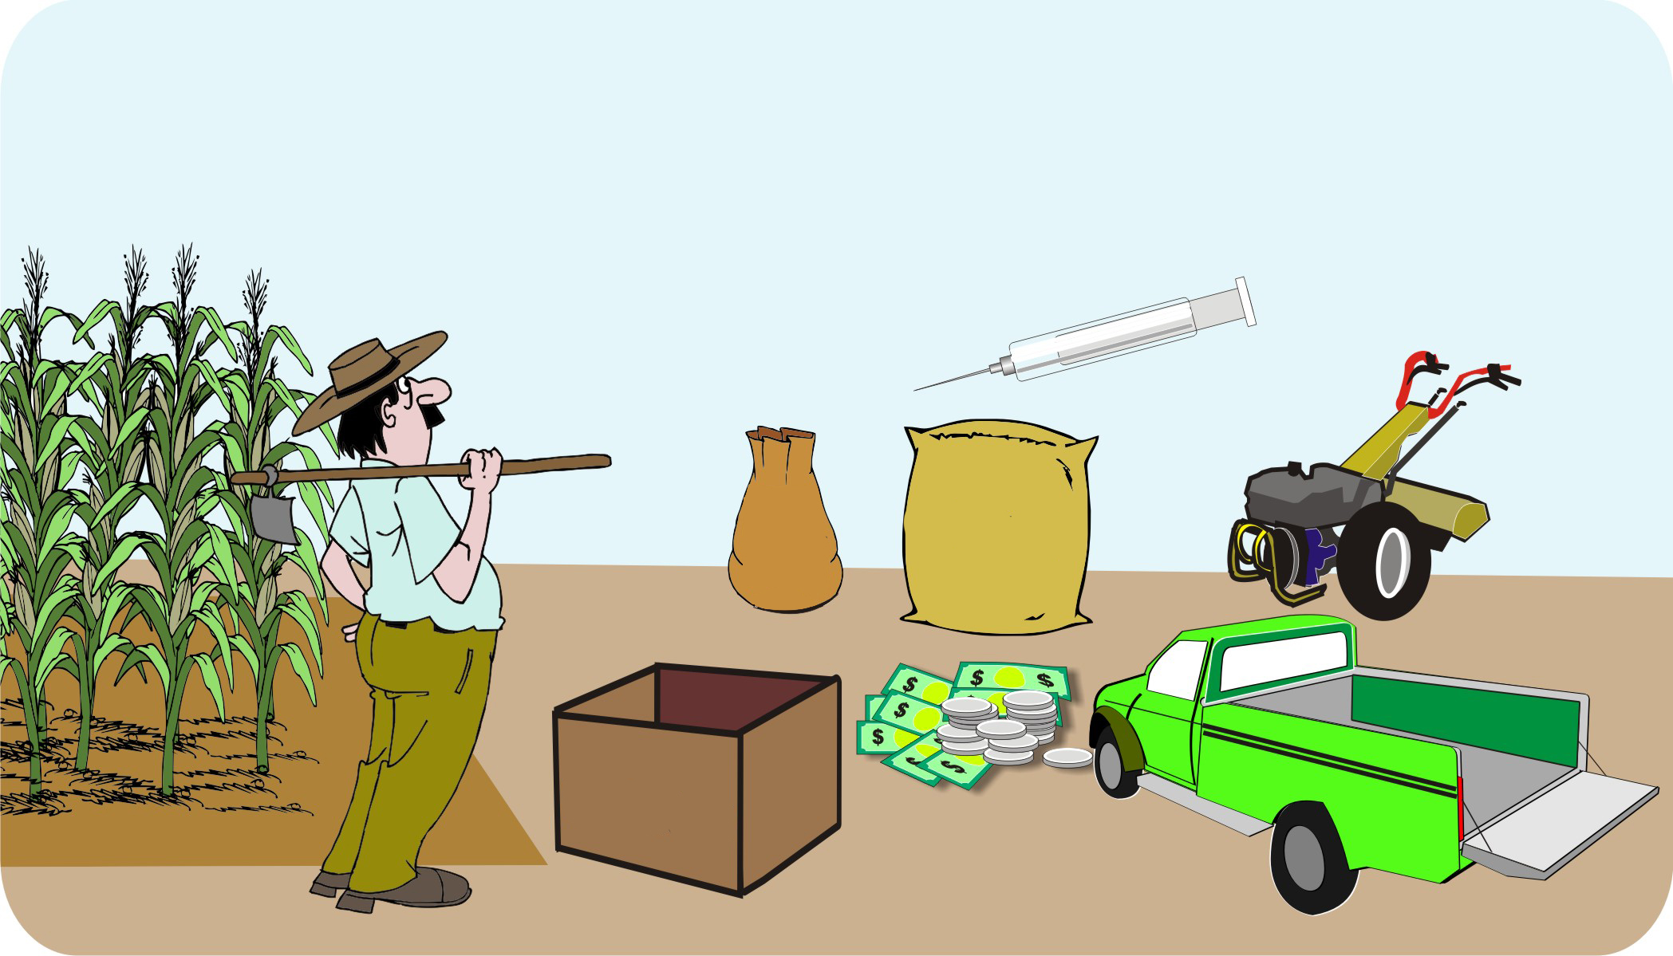
Surveying business services
All farmers need supplies, advice and access to financial services. The businesses that provide these services are called business development services or business support services.

Slide 37
Surveying business services: Role of the field agent
As field agents, you have to work with local business services to access specific service needs, rather than provide them yourself.
Evaluate business services by:
Review the market map exercise that was done by the farmers in the marketing section
Interviewing farmers and service providers

Slide 38
Surveying business services: Assessment
Help the farmers marketing team and other local experts to assess:
Is the service essential for farmers to produce their products and access markets in a sustainable way?
How frequently will the farmers need this service?
What are the technical, financial and business benefits?
What are the risks of not using this service?
What are the costs? How can farmers cut their costs?
What financial services will the farmers need (savings, loans, grants, co-investments)?

Slide 39
Farmers not being able to access essential services
You may find the following situations:
Services are available, but weak, distant or too expensive for the farmers to use:
Consider providing training and short-term subsidies to help rebuild the services.
Services are not available:
Select a different product for which there are available services
Work with local private-sector actors to build up the required service.

Slide 40
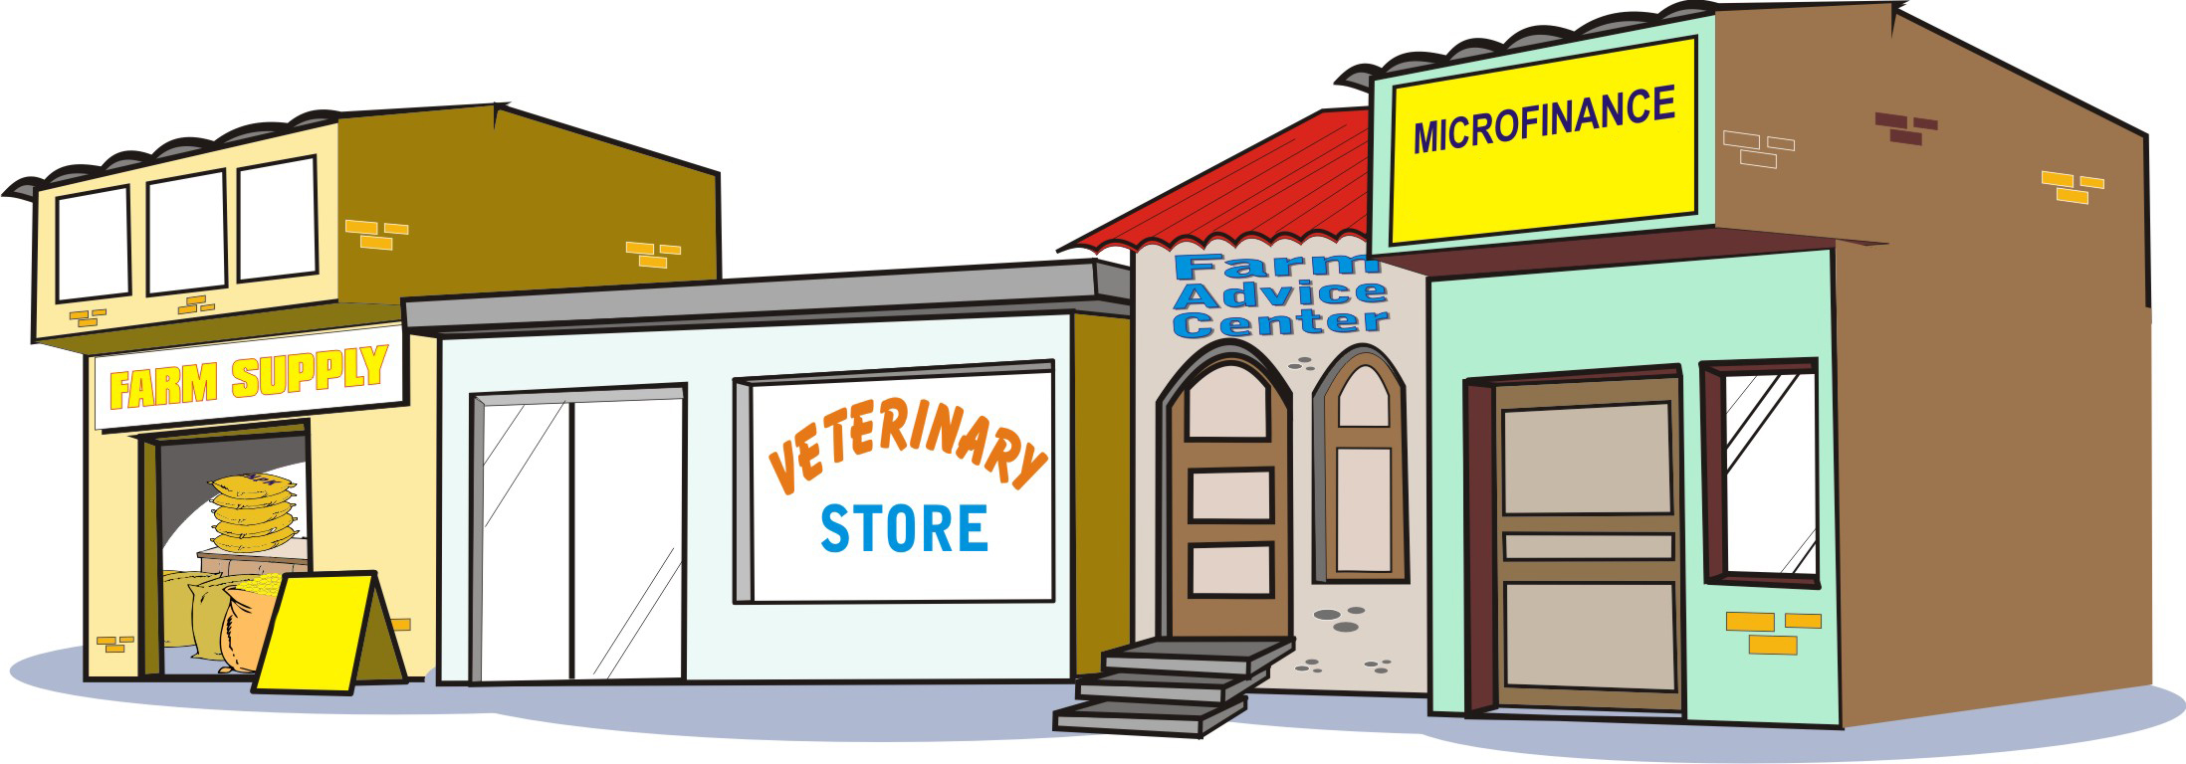
Fostering business services
Build demand for business services by linking farmers to the providers of services that they need
Help business services (e.g. local service providers) develop by building their business plans and linking them to farmers
Train farmers to provide the services themselves

Slide 41
Fostering business services: Seed supply
Introducing new and improved varieties is a way of:
Boosting crop productivity
Avoiding losses through pests and disease

Slide 42
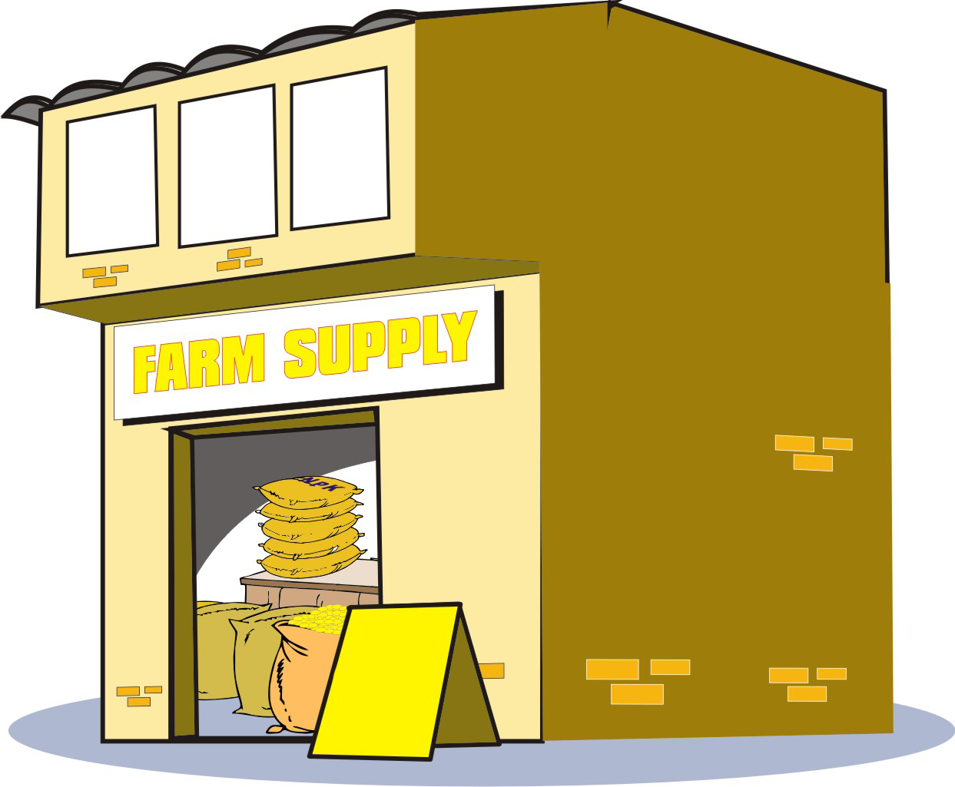
Fostering business services: Seed supply (Continued)
Do not hand out free seed. Instead:
Identify a source of new seed through links to research institutions or business.
Find out the price of seed delivered to farmers.
Include the cost of seed in farmers’ business plan.

Slide 43

Fostering business services: Livestock inputs
Farmers need:
Training in animal care
Land to supply feed
Access to veterinary services and medicines

Slide 44
Fostering business services: Livestock inputs (Continued)
Veterinary care may be available from the government or the private sector.
Make sure that the costs for livestock inputs and animal are included in the business plan.
If the services and unavailable or too expensive for farmers, do not invest in animals.

Slide 45
Fostering business services: Using vouchers
It is better to arrange for an animal sale and give farmers vouchers to buy livestock, rather than buying and delivering the animals to farmers.
All animals should be inspected at the time of purchase.
Farmers who receive animals should be given intensive training in livestock husbandry, pests and diseases and appropriate use of medicines.
Regular inspections by veterinary services should be a part of any animal business.

Slide 46
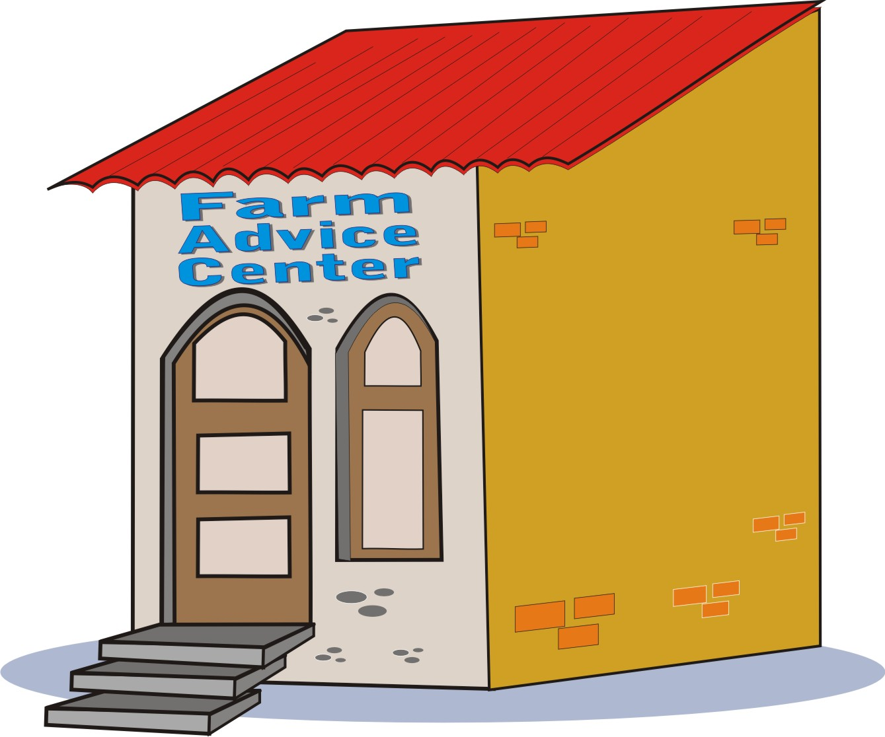
Fostering business services: Market information
Farmers need:
Information about markets, so they can negotiate reasonable prices for their goods
Advice on how to access, understand and act upon market information.

Slide 47
Fostering business services: Market information
Market information can be provided by:
Government services and market contacts
Mobile phones and short messaging services (SMS)
Building a list of local traders, transporters and processors that farmers can call to find out latest prices and conditions
Regular market visits

Slide 48
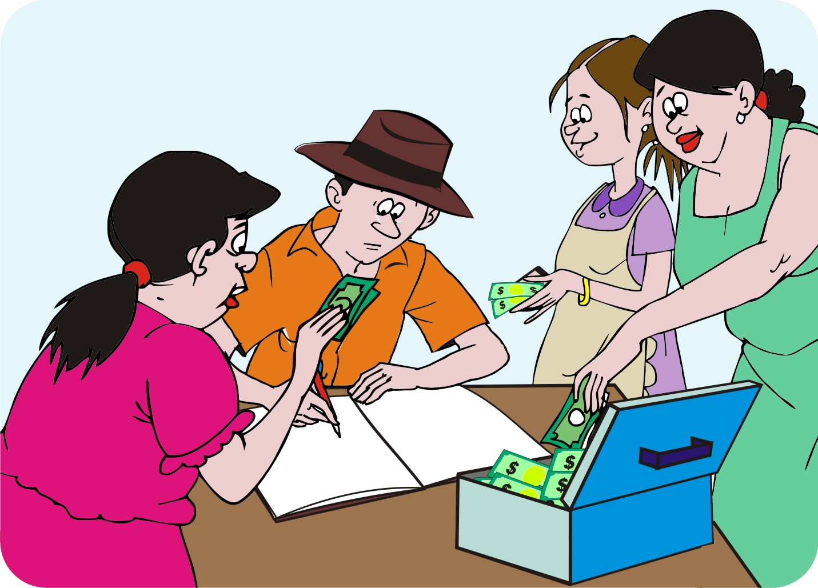
Financing
Farmers need to find ways of financing basic inputs, production and marketing costs.
Help farmers in the following ways to get financial services:
Savings groups
Savings and loans
Loans to individuals
Loans to farmer groups
Farmer group financial
  delivery

Slide 49
Financing: Savings groups
By saving, farmers’ groups can reduce the costs of investing in their agroenterprise:
Farmers pay a small amount every week into a common pot.
The treasurer keeps a record of how much each person has saved.
At the start of the season, the money is distributed to the members, so that they can buy seed and other inputs, which means they do not have to borrow from a moneylender.

Slide 50
Financing: Savings and loans
Savings groups also combine regular savings with lending schemes.
Small groups save small amounts of cash every week or month. The savings are then offered as loans to group members at an agreed interest rate.
After six months of a year, the entire pot of savings is shared out among the members.
Savings and internal lending schemes:
Are an excellent way for farmers to learn financial skills
Allow people to save if there are nog microfinance institutions or banks nearby.

Slide 51
Financing: Individual and group loans
A producer or an entrepreneur, who has collateral or a financial history, may be able to write a business plan and get a loan from a bank or microfinance institution.
A group of farmers may approach a bank or microfinance institution for a loan. They may ask the lender to consider their savings scheme as a form of credit history.
Sometimes a support agency may guarantee the loan, thereby reducing the risk to the lender.

Slide 52
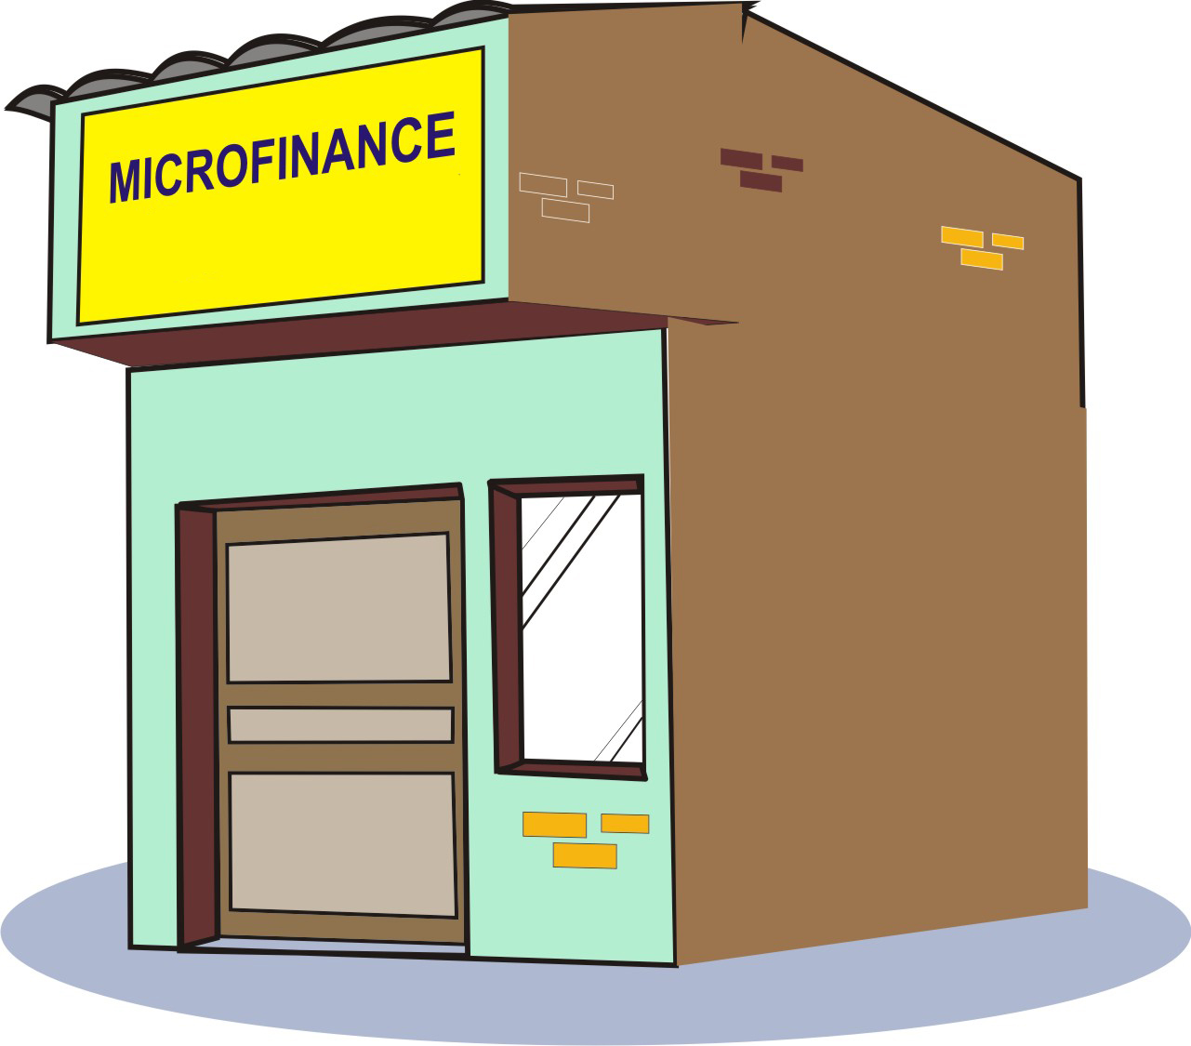
Financing: Group-managed financial services
The farmer group or an association of farmer groups, (such as a cooperative) can borrow money from a bank or microfinance institution.
It can also use its own funds to provide smaller loans to its members.
To do this, the group needs strong management and governance.

Slide 53
Lesson 10:
Tools for financial analysis

Slide 54
Outcomes
After this lesson you will be able to:
Describe how to get information about farmers’ costs.
Identify the two types of materials costs, and give examples of each type.
Give examples of labor and services costs.
Calculate a farmer’s total costs.
Calculate a farmer’s income and profit.

Slide 55
Overview
Lesson 10 covers the following content:
Financial information sources
Using sampled cost data to predict costs of others
Cost of materials and labor
Total costs
Estimating income and profit
Multiple harvests, storage and slow-maturing products
Growing for food and income
Options to balance food and financial security

Slide 56
Learning about finance
Any business has to keep track of its investments, costs and income. In order to make good decisions and to put together a viable business plan, farmers must know the following financial information:
The costs of material and labor
How much money comes in
How much profit to expect: this information will enable the farmers to put together a viable business

Slide 57
Using farmer records for financial information
Getting costs from farmer records is the best way for a field agent to get financial information, as you simply have to check through the financial records of farmers who are willing to share their information.
Very few farmers keep good records. Therefore, you have to use one of the other two financial information sources too.
Throughout the project, encourage farmers to keep records of their costs and expenses, so that they can make informed business decisions.

Slide 58
Researching existing financial information
Some countries have detailed surveys that have been undertake to measure the yield and costs of production of key value chains.
These sources of information are very helpful as a guide, but you have to verify the information with farmer information, because:
They are often outdated
Prices change due to market conditions

Slide 59
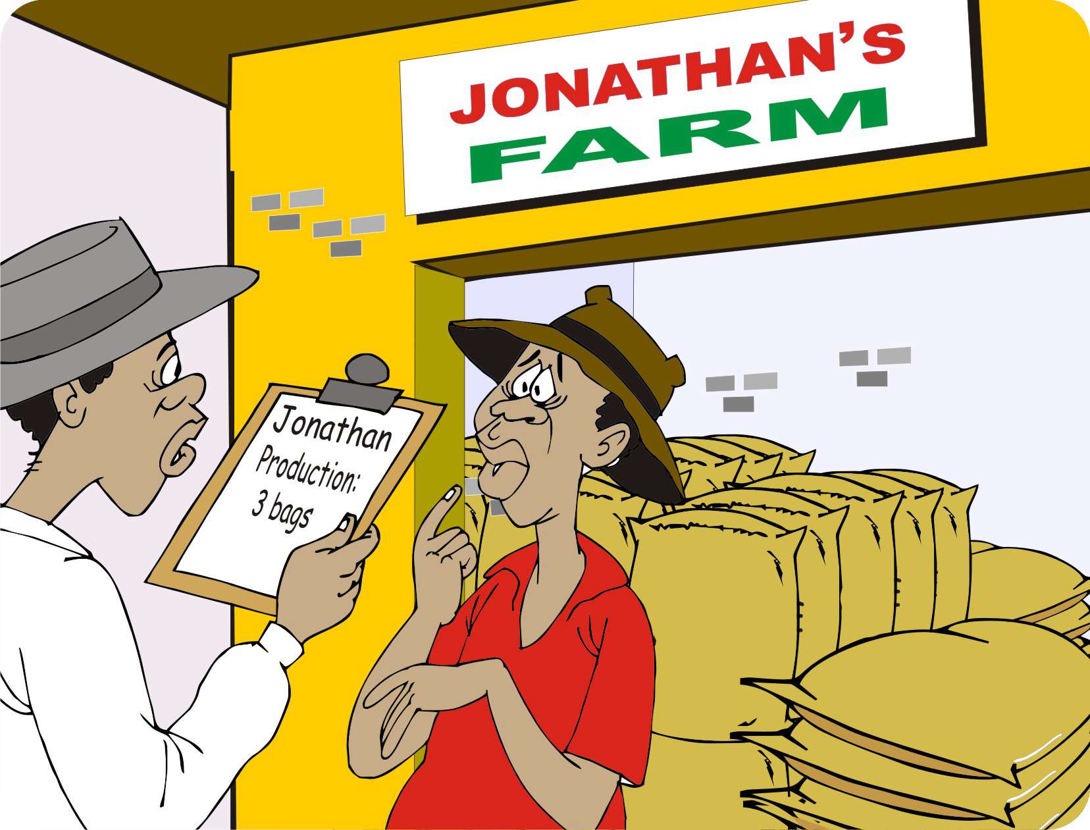
Collecting financial information from farmers: Problems
Farmers often give inaccurate information on costs and income.
Some farmers do not want to share information about money, which they regard as sensitive.
If they are not be sure about the actual figures, they guess.

Slide 60
Collecting financial information from farmers : Guidelines
Conduct cost interviews with single farmers to avoid distractions.
Ask clear questions and double-check the answers.
Disregard figures that are obviously incorrect, inflated or misleading.
Because farmers are sensitive about questions about money, explain clearly and in simple terms why you want the information. Make it clear that you are not a tax official.
If they are illiterate, ask them to bring along a relative who can help them with the calculations.

Slide 61
Collecting financial information from farmers: Lead farmers’ assistance
Before interviewing farmers, ask a lead farmer in the area to go through the production costs with you.
Spending time with a well-organized commercial farmer can help you learn about all the equipment, best practices and costs.
Keep in mind that the commercial farmer may get better input prices than smaller farmers.
It may also be helpful to visit an agri-dealer in the region and write down the costs of seed, fertilizer, equipment and agrochemicals.

Slide 62

Collecting financial information from farmers: Using calculators and computers
Consider using:
A spreadsheet program, such as Microsoft Excel
CRS Farmbook program, which can also help with these calculations.
More information on Farmbook is available at: https://farmbookhub.crs.org/

Slide 63
Using sampled cost data
To estimate the costs for many farmers, you can gather information from a number of representative farmers and use this sample to generate the approximate costs for other farmers in a group.
You must have a specific sampling method to generate an average that you can use to estimate other costs for:
Farmers having similar area and using similar production methods
Farmers having very different areas or using different production methods

Slide 64
Using sampled cost data: Similar production methods
If farmers have similar areas and using similar production methods, you can take a sample of three representative farmers and choose the farmers based on their land area. Consider the following ways:
Select the mode and interview three farmers with that farm size.
Calculate the mean size of all the farms, then interview three farmers with that size of farm.
Select the smallest, middle and largest farmers, calculate the average and interview three farmers with that farm size.

Slide 65
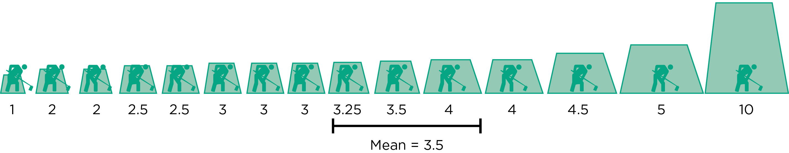
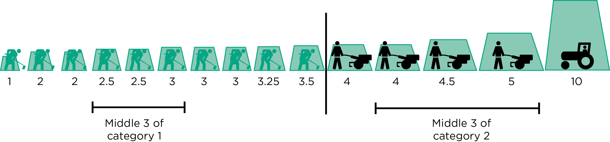
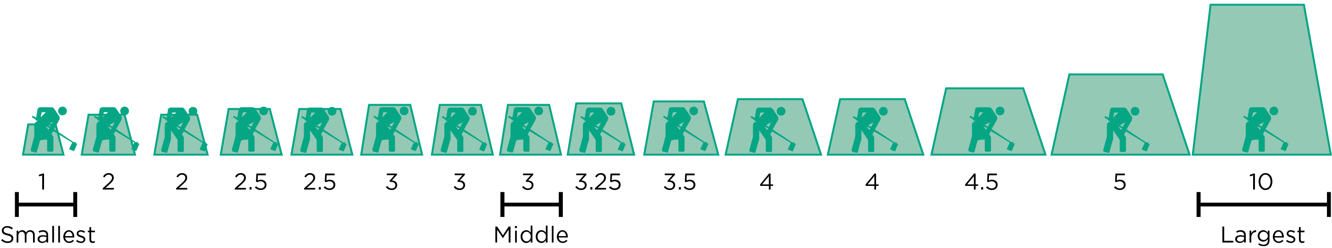
Using sampled cost data: Example of a sample based on farm size

Slide 66
Using sampled cost data: Different areas and production methods
Divide farmers into sub-groups.
Work out the average costs for a sample of farmers in each category.
Use these averages to estimate the costs for the other farmers in the same category.
Instead of using land area, you may divide the farmers into categories based on the production technology they use, e.g. farmers with and without irrigation or farmers with and without fertilizer.

Slide 67
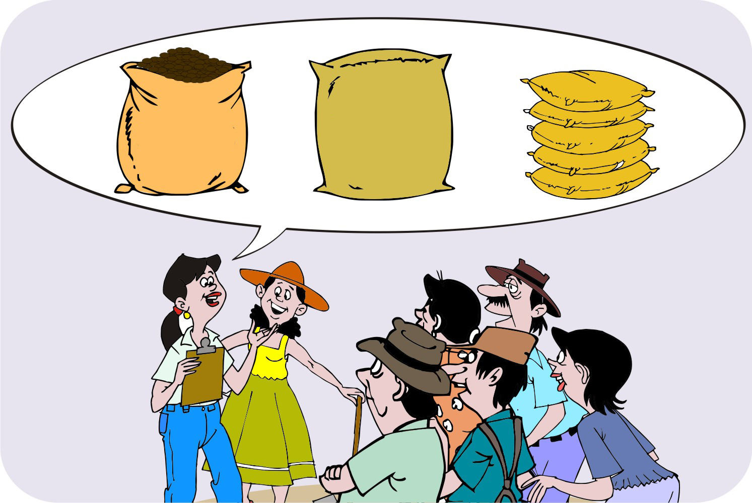
Cost of materials: Consumables
Consumables are items that are used up in the production cycle, including:
Costs of renting, land and buildings
Hiring equipment and using irrigation
Costs of seeds, fertilizer, agrochemicals, fuel,
  transport and packaging materials

Slide 68
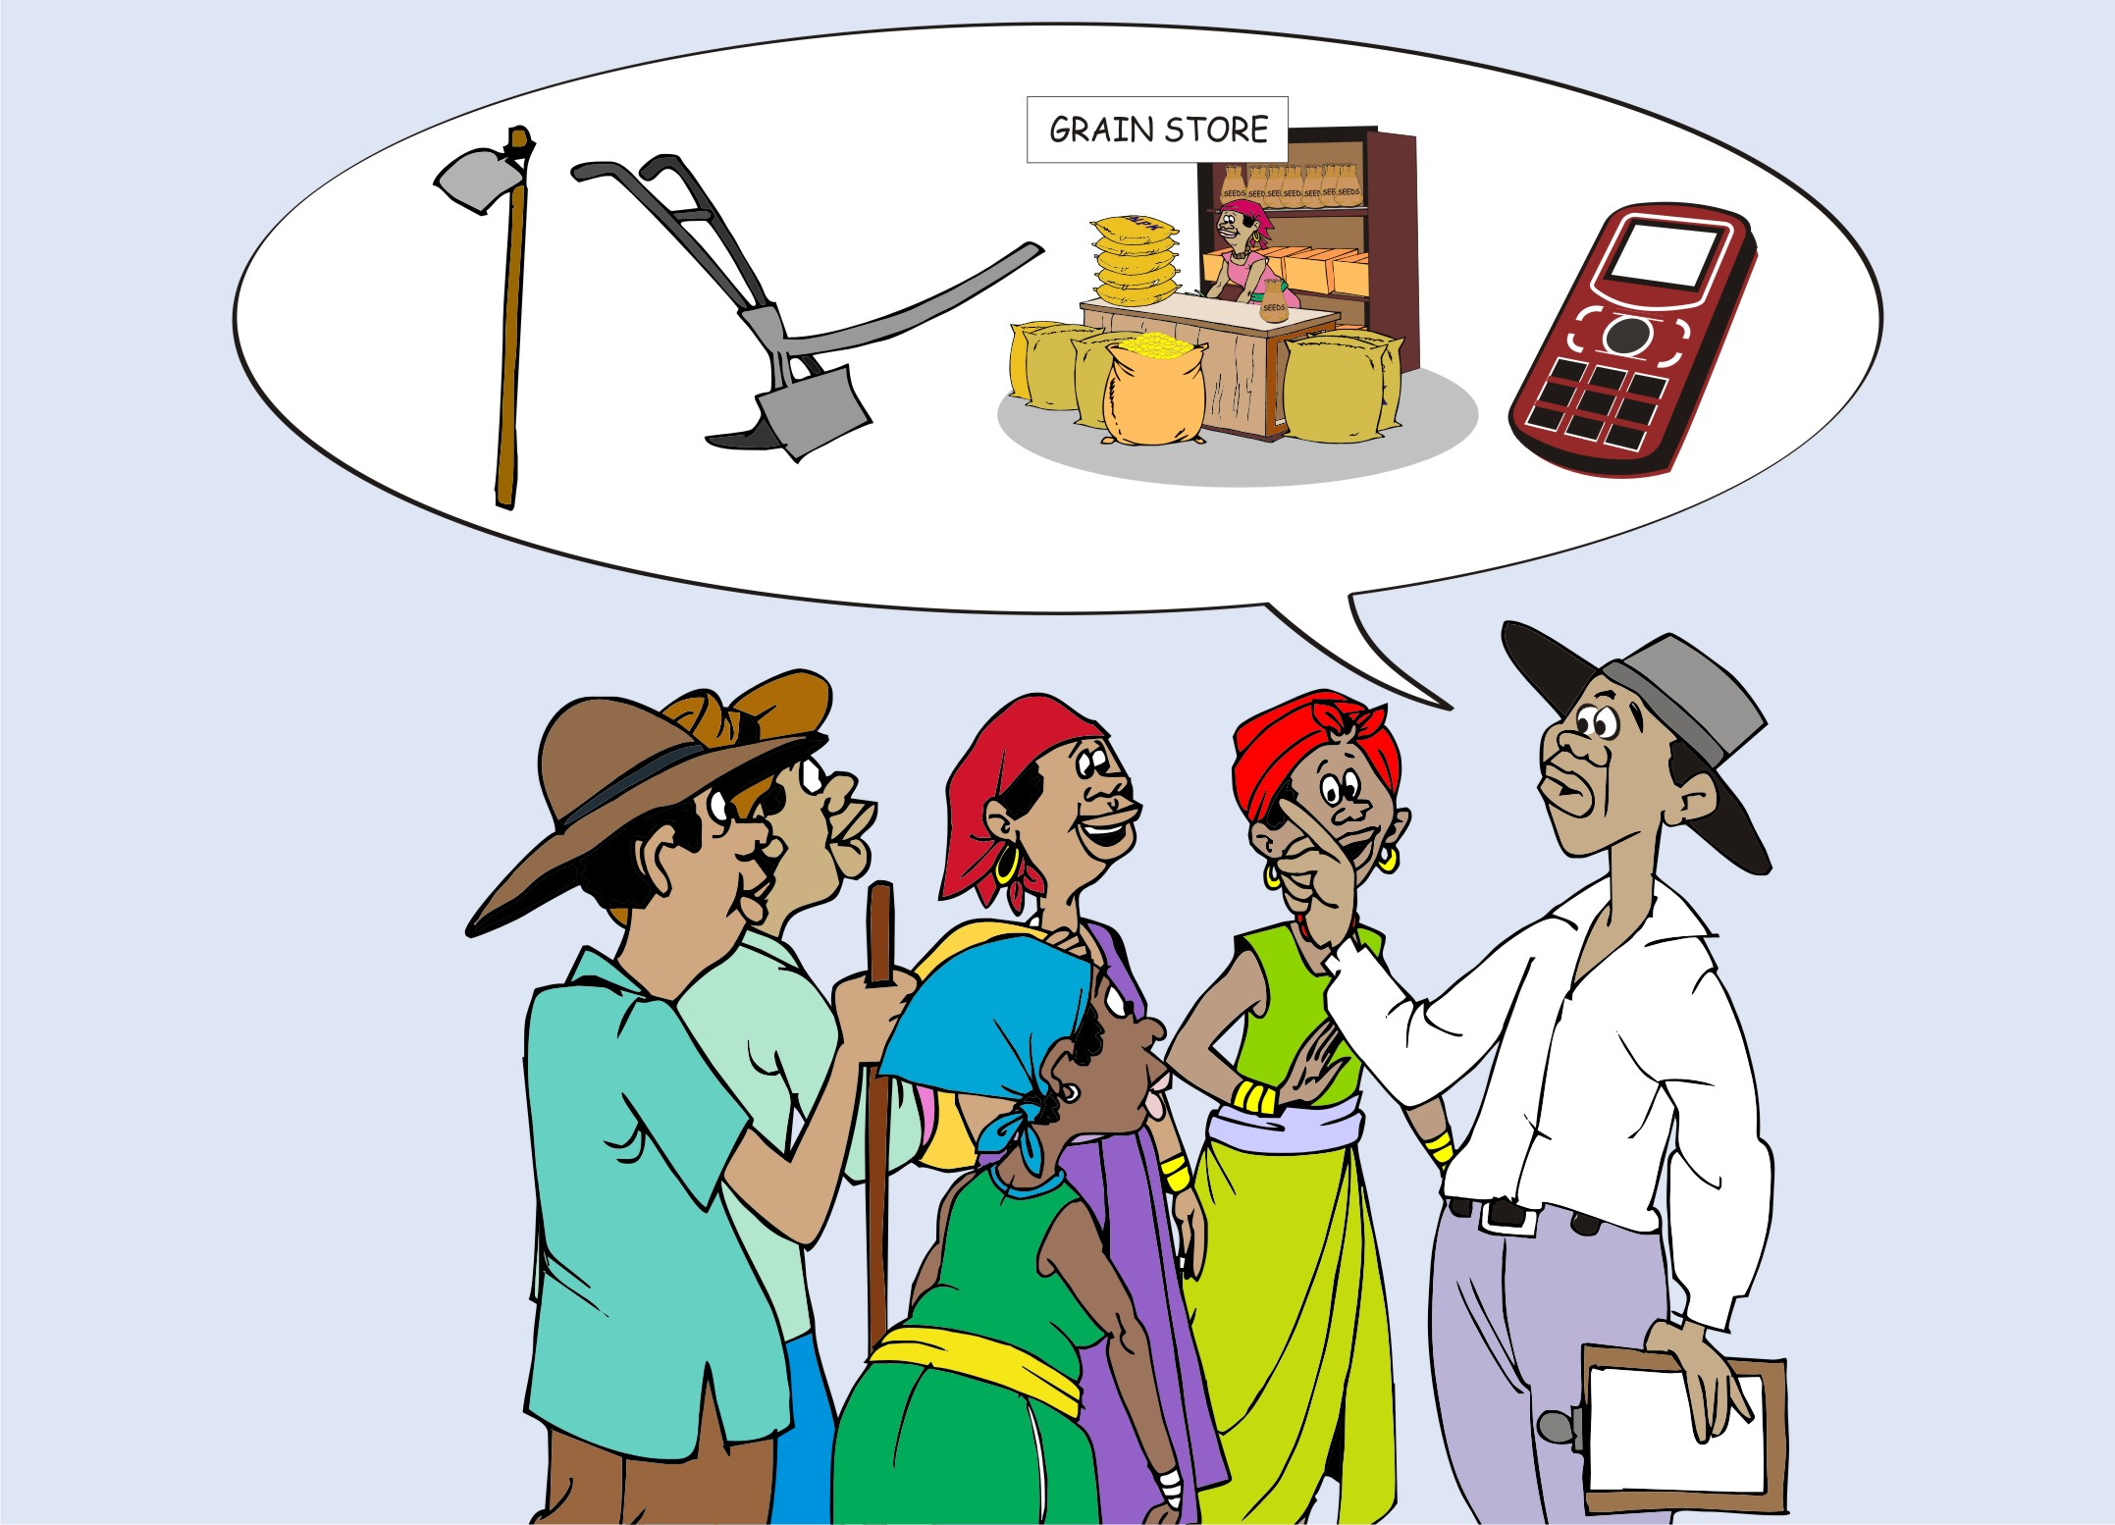
Cost of materials: Durables
Durables are (expensive) items that last a long time (many years) such as:
Buildings
Tree seedlings
Equipment
Livestock
You need to estimate how many years the item will last and then divide the cost by this number of years.

Slide 69
Total material costs
Total material costs = Consumable material costs + Durable material costs

Slide 70
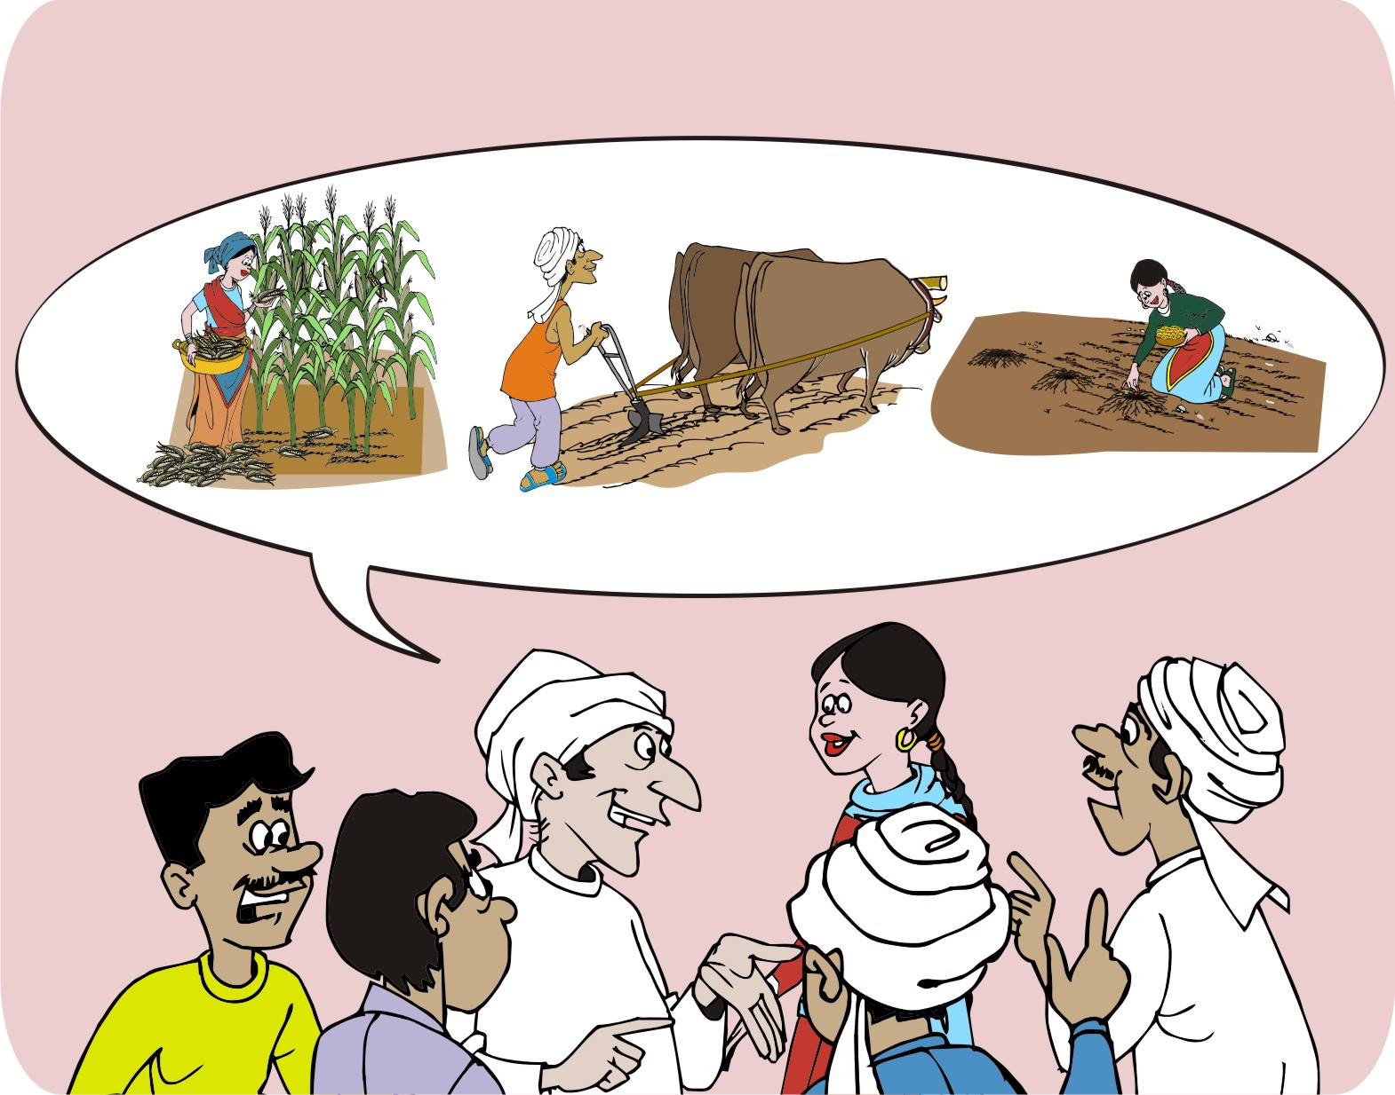
Cost of labor
Labor costs include payment for people to do tasks such as:
Nursery preparation
Land clearing and plowing
Planting and weeding
Irrigating
Applying fertilizer
Animal feeding and milking
Crop harvesting
Packing and storage handling
Negotiating with traders

Slide 71
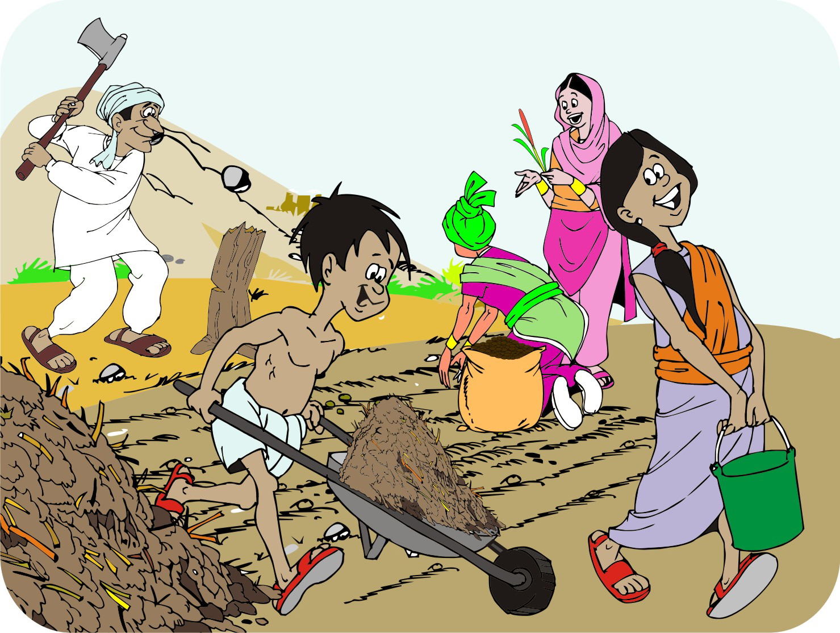
Cost of labor: Family labor
The work of family members is a vital part of many farm enterprises.
Family members often do not get paid in cash. Instead, they are paid in kind, in the form of food and accommodation.
Family labor needs to be accounted for and farmers should estimate how much this would cost in money terms.

Slide 72
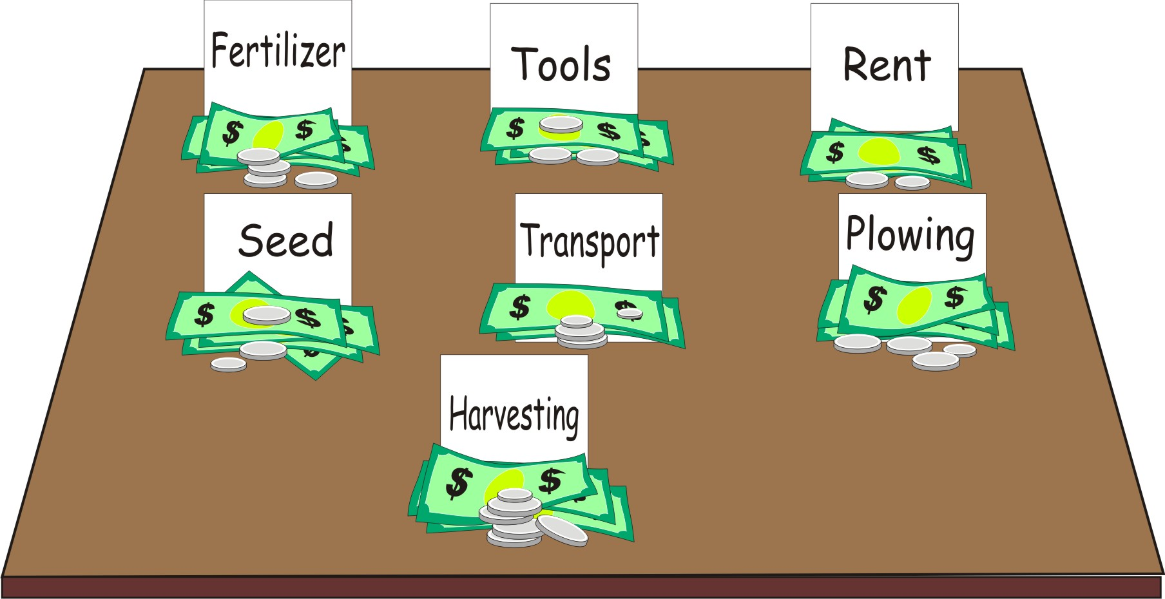
Total costs
Total costs = Total material costs + Labor costs
Example:
Total material costs (Consumables + Durables) | A | $130
Total labor costs | B | $70
Total costs | A + B | $200

Slide 73

Estimating income: Information needed
You need the following information to calculate the income that a farmer can earn from a product:
Amount of the product that the farmer expects to produce and sell
The price that the farmer expects to get for selling the product

Slide 74
Estimating income: Guidelines
Make sure that you use realistic estimates of the amount to be sold and the price.
It is better to be conservative about production and prices.
Use information on output and prices of the last few years as a basis for the estimates.
It is best to take the average of previous years’ figures, giving more weight to the most recent years.
Check the farmer’s information against the national and regional average yield.

Slide 75
Estimating profit
Gross margin (profit) = Total income - Total cost
Example
Total income | A | $420
Total material costs | B | $130
Total labor costs | C | $70
Total costs | D = B + C | $200
Profit per acre | A - D | $220

Slide 76
Multiple harvests
Calculating the costs of some products is more complicated, for example:
Vegetables can be planted and harvested several times in a season with multiple production cycles and sales, but because they are so perishable storing them is much harder. It is important to consider that the product price may change over time: vegetables usually get a higher price out of season.
Chickens produce more than one product. They produce eggs for 2–3 years and then meat at the end of their laying lives.

Slide 77
Storage and slow-maturing products
Storage
Some products (especially grain) can be stored for weeks or months until the price rises.
Make sure you include the costs of storage and the losses due to spoilage.
Slow-maturing products
Products such as fruit trees and livestock take more than a single season to start producing, but then continue producing over a number of years.
The farmer must pay many of the costs up front, and wait for the trees to grow or the cows to mature.

Slide 78
Growing for food and income
Many farmers try to grow all the food they need and then sell any surplus.
For many crops, a part of the production is kept on farm for internal consumption. Think of this as the cost of the fuel (calories, vitamins and minerals) a family needs to work in the farm.
Example
In the major maize growing areas of Africa, a family of six needs to produce about ten 100-kg bags of maize to feed the family before they have surplus to sell.

Slide 79
Options to balance food and financial security
Farmers have the following options to improve the productivity and profitability of their maize enterprise and, thereby their food and financial security:
Extensification
Intensification
Diversification
Reducing production costs

Slide 80
Extensification
Farmers with access to underutilized land have the option to increase production is to grow more of that by planting on additional land.
Farmers ability to extend their production of a crop depends on whether they have additional available land.
An alternative is to rent land at a price that would make a larger area profitable.
Note that the additional land may be more marginal or less fertile and that the additional area will increase the costs of materials, labor and loans.

Slide 81
Intensification
Increasing yields per unit area can be achieved by improving production practices. This generally means a combination of:
Increased use of technology, which requires investing in things like seed, fertilizer, irrigation, or equipment
A more disciplined approach to the farming activities required to grow a crop, including preparing land on time, planting on time, use of recommended rates of seed and fertilizer, weeding on time etc.
This approach is both technology and knowledge intensive.

Slide 82
Diversification
Another alternative is to use a part of the available land to grow higher-value crops or to keep livestock.
Depending on market conditions, products such as horticultural crops can provide a higher return to the land and labor costs, compared with growing more maize.
Helping farmers make choices about diversification options requires field agents to have a sound understanding about profitable options and working with farmers to make sound production and financial decisions.

Slide 83
Reducing production costs
This approach can increase profitability by lowering costs or making efficiency gains.
Once farmers know their costs of production for a crop, they can explore ways of reducing costs.
Examples
Micro-dosing fertilizer
Better use of water to ensure crops do not suffer from drought
Spraying herbicides to cut the labor costs for weeding

Slide 84
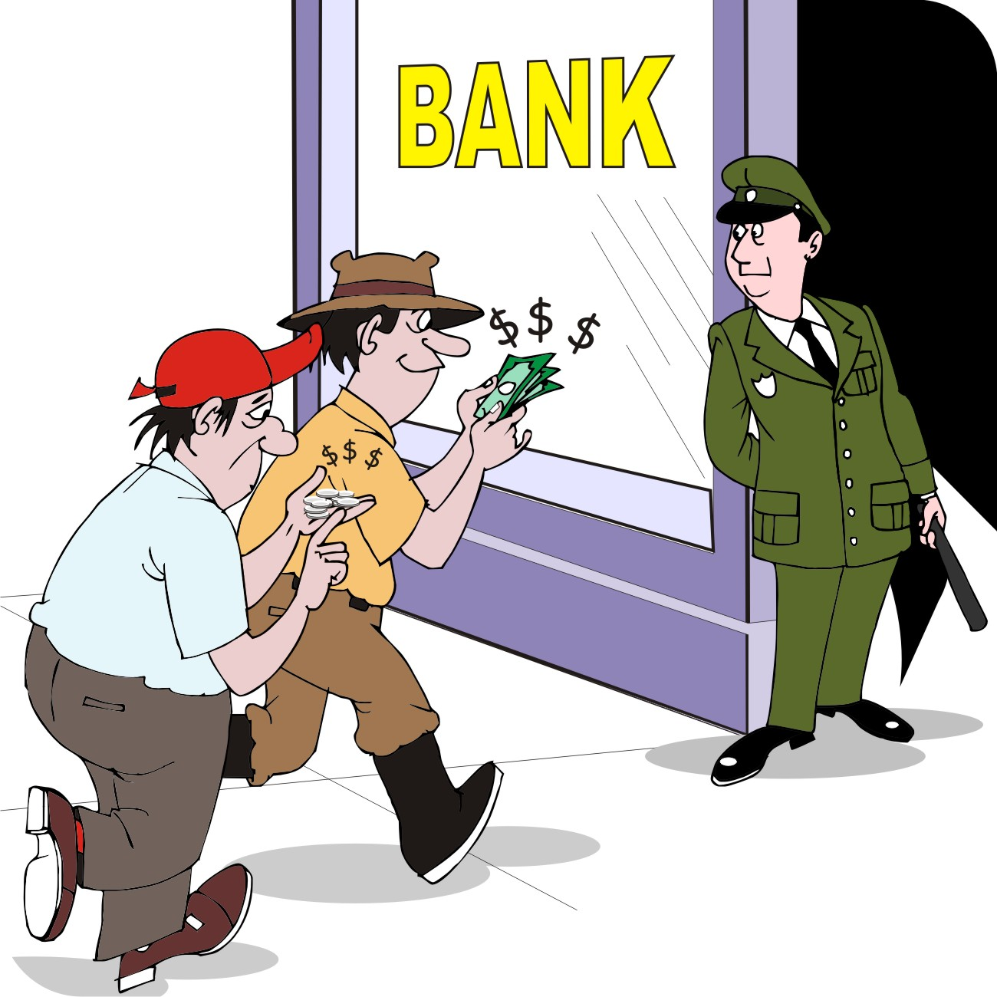
Saving
It costs money to borrow money for farming.
Farmers who save more to invest in their farming system can reduce the amount they have to borrow and so reduce on their loan costs.

Slide 85
Off-farm employment
Increasing populations have resulted in average plot sizes declining. Millions of farmers, particularly those with less than 4 hectares (10 acres) now have insufficient land to farmer grain crops at a commercial scale.
These farmers must find additional ways to make money outside the farm and their off-farm incomes may include:
Providing labor to neighboring farms
Working in a village shop or on a plantation during harvest season
Working on construction sites or manufacturing firms

Slide 86
Comparing among farmers
Because every farm is different, farmers can learn from one another.
You can help the best farmers explain to other farmers how they invest in their crops, where they pay more money and where they keep their costs down.
Making comparisons between good farmers and others is often called benchmarking, because you:
Collect information on different farmers
Find good farmers to use as a benchmark
Use them to help others learn

Slide 87
Lesson 11:
Deciding on credit

Slide 88
Outcomes
After this lesson you will be able to:
List the sources of credit in your area.
Explain what is meant by principal, interest rate, installment, default and other terms.
Explain why farmers take loans.
Calculate whether it is profitable for a farmer to take a loan.
List the five things a bank or microfinance institution will consider before approving a loan.

Slide 89

Overview
Lesson 11 covers the following content:
Places to get credit
Credit terminology (words)
Types of loans
Should farmers borrow money?
How much should farmers borrow?
How much will the loan cost?
What does the bank look for?

Slide 90
Places to get credit
One of the main reasons farmers do not produce more is because they do not have enough money to pay for the inputs they need.
Farmers can consider the following credit options:
Individual savings
Borrowing from family members
Loans from a moneylender
Loans from an input supplier or a customer
Credit from a bank or a microfinance institution

Slide 91
Credit terminology (words): C–I
Collateral: In order to ensure that the borrower repays, the lender may demand collateral, which is an asset (such as land or equipment) that the lender can seize and sell if the borrower does not repay.
Default: If the borrower does not repay, he/she defaults on the loan.
Installments: These are the amounts of money that a borrower pays to the lender on a regular basis.
Interest rate: The fee charged by the lender, which may be calculated per month or over the whole loan period.

Slide 92
Credit terminology (words): L–S
Loan cost: The cost of borrowing the principal amount
Loan period: The length of time the borrower has before repaying all the money
Principal: The amount of money the lender lends to the borrower
Repayment: The amount of money the lender must pay back in regular installments or in a lump sum
Social collateral: Microfinance institutions often rely on “social collateral, which requires the borrowers to be organized in a group and the group as a whole guarantees that each member will repay their loans.

Slide 93
Example of a complex credit arrangement
Credit arrangements are complex, for example:
Before a lender will provide a loan, they may require the borrower to have a history of having saved money, to make a deposit up front or pay a one-time fee.
If the borrower repays in installments, the interest may be charged only on the remaining amount owed, not on the full principal.
The repayment schedule may be flexible, e.g. the borrower may be able to repay part of or the full loan amount as a lump sum rather than in regular installments.

Slide 94
Types of loans
Seasonal loans for working capital: Used to pay for production inputs, e.g. seed and fertilizer
Harvest loans: Short-term loans to hire laborers or equipment at harvest time
Short-term improvement loans: Used to pay for smaller investments, e.g. an irrigation pump
Long-term investment loans: Use to buy land, buildings or equipment for long-term use
Multi-phase loans: Disbursements are made at specific times in the production and marketing season to meet farmers’ needs at the time

Slide 95
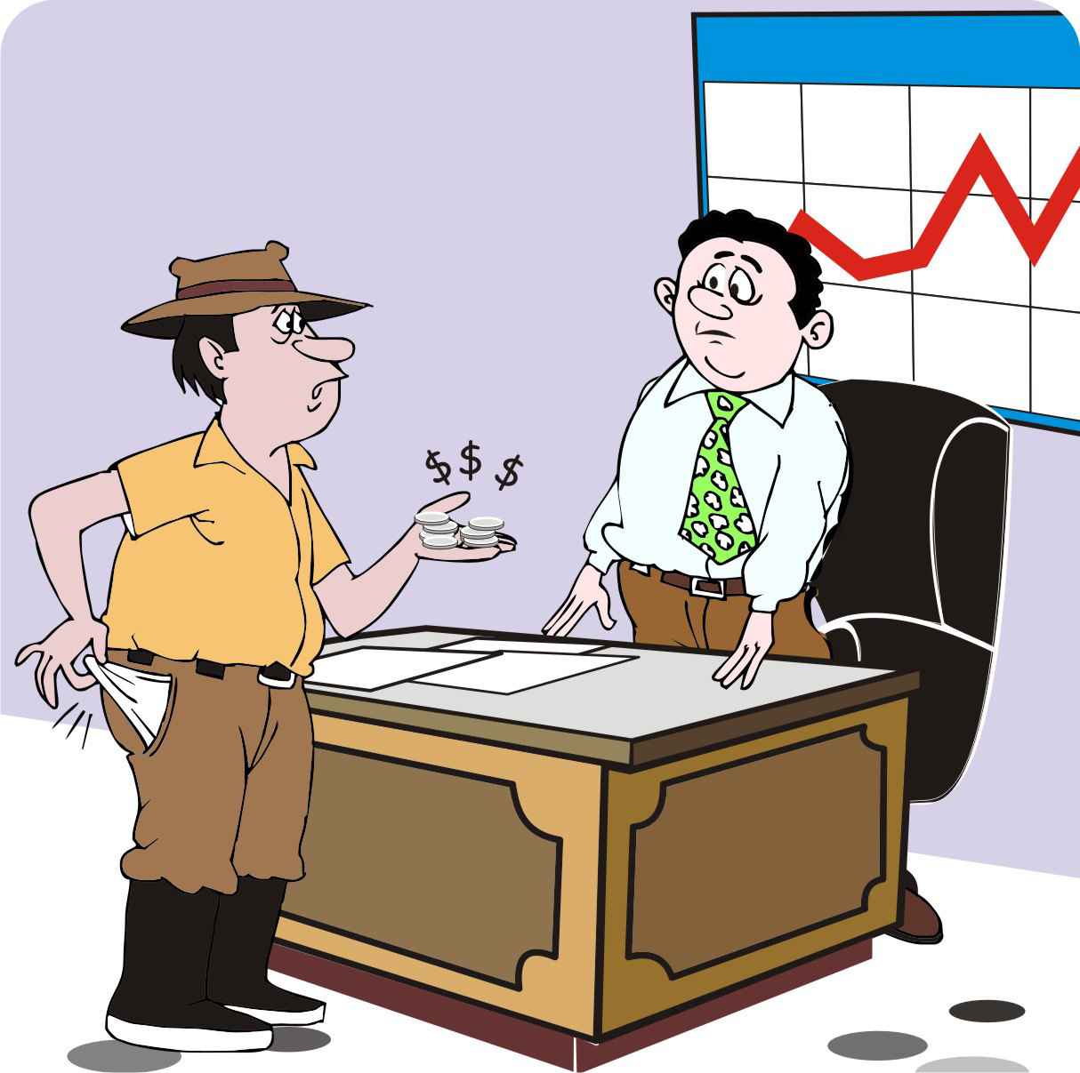
Should farmers borrow?
Borrowing is always risky and farmers should only borrow if:
They will be able to use the money to increase their profit
They are reasonably sure they will be able to repay the loan.

Slide 96
How much should farmers borrow?
Farmers can then decide on the amount of the loan they need. The may borrow:
The same amount as the amount of money needed
More (a higher amount as the amount needed) to cover additional expenses, including any deposit required to get the loan
Less (a lower amount as the amount needed) to include some costs in the loan portion
The amount borrowed is called the principal.
The cost of borrowing money is called the loan cost.

Slide 97
Calculating the cost of the loan
Farmers can calculate the loan costs from:
Size of the loan
Interest rate per month
Number of months of repayment
The amount to be repaid = Interest
Interest = The cost of the loan + the amount borrowed (the principal)

Slide 98
What do banks look for?
When a bank, a microfinance institution or a savings group lends someone money, it wants to be sure that the borrower will pay it back.
It will look at five basic questions, which are known as the five Cs

Slide 99
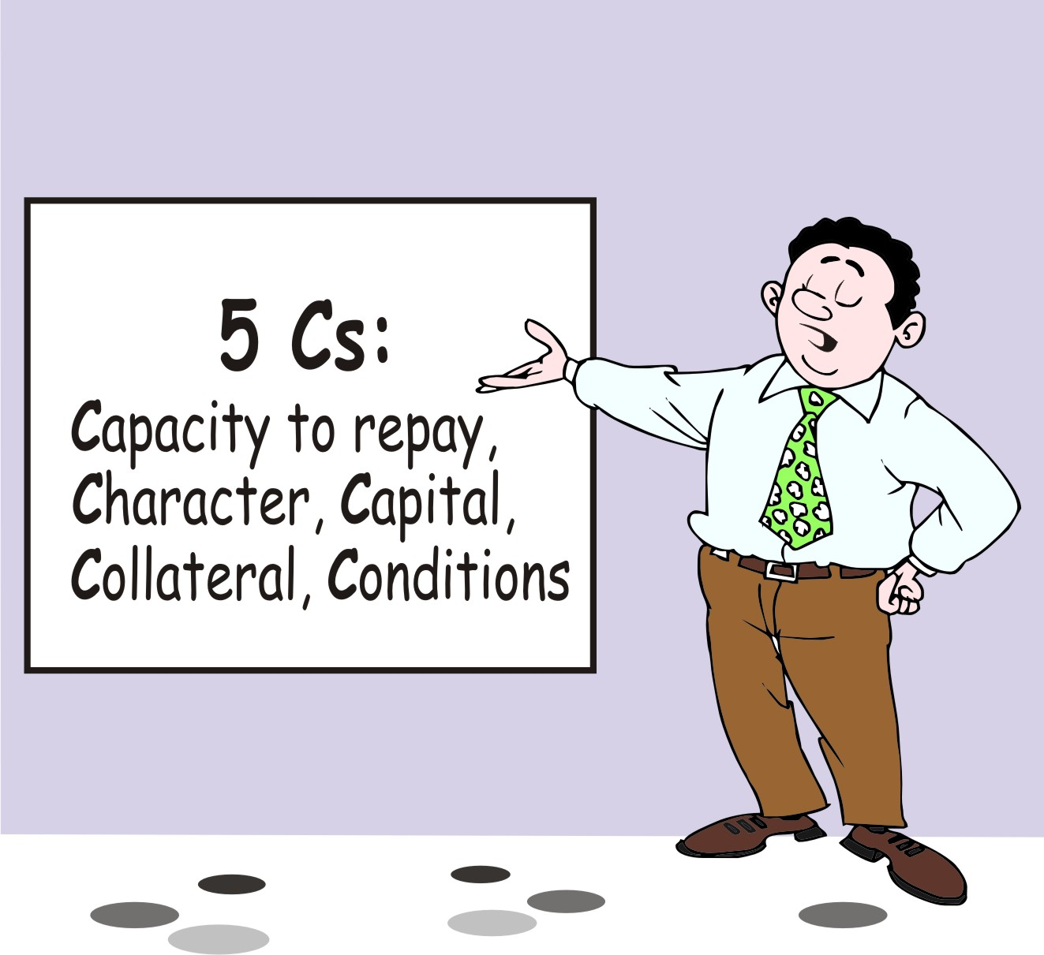
What do banks look for: The five Cs
The five Cs:
Capacity to repay
Character of the borrower
Capital invested in the enterprise
Collateral
Conditions

Slide 100
Capacity: The ability to repay the loan
The basic question is: Is the borrower able to repay the loan?
What does the business plan say about the enterprise’s income and profitability?
Can the enterprise generate enough cash to make the loan payments with interest?
Will there be enough extra cash or collateral in case of problems?

Slide 101
Capacity: The ability to repay the loan (Continued)
The basic question is: Is the borrower able to repay the loan? (Continued)
When will the enterprise be able to repay the loan?
What other expenses does the enterprise have?
What effects may variations in price have on the income and expenses of the enterprise?

Slide 102
Character: The integrity of the enterprise
The basic question is: Will the borrower do everything it can to repay the money?
How is the enterprise managed?
Are the managers and group members honest and trustworthy?
Is the group organized in a suitable way?
Has it repaid bills and previous loans on time?
Does it spend money on inappropriate things?
Is the enterprise innovative, and does it look for new business opportunities?

Slide 103
Capital: Money invested in the business
The basic question is: Does the borrower have enough resources to withstand a problem that may arise?
What money and assets are invested in the enterprise?
Does the group reinvest its profits in the enterprise?
Does the group have the ability to deal with problems such as drought or pest attacks?

Slide 104
Collateral: Backup sources of repayment for the loan
The basic question is: If the borrower does not repay the loan, what can the lender do to get its money back?
Are the personal guarantees of the group trustworthy?
What assets can the group offer as collateral?
If a member of the group defaults, will the other members pay the amount due?
Are the assets of the group and the personal guarantees of the member enough to cover the loan if necessary?

Slide 105
Conditions that may affect the borrower’s ability to repay the loan
Is the enterprise likely to make a profit
by investing the loan?
Is the business plan ground on realistic cost and revenue projections?
Is the market for its product adequate and stable?
Are the loan terms suited to the group’s ability to repay?
What risks might affect the price of the product or the level of production?
What are the general market trends of the sector?

Slide 106
Lesson 12:
Choosing an agroenterprise

Slide 107
Outcomes and overview
After this lesson you will be able to:
Help farmers choose an agroenterprise and a market strategy.
Lesson 12 covers the following content:
It is crunch time
Fundamental and additional criteria
Examples of market strategies to sell selected products

Slide 108
It is crunch time
At this point, the farmers have:
Gathered information about the markets, production and business services for various products
Calculated the costs, income and profit they can expect from the same products and the credit options available to them
A better understanding of the opportunities and risks associated with these products.
It is time to bring all this information together and to make a big decision:
What product should they produce?

Slide 109
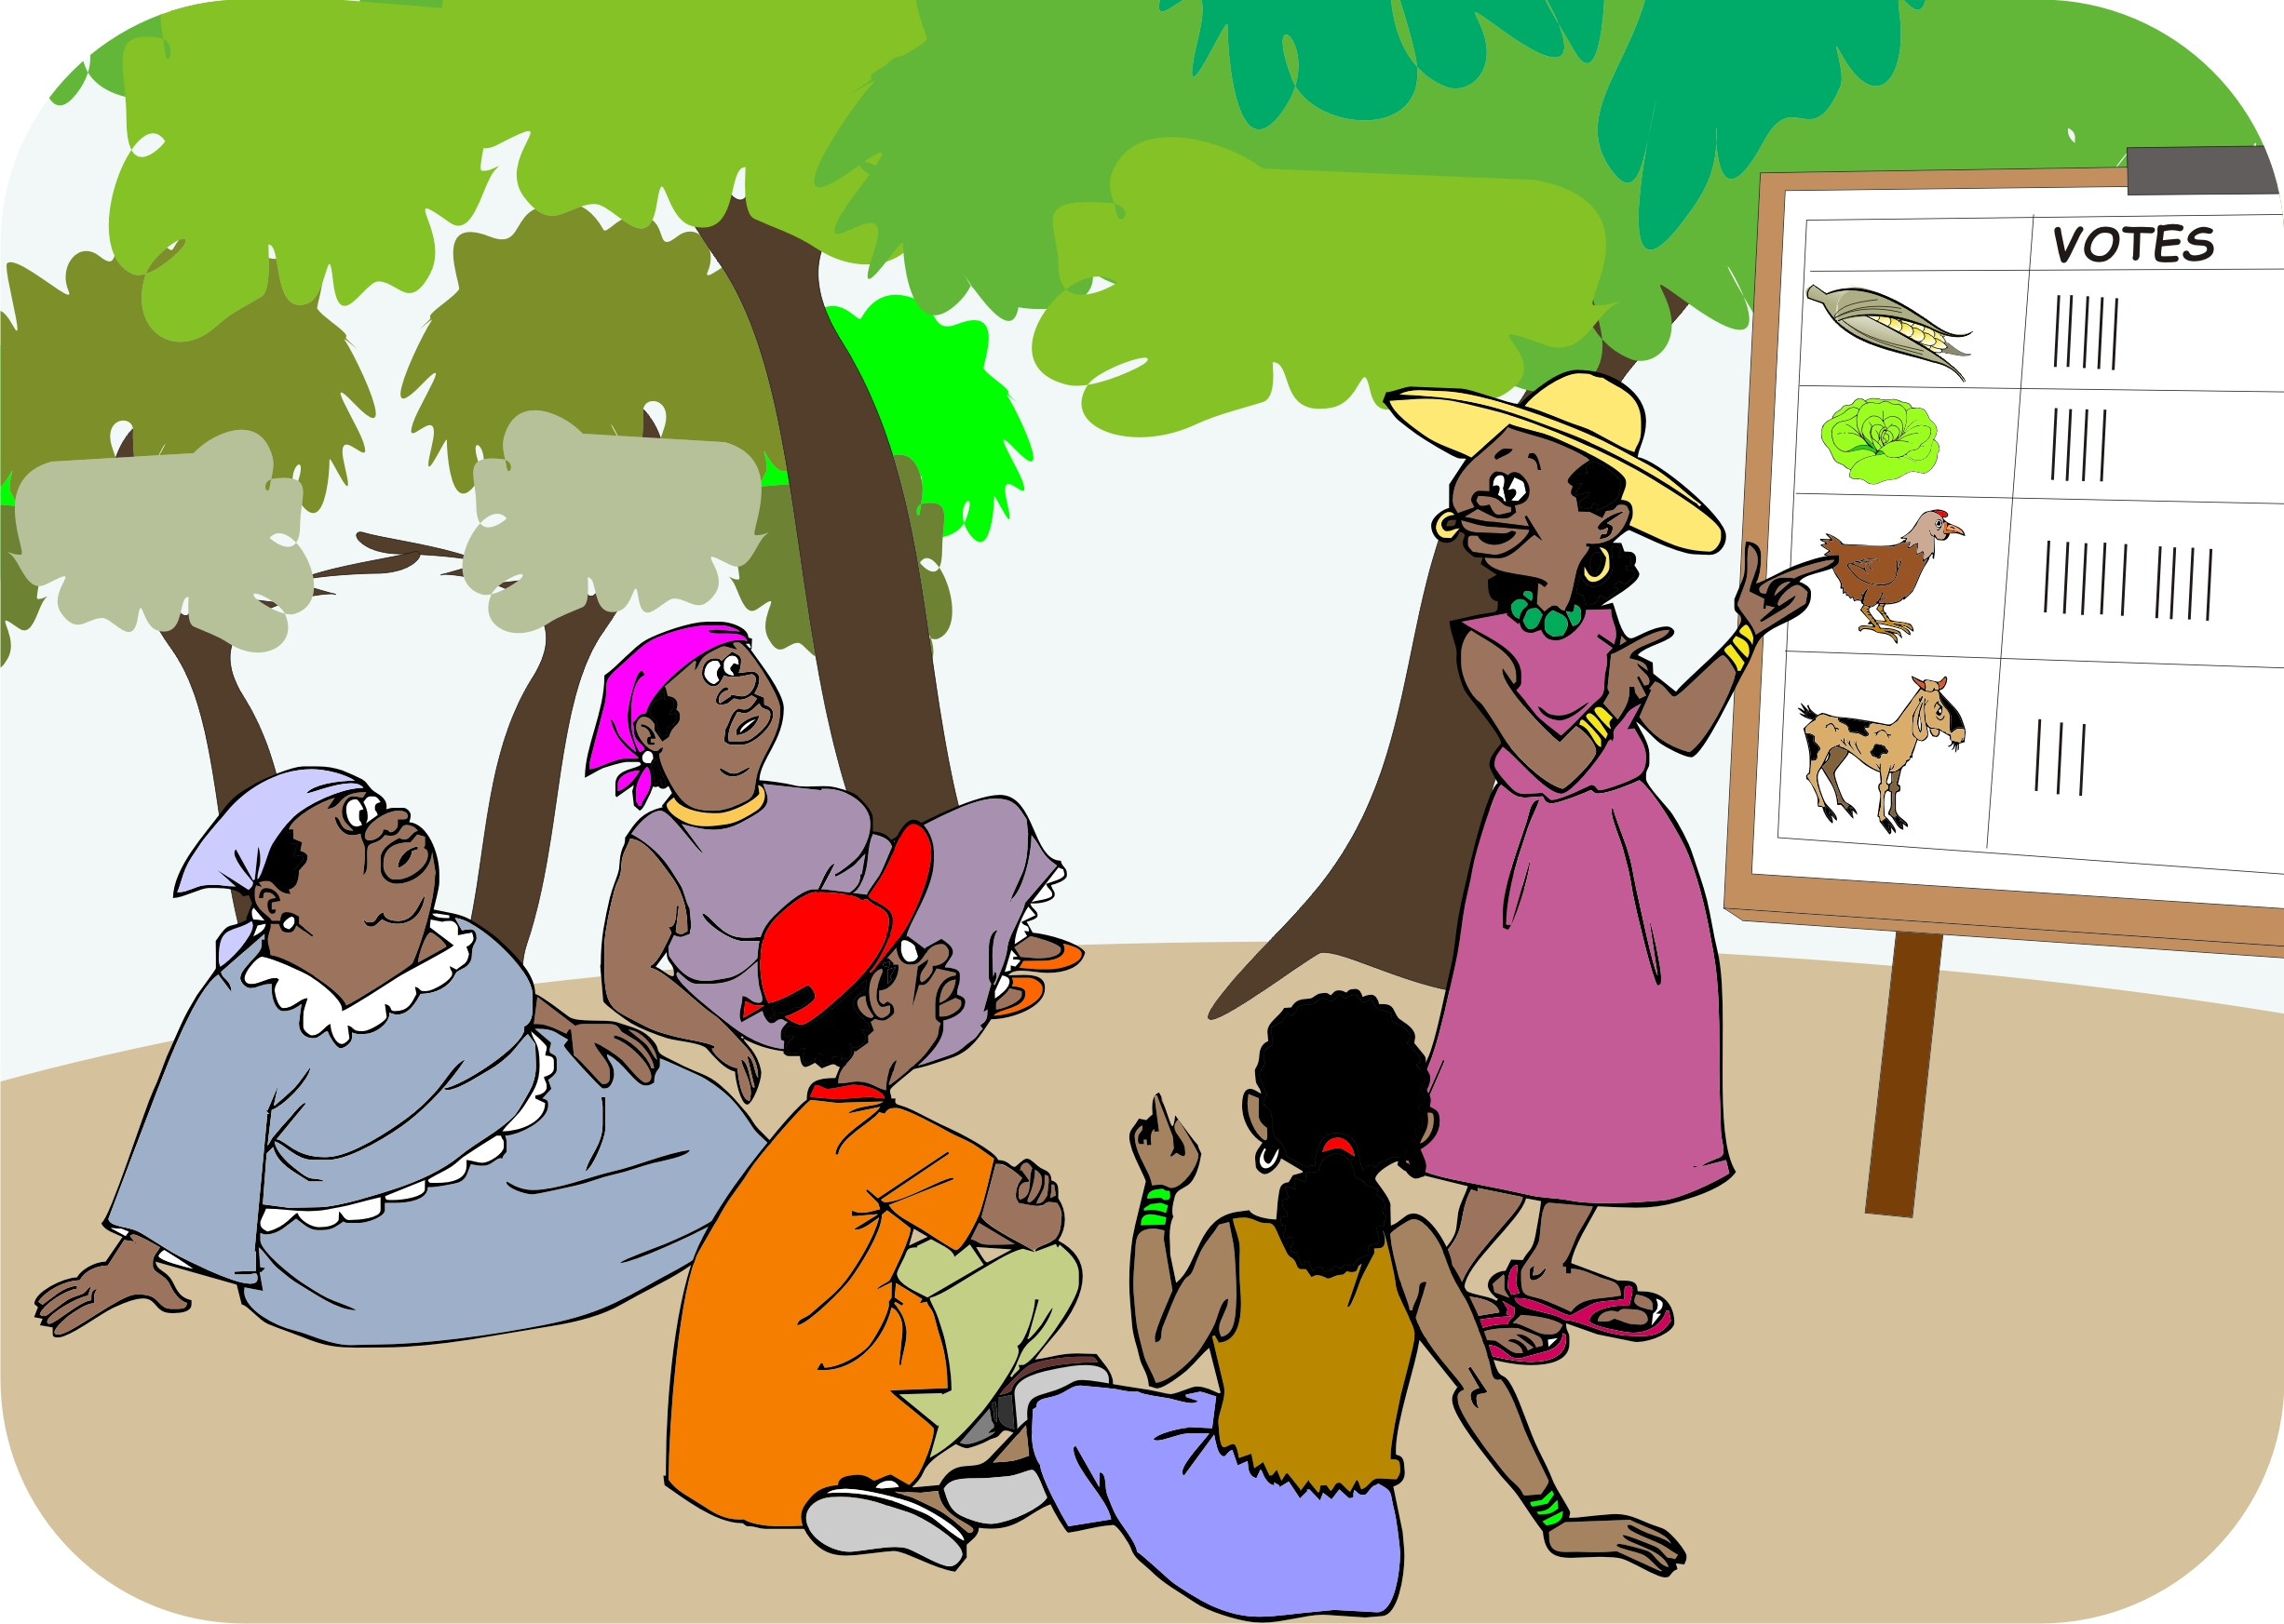
The crunch time meeting: The four Ps of marketing
Use the four Ps of marketing to reach consensus about the product and where to sell it:
What is the best market opportunity in terms of product type and prices?
How to sell and promote the product?
Where (which place) to sell the product?

Slide 110
Fundamental criteria
Is there a good demand and market access for the product?
Can we produce the product with the land, soil and water resources that we have available?
Can we continue producing the product without degrading these resources?
Will we be able to access the necessary inputs, technical and business support and financial resources?
Will we cover all our costs and make a profit?

Slide 111
Additional criteria
Risk: Consider riskiest and safest options
Alternative uses: Can the product contribute to both nutritional needs and generate income?
Cultural appropriateness: Are there cultural, religious or ethical objections to the product?
Unused resources: Can the product be produced on unused land?
Policies and incentives: Is the product favoured by government policies and regulations?
Labor: Does the product fit with other farming activities?
Women: Does the product disadvantage women?

Slide 112
Market strategies: New product in an existing market
Farmers may be able to attract better prices by selling an existing product into a different market, which may be a bigger, more distant market, or a larger trader or a processor.
When considering this option, remember that, when someone (e.g. the middleman) is cut from the chain, it may mean taking on additional costs and responsibilities.
The gain in income by cutting out a chain actor, must be large enough to cover any new costs and risks.

Slide 113
Market strategies: New product in a new market
A market survey may reveal that farmers can earn more by supplying a new product to a new market.
Consumer demands are always changing and new products come onto the market to fulfill these needs.
However, this is a high-risk strategy as the market may be volatile.
Farmers with experience in market linkages may want to take on this risk.

Slide 114
Market strategies: Extending production and harvesting period
At harvest:
  Markets are oversupplied
  Traders cannot find customers to buy the surplus
  Prices that farmers get for their produce are often at their lowest
Farmers may be able to earn more by producing off-season.
The farmers need a good knowledge of the price fluctuations and the product’s growing cycle, so that they can match harvest time with high prices.

Slide 115
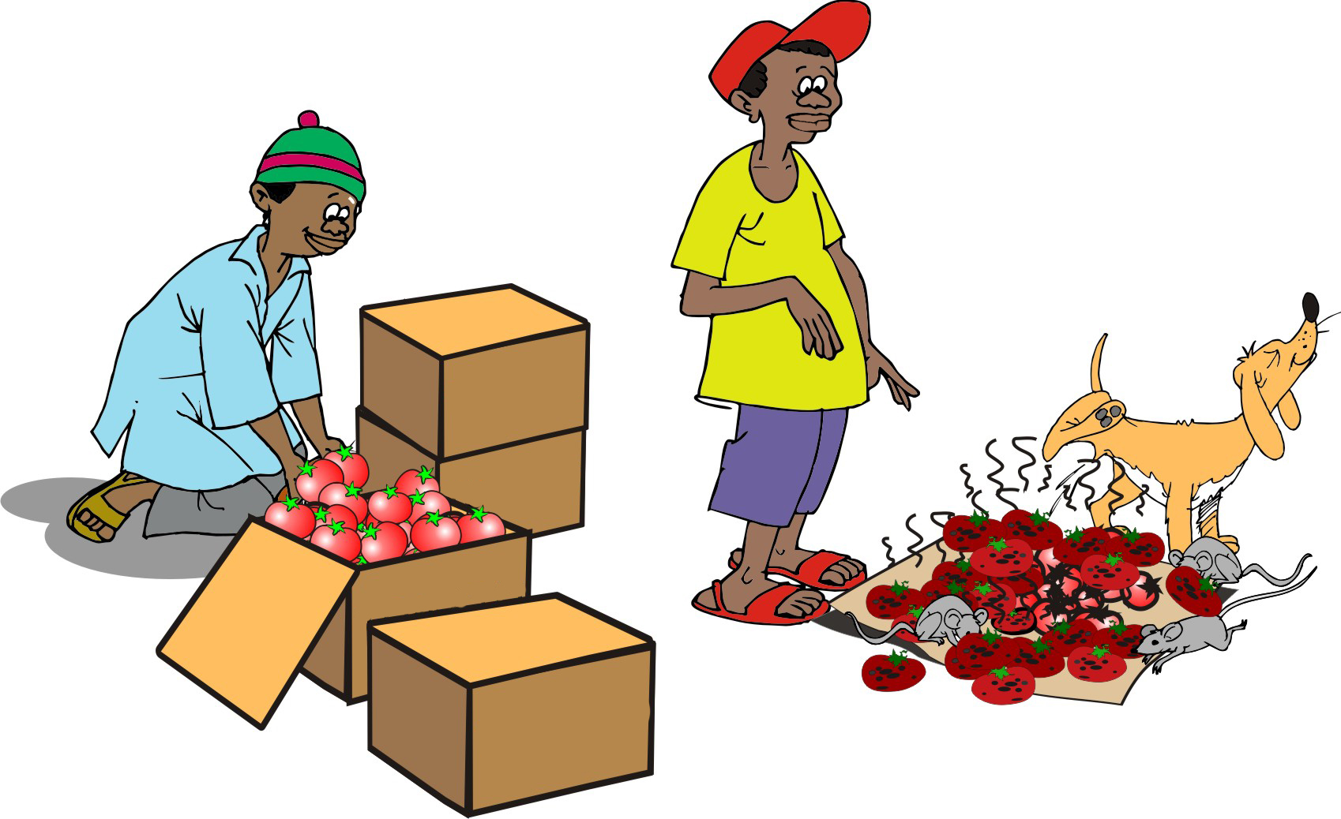
Storage and processing
It may be possible to make a profit by storing a product until prices go up, if:
Crop is sufficiently dried beforehand
The store is dry and well managed
As with the other strategies, farmers must know when to sell by accessing market information on this and last year’s prices.

Slide 116
Step 4:
Building a business plan

Slide 117
Lesson 13:
Tools for business planning

Slide 118
Outcomes
After this lesson you will be able to:
Describe what a business plan is and why a farmers’ group should write one.
Conduct a visioning exercise to help farmers plan their enterprise.
Conduct a market mapping exercise.
Conduct a problem analysis exercise to help farmers identify and analyze their problems.
Help a farmers’ group plan how much each member should grow to reach a production target.
Identify ways to improve the steps from production to marketing.

Slide 119
Overview
Lesson 13 covers the following content:
What is a business plan?
Why write a business plan?
Market mapping
Visioning
Problem analysis
Setting production targets
Pathway analysis

Slide 120
What is a business plan?
A business plan is a document that outlines an enterprise’s future by describing:
The enterprise and what it produces
How it produces the products
How it markets its products
The risks its faces and how to deal with them
The financial situation and financing needs of the enterprise
A typical business plan consists of the following three parts: An outline of the business, a financial analysis and a loan analysis.

Slide 121
Why write a business plan?
An agroenterprise writes a business plan to:
Guide the enterprise in the long-term
Facilitate understanding and agreement among group members
Improve organization and decision-making
Test and strengthen financial feasibility
Measure performance

Slide 122
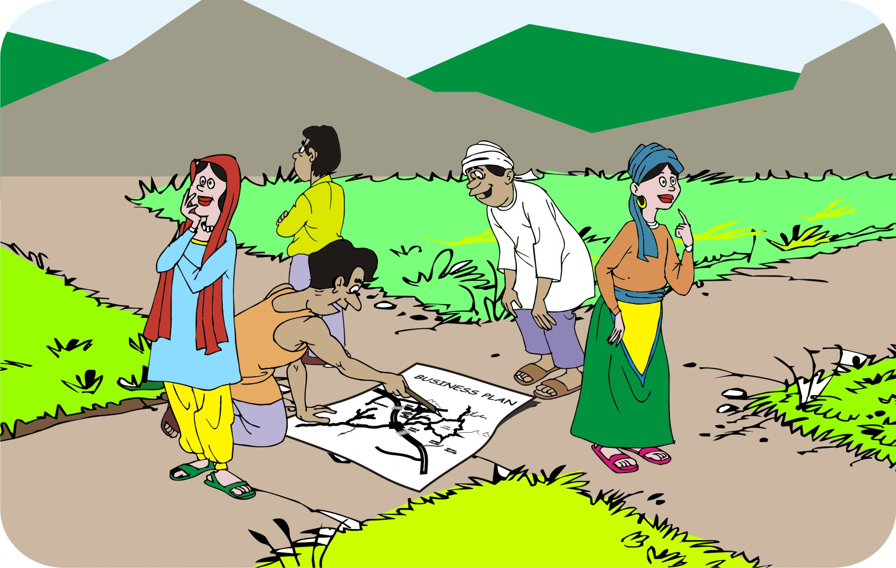
Why write a business plan? (Continued)
An agroenterprise writes a business plan to:
Ensure continuity
“Sell” the enterprise
Convince lenders and donors that the enterprise will be profitable
Guide implementation

Slide 123
Business plan: Part 1
Part 1: Outline of the business
Introduction
Business organization
Product
Marketing strategy
Risks
Business operations plan

Slide 124
Business plan: Part 2 and 3
Part 2: Financial data and analysis
Marketing costs
Income streams
Profit and loss analysis
Part 3: Loan analysis
Financial requirements for a loan

Slide 125
Market mapping:
Existing versus future marketing situation
Use new (updated) information to create a second map that shows the:
Marketing situation
Chosen product and prices
Changes in production and processing
Volumes produced
Changes in marketing channels and customers

Slide 126
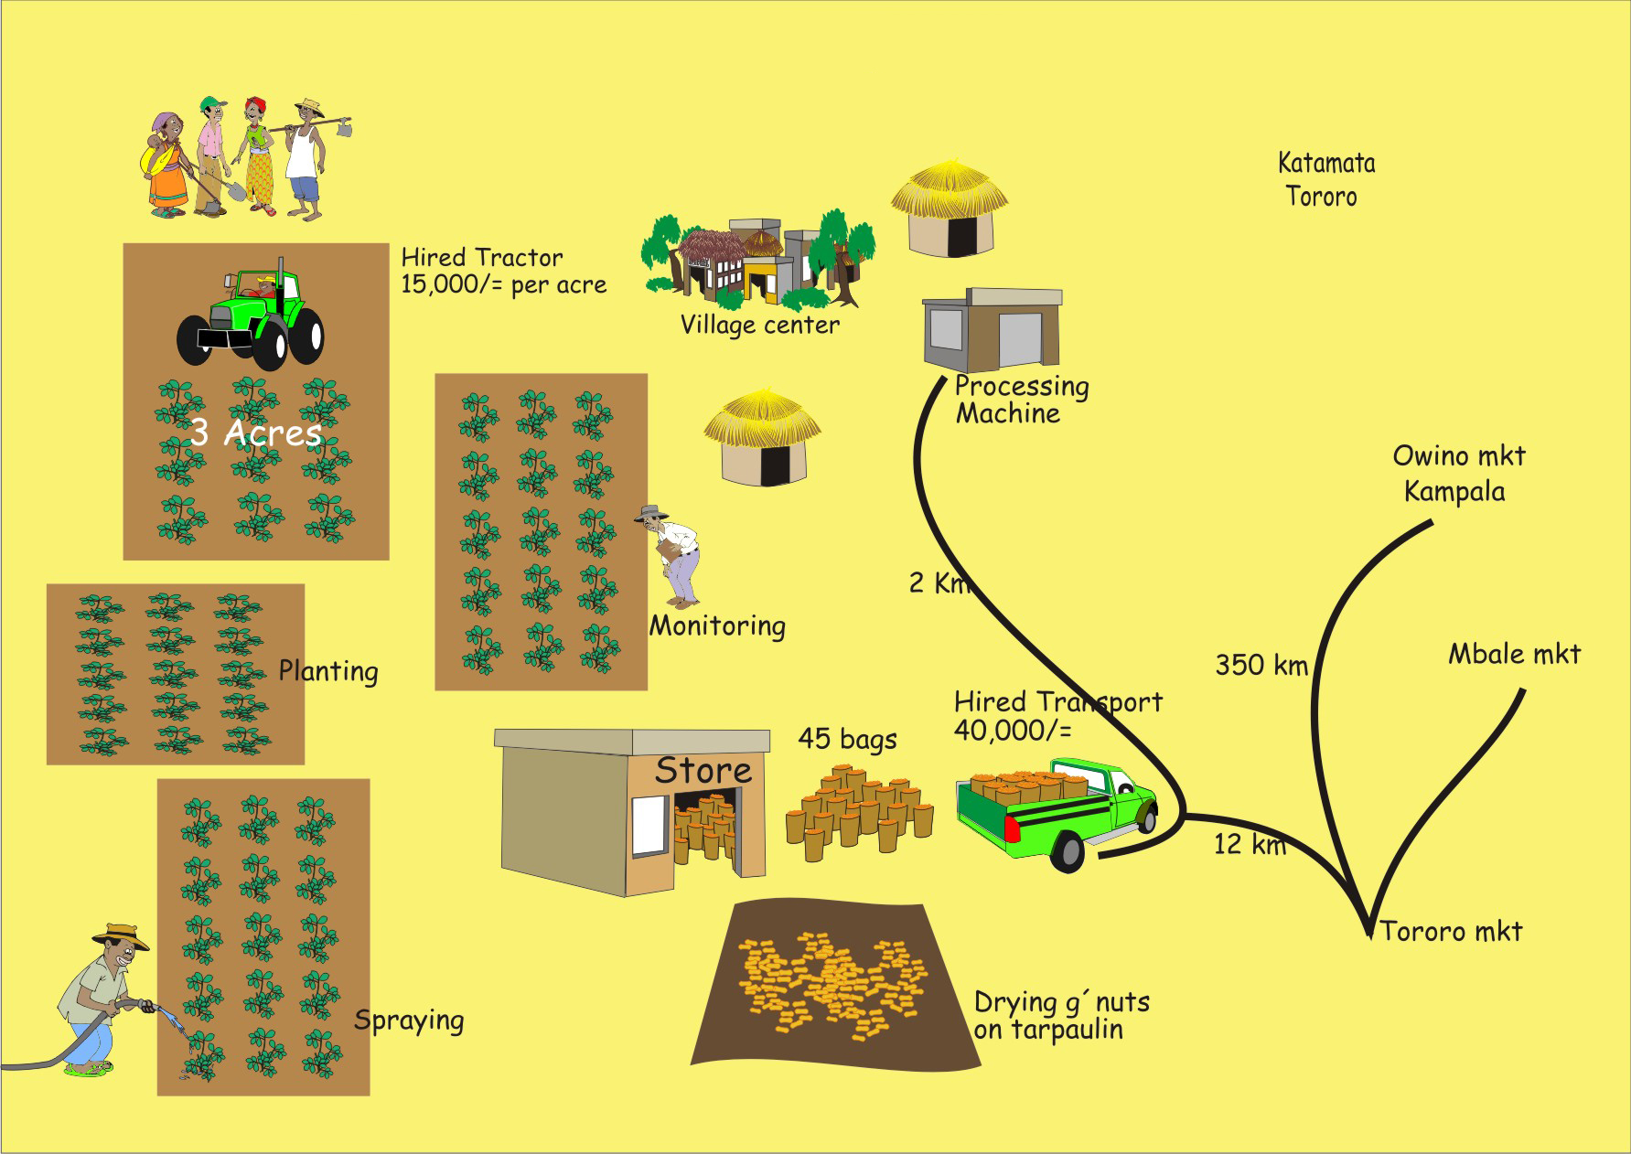
Market mapping: Examples

Slide 127

Visioning
Visioning:
Is a technique that is used to help the farmers think of what they want to achieve in the future.
Can also be applied to help farmers build their business plan.

Slide 128
Steps in visioning session
Start the session with a long-term vision, e.g. ask the farmers to imagine what they would like their production and marketing to be like in five years.
Ask the group to think of the situation in a shorter time frame, e.g. three years.
Ask them what they need to do to put these changes into effect. This forces the farmers to be more realistic and to prioritize activities.
Ask them to shorten the time frame again: What will things be like in one year and what do they have to do to make the changes happen.

Slide 129
Problem analysis
In problem analysis, you help the farmers to:
List the problems they face in producing and marketing their selected product
Describe how they currently address these problems
Think of ways in which they may overcome their problems in future

Slide 130
Setting production targets
Setting targets for the next season or production cycle forces farmers to think of what they need to do to achieve these targets.
That, in turn, means they have to think of realistic changes in their production, postharvest and marketing activities.

Slide 131
Setting production targets (Continued)
Targets can be set by:
The group itself or by a larger group (e.g. the farmer’s marketing association)
A buyer (e.g. a trader or a supermarket or a factory that buys regular supplies)
A donor or a lender

Slide 132
Taking action to achieve targets
In order to achieve a target, which is normally higher than current production, they group may have to:
Increase the output per member, e.g. planting a larger area or raising more animals
Increase the yield per hectare or per animal
Extend the supply period, e.g. changing the timing of planting and harvesting
Process the output in a different way, e.g. reducing wastage or improving quality

Slide 133
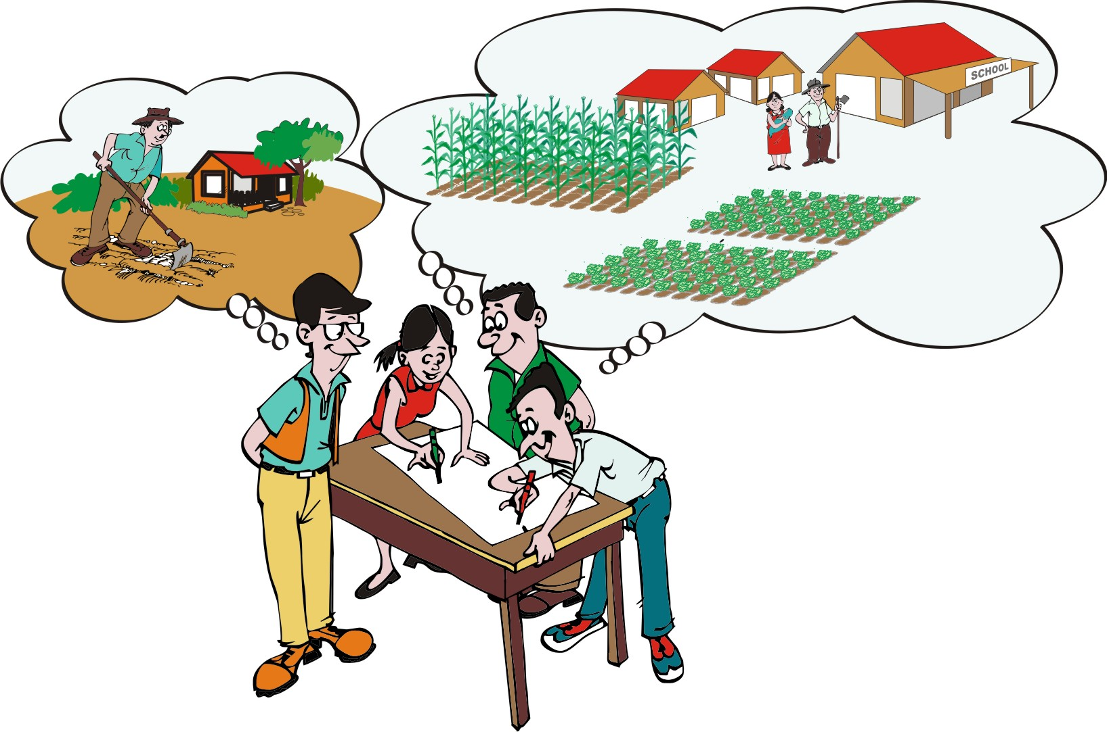
Pathway analysis
Pathway analysis breaks the “pathway” from production to marketing down into steps and looks for ways to improve each step in order to achieve your goals.

Slide 134
Pathway analysis (Continued)
Pathway analysis helps the farmers think through the specifics of how to get from their current situation to their desired goal in production and marketing.
The “pathway” is the route from “where we are now,” through a series of improvements, to “where we want to be.”

Slide 135
Pathway analysis: Procedure
Ask the farmers to summarize their current production and marketing situation. This is “Where we are now”.
Ask them to say what the desired situation or goal would be. This “Where we want to be.”
List the general improvements that farmers need to make at each of the stages in pre-production, production, postharvest and marketing.
List the activities farmers need to undertake in order to make the improvements in every stage.
Identify the output of the improvements in each stage.

Slide 136
Lesson 14:
The business model canvas

Slide 137
Outcomes
After this lesson you will be able to:
Draw and label a business model canvas.
Explain the meaning of each of the nine areas in the canvas.
Use the business model canvas to analyze an existing production and marketing system.
Use the canvas to prepare information on building a business plan.
Transfer information from the business canvas into a written business plan.

Slide 138
Overview
Lesson 14 covers the following content:
Visualizing a business plan
Nine areas of the business model canvas
Interpreting the business model canvas
Using the business canvas to understand and plan business options
Using the business canvas to analyze a current production and marketing system
Using the business canvas to organize information for a business plan
Using the business canvas to build a business plan

Slide 139
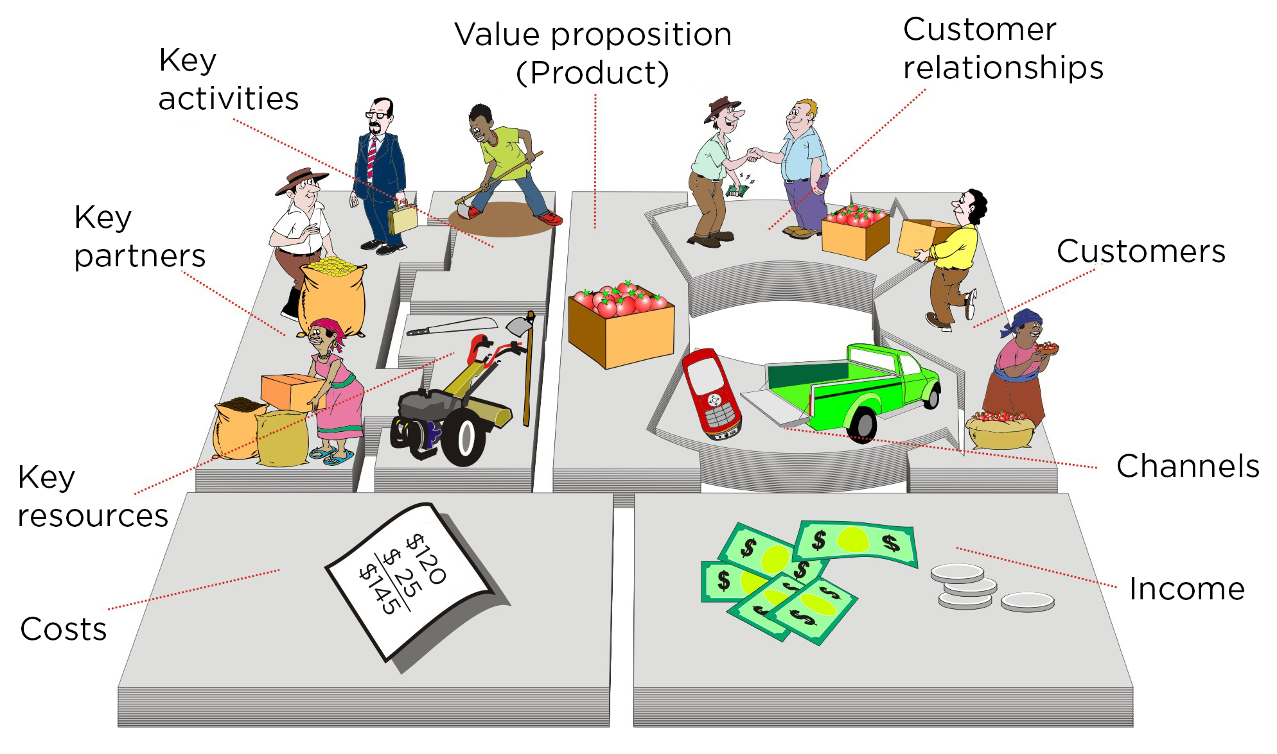
Visualizing a business plan
The business model canvas is a visual method to help farmers understand how a business plan is built from basic parts and how to design a business plan.

Slide 140
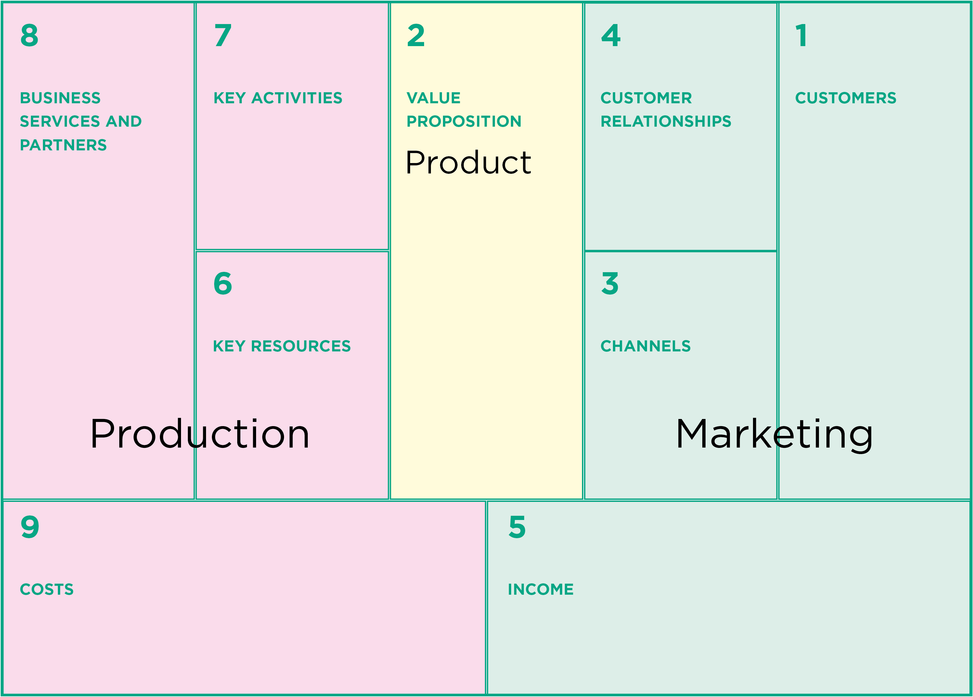
The business model canvas

Slide 141
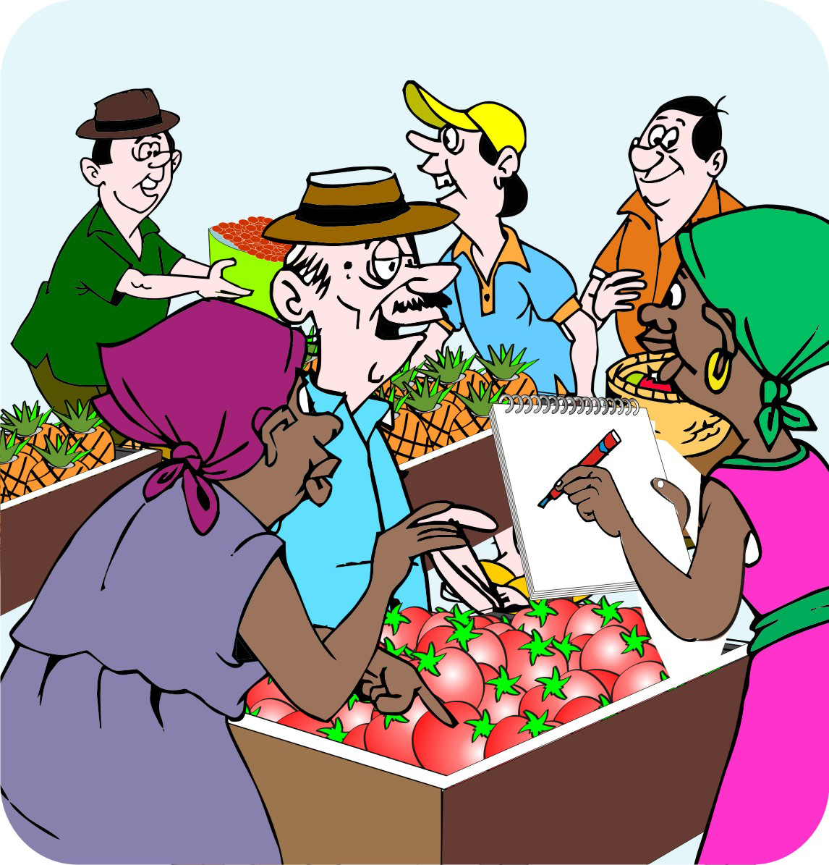
Areas of the business model canvas: Customers
Customers are the buyers or customers of the product, such as traders or consumers.
For most products there is more than one type of customer.

Slide 142
Areas of the business model canvas:
Value proposition
The value proposition:
Is a statement that clearly and concisely describes the unique value of a group’s products and services.
States the group’s core objectives that set it apart from the competition.
Focuses on a specific product or service that the farmers plan to produce or sell, e.g. maize or milk (products) and drying and cleaning facilities (services).

Slide 143
Areas of the business model canvas: Channels
Channels are the ways in which the group plans to deliver the product to the buyer, for example by having members deliver to a village collection center ready for pick-up.
In the Four Ps model, these channels correspond to Place.

Slide 144
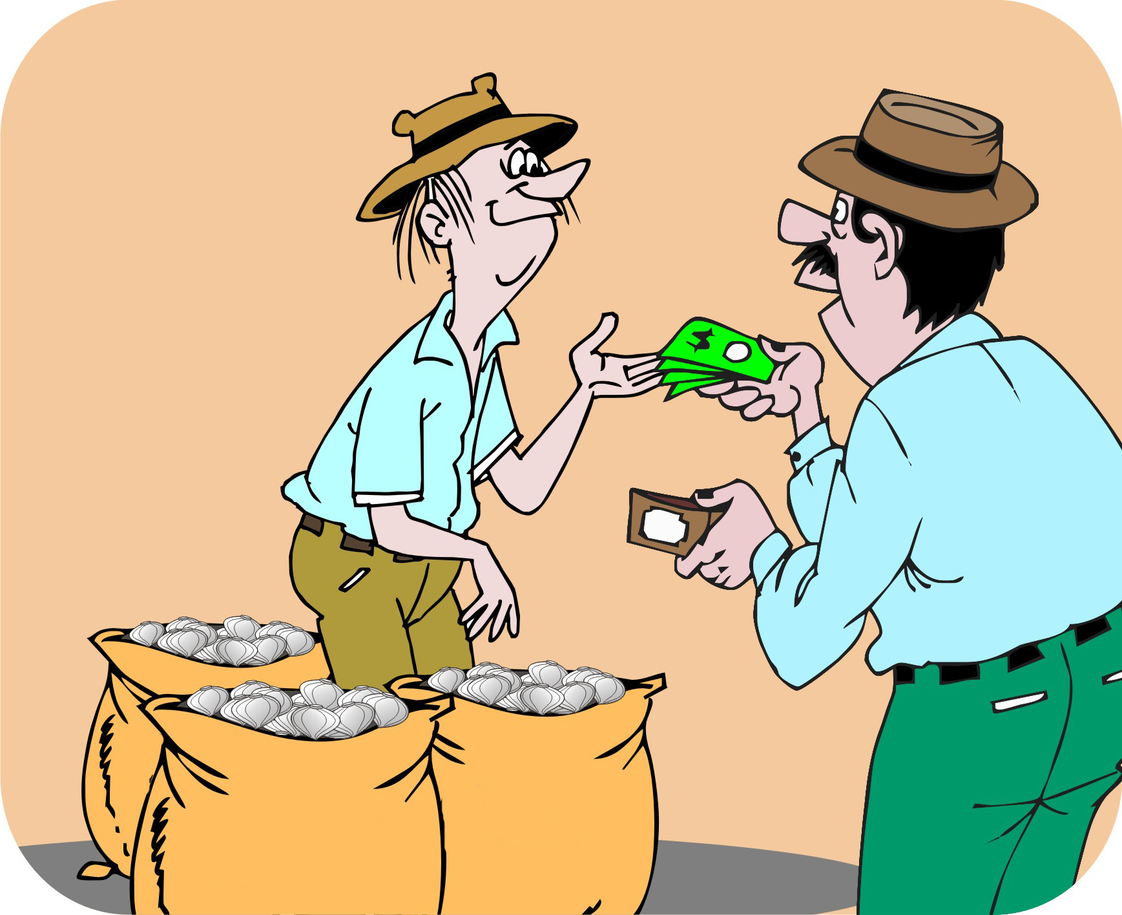
Areas of the business model canvas: Customer relationships
Customer relationships refer to the way in which the group plans to identify buyers and create and maintains relationships with them.

Slide 145
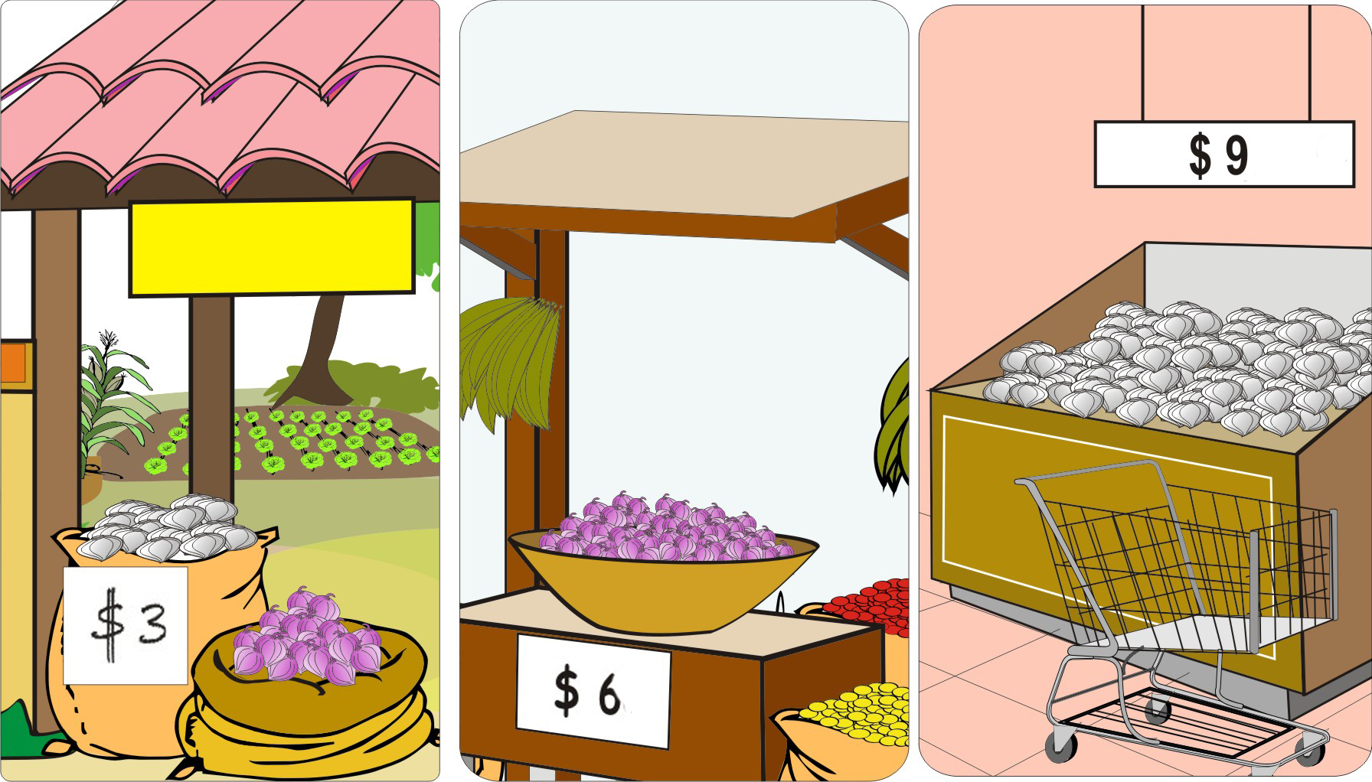
Areas of the business model canvas: Income
Income is the money the group earns from selling the product.

Slide 146
Areas of the business model canvas: Key resources
Key resources are the inputs and resources the group uses to produce the product and they include:
Land
Equipment
Seed and fertilizer
Labor
The group’s internal organization

Slide 147
Areas of the business model canvas: Key activities
Key activities are the activities the group plans to do to produce the product, such as planting, crop management, harvesting and drying.

Slide 148
Areas of the business model canvas: Business services and partners
Business services are the services and partners that the group uses to produce and market its product.
Examples
  Input suppliers
  Agricultural extension service
  Microfinance institution

Slide 149
Areas of the business model canvas: Costs
These are the costs that the group incurs in order to produce and market the product.

Slide 150
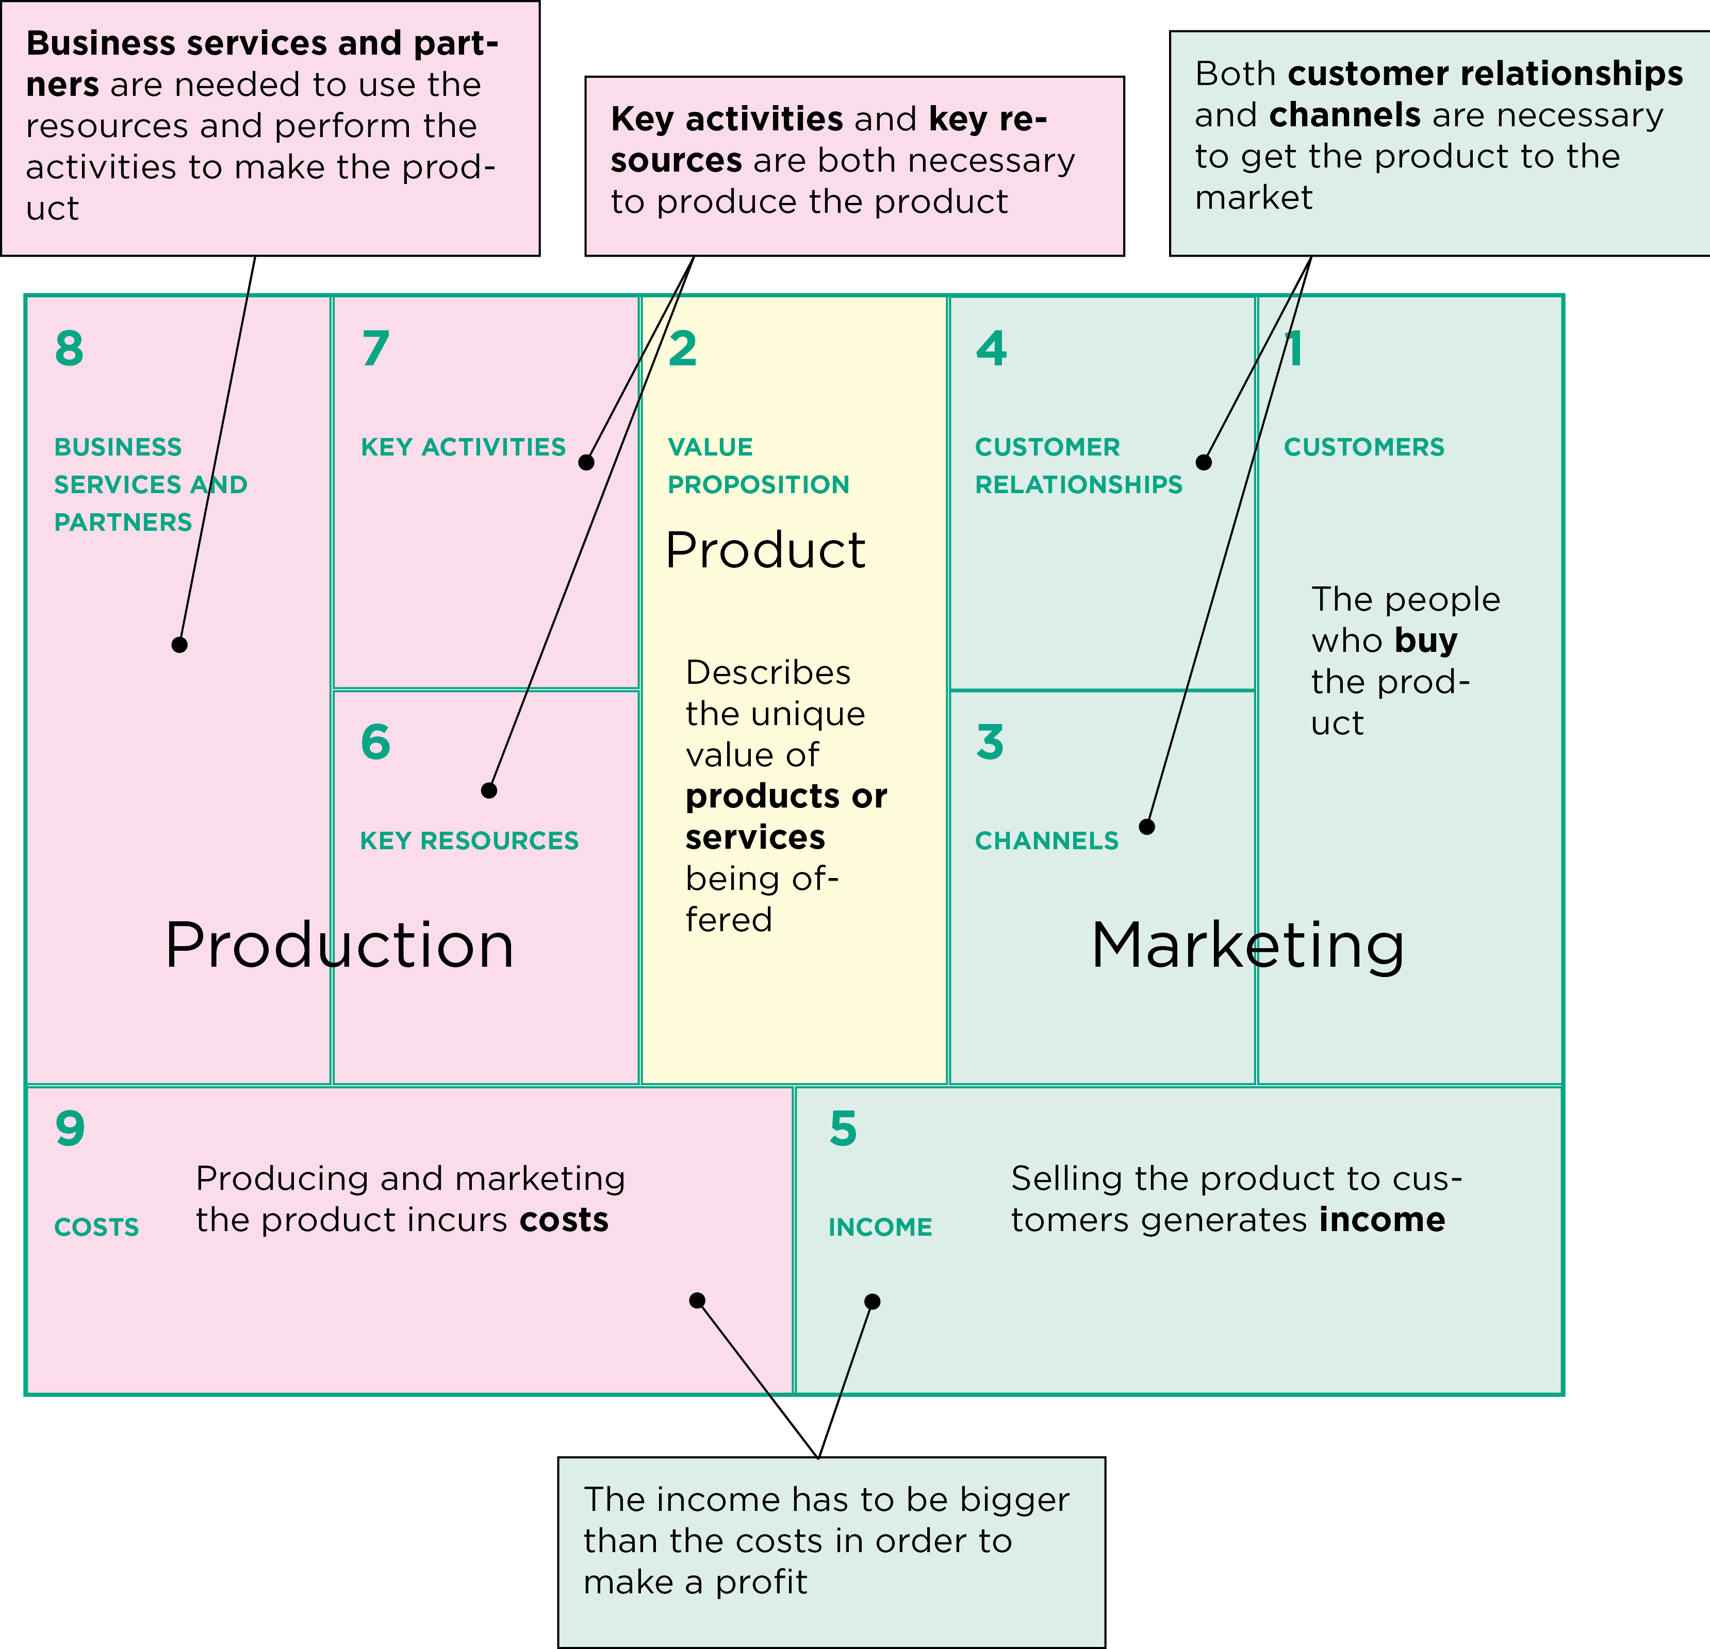
Interpreting the business canvas

Slide 151
Using the business canvas to plan business options
You can use the business canvas to:
Help the project team understand their business situation
Help the farmers gather and organize information for a business plan
Explain a business plan or an existing enterprise to other farmers, value chain actors, business service providers, or donors

Slide 152
Using the business canvas to plan business options (Continued)
You can use the business canvas to:
Help the farmers show and analyze their current production and marketing system
Help the farmers plan improvements to their current system
Help the farmers plan a completely new production and marketing system

Slide 153
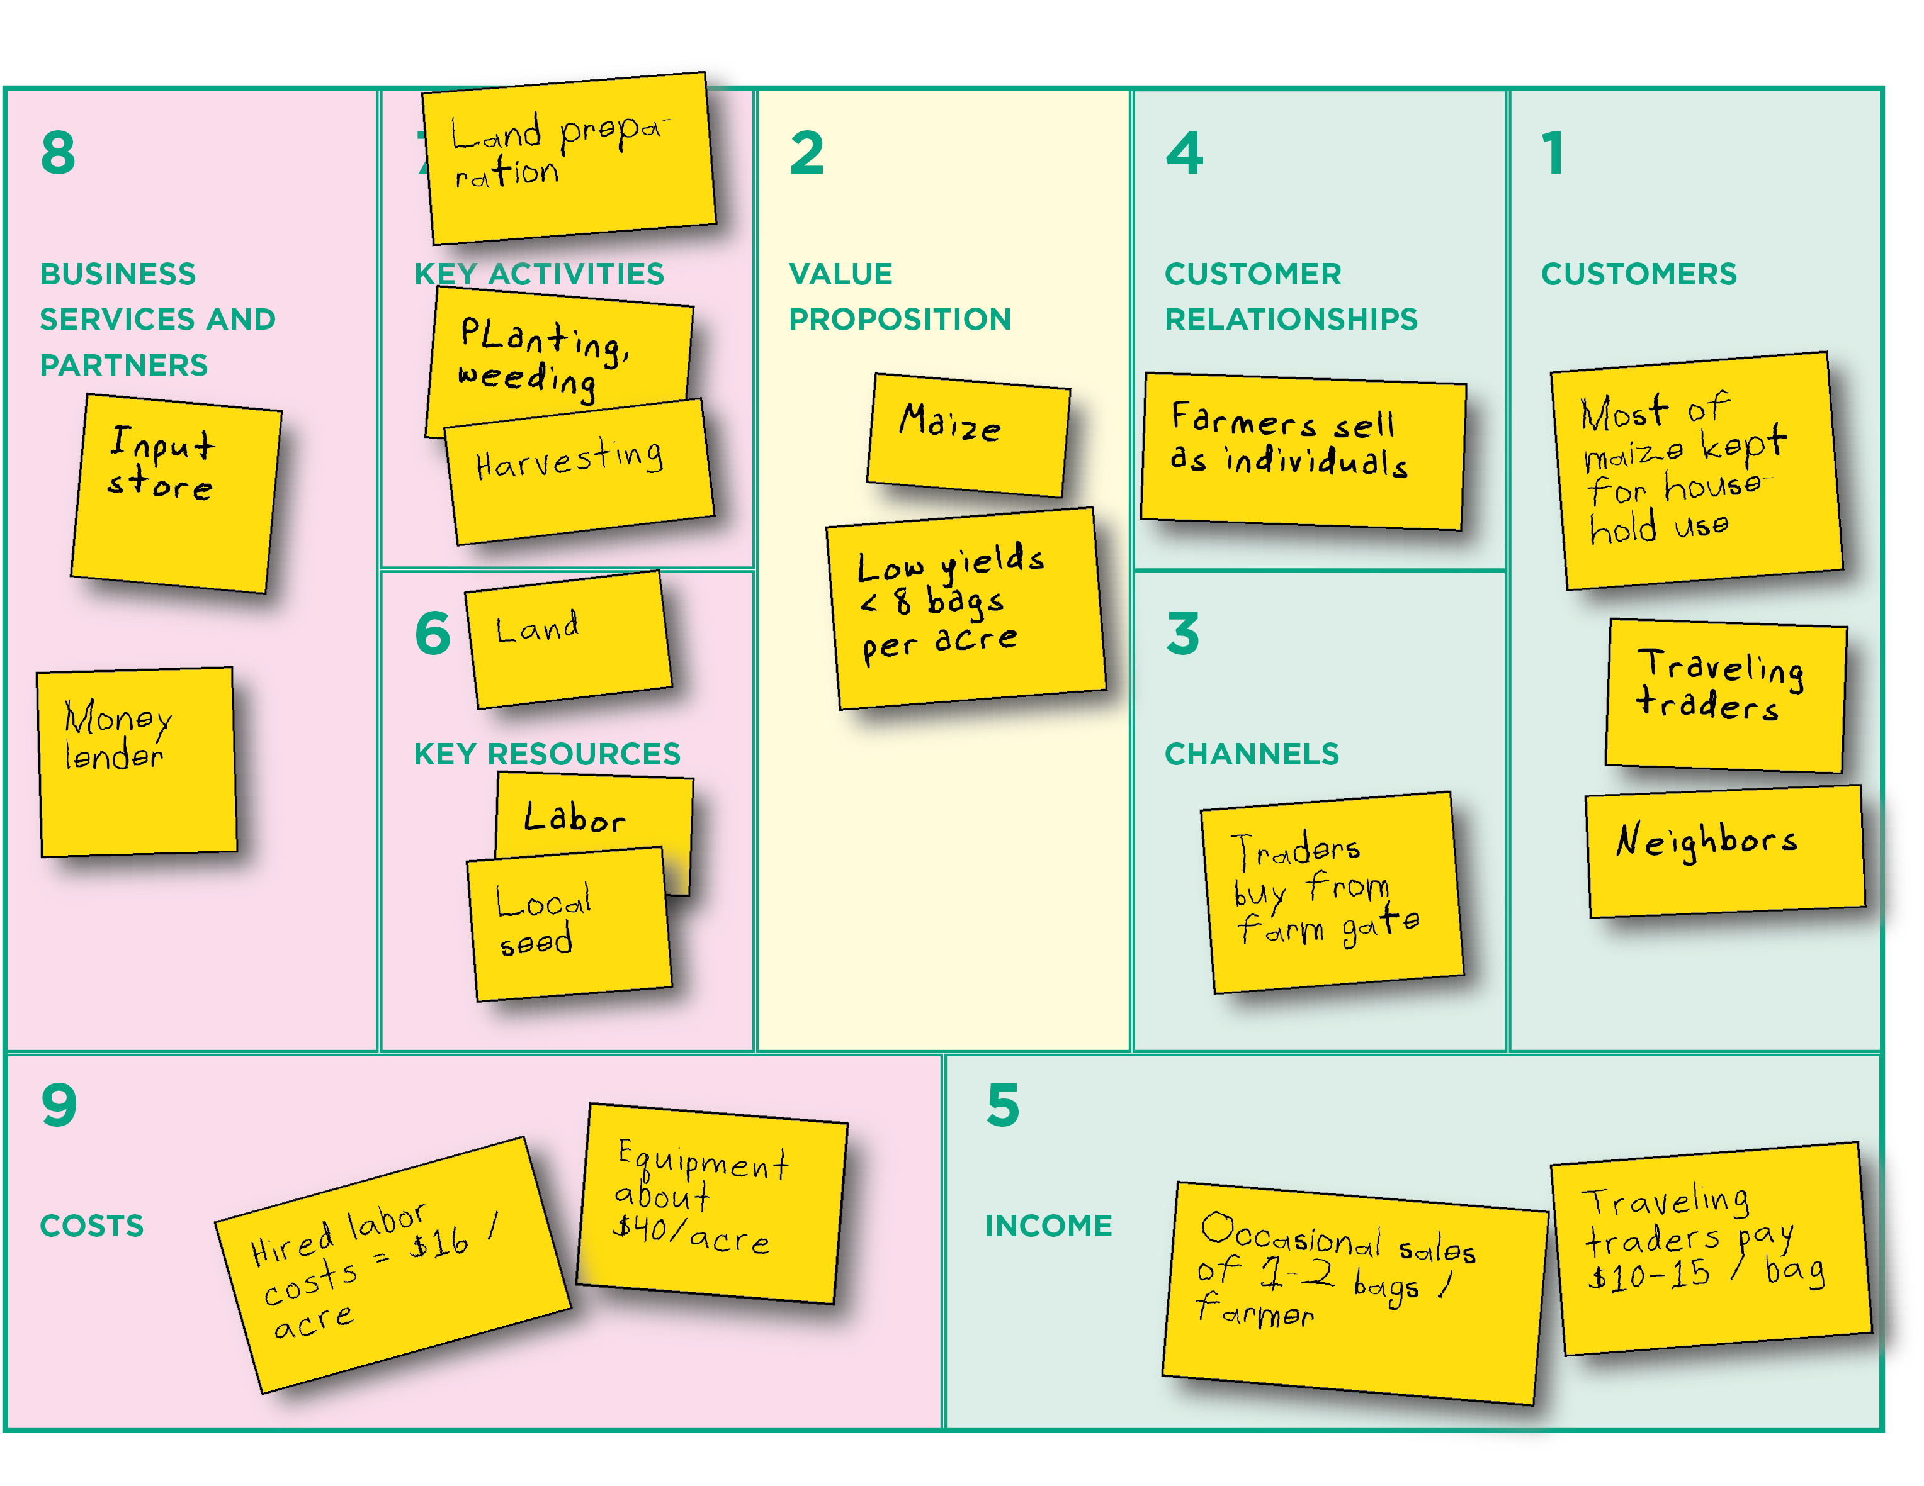
Using the canvas to analyze a current production and marketing system

Slide 154
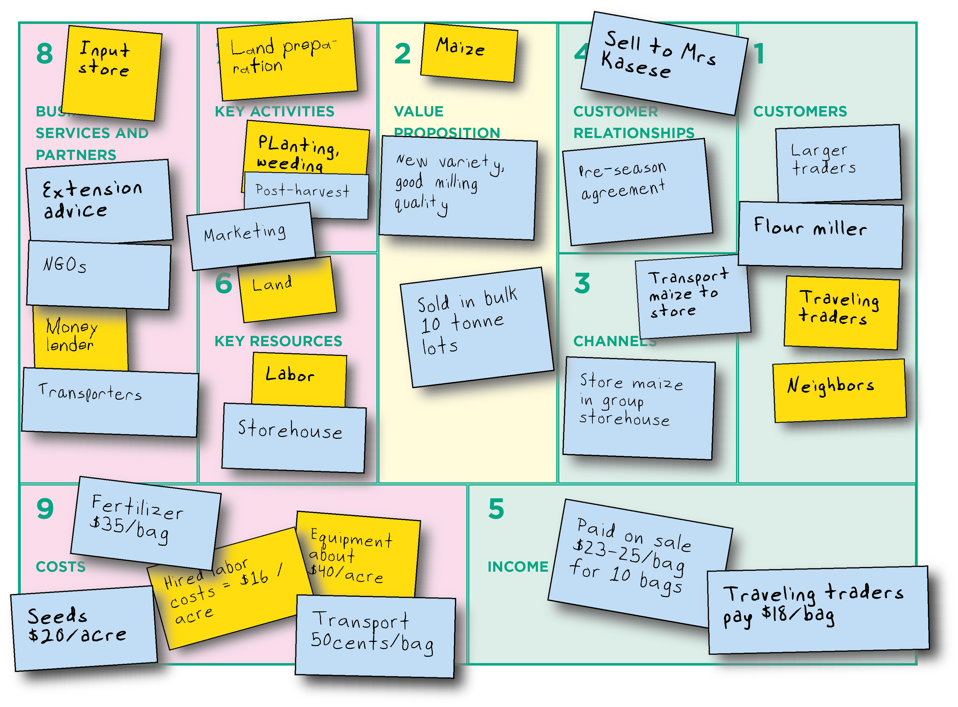
Using the canvas to organize information for a business plan

Slide 155
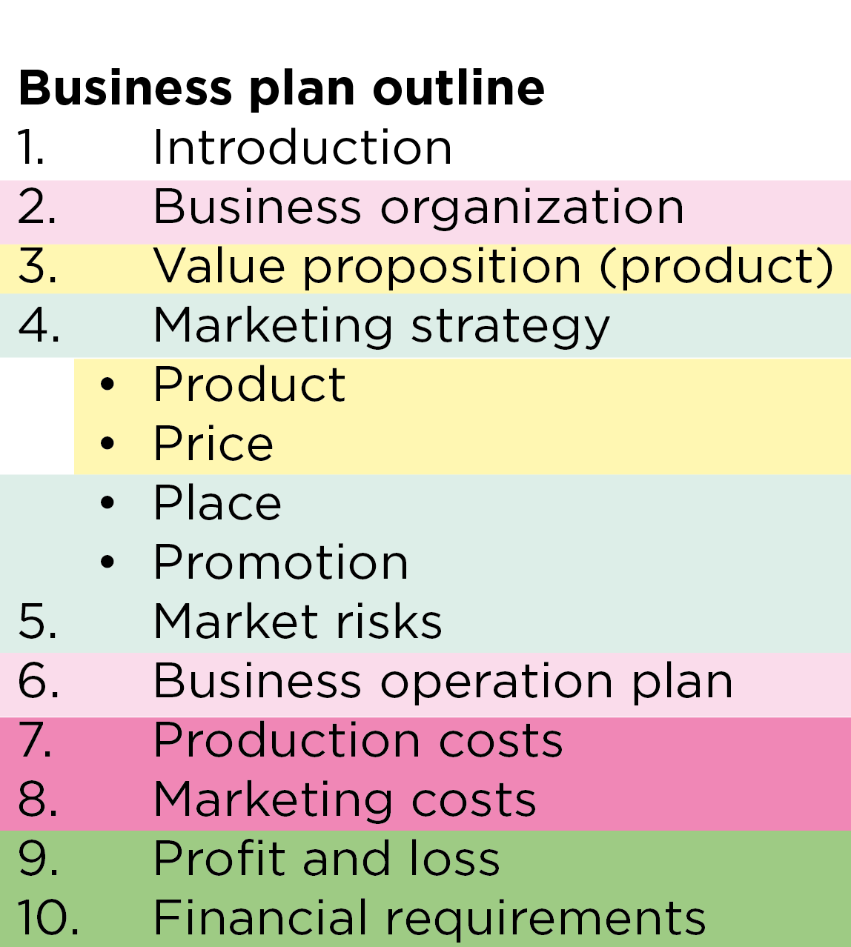
Using the canvas to build a business plan
You can use the canvas to gather and analyze the information needed for a business plan.
The nine areas of the canvas mostly correspond to the ten parts of a standard business plan, which makes it a valuable tool to use when writing the business plan.

Slide 156
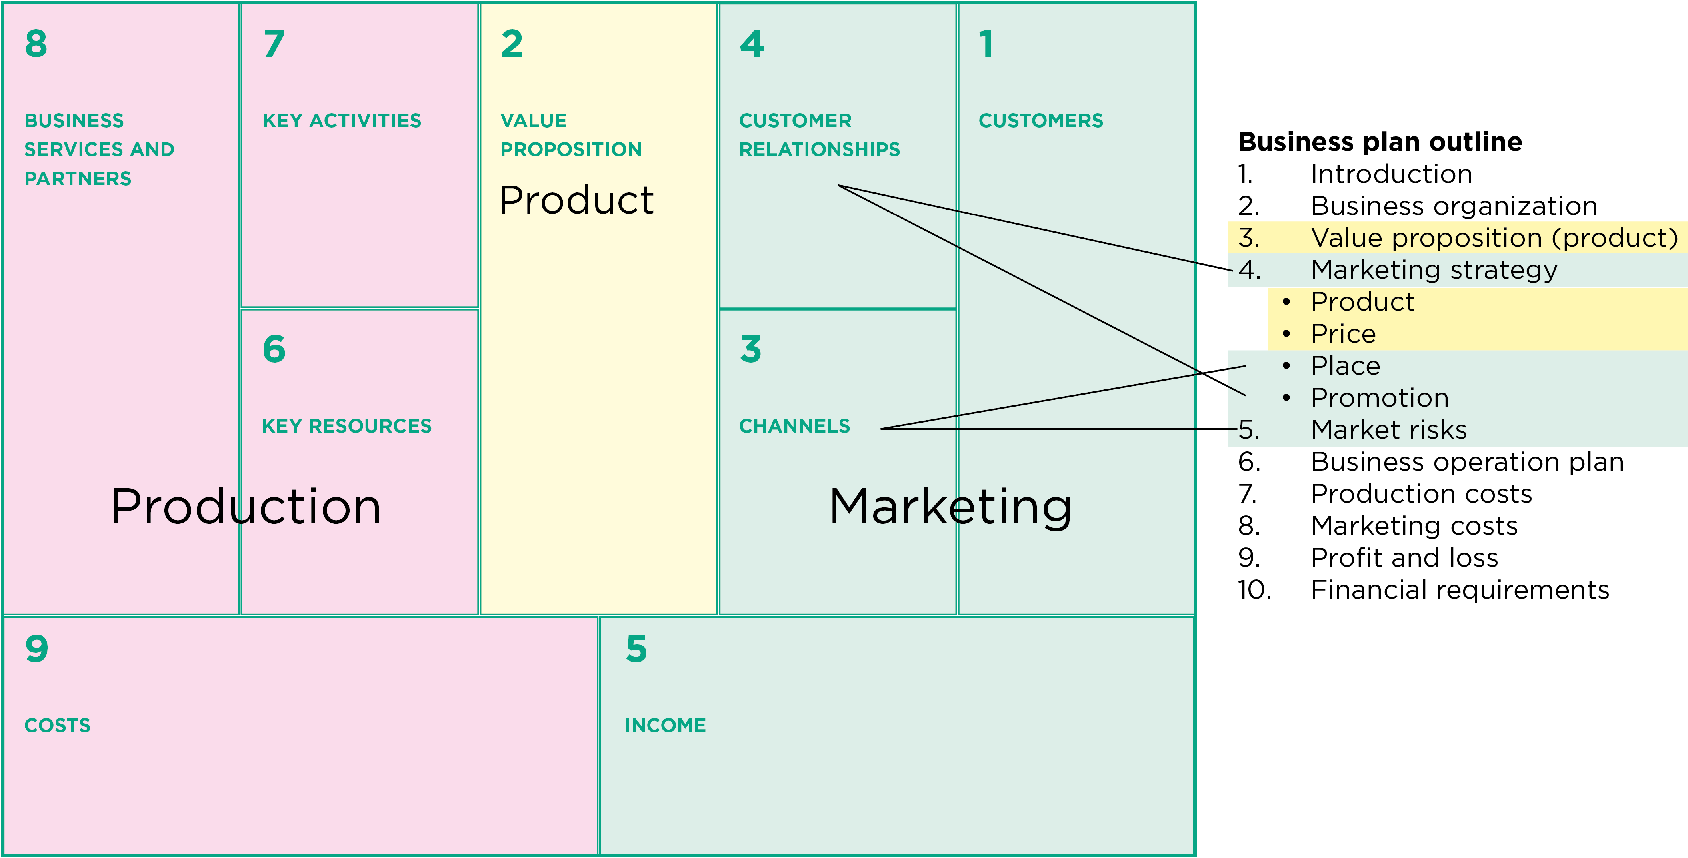
The business canvas and value proposition

Slide 157
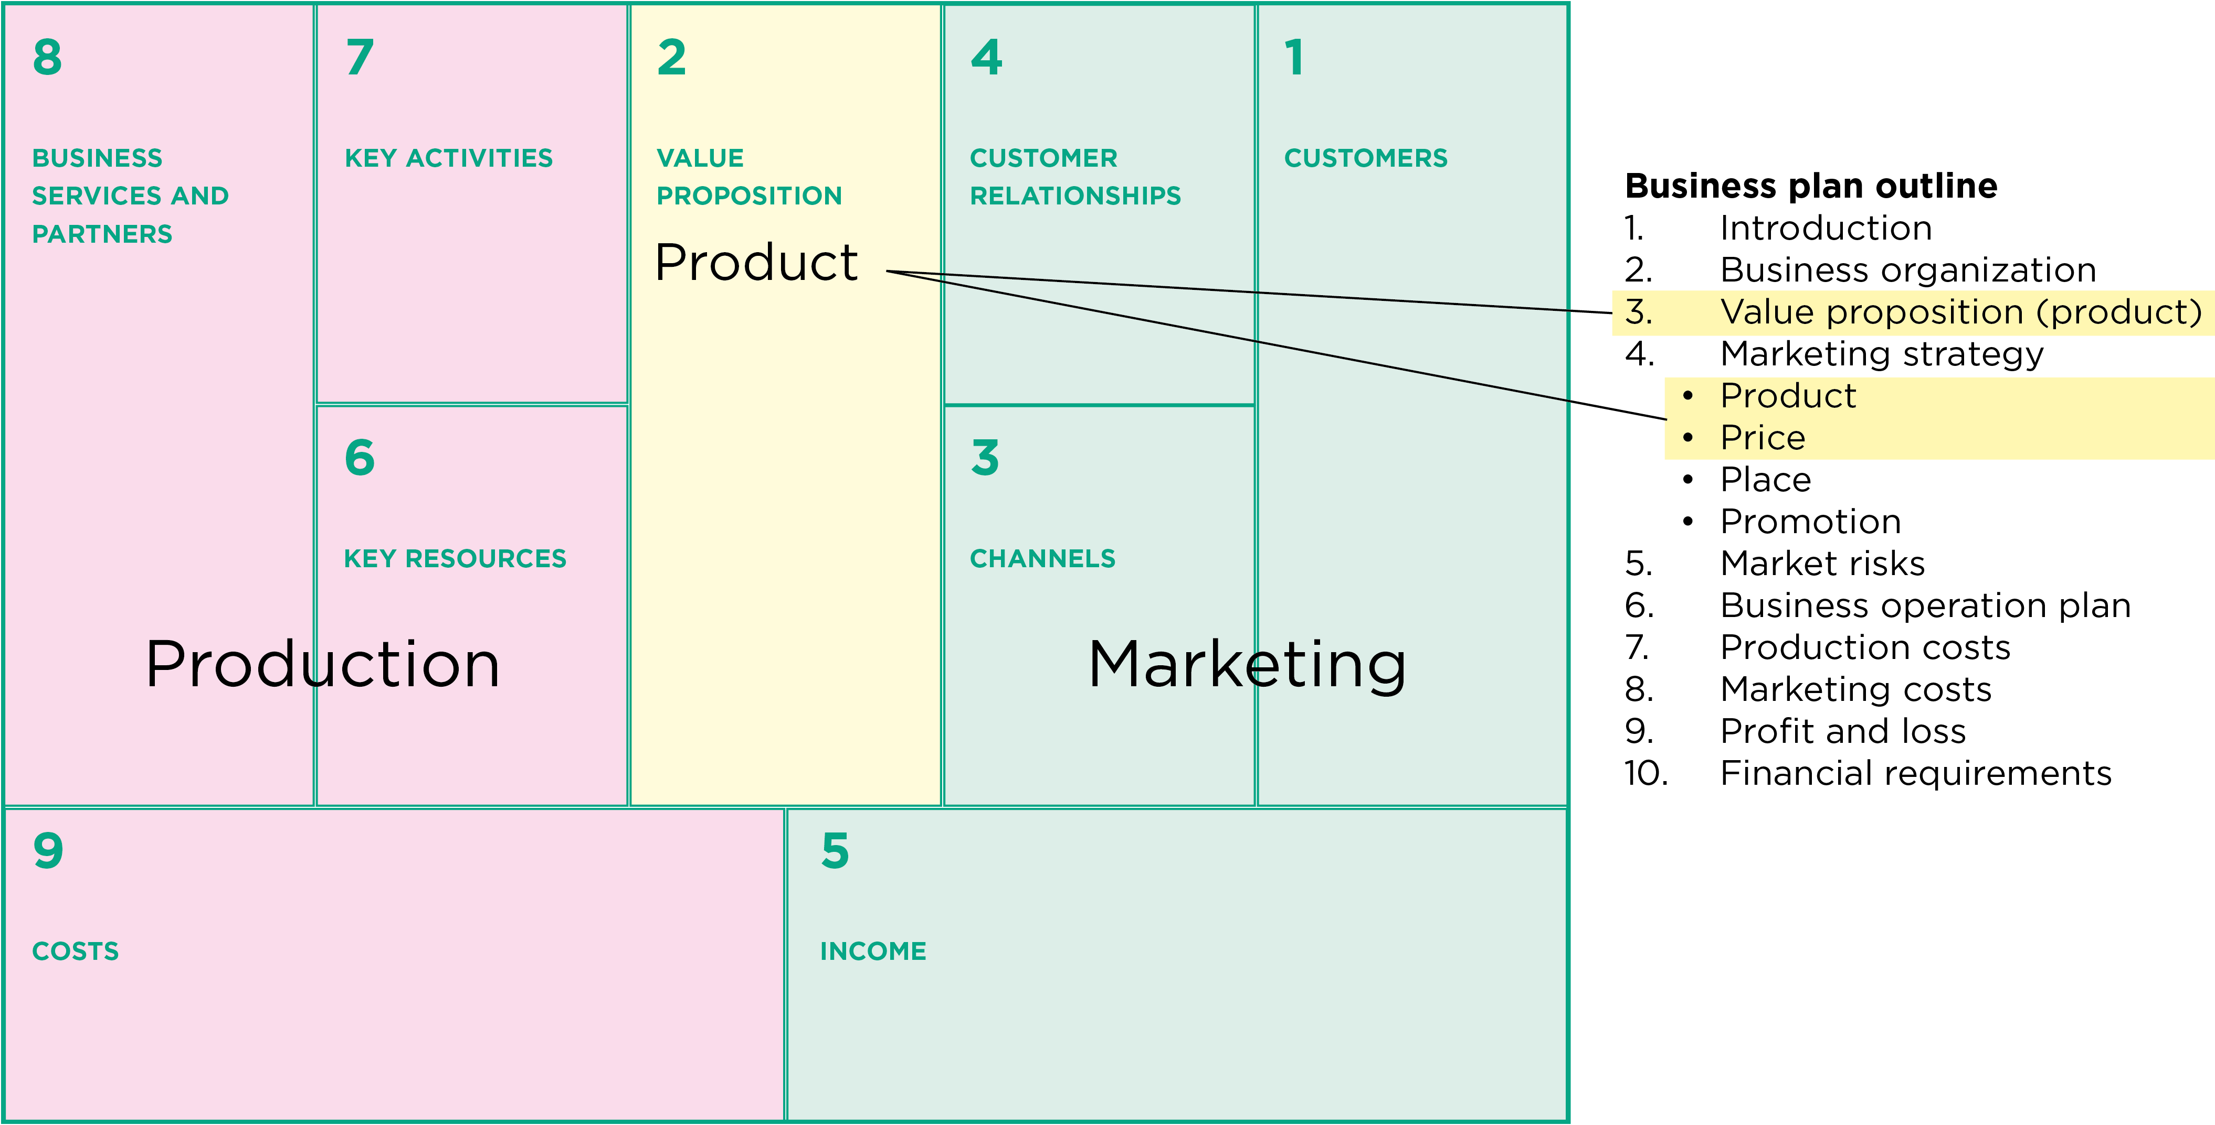
The business canvas and marketing

Slide 158
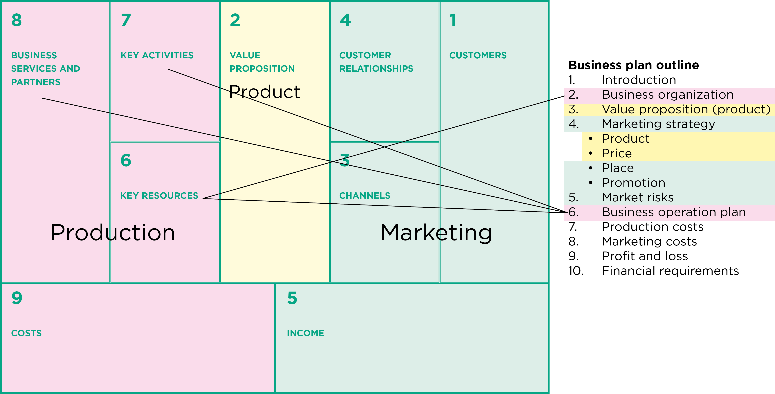
The business canvas and production

Slide 159
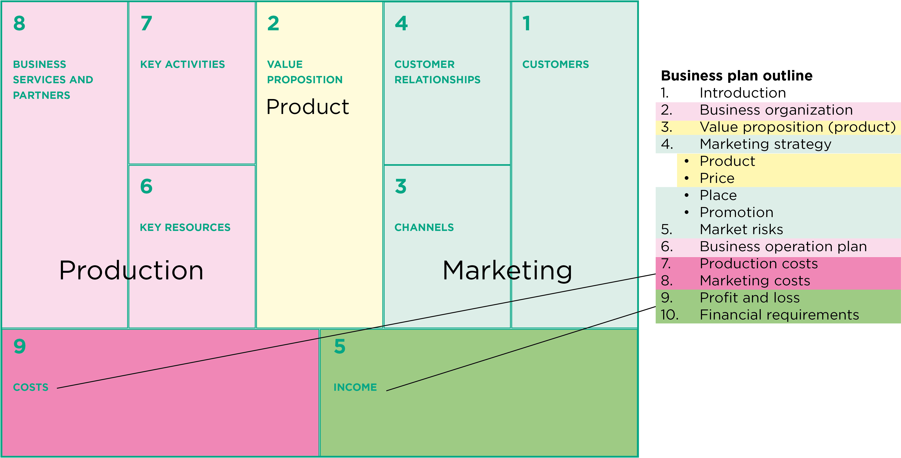
The business canvas and costs and income

Slide 160
Lesson 15:
Filling in the business plan

Slide 161
Outcomes
After this lesson you will be able to:
List the elements in a business plan and describe what goes in each one.
Guide the farmers’ group to write the narrative section of their business plan.
Guide the group to write the profitability section of the plan.
Guide the group to review the loan section of the plan.

Slide 162
Overview
Lesson 15 covers the following content:
Writing a business plan
Farmbook software
Part 1: Outline of the business plan
Part 2: Profitability analysis
Part 3: Loan analysis

Slide 163
Part 1: Outline of the business plan
Part 1 consists of the following five sections:
1. Introduction
2. Business organization
3. Product
4. Marketing strategy
5. Risks
6. Business operation plan
Part 1 gives details about the goal and structure of the organization, the product the farmers have chosen, and details of the market strategy.
The text should be short, simple and to the point.

Slide 164
Part 1: Introduction
The introduction gives basic data and contact details of the group, for example:
Name of the farmers’ group
Type of enterprise (Product and market of the agroenterprise)
Production cycle (Start and end dates)
Address and telephone number

Slide 165
Part 1: Business organization
This subsection describes the farmers’ group and how it is organized, for example:
Vision and sales goal or target for the enterprise
Organization description: How has the group been constituted?
Legal status or format of the organization
Key positions in the organization and the names of the people in them
Current savings levels and the latest financial statement

Slide 166
Part 1: Product
This subsection focuses on the product that the farmers plan to grow and sell and gives information on:
Product type: What product will the group sell
Existing or new product?
Product benefits to the buyer: Why would the buyer be interested in the product ?
Trends in demand or changes in buyer preferences that favour the sale of the product

Slide 167
Part 1: Marketing strategy. Introduction
This subsection provides details about the product:
Target market: Local town or district, major national market, supermarket or international market
Location: How far is the market from the production site ?
Market type: Is this an existing or a new market for the group?
Alternative markets: Are there alternative markets for the surplus product?
Customer type
Main competitors in the market
General marketing objective

Slide 168
Part 1: Marketing strategy. Customer relations
This subsection shows how the farmers’ group will maintain relations with the customers:
Customer relations: A description of the types of relationships the group has with its buyers or customers
Sales method: Direct sales, contracts, sold as seen

Slide 169
Part 1: Marketing strategy. Product
This subsection provides details about the product:
Key product attributes: Variety, quality, presentation, packaging, etc.
Product differentiator: How will the product be different from competitors’ products?

Slide 170
Part 1: Marketing strategy. Price
This subsection provides information on the product price:
Price setting: A description of the way in which the price will be established
Price strategy: A description of the strategy or action plan that will be used to achieve the price objective

Slide 171
Part 1: Marketing strategy. Place
This subsection describes where the group will sell the product and how it will deliver it – i.e. information on market transport:
A description of the way in which the product will flow to the customer
Sales team, street vending, mail, wet markets, the Internet, etc.

Slide 172
Part 1: Marketing strategy. Promotion
This subsection describes any promotional or advertising activities the group plans and how it communicates with the customers:
Customer awareness: How will the group communicate the merits of its product to potential buyers?
Promotional strategy: A description of the strategy or action plan that will be used to achieve the promotion objective

Slide 173
Part 1: Risks
This section covers the major risks lively to be encountered in production and marketing, and how the group plans to deal with them
Identification of the key risks to the marketing plan: What are the problems or constraints to undertaking the action plan? How can these risks be overcome?
Mitigation plan: Are there ways of minimizing the risks?

Slide 174
Part 1: Business operations outline
The activities in the business flow from production to sale
Pre-production activities: Input, procurement, nursery
Production activities: Plowing, sowing, weeding
Post-harvest activities: Drying, sorting, storage
Agro-processing activities: Processing methods and services
Marketing activities: Buyer linkage, negotiation, transport
Key partners: Extension agent, input supplier, transporter
Key resources: Land, labor, staff

Slide 175
Part 2: Profitability analysis
Part 2 consists largely of tables showing how to calculate costs, income and profit.
You can calculate this information using pencil and paper or a spreadsheet. You can use also the profitability calculator CRS Farmbook software.
Part 2 consists of the following three sections:
7. Costs
8. Income
9. Profit and loss analysis

Slide 176
Part 2: Costs
This section provides details of the costs of production and marketing:
Materials costs of production and marketing per unit of production (e.g. per acre) for one season or year.
Labor costs of production and marketing per unit of production for one.
Total cost of labor and services + materials and other costs

Slide 177
Part 2: Income
This section shows how much money the group expects to earn by selling the product.
Project sales volumes: Clear units of sale
Estimate season income (sales)

Slide 178
Part 2: Profit and loss analysis
This section calculates the profit (or loss) by comparing the costs and the income. The profit is called the gross margin.
Calculate the gross margin. The calculation shows:
The effect on the gross margin when only hired labor is considered
The reduction in gross margin when family labor is included

Slide 179
Part 3: Loan analysis
The final section of the business plan gives details of any loans or credit that the enterprise wishes to apply for.
Virtually all enterprises borrow some money to pay for the business costs.
Calculating credit needs will help farmers to understand that borrowing money has a cost that cuts into their profit.

Slide 180
Part 3: Financial requirements
You can do the loan calculations for the whole group or for each farmer individually.
A bank or microfinance institution may help the group do the loan calculations.
This section shows how much money the group members need to borrow and calculates the costs of their loans.
Farmers have to pay loan fees, which reduces the profitability of the enterprise.
Using savings is a more effective means of increasing profit than relying solely on loans.

Slide 181
Lesson 16: Putting the business plan into effect

Slide 182
Outcomes
After this lesson you will be able to:
Describe what to do with a business plan after it has been prepared.
Develop an implementation plan.
Show farmers how to keep a record of their costs.
Show farmers how to assess their performance against targets.

Slide 183
Overview
Lesson 16 covers the following content:
Using the business plan as a management tool
Developing an implementation plan
Maintaining records of costs

Slide 184
The business plan as a management tool
The business plan:
Provides a guide for the direction of the enterprise
Reminds the farmers and others of the enterprise’s goals and directions
Is one of group’s key tools in managing its activities.

Slide 185
Getting the business plan approved
As a field agent, you may need to submit the plan to your supervisor and get approval for it.
If your supervisor has comments on the plan, discuss these with the farmers and consider revising the plan if necessary.
Outsiders can often give valuable comments about business plans, because they have a different perspective or have experience with similar situations elsewhere.

Slide 186
Developing an implementation plan
An implementation plan is a list of activities that have to be done to put the business plan into effect. It shows who is responsible for each activity and when it will be done.
The implementation plan involves:
Decide on production and marketing targets
Use the business plan as a guide for the enterprise
Use the business plan to borrow money
Use the business plan to gather support from business services
Revise the business plan

Slide 187
Decide on production and marketing targets
If you have not already done so, you should help the group plan:
How much each individual farmer will produce
When he/she should deliver it.

Slide 188
Using the business plan as a guide for the enterprise
Like the constitution and the accounts, the business plan guides the group in what it does.
Each member should be familiar with the outlines of the plan, so that they know what the group aims to do and what their roles are.
The business plan is the basis for several decisions, e.g. how much of each crop a farmer grows

Slide 189
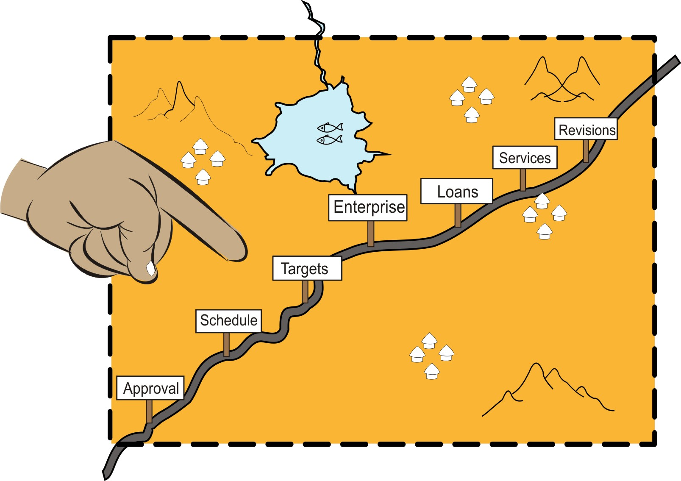
Using the business plan as a guide for the enterprise (Continued)

Slide 190
Use the business plan to borrow money
Submitting a well-prepared business plan shows banks and microfinance institutions that the group is serious and is likely to be creditworthy.
The financial institution may require some extra information, but this should be easy to gather if you already have prepared a business plan.

Slide 191
Use the business plan to borrow money (Continued)
You should work with both the farmers and the financial institutions to make sure that:
The loan is suitable for the group’s needs
Both the group and the financial institution understand the constraints and risks involved.

Slide 192
Use the business plan to get support from business services
Other business services may also ask to see a business plan. These services may include:
Input suppliers
Transporters
Major customers
Extension services
A credible business plan is a valuable tool to convince such services that the group deserves their support and can make the most of a partnership.

Slide 193
Revising the business plan
Once the business plan is agreed, try not to change it unless it is necessary.
Many business plans stay largely the same for each business cycle or season.
Some business plans can remain as they are for several years, with some sections updated to reflect production, cost and price changes.
Adjustments should be made with discussion and agreement of all concerned.
Major changes are best left until the end of the production and marketing cycle.

Slide 194
Developing an implementation plan
The business plan describes what the farmers’ enterprise plans to do in general terms, whereas the implementation plan gives details about how to get everything done:
Who will plant what area of crops and at what time
Who will open a bank account for the group
Who will buy the inputs
The implementation plan is a list of the activities that need to be done, based on the business plan. For each activity, it says who is responsible for doing it and when it has to be done.

Slide 195
The implementation plan: Sections
The implementation plan is divided into the following sections:
Pre-production
Production
Post-harvest
Marketing
You can add more sections if necessary.

Slide 196
Maintaining records of costs
Keeping a record of the farmers’ actual costs is important to:
Check the estimates made earlier
Enable the farmers to manage their enterprise effectively.

Slide 197
Maintaining records of costs (Continued)
The farmers should record the costs of:
Consumable materials
Durable items (materials)
Labor throughout the season
Any costs that have not been included in previous estimates

Slide 198
Module summary
This was the second booklet in the Seven steps of marketing series.
In this booklet (module), you have learned the following two steps involved in linking farmers to markets and helping them to develop their agroenterprises:
Step 3: Collecting information for the business plan
Step 4: Building a business plan

