Slide 1
The seven steps marketing Booklet 1: Organizing groups for marketing
A SMART Skills Manual

Slide 2
Skills for Marketing and Rural Transformation (SMART skills)
SMART Skills manuals:
Introduction to SMART skills for rural development
Organizing and managing farmer groups
Understanding natural resources
Managing natural resources
Marketing basics
Seven steps of marketing
Promoting innovation

Slide 3
Purpose of the SMART skills series
To introduce you to the following five skill areas:
Group organization
Natural resources management
Finance
Marketing
Innovation

Slide 4
The seven steps of marketing : Content
Step 1: Getting organized
Step 2: Identifying products and organizing groups
Step 3: Collecting information for the business plan
Step 4: Building a business plan
Step 5: Marketing as a group
Step 6: Reviewing agroenterprise performance
Step 7: Scaling up

Slide 5
Booklet 1: Organizing groups for marketing: Content
Step 1: Getting organized
Lesson 1: Organizing the project team and working with the community and project partners for the first time
Lesson 2: Working with the community
Lesson 3: Asset transfer and sustainability
Lesson 4: Deciding where to start the project
Step 2: Identifying products and organizing groups
Lesson 5: Choosing products and markets
Lesson 6: Working with farmers’ groups

Slide 6
Step 1: Getting organized

Slide 7
Lesson 1: Organizing the project team and working with the community and project managers for the first time

Slide 8
Outcomes
After this lesson you will be able to:
List the seven steps in agroenterprise development, and describe each of the steps
Evaluate the agroenterprise skills of potential team members
Describe the differences between the production and marketing approaches to rural development
List the types of information you will need about the target area
Describe some considerations for working with partners on agroenterprise development

Slide 9
Overview
Lesson 1 covers the following content:
The project team
The seven steps in agroenterprise development
Evaluating the project team’s agroenterprise skills
Targeting project staff
Developing a new mindset
Gathering initial information about the target area
Initial meetings with staff and communities
Working with partner organizations
Conditions of collaboration
Deciding on an approach

Slide 10
Seven steps in agroenterprise development
The agroenterprise development process has the following seven steps:
Step 1: Getting organized
Step 2: Identifying products and organizing groups
Step 3: Collecting information for the business plan
Step 4: Building a business plan
Step 5: Marketing as a group
Step 6: Reviewing agroenterprise performance
Step 7: Scaling up

Slide 11
The project team
Many agroenterprise projects are managed by a small team of people from a lead organization. This project management team works with many other people: district supervisors and field agents, traders,
processors and retailers, business and financial services
and farmers and community leaders.

Slide 12
Project team members
The project team includes:
Theme or task leaders, who coordinate activities and provide training in different subjects, e.g. working with groups, inputs and business services, production, finance and marketing.
The theme leaders train and coordinate field staff from the lead agency.
The field staff, in turn, coordinate staff of local partner organizations.
Field agents from these local organizations work directly with groups of farmers.

Slide 13
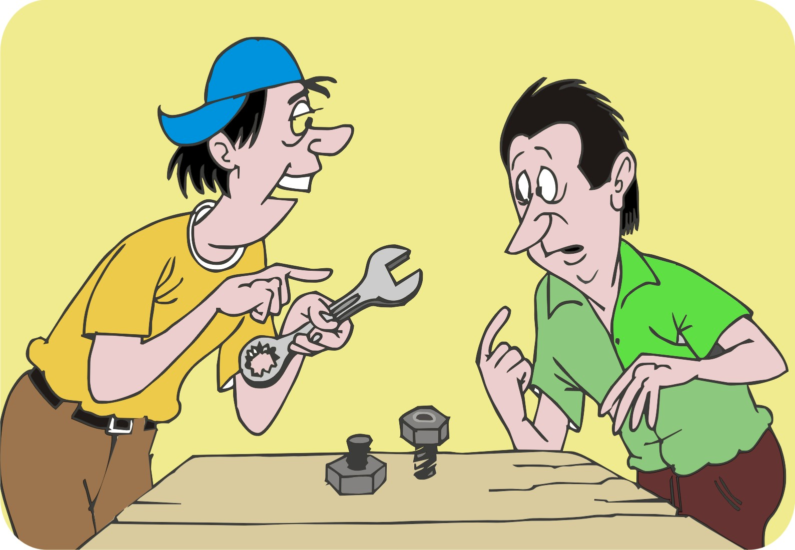
Evaluating the project team’s entrepreneurial skills
Evaluating/assessing the project team’s entrepreneurial skills will:
Help managers to decide on the type of marketing in which the team should engage
Indicate any training needs

Slide 14
Evaluating entrepreneurial skills: Questions
What experience do you have in marketing?
Is working with markets a new area for your team?
Are your partners experienced in marketing and agroenterprise?
Does your capacity affect what you want to do with farmers?
What additional skills and experience does your team need?
How can you get these skills?

Slide 15
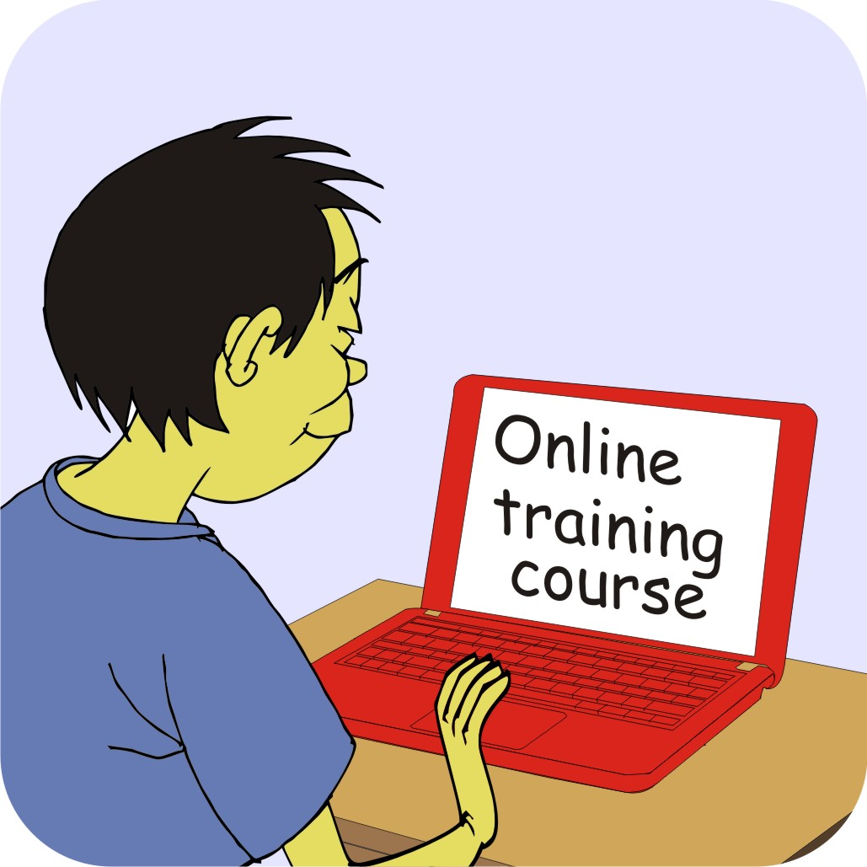
Training project staff
Marketing requires many skills.
Supervisors and field agents need to learn first; then apply.
Once you have determined the team’s level of marketing skills, you can design training to give them the skills they need.

Slide 16
Training project staff: Methods
You can help your team improve their skills in the following ways:
Get them to read through the Marketing basics course and this course.
Arrange a face-to-face or online training course.
Enable staff to learn on the job, e.g. by being coached by a more experienced staff member.
Hire new staff with the missing skills.
Work with partners who have marketing skills and include private sector partners.
Ask local business people for help.

Slide 17
Developing a new mindset: Production strategy
Many development projects focus on increasing agricultural production. They promote new farming technology and methods that help farmers grow more produce.

Slide 18
Production-based strategy: Focus areas
Primary focus | Increase production to meet household food needs
Business outlook | Sell surplus production to opportunistic buyers
Group formation | Farmers form group to learn new technologies
Targets | Production levels based on new technology
Collective action | Evaluation of new technologies
Technologies | Provided free to farmers to boost production
Monitoring | Focus on training and production gains

Slide 19
Developing a new mindset: Market-based strategy
Marketing projects aim to help farmers increase their income and profit in sustainable ways. Therefore, marketing projects need another mindset and additional set of skills.

Slide 20
Market-based strategy
Market-based strategy requires the project team to:
Focus on costs, income and profit – not only on yields
Understand the agroenterprise process and improving farmers’ market performance
See farming as a business – not a way of life for poor people
Collect, organize and analyze information build and act on a business plan
Invest the time, energy and money to achieve their targets

Slide 21
Market-based strategy: Focus areas
Primary focus | Grow and sell products with an identified market demand
Business outlook | Farmers produce to supply identified buyers at a profit
Group formation | Farmers’ group sets targets for production, sales, productivity, collective marketing and profit
Targets | Production, sales and profit targets
Collective action | Focus on collective marketing
Technologies | All transfers come with a plan; inputs paid by farmers
Microfinance | Use of savings and of loans from group or financial institutions
Monitoring | Focus on impacts, volume of sales, profits, collective marketing, use of business services

Slide 22
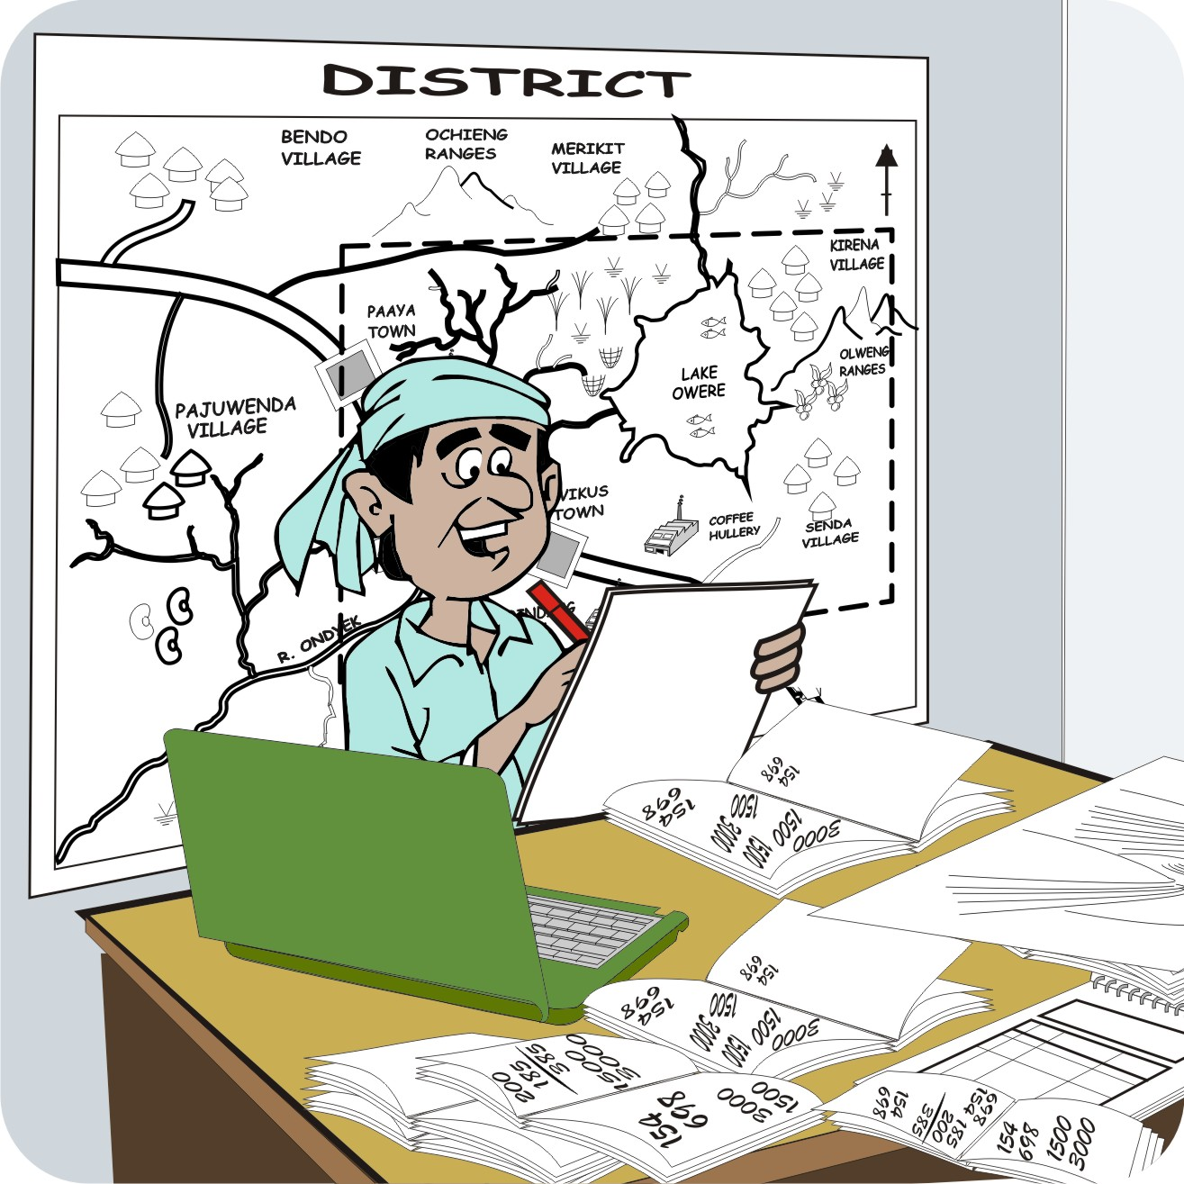
Collecting initial information on the target area
Social context:
General information on the local area
Natural resources:
Information on soils, water, crops, livestock, etc.
Production resources:
Data on farm sizes, growing seasons, typical farming practices, market infrastructure

Slide 23
Collecting initial information on the target area (Continued)
Business and market organization:
Detailed information on the:
Marketing system
Major products and services
Input supplies
Business challenges
Business opportunities

Slide 24
Initial meeting with staff and communities
Hold initial meetings with:
Other members of the project team
Public and private sector partners
The community
These meetings give the team a chance to learn about the farmers’ resources, assets, skills and business ambitions.

Slide 25
Working with partner organizations
Partners may include
Local communities
NGOs
Church organizations
Government agencies
Research institutions
Private companies
Local entrepreneurs

Slide 26
Working with partner organizations: Points of discussion
Points to discuss with potential partner organizations:
Skills: What skills does the partner offer the project?
Commitment: Is the partner’s management committed to support the project for 24–36 months?
Location: Does the partner work in the same geographical area?
Resources: Does the partner have the resources to engage in the project, or is funding required?
Information: Does the partner agree to link field data and financial reporting into a single routine reporting process?

Slide 27
Conditions of collaboration
Partners should discuss conditions for their collaboration.
Based on the discussions, they should prepare a formal memorandum of understanding that outlines their roles, responsibilities and any financial arrangements.
It is important to engage farmers in the evaluations of project activities.
To support women in agroenterprise work, partners should include women field agents.

Slide 28
Conditions of collaboration: Selection of field agents
If partners provide field agents, they should be selected carefully. Field agents should:
Be dynamic
Interested in their new role
Have strong participatory skills
Have some business background (if possible)
It may be necessary to hire new staff with these attributes.

Slide 29
Conditions of collaboration: Reporting
Financial support requires:
Clear rules of financial accountability
Reliable financial records
Technical and financial reports based on agreed formats
Information and reports on farmer groups’ market performance

Slide 30
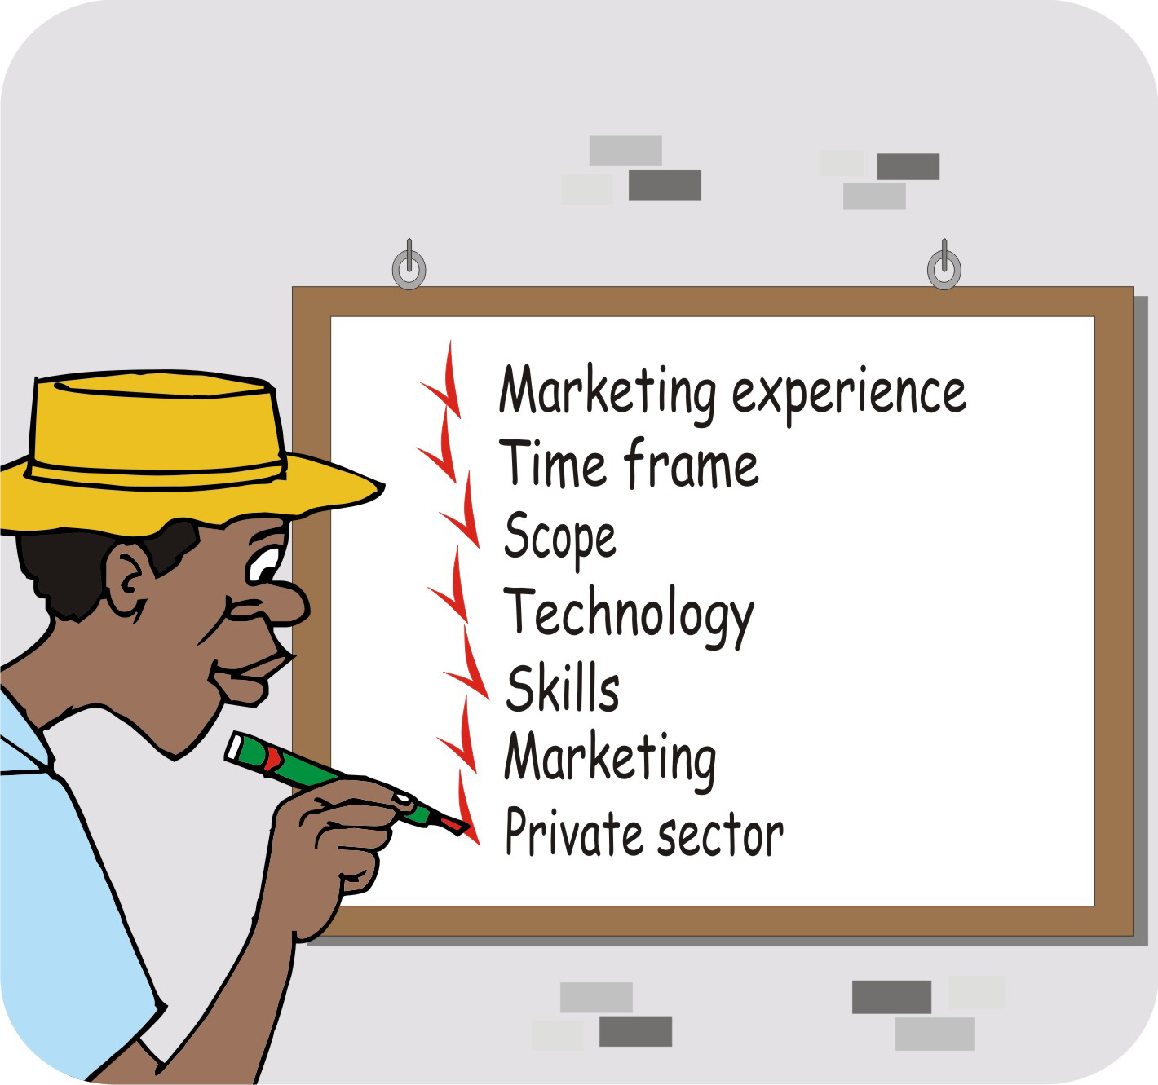
Deciding on effective marketing approach
An effective marketing approach has to:
Be based on local market conditions
Suit the team’s skills and capacity
Match the needs and abilities of the local farming community.

Slide 31
Deciding on effective marketing approach: Discussion points
Issues to discuss with the partners and team members :
Team’s marketing experience
Project time frame and scope of investments
Technology packages that the project aims to supply
Skills of partner organizations
Farmers’ marketing experience and organization
Maturity of the local private sector

Slide 32
Lesson 2: Working with the community

Slide 33
Outcomes
After this lesson you will be able to:
Explain the marketing approach to local people.
Describe several tools used to familiarize local people with marketing ideas.
Conduct a visioning session with villagers.

Slide 34
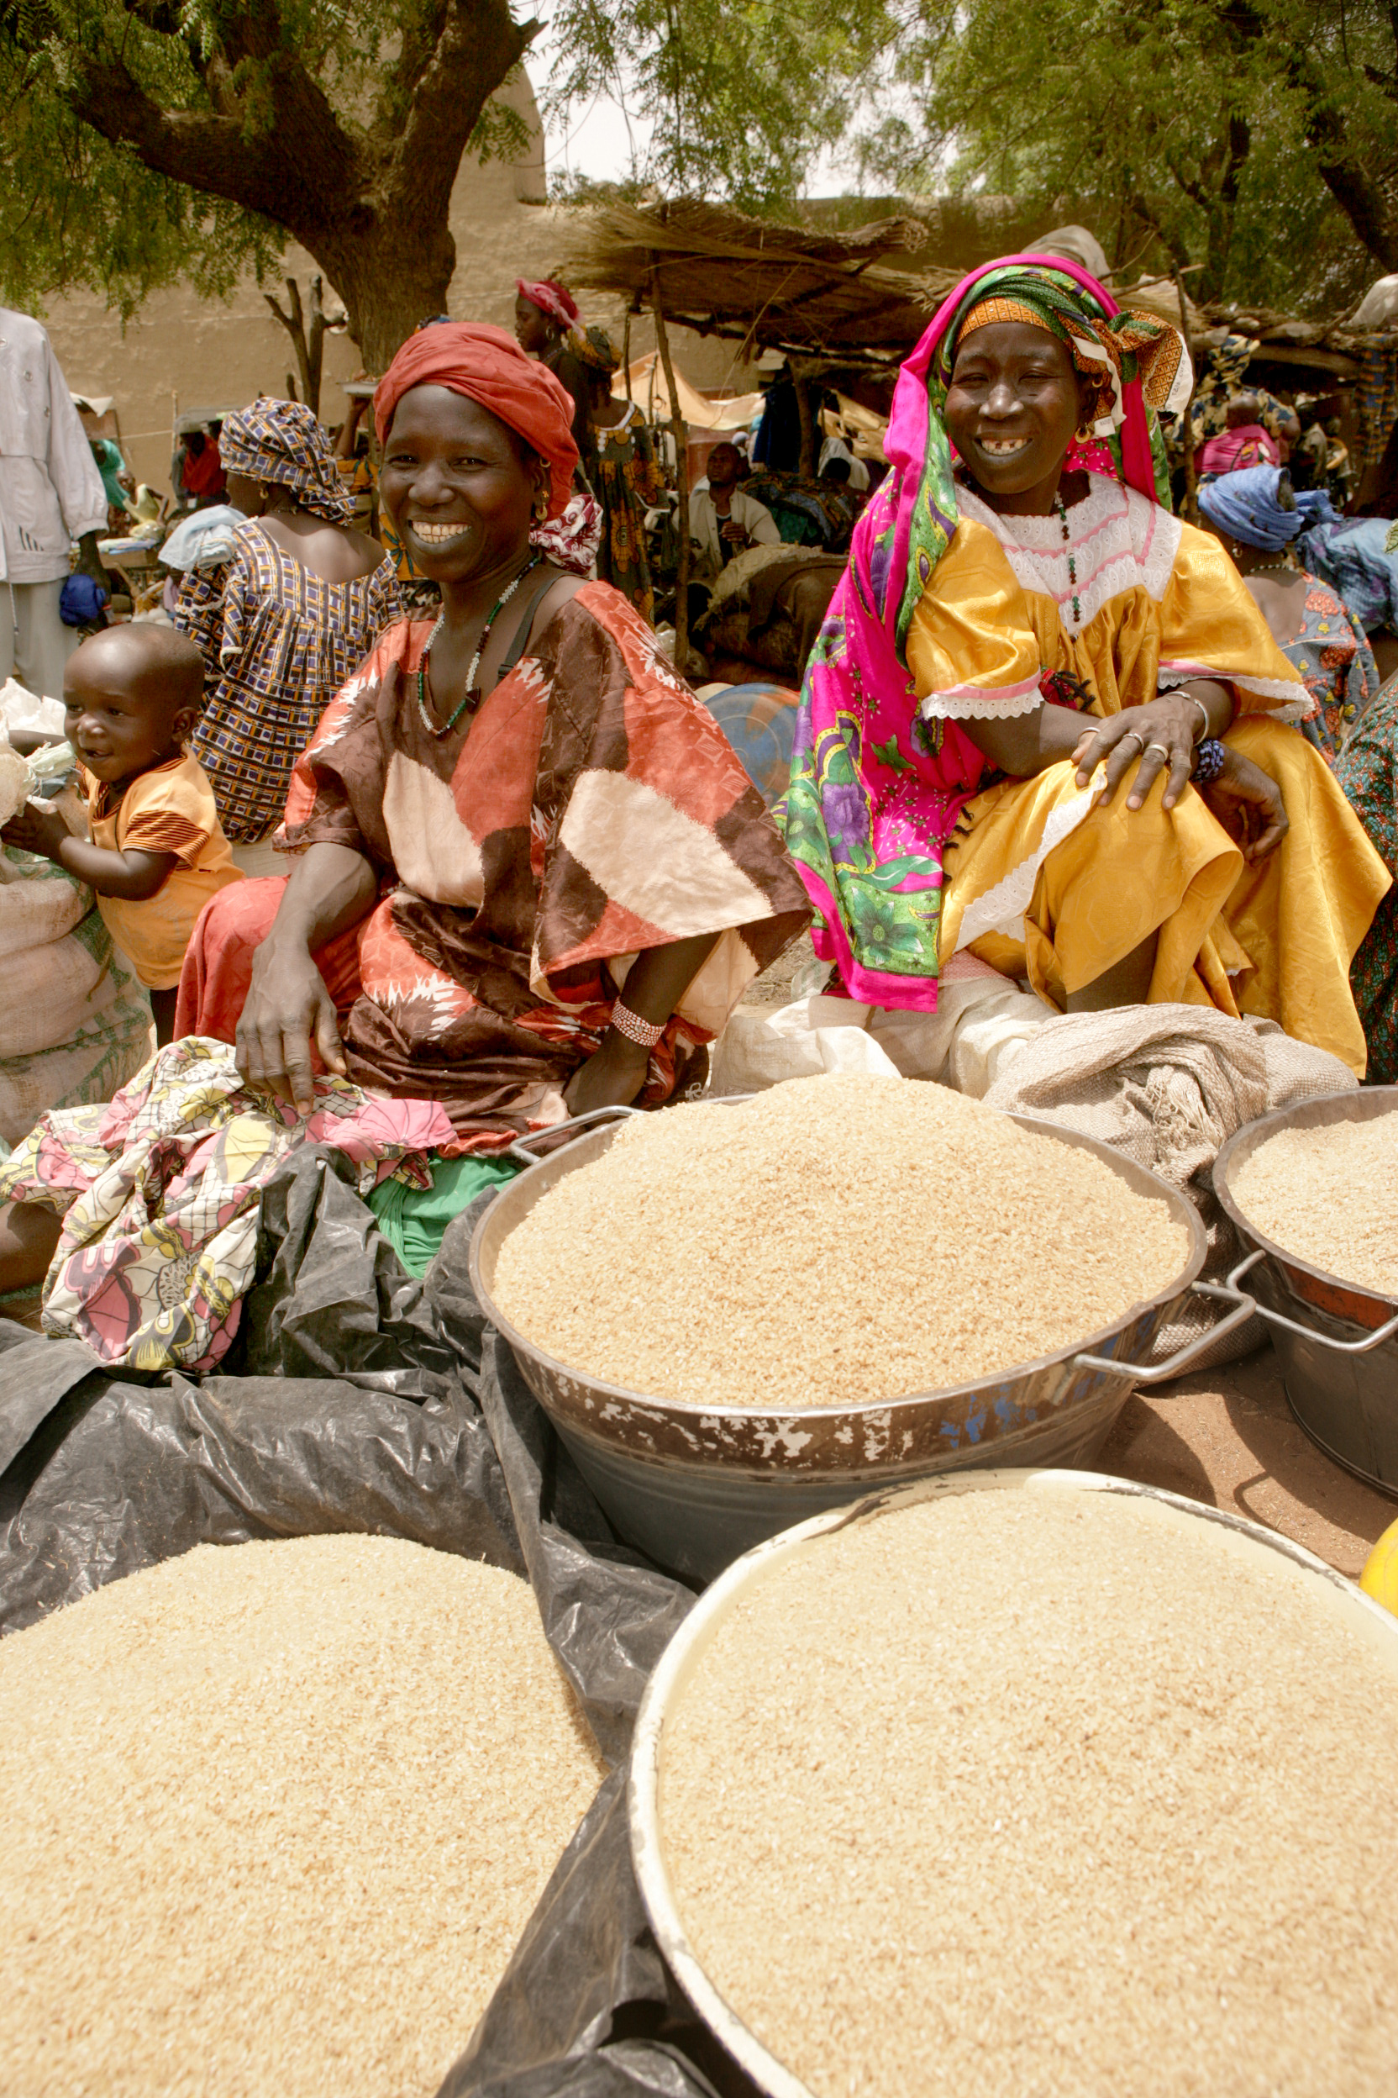
Overview
Lesson 2 covers the following content:
Introducing the ideas of marketing, self-reliance and visioning
Familiarizing people with marketing
Participatory tools for introducing marketing

Slide 35
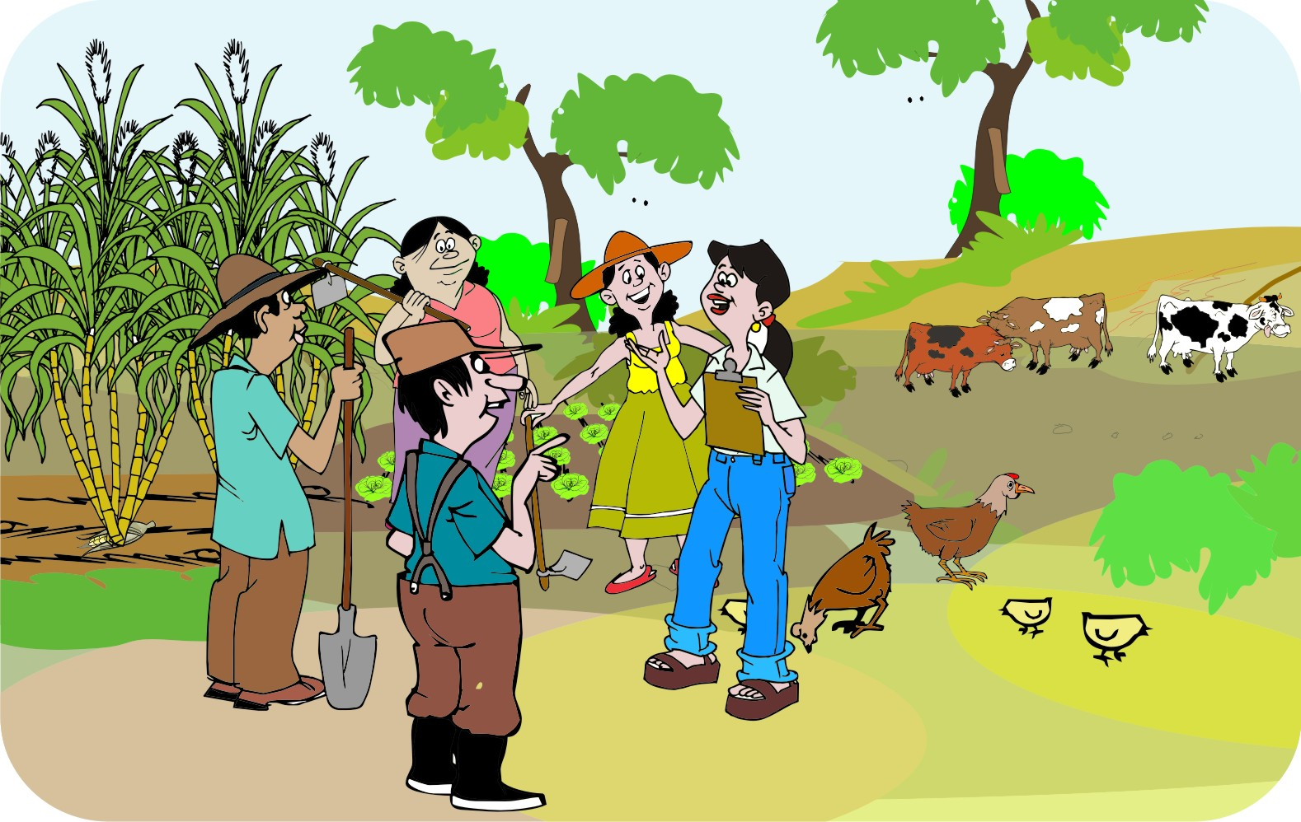
Introducing the ideas of marketing, self-reliance and visioning
If you are working in a new location, you need to:
Introduce yourself
Get to know the local community
Gain their trust
Get the support of both formal and traditional local leaders

Slide 36
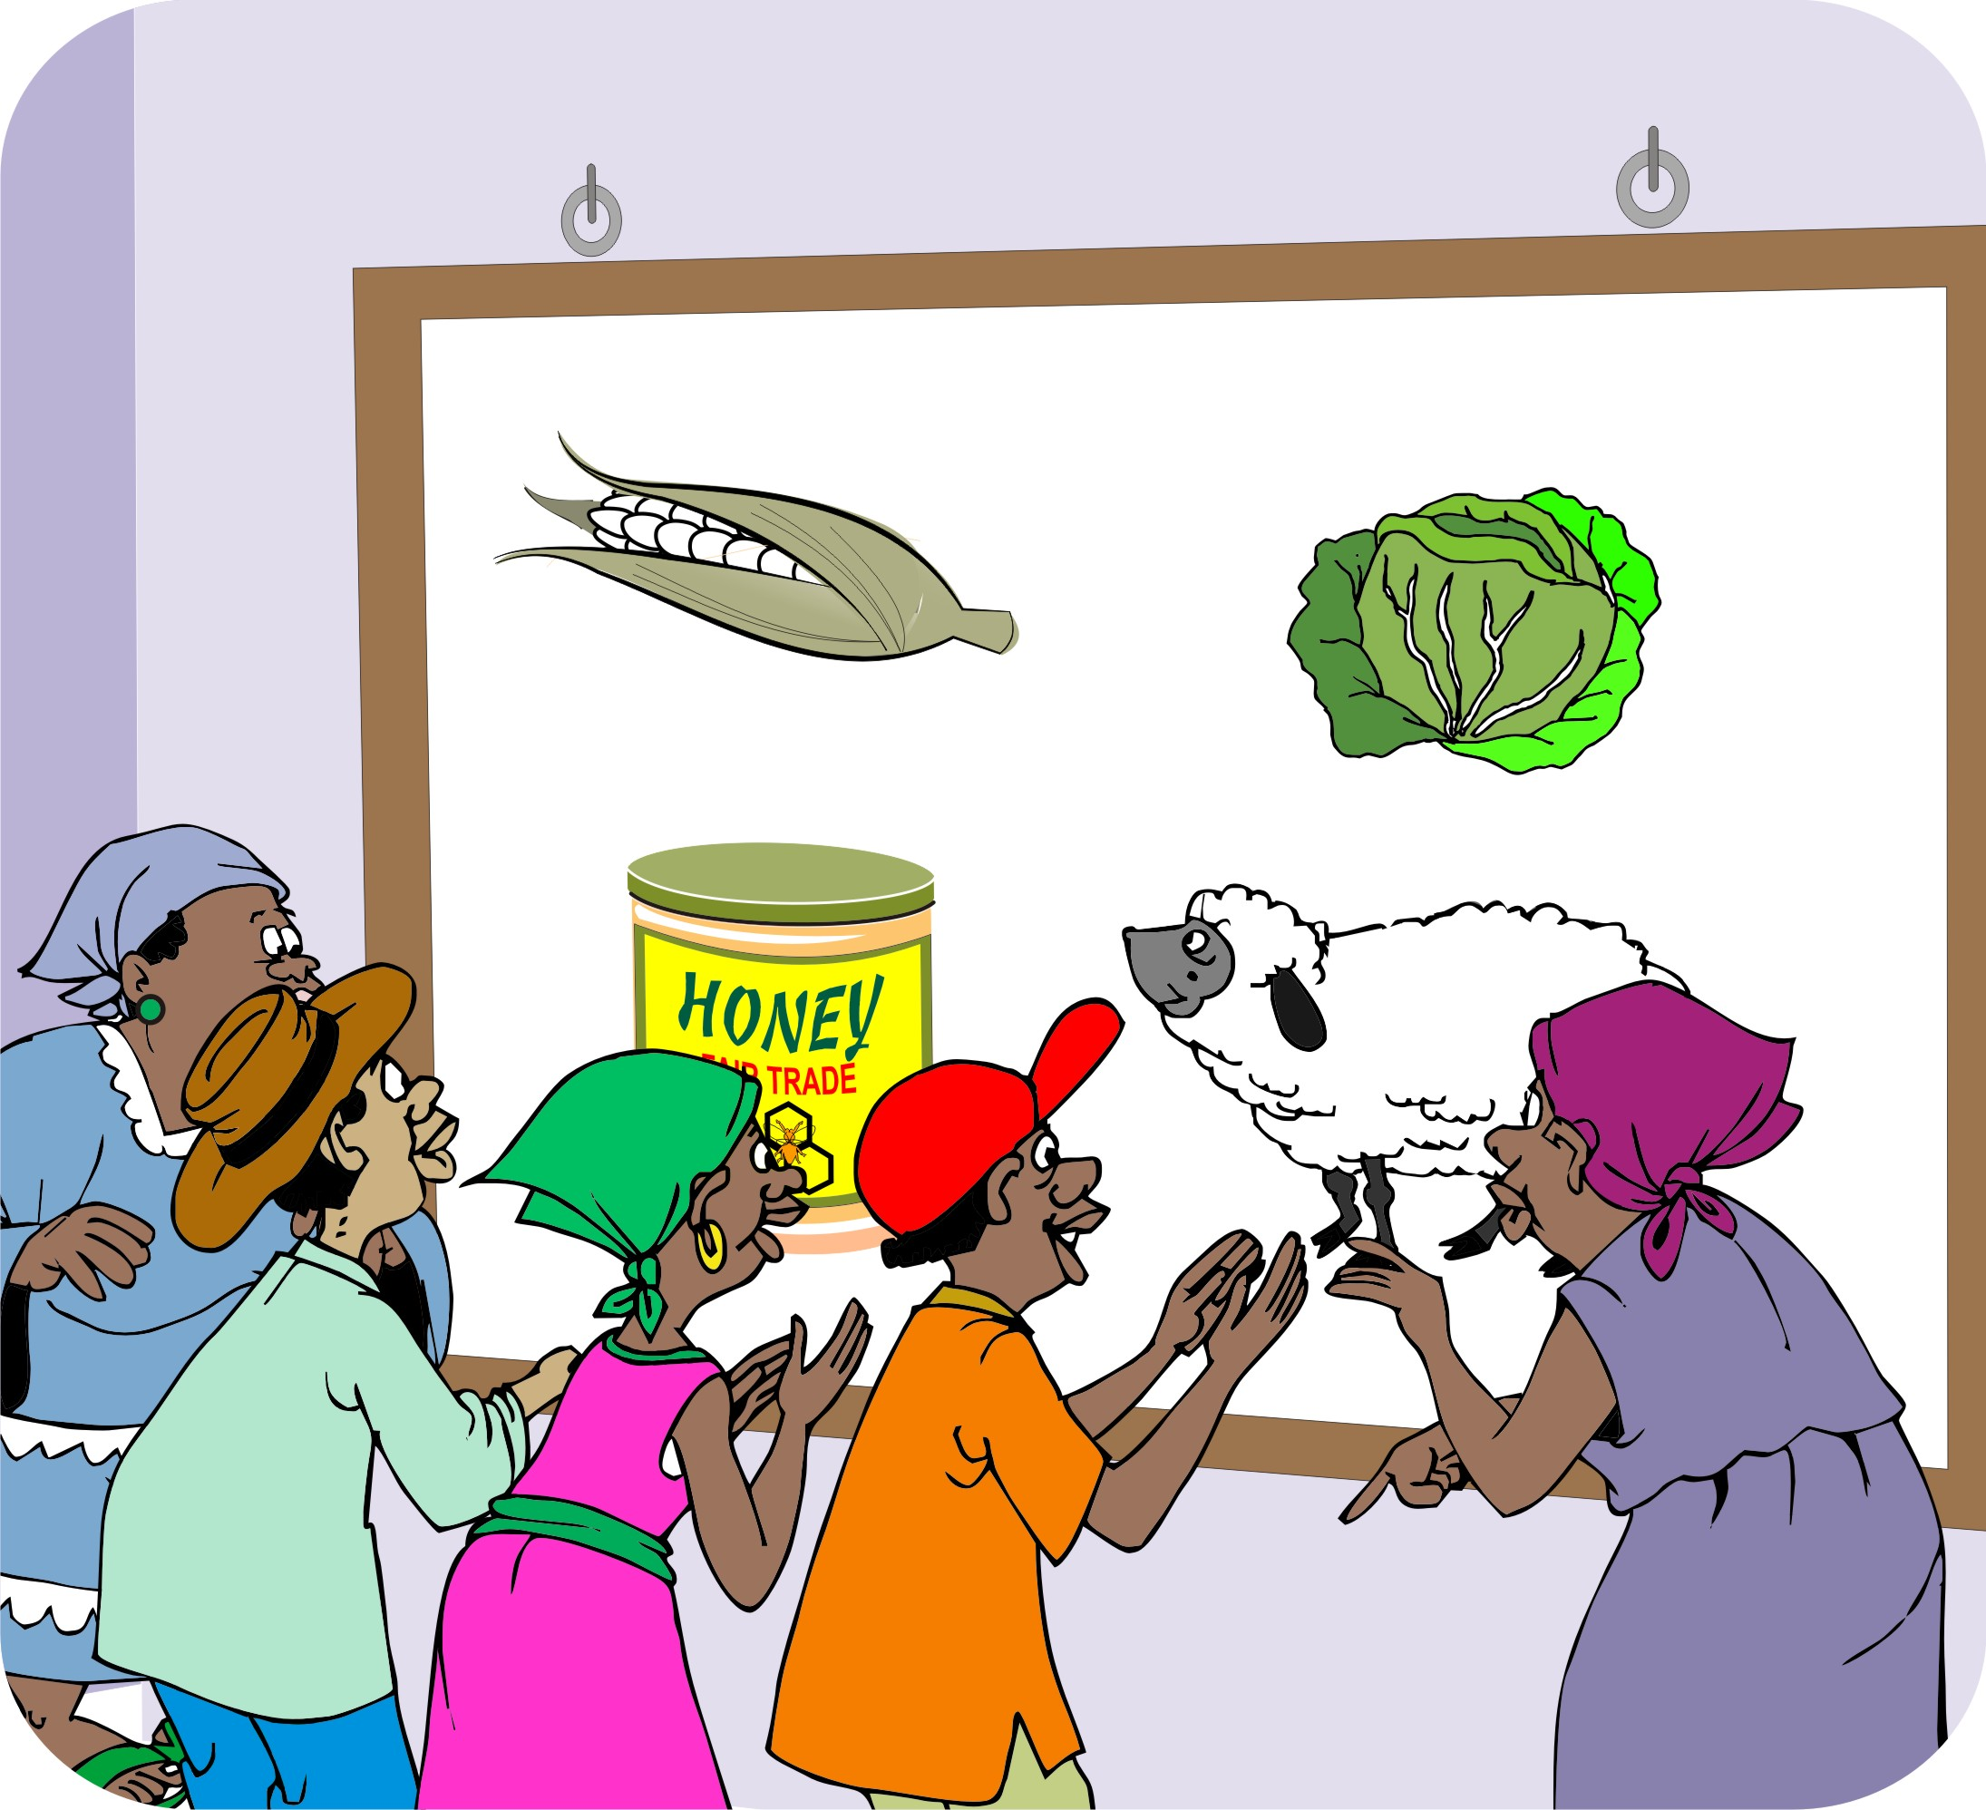
Introducing marketing
Describe the market approach and explain how it differs from a production project.
Explain that the project will work with local people and that it will target specific types of farmers.
Explain the types of target clients to be involved in the project.

Slide 37
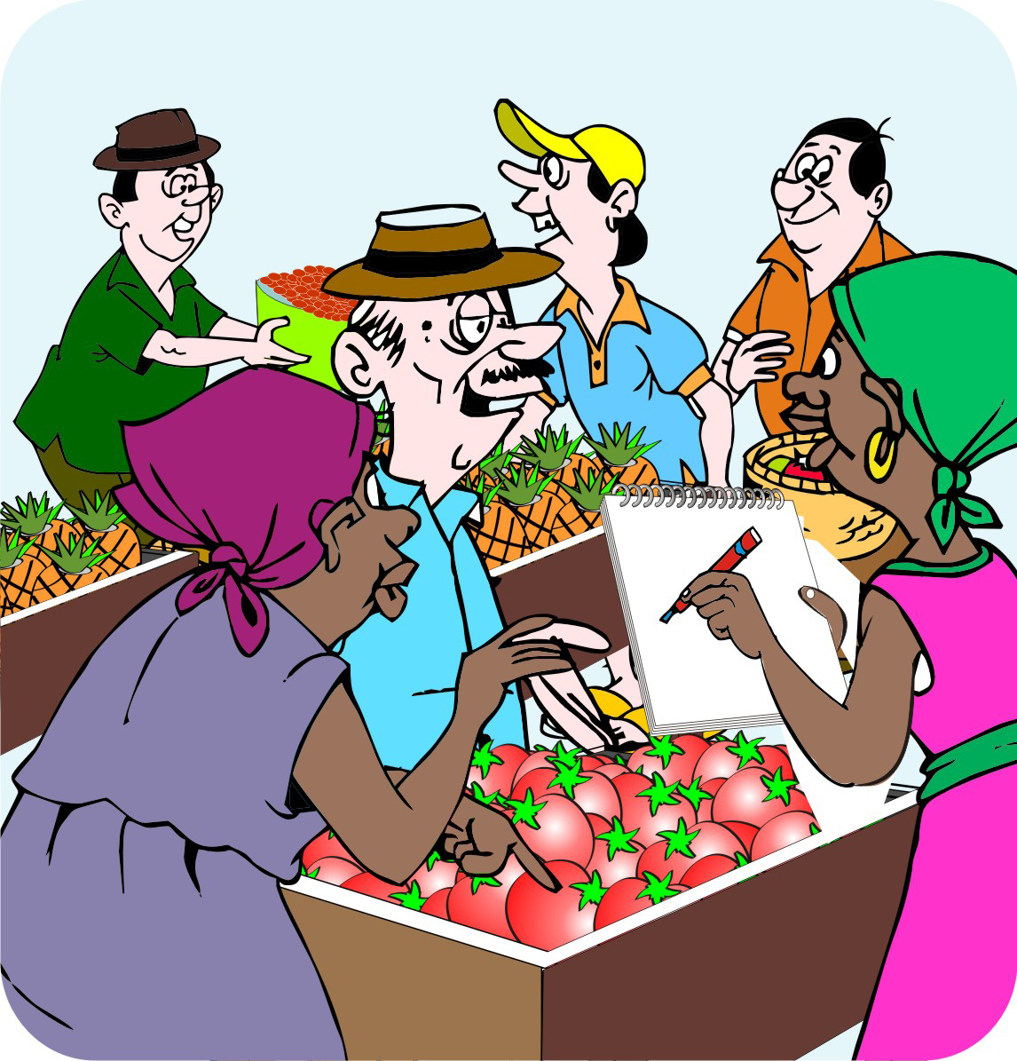
Introducing marketing (Continued)
The selection of target farmers needs the community’s support and should be based on:
Land area
Education levels
Asset levels
Wealth ranking

Slide 38
Introducing marketing with participatory tools
You can use different participatory tools to:
Set up introductions
Organize local people
Teach them about the market

Slide 39
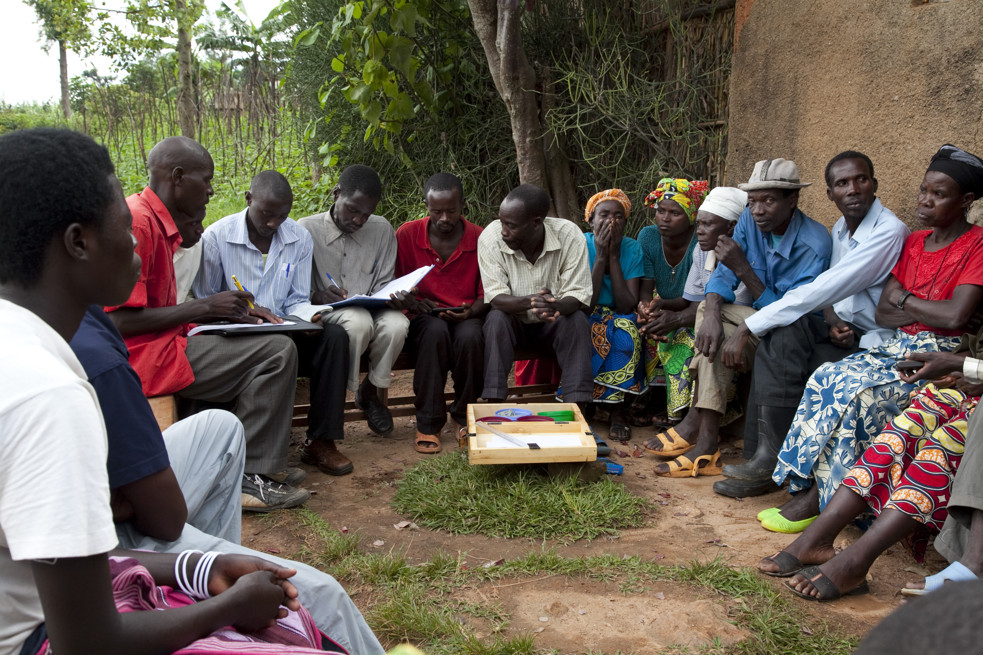
Types of participatory tools
You can use the following types of participatory tools to introduce marketing:
Role plays
Games
Focus groups
Visioning

Slide 40
Participatory techniques: Role plays
Role plays help community members to:
Present a new idea
Act out a new idea
Discuss a new idea among themselves

Slide 41
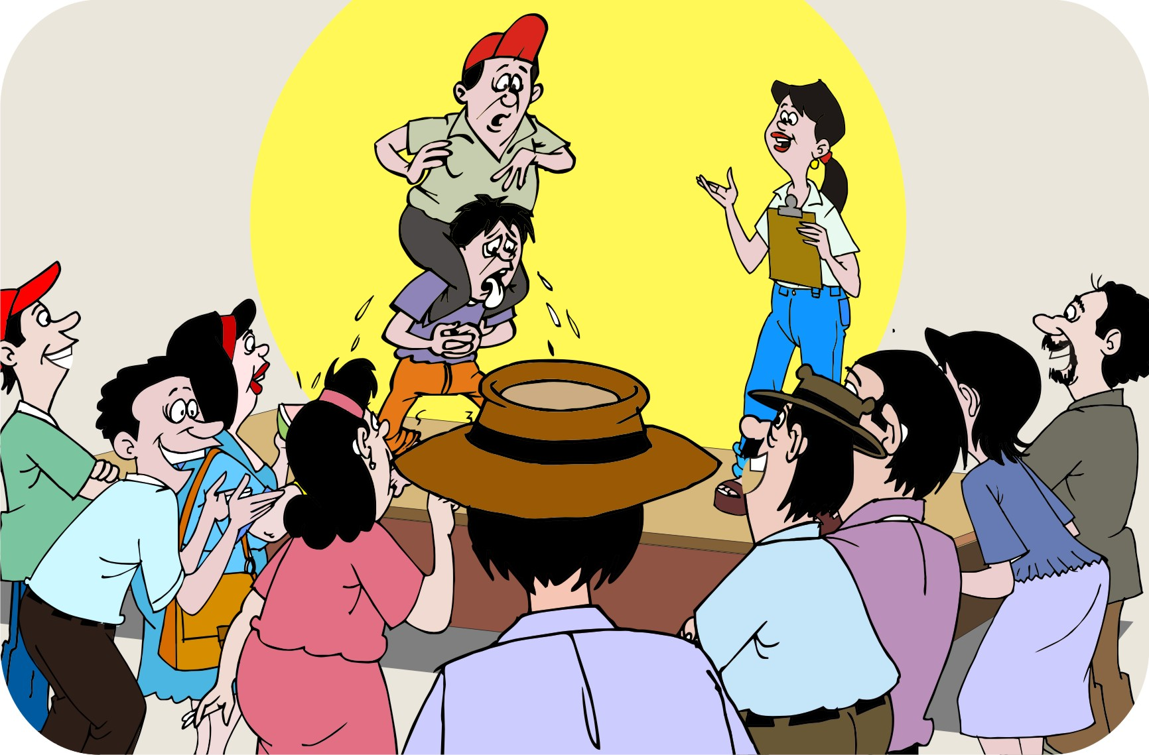
Participatory techniques: Games
Games are a fun way to start taking about marketing and business. Use games to get people thinking about entrepreneurship and marketing and to help them learn the marketing words.

Slide 42
Participatory techniques: Focus groups
Focus groups are a good way to:
Gather information on a particular subject
Identify challenges and opportunities
Explore interest in possible solutions

Slide 43
Participatory techniques: Visioning
Visioning is a technique that can be used to help a group or a community think about what their ambitions are, what they want to achieve in the future and the steps they need to take to reach their goals.

Slide 44
Visioning: Steps
Ask the farmers:
About their long-term vision
To imagine what they would like their production and marketing to be like in five or ten years, for example
To think of what the situation will be like in a shorter time frame, e.g. three years
What they need to do to put the changes into effect: this forces them to be realistic and to prioritize activities
About their short-term time frame again, e.g. what will things be like in one year

Slide 45
Explaining the agroenterprise process
It is important that the community members are clear about the process they are embarking on and that it consist of multiple steps.

Slide 46
Lesson 3: Asset transfers and sustainability

Slide 47
Outcomes
After this lesson you will be able to:
Explain why giving free handouts is generally a bad idea.
List some alternative ways to ensure farmers get the assets they need to improve their agroenterprise.

Slide 48
Overview
Lesson 3 covers the following content:
Thinking about sustainability
Free handouts
Using vouchers
Co-investment
Physical assets
After a disaster
Should training be free?

Slide 49
Thinking about sustainability: Rules
Considering the sustainability of the project means the project team needs to have clear rules about:
The delivery of training and assets
Limiting free handouts
Keeping asset transfer as small as possible

Slide 50
Thinking about sustainability: Assets and inputs
Considering the sustainability of the project means the project team needs to review:
Types of assets that can be used in the project and the way they will be transferred to communities
Types of inputs used in projects, e.g. seeds, fertilizer, etc.

Slide 51
Thinking about sustainability: Points to remember
The community has to pay for all goods and services themselves at the end of the project.
If you try to change the existing by giving away free inputs, the project will be less sustainable in future.
Do not give things to farmers if local businesses sell the same products in the area.
The sustainability of a project declines as the level of free handouts increase.
Follow the rule of No free handouts as far as possible.

Slide 52
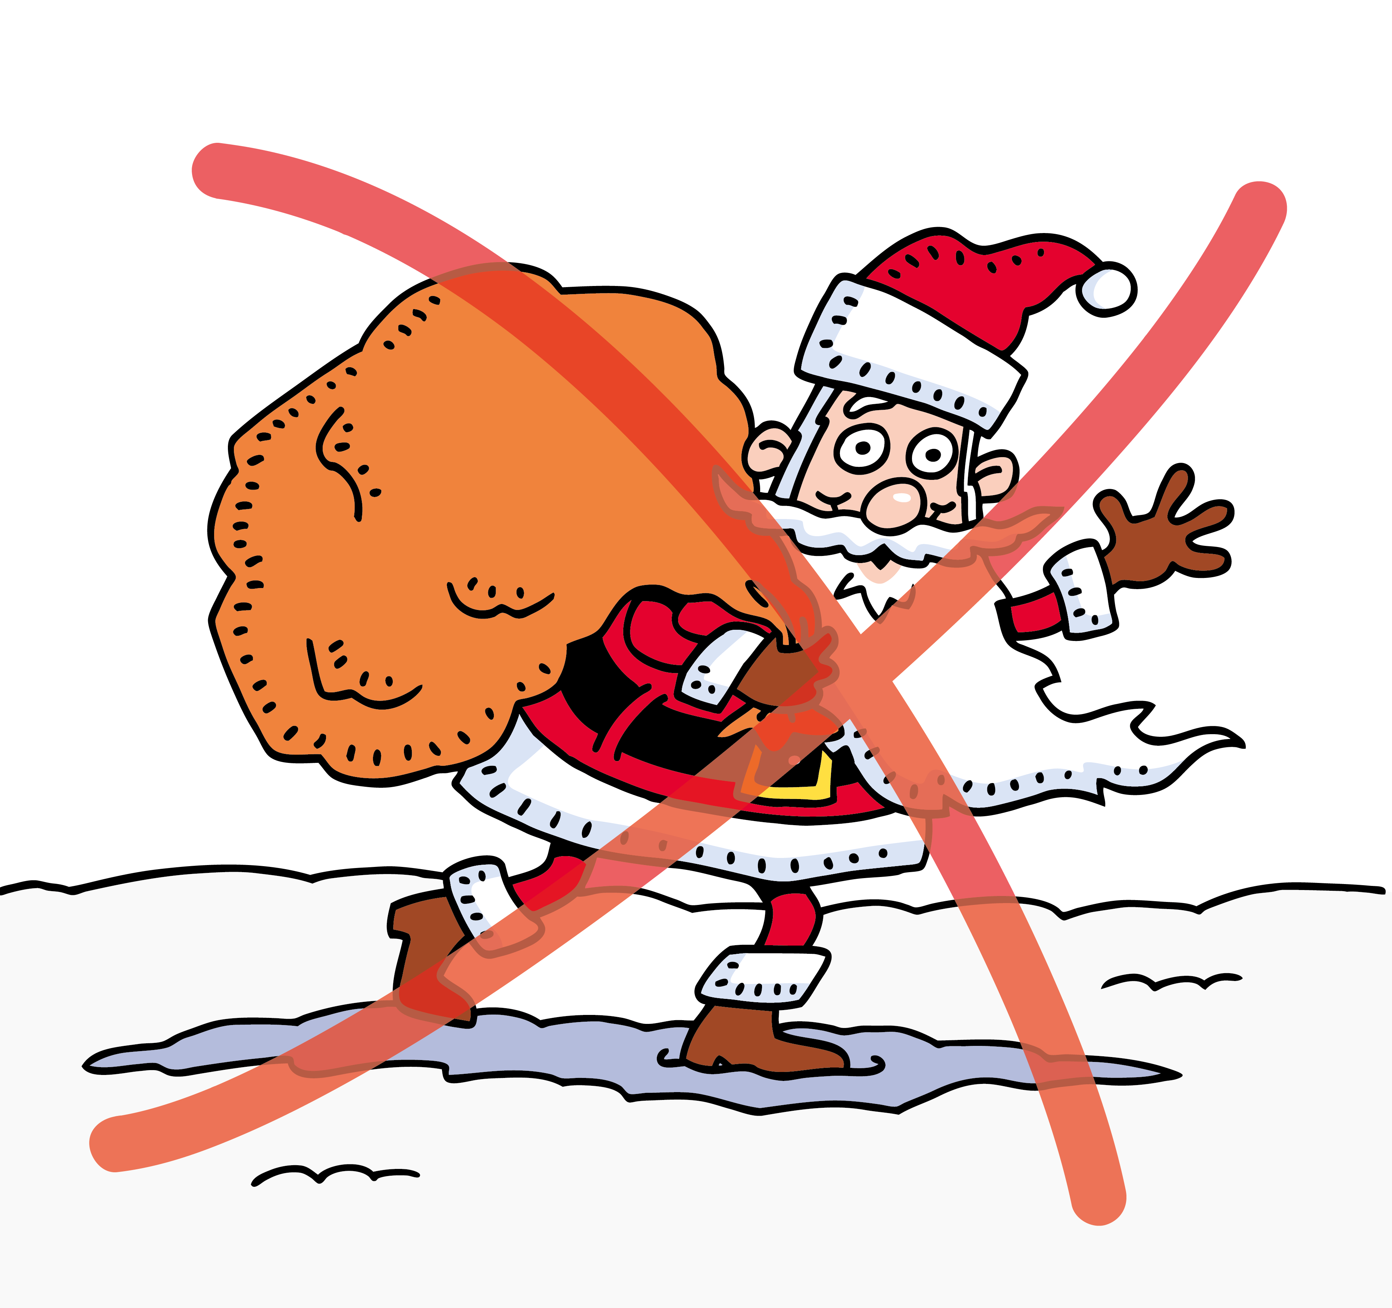
Free handouts
Providing assets for free should be a last resort.
Everyone likes being given free things, but it does not work in a business approach.
Avoid being Father Christmas.
Instead, try to find alternative approaches to managing assets, or make sure the farmers or the community pay for them over time.

Slide 53
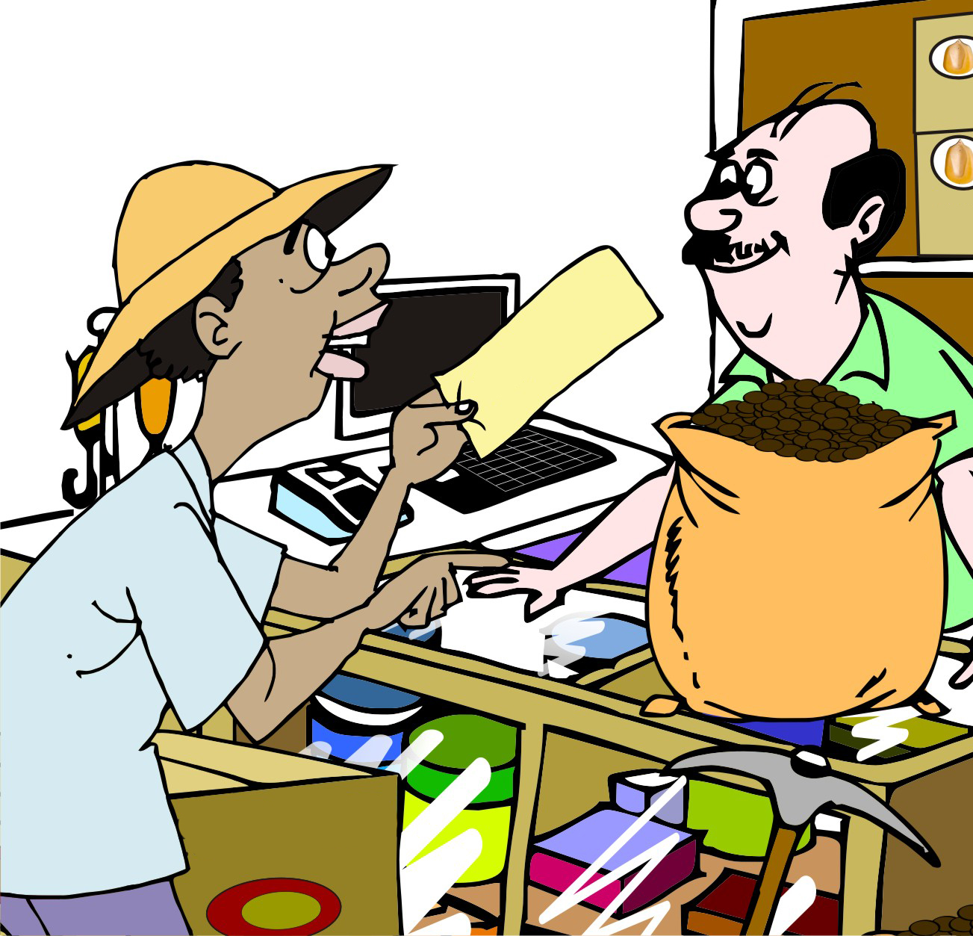
Using vouchers to jump-start activities
Vouchers are a more accountable form of exchange than cash, as someone can redeem them only with certain vendors or for particular types of goods.
Vouchers can either be full payment or partial payment.
Linking farmers with input dealers through vouchers helps to build relationships between them.

Slide 54
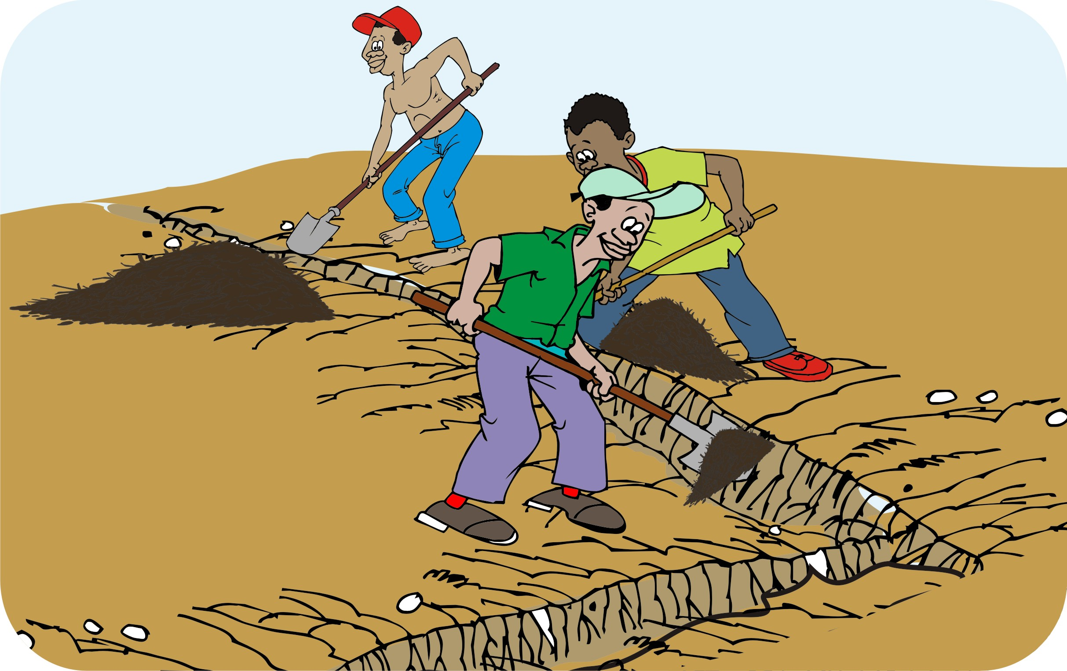
Co-investment
If you are working with the community to build specific assets –(e.g. irrigation channels) that require significant labor, discuss ways in which the community can co-invest in the project, e.g. by providing free labor for the construction.

Slide 55
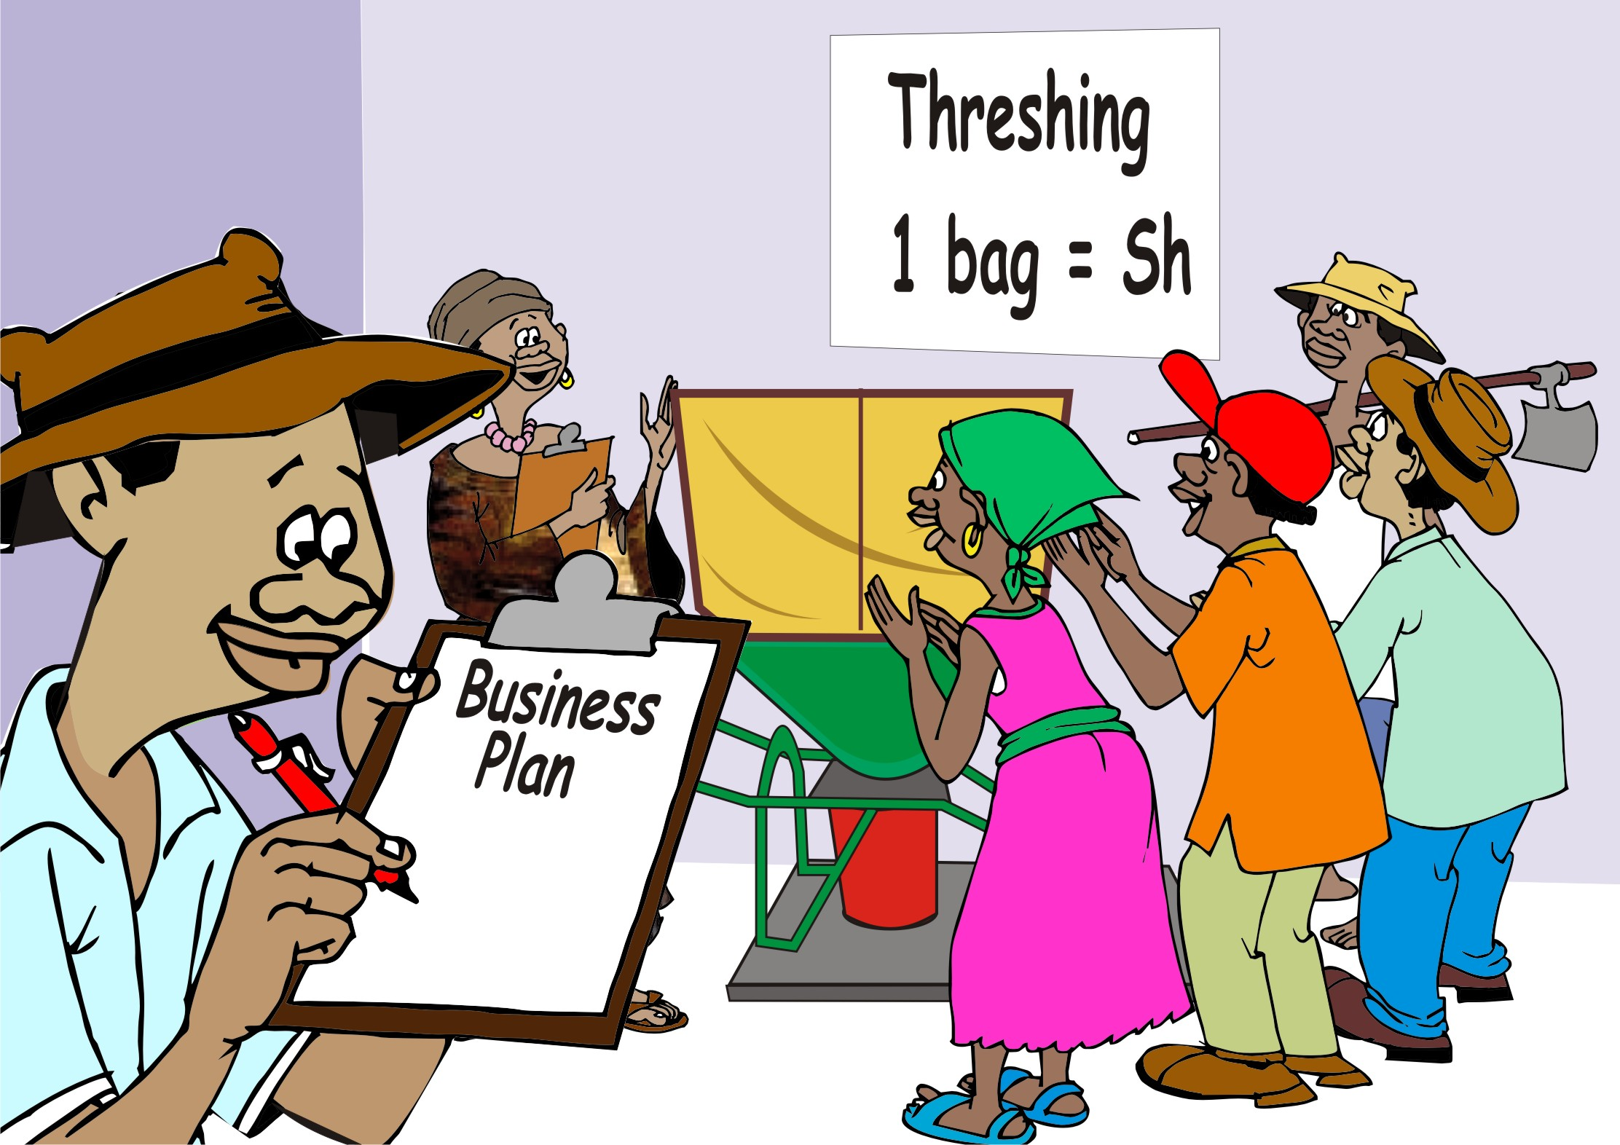
Physical assets
Avoid giving farmers large physical assets for free – unless this is essential to progress.
If you do make a major asset transfer, do so with a clear business plan on how the asset will be managed over time.
These are important enterprise principles to avoid mismanagement, under-use or capture by a local elite.

Slide 56
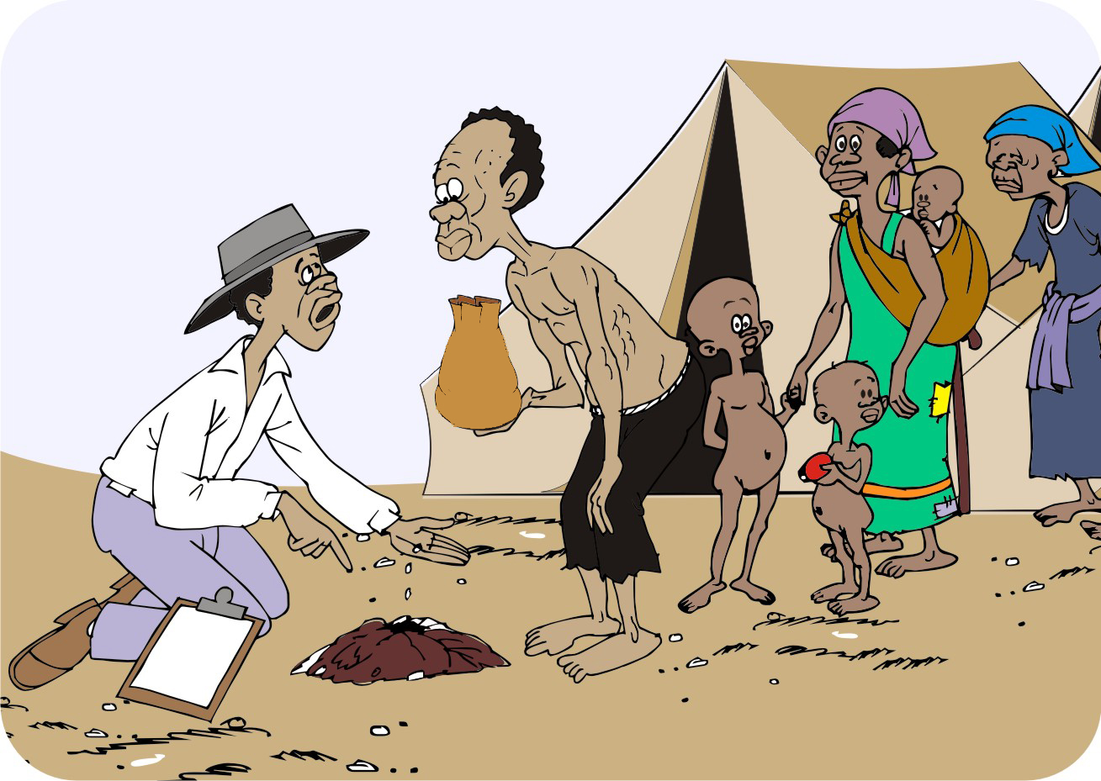
After a disaster
If farmers have lost all their assets, it may be necessary to provide startup seeds, fertilizer and tools.
Identify asset transfer as a startup investment and not a regular annual handout.
Give farmers small amounts of improved seed and help them to multiply and manage it carefully.
Avoid giving handouts to enterprise groups.

Slide 57
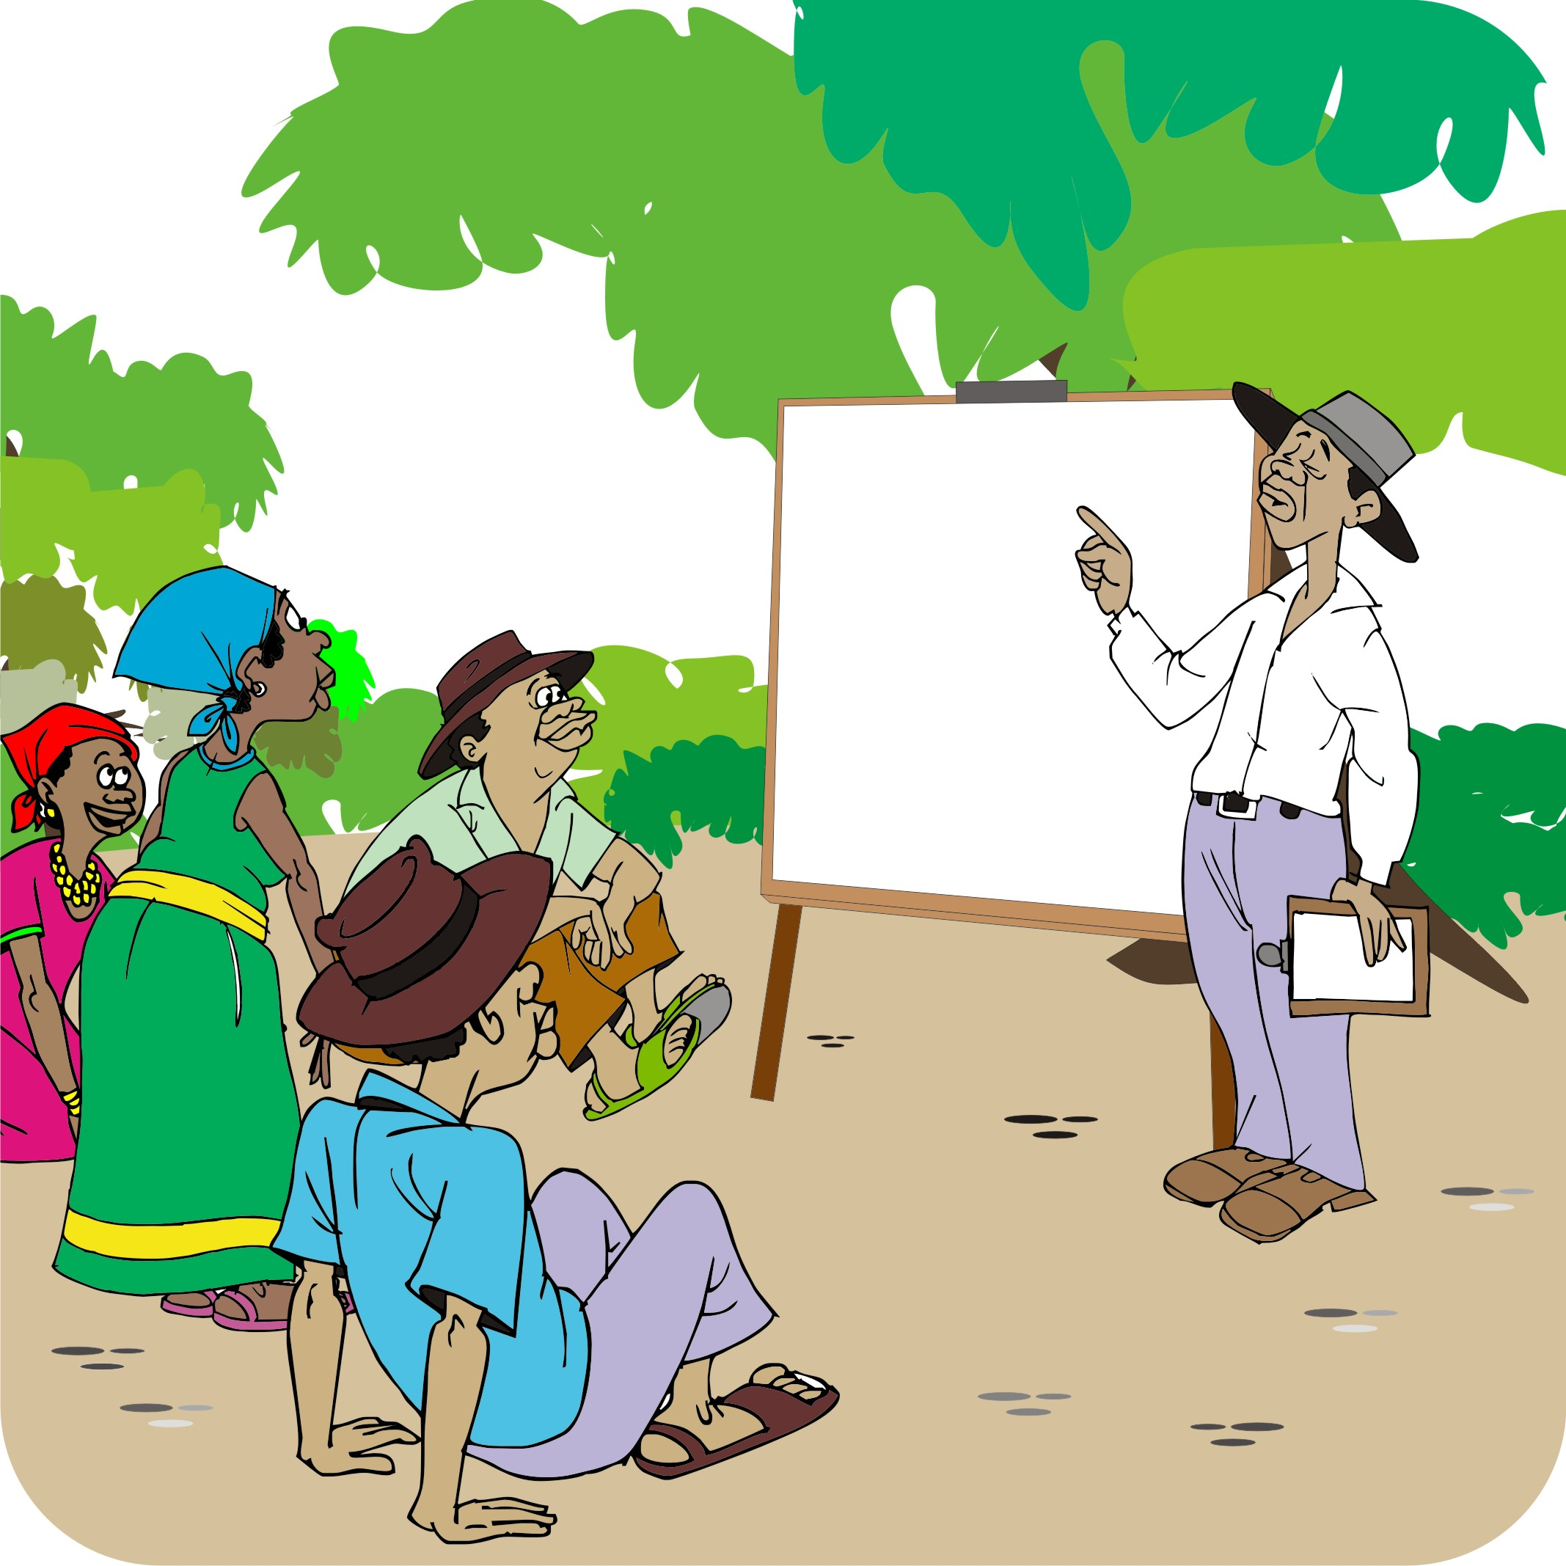
Should training be free?
Future development project services will use the approach of training local community workers, who charge for their training after an initial grace period. This process builds in more sustainability and increases employment options.
Skills set training may be introduced to the community on a no-cost basis at first, but in the future farmers will have to pay.

Slide 58
Lesson 4: Deciding where to start the project

Slide 59
Outcomes
After this lesson you will be able to:
Describe possible entry points for an agroenterprise project
Help local people decide on the entry point.

Slide 60
Overview
Lesson 4 covers the following content:
Choosing an entry point
Entry point 1: Production and natural resource management
Entry point 2: Starting with savings and loans
Entry point 3: Pre-selected commodity
Entry point 4: Pilot testing
Entry point 5: Supporting farmers already in groups
Entry point 6: Existing buyer or contract farming
Entry point 7: Supporting business services

Slide 61
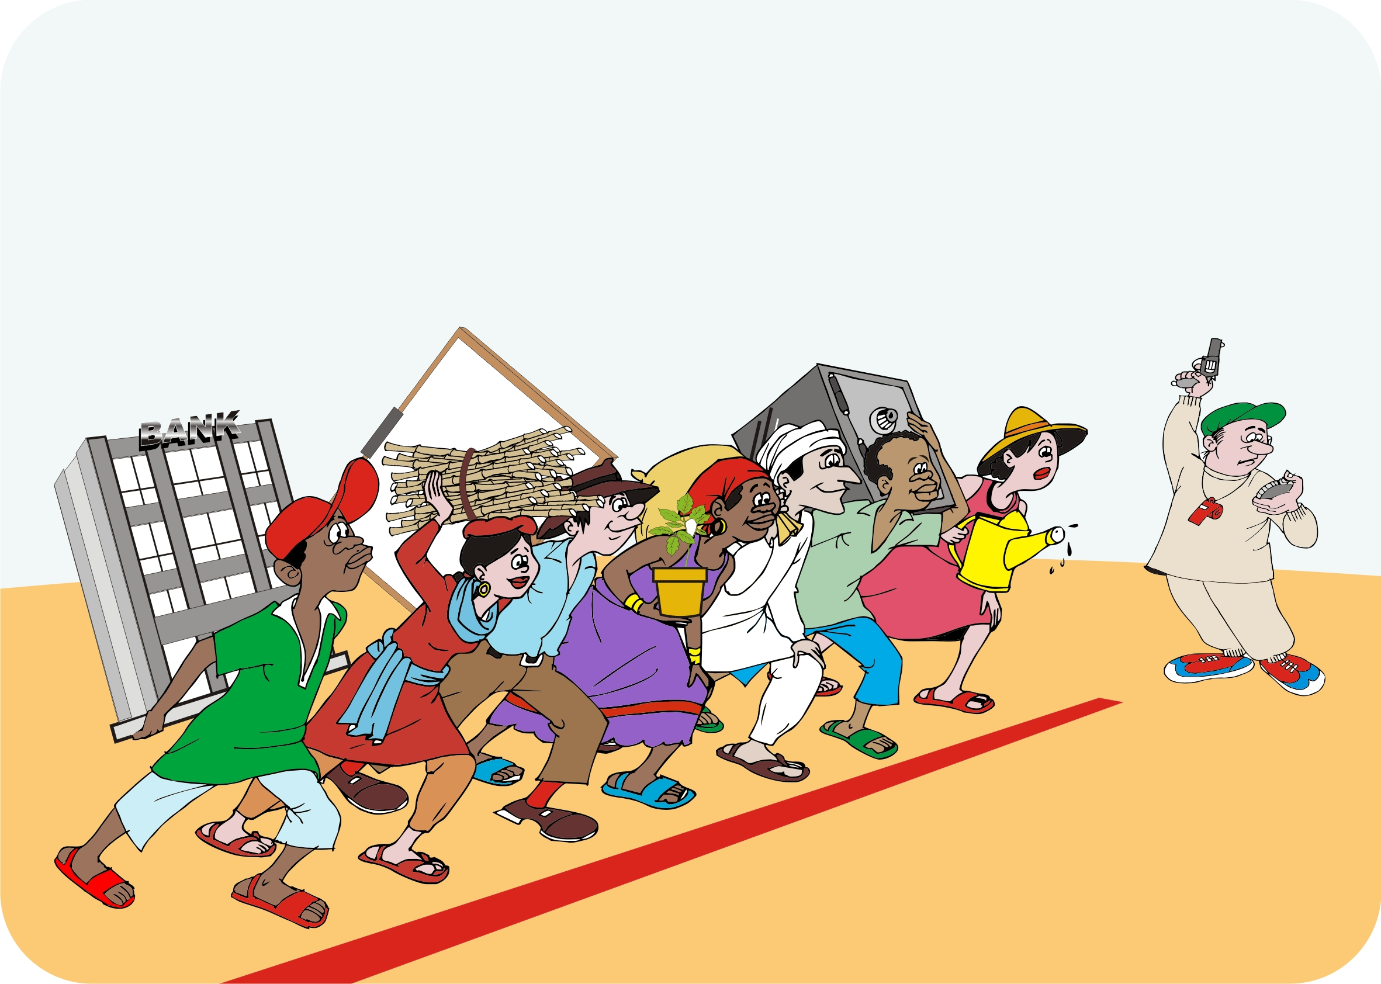
Choosing an entry point
Projects rarely start from zero: farmers already grow crops and raise livestock.
Starting the agroenterprise process depends on a number of factors, including:
The project document
In-house assessments
Site of assessment

Slide 62
Entry point 1: Production and natural resource management
It may be necessary to deal with critical production or natural resource issues before an agroenterprise project can begin, e.g. it may be necessary to control erosion or manage water before starting commercial production.
Protecting and maintaining soil and water resources is a vital part of sustainable agroenterprise development.

Slide 63
Entry point 2: Starting with savings and loans
Organizing farmers by means of savings groups has the following advantages:
Farmers choose who they want to learn and save with
Regular meetings build trust and help farmers learn basic financial literacy skills
The approach is particularly helpful when working with poor farmers and women, because they lack savings for basic investments
It may improve the group sustainability and increase their prospects of working together in a business environment

Slide 64
Entry point 3: Pre-selected commodity
Many development projects are based on a previous market study that has already targeted a particular commodity or product.
This means that the agroenterprise process can start immediately and business plans can be developed for the selected product.
This fast startup approach enables the agroenterprise team and farmers’ group to get to the investment and production stage more quickly.
The focus of this option as an entry point is to increase sales of the selected product.

Slide 65
Entry point 4: Pilot testing
Farmers want to evaluate a new crop or variety before they plant it on a commercial scale. Consider starting a demonstration pilot project, so that the farmers can see and understand the approach.
A successful pilot will allow both the agroenterprise team and farmers’ groups to learn about the production and marketing issues of a product before going to scale.

Slide 66
Entry point 5: Supporting farmers already in groups
Build on existing groups by assessing the group’s skills, markets and access to services and helping farmers to:
Upgrade their business linkages
Bulk goods to sell collectively
Strengthen the services they need
The focus should be on:
Building key skills
Optimizing links to existing markets
Researching new and higher value options
Improving links to financial, marketing and business services

Slide 67
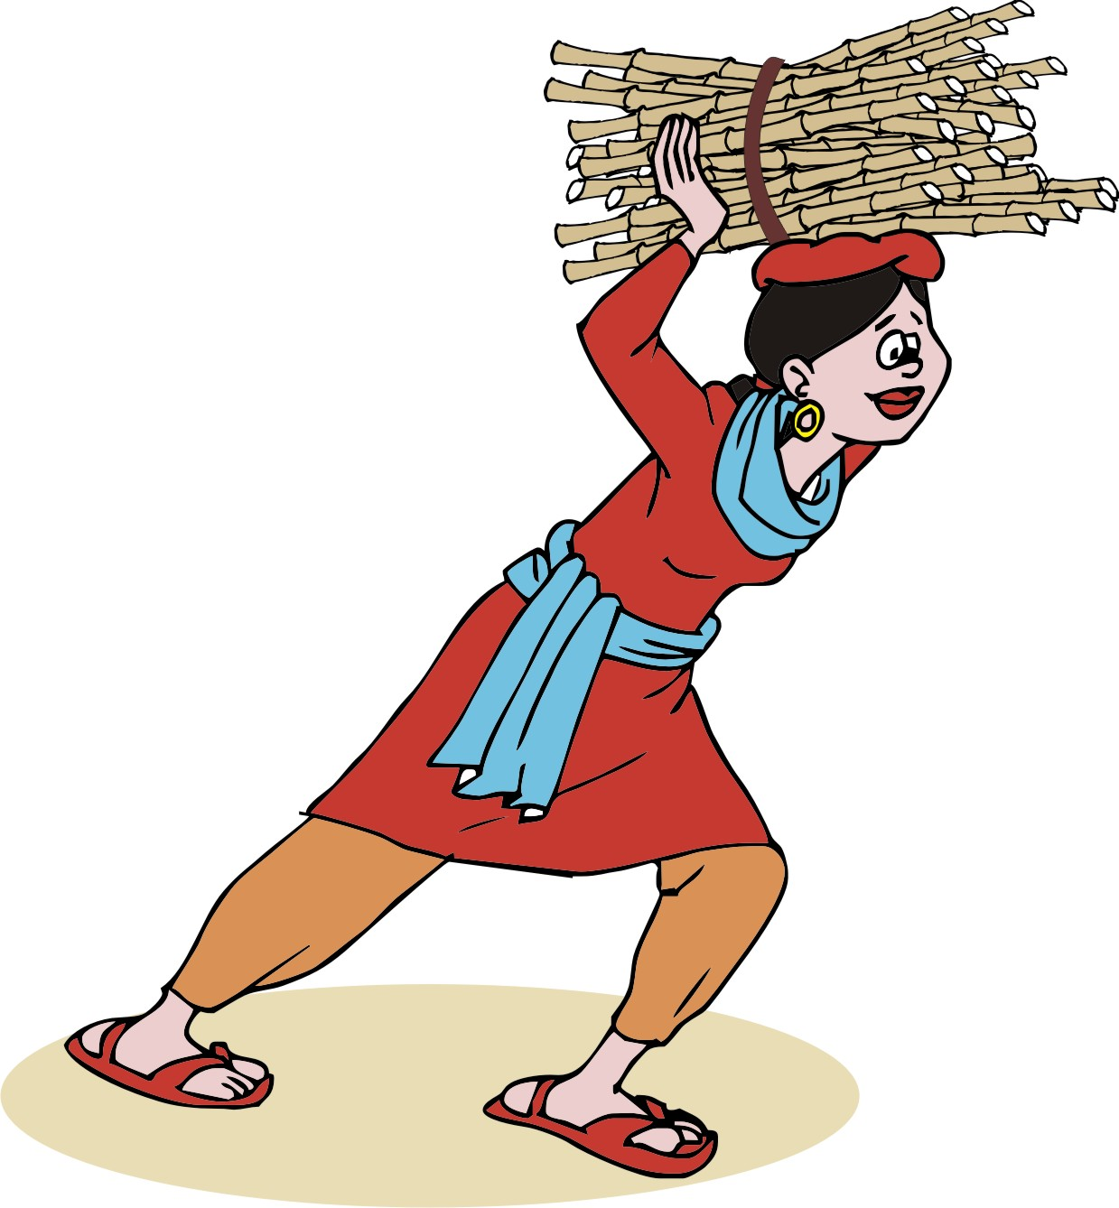
Entry point 6: Existing buyer or contract farming
If you need to provide assistance in supplying a product, you can:
Work with the buyer to determine their delivery needs (price, quality, volume)
Help the farmers’ group to increase the quality and competitiveness of their output
Support the farmers to negotiate a fair and sustainable deal that meet commercial specifications

Slide 68
Entry point 7: Supporting business services
Access to a business service (inputs, logistics, storage, process and packaging) may a the most important constraint on improving the marketing chain.
Help the farmers to develop a business plan that addresses the barriers preventing them from accessing these business services.
Consider strengthening local business service firms or introducing service providers to the project area.

Slide 69
Step 2: Identifying products and organizing groups

Slide 70
Lesson 5: Choosing products and markets

Slide 71
Outcomes
After this lesson you will be able to:
Guide farmers in listing the products they grow for food and for sale.
Help farmers consider new products for sale and alternative market options.
Assist farmers in assessing the risks of various product and market options.
Describe how to ensure that women can be involved in choosing products and markets.

Slide 72
Overview
Lesson 5 covers the following content:
Choosing a product
Participatory tools for assessing product and marketing options
Discussing product options with farmers and traders
Identifying market opportunities for products
Products and marketing opportunities for women
Including women in agroenterprise development
Assessing risks of product and marketing options

Slide 73
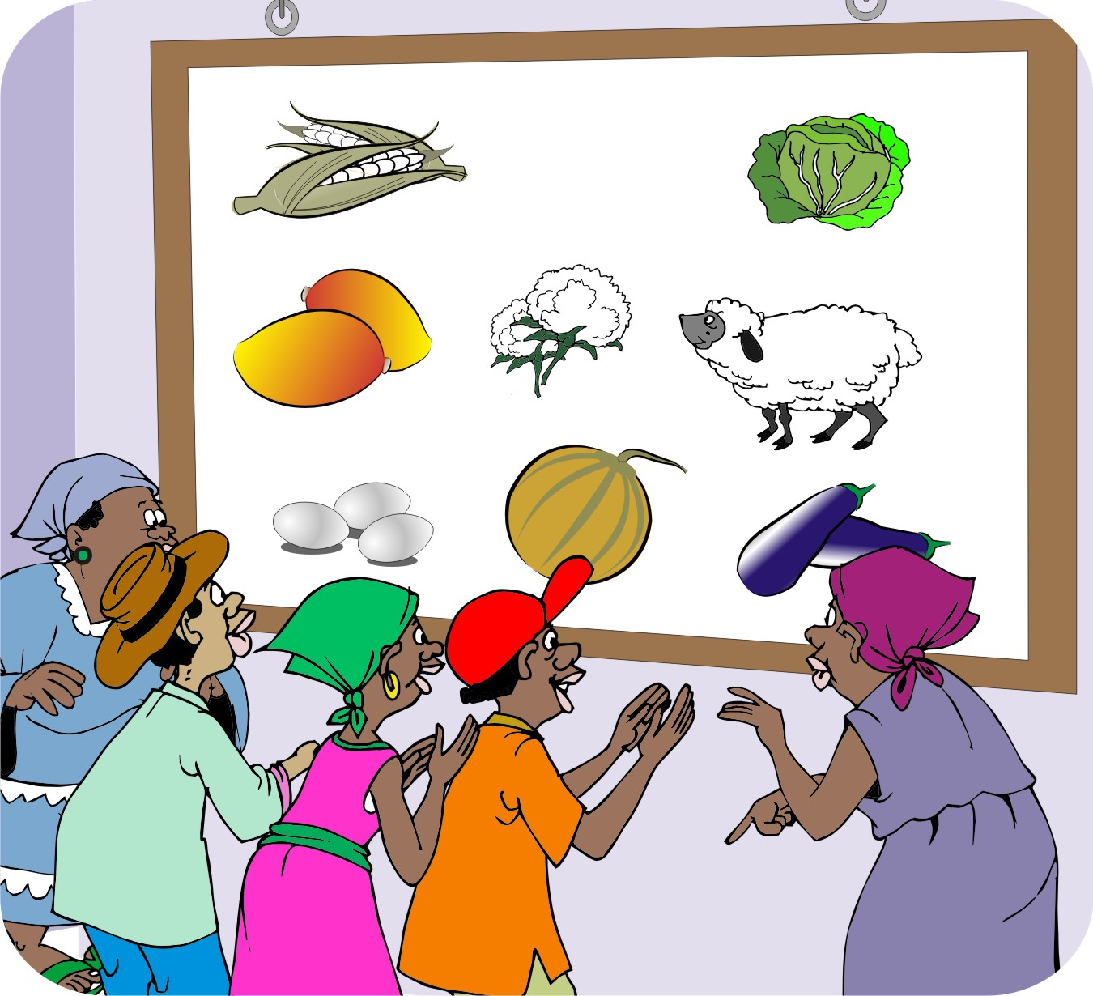
Choosing a product
There are no strict rules on whether it is better to choose a product beforehand or after the project has started.
Some donors prefer to have products selected in the project design; others prefer the products to be chosen during the project.

Slide 74
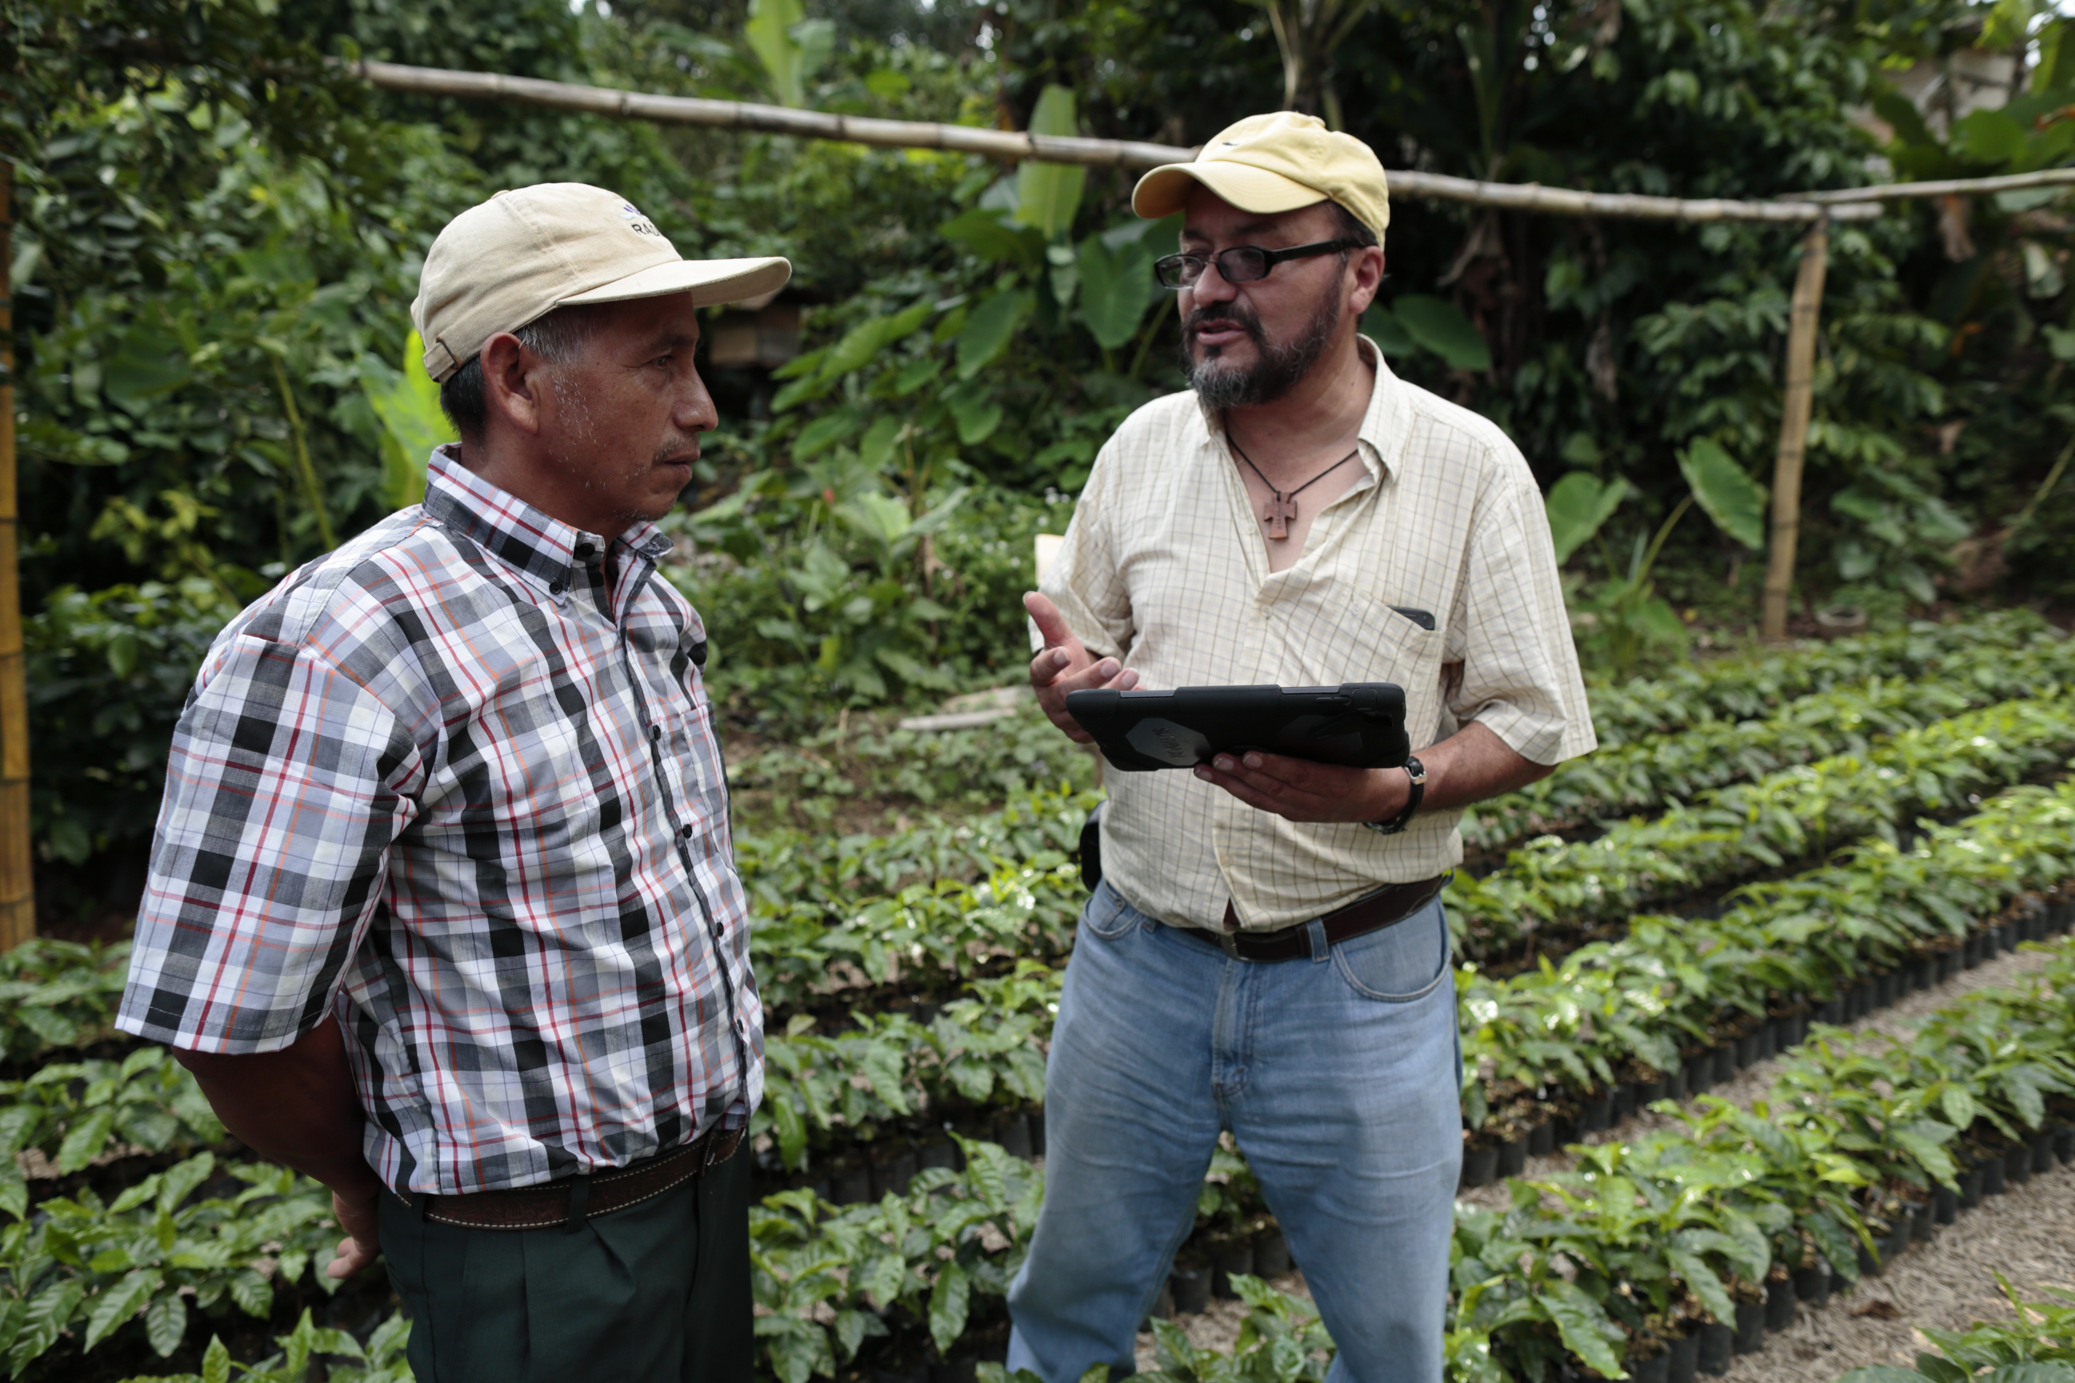
Choosing a product (Continued)
If the product has not been chosen, you need to help farmers form groups and learn how to identify market opportunities.

Slide 75
Participatory tools used to assess product and marketing options
Community resource and asset map
Farmer segmentation
Crop calendars
Product selection criteria
Product ranking exercise
Assessing market risk for products
Market visits
New product evaluation

Slide 76
Community resource and asset map
Steps
Get to know you clients and their assets.
Collect information on the village resources, assets and local markets.
Outcome
Information on:
What is produced and when, where and why it is produced
Availability of productive land for expansion
Time frame
One day

Slide 77
Community resource and asset map: Example

Slide 78
Farmer segmentation
Steps
Understand types of farmers, farm sizes, assets, income, crops, livestock, organizations, laboring and/or off-farm activities
Outcome
Information on farmer types: rich, medium and poor farmers
What distinguishes them?
Time frame
Half a day

Slide 79
Crop calendars
Steps
Understand what farmers grow during the year.
Compare labor needs for existing products and proposed new products.
Outcome
A calendar of the basic cropping pattern or system used in the target area
Time frame
Half a day

Slide 80
Product selection criteria
Steps
Set up production selection criteria such as:
Has a good market
Price is high
We know how to produce it
We can eat and sell
Labor use
Number of farmers growing the product
Outcome
Farmers understand the voting system and use it to select a product
Time frame: One hour

Slide 81
Product ranking exercise
Steps
Based on the selection criteria, a focus group identifies and prioritize five food and the top five market products.
Repeat the exercise in focus groups with specific farmer segments, e.g. men, women and youth.
Outcome
Identification of the five top food and income crops
Identification of how many farmers grow and sell the top five marketed products
Time frame: Half a day

Slide 82
Assessing market risk for products
Steps
Identify how risky a product is in terms of market options and knowledge of product.
Outcome
Farmers learn how risky a product is for their investments.
Time frame
One hour

Slide 83
Market visits
Steps
Gather information from markets on prioritized products, which is an essential part of the business planning process.
Outcome
A visit to the market can:
Confirm the demand for product proposed by the farmers
Identify any new products that were not suggested by the farmers
Time frame: 1–2 Days

Slide 84
New product evaluation
Steps
Brainstorm on new products that the farmers would like to produce and why they would like to produce them.
Outcome
Identify if there are any products that farmers would like to invest in, which they are currently not growing.
Time frame
1–2 Days

Slide 85
Discussing product options with farmers
You can discuss marketing with farmers at their regular group meetings.
It is usually in the farmers’ interest to work together, so they will help one another come to a joint decision.

Slide 86
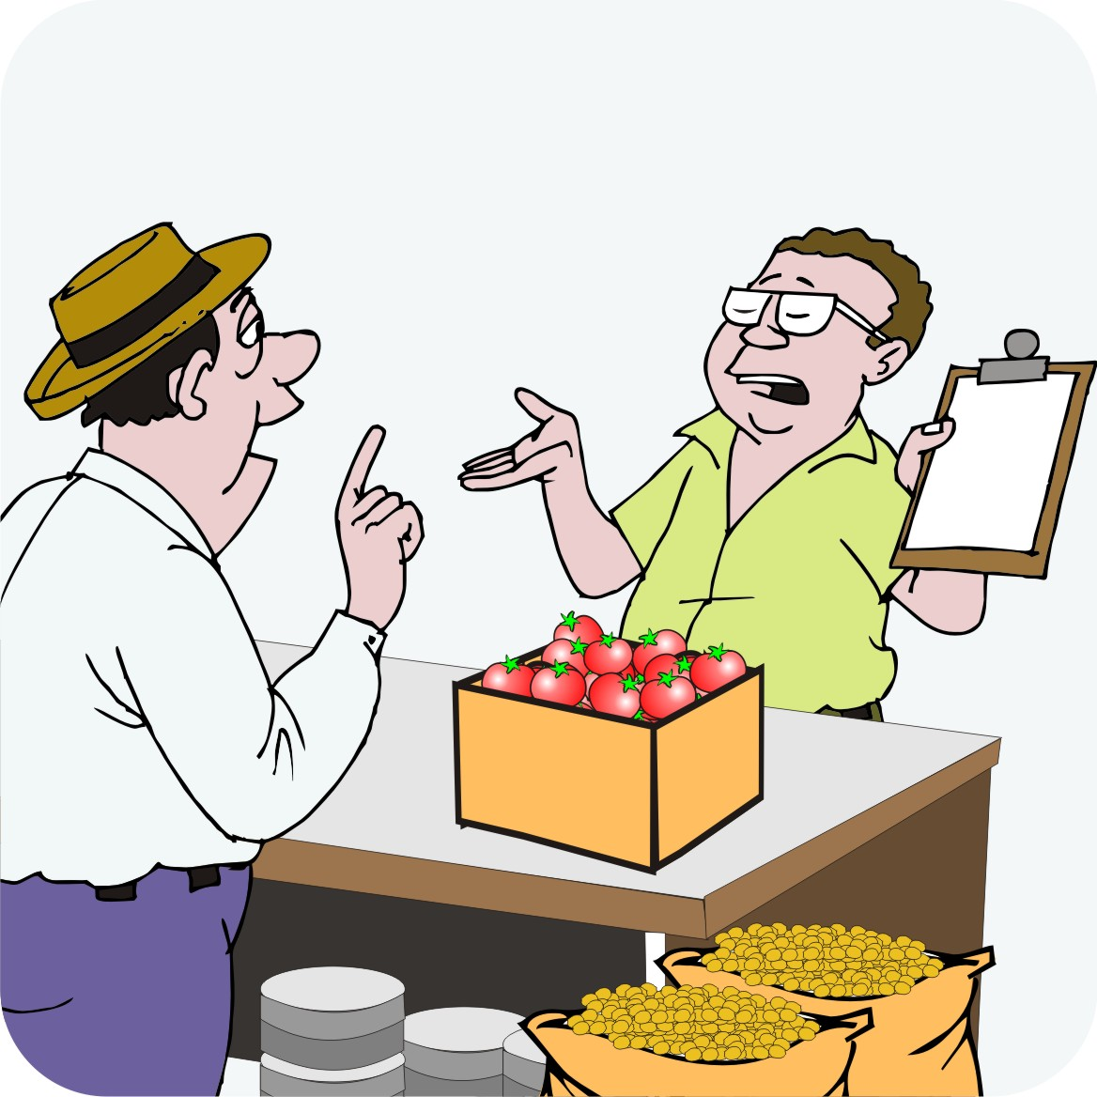
Discussing product options with traders
It is best to interview traders individually.
Traders operate their businesses as individuals and they have little interest in cooperating with one another.
If you interview a group of traders, they may exaggerate their answers; so it will be hard to get reliable information.

Slide 87
Discussing ideas with other role players
Also discuss ideas with:
Extension personnel
Local government staff
Service providers, e.g. input suppliers, banks, NGOs and other development projects
These role players may be able to provide information on and insights into opportunities
and challenges.

Slide 88
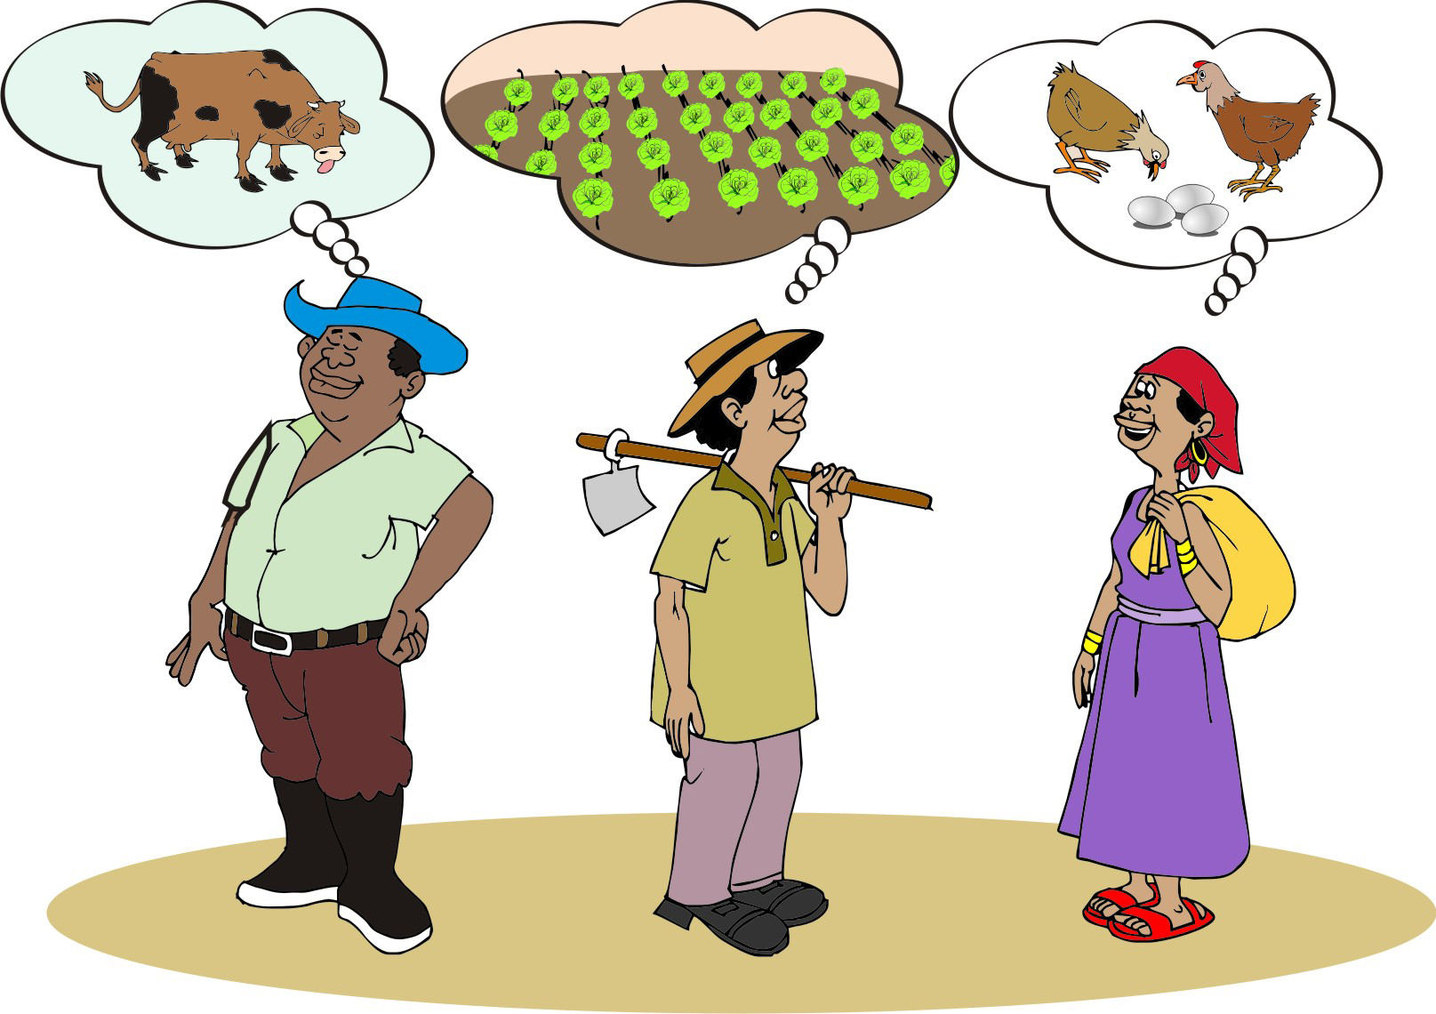
Identifying market opportunities for products
Farmers may have diverse views on the best product for example:
Richer farmers may want to invest in larger livestock
Farmers with irrigation may want to grow vegetables all year round
Women may prefer items such as eggs, because they can produce and sell them close to their homes.

Slide 89
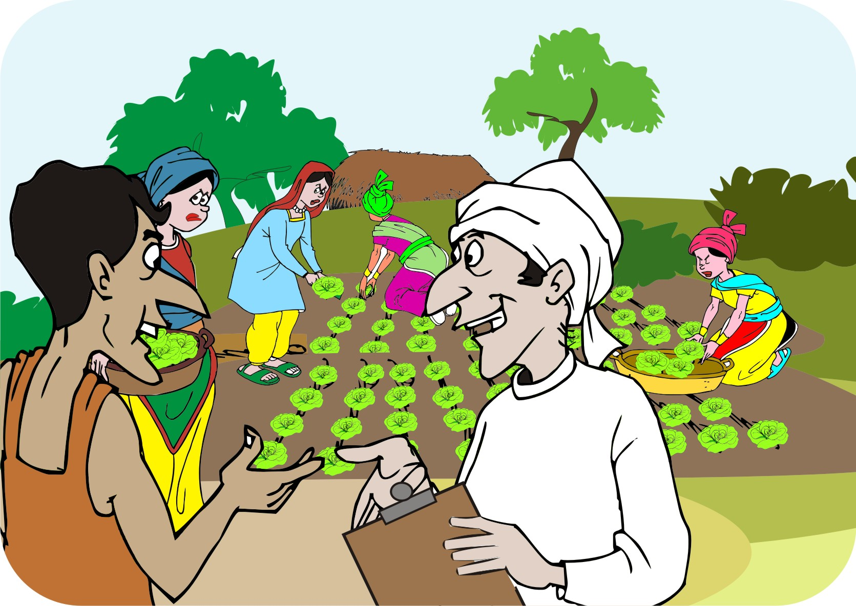
Including women in agroenterprise development
Hold meetings with women only.
Ask them what products they could work on where they could keep all or most of the income.
Hire women field agents work with women farmers.
Make sure that women have the opportunity to speak in mixed groups.

Slide 90
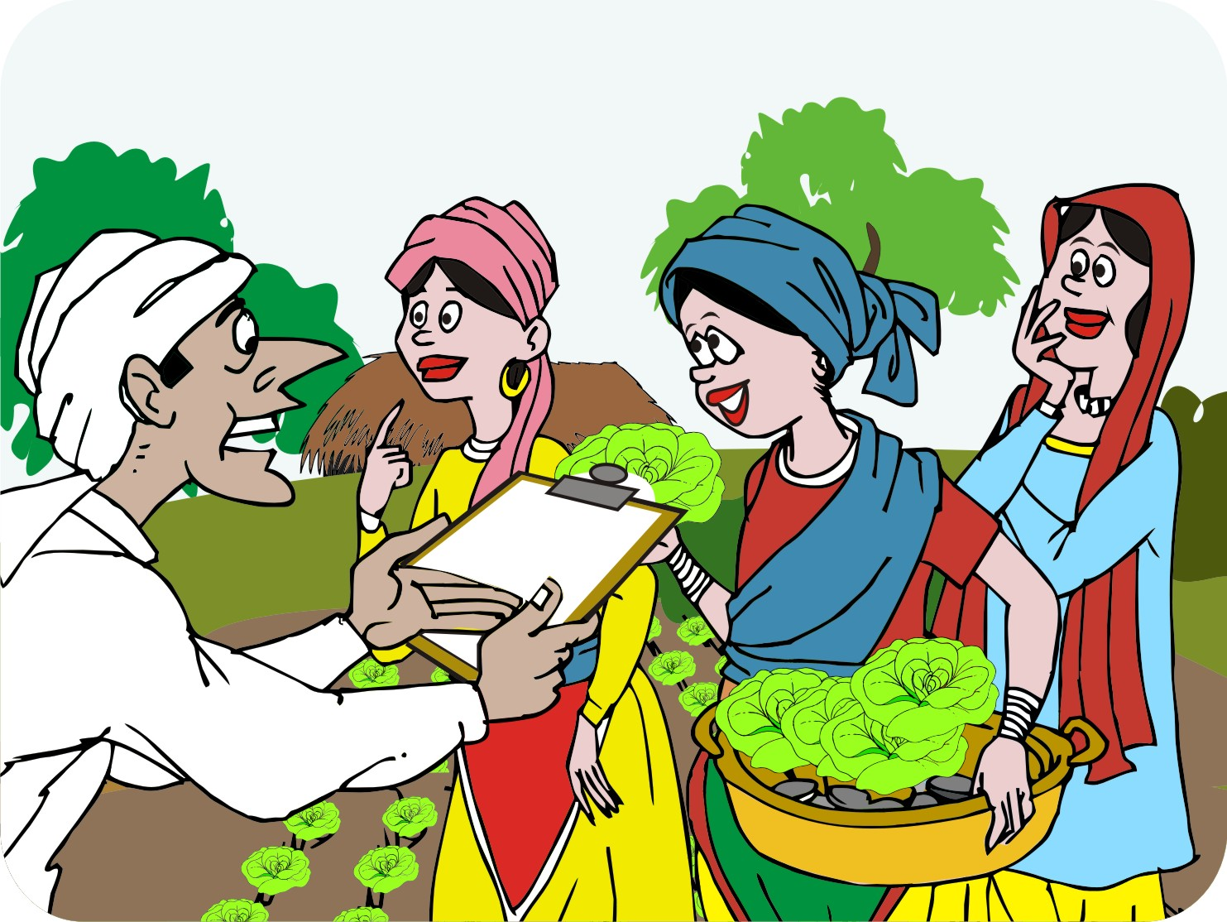
Including women in agroenterprise development (Continued)
Combine agricultural development with savings and loan activities.
Raise women’s issues with community leaders.
Do not get women to work on community plots: this creates an artificial situation that will fail when the product ends.

Slide 91
Things to ask women
Find out:
What women do in production and sales
Where women get vegetables and fruit for the family
If there are crops that are thought of as women’s crops?
If there are ways to improve the marketing of products that are controlled by women
If women are members of mixed farmers’ groups

Slide 92
Assessing risks of product and marketing options
Agriculture is particularly risky because of:
Variable weather
Pest and disease attacks
Uncertain markets
Price fluctuations
When selecting products and market options, it is important to consider these risks.
One way to assess risks is using the product/market matrix.

Slide 93
Product/market matrix: Questions
The product/market matrix shows the answers to the following two questions about a particular crop or livestock product:
Do the farmers already sell the product or is it a new product for them?
Do they already sell it to a particular buyer or market or do they want to sell it in a new market?

Slide 94
Product/market matrix: Answers
There are four possible answers to these two questions:
Farmers already sell the product to a particular market. This is the least risky option.
They want to sell a new product to an existing market. This is a medium-risk option.
They want to sell an existing crop to a new market. This is also a medium-risk option.
They want to sell a new product to a new market. This is the riskiest option.

Slide 95
Lesson 6: Working with farmers’ groups

Slide 96
Outcomes
After this lesson you will be able to:
Describe the requirements for a marketing group
Assist a group to get organized and registered
Plan a work program with the group.

Slide 97
Overview
Lesson 6 covers the following content:
Building on existing groups
Requirements for a marketing group:
Group size and members
Vision and leadership
Meetings and records
Bylaws and constitution
Business plan
Internal savings and lending
Relationship with support agency
Designing a curriculum
Challenges with farmer groups

Slide 98
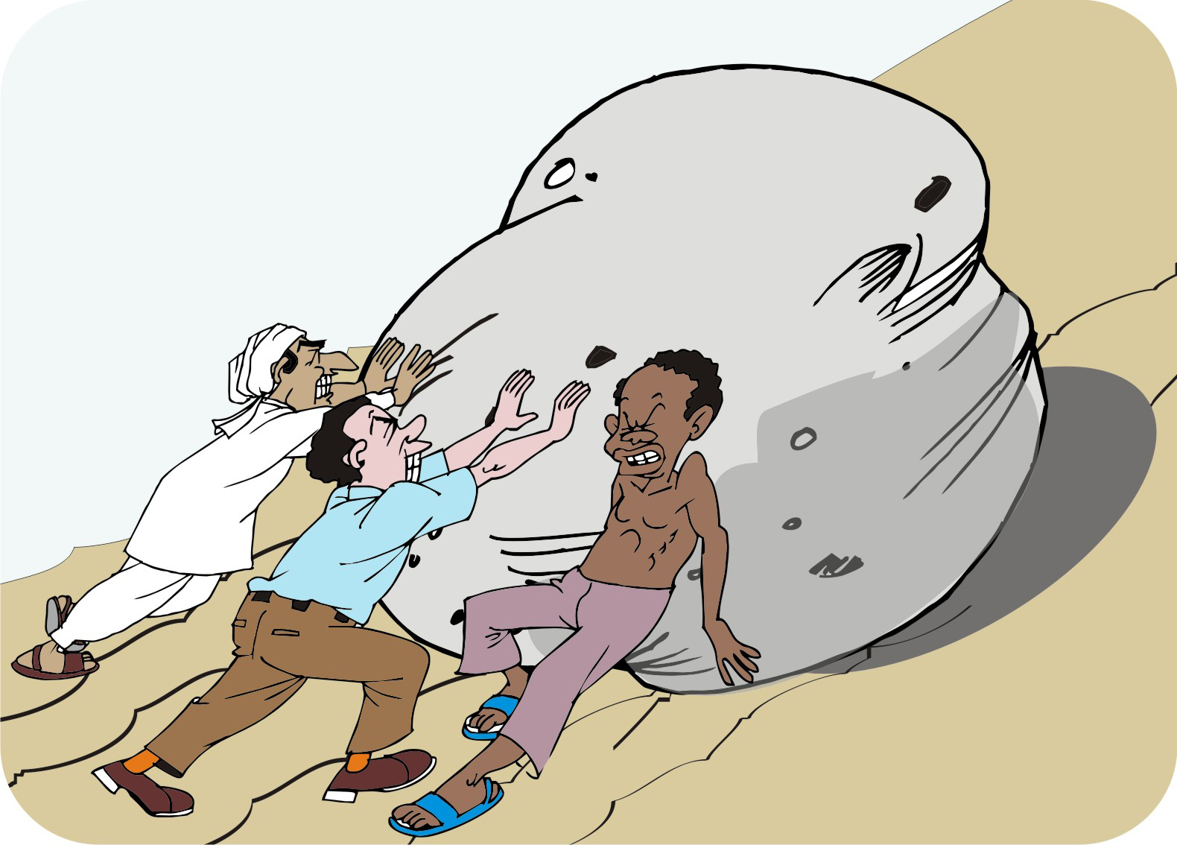
Building on existing groups
You can work with any type of existing group on marketing, for example:
Farmer field schools
Adult literacy groups
Women’s groups
Youth groups
Village savings and lending groups

Slide 99
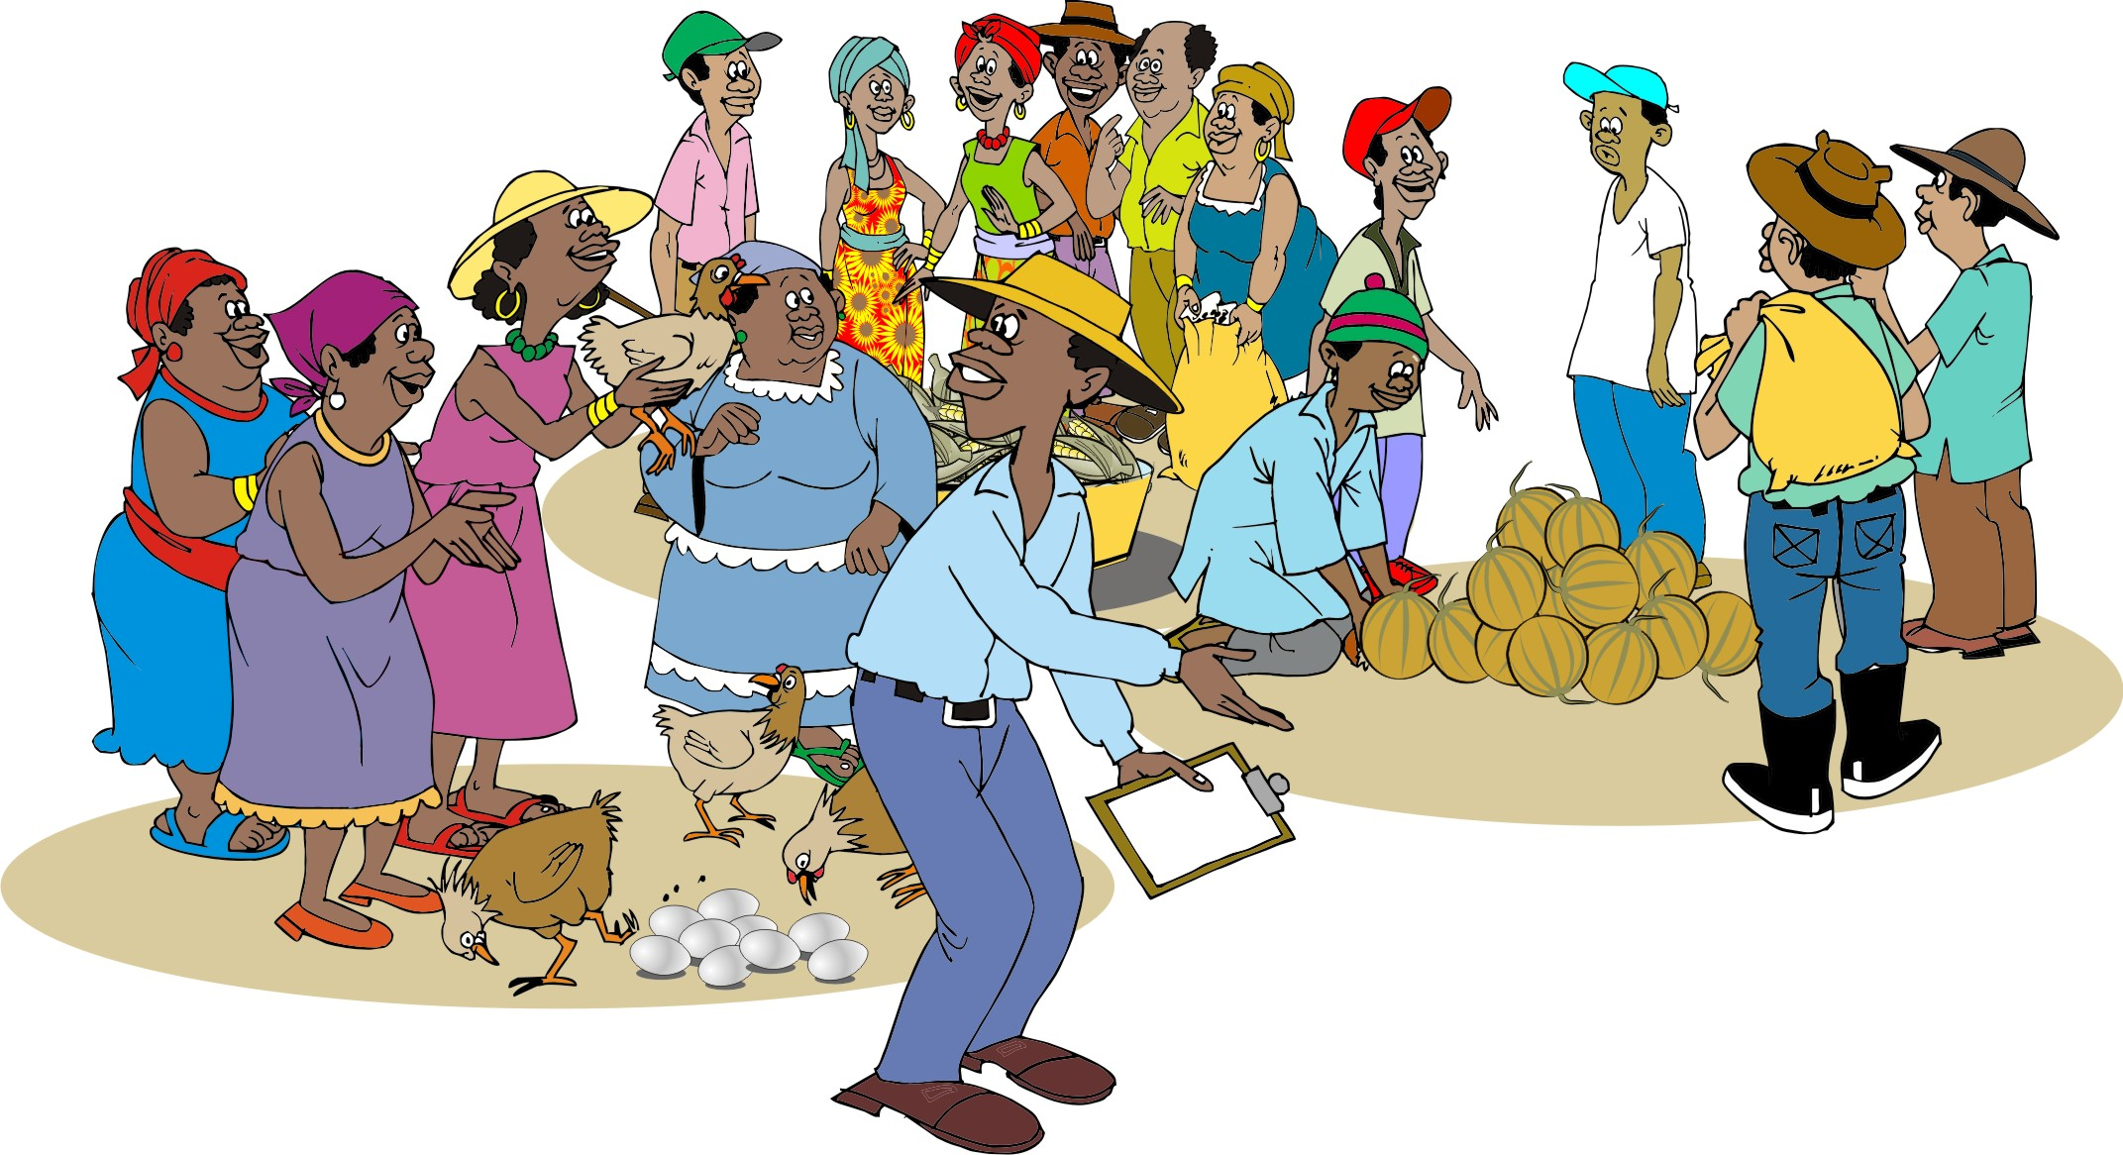
The marketing group
Marketing groups produce as individuals but sell their output collectively.

Slide 100
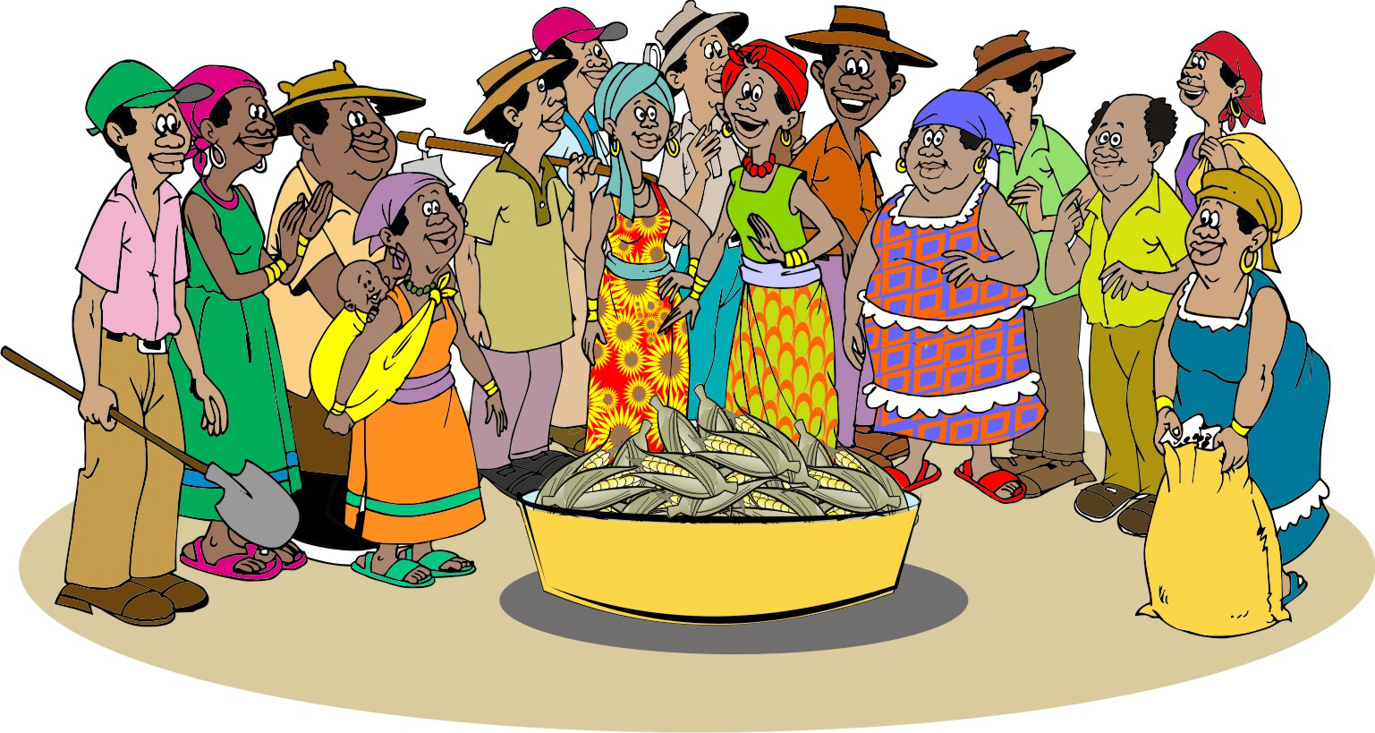
Requirements for a marketing group: Size
A group should have between 15 and 30 members – and never fewer than 10 members. This number is manageable, group members know one another and there is trust among members.

Slide 101
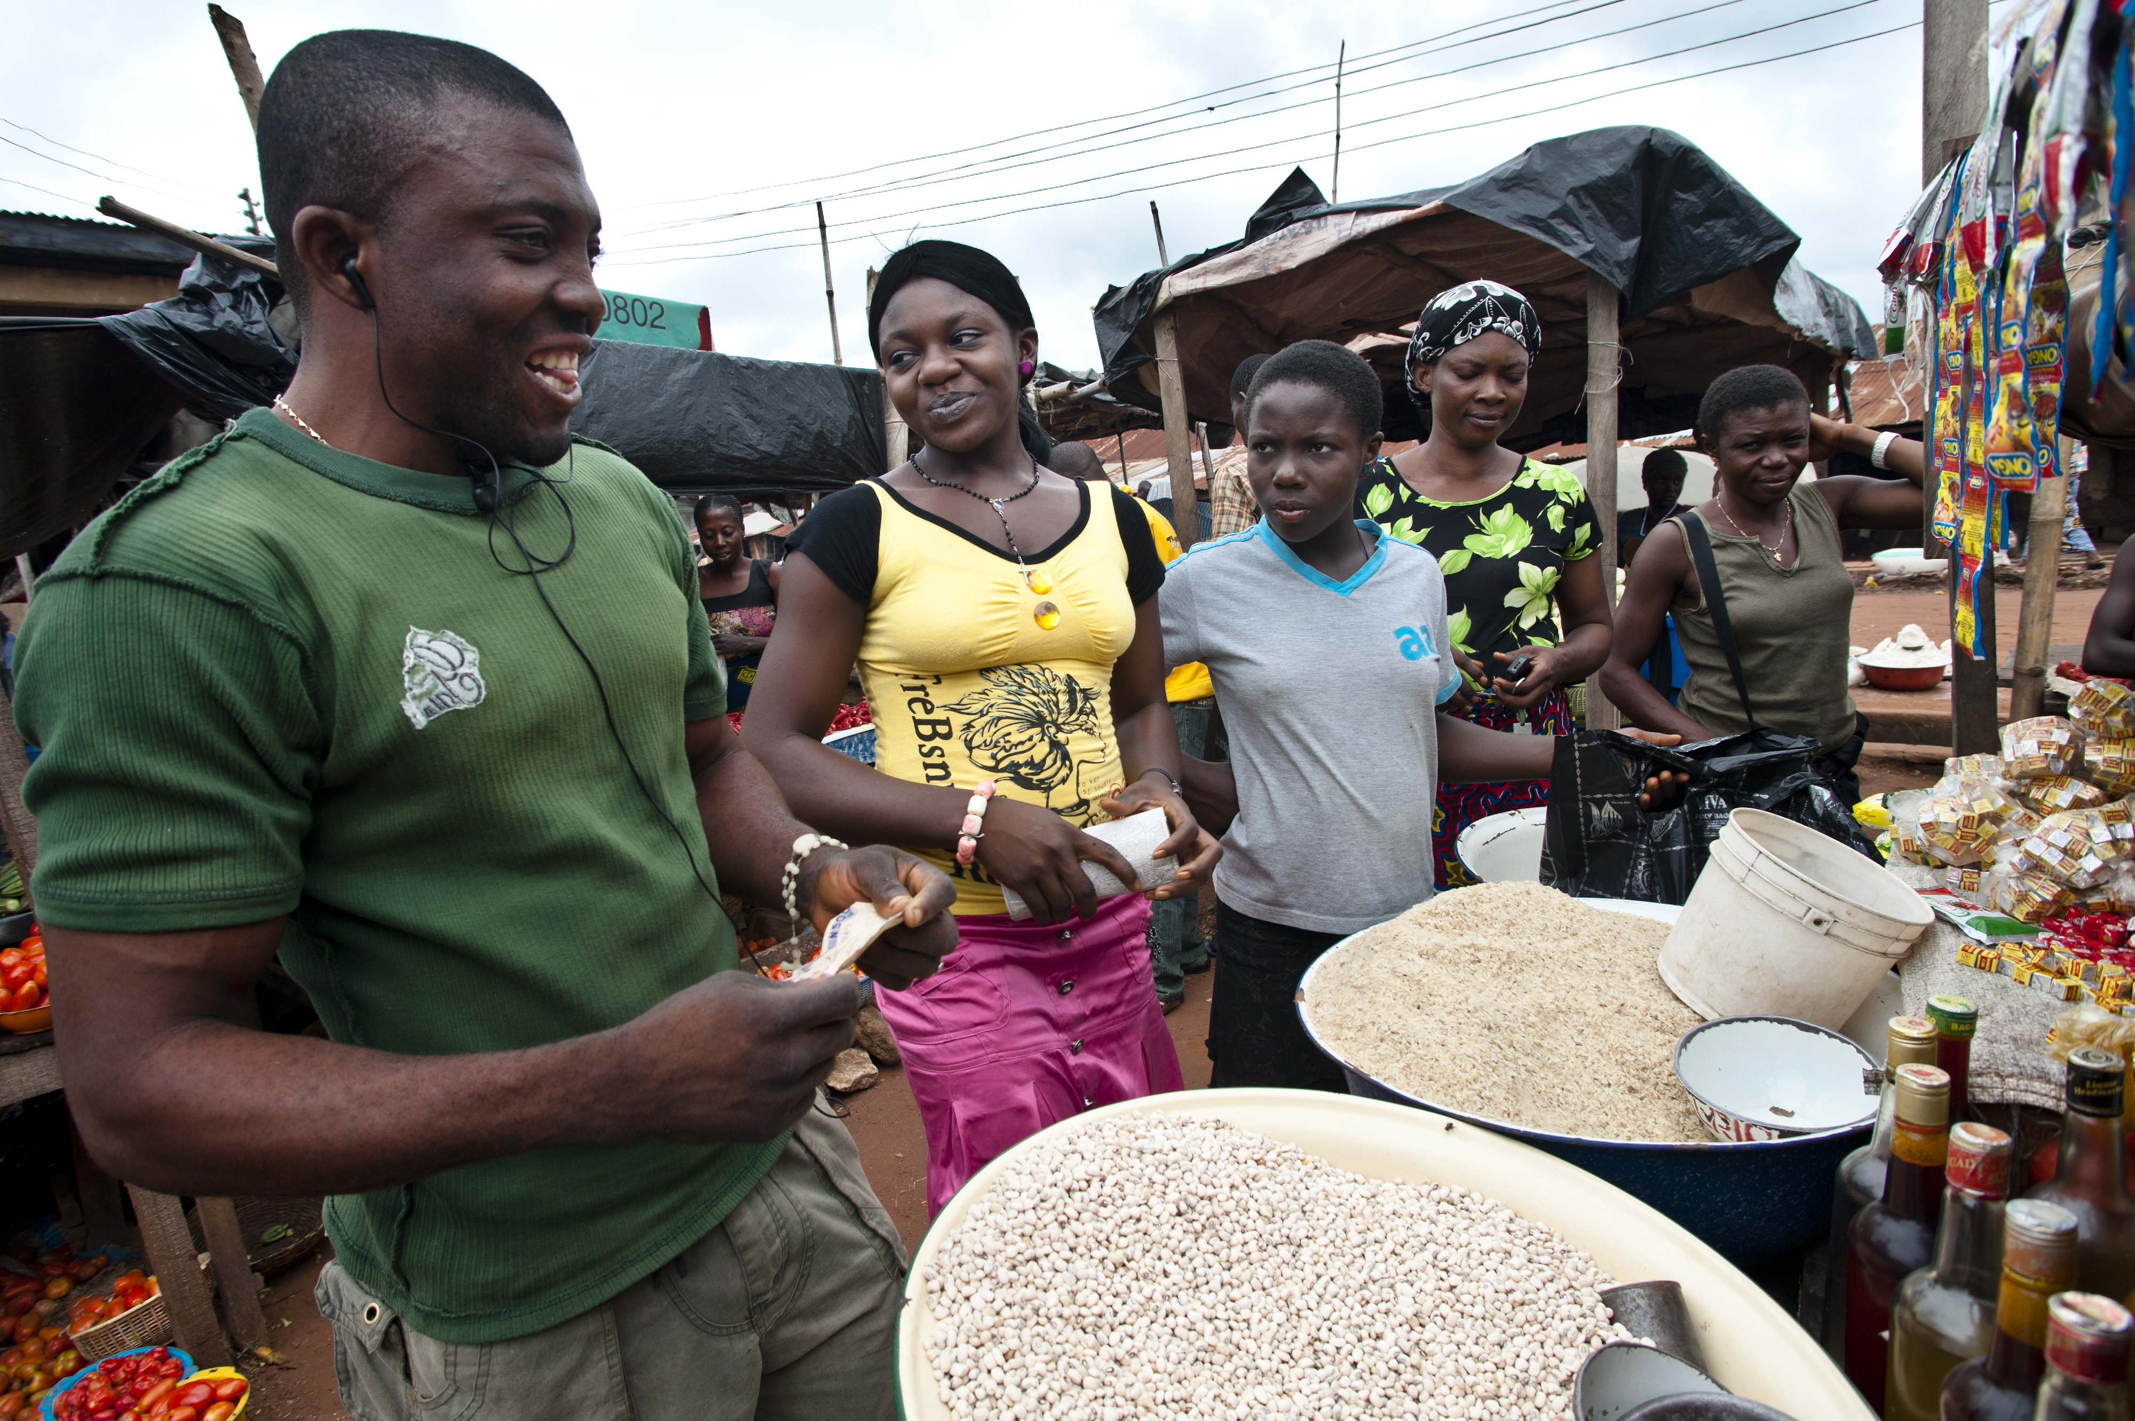
Requirements for a marketing group: Size (Continued)
If more farmers want to join, then larger production may be needed to fulfill larger market requirements.
If the group grows to more than 30 members, it should be split into two or more smaller groups, each with 15–30 members.

Slide 102
Requirements for a marketing group: Selection of members
The process of forming a group should be transparent and open to all community members.
The members should select themselves: they should not be appointed or forced to join.
All group members should have a similar culture and economic status.
In some cultures, it may be important to have separate groups for men and women.

Slide 103
Requirements for a marketing group: Vision
Group members should establish a clear, shared idea about:
The purpose of the group
What they expect to gain from it
What they want to achieve within a certain timeframe, e.g. one, three or five years.
These goals may be social or business-related.
Group members must be clear that they own the group and that strong groups rely on the principles of purpose, unity and self-reliance.
Groups that are not clearly owned by their members are likely to fail.

Slide 104
Requirements for a marketing group: Leadership
A group of 25 farmers should have some or all of the following officers:
Chairperson
Treasurer
Secretary
Production coordinator (Lead farmer)
Marketing coordinator
The roles and responsibilities of each officer should be clear. The members should audit the officers’ performance at the end of each year.

Slide 105
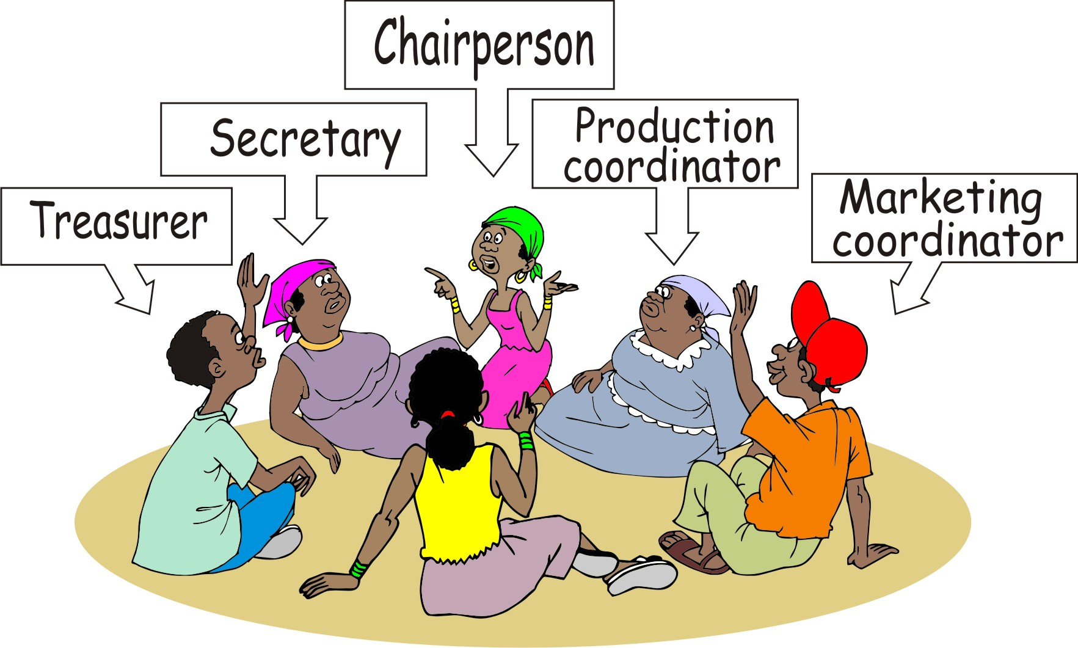
Marketing group leadership: Nomination and election
Officers should be nominated and democratically elected by the group members. Each of the officers should be re-elected on an annual basis.

Slide 106
Requirements for a marketing group: Meetings and records
The responsibility for record keeping can be divided as follows:
Chairperson: Overall coordination
Treasurer: Financial records, loans, sales and payments
Secretary. Records of meetings, business plan, lists of members, constitution, bylaws
Production coordinator: Production targets and actual production figures
Marketing coordinator: Marketing targets and profits

Slide 107
Requirements for a marketing group: Bylaws
The group should decide on its bylaws that should cover:
Number of members allowed
Level of membership fees
Frequency of meetings
Election of officers and duration of posts
How to share costs
Record keeping methods
Actions to be taken when a member does not comply with one of these rules, e.g. penalties

Slide 108
Requirements for a marketing group: Constitution
The constitution that should cover:
The group name and list of members
Purpose and vision of the group
Bylaws
Membership fees
Rules on meetings
Record-keeping
Financial procedures
Banking details
Monitoring performance
Penalties

Slide 109
Requirements for a marketing group: Business plan
The group’s business plan has to cover:
Product type and production plan
Production volume and quality
Target buyers and sales price
Financial investments and costs
Information on pre-production, production, post-harvest, marketing, monitoring and evaluation

Slide 110
Requirements for a marketing group: Internal savings and lending
Access to a system that allows group members to save money in a common pool and to lend money at interest enables the group to:
Generate capital
Reduce members’ vulnerability
Strengthen the group’s capabilities
Enable members to learn financial responsibility and financial management skills

Slide 111
Requirements for a marketing group: Relationship with the support agency
Before facilitation begins, the group and the support agency should be clear about their roles, responsibilities and aims.
Group members should realize that the support agency will not provide handouts, but will help them improve their ability to produce and market their products.

Slide 112
Requirements for a marketing group: Registering the farmers’ group
Once the group has been formed it must be registered with the project, so that the project can:
Provide services to the group
Monitor progress
You may also have to advise the group how to register with the government so it is officially recognized and can open a bank account.

Slide 113
Planning your work with the group: Short project
Your work with the farmers’ group will consist of several types of activities:
Training and coaching
Facilitating activities
Monitoring and information gathering
In a short (two-year) project, you should provide support to the farmers regularly throughout.

Slide 114
Planning your work with the group: Longer project
In a longer project (three years or more), you can organize your support in three phases:
An intensive start-up training period (First production cycle)
A coaching period (Second production cycle)
A consolidation period when you provide training intermittently or on request (Third and subsequent production cycles)
This training plan pattern enables you to transfer your attention to other farmers’ groups after the startup period.

Slide 115
Designing a curriculum
For each farmer group you will need to develop a training timetable or curriculum. The topics to cover in the training should be aligned to the different stages in the production and marketing cycle:
Pre-production (Market and crop)
During production (Crop performance review)
During and after harvest
Marketing
After marketing

Slide 116
Dealing with stronger groups: Sharing time
It is better to focus your attention on those groups who are motivated and interested in investing their time and money in the developing their agroenterprise.
Some support agencies have clear rules on providing free market training:
If members do not turn up to the meeting, they pay a fine.
If the group does not make an effort to achieve its targets, the group is dropped.
This approach puts responsibility onto the group to focus on the goals.

Slide 117
Challenges with farmer groups
Groups may fail for the following reasons:
Highly dispersed population: People cannot meet to share ideas and plan
Poor governance: Weak rules, poor leadership, mismanagement of funds
Dominance by the rich and powerful
High market access: Farmers do not need to bulk their products
Low barriers to entry within a specific market

Slide 118
Module summary
This was the first booklet in the Seven steps of marketing series.
In this booklet (module), you have learned the first two steps involved in linking farmers to markets and helping them to develop their agroenterprises:
Step 1: Getting organized
Step 2: Identifying products and organizing groups

