Slide 1
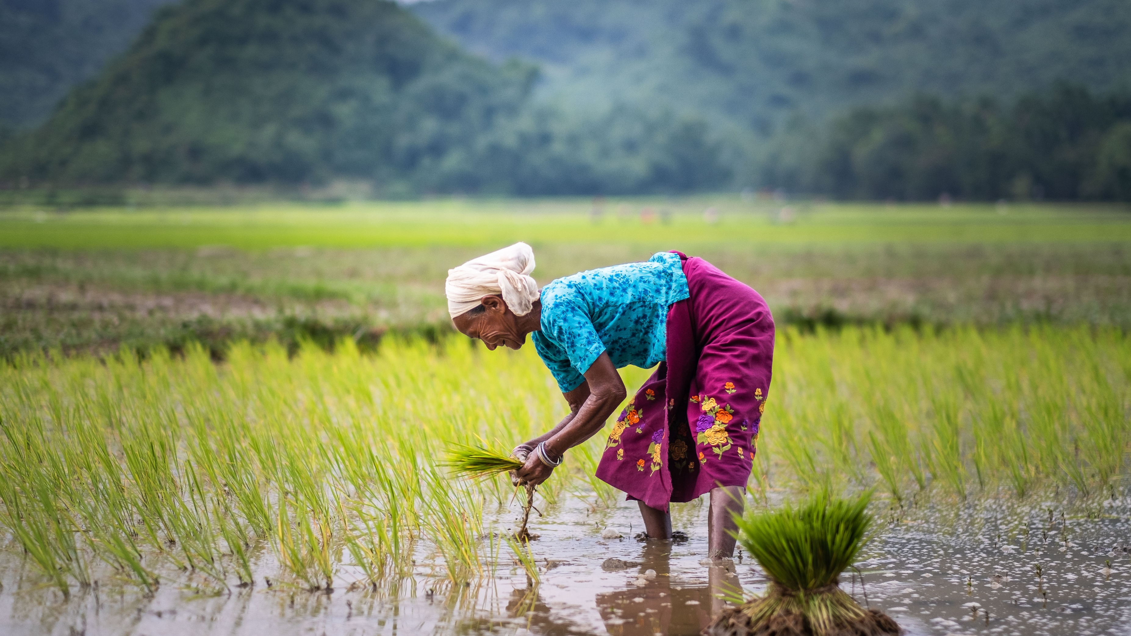

S34D RSSSA & Gender
RSSSA Training Manual

Slide 2
FEED THE FUTURE GLOBAL SUPPORTING SEED SYSTEMS FOR DEVELOPMENT – S34D

Slide 3
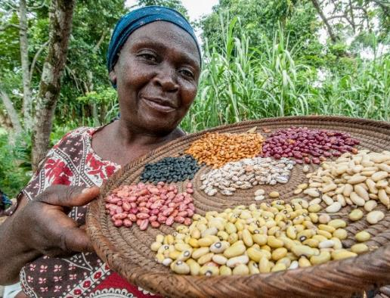
Content Overview
Case for Gender Equality
What is Gender?
Gender Equality vs Gender Equity
Gender in Seed Systems Response
Gender Integrated Response Options

Slide 4
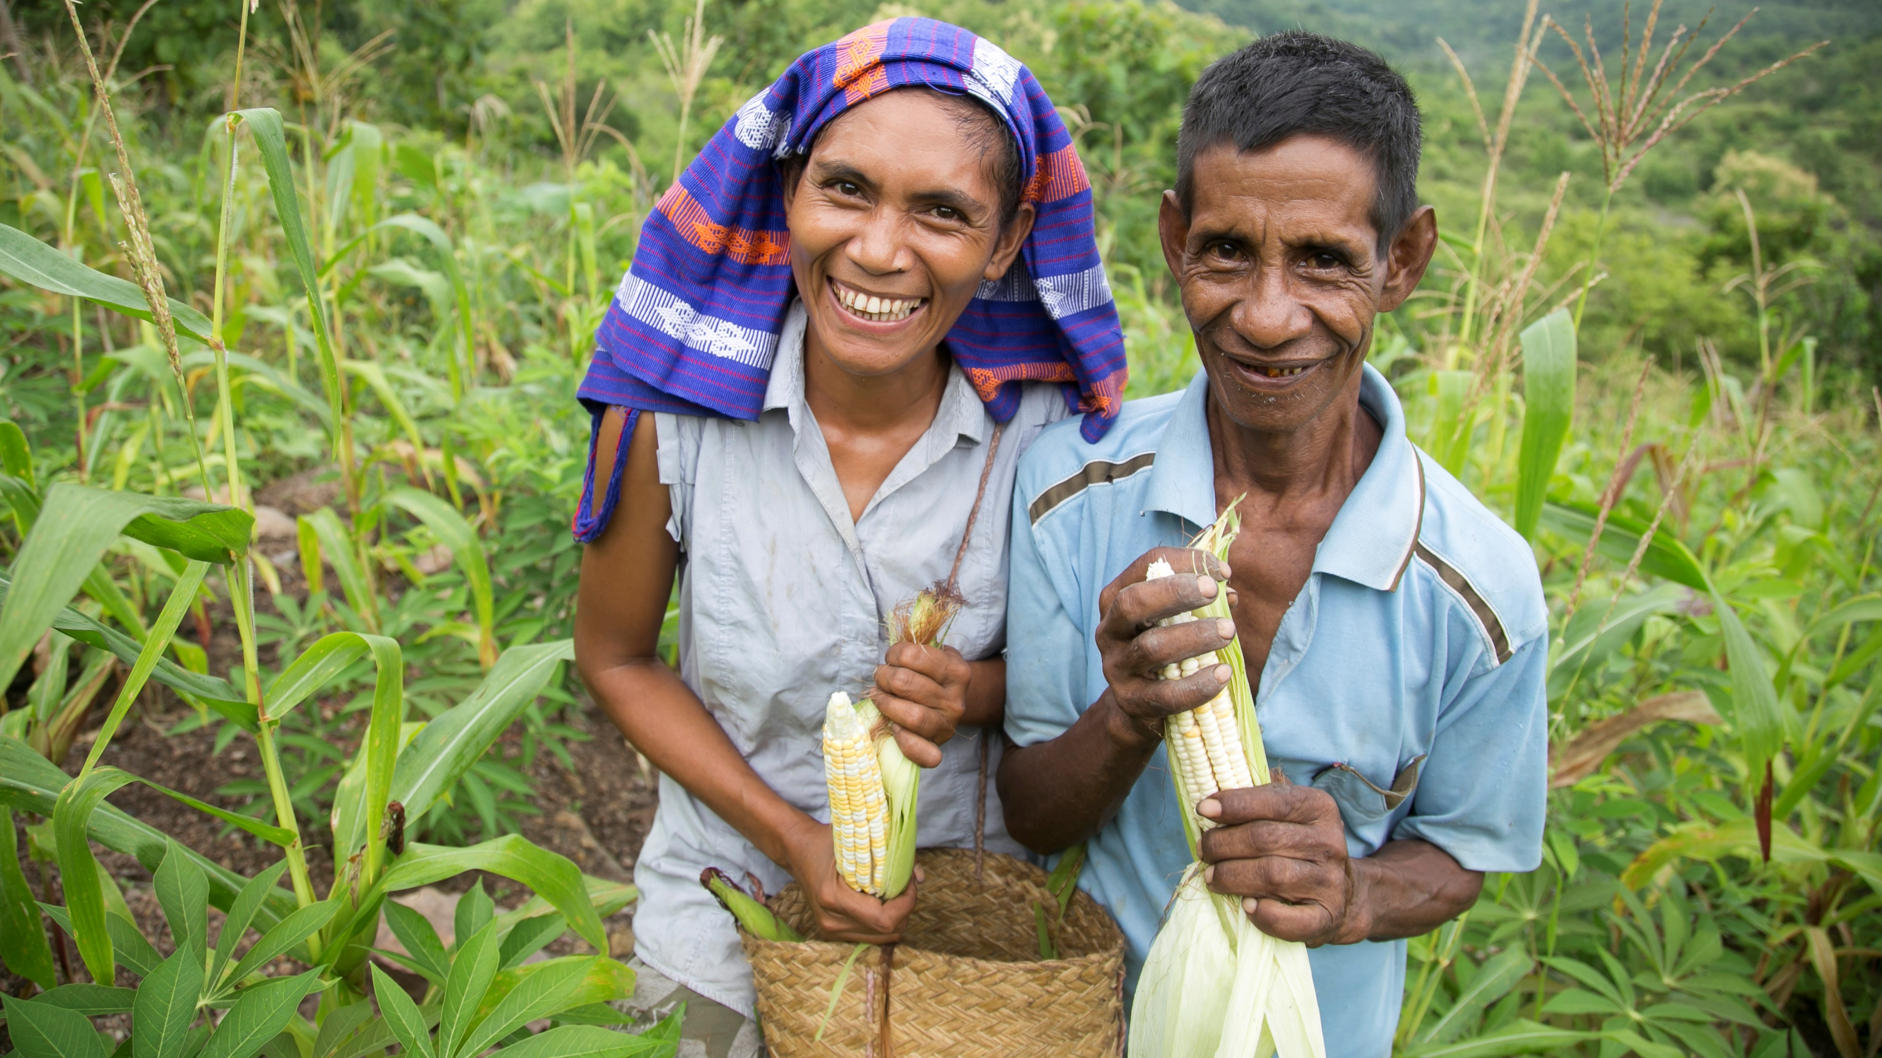
Case for Gender Equality
Notes:
Hold “quiz” (SLIDE #5-12)on gender equality facts (that show how gender inequality constrains development, and gender equality is an accelerator) (15 min)

Slide 5
Quiz!
In 2019, across all continents, the prevalence of food insecurity for women was _____ than/as men.
Lower
Same
Higher
Answer: C (higher) In 2019, across all continents, the prevalence of food insecurity was higher for women than for men. While there is evidence that gender inequality causes food insecurity (levels of hunger are higher in countries with a lower degree of gender equality), there is evidence that increasing gender equality and the empowerment of women results in improved food security and nutrition.
FAO, 2019, The State of Food Insecurity and Nutrition in the World/ Gender Equality and Women’s Empowerment in the context of Food Security and Nutrition

Slide 6
Quiz!
Women make up 43% of the agricultural labour force in the developing world with the share rising to x% in Asia and sub-Saharan Africa.
  50%
  60%
  65%
Answer: A
Women make up 43% of the agricultural labour force in the developing world, with the share rising to 50% in Asia and sub-Saharan Africa. Their work in agriculture is precarious; they are over-represented in seasonal, part-time and low-wage work, and the informal sector constitutes their primary source of employment.
FAO, 2014, The State of Food and Agriculture/ OECD, 2019, SIGI Global Report: Transforming Challenges into Opportunities, Social Institutions and Gender Index

Slide 7
Quiz!
FAO estimates that if women had access to the same productive resources as men, they could increase yields on their farms by X%. This could in turn reduce the number of hungry people in the world by 12-17%.
15-25%
20-30%
5-10%
Answer: B (20-30%) https://www.fao.org/news/story/en/item/52011/icode/

Slide 8
Quiz!
Only X% of formal agricultural extension services are accessed by women, globally.
  5%
  15%
  20%
Answer: A (5%)

Slide 9
Quiz!
In the Ivory Coast and Ghana, when women’s income increased, they spent the extra money on more ____for the family.
  Food
  Education
  Clothes
Answer: A
“In the Ivory Coast and Ghana, when women’s income increased, they spent the extra on more food for the family, whereas an increase in men’s income made no significant difference.”19 (ILO 2009)
Notes:
Answer – a, food

Slide 10
Quiz!
In Tanzania, when more equitable division of labor was promoted in the household, this resulted in a household income increase of ____%, labor productivity increase of 15%, and capital productivity increase of 44%.
  5%;
  10%;
  15%
Answer: B
Notes:
Answer: b, 10%
“Reducing women’s non-market work enhances their ability to earn a remunerative income… Changing the gender division of labor in the household to a more equitable division of tasks, and investing in labor saving technology has significant benefits for productivity. A study from Tanzania showed that when efforts were made to lessen gender constraints in the household this resulted in increases in household income by 10%, labor productivity by 15% and capital productivity by 44% among smallholder coffee and banana growers.”28 (ILO 2009)

Slide 11
Quiz!
Employers rate ____ as the most desirable employees, followed by ___, ____, and finally ____.
(a) Fathers; childless women; childless men; mothers; (b) mothers; fathers, childless men; childless women; (c) childless women; childless men; fathers; mothers
A: “One of the worst career moves a woman can make is to have children. Mothers are less likely to be hired for jobs, to be perceived as competent at work or to be paid as much as their male colleagues with the same qualifications. For men, meanwhile, having a child is good for their careers. They are more likely to be hired than childless men, and tend to be paid more after they have children. These differences persist even after controlling for factors like the hours people work, the types of jobs they choose and the salaries of their spouses. So the disparity is not because mothers actually become less productive employees and fathers work harder when they become parents — but because employers expect them to.” http://amj.aom.org/content/early/2017/09/14/amj.2016.0148.abstract
Notes:
Answer: a
“Employers read fathers as more stable and committed to their work; they have a family to provide for, so they’re less likely to be flaky,” Ms. Budig said. “That is the opposite of how parenthood by women is interpreted by employers. The conventional story is they work less and they’re more distractible when on the job.” In her research, Ms. Correll found that employers rate fathers as the most desirable employees, followed by childless women, childless men and finally mothers. They also hold mothers to harsher performance standards and are less lenient when they are late. NOTE: Two studies show that mothers are MORE productive than childless women. https://docs.iza.org/dp7904.pdf and https://s3.amazonaws.com/real.stlouisfed.org/wp/2014/2014-001.pdf

Slide 12
Quiz!
In a study of Fortune 500 companies, Catalyst found that firms with higher gender diversity in management had X% better return on equity than firms with poor gender equity.
  15%
  25%
  35%
Answer: C https://www.usaid.gov/engendering-industries/business-case

Slide 13
Do you have examples that demonstrates why gender equality is important for our work and in seed in particular?
Notes:
Reinforce key messages: gender inequality constrains development, and gender equality is an accelerator.

Slide 14
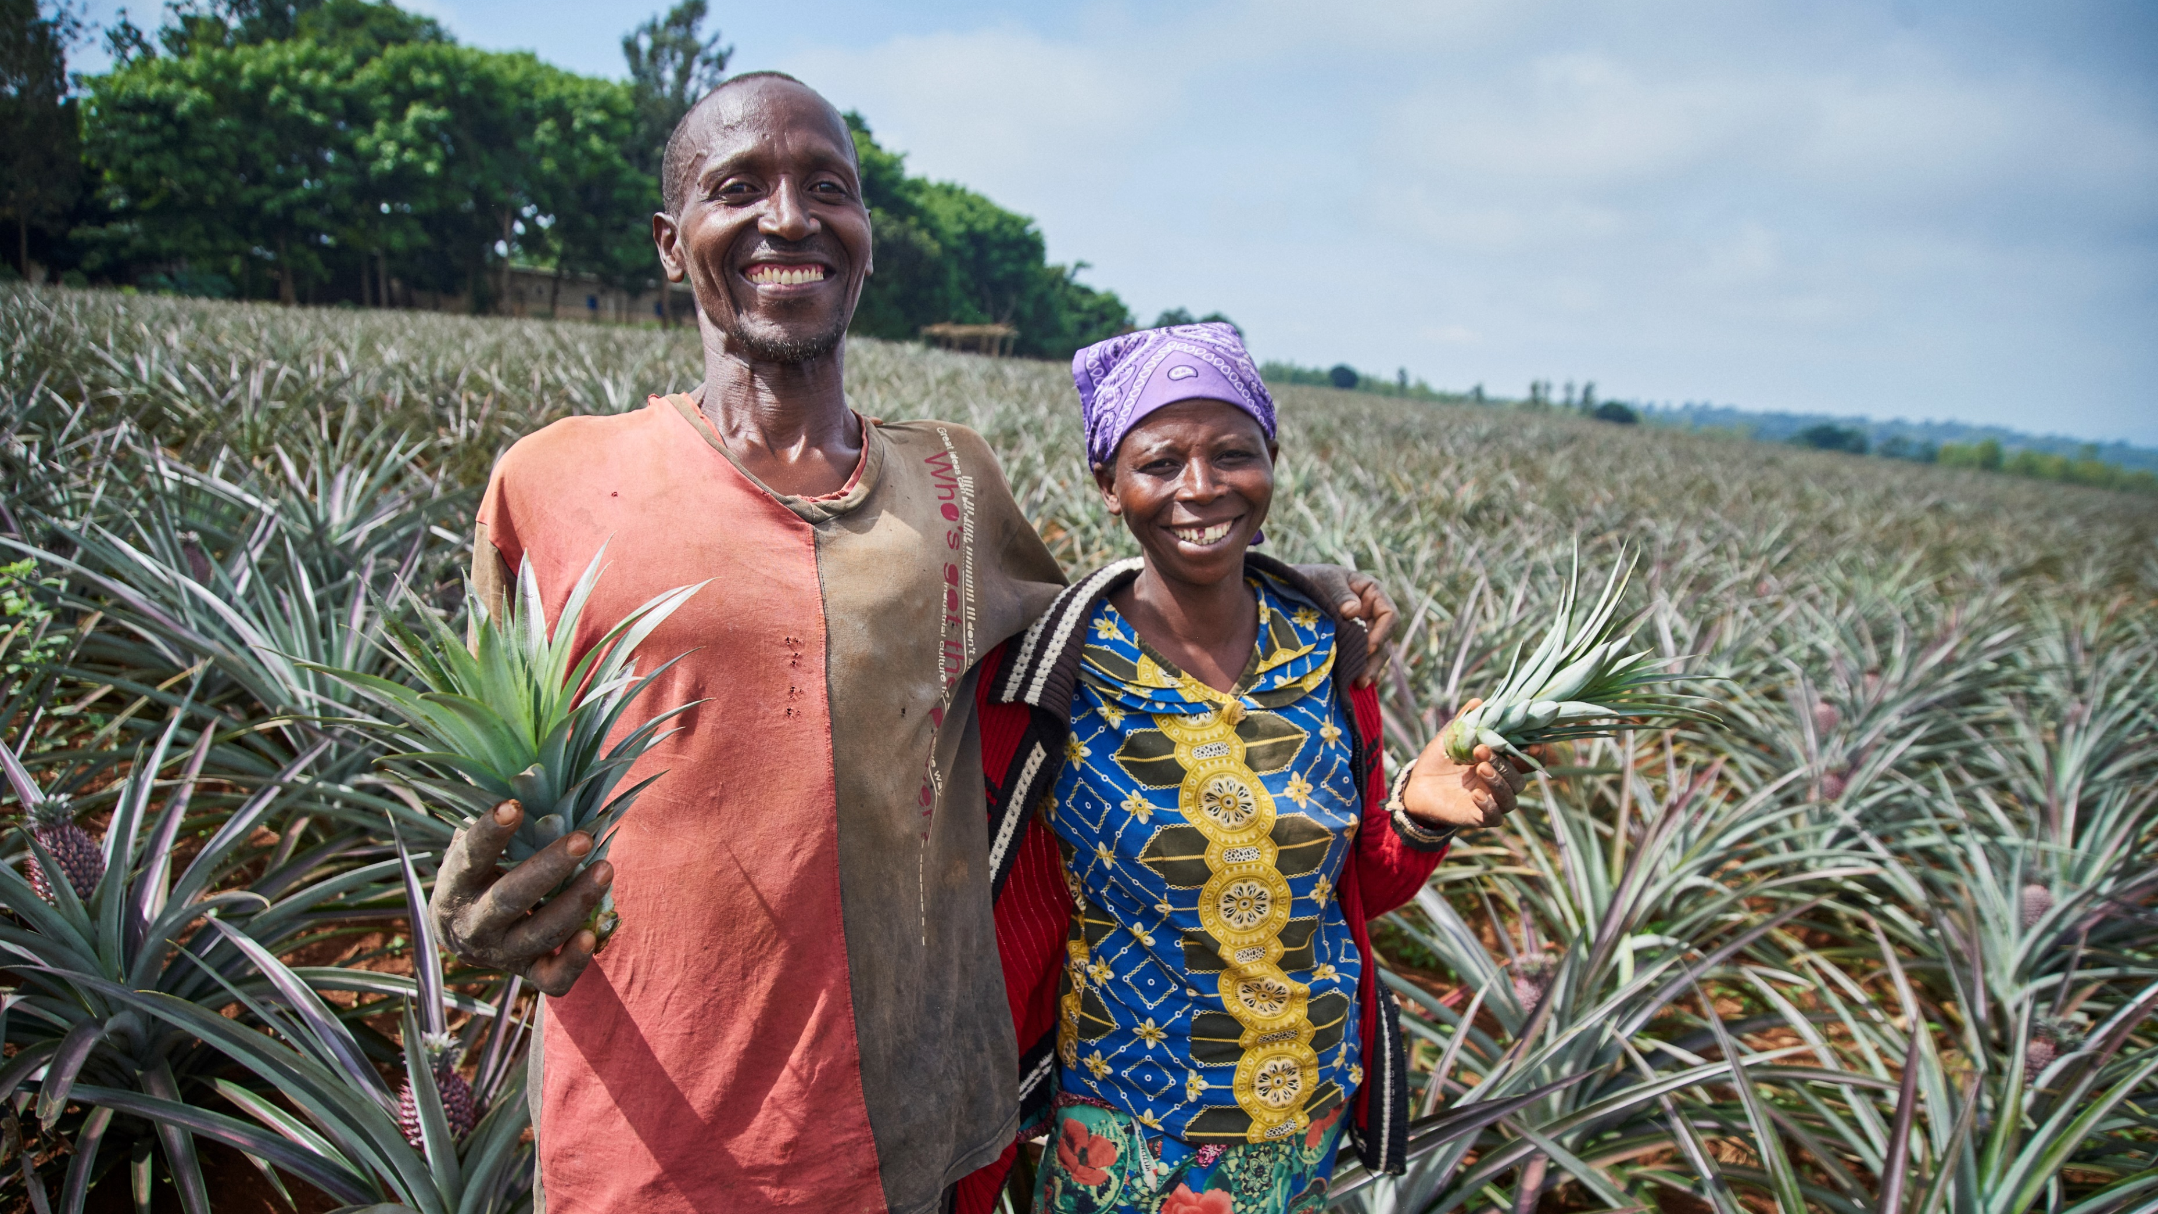
What is Gender?
Notes:
Having a common and foundational understanding of gender is essential as we consider the seed and associated input needs of clients.. Using a gender lens to identify how to tailor the responses based on the RSSSA will support programs to be at least gender-responsive and mitigate unintended biases in seed systems support. In this section, we will:
Identify and understand the differences between sex and gender
Reflect on gender in their society

Slide 15
What is the definition of Gender and Sex?
Sex
Biological differences between men and women
Gender
Social relationships between men and women that vary from one society to another and at different points in history
Notes:
Ask participants to define gender and sex. Based on their responses, briefly explain definitions of gender and sex using this slide. Emphasize that gender is socially constructed (and can change over time) versus sex which is biological. 10 minutes

Slide 16
Activity
 | Statement | G for gender S for Sex
1 | Men plough and prepare the land; women take care of weeding
2 | Women breast-feed babies
3 | Men grow cash crops, women grow food crops
4 | Women give birth to babies
5 | Women stay at home, men work for an income
6 | Men own land, women do not
Notes:
To confirm participants understanding of gender and sex, read these statements and ask participants to decide if it reflects Gender or Sex – 5 minutes
The correct responses are beliw:
STATEMENT
Men plough and prepare the land; women take care of weeding – G
Women breast-feed babies – S
Men grow cash crops; women grow food crops – G
Women give birth to babies - S
Women stay at home, men work for an income - G
Men own land; women do not – G

Slide 17
Activity: Vote With Your Feet
Men are better farmers than women
Men can take care of babies and children as well as women
Men should be free to make their decisions about how to use their income
Women’s incomes should only be used for household expenses
Men and women can equally run a profitable business when both have the same knowledge, education and access to resources
Notes:
Vote with your feet exercise – 30 minutes
Introduce “Vote with your Feet” exercise. Explain that an important aspect of understanding how gender impacts seed work is to also understand how our personal attitudes & beliefs related to gender and sex manifest. To explore this, we will do an activity to explore personal beliefs and attitudes. There is no “right” or “wrong” answer here – 3 minutes.
Read one statement at a time. Ask participants to decide if they agree, do not agree, or are not sure and based on their response, move to the flip chart corresponding with their response. Facilitator then asks one volunteer from the different opinions for why they agree or not (or are unsure). Manage time well!
Statements: (Facilitator’s Tip: statements should be adjusted to context)
Men are better farmers than women
Men can take care of babies and children as well as women
Men should be free to make their own decisions about how to use their income
Women’s incomes should only be used for household expenses
Men and women can equally run a profitable business when both have the same knowledge, education and access to resources
Have participants return to their seats. Make the point that gender is personal for everyone. It’s important to reflect on our own experiences related to gender so we can understand how it impacts our daily work and how we support seed systems. You can see not everyone agrees all the time—that is OK but we should respect each other’s experience, opinion and also be open to hearing/learning about new ideas and concepts. It’s equally important to be aware that our personal attitudes and experiences may, at times, create bias. This is normal. It’s important, however, to realize that we have these biases and they can, at times, impact our work.

Slide 18
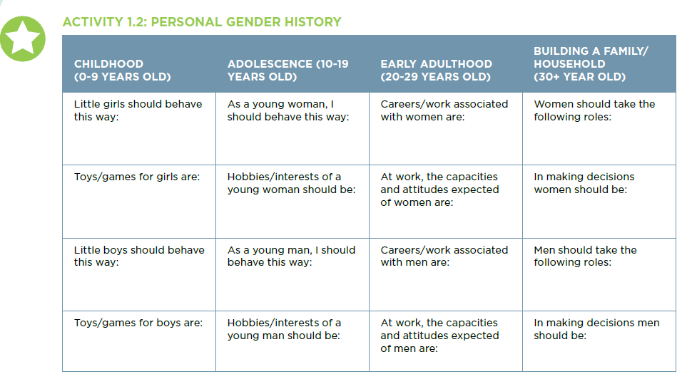
Optional Activity: Personal Gender History
Take 10 minutes to reflect in groups on the questions in one of the columns
TEAM 1
TEAM 2
TEAM 3
TEAM 4
Notes:
The final exercise in this session brings all of the ideas that we have discussed today into our own personal experiences. This is in line with adult learning principles, that we are facilitating self-reflection, based on lived experiences, strengths and personal history. And we have built the base knowledge or refreshed the based knowledge to work up to this point.
You will ask participants to use the personal history handout to help them share their own personal gender history (in the past). Next divide participants into groups and assign each group row.. Have the participants fill in the chart horizontally. For example, “when I was a little girl, I was taught to wash the clothes or when I was a little boy I was taught how to feed the goats. Emphasize this is what participants ‘KNOW’ to be true. What they lived within their own lives. Remind them there are no right or wrong answers and ask them to be ready to share these sensitive experiences.
Remind participants that personal sharing can be sensitive and to not judge people for sharing. It is important to reiterate these rules to participants.
When we break out into our group, together you will fill out this table. GROUPS SHOULD assign one recorder to fill in the sheet, one facilitator, one presenter, one time keeper, as you see fit. Have the recorder/notetaker open the document and share their screen in their breakout room. Again Team 1 is doing the top row, Team 2 is doing the second row Team 3 is doing the third row and Team 4 is doing the fourth row.
Any questions on how to do the activity? (May need to provide example again) You are not waiting for a facilitator, once you get the room the selected facilitator from your groups will start the conversation.

Slide 19
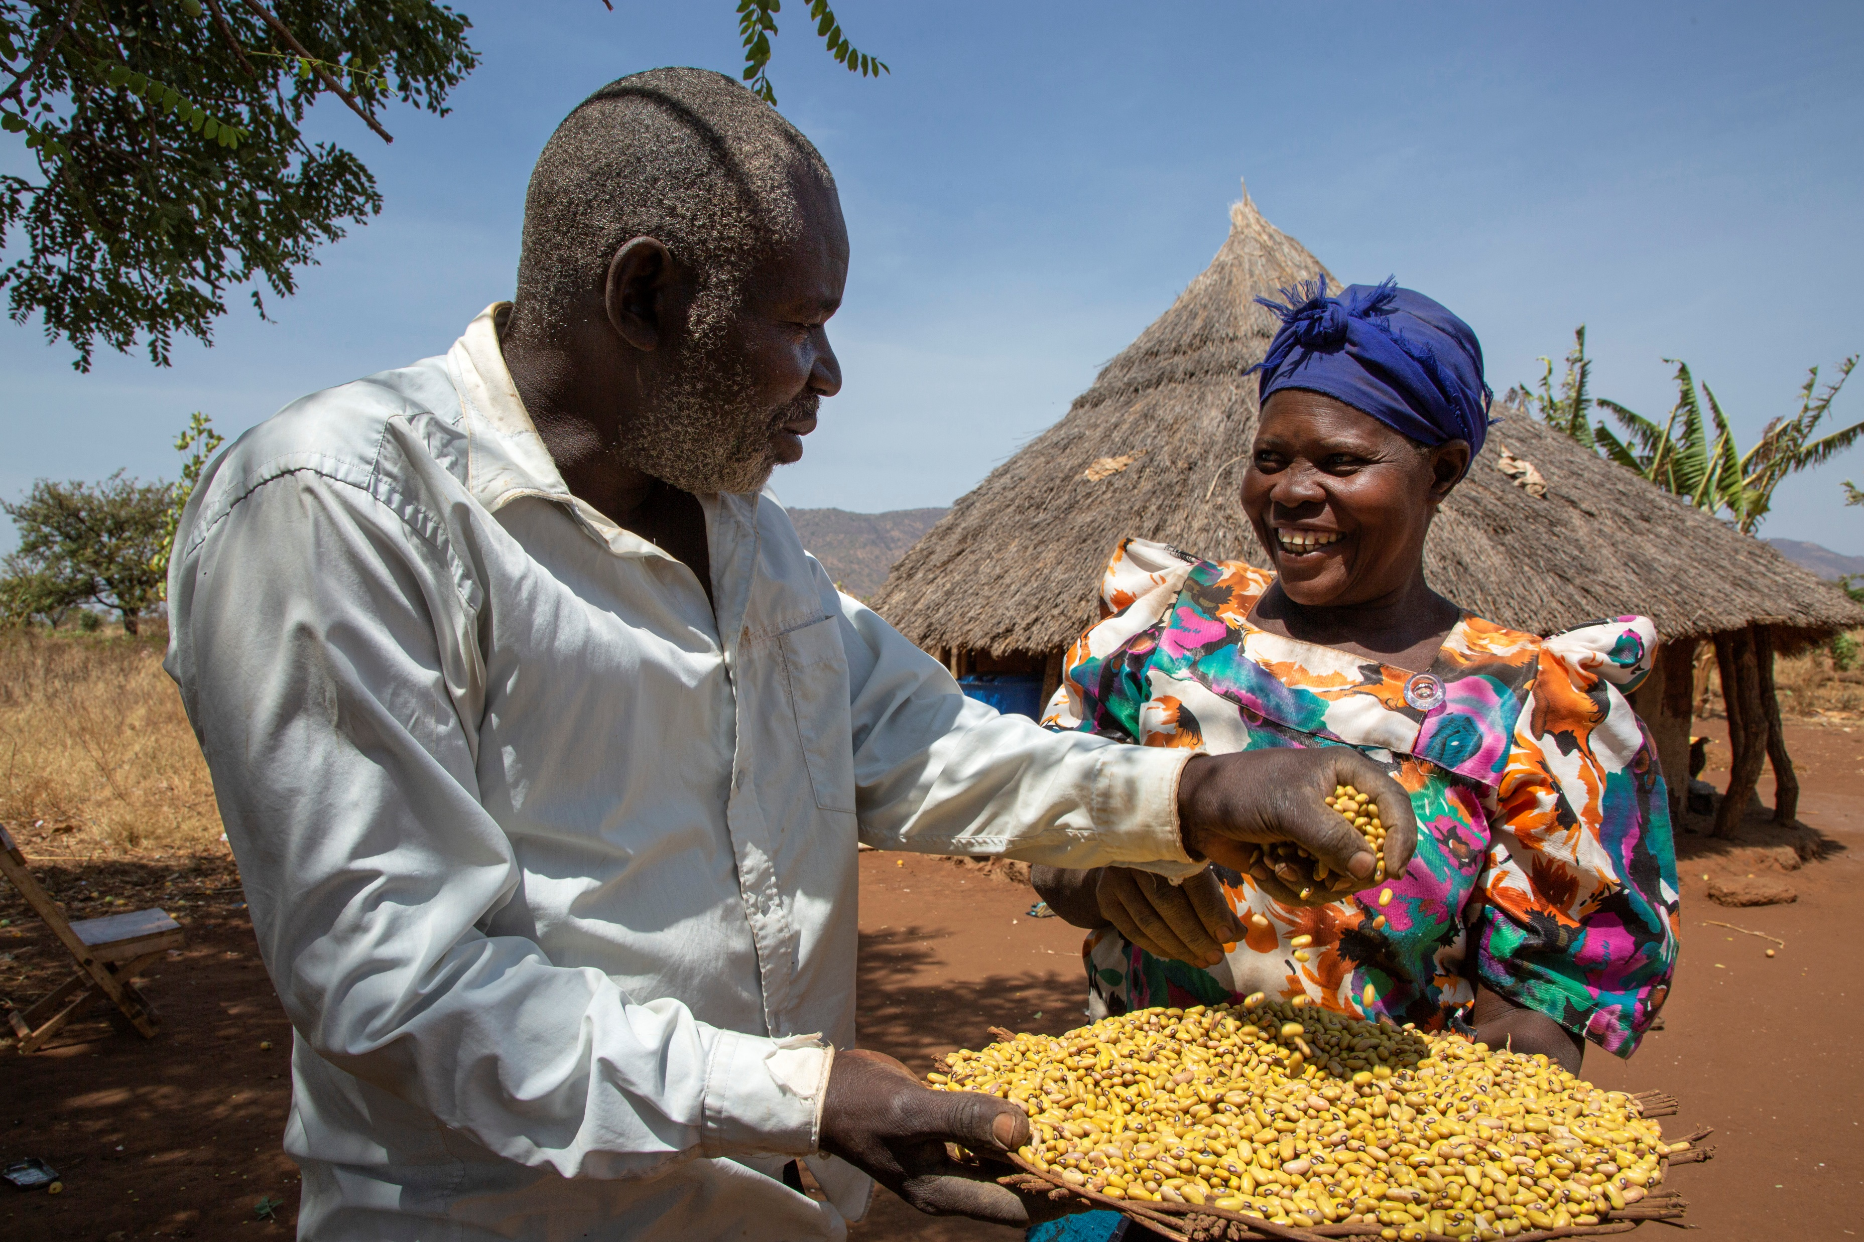
Equality vs Equity

Slide 20
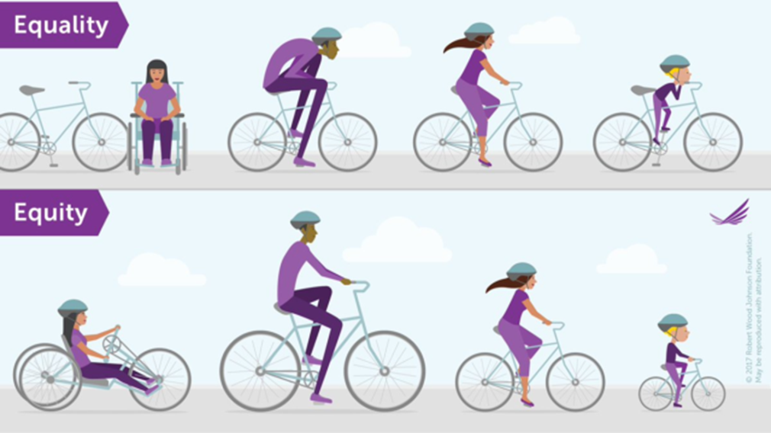
Equality Versus Equity
Notes:
What does this illustration suggest to you about what is meant by “equality” and what is meant by “equity”. Facilitate a discussion that ends with participants understanding the difference.
Equality is about ensuring everyone has the exact same resources. In this example, ,everyone gets the same kind of bike, while Equity requires distributing resources based on the different needs, wants and interest of the recipients. In this example, it means everyone gets a bike tailored to their needs.
Equity is a means to achieve gender equality

Slide 21
Why is it important to understand the difference between Equality and Equity in Seed Systems Response?
Notes:
Ask participants “Why is it important to understand the difference between Equality and Equity in Seed Systems Response?”
An equality lens would have us design a response that treat everyone the same in regards to type of seed to supply and how seed is accessed.
An equity lens would have us dive deeper into the data to understand the needs of different demographic groups and barriers in accessing seed at this time so the response addresses them and treats clients fairly.

Slide 22
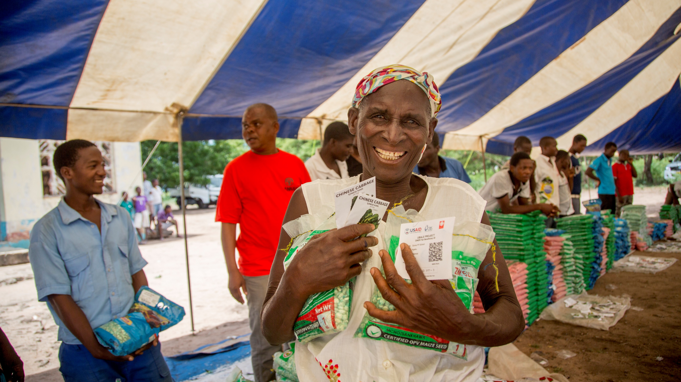
How does gender effect seed systems?

Slide 23
Gender Domains
Law, Policies, Regulations and Institutional Practices
Cultural Norms and Beliefs
Gender Roles, Responsibilities, and Time Used
Access to and Control over Assets and Resources
Shared Power and Decision-Making
Effective Participation and Leadership
Source: Adapted from USAID, ADS Chapter 205: Integrating Gender Equality and Female Empowerment in USAID’s Program Cycle
Notes:
Being able to understand how gender effect seed systems you need to understand these 6 gender domains. Review the gender domains quickly, without giving examples, explaining that the next exercise will help them get more familiar with the domains,
Roles, Responsibilities, & Time Use: Identifies different roles and responsibilities of household members by examining what females and males at different ages do (reproductive, productive, and community labor roles); how time is spent (day, month, year, season); Recognizes gender differences in availability and location; Considers the implications that time, roles, and responsibilities have on project activities
Access to & Control of Assets and Resources: Examines who has access or can use resources and services and who has control over when and how resources are used, discarded, sold, etc. Includes physical resources, income, services, employment, information, as well as benefits
Power Relations: How women and men decide, influence, and exercise control over material, human, intellectual, and financial resources in the family, community, and country; voice in decisions made by public, private, and civil society organizations
Participation & Leadership: How gender roles/responsibilities influence their level of participation in community groups and associations, including roles; Ways in which females and males may engage in development activities: attendance at meetings and courses, accepting or seeking out services, taking up leadership positions
Cultural norms and beliefs: pes of knowledge that female/ male possess. Beliefs that shape gender identities and behavior. Different perceptions that guide people’s understanding of their lives, depending upon their gender identity.
Legal Environment: Laws, policies, regulations, and institutional practices that influence context in which females and males act and make decisions. Includes formal statutory laws, regulations, procedures, and informal and customary legal systems, rules, and procedures. Assesses how people are regarded and treated by customary and formal legal systems. Right to inheritance, employment, and legal representation. Legal documentation such as ID cards that affect participation in project activities

Slide 24
Gender Domains Competition
We will have a friendly competition now.
There are ten questions which is given 1 point for each correct answer. Please respond with which domain you think it corresponds to.
Several domains may apply, choose the one answer that you think is most applicable!
READY!?

Slide 25
Question 1
Yes, Gender Roles and Responsibilities!
On average, women were mainly involved in household daily chores and seed related activities , whereas men mainly took part in activities that are performed outside the household (Source). Prior studies highlighted the crucial role of women in conserving local seeds and maintaining household seed security (Sperling and Katungi, 2009),
Cultural Norms and Beliefs
Laws, Policies, Regulations, Institutional Practices
Gender Roles, Responsibilities, and Time Use
Equitable Access to and Control over Assets and Resources, and Services
Shared Power and Decision-Making
Effective Participation and Leadership

Slide 26
Question 2
Yes, Access to and Control over Assets Resources, and Services
Gender stereotypes restrict women’s access to advanced technology that would reduce their workloads. (SL)
Cultural Norms and Beliefs
Laws, Policies, Regulations, Institutional Practices
Gender Roles, Responsibilities, and Time Use
Equitable Access to and Control over Assets and Resources, and Services
Shared Power and Decision-Making
Effective Participation and Leadership
Notes:
Doss and Morris (2001) found in Ghana that gendered differences in technology adoption reflect differences in access to the inputs required.

Slide 27
Question 3
Shared Power and Decision-Making
SNAP’s Baseline Survey found that 26% of women reported that they can make decisions independently when spending money they have earned themselves from non-farm activities. Moreover, these decisions are limited to reproductive tasks, such as the purchasing food or clothing. Women have even less decision-making capacity for more significant familial issues. Less than 6% of women in SNAP Districts make decisions on obtaining loans, child education expenses, medical expenses, family planning expenses, or expenses for the marriage of their children. (SL SNAP p.59-60)
Cultural Norms and Beliefs
Laws, Policies, Regulations, Institutional Practices)
Gender Roles, Responsibilities, and Time Use
Equitable Access to and Control over Assets and Resources, and Services
Shared Power and Decision-Making
Effective Participation and Leadership

Slide 28
Question 4
Gender Roles, Responsibilities and Time Use
A gender analysis in identified that women woke up before the sun rose while men woke up while the sun was rising, Women managed field and domestic chores throughout the day. In Petauke, women and men both had free time from 1-3pm while in Chipata, men and women had free time coinciding right after lunch. Field agents visited Chipata right after lunch to reach both women and men while other agents visit Petauke a bit later in the day when men and women were both available so both have access to the seed information they were sharing.
Cultural Norms and Beliefs
Laws, Policies, Regulations, Institutional Practices)
Gender Roles, Responsibilities, and Time Use
Equitable Access to and Control over Assets and Resources, and Services
Shared Power and Decision-Making
Effective Participation and Leadership

Slide 29
Question 5
Access to and Control over Assets Resources, and Services
Last mile agents sold seed on credit to female clients. After harvest, when the agent return to collect payment, several female clients did not have money to repay the credit. The agents learned that although they sold the seed on credit to the wife, her husband controlled the income earned from the sell of the products produced from the seed.
Cultural Norms and Beliefs
Laws, Policies, Regulations, Institutional Practices)
Gender Roles, Responsibilities, and Time Use
Equitable Access to and Control over Assets and Resources, and Services
Shared Power and Decision-Making
Effective Participation and Leadership

Slide 30
Question 6
Cultural Norms
“The Mossi and Bissa adhere to the ideal that men should provide the staple cereal (millet) and women the sauce; women have become millet providers. They do not talk about themselves in such terms; they talk about their farming as part of their mothering role. They are “feeding their children.” In 2 villages, women presented themselves as marginal producers while they farmed as much as 56% of the cultivated area of these villages. Women talked about their fields as groundnut fields while they had planted 56% of the area with millet and 37% with groundnuts, both a sauce ingredient and cash crops.” (Helmfrid 2004).
Cultural Norms and Beliefs
Laws, Policies, Regulations, Institutional Practices)
Gender Roles, Responsibilities, and Time Use
Equitable Access to and Control over Assets and Resources, and Services
Shared Power and Decision-Making
Effective Participation and Leadership

Slide 31
Question 7
Laws, Policies, Regulation, Institutional Practices
“The needs of farmers and seed producers, especially women and youth is wholly missing from [seed] policies. Because seed policies focus on the formal sector and assume that farming and seed production will be a commercial enterprise, it is difficult for women and youth to participate in seed production and policies aggravate inequality.
Cultural Norms and Beliefs
Laws, Policies, Regulations, Institutional Practices
Gender Roles, Responsibilities, and Time Use
Shared Power and Decision-Making
Effective Participation and Leadership
Equitable Access to and Control over Assets and Resources, and Services

Slide 32
Question 8
Cultural Norms
“Sweet potato has long been, considered… to be food for women and children, and deeply held cultural practices link women—as key purveyors of food within the family—and sweet potato. Traditionally, upon marriage, a couple would move to the husband’s parents homestead for an initial period, and the in-laws would allocate the new wife a plot of land to grow sweet potato. This was a test to see whether the new wife was able to grow sweet potato to feed her children and herself.”
Cultural Norms and Beliefs
Laws, Policies, Regulations, Institutional Practices)
Gender Roles, Responsibilities, and Time Use
Shared Power and Decision-Making
Effective Participation and Leadership
Equitable Access to and Control over Assets and Resources, and Services

Slide 33
Question 9
Shared Power and Decision-Making
In Ethiopia, cash transfers for vegetable seeds were given, a study found that 50% of women who received cash for vegetable seed made their own decision on how and for what purpose to use the cash. This ranges from 88% in Hadiya to 19% in West Arsi.
Cultural Norms and Beliefs
Laws, Policies, Regulations, Institutional Practices)
Gender Roles, Responsibilities, and Time Use
Shared Power and Decision-Making
Effective Participation and Leadership
Equitable Access to and Control over Assets and Resources, and Services

Slide 34
Question 10
Participation and Leadership
In Zacapa and Chiquimula, Guatemala it was documented that 82% of selected Farmer Field Schools participants were men; in Ethiopia, 46% of selected livelihood groups were women; in Timor Leste, 59% of select agriculture groups were women and 30% of selected Niger agriculture innovation groups were women. ​
Cultural Norms and Beliefs
Laws, Policies, Regulations, Institutional Practices)
Gender Roles, Responsibilities, and Time Use
Shared Power and Decision-Making
Effective Participation and Leadership
Equitable Access to and Control over Assets and Resources, and Services

Slide 35
Group Discussion: Based on the Gender Domains, how can gender effect seed system response

Slide 36
Gender Integration Continuum
Adaptation of IGWG continuum
Level 1: Gender Blind
Level 2: Gender Responsive
Level 3: Gender Transformative
Notes:
Earlier we learned about equality and equity and we learned that equity has us start to look at difference across groups and suggest that our responses may different to be fair and so all can reach the desired outcomes. Within gender, we use the gender integration continuum to help us thing about the type of programming we are designing as it relates to gender. “If you know about the gender integration continuum, please raise your hand. ​
​
​
For our training, It is not as important to understand and remember the terms but more important to understand the process and journey. The colors help to reinforce these ideas, usually being universal like a stop light. We will dive into each of these terms in the coming slides. ​
​
If we do not really think about their gender-based constraints with accessing agricultural goods and services as well as interest, needs and different uses. This is the lowest level of gender inclusivity. (Refer to the Red Arrow) Technically, we call this Gender-Blind, but we can also call it RED. We do not recognize gender differences and we just assume that everyone is the same.​
​
​If we consider the different needs and constraints of the people we are serving and provide services based on this information we would be Gender Responsive, but we can also call this YELLOW You are not changing any cultural norms, but you are looking at what men and women do and what they need within their current roles. This means we would be responding to the needs of our customers.
If we changed the cultural norms, structure or systems for our clients through our services, then our approach would be considered Gender Transformative, but we can also all this GREEN

Slide 37
Gender Integration Continuum
Women are responsible for growing vegetables while men grow maize, maize and vegetable seeds are available at district retailers at an elevated price. Women sell vegetables while men sell maize, men control the income from the sell of both foods. Women are not allowed to travel alone to the district center
Level 1:
Gender Blind
Level 2: Gender Responsive
Level 3: Gender Transformative
Offer maize seed through a subsidized voucher to be used at district level stores
Offer maize and vegetable seed with a subsize voucher at a local fair.
Offer maize and vegetable seeds with a subsidized voucher at a local fair. Layer a gender norms and couples communication approach on decisions related to using the voucher
Notes:
Lets look at an example. Read the top paragraph. Then provide the example of what a genderblind response would be, then the gender-responsive and last the gender-transformative

Slide 38
Activity: Gender Journey and RSSSA Response Option
Review slide
Adapt the approach, product or service to address differences between males and female in access, gender roles or workloads
Adapt the approach, product, service to address control and decision-making issues identified (household or community)
Notes:
Need to identify a case study

Slide 39
Key Findings: rSSSA Pilot Evaluation - IRC-Niger (2021)
Intervention zone: Chetimari, Diffa and Mainé-Soroa, Diffa region, Niger.
Agricultural situation: cropping system, rainfed cropping season, targeted crops are millet, sorghum, cowpea, peanut, sesame, sorel and okra
Seed Availability
Men controlled crops: average: 42% millet 37%, cowpea, 40% peanut 47% sorghum
Women controlled crops: 60%, sorel, 42%, peanut, 53% Okra 53%, 33% sesame
Youth headed of Chetimari and Diffa indicated 33% for cowpea, millet & maize

Slide 40
Key Findings from rSSSA (cont’d.)
Seed Access
Men: 100% informal local market, 89% own-reserve, 44% community to community aid, 11% NGO/GoN
Women: 89% own-reserve, 59% informal local market, 33% community to community aid, 4.3% NGO/GoN
Youth headed households: 42% own-saved seeds, 25% community to community aid, 25% informal market, and 17% (Diffa and Chetmari only) from agro-dealers

Slide 41
Key Findings from rSSSA (cont’d.)
Seed Quality:
Most women and men declared that own saved seed is of good quality
Women declared 67% cowpea, 27% Peanut, 50% okra and 29% sesame seeds they buy from the informal market are of poor quality
Men indicated that 25% millet, 33% cowpea, 40% sorghum and 25% peanut seeds they procured are of poor quality
100% of youth interviewed declared the seeds they buy from informal market are of poor quality.
50% of grain vendors confirmed grains they sell are not adapted for use as seed in Diffa.
Seeds purchased from agro-dealers or received from NGO and Govt support programs are considered to be of good quality

Slide 42
Key findings from rSSSA - Gender and Youth
Women
Women controlled crops: Okra, sorel, Peanut, Sesame
Women in farming HHs have access to land at 78% in Diffa, 89% in Mainé and 56% in Chétimari to conduct their own cropping
Women rely mostly on their seeds reserved (89%), informal market (59%) and community aid (33%) and less on NGO/GoN seeds aid (4.3%) compared to the men famers (11%)
Youth
Diffa and Chetimari communes prefer to cultivate millet, cowpea, and peanut crops;
Mainé-Soroa commune prefer to cultivate cowpea and maize crops;
30% (Maine), 10% (Diffa), & 25% (Chétimari) of youth have access to land plot for their cropping
Youth source their crops seeds at about 50% from informal market and 50% from social network

Slide 43
Key Findings from USAID/NIGER COVID-specific Gender Analysis (Banyan Group) – selected results
Women and youth, particularly young women, may not have access to or control of radios and digital media, which limits their access to information
Women have lower levels of earnings and productivity than men, which are a result of differences in choice of economic activities, access to land, labor, and capital, and returns to these endowments due to underlying social and economic constraints. COVID may exacerbate these endowment constraints for women, especially for women in VSLAs, where they may find they are unable to pay debts owed to the group, access money from it, or meet with other women on whom they rely for emotional support.
The pandemic has created an increased reliance on technology, 45% gender gap in mobile ownership in Niger. Barriers to mobile access and usage include: cost and network quality, especially in rural areas; insufficient digital literacy and confidence around mobile access and usage, which is due to low literacy and education levels; and lack of access to battery-charging facilities for rural women, where the divide is the greatest.

Slide 44
Key Findings from USAID/NIGER COVID-specific Gender Analysis (Banyan Group)– selected results
Men’s access to income is limited: Men face the stress of not being able to provide for their families and feelings of helplessness, which could lead to negative coping mechanisms, such as GBV. Fear of contracting the virus increases home confinement and adds to the possibility of stress and violence. Women may lose access to and control over income.
COVID-19 is increasing women’s time burden related to domestic and care work, which may further limit their ability to participate in decision-making in different levels of governance, including at the community, regional, and national levels.
Women VSLAs play important leadership roles in the pandemic: One report suggested that women’s savings groups in the community are becoming more involved in community decision-making.
Women’s leadership in politics and government is still lagging: Decision-making structures within government bodies that men traditionally dominate has improved somewhat since the implementation of the first quota for women’s participation in 2000 and revised quota in 2014.

Slide 45
Contact Information
Activity Email: S34D@crs.org
Chief of Party: Jason.Sullivan@crs.org
Website: S34D
Reports and publications: DEC

Slide 46
www.feedthefuture.gov

