Slide 1






Seed System Assessment
Session Two
This session is adapted from a training provided to the Seeds Learning Group of SCALE funded by USAID. .
The contents are the responsibility of the SCALE Award and do not necessarily reflect the views of USAID or the United States Government.
1

Slide 2

Session Two: The Seed System Assessment (SSA)
1
Introduction to SSA
2
Websites introduction
3
SSA Content
Today’s Agenda
4 Responses
5
Resources, post-session task
3

Slide 3


Introduction to Seed System Assessment (SSA)

Slide 4

Rationale for SSA?

Slide 5
Food issues ≠ Seed issues
Households can have enough seed to sow a plot, but little to eat
Households can have adequate food, but lack access to the seed they need to make plots productive
Food insecurity ≠ Seed insecurity
7
Notes:
In the first statement HH are seed secure but not food secure
In the second statement HH are food secure but not seed secure

Slide 6
Intervening in seed systems is serious business
Even short-term interventions can have effects over many seasons
Repeated seed aid can have ‘negative’ consequences
  Undermines local systems
  Creates farmer dependencies
  Distorts crop profiles
  Destroys real seed business

Slide 7
History of SSA

Slide 8
“Routine” Seed Security Assessment c. 2005
No Assessment
Food Need Assessed =
Seed need assumed
Production (harvest) drops =
Seed need assumed
Lengthy surveys undertaken = Seed need decided
(before data in and analyzed)
so assumptions, not facts, were shaping response
10
Notes:
In the past, typically no seed assessments were undertaken prior to seed being distributed. If there was a food security crisis or harvests dropped it was assumed that there was also seed insecurity. Or, lengthy surveys were undertaken but the seed intervention took place before the results of the survey had been processed.

Slide 9
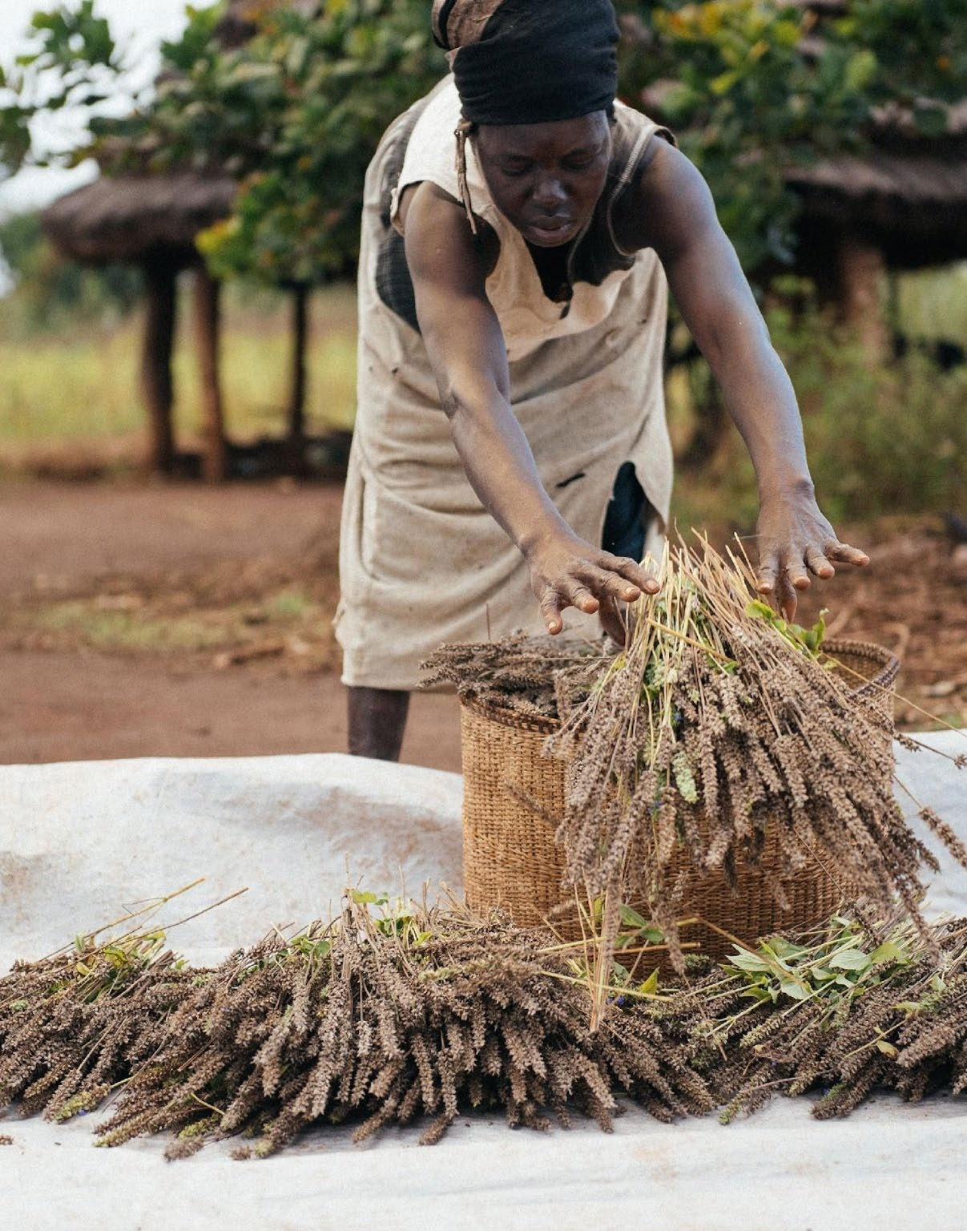


Frequent assumptions
1. Harvest failure = no seed (wrong!)
1. Farm families in stress eat their seed (often wrong)

Slide 10
Assumption 1: Harvest Failure = No Seed
Sorghum Seed Basics in Ethiopia
Crop | Miesso (Lowland)
Surface Area per Household | 3/4 ha
Sowing needs (kg – for area) | 11-12
Harvest/yield (good year) | 1600 kg
% Harvest needed for seed (good year) | 0.75 (=12/1600)
Harvest/yield (bad year) | 260 kg
% Harvest needed for seed (bad year) | 4.6 (=12/260)
Harvest shortfall NOT necessarily equal to seed shortfall

Slide 11
Assumption 2: Farmers’ eating seed is a sign of stress (from SERT)
Farmers in Biré, Haiti, eat their entire bean stock year after year. Beans are sown only one season annually and keeping seed for the next year just doesn’t make sense. Beans stored for many months often fail to germinate and chemicals for keeping insects away are often unavailable and costly. Besides, the local market can easily provide the bean varieties routinely used.
Eating seed NOT necessarily a sign of stress

Slide 12
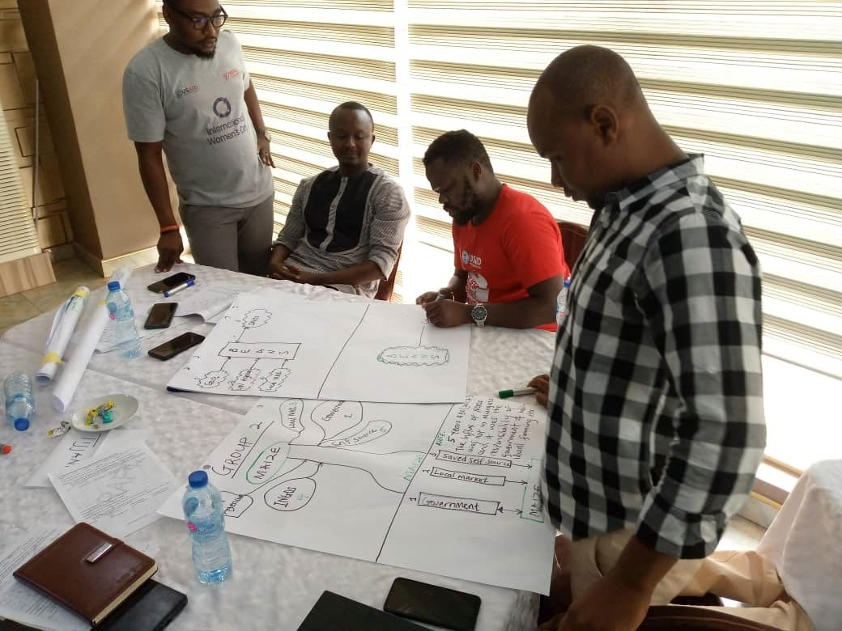
Vision: Seed System Assessment (SSA)
NOT calculating seed needs
Looking at functioning of
seed systems
Assessing if there is problem
Matching problem to response
  Acute problems
  Chronic problems
  Developmental opportunities
19

Slide 13
Seed System Assessment Content

Slide 14
SSA Content: Overview
Assess Seed System Functioning
  Demand side/need (Community/Household)
  Supply channels
Identify if/type of problem
  Problem: Short-term (Acute)
  Problem: Longer-term (Chronic)
  Opportunities?
Recommend Response(s)
38

Slide 15
Seed Security Framework
Parameters | Definition
Availability | Sufficient quantity of seed of adapted crops is within reasonable proximity (spatial availability) and in time for critical sowing periods (temporal availability)
Access | People have adequate income or other resources to purchase or barter for appropriate seeds
Seed Health / Quality | Seed is healthy: good physical, physiological and sanitary quality
Variety Suitability / Quality | Varieties are adapted, meet farmers’ preferences (men and women) and are market-acceptable

Slide 16
Seed system problems and appropriate responses
Parameter | Acute (short-term) | Chronic (long-term)
Unavailability of seed | Direct distribution of seed | Rarely happens: except for new varieties
Farmers do not have access ($) to seed | Vouchers and cash (w/seed fairs) | Income generation activity; Agro-enterprise development- value chains

Slide 17
Seed system problems and appropriate responses
Parameter | Acute | Chronic
Seed of poor quality | Seed fairs with quality controls Direct distribution of test samples of quality seed | Programs to improve seed quality seed companies on-farm (CBSP) in local markets
Lack of appropriate varieties/crops | Limited introductions of new varieties | Introduce new varieties/ with technical support Variety selection/ breeding
Notes:
CBSP – Community Based Seed Producers

Slide 18
Repeated Seed Aid Delivery in Many Countries
Site | Extent of Seed Aid
Burundi | 36+ seasons: since 1995……….
Eastern Kenya | 92-93; 95-97; 2000-2002, 2004, 2006, 2009, 2010, 2011………
Zimbabwe | Near continuous since 1991 (food aid, seed aid or both) …. 2016??
Malawi | 15 seasons or more, since 1992
Ethiopia | Since 1974 : 42 years
Notes:
Repeated seed aid shows that there is inappropriate assessment of seed need and has resulted in seed dependency on the part of farmers

Slide 19
Demand

Slide 20
Does this answer give you enough information to understand the need?
The Farmer/community says: | Does this give you enough information to understand the need?
 | Y | N
I have no seed/ there is no seed
I/we ate our seed
Notes:
Ask – Why or why not?

Slide 21
SSA Content: Assessing demand/need
Key technique: Ask,“Why are you planting less?” (or more/same)
Uncovers:
If there is a concrete problem
The extent of the problem
The exact stress (so tailor response)

Slide 22
Key Technique: Reasons for ‘Planting less’ (subset)
CONSTRAINTS THAT ARE SEED RELATED
Seed availability
1=
2=
no seed available in market
no seed/cuttings available from neighbors
Seed access
3= no money to buy seed/poor finances or seed price too high
Seed quality
4= seed available is not good quality or the variety is not liked
NON-SEED FACTORS OF PRODUCTION (limits)
5=
6=
7=
8=
9=
no/insufficient labor illness/health problems
no/insufficient land or land not appropriate/sufficiently fertile lack of tools/tractor/ other machinery to farm
plant pests/diseases make production not possible
→ Large range of possible reasons!!
OTHER PRIORITIES/STRATEGIES
14=
15=
16=
markets for crop or crop products not well-developed other priorities than agriculture (e.g. have shop) Changing crop priorities or changing agricultural practices
Gets at exact stresses

Slide 23
SSA Content: Supply Side
Not counting seeds (!!)
Figuring out if supply channels are working (i.e., if they can serve farmers needs)
Notes:
We are not counting farmers’ seed stock, or the stock in the marketplace.

Slide 24
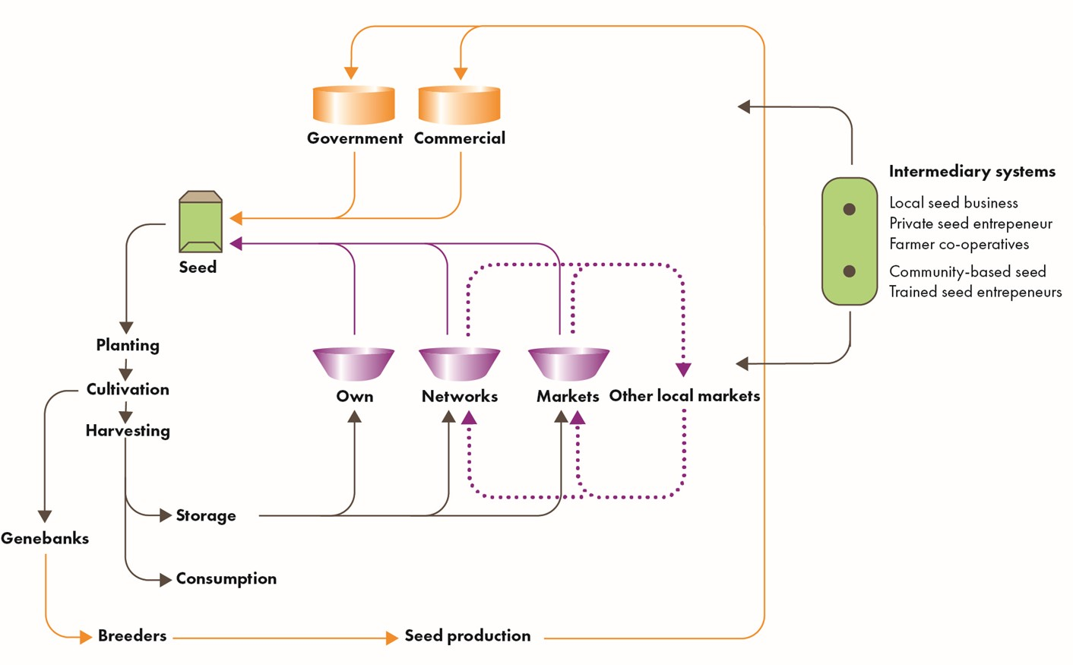
Channels through which Farmers Source Seed

Slide 25
Activity 1: Seed System Functioning (Supply Side)
drawing on your expertise
Imagine your team has been tasked with assessing how well seed channels are functioning.
Discuss as a group how you would do this assessment. For example, consider:
  Which seed channels would you assess?
  Which sources/types of actors would you talk to? What info would they have? What kinds of questions would you ask them?
  How are you going to do it? (i.e., elements of the process).
  ….what else?

Slide 26
Activity 1 Responses: Seed System Functioning
All seed channels: so not just the formal ones. Don’t forget farmers’ own stocks
Key crops: Be clear about which crops are the main focus for the upcoming season-
Talk to key suppliers: (formal, informal and intermediary)
  Seed companies and local agro-dealers;
  Large traders who know something about local seed (regionally as well as local)
  Specialized community based groups (although they provide only small amounts)
Visits to markets/stores/seed outlets: Observe the quality on offer, ask about its origins and if it can be planted
Prices: Prices of seed (incl local seed); Prices of accompanying inputs, like fertilizer

Slide 27
SSA: Responses
Seed System Assessment + Response

Slide 28
Choice of response(s) should depend on:
The seed security problem(s)
The context- logistics
The organization’s capacity
Institutional philosophy (Rights based?)
…

Slide 29
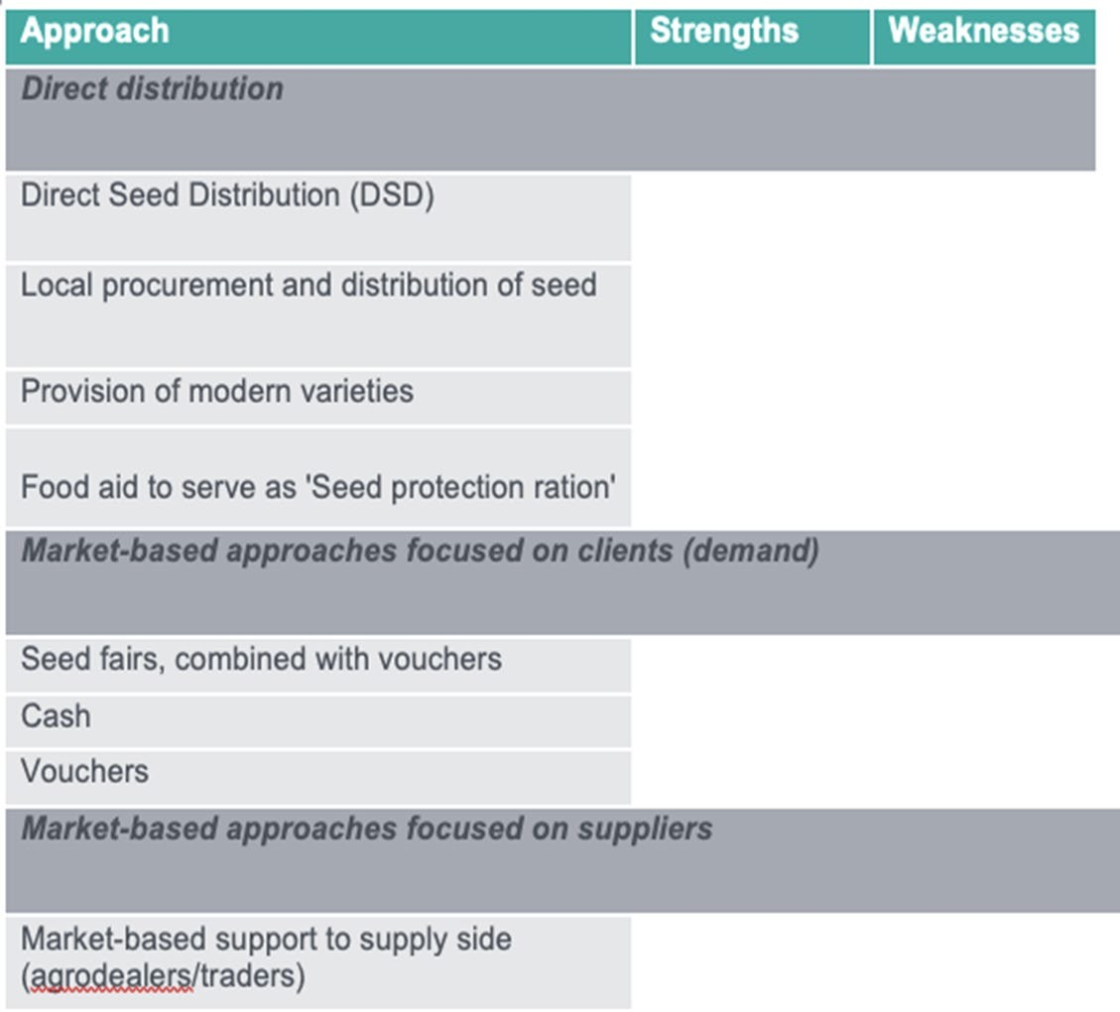
Range of Response Interventions from SERT

Slide 30
Key: Distinguishing short-term versus longer-term seed security problems
Parameter | Acute (short-term) | Chronic (long-term)
Unavailability of seed | Direct distribution of seed | Rarely happens: except for new varieties
Farmers do not have access to seed | Vouchers and cash (w/seed fairs) | Income generation activity; Agro-enterprise development: value chains

Slide 31
Activity 2: Three common seed security problems. How should you respond?
Acute Problem 1: Farmers need more seed but cannot access (buy)
Acute Problem 2: Seed/planting material (vines/cuttings) is not available
Chronic Problem 3: The seed that farmers use is of poor quality
Instructions: Brainstorm potential responses and the advantages and disadvantages of each

Slide 32
Acute Problem 1: Farmers need more seed but cannot access (buy)
Response options | Yes, this response is appropriate. | No, this response is not appropriate. | If Yes, what are the key advantages? | If Yes, what are the key disadvantages / limitations?
Vouchers tied to seed or input fairs
Vouchers tied to agrodealers
Cash grants
Direct Seed Distribution (DSD)
Notes:
For this question ask participants whether each response option is appropriate If time discuss the advantages and limitations of the different options. Look at suggested responses in next slide.

Slide 33
Correct Response Options
Acute Problem 1: Farmers need more seed but cannot access (buy)
Vouchers tied to agro-dealers (if correct crops on offer)
Vouchers tied to seed or input fairs (includes local seed)
Cash grants

Slide 34
Acute Problem 1: Farmers need more seed but cannot access (buy)
Response options | Yes, this response is appropriate. | No, this response is not appropriate. | If Yes, what are the key advantages? | If Yes, what are the key disadvantages / limitations?
Vouchers tied to seed or input fairs | x |  | Vouchers would solve problem of access, which is the key issue Gives farmers a choice on which type of seed(s) they want Restricts farmers to purchasing seeds with voucher | Must ensure seed companies have stock, appropriate varieties Restricts farmers to purchasing seeds with voucher May disrupt local market system
Vouchers tied to agrodealers | x |  | Minimizes disrupting existing seed system Can ensure seed quality More sustainable; farmers in contact with agrodealers | Potential issues with pricing If farmers’ priorities are diﬀerent from seeds this could be restricting. Consider opening to anything
 |  |  | Can speed up seed distribution | agrodealer sells so they choose
Cash grants | x |  | Seed price can be more aﬀordable compared to voucher price Recipient can choose what seeds they will use | May purchase other things than seeds Limited linkages with agrodealers Viable if farmers know where they can access the seeds Can be hard to control how recipients obtain seeds
Direct Seed Distribution (DSD) |  | x | Quick action to distribute seeds Introducing new varieties and controlling the quality of the seeds | Limits recipient’s seed options Quantity may diﬀer between recipients Applicable if supported by need assessment No linkage with seed market actors, may have limited sustainability
Notes:
See if answers to previous slide correspond to this table. Discuss

Slide 35
Correct Response Options
Acute Problem 2: Seed/planting material (vines/cuttings) is not available
Direct Seed Distribution (DSD) - *in limited quantity and with care*
(better not to do fairs as VPC planting material needs to be carefully screened !!)

Slide 36
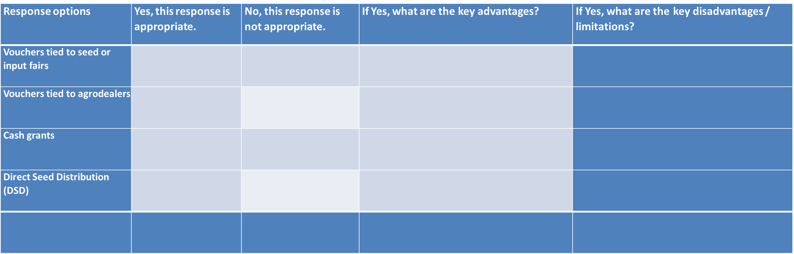
Acute Problem 2: Seed/planting material (vines/cuttings) is not available
Notes:
For this question ask participants whether each response option is appropriate If time discuss the advantages and limitations of the different options. Look at suggested responses in next slide.

Slide 37
Acute Problem 2: Seed/planting material (vines/cuttings) is not available
Response options | Yes, this response is appropriate.. | No, this response is not appropriate. | If Yes, what are the key advantages? | If Yes, what are the key disadvantages / limitations?
Vouchers tied to seed or input fairs | X |  | introducing the planting material (maybe varieties resistant to disease if that is the underlying cause) Provides some freedom in the choice of crops and quantities of seeds | limited choice
Vouchers tied to agro-dealers |  | X | can be opened up to other agricultural inputs Could be the reason why planting materials are not available (traders don’t stock if they think there will be no demand) | if the unavailability is due to a market-related issue, that won’t necessarily solve it
Direct Seed Distribution (DSD) | X |  | control of the quality of seeds provided introduction of new varieties | no choice for the farmer needs to be tied to a very good assessment of prefered crops
Other, specify | Market-based response (transport vouchers to traders, loans to traders, etc…) |  | if the shortage is due to market issues (cost of transport, traders unable to purchase stock on credit,...) a support to traders could be advisable | needs further market assessment
Notes:
See if answers to previous slide correspond to this table. Discuss

Slide 38
Chronic Problem 3: The seed that farmers use is of poor quality
Response options | Yes, this response is appropriate. | No, this response is not appropriate. | If Yes, what are the key advantages? | If Yes, what are the key disadvantages / limitations?
Direct Seed Distribution (DSD) of “clean” seed
Work with farmers on seed selection, management + storage
Work with traders (local + regional markets) on seed selection, management + storage
Work with seed companies and agro-dealers on seed selection, management + storage
Other, specify
Notes:
For this question ask participants whether each response option is appropriate If time discuss the advantages and limitations of the different options. Look at suggested responses in next slide.

Slide 39
Correct Response Options
Chronic Problem 3: The seed that farmers use is of poor quality
1.Work with farmers on seed selection, management and storage 1.Work with traders (local and regional markets) on seed storage
and management
1.Work with seed companies and agro-dealers on seed storage and management
(better not to do DSD as too small coverage for extent of problem!)

Slide 40
Chronic Problem 3: The seed that farmers use is of poor quality
Response options | Yes, this response is appropriate. | No, this response is not appropriate. | If Yes, what are the key advantages? | If Yes, what are the key disadvantages / limitations?
Direct Seed Distribution (DSD) of “clean” seed | X |  | control f the quality of the seeds | logistic issues (tardiness of distribution) bypass of the market actors (sustainability?)
Work with farmers on seed selection, management + storage | X |  | provides locally produced (adapted) seeds | longer term intervention, could be unsuitable for emergency response if no existing farmers groups to build on
Work with traders (local + regional markets) on seed selection, management + storage | X |  | ensures local engagement of farmers and traders in the production, selection and storage of seeds | Would require extensive training of both farmers and traders, no sure outcome as traders could still decide not to stock on these improved seeds or invest on storage equipment (packaging, Treatment, etc.
Work with seed companies and agro-dealers on seed selection, management + storage |  | X | use of seeds of poor quality is most likely not because good quality seeds don’t exist but are too expensive or available only in further out towns or because of diseases
Notes:
See if answers to previous slide correspond to this table. Discuss

Slide 41
Questions?

Slide 42
Resources

Slide 43
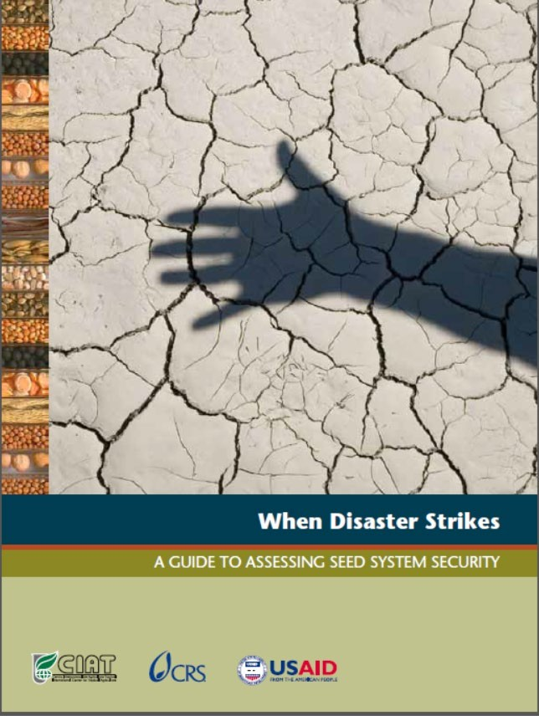
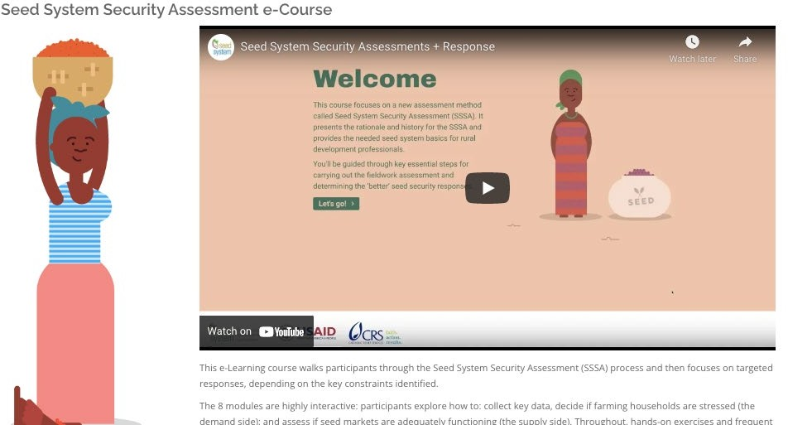
E-learning course
Overview guide

Slide 44
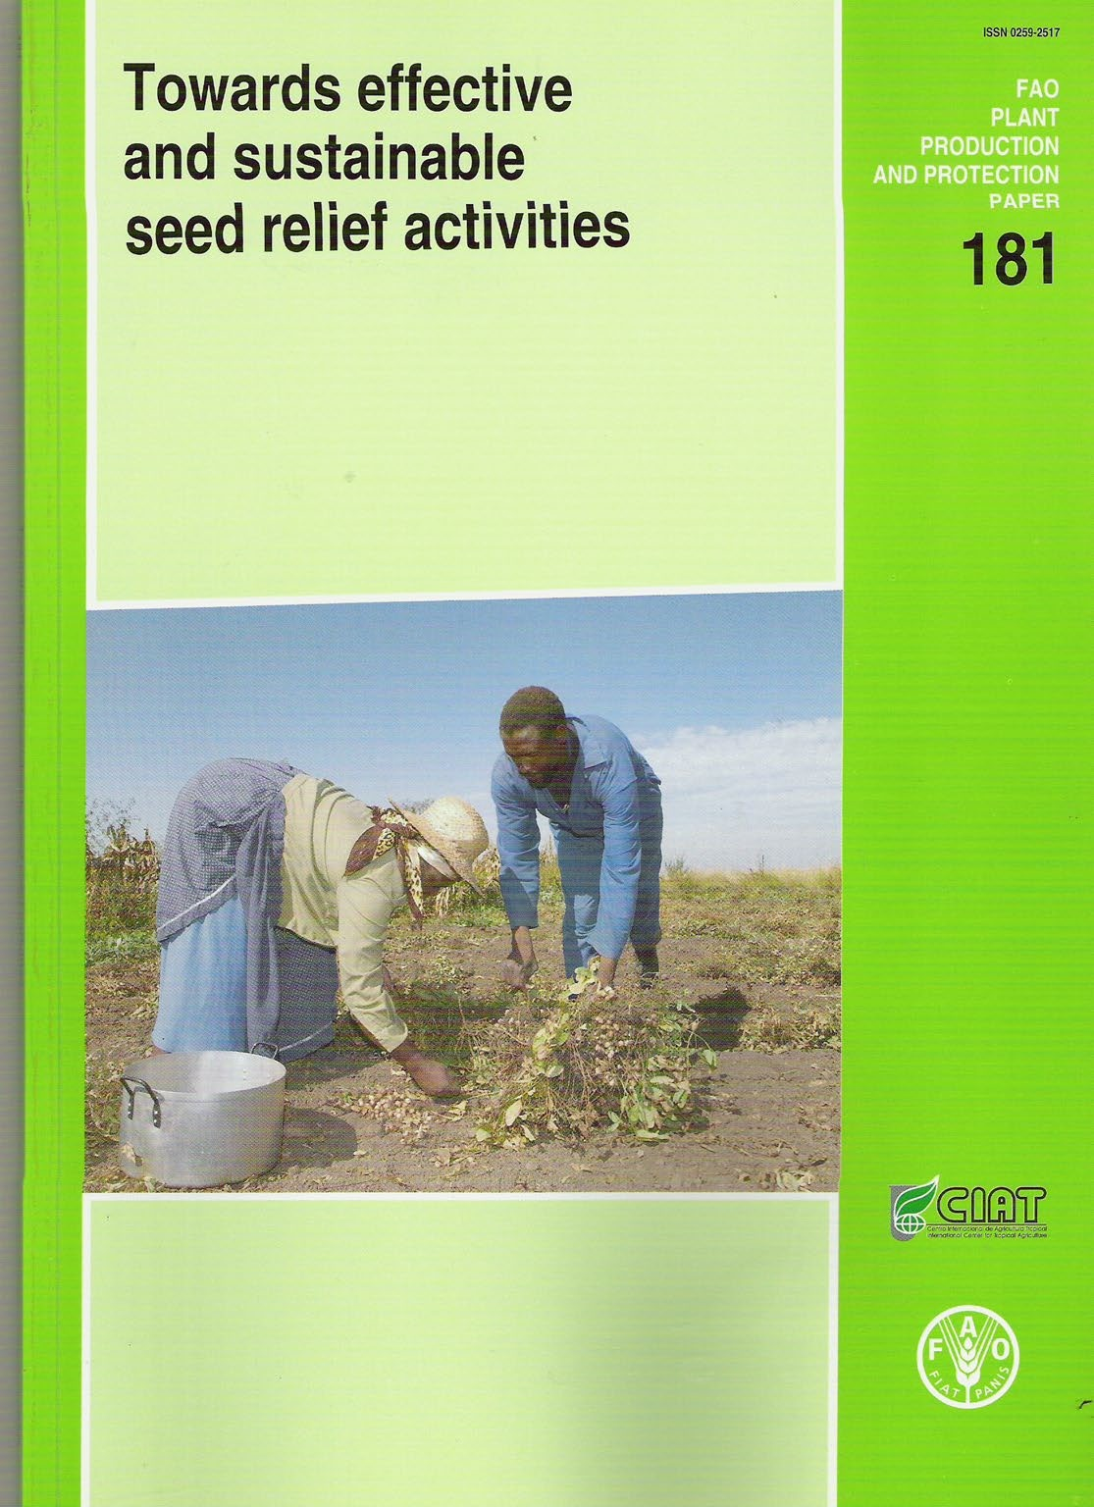
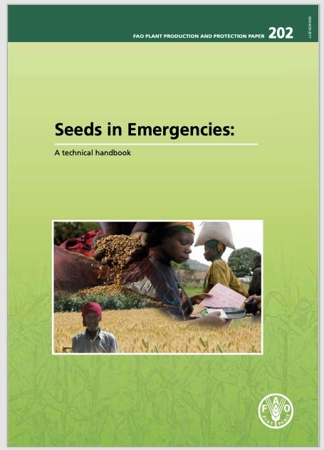
Seed quality
Standards

Slide 45

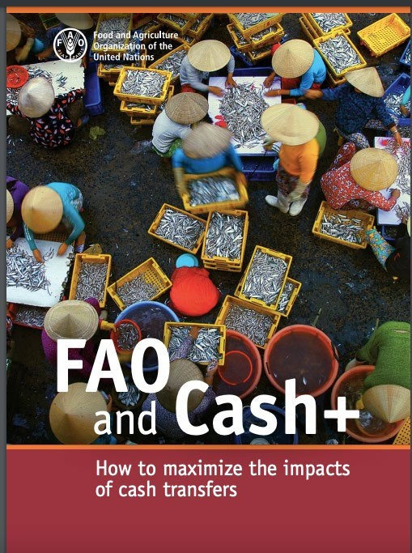
Resources: diverse approaches

Slide 46

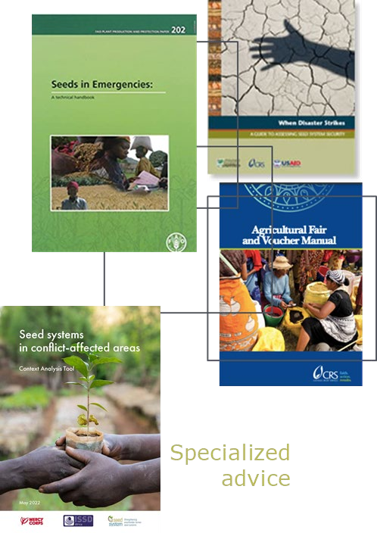
Response: Many recent developments

Slide 47

Sphere (2011)
Special seed security assessment checklist
17

Slide 48
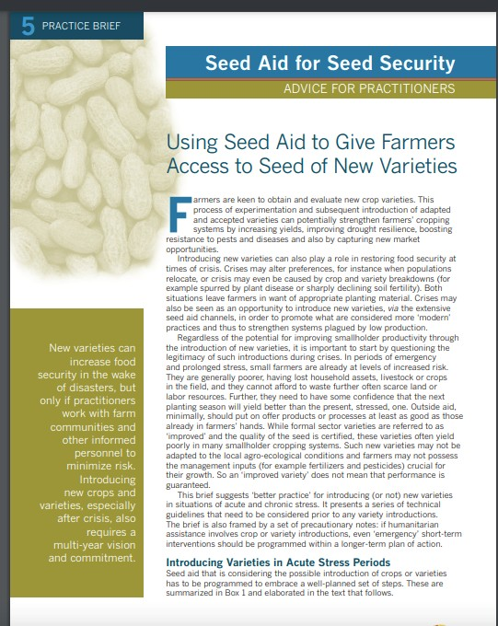

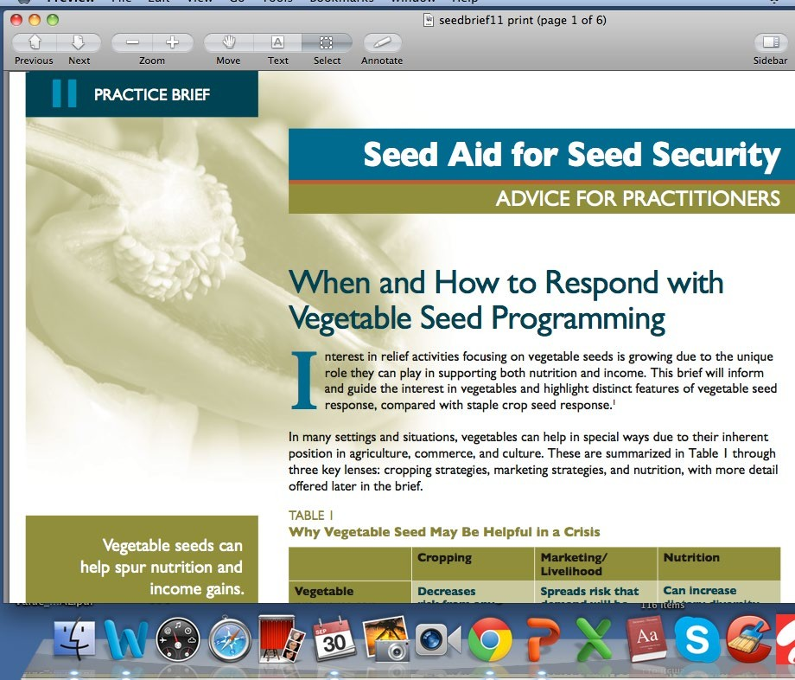
Specific programming

Slide 49
Websites for SSA (SSSA)

Slide 50
Tool Development
SeedSystem - 2006-ongoing https://seedsystem.org/
FAO – 2016
https://www.fao.org/resilience/resources/resources-detail/en/c/282218/
gFSC/CRS - 2023- ongoing

