Slide 1





Seed System Basics
Session One
This session is adapted from a training provided to the Seeds Learning Group of SCALE funded by USAID.
The contents are the responsibility of the SCALE Award and do not necessarily reflect the views of USAID or the United States Government.

Slide 2


SESSION ONE: UNDERSTANDING SEED SYSTEMS

Slide 3

What is seed?
1
2
Seed security framework
3
Seed system basics
4
Goals of seed aid work
5 Summary and after-session task
Session One Agenda
18

Slide 4
WHAT IS SEED?!!

Slide 5

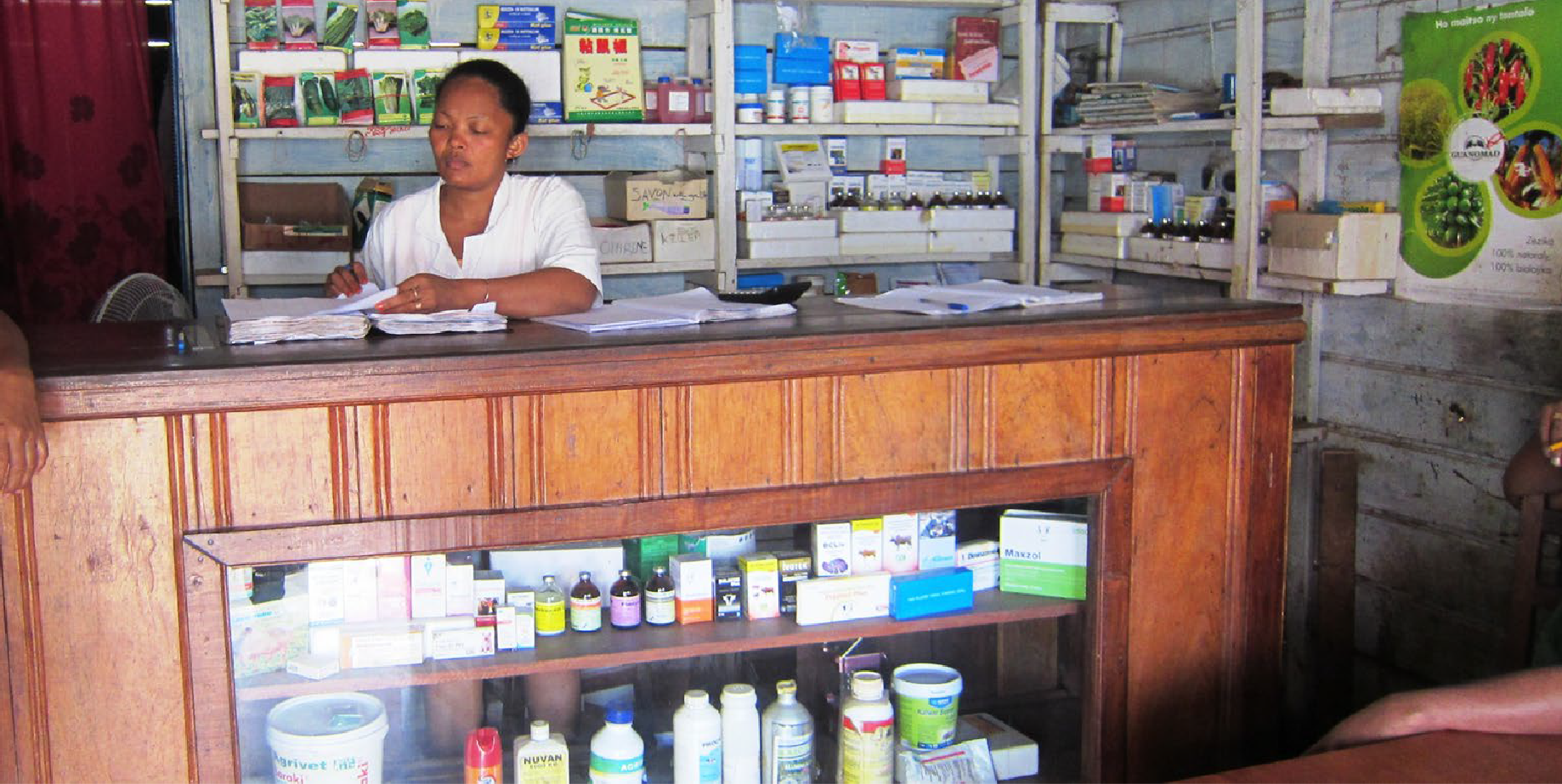
1.Is this Seed?
TITLE FOR IMAGE OR INTRO

Slide 6
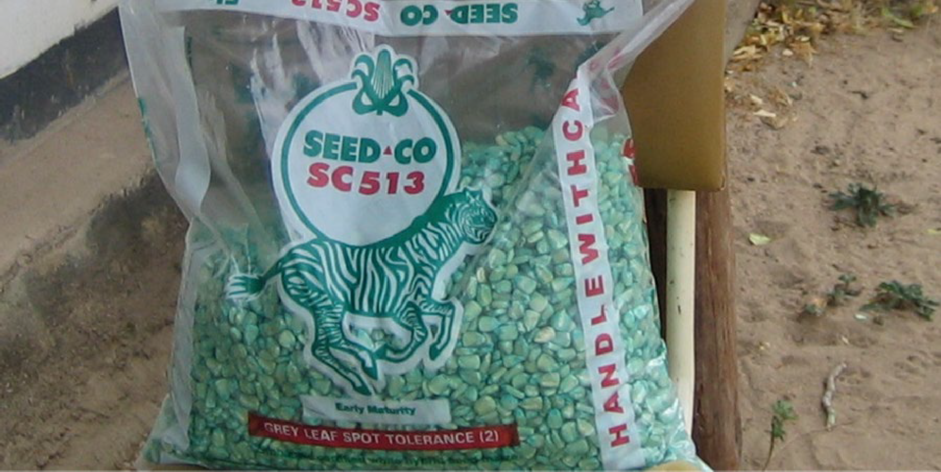
2. Is this Seed?
TITLE FOR IMAGE OR INTRO

Slide 7
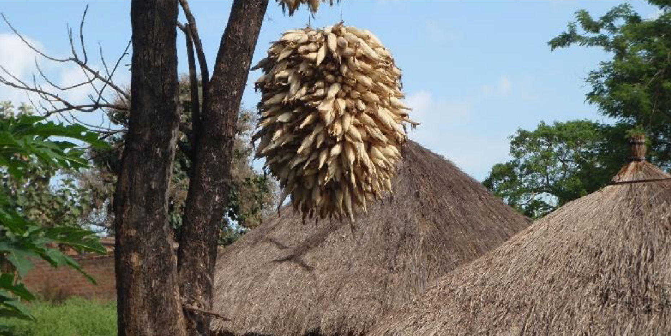
3. Is this Seed?
TITLE FOR IMAGE OR INTRO

Slide 8
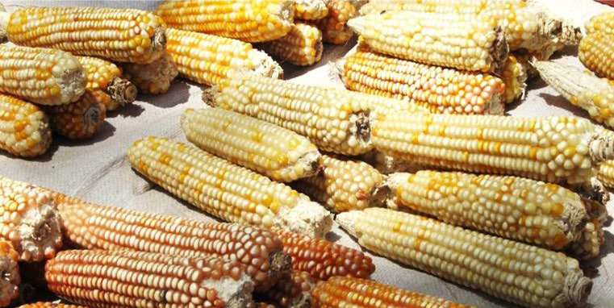
4. Is this Seed?
TITLE FOR IMAGE OR INTRO

Slide 9
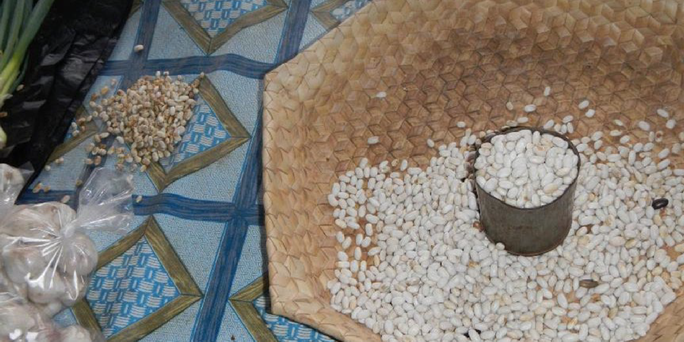
5. Is this Seed?
TITLE FOR IMAGE OR INTRO

Slide 10
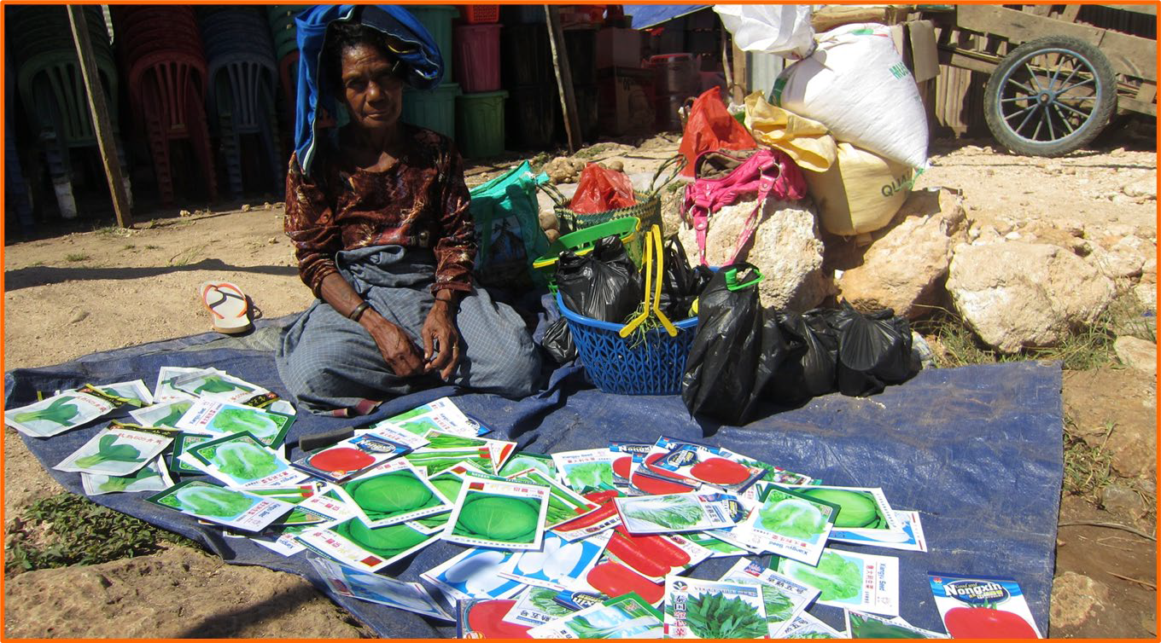
6. Is this Seed?

Slide 11
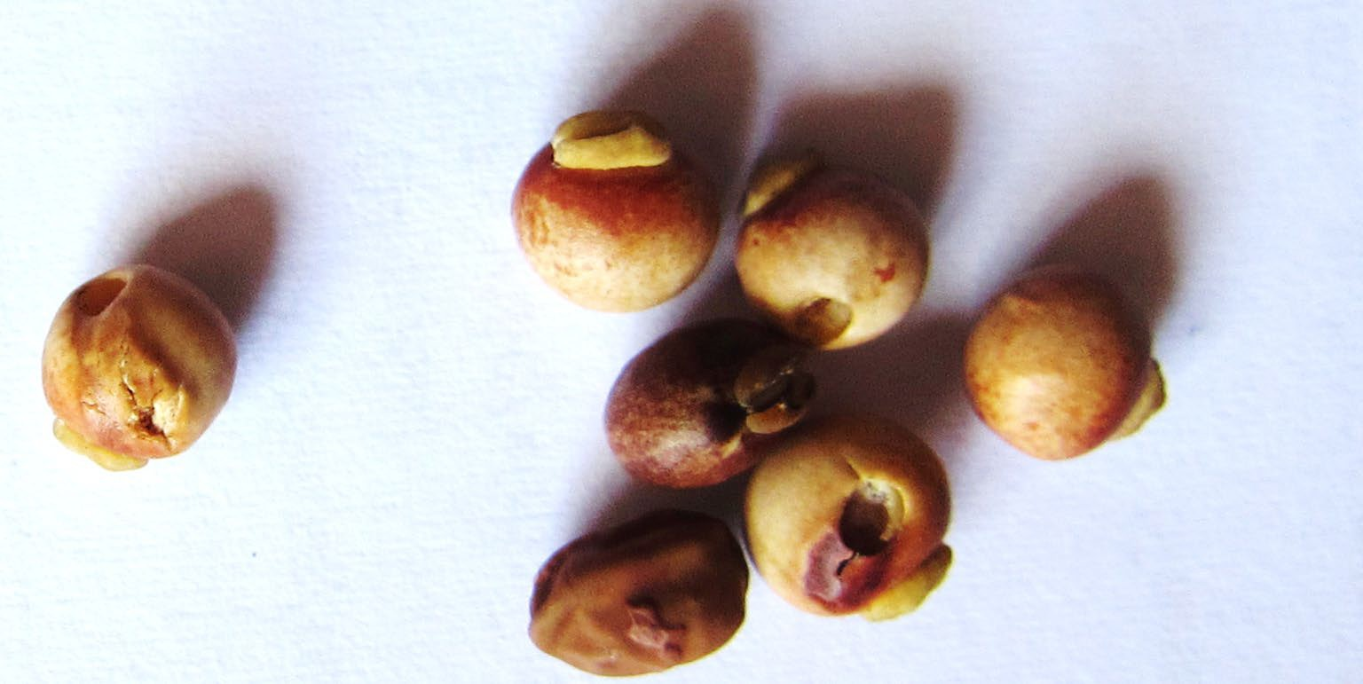
7. Is this Seed?
TITLE FOR IMAGE OR INTRO

Slide 12
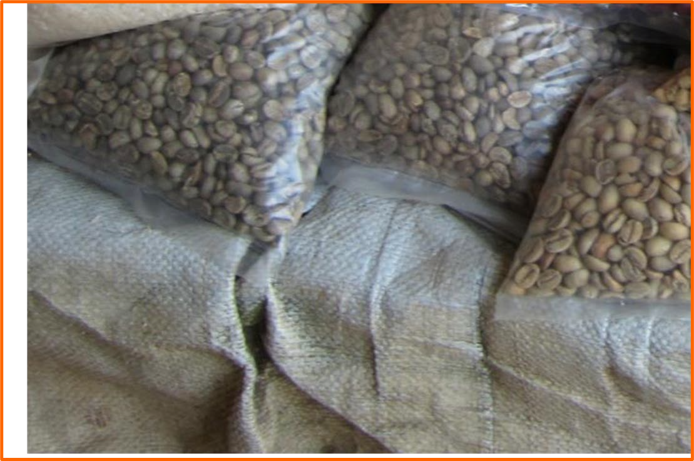
8. Is this Seed?

Slide 13
What is Seed?
ANSWERS and DISCUSSION
#
Is this seed?
Yes
No
1
X
2
X
3
X
4
X
5
X
6
X
7
X
8
X

Slide 14
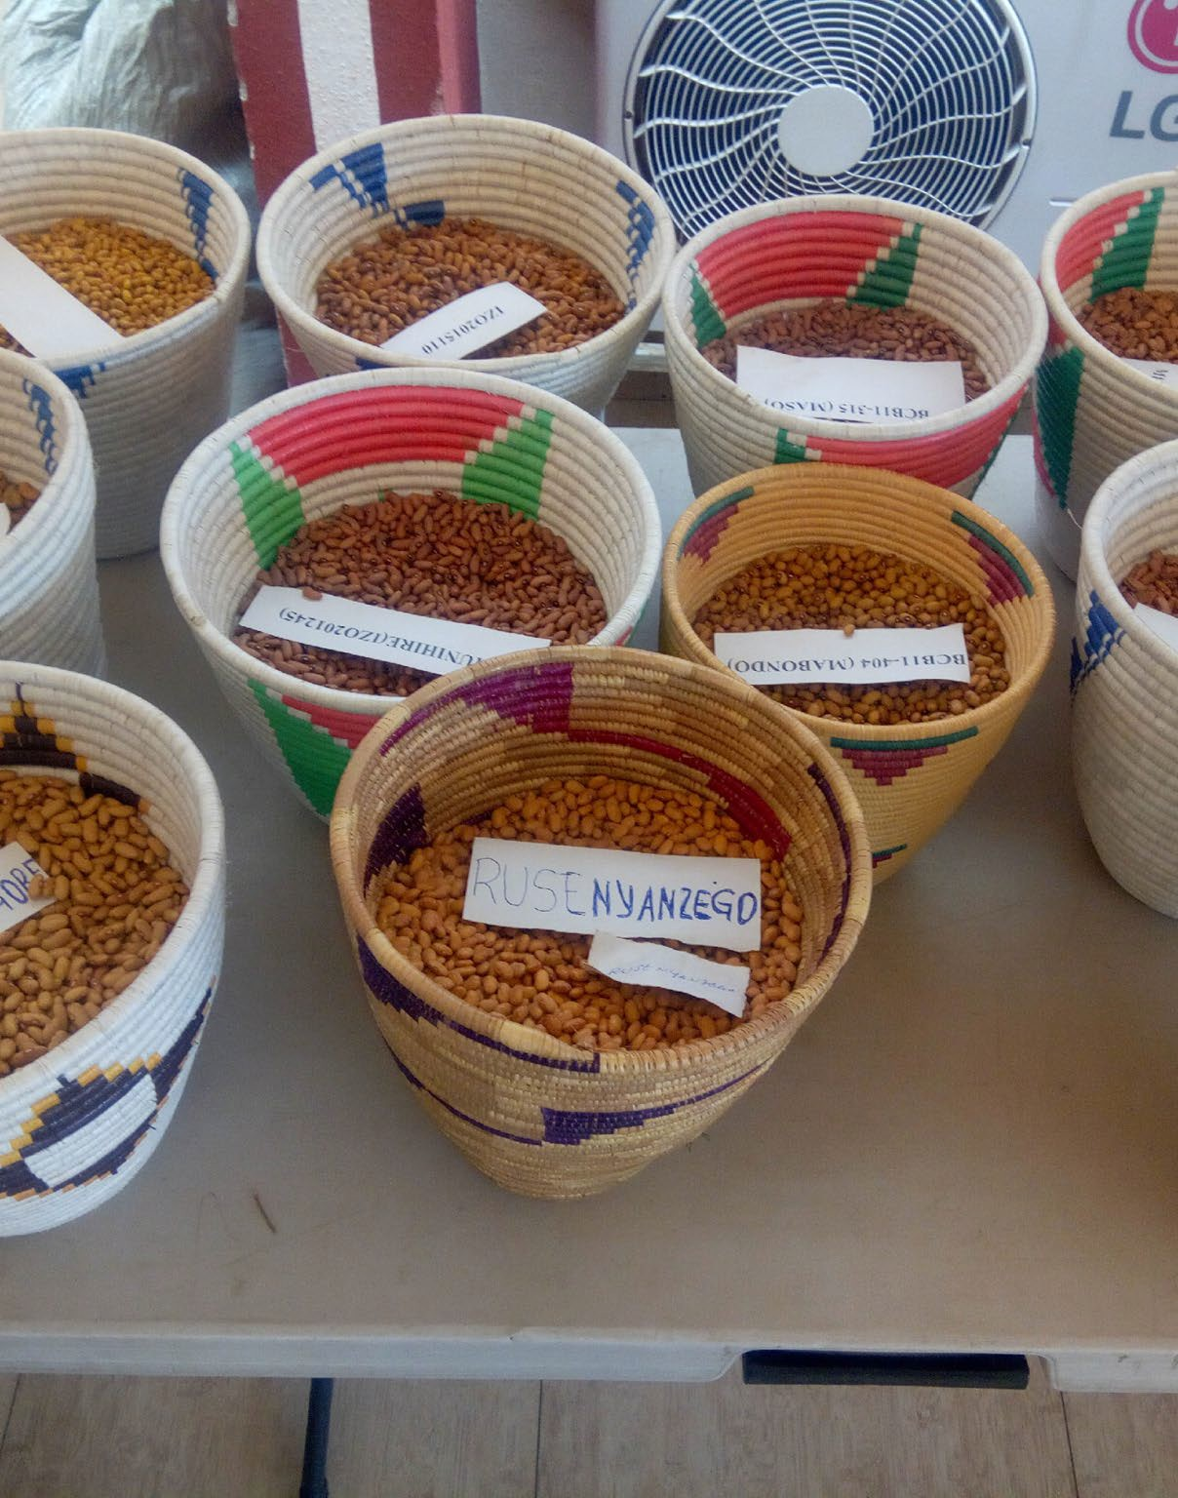



Summary
Seed can be sourced from different places
Different signals help people determine if it can be planted
Formal sector: labels/expiration dates; dyes; packaging
Informal sector: storage conditions (cobs, on trees); sorting
Always important to visually inspect; and test (if possible)
Remember that seed has to be: right crop, right varieties, healthy, good germination

Slide 15
SEED SECURITY FRAMEWORK (SSF)

Slide 16
Seed Security Framework
Parameters | Definition
Availability | Sufficient quantity of seed of adapted crops is within reasonable proximity (spatial availability) and in time for critical sowing periods (temporal availability)
Access | People have adequate income or other resources to purchase or barter for appropriate seeds
Seed Health / Quality | Seed is healthy: good physical, physiological and sanitary quality
Variety Suitability / Quality | Varieties are adapted, meet farmers’ preferences (men and women) and are market-acceptable
Notes:
The Seed Security Framework is analogous to food security framework of Availability, Access, and Utilization. Rather than utilization as in food security we have seed health/quality. We also have variety suitability/quality

Slide 17
IDENTIFYING SEED SECURITY PROBLEM
TESTING OUR UNDERSTANDING - Fun!

Slide 18
Activity Instructions: What is the Seed Security Problem?
Discuss 5 seed security scenarios and decide which seed security problem each is referring to.
Each scenario can describe one or a combination of the problems listed below
Availability
Access
Seed Health/quality
Variety suitability/quality

Slide 19
Activity 1: What is the Seed Security Problem?
The household does not have sufficient common bean seed for the upcoming season and wants to acquire more from local markets. BUT now is also the time for school fees. The family has no ‘extra’ seed money.
Modern varieties of sorghum have been distributed following a drought. While their heads (panicles) are big, the stems are too short and not tasty for fodder. The farmers, here, are agro- pastoralists.
Cassava Mosaic Disease has wiped out all healthy planting material and there are NO clean stems to plant, not anywhere in the region.
Farmers say that insects are attacking their cowpea in storage (losses of even 70%) and the grains that survive rarely emerge (sprout) when planted.
Very few in the village have even tried new varieties of maize as there are no agro-dealers anywhere in the province. These commercial sellers say the area is just too remote and transport too costly.
Availability
Access
Seed Health/quality
Variety suitability/quality

Slide 20
What is the seed security problem (1)?
The household does not have sufficient common bean seed for the upcoming season and wants to acquire more from local markets. BUT now is also the time for school fees. The family has no ‘extra’ seed money.
Availability
Access
Seed Health/quality
Variety suitability/quality

Slide 21
What is the seed security problem (2)?
Modern varieties of sorghum have been distributed following a drought. While their heads (panicles) are big, the stems are too short and not tasty for fodder. The farmers, here, are agro-pastoralists.
Availability
Access
Seed Health/quality
Variety suitability/quality

Slide 22
What is the seed security problem (3)?
Cassava Mosaic Disease has wiped out all healthy planting material and there are NO clean stems to plant, not anywhere in the region.
Availability
Access
Seed Health/quality
Variety suitability/quality

Slide 23
What is the seed security problem (4)?
Farmers say that insects are attacking their cowpea in storage (losses of even 70%) and the grains that survive rarely emerge (sprout) when planted.
Availability
Access
Seed Health/quality
Variety suitability/quality

Slide 24
What is the seed security problem (5)?
Very few in the village have even tried new varieties of maize as there are no agro-dealers anywhere in the province. These commercial sellers say the area is just too remote and transport too costly.
Availability
Access
Seed Health/quality
Variety suitability/quality

Slide 25
ANSWERS
and DISCUSSION
Which problem is this?
Access Availability
Seed Health
Variety Suitability
1 Family has no extra seed money
X
2 Modern varieties of sorghum post- drought
X
3 Cassava Mosaic Disease wiped out planting material
X
X
4 Insects attacking cowpea in storage
X
X
5 No agro-dealers for new maize varieties
X
X

Slide 26


DISCUSSION
Explore common seed security problems faced by participants

Slide 27
SEED SYSTEMS CHANNELS

Slide 28
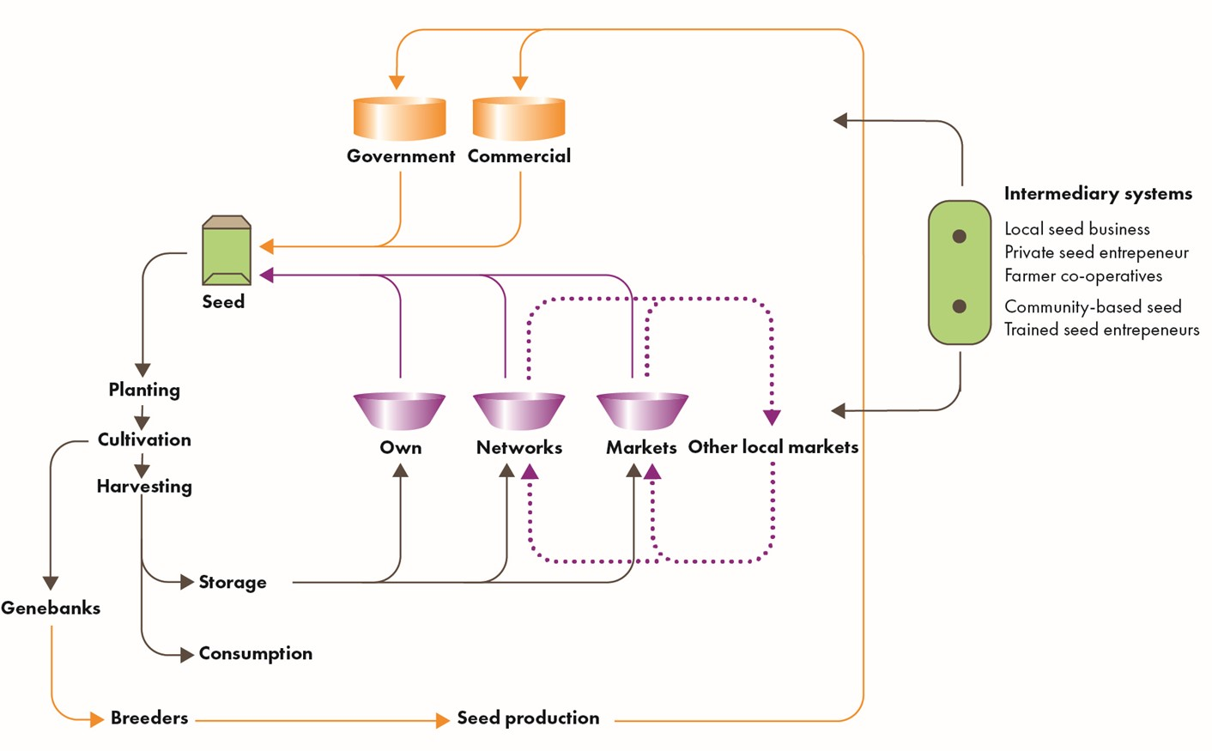
Channels through which Farmers Source Seed
Notes:
Formal seed is certified seed produced through controlled standards. Informal seed is that seed The gold color is the formal seed production system. The formal interacts with farmers and their seed sources in purple (either own stock, social networks, or informal and formal markets) through emergency seed distributions and sales through formal channels (i.e. agrodealers)

Slide 29
Focus: key crops + seed supply channels (sample)
Crop | Home saved (%) | Social networks (%) | Local markets (%) | Formal + Comm. sector (%) | Seed aid (%) | Total (%)
Maize | 45 | 5 | 15 | 20 | 15 | 100
Rice | 55 |  | 15 |  | 30 | 100
Cassava | 70 | 30 |  |  |  | 100
Beans | 20 |  | 70 | 10 |  | 100
Notes:
Over 90% of farmers seed worldwide comes from informal sources. Maize has a higher amount of formal seed use with the widespread adoption of hybrid varieties.

Slide 30
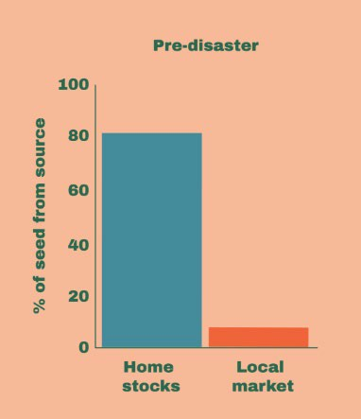
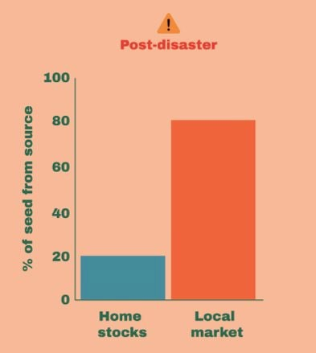
Seed channel use can change during stress
46
Notes:
In a disaster, as home stocks dwindle or are sold off, farmers rely more on the local market to provide them with seed

Slide 31
SEED OUTLETS

Slide 32
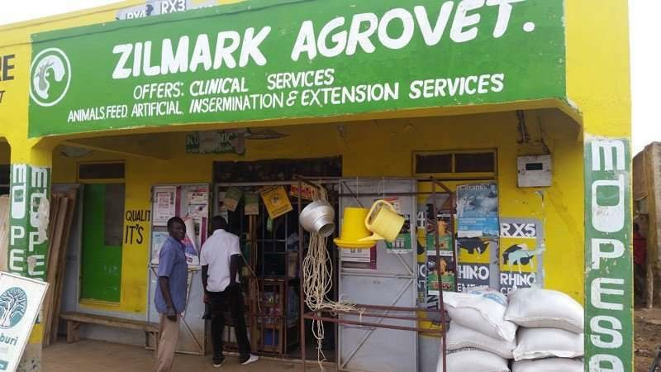
Agro-dealers)
Few legumes– except for FISP, sometimes
Notes:
FISP – Malawi’s Farmer Input Subsidy Program

Slide 33
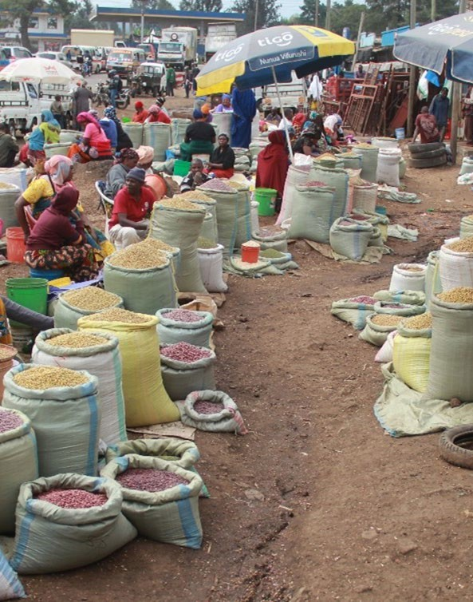
Local Markets (grain/seed)
Not all grain can be sown
But some ‘grain’ also is ‘very good seed’ (potential seed )
Adapted (right variety)
Good quality
Notes:
Often vendors in the local market will know the source and varieties of their grain. Some will separate seed quality grain and set it apart (often at a higher price) especially during planting season. Farmers often return to the same vendors every year for seed

Slide 34
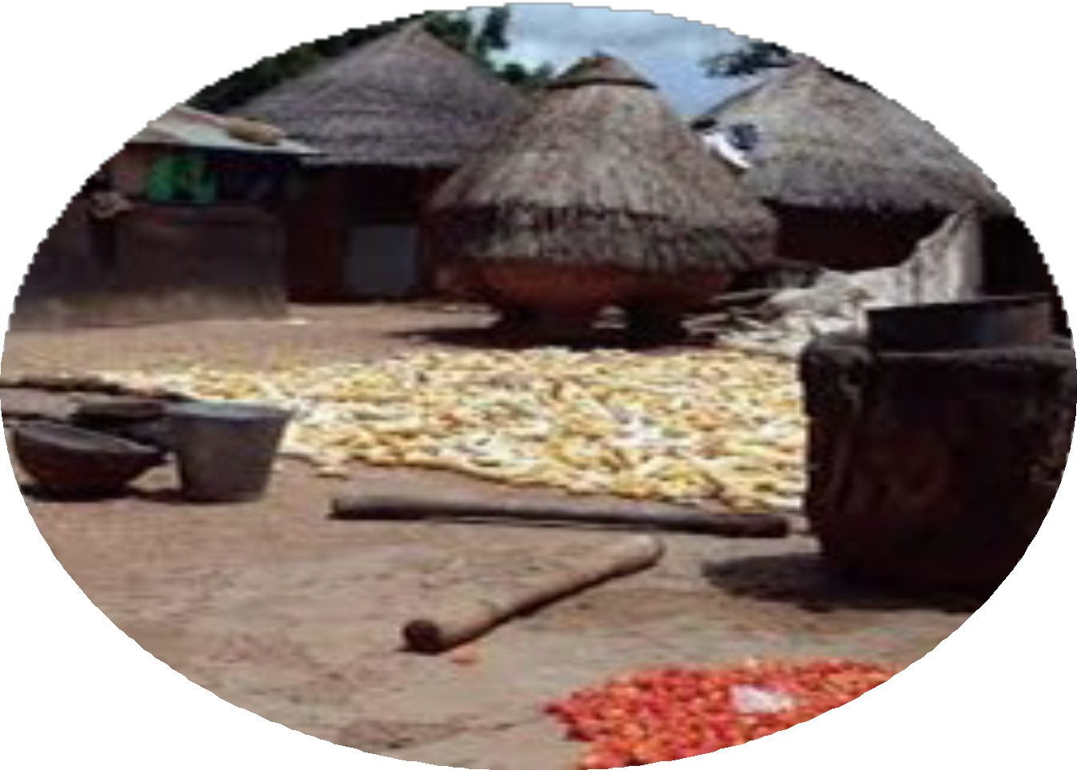
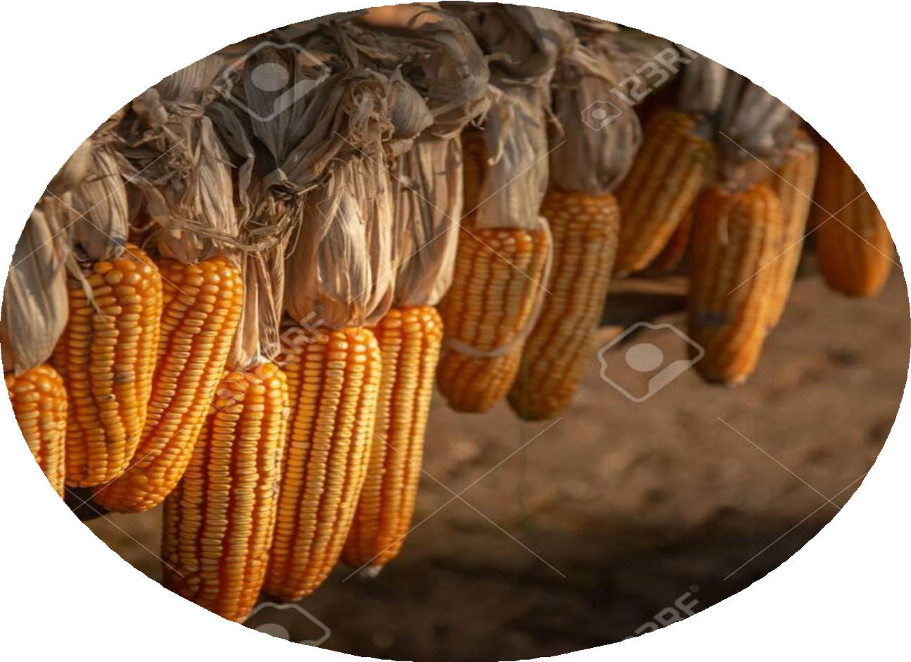
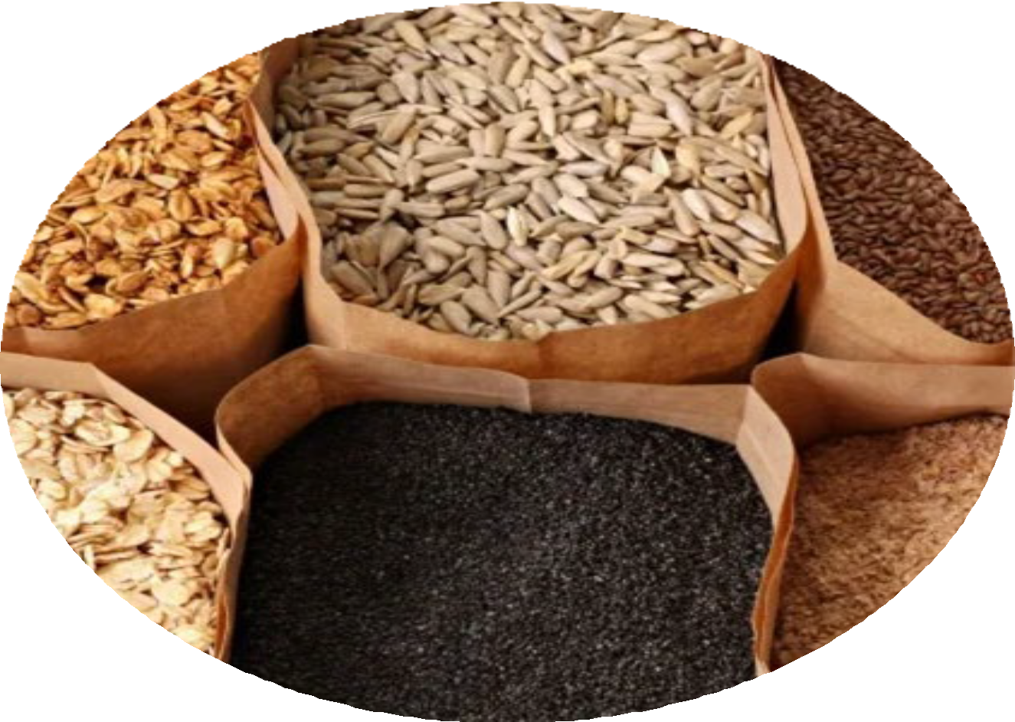
Farmers own stock
Traditional Granaries
Maize cobs hung to dry
Open Plastic Buckets

Slide 35
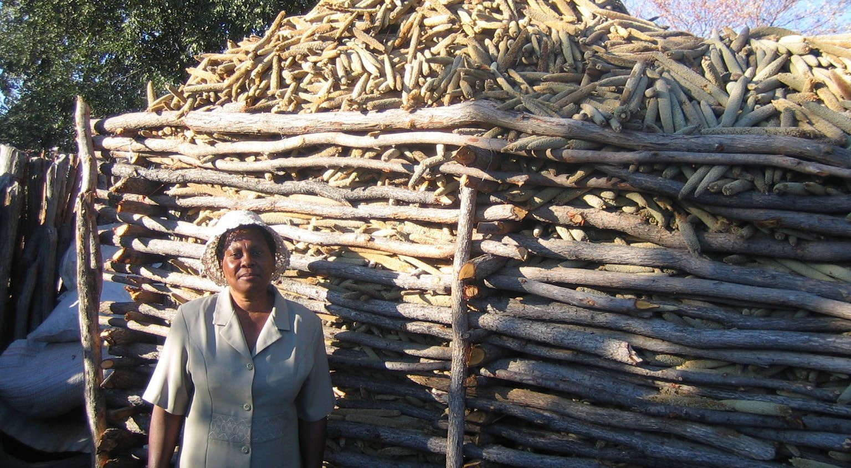
Seed Producer Groups

Slide 36
Summary of seed systems + discussion
Formal, informal and intermediary systems all matter
Seed channel use varies by crop
Poorer farmers may use different mix of channels from wealthier
Seed channel use may change after disaster
One channel is not necessarily better than another

Slide 37
Goals of seed aid work

Slide 38
Seed aid can be designed for different goals:
Food security
Nutrition
Climate resilience
Income generation

Slide 39
Goal | Crop/varietal issues: broad choices
Food security (classic approach) | Major staple crops Crops/varieties responsive to inputs
Nutrition | Focus beyond calories to include nutritive elements: Varieties biofortified with micronutrients Crops contributing to dietary diversity Specialty crops: leafy vegetables, orange-fleshed sweet potatoes
Climate resilience | Crops that tolerate abiotic stress: >Heat tolerant crops/varieties; >Water efficient crops/varieties Crops that add value or diversity to resource base >Legumes to fix nitrogen >Fodder crops; Perennials
Income generation | Crops geared to markets ('high value crops') Crops linked to value-added/ processing chains Crops linked to non-food livelihood activities (e.g., fiber production)

Slide 40
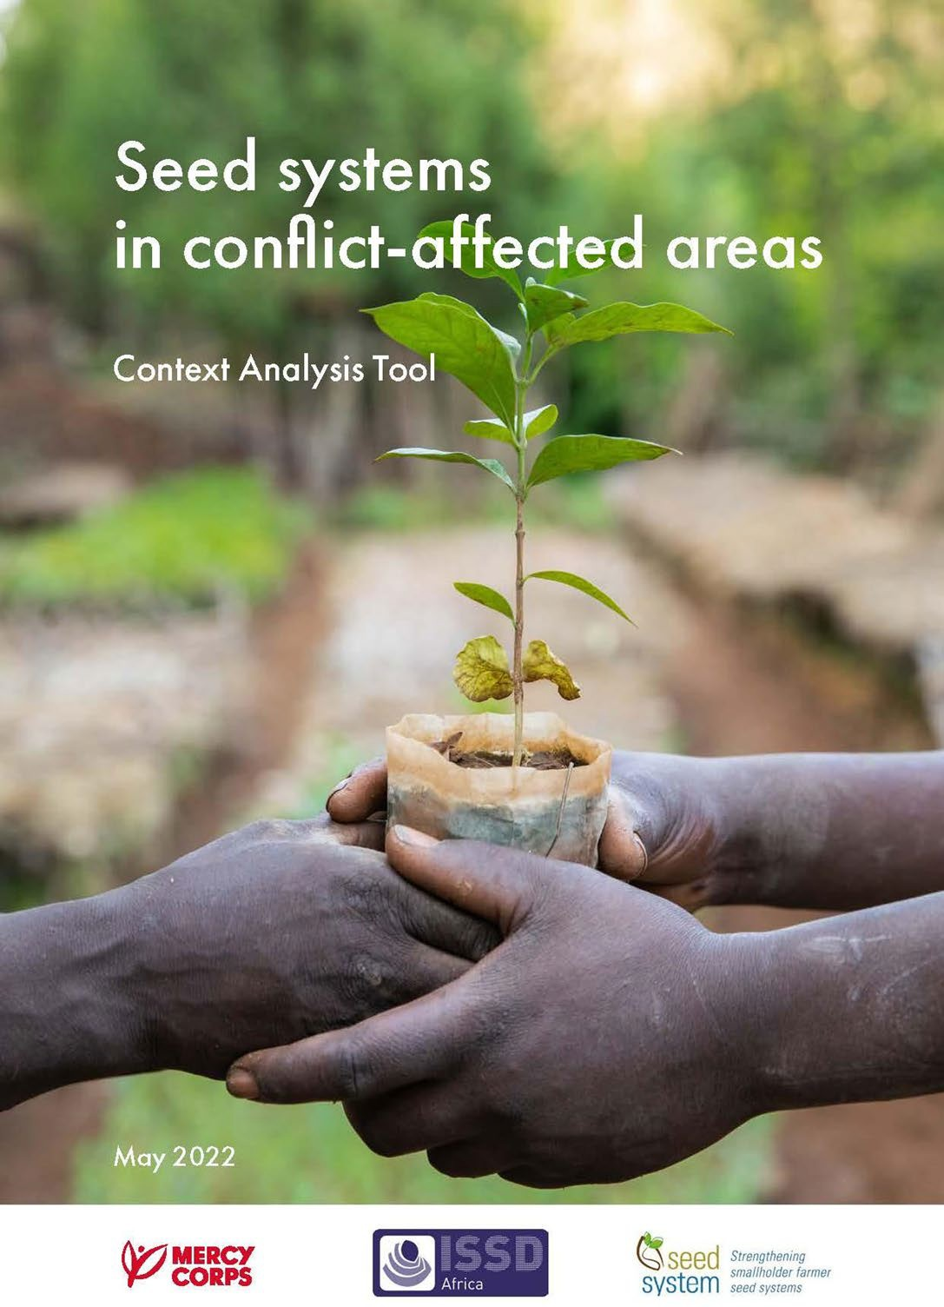
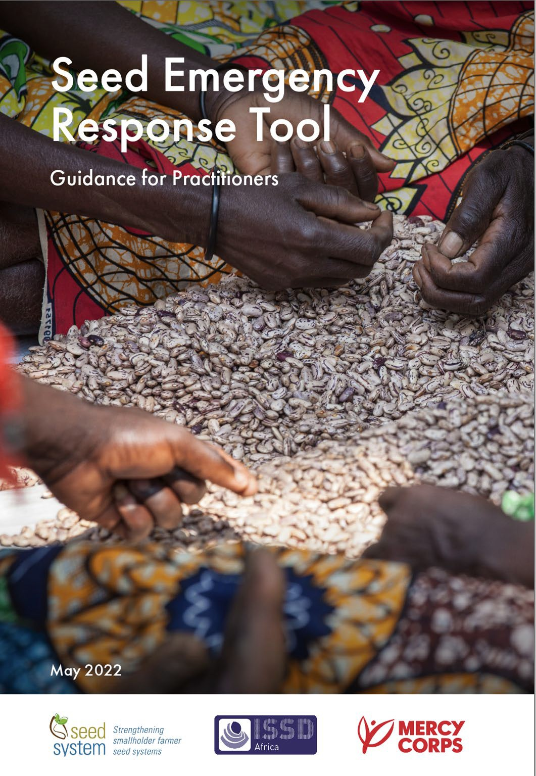
Context Analysis Tool
Seed Emergency Response Tool

Slide 41
