Slide 1

Module 9:
Supporting ART Adherence, Continuity of Treatment and VLS
Notes:
The CPs have maintained strong client continuity of treatment rates; between 92-94% continuity of treatment [as presented in Mod 1 – see data slides].
This module contains a summary of the CP model’s overall continuity of treatment and adherence strategies; as well as strategies tailored to new client; DSD adherence strategies for stable clients; and enhanced support for client with VLS challenges.

Slide 2
Module 9 Objectives
Describe the overall strategies implemented in the CP model to promote continuity of treatment, ART adherence and VLS
Describe specific continuity of treatment strategies for clients new on ART
Describe the differentiated service delivery (DSD) strategies to promote continuity of care & treatment among clients stable on ART
Describe enhanced support for clients with difficulty achieving VLS
Outline the protocol to bring clients with interruption in treatment back to care
Understand CP staff roles and responsibilities related to supporting client continuity of treatment, adherence and VLS
Notes:
Introduce Module 9 to participants and read aloud the module objectives.​

Slide 3
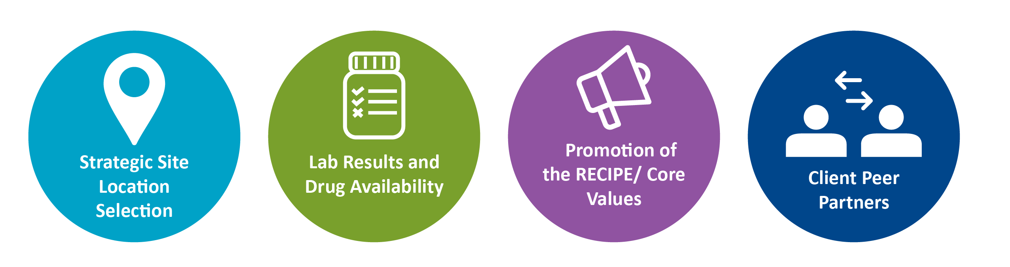
Overall Client Continuity of Treatment Strategies
Notes:
Strategic Site Location Selection: CPs are strategically located in the community, in an accessible location, and not branded to facilitate their access, minimize stigma, and enhance continuity of treatment.
Lab Results and Drug Availability: Offering lab services and essential drugs contributes to ease/accessibility of services and is consistent with what clients expect of a service provider; contributes to continuity of treatment.
Promotion of the RECIPE/ Core Values: Promoting the model’s core values/ RECIPE is also key to client continuity of treatment. This includes making clients feel welcome/not stigmatized, utilizing Client-centered strategies; offering support based on interruption in treatment risk profile; and providing holistic support for the family, etc. CP staff must NOT vilify clients who miss appointments for instance, but rather provide the outreach/support needed to encourage them to return to care
Client Peer Partners: These are buddies/emergency contacts that clients identify. Their information is kept on file at the CP. These contacts can collect drugs of stable clients and can be contacted in case client is not reachable, etc. The peer system is close to the next of kin but is not necessarily a treatment buddy.

Slide 4
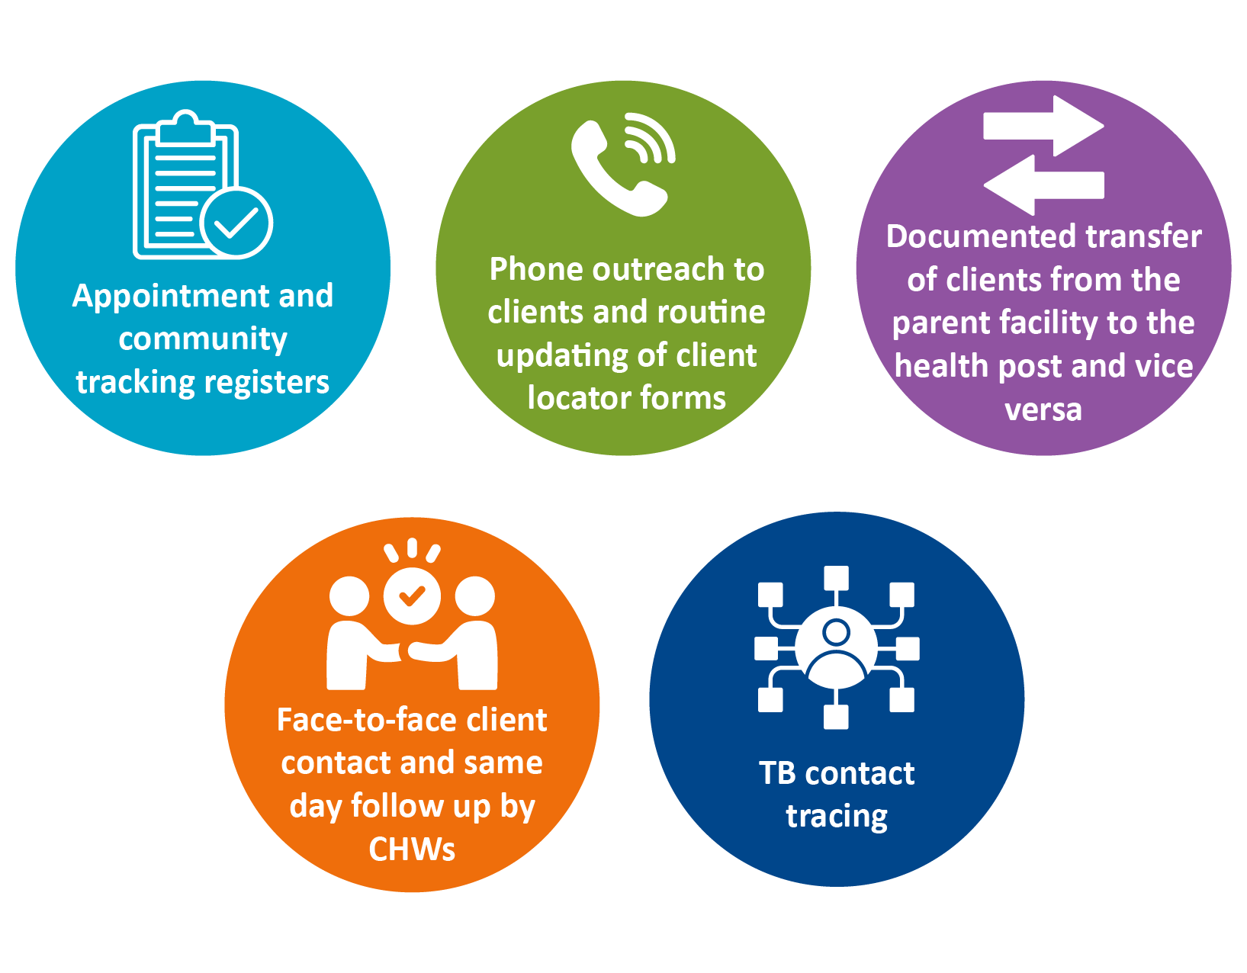

Overall Client Continuity of Treatment Strategies (cont'd)
Notes:
These are additional overall client continuity of treatment strategies at CPs.
They are also used in enhanced support for client VLS challenges with shortened appointment periods.
Appointment Register: CPs maintain this register to capture information on appointment history and future appointments. Each day, the CP (data associate) generates a list of clients from SmartCare that have appointments or that are scheduled to pick-up medicines at the pharmacy.
All client appointments are recorded in the appointment register and all clients who miss their appointments are transferred to the community tracking register. The clients that are now in the community register are followed up with phone calls, visits, etc.
Phone outreach: CPs are supported with airtime to enable efficient tracking of clients via follow-up calls and texts. CPs maintain updated client locator forms with individual client info (address, phone number) and contact history to ensure communication with clients as necessary.
The CP prints a list of clients due for visits the following day.
CHWs call them to inform them that they are due for an appointment; pharmacy pick up; or VL monitoring as appropriate/ indicated.
For client that can’t make it to the CPs, a follow up visit to their home is organized to take their VL and bring drugs.
Face-to-Face Client contact: CHWs meet clients in person at home, in hotspots, and other places within the community. Face-to-face contact is used in cases of frequent defaulting, unsuppressed VL, and in cases of excellent adherence and suppression (affirmation and role model).
Documented transfer: There is documentation of all clients transferring from the health facility to CP or vice versa (the latter is rare) so that all new clients can be appropriately tracked and reached with services.
TB contact tracing: CHWs facilitate linkage between community and facility. TB contact tracing starts with elicitation and follow up. There is a particular focus on close family members, spouses, and workmates. Intensified focus is placed on contacts already on ART that are tested for TB as appropriate.

Slide 5
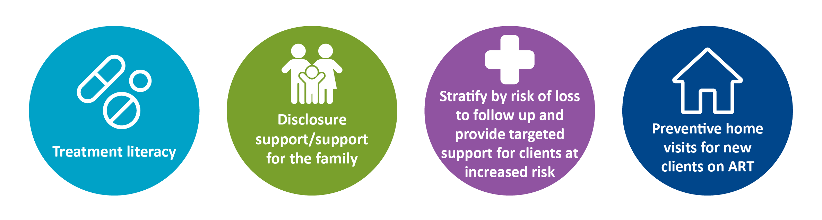

Continuity of Treatment Strategies for New Clients
Notes:
This slide includes a summary of continuity of treatment strategies for new clients.
Treatment literacy: Compulsory adherence sessions are given at each visit with particular focus on U=U messaging. This is included in the HIV cascade of care.
Age-appropriate disclosure support/support for the family (given the ICT/PNS): This refers to any client needing support to disclose his/her new status to spouse, next of kin, close family members, etc. This support is given through accompaniment, family sessions etc.
Preventive home visits for new client on ART: These are conducted when clients are deemed to have acceptance challenges, spouse violence, child-headed households, or grandparent-headed households.
Stratify new client by risk of interruption in treatment and provide targeted support for client at increased risk: Client appearing in the community tracking register are classified in terms of days after due date; priority populations; gender; age; adherence history; etc.

Slide 6

Differentiated Service Delivery for Stable Clients
Notes:
These are the differentiated service delivery (DSD) strategies to support long-term ART continuity of treatment among stable clients, as defined in Zambia's Differentiated Service Delivery Framework.
Provide a brief summary of each DSD model:
Community ART Refill Groups (CARGs): clients are formed into groups of six; each month one of the client comes to collect drugs for all group members.
Multi Month Scripting/Dispensation (MMS/MMD): Depending on the stability of the client, client receives 3-6 months of drug regimen. This helps eligible clients with confidentiality, adherence, and time management between work and facility visits. This creates a win-win situation in relation to continuity of treatment.
Urban and Rural Adherence Support Groups (U/RASGs): These are client led support groups that encourage each other and share experiences in the treatment journey. They are linked to the CP and provide support to new and old client.
Client fast tracking: New clients are seen quicker than old clients, both at the CP and health facilities. They are given priority as an incentive and for encouragement.
Adolescent Support Groups: These are beginning to form. However, the CP model has not enrolled a high number of adolescents to date and therefore this is a nascent strategy within the model. An adolescent focal person from the CP or the parent facility leads and facilitates these meetings usually held once per month with additional ad hoc meetings in accordance with need. A committee of adolescents is set up that will work and plan with the focal person.

Slide 7
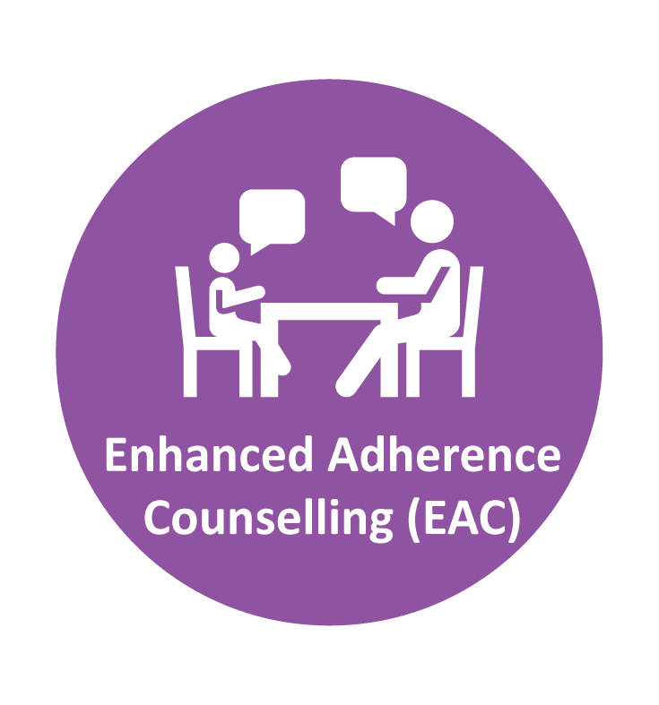
Enhanced Support for Clients with Difficulty Achieving VLS
Notes:
These are strategies that reflect enhanced support for clients with challenges achieving VLS.
The strategies in Slide 4 are also used in enhanced support for client VLS challenges.
Enhanced adherence counseling: This is offered to clients with unsuppressed viral load.
This is counselling that includes application of the RECIPE and targets the whole person (social, emotional, spiritual, financial & economic, worth, legacy, etc.)

Slide 8
Interruption in Treatment Protocol
Data associate at CP uses an appointment register to track clients with missed appointments
Data associate provides list of clients who have missed appointments to the CHW
CHW utilizes client locator form to call and reschedule clients following first missed appointment within X days
If client misses next appointment, then client is transferred to the community tracking register for appropriate follow up.
Notes:
This slide provides a summary of the steps in the CP model to ensure that client missing their appointment are traced and brought back to care as soon as possible

Slide 9
Referrals for social/non-clinical support
Linkage to support services is done through referral and accompaniment to partner organizations providing services
Examples of services for which client would be referred include:
Nutritional support for client and families in distress
GBV services
Counselling and psychosocial support for child abuse
Educational services for OVC
OVC programs
Enhanced/ specialized counseling services for clients with complex social and structural challenges to treatment adherence
Notes:
This slide describes how CPs link client to social/non-clinical support
The client is escorted or accompanied by a CHW to the partner organization
For nutritional support for clients and families in distress, partners include government ministries and NGOs, including FBOs providing food and nutritional services
For GBV services, partners include local police units and legal services for victims of GBV
For child abuse, service partners include police units and other NGOs providing child counselling and psychosocial support services for victims
For educational services for clients that are orphans and vulnerable children (OVC), service partners include OVC programs and DREAMS for full scholarships to private schools (FBO) and school materials/ requirements for public or community schools
For enhanced/ specialized counseling services for clients with complex social and structural challenges to treatment adherence, they are referred to FBOs that provide family counselling services and legal clinics for marital problems

Slide 10
CP staff roles in supporting continuity of treatment
Service | Responsible
Launch of Community ART Groups (CAGs) | CP Clinician/Team Leader with ART in-charge at parent facility
Facilitation of CAGs | Counselor and CHW
Client transfer to parent facility | Clinician/Team Leader
Client appointment reminders | CHWs
Updating client locator forms | Counselor
Client appointment/pharmacy pick up tracking | Data Associate
Missed appointment follow up | Counselor and CHW
Notes:
This slides highlights how each of the CP team members contribute to supporting ART continuity of treatment among clients
The Team Leader with support from the parents facility is responsible for the establishment of Community ART groups (CAGs), while the PSS counselors facilitates the CAGs
The CHW and PSS counselors follow up with client who miss their appointment and send appointment reminders, especially to most vulnerable client.
The DA tracks and provides information on client missing appointments using the database

Slide 11
CP roles in VL monitoring and achieving suppression
Service | Responsible
Produce list of clients needing VL testing | Data Associate
Contact clients in need of VL testing | CHWs/PSS Counselor
VL sample collection & works as VL Champion | Clinician
Call/visit “no show” VL testing clients | CHWs/PSS counselor
Facilitation of Enhanced Adherence Counseling | PSS Counselor
MMS/MMD enrolment | Clinician/Team Leader
Prescribing 2nd line ART | Clinician/Team Leader
Notes:
This slide highlights the role of CP team members in VL monitoring.
The DA produced lists on client due for VL. Client due are contacted by CHW or counselors. Client not showing up are followed up by CHW our PSS counselors
Client who are not virally suppressed receive enhanced adherence counseling from the PSS counselors or enrolled on 2nd line ART, as eligible.
Those who are suppressed en eligible are enrolled onto multi-months scripting.

Slide 12
Thank You!
Notes:
Thank participants for their participation. See if there are any questions or comments.

