Slide 1

Module 8:
Finding and Linking Clients to Services in the Community Post: Case Identification & Linkage Strategies
Notes:
This module focuses on the strategies used to identify clients in need of HIV services offered in the CP, through targeted HIV testing strategies, and effectively linking them CP services, including HIV care and treatment for those that are HIV positive and HIV prevention for those who are HIV negative and at high risk of HIV.

Slide 2
Module 8 Objectives
Understand contextual challenges in achieving epidemic control
Explain the strategies used within the CP model to identify high-risk individuals in greatest need of HIV testing services and promote HIV testing
Describe the roles of CP teams, and faith and community leaders, in promoting and creating demand for HIV services in the CP model
Demonstrate understanding of the Walk and Celebration strategies used within the CP model to link clients to services and support index testing
Describe the patient flow in the CP, including referral from community to health facility
Notes:
Read the Module 8 objectives aloud to participants.

Slide 3
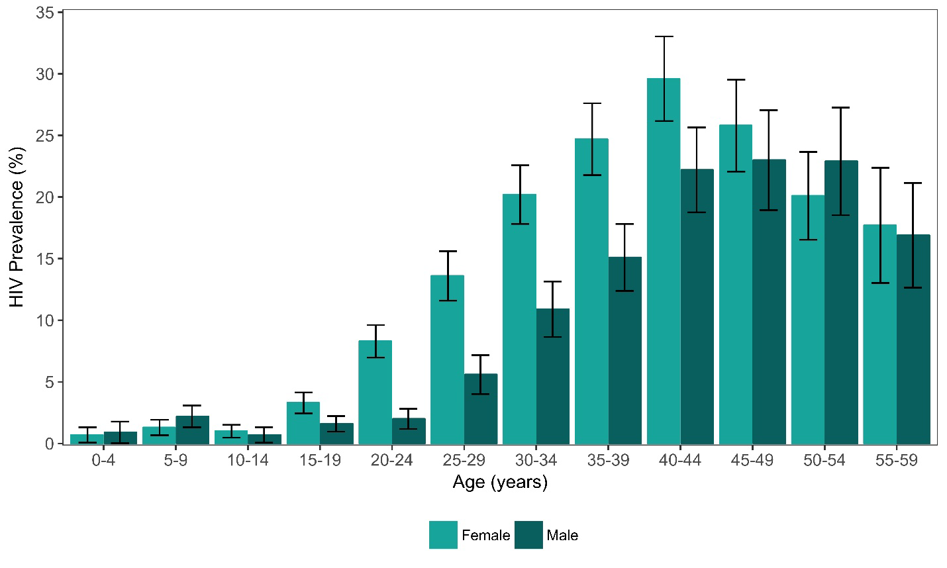
HIV prevalence by age and sex (ZAMPHIA 2016)

Slide 4
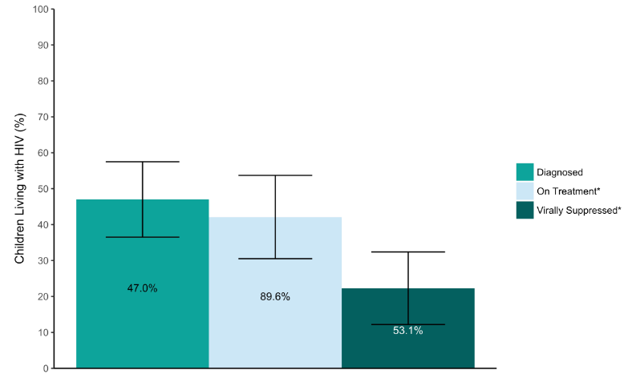
Challenges in Achieving Epidemic Control Goals
Zambia 2016 Progress Toward Pediatric 90-90-90
(laboratory ARV-adjusted data): (ZAMPHIA 2016)
Ineffective case identification approaches (community door-to-door testing has low positivity yield)
Progress in uptake of HIV testing services stalled during the COVID-19 pandemic
Lower uptake of HIV testing among men, adolescents and young adults
Insufficient testing of children of adults on ART
Interruptions in treatment for the working population (focus on income generation activities vs. treatment)
Interruption in treatment for mobile populations
Source: ZAMPHIA Report 2019
Notes:
Please note that the information in this slide should be adjusted to reflect the situation in your country/community. [To do this, open the slides in desktop app, right click on the figure, go to ‘Edit Data’ to edit data in excel sheet.]
This slide reflects the challenges in achieving epidemic control goals in the Zambia context.
The content presented here will pave the way to discuss the need for targeted strategies to improved demand for HIV testing and case identification within the CP model in your context.
Please include your country’s progress in relation to UNAIDS 90-90-90 targets in the figure on the left.
On the right include a bullet each on: sub-populations lagging behind; gaps in promoting testing, and gaps in improving case finding.
Include information that you think is most realistic in making the case for decentralized service delivery through the CP model.
Think about the challenges that are prevailing in your own context; and identify the gaps that need to be addressed in order to close the gap in epidemic control.
Source: https://phia.icap.columbia.edu/wp-content/uploads/2019/02/ZAMPHIA-Final-Report__2.22.19.pdf

Slide 5
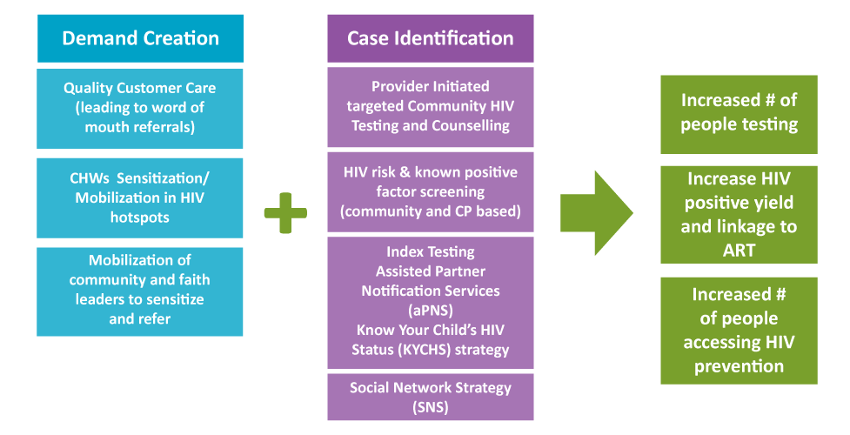
How do Community Posts Increase Uptake of HIV Services?
Notes:
The CP model utilizes a range of targeted strategies to create awareness of and demand for HIV testing, targeting those most in need of HIV testing, and promote the services offered in the CP
The targeted strategies are designed to increase testing among those most at risk and more efficiently identify those that are HIV positive and link them to ART.
Additionally, these strategies aim to ensure that those at increased risk but not-HIV positive are accessing HIV prevention services, including PrEP.
Specific model strategies include delivery of messages of hope and U=U messaging to the community meetings hosted by both local community leaders and faith community leader
Demand creation activities include mobilization of community and faith leaders to promote utilization of services; leverage community and faith platforms to increase awareness of and deliver services; mobilize CHWs; and focus on quality customer care – which in turn leads to word-of-mouth referrals.
Through a combination of evidence-informed case identification strategies and targeted promotion approaches, CPs have been successful in increasing the number of individuals tested, particularly from certain populations (e.g., men) and increasing case finding (e.g., HIV positivity yields).
HIV risk and known positive factor refer to a screening tool developed and used in identifying potential known positives who may want to present as new positives for various reasons. This screening approach includes enhancing probing that focuses on counselling the whole person.
Know Your Child’s HIV Status (KYCHS) strategy is a CRS EpiC3-90 pediatric case identification strategy, which focuses of following HIV-positive women ages 15-49 years who have been on ART for more than 3 months with children of unknown HIV status

Slide 6
Creating Demand for CP Services: Quality Customer Care
A Satisfied Client…..
Helps build the image, brand, and reputation of a facility and MOH
Is a natural repeat client
Is a compliant client
Progresses along the HIV treatment cascade/continuum of care –
  95-95-95
  ….....and is a healthy client!
Is best at marketing and advertising for others to see and experience
Can potentially attract funding and partnerships
Notes:
Quality customer care is key to promoting the services offered in the CP.
A satisfied client is one of the most effective ways to promote CP services to others in the community.
The transformative experiences of satisfied customers are shared via word of mouth - from index cases to family and community members - generating referrals to services at the CP.

Slide 7
Creating Demand for CP Services: Mobilizing Faith & Community Leaders/Stakeholders
Faith/Community Leader Trainings: deliver information/education on services, including HTS
Ongoing relationship-building and mobilization of key influencers: promote HTS uptake among high-risk individuals
Distribution of Information, Education and Communication & Social and Behavioral Change Communication materials
Leverage health and non-health community meetings: Provide information, education, and services (e.g., HTS screening and testing)
Attend meetings of faith communities (especially 'healing crusades'): screen and follow-up healing seekers
Notes:
CPs do not brand themselves, and therefore relationships between CP team members and community/faith leaders are critical in creating awareness of services.
In fact, the first training of faith/community leaders is seen as a “marriage ceremony,” meaning marrying leaders to their CP and ensuring they understand their own role in supporting the CP.
The CP Team Leader is seen as the “health parent” within the community: he/she must maintain a good reputation and trust with community/faith leaders.
Establishing this reputation as ‘health parent’ is part of ongoing training for Team Leaders; Team Leaders are encouraged to be proactive in maintaining the relationship with community/faith leaders.
Community leaders may include market leaders, bus station leaders, rural development committee leadership, ward councilors.
They are important for promoting testing and capturing intelligence around those in need of testing, for instance leaders may have useful information on certain community members’ partner status and risk.
CP staff have a relationship with other strategic community stakeholders – e.g., hotspot owners such as bar/club owners, which can support and encourage HIV testing; CP staff help community stakeholders understand the business value of having healthy patrons.
Trainings enable faith and community leaders to provide information/education around testing and other services.
Healing crusades are used for case finding of clients by the CHWs
Community leaders and certain business owners can be aware of individuals with high risk behaviors, such as traders.
Relationship building also supports the utilization of community and faith platforms for delivering messaging (direct from implementing partners) about services available at the CP and delivering services directly.
Faith/Community leader trainings include Messages of Hope, U=U, Child Safeguarding, GBV, etc.
Distribution of IEC & SBCC materials include flyers, posters, leaflets, dialogue tools
They leverage health and non-health community meetings: examples include community health days-immunization days, community development meetings, market days and church services.
Please refer to https://www.faithandcommunityinitiative.org/ for additional resources for faith community engagement.

Slide 8
Creating Demand for CP Services: CHW Sensitization and Mobilization in HIV Hotspots
CHWs embed themselves in the day-to-day life of the community and understand what is happening in relation to the three “95s”
Establish/build relationships with community members and key influencers to identify individuals in greatest need of testing
Some CHWs are expert clients who act as models to demonstrate the benefits of ART
Notes:
CHWs have a critical role in demand creation to understand the “story” behind the current status of 90-90-90.
They build relationships in communities, which enable them to better identify those in need of HIV testing, in particular men and adolescents.
Some CHWs are actually clients themselves and demonstrate the benefits of ART.

Slide 9
Creating Demand for CP Services: Reaching Men
Community leader endorsement of CP instills trust in men
Location of the Community Post is convenient for men
  Located in busy work settings where men work and socialize
  No additional costs to reach services as they are offered where men are
  Men spend very little time off their work to access the services
  Blended into its setting (market, bus stop area) CPs remove stigma attached to accessing a typical clinic
Walk strategy and partner notification:
  As more women test for HIV than men, the women who test HIV+ become the index clients to reach their male partners
Notes:
The CP and its parents facility receive endorsement by the community leaders, such as market executive committees, local resident development committees, bus stop chairpersons (through the stakeholder engagement approach described in previous modules). This acts as a catalyst in increasing access of the services by men.
Additionally, the location of the CP promotes and facilitates access by men in a few ways:
They are located in areas where men usually are found or congregate during the day, areas where they work and socialize, such as markets, bus stops or taxis ranks, waiting wheelbarrow pushers, etc.
As a results, men spend little time or costs to reach the services.
Also, as services are offered near workplaces, men spend little time off work to access the services.
Finally, the CPs blend in with their surroundings and are not marked as clinics, thereby removing much of the stigma often attached to accessing a typical clinic or health facility.
Finally, index case testing and partner notification are in particular effective in reaching men. As overall more women are tested for HIV than men, the women who test HIV+ become the index clients to reach their male partners through assisted partner notification, which is promoted through the walk strategy (explained in more detail later).

Slide 10
Case Identification
Everyone is involved in case identification: all members of the CP team (Team Leader to CHWs) and community stakeholders have a shared responsibility to identify individuals for testing
Case ID relies on building relationship and trust with clients and communities
Capacity building of Community Post staff focuses heavily on building their emotional intelligence to support case ID
Every person counts: Individual to be tested (and eventually put on treatment) come on board one at a time
Notes:
In this stage of the HIV epidemic, finding positives (i.e., tackling the “first 90”) is particularly difficult.
Capacity building of CP teams focuses heavily around equipping with skills to employ efficient case identification approaches.
The Core Value of responsibility is particularly relevant here: there is a shared responsibility among the entire CP team to support case identification.

Slide 11
Case Identification: Provider Initiated Targeted Community Testing & Counselling
Majority of testing occurs in the community
CHWs utilize community knowledge, connections, and risk screening tools to identify individuals for testing
  Sensitivity and emotional intelligence
  Embedded in community/know networks and hotspots
  Enhanced probing skills/graceful persuasiveness
CHWs and Psycho-Social Counsellors (PSS) are certified testers
Following an initial positive test (in community), the individual is accompanied to the Community Post (Walk Strategy) for confirmatory test
Notes:
CHWs can utilize their understanding of the community dynamics; individuals in the community; and their access to community platforms to identify individuals for testing; Examples of this may include attendance at funerals and identification of couples who are separated and may have other partners.
Index case testing is the primary strategy for case identification in the COP model. As such, most of the HIV testing carried out by the CP is done within the community by the CHWs and the PSS Counselors.
The ability of CHWs to gain consent from individuals for HIV testing requires certain characteristics/ attributes (hence why careful selection of this team member is so critical).
They must possess sensitivity and emotional intelligence to effectively seek out clients in need of testing and encourage them to be tested.
Their ability to effectively probe and persuade potential testers is critical and honed through ongoing capacity building.
When an individual tests positive in community, a CHW walks them to the CP (walk strategy) where they receive a confirmatory test from the PSS Counselor.
The walk is a time to build the relationship and also ask clients about their contact(s) in need of HIV testing.
The client is then connected to Team Lead/clinician for ART initiation.

Slide 12
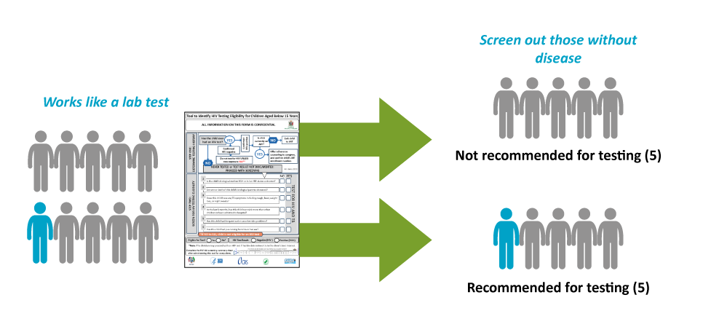
Case Identification: HIV Risk Screening
Notes:
All CP staff are trained to use national HIV Risk Screening tools to help determine those individuals most in need of testing and target resources, including staff time, HIV tests, etc.

Slide 13
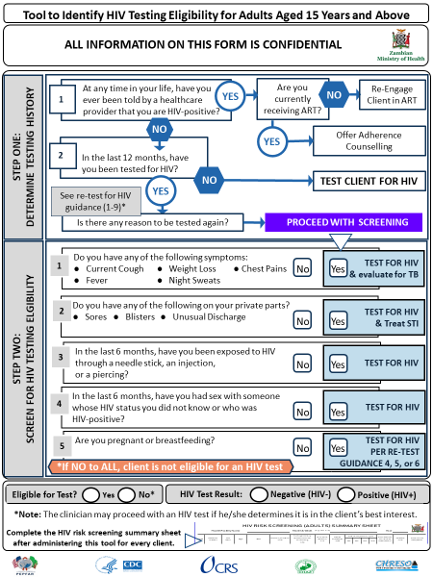
Adult
(15+ years) HIV Risk Screening Tool
Notes:
Now we are going to share some examples of screening tools from the Zambia context.
Please note: information contained on this slide should be adjusted to the specific country context.
This is an example of the risk screening tool used for adults in Zambia.
As part of the CP team capacity building in Zambia, the CP team learns to use this tool to facilitate dialogue to put clients at ease.
This tool is meant to be used as a guide for a conversation and the CP team should not read from tool.

Slide 14
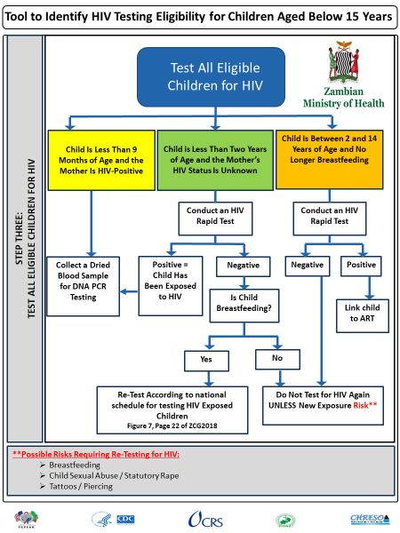
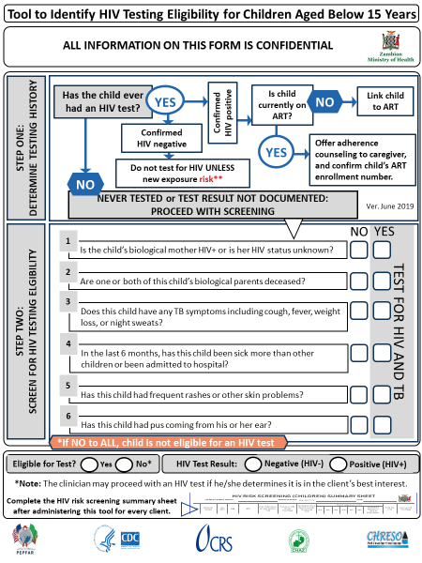
Children’s (<15 years) HIV Risk Screening Tool
Notes:
Please note: information contained on this slide should be adjusted to the specific country context
A separate tool is used to screen children under 15 years of age for HIV testing eligibility in Zambia.

Slide 15
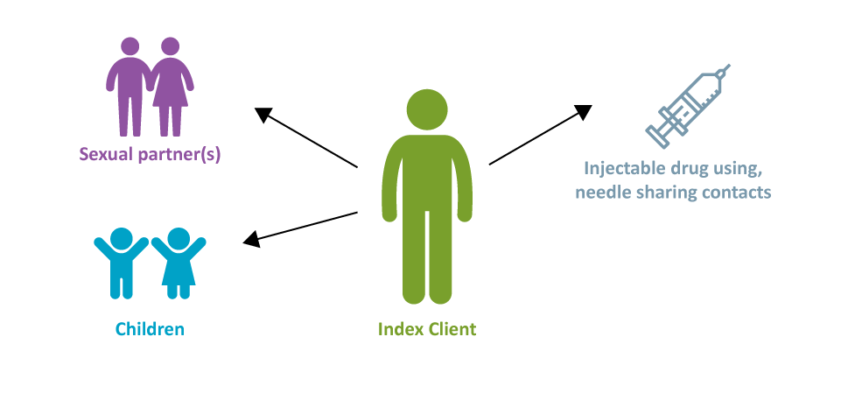
Case Identification: Index Contact Testing & Assisted Partner Notification
Biological Children (<19 Years)
Notes:
Index testing is the #1 source of CP HTS clients followed by targeted community testing.
It is an important way to help identify those who were exposed to HIV and quickly link them to care if they test positive.
• This strategy has proven to be very effective in finding, testing, and treating HIV positive individuals in the community.
Aim to contact ALL sexual contacts of index cases and ALL biological children < years of age.
Know Your Child’s HIV Status (KYCHS) strategy is a CRS EpiC3-90 pediatric case identification strategy, which focuses on following HIV-positive women ages 15-49 years who have been on ART for more than 3 months with children of unknown HIV status.
In terms of the age limit for notification of parents for index testing, most countries have 16 years and below as an age for requiring consent before testing. Should an adolescent be an index, the same consent process of contacting the guardian and or parent is followed through, which eventually may lead to testing parents or siblings. With the benefits of early treatment highlighted coupled with the RECIPE Elements all index client (minor and adults) do take up the responsibility to inform or ensure that their loved ones are notified and tested as appropriate.
CHWs and PSS Counselors:
Gather index case contact info (Walk Strategy) and sensitize index clients on core values; encourage them to protect negative sexual partners and to persuade their partners to seek testing quarterly.
CP staff are trained on enhanced probing skills-This is the model's counselling that includes employing the RECIPE core values when counselling the client in order to show and make the client feel wholly cared for as a human being socially, emotionally, physically, spiritually, and clinically.
Notify partners in the right way and at the right time
In this context the right way and the right time refers to the index contacts being contacted and tested in the best possible way resulting from the contact profiling resulting from information given by the index. Information from the index will determine how and when best to contact the contacts.
Notify parents of any children who have tested positive.
Encourage index case contacts to be tested.
The goal is to test at least half of index case sexual contacts/family members on the same day as index case.

Slide 16
Elements of Successful Index Testing
Overcoming personal stigma
RECIPE
Emotional intelligence
Index profiling
Elicited contacts profiling
Accompaniment; “the Walk”
Celebration (the welcome)
Notes:
These are the elements of success of index testing:
Overcoming personal stigma: This begins with us; overcoming personal stigma impacts how we interact with clients.
This is done through:
Accepting God’s love for us as individuals; Accepting God’s forgiveness; Learning to love yourself; Learning to forgive yourself; Learning to love others; Deploying self leadership – this enables you to accept others as you would accept yourself; You cannot love your neighbor as yourself if you don’t love yourself; This allows you to deploy the recipe in your life and work.
RECIPE: Responsibility; Empathy; Compassion; Integrity; Passion; Ethical
Index profiling: discussed in ”the Walk”: refers to gathering info on client attributes (e.g., male/female; type of dress; language; marital status; employment status and type of work) to help understand who is the best placed counselor/ CHW to interact with clients.
Customer care: discussed at the beginning of the presentation as the components of delivering quality customer care.
Accompaniment/ “The Walk”: We are going to discuss this next: this is when the index contact has tested positive in the community, the CHW physically walks with those who test positive in the community to the community post for confirmatory testing and same day antiretroviral treatment (SDART) initiation.
The Celebration refers to the warm greeting received at the CP. We will discuss this in more detail shortly.

Slide 17

Case Identification: Social Network Strategy (SNS)
A recruitment strategy for reaching and providing HTS to persons who are unaware of their HIV infection by using social network connections to locate individuals at the highest risk for HIV
Based on the notion that people may be more likely to accept testing when encouraged by someone within the same social network
Enlist HIV-positive and high-risk, HIV-negative persons (recruiters) to identify individuals from their social, sexual, and drug-using networks (network members) for HTS
Notes:
The SNS is based on the notion that people may be more likely to accept testing when encouraged by someone within the same social network who they know and trust, and with whom they share similar risk behaviors.
In the CP model social network strategies are developed in particular communities based on social interactive trends and social drivers fuelling risky behaviours in that community.
HIV testing is used in the SNS model through distribution of self test kits to members of the faith community and the local leadership. These leaders working with CHWs distribute to targeted individuals within their constituents.

Slide 18
The CP Model Walk Strategy
Following positive test results in the community, CHWs or PSS Counselors personally walk clients back to CP for confirmatory test AND Same Day ART Initiation (SDART) or PrEP
During walk (approx. 10-20 minutes), CHWs/PSS Counselor builds a relationship with the client by:
  Listen more, talk less (allow client to talk about anything and everything)
  Be aware of client’s feelings and affirm those feelings
  Show empathy/offering holistic care (e.g., connecting on a human level)
  Support clients to manage personal stress
  Provide client-centered tailored services
Gather info/index profiling on client attributes (e.g., male/female; type of dress; language; marital status; employment status and type of work)
Notes:
HIV testing occurs at the parent facility; a client that tests positive is an index case.
CHWs think of other PLHIVs connected to this client and needs to employ customer care and emotional intelligence to obtain more information.
CHW walks/accompanies the Index client to CP where PSS Counselor and Clinician do confirmatory test; walk typically takes 10-20 minutes; As they are walking, they have a chance to discuss and connect with the client.
The Walk strategy focuses on newly positive clients. Any high risk neg individual is counselled and requested to retest after three months. Preventive messages are also given to them including benefits of PREP and safe sex.
There are 5 levels of connecting – emotional connection/sympathize with the client and ask questions to help him/her share how they are feeling; social connection – married, children, etc. get info on “how they live socially” – this isn’t Q&A (CHW also shares personal info); economic and financial standing; spiritual – get info on their faith; physical – e.g., show some sort of physical touch to send reassurance such as holding hands for a minute or bump shoulders
The walk helps to bring down the client’s defense system and for them to open up and discuss # of sexual partners.
Index profiling helps you to know if you are the best placed counselor/ initiator to interact.
When you arrive at CP, Celebration Strategy starts with Team Lead, Data Associate and PSS Counselor.

Slide 19
How Does the Walk Strategy Increase Client Continuity of Treatment?
Enhances client’s personal contact/trust with CHWs and ART providers
Improves social support system
Personal information gathered enables CP to tailor services (index testing) to the need of the individual client
Contributes to improved client tracking as CP staff come to know/understand the client better
Partner notification introduced at the right time
Notes:
Through the Walk Strategy, the CHW builds a relationship with the client, which prepares the CHW to discuss and support partner notification and to encourage testing of the sexual contacts and biological children of that client.
The CHW applies the Core Values and principles of customer care to determine the best approach for notifying partners.
PNS is ideally done on the same day; the CP facilitates for sexual partner living in the same community- given its location within the community
Data from the CP model in Zambia shows the success of the model in notifying partners and initiating same day testing of approximately 50% of index case contacts
In this context the right way and the right time refers to the index contacts being contacted and tested in the best possible way resulting from the contact profiling resulting from information given by the index. Information from the index will determine how and when best to contact the contacts.

Slide 20
How Does the Walk Strategy Support Index Testing?
During Walk, CHW encourages client to take responsibility for their lives and the lives of others
CHWs captures names/contact info of index case contacts by asking:
  Do you have any contacts (biological children (<19 years of age), sexual/injecting partners) that you care about?
  Wouldn’t it be better if they are also placed on treatment?
CHWs highlights benefits of HIV treatment
  Reduces the amount of HIV (i.e., viral load) in your blood
  Helps you stay healthy and prevent illness
  Reduces risk of HIV transmission to HIV-negative partners ('Undetectable = Untransmittable' (U=U)
Notes:
These are examples of how the Walk Strategy supports index testing.

Slide 21
Celebration/Welcome Strategy
Celebration/Welcome Strategy is designed to make client feel safe, assured, accepted, cared for and celebrated
Upon arrival at CP, Team Leader and PSS Counsellor warmly welcomes client with a smile, handshake, and/or hug (if possible)
Through signalling, the CHW gives indicates to the Team Leader/PSS Counsellor if they have asked the client question about sexual contacts
If not, CP team decides who will inquire about client’s sexual partners based on client profiling results
Notes:
The Welcome creates an environment in which the client feels safe, assured, accepted, cared for, and celebrated.
CP staff gives them a smile and handshake at a minimum, and a hug and water or soda where possible.
Signaling: during walk strategy, CHWs use “emotional intelligence” so they can profile each index/client:
If a client thinks they are a high level of social standing – they may be more discrete about personal info as they don’t want to share with CHWs; so the Team Leader is then the one to try to extract information about sexual contacts – thumbs up means they’ve asked the question; thumbs down means the Team Leader needs to ask the question about sexual contacts.
Signaling is done by the returning CHWs at the CP who would use a thumbs up sign to imply a successful index elicitation during the walk strategy or a thumbs down sign to pass on the elicitation process to the CP Team lead (Clinician).

Slide 22
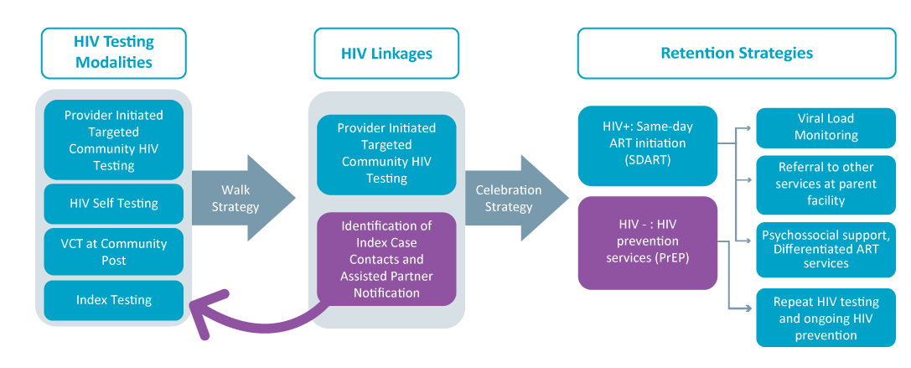
Patient Flow
Notes:
This slide contains a review of the patient flow of the components we discussed in this module.
First there are a range of targeted strategies used in the COP model to create demand for HIV testing.
These are combined with strategies to identify and then link those most in need of testing to services. Demand creation activities include mobilization of community and faith leaders in promoting utilization of services and leveraging of community and faith platforms to increase awareness of and deliver services, mobilization of CHWs, and focus on quality customer care – which in turn leads to word of mouth referrals.
Evidence-informed case identification strategies include community risk factor screening, provider-initiated testing and counseling, and application of the social network strategy.
Through these demand creation and case ID approaches, the model creates a pool of individuals who would like to access testing services. Most testing is done in the community, but VCT is also available in the CP.
Following testing that occurs in the community, the COP model uses its innovative Walk Strategy to 1) create a linkage to treatment services at the CP and 2) capture information on index contacts that are notified and offered testing at the right place and right time.
For all clients who test positive either at the CP or linked to the CP via the walk strategy, the Celebration strategy is then applied.
Following the celebration strategy, the client is enrolled in the ART program. The CP model then utilizes a set of strategies for ART client continuity of treatment.

Slide 23
Prioritizing core values
and
motivating CP teams
are critical to the success of case identification and testing promotion!

Slide 24
Thank You!
Notes:
Thank participants for their participation. See if there are any questions or comments.

