Slide 1

Module 7:
Service Delivery in the Community Post Model
Notes:
This session provides an overview of the standard service offerings at CPs, as well as the roles of the different CP team members in delivering services.
As the model continues to evolve, the service menu will be updated regularly to include additional services in line with national guidelines and as appropriate for your context.

Slide 2
Module 7 Objectives
Describe the package of services along the HIV prevention, care and treatment cascade that is provided in the CP
Describe CP staff responsible for provision of the different services provided in the CP
Describe the five Cs of HIV testing
Describe flow of laboratory sample referral and results return
Describe service delivery considerations for pregnant and breastfeeding women, children and adolescents, and TB/HIV co-infected patients
Describe referral from CP to the parent facility
Notes:
These are the objectives for Module 7.​
By the end of Module 7, participants should (read Module 7 objectives)…

Slide 3
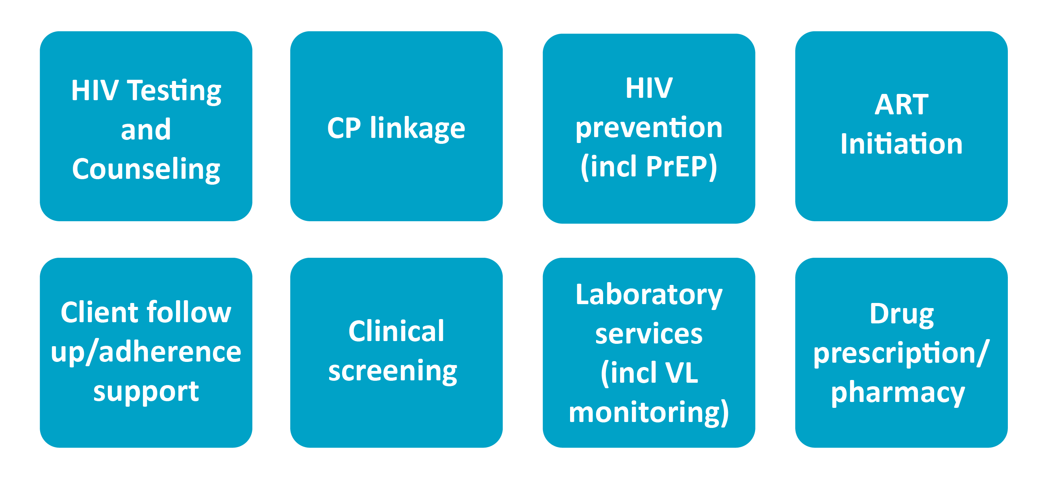
CP Service Delivery
Notes:
CPs offers a comprehensive package of HIV prevention, care, and treatment services that aim to reach client's that have not been reached thus far with services and improve continuity of treatment in care.
CPs serve as one-stop-shops where services are provided in an integrated manner.
Service offerings in rural CPs are typically the same as those in urban/peri-urban CPs.

Slide 4
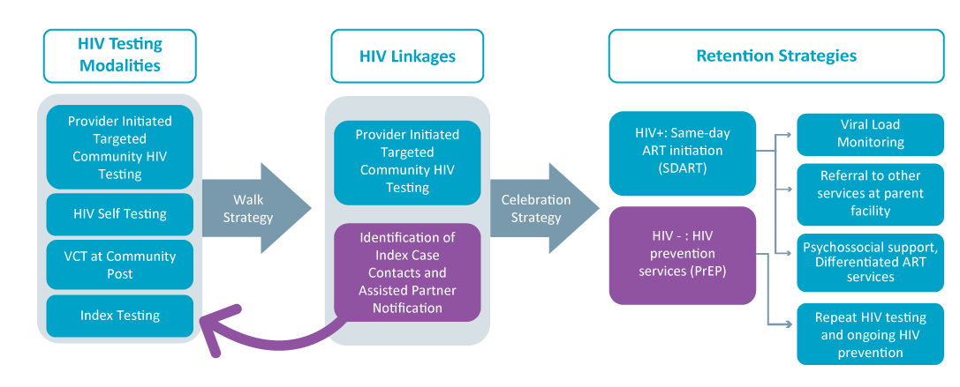
Patient Flow
Notes:
This slide shows the patient flow associated with the CP model.
First there are a range of targeted strategies used in the COP model to create demand for HIV testing.
These are combined with strategies to identify and then link those most in need of testing to services. Demand creation activities include mobilization of community and faith leaders in promoting utilization of services and leveraging of community and faith platforms to increase awareness of and deliver services, mobilization of CHWs, and focus on quality customer care – which in turn leads to word of mouth referrals.
Evidence-informed case identification strategies include community risk factor screening, provider-initiated testing and counseling, and application of the social network strategy.
Through these demand creation and case ID approaches, which we will discuss more in subsequent modules, the model creates a pool of individuals who would like to access testing services. Most HIV testing is done in the community, but HIV testing is also available in the CP.
Following testing that occurs in the community, the COP model uses its innovative Walk Strategy to 1) create a linkage to treatment services at the CP and 2) capture information on index contacts that are notified and offered testing at the right place and right time.
For all clients who test positive either at the CP or linked to the CP via the walk strategy, the Celebration strategy is then applied.
Following the celebration strategy, the client is enrolled in the ART program. The CP model then utilizes a set of strategies for ART client continuity of treatment.

Slide 5
Service Roles & Responsibilities
Service | Responsible
HIV Testing | CHWs, PSS Counselor
Pre/Post Test Counselling | PSS Counselor, CHWs
CP Linkage | CHWs, PSS Counselor
ART Initiation | Clinician/Team Leader
Client follow up/adherence support | PSS Counselor, CHWs
Clinical screening | Clinician/Team Leader
Laboratory services (incl VL samples) | Clinician/Team Leader
Drug Prescription/Pharmacy | Clinician/Team Leader
Notes:
This slide provides an overview of CP staff responsible for providing different services at CPs.

Slide 6
Targeted HIV Testing Strategies
Provider-initiated community HIV testing & counselling Index case testing (including assisted partner notification and testing of biological children of HIV+ clients) Voluntary counseling & testing (Clients seeking HTS) Self-testing: Sexual contacts of existing clients (especially those with high VL) Faith communities via clergy and church liaisons High-risk individuals via community leaders
Notes:
HIV testing is the main point of client entry into CPs.
The majority of CP HIV testing takes place in the community (by CHWs and PSS counselors certified in testing).
A limited volume of HIV testing takes place at actual CP sites (1) client who voluntarily seek testing or (2) client recommended for testing by the provider/clinician (provider-initiated testing and counselling (PITC).
All CP staff share responsibility to promote HIV testing.
Self-testing is offered through three main avenues:
1) to contacts of existing clients;
2) via distribution of test kits to faith communities; and
3) via distribution of test kits by community leaders to individuals in need
Self-testing is appropriate for contacts (including spouses) of index clients who do not want to be tested; these clients can utilize a self-test and then be referred to appropriate facility; CP provides linkage to this facility (CP or other facility).

Slide 7
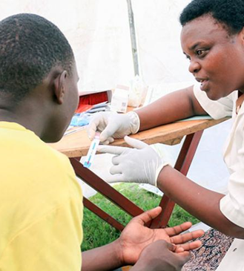
The 5 Cs of Testing
Consent​
Confidentiality​
Counseling and information giving​
Correct results​
Connection (Linkage)​
Notes:
These are the 5 “Cs” of HIV testing.
1. Consent: HIV testing must be informed and free of coercion. It can be ​verbal or written. The legal consent age for an HIV test in [X Country] is X years. Please add any additional relevant information. For example, in Zambia, ​emancipated minors and married minors​ under 16 years of age are permitted to consent to testing. Limiting factors to consent may include underage, incapacitating health.
​
2. Confidentiality: CHWs, PSS Counselor and distributors (in the case of self-testing) must protect client confidentiality​
3. Counseling and information giving: The PSS counselor and CHWs play a key role in counseling at the CP while in the case of self-testing distributors play an important role in ensuring clients have the correct pre-test information and are linked to counseling​.
4. Correct Results: The PSS counselor and CHWs are responsible for delivering results to client at the CP, while the distributor plays an important role in ensuring client can read results correctly by giving correct information.​
5. Connection (linkage): Clients need to be linked to post-testing services whether negative or positive. The PSS counselor and CHWs fill this role.

Slide 8
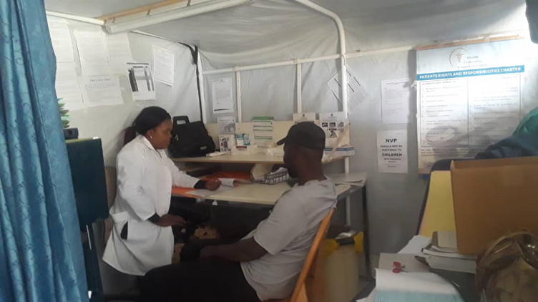
HIV Treatment
Same day ART initiation ART adherence support Viral Load (VL) monitoring Tracking of clients with interruptions in treatment (IIT)
Notes:
These are HIV treatment services offered at CPs.
HIV treatment initiation:
The clinician at the CP puts a newly diagnosed client on lifetime ART after conducting all clinical assessments and the client meeting the clinical standards for initiation.
After testing positive in the community or the facility, the Walk Strategy is done, emphasizing adherence and index testing.
At the CP, they do a confirmatory HIV test with post test counselling.
Before ART initiation, the client is screened for TB and other HIV co-morbidities.
The CP conducts urinalysis and if protein is two or less, the client is initiated on ART and the CP conducts other baseline investigations, such as CD4 count, LFTs, creatinine, etc.
Adherence services:
Newly diagnosed client, or client already on ART, are counselled and advised on the importance of taking their ART as prescribed by the clinician.
Client receive an explanation of the benefits of ART and the importance of adhering to ART and attending all of their appointments
Client also receive counseling and education on change of lifestyle while on medication like alcohol abuse, condom use, sticking to one sexual partner, PEP/PrEP, and any other psycho-social challenges a client could be facing
VL monitoring:
All client on ART are documented in an appointment register, which also shows the date a client is due for VL
VL is explained to client at initiation and done at 6 and 12 months
For high VL, CPs do index testing, IAC, and also check for poor adherence and treatment failure.
CP call all client due for VL testing the week in advance and then a day in advance to remind them about the VL test
For client that can’t be reached, CHWs follow up with them at home
Clinicians conduct VL sample collection at home for those unable to come to the CP
Tracking of interruption in treatment at the CP
All client who are on ART are documented into as appointment register so when they miss their appointment date, they are entered into a community tracking register for follow up.
The clinician coordinates follow up activities; he/she assigns the caregivers clients who have missed their appointment dates.
Follow ups are done either by phone calls or home visitation by the caregivers; it can be difficult to reach those with unknown addresses and/or phones.

Slide 9
CP Viral Load Monitoring Procedures
CP collects VL samples and send to parent facility
Parent facility tests VL; results shared with CP
Enhanced Adherence Counselling
(unsuppressed)
CPs produce list of clients due for VL testing
CHWs/PSS counselors contact clients to come for VL sample collection
CHWs/PSS Counselors call/ visit “no show” VL clients
MMD and TLD (suppressed clients meet other criteria)
Periodic Viral Load campaigns
CP Viral Load Target Setting, Daily Progress Reporting & Clinical Meetings
Notes:
NOTE: Facilitator should adjust guidance presented in this slide on appropriate management of clients with unsuppressed VLs, according to country specific guidelines/context.
The SmartCare database generates clients lists, which are given to CHWs/PSS counselors.
These VL results are maintained in clients files and Smart Care.
All clients due for VL collection are called a week before appointment and a day before just as a reminder.
Clients with unsuppressed VL are followed up and attend enhanced adherence counseling (EAC).
These clients repeat VL testing after attending at least six EAC sessions. If still unsuppressed, clients is switched to second line treatment. If still unsuppressed and already on second line of treatment, clients is referred to the University Teaching Hospital (in Zambia).
Periodic clinical meetings are conducted to share knowledge on management of VL.

Slide 10
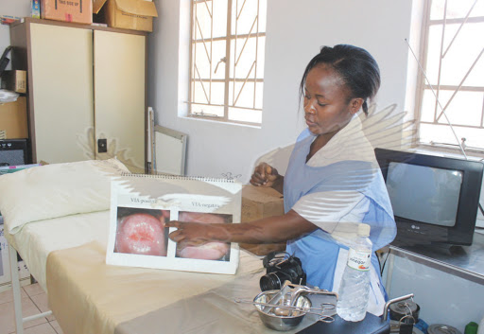
Prevention Services
HIV risk screening and prevention counseling
Pre-exposure prophylaxis (PreP)
Post Exposure Prophylaxis (PEP)
Cervical Cancer Screening
  outreach to CP
Hypertension screening
VMMC
  to be included in FY2021
Sr. Mercy Mtonga (Livingstone) Picture: Zambia Daily Mail
Notes:
CPs offer general screening for HTN in the community.
They refer to their parent facility for cervical cancer and VMMC.

Slide 11
Clinical Services
Opportunistic Infection (OI) screening and prevention
STI screening and STI treatment
Malaria
TB screening and treatment/TB Preventative Treatment (TPT)
Diabetes screening (some CPs)
PrEP
Post-violence care/PEP
Notes:
These are the clinical services offered in CP.

Slide 12
TB Screening and Treatment
Client with TB+ test:
CP prescribes TB treatment
Parent facility tests sputum
CHWs and the clinician conduct TB screening to identify people with symptoms
CP collects sputum and sends to parent facility
CP clinician shares results with client via phone
TB contacts screened for TB
CP prescribes TB preventive therapy to client as they await results
HIV+ clients with TB- Tests:
CP prescribes TPT for 6 months
Notes:
CPs use a TB screening tool to identify individuals with symptoms (i.e. coughing, fever, night sweats) and send to CP for screening.
The TB screening is done both in the community by the CHWs using a screening tool and at the CP by the clinician during general screening.
The CP clinician collects sputum and sends to the main facility in cooler boxes for testing by qualified lab technicians.
Clients receive TB preventative therapy (TPT) as they await their results (TPT helps to prevent TB infection).
The lab facility techs contact the CP clinician with results. Th clinician at the CP then contacts the clients with results; and if positive, orders the TB treatment and initiates the clients on TB treatment at that CP. This is documented in the CP registers.
TB contacts are also screened for TB and if negative, they are put on Isoniazid for six months.
HIV+ client with negative TB results receive TPT for six months. All those on TPT are documented in the TPT registers.

Slide 13
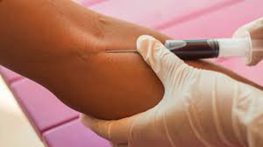
Community Post Laboratory Services
Onsite services
Specimen collection for analysis in referral lab
HIV rapid test Syphilis rapid test Random blood sugar (RBS) Urinalysis TB LAM [Hepatitis B]
Viral load testing
CD4 count
Early infant diagnosis (DBS PCR)
Full blood count
Serum creatinine
Blood lipids
Urine MCS
Sputum
CrAg
[Hepatitis B ]
[Syphilis]
Notes:
Note: For more information on the acquisition/management of laboratory supplies, please refer to Session 4: Site Scanning, Selection & Preparation.
Services in [ ] are services that are offered on site in some CP and in parents facility in others, depending on situation

Slide 14
Flow of Laboratory Specimen Collection Services
Specimens collected by the Team Lead
Specimens stored in cooler box with same-day delivery to parent facility
Drivers from parent facility transport specimens to parent facility using vehicle/logistics
Parent Facility conducts daily testing and analysis
Team Leaders share results received from the Lab during the Morning PEP Talk
Notes:
Note: For more information on the acquisition/management of laboratory supplies, please refer to Session 4: Site Scanning, Selection & Preparation.
Parent Facility conducts daily testing and analysis depending on when samples come in and the type of test (VL is 2-14 days).

Slide 15
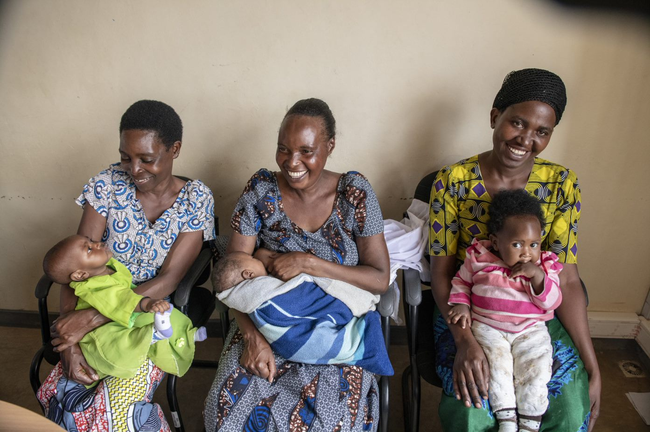
Special Considerations: Pregnant and Breastfeeding Women
Women on ART requiring ANC are referred to parent facility
Are offered all lab requirements and ART
ANC to be added to the CP model
Photo: Eric Bond/EGPAF, 2019
Notes:
These are considerations for pregnant and breastfeeding women receiving care at CPs.
Women on ART are referred for prenatal, delivery and postnatal care in the parent facility; once final HIV status of HEI infants is determined in the parent facility, the mother (and child) return for care to the CP
There are CPs where pre/postnatal care and infant follow up will be integrated into the service package, with ANC provided on a special day by a MCH nurse from the parent facility.
FP is not being provided in the CPs in Zambia and is also not a focus on what clients would be counselled on, but in other settings it could be part of the package.

Slide 16

Special Considerations: Children and Adolescents
Index case testing for biological children (<19) of newly identified HIV+ adults
HIV testing of children of women on ART > 3 months (Know Your Child’s HIV Status)
Provide HIV testing and linkages for those with special needs:
  Malnutrition/failure to thrive/poor growth
  Gender-based violence cases
  TB symptoms or diagnosis
  Referral to OVC program for CLHIV
All HIV+ children and adolescents receive comprehensive HIV care services at CPs
Photo: Eric Bond/EGPAF, 2019
Notes:
The CP implements also targeted strategies to increase case identification among children
This includes testing of all biological children (<19 years of age) of newly identified HIV+ adults.
Also the children of women on ART who have not been previously tested are offered HIV testing as part of the Know Your Child’s HIV Status campaign (KYCHS).
The CP also offers HIV testing to children preventing with symptoms suggestive of HIV infection, including failure to thrive/poor weight gain or TB or other OIs, as well as victims of sexual violence., with referral to the parent facility if there are care needs not provided in the CP. In general PSS group activities for children and adolescents are not provided in the CP as the numbers are too small in CP sites. Children and adolescents can access PSS groups in the parent facility.

Slide 17

TB/HIV Co-Infected Patients
All clients at the CPs with HIV/TB co-infections are treated within the CPs
They are monitored closely esp. in the initial phase of treatment
Medical refills; appointments; and drug pickups are all done at the CPs
Notes:
These are considerations for TB/HIV co-infected patients at CPs.

Slide 18
Patient Referral to Parent Facility
Referral is done through referral and accompaniment to the parent facility
Examples of cases for which client would be referred include treatment failure; drug resistance; acute malaria; cervical cancer testing; need of a TB test (GeneXpert), or last trimester of pregnancy
A client in need of care beyond the scope of a CP is referred by the Team Leader/Clinician through a written referral letter
The client is escorted or accompanied by a CHW to the parent facility and could also be transported by the vehicle collecting lab samples on the way to the parent facility
Notes:
This slide provides insight on how CPs link client to parent facilities.
The referral letter written by the clinician specifies the problem, suspected diagnosis, or required testing.
In addition to these examples of cases that would be referred, repeated treatment defaulters are also referred to the ART coordinator for counseling or to the in-charge at the parent facility.
Client with that require certain services or have certain conditions are referred to other health facilities.
Client that require certain services, like x-rays, or with conditions, such as cervical cancer that require special medical equipment, are referred to other health facilities.
Client requiring antenatal care are referred as well
The Team Leader/ Clinician follows up to confirm referrals through phone calls or written documents.
Referrals follow national guidelines.

Slide 19
Thank You!
Notes:
Thank participants for their participation. See if there are any questions or comments.

