Slide 1

Module 6:
Staffing & Capacity Building
Notes:
Module 6 provides an overview of the staff at a CP and their reporting structure; an overview of the qualifications, roles, and responsibilities of CP staff; the recruitment process; and initial and ongoing training, mentoring & support supervision.

Slide 2
Module 6 Objectives
Understand the CP team composition and organization
Describe core competencies required of all CP staff and why they are essential for working in a CP
Define the roles and critical competencies of different CP team members
Understand the recruitment process for CP staff
Describe initial and ongoing capacity building activities of the CP team
Identify questions/approaches for assessing the core competencies in CP team candidates
Notes:
These are the objectives for Module 6.
By the end of Module 6, participants should (read Module 6 objectives)…

Slide 3
Community Post Composition
Parent Facility
Parent Facility ART In-Charge
_________________________________________________________________________________
Community Post Team Lead
(Clinician or Nurse)
(1)
Psychosocial Counselor (1)
Community Health Workers (4) *
Data Associate (1)
Community Post
*additional CHW if number of clients on ART > 1000
Notes:
This organigram shows the reporting structure of a CP and its parent facility.
An in-charge in the ART clinic at the parent facility supervises the CP.
The CP team lead reports to this in-charge at the parent facility.
The data associate and psychosocial counselor report to the CP team lead.
The four CHWs report to the psychosocial counselor.

Slide 4
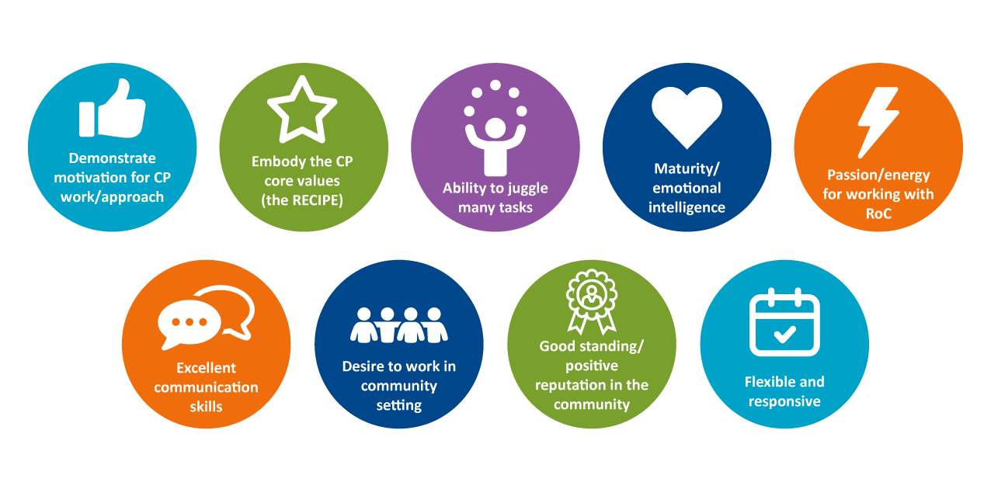
Core Competencies Critical for All CP Team Members
Notes:
Before we discuss specific team members and their qualifications and roles, we want to touch upon some critical and cross-cutting core competencies (or “soft skills.”)
As we have discussed, the core values (RECIPE) are key to the success of the CP model.
As such, it is essential that the CP staff recruited embody certain characteristics beyond just education/credentials and number of years of work experience.
These skills that are defined as soft skills are critical for every CP team member.

Slide 5
Why Are These Core Competencies Essential?
High performance expectations for case ID, treatment, linkage, and continuity of treatment
Busy/demanding environment
Team leader works independently and “wears many hats”
CHWs work full-time (in contrast to normal structure)
Earning the community’s trust is a key element of the model’s success
Understanding of community dynamics (especially among CHWs) is essential for identifying/engaging most at risk
Notes:
These are some of the reasons that these core competencies are so important.
High performance expectations: CP teams are accountable to meet ambitious targets around case ID, treatment, linkage, and continuity of treatment.
Earning the community’s trust is an important element of the model’s success; an effective team leader is viewed as the “health parent” of the community.
These Core Competencies (or soft skills) are essential for every role. Now we are going to discuss the roles and some of the unique skills of different team members.
It is important for the recruitment team to decipher which candidates – especially for the Team Leader and CHW positions – embody these unique characteristics.
Some characteristics are hard to gauge; in this session we will explore more in depth the critical skills for each member of the CP team.

Slide 6

Overview of Team Leader Roles
Manages the day-to-day operations of a CP
Provides leadership and oversight to all CP staff and ensures quality of patient care
Responsible for capacity building of the CP team and community leaders
As the only clinician at a CP, is responsible for patient care as well as sample collection, dispensing medication, and other pertinent administrative duties
Monitors and reports on drugs and supplies
Reviews, analyzes and presents CP data
Notes:
This slide summarizes the roles and responsibilities of the team leader (an example job description is included in the Participant Guide).
The team leader should be a licensed clinician or HIV nurse practitioner/ prescribing nurse with at least two years of experience in HIV service delivery.
The team leader has many roles; he/she is responsible for the day-to-day management of the CP; providing leadership and oversight to all CP staff; and ensuring quality of patient care.
As such, the Team Leader must be prepared for a fast-paced and stressful job in which they are responsible for taking on a diverse set of responsibilities; they may feel overwhelmed/exhausted and requires passion for the work.
Their role requires understanding of the theory behind the model and excitement about the goals and ambitious targets of the CP – the CP model should “move their heart”
As the only clinician at the site, he/she is responsible for all aspects of clinical care at the CP.
The team leader also has a number of roles in monitoring for supplies needed and client that have missed appointments.
They work closely with the data associate to conduct data analysis and present data for review meetings.
They also have an important role vis-à-vis the community.
Because of the importance of their role in interacting with the community; their management role in the CP; and the necessity to communicate with the parent facility, the team leader must have excellent relationship management skills.
Must enjoy engaging with people; a good Team Leader comes to be viewed by the community as a “health parent” or trusted resource.
Does not need to be an actual resident of the community, but should understand and be in good standing with the community.
More detailed information is available in the job description in the implementation guide.

Slide 7

Overview of Data Associate Role
Assists in the management and responsible for the accuracy and completeness of CP service data recorded in patient files, registers, and electronic databases and reporting of this data
Works with CP team leader to resolve questions, inconsistencies, or missing data and verifies accuracy to ensure documentation is correct, consistent, and complete
Generates all CP-level reports required to support daily activities and performance monitoring
Triangulates data in electronic database with pharmacy and laboratory records to ensure they are complete, correct, and up to date
Tracks summary data and source documents and assists in updating and preparation of summary reports
Ensures that all data tools are available at the CP
Notes:
This slide summarizes the key roles of the data associate (an example job description is included in the Participant Guide).
The data associate must have a diploma in computer science, social sciences, or related field with two years of experience working in M&E.
The data associate must have a diploma in computer science, social sciences, or a related field.
The data associate is overall responsible for the accuracy and completeness of CP service data in paper-based and electronic systems and reporting this data.
He/she works with the team leader to resolve any issues; triangulate data with pharmacy and lab records; and generates different types of reports to support performance monitoring.
More detailed information is available in the job description in the Participants Guide.

Slide 8

Overview of Psychosocial Counsellor Role
Oversees and conducts confidential HIV counselling service delivery to client at CP to support HIV testing uptake, continuity of treatment, and positive living
Collaborates closely with the CP team members to determine client follow up needs, and to support effective follow-up of index contacts in the community
Provides support supervision to CHWs in client counselling, follow-up, client visits, index, and elicitation, and oversees CHW data capture efforts
Brings passion and energy for delivering non-judgemental, high quality counselling and psychosocial support services to support clients’ care and treatment
Notes:
This slide summarizes the key roles of the psychosocial counselor (an example job description is included in the Participant Guide).
The psychosocial counsellor is required to have a certificate or diploma in psychosocial counselling or social work; two years of experience in a professional counselling role; and three plus years of experience in a management or supervisory position.
The psychosocial counselor must have a certificate or diploma in psychosocial counselling or social work along with the relevant experience described above.
He/she oversees and conducts confidential HIV counselling service delivery to client at CP to support HIV testing uptake, continuity of treatment, and positive living
The psychosocial counselor works closely with CP team members to determine client follow up needs, and to support effective follow-up of index contacts in the community and supports and supervises the four CHWs that work at a CP in client counselling, follow-up, client visits, index, and elicitation, and oversees their data capture activities.
More detailed information is available in the job description in the implementation guide.

Slide 9

Overview of CHW Role
Works collaboratively with other CHWs to create demand for and provide linkages to a range of HIV prevention and treatment services at the CP
Understands and applies targeted HIV testing approaches to identify and link community members to services, including children and adolescents and men
Oversees and supports client preliminary enrollment in the CP and facilitate referrals to parent health facility for client requiring additional services
Organizes/leads various activities to support demand creation, health education, and client continuity of treatment
Facilitates community-based referrals to the parent health facility for clients needing additional services
Notes:
This slide summarizes the key roles of CHWs (an example job description is included in the Participant Guide).
CHWs must be literate and have previously worked with client
Approximately 60% of recruited CHWs are already working as part of the CHW system (most on part time basis).
It is critical for CHWs to be “community smart:” understand trends and hot spots; know which individuals in the community are influential and how to utilize them; know when to use what language with client; and know when to pull certain strings.
Example: They must have an “ATM Card,” which is slang and refers to a Smartcare card. This is an example of community slang meant to reduce stigma.
CHWs must be well integrated within their community (e.g., not secluded) and have good standing/reputation in the community.
It is important for them to be passionate about serving the community; show empathy; and have the ability to handle challenging situations/solve problems.
Within the CP model, CHWs work full-time and receive a stipend.
It is recommended to have one CHW slot reserved for someone recommended by the local or faith leadership, and/or market chairperson. This enhances the partnership and contributes to successful demand creation for services.
Previous CHWs may also be able to make recommendations for potential candidates

Slide 10
Recruitment process
Adapt job descriptions for the 4 Community Post positions to fit your context (templates in Community Post Resource Packet)
Advertise positions at facility level to identify candidates from within the community
Consult with community and faith leaders to get recommendations for CHW staff
Conduct interviews and shortlist candidates
Consultation with CoH to review candidates and finalize staff selections
Notes:
Following this session, training participants will have a better understanding of the core competencies needed for the CP team positions.
The search for candidates is in practice mostly through “word of mouth.”
The selection process is very focused on personal attributes that embody the model as opposed to educational qualifications for example.
The usual process also involves recommendations from the staff already working in that district or parent facility.
The job postings are also posted in local churches and across the local communities, at the district office, and the parent facility for the sake of transparency.
Job description templates (provided in the Community Post Resource Packet) are used to create job postings for the four roles required to operate the CP.
With model scale up and an increasing number of sites, expectantly once the appropriate IP and district or parent site has undergone training, they should be able to select staff to be engaged in the CP. This promotes ownership of the CP as opposed to seeing it as a CRS/CoH CP. Appropriate mentors can be selected for success strategies.

Slide 11
Initial CP Team Training
Critical elements – RECIPE “secret sauce”
Customer care
Demand creation strategies
Service delivery
Community linkage and integration/patient support and follow up
Notes:
An initial (one-day) training/orientation occurs shortly after identification of the CP sites and recruitment of teams.
It convenes CP staff and parent facility staff, including HTS coordinators, M&E coordinators, lab technicians, and pharmacists.
The training covers select sessions of the Community Post Facilitator’s Guide, with emphasis on CP Core Values/RECIPE, Customer Care, Index Testing, and the Walk and Celebration Strategies.
CP teams and parent facility staff are trained on the points mentioned above.

Slide 12
On-site Mentorship
Use of risk screening tool
Index testing and contact elicitation
Data collection, use, and sharing
Troubleshooting various issues/challenges as they arise
Notes:
Following the initial training, the team leader/ clinician is allocated one trainer mentor clinician to work with them for at least one week after CP launch.
This trainer mentor is well-versed in the operational aspects of the CP model and provides mentorship around case identification, use of screening tool, index testing, and data collection/use/sharing.
The trainer mentor clinician also helps the CP team to troubleshoot problems as they arise.

Slide 13
Ongoing Capacity Building
Daily morning Pep Talks
Expert community health worker placement
Community post team meetings
Needs based technical and refresher training
Team leader meetings and performance reviews
Quarterly award ceremonies
Technical assistance visits
Community Post WhatsApp group
Notes:
This is a summary of ongoing CP capacity building efforts and includes ongoing training, mentorship and supportive supervision.
Ongoing capacity building:
Once the CPs are established, they receive various ongoing training, mentoring, and support supervision to help them deliver quality services in pursuit of epidemic control.
Trainings are typically organized by CP cluster, which are designated groups of CPs located in the same zone. Each cluster is comprised of approximately 5-6 CPs.
These are some examples of ongoing capacity building efforts.
Daily morning pep talks: Convene CP team members daily/ rotating topics covered around the Core Values/RECIPE. We will talk about these more in a moment.
Expert community health worker placement: Provide initial support to CP CHWs at outset to help them understand their roles and responsibilities and core values of the model
Monthly Saturday CP team meeting: Address concerns- focusing on making work a transformative experience for staff and clients.
Specific technical trainings based on identified needs: For example to train participants on updated national guidelines/ policies/ standards related to client care (2-3 times per year).
Quarterly Data Review Sessions: To review data and progress against starts among CP operating in a specific zone.
Quarterly Community Health Worker Trainings: To provide CHWs with refresher training on selected topics.
Monthly Team Leader Training: This is held in the context of the data review of the reports in the previous month. Any gaps identified in the CP operations are highlighted and these would include case identification, clinical (linkage to treatment), customer care (feedback), continuity of treatment, VL suppression results, index testing elicitation and yields, community relations, other partnerships relations such as MoH, CRS, CDC, other IPs etc. The barriers and RECIPE application are also discussed.
Quarterly Award Ceremonies: These are held every quarter as a celebration for a for affirmation, recognition, and appreciation event of all CP and facility staff. Up to 18 different categories can be acknowledged, including best case-finding CP, best RECIPE exhibiting CP and staff, best linkage CP, best customer care CP, best VL results, executive directors prize, best discipline staff, best innovative CP and staff, best index testing contribution, best index testing positivity yield, best clean CP, best continuity of treatment CP, best relation with local market leadership CP, best relationship with faith community CP, best overall positivity yield CP, best CP team leader selected by other team leaders, best CHW selected by other CHWs etc. All awards/gifts are non-monetary and would include wall clocks, duvas, blankets, dinner sets, etc.
Technical Assistance Visits: To observe functioning of SP operations and provided targeted support and troubleshooting of challenges.
Community Post WhatsApp group: To share progress of CP within a given area against daily performance indicators and for CPs to share successes and challenges that underlie the data and provide feedback to CP team on performance.

Slide 14
Morning Pep Talk
Daily meeting with entire CP team to share any new information, updates, guidelines, and policy changes
An element of the RECIPE is highlighted and reflected on each day for sustained daily inspiration and support
Includes CP team leaders, which inspires and encourages other members of the CP
Platform also coordinate's all HIV services continuum at the community level.
Notes:
The daily inspirational morning pep talk has been the bedrock for the success of CP model so we are going to discuss the morning pep talk in more detail.

Slide 15
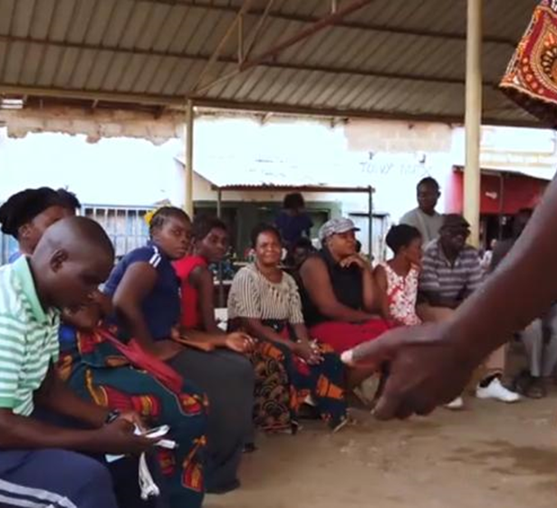
Components of the Morning PEP Talk
Updates and announcements
RECIPE/ inspiration element for the day
Clinical
Pharmacy
Lab
HTS
Data
Logistics
Notes:
These are the components of the morning meeting and a summary of different topics that could be discussed on a given day. (Refer to guidance in Participant Guide. Tool 6.7.)
Updates and announcements: This includes any emerging issues from the CPs in relation to utilities, security issues, community relationships – continuous leveraging of relationship capital, and the physical condition of the CP.
RECIPE- Each day there is a focus on one aspect of the recipe. Any element of the RECIPE is used to inspire & exalt.
Clinical-This encompasses case presentation, interesting cases, viral load issues, TB updates, paediatrics updates/ nutrition, clinical feedback – Innovation, and client – continuous community customer care
Pharmacy- This relates to discussion about supply of drugs; MMD/TLD transitioning; stocking of essential drugs; use of stock monitoring bin cards; frequent checks of expiry dates; and FIFO
Labs-collection of lab samples and results; ordering of daily requirements/ lab supplies; and ordering of daily activity registers
HTS: hot spots identification and mapping; index testing; elicitation of index contacts; continuity of treatment issues; and counselling – emerging issues
Logistics: transports allocation to the CPs; purchase and supply of cleaning materials; availability of folders and file clips

Slide 16
Thank You!
Notes:
Thank participants for their participation. See if there are any questions or comments.

