Slide 1

Module 5:
Community Scanning, Site Selection & Preparation
Notes:
Module 5 focuses on site scanning, selection & preparation in the CP model.
Consult the Community Mapping Process Guide in the Community Post Resource Packet for more detailed information on the process.

Slide 2
Module 5 Objectives
Describe the purpose and process of site scanning and selection
Explain the considerations when selecting the location and space for the functioning of a CP, including in rural areas
Understand attributes of a successful site scanning process
Explain the different aspects of site preparation
Describe the equipment necessary to set up a CP, including lab and pharmacy supplies
Understand role of parent facility lab and pharmacy in relation to a CP
Describe CP budget considerations
Notes:
Introduce Module 5 to participants and read aloud the module objectives.

Slide 3
Purpose of Site Scanning
To assess the most strategic locations/areas and structures (e.g., office spaces) within the target community to situate a CP
To gather information on potential faith organizations and other local resources to potentially support the functioning of the CP
To introduce the model to community leaders (e.g. civic/political leaders, clergy, market chairperson, etc.) and engage them in identifying strategic positioning of CP
Notes:
This slide summarizes the purpose of site scanning.
Site scanning is designed to narrow in on the most strategic place(s) for setting up a CP. The process utilizes data, inputs from the community, and direct observations to assess and select sites. The community engagement component is particularly essential for maintaining the Core Values (the RECIPE) of the model.

Slide 4
Area Selection Factors
High population density
Located within 1-2 km of a public health facility
Ongoing social, economic, and spiritual activities (markets, churches, busy residential areas)
Reasonable presence of men engaging in social and economic activities
Presence of local leadership structures and stakeholders (e.g. market executive committees, pastor fellowships, local development committees)
Presence of community hots spots (bars/taverns, lodges, football fields, markets, bus stops, night clubs, business offices, churches, large shops/grocery chains)
Presence of social networks (e.g., brothel rings, commercial sex workers)
Reasonable number of client's already living in that community (reverse mapping)
Notes:
This slide summarizes area selection factors.
Hot spots refer to places where there is a high concentration of populations/persons at high risk of HIV - e.g., truck drivers, sex workers, etc. and where potential CP clients who may needing testing can be accessed, in particular men.
For rural areas, weekly convergence trading areas are an area selection criteria
Reverse mapping can also be an area selection factor. This is when a parent facility has many ART client's from a particular community and infers that there are potentially a lot more people from that community who may have hindered access to HIV services at health facilities due to the barriers covered in Module 1 and who would benefit from easier ART access in a CP.

Slide 5
Step 1: Pre-Scanning
Pre-scanning is done by IP with parent facility staff or partner organization working with IP before entering the community
This process helps to identify the community(s) within a given zone/town that may be most strategic to set up a CP and place(s) to conduct the scanning activity
Involves compiling/triangulating the following information from individual facilities and districts/provinces on:
  HIV data (e.g., treatment coverage, interruptions in treatment, known status)
  Number of health facilities in the area
  Existence of possible hotspots and social networks in the area
Information can be gathered from statistical data; interviews with individuals familiar with an area; and visits to the community
Notes:
The pre-scanning process helps gather general information on possible areas to set up a CP in advance of the actual scanning.
This helps to focus the scanning in areas most appropriate for a CP (based on data, activity level, proximity to health facility, etc.)
For information gathering, interviews can include staff members.
Visits to the community can include incognito visits or evening drives.

Slide 6
Step 2: Team Formation
A technical site scanning team is assigned to carry out site scanning
The team includes:
  Program officers and leadership from IP (with at least one person conversant in the local language of the community)
  Community Leaders
  Parent facility staff, including in-charge (i.e., clinicians), HTS coordinator, ART coordinator, CHWs
Once team is formed, it identifies and works with a local person in the target community who understands the area (geographically and in terms of socio-cultural dynamics) and can walk with the site scanning team to assess different locations
Notes:
The involvement of community leaders is essential; it is important to make a connection with community leaders and convey that they are an important part of the site scanning process, and of the CP operation in general.
Getting community leaders to have a leadership role from inception serves the functioning of the CP in the long run (e.g., operational support, demand creation, etc.).
The involvement of community leaders in site scanning activity also provides critical insights and information regarding the community that CP teams and IPs must consider.
For example, this might include understanding certain sensitivities inherent in community dynamics and/or acquiring better understanding of specific terminologies used in a given community.

Slide 7
Step 3: Community Entry & Scanning
Prior to the community visit, relevant district authorities are informed about the plans for scanning
Upon arrival in the community, the technical team meets with the community leader identified
Together, they make courtesy calls to key community gatekeepers (e.g., ward committee chairperson, market leaders, etc.)
The team then conducts the scanning activity, walking through the community to assess different areas (based on site selection factors) and possible office spaces within those areas
Other community leaders (e.g., clergy) may also join the walk-through team, as needed, to inform selection of relevant sites
Notes:
It is critical to communicate with, and enlist and work with the community, and community leadership, through the whole process.
This slide summarizes key steps aimed at enlisting community leadership in the process.
Note that the specific details associated with this process will vary by context.

Slide 8
Step 4a: Site Selection
Easily accessed within the community scanned (e.g., near markets, bus stops, and residences where the people live)
Location ideally provides some privacy (e.g., avoid roadside locations)
Structure must blend into existing physical structures (no branding)
Structure must have a minimum space of 3.5m x 3.5m
Structure must have one or two large windows
Spaces that can be donated by the community (e.g., community halls or market committee offices) or spaces that can be rented from vulnerable groups (e.g., OVC caretaker) are preferred
For donated spaces, the CP can provide resources towards garbage collection, levies, sanitation, electricity, water, and other related fees
Notes:
This slide summarizes the qualities/characteristics upon which site selection should be based.
Site selection must strike a balance between the site being discrete (especially important for attracting men) and having some visibility to attract client's.
If there is no infrastructure of an appropriate size space, the CP can use two side-by-side spots.
Some of the necessary conditions can be created through small renovation (e.g. windows)
The typical rent for a CP (in the Zambia model) is USD$30-$50/month. However, one of the purposes of engaging community leaders is to explore the possibility of free or reduced rent. In these instances, the CP would make a contribution of some sort (e.g., garbage payment).

Slide 9
Step 4b: Site Selection (Rural Settings)
In rural areas, the selection and operation (e.g., days/hours of operation) of CPs is adapted to fit the needs of the given context
Rural CPs may be situated in a town in a rural area
Where there is not a big enough town, the CP could be operated as a mobile service during community market days (approx. 2-3x/week)
Civic spaces used for voting (e.g., schools, local council rooms) may also be viable for setting up a CP
Engagement of local authorities or health facilities is equally important in selecting appropriate rural sites for CPs
Notes:
The majority of CPs established to date have been in urban/peri-urban areas.
IPs are continuing to learn about the site selection process and demand creation of CP in rural locations.
Criteria for rural setting CP is evolving.

Slide 10
Step 5: Making the Decision
Following the scanning, the team returns
Field report is submitted to management (of the implementing partner)
Management and site scanning team review field report together
Depending on the findings, they agree on whether the location and existing infrastructure are appropriate/ conducive to setting up a CP
Notes:
The day after the community scanning, the site scanning team reconvenes to decide on the location(s) to establish the CP.

Slide 11
Attributes of a Successful Site Scanning Process
Timely and thorough pre-scanning efforts to narrow in on specific community(ies) within an identified zone/town
Efficient planning and preparation of community walk, including timely engagement of stakeholders and logistics
Active involvement of community leaders/stakeholders on the day of the walk through
Negotiation with potential landlords for rooms earmarked for selection
Use of local active clients for their impression of the viability of CP
Notes:
This is a summary of the characteristics of a successful site scanning process.
Efficient planning of community walk through logistics refers to notifying local stakeholders, such as health and local government authorities, local leaders) in advance of the walk through.

Slide 12
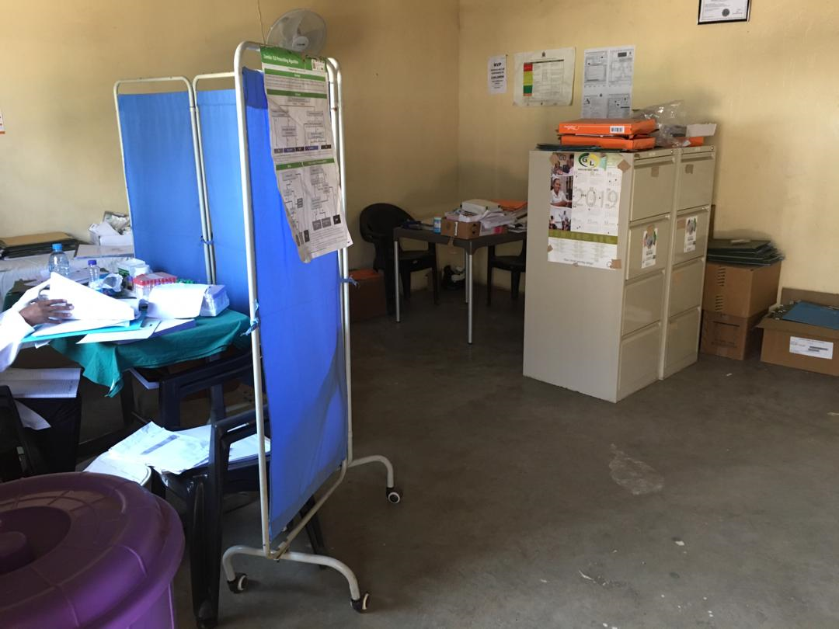
Step 6: Site Preparation
Maintenance/refitting of office space selected for Community Post is done immediately after the scanning and payment to secure the site
Community Posts are painted in a light color (e.g. cream)
Adequate electrical lighting is installed and sockets for M&E laptops
Install lock on Community Post door (and possibly install grill doors) for security (local community leader – e.g., market chairperson – keeps keys for Community Post)
Minimal branding – Community Post must fit the community profile and should not stand out, to avoid stigmatization
Notes:
After the scanning and area selection, office space is selected (criteria described in previous session); This space is then transformed into a CP.
While some refurbishment may be required, it is important that the CP blend well within the setting,and should not be extra-ordinary or stand out. This discreteness and community feel is part of the draw for client's.
In addition to the preparation, the ongoing maintenance/upkeep and cleanliness of the site is critical and integral to good customer care.
Note that ensuring internet connectivity is not part of site preparation as given the poor communication infrastructure in most community settings. To compensate the data associate uses external storage devices to transfer data and merge with the parent facility server.
Note: Refer to Community Post Infrastructure Requirements & Features Checklist in the Community Post Resource Packet for more information.

Slide 13
Materials
Laptop for capturing data
Two screens to ensure confidentiality
Filing cabinets to store patient records
Three (3) tables – M&E, Counsellor and Clinician
Eight (8) chairs (basic)
One (1) waiting bench
Hand washing basin and hand wash – Infection control
Disinfectants for infection control
Stationary – clinical forms, registers, suspension files, etc.
Cooler boxes for blood sample collection
Wall fans for proper circulation
Water buckets with tap
Small fridge (if there is electricity)
Examination table
Additional COVID-19 infection control as appropriate: masks; thermometer, etc.
Notes:
This is a minimum list of material supplies needed in each CP.
Ideally a CP will have an examination table, but in reality most CPs don’t have an examination table due to space limitations.
Note: Please refer to the Community Post Basic Equipment Checklist in the Community Post Resource Packet for more information.

Slide 14
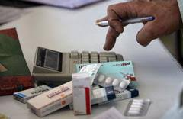
Lab and Pharmacy Supplies
Lab Supplies: HIV testing kits (Determine & Bioline) and consumables (EDTA, red top containers, methylated, vacutainer needles and holders, syringes, cotton wool, etc.)
Pharmacy supplies include ARVs and OIs drugs
Drug supplies are recorded in Electronic Management Information Systems (ELMIS)
ARVs are reordered every 2-3 months (by parent facilities

Slide 15
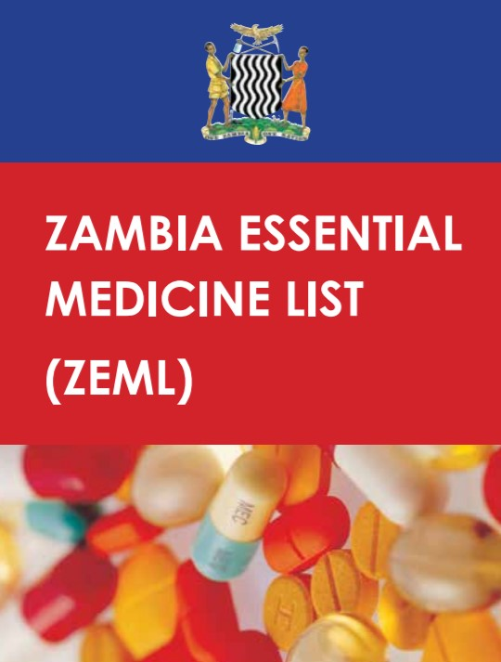
Pharmacy
ARVs
Cotrimoxazole
Isoniazid and Vitamin B6
Basic essential medicines:
  Paracetamol
  Ibuprofen
  Amoxicillin
  Metronidazole
  Doxycycline
  Ciprofloxacin
  Deworming
  Injectable Penicillin
Notes:
Note: Facilitator please adapt this information to context.
This slide shows the pharmacy supplies that are stocked at CPs.
Drug supplies are recorded in an Electronic Management Information Systems (ELMIS).
Drug supply chain is overseen by parent health facilities and ARVs are reordered every 2-3 months.
Pharmacy supplies are ordered through government pipelines (MSL) and District Hub (Kalingalinga).
CP Team Leaders collect pharmacy supplies daily from parent facility; quantities based on Daily CP Activity Registers.
Drug distribution considers/ takes into account daily targets and consumption patterns
When there are MSL stockouts or delayed order processing, the pharmacy team regularly be in touch with other facilities’ pharmacies within the sub-district.
The pharmacy ensures quality management of ARV’s at CP through weekly checks.

Slide 16
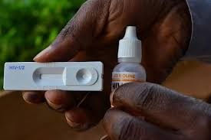
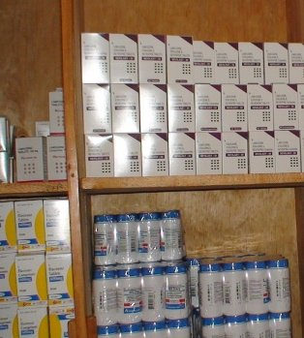
Role of the Parent Facility Pharmacy and Lab
Oversees supply chain management for CP
Supplies drugs to CP through the government structures
Forms main storage facility for the CP as they may not have conducive storage
Some supplies maybe stored at CPs
Drug quantification & distribution
Drug redistribution in case of stock-outs or delayed order processing
Image: Lusaka Times
Notes:
Parent health facility pharmacy oversees supply chain management for CP (medications, lab supplies)
Pharmacy supplies are ordered through government pipelines
CP team leader collects pharmacy supplies daily during morning Pep Talk at the parent facility
Pharmacy supplies should not be stored at CPs due to controlled temperatures
Drug distribution quantities to CPs are based on daily activity registers and daily targets and consumption patterns (expected ART refills)
In case of stock-outs or delayed order processing, the pharmacy team must be regularly be in touch with other facility pharmacies within the sub-district
Pharmacy ensures quality management of ARVs at CPs through weekly checks
Note to Facilitator: Please adapt this slide to the context.
This slide provides an overview of the role of the parent with regards to supply chain of laboratory and pharmacy supplies and commodities to the CP.

Slide 17
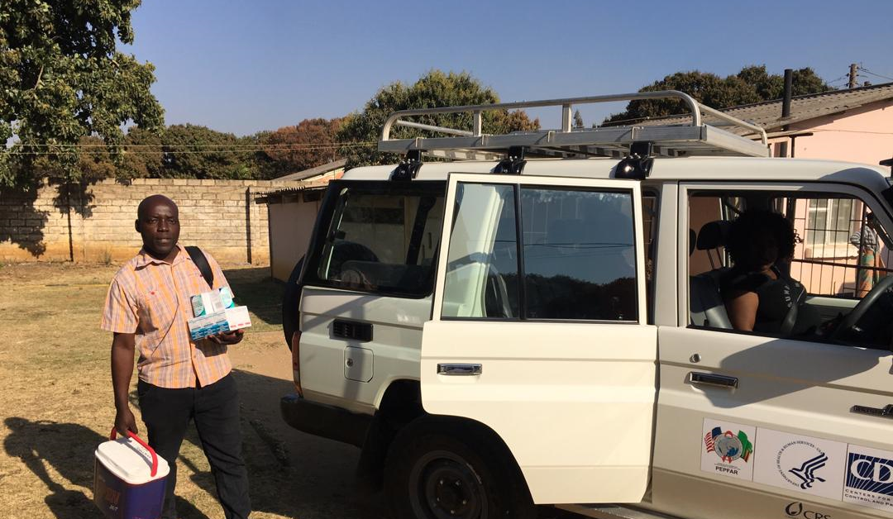
CP Team Leader collects CP supplies from parent facility
Notes:
The CP Team Leader collects lab and pharmacy supplies during daily Morning Pep Talks that are conducted at the parent health facility.
The vehicle is also used to to bring CP staff from the parents facility to the CP.
The vehicle is also used for sample transportation form the CP to the parents facility laboratory.
Vehicles are used to take CHWs to the community for patients follow up, in particular contact elicitation and index case testing, as well as patients referral to the parents facility if necessary.

Slide 18
Budget Considerations
Two-to-three scans for CP site selection fuel and other transportation costs) ($30/ trip)
Two-to-three meetings with stakeholders, community leaders, and health workers for their input ($25/meeting)
Market and facility contribution (monthly rental) for CP ($80/month)
HRH salaries (one clinical officer and/or nurse prescriber ($1,100/month); one lay counsellor ($500/month); four community health workers ($150/month/each)
Community post site renovation ($500)
Furniture and medical supply costs for initial setup, including tables, chairs, benches, BP machines, scales (adult & pediatric), screens, stethoscopes, thermometers, curtains, consumables for 12 months ($2,000)

Slide 19
Budget Considerations (continued)
Monthly fuel ($500)
Support for HTS and continuity of treatment outreach activities, including T-shirts, banners, "I know my status" pins, backpacks, umbrellas, bicycles, and boots ($750/ year)
Recurrent costs for HTS and continuity of treatment outreach activities, including transport refunds, fuel, community sensitization, lunch for staff for each HTS point ($1,200/ year)
Timers for HTS ($15/each)
HTS SOPs: Job aids, Policy, Registers and other printed material ($30/ year)
Mobile hot spot testing pack, including standard testing supplies ($400/year)

Slide 20
Thank You!
Notes:
Thank participants for their participation. See if there are any questions or comments.

