Slide 1

Module 3:
Customer Care in the Community Post Model
Notes:
Module 3 focuses on customer care in the CP model, which is critical to the success of the CP.

Slide 2
Module 3 Objectives
Define customer care and its importance to the success of the CP model
Describe how poor customer care drives clients to exit services
Explain how customer care is put into action
Summarize critical competencies of customer care
Understand how to integrate customer care in staff training, coaching & mentoring
Describe communication tips for better customer care
Describe how health providers can overcome personal stigma that affects customer care
Describe how to sustain and monitor customer care
Notes:
Introduce Module 3 to participants and read aloud the module objectives.

Slide 3
What is Customer Care?
The client's experience in interacting with service providers and health service delivery overall
Involves the provision of care to the client, looking at the whole person, and providing services in the right way, in a timely manner, and according to approved protocols/standards
A process of looking after customers to ensure their satisfaction
Practiced throughout the continuum of care from the community to the facility where it is amplified and re-enforced
More powerful than any marketing strategy – your client hear even what you have not said!
Notes:
Customer care is a practice that entails looking after the whole client.
Customer care is also a goal, process and outcome.
Customer care is not a one off; it starts in community, extends to the health service, and is sustained in community.
Our health services exist because of clients; all that we do must keep clients at the center.

Slide 4
Reasons Clients Leave Services
Data Source: CIDRZ ACHIEVE Project - RAPID APPRAISAL ON REASONS FOR ‘Silent transfers’ in Lusaka Urban District
Notes:
Now we are going to talk about the importance of customer care in achieving epidemic control.
Note that this slide is an example of data to be presented. FOR PRESENTATION, THIS SLIDE SHOULD BE SKIPPED [HIDDEN] AND THE FACILITATOR SHOULD FILL IN RELEVANT DATA FOR THEIR COUNTRY/DISTRICT CONTEXT USING THE NEXT SLIDE. THE NEXT SLIDE CONTAINS A TEMPLATE FOR RECREATING THIS SLIDE WITH LOCALLY APPROPRATE DATA.
According to OBSERVATIONS from Circle of Hope (please specify data source), each year organizations lose 15% of client due to interruption in treatment (previously called loss to follow up)
This pie chart shows the different reasons that clients leave services.
The 68% of client that left for rude/discourteous behavior in this slide represent clients that have moved to other providers without mention or a formal transfer request primarily because their reason for leaving has to do with a staff attitudes that reflect poor customer care.
Competitive reasons include flexibility in terms of opening times and days, proximity to CP or facility to large communities, and friendly and welcoming environment etc.

Slide 5
[Template:] Reasons Clients Leave Services
Each year, 15% of customers do not return to services and interrupt their treatment (Interruption in Treatment)
Notes:
To adapt this slide to your context and include local data: Open in Desktop App, right click on graph, then edit data. This will bring you to excel where you can enter your local data.

Slide 6
Poor Customer Care Drives Clients to Exit
Clients switch to other service providers because of poor or indifferent customer service (known as “silent transfers”)
Silently transferring client switch providers because of a specific customer service issue
Clients never stop comparing providers
Clients are looking for satisfaction and a positive client and transformative experience at each visit

Slide 7
A Satisfied Client
Helps build the image, brand, and reputation of a facility and of a Ministry
Is a natural repeat client
Adheres to treatment and visits
Progresses along the HIV Cascade continuum of care of the 95-95-95
Is the best marketer and advert for others to see and experience
Is a potential attracter of funding and partnerships

Slide 8
Remember our RECIPE?
Community Posts in Zambia have an ART retention rate of 94.1%
Responsibility
Empathy
Compassion
Integrity
Passion
Ethical

Slide 9
Customer Care is Critical to our RECIPE
CPs exist to serve clients
Clients must be at the centre of CP programming and activities
Helps CP staff take RESPONSIBILITY for the entire wellbeing of clients (i.e., psychosocial, clinical, mental health wellbeing etc.)
It re-enforces EMPATHY towards clients
It brings alive the COMPASSION to serve
It affirms the resolve to serve with INTEGRITY
It helps ignite and maintain PASSION to serve due to positive client feedback
It ensures serving ETHICALLY within norms
Notes:
Customer care is the most critical component of the RECIPE/core values.
Client must be at the center of all CP programming and activities.
Ensuring customer care reinforces all of the core values in the RECIPE as described in the slide.

Slide 10
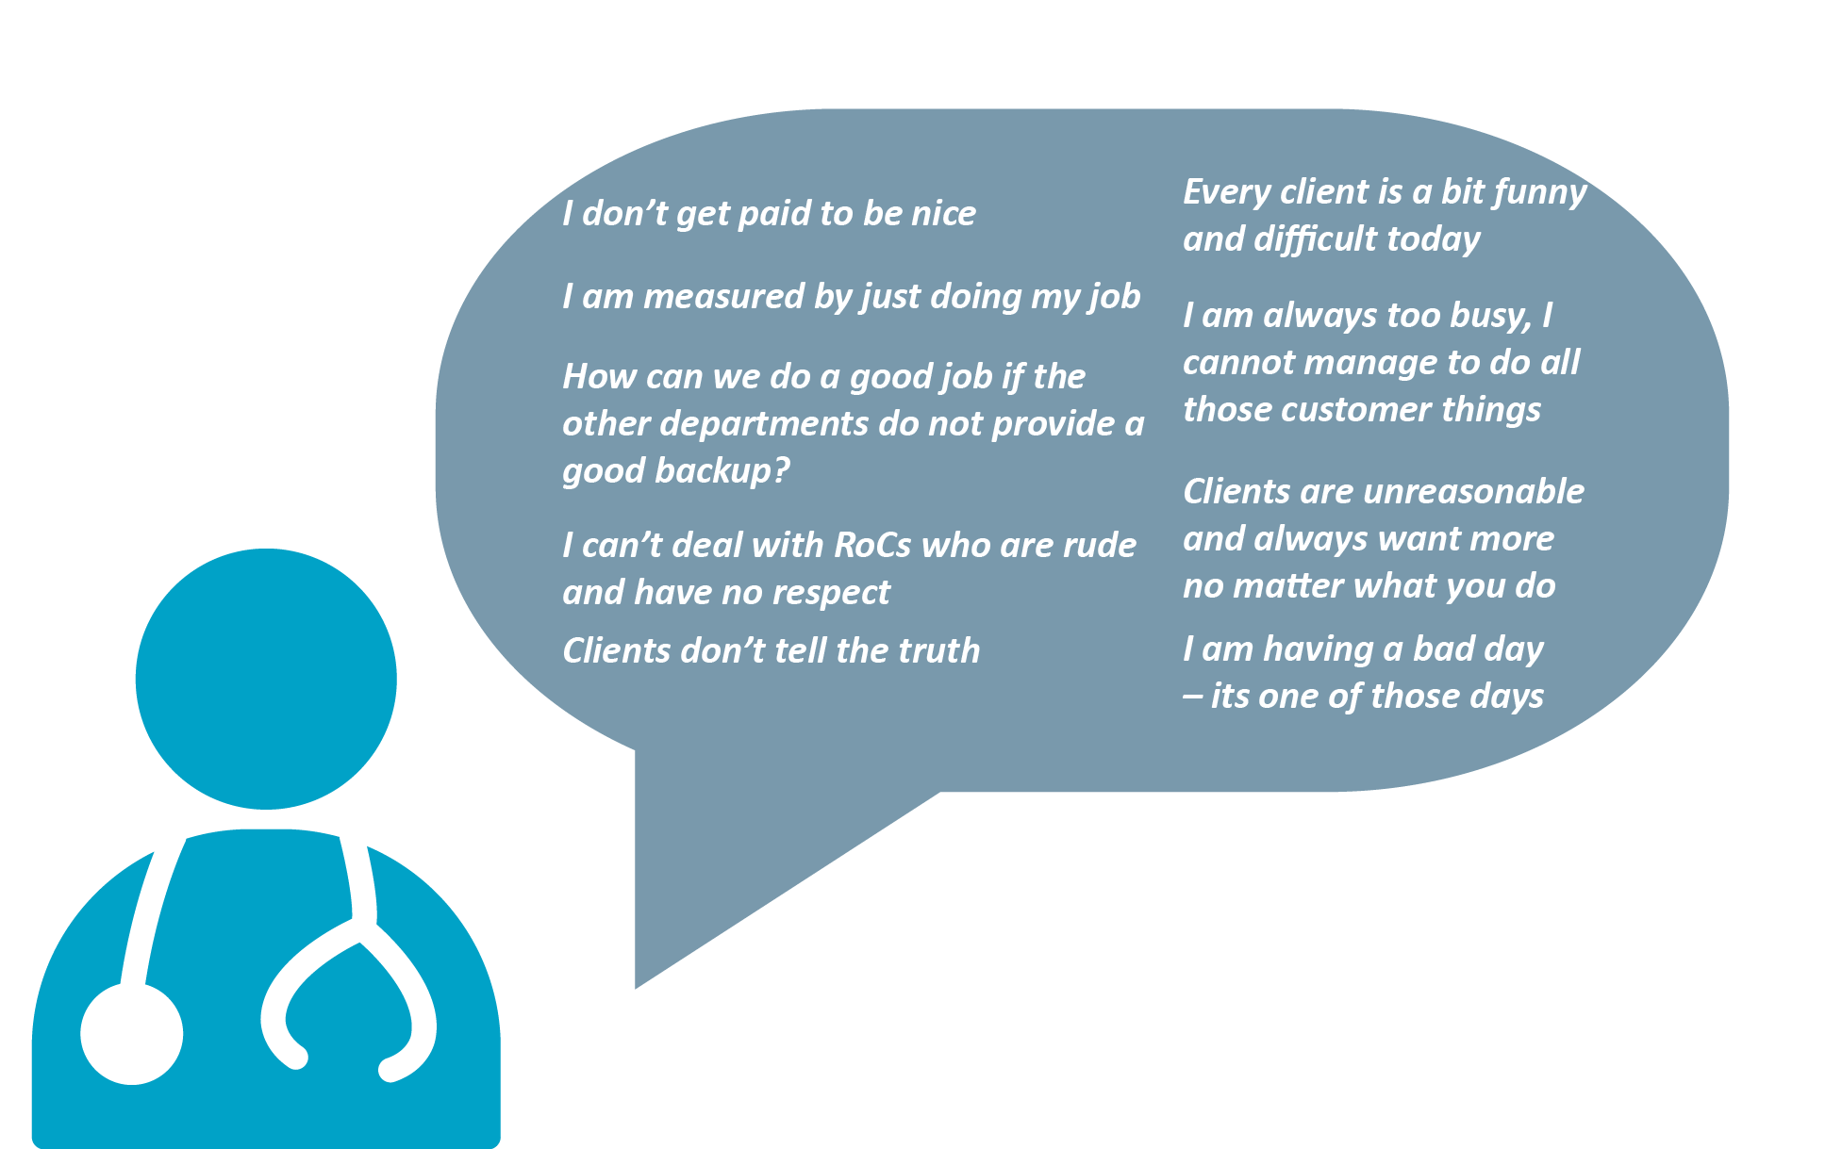
Health Care Provider Excuses for Poor Customer Care
Notes:
These are some additional examples of health care provider excuses for poor customer care.
Read aloud a few more of the examples that may not have been mentioned by the group in the discussion with the previous slide.

Slide 11
Delivering Customer Care
Essential for management and leadership to model customer care in the way they manage and lead CP staff
CP staff provide customer care for:
  New client (e.g., Walk Strategy, Welcome Strategy)
  Existing client (affirming, celebrating, caring, and supporting)
New ideas for customer care are generated through:
  Encouraging staff to generate ideas about customer care improvements
  Promoting creativity and innovation around customer care
Notes:
Now we are going to discuss how customer care is put into action.
Customer care requires thinking about specific needs of different sub-populations.
First, it is important that management and leadership care for CP staff as this affects their motivation and in turn how CP staff treat client.
CP staff provide customer care to new client through the Walk and Welcome Strategies and existing client through the core values and affirming, celebrating, caring for and supporting them.
This slide also shows how new ideas for customer care are generated by encouraging staff to generate new ideas and promote creativity and innovation around customer care by providing an innovation award to staff that bring good ideas.

Slide 12
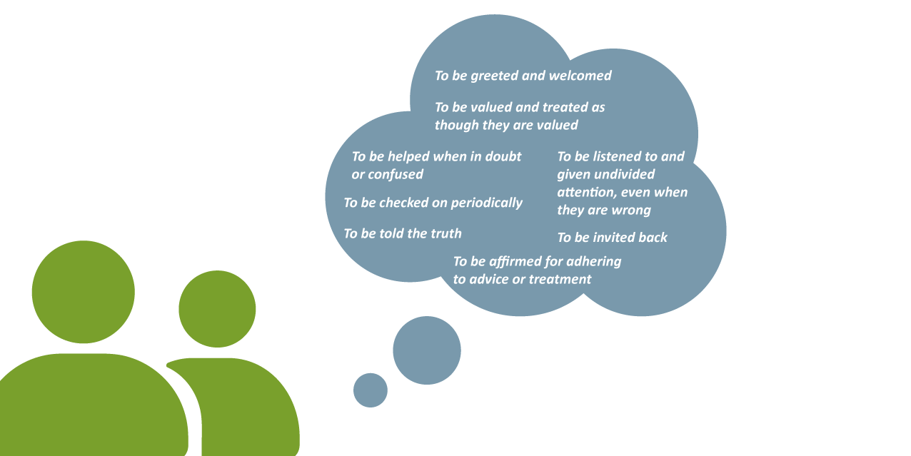
Understanding What Clients Want
Notes:
This slide provides some general feedback on what client want and expect from services in relation to customer care.
Ask participants if they can think of additional examples and drawing on Activity 1 of this module where participants shared what a service provider said/did to make you feel good or bad.
Discussion prompts:
What do you want when you go to get a health service?
What makes you feel comfortable and open to going back?

Slide 13
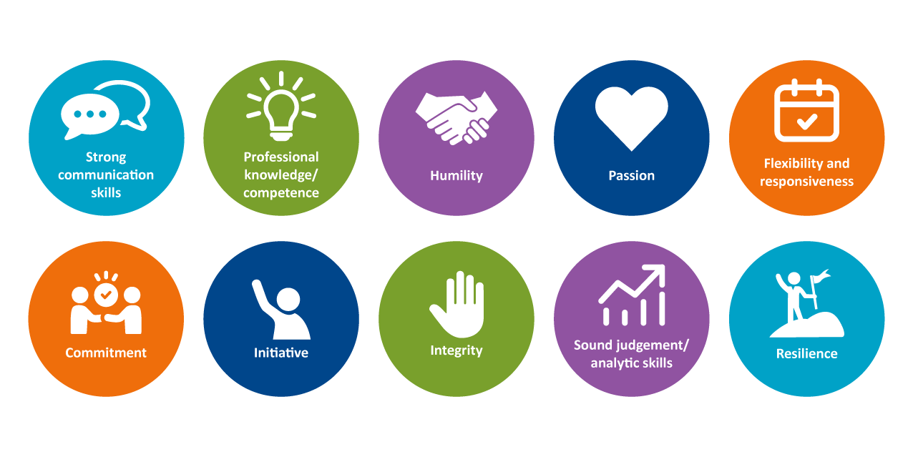
Critical Competencies of Customer Care
Notes:
This slide shows the critical competencies of customer care.
Recognize that clients may be coming from difficult situations (e.g., health, family, work). It can be devastating for clients to then receive poor care.
Strong communication skills means good listening (not interrupting)and persuasive communication.
Professional knowledge/ competence refers to mastering your area of expertise and showing clients that you know what you are doing. If a client asks a question you cannot answer, demonstrate that you are part of larger support network. This is valuable to the client. You can call and consult with superiors to ensure you provide correct information.
Humility means having the willingness to consult peers or superiors on difficult matters and being sensitive to clients’ needs).
Passion refers to having the motivation to bring positive change for clients. Each client deserves undivided attention.
Flexibility and responsiveness alludes to not being rigid/ being openness to new ways of doing things to be responsive to client needs. It also refers to not having a silo mentality.
Commitment means commitment to client follow up through calls or home visits.
Initiative refers to CP staff undertaking the appropriate planning of tasks and learning to innovate.
Integrity in this context means that words and deeds must collide, conform, and adhere to set norms.
Sound judgement and analytic skills is thinking on your feet thinking
Resilience means not giving up easily!
Possible Discussion Questions/Points:
How have you seen customer care in action and what outcomes did it lead to?
Why do you think these competency areas are important?

Slide 14
Staff Training, Coaching & Mentoring
Encourage staff to always strive to go above and beyond in client interactions and care
Conduct basic and quarterly training on customer care (e.g., workshops, unit discussions, meetings)
Educate staff on the entire patient experience (reception to pharmacy) and importance of every step in the care process
Teach staff how to obtain honest feedback from clients (e.g., side effects)
Teach staff how to identify and analyse client problems
Engage staff to develop and cultivate healthy, worthwhile client relationships
Ensure staff learn two things about clients daily and document
Notes:
This slide summarizes capacity building efforts and strategies used to reinforce customer care in the CP model.
CP staff are trained quarterly on customer care, with rotating focal areas, and training is coupled with mentorship in the field conducted by IP.
Focal areas would include customer care in the following areas: case finding, linkage, index, continuity of treatment, VL, new clients, existing clients, community leaders, faith community, MoH, other IPs, and partners (all these stakeholders must experience transformative customer care from the CP)
Training cultivates ownership of customer care in all team members (e.g., CHWs, implementing partner staff, other stakeholders delivering technical support, etc.).
It is critical for everyone at the CP to provide good customer care (from the security guard to the clinician). And no one member of the team is more important than the others.
Unhealthy competition within teams or departments is detrimental to customer care; it is therefore critical to help teams see themselves as contributing to the patients experience and thus their outcomes.
Clients are encouraged to let CP staff know how things are going and CP staff are trained to address client feedback.
Daily Pep Talks and monthly data review meetings are used to discuss specific gaps in customer care identified through patient and partner feedback.

Slide 15
Communication Tips for Providers
Practice two-way, active listening with clients and staff
Dress code appropriate for the setting and community environment; need to be relatable to clients
Minimise the use of medical jargon and acronyms
Learn the art of listening to clients
Never raise your voice to a defaulting client, rather listen and counsel
Use varied means of communicating (i.e. texts, phone, visits, gestures, tokens (priority cards in which elderly and children are served first)
Use local language, as appropriate, and even slang to facilitate understanding by client
Notes:
This slide provides an overview of some of the key communication tips that are shared with providers for delivery of good customer care in training and mentoring.
Most of these points are self-explanatory, but I am just going to provide a few more details.
For two-way communication with clients and staff, this means having good listening skills and avoiding lecturing; never use an aggressive tone or raise your voice.
For the art of listening, allow clients to fully explain concerns/issues without interruption.
Show empathy to defaulters.
Try to break down language and use local slang when interacting with clients and community members

Slide 16
Overcoming Stigma
Personal stigma impacts our treatment of clients and affects Customer Care
Overcoming stigma means…. ​
  Accepting love from God or authority figure
  Accepting forgiveness​ from God or authority figure
  Learning to love yourself​ and accept yourself as you are
  Learning to forgive yourself​ and past mistakes or baggage
  Learning to love others​ now that you love yourself
  Deploying self-leadership – this enables you to accept others as you would accept yourself and manage self. You cannot love your neighbor as yourself if you don’t love yourself.​
Notes:
Personal stigma impacts our treatment of clients and affects Customer Care
Overcoming stigma means…. ​
Accepting love from God or authority figure (e.g., God, society, parents) ​
Accepting forgiveness​ from God or authority figure (e.g., God, society, parents) ​
Learning to love yourself​ and accept yourself as you are
Learning to forgive yourself​ and past mistakes or baggage
Learning to love others​ now that you love yourself
Deploying self leadership – this enables you to accept others as you would accept yourself and manage self. You cannot love your neighbor as yourself if you don’t love yourself.​
Possible Discussion Questions:
Can you share your experience of how you have seen stigma affect customer care?
Can you share some examples of how you overcome personal stigma as a human being?

Slide 17
How Do We Sustain Customer Care?
Developing customer care competencies to reinforce the core values in the RECIPE
Conveying messages that CP staff are here to help client and client feedback is valued
Capturing and sharing customer feedback with employees/ supervisors
Recognizing and affirming staff and managers that deliver good customer care
Create environment where staff have authority to act on good attitude
Make customer care consistent across parent facility and CP
Notes:
Once a CP has established good customer care, it is critical to sustain it.
This slide provides a summary of some strategies to sustain good customer care.
The mission statement in the CP model is the RECIPE.
Posters and signs may be used to convey messages that CP staff are here to help clients and client feedback is valued.
Customer feedback can be shared through different mechanisms such as internal newsletters, WhatsApp groups, quarterly staff review meetings, Daily Pep Talks, etc.). Client survey results should be posted and shared with all CP staff.
Having suggestion boxes and encouraging their use show client that their feedback is valued.
It is important for teams to recognize how quality of care at each stage helps the next provider to do their job better (e.g., a misdiagnosis by clinician effects work of pharmacist).
It is important to get teams to celebrate one another.
Examples of ways to affirm staff that perform good customer care include quarterly/semi-annual motivational awards and incentives.
Quarterly data review meetings, that include CP staff with their respective parent facility staff, help establish consistency between CP and parent facilities. These meetings involve discussion of all performance issues, including customer care.
Faith and community leaders are trained on supporting and sustaining customer care; they are taught to value their constituents with emphasis on the RECIPE as a bedrock for customer care.

Slide 18
Monitoring Customer Care
Establish deliberate monitoring system to gauge level of customer care:
Use information from feedback loops to discuss the reality and address specific and common issues related to client care
  Ongoing exit interviews for clients transferring out, lost to follow up, and defaulting, as well as staff leaving
  Entry interviews for clients transferring in, staff wanting to join a CP, and stakeholders wanting to partner
  Suggestion boxes within and outside the facility
  Walk-throughs during site supervision
  In daily pep talks and other interactions, such as daily performance digital platforms, to continuously encourage positive staff attitudes
  Provide coaching and mentorship to build skills of CP staff to address gaps in customer care identified through feedback
  Adapt the operating environment in response to feedback to continuously improve customer care
Notes:
This slide provides an overview of monitoring customer care in more depth and how information from monitoring customer care is used.
The CP model has in place a monitoring system, which collects feedback through exit interviews, entry interviews, suggestion boxes, and walk throughs (refer to resources in Participant Guide).
The walk-throughs during supportive supervision highlight key points around customer care and include random interviews with clients; staff at CPs, parent facilities, community faith partners, and local leadership
The information collected from feedback loops is used in daily Pep Talks and digital platforms; mentoring and coaching; and in adaptation of the operating environment.

Slide 19
Remember:
Customer Care & RECIPE are Key to
Epidemic Control
Notes:
In closing, it is critical to note that customer care is essential to the RECIPE core values; achieving 95-95-95 targets, and ultimately to achieve epidemic control.

