Slide 1

Module 2:
Core Values & Principles
(The RECIPE)
Notes:
Module 2 focuses on the core values and principles of the CP model, known as the RECIPE.

Slide 2
Module 2 Objectives
Describe each component of the core values of the CP model-the RECIPE and how it contributes to the success of the CP model
Demonstrate how to implement the RECIPE values in the CP model
Notes:
Introduce Module 2 to participants and read aloud the module objectives.

Slide 3
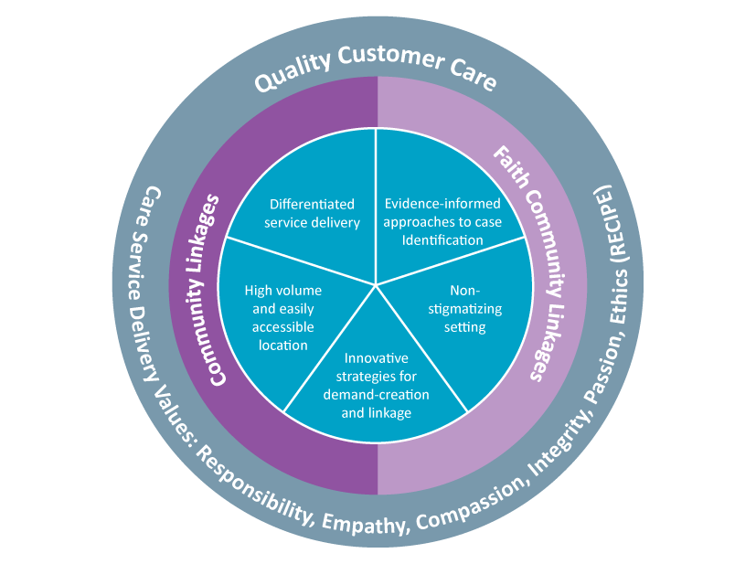
Core Values: The RECIPE
R esponsibility
E mpathy
C ompassion
I ntegrity
P assion
E thical
Notes:
The core values are a critical component of operating the CP and underpin its success. Each person involved in setting up, operating, and supporting the CP needs to understand the core values and embody them in their daily work.
The Core Values are captured in ‘the RECIPE.’ Each letter of the word RECIPE represents a different core value that guides the work of Community Post teams. Using this framework helps teams become familiarized and take ownership of the values we have found are most important.
Who is Responsible for Promoting the Values?
Everyone involved in operating and supporting the CP should be introduced to and embody the core values – from the security guard, to the health providers, to the community, and faith leaders supporting the operation of the CP.
How are the Values Implemented within the Model?
This RECIPE is used to guide and motivate CP teams. Each morning at a PEP talk, teams are reminded of the importance of core values for their daily work. Each Pep Talk features focus on a specific component of the RECIPE (e.g., Monday is responsibility, Tuesday empathy, etc.).

Slide 4
Responsibility
Responsibility barriers that limit HIV service delivery:
  Blaming
  Excuses
  Self-acquittal
  Indecision/delayed decision making
  Deferment
Responsibility means collective understanding and ownership of challenges/problems
Instilling CP teams with responsibility leads to collective action to address the problem
Examples...
Notes:
As stakeholders address shortfalls in HIV service delivery, there is a tendency to blame others.
The success of the CP model relies on ending the “blame game” and requires that different stakeholders work together and take collective responsibility and not blaming others for problems that exist.
Everyone has a shared responsibility in improving and delivering quality services. Responsibility involves taking stock of the challenges/gaps faced in delivering efficient HIV services (e.g., challenges in case identification, linkage, continuity of treatment and VLS), owning the problem, and working collectively with other stakeholders to address the problem.
To improve service delivery, it is critical to understand the current problems/challenges at all levels (from the donor, to implementing partners, to facilities to communities). Stakeholders at all levels must then own these problems collectively and work in collaborative ways to address them.
Examples of Responsibility in Action:
Ask participants if they can think of an example of responsibility in action?
There is a stockout of needed supplies in your CP. Instead of blaming the pharmacy, you help identify a temporary solution so clients don’t miss their doses while communicating with relevant stakeholders to address the stockout.

Slide 5
Empathy
Understand the social, economic, psychological, and health factors affecting each client’s needs and care plans
Put yourself in the situation of the client and deliver services accordingly
Eliminate entitlement mentality among staff at all levels
Remember – it is an honor to serve another being!
Examples...
Notes:
In some parts of the health sector, there has been desensitization around HIV.
In some instances, health workers may not have an empathic approach to their work.
For the CP model to work effectively, it is important that health workers bring an empathetic approach to each client.
Each member of the CP team must try to walk in the client’s shoes to understand and reflect on what kind of care they need.
It is important to try to understand the client’s social, economic, psychologic, and clinical health needs.
Remember that it is an honor to be able to serve another human being!
Examples of Empathy in Action:
Ask participants if they can think of an example of empathy in action?
A client looks pre-occupied during their appointment. Take a moment to ask the client how they are doing today and if there is anything you can do to help address any of their concerns. Listen to their individual concerns and work with them to address them.

Slide 6
Compassion
Empathy put into action
Doing something about how you feel about someone else’s situation
The active force needed to execute positive change in HIV epidemic control
Helps leaders to roll up their sleeves and support “field soldiers”
Moves providers to think outside of the box in terms of new strategies for case finding, linkage and continuity of treatment
Examples...
Notes:
Compassion is empathy in action; the active force needed to execute positive change in HIV service delivery.
Compassion means being proactive about helping someone with their challenges and responding to their needs.
This requires thinking about not only the clinical needs of clients, but also the emotional and psychological aspects.
Compassion helps drive innovation and helps advance a collective mandate for service delivery.
Examples of Compassion in Action:
Ask participants if they can think of an example of compassion in action?
Taking the time to sit with a client to help them strategize how they can disclose their HIV status to their partner

Slide 7
Integrity
Bringing honesty and strong moral principles to the work you do each day
Ensure clients are treated appropriately/according to care standards across all areas of service, regardless of their situations
Integrity is important for strengthening/attracting partnerships
Examples...
Notes:
Integrity is the practice of being honest and showing a consistent and uncompromising adherence to strong moral and ethical principles and values.
It is key to observe integrity in all areas of service.
Examples of integrity in action:
Ask participants if they can think of an example of integrity in action?
When you agree with a client that you will follow up with them (by phone/home visit), you follow through and do as you say.

Slide 8
Passion
Energy to serve for the good of others
Energy to serve with undivided attention to client
Energy for sustained quality performance
Energy to overcome new barriers and challenges
Energy to love unconditionally
Energy to celebrate and affirm others (e.g., clients, colleagues)
Energy to innovate
Examples...
Notes:
We have been fighting HIV for a long time and we may not bring the same energy that we did in earlier days.
Reinvigorating our passion to serve clients is critical to the success of the CP model.
CP teams can demonstrate passion through the energy they bring to their work on a daily basis, including energy to serve for the good of others, serve clients with your undivided attention, overcome new barriers and challenges, and to sustain a high level of performance.
This kind of passion is key to successfully engaging and retaining client within HIV services.
Passion can help establish a social contract between health workers and client that makes providing care easier and more effective.
Examples of Passion in Action:
Ask participants if they can think of an example of integrity in action?
Following up with clients by text or phone to find out if they are having challenges with their treatment
Taking time to listen to client’s problems/concerns, even when you have had a long day

Slide 9
Ethics
Adhering to quality-of-care standards (e.g. confidentiality)
Showing total regard/respect for client
Eliminating shortcuts
Examples...
Notes:
It is critical to respect and follow all guidelines pertaining to service delivery without taking any shortcuts. This means enforcing confidentiality. Having a high level of respect for clients and your co-workers.
Examples of Ethics in Action:
Ask participants if they can think of examples of ethics in action?
Respecting client confidentiality
Declining to discuss client's private information when asked by someone in the community
Ensuring the CP space is set up to provide privacy/confidentiality
Reporting wrong-doing that affects the quality of the CP

Slide 10
Thank You!
Notes:
Thank participants for their participation. See if there are any questions or comments.

