Slide 1

Module 10: Monitoring and Data Use for Program Improvement in the Community Post Model
Notes:
This presentations focuses on:
The critical role of daily monitoring in CP performance, and how it is done, in particular the role, logistics and responsibilities of the data associate
Key performance indicators for the CP and performance expectations for these key indicators
A summary of electronic data flow from CP to higher levels
Best practices in daily, weekly, and monthly reporting.

Slide 2
Module 10 Objectives
Relay why daily monitoring is important and how it improves CP performance
Explain the key indicators assessed in the CP model performance
Describe performance expectations for CP
Describe the logistics, roles, and responsibilities associated with data associates (DA)
Explain the flow of data from CP to higher levels
Provide an overview of best practices in the CP’s robust M&E system
Notes:
These are the objectives for Module 10.​
By the end of Module 10, participants should (read Module objectives)…
Relay why daily monitoring is important and how it improves CP performance
Explain the key indicators assessed in the CP model performance
Describe performance expectations for CP
Describe the logistics, roles, and responsibilities associated with data associates (DA)
Explain the flow of data from CP to high levels
Provide an overview of best practices in CP robust M&E, including reporting and feedback, daily reporting, use of the WhatsAPP platform for weekly and monthly reporting, and WhatsAPP as a tool to communicate on performance

Slide 3
Performance Expectations
% HIV-POS Yield Overall | 5%
Linkage to ART | 100 %
Index case testing | 70% (of all those tested)
% HIV-POS Yield Index | 19%
% Index POS Contribution | 65 % (of all testing HIV positive)
Continuity of treatment | 95%
Viral Coverage | 100%
Viral Load Suppression | 95%
% TPT Completion | 90%
Notes:
CP in this model have been recognized for their high performance in routine HIV indicators.
Daily, rigorous performance monitoring is key to the high performance of CP sites in this model.
These are the key indicators closely monitored to assess CP performance, along with expectations for performance (currently).
Each CP is given targets upon opening.
Index case testing is a primary strategy for case identification in the CP. Therefore, the expectation is that of all clients tested, 65% are reached through Index testing and that of all newly identified positive clients, 40% are identified through index case testing. 5 the positive.
CP are expected to retain 95% of those initiated on ART and achieve 95% viral load suppression among all patients enrolled on ART at the CP.
Community posts have been a way to reach men; of 100% tested positive, 50% should be men (15+); 10% should be children (less than 15); 40% should be adolescent girls and women.

Slide 4
Importance of Daily Monitoring
Robust, daily monitoring of CP performance is key to maintain high performance.
It helps to identify gaps, weaknesses, and poor performance among CP and facilitates provision of immediate remedial action.
Daily reporting (shared with all CP) and feedback motivates delivery of better results.
It also facilitates the ease and accuracy of weekly and monthly reporting.
Notes:
The CoH CP model focuses on daily review of data to facilitate immediate feedback to CP staff and action to improve, instead of waiting until the end of the week or month.
This provides motivation for delivery of results and makes longer term reporting more accurate.

Slide 5
Overview of role of Data Associates
Each data associate (DA) is responsible for two CP
DAs are supervised by senior M&E officers and based at CPs near clinicians and counsellors
DA can handle up to 700 clients at one CP.
DAs are equipped with a laptop/tablet, external hard-drive, and mobile Wi-Fi.
They use a transport database (TDB) to capture and migrate weekly CP data to the main server for SmartCare (Zambia’s patient medical record system), using external hard drives.
Notes:
Data associates play a key role in CP reporting and are critical to the model.
Each CP has a DA that works in close proximity to key CP staff; DA are typically responsible for two CP.
Each DA has responsibility for two CPs; when the DA isn’t at the post, there is a back log of data.
If there are more than 700 clients at a site, a DA will focus on only that CP.
DAs use equipment called a transport database that facilitates the weekly migration of data to SmartCare, Zambia’s patient record system.

Slide 6
Logistics for Data Associates
DAs from different CPs convene daily at 08:00 AM at the main facility
M&E short briefing
Collection of equipment and tools:
  Laptops
  External hard drives
  Wi-fi
  Registers and patient forms
  Lab results
  ART numbers
They print out the necessary documents (i.e. daily appointment list, late for pharmacy pickup lists, etc.)
Notes:
These are some of the logistics associated with DA.
DAs from the CPs convene at the parent facility at 8am to attend the daily briefing.
This includes an M&E briefing, which is a short side talk done in association with the Morning Pep talk and can be done after the substantive morning pep talk or just before. It is extremely focused on M&E issues such as hard drives, reporting template sharing, tools, etc. It is very informal and only happens as necessary.
At this meeting, they collect the following:
Laptops: used for data input using the database (SmartCare); data analysis; and report preparations
External hard drive: used to transport database to parent facility to be merged with the central database
Wi-Fi: to provide internet services to use when submitting reports
Registers and patient forms: They collect these to use at CPs for documenting patient interactions
Lab results: DAs collect lab results, such as VL results
ART numbers: DAs also collect ART numbers allocated from the HTS department
They also print out any necessary documents for the day.

Slide 7
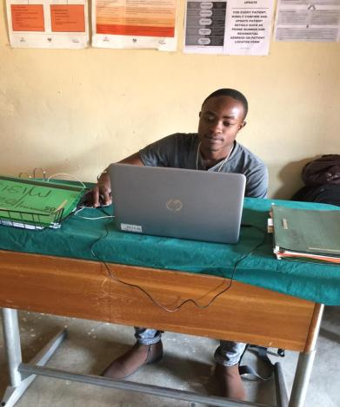
Responsibilities of the DA
Analyze and visualize data for each of their posts
Ensure that all patient files are systematically filed in cabinets
Provide weekly data quality checks and monthly data audits
All CP reports are submitted to M&E officers at the main facility who validate, verify, consolidate, and submit the reports to CRS and MoH
Notes:
DAs are responsible for showing data for each of their posts.
They first capture data on an electronic form and make sure the data has been entered correctly.
They provide quality checks weekly and monthly.
M&E officers at a higher level assist and then submit to the MOH.

Slide 8
Summary of Electronic Data Flow at the CP
DA inputs data into SmartCare using e-last/e-fast
A TDB is created from SmartCare at the CP and saved on the laptop then transferred to an external hard drive
TDB merged into the main facility database
TDB sent to the district/ IP/donor
Required consolidated reports retrieved from central database
Notes:
It is important to remember that CPs are not independent sites. A CP is always opened through an existing health facility recognized by the MOH and linked to that health facility.
Therefore the M&E of the CP occurs in the context of the parent facility and feeds into the larger M&E system.
The first step in the electronic data flow is that the DA inputs data into SmartCare using e-last/e-fast
E-fast refers to what happens at a CP when data is entered into the SMARTCARE electronic system before a patient leaves a facility.
E-last is when data is when paper-based info is captured and entered into SMARTCARE before a patient’s next visit (ensure that the details of the previous visit are electronic).
E-first refers to when the point of data capture is electronic. This is not possible at CP because only one person has a computer.
In most of the CPs, e-Last is used for data entry. The Team Lead (clinician) uses paper-based data collection tools during clinical assessments, then after the patient has already left the CP, the DA will then input that data from the paper patient forms into SmartCare, usually on the following day since most DAs are responsible for two CPs.
In cases where one DA is responsible for one CP, the DA will then use e-fast, meaning before the patient leaves the CP the database will be updated with the patient’s clinical interactions.
This diagram then shows the rest of the electronic data flow process.

Slide 9
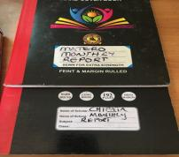
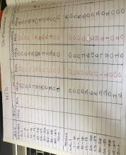
Best practices - Reporting and Feedback
CoH uses MoH provided registers to capture data
Were gaps exist, CoH has improvised hard cover books that are used for report compilation at CPs
Some reporting indicators have been included to make it easier for report consolidation and used as a backup in CPs that do not have SmartCare installed yet.
The data is collected from the registers.
Notes:
Now we are going to discuss some of the best practices associated with robust M&E of CP.
The first one is hard cover books that CoH has used to collect reporting indicators at CP, which make it easier for report compilation.
These are also used as a backup for CPs that don’t have SmartCare installed yet.

Slide 10
Best Practice – Daily Reporting
All CPs submit their performance for key indicators every day by 5:30 PM to a WhatsApp group with all CP team leaders, DA, and management.
  Aggregate data for key indicators is shared (i.e. HTS_TST, HTS_POS, TX_NEW)
Daily reporting facilitates continuous monitoring and review of CP performance, motivates performance, enables manager awareness of performance, and allows for immediate corrective actions.
Team leaders from high performing CPs provide insight on any successful strategies contributing to performance (finding positives, index testing etc.).
The Team Leader is responsible for the performance of the CP.
Notes:
Daily reporting and feedback is key to the CoH model and influences positive performance in multiple ways:
It motivates CPs to perform as they know their manager constantly reviews their performance; good feedback from management is a motivation for great performance. The management refers to heads of all the departments, including all CP Team leads, DAs and Parent facility staff). Feedback is provided by the Heads/ Managers in form of appreciation, concerns, action points, or questions.
CPs compare their performance to other CPs and want to do better and/or learn how another team was successful.
Daily reporting facilitates taking action quickly (whenever the problem is identified).
When facilities are having problems, it is important to understand the underlying reasons.
Daily tracking makes it easier to identify if a CP is/is not understanding a strategy and need more guidance.

Slide 11
Best Practice – WhatsApp Platform for Weekly-Monthly Reporting
WhatsApp is used as a data review and feedback platform
DAs submit CP daily performance to a specific DA that compiles the submissions using an excel-based App sheet
This DA then submits the performances to the WhatsApp platform for review; the parent facility also submits their daily performance to the assigned DA
The Facility M&E staff send out weekly and monthly performance updates to the WhatsApp platform for each parent facility and CPs
CPs provide feedback on what accounts for the data and M&E managers provide feedback for improvement
Notes:
M&E staff deliver weekly and monthly updates via What’sApp to the CPs associated with a health facility; they post data on how CPs have performed to facilitate quick delivery of feedback.
DAs are responsible for submitting the CP daily performance to a specific DA who is assigned to compile the submissions using an excel-based App sheet.
This DA then submits the performances to the WhatsApp platform for review and the parent facility also submits their daily performance to the assigned DA.
The Facility M&E staff send out weekly and monthly performance updates to the WhatsApp platform for review. This is often discussed immediately following the daily pep talk.
CPs then respond to the data and provide feedback on what has been done/ what were issues that account for why they didn’t do well and identify how they are going to improve their performance and what they need (mentorship to improve).
M&E team provides feedback on additional strategies CPs can use to improve.
After the daily morning inspirational pep talk, the M&E Team (CP DAs and Facility M&E staff) also meet at the main facility for a few minutes to present their challenges and learn from each other, they also receive updates and information pertaining to their work.
This practice has created massive improvement in the CPs performances.

Slide 12
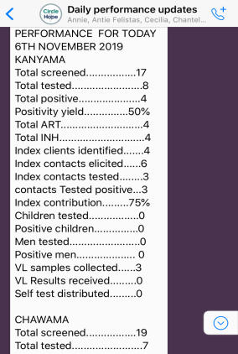
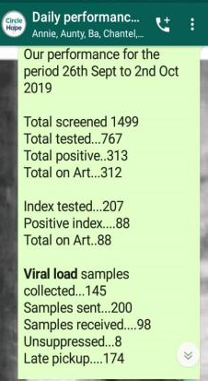
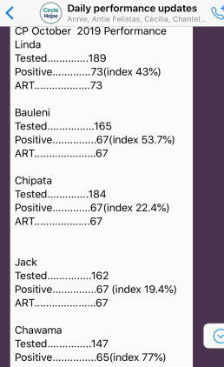
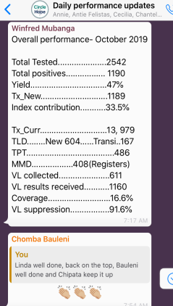
Notes:
The first screen shot on the left shows the daily performance per CP submitted via WhatsApp by the assigned DA.
The second screen shot from the left shows consolidated/ combined CP weekly performance submitted via WhatsApp by the parent facility M&E staff.
The third screen shot shows monthly performance per CP, ranging from the highest to the lowest performing CP, in terms of case finding and index pos contribution, submitted to the WhatsApp platform by the parent facility M&E staff.
The screen shot on the right shows consolidated monthly performance for all CPs with comments and applaud of the best performing teams by the managers.

Slide 13
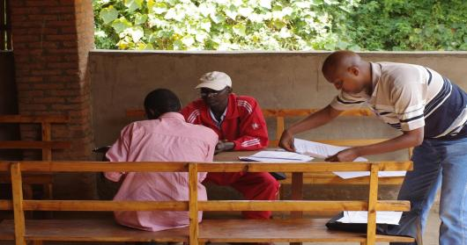
Work not documented = Work not done
Notes:
This slide is just a reminder of the importance of documenting work and collecting data to substantiate the work that was done.

Slide 14
Thank You!
Notes:
Thank participants for their participation. See if there are any questions or comments.

