Slide 1

Module 1:
Introduction & Overview of the Community Post Model
Notes:
The purpose of this introductory module is to share with you the context in which the CP model was developed; provide an overview of the CP model, its core values, and its key components; present evidence of the success of the CP model; and explore the RECIPE of the model in more depth.
Each of the components we discuss in this module are covered in greater depth in subsequent modules.

Slide 2
Module 1 Objectives
Describe existing gaps along the HIV prevention, care, and treatment cascade and HIV service access barriers that community posts (CPs) aim to address.
Describe the three-pronged strategy and the critical elements of the CP model that address the gaps along the HIV prevention, care and treatment cascade.
Describe the core values or RECIPE of the model.
Outline the steps to setting up a CP and the overall service delivery strategies CPs employ
Describe overall impact and successes of the CP Model in Zambia
Notes:
Introduce Module 1 to participants and read aloud the module objectives.

Slide 3
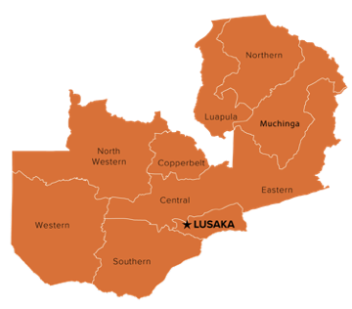
HIV Situation in Zambia
Estimated 1.2 million PLHIV
Estimated 66,000 children aged 0-14 living with HIV
51,000 annual new infections, including 6,000 infections in children 0-14 yrs
HIV prevalence of 11.5% among those ages 15-49 years
Prevalence higher in women (14%) than men (8.9%)
More than 59% of PLHIV were women
About 17,000 AIDS related deaths in 2019
Source: UNAIDS, 2019
Notes:
This slide provides more insight on the HIV situation in Zambia.
Please note that these statistics should be adjusted to reflect the situation in your country/community. Please include data that you think is most realistic in presenting the need for decentralized service delivery. UNAIDS 2019 data can be found at: https://aidsinfo.unaids.org
These are PLHIV with highest probability of NOT being on ART in the Zambia context (anecdotal examples):
Client admitted to medical/paediatric ward
Client with a STI/STD
Pregnant women
Client with Tuberculosis
Children in malnutrition unit
Men <age 35 yrs, especially (ages 15-24 yrs)
AGYW (ages 15-19 and 20-24 yrs)
Sexual contacts of newly diagnosed clients, especially pregnant women and men (> 29-50 yrs)
Children biologically exposed to HIV through their mothers
Sexual partners of newly diagnosed pregnant women

Slide 4
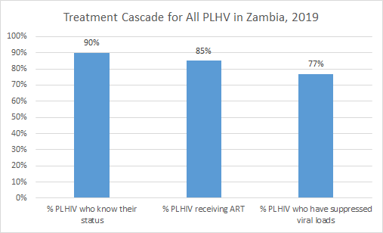
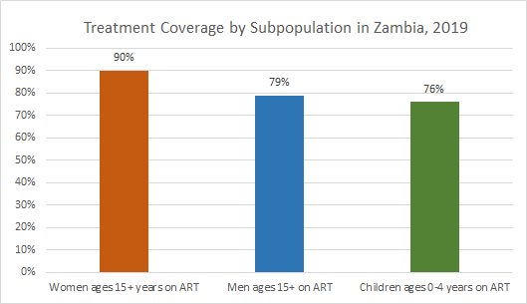
Treatment Cascade
Source: UNAIDS, 2019
Notes:
Please note that these statistics should be adjusted to reflect the situation in your country/community. Please include data that you think is most realistic in presenting the need for decentralized service delivery. [To access the editable excel sheet, open the file in the Desktop App, right click on the figure, go to ‘edit data’ to edit the data in the excel sheet].
This slide provides an overview of the treatment cascade in Zambia and compares treatment coverage among women (ages 15+ years), men (ages 15+ years), and children (ages 0-14 years).
On the left it shows that as we move further along the cascade there are challenges with initiating all those that know their HIV+ status on treatment (85%) and then increasing challenges with adherence and continuity on treatment (77%).
The comparison of ART coverage between different populations reveals that women have the highest treatment coverage (90%) compared to men (79%) and children (76%).

Slide 5
Challenges in Achieving Epidemic Control Goals
Ineffective case identification approaches (community door-to-door testing has low positivity yield)
Progress in uptake of HIV testing services stalled during COVID-19 due to declines in outpatient department attendance across the country
Lower ART coverage among children, men, and young adults compared to women
Treatment interruption due to side effects, drug fatigue, stigma for adolescents attending boarding school, and inflexible dispensing regimes
Clients starting and stopping treatment, including mobile populations that stop and start treatment
Notes:
These are some the major challenges that Zambia has confronted in achieving epidemic control that have also emerged in the experiences of implementing the community post model, as described here.
For the challenge with continuity in care and a focus on income generation activities vs. treatment, the CP model has greatly improved this.
Please note that this information should be adjusted to reflect the situation in your country/community. Please include information that you think is most realistic in making the case for decentralized service delivery through the CP model. Think about the challenges that are prevailing in your own context. What are the trends that need to be addressed in order to close the gap in epidemic control?

Slide 6
Barriers to HIV Service Delivery
Demand Side (Client)
Supply Side (Providers)
Poor leveraging of relationship capital between community stakeholders (gate keepers) and clinic-based providers (silo mentality)
Poor customer care (from service providers) - lack of client centered services
Competition among sector players and stakeholders at various levels limits coordination and effectiveness
Time (client wait times and time to reach services)
Cost of access (transport, fees for HIV related services)
Stigma (especially among men and adolescents)
Notes:
This a summary of demand and supply side barriers to HIV service delivery encountered in the Zambia context.
Please note that these barriers should be adjusted to reflect the situation in your country/community. Please include information that you think is most realistic in making the case for decentralized service delivery through the CP model. Think about the existing barriers in your own context and how the model may be positioned to address those.
At this point, Activity 5: Access Barriers & Opportunities Gallery Walk can occur.

Slide 7
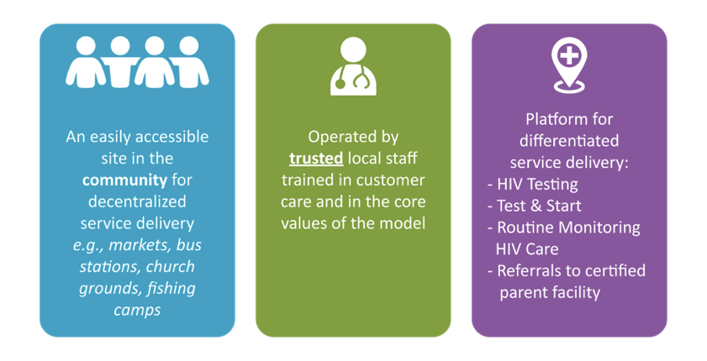



What Is a Community Post?
Notes:
The CP model has three intended outcomes:
Improved efficiency and efficacy of HIV case finding
Improved linkage to HIV treatment
Improved continuity of treatment and care
It was designed to overcome barriers related to:
Time to access services
Transportation to reach services
Stigma attached to seeking services (especially among men)
Services provided at the community post include (this will need to be tailored to context in accordance with CP service delivery):
HIV counseling and testing, including Index testing and partner notification services
ART initiation and treatment monitoring, including viral load testing, with multi-month dispensing and other differentiated ART delivery for eligible patients
Enhanced adherence counseling for clients with unsuppressed viral load, focused on addressing drivers and barriers to improved medication adherence
Prevention and management of opportunistic infections
TB screening and preventive therapy
STI screening & treatment
Primary health care
Cervical cancer screening (once a week)
Basic screening and tests for non-communicable diseases such as diabetes, hypertension, and malaria

Slide 8
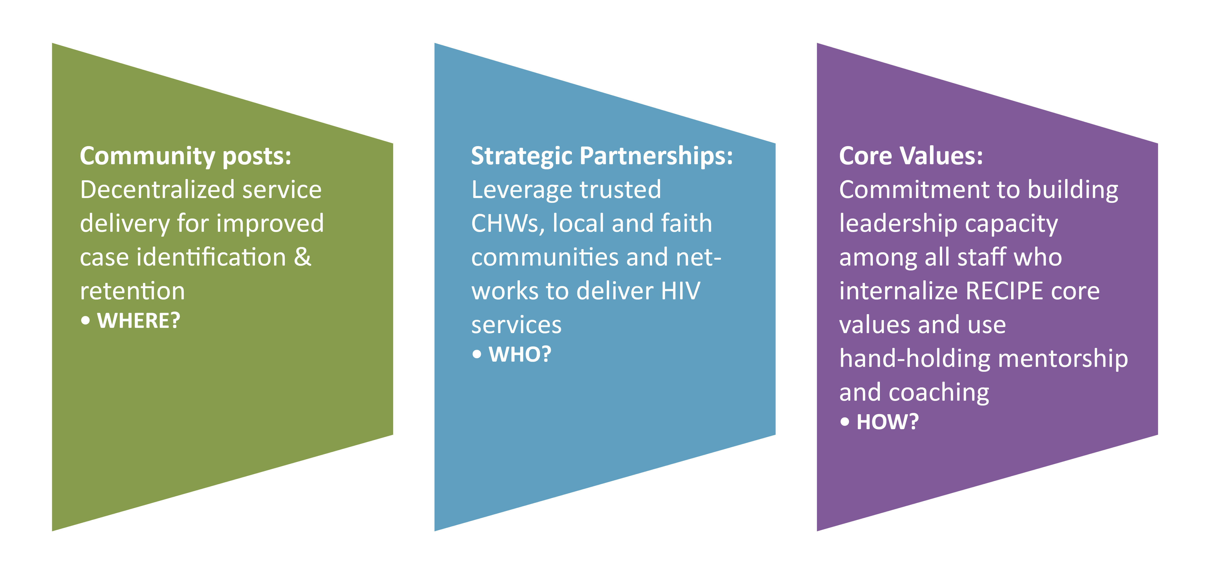
Three-Pronged Response Approach
Notes:
The model has a three-pronged approach to improve access:
1) Community Posts (WHERE services are offered):
Offer a range of decentralized services closer to where people of lower socio-economic status work and live and improves access to health services, particularly for men and other target populations less likely to access a health facility. Provision of these services at CPs is designed to maximize client preferences for accessible, personal, time efficient, and comprehensive care.
Strategic selection of high-volume locations or hot spots through community mapping is used to identify busy and high activity settings within areas where there is a concentration of people at high-risk for HIV transmission location of the community post.
Discrete services (e.g., no site branding) helps attract individuals, particularly men, who fear stigma.
Shorter client wait times than typical health facilities are appealing for working individuals. Average wait time at the CP is less than one hour, compared to five or more hours at health facilities due to lower client volume.
Strategic Partnerships (WHO is involved in promoting, delivering and supporting services?):
The early and continued engagement of local stakeholders is key to building trust in the community around the model.
This includes community leaders/structures (e.g., market chairperson, bus stop chairperson) and faith leaders.
These stakeholders help identify suitable and appropriate locations for situating the CP, and help negotiate support for operations (e.g., reduced rental costs, security, and waste pick up).
A multidisciplinary team includes trusted individuals recruited from the community who know the geographic and social terrain of the community, and one data associate.
Core Values (HOW are services delivered?): Building the leadership capacity of ALL staff and stakeholders involved in operating and supporting the CP model around a set of Core Values is essential. These Core Values contribute to quality customer care and are framed around the CP ‘RECIPE’ (discussed in next slide):​
Responsibility
Empathy
Compassion
Integrity
Passion
Ethics​

Slide 9
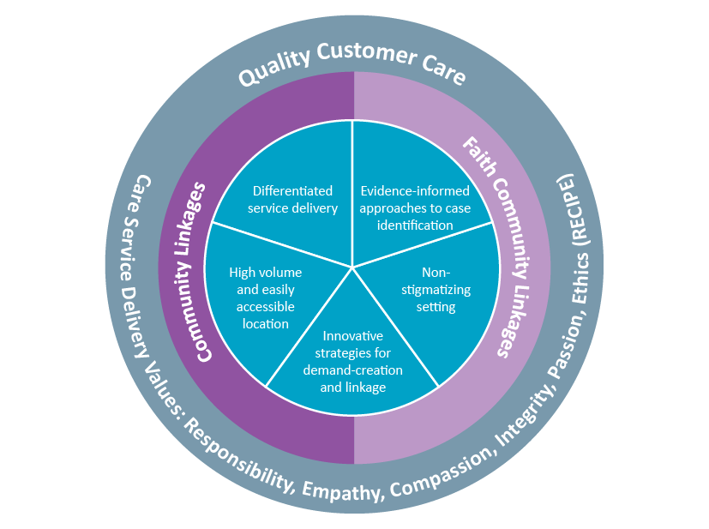
Core Values: The RECIPE
Responsibility
Empathy
Compassion
Integrity
Passion
Ethics
Notes:
The Core Values are critical and underpin the success of the CP model.
Each person involved in setting up, operating, and supporting the CP is required to understand the core values and commits to embodying them in their daily work.
The Core Values are captured in, what we like to call, the “RECIPE” behind the CP model.
Each letter of the word RECIPE represents a different core value that guides the work of CP teams.
This RECIPE is used to guide, motivate, and promote ownership of the core values in CP teams.
For instance, each morning at the routine Morning Pep Talk, the teams will be engaged on a specific component of the RECIPE (e.g., Monday is responsibility, Tuesday empathy, etc.). We will talk more about the RECIPE in our next session.
We will discuss each of the components of the RECIPE in Module 2.

Slide 10
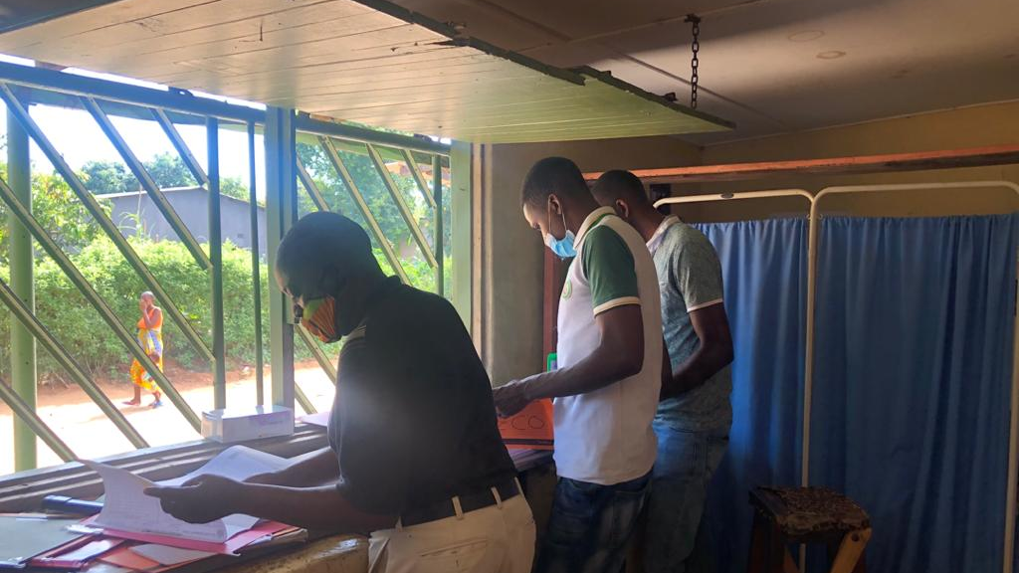
Linda Compound Community Post, Zambia
Notes:
This slide shows a photo of an actual CP in Zambia.

Slide 11
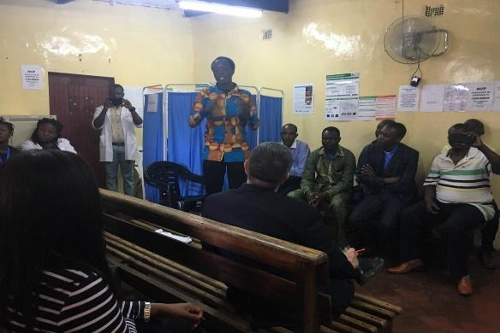
Engaging Community/Faith Leaders
Sensitization and engagement of faith and community leaders (e.g., councils, market leaders, schools) from the outset and throughout operation
Partnerships with churches create awareness and mobilize demand for HIV services
"Faith Champions" help promote uptake of HIV testing services
"Life Coaches" mobilize demand among adolescents
Notes:
Now we are going to explore a brief overview of the key steps or activities involved in implementing the CP model. (A more detailed Step by Step process can be found in the Participant Guide Tool 1.3.)
A critical key step is engaging the community.
Local stakeholders are involved from the conception phase of starting a CP.
They are sensitized around the core values of the model (the RECIPE); assist in identifying the location of the CP and support its set up; are part of the effort to sensitize their fellow communities about the need for HIV testing services; and support continuity of treatment and VLS.
Both Community and Faith leaders have several meetings where they deliver awareness, sensitization, U=U messages, and messages of hope, all of which cover continuity of treatment and VLS.
Please refer to the website https://www.faithandcommunityinitiative.org/, a resource that describes how churches can be engaged and messages that support PLHIV and seeking HIV care.
As often as possible the CP team lead is invited to give 10 minutes health pep talks at both community and faith meetings, which includes covering continuity of treatment and VLS.

Slide 12
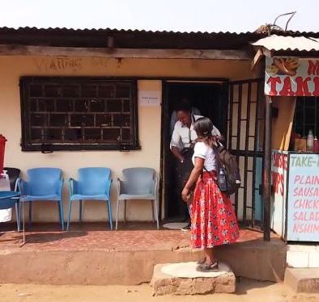
Mapping for Strategic Site Selection
  Decentralized service delivery improves case identification and continuity of treatment
  Key is to identify potential CP close to the community where people live, work, socialise, and worship
        Markets (trading areas for men, women & adolescents)
        Bus stops (finding men & adolescents )
        Busy residential settings (migrant patients; patients ITT)
        Fish camps and weekly farm produce sales centres for rural areas (migrant patients)
    Sites are NOT branded as CP on the outside
Notes:
The next step is identifying where the CP will be located.
We know that decentralized service delivery improves case identification and continuity of treatment; it is therefore key to identify potential CP sites that are close to the community.
Sites are selected based on location and similar steps are taken in either rural or urban settings.
Site selection is key to success of CP and reaching otherwise hard to reach groups (as indicated on the slide)
To avoid stigmatizing, the CP location is not branded externally.

Slide 13
Securing Infrastructure & Supply Needs
    One or two-room building
    Fittings and fixtures
    Laptop or tablet with SC Lite
Two screens/dividers (for confidentiality)
File cabinets
Three (3) tables
Eight (8) chairs
One (1) waiting bench
Hand washing basin and hand wash
Disinfectant supplies
Stationary – clinical forms, registers, suspension files (E-Last Patient files), etc.
Cooler boxes (2) for blood samples
Adult and baby scales
Fans for comfortable climate
Notes:
Once the location of a CP is identified, certain infrastructure and supplies are needed for start up. (A complete list of equipment and supplies can be found in the Participant Guide)
This slide provides an overview of the infrastructure, equipment, and supplies used to set up a CP.
This may vary slightly in each context and in accordance with what is available.
To avoid stigma, the CP location is not branded.
Please note that this information should be adjusted to reflect the situation in your country/community. For example the infrastructure and supply needs may vary depending on the volume of client that the CP will serve.

Slide 14
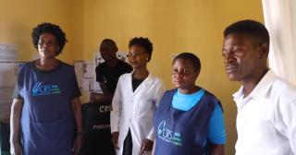
Identifying the CP Team
    Team leader/clinician (clinical officer/nurse practitioner) (x1)
    Psychosocial counsellor (x1)
    Data entry clerk (x1)
    Community-health worker (CHW) (x4)
      These are balanced gender and age
      Expert clients integrated with staff and CHWs
Notes:
Once the CP is set up structurally, the next step is to identify the CP team.
Each CP is staffed by:
Team leader/clinician (clinical officer/nurse practitioner) trained/experienced in Clinical HIV, ICT/PNS, RECIPE, Customer Care (CC) and Index Testing
Psychosocial counsellor (x1) trained in Counselling, HTS screening tool
Data entry clerk (x1) trained in M&E
Community-health worker (CHW) (x4), balanced gender and age trained in HTS testing, walk strategy, RECIPE, etc.
If an expert client exists within the catchment area of the CP, and if they are willing to work as a CP CHW, then they would be would incorporated as one of the four CHW as long as they meet the other minimum requirements.
CPs with a higher volume of clients have more CHWs; If a CP grows beyond 1200 client then add an extra CHW.
All CP are affiliated to a fully certified parent facility.

Slide 15
CP Staff Capacity Building & Mentoring
Initial CP orientation and on-site mentorship
  All staff, counsellors, CHWs, and data entry clerks are trained in CP data capture for respective Management Information Systems (e.g., registers, etc.)
  CHWs trained to use a mix of testing approaches (e.g., index testing & partner notification services, targeted testing, HIV risk screening tools)
Daily coaching (Pep Talk):
Review of targets and performance, identify challenges, additional guidance and support
Refresher training and updates
Notes:
Once the CP team is in place, continuous capacity building and mentoring are key to its success.
Continuous mentoring and feedback to community post teams helps to assess progress, identify barriers, and build morale.
Incentives include the use of daily targets, performance updates using mobile technology, and quarterly non-monetary recognition and awards.
Capacity-building mechanisms are discussed in Module 7. These are some examples of capacity-building that occurs at CP.

Slide 16
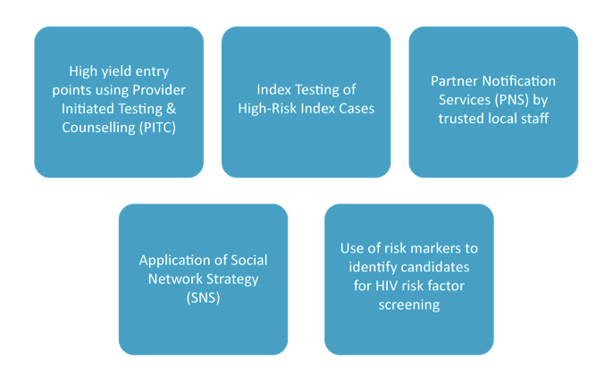
Service Delivery: Employing Diversified Case Identification Strategies
Notes:
The CP model is designed to utilize high impact strategies to identify cases, link people to treatment, sustain people on treatment, and help them achieve and maintain viral suppression.
Index Testing and Partner Notification Services (IT & PNS) are offered to all index cases, with urgent priority for contacts of high-risk index cases. If contacts test positive, they can be initiated on ART on the same day in the CPs.
Application of Social Network Strategy (SNS) to offer priority (hot spot) location testing.
Using risk markers (relationship/substance problems, prayer for healing) to identify candidates for risk factor screening, improves HTS targeting, to improve efficiency. High risk lifestyle residents are prioritized by the CHWs.

Slide 17
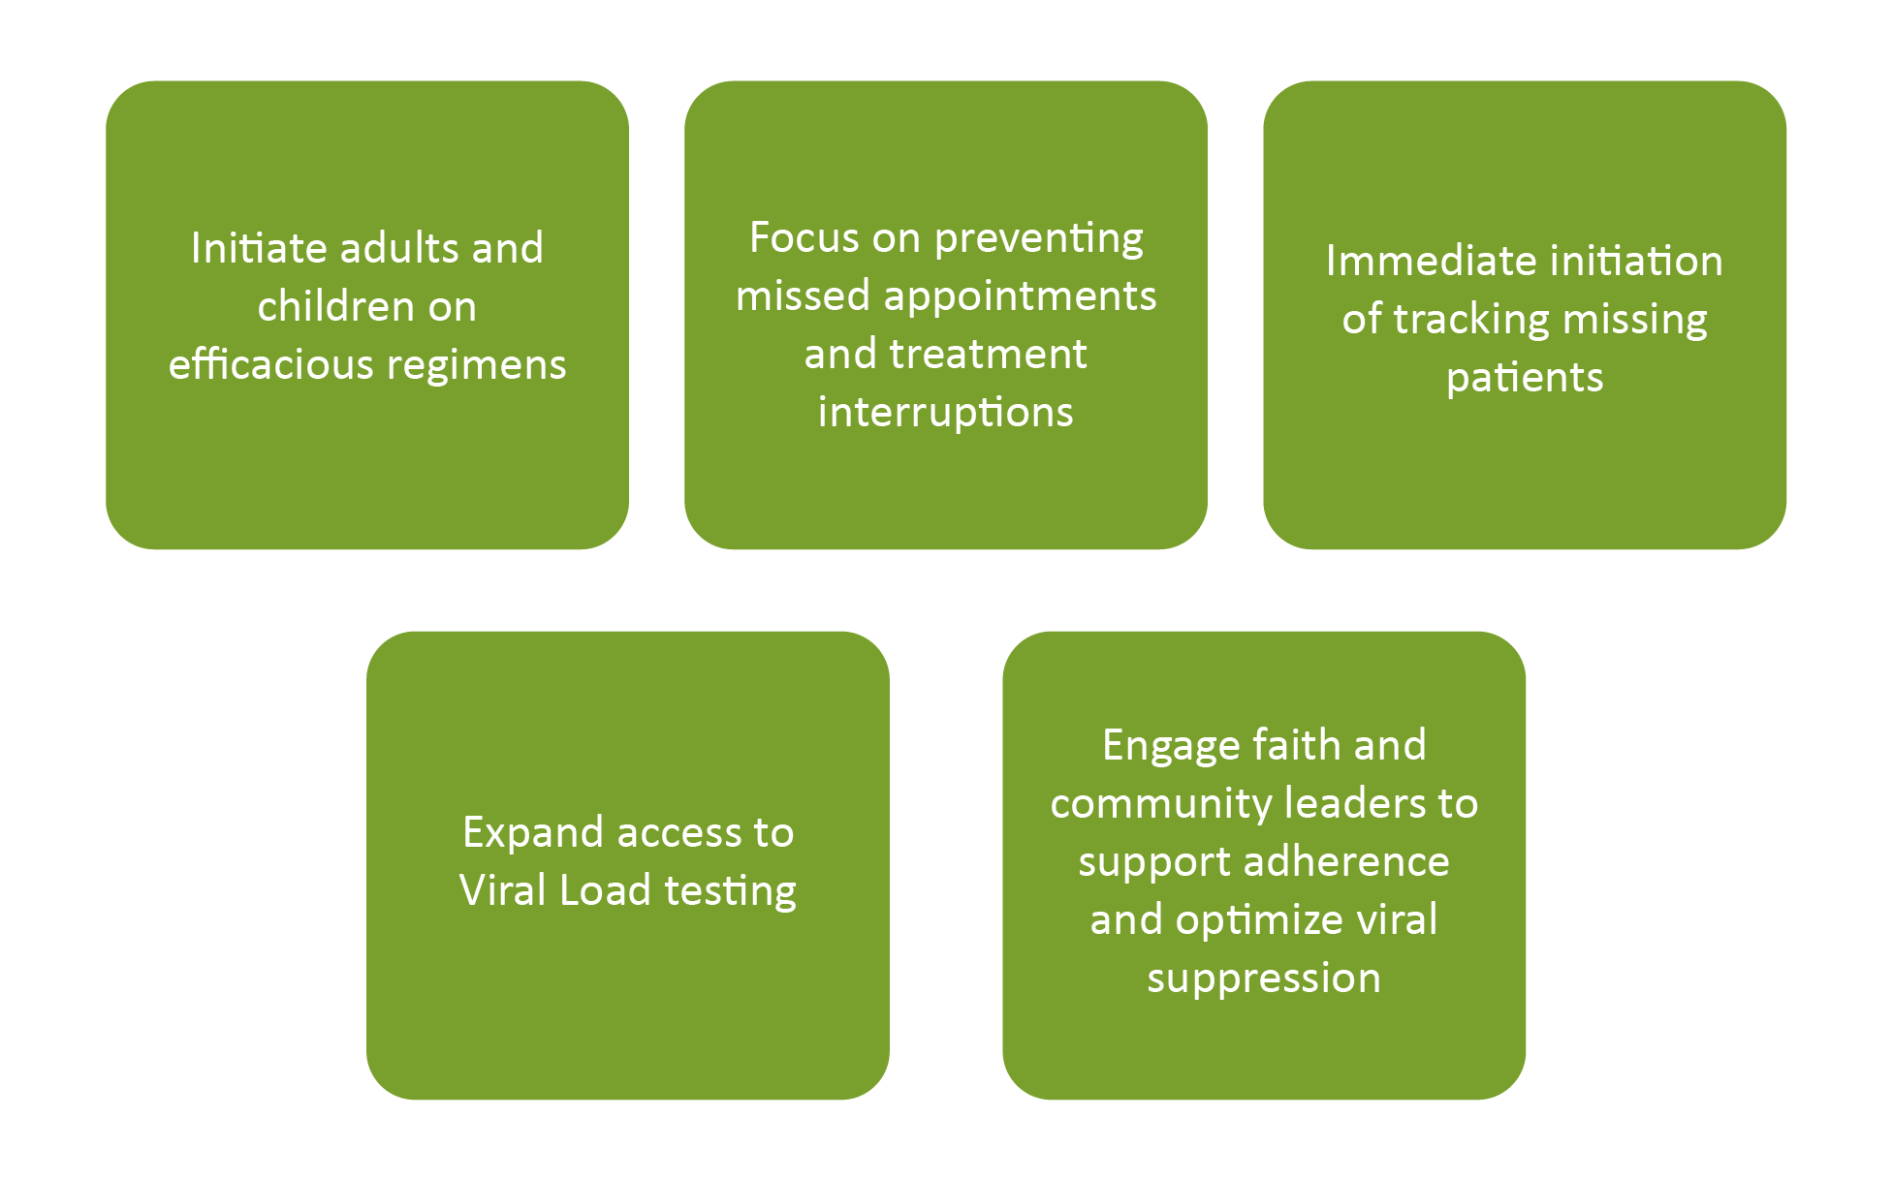
Service Delivery: Adopting Sustainable Treatment & Viral Suppression Strategies
Notes:
These are some the CP strategies for sustainable treatment and to facilitate viral suppression. This will be covered in greater depth in Module 9.
CPs offers same-day ART initiation, ensuring patients are started on efficacious regimens.
New PLHIV receive support for treatment adherence (treatment literacy support) and continuity of treatment and care.
Each new client is –as much as possible - followed and support by the CHW who identified client and linked them to the CP (phone calls/home visits).
Client missing an appointment are immediately contacted.
The CP offers viral load testing with results sent back to client.
The CP team leader or clinician from the lab personnel collects results. The CP Team leader then delivers the results to the client either at their next appointment or they are called for an appointment, depending on the urgency and gravity of the results. The results are delivered in person and recorded in the appropriate registers.
Engage community and faith leaders to support adherence and VLS.
Both community and faith leaders have several meetings where awareness, sensitization, U=U messages, and messages of hope are delivered.
As often as possible the CP team lead is invited to give 10-minute health pep talks at both community and faith meetings.

Slide 18
CP Performance: Ongoing Team Motivation
Establish and share daily targets for new people initiated on ART
Daily inspirational team Pep Talks focusing on the “RECIPE” core values
Daily performance updates
Monitoring using WhatsApp groups
Monthly data/ lab audits
Peer-to-peer mentoring for skills transfer (pairing low and high performing CHWs)
CHW stipends for reaching contacts and community members
Quarterly, non-monetary recognition and awards to CHWs
Notes:
This slide provides an overview of how CP teams are continuously motivated. We will discuss these motivation strategies in more detail in the modules.

Slide 19
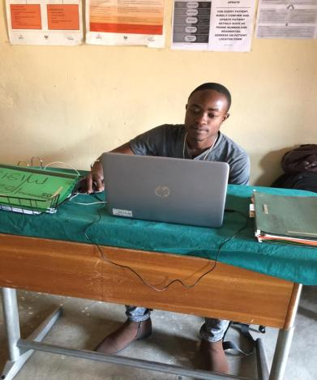
CP Performance: Ongoing Monitoring and Reporting
Work not documented is not done
Data Associates support 2 CPs each to capture the data electronically
Facilities use MoH provided registers to enter the data (sometimes improvise)
Daily reports are submitted for consolidation

Slide 20
Key Successes of the CP Model in Zambia
Improved case identification
High yield through index testing
Has attracted more males compared to conventional health facilities
Improved continuity of treatment
Comparable viral load suppression with conventional health facilities
Recognition from MoH, PEPFAR, CDC, WCC, UNAIDS, CRS, and CAF
Replicating model in peri-urban and three rural settings
Notes:
This slide provides a summary of key successes of the COP model in Zambia.
Since March 2018, 46 CPs have been established (including 34 by CRS/COH)
CRS/COH’s 34 CPs have served >20,000 ART clients
Between March 18-Dec 19 950 of clients were initiated per month
In 2020 an average of 760 ART clients were initiated monthly
Previously initiated an average of 20 ART clients per month (only COH CPs)
Increase in HIV positivity yield (13% in Dec 2018 and 34% in Sept 2019)
ART continuity of treatment rate is 94.1%
Recognition from MoH, PEPFAR, CDC, WCC, UNAIDS, CRS, and CAF
Replicating model in peri-urban and three rural settings
Data is sourced from 34 Community Posts established by Circle of Hope for the period March 2018 – May 2020

Slide 21
CRS/COH PERFORMANCE STATISTICS
Oct 18-June 20

Slide 22
Key
EpiC 3-90 facilities: 101 Facilities distributed across 4 provinces of Zambia including COH
COH: Circle of Hope (and all its 32 CPs) is one of the 101 supported facilities
Other EpiC 3-90 facilities: All EpiC 3-90 supported facilities with exclusion of COH
Tx_New: Number of adults and children newly enrolled on antiretroviral therapy (ART)
Tx_Curr: Number of adults and children currently receiving antiretroviral therapy (ART)

Slide 23
HTS Yield: CoH vs Other EpiC Sites
Notes:
Formula = HTS2a (Number of individuals who tested positive for HIV and collected their test results) / HTS2 (Number of individuals who received HIV testing and counseling services and received their test results)

Slide 24
Index Testing Yield: CoH vs Other EpiC Sites
Notes:
Data show higher yield from index case testing by COH (contribution of the community posts), compared to other health facilities.
[Formula = nr of elicited contacts who tested HIV positive and received their result) / nr of contacts elicited from index clients who accepted index testing service)]

Slide 25
Case Identification in Adolescents (15-19): CoH vs Other EpiC 3-90 Sites (% of Tx_New/Tx_Curr)
Notes:
This slide demonstrates that CoH has been more successful in finding HIV positive adolescents compared to other EpiC 3-90 facilities (due to contribution in CPs)

Slide 26
Tx_Curr (Males aged 15-49): CoH vs Other EpiC Sites
Notes:
Data show that in the CoH sites (CP contribution) the proportion of those enrolled on ART that are men has increased and is higher in the CoH sites compared to EpiC sites, showing that the CP have been effective in reaching men.
[Formula = Tx_Curr (male aged 15-49)/Total Tx_Curr]

Slide 27
Tx_New (PLHIV aged 15-49): Other EpiC 3-90 Sites
Notes:
This and the next slide compare ART enrollment (TX_New) between CoH and other EpiC sites (this slide) (where the CoH results can be contributed to the CPs).

Slide 28
Tx_New (PLHIV aged 15-49): CoH
Notes:
Data show acceleration of case identification, including among men, in the Community Posts (whereas previous slides showed little change)

Slide 29
Attrition Rate: CoH Vs Other Epic 3-90 Sites
Notes:
Data show very low attrition rate in the CP, as if the case in other health facilities, showing that the quality of care is comparable.
Formula = Attrition/Tx_Curr

Slide 30
Viral Load Suppression: CoH vs Other EpiC Sites
Notes:
VLS rates in the CP are over 90%; demonstrating that quality of care at the CP is comparable to that of other health facilities.

Slide 31
Thank You!

